Slide 1
Respiratory syncytial virus (RSV) vaccination of pregnant women for infant protection Core training slideset for healthcare practitioners Version 1 Last update: July 2024

Slide 2
Content
information about RSV
UK RSV epidemiology
the UK RSV vaccination programmes
how the Abrysvo® vaccine (Pfizer Limited) works
when pregnant women should receive an RSV vaccine
legal mechanisms for supply and administration of Abrysvo®
how to store, prepare and administer Abrysvo®
additional sources of information about RSV and Abrysvo® and the UK RSV vaccination programmes
this slide set focuses on the RSV vaccination programme of pregnant women for infant protection. There is a separate slide set for the RSV vaccination of older adults programme on the RSV immunisation page on the gov.uk website

Slide 3
Learning objectives
By the end of this session, you should be able to:
explain what RSV is and be aware of the UK epidemiology
understand the rationale for the maternal RSV vaccination for infant protection programme
describe how the Abrysvo® RSV vaccine works
state when the RSV vaccine should be offered to pregnant women
describe the process of consent and how this applies when giving vaccines
understand the legal mechanisms by which immunisers can supply and administer Abrysvo® RSV vaccine
describe how to correctly store, prepare and administer Abrysvo® RSV vaccine
communicate key facts in response to questions from pregnant women and direct them to additional sources of information

Slide 4
Prerequisites to administering RSV vaccines
Before administering the RSV vaccines, you should have:
undertaken training in the management of anaphylaxis and Basic Life Support (BLS) (adult) as specified by the policy for your local area
undertaken any additional statutory and mandatory training as required by your employer
undertaken theoretical and practical vaccination training and been assessed as competent
undertaken specific training on the RSV vaccination programme and familiarised yourself with the process for preparation of Abrysvo®
accessed and familiarised yourself with the following key documents: Green Book RSV Chapter 27a, the UKHSA RSV vaccination of pregnant women for infant protection programme: information for healthcare practitioners guidance and the vaccine product information in the Summary of Product Characteristics (Electronic Medicines Compendium website)
an appropriate legal framework to supply and administer RSV vaccine in place, for example a patient specific prescription, Patient Specific Direction (PSD) or Patient Group Direction (PGD)

Slide 5
Significant messages
Respiratory syncytial virus (RSV) causes hundreds of thousands of infections across the UK each winter in the young and the old
RSV accounts for approximately 33,500 hospitalisations annually in children aged under 5 years old, is a leading cause of infant mortality globally, and results in 20 to 30 deaths per year in the UK
RSV vaccines have now been developed which have been rigorously tested for safety and efficacy
vaccinating a woman in pregnancy enables her to produce RSV antibodies which pass across the placenta to provide the baby with passive protection during the first six months of infancy
a study of RSV vaccination of pregnant women indicated that infants had a 70% reduced risk of severe lower respiratory tract disease caused by the RSV virus
all pregnant women should be offered one RSV vaccine in every pregnancy, from week 28. This is ideally given in week 28 or soon after, to ensure sufficient time to generate enough antibodies to protect the infant
those with a role in delivering the RSV vaccine programme need to be knowledgeable, confident and competent in order to promote confidence in the RSV vaccination programme and deliver the vaccine safely

Slide 6
Introduction
in 2010, the Joint Committee on Vaccination and Immunisation (JCVI) recommended a monoclonal antibody programme (palivizumab) for high-risk infants to protect them against RSV
in 2022 and 2023, a number of RSV products were licensed in the UK for immunisation of infants (nirsevimab), pregnant women (Abrysvo vaccine) and older adults (Abrsyvo and Arexvy vaccines)
since 2023, the JCVI has been actively reviewing evidence and considering a range of issues including disease epidemiology, vaccine efficacy, vaccine safety and the cost-effectiveness of introducing a routine RSV vaccination programme in the UK. They subsequently recommended that a programme that is cost effective should be developed for both infants and older adults
from 1 September 2024, the RSV vaccine should be offered to:
all pregnant women from 28 weeks' gestation
adults turning 75 years old on or after 1 September 2024
adults already aged 75 to 79 years on 1st September 2024 (please see the RSV vaccination of older adults: information for healthcare practitioners document and slide set for more information on this programme)
RSV vaccine should be offered to eligible individuals throughout the year as this is a year-round programme

Slide 7
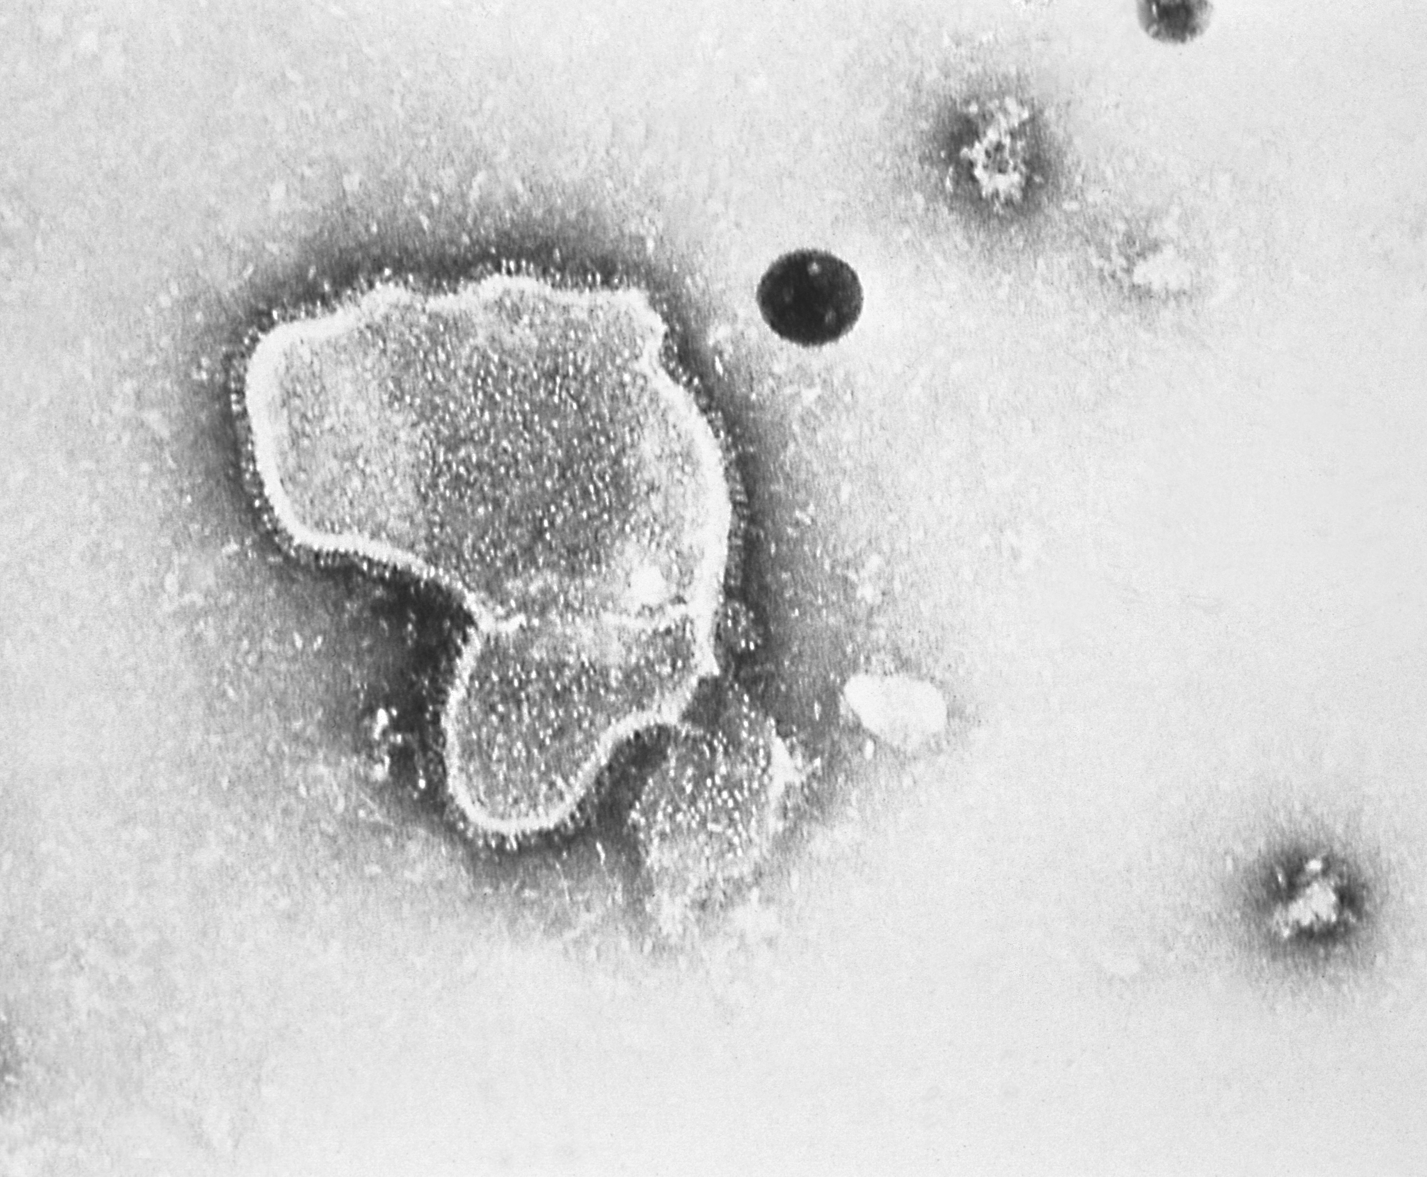
Respiratory Syncytial Virus (RSV)
Respiratory syncytial virus (RSV) is an enveloped, single-stranded RNA virus that belongs to the Orthopneumovirus genus of the Pneumoviridae family
RSV is a common cause of respiratory tract infections
it usually causes a mild self-limiting respiratory infection in adults and children but can be severe in infants and older adults who are at increased risk of acute lower respiratory tract infection
RSV is best known for causing bronchiolitis in infants. Prior to the RSV vaccination programme implementation, around 20,000 infants are admitted to hospital with bronchiolitis in England each year. Severe bronchiolitis may lead to intensive care admission and can be fatal
over 60% of children have been infected by their first birthday, and over 80% by 2 years of age
previous infection by RSV may only confer partial immunity to RSV and so individuals may be infected repeatedly with the same or different strains of RSV
clinical risk factors for severe RSV infection in infants include prematurity, severe congenital heart disease, chronic lung disease of prematurity and severe combined immunodeficiency
exposure to environmental tobacco smoke is a risk factor for severe RSV infection in infants
RSV virion highly magnified by transmission electron microscopic
Image courtesy of the CDC

Slide 8
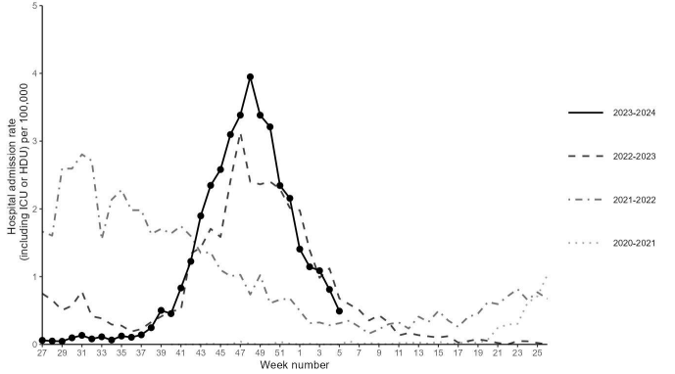
RSV epidemiology
activity is higher in winter, with RSV season in the UK starting from October, peaking in December and declining by March
whilst the occurrence of the mid-winter peak is predictable, its size varies from year to year
RSV infects up to 90% of children within the first 2 years of life and frequently reinfects older children and adults
RSV accounts for approximately 33,500 hospitalisations annually in children aged under 5 years old, most commonly as bronchiolitis
it is a leading cause of infant mortality globally, and results in 20 to 30 deaths per year in the UK
UKHSA monitors levels of RSV activity in England throughout the RSV season - epidemiological data are available at gov.uk/government/collections/weekly-national-flu-reports
Weekly overall hospital admission rates (including ICU or HDU) of RSV positive cases per 100,000 population reported through SARI Watch sentinel surveillance, England
Notes:
In recent years, the RSV season has been interrupted by control measures against the COVID-19 pandemic which has resulted in unseasonal RSV activity; this included significant rebound activity in summer 2021 and summer 2022 and a very prolonged period of virus activity in 2022.
RSV is a leading cause of infant mortality globally, resulting in 20 to 30 deaths per year in the UK. RSV-related mortality in low-income countries is considerably higher, and in some analyses is the second commonest cause of death (after malaria) in infancy.

Slide 9
Transmission of RSV
RSV is highly communicable, but humans are the only known reservoir
the incubation period (time between infection and appearance of symptoms) varies from 2 to 8 days (usually 3 to 5 days)
the virus is spread from respiratory secretions following close contact with an infected person, via respiratory droplets or contact with contaminated surfaces or objects
the virus can survive on surfaces or objects for about 4 to 7 hours

Slide 10
RSV symptoms
for most people, RSV infection causes a mild respiratory illness
RSV can cause a range of symptoms such as rhinitis (runny nose, sneezing or nasal congestion), cough, wheeze, shortness of breath, fever, lethargy and decreased appetite
symptoms in young children can progress to bronchiolitis (inflammation of the small airways of the lung), and other acute lower respiratory tract infections such as pneumonia, as well as croup and ear infections (otitis media)
short- or long-term complications may include respiratory complications such as apnoea and hypoxemia, cardiovascular abnormalities, and bacterial infections including pneumonia
children who have RSV bronchiolitis in early life may be at increased risk of developing asthma later in childhood (it may be that some children are more susceptible to both) and are at increased risk of recurrent wheezing
those most at risk of developing severe, and occasionally fatal, RSV infection are very young infants born prematurely who have predisposing conditions such as chronic lung disease, congenital heart disease or children who are immunodeficient

Slide 11
High risk groups for RSV
the very young (under 1 year of age) and older adults are at the greatest risk from RSV
while most RSV infections usually cause mild illness, infants aged less than 6 months are at the highest risk of bronchiolitis and pneumonia, which may result in hospitalisation
children born prematurely, who have predisposing conditions such as chronic lung disease, congenital heart disease, children who are immunodeficient and the elderly with chronic disease are at increased risk of developing severe, and occasionally fatal disease
infants with severe bronchiolitis from RSV may need intensive care and the infection can be fatal

Slide 12
Treatment and prevention
treatment is aimed at supporting the patient and relieving symptoms
ribavirin is an antiviral drug licensed for treatment of RSV infection but its effectiveness is not established and there are concerns with toxicity
transmission can be reduced through standard infection control practices such as respiratory hygiene, hand washing with soap and warm water, and cleaning of surfaces
ideally, people with colds should avoid close contact with newborn babies, infants born prematurely (before 37 weeks), children under 2 years born with heart or lung conditions, and those with weakened immune systems
smoking around young children is a risk factor for severe RSV infection
Notes:
Supportive treatment includes nasogastric feeding, IV fluids, low flow or high flow oxygen therapy, breathing support (continuous positive airway pressure (CPAP) or bilevel positive airway pressure (BiPAP)

Slide 13
RSV immunisation
the Joint Committee of Vaccination and Immunisation (JCVI) has reviewed evidence from manufacturers on the efficacy, safety and duration of protection of the newly available products alongside clinical and epidemiological data on the burden of RSV in infants and older adults in the UK
following advice from JCVI, two RSV immunisation programmes are to start from 1 September 2024
to protect all infants, a universal year-round vaccination programme offering an RSV vaccine to all pregnant women from 28 weeks' gestation in every pregnancy will be implemented
a separate ‘older adults’ RSV vaccination programme will also be implemented (with a separate training slide set and resources available)

Slide 14
RSV monoclonal antibody for high-risk infants
It is not possible to vaccinate newborn babies to protect them against RSV during the early months of life – the immature immune system is not able to make a good response. Instead, passive immunisation can be used
an RSV monoclonal antibody passive immunisation programme for eligible high-risk infants has been delivered in secondary care by paediatric services since the JCVI recommended it in 2010
this programme will continue, and high-risk infants will remain eligible for monoclonal antibody immunisation in addition to all pregnant women being eligible for RSV vaccination during every pregnancy
high-risk infants and children who meet the eligibility criteria in the high-risk section of the Green Book RSV chapter should be offered a monoclonal antibody immunisation regardless of whether or not their mothers received RSV vaccine in pregnancy
monoclonal antibody for high-risk infants is a different product to the vaccine offered to pregnant women and older adults
further information on monoclonal antibodies and the high-risk infant programme can be found in the Green Book RSV chapter

Slide 15
RSV vaccination of pregnant women for infant protection

Slide 16
RSV vaccine of pregnant women programme
the purpose of the RSV vaccination of pregnant women programme is to boost immunity in women during pregnancy so RSV antibodies are passed from mother to baby to passively protect infants in the first months of life
most women will have had RSV, but infection does not give them good immunity to pass on to their baby in the womb
if the woman is given an RSV vaccine from week 28 of pregnancy, the vaccine will temporarily boost their antibody to high levels
this enables the mother to transfer a high level of RSV antibodies across the placenta to their unborn child which should passively protect the infant against RSV disease until at least 6 months of age
this will be a year-round programme and all women should be offered an RSV vaccine in every pregnancy
vaccination should be offered from 28 weeks' gestation (ideally in week 28 or soon after), however women may be offered vaccination up until delivery
it is clinically reasonable for women who present in labour and have not received the RSV vaccine during pregnancy to be offered the vaccine up until the time of discharge from hospital following delivery, or in comparable circumstances for births outside of hospital. This will not offer passive protection to the baby through transplacental antibody transfer but may protect the mother from contracting RSV, reducing the chance of transmission to the infant, and may help increase levels of antibodies in breast milk, though neither of these is expected to be as protective a transplacental antibody transfer from vaccination earlier in pregnancy

Slide 17
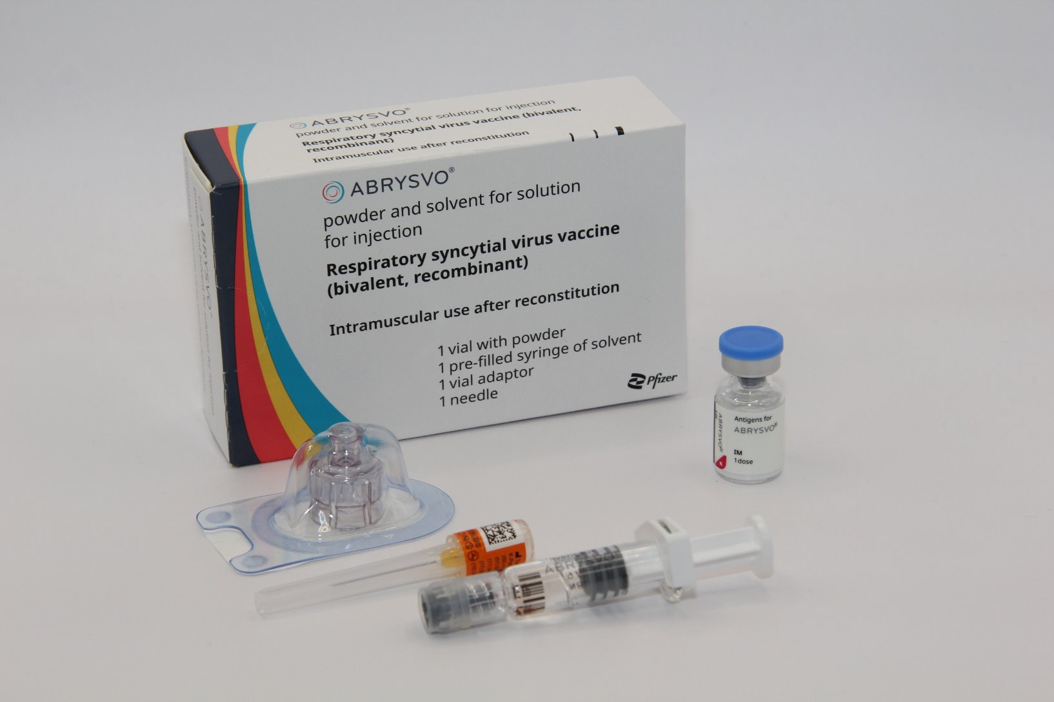
Abrysvo® RSV vaccine
Abrysvo® is the only vaccine licensed for RSV vaccination of pregnant women and is the only vaccine currently available for use within the national programme in the UK
infants born to women who have received Abrysvo® can be safely breastfed
it is a non-live, bivalent recombinant vaccine
because it does not contain any live organisms, it cannot cause the disease against which it protects and is suitable to be given in pregnancy
a single dose should be administered at week 28 of gestation or soon after
the full volume (0.5 mL) of the reconstituted vaccine should be administered

Slide 18
How Abrysvo® vaccine works
the RSV vaccine Abrysvo® is a non-live bivalent recombinant vaccine
recombinant means a small piece of DNA from the protein of the virus is taken and inserted into a manufactured cell. As these cells grow the protein is made too. This protein is then purified and put into the vaccine which, when introduced into the body via IM injection, activates the immune system
it is referred to as bivalent because Abrysvo® contains versions of two proteins found on the surface of the virus called ‘RSV subgroup A stabilised prefusion F’ and ‘RSV subgroup B stabilised prefusion F’
the vaccine antigen (prefusion F proteins) stimulates the immune system to produce antibodies. When the individual encounters RSV virus, the antibodies neutralise the prefusion F proteins thus preventing the virus particle from fusing with and entering the host’s cells and causing an RSV infection
the vaccine is sometimes called pre-F because it is based on the prefusion form of the fusion (F) protein which the virus uses to invade human cells
Notes:
How RSV causes infection:
any virus particle consists of a protein shell (capsid) inside which is the nucleic acid (DNA or RNA) – the genome or the genetic code for that virus; RSV is an RNA virus
when a virus particle enters the host’s cells it is able to reproduce and release more virus particles which in turn infect other cells – establishing an infection
RSV virus particles use a special type of protein on the surface of the virus called a fusion (F) glycoprotein to pass through the cell membrane
the F proteins does this by fusing the virus cell membrane and the host’s cell membrane together; this allows the virus to move through the host’s cell membrane and enter the cells
the F protein changes shape as it fuses the RSV virus and human cell membranes together: while on the virus surface before infection, the protein is in a “prefusion” form, but as it interacts with the cell membrane it rearranges into an inactive, “postfusion” form
the prefusion form is antigenic – it stimulates an immune response; the immune system is able to recognise and respond to the presence RSV virus particles with prefusion F proteins on their surface by producing antibodies to combat the infection; the postfusion form is not antigenic
there are two subgroups of the prefusion form: A and B
Recombinant vaccine technology
different cells (for example bacteria, yeast, other established laboratory cell culture lines) are used to manufacture the vaccine
a small piece of genetic material (DNA) is taken from the microorganism (virus or bacterium) against which we want to protect and inserted into the manufacturing cells: this results in a “recombinant” version of those cells
the role of these recombinant cells is to help transport the DNA instructions for making the antigen into a host cell
once the recombinant cell enters the host cell line it instructs the host cells to rapidly produce the antigen
this antigen is grown in bulk, collected, purified, and then packaged as recombinant vaccine (the cell line used to manufacture the cells is not in the vaccine)
when the vaccine is injected, the antigen in it triggers the immune system to create antibodies that specifically target that antigen
recombinant vaccines are non-live so they cannot cause disease in the vaccine recipient

Slide 19
How the vaccine works to protect the infant
when a pregnant woman is given RSV vaccine, her immune system recognises the proteins in the vaccine as being foreign and makes antibodies against them
these antibodies pass across the placenta and provide the baby with protection against RSV during their first few months of life
in the trial, Abrysvo® was shown to be effective at preventing lower respiratory tract disease caused by RSV in infants born to vaccinated mothers for at least the first 6 months of life
for the best protection, Abrysvo® is recommended for pregnant women in week 28 or soon after. This gives enough time for the mother to make antibodies and for these to cross the placenta, to help protect the baby, even if born early
RSV vaccine can be offered to pregnant women up until delivery but this may not offer as high a level of passive protection to the baby

Slide 20
Abrysvo® vaccine effectiveness
Abrysvo® was licensed in the UK in November 2023 following clinical trials which showed it to be safe and effective. It is currently the only RSV vaccine licensed for use in pregnancy.
Abrysvo® has been licensed for use as a maternal vaccination in the United States since August 2023. It has also been licensed for use in several European countries, Canada, Australia, Argentina and Japan.
In trials, Abrysvo® was shown to be 70% effective at preventing severe lower respiratory tract disease caused by RSV in infants born to vaccinated mothers for at least the first 6 months of life (which is the period of time when infants are most vulnerable to severe RSV infection).
Notes:
Source: Abrysvo powder and solvent for solution for injection - Summary of Product Characteristics (SmPC) - (emc) (medicines.org.uk)
Source: Bivalent Prefusion F Vaccine in Pregnancy to Prevent RSV Illness in Infants | New England Journal of Medicine (nejm.org)
The Green Book, Chapter 27A (https://www.gov.uk/government/publications/respiratory-syncytial-virus-the-green-book-chapter-27a) contains the following information regarding vaccine effectiveness following maternal vaccination:
Maternal (antenatal) vaccination has been demonstrated to be efficacious against RSV LRTI in infants from birth through 6 months of age (Kampmann et al., 2023). The pivotal phase 3, multi-country, randomised, double-blind, placebo-controlled trial assessed the prevention of RSV LRTI and severe RSV LRTI (co-primary efficacy endpoints) in infants born to pregnant women vaccinated between weeks 24 and 36 of gestation. Vaccine was administered to 3,695 pregnant women with uncomplicated, singleton pregnancies; 3,697 received placebo. In the final analysis, VE against severe RSV LRTI was 82.4% (95%CI: 57.5 to 93.9%) at 90 days and 70.0% (95%CI: 50.6 to 82.5%) at 180 days. VE against RSV LRTI was 57.6% (95%CI: 31.1 to 74.6%) at 90 days and 49.2% (95%CI: 31.4 to 62.8%) at 180 days (Munjal et al., 2024). VE estimates by RSV subtype have overlapping confidence intervals. There is some data showing high levels of antibody transfer to the infant even in infants born within two weeks of immunisation.

Slide 21
Abrysvo® vaccine safety
Abrysvo® was licensed in the UK in November 2023 by the Medicines and Healthcare products Regulatory (MHRA) on the basis of quality, safety and efficacy following clinical trials in over 17,000 adults over the age of 60 and over 4,000 pregnant women
the RSV vaccine is a non-live vaccine (may be referred to as inactivated). It does not contain any live organisms, cannot replicate and therefore cannot cause infection in either the mother or the fetus
injection site pain, headache and myalgia were the most frequently reported adverse reactions when given to pregnant women in clinical trials
there were slightly more premature births in the vaccine group compared to the unvaccinated group (2.1% in the vaccine group and 1.9% in the placebo group in the month following vaccination), but this was not statistically significant and there was no temporal relationship between vaccination and premature birth. Average birth weight and average gestational age at birth was the same in infants of vaccinated and unvaccinated mothers
as of July 2024, Abrysvo® has been given to more than 100,000 pregnant women in the USA where monitoring has shown a good safety record
21

Slide 22
When Abrysvo® should be given
this is a year-round programme; all women are to be offered an RSV containing vaccine from week 28 in every pregnancy
Abrysvo® is licensed between week 28 and week 36 gestation but can be given off-label up until delivery
ideally the vaccine should be given in week 28 gestation or soon after that.
Women who have not yet received it should still be vaccinated later in pregnancy:
vaccination late in pregnancy may not provide optimal protection to the infant as there may be insufficient time for the mother to make a good response and have antibodies to pass across the placenta
however, data show that most women who gave birth within two weeks of vaccination still passed on protective antibodies to their babies
late vaccination may also protect the mother from RSV infection and reduce the risk of her becoming a source of infection to their infant, and may help pass on some antibodies through breast milk
Notes:
Please note: Abrysvo® is licensed to be given up to 36 weeks gestation (this was based on the gestational ages included in the clinical trials). Pregnant women who have not received the RSV vaccine before 36 weeks remain eligible until delivery, and under the PGD the vaccine can be given off label in these circumstances.

Slide 23
Abrysvo® excipients
Abrysvo® contains the following excipients:
Powder vial
trometamol
trometamol hydrochloride
sucrose
mannitol
polysorbate 80
sodium chloride
hydrochloric acid (for pH adjustment)
Solvent
water for injection
There is no animal content in the vaccine.
Abrysvo® has been certified Halal by The Islamic Food and Nutrition Council of America (IFANCA).
Rarely, people may be allergic to polysorbate 80. However, polysorbate 80 is widely used in medicines and foods, and is present in many medicines including monoclonal antibody preparations:
some vaccines contain polysorbate 80. It is also commonly used in foods such as ice cream, and other frozen desserts
women who have tolerated injections that contain polysorbate 80 are likely to tolerate the Abrysvo® vaccine

Slide 24
Abrysvo® contraindications and precautions
Abrysvo® is contraindicated following confirmed anaphylactic reaction to a previous dose or to any of the components of the vaccine
immunisation of women who are acutely unwell with fever should be postponed until they have recovered fully to avoid confusing the diagnosis of any acute illness by wrongly attributing any sign or symptoms to the adverse effects of the vaccine
minor illness without fever or systemic upset are not valid reasons to postpone immunisation
refer to the Green Book RSV Chapter 27a and Abrysvo® Patient Group Direction (PGD) for full details

Slide 25
Women with current or previous history of RSV
Although it might be expected that a woman diagnosed with RSV infection during pregnancy would transfer some antibodies to her unborn baby, there is no assurance that the levels would be high enough to sufficiently protect the infant. As high levels of antibodies are made following vaccination, offering vaccine in week 28 of pregnancy or as soon as possible after that should ensure that optimal antibody levels can be passed to the baby.
Vaccination of women who may be infected or asymptomatic or incubating RSV infection is unlikely to have a detrimental effect on the illness but women currently experiencing symptoms of RSV disease should not attend for vaccination if they are acutely unwell with a fever.

Slide 26
Vaccine ordering
vaccines for the national RSV vaccination programmes in England should be ordered via the ImmForm website
vaccines should be ordered regularly throughout the year
to minimise wastage due to fridge failures or expiry, no more than 2 weeks’ worth of stock should be ordered
vaccines should be ordered, stored and monitored as described in the Green Book Chapter 3 (Storage, distribution and disposal of vaccines).
please note, although the same Abrysvo® vaccine will be used for both the older adult and the vaccination of pregnant women, they will be listed as separate items on ImmForm and the vaccine allocated for each programme should be managed independently where possible. More information can be found on the ImmForm website

Slide 27
Storing the Abrysvo® vaccine
Abrysvo® should be stored in a vaccine fridge between +2°C and +8°C
do not freeze: discard if the carton has been frozen
Abrysvo® should be administered immediately after reconstitution
further information on vaccine storage and stability is available in the Summary of Product Characteristics (SPC), the Patient Group Direction and from the manufacturer

Slide 28
Pack contents
Each pack of Abrysvo® RSV vaccine contains:
powder for 1 dose in a vial
solvent (water for injection) in a pre-filled glass syringe with a stopper (synthetic chlorobutyl rubber), luer lock adaptor and tip cap (synthetic isoprene/bromobutyl blend rubber)
vial adaptor
25G 25mm needle (suitable alternatives can be used if required)

Slide 29
Preparing the Abrysvo® vaccine
Abrysvo® must be reconstituted prior to the administration by adding the entire contents of the pre-filled syringe of solvent to the vial containing the powder using the vial adaptor
the vaccine must only be reconstituted with the solvent provided
Clear instructions on how to prepare the vaccine for administration can be found in the SmPC and in the manufacturer's video. Immunisers are strongly encouraged to watch the video in its entirety before preparing the vaccine for the first time.
Images from Abrysvo® vaccine SPC

Slide 30
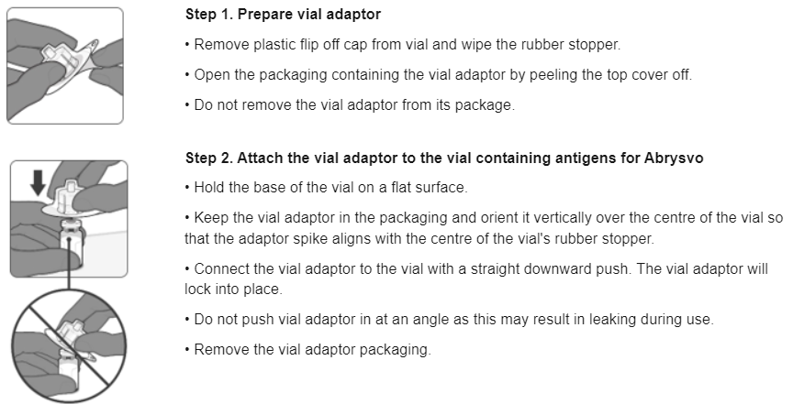
Preparing the Abrysvo® vaccine
Images from Abrysvo® vaccine SPC

Slide 31
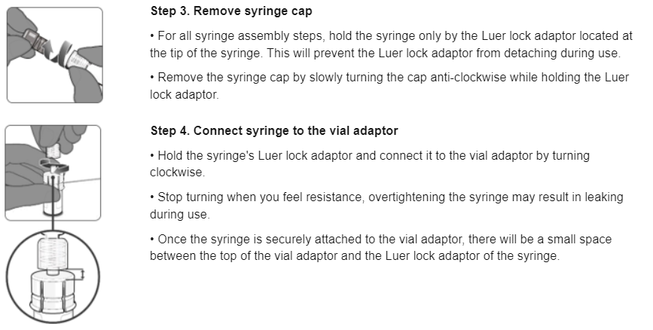
Preparing the Abrysvo® vaccine
Images from Abrysvo® vaccine SPC

Slide 32
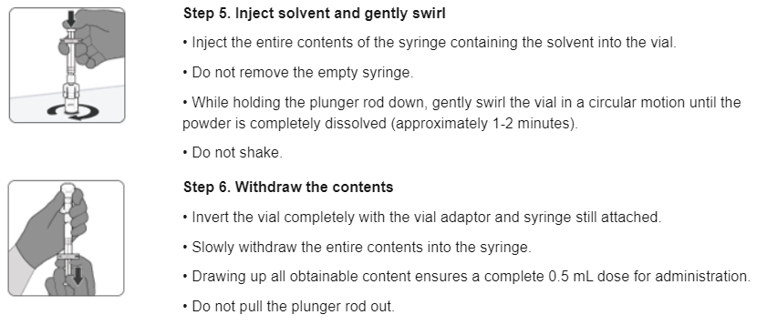
Preparing the Abrysvo® vaccine
Images from Abrysvo® vaccine SPC

Slide 33
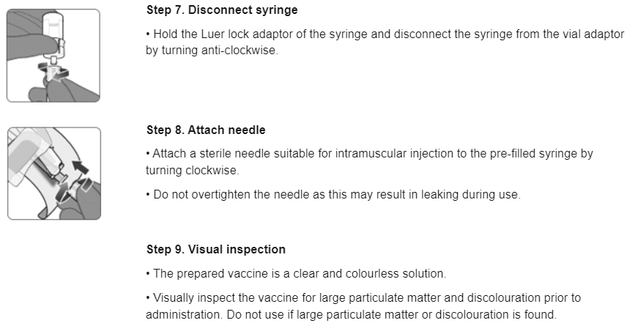
Preparing the Abrysvo® vaccine
Images from Abrysvo® vaccine SPC

Slide 34
Vaccine co-administration in pregnancy
Where possible, vaccines should be given once a pregnant women becomes eligible. However, there may be times when a pregnant women presents late for vaccination. During influenza and COVID seasonal vaccination campaigns, pregnant women may also become eligible for more than one vaccine at the same time.
Influenza vaccine
Abrysvo® can be given concomitantly with inactivated influenza vaccine to pregnant women
there are no safety or effectiveness concerns around giving Abrysvo® to pregnant teenagers who are due to have or who have recently had a live attenuated influenza vaccine nasal spray
Coronavirus (COVID-19) vaccine
pregnant women who are eligible for COVID-19 vaccine during a seasonal vaccination campaign may receive this at the same time as Abrysvo®

Slide 35
Vaccine co-administration in pregnancy
Pertussis-containing vaccine
some evidence suggests that coadministration of RSV and pertussis containing vaccines may reduce the response made to pertussis components. The clinical significance of this is unclear and any impact on protection is likely to be small; the key pertussis toxoid component is least affected
giving the vaccines separately at the usual scheduled times (around 20 weeks' gestation for pertussis (usually given around time of the fetal anomaly scan) and from 28 weeks' gestation for RSV) will avoid any potential attenuation (weakening) of antibody response to the pertussis containing vaccine
if a woman has not received a pertussis containing vaccine by the time she presents for an RSV vaccine, they can and should both be given at the same appointment to provide timely protection against both infections to the infant and to avoid the risk of the woman not returning for a later appointment

Slide 36
Co-administration and anti-D immunoglobulin
The response to Abrysvo® will not be affected by, nor interfere with, anti-D immunoglobulin.
The administration of Abrysvo® should not be delayed due to the woman receiving anti-D immunoglobulin (or vice-versa).
Co-adminstration of vaccines
If more than one injection is administered at the same time, these should be given at a separate sites, preferably in different limbs.
If given in the same limb, the injections should be given at least 2.5cm apart. The sites of each injection given should be noted in the woman's health records.

Slide 37
Before administering a vaccine
Before administering a vaccine, the woman should be assessed to ensure that:
there are no contraindications to the vaccine being given
they have not experienced any serious reactions to a previous dose or component of the vaccine
they are fully informed about the vaccine to be given and understand the vaccination procedure
they are aware of possible adverse reactions to the vaccine and how to treat them
they have consented to having the vaccine
Immunisers should ensure that:
they have the appropriate knowledge and legal authority to administer the vaccine
the vaccine has been properly stored and prepared for use and they know where and how to administer it

Slide 38
Consent
Before vaccinating, ‘informed’ consent must be obtained.
Informed consent is a legal requirement, and the individual's views must be respected.
Sufficient evidence-based information must be provided to enable the person to make a balanced and informed decision about their care and treatment.
As well as a general explanation of the procedure, there is also a duty to explain the risks inherent in the procedure and the risks inherent in refusing the procedure.
Consent can be given verbally, in writing or it can be implied, but however it is given, the person must understand what they are consenting to.
If there are any issues or uncertainties with seeking or gaining consent, ask for advice from an experienced colleague rather than abandon the offer of immunisation.
Consent is a process and can be withdrawn.
Notes:
Before giving COVID-19 vaccine, immunisers must ensure that they have obtained informed consent from the woman or that a best interest decision has been made if the woman does not have mental capacity at the time of vaccination.
In order to be able to consent to vaccination, the vaccinee should receive an explanation of the treatment and its benefits and risks, either verbally from a clinician, or in the form of a leaflet and letter.
When assessing capacity to consent, the immuniser should be guided by the principles of the Mental Capacity Act (2005). This Act applies to those aged 16 years and over and is designed to protect and empower people who may lack the mental capacity to make their own decisions about their care and treatment.
Consent is a process, not a one-off discussion and must consider 3 factors:
the person giving consent must be appropriately informed: they must have the necessary information in order to make the decision
consent must be voluntary by the woman without undue pressure or coercion
the person consenting must have the capacity to make the decision
.

Slide 39
Informed consent
Information to be given includes:
How much information should you give?
which vaccine is being offered and the disease against which it protects​
benefits/risks of immunisation versus risks of the disease​
any possible vaccine reactions and what to do if these occur
this will be personal to the woman at the time and will depend on their previous knowledge and discussions with others
give people as much information as they need and/or want to make an informed decision
some people will just ‘trust’ what you say while others want lots of information; either is fine
how much each woman needs is up to them, no one is obliged to seek full information

Slide 40
Legal requirements for the supply and administration of vaccines
The regulation of medicines is defined under the Human Medicines Regulations 2012.
All vaccines are classified as Prescription Only Medicines (POMs).
This means that they are subject to legal restrictions and in order to give them, there needs to be an appropriate legal framework in place before they can be supplied and/or administered to eligible people.
Additionally, any person who supplies and administers a vaccine must have a legal authority to do so.

Slide 41
Legal requirements for the supply and administration of vaccines
As vaccines are Prescription Only Medicines (POMs), there must be a legal framework to supply and/or administer the vaccine in place. This can be in the form of:
a written patient specific prescription
a Patient Specific Direction (PSD): a written instruction, signed by a doctor, dentist, or non-medical prescriber for medicines to be supplied and/or administered to a named patient after the prescriber has assessed the patient on an individual basis
a Patient Group Direction (PGD): allows some registered specified health care professionals to supply and/or administer a POM directly to an individual with an identified clinical condition rather than needing an individual prescription or an instruction from a prescriber. PGDs are often used for the administration of vaccines
another process such as a national pandemic protocol or occupational health Written Instruction
Notes:
A PSD is a written instruction, signed by a doctor, dentist, or non-medical prescriber for medicines to be supplied and/or administered to a named patient after the prescriber has assessed the patient on an individual basis. It must include the dose, route and frequency or appliance to be supplied or administered to a named patient.
A PGD provides a legal framework to allow some registered specified health care professionals for the supply and/or administration of a POM directly to a patient with an identified clinical condition rather than needing an individual prescription or an instruction from a prescriber and is often used for vaccines. It sets out the core requisites of those people who can have the medicine under the direction and those who should not. The health care professional working within the PGD is responsible for assessing that the patient fits the criteria set out in the PGD.

Slide 42
Patient Group Directions (PGD)
PGDs set out the core requisites of those people who can have the medicine under the direction (and those who should not).
the document will also include details of any additional training that should have been undertaken, actions to be taken if the patient is excluded or declines the medicine, a description of the medicine(s), route of administration, doses, frequency, reporting of adverse reactions, recording, storage and disposal
the healthcare practitioner working under a PGD is responsible for assessing that the patient fits the criteria set out in the PGD. The healthcare practitioner operating under the PGD may not delegate the role to others
PGDs must be authorised before use by a doctor, a pharmacist and by an appropriate body, for example NHSE, UKHSA, NHS Trust
the UKHSA immunisation PGD webpage contains PGD templates and will include one for RSV vaccination. This has been developed by the UKHSA immunisation team and will be available to download for local authorisation and use
healthcare practitioners who will be using the PGD must be named and authorised before they use it to provide care
Notes:
Please note: Abrysvo® is licensed to be given up to 36 weeks gestation (this was based on the gestational ages included in the clinical trials). Pregnant women who have not received the RSV vaccine before 36 weeks remain eligible until delivery, and under the PGD the vaccine can be given off label in these circumstances.

Slide 43
Vaccine intramuscular administration
Giving vaccine into the muscle:
leads to a better immune response to the vaccine (as the muscle contains the appropriate cells necessary to initiate the immune response)
is less likely to cause local reactions than if the vaccine is given under the skin (subcutaneously)
The needle needs to be long enough to ensure vaccine is injected into the muscle. For this reason, the orange 25 gauge 25mm needle supplied in the Abrysvo® packs should be suitable for administration of the RSV vaccine for most women.
In larger women however, a longer length (e.g. 38mm) may be required, and an individual assessment should be made.
Abrysvo® should be injected into the deltoid muscle in the upper arm. If there is insufficient muscle mass in the deltoid or a particular reason the deltoid muscle is unsuitable, the vaccine should be given into the vastus lateralis muscle in the anterolateral aspect of the thigh.

Slide 44
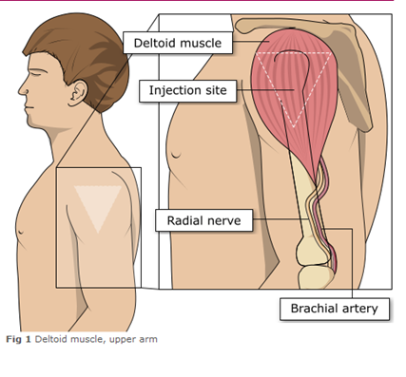
Administering vaccine into the deltoid muscle (upper arm)
it is essential that the correct site and injection technique is used to administer vaccines
injecting too high into the upper arm might result in a shoulder injury or a frozen shoulder, leading to pain, weakness and a limited range of motion that can last for months
injecting too low or too far to the side of the arm risks injecting into the axillary nerve or the radial nerve
to avoid shoulder injury, always assess the limb before administering the vaccine to identify the correct site for injection
Image adapted from the Australian Immunisation Handbook

Slide 45
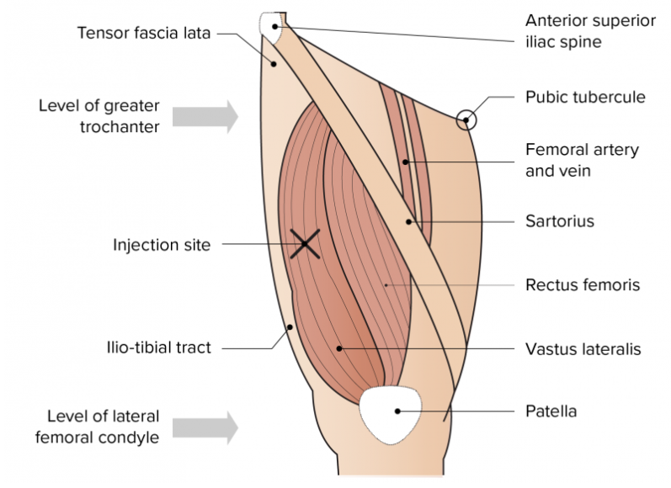
Administering vaccine into the vastus lateralis muscle (anterolateral aspect of the thigh)
Although the deltoid muscle is more commonly used in older children and adults as it is quicker and easier to access, the vastus lateralis muscle in the thigh can be used in these age groups if necessary.
Image from the Australian Immunisation Handbook

Slide 46
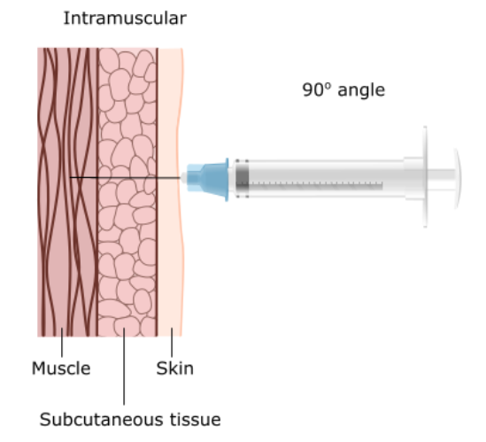
Vaccine administration
Skin does not need to be specially cleaned prior to vaccination. If it is visibly dirty, then water is sufficient to clean it.
Intramuscular process:
identify the correct site for IM injection
stretch the skin at the site
insert the needle at a 90 degrees angle far enough to ensure vaccine is delivered into muscle
depress the plunger
gently remove the needle
apply light pressure using gauze or cotton wool if bleeding occurs
Notes:
https://assets.publishing.service.gov.uk/government/uploads/system/uploads/attachment_data/file/147915/Green-Book-Chapter-4.pdf

Slide 47
Women with bleeding disorders or taking anticoagulation therapy
Women with bleeding disorders may be vaccinated intramuscularly if, in the opinion of a doctor familiar with the woman's bleeding risk, vaccines or similar small volume intramuscular injections can be administered with reasonable safety by this route.
If the woman receives medication/ treatment to reduce bleeding, for example treatment for haemophilia, intramuscular vaccination can be scheduled shortly after such medication/ treatment is administered.
Women on stable anticoagulation therapy, including women on warfarin who are up-to-date with their scheduled INR testing and whose latest INR is below the upper level of the therapeutic range, can receive intramuscular vaccination. Note that warfarin is not commonly prescribed for anticoagulation in pregnant women and anticoagulation may be through heparin injections
A fine needle (23 or 25 gauge) should be used for the vaccination, followed by firm pressure applied to the site without rubbing for at least 2 minutes.
The woman should be informed about the risk of haematoma from the injection.
If in any doubt, consult with the clinician responsible for prescribing or monitoring the woman’s anticoagulant therapy.

Slide 48
Post-vaccination
following RSV vaccine administration, women should be observed for any immediate reactions whilst giving them any verbal post vaccination information
vaccinees should be given a copy of the patient information leaflet for the vaccine that they have received and any other relevant written information
vaccinees should be given information about possible vaccine reactions, how to treat these, and when and from whom to seek further advice if required
symptoms post vaccination generally resolve within a few days without treatment, but paracetamol can be taken if necessary to relieve pain or fever
if women are concerned about any symptoms following vaccination, they should be advised to seek advice from their GP or NHS 111
facilities for management of anaphylaxis should be available at all vaccination sites and staff should have undertaken basic life support and anaphylaxis training

Slide 49
Disposal of consumables
needles should not be re-sheathed following vaccination under any circumstances because of the risk of sustaining a needlestick injury
the needle and syringe should be disposed of immediately after use in a puncture resistant yellow sharps bin
the yellow sharps bin should be sealed when it is two-thirds full and replaced with a new one
any blood-stained gauze should be placed in an appropriate bin for healthcare waste
local policy should be followed for the disposal of PPE

Slide 50
Adverse reactions following vaccination
Some people can feel unwell following an injection and some people may experience an adverse reaction.
Pregnant women should be informed of the most frequently reported potential reactions to Abrysvo® which are:
injection site pain (41%)
headache (31%)
myalgia (27%)
(figure in brackets is percentage of recipients who reported reaction in clinical trials)
For pregnant women, the majority of local and systemic reactions are mild in severity and resolve within a few days of onset.
Abrysvo® is a newly licensed vaccine in the UK and is subject to additional monitoring under the black triangle labelling scheme by the Medicines and Healthcare Regulatory Agency (MHRA). All suspected adverse reactions should be reported to the MHRA using the Yellow Card scheme.

Slide 51
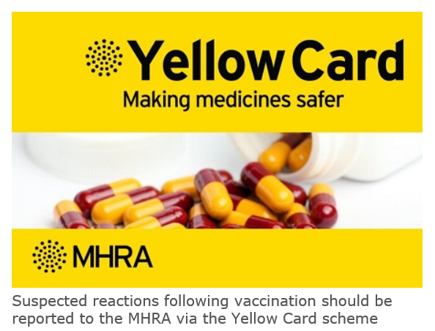
Reporting adverse reactions
Abrysvo® is a newly licensed vaccine in the UK and is subject to additional monitoring under the black triangle labelling scheme by the MHRA. This means that all suspected adverse reactions following administration should be reported to the MHRA using their Yellow CARD reporting scheme at Yellow Card | Making medicines and medical devices safer (mhra.gov.uk).
vaccines are carefully monitored to ensure they are safe, not causing untoward side effects and are suitable for the immunisation programme
MHRA promotes the collection and investigation of adverse reactions through the Yellow Card scheme which is a voluntary reporting system for suspected adverse reactions
anyone (vaccine recipients and healthcare practitioners) can make a Yellow Card report, even if they are uncertain as to whether a vaccine caused the condition

Slide 52
Documentation and record keeping
The information in Box 1 must be recorded for all vaccines given to ensure complete and accurate patient vaccination records and to enable extraction of the correct data for programme monitoring.
If not administered at the woman's GP surgery, the vaccination must be recorded using the Record a Vaccination Service (RaVS) point of care app (in additional to any local/Trust recording requirements), so the record is sent to the GP and including in national monitoring. The estimated date of delivery (EDD) is required in the RaVS record.
Examples of patient records where vaccination details may need to be recorded:
Record a Vaccination Service (RaVs) app
woman’s electronic patient record
practice computer system
maternity record
Recording of vaccination details may be required in multiple systems to ensure completeness and to reduce the risk of duplicate vaccination
Box 1. Following vaccination, the following information should be recorded:
vaccine name
product name
batch number
expiry date
dose administered
date immunisation given
route/site used
name and signature of vaccinator

Slide 53
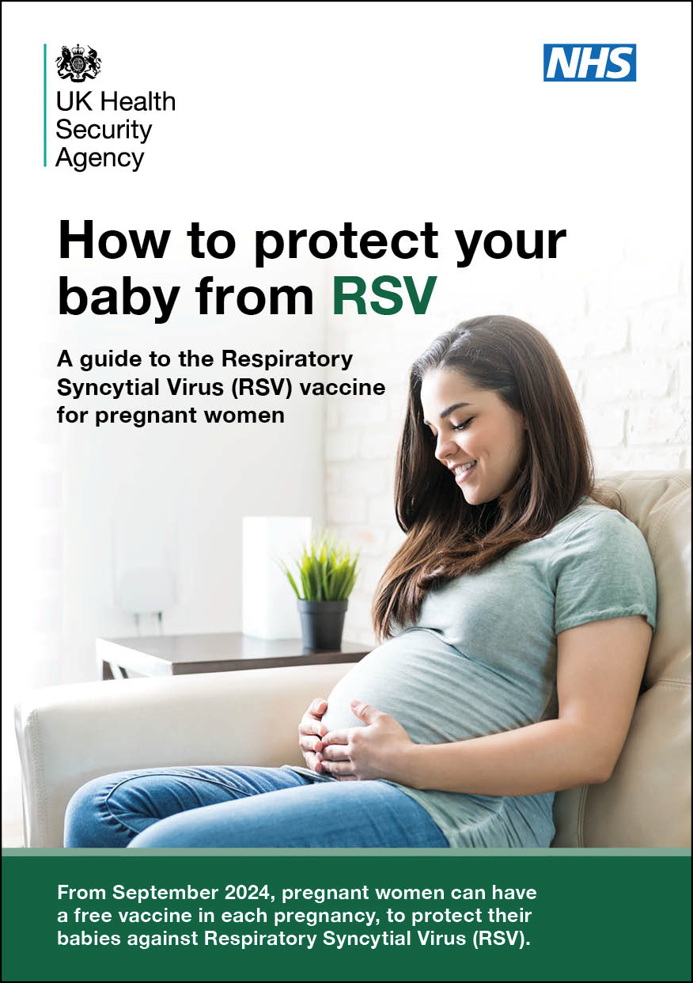
Resources for pregnant women
Leaflets, posters and stickers for pregnant women are available to order now. This includes:
How to protect your baby from RSV leaflet and poster
Please visit the health publications website for availability of resources in different languages and formats
RSV stickers, translated leaflets and accessible versions are also ready to order but stocks will arrive shortly.
Maternal RSV Leaflet: product code: C24RSV03EN
Maternal RSV Poster: product code: RSVPGEN

Slide 54
Further information
all UKHSA healthcare practitioner resources relating to the RSV vaccination of pregnant women for infant protection programme can be accessed in the UKHSA RSV immunisation programme collection. These include the ‘information for healthcare practitioners’ document, RSV training slide set and relevant patient leaflets. A separate training side set and information for healthcare practitioners document is also available for the RSV older adults vaccination programme
Marketing authorisation holder’s Summary of product characteristics
Medicines and Healthcare products Regulatory Agency (MHRA): reporting adverse reactions
The Green Book: Immunisation against infectious disease: RSV Green Book Chapter (27a)
UKHSA Patient Group Direction (PGD): RSV vaccine
Pfizer Abrysvo® vaccine preparation instructional video
NHS website: Bronchiolitis
UKHSA RSV overview: RSV: symptoms, transmission, prevention, treatment

Slide 55
Resources: Information for healthcare practitioners guidance
The information for healthcare practitioners guidance available on the UKHSA RSV vaccination of pregnant women programme collection is recommended reading for anyone involved in RSV immunisation.
This is a practical document for healthcare practitioners administering or providing advice about RSV vaccination of pregnant women for infant protection. It includes the vaccination programme recommendations, contraindications, precautions and examples of scenarios that staff may experience when immunising.

Slide 56
Learning objectives
You should now be able to:
explain what RSV is and be aware of the UK epidemiology
understand the rationale for the maternal RSV vaccination for infant protection programme
describe how the Abrysvo® vaccine works
state when the RSV vaccine should be offered to pregnant women
describe the process of consent and how this applies when giving vaccines
understand the legal mechanisms by which immunisers can supply and administer Abrysvo® RSV vaccine
describe how to correctly store, prepare and administer Abrysvo® RSV vaccine
communicate key facts in response to questions from pregnant women and direct them to additional sources of information

