Slide 1
Respiratory syncytial virus (RSV) vaccination programme for older adults Core training slide set for healthcare practitioners Version 1 Last update: July 2024

Slide 2
Content
information about RSV
UK RSV epidemiology
the UK RSV vaccination programmes
how the Abrysvo® Pre-F RSV vaccine (Pfizer Limited) works
which groups are eligible to receive an RSV vaccine
legal mechanisms for supply and administration of Abrysvo®
how to store, prepare and administer Abrysvo®
additional sources of information about RSV, Abrysvo® and the UK RSV vaccination programmes
*this slide set focuses on the RSV vaccination programme for older adults. There is a separate slide set for the RSV vaccination of pregnant women for infant protection on the RSV immunisation page on the gov.uk website

Slide 3
Learning objectives
By the end of this session, you should be able to:
explain what RSV is and be aware of the UK epidemiology
understand the rationale for the RSV older adult vaccination programme
describe how Abrysvo® RSV vaccine works
identify the groups that are eligible to receive an RSV vaccine
describe the process of consent and how this applies when giving vaccines
understand the legal mechanisms by which immunisers can supply and administer Abrysvo® RSV vaccine
describe how to correctly store, prepare and administer Abrysvo® RSV vaccine
communicate key facts in response to questions from individuals and/or their carer(s) and direct them to additional sources of information

Slide 4
Prerequisites to administering RSV vaccines
Before administering the RSV vaccine, you should have:
undertaken training in the management of anaphylaxis and Basic Life Support (BLS) (adult) as specified by the policy for your local area
undertaken any additional statutory and mandatory training as required by your employer
undertaken theoretical and practical vaccination training and been assessed as competent
undertaken specific training on the RSV vaccination programme and familiarised yourself with the process for preparation of Abrysvo®
accessed and familiarised yourself with the following key documents: Green Book RSV Chapter 27a, RSV vaccination programme for older adults information for healthcare practitioners and the vaccine product information in the Summary of Product Characteristics (Electronic Medicines Compendium website)
an appropriate legal framework to supply and administer RSV vaccine in place for example patient specific prescription, Patient Specific Direction (PSD), Patient Group Direction (PGD)

Slide 5
Significant messages
Respiratory syncytial virus (RSV) causes hundreds of thousands of infections across the UK each winter in the young and the old
RSV is an important cause of lower respiratory tract infections in older adults, resulting in illness (including pneumonia), admissions and deaths
vaccines have now been developed which have been rigorously tested for safety and efficacy; Abrysvo® RSV vaccine (Pfizer Limited) will be introduced into the UK schedule from 1st September 2024
Vaccination through the routine offer of a single dose at age 75 years and the catch-up programme (of 75 to 79 year olds) will help protect eligible older adults, particularly if given before winter RSV activity
The RSV vaccine protects for at least two years. Studies are ongoing to see how long it lasts. There are no data currently to support second doses in older adults
those with a role in delivering the RSV vaccine programme need to be knowledgeable, confident and competent in order to promote confidence in the vaccination programme and deliver the vaccine safely
Notes:
See JCVI statement: Respiratory syncytial virus (RSV) immunisation programme for infants and older adults: JCVI full statement, 11 September 2023 - GOV.UK (www.gov.uk) and:
Hardelid P, Pebody R and Andrews N. Mortality caused by influenza and respiratory syncytial virus by age group In England and Wales 1999 to 2010. Influenza and Other Respiratory Viruses 2012: 1(7), 35-45.
Li Y and others. Adjusting for case under-ascertainment in estimating RSV hospitalisation burden of older adults in high income countries: a systematic review and modelling study. Infectious Diseases and Therapy 2023: 12, 1137-1149.
Fleming DM and others. Modelling estimates of the burden of respiratory syncytial virus infection in adults and the elderly in the United Kingdom. BMC Infectious Diseases 2015: 15, 443.

Slide 6
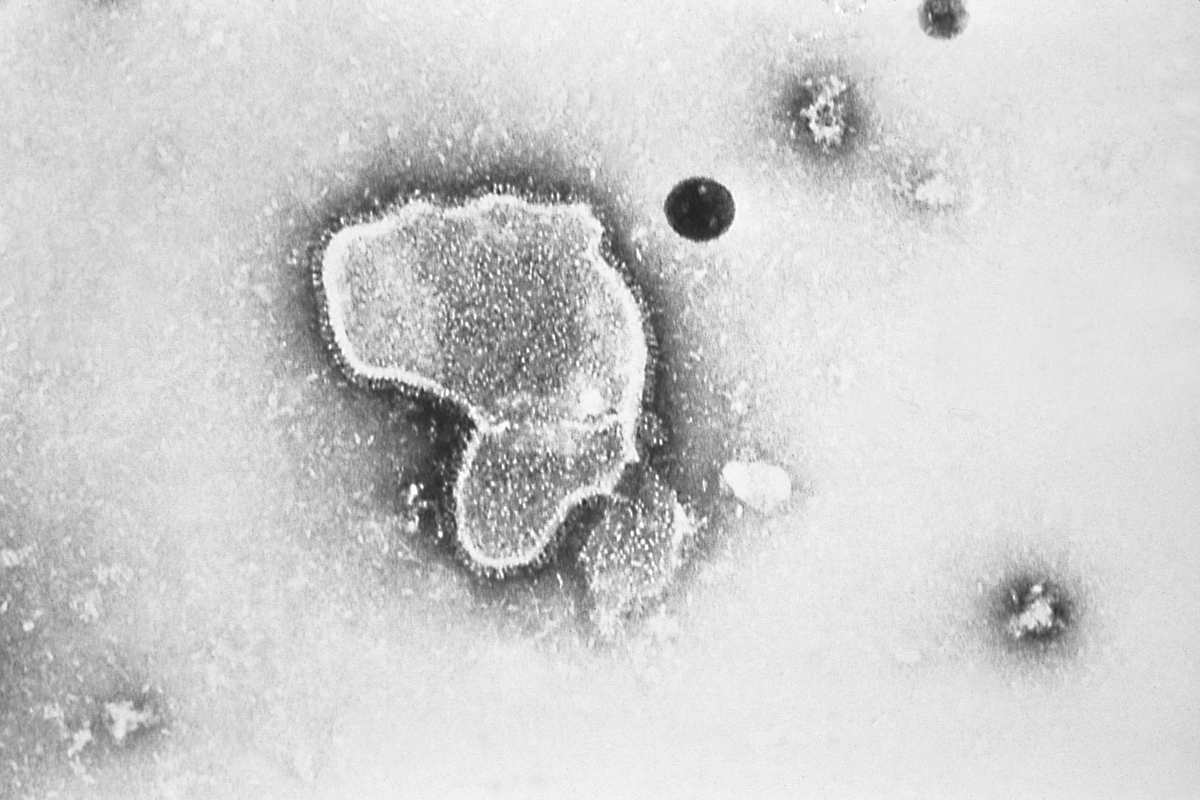
What is RSV
Respiratory syncytial virus (RSV) is an enveloped, single-stranded RNA virus that belongs to the Orthopneumovirus genus of the Pneumoviridae family
RSV is a common cause of respiratory tract infections
it usually causes a mild self-limiting respiratory infection in adults and children but can be severe in infants and older adults who are at increased risk of acute lower respiratory tract infection
RSV is best known for causing bronchiolitis in infants. RSV disease may be under-recognised in older adults.
previous infection by RSV may only confer partial immunity to RSV and so individuals may be infected repeatedly with the same or different strains of RSV
Older adults may become vulnerable to RSV due to age-related decline of parts of their immune system (T-cell immunosenescence)
RSV virion highly magnified by transmission electron microscopic​
Image courtesy of the CDC

Slide 7
Transmission of RSV
RSV is highly communicable, but humans are the only known reservoir
the incubation period (time between infection and appearance of symptoms) varies from 2 to 8 days (usually 3 to 5 days)
the virus is spread from respiratory secretions following close contact with an infected person via respiratory droplets or contact with contaminated surfaces or objects
the virus can survive on surfaces or objects for about 4 to 7 hours

Slide 8
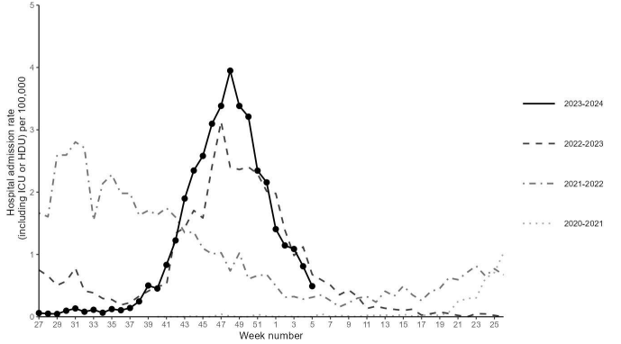
RSV epidemiology
RSV infection is a winter virus, with RSV season in the UK starting from October, peaking in December and declining in March
whilst the occurrence of the mid-winter peak is predictable, its size varies from year to year
almost all children will experience RSV in the first 2 years of life and RSV frequently reinfects older children and adults
UKHSA monitors levels of RSV activity in England throughout the RSV season - epidemiological data are available at gov.uk/government/collections/weekly-national-flu-reports
Weekly overall hospital admission rates (including ICU or HDU) of RSV positive cases per 100,000 population reported through SARI Watch sentinel surveillance, England
Notes:
In recent years, the RSV season has been interrupted by control measures against the COVID-19 pandemic which has resulted in unseasonal RSV activity; this included significant rebound activity in summer 2021 and summer 2022 and a very prolonged period of virus activity in 2022.

Slide 9
RSV epidemiology in adults
whilst the burden of RSV is well understood in infants and children, the burden of RSV in older adults is comparatively poorly understood and considered to be underestimated by existing routine surveillance
only a minority of adult infections are diagnosed as RSV is not widely recognised as a cause of respiratory infections in adults
RSV has been estimated to account for 175,000 annual GP episodes in those age 65 years and older in the UK
it has been estimated in that in each winter season there are 4,000 deaths due to RSV in those aged over 75 years in England and Wales
Notes:
Hardelid, P., Pebody, R. and Andrews, N. (2013), Mortality caused by influenza and respiratory syncytial virus by age group in England and Wales 1999–2010. Influenza and Other Respiratory Viruses, 7: 35-45. https://doi.org/10.1111/j.1750-2659.2012.00345.x (first published 09 March 2012)
Fleming DM and others. Modelling estimates of the burden of respiratory syncytial virus infection in adults and the elderly in the United Kingdom. BMC Infectious Diseases 2015: 15, 443.

Slide 10
RSV symptoms
for most people, RSV infection causes a mild respiratory illness
RSV can cause a range of symptoms such as rhinitis (runny nose, sneezing or nasal congestion), cough, shortness of breath, fever, lethargy and decreased appetite
symptoms can progress to acute lower respiratory tract infection
short or long-term complications may include respiratory complications, cardiovascular abnormalities, and bacterial infections such as pneumonia
RSV may manifest as exacerbations of underlying COPD or cardiovascular disease

Slide 11
Treatment and prevention
there is no specific treatment suitable for RSV and treatment is therefore aimed at supporting the patient and relieving symptoms
transmission can be reduced through standard infection control practices such as respiratory hygiene, hand washing with soap and warm water, and cleaning of surfaces
ideally, people with colds should avoid close contact with vulnerable older adults, particularly those with weakened immune systems, and co-morbidities (particularly respiratory and cardiac disease)

Slide 12
Immunisation
the Joint Committee of Vaccination and Immunisation (JCVI) has reviewed evidence from manufacturers on the efficacy, safety and duration of protection of the newly available vaccine products alongside clinical and epidemiological data on the burden of RSV in infants and older adults in the UK
following a recommendation from the JCVI, two RSV immunisation programmes are to start from 1 September 2024. These are:
older adults programme
adults turning 75 years old on or after 1 September 2024 until their 80th birthday
adults already aged 75 to 79 years on 1 September 2024 until their 80th birthday (or until 31 August 2025 if they have their 80th birthday within the first year of the programme)
infant protection programme
offered to all pregnant women from 28 weeks' gestation in every pregnancy for infant protection (with a separate training slide set and resources available)

Slide 13
RSV vaccination of older adults programme

Slide 14
Aim
The aim of the programme is to reduce the incidence and severity of RSV disease, and hospitalisation as a result of RSV disease, in eligible older adults.

Slide 15
Schedule and dose
The vaccine is given in older adults as a single, one-off dose.
There is not currently data to support second doses in older adults.
See the following slides for recommended age of administration.
The dose is a single (0.5 ml) dose of Abrysvo® pre-F vaccine (Pfizer), using the full volume of the reconstituted vaccine drawn up into the syringe.

Slide 16
Routine programme
From 1 September there will be a routine, year-round programme:
individuals will become eligible on their 75th birthday and remain eligible until aged 79 years and 364 days (that is, up until and including the day before their 80th birthday)
eligible individuals will have been born on or after 1 September 1949
clinically it is preferable to vaccinate as soon as possible after they become eligible so that they are protected at the earliest opportunity:
for those turning 75 years of age between March and October each year, the vaccine should ideally be given by the end of October before RSV activity increases
soon after turning 75 if their birthday falls during the RSV season (November to February).

Slide 17
Catch-up campaign
there will also be a catch-up campaign for those already aged 75 to 79 (but not yet 80) on 1 September 2024
individuals who are aged 79 years on 1st September will have their 80th birthday within the first year after the catch-up campaign commences (date of birth range 2 September 1944 to 31August 1945 inclusive) but they remain eligible up until and including 31 August 2025 to ensure that they have sufficient opportunity to be vaccinated
other eligible individuals (date of birth range 1 September 1945 to 31 August 1949) are eligible until and including the day before their 80th birthday
for all individuals eligible for the catch-up campaign, the expectation is that they will be called and offered vaccination as soon as possible after the programme commences in order to provide them with protection against RSV disease at the earliest opportunity, ideally in September or October 2024 for protection ahead of RSV activity.

Slide 18
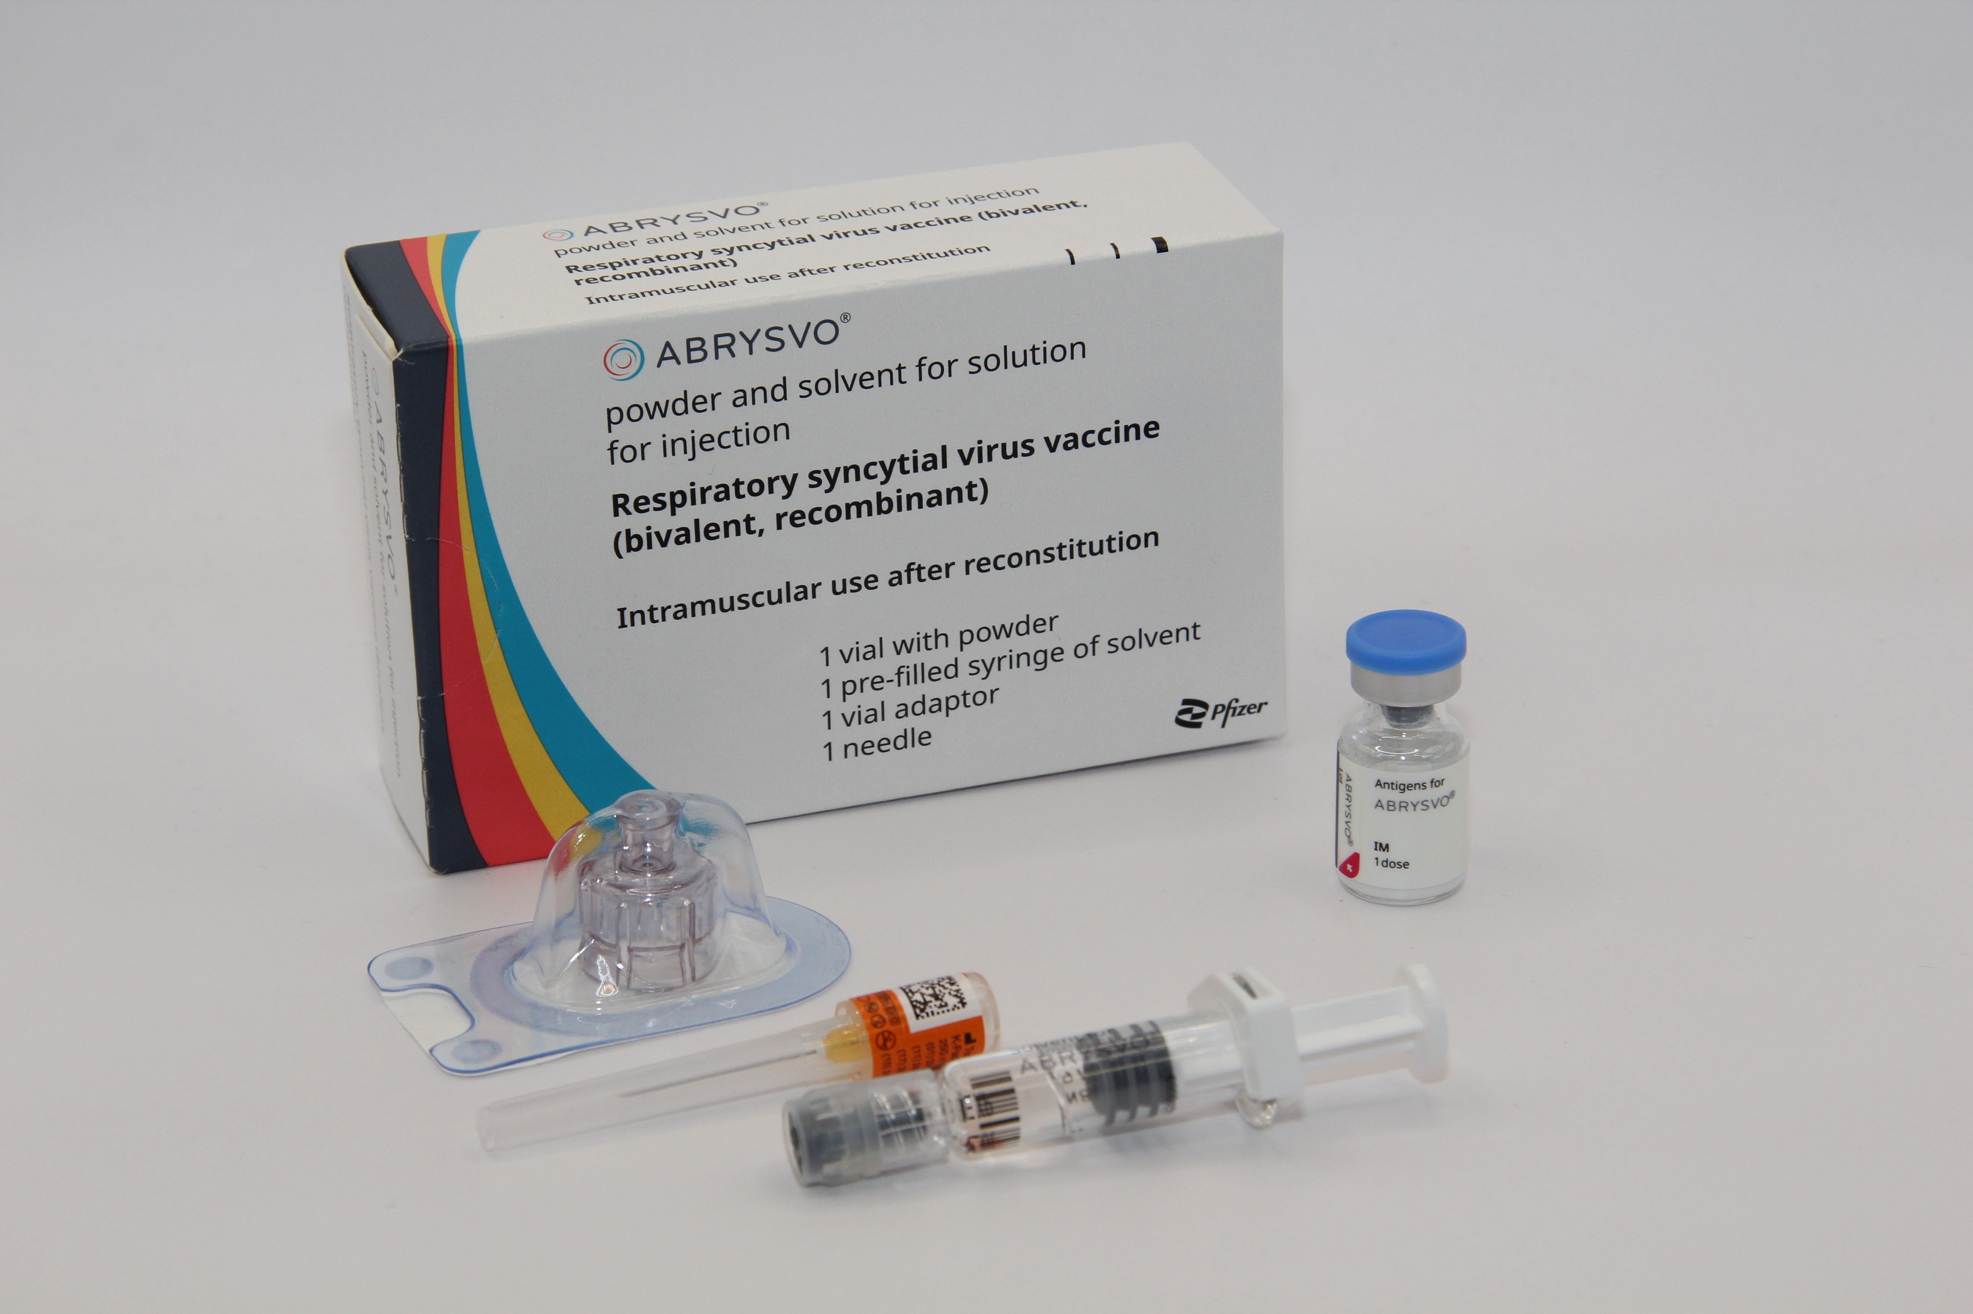
Abrysvo® vaccine: pharmaceutical information
Abrysvo® is the recommended vaccine for RSV vaccination of older adults and is the only vaccine currently available for use within the national programme in the UK
it is a non-live, bivalent recombinant vaccine
as it does not contain any live organisms, it cannot cause the disease against which it protects and can be given to immunosuppressed individuals
Abrysvo® requires reconstitution prior to administration
after reconstitution, one 0.5ml dose of Abrysvo® contains:
RSV subgroup A stabilised prefusion F antigen 60 micrograms
RSV subgroup B stabilised prefusion F antigen 60 micrograms
Abrysvo® is licensed for active immunisation of individuals 60 years of age and older for the prevention of lower respiratory tract disease caused by RSV (Note: individuals aged 60 to 74 are not included in the national programme.)

Slide 19
How Abrysvo® vaccine works
the RSV vaccine Abrysvo® is a non-live bivalent recombinant vaccine
recombinant means a small piece of DNA from the protein of the virus is taken and inserted into a manufactured cell. As these cells grow the protein is made too. This protein is then purified and put into the vaccine which, when introduced into the body via IM injection, activates the immune system
it is referred to as bivalent because Abrysvo® contains versions of two proteins found on the surface of the virus called ‘RSV subgroup A stabilised prefusion F’ and ‘RSV subgroup B stabilised prefusion F’
the vaccine antigen (prefusion F proteins) stimulates the immune system to produce antibodies. When the individual encounters RSV virus, the antibodies neutralise the prefusion F proteins thus preventing the virus particle from fusing with and entering the host’s cells and causing an RSV infection
the vaccine is sometimes called pre-F because it is based on the prefusion form of the fusion (F) protein which the virus uses to invade human cells
Notes:
How RSV causes infection:
any virus particle consists of a protein shell (capsid) inside which is the nucleic acid (DNA or RNA) – the genome or the genetic code for that virus; RSV is an RNA virus
when a virus particle enters the host’s cells it is able to reproduce and release more virus particles which in turn infect other cells – establishing an infection
RSV virus particles use a special type of protein on the surface of the virus called a fusion (F) glycoprotein to pass through the cell membrane
the F proteins does this by fusing the virus cell membrane and the host’s cell membrane together; this allows the virus to move through the host’s cell membrane and enter the cells
the F protein changes shape as it fuses the RSV virus and human cell membranes together: while on the virus surface before infection, the protein is in a “prefusion” form, but as it interacts with the cell membrane it rearranges into an inactive, “postfusion” form
the prefusion form is antigenic – it stimulates an immune response; the immune system is able to recognise and respond to the presence RSV virus particles with prefusion F proteins on their surface by producing antibodies to combat the infection; the postfusion form is not antigenic
there are two subgroups of the prefusion form: A and B
Recombinant vaccine technolgy
different cells (for example bacteria, yeast, other established laboratory cell culture lines) are used to manufacture the vaccine
a small piece of genetic material (DNA) is taken from the microorganism (virus or bacterium) against which we want to protect and inserted into the manufacturing cells: this results in a “recombinant” version of those cells
the role of these recombinant cells is to help transport the DNA instructions for making the antigen into a host cell
once the recombinant cell enters the host cell line it instructs the host cells to rapidly produce the antigen
this antigen is grown in bulk, collected, purified, and then packaged as recombinant vaccine (the cell line used to manufacture the cells is not in the vaccine)
when the vaccine is injected, the antigen in it triggers the immune system to create antibodies that specifically target that antigen
recombinant vaccines are non-live so they cannot cause disease in the vaccine recipient

Slide 20
Abrysvo® vaccine: effectiveness
Abrysvo® was licensed in the UK by the MHRA in November 2023 on the basis of safety and efficacy following a clinical trial of over 17,000 immunocompetent adults aged 60 years and above, 52% of whom had at least one stable chronic underlying condition
at the end of the first RSV season, analysis demonstrated statistically significant vaccine efficacy (VE) for Abrysvo® for reduction of RSV-associated lower respiratory tract illness with 2 or more symptoms of 65.1% and 3 or more symptoms of 88.9%
in the second season, the efficacy against 2 or more symptoms was 55.7% and against 3 or more symptoms was 77.8%.
Abryvso® is licensed for use in Europe, the USA and in many other parts of the world. Over 3 million doses were administered to adults in the USA during winter 2023 to 2024
healthcare professionals are asked to report all suspected adverse reactions via the Yellow Card Scheme at: www.mhra.gov.uk/yellowcard
Notes:
Source: Abrysvo powder and solvent for solution for injection - Summary of Product Characteristics (SmPC) - (emc) (medicines.org.uk)
The Green Book, Chapter 27A (https://www.gov.uk/government/publications/respiratory-syncytial-virus-the-green-book-chapter-27a) contains the following information regarding vaccine effectiveness in older adults:
For older adults, the pivotal phase 3, multi-country, randomised, double-blind, placebo-controlled trial recruited from the age of 60 years to assess Abrysvo’s efficacy against RSV lower respiratory tract infection (LRTI) with 2+ or 3+ symptoms (Walsh et al., 2023). Participants were randomised to receive vaccine (n=18,488) or placebo (n=18,479), stratified by ages 60-69 years (63%), 70-79 years (32%) and ≥80 years (5%). Stable chronic underlying conditions were present in 52% of participants; immunocompromised individuals were excluded. At the end of the first RSV season VE against RSV LRTI with ≥2 symptoms was 65.1% (95%CI: 35.9 to 82.0%) and with ≥3 symptoms 88.9%, (95%CI: 53.6 to 98.7%) (Pfizer 2024). VE estimates by RSV subtype have overlapping confidence intervals (Walsh et al., 2023). In the second season, VE was 77.8% against lower respiratory tract infection (LRTI )with 3+ symptoms (95%CI: 51.4 to 91.1%) and 55.7% (95%CI: 34.7 to 70.4%) against 2+ symptoms (Pfizer 2024).

Slide 21
Vaccine safety
A small number of cases of Guillain-Barré syndrome (GBS) have been reported in older adults following vaccination with Abrysvo® in the trials and in post-marketing surveillance in the USA. GBS is a rare and serious condition that affects the nerves. It mainly affects the feet, hands and limbs, causing problems such as numbness, weakness and pain. In severe cases, GBS can cause difficulty moving, walking, breathing and/ or swallowing. GBS is most common following infection, including campylobacter and influenza.
Around 5 cases of GBS were reported for every million doses of Abryvso® given to recipients in the USA (against a background rate of 0.5 per million people vaccinated with vaccines considered not to have association with GBS).
Overall, the benefits of RSV protection in the eligible group are highly favourable relative to the risks of serious adverse reactions.
Healthcare professionals should be alert to the signs and symptoms of GBS, to ensure correct diagnosis in order to initiate adequate supportive care and treatment and to rule out other causes.
individuals with a history of GBS should be vaccinated if they are in an eligible group. There is evidence from other vaccines to suggest that having had a prior diagnosis of GBS does not predispose an individual to further episodes of GBS following immunisation
cases of GBS that occur following vaccination may occur by chance (the background rate of GBS is 20 per million per year in the population)

Slide 22
Abrysvo® contraindications and precautions
Abrysvo® is contraindicated following confirmed anaphylactic reaction to a previous dose or to any of the components of the vaccine
immunisation of individuals who are acutely unwell with fever should be postponed until they have recovered fully to avoid confusing the diagnosis of any acute illness by wrongly attributing any sign or symptoms to the adverse effects of the vaccine
minor illness, such as a common cold, without fever or systemic upset are not valid reasons to postpone immunisation
refer to the Green Book RSV Chapter 27a and Abrysvo® Patient Group Direction (PGD) for full details

Slide 23
Abrysvo® vaccine excipients
Abrysvo® contains the following excipients:
Powder vial
trometamol
trometamol hydrochloride
sucrose
mannitol
polysorbate 80
sodium chloride
hydrochloric acid (for pH adjustment)
Solvent
water for injections
There is no animal content in the vaccine
Abrysvo® has been certified Halal by The Islamic Food and Nutrition Council of America (IFANCA)
Rarely, people may be allergic to polysorbate 80. However, polysorbate 80 is widely used in medicines and foods, and is present in many medicines including monoclonal antibody preparations
some vaccines (such as the main injected influenza vaccines for individuals aged 65 years and above) contain polysorbate 80. It is also commonly used in foods such as ice cream, and other frozen desserts
it is likely that people will know if they are allergic to it and individuals who have tolerated injections that contain polysorbate 80 are likely to tolerate the Abrysvo® vaccine

Slide 24
Administering Abrysvo at the same time as other vaccines
advice for co-administration is different for different vaccines.
please see the following slides for specific scenarios
where more than one vaccine can be administered at the same time, the vaccines should be given at a separate site, preferably in a different limb
if more than one vaccine is given in the same limb, they should be given at least 2.5cm apart
the sites at which each vaccine is given should be noted in the individual’s health records
when co-administered, any reactions experienced are expected to be the same as those experienced when receiving the vaccines separately

Slide 25
Administering Abrysvo® at the same time as seasonal influenza vaccine
there is some data which shows that in older adults administering Abrysvo® at the same time as seasonal influenza vaccine may reduce the immune response to the RSV vaccine
there is also data that suggests that the response to the influenza A(H3N2) component of seasonal influenza vaccine (the influenza subtype which most severely affects older adults) may be diminished when RSV and seasonal influenza vaccine are co-administered to older adults
the clinical significance of any reduced response is unknown, but influenza immune response is known to correlate with protection against infection, and there is emerging data that RSV immune response also correlates with clinical protection
it is therefore recommended that these vaccines are not routinely scheduled to be given at the same appointment or on the same day
no specific interval is required between administering the vaccines
if it is thought that the individual is unlikely to return for a second appointment or immediate protection is necessary, Abrysvo® can be administered at the same time as the influenza vaccine

Slide 26
Administering Abrysvo® at the same time as COVID-19 vaccine
there is some data which shows co-administration with COVID 19 vaccination and RSV vaccination may reduce the immune response to the RSV vaccine
the clinical significance of any reduced response is unknown
it is therefore recommended that these vaccines should not routinely be scheduled to be given at the same appointment or on the same day
no specific interval is required between administering the vaccines
if it is thought that the individual is unlikely to return for a second appointment or immediate protection is necessary, Abrysvo® can be administered at the same time as the COVID 19 vaccine

Slide 27
Administering Abrysvo® at the same time as other vaccines
Co-administration with pneumococcal, Shingrix® (shingles) and other inactivated or non-live vaccines
in line with general advice about co-administration of inactivated and non-live vaccines, Abrysvo® can be safely given concomitantly with pneumococcal and/or the Shingrix shingles vaccines
Abrysvo® can be given at any interval before or after these vaccines or other inactivated or non-live vaccines
Co-administration with a live vaccine
although live vaccines are not commonly indicated in older adults, Abrysvo® is an inactivated or non-live vaccine so can be given at the same time as any live vaccines

Slide 28
Vaccine ordering
vaccines for the national RSV vaccination programmes in England should be ordered via the ImmForm website
vaccines should be ordered regularly throughout the year
to minimise wastage due to fridge failures or expiry, no more than 2 weeks’ worth of stock should be ordered
vaccines should be ordered, stored and monitored as described in the Green Book Chapter 3 (Storage, distribution and disposal of vaccines)
please note, although the same Abrysvo® vaccine will be used for both the older adult and the vaccination of pregnant women, they will be listed as separate items on ImmForm and the vaccine allocated for each programme should be managed independently where possible. More information can be found on the ImmForm website
vaccines required for individuals who are not in the eligible cohort, for example where a clinician has decided that it is clinically appropriate to vaccinate the individual, but they are not within the eligible age cohorts for the national vaccination programme, would require the GP practice to purchase the vaccine directly from the manufacturer and then reclaim the cost of the vaccine

Slide 29
Storing the Abrysvo® vaccine
Abrysvo® should be stored in a vaccine fridge between +2°C and +8°C
do not freeze: discard if the carton has been frozen
Abrysvo® should be administered immediately after reconstitution
further information on vaccine storage and stability is available in the Summary of Product Characteristics (SPC), the Patient Group Direction and from the manufacturer

Slide 30
Pack contents
Each pack of Abrysvo® RSV vaccine contains:
powder for 1 dose in a vial
solvent (water for injection) in a pre-filled glass syringe with a stopper (synthetic chlorobutyl rubber), luer lock adaptor and tip cap (synthetic isoprene/bromobutyl blend rubber)
vial adaptor
25G 25mm needle (suitable alternatives can be used if required)

Slide 31
Preparing the Abrysvo® vaccine
Abrysvo® must be reconstituted prior to the administration by adding the entire contents of the pre-filled syringe of solvent to the vial containing the powder using the vial adaptor
the vaccine must be reconstituted only with the solvent provided
Clear instructions on how to prepare the vaccine for administration can be found in the SmPC and the manufacturer's video. Immunisers are strongly encouraged to watch the video in its entirety before preparing the vaccine for the first time.
Image from Abrysvo® vaccine SPC

Slide 32
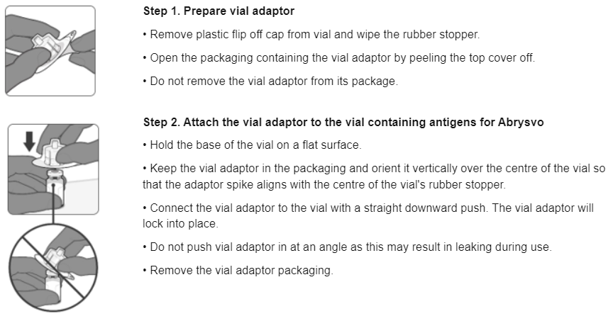
Preparing the Abrysvo® vaccine
Images from Abrysvo® vaccine SPC

Slide 33
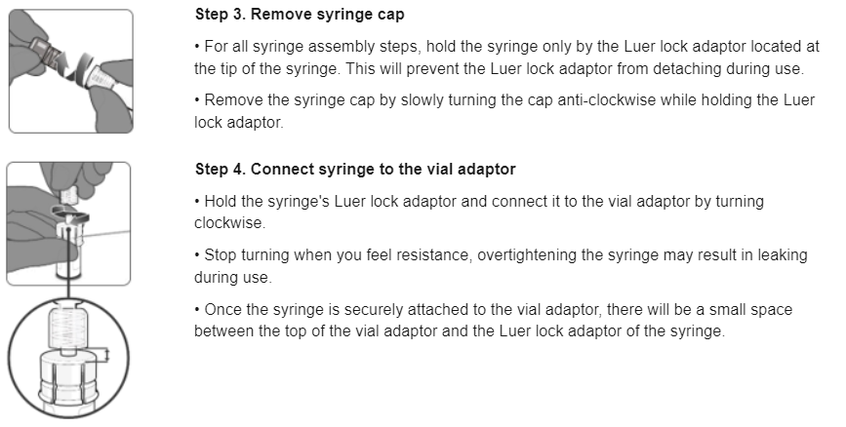
Preparing the Abrysvo® vaccine

Slide 34
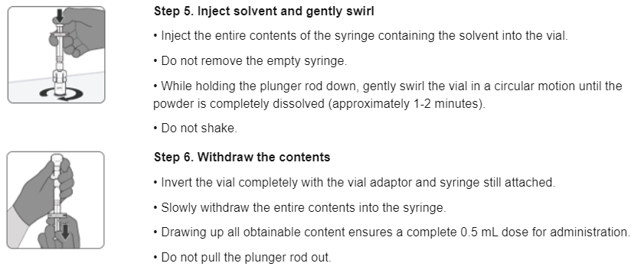
Preparing the Abrysvo® vaccine

Slide 35
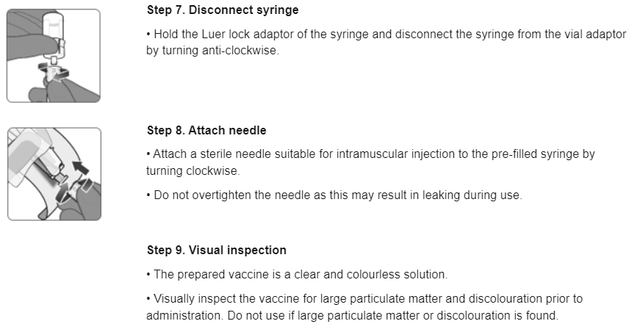
Preparing the Abrysvo® vaccine

Slide 36
Before administering a vaccine
Before administering a vaccine, the individual should be assessed to ensure that:
there are no contraindications to the vaccine being given
they have not experienced any serious reactions to a previous dose or component of the vaccine
they or carer is fully informed about the vaccine to be given and understand the vaccination procedure
they or their carer are aware of possible adverse reactions to the vaccine and how to treat them
they have consented to having the vaccine
Immunisers should ensure that:
they have the appropriate knowledge and legal authority to administer the vaccine
the vaccine has been properly stored and prepared for use and that they know where and how to administer it

Slide 37
Consent
Before vaccinating, ‘informed’ consent must be obtained.
Informed consent is a legal requirement, and the individual’s views must be respected.
Sufficient evidence-based information must be provided to enable the person to make a balanced and informed decision about their care and treatment.
As well as a general explanation of the procedure, there is also a duty to explain the risks inherent in the procedure and the risks inherent in refusing the procedure.
Consent can be given verbally, in writing or it can be implied, but however it is given, the person must understand what they are consenting to.
If there are any issues or uncertainties with seeking or gaining consent, ask for advice from an experienced colleague rather than abandon the offer of immunisation.
Consent is a process and can be withdrawn.
Notes:
Before giving COVID-19 vaccine, immunisers must ensure that they have obtained informed consent from the individual or that a best interest decision has been made if the individual does not have mental capacity at the time of vaccination.
In order to be able to consent to vaccination, the vaccinee should receive an explanation of the treatment and its benefits and risks, either verbally from a clinician, or in the form of a leaflet and letter.
When assessing capacity to consent, the immuniser should be guided by the principles of the Mental Capacity Act (2005). This Act applies to those aged 16 years and over and is designed to protect and empower people who may lack the mental capacity to make their own decisions about their care and treatment.
Consent is a process, not a one-off discussion and must consider 3 factors:
the person giving consent must be appropriately informed: they must have the necessary information in order to make the decision
consent must be voluntary by the individual without undue pressure or coercion
the person consenting must have the capacity to make the decision
.

Slide 38
Informed consent
Information to be given includes:
How much information should you give?
which vaccine is being offered and the disease against which it protects
benefits/risks of immunisation versus risks of the disease​
any possible vaccine reactions and what to do if these occur
this will be personal to the individual at the time and will depend on their previous knowledge and discussions with others
give people as much information as they need and/or want to make an informed decision
some people will just ‘trust’ what you say while others want lots of information; either is fine
how much each individual needs is up to them, no one is obliged to seek full information

Slide 39
Legal requirements for the supply and administration of vaccines
The regulation of medicines is defined under the Human Medicines Regulations 2012.
All vaccines are classified as Prescription Only Medicines (POMs).
This means that they are subject to legal restrictions and in order to give them, there needs to be an appropriate legal framework in place before they can be supplied and/or administered to eligible people.
Additionally, any person who supplies and administers a vaccine must have a legal authority to do so.

Slide 40
Legal requirements for the supply and administration of vaccines
As vaccines are Prescription Only Medicines (POMs), there must be a legal framework to supply and/or administer the vaccine in place. This can be in the form of:
a written patient specific prescription
a Patient Specific Direction (PSD): a written instruction, signed by a doctor, dentist, or non-medical prescriber for medicines to be supplied and/or administered to a named patient after the prescriber has assessed the patient on an individual basis
a Patient Group Direction (PGD): allows some registered specified health care professionals to supply and/or administer a POM directly to a patient with an identified clinical condition rather than needing an individual prescription or an instruction from a prescriber. PGDs are often used for the administration of vaccines
or another process such as a national pandemic protocol or occupational health Written Instruction
Notes:
A PSD is a written instruction, signed by a doctor, dentist, or non-medical prescriber for medicines to be supplied and/or administered to a named patient after the prescriber has assessed the patient on an individual basis. It must include the dose, route and frequency or appliance to be supplied or administered to a named patient.
A PGD provides a legal framework to allow some registered specified health care professionals for the supply and/or administration of a POM directly to a patient with an identified clinical condition rather than needing an individual prescription or an instruction from a prescriber and is often used for vaccines. It sets out the core requisites of those people who can have the medicine under the direction and those who should not. The health care professional working within the PGD is responsible for assessing that the patient fits the criteria set out in the PGD.

Slide 41
Patient Group Directions (PGD)
PGDs set out the core requisites of those people who can have the medicine under the direction and those who should not:
the document will also include details of any additional training that should have been undertaken, actions to be taken if the individual is excluded or declines the medicine, a description of the medicine(s), route of administration, doses, frequency, reporting of adverse reactions, recording, storage and disposal
the HCP working under a PGD is responsible for assessing that the individual fits the criteria set out in the PGD. The healthcare professional operating under the PGD may not delegate the role to others
PGDs must be authorised before use by a doctor and a pharmacist and by an appropriate body for example NHSE, UKHSA, NHS Trust, and so on
health professionals who will be using the PGD must be named and authorised before they use it to provide care
the UKHSA immunisation PGD webpage contains PGD templates and will include one for RSV vaccination. This has been developed by the UKHSA immunisation team and will be available to download for local authorisation and use

Slide 42
Vaccination intramuscular administration
Giving vaccine into the muscle:
leads to a better immune response to the vaccine (as the muscle contains the appropriate cells necessary to initiate the immune response)
is less likely to cause local reactions than if the vaccine is given under the skin (subcutaneously)
The needle needs to be long enough to ensure vaccine is injected into the muscle. For this reason, a 25mm needle is being provided for administration of the RSV vaccine. In larger adults, a longer length (for example, 38mm) may be required, and an individual assessment should be made. Abrysvo® packs contain a 25mm 25G needle.
Abrysvo® should be injected into the deltoid muscle in the upper arm. If there is insufficient muscle mass in the deltoid or a particular reason the deltoid muscle is unsuitable, the vaccine should be given into the vastus lateralis muscle in the anterolateral aspect of the thigh.

Slide 43
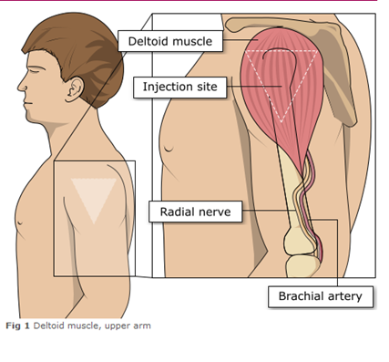
Administering vaccine into the deltoid muscle (upper arm)
It is essential that the correct site and injection technique is used to administer vaccines.
Injecting too high into the upper arm might result in a shoulder injury or a frozen shoulder. This leads to pain, weakness and a limited range of motion that can last for months.
Injecting too low or too far to the side of the arm risks injecting into the axillary nerve or the radial nerve.
To avoid shoulder injury, always assess the limb before administering the vaccine to identify the correct site for injection.
Image adapted from the Australian Immunisation Handbook

Slide 44
The vastus lateralis muscle (anterolateral aspect of the thigh)
Although the deltoid muscle is more commonly used in older children and adults as it is quicker and easier to access, the vastus lateralis muscle in the thigh can be used in these age groups if necessary.
Image from the Australian Immunisation Handbook

Slide 45
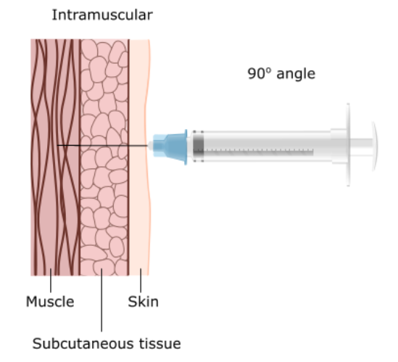
Vaccine administration
Skin does not need to be specially cleaned prior to vaccination. If it is visibly dirty, then water is sufficient to clean it.
Intramuscular process:
identify the correct site for IM injection
stretch the skin at the site
insert the needle at a 90 degrees angle far enough to ensure vaccine is delivered into muscle
depress the plunger
gently remove the needle
apply light pressure using gauze or cotton wool if bleeding occurs
Notes:
https://assets.publishing.service.gov.uk/government/uploads/system/uploads/attachment_data/file/147915/Green-Book-Chapter-4.pdf

Slide 46
Individuals with bleeding disorders or taking anticoagulation therapy
Individuals with bleeding disorders may be vaccinated intramuscularly if, in the opinion of a doctor familiar with the individual’s bleeding risk, vaccines or similar small volume intramuscular injections can be administered with reasonable safety by this route.
If the individual receives medication/ treatment to reduce bleeding, for example treatment for haemophilia, intramuscular vaccination can be scheduled shortly after such medication or treatment is administered.
Individuals on stable anticoagulation therapy, including individuals on warfarin who are up-to-date with their scheduled INR testing and whose latest INR is below the upper level of the therapeutic range, can receive intramuscular vaccination.
A fine needle (23 or 25 gauge) should be used for the vaccination, followed by firm pressure applied to the site without rubbing for at least 2 minutes.
The individual or their carer should be informed about the risk of haematoma from the injection.

Slide 47
Post vaccination
following RSV vaccine administration, individuals should be observed for any immediate reactions whilst you are giving them any verbal post vaccination information
vaccinees should be given a copy of the patient information leaflet for the vaccine that they have received and any other relevant written information
they should be given information about possible vaccine reactions, how to treat these, and when and from whom to seek further advice if required
generally, symptoms post vaccination resolve within 1 to 2 days without treatment, but antipyretics and/or analgesics can be taken if necessary to relieve any symptoms
if individuals are concerned about any symptoms following vaccination, they should seek advice from their GP or NHS 111
facilities for management of anaphylaxis should be available at all vaccination sites and staff should have undertaken BLS and anaphylaxis training

Slide 48
Disposal of consumables
needles should not be re-sheathed following vaccination under any circumstances because of the risk of sustaining a needlestick injury
the needle and syringe should be disposed of immediately after use in a puncture resistant yellow sharps bin
the yellow sharps bin should be sealed when it is two-thirds full and replaced with a new one
any blood-stained gauze should be placed in a bin for healthcare waste
local policy should be followed for the disposal of PPE

Slide 49
Adverse reactions following vaccination
Some people can feel unwell following an injection and some people may experience an adverse reaction.
Vaccinees should be informed of the potential expected reactions to Abrysvo®:
the adverse reactions reported by Abrysvo® clinical trial participants were the expected side-effects commonly reported after any vaccination, reflecting the initiation of the inflammatory and immune responses that lead to vaccine-induced protection against disease
for individuals aged 60 years and above, only vaccination site pain was very commonly reported (reported by 11% of those who received the vaccine in clinical trials)
commonly reported reactions (affecting more than 1 in 100 but not as many as 1 in 10 of those receiving the vaccine) were vaccination site redness and swelling
although headache and myalgia were commonly reported adverse reactions from the clinical trial of younger adults (aged 49 years or below), these were not reported by the 60 years and above age group

Slide 50
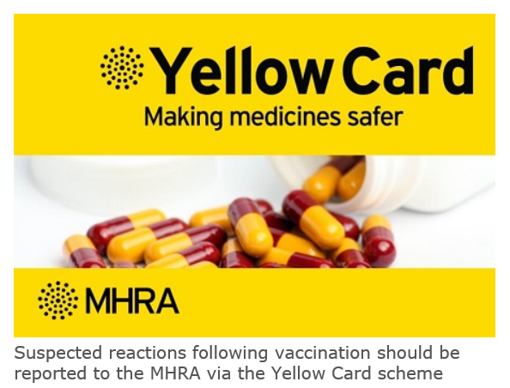
Reporting adverse reactions
Abrysvo® is a newly licensed vaccine and is subject to additional monitoring under the black triangle labelling scheme. This means that all suspected adverse reactions following administration should be reported to the MHRA using their Yellow CARD reporting scheme at Yellow Card | Making medicines and medical devices safer (mhra.gov.uk).
vaccines are carefully monitored to ensure they are safe, not causing untoward side effects and are suitable for the immunisation programme
MHRA promotes the collection and investigation of adverse reactions through the Yellow Card scheme which is a voluntary reporting system for suspected adverse reactions
anyone (vaccine recipients and HCWs) can make a Yellow Card report, even if they are uncertain as to whether a vaccine caused the condition

Slide 51
Documentation and record keeping
It is essential that the information in Box 1 is recorded for all doses of vaccine given to ensure complete and accurate patient vaccination records and to enable extraction of the correct data for surveillance and vaccine coverage purposes.
If not administered at the individual's GP surgery, a record of the vaccination given should be sent to the individual's GP to avoid duplicate vaccination and so that data can be submitted to the national RSV vaccine uptake data survey.
Box 1. Following vaccination, the following information should be recorded:
vaccine name
product name
batch number
expiry date
dose administered
date immunisation given
route/site used
name and signature of vaccinator
Examples of patient records where vaccination details may need to be recorded:
patient's GP record (or other patient record, depending on location)
practice computer system
Recording of vaccination details may be required in multiple systems to ensure completeness and to reduce the risk of duplicate vaccination

Slide 52
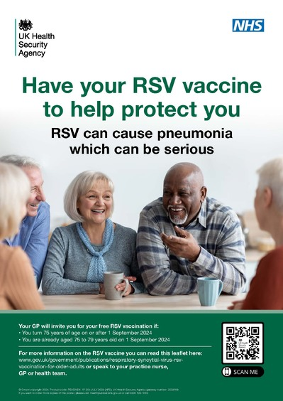
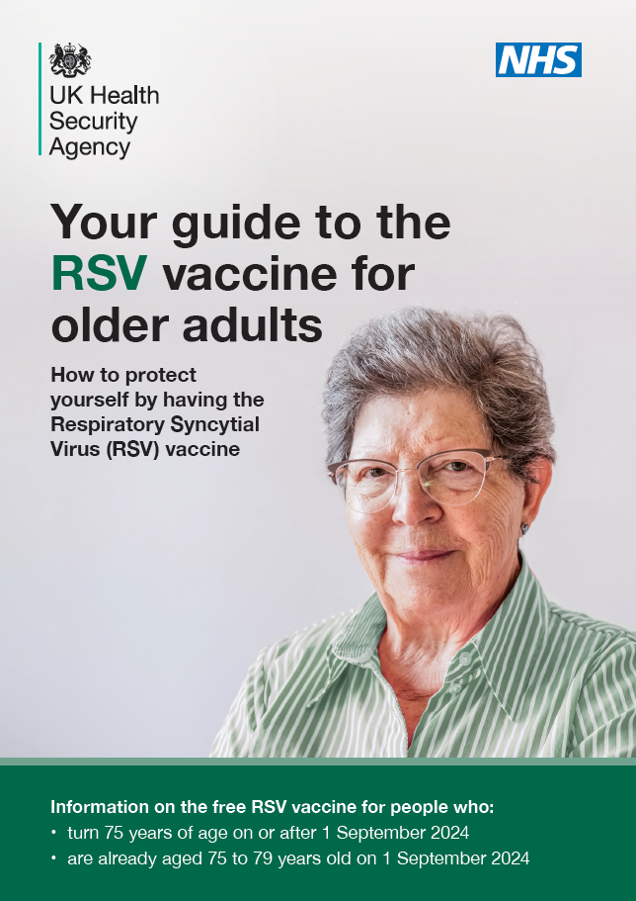
Patient resources
Leaflets, posters, stickers for older adults are available.
This includes:
your guide to the RSV vaccine for older adults
translated leaflets and accessible versions can be ordered now. Stock will arrive in a few weeks. Place your orders now.
Please visit the health publications website for availability of resources in different languages and formats
Older Adults Leaflet: product code:C24RSV01EN
Older Adults Poster: product code: RSVOAEN

Slide 53
Further information
all UKHSA healthcare practitioner resources relating to RSV vaccination for older adults can be accessed in the UKHSA RSV immunisation programme collection collection. These include the ‘information for healthcare practitioners’ document, RSV training slide set and relevant patient leaflets. A separate training side set and information for healthcare practitioners document is also available for the RSV vaccination of pregnant women for infant protection
Marketing authorisation holder’s Summary of product characteristics
Medicines and Healthcare products Regulatory Agency (MHRA): reporting adverse reactions
The Green Book: Immunisation against infectious disease: RSV Green Book Chapter (27a)
UKHSA Patient Group Direction (PGD): RSV vaccine
Pfizer Abrysvo® vaccine preparation instructional video
UKHSA RSV overview: RSV: symptoms, transmission, prevention, treatment

Slide 54
Resources: Information for healthcare practitioner guidance
The information for healthcare practitioners guidance available on the UKHSA RSV vaccination of older adults programme collection is recommended reading for anyone involved in RSV immunisation.
This is a practical document for healthcare practitioners administering or providing advice about RSV vaccination of older adults. It includes the vaccination programme recommendations, contraindications, precautions and examples of scenarios that staff may experience when immunising.

Slide 55
Learning objectives
You should now be able to:
explain what RSV is and be aware of the UK epidemiology
understand the rationale for the RSV older adult vaccination programme
describe how Abrysvo® RSV vaccine works
identify the groups that are eligible to receive the RSV vaccines
describe the process of consent and how this applies when giving vaccines
understand the legal mechanisms by which immunisers can supply and administer Abrysvo® RSV vaccine
describe how to correctly store, prepare and administer Abrysvo® RSV vaccine
communicate key facts in response to questions from individuals and/or their carer(s) and direct them to additional sources of information

