Slide 1
Vaccination against shingles
(Herpes Zoster)
August 2025
Notes:
Background
In 2010, the Joint Committee on Vaccination and Immunisation (JCVI) was asked by the Secretary of State for Health to review the available evidence relevant to the introduction of a universal vaccination programme to protect against shingles (herpes zoster).
The JCVI considered a range of issues including disease epidemiology, vaccine efficacy, vaccine safety and the cost effectiveness of introducing a routine shingles vaccination programme in the UK. Based on the findings of the cost-effectiveness analysis, the JCVI recommended a universal routine herpes zoster (shingles) vaccination programme using a single dose of the live Zostavax shingles vaccine for adults aged 70 with a catch-up programme for those aged 71 to 79 years. Individuals who reached their 80th birthday were not eligible for a shingles vaccination due to the reduced efficacy of Zostavax vaccine with increased age.
From September 2013, a single dose of Zostavax shingles vaccine was offered routinely to individuals aged 70 years (born on or after 1 September 1942) with a phased catch-up programme based on age as of 1 September that year. From August 2021 Shingrix vaccine was introduced as an alternative vaccine for immunocompromised individuals.
From September 2023 Shingrix was offered to all severely immunosuppressed individuals from 50 years of age and to immunocompetent individuals from 60 years of age over a 10-year phased introduction.
From November 2024, supplies of Zostavax had been exhausted (the final batch supplied expired 31 October 2024). Immunocompetent individuals aged 70 to 79 years of age who have yet to receive a dose of Zostavax should be offered two doses of Shingrix.
In November 2024 the JCVI recommended that Shingrix should be offered to all severely immunosuppressed individuals aged 18 years and over. Previously, only severely immunosuppressed individuals aged 50 years and over were eligible. The JCVI reviewed evidence which examined the risk of hospitalisation due to zoster and/or post herpetic neuralgia (PHN) in severely immunosuppressed individuals aged 18 – 49 years. They concluded that the risk of severe disease in these individuals was similar to individuals in cohorts who were already eligible for vaccination. They therefore recommended the use of shingles vaccine in this cohort due to their equivalent risk. A bipartite programme letter confirming that this recommendation was to be implemented was published on 22 July 2025.
This resource is designed to support healthcare practitioners involved in discussing routine vaccination against shingles. This resource does not cover vaccine administration techniques; practical training and competency assessment should be provided locally for new or returning immunisers.
Shingles is also known as herpes zoster. Shingles is the term used throughout this slide set.

Slide 2
Learning outcomes
After completing this training, immunisers will be able to:
describe the aetiology and epidemiology of shingles
describe the relationship between shingles and chickenpox (varicella zoster) and the severity of shingles disease in the older population
discuss the important role of vaccination against shingles
describe the national shingles vaccination programme identify sources of additional information
Notes:
Content
Shingles infection
Epidemiology
National shingles vaccination programme
Shingles vaccine
Resources

Slide 3
Significant messages
shingles is a severe painful illness, mostly affecting older people, that can persist for several months or even years
the severity of the illness increases with age and those 70 years of age and over are at an increased risk; severe immunosuppression is also a risk factor
prior to introduction of the vaccination programme, over 50,000 cases of shingles occurred in people aged 70 years and over each year in England and Wales with approximately 50 cases resulting in death
since 2013, Zostavax was offered routinely to patients 70 to 79 years of age to reduce the incidence and severity of shingles and shingles related complications; Zostavax is no longer being supplied and from 1 November 2024 eligible but not yet vaccinated individuals in this cohort should have been offered Shingrix
since 2021, Shingrix has been available as an alternative vaccine for eligible patients where Zostavax was clinically contraindicated such as individuals with immunosuppression
from 1 September 2023 Shingrix has been available for all severely immunosuppressed individuals from 50 years of age and is also offered to immunocompetent individuals from 60 years of age in a phased implementation over a 10-year period starting with those turning 65 and 70 years of age
from 1 September 2025, Shingrix will be offered to all severely immunosuppressed individuals from 18 years of age
it is important that healthcare professionals offer vaccination to all individuals at the earliest opportunity once they become eligible

Slide 4
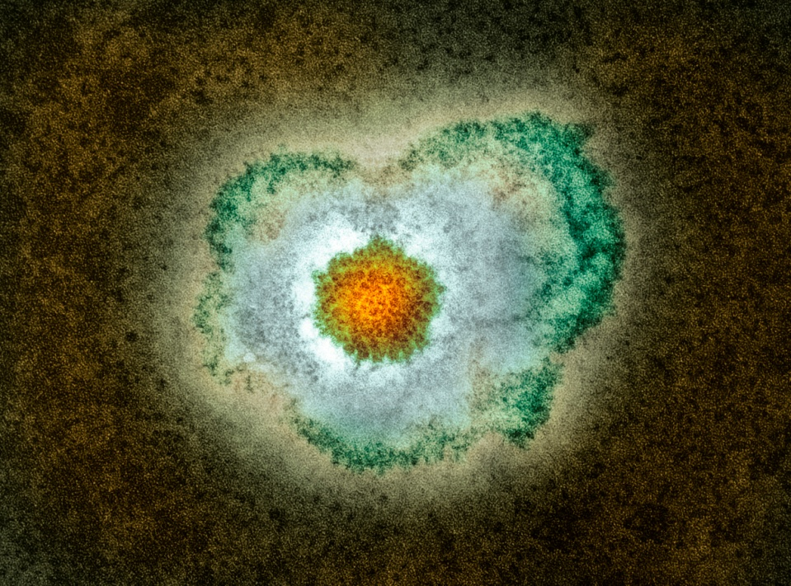
Shingles infection
shingles is a viral infection of the nerve cells and surrounding skin
after a person recovers from chickenpox infection (caused by the varicella zoster virus), the virus remains dormant in the nerve cells and can reactivate at a later stage when the immune system is weakened
reactivation of the dormant virus leads to the clinical manifestation of shingles
reactivation can be associated with older age or immunosuppression
Image courtesy of UKHSA/SPL
Notes:
Shingles (herpes zoster) is caused by the reactivation of a latent varicella zoster virus (VZV) infection, generally decades after the primary infection
Following primary VZV infection, the virus enters the sensory nerves and travels along the nerve to the sensory dorsal root ganglia and establishes a permanent latency.
Reactivation of the latent virus leads to the clinical manifestations of shingles and is associated with immune senescence or suppression of the immune system e.g. immunosuppressive therapy, HIV infection, malignancy . The risk and severity of shingles increases with age.
Although rare, it is possible to have shingles more than once
Shingles is not caused by the same virus that causes genital herpes
Green Book Shingles chapter: Shingles (herpes zoster): the green book, chapter - GOV.UK

Slide 5
Clinical presentation of shingles
Prodromal phase – the first signs of shingles may include:
abnormal skin sensations and pain in the affected area of skin
headache
feeling generally unwell
photophobia
malaise
fever (although this is less common)
A prodromal illness is experienced by 80% of individuals with shingles and can begin up to 72 hours before the rash appears.
Notes:
Shingles images are available on the NHS website: https://www.nhs.uk/conditions/shingles/

Slide 6
Clinical presentation of shingles (2)
Acute stage
a rash of fluid filled blisters develops after a few days, commonly on one side of the face or body, usually within the distribution of a dermatome (an area of skin that is supplied by a single nerve)
the rash often causes intense pain, burning, tingling, itching or numbness in the area of the affected nerve
the rash forms blisters that typically scab over in 7 to 10 days and eventually clears within 2 to 4 weeks
in individuals with a weakened immune system, a more disseminated rash covering multiple dermatomes may occur and this may appear similar to the chickenpox rash
Notes:
Shingles can affect any part of the body, although most commonly affected areas include face (including eyes) chest and abdomen.
Individuals may also experience pain in the arms and legs and may feel exhausted.
A dermatome can be defined as an area of skin that is supplied by a single nerve. Shingles can affect one or more isolated dermatomes.

Slide 7
Possible complications of shingles
Although shingles can occur at any age, without a vaccination programme incidence increases with age, with an estimated lifetime risk of one in four (see slide 12)
Most common complications are:
post herpetic neuralgia (PHN)
secondary bacterial skin infections
Less common complications can include:
ophthalmic zoster (leading to keratitis, corneal ulceration, conjunctivitis, retinitis, optic neuritis and or glaucoma)
peripheral motor neuropathy
In severe cases, shingles can lead to hospitalisation and death.
The risk of hospitalisation from shingles or resulting PHN is equivalent for immunosuppressed individuals aged 18 years and above and older adults.
Notes:
Shingles can cause a number of secondary complications and the severity of these can be dependent on how weak the individual’s immune system is.
Most commonly reported complications in the older age groups include secondary bacterial infections at the site of the rash (that may require antibiotic therapy) and post herpetic neuralgia.
Other less common complications can include ophthalmic shingles and peripheral motor neuropathy. Ophthalmic shingles affects the facial nerve (trigeminal) and can cause ulceration and scarring of the eye and uveitis (inflammation of the inner eye). Ophthalmic shingles can also cause loss of vision if untreated and is often associated with long term pain. Estimates show between 10 and 20% of shingles cases result in ophthalmic zoster with approximately 4% of these cases resulting in long term sequelae
Peripheral motor neuropathy is more common in the elderly population and results in temporary nerve damage to a peripheral motor nerve that controls movement of a limb, such as the arm or leg, causing paralysis in that limb. This effect is temporary and individuals can make a good recovery.
Disseminated disease is more likely to occur in those who are severely immunosuppressed, most deaths being attributable to pneumonia.

Slide 8
Post Herpetic Neuralgia (PHN)
Post herpetic neuralgia (PHN) is a common complication of shingles in older adults:
PHN is pain at the rash site that persists for, or appears more than 90 days after the onset of the shingles rash
on average PHN lasts from 3 to 6 months, but can persist for longer
severity of pain may be constant, intermittent or triggered by stimulation of the affected area, such as a breeze on the face
the pain may be described as burning, itching, stabbing or aching; the site may be extremely sensitive to touch; it is not generally relieved by common painkillers
PHN is more likely to develop, and is more severe, in people over the age of 50, with one-third of sufferers over the age of 80 experiencing intense pain
Notes:
PHN is defined as an intense pain that persists for or develops after 90 days following the onset of the shingles rash and persists on average for between 3 and 6 months in those affected. This pain can last longer and is dependent on the individual’s immune system.
As the pain can be intense and is not generally relieved by common pain killers, PHN can have a negative impact on the individual’s quality of life. PHN can contribute to fatigue, insomnia, depression, anxiety and can impair the basic activities of daily living for the individual.

Slide 9
Infectious period
a person with shingles is only infectious when the rash is present and fluid filled vesicles are present
a person is not infectious before the rash is present or when the rash has crusted
Shingles is less infectious than chickenpox and covering the rash will greatly reduce the risk of exposure to those non-immune to chickenpox.

Slide 10
Incidence of shingles
Prior to the introduction of the shingles vaccine:
over 50,000 cases of shingles occurred in people aged 70 years and over each year in England and Wales
of these,14,000 developed post herpetic neuralgia (PHN)
1,400 cases of shingles resulted in hospitalisation
one in 1,000 cases of shingles in people 70 years of age and over are estimated to result in death*
the risk of shingles is increased in individuals with certain conditions, including systemic lupus erythematosus, rheumatoid arthritis, diabetes and Wegener’s granulomatosis
* Due to the nature of the population and risk of co-morbidities some deaths recorded as being shingles-related may not be directly attributable to the disease.
Notes:
Data from GP-based studies in England and Wales; Green Book Shingles Chapter
See slide 13 for more PHN data.

Slide 11
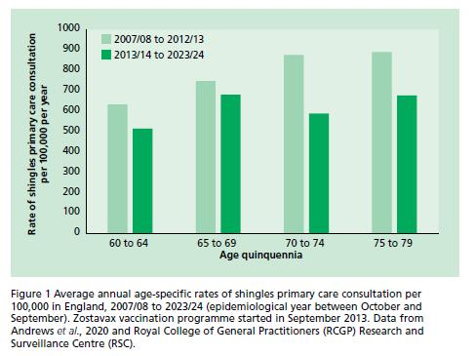
Epidemiology of shingles in England and Wales
Notes:
The above graph shows the estimated annual age-specific incidence of shingles per 100, 000 per year in the immunocompetent population (Y-axis) against the age quinquennia (X-axis).
(Quinquennia = 5-year divisions)
The graph shows a continued increase in cases of shingles with advancing age, prior to vaccine introduction (light green bars) confirming that the incidence of shingles is largely associated with older age and that older individuals are more at risk of developing the disease. After vaccine introduction (dark green bars), older people aged between 70 and 79 years (who will have had an opportunity to receive the vaccination) had lower GP consultation rates compared to those aged 65 to 69 years (darker bars).
Data from Andrews et al., 2020 and Royal College of General Practitioners (RCGP) Research and Surveillance Centre (RSC) – see Green Book for references. These are estimates (based on available data sources) as shingles is only clinically diagnosed, thus no lab confirmation of this is available.

Slide 12
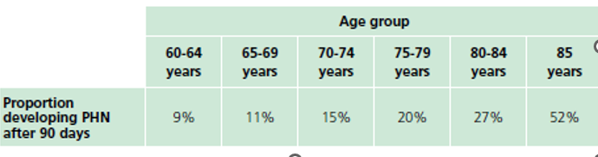
Epidemiology of shingles in England and Wales
Estimated percentage developing PHN by age group in the immunocompetent population in England and Wales in the pre vaccine era (population 2007). Data taken from van Hoek et al 2009.
Notes:
This table shows the estimated percentage of individuals with shingles developing post herpetic neuralgia (PHN) after 90 days, prior to vaccine introduction. It clearly shows that the incidence increases with age. In particular, those individuals above 75 years of age account for a higher percentage of those developing PHN and the incidence is markedly increased in individuals aged 85 years and over who account for 52% of individuals developing PHN. As shown on the previous slide, prior to vaccine introduction, PHN leads to hospitalisation in 1 : 1000 cases. This highlights the importance of offering vaccination to older individuals.

Slide 13
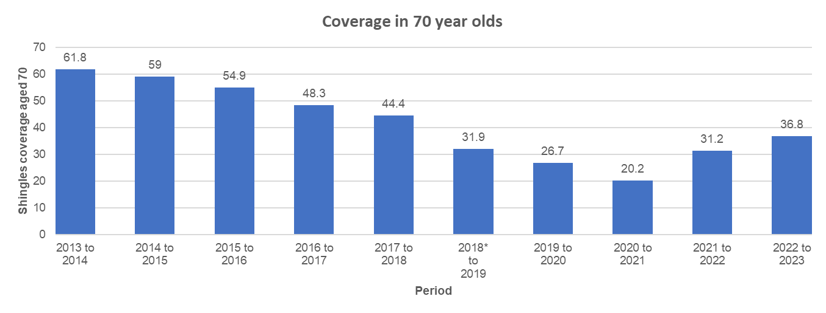
Shingles vaccine coverage data: England
shingles vaccination was successfully introduced in England during September 2013
from 2013/14 to 2019/20, there was a year-on-year decline in vaccine uptake (coverage) in the routine (70-year-old) cohort, however, since 2020/21 uptake has increased each year
* Different methodology and eligibility criteria was adopted from this year onwards.
Notes:
There is evidence of subsequent catch-up as individuals remained eligible until their 80th birthday, with coverage reaching 83.0% for 79 year-olds in 2022/23.
Shingles vaccine coverage reports are available Herpes zoster (shingles) immunisation programme 2022 to 2023: evaluation reports - GOV.UK
Shingles vaccine is available through GP surgeries in primary care and GPs are required to identify and put in place a call/recall arrangement to offer the shingles vaccination to eligible patients. Shingles vaccine can be offered throughout the year.

Slide 14
Evaluation of the shingles vaccination programme
Large and sustained reductions in herpes zoster and PHN consultations and hospitalisations were observed in the first 5 years of the routine and catch-up shingles programme in England when the live Zostavax vaccine was used.
Due to the two vaccination programmes, amongst those aged 70 to 79 years, there were an estimated:
40,500 fewer herpes zoster GP consultations
1,840 fewer herpes zoster hospitalisations including 540 PHN consultations
The vaccine effectiveness against GP consultations for the two programmes were estimated to be 50 to 60% for herpes zoster and 66 to 75% for PHN. The vaccine effectiveness against hospitalisations was estimated to be 37 to 50% for herpes zoster and 49 to 50% for PHN.
Notes:
https://bmjopen.bmj.com/content/bmjopen/10/7/e037458.full.pdf
Impact of the herpes zoster vaccination programme on hospitalised and general practice consulted herpes zoster in the 5 years after its introduction in England: a population-based study
Andrews N, Stowe J, Kuyumdzhieva G, Sile B, Yonova I, de Lusignan S, Ramsay M, Amirthalingam G
e037458.full.pdf (bmj.com)

Slide 15
The shingles vaccination programme
in February 2019, based on impact and cost effectiveness modelling, the JCVI recommended that the national shingles immunisation programme be changed such that Shingrix is offered
  routinely at 60 years of age
  to immunocompromised individuals aged 50 years and over
JCVI also advised a catch-up of 60- to 70-year-olds that should be implemented in stages, starting with vaccination of those turning 65 and 70 years, then moving to vaccination of those turning 60 and 65 years, following which time vaccination could then be routinely offered to those turning 60 years of age
the advice was based on the high efficacy, safety, and immunogenicity of Shingrix observed in clinical trials
evidence suggests that Shingrix provides a substantially longer duration of protection from shingles than Zostavax
from 1 September 2023, there was sufficient supply of Shingrix to implement the JCVI recommendations
from 1 September 2025 the eligibility expanded to all severely immunosuppressed individuals (eligibility as defined in the Green Book Shingles Chapter) aged 18 years and over (with no upper age limit)

Slide 16
Key points about the programme changes to eligibility: severely immunosuppressed
Severely immunosuppressed cohort
since September 2021, Shingrix has been available to immunocompromised individuals aged 70 to 79 years, who were contraindicated to receive Zostavax
from 1 September 2025 the eligibility expanded to all severely immunosuppressed individuals (eligibility as defined in the Green Book Shingles Chapter) aged 18 years and over (with no upper age limit)
severely immunosuppressed individuals who have already received 2 doses of Shingrix do not need to receive re-vaccination or additional doses
severely immunosuppressed individuals represent the highest priority for vaccination given their risk of severe disease
the second dose of Shingrix should be given 8 weeks to 6 months after the first dose for this cohort
Notes:
There should be a minimum interval between the 2 doses of Shingrix vaccine of 8 weeks.

Slide 17
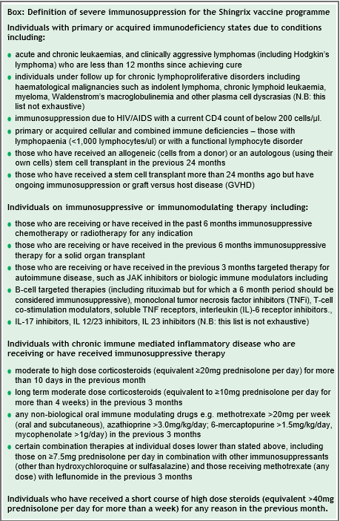
Green Book: Definition of severe immunosuppression
For details about which individuals with severe immunosuppression should be offered Shingrix vaccine from 18 years of age, vaccinators should refer to the box in the Green Book Shingles Chapter.
If there is any doubt, individual patients should be discussed with their specialist.
Box from Green Book Chapter Shingles (herpes zoster)

Slide 18
Shingrix vaccine eligibility
severely immunosuppressed individuals 18 years of age and over who have not received shingles vaccine before (eligibility as defined in the Green Book Shingles Chapter)
immunocompetent individuals from 60 years of age in a phased implementation over a 10-year period starting with those turning ’65’ and ’70’ years of age
immunocompetent individuals 70 to 79 years of age already eligible for the routine immunisation schedule once all nationally procured stock of Zostavax was used up (from 1 November 2024)
for the first 5 years, those turning ‘65’ and ‘70’ years of age each year from 1 September until the following 31 August (inclusive) will become eligible for Shingrix vaccine on their birthday and will remain so until they are 80 years of age
Notes:
From 1 September 2023
For the first 5 years, those turning ‘65’ and ‘70’ years of age each year from 1 September until the following 31 August (inclusive) will become eligible for Shingrix vaccine on their birthday and will remain so until they are 80 years of age.
For the following 5 years, from 1 September 2028, the eligible age will then reduce and those becoming ‘60’ and ‘65’ years of age from 1 September to 31 August (inclusive) each year, will become eligible on their birthday, so that in 10 years’ time, Shingrix will be offered routinely to all immunocompetent individuals from 60 years of age.
From 1 September 2025
Shingrix should be offered to all severely immunosuppressed individuals over the age of 18 years.
Immunocompetent individuals who reach their 80th birthday are no longer eligible for a shingles vaccination.

Slide 19
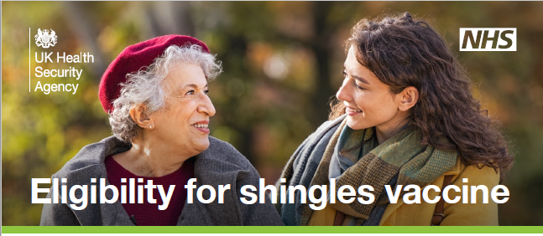
Eligibility for Shingrix vaccine
further information about the shingles national vaccination programme is available on the GOV.UK website: www.gov.uk/government/collections/shingles-vaccination-programme
this includes an eligibility chart for shingles vaccine by age

Slide 20
Expansion of the Shingles vaccine programme for immunocompetent individuals
The eligible age for immunocompetent individuals is changing from 70 to 60 years of age for the routine cohort, in a phased implementation over a 10-year period in two 5-year stages:
Stage 1 (1 September 2023 to 31 August 2028)
  Shingrix should be offered to those turning 70 and 65 years on or after 1 September 2023
  anyone aged 65 to 69 before 1 September 2023 will not be eligible for shingles vaccination until they turn 70 years of age
Stage 2 (1 September 2028 to 31 August 2033)
  Shingrix will be offered to those turning 65 and 60 years of age
All immunocompetent individuals remain eligible for shingles vaccine until their 80th birthday.
The second dose of Shingrix should be given 6 to 12 months after the first dose for this cohort.
Where an individual has turned 80 years of age following their first dose of Shingrix, a second dose should be provided before the individual’s 81st birthday to complete the course.
From 1 September 2033 and thereafter, Shingrix will be offered routinely at age 60 years.
Notes:
Those that become eligible but do not take up the vaccine offer immediately remain eligible until their 80th birthday.
Individuals who were eligible for Zostavax continued to receive Zostavax until central stocks were depleted, after which time they could receive Shingrix.
The 80th birthday upper age cut off remains in place for the immunocompetent cohort regardless of vaccine offered.
Recommended scheduling for immunocompetent individuals is to give the second dose 6 to 12 months after the first dose.

Slide 21
Implementation stages for Shingrix vaccine for immunocompetent individuals from 1 September 2023
Implementation stages | Delivery period | Eligible for first dose
Stage 1 (5 year duration) | 1 Sept 2023 to 31 Aug 2028 | Those who reach age 65 or 70 years during this period should be called in on or after their 65th or 70th birthday
Stage 2 (5 year duration) | 1 Sept 2028 to 31 Aug 2033 | Those who reach age 60 or 65 years during this period should be called in on or after their 60th or 65th birthday
Ongoing routine offer | 1 Sept 2033 onwards | Those turning 60 years of age should be called in on or after their 60th birthday

Slide 22
Shingrix vaccine
Shingrix
Herpes zoster vaccine
GlaxoSmithKline UK
Shingrix is a recombinant adjuvanted subunit shingles vaccine
it does not contain live varicella-zoster virus
it contains a single protein glycoprotein E found in the outer shell of the herpes zoster virus, and an adjuvant to enhance the body's immune response to an antigen
by combining the VZV specific antigen (gE) with an adjuvant system (AS01B), Shingrix is designed to induce antigen-specific cellular and humoral immune responses in individuals with pre-existing immunity against VZV
Shingrix does not contain latex, thiomersal or gelatine
the vial rubber stopper is composed of butyl rubber which does not contain natural rubber latex
Notes:
Shingrix vaccine was introduced in 2021 to ensure immunocompromised individuals, eligible for shingles vaccine under the current programme, developed a similar level of protection to those who were not immunocompromised.

Slide 23
Shingrix efficacy
Shingrix vaccine was approved for use in adults 50 years of age or over in the US, Canada and Australia in 2017, and for use in the European Union and Japan in 2018. The UK license (SmPC) includes “adults 18 years of age or older at increased risk of HZ”.
In the phase 3 randomised placebo controlled clinical trials of 15,411 participants, vaccine efficacy in the 7,695 immunocompetent adults ≥ 50 years and 6,950 ≥70 years, who were given two doses of Shingrix, 2 months apart, was estimated at 97.2% and 91.2% respectively (Lal et al 2015).
A real-world effectiveness study found vaccine effectiveness of 70% against herpes zoster and 76% against post herpetic neuralgia in individuals 65+ years of age given 2 doses of vaccine.
Notes:
SmPC for Shingrix:
https://www.medicines.org.uk/emc/product/12054
Lal H, Cunningham AL, Godeaux O, et al (2015)
Efficacy of an adjuvanted herpes zoster subunit vaccine in older adults.
NEJM. 372:2087-2096 doi: 10.1056/NEJMoa1501184
https://pubmed.ncbi.nlm.nih.gov/25916341/
Izurieta HS and others. Recombinant Zoster Vaccine (Shingrix) real-world effectiveness in the first two years post licensure
Clinical Infectious Diseases 2021 Feb 13:ciab125. doi: 10.1093/cid/ciab125
https://pubmed.ncbi.nlm.nih.gov/33580242/

Slide 24


Shingrix composition
Composition
  After reconstitution 0.5ml contains:
  Varicella Zoster Virus glycoprotein E antigen^{2,3} 50mcg
  ² adjuvanted with AS01_{B} containing:
  plant extract Quillaja saponaria Molina, fraction 21 (QS-21) 50 mcg
  3-O-desacyl-4'-monophosphoryl lipid A (MPL) from Salmonella Minnesota 50 mcg
  ³ glycoprotein E (gE) produced in Chinese Hamster Ovary cells by recombinant DNA technology
Excipients
  Powder (gE antigen):
  Sucrose
  Polysorbate 80 (E 433)
  Sodium dihydrogen phosphate dihydrate (E 339)
  Dipotassium phosphate (E 340)
  Suspension (AS01_{B} Adjuvant System):
  Dioleoyl phosphatidylcholine (E 322)
  Cholesterol
  Sodium chloride
  Disodium phosphate anhydrous (E 339)
  Potassium dihydrogen phosphate (E 340)
  Water for injections
Notes:
https://www.medicines.org.uk/emc/product/12054

Slide 25
Shingrix contraindications
Contraindications to Shingrix
Systemic allergic reaction (including immediate-onset anaphylaxis) to:
a previous dose of Shingrix vaccine or
any component (excipient) of Shingrix
Notes:
https://www.medicines.org.uk/emc/product/12054

Slide 26
Shingrix co-administration
Shingrix can be given at the same time as inactivated or live vaccines
this now includes the adjuvanted quadrivalent influenza vaccine (aQIV), and COVID19 and RSV vaccines
previously, a 7-day interval was recommended between Shingrix and aQIV because the potential reactogenicity from two adjuvanted vaccines may reduce tolerability in those being vaccinated
interim data from a US study on co-administration of Shingrix with aQIV is reassuring - there were no safety concerns when the two vaccines were given together
therefore, an appointment for flu vaccination can be an opportunity to also provide shingles vaccine, although shingles vaccine should be offered all year round, rather than purely as a seasonal programme
Shingrix may also be offered at the same appointment to individuals aged 75 years and above who attend, year-round, for their RSV vaccination
when Shingrix is given at the same time as the 23-valent pneumococcal polysaccharide vaccine (PPV23) individuals should be advised about possible side effects of fever and shivering
Notes:
Shingrix can be given concomitantly with, or at any interval before or after any other vaccines for which the individual is eligible (and not contraindicated). This includes but is not limited to vaccines commonly administered around the same time or in the same settings. In such circumstances, patients should be informed about the likely timing of potential adverse events relating to each vaccine. It was previously advised that there should be a 7-day interval between Shingrix and the adjuvanted quadrivalent influenza vaccine, aQIV. This interval was because there was a concern that there may be potentially be more adverse reactions when these two adjuvanted vaccines are given together. A study looking at co-administration of Shingrix and the adjuvanted flu vaccine has been carried out in the United States. Interim data from this study showed that there were no safety concerns when the two vaccines were given together. Therefore, if a person attends for flu vaccination and they are also eligible for Shingrix vaccine, the two can be given together. However, as shingles is a year-round programme, it should not be delayed so it can be given with the seasonal flu vaccine.
Shingrix may also be offered at the same appointment to individuals aged 75 years and above who attend, year-round, for their RSV vaccination
Shingrix can also be given with the 23-valent pneumococcal polysaccharide vaccine, PPV23, pneumococcal conjugate vaccines (PCV) and with COVID-19 vaccines. In phase III controlled open label clinical studies of Shingrix® in adults aged 50 years and older, individuals received PPV23 in one study, and PCV13 in another study (Min et al 2022) with their first dose of Shingrix. The immune responses of both the co-administered vaccines were unaffected, although fever and shivering were more commonly reported when PPV23 was given with Shingrix.

Slide 27
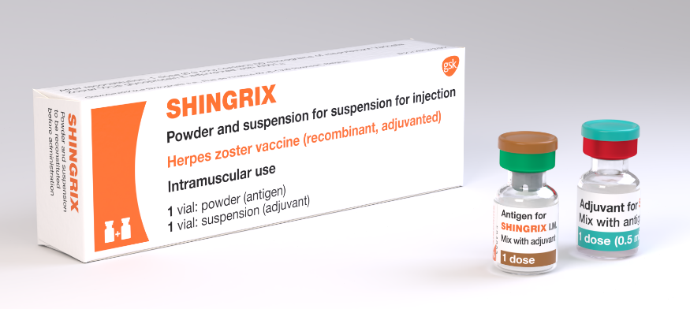
Shingrix dosage and schedule
After reconstitution Shingrix should be administered as a 0.5ml dose.
The schedule consists of 2 doses of vaccine with the following interval between doses:
  8 weeks to 6 months for severely immunosuppressed individuals
  6 months to 12 months for immunocompetent individuals
There is no current recommendation for a booster dose
(the need for booster doses following 2 primary doses has
not yet been determined).
Storage:
Shingrix should be stored in a vaccine refrigerator
between +2ºC to +8ºC.
Notes:
The second dose can be given 8 weeks to 12 months after the first dose but when Shingrix vaccine is being offered to severely immunosuppressed individuals, they should be protected with a full course as soon as possible and so the recommendation is to give the 2nd dose of vaccine at 8 weeks (ideally) to 6 months.
The need for, and the timing of a booster dose, for Shingrix has not yet been determined therefore no booster is currently recommended.

Slide 28
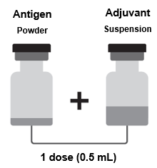
Shingrix reconstitution
One vial contains the powder
One vial contains the suspension (adjuvant)
The powder and the suspension must be reconstituted prior to administration
withdraw the entire contents of the vial containing the suspension into the syringe
add the entire contents of the syringe into the vial containing the powder
shake gently until the powder is completely dissolved (reconstituted vaccine is an opalescent, colourless to pale brownish liquid)
withdraw the entire contents of the vial containing the reconstituted vaccine into the syringe
change the needle so that you are using a new needle to administer the vaccine
if any foreign particulate matter and or variation of appearance is observed vaccine should not be administered
after reconstitution, the vaccine should be used immediately
Notes:
GSK Shingrix including reconstitution instructions: https://gskpro.com/en-gb/products/shingrix/home/

Slide 29
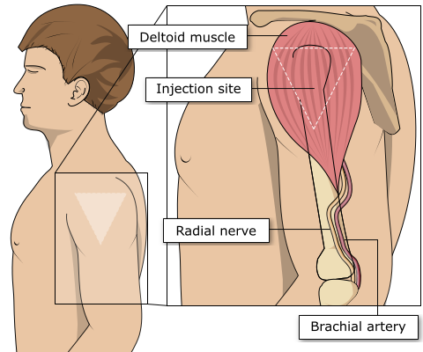
Site of administration
Shingles vaccine should be injected into the deltoid muscle in the upper arm
injecting too high into the upper arm might result in a shoulder injury or a frozen shoulder. This leads to pain, weakness and a limited range of motion that can last for months
injecting too low or too far to the side of the arm risks injecting into the axillary nerve or the radial nerve
to avoid shoulder injury, always assess the limb before administering the vaccine to identify the correct site for injection
Notes:
Shingles vaccine should preferably be injected into the deltoid muscle in the upper arm (or anterolateral aspect of thigh if not possible to use the deltoid muscle).
Injecting too high into the upper arm might result in the vaccine being deposited in the shoulder capsule rather than the deltoid muscle.
This can cause inflammation that can lead to a shoulder injury or a frozen shoulder leading to pain, weakness and a limited range of motion that can last for months.
Injecting too far to the side of the arm or too low on the arm risks injecting into the axillary nerve or the radial nerve.
This can cause a burning or shooting pain during the procedure and can lead to nerve damage (neuropathy/paralysis).
To avoid shoulder injury, the limb should be assessed before administering the vaccine to identify the correct site for injection.

Slide 30
Shingrix possible adverse reactions
Most commonly reported (1:10 of people vaccinated)
Pain, redness, swelling at the injection site;
headache; gastrointestinal symptoms, (nausea, vomiting and/or abdominal pain)
myalgia, fatigue, chills, fever
Generally lower in those 70 years of age and above
Less commonly reported (≥1/100 to <1/10)
Injection site pruritus, malaise
Uncommon (≥1/1,000 to <1/100)
Lymphadenopathy, arthralgia
Rare (≥1/10,000 to <1/1,000)
Hypersensitivity reactions including rash, urticaria, angioedema (from spontaneous reporting)
Notes:
A full list of side effects can be found in the Shingrix summary of product characteristics:
https://www.medicines.org.uk/emc/product/12054

Slide 31
Anticipating immunosuppressive therapy
Individuals aged 18 years and older anticipating immunosuppressive therapy:
eligible individuals anticipating immunosuppressive therapy should ideally be assessed for vaccine eligibility before starting treatment
if not previously vaccinated, they should commence a course of Shingrix at the earliest opportunity, at least 14 days before starting immunosuppressive therapy. Leaving one month would be preferable if a delay is possible
there should be a minimum interval of 8 weeks between doses
if immunosuppressive treatment is subsequently commenced after the first dose of Shingrix is given, the second dose may be given 8 weeks to 6 months later
Notes:
The risk and severity of shingles is considerably higher amongst severely immunosuppressed individuals

Slide 32
Current or recent shingles infection
shingles vaccine is not recommended for treatment of shingles or post herpetic neuralgia (PHN)
as postherpetic neuralgia (PHN) can persist for many months or years, if the patient is eligible for shingles vaccine by age and they have no other symptoms, then the recommendation would be to offer the Shingrix vaccine without any specific interval before offering vaccine
patients who have 2 or more episodes of shingles in one year should have immunological investigation prior to vaccination
Notes:
Immunisation of individuals who are acutely unwell should be postponed until they have recovered fully. This is to avoid confusing the diagnosis of any acute illness by wrongly attributing any sign or symptoms to the adverse effects of the vaccine.
Shingrix vaccine can be given as long as the individual has recovered from acute infection and they have no active vesicles

Slide 33
Prescription only medication (POM)
Shingrix should only be administered using a:
prescription written manually or electronically by a registered medical practitioner or other authorised prescriber
patient specific direction (PSD)
patient group direction (PGD)
A PGD template to support the national shingles vaccination programme for eligible adults is available from UKHSA on the GOV.UK website.
Local authorisation is required before PGD templates can be used.

Slide 34
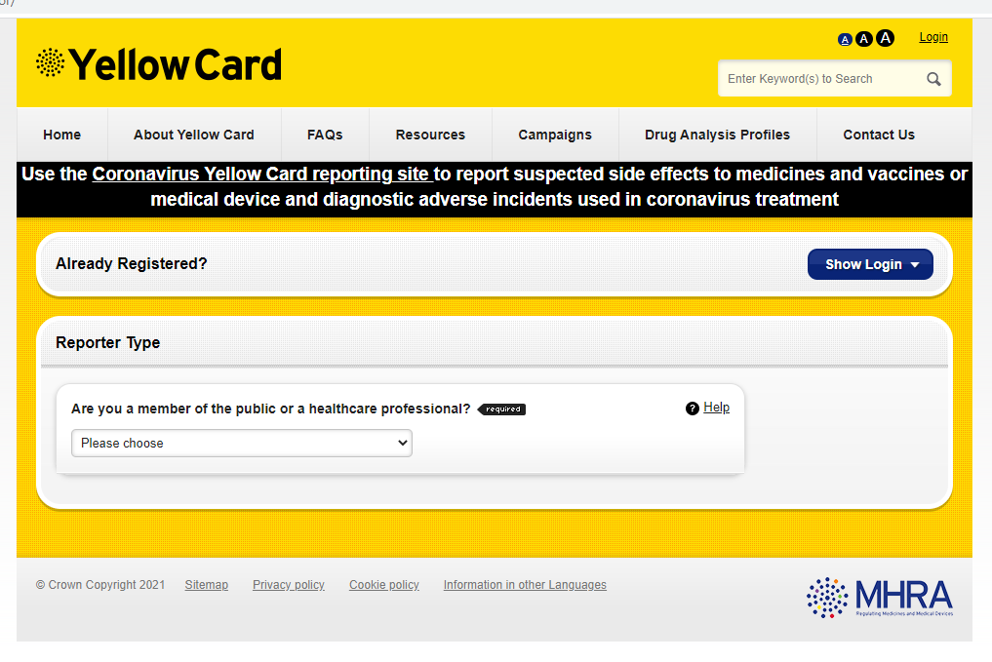
Reporting suspected adverse reactions
    Suspected adverse reactions to Shingrix should be reported to the Medicines and Healthcare products Regulatory Agency (MHRA) using the Yellow Card reporting scheme.
Yellow Card scheme:
voluntary reporting system for suspected adverse reaction to medicines or vaccines
success depends on early, complete and accurate reporting
report even if uncertain about whether vaccine caused condition
reporting site for the Yellow Card scheme: https://yellowcard.mhra.gov.uk/
see the Green Book Chapter 8 for further details
Notes:
Healthcare professionals and patients are encouraged to report suspected adverse reactions to the Medicines and Healthcare products Regulatory Agency (MHRA) using the yellow card reporting scheme.
Yellow Card | Making medicines and medical devices safer (mhra.gov.uk)
https://yellowcard.mhra.gov.uk/

Slide 35
Maximising vaccine coverage
since the introduction of the shingles vaccination programme in 2013 there has been a year-on-year decline in vaccine uptake
efforts to identify and vaccinate all eligible individuals are needed to achieve a continuing reduction in the number of cases of this debilitating and painful condition; if not already in place, a system of call/ recall should be implemented
all those advising on or administering the shingles vaccine should take every opportunity to offer vaccine to eligible patients as soon as they become eligible to help to protect them from this serious illness
shingles vaccine can be offered when an eligible individual is attending for another vaccine such as flu, RSV, pneumococcal or COVID vaccine (although the shingles vaccine should be offered at any time of year, not only when seasonal vaccines such as flu are offered)
Notes:
Refer earlier slide ‘Shingles vaccine coverage data: England’

Slide 36

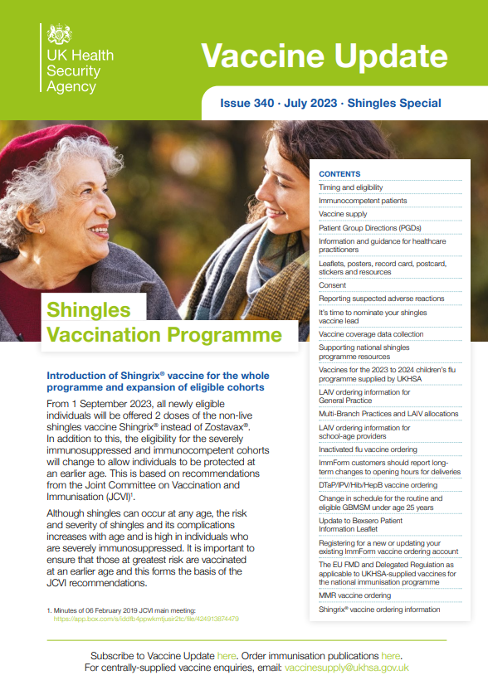
Leaflets and posters
Leaflets, record cards and posters on shingles can be found and ordered through the Health publications site:
www.healthpublications.gov.uk/Home.html
Vaccine update
This is a monthly newsletter which describes the latest developments in vaccines, vaccination policies and procedures. There is a special edition about the changes to the shingles vaccination programme
Sign up to receive the newsletter by email:
www.gov.uk/government/collections/vaccine-update

Slide 37
Significant messages
shingles is a severe painful illness, mostly affecting older people, that can persist for several months or even years
the severity of the illness increases with age and those 70 years of age and over are at an increased risk; severe immunosuppression is also a risk factor
prior to introduction of the vaccination programme, over 50,000 cases of shingles occurred in people aged 70 years and over each year in England and Wales with approximately 50 cases resulting in death
since 2013, Zostavax was offered routinely to patients 70 to 79 years of age to reduce the incidence and severity of shingles and shingles related complications; Zostavax is no longer being supplied and from 1 November 2024 eligible but not yet vaccinated individuals in this cohort should have been offered Shingrix
since 2021, Shingrix has been available as an alternative vaccine for eligible patients where Zostavax was clinically contraindicated such as individuals with immunosuppression
from 1 September 2023 Shingrix has been available for all severely immunosuppressed individuals from 50 years of age and is also offered to immunocompetent individuals from 60 years of age in a phased implementation over a 10-year period starting with those turning 65 and 70 years of age
from 1 September 2025, Shingrix will be offered to all severely immunosuppressed individuals from 18 years of age
it is important that healthcare professionals offer vaccination to all individuals at the earliest opportunity once they become eligible

Slide 38
Resources
Immunisation against infectious disease (the Green Book) Shingles (herpes zoster) chapter
Shingles: guidance and vaccination programme
Shingles vaccination: guidance for healthcare practitioners
  This provides additional information about the shingles vaccination programme for healthcare practitioners.
Patient Group Direction templates
Notes:
UKHSA and NHS England Letter Shingles immunisation programme: www.gov.uk/government/publications/shingles-immunisation-programme-letter

