Slide 1
Attitudes to the childhood vaccination programme in parents of babies and children under 5 years of age January 2023 UKHSA Immunisation and vaccine preventable diseases division

Slide 2
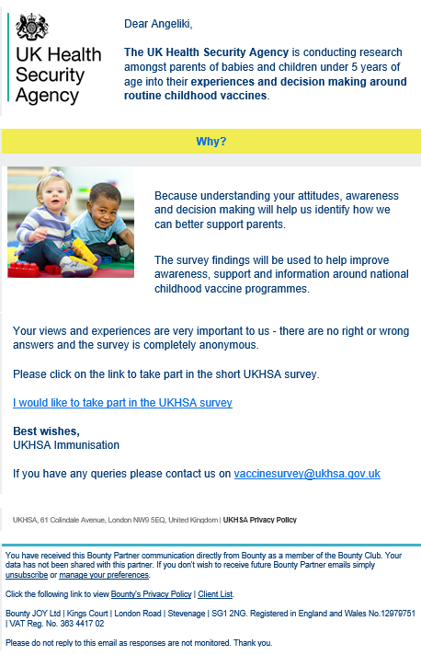
Methodology ‘tell us what you think’
an email was sent to parents registered with Bounty (commercial parental marketing organisation) on behalf of UKHSA with an invitation to take part in a survey. The email included a link to the survey
first email sent on 2 September 2022 to 328,542 email addresses of which 43,190 were opened and 2,168 clicked the survey link
reminder email sent on 16 September 2022 resulting in an additional 1,648 clicks on the survey link
there were 1,620 (3.8% of 43,190 opened emails, 76% of those who clicked the link) people who started the survey
1,485 (91.7%) were eligible to complete the survey (living in England with parental responsibility for one or more child aged 2 months to under 5 years)

Slide 3
Parental study population
97% were female
94% were aged between 25 and 44 years
88% were married or in a civil partnership or living as a couple, 9% were single
5% reported they had a disability
79% were white British, 8% were any other white background, 4% were Asian/ British Asian, 3% were black/ black British
The main income earner in the household was: 13% higher managerial/professional/ administrative, 35% intermediate managerial/professional/administrative, 24% supervisory or clerical/junior managerial/professional/administrative, 10% skilled manual worker, 5% semi or unskilled manual work

Slide 4
Parental study population
people living in London were under-represented and the South East were over-represented according to population data in England for all ages (based on region at birth, 2021)
older mothers were over-represented and younger mothers were under-represented (based on mother age at birth, 2021)
parents of children aged between 3 years 4 months and under 5 years were under-represented
White British parents were over-represented and non-white parents were under-represented (based on ethnicity of live births, 2007 to 2019)

Slide 5
Age of children with parents who completed the survey
most respondents (78%) had one child
most respondents had children aged under 3 years and 4 months, that is not yet offered pre-school booster (1,420 of 1,822 (78%) children, 1,420 of 1,661 (85%) children with known age)
Response | 0 years | 1 year | 2 years | 3 years | 4 years | Age NK | <3Y4M | 3Y4M+ | Total parents
1 child | 370 | 256 | 255 | 215 | 69 | 0 | 1,034 | 131 | 1,165
2 children | 122** | 93 | 91^ | 117# | 35 | 150 | 362 | 96 | 304
3 children | 12 | 2 | 5 | 8** | 9 | 9 | 23 | 13 | 15
4 children | 1 |  |  | 1 |  | 2 | 1 | 1 | 1
Total children | 505 | 351 | 351 | 341 | 113 | 161* | 1,420 | 241 | 1,485 1,822
** 1 set of twins
^2 sets of twins
# 4 sets of twins
* Assumed to be aged 5 years or older

Slide 6
Most parents (71%) remember recently coming across information about vaccines for babies or young children
Q. Have you seen, heard or read anything about vaccines for babies or young children in the last 12 months?
80% of parents who saw vaccine information said it was positive.

Slide 7
Q. And where did you see or hear about vaccination for babies or young children?
Parents reported that the most common sources of vaccine information they came across were:
the red book/ Personal Child Health Record (52%)
health visitor or midwife (49%)
other healthcare professional (40%)
the NHS website (31%)
NHS leaflet (25%)

Slide 8
Most parents came across information that made them feel vaccination was important for their baby or child
Q. Is there anything you have come across that made you feel it was important for your baby, or young child to have their vaccines?
Q. Is there anything you have come across that would make you concerned or worried about your baby or young child having a vaccine?

Slide 9
Official sources were key in highlighting the importance of vaccines
Parents reported that the most common sources of information making them feel vaccines were important came from:
health visitor or midwife (47%)
the red book/ Personal Child Health Record (42%)
other healthcare professionals (40%)
the NHS website (27%)
NHS leaflet (27%)

Slide 10
There were some sources of information that made a small proportion of parents worry
Only 15% of parents reported they had come across information that made them feel worried about vaccines.
This most often came from:
friends, other parents (56%, 74 parents)
social media – Facebook (46%, 60 parents)
family members (24%, 31 parents)
internet – Netmums or Mumsnet (24%, 31 parents)
TV or magazines or radio (23%, 30 parents)
This was most often about:
coronavirus (COVID-19) vaccine
MMR vaccine
DTaP-IPV-Hib-HepB vaccine

Slide 11
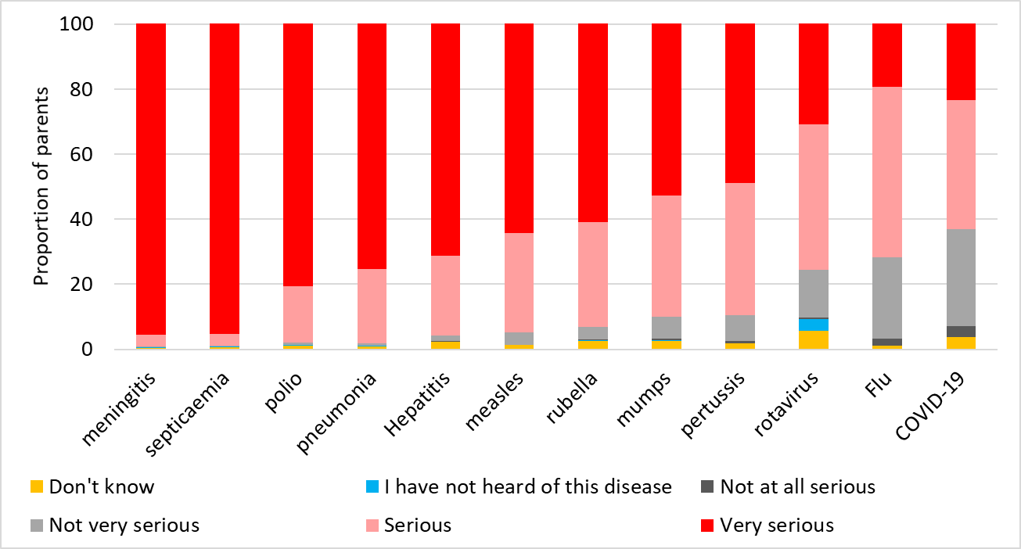
Most parents thought that vaccine preventable diseases could be serious for their child
Q. How serious do you think it could be if your baby or young child got the following diseases?
meningitis and septicaemia were considered very serious by 95% of parents
over 90% of parents thought that measles, rubella, mumps, polio, pneumonia and hepatitis could be serious or very serious
COVID-19, flu and rotavirus were least likely to be considered serious

Slide 12
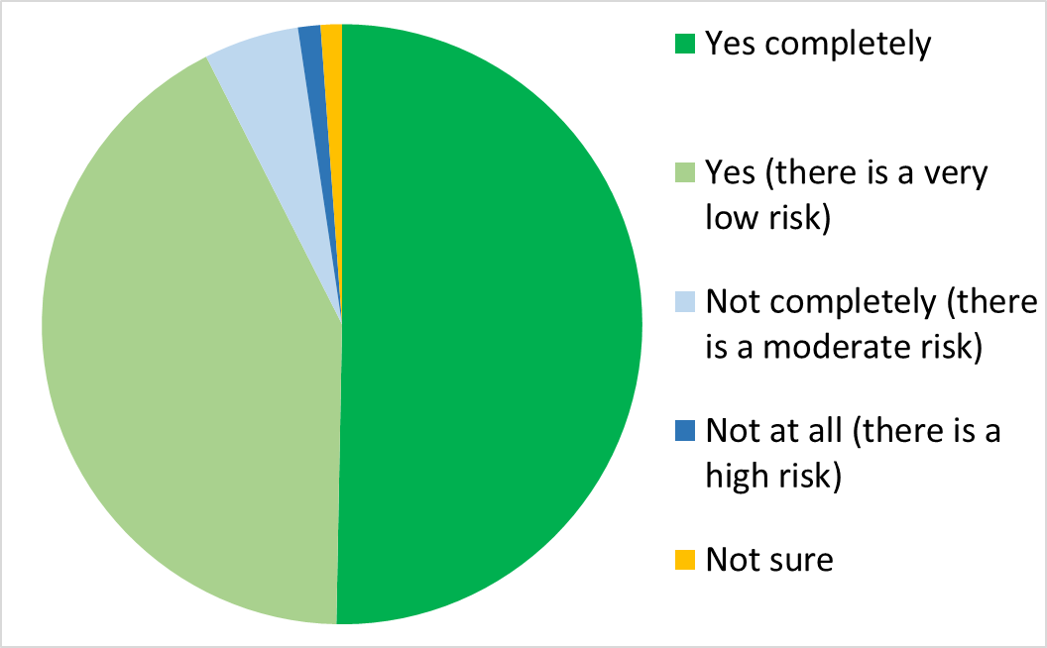
92% of parents were happy with vaccine safety
Q. Overall are you happy with the safety of vaccines for babies and young children?

Slide 13
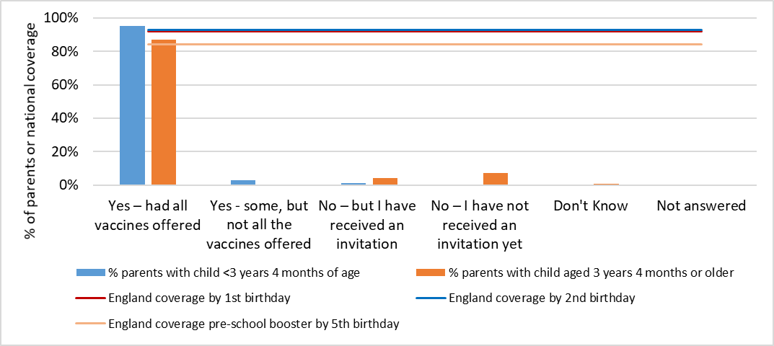
Most parents said that their children had received all the vaccines they had been offered
Q. Has/have your child(ren)who are currently younger than 3 years and 4 months received any vaccines?
Q. Has/have your child(ren)who are currently aged 3 years and 4 months or older had either or both of their pre-school vaccines yet: that is, the second dose of MMR and the pre-school booster?

Slide 14
81% of parents said they had enough information to make an informed decision about vaccinating their child
The following were the most common ways that parents received vaccine information:
Red Book/ Child’s personal health record (72%)
health visitor or midwife (66%)
other healthcare professional (for example GP, nurse pharmacist) (62%)
the NHS website (56%)
NHS leaflets (32%)

Slide 15
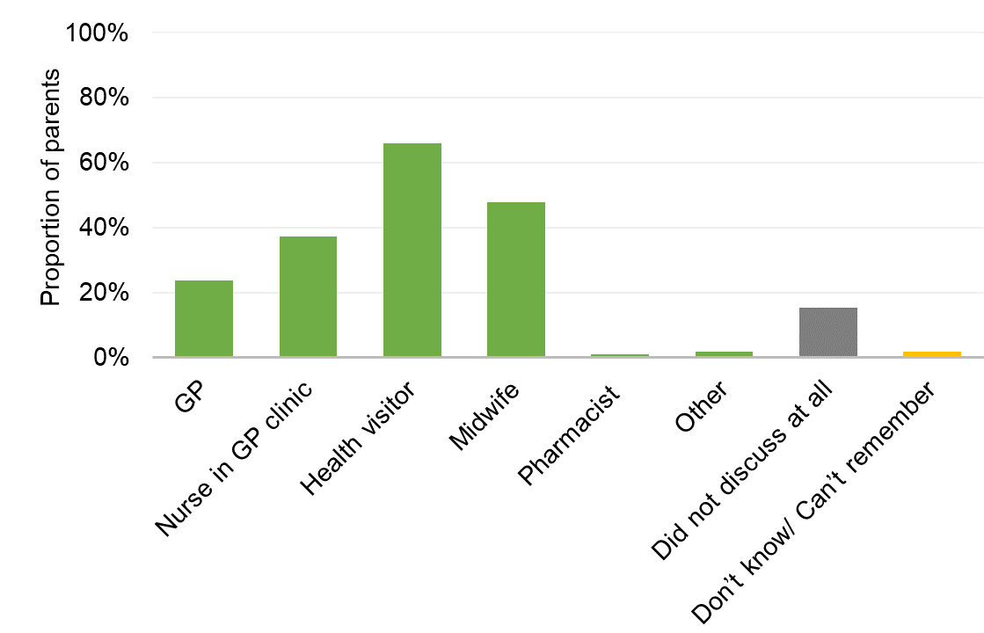
A health professional spoke to 89% of parents of children under 3 years and 4 months of age about vaccines
75% of parents reported that a health professional first spoke to them during pregnancy or after birth but before the first vaccines were due
14% of parents reported that a health professional first spoke to them when they took their baby for the first vaccines
5% of parents did not talk to a health professional
5% of parents couldn’t remember
Q. Which health professionals did you discuss vaccines with before your youngest child had their first baby vaccines or was due to have these vaccines?

Slide 16
95% of parents felt that their baby would have all vaccines offered before any discussion with a health professional, importantly…
36% of parents felt more confident about vaccinating their baby after receiving information from a health professional
42% of parents who were undecided about whether to get their baby vaccinated felt more confident about vaccination after speaking to a health professional

Slide 17
Most parents automatically get their children vaccinated
98% of parents chose to have their child vaccinated
86% automatically had all their vaccines done when they were due/offered
12% weighed up the pros and cons of one or more vaccines before deciding to have them vaccinated
1% weighed up the pros and cons of one or more vaccines before they decided not to have them vaccinated
0.3% wanted to have them vaccinated but were unable to book a suitable appointment
0.2% wanted to have them vaccinated but didn’t get round to it
0.2% were never going to have them vaccinated

Slide 18
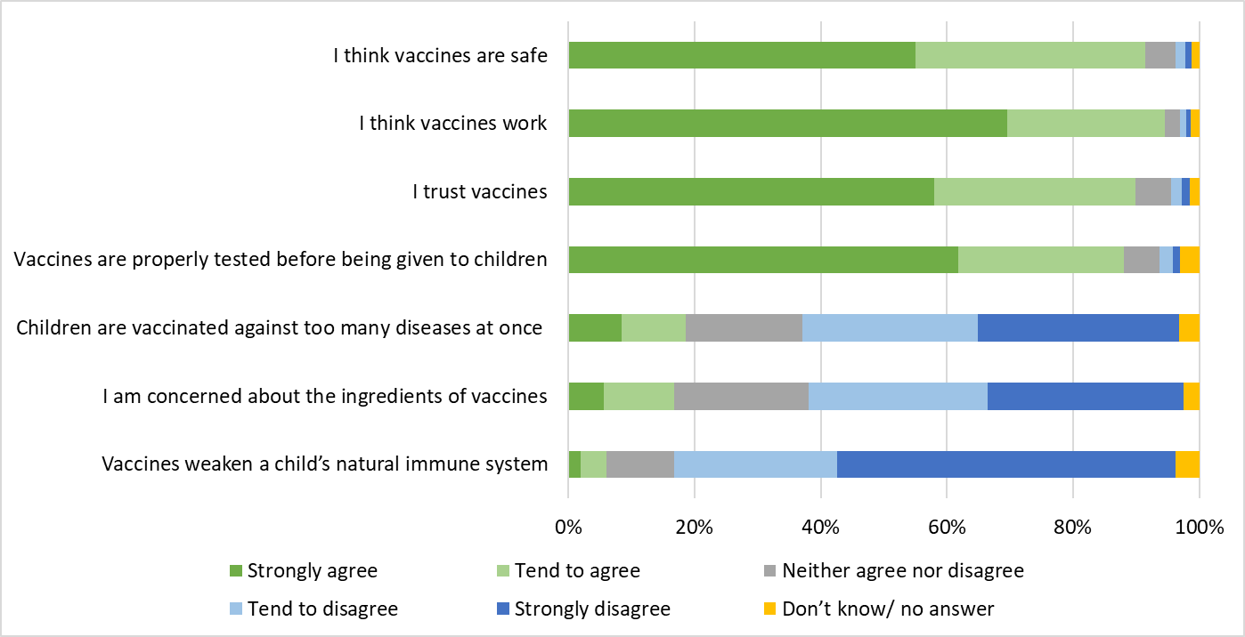
95% of parents think vaccines work, 91% of parents think vaccines are safe and 90% trust vaccines
Q. Here are some things that other people have said about vaccines for children. How much do you agree or disagree with each one?

Slide 19
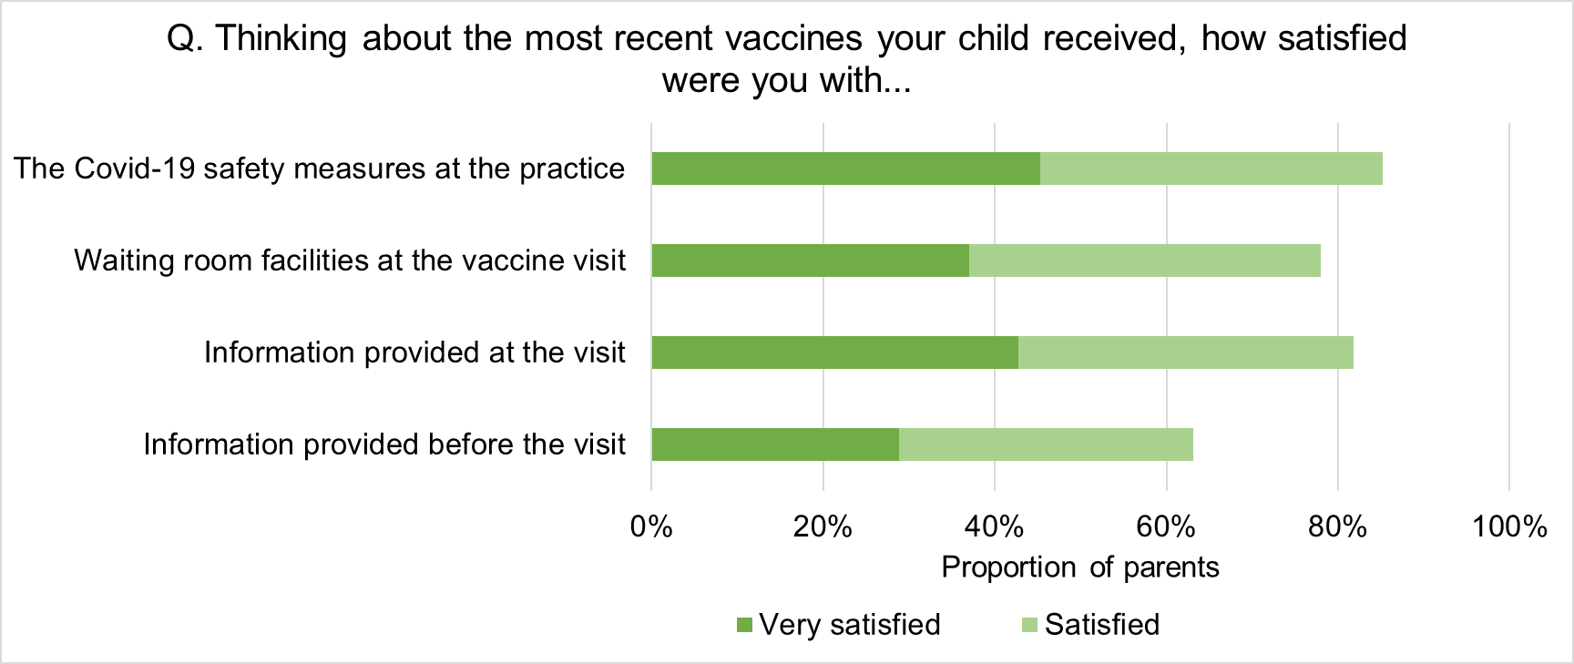
Most parents were satisfied with their most recent vaccine visit
Some parents would have liked more information before their child’s appointment

Slide 20
Of the 688 parents who were not satisfied with their latest visit:
32% felt they were not given enough information or explanation
27% were concerned about pain, distress or side effects caused by the vaccine
20% felt the procedures were too rushed
12% said it was the behaviour or attitude of the health professional

Slide 21
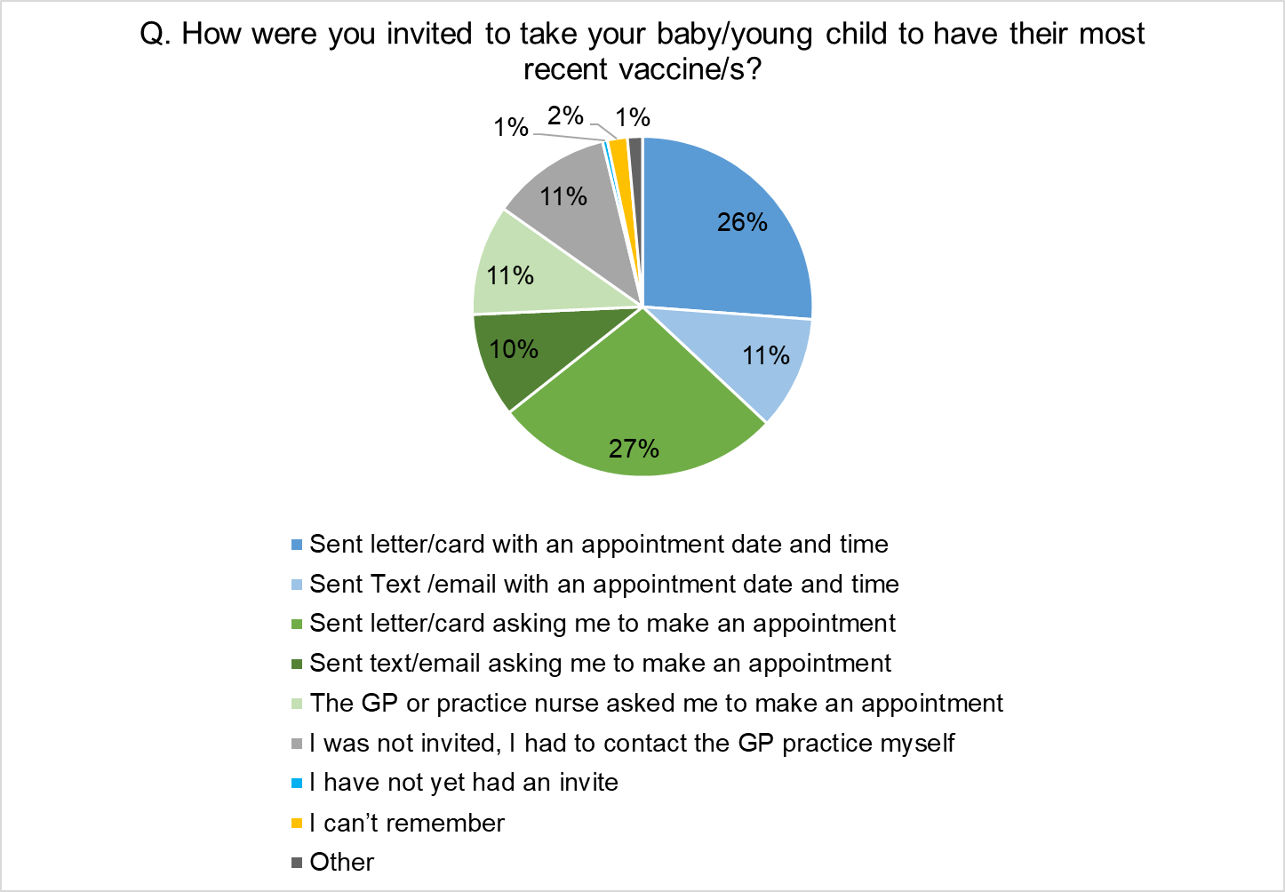
How did parents get appointments for their child?
84% of parents found it easy to get a convenient appointment
58% of most recent vaccine appointments had to be organised by parents

Slide 22
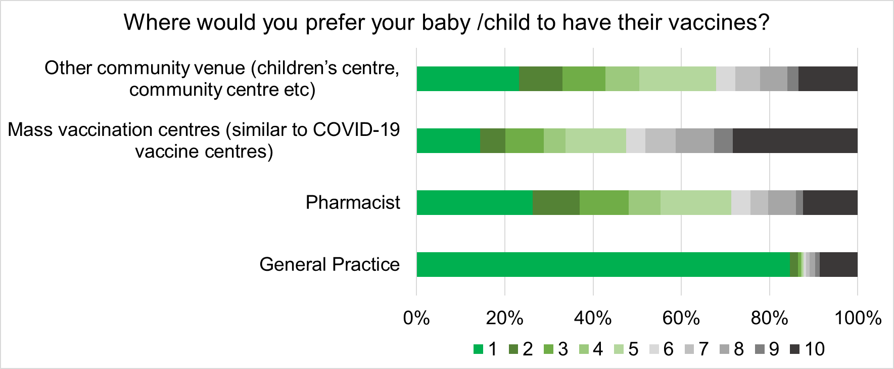
Parents showed a strong preference to have children vaccinated in General Practice
Q. Where would you prefer your baby /child to have their vaccines? Please rate each option on a scale of 1 to 10, where 1= would definitely use and 10= would not use.

Slide 23
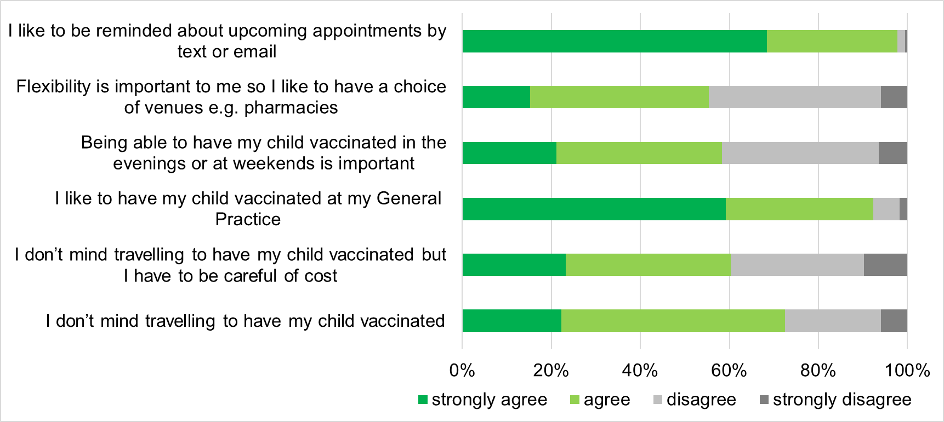
Almost every parent likes to be reminded about vaccine appointments and over 90% like to have their child vaccinated at their GP practice
Q. Please indicate below how much you agree with the following:

Slide 24
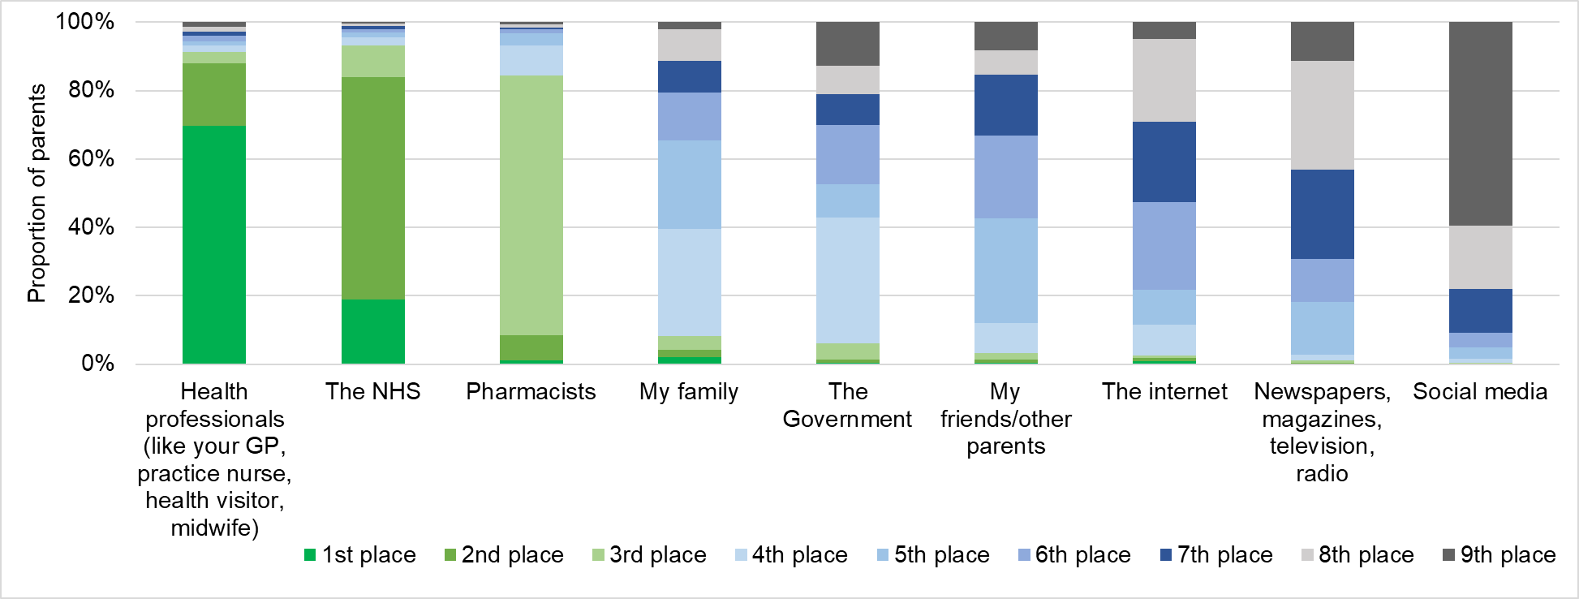
Parents most trust health professionals and the NHS
Q. Parents were asked to rank the following in the order of how much they trusted them on sources of information on vaccines: health professionals (like your GP, practice nurse, health visitor, midwife), the NHS, pharmacists, the government, newspapers/magazines/television/radio, the internet, social media, my family, my friends/other parents
most likely to trust health professionals and the NHS
least likely to trust social media

Slide 25
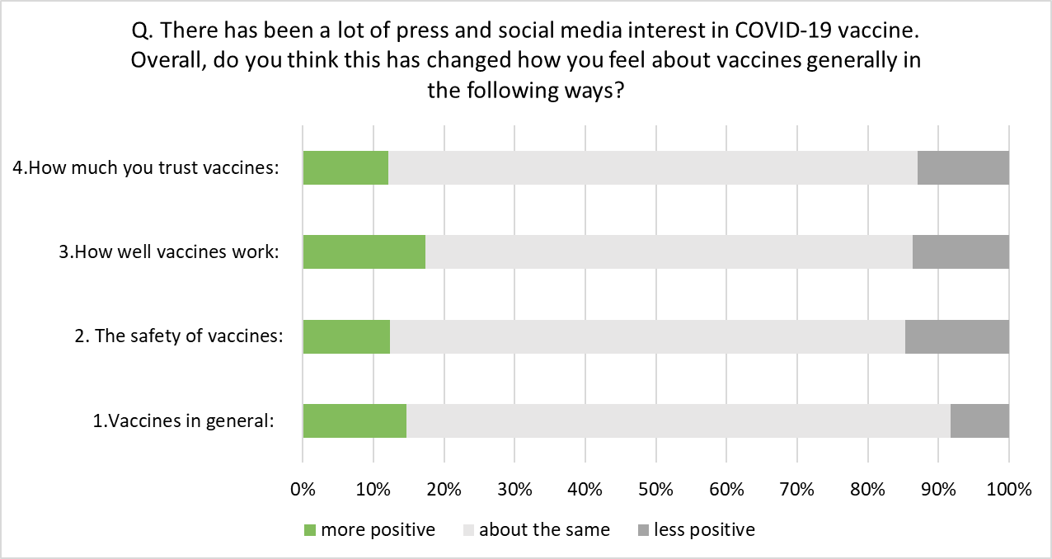
In general, parents did not feel that press and media interest in COVID-19 vaccine had changed how they felt about vaccines

