Slide 1
Co-administration of vaccines routinely offered to older adults

Slide 2
Purpose and scope
This set of slides:
  explains which routine vaccines may or may not be co-administered in older adults (for this slide deck: age 65 years and older); it then provides further information about underpinning principles of co-administration
While some of these vaccines are also routinely given in other groups, this slide set does not cover vaccinations given:
  in pregnancy, or
  to younger adults in clinical risk groups, or
  to children
For these groups, refer to other resources published by the UK Health Security Agency (UKHSA). The principles of co-administration can inform vaccination in these groups and other vaccines that may be indicated for an older adult, for example travel vaccines.
Nothing in these slides is intended to replace the other requirements for these programmes; for example the recommended minimum intervals between doses of the same antigen should still be maintained.
‘Older adults’ also includes all adults residing in care homes for older adults, regardless of age.

Slide 3
Contents
Topic | Slide
Routine vaccinations for older adults | 4
Older adult routine vaccinations co-administration quick reference chart | 5
Co-administration of RSV and seasonal flu vaccines | 6
Principles (underpinning knowledge) Eligibility and Scheduling Clinical considerations How does the immune system respond when vaccines are co-administered? Side effects for co-administered vaccines Why are some vaccines not recommended to be co-administered? Why does co-administration guidance sometimes change? | 7 8 9 10 11 12 13
Resources | 14

Slide 4
Routine vaccinations for older adults
Year-round routine vaccination
Campaign-based routine programmes
Pneumococcal, single dose:
  from age 65 years
  no upper age limit
Respiratory syncytial virus (RSV), single dose:
  from age 75 years
  adults living in a care home for older adults
  no upper age limit
Shingles, 2-dose course:
  from 1 September 2023, those reaching turning
  65 and 70 years of age from 1 September each year
  must be vaccinated before their 80th birthday
COVID-19, single dose each spring and autumn campaign:
  those aged 75 years and over
  all adults living in a care home for older adults
  no upper age limit
Seasonal influenza, single dose each autumn campaign:
  those aged 65 years and over
  those in long-stay residential care homes
  no upper age limit
Notes:
Pneumococcal routine vaccination of individuals aged 65 years or above: Administer PPV23 if it is still available. Administer PCV20 once supplies of PPV23 (including locally held stocks) have been used up. The principles of co-administration with RSV, shingles, COVID-19 and seasonal influenza vaccines are the same for both products. For full programme information see: Pneumococcal vaccination programmes for infants, adults and individuals at increased clinical risk - GOV.UK.
RSV vaccination: care home residents and removal of upper age limit of 80 years from 1st April 2026. For full programme information see: Respiratory syncytial virus (RSV) vaccination programme - GOV.UK
Shingles vaccination: only the current cohorts are listed; for the full roll-out and information about the intervals between doses. For full programme information see: Shingles: guidance and vaccination programme - GOV.UK
COVID-19 vaccination: a minimum of 3 months should be observed between any 2 routine doses. For full programme information see: COVID-19 vaccination programme - GOV.UK
Flu vaccination: administer in the autumn (from October) each year for maximum benefit; if individuals receive their vaccine late (e.g. in the winter/spring of the following year) they should still receive the next season’s recommended vaccine (virus antigens) once it becomes available again in October. For full programme information see: Annual flu programme - GOV.UK

Slide 5
Older adult routine vaccinations co-administration quick reference chart
 | RSV | Pneumococcal | Shingles | Flu | COVID-19
RSV | _ | ü | ü | In specific clinical circumstances* | ü
Pneumococcal | ü | _ | ü | ü | ü
Shingles | ü | ü | _ | ü | ü
Flu | In specific clinical circumstances* | ü |  | _ | ü
COVID-19 | ü | ü | ü | ü | _
* There is some evidence that coadministration of influenza vaccines with RSV vaccines in older adults may reduce the immune response to the RSV vaccine and the H3N2 component of the flu vaccine. See next slide. If it is thought that the individual is unlikely to return for a second appointment or immediate protection is necessary, RSV vaccine can be administered at the same time as influenza vaccination.
NB: these are all inactivated vaccines and there are no restrictions on co-administration of any of them with any other vaccine not covered by this slide set, but the Green Book should be consulted.
Notes:
Immunisation against infectious disease: the green book Immunisation against infectious disease - GOV.UK

Slide 6
Co-administration of RSV and seasonal flu vaccines
some data show that in older adults administering seasonal influenza vaccine at the same time as Abrysvo® (the RSV vaccine offered in the UK) may reduce the immune response to the RSV vaccine
data also suggest that the response to the influenza A(H3N2) component of seasonal influenza vaccine (the influenza virus subtype which most severely affects older adults) may be reduced when RSV and seasonal influenza vaccines are co-administered to older adults
the clinical significance of any reduced response
is unknown, but influenza immune response (antibody production after vaccination) is known to correlate with protection against infection, and emerging data show that RSV immune response also correlates with clinical protection
therefore, it is recommended that RSV vaccine is not routinely scheduled to be given to an older adult at the same appointment or on the same day as an influenza vaccine
no specific interval is required between administering the vaccines
if it is thought that the individual is unlikely to return for a second appointment or immediate protection is necessary, Abrysvo® and influenza vaccination can be given at the same time
these considerations do not apply in pregnant women, who can always have RSV and influenza vaccines booked for the same appointment
Notes:
As we age our immune system ages too. This is called Immunosenescence. An older immune system is less able to respond to infection and may respond less to vaccination. Sometimes older adults’ immune systems may not respond as strongly to some antigens (the weakened, copied or inactivated part of the pathogen the vaccine contains to trigger an immune response) when several vaccines are given at the same time. This may not be clinically significant, but when this is a potential concern – as it is for flu and RSV vaccines – it is preferable to avoid co-administration unless the risks of potential infection outweigh the benefits of waiting.
Whether or not to co-administer RSV and flu vaccines requires a judgement call from the clinician. In order to maximise the immune response to both vaccines, it is preferable to avoid co-administration when it is very likely that the recipient will return for the other vaccine in a timely manner, such that they are not unprotected against the second disease for long, particularly during a period of peak disease activity. When there is doubt that the person will return – or return in time so that they are protected during peak disease activity - then co-administration is acceptable; in such circumstances, because it is likely that the person will be left unprotected against the 2nd antigen, it is considered preferable to quickly ensure protection against both diseases even if this might be reduced. Giving separately is also intended to help maintain long term protection against RSV, which does not get given annually.
When vaccines are given separately: it does not matter which vaccine is given first and which second. Flu is a seasonal vaccine (therefore a time-limited offer) administered to older adults from the beginning of October and ideally completed by the end of November to provide optimal protection during the highest risk period (flu disease typically peaks in December or January), but no later than 31st March when the annual programme officially ends. The protection from flu vaccines wanes relatively fast in older adults and there is limited protection when flu is prevalent if flu vaccines are given too early. The RSV programme is year-round, and the vaccine offers protection across multiple seasons. Peak RSV disease activity is usually November to February, therefore for those turning 75 years of age between March and October each year, the vaccine should ideally be given by the end of October before RSV activity increases, otherwise soon after turning 75 if this occurs during the RSV season.

Slide 7
Principles

Slide 8
Eligibility and scheduling
recommendations for the age at which vaccines should be administered are informed by the age-specific risk for a disease, the risk of disease complications, the ability to respond to the vaccine, and the impact on spread in the population
vaccinations are offered throughout older life to provide protection against infections when defined groups of people reach an age where they can derive most benefit (for example, because of an increased individual risk)
the recommended timing of seasonally administered vaccines such as influenza are also intended to optimise protection
the recommended eligibility criteria and schedules should therefore be followed as closely as possible
some individuals may be eligible for additional vaccines due to an underlying medical condition or circumstances that put them at increased risk of catching a vaccine preventable disease or of complications from that disease. These individuals should be vaccinated in accordance with the recommendations in the Green Book

Slide 9
Clinical considerations
giving multiple vaccines at the same time can improve timely protection and vaccine coverage
reducing the number of appointments or visits to patients has
time-saving benefits for both providers and the public
vaccines can be routinely co-administered unless the Green
Book either advises against doing so or states a specific
minimum interval required between doses of different vaccines
there is specific guidance about a small number of live (replicating) vaccines (Green Book chapter 11). Live vaccines are not part of the routine programmes for older adults
if not given concomitantly, inactivated vaccines can usually be administered at any interval. The Green Book will list where a minimum interval is required
the vaccines routinely given to older adults are all non-live (i.e. inactivated, non-replicating or replication deficient) and can be routinely co-administered, with the exception of RSV and influenza (flu) vaccines. Flu and RSV vaccines are non-live but may reduce the immune response to one another, as described earlier
if more than one vaccine is given by injection at the same appointment they should be administered at separate sites, preferably in a different limb
if given in the same limb, vaccines should be given at least 2.5cm apart
the specific site at which each injection is given and the batch numbers of the immunisations should always be recorded in the individual’s records
Notes:
Doses of different inactivated vaccines can usually be administered at any time before, after, or at the same time as each other, unless stated otherwise. Doses of inactivated vaccines can also be given at any interval before, after, or at the same time as a live vaccine and vice versa.
A minimum four-week interval is normally recommended between successive doses of the same vaccine; a better response is made to some vaccines when longer interval is observed between doses (this will be specified in the Green Book Immunisation against infectious disease - GOV.UK). Although shorter intervals may be advised to achieve more rapid protection, e.g. for travel or during an outbreak, this may lead to a lower immune response and may therefore provide less durable protection. Early vaccination should therefore be avoided unless necessary to ensure rapid protection or to improve compliance; in such circumstances, additional doses may be recommended to ensure longer term protection.
Advice about intervals between different live vaccines is based on the available evidence of interference between vaccines. The current advice is detailed in Table 11.4 of the Green Book (chapter 11) UK immunisation schedule: the green book, chapter 11 - GOV.UK. Recommended intervals between subsequent doses of the same live vaccine will depend upon the specific incubation period of the vaccine virus, and other factors, such as decline in maternally derived antibody. Please also refer to the relevant disease chapters of the Green Book Immunisation against infectious disease - GOV.UK.

Slide 10
How does the immune system respond when vaccines are co-administered?
the immune systems recognises and responds to many different antigens at once: it does so all the time to fight off potential infections
the immune system is similarly able to respond to many antigens given at the same time in vaccines. This includes:
  multivalent vaccines that are formulated to have multiple different antigens in the same vial, such as influenza or pneumococcus, or
  when different monovalent vaccines get given at the same appointment (such as current COVID-19 and shingles vaccines), or
  when multiple multivalent and/or monovalent vaccines are given at the same time
Notes:
To obtain a marketing authorisation for multivalent vaccines the manufacturer has to first demonstrate that the immune response is not any worse than would be obtained from giving each antigen separately, and without this leading to additional, unacceptable adverse events

Slide 11
Side effects for co-administered vaccines
there are no safety concerns when vaccines are co-administered as part of the routine schedule
for recommended co-administered vaccines, the post-vaccination reactions are usually as expected for each vaccine when given separately
vaccines typically have some systemic side effects associated the immune response such as fever, tiredness and headache which are usually mild and go away within a few days
  these may occur more commonly when two or more vaccines are co-administered
  there is no expectation than any side effects are more severe when vaccines are co-administered
when co-administration does occur, individuals and, when applicable, their carers should be informed about the likely timing of potential adverse events relating to each vaccine
it may be more difficult to attribute any adverse events that occur post-vaccination to a specific vaccine but this is not a reason to avoid co-administration. Documenting the limb (or site if more than one is given in the same limb) of vaccination helps attribute any localised reactions

Slide 12
Why are some vaccines not recommended to be co-administered?
sometimes there is evidence from studies, or a scientifically based concern, that the benefits of co-administration could be outweighed by the potential downsides and should preferably be avoided
usually this is for one of two reasons:
  the immune response to one or more of the co-administered vaccines may be attenuated (reduced), potentially leaving the recipient with sub-optimal protection, or
    there may be an unacceptable increase in side-effects when vaccines are co-administered which outweighs the benefits and/or is expected to negatively impact on uptake

Slide 13
Why does co-administration guidance sometimes change?
  guidance may change as further information is obtained from studies and real-world experience.
  examples include:
    new clinical trial evidence showed that RSV and COVID-19 vaccines can be co-administered without weakening immune responses. Previously these were given on different days because some data suggested COVID-19 vaccines might affect the RSV immune response
    new evidence from a US study showed that the adjuvanted flu vaccine and Shingrix, the adjuvanted shingles used in the UK programme, could be given at the same time. Previously these were given at least a week apart in case giving two adjuvanted vaccines at the same time led to higher reactogenicity (more intense immune response side effects). The study showed they don’t

Slide 14
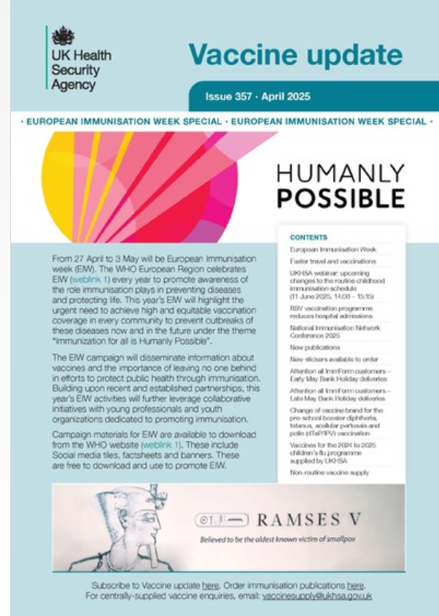
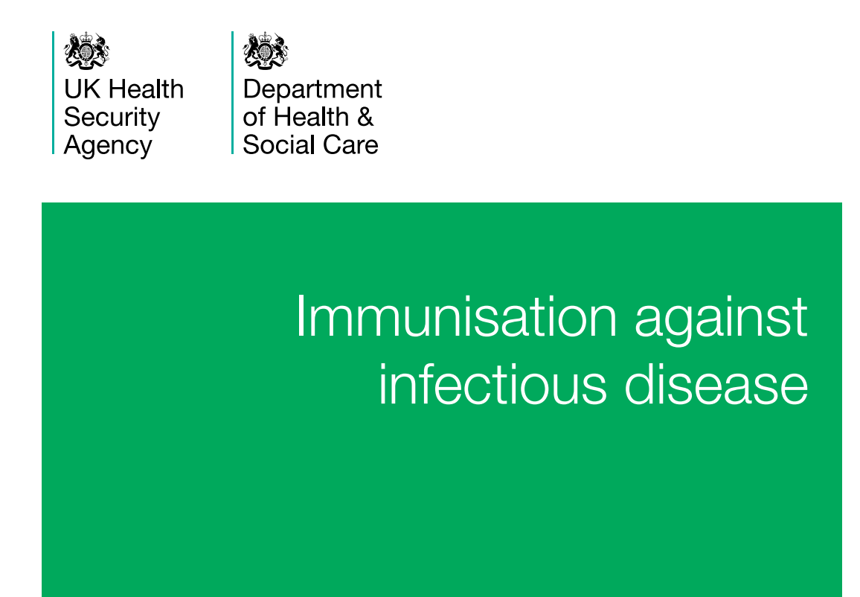
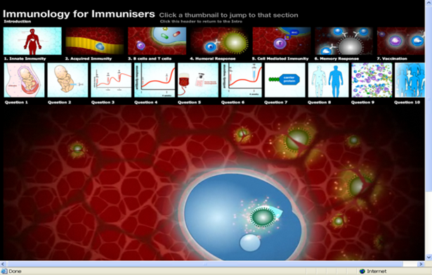
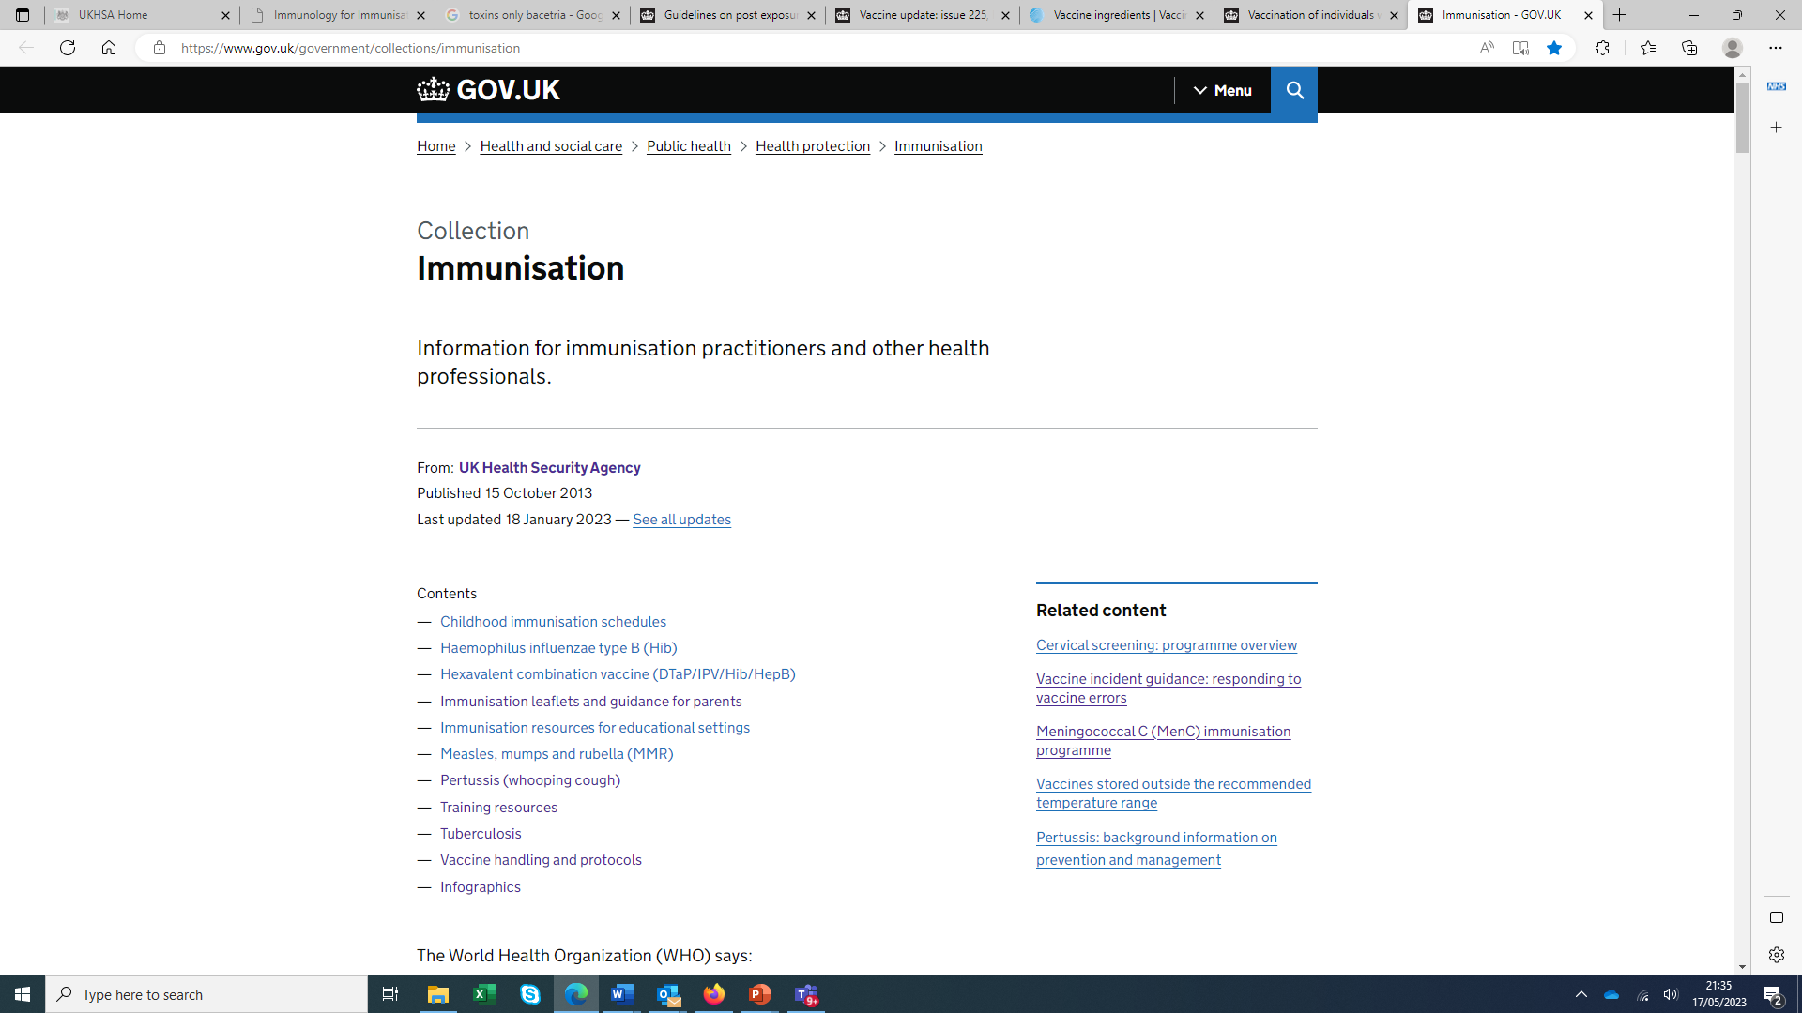
Resources
Main UKHSA immunisation page – includes links to:
all programme materials (including Information for healthcare practitioners’ documents and resources for the public)
Immunisation against infectious disease: the green book (primary source of information)
training materials including an Immunology for immunisers animation that explains how the immune system responds to antigens and how vaccines work (key underpinning knowledge)
Vaccine Update – sign-up for alerts to keep abreast of the latest information
Notes:
Note: the Immunology for immunisers question 6 is no longer correct – please follow the Green Book chapter 11 UK immunisation schedule: the green book, chapter 11 - GOV.UK guidance (including table 11.4) about co-administration of live vaccines.
For public and some healthcare professional materials see also: Find public health resources - GOV.UK

