Slide 1
Human Papillomavirus (HPV) vaccination programme for gay, bisexual and other men who have sex with men (GBMSM) Updated June 2023
Notes:
Rationale for resource
This resource is designed to support healthcare professionals involved in the delivery of the HPV GBMSM vaccination programme.
This resource does not cover the actual administration techniques involved in vaccination against HPV. If staff are required to deliver vaccinations they should refer to their line manager for additional training.

Slide 2
Key Messages
gay, bisexual and other men who have sex with men (GBMSM) are at increased risk of HPV infection and related disease and adverse outcomes compared to heterosexual men
a targeted GBMSM HPV vaccination programme was introduced in England from April 2018
aim of the programme is to provide direct protection against HPV infection, HPV associated cancers and genital warts to the GBMSM population up to and including 45 years of age
the vaccine can be offered opportunistically through existing attendances at specialist Sexual Health Services (SHSs) and/or HIV clinics
following a review of the latest evidence on one-dose schedules, the JCVI agreed that there is now sufficient evidence to advise a change to the HPV schedule from 1st Sept 2023:
– a 1-dose schedule for the routine adolescent programme and GBMSM programme before the 25th birthday
– a 2-dose schedule from the age of 25 in the GBMSM programme
– a 3-dose schedule for individuals who are immunosuppressed and those known to be living with HIV
Notes:
Background: In June 2012, the Joint Committee on Immunisation and Vaccination (JCVI) asked the Health Protection Agency (now UK Health Security Agency, previously Public Health England), to undertake modelling studies to assess the impact and cost effectiveness of HPV vaccination for gay, bisexual and other men who have sex with men (GBMSM), acknowledging this group were at higher risk of HPV infection and related disease and were expected to benefit far less from indirect herd protection from the HPV vaccination programme at the time in which the vaccine was being offered to adolescent females.
Since 2012, the JCVI has regularly reviewed all the available evidence on the disease epidemiology, vaccine efficacy and cost effectiveness of an HPV GBMSM immunisation programme in the UK.
In November 2015, the JCVI published its advice on the extension of HPV vaccination to GBMSM. It advised that a programme should be undertaken to vaccinate all GBMSM up to and including 45 years of age who attend sexual health services and HIV treatment services, subject to procurement of the vaccine and delivery of the programme at a cost-effective price
In June 2016, a Public Health England (PHE) -led pilot commenced in which the HPV vaccine was offered opportunistically to GBMSM up to and including the age of 45, attending selected local sexual health services. The purpose of the pilot was to evaluate the feasibility, acceptability, uptake, impact and equity of a potential national HPV vaccination programme for MSM. The pilot demonstrated that such a programme could be delivered opportunistically in an acceptable and equitable manner through specialist Sexual Health Services and HIV clinics and consequently, the decision was made to roll out a national programme to all clinics across the country from April 2018.
From 1st September 2023, the JCVI have recommended that a change to the following schedules for the HPV programme:
– a one-dose schedule for the routine adolescent programme and GBMSM programme before the 25th birthday
– a 2-dose schedule from the age of 25 in the GBMSM programme
– a 3-dose schedule for individuals who are immunosuppressed and those known to be HIV-positive
Joint Committee on Vaccination and Immunisation. Statement on HPV vaccination of men who have sex with men. November 2015. Available at: www.gov.uk/government/publications/jcvi-statement-on-hpv-vaccination-of-men-who-have-sex-with-men
2. JCVI statement on a one-dose schedule for the routine HPV immunisation programme - www.gov.uk/government/publications/single-dose-of-hpv-vaccine-jcvi-concluding-advice/jcvi-statement-on-a-one-dose-schedule-for-the-routine-hpv-immunisation-programme

Slide 3
Aims of training resource
to support healthcare professionals involved in discussing HPV vaccination with GBMSM by providing evidence based information
to raise awareness of the current epidemiology of HPV and the important role of vaccination in the GBMSM population
to provide guidance on the administration of the vaccine including recommended dosage and schedule, contraindications, precautions and potential adverse reactions

Slide 4
Learning Outcomes
After completing this resource, immunisers will be able to:
describe the epidemiology of HPV and the possible consequences of infections with HPV
understand the rationale and evidence base for a targeted HPV-GBMSM vaccination programme to those aged up to and including 45 years and their role in delivering it
discuss the benefits of vaccination against HPV with their eligible GBMSM clinic-attending population
safely administer the HPV vaccination
identify sources of additional information

Slide 5
Human Papillomavirus (HPV)
HPV is a double stranded DNA virus
it infects the deepest layer of the skin or mucosae of the upper respiratory and anogenital tracts through skin-to-skin contact
HPVs are a large group of related viruses. Each virus in the group is given a number, which is called an HPV type
HPV infections are often asymptomatic
infection can resolve spontaneously:
- 70% new high-risk infections will clear within a year
- 90% new infections clear within 2 years
persistent infection with high risk HPV types such as types 16 and 18 can lead to cancer – most notably cervical cancer in women, as well as cancer of the anus, the genitals and oropharyngeal (head and neck) cancers
infection with low risk HPV types 6 and 11 cause most genital warts
Notes:
HPV is the abbreviation for the human papillomavirus. This is a double stranded DNA virus that infects the deepest layer of the skin or mucosae of the upper respiratory and anogenital tracts.
The majority of HPV infections do not cause any symptoms and infection is usually cleared by the body’s own immune system without the need for other treatment. Around 70% of new infections will clear within one year and approximately 90% will clear within 2 years.
Persistent infection with high risk HPV types such as types 16 and 18 can lead to cancer – most notably cancer of the anus, penis and oropharynx as well as cervical cancer in women. Other types of HPV such as 6 and 11 cause genital warts
Immunisation against infectious disease (the Green book), Chapter 18a (HPV), Available at www.gov.uk/government/publications/human-papillomavirus-hpv-the-green-book-chapter-18a

Slide 6
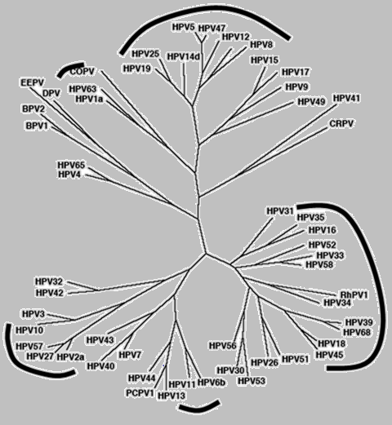
HPV Genotypes
Plantar Warts
Cutaneous (mostly asymptomatic)
Genital mucosa (cancer–associated)
Common and flat warts
External genital warts
De Villiers and others. Classification of papillomaviruses. Virology, 2004
Notes:
There are over 200 types of HPV virus. Some viruses cause genital warts and others, 'oncogenic' strains, cause cancers.

Slide 7
Human Papillomavirus (HPV)
Of the 200+ different types of HPVs:
over 40 types affect genital area
high risk types (including HPV 16,18,31,33,45,52,58) cause cancer
low risk types (HPV 6,11) cause genital warts
HPV16
HPV18
HPV6
HPV11
together account for over 70% of all cervical cancers
also associated with most cases of cancer of the anus, penis, oropharyngeal, vagina & vulva
over 90% of cases of genital warts are due to HPV 6 and 11
Notes:
There are over 100 different types of HPV of which around 40 infect the genital area.
Genital HPVs are categorised as either High risk types - known to be associated with cancer, or Low risk types- known to lead to the development of genital warts.
HPV16 and HPV18 responsible for between 70%-80% of all cervical cancers.
Types 16 and 18 are also associated with the majority of HPV related cancers of the anus, penis, oropharyngeal, vagina and vulva.
HPV infection is associated with 80-90% of all anal squamous cell cancers and HPV types 16 and 18 are found in the majority of HPV-related anal cancers.
Around 90% of cases of genital warts are thought to be due to HPV type 6 and 11. Although they do not cause cancer, genital warts can be difficult to treat. Some individuals may also experience frequent recurrent episodes which may cause significant distress to the individual and substantial costs to healthcare.

Slide 8
Transmission
HPV is one of the most common sexually transmitted infections in the UK
nearly all sexually active people become infected with HPV at some point in their lives
the risk of acquiring infection increases with the:
number of previous sexual partners
introduction of a new sexual partner
sexual history of partners
HPV can still be present even if it has been years since an individual has been sexually active
transmission of genital HPV’s is primarily by sexual contact with an infected partner, particularly through sexual intercourse but also by non-penetrative genital contact, including oral sex
Notes:
It is estimated that around 8 out of 10 people will be infected with HPV at some point in their lives. Most people never know they are infected – HPV infections are typically asymptomatic and most of the time the body clears the infection without it causing any problems. Persistent infection with high risk HPV types can damage DNA. This can cause cells to divide and grow out of control which can lead to cancer.

Slide 9
Introduction of HPV vaccination in England
The National HPV Immunisation Programme began throughout the UK in September 2008
Delivered in schools:
targeted school Year 8 females (aged 12 to 13 years)
catch up for all girls aged under 18 years
Following a successful pilot in 2018, the programme was extended to offer vaccine to MSM up to 45 years of age attending local specialist Sexual Health Services and/or HIV clinics
In 2019 the HPV adolescent programme was extended to include boys as well as girls
Eligible girls and boys (eligible boys born after 01/09/2006) can continue to be caught up until their 25th birthday
From 1 September 2023 the HPV vaccination schedule will change to:
a 1 dose schedule for the routine adolescent programme and GBMSM programme for eligible individuals less than 25 years of age
a 2 dose schedule from the age of 25 years for the GBMSM programme
a 3 dose schedule for individuals who are immunosuppressed and those known to be living with HIV
Notes:
The national HPV Immunisation Programme was introduced for girls in September 2008 and has been delivered throughout the UK to help prevent cervical cancer.
In September 2019, the HPV vaccination programme was extended to boys from 12 years of age with the expectation that it would provide clear additional health benefits including:
direct protection for vaccinated boys against HPV infection and associated disease such as genital warts, anal, penile and oropharyngeal cancers
protection against HPV for GBMSM by offering them vaccination before their sexual debut
indirect protection for non-vaccinated males and females
Extending the offer of the HPV vaccine to boys should also improve the resilience of the UK programme, accelerate the control of cervical cancer in women and has the potential to eliminate HPV vaccine types in the UK.
The programme offers vaccination to school Year 8 (age 12-13 years) with a catch up for those eligible up to 25 years of age.
Based on advice from the Joint Committee on Vaccination and Immunisation (JCVI), from 1st September 2023, the HPV vaccination schedule will change to:
a 1 dose schedule for the routine adolescent programme and GBMSM programme for eligible individuals less than 25 years of age
a 2 dose schedule from the age of 25 years for the GBMSM programme
a 3 dose schedule for individuals who are immunosuppressed and those known to be living with HIV

Slide 10
Schedule summary table
Cohort | Schedule from 1 Sep 2023
GBMSM under 25 years | 1 dose schedule for those not yet vaccinated. Consider fully vaccinated if have received 1 dose
GBMSM aged 25 years to 45 years (inclusive) | 2 dose schedule (0, 6 to 24 months)
Eligible individuals who are known to be immunosuppressed at the time of vaccination and those who are living with HIV, including those on antiretroviral therapy | 3 dose schedule (0, 1, 4 to 6 months)
Notes:
GBMSM aged 25 years and older (up to and including 45 years) should continue on the 2 dose HPV vaccination schedule. The recommendation to continue with 2 doses is because there is currently insufficient evidence of the efficacy of a single dose in this age group. However, if they received 1 dose prior to their 25th birthday, they do not require a second dose.

Slide 11
Why vaccinate GBMSM against HPV?
HPV infection in all men is associated with :
80 to 85% of anal cancers
50% of penile cancer
36% of oropharyngeal cancer
GBMSM who attend sexual health and HIV treatment services experience higher rates of HPV infection and related cancers
HPV-associated anal cancers are far more common in GBMSM compared to heterosexual men
the incidence of anal cancer is also highest in GBMSM who have HIV infection
some GBMSM have high risk sexual behaviour
GBMSM would benefit from direct effect of vaccine
Notes:
JCVI considered modelling studies to assess the cost-effectiveness of a targeted HPV vaccination of MSM in SSHS and HIV clinics, looking at the impact of vaccination against penile, anal and oropharyngeal (head and neck) cancers, and genital warts.
In all men 80-85% of anal cancers, 36% of oro-pharyngeal cancer and 50% of penile cancers are associated with HPV infection. Evidence suggests gay, bisexual and other men who have sex with men (GBMSM) attending sexual health and HIV treatment services have a significantly increased burden of HPV related disease and adverse outcomes compared to heterosexual men. HPV type 16-associated anal cancers in particular are far more common in GBMSM compared to heterosexual men and this is even more marked in those with HIV infection.^{(11,12)}
This group is expected to have received very little indirect benefit from the adolescent HPV vaccination programme which was previously offered to adolescent females only prior to 2019.

Slide 12
Introduction of the GBMSM HPV vaccination programme
Following a review of all the epidemiological and economic evidence as well as vaccine safety and efficacy, the JCVI advised the introduction of a targeted HPV vaccination programme for GBMSM attending SHSs and HIV clinics to reduce the number of preventable HPV infections in the GBMSM population and their onward transmission.
Cost-effectiveness analyses showed that offering vaccination to GBMSM to prevent and/or reduce disease burden is cost-effective up to and including 45 years of age.

Slide 13
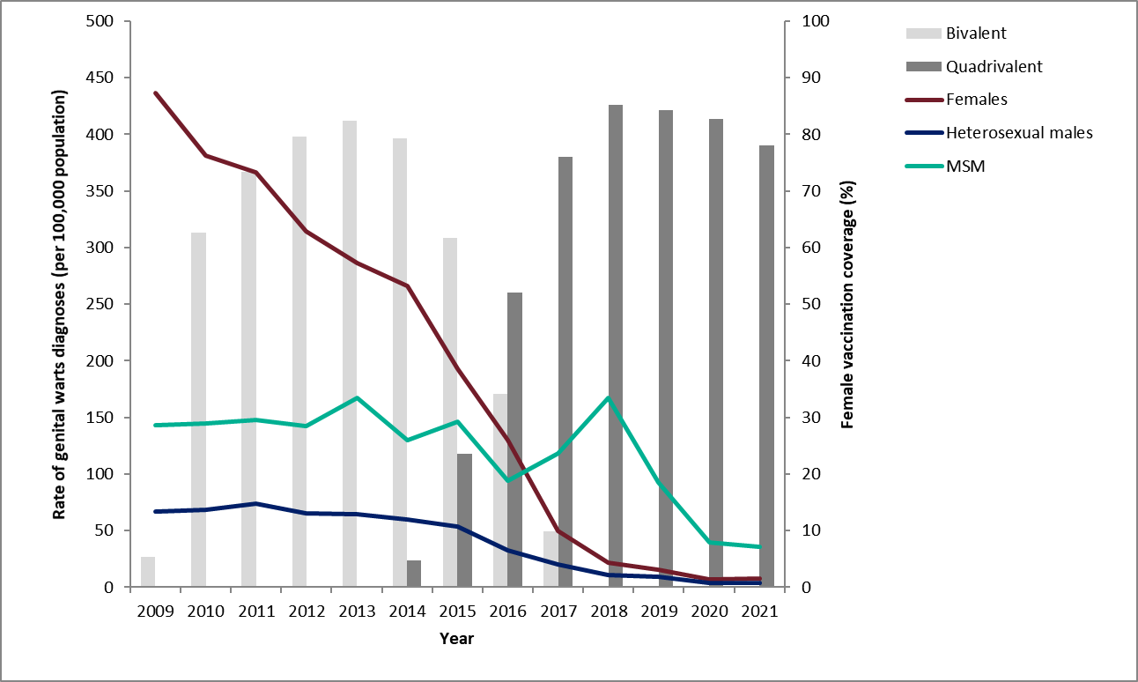
Declines in genital warts diagnoses in England: 2009 to 2021
Notes:
Latest data on declines in GW diagnoses in England. As reported in latest STI report Sexually transmitted infections and screening for chlamydia in England: 2021 report - GOV.UK (www.gov.uk)):
In 2021, the rate of first episode genital warts diagnoses among young women aged 15-to-17 years attending SHSs, most of whom would have been offered the quadrivalent HPV vaccine (protecting against HPV types 16, 18, 6 and 11) aged 12 to 13, was 84.9% lower compared to 2017 (7.4 vs 49.1 per 100,000 population). A decline of 80.0% (4.1 vs 20.3 per 100,000 population) was seen in heterosexual young men of the same age over the same period, suggesting substantial herd (or indirect) protection. These declines were also seen in 18-to-20-year-olds and 21-to-24-year-olds. These are all age groups with direct or herd or indirect protection from the quadrivalent HPV vaccine. A substantial decline of 69.8% (35.7 vs 118.3 per 100,000 population) was seen in GBMSM aged 15-to-17 years, which is likely due to both protection from vaccination of young GBMSM in SHSs and continuing herd protection from the adolescent programme.

Slide 14
Why deliver the service through sexual health and HIV clinics?
GBMSM accessing specialist sexual health and/or HIV services are known to be at higher risk of HPV infection and disease
more known about GBMSM using these services, which allowed the evidence for benefit from HPV vaccination to be assessed for this group
GBMSM are most likely to self-declare their sexual orientation in sexual health services
efficiencies in delivery, cost and clinic capacity are likely to be added advantages of this approach
may have an additional benefit of increased adherence and acceptability
Notes:
The cost-effectiveness analysis considered by JCVI is only possible because of the sexual health data available from SSHS and HIV clinics.
There is more known about GBMSM using these services, which allowed the evidence for benefit from HPV vaccination to be assessed for this group of GBMSM.
JCVI also agreed with the HPV sub-committee that specialist SHS and HIV clinics are by far the most accessed sexual healthcare service by self-declaring GBMSM, who might not otherwise self-declare to a GP, and that GBMSM accessing SHSs are known to be a high-risk group within the GBMSM population in terms of risk behaviour and STI transmission.
Overall the best available evidence was found to show delivering a targeted programme through Sexual Health/HIV services to be the most likely pragmatic and cost effective option at this time.

Slide 15
Aims of the HPV GBMSM immunisation programme
to provide the HPV vaccine to GBMSM up to, and including, the age of 45 attending participating specialist Sexual Health Services (SHSs) and/or HIV clinics
to reduce the number of preventable HPV infections and their onward transmission
to reduce morbidity and mortality from HPV-related disease including anal, penile and oropharyngeal cancers and genital warts

Slide 16
Programme eligibility
all GBMSM up to and including 45 years of age attending specialist Sexual Health Services and/or HIV clinics, regardless of risk, sexual behaviour or disease status
GBMSM older than 45 years are not eligible for HPV vaccination under this NHS England procured service
any eligible vaccinee that started but did not complete the schedule before reaching the age of 46 years should complete the vaccination course
there may be considerable benefit in offering the HPV vaccine to individuals attending SHSs or HIV clinics who were not eligible for the routine adolescent HPV programme and are deemed to have a similar risk profile to that seen in the GBMSM population including
-some transgender individuals
-sex workers
-men and women living with HIV infection
those whose risk of acquiring HPV is considered equivalent to the risk of GBMSM eligible for the HPV vaccine should be offered vaccination
for those who have previously completed a course of HPV vaccination as part of the school HPV programme, no further doses need be given
Notes:
The HPV vaccine is recommended for all GBMSM up to and including 45 years of age, attending participating SHSs or HIV clinics, regardless of risk, sexual behaviour or disease status.
GBMSM older than 45 years are not eligible for HPV vaccination under this NHS England procured service.
JCVI considers that there may be considerable benefit in offering the HPV vaccine to individuals attending SHSs or HIV clinics who were not eligible for the routine adolescent HPV programme and are deemed to have a similar risk profile to that seen in the GBMSM population. This includes some transgender individuals, sex workers, and men and women living with HIV infection. Those whose risk of acquiring HPV is considered equivalent to the risk of GBMSM eligible for the HPV vaccine, should be offered vaccination.

Slide 17
HPV vaccine introduction
Cervarix vaccine used September 2008 to 2012
HPV types 16, 18
Gardasil vaccine used from September 2012 to 2022
HPV types 6, 11, 16, 18
Gardasil 9 vaccine introduced in 2022
HPV types 6, 11, 16, 18, 31, 33, 45, 52, 58
Notes:
The bi-valent Cervarix vaccine was offered for the first 4 years of the national programme. This vaccine protects against the 2 HPV types which cause the majority of cervical cancer.
From September 2012, the quadrivalent vaccine, Gardasil, was used for the national programme. Gardasil provides protection against HPV types 6 and 11, the HPV types that cause genital warts, in addition to the cancer causing types 16 and 18.
In 2022 Gardasil 9 was introduced and this vaccine offers protection against 5 additional types of HPV (31, 33, 45, 52, 58) which, although less common than types 16 and 18, are also considered high-risk HPV types.

Slide 18
Gardasil 9
Brand name: Gardasil 9
Generic name: Human Papillomavirus Vaccine
[HPV types 6, 11, 16, 18, 31, 33, 45, 52, 58]
Type of vaccine: Recombinant, adsorbed
Marketed by: Merck Sharp & Dohme Limited (MSD)
Licensed from: 9 years of age
Notes:
Gardasil 9 is the recommended vaccine for the GBMSM programme and is the only market authorised 9 valent HPV vaccine in the UK. The vaccine is approved for use in females and males from 9 years of age.
Gardasil 9 provides protection against 9 HPV types: 6, 11, 16, 18, 31, 33, 45, 52, 58.
Although less common than types 16 and 18, types 31, 33, 45, 52, 58, are also considered high-risk HPV types.
Gardasil 9 is expected to prevent the majority of cervical, vaginal and vulvar cancers and premalignant lesions, as well as genital warts associated with HPV
SPC for Gardasil 9: www.medicines.org.uk/emc/product/7330/smpc

Slide 19
HPV vaccine interchangeability
in 2022 Gardasil 9 vaccine was introduced into the programme and supplied for those eligible for the HPV vaccine
as the programme has transitioned from Gardasil to Gardasil 9, individuals who are eligible to receive more than one dose who had already commenced vaccination prior to the introduction of Gardasil 9 might receive a mixed schedule
both Gardasil and Gardasil 9 vaccines should be considered as interchangeable

Slide 20
HPV vaccines
vaccine made from the proteins of the outer coat of the virus types
these proteins assemble into small spheres that are called virus-like particles (VLPs)
VLPs are not infectious and cannot cause HPV-associated cancers or genital warts as they do not contain the virus’s DNA
VLPs are very immunogenic, which means that they induce high levels of antibody production by the body
upon subsequent exposure to the live virus, the immune system reacts quickly to prevent infection
an adjuvant (aluminium hydroxyphosphate sulfate) is added to increase the immune response made
Notes:
The HPV Gardasil vaccine is made from the proteins that make up the outer surface of the virus types. The protein is grown in the lab in yeast cells. Once the protein is grown, it assembles itself into small spheres that are called virus-like particles (VLPs) to look like the HPV virus;. VLPs are not infectious and cannot cause HPV-associated cancers or genital warts as they do not contain the virus’s DNA (HPV genetic material), so they cannot reproduce or cause illness. The Gardasil 9 vaccine is composed of the surface protein from 9 different types of HPV.
VLPs are very immunogenic, which means that they induce high levels of antibody production by the body. Vaccination delivers the VLP antigen via a pathway completely different to that for natural infection whereby the virus gains entry via the mucosa. The structure and geometry of the VLP is such that neutralising epitopes are optimally arranged and presented. The HPV VLP is also a very rigid and stable structure providing a sustained presentation to the immune system.
As with many other immunisations, when a person is vaccinated, their immune system mounts a response against these VLPs. When a person is then exposed to the live virus, the body’s immune system reacts quickly to stop the infection.

Slide 21
HPV vaccine effectiveness
shown to be highly effective in preventing HPV infection for the serotypes contained in the vaccine
clinical trials show very high efficacy and well tolerated
over 99% effective at preventing pre-cancerous lesions associated with HPV types 16 and 18
99% effective at preventing genital warts associated with vaccine types in young women
a clinical trial of Gardasil in men indicated that it can prevent anal cell changes caused by persistent infection and genital warts
may boost immunity and prevent re-infection or reduce reoccurrences in people with previously treated high-grade anal intraepithelial neoplasia established diseases
Notes:
A clinical trial of Gardasil in men indicated that it can prevent anal cell changes caused by persistent infection, and genital warts.
HPV vaccines have not been shown to have an impact on an existing infection or any of the outcomes of an existing HPV infection, such as genital warts but may boost immunity and prevent re-infection or reduce reoccurrences in people with previously treated high-grade anal intraepithelial neoplasia.
Swedish KA, Factor SH, Goldstone SE. Prevention of recurrent high-grade analneoplasia with quadrivalent human papillomavirus vaccination of men who have sexwith men: a nonconcurrent cohort study. Clin Infect Dis. 2012;54:891-8.Available at www.ncbi.nlm.nih.gov/pubmed/22291111
evidence from surveillance consistent with:
very high vaccine effectiveness among those vaccinated
a substantial herd protection effect with lower HPV16 and 18 prevalence over time in unvaccinated women
cross-protection – declines in HPV types 31, 33 and 45 in the post-vaccination period
There is no evidence of non-vaccine type replacement to date.

Slide 22
HPV vaccines (cont)
prior infection with one HPV type does not diminish the efficacy of the vaccine against other HPV types included in the vaccine
to get the best protection, it is important the full course of vaccination is received if more than one dose indicated
currently studies show that protection is maintained for at least 10 years although based on immune responses, protection is expected to last longer than this
long-term follow-up studies are ongoing to evaluate length of protection and whether booster doses will be needed
booster doses are not currently indicated
Notes:
Current studies suggest that protection is maintained for at least 10 years. Based on the immune responses, it is expected that protection will be extended further; long-term follow-up studies are in place to evaluate this and will determine the need for any subsequent boosters.

Slide 23
Safety of HPV vaccine
the safety of HPV vaccine has been established through rigorous testing in clinical trials, followed by extensive use with more than 500 million doses given across the world
some people may experience a mild side effect, but these are generally of short duration and are far outweighed by the expected benefits of the vaccine
The Medicines and Healthcare products Regulatory Agency (MHRA) monitors the safety of vaccination programmes:
volume of suspected side effects reported via the Yellow Card Scheme for HPV is not unusual
overwhelming majority relate to possible side-effects that might result from any adolescent vaccination programme e.g. injection site reactions, rashes, mild allergic events, nausea, dizziness, fatigue, immediate faints due to needle phobia, etc
Notes:
The safety of HPV vaccine has been established through rigorous testing in clinical trials followed by extensive global use with millions of doses administered to date. As with any medicinal product, some people may experience a side effect but these are generally mild, of short duration and outweighed by the benefits of the vaccine.

Slide 24
Vaccine safety reviews
JCVI carried out a routine review of HPV vaccine safety in 2015 and concluded that it had no concerns about the safety of the HPV vaccine:
extensive reviews of HPV vaccine safety have also been undertaken by various independent health bodies and authorities worldwide
MHRA
World Health Organization’s Global Advisory Committee on Vaccine Safety
European Medicines Agency
US Centre for Disease Control and Prevention
Health Canada
All concluded that the evidence does not support a link between HPV vaccine and the development of a range of chronic illnesses
Notes:
Both the WHO and the US Centers for Disease Control and Prevention (CDC) have posted clear advice on their website supporting the safety of HPV vaccine. The safety of the HPV vaccine has been regularly reviewed by the Global Advisory Committee for Vaccine Safety (GACVS) and they have not found any safety concerns.
Despite concerns raised by the media and some campaign groups, no links have been found between HPV vaccine and adverse events, including blood clots, allergic reactions, strokes, seizures, Guillain-Barré Syndrome (a rare cause of paralysis), birth defects, miscarriages, infertility or premature ovarian failure, or infant/fetal deaths.

Slide 25
HPV schedule for GBMSM
From 1 September 2023, all individuals receiving HPV vaccine through the GBMSM programme should follow the vaccine schedules below:
a 1 dose schedule for eligible individuals less than 25 years of age
a 2 dose schedule from the age of 25 years
a 3 dose schedule for individuals who are immunosuppressed at the time of vaccination and those known to be living with HIV
2 dose schedule: give 2nd dose 6 to 24 months after the first dose
3 dose schedule: give 2nd dose at least one month after the first and 3rd dose at least 3 months after the 2nd
For those who have commenced HPV vaccination prior to 1 September 2023:
-eligible GBMSM who received 1 dose before their 25th birthday can be considered to have completed their course
-GBMSM aged 25 years and older (up to and including 45 years) should continue on the 2 dose schedule
Notes:
The course should be completed according to the advised vaccination schedule (either 0, 6-24 months or 0, 1, 4-6 months) for the individual involved. If the course is interrupted, it should be resumed where it was left off – it is not necessary to repeat doses given previously or restart the course.
For the 2 dose schedule, any interval between doses of between 6 and 24 months is clinically acceptable.
There is no change to the eligibility criteria

Slide 26
Why has the schedule changed for GBMSM under 25 years of age?
JCVI has made a detailed review of cumulative evidence that has been building over years and considers that the evidence is now very strong that 1 dose of the HPV vaccine provides similar protection to that induced by 2 doses
trial and non-trial evidence shows that initial vaccine efficacy from 1 dose is very high and likely comparable to that from 2 doses
in addition, the long duration of protection (more than 10 years) already seen is associated with a steady antibody level which has ongoing persistence and is expected to continue along the same trajectory
the one-dose antibody level is associated with high efficacy against persistent infection of HPV vaccine types
Notes:
The JCVI has been reviewing the mounting evidence about protection from a single dose of HPV vaccine since 2018 and they have been considering the issue of a potential change in the vaccine schedule to one dose of the HPV vaccine during this time. The first major review of a one dose schedule took place in June 2020. After a further review of the latest evidence on one dose schedules, in August 2022, the JCVI concluded its advice on a move from a 2 dose to a one dose schedule for the routine adolescent programme and GBMSM programme for eligible individuals aged under 25 years
JCVI statement on a one-dose schedule for the routine HPV immunisation programme - GOV.UK (www.gov.uk)
One-dose Human Papillomavirus (HPV) vaccine offers solid protection against cervical cancer (who.int)

Slide 27
Why has the schedule changed for GBMSM under 25 years of age?(cont)
the WHO Strategic Advisory Group of Experts on Immunization (SAGE) met in April 2022 to evaluate the evidence that has been emerging over past years that single-dose schedules provide comparable efficacy to the 2- or 3-dose regimens
SAGE’s review concluded that a single-dose of HPV vaccine provides comparable efficacy and durability of protection to 2-dose schedules
single dose schedules are now being considered in several countries and have already been recommended in Australia, Mexico, Nigeria and Bangladesh and introduced in Cape Verde, Tonga and the Solomon Islands
following a move to a 1 dose schedule, robust UK surveillance will continue to monitor the incidence and prevalence of genital warts and high-risk HPV infections in the population
2 doses still recommended from 25 years as currently insufficient evidence of the efficacy of a single dose in this age group
Notes:
The World Health Organization (WHO) have also looked at and subsequently updated their recommendations for the human papillomavirus (HPV) vaccine. Their paper states that a single-dose schedule can provide comparable efficacy and durability of protection to a 2-dose regimen. The recommendation for an alternative single-dose off-label scheduling option for routine and multi-age-cohort catch-up vaccination was made by WHO’s independent expert advisory group, SAGE in 2022. Single dose schedules are now being considered in several countries and have already been recommended in Australia, Mexico, Nigeria and Bangladesh and introduced in Cape Verde, Tonga and the Solomon Islands.

Slide 28
Immunosuppression and HIV infection
individuals in the eligible cohort who are known to be living with human immunodeficiency virus (HIV) can be given HPV vaccine regardless of CD4 count, antiretroviral therapy use or viral load
individuals who are have HIV are at increased risk of acquiring HPV and persistent infection, as well as frequent carriage of multiple HPV types and increased risk of HPV-related rapidly progressive malignancies
HPV vaccines are known to be safe and immunogenic when given to individuals who have HIV, however the immune response to this vaccination and its effectiveness may be less than that observed among those who do not have HIV
individuals known to be living with HIV (including those on antiretroviral therapy) or who are immunocompromised at the time of vaccination should be offered a 3-dose course of vaccine as currently no data on fewer than 3 doses in these groups
Notes:
Evidence suggests individuals who are living with HIV are at increased risk of acquiring HPV and persistent infection, as well as frequent carriage of multiple HPV types and increased risk of HPV related rapidly progressive malignancies.
HPV vaccines are known to be safe and immunogenic when given to individuals who are HIV positive. There is however no data to support giving fewer than 3 doses among HIV positive individuals, For this reason, a 3-dose schedule at 0,1 and 4 to 6 months should continue to be offered to individuals in the eligible cohort who are known to be HIV positive or known to be immunocompromised at the time of immunisation. Antibody levels may be lower in individuals who are HIV positive compared to individuals who are HIV negative. However, despite this, HPV vaccines appear to show good efficacy in this population.

Slide 29
Legal mechanisms for administration of HPV vaccine
Gardasil 9 is a prescription only medicine and should only be administered using one of the following:
prescription written manually or electronically by a registered medical practitioner or other authorised prescriber
Patient Specific Direction (PSD)
Patient Group Direction (PGD)
UKHSA have developed a national PGD template which should be reviewed and authorised locally before use.
Providers may choose to use this to source their own PGD locally or prescribe the vaccination on an individual patient basis using a Patient Specific Direction (PSD)
The currently approved schedule for HPV vaccine is a 2-dose course. Use of a single dose is therefore off-label
In line with advice from the MHRA, where authoritative advice and current practice supports the use of a medicine outside the terms of its licence, it is not always necessary to draw attention to this when seeking consent
Notes:
UKHSA Immunisation PGD template:
www.gov.uk/government/publications/human-papillomavirus-hpv-vaccine-pgd-template

Slide 30
Contraindications and Precautions
Contraindications
Gardasil 9 should not be administered to those who have had:
a confirmed anaphylaxis to a previous dose of the vaccine
a confirmed anaphylaxis to any constituent or excipient of the vaccine
Yeast allergy is not a contraindication to the HPV vaccine. Even though the vaccine antigen in Gardasil 9 is grown in yeast cells, the final vaccine product does not contain any yeast
Precautions
If an individual is acutely unwell, immunisation may be postponed until they have fully recovered to avoid confusing the differential diagnosis of any acute illness by wrongly attributing any signs or symptoms to any possible adverse effects of the vaccine
Notes:
There are very few individuals who cannot receive HPV vaccines. Where there is doubt, instead of withholding immunisation, appropriate advice should be sought from a consultant with immunisation expertise, a member of the screening and immunisation team or from the local health protection team.
A mild fever or upper respiratory infection (for example, a cold) itself is not a reason to delay vaccination.
If acutely unwell, the immunisation may be deferred until the individual has recovered – this is to avoid confusing the differential diagnosis of acute illness by wrongly attributing signs or symptoms as adverse effects of the vaccine.
For the composition and full list of excipients of the vaccine, please refer to the manufacturer’s Summary of Product Characteristics (SPC).

Slide 31
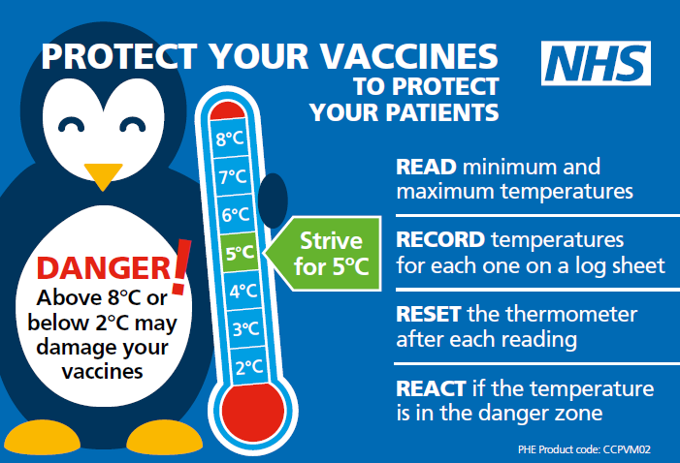
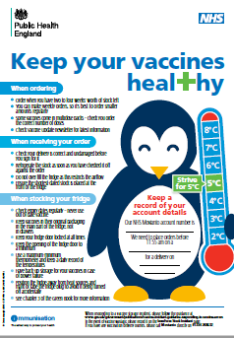
Storage of HPV vaccine
store between +2 and +8ºC
store in original packaging
protect from light
use as soon as possible after removing from fridge
Effectiveness cannot be guaranteed for vaccines unless the cold chain has been maintained and vaccine has been monitored as per national recommendations
Notes:
Gardasil 9 must be stored in accordance with the manufacturer’s instructions and stored between +2°C and +8°C.
The vaccine should be stored in the original packaging. This makes it easy to identify in the vaccine fridge, provides some protection against fluctuation of temperature and will protect from light.
Vaccines are expensive and it is important to minimise wastage through inappropriate storage.
Further information on the storage and handling of vaccines is included in chapter 3 of the green book.
www.gov.uk/government/publications/storage-distribution-and-disposal-of-vaccines-the-green-book-chapter-3
The vaccine incident guidance document provides further information on actions to take in the event of a vaccine storage event
www.gov.uk/government/publications/vaccine-incident-guidance-responding-to-vaccine-errors

Slide 32
Vaccine stock management
All vaccine providers should:
review available fridge space to ensure adequate storage capacity before ordering new vaccine
ensure that there is enough stock for 2 to 4 weeks of use and not over order or stockpile vaccine
have local protocols in place to reduce vaccine wastage to a minimum and protect vaccines in the event of a cold chain incident
report any cold chain failures or vaccine wastage through the ImmForm website on the stock incident page
Small percentage reductions in vaccine wastage have a major impact on the financing of vaccine supplies
Notes:
Effective management of vaccines throughout the supply chain is essential to reduce vaccine wastage and it is recommended that healthcare professionals order only what they need for a 2-4 week period rather than over-ordering or stockpiling vaccines.
Providers should review available fridge space to ensure adequate storage capacity before ordering and the delivery of vaccine.
All providers should have emergency vaccine storage and handling plans which clearly outline the actions to take in the event of out of range temperature excursions or refrigerator break down.
Cold chain failures must be documented and reported through the ImmForm website on the stock incident page.

Slide 33
Administration of Gardasil 9
the vaccine is provided in single dose packs containing a pre-filled syringe with a dose of 0.5ml
it presents as a suspension that must be shaken well before use to form a cloudy white suspension
2 separate needles are available with the pre-filled syringe, choose the appropriate needle to ensure an intramuscular (IM) administration depending on the patient’s size and weight
attach the needle by twisting in a clockwise direction until the needle fits securely onto the syringe
administer by intramuscular injection, preferably into the deltoid muscle in the upper arm
individuals with bleeding disorders – see specific guidance in HPV PGD
the vaccine can be given at the same time as other vaccines such as Hepatitis B (at a separate site, preferably in a different limb)
Notes:
A small air bubble may be visible in the prefilled syringe. This is not harmful and should not be removed prior to administration. This small bolus of air injected following administration of medication clears the needle and prevents a localised reaction from the vaccination. To try to expel it risks accidently expelling some of the vaccine and therefore not giving the patient the full dose.
HPV vaccine can be given at same time as other vaccines such as Hepatitis B. The vaccines should be given at a separate site, preferably in a different limb. The sites at which each vaccine was given should be noted in the individual’s health records.
Healthcare professionals are encouraged to read the Summary of Product Characteristics (SPC) to ensure accurate reconstitution and delivery of the product.
Individuals with bleeding disorders may be vaccinated intramuscularly if a doctor familiar with the individual's bleeding risk advises vaccines or similar small volume intramuscular injections can be administered with reasonable safety by this route. If the individual receives medication/treatment to reduce bleeding, for example treatment for haemophilia, intramuscular vaccination can be scheduled shortly after such medication/treatment is administered.
Individuals on stable anticoagulation therapy, including individuals on warfarin who are up to date with their scheduled INR testing and whose latest INR was below the upper threshold of their therapeutic range, can receive intramuscular vaccination. A fine needle (equal to 23 gauge or finer calibre such as 25 gauge) should be used for the vaccination, followed by firm pressure applied to the site (without rubbing) for at least 2 minutes.
If in any doubt, consult with the clinician responsible for prescribing or monitoring the individual’s anticoagulant therapy. See details specific vaccine PGD.

Slide 34
Possible adverse reactions
Gardasil 9
Most common:
pain, redness and swelling at the injection site
headache, fever, fatigue, nausea, dizziness
These adverse reactions are usually mild or moderate in intensity and short lasting.
Full details available from the manufacturer’s SPC for Gardasil 9
Notes:
In clinical vaccine trials, the most common adverse reaction observed following Gardasil 9 were injection-site reactions (84.8% of vaccinees within 5 days following any vaccination visit) and headache (13.2% of vaccinees within 15 days following any vaccination visit). These include mild to moderate short-lasting pain at the injection site, immediate localised stinging sensation and redness at the injection site. Other reactions commonly reported are headache, fatigue, nausea, dizziness and low grade fever. These adverse reactions are usually mild or moderate in intensity.
The full list of adverse reactions associated with HPV vaccine is available in the marketing authorisation holder’s ‘Summary of Product Characteristics’

Slide 35
Reporting suspected adverse reactions
vaccinees should be advised that they can report any adverse reactions or suspected side effects to the MHRA through the online yellow card scheme website or the Yellow Card app
anyone (patients and HCWs) can make a Yellow Card report, even if they are uncertain as to whether a vaccine caused the condition
www.mhra.gov.uk/yellowcard or call 0800 731 6789 (9am to 5pm Monday to Friday)
see Green Book Chapter 9 for detailed guidance on reporting vaccine reactions
Notes:
Healthcare professionals and patients are encouraged to report suspected adverse reactions to the Medicines and Healthcare Products Regulatory Agency (MHRA) using the yellow card reporting scheme.

Slide 36
Vaccine coverage data collection for the GBMSM HPV vaccination programme
HPV vaccination data for GBMSM should be entered for all attendances via the GUMCAD and HARS mandatory reporting systems for SHSs and HIV clinics
GUMCAD and HARS clinical guidance will be updated to clearly indicate the change to a one dose schedule for GBMSM less than 25 years old (with the exception of immunocompromised and GBMSM living with HIV, who will continue to receive a 3 dose schedule)
this will include guidance stating Sexual Health and HIV Activity Property Type (SHHAPT), now SNOMED CT, coding for vaccination course completion should be recorded after dose one is administered for those receiving a first dose from 1 September 2023
accurate recording of all vaccine doses given and reasons for not offering or giving the vaccine to eligible GBMSM (via the codes available in GUMCAD and HARS surveillance and reporting systems) is essential
annual reports of HPV vaccination uptake in GBMSM are available at: www.gov.uk/government/publications/hpv-vaccination-uptake-in-men-who-have-sex-with-men-msm
Notes:
HPV vaccination uptake collections for the NHS GBMSM HPV vaccination programme will not be significantly impacted by the change to the vaccine schedule in September 2023. Vaccine coverage (uptake and completion) will continue to be evaluated for GBMSM aged up to and including 45 years attending specialist sexual health services (SHSs) and HIV clinics.
HPV vaccination data for GBMSM is entered for all attendances via the GUMCAD and HARS mandatory reporting systems for SHSs and HIV clinics, respectively. GUMCAD and HARS clinical guidance will be updated to clearly indicate the change to a one dose schedule for GBMSM less than 25 years old (with the exception of immunocompromised and GBMSM living with HIV, who will continue to receive a 3 dose schedule). This will include guidance stating Sexual Health and HIV Activity Property Type (SHHAPT), now SNOMED CT, coding for vaccination course completion should be recorded after dose one is administered for those receiving a first dose from 1 September 2023.
Accurate recording of all vaccine doses given and reasons for not offering or giving the vaccine to eligible GBMSM (via the codes available in GUMCAD and HARS surveillance and reporting systems) is essential.

Slide 37
The role of healthcare professionals
to provide clear and concise information regarding vaccination against HPV
to emphasise the importance of completing the full course of vaccine to ensure full protection and encourage timely uptake of doses
to safely administer the vaccine to GBMSM in the eligible cohort
Notes:
The success of the HPV MSM programme relies heavily on healthcare professionals having a clear understanding around the rationale for offering the vaccine to this group and the key role that sexual health clinics have to play in delivering the vaccine.
Every effort should be made by healthcare professionals to maximise the success of the HPV GBMSM programme and promote the opportunistic uptake of the HPV vaccine.

Slide 38
Hepatitis B vaccination
Good opportunity to check and correctly code HBV vaccination status:
the UK’s risk-based vaccination policy for Hepatitis B Virus (HBV) includes GBMSM
HBV vaccination uptake amongst GBMSM attending specialist Sexual Health Services is below national targets
recording of both HBV immunity and HBV vaccine delivery by clinician coding is also suboptimal
maintaining high vaccine coverage in GBMSM is important to avoid outbreaks of infection
Hepatitis B vaccine can be given at the same time as HPV vaccine
the vaccines should be given at a separate site, preferably in a different limb, and site where each was given should be recorded
Notes:
Healthcare professionals should also take this opportunity to check patients’ Hepatitis B Virus (HBV) vaccination status.
Hepatitis B vaccine can be given at the same time as HPV vaccine. The vaccines should be given at a separate site, preferably in a different limb. The sites at which each vaccine was given should be noted in the individual’s health records, recorded and coded correctly.
Useful link:
UKHSA Immunisation against infectious diseases: Hepatitis B Chapter 18
www.gov.uk/government/publications/hepatitis-b-the-green-book-chapter-18
United Kingdom National Guideline on the Management of the Viral 1 Hepatitides A, B & C 2015 www.bashh.org/documents/New%20Viral%20Hepatitides%20FINAL%20DRAFT%20MAY15.pdf

Slide 39
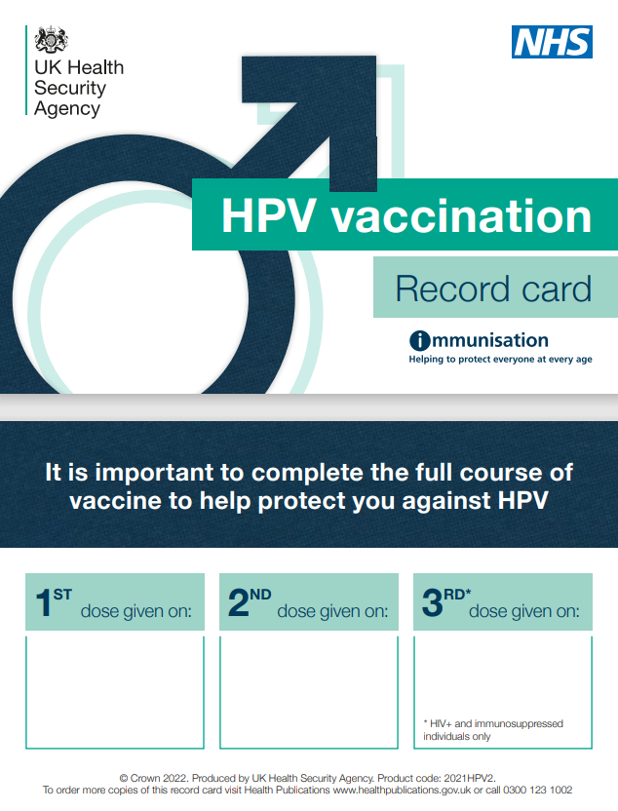
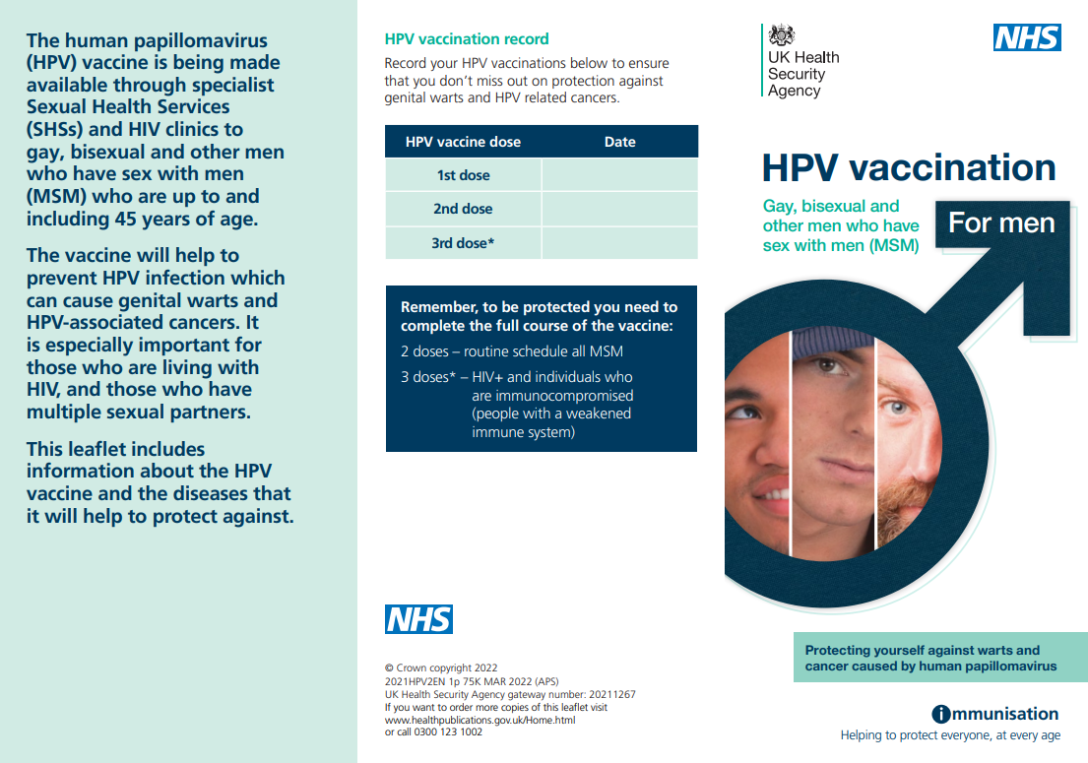
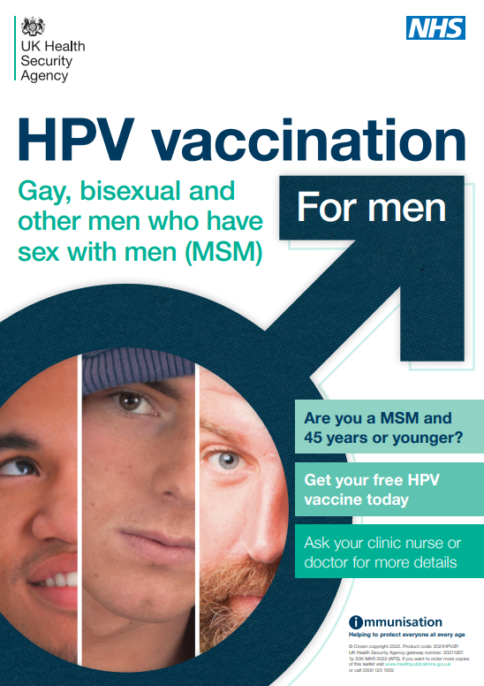
Resources – posters and leaflets
HPV vaccination record card
HPV vaccination for GBMSM programme information leaflet
HPV for MSM programme poster
Notes:
Leaflets and posters available from Health Publications:
www.healthpublications.gov.uk/Home.html

Slide 40
Resources
1) UKHSA Immunisation against infectious diseases The Green Book: Human papillomavirus (HPV) Chapter18a
www.gov.uk/government/publications/human-papillomavirus-hpv-the-green-book-chapter-18a
2) UKHSA and NHS England. Human Papillomavirus (HPV) Vaccination Programme: Change in schedule for the routine adolescent HPV programme and eligible men who have sex with men (MSM) under age 25 years. June 2023.
3) Joint Committee on Vaccination and Immunisation (JCVI). Statement on HPV vaccination of men who have sex with men. November 2015. Available at: www.gov.uk/government/publications/jcvi-statement-on-hpv-vaccination-of-men-who-have-sex-with-men
4). JCVI statement on a one-dose schedule for the routine HPV immunisation programme https://www.gov.uk/government/publications/single-dose-of-hpv-vaccine-jcvi-concluding-advice/jcvi-statement-on-a-one-dose-schedule-for-the-routine-hpv-immunisation-programme
5) HPV guidance for healthcare practitioners
www.gov.uk/government/publications/hpv-universal-vaccination-guidance-for-health-professionals
6) Summary of Product Characteristics for Gardasil 9
www.medicines.org.uk/emc/product/7330/smpc
7) UKHSA HPV vaccination programme for men who have sex with men (MSM)
www.gov.uk/government/collections/hpv-vaccination-for-men-who-have-sex-with-men-msm-programme

