Slide 1
Human papillomavirus (HPV) vaccination Routine adolescent immunisation programme Updated June 2023

Slide 2
Key messages
the Human papillomavirus (HPV) vaccine is highly effective at protecting against cervical cancer, a range of other cancers and genital warts
since the HPV vaccine programme for girls was introduced in 2008:
- there have been substantial declines in HPV16 and HPV18 in 16 to 21 year old females
- cervical cancer rates have reduced by nearly 90% in women in their 20s who were vaccinated at 12 to 13 years
- diagnoses of genital warts have fallen sharply in both males and females, indicative of herd protection
the HPV vaccination programme was extended to include GBMSM in 2018 and adolescent boys from September 2019 to prevent more cases of HPV-related cancers and the burden of HPV related disease (e.g. genital warts)
from 1 September 2023, the schedule will change to a single dose of vaccine for those aged up to 25 years
Notes:
In 2021, evidence from an evaluation of the programme, published in the Lancet, showed that the HPV vaccine has dramatically reduced cervical cancer rates by almost 90% in women in their 20s who were offered the vaccine aged 12 to 13 years in England, when compared to an unvaccinated population. Earlier evidence had shown that the number of young women with pre-cancerous cervical disease has decreased significantly (Scotland data), and that the number of infections with HPV types 16 and 18, the main cancer-causing types, has reduced by 86% in 16 to 21 year old women in England. In 2018, 10 years after vaccination was introduced, no HPV16 and/or 18 infections were detected in 16 to 18 year olds, indicating the programme has succeeded in delivering both direct and indirect protection. In 2021, the rate of genital warts diagnoses among 15 to 17 year old girls was 85% lower compared to 2017 and a decline of 80% was seen in the same aged heterosexual boys over the same period, suggesting substantial herd protection. Current indications are that this protection will last for many years.
The authors of the 2021 Lancet paper estimated that by June 30, 2019 there had been 448 fewer than expected cervical cancers and 17 235 fewer than expected cases of grade 3 cervical intraepithelial neoplasia (CIN3) in vaccinated cohorts in England.
Falcaro M et al. The effects of the national HPV vaccination programme in England, UK, on cervical cancer and grade 3 cervical intraepithelial neoplasia incidence: a register-based observational study - The Lancet Nov 2021

Slide 3
Aims of resource
to provide information for healthcare practitioners involved in advising on and delivering the HPV vaccination programme
to raise awareness of the current epidemiology of HPV and the impact of the HPV vaccination programme
to describe the HPV vaccine programme including: eligibility, recommended dosage and schedule, contraindications and precautions, vaccine administration potential adverse reactions and information resources

Slide 4
Learning outcomes
After completing this resource, vaccinators will be able to:
describe the aetiology and epidemiology of HPV
understand the rationale and evidence base for the HPV vaccination programme
discuss the benefits of vaccination against HPV
safely administer the vaccine
identify sources of additional information

Slide 5
Human Papillomavirus (HPV)
HPV is a double stranded DNA virus
it infects the deepest layer of the skin or mucosae of the upper respiratory and genital tracts through skin-to-skin contact
HPVs are a large group of related viruses. Each virus in the group is given a number, which is called an HPV type
HPV infections are often asymptomatic
infection can resolve spontaneously:
- 70% new high-risk infections will clear within a year
- 90% new infections clear within 2 years
persistent infection with high-risk HPV types such as types 16 and 18 can lead to cancer – most notably cervical cancer in women, as well as cancer of the anus, the genitals and oropharyngeal (head and neck) cancers
infection with low-risk HPV types 6 and 11 cause most genital warts
Notes:
HPV is the abbreviation for the human papillomavirus. This is a double stranded DNA virus that infects the deepest layer of the skin or lining of the upper respiratory and anogenital tracts.
The majority of HPV infections do not cause any symptoms and infection is usually cleared by the body’s own immune system without the need for other treatment. Around 70% of new infections will clear within one year and approximately 90% will clear within 2 years.
Persistent infection with high risk HPV types such as types 16 and 18 can lead to cancer – most notably cervical cancer in women as well as cancer of the anus, oropharyngeal and in men, cancer of the penis. Other types of HPV such as 6 and 11 cause genital warts.

Slide 6
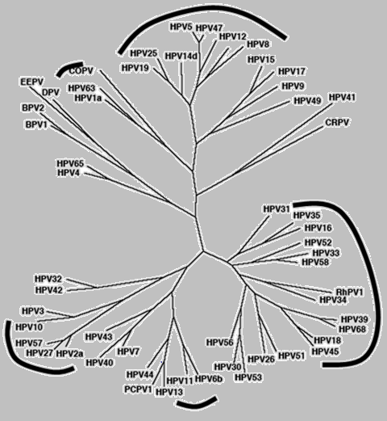
HPV Genotypes
Plantar Warts
Cutaneous (mostly asymptomatic)
Genital mucosa (cancer–associated)
Common and flat warts
External genital warts
De Villiers and others. Classification of papillomaviruses. Virology, 2004
Notes:
There are over 200 types of HPV virus. Some viruses cause genital warts and others, 'oncogenic' strains, cause cancers.

Slide 7
Human Papillomavirus (HPV)
Of the 200+ different types of HPVs:
over 40 types affect genital area
high risk types (including HPV 16, 18, 31, 33, 45, 52, 58) cause cancer
low risk types (HPV 6,11) cause genital warts
HPV16
HPV18
HPV6
HPV11
together account for between 70 to 80% of all cervical cancers
also associated with most cases of cancer of the anus, penis, oropharyngeal, vagina and vulva
90% of cases of genital warts are due to HPV 6 and 11
Notes:
There are over 200 different types of HPV of which around 40 infect the genital area.
Genital HPVs are categorised as either High risk types - known to be associated with cancer, or Low risk types- known to lead to the development of genital warts.
HPV16 and HPV18 responsible for between 70%-80% of all cervical cancers.
Types 16 and 18 are also associated with the majority of HPV related cancers of the anus, penis, oropharyngeal, vagina and vulva.
Around 90% of cases of genital warts are thought to be due to HPV type 6 and 11. Although they do not cause cancer, genital warts can be difficult to treat. Some individuals may also experience frequent recurrent episodes which may cause significant distress to the individual and substantial costs to healthcare.

Slide 8
Transmission
HPV is one of the most common sexually transmitted infections in the UK
nearly all sexually active people are infected with HPV at some point in their lives
the risk of acquiring infection increases with the:
number of previous sexual partners
introduction of a new sexual partner
sexual history of partners
HPV can still be present even if it has been years since an individual has been sexually active
transmission of genital HPVs is primarily by sexual contact with an infected partner, particularly through sexual intercourse but also by non-penetrative genital contact, including oral sex
infection usually occurs after sexual debut and almost 40% of women are infected within 2 years
Notes:
It is estimated that around 8 out of 10 people will be infected with HPV at some point in their lives. Most people never know they are infected – HPV infections are typically asymptomatic and most of the time the body clears the infection without it causing any problems.. The average length of an infection is around 8 months but for 10% women, infection can last longer than 2 years. It is this group of women who are at increased risk of developing cervical cancer. Cervical cancer often doesn’t occur until 20 years after the initial infection.
Persistent infection with high risk HPV types can damage DNA. This can cause cells to divide and grow out of control which can lead to cancer.

Slide 9
HPV and cervical cancer
persistent infection by high risk HPV types is detectable in more than 99% of all cervical cancers
cervical cancer is still one of the commonest cancers amongst women worldwide, with 604,000 new cases and 342,000 deaths estimated in 2020
cervical cancer is the most common cancer among women under the age of 35 (peak incidence 30 to 34 years)
approximately one third of women die within 5 years of the diagnosis of invasive cervical cancer in the UK
in the UK before the impact of the HPV vaccination programme started to take effect:
over 3,000 women were diagnosed with cervical cancer every year
around 900 women died from cervical cancer every year
Notes:
In the UK, cervical cancer is the 14th most common cancer in women. Between 2016-2018, around 3,200 women are diagnosed with cervical cancer in the UK each year. That’s nearly 9 cases diagnosed every day (Source: CRUK)

Slide 10
Other HPV associated cancers
HPV is also associated with:
anal and cervical cancers (more than 90%)
vaginal and vulvar cancers (about 70%)
oropharyngeal cancers (up to 70%)
more than 60% of penile cancers
Cancer Research UK (CRUK) suggests that the proportion of cancer cases linked to HPV is rising and that in Europe:
73% of oropharangeal cancer cases are HPV positive
12% of oral cavity, hypopharynx and larynx cancer cases are HPV-positive
laryngeal squamous cell carcinoma (SCC) risk is 5.4 times higher in people with HPV infection
the cancer risk for oropharyngeal, tonsil, and base of tongue is higher in people with more past sexual partners, people who started having sex at a younger age, and men who have ever had sexual contact with men
Notes:
In recent years there has been an increase of HPV positive oropharyngeal cancer and it is being seen in younger people aged between 40 and 50 years, who do not smoke. 1 in 55 men and 1 in 108 women will be diagnosed with oral cancer at some point in their life.
www.ncbi.nlm.nih.gov/pmc/articles/PMC4830161/
www.cancerresearchuk.org/about-cancer/causes-of-cancer/infections-eg-hpv-and-cancer/does-hpv-cause-cancer?_ga=2.107067074.1715641418.1562227587-1516946824.1550596213
www.cancerresearchuk.org/health-professional/cancer-statistics/statistics-by-cancer-type/head-and-neck-cancers/risk-factors#ref-10

Slide 11
The HPV vaccination programme
The National HPV Immunisation Programme began throughout the UK in September 2008
Delivered in schools:
targeted school Year 8 females (aged 12 to 13 years)
catch up for all girls aged between 13 to 18 years
Following a successful pilot, in 2018 the programme was extended to offer vaccine to GBMSM up to 45 years of age attending local specialist Sexual Health Services and/or HIV clinics
In 2019 the HPV adolescent programme was extended to include boys as well as girls
Eligible girls and boys (eligible boys born on/after 01/09/2006) can continue to be caught up until their 25th birthday
From 1 September 2023 the HPV vaccination schedule will change to:
a 1 dose schedule for the routine adolescent programme and GBMSM programme for eligible individuals less than 25 years of age
a 2 dose schedule from the age of 25 years for the GBMSM programme
a 3 dose schedule for individuals who are immunosuppressed and those known to be living with HIV
Notes:
The national HPV Immunisation Programme was introduced for girls in September 2008 and has been delivered throughout the UK to help prevent cervical cancer.
In September 2019, the HPV vaccination programme was extended to boys from 12 years of age with the expectation that it would provide clear additional health benefits including:
direct protection for vaccinated boys against HPV infection and associated disease such as genital warts, anal, penile and oropharyngeal cancers
protection against HPV for GBMSM by offering them vaccination before their sexual debut
indirect protection for non-vaccinated males and females
Extending the offer of the HPV vaccine to boys should also improve the resilience of the UK programme, accelerate the control of cervical cancer in women and has the potential to eliminate HPV vaccine types in the UK.
The programme offers vaccination to school Year 8 (age 12-13 years) with a catch up for those eligible up to 25 years of age.
Based on advice from the Joint Committee on Vaccination and Immunisation (JCVI), from 1st September 2023, the HPV vaccination schedule will change to:
a 1 dose schedule for the routine adolescent programme and GBMSM programme for eligible individuals less than 25 years of age
a 2 dose schedule from the age of 25 years for the GBMSM programme
a 3 dose schedule for individuals who are immunosuppressed and those known to be living with HIV

Slide 12
Year | Change to HPV programme
September 2008 | HPV national vaccination programme introduced for Year 8 girls (aged 12 to 13 years old). A catch-up programme also took place to vaccinate all girls aged 13 to 18 years old.
September 2012 | Gardasil vaccine (4 HPV types) replaced the previously used Cervarix vaccine (2 HPV types)
September 2014 | 3 dose schedule reduced to a 2 dose schedule for girls under 15 years of age.
April 2018 | HPV vaccination programme extended to include GBMSM up to and including 45 years attending all specialist Sexual Health Services (SHSs) and HIV clinics.
Sept 2019 | HPV vaccination programme extended to boys from 12 years of age.
April 2022 | HPV schedule changed from a 3 dose schedule to a 2 dose schedule for those starting the programme when they were aged 15 years and above and for those eligible through the GBMSM programme. People known to be living with HIV, including those on antiretroviral therapy, or known to be immunocompromised at the time of immunisation continued to be offered a 3 dose schedule.
July 2022 | Gardasil 9 vaccine (9 HPV types)replaced the previously used Gardasil vaccine (4 HPV types)
September 2023 | HPV vaccination schedule to change to: a 1 dose schedule for the routine adolescent programme and GBMSM programme for eligible individuals less than 25 years of age a 2 dose schedule from the age of 25 years for the GBMSM programme a 3 dose schedule for eligible individuals who are immunosuppressed and those known to be living with HIV, including those on antiretroviral therapy (0, 1, 4 to 6 month schedule)

Slide 13
HPV vaccine introduction
Cervarix vaccine used September 2008 to 2012
HPV types 16, 18
Gardasil vaccine used from September 2012 to 2022
HPV types 6, 11, 16, 18
Gardasil 9 vaccine introduced in July 2022
HPV types 6, 11, 16, 18, 31, 33, 45, 52, 58
As the programme has transitioned from one vaccine to another, individuals may have received a mixed vaccine schedule but all of the HPV vaccines are considered to be interchangeable in terms of protection against types 16 and 18.
Gardasil 9 offers protection against 5 additional types of HPV which although less common than types 16 and 18, are also considered high-risk types.
Notes:
The bi-valent Cervarix vaccine was offered for the first 4 years of the national programme. This vaccine protects against the 2 HPV types which cause the majority of cervical cancer.
From September 2012, the quadrivalent vaccine, Gardasil, was used for the national programme. Gardasil provides protection against HPV types 6 and 11, the HPV types that cause genital warts, in addition to the cancer causing types 16 and 18.
In 2022 Gardasil 9 was introduced and this vaccine offers protection against 5 additional types of HPV (31, 33, 45, 52, 58) which, although less common than types 16 and 18, are also considered high-risk HPV types.
Gardasil 9 is expected to prevent the majority of cervical, vaginal and vulvar cancers and premalignant lesions, as well as genital warts associated with HPV.

Slide 14
Gardasil 9
Brand name: Gardasil 9
Generic Name: Human Papillomavirus Vaccine
[HPV types 6, 11, 16, 18, 31, 33, 45, 52, 58]
Type of vaccine: Recombinant, adsorbed
Marketed by: Merck Sharp & Dohme Limited (MSD)
Licensed from: 9 years of age
Notes:
Gardasil 9 provides protection against Types 6, 11, 16, 18, 31, 33, 45, 52, 58.
The additional Types 31, 33, 45, 52, 58 although less common than types 16 and 18, are also considered high-risk HPV types.
Gardasil 9 is expected to prevent the majority of cervical, vaginal and vulvar cancers and premalignant lesions, as well as genital warts associated with HPV
SPC for Gardasil 9: www.medicines.org.uk/emc/product/7330/smpc

Slide 15
HPV vaccines
vaccine made from the proteins of the outer coat of the virus types
these proteins assemble into small spheres that are called virus-like particles (VLPs)
VLPs are not infectious and cannot cause HPV-associated cancers or genital warts as they do not contain the virus’s DNA
VLPs are very immunogenic, which means that they induce high levels of antibody production by the body
upon subsequent exposure to the live virus, the immune system reacts quickly to prevent infection
an adjuvant (aluminium hydroxyphosphate sulfate) is added to increase the immune response made
Notes:
The HPV Gardasil vaccine is made from the proteins that make up the outer surface of the virus types. The protein is grown in the lab in yeast cells. Once the protein is grown, it assembles itself into small spheres that are called virus-like particles (VLPs) to look like the HPV virus. VLPs are not infectious and cannot cause HPV-associated cancers or genital warts as they do not contain the virus’s DNA (HPV genetic material), so they cannot reproduce or cause illness.
VLPs are very immunogenic, which means that they induce high levels of antibody production by the body. Vaccination delivers the VLP antigen via a pathway completely different to that for natural infection whereby the virus gains entry via the mucosa. The structure and geometry of the VLP is such that neutralising epitopes are optimally arranged and presented. The HPV VLP is also a very rigid and stable structure providing a sustained presentation to the immune system. The Gardasil 9 vaccine is composed of the surface protein from 9 different types of HPV.
As with many other immunisations, when a person is vaccinated, their immune system mounts a response against these VLPs. When a person is then exposed to the live virus, the body’s immune system reacts quickly to stop the infection.

Slide 16
HPV vaccines (cont)
prior infection with one HPV type does not diminish the efficacy of the vaccine against other HPV types included in the vaccine
currently studies show that protection is maintained for at least ten years although based on immune responses, protection is expected to last longer than this and may be lifelong
long-term follow-up studies are ongoing to evaluate length of protection and whether booster doses will be needed
booster doses are not currently indicated
the HPV vaccine is used in over 113 countries around the world including the USA, Australia, Canada and most of Western Europe
Notes:
Current studies suggest that protection is maintained for at least ten years. Based on the immune responses, it is expected that protection will be extended further; long-term follow-up studies are in place to evaluate this and will determine the need for any subsequent boosters.
Most women aged 15 to 24 years in England have now been given the vaccine
In time it is expected that the vaccine will save hundreds of lives every year in the UK

Slide 17
HPV vaccine effectiveness
Gardasil shown to be highly effective in preventing HPV infection for the serotypes contained in the vaccine
clinical trials show very high efficacy and well tolerated
over 99% effective at preventing pre-cancerous lesions associated with HPV types 16 and 18
99% effective at preventing genital warts associated with vaccine types in young women
a clinical trial of Gardasil in men indicated that it can prevent anal cell changes caused by persistent infection and genital warts
may boost immunity and prevent re-infection or reduce reoccurrences in people with previously treated high-grade anal intraepithelial neoplasia established diseases
Notes:
In clinical trials in young women with no previous history of HPV infection, vaccine was 99% effective at preventing pre-cancerous lesions associated with HPV types 16 and 18.
Gardasil is also 99% effective at preventing genital warts associated with vaccine types in young women.
A clinical trial of Gardasil in men indicated that it can prevent anal cell changes caused by persistent infection, and genital warts.
HPV vaccines have not been shown to have an impact on an existing infection or any of the outcomes of an existing HPV infection, such as genital warts but may boost immunity and prevent re-infection or reduce reoccurrences in people with previously treated high-grade anal intraepithelial neoplasia.
evidence from surveillance consistent with:
very high vaccine effectiveness among those vaccinated
a substantial herd protection effect with lower HPV16 and 18 prevalence over time in unvaccinated women
cross-protection – declines in HPV types 31, 33 and 45 in the post-vaccination period
There is no evidence of non-vaccine type replacement to date.

Slide 18
HPV vaccine effectiveness (cont)
studies show the number of:
young women with pre-cancerous cervical disease has decreased significantly
infections with HPV types 16 and 18, the main cancer-causing types, has reduced by 86% in 16 to 21 year old women in England
in 2018, 10 years after vaccination was introduced, no HPV16 and/or 18 infections were detected in 16 to 18 year olds, indicating the programme has succeeded in delivering both direct and indirect protection
in 2021, the rate of genital warts diagnoses among 15 to 17 year old girls was 85% lower compared to 2017 and a decline of 80% was seen in heterosexual boys of the same age over the same period, suggesting substantial herd protection
in 2021, evaluation evidence showed HPV vaccine has dramatically reduced cervical cancer rates by almost 90% in women in their 20s who were offered the vaccine at age 12 to 13 years in England, when compared to an unvaccinated population

Slide 19
Prevalence of HPV16 and/or 18 among 16-18 year old females
Notes:
The graph shows post-vaccination changes in prevalence of HPV type 16/18 and the impact the girls vaccination programme has had to date. This prevalence estimate is derived from UKHSA’s ongoing surveillance among young women attending for chlamydia screening.
Among 16-18 year old females where vaccine coverage was highest, HPV 16/18 prevalence decreased from 15% in 2008 prior to the introduction of the vaccination programme, to 8.2% in 2010/11 and subsequently to 1.6% in 2016. In 2018, 10 years after vaccination was introduced, no HPV16/18 infections were detected in 16-18 year olds. These results indicate the programme has succeeded in delivering both direct and indirect protection.

Slide 20
Impact of vaccination on cervical cancer
in a study published in the Lancet¹, evidence showed that
HPV vaccination in England dramatically reduced cervical cancer rates by almost 90% in women in their 20s who were offered it at age 12 to 13
the HPV immunisation programme has successfully almost eliminated cervical cancer in women born since 1 September 1995
the HPV vaccination programme has prevented around 450 cervical cancers and 17,200 cases of precancerous conditions over an 11 year period
modelling study² suggests that vaccinated women may only need 3 cervical screens in their lifetime (rather than the current 12 lifetime screens offered in England) therefore information on vaccination status is essential
¹Falcaro M et al P. Lancet. 2021 Dec 4;398(10316):2084-2092. ²Landy R et al. Int J Cancer. 2018 Feb 15;142(4):709-718.
Notes:
Falcaro M, Castañon A, Ndlela B, Checchi M, Soldan K, Lopez-Bernal J, Elliss-Brookes L, Sasieni P. The effects of the national HPV vaccination programme in England, UK, on cervical cancer and grade 3 cervical intraepithelial neoplasia incidence: a register-based observational study - The Lancet Nov 2021. Available at: www.thelancet.com/journals/lancet/article/PIIS0140-6736(21)02178-4/fulltext
Landy R, Windridge P, Gillman MS, Sasieni PD. What cervical screening is appropriate for women who have been vaccinated against high risk HPV? A simulation study. Int J Cancer. 2018 Feb 15;142(4):709-718. doi: 10.1002/ijc.31094. Epub 2017 Nov 10. PMID: 29023748; PMCID: PMC5765470. Available at: www.ncbi.nlm.nih.gov/pmc/articles/PMC5765470/

Slide 21
Safety of HPV vaccine
the safety of HPV vaccine has been established through rigorous testing in clinical trials, followed by extensive use with more than 500 million doses given across the world
some people may experience a mild side effect, but these are generally of short duration and are far outweighed by the expected benefits of the vaccine
The Medicines and Healthcare products Regulatory Agency (MHRA) monitors the safety of vaccination programmes:
volume of suspected side effects reported via the Yellow Card Scheme for HPV is not unusual
overwhelming majority relate to possible side-effects that might result from any adolescent vaccination programme e.g. injection site reactions, rashes, mild allergic events, nausea, dizziness, fatigue, immediate faints due to needle phobia, etc
Notes:
The safety of HPV vaccine has been established through rigorous testing in clinical trials followed by extensive global use with millions of doses administered to date. As with any medicinal product, some people may experience a side effect but these are generally mild, of short duration and outweighed by the benefits of the vaccine.

Slide 22
Vaccine safety reviews
JCVI carried out a routine review of HPV vaccine safety in 2015 and concluded that it had no concerns about the safety of the HPV vaccine:
extensive reviews of HPV vaccine safety have also been undertaken by various independent health bodies and authorities worldwide
MHRA
World Health Organization’s Global Advisory Committee on Vaccine Safety
European Medicines Agency
US Centre for Disease Control and Prevention
Health Canada
All concluded that the evidence does not support a link between HPV vaccine and the development of a range of chronic illnesses
Notes:
Both the WHO and the US Centers for Disease Control and Prevention (CDC) have posted clear advice on their website supporting the safety of HPV vaccine. The safety of the HPV vaccine has been regularly reviewed by the Global Advisory Committee for Vaccine Safety (GACVS) and they have not found any safety concerns.
Despite concerns raised by the media and some campaign groups, no links have been found between HPV vaccine and adverse events, including blood clots, allergic reactions, strokes, seizures, Guillain-Barré Syndrome (a rare cause of paralysis), birth defects, miscarriages, infertility or premature ovarian failure, or infant/fetal deaths.
Safety Information for HPV Vaccine | Vaccine Safety | CDC

Slide 23
Change to HPV vaccination schedule
From 1 September 2023, eligible adolescents up to 25 years of age will be offered a single dose of HPV vaccine, instead of the 2 doses up to this date
those who have not yet received any HPV vaccinations will be eligible to receive one dose of the HPV vaccine
those who started their HPV vaccination schedule and have already received one dose of the vaccine will be considered fully vaccinated
Eligible individuals known to be immunosuppressed at the time of vaccination and those who are living with HIV, including those on antiretroviral therapy, should continue to be offered a 3 dose schedule (0, 1, 4-6 months)
There is no change to the eligibility criteria
all adolescents (male and female) in school Year 8 (usually aged 12 and 13)
once eligible, remain so until their 25th birthday
Notes:
For those who have commenced HPV vaccination prior to 1 September 2023:
-if they have received 1 dose before their 25th birthday, they can be considered to have completed their course

Slide 24
Why has the schedule changed?
JCVI has made a detailed review of cumulative evidence that has been building over years and they consider that the evidence is now very strong that 1 dose of the HPV vaccine provides similar protection to that induced by 2 doses
trial and non-trial evidence shows that initial vaccine efficacy from 1 dose is very high and likely comparable to that from 2 doses
in addition, the long duration of protection (more than 10 years) already seen is associated with a steady antibody level which has ongoing persistence and is expected to continue along the same trajectory
the one-dose antibody level is associated with high efficacy against persistent infection of HPV vaccine types
Notes:
The JCVI has been reviewing the mounting evidence about protection from a single dose of HPV vaccine since 2018 and they have been considering the issue of a potential change in the vaccine schedule to one dose of the HPV vaccine during this time. The first major review of a one dose schedule took place in June 2020. After a further review of the latest evidence on one dose schedules, in August 2022, the JCVI concluded its advice on a move from a 2 dose to a one dose schedule for the routine adolescent programme and GBMSM programme for eligible individuals aged under 25 years
JCVI statement on a one-dose schedule for the routine HPV immunisation programme - GOV.UK (www.gov.uk)
One-dose Human Papillomavirus (HPV) vaccine offers solid protection against cervical cancer (who.int)
Single dose of HPV vaccine: JCVI interim advice - GOV.UK (www.gov.uk)

Slide 25
Why has the schedule changed? (cont)
the WHO Strategic Advisory Group of Experts on Immunization (SAGE) met in April 2022 to evaluate the evidence that has been emerging over past years that single-dose schedules provide comparable efficacy to the 2- or 3-dose regimens
SAGE’s review concluded that a single-dose HPV vaccine provides comparable efficacy and durability of protection to 2-dose schedules
single dose schedules are now being considered in several countries and have already been recommended in Australia, Mexico, Nigeria and Bangladesh and introduced in Cape Verde, Tonga and the Solomon Islands
following a move to a 1 dose schedule, robust UK surveillance will continue to monitor the incidence and prevalence of genital warts and high-risk HPV infections in the population
Notes:
The World Health Organization (WHO) have also looked at and subsequently updated their recommendations for the human papillomavirus (HPV) vaccine. Their paper states that a single-dose schedule can provide comparable efficacy and durability of protection to a 2-dose regimen. The recommendation for an alternative single-dose off-label scheduling option for routine and multi-age-cohort catch-up vaccination was made by WHO’s independent expert advisory group, SAGE in 2022. Single dose schedules are now being considered in several countries and have already been recommended in Australia, Mexico, Nigeria and Bangladesh and introduced in Cape Verde, Tonga and the Solomon Islands.
JCVI statement on a one-dose schedule for the routine HPV immunisation programme - GOV.UK (www.gov.uk)
One-dose Human Papillomavirus (HPV) vaccine offers solid protection against cervical cancer (who.int)
Single dose of HPV vaccine: JCVI interim advice - GOV.UK (www.gov.uk)

Slide 26
Immunosuppression and HIV infection
evidence suggests individuals living with HIV are at increased risk of acquiring HPV and persistent infection, as well as frequent carriage of multiple HPV types and increased risk of HPV related rapidly progressive malignancies
currently no data on fewer than 3 doses among individuals living with HIV or who are immunosuppressed
a 3 dose schedule should still be offered to individuals who are known to be
living with HIV, including those on antiretroviral therapy, or
immunosuppressed at the time of immunisation
HPV vaccines are known to be safe and immunogenic for individuals living with HIV although the immune response and its effectiveness may be less than that observed among those who do not have HIV
Notes:
Evidence suggests individuals who are HIV positive are at increased risk of acquiring HPV and persistent infection, as well as frequent carriage of multiple HPV types and increased risk of HPV related rapidly progressive malignancies.
HPV vaccines are known to be safe and immunogenic when given to individuals who are HIV positive. There is however no data to support giving fewer than 3 doses among HIV positive individuals, For this reason, a 3-dose schedule at 0,1 and 4 to 6 months should continue to be offered to individuals in the eligible cohort who are known to be HIV positive or known to be immunocompromised at the time of immunisation. Antibody levels may be lower in individuals who are HIV positive compared to individuals who are HIV negative. However, despite this, HPV vaccines appear to show good efficacy in this population.

Slide 27
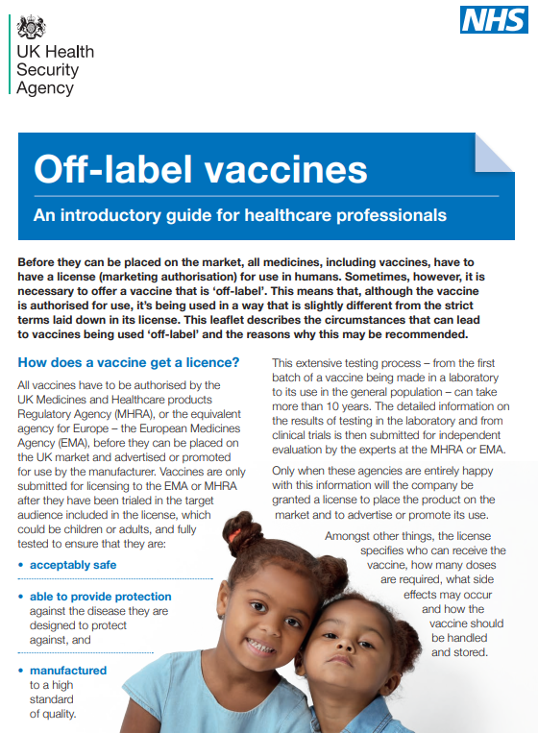
Legal mechanisms for administration of HPV vaccine
Gardasil 9 is a prescription only medicine and should only be administered using one of the following:
prescription written manually or electronically by a registered medical practitioner or other authorised prescriber
Patient Specific Direction (PSD)
Patient Group Direction (PGD)
UKHSA have developed a national PGD template which should be reviewed and authorised locally before use
The currently approved schedule for HPV vaccine is a 2-dose course. Use of a single dose is therefore off-label
In line with advice from the MHRA, where authoritative advice and current practice supports the use of a medicine outside the terms of its licence, it is not always necessary to draw attention to this when seeking consent.
Notes:
UKHSA Immunisation PGD template:
www.gov.uk/government/publications/human-papillomavirus-hpv-vaccine-pgd-template
The currently approved schedule for HPV vaccine is a 2 dose course. Use of a single dose is therefore off-label but it is in accordance with JCVI advice, as outlined in the Green Book.
In line with advice from the MHRA, where authoritative advice and current practice supports the use of a medicine outside the terms of its licence, it is not always necessary to draw attention to this when seeking consent. Further useful guidance about this is available in the following:
Off-label or unlicensed use of medicines: prescribers’ responsibilities - GOV.UK (www.gov.uk)
Off-label vaccines: introductory guide for healthcare professionals
Off-label vaccines: a guide for parents

Slide 28
Consent
consent can be obtained verbally or through a written consent form
in the routine school-based immunisation programmes, an information leaflet and consent form are usually sent to the parent to complete and return
consent forms should not act as a barrier to immunisation and they should be as simple to complete as possible
consent can also be taken from a parent over the phone
as is clearly outlined in the Green Book Consent chapter, some young people can self-consent
if a parent cannot be reached on the phone at the time of the immunisation session, self-consent should be used, where appropriate, to ensure the child is protected
Notes:
Written consent
In the routine school-based immunisation programmes, an information leaflet and consent form are usually sent to the parent to complete and return as they are not present at the time of vaccination. Email or electronic forms of consent are increasingly being used.
Consideration should be given for appropriate routes to reach parents/families who may not easily access information digitally. Providers should make sure parents have sight of the NHS information leaflets.
Consent forms should not act as a barrier to immunisation and they should be as simple to complete as possible. Any information being collected about the young person, such as their health and immunisation status, or medications being taken, should be relevant to the immunisation being offered.
Verbal consent
On the day of the immunisation session, school nurses and school immunisation teams should attempt to make contact with the parent or guardian of young people who are keen to be immunised but who have not returned a written consent form. This enables consent to be obtained over the phone which maximises uptake and reduces the need for additional catch-up sessions. This strategy also has the added benefit of including people who are unable to complete written consent forms due to language or literacy issues therefore addressing inequalities.
Self-consent
As is clearly outlined in the Green Book Consent chapter, some young people can self-consent. If a parent cannot be reached on the phone at the time of the immunisation session, self-consent should be used, where appropriate, to ensure the child is protected:
young people aged 16 and 17 are presumed, in law, to be able to consent to their own medical treatment
younger children who understand fully what is involved in the proposed procedure (referred to as ‘Gillick competent’) can also give consent, although ideally their parents will be involved. Although there is no lower age for Gillick competency, as this will vary from child to child, some immunisation teams choose to reserve this option for senior school children
if a person aged 16 or 17 or a Gillick-competent child consents to treatment, a parent cannot override that consent
if the health professional taking consent felt a child was not Gillick-competent then the consent of someone with parental responsibility would be sought
if a person aged 16 or 17 or a Gillick-competent child refuses treatment that refusal should be accepted. It is unlikely that a person with parental responsibility could overrule such a refusal.
A number of local areas are already successfully using self-consent for young people aged 16 or 17 and Gillick-competent children in their schools-based programmes. Some teams advise parents in the information provided, that the young person will be offered the opportunity to self-consent if the completed consent form is not returned. Self-consent can also increase inclusion where parents have language or literacy issues and could also reduce the need for additional immunisation sessions at the school

Slide 29
Contraindications and Precautions
Contraindications
Gardasil 9 should not be administered to those who have had:
a confirmed anaphylaxis to a previous dose of the vaccine
a confirmed anaphylaxis to any constituent or excipient of the vaccine
Yeast allergy is not a contraindication to the HPV vaccine. Although the vaccine antigen in Gardasil 9 is grown in yeast cells, the final vaccine product does not contain any yeast
Precautions
If an individual is acutely unwell, immunisation may be postponed until they have fully recovered to avoid confusing the differential diagnosis of any acute illness by wrongly attributing any signs or symptoms to any possible adverse effects of the vaccine
Notes:
There are very few individuals who cannot receive HPV vaccines. Where there is doubt, instead of withholding immunisation, appropriate advice should be sought from a consultant with immunisation expertise, a member of the screening and immunisation team or from the local health protection team.
A mild fever or upper respiratory infection (for example, a cold) itself is not a reason to delay vaccination.
If acutely unwell, the immunisation may be deferred until the individual has recovered – this is to avoid confusing the differential diagnosis of acute illness by wrongly attributing signs or symptoms as adverse effects of the vaccine.
For the composition and full list of excipients of the vaccine, please refer to the manufacturer’s Summary of Product Characteristics (SPC).

Slide 30
HPV vaccine ordering
HPV vaccine for use in the delivery of the NHS HPV programme can be ordered from UKHSA via ImmForm in the usual way
when placing orders for HPV vaccine, providers are asked to consider the schedule change and make sure that locally held stocks of vaccine are rotated in fridges so that wastage is minimised
there are separate order lines for the adolescent and GBMSM HPV programmes on ImmForm. The correct one must be used to order vaccine volumes for each programme, even where an ImmForm account holder is ordering for both

Slide 31
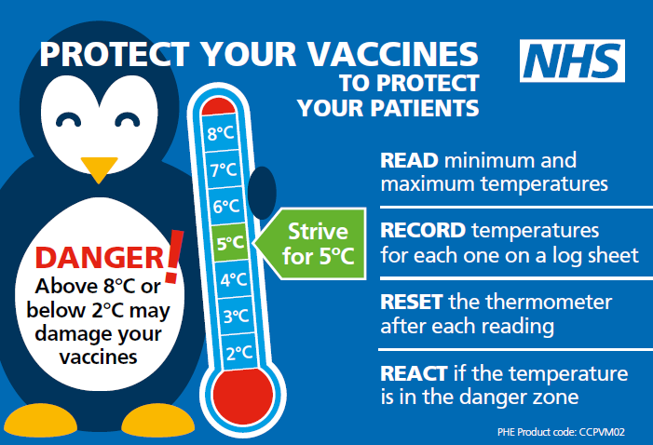
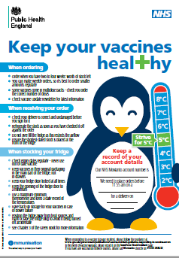
Storage of HPV vaccine
store between +2 and +8ºC
store in original packaging
protect from light
use as soon as possible after removing from fridge
Effectiveness cannot be guaranteed for vaccines unless the cold chain has been maintained and vaccine has been monitored as per national recommendations
Notes:
Gardasil 9 must be stored in accordance with the manufacturer’s instructions and stored between +2°C and +8°C.
The vaccine should be stored in the original packaging. This makes it easy to identify in the vaccine fridge, provides some protection against fluctuation of temperature and will protect from light.
Vaccines are expensive and it is important to minimise wastage through inappropriate storage.
Further information on the storage and handling of vaccines is included in chapter 3 of the green book.
www.gov.uk/government/publications/storage-distribution-and-disposal-of-vaccines-the-green-book-chapter-3
The vaccine incident guidance document provides further information on actions to take in the event of a vaccine storage event
www.gov.uk/government/publications/vaccine-incident-guidance-responding-to-vaccine-errors

Slide 32
Vaccine stock management
All providers should:
review available fridge space to ensure adequate storage capacity before ordering new vaccine
ensure that there is enough stock for 2 to 4 weeks of use and not over order
have local protocols in place to reduce vaccine wastage to a minimum and protect vaccines in the event of a cold chain incident
report any cold chain failures or vaccine wastage through the ImmForm website on the stock incident page
Small percentage reductions in vaccine wastage have a major impact on the financing of vaccine supplies
Notes:
Effective management of vaccines throughout the supply chain is essential to reduce vaccine wastage and it is recommended that healthcare professionals order only what they need for a 2-4 week period rather than over-ordering or stockpiling vaccines.
Providers should review available fridge space to ensure adequate storage capacity before ordering and the delivery of vaccine.
All providers should have emergency vaccine storage and handling plans which clearly outline the actions to take in the event of out of range temperature excursions or refrigerator break down.
Cold chain failures must be documented and reported through the ImmForm website on the stock incident page.

Slide 33
Administration of Gardasil 9
the vaccine is provided in single dose packs containing a pre-filled syringe with a dose of 0.5ml
it presents as a suspension that must be shaken well before use to form a cloudy white suspension
2 separate needles are available with the pre-filled syringe: choose the appropriate needle to ensure an intramuscular (IM) administration depending on the patient’s size and weight
administer by intramuscular injection, preferably into the deltoid muscle in the upper arm
individuals with bleeding disorders – see specific guidance in HPV PGD
can be given at the same time as other national schedule vaccines (at a separate site, preferably in a different limb)
Notes:
A small air bubble may be visible in the prefilled syringe. This is not harmful and should not be removed prior to administration. This small bolus of air injected following administration of medication clears the needle and prevents a localised reaction from the vaccination. To try to expel it risks accidently expelling some of the vaccine and therefore not giving the patient the full dose.
HPV vaccine can be given at same time as other vaccines if required. The vaccines should be given at a separate site, preferably in a different limb. The sites at which each vaccine was given should be noted in the individual’s health records.
Healthcare professionals are encouraged to read the Summary of Product Characteristics (SPC) to ensure accurate reconstitution and delivery of the product.
Individuals with bleeding disorders may be vaccinated intramuscularly if a doctor familiar with the individual's bleeding risk advises vaccines or similar small volume intramuscular injections can be administered with reasonable safety by this route. If the individual receives medication/treatment to reduce bleeding, for example treatment for haemophilia, intramuscular vaccination can be scheduled shortly after such medication/treatment is administered.
Individuals on stable anticoagulation therapy, including individuals on warfarin who are up to date with their scheduled INR testing and whose latest INR was below the upper threshold of their therapeutic range, can receive intramuscular vaccination. A fine needle (equal to 23 gauge or finer calibre such as 25 gauge) should be used for the vaccination, followed by firm pressure applied to the site (without rubbing) for at least 2 minutes.
If in any doubt, consult with the clinician responsible for prescribing or monitoring the individual’s anticoagulant therapy. See details specific vaccine PGD.

Slide 34
Possible adverse reactions
Gardasil 9
Most common:
pain, redness and swelling at the injection site
headache, fever, fatigue, nausea, dizziness
These adverse reactions are usually mild or moderate in intensity and short lasting.
Full details available from the manufacturer’s SPC for Gardasil 9
Notes:
In clinical vaccine trials, the most common adverse reaction observed following Gardasil 9 were injection-site reactions (84.8% of vaccinees within 5 days following any vaccination visit) and headache (13.2% of vaccinees within 15 days following any vaccination visit). These include mild to moderate short-lasting pain at the injection site, immediate localised stinging sensation and redness at the injection site. Other reactions commonly reported are headache, fatigue, nausea, dizziness and low grade fever. These adverse reactions are usually mild or moderate in intensity.
The full list of adverse reactions associated with HPV vaccine is available in the marketing authorisation holder’s ‘Summary of Product Characteristics’

Slide 35
Reporting suspected adverse reactions
vaccinees should be advised that they can report any adverse reactions or suspected side effects to the MHRA through the online yellow card scheme website or the Yellow Card app
anyone (patients, parents and HCWs) can make a Yellow Card report, even if they are uncertain as to whether a vaccine caused the condition
www.mhra.gov.uk/yellowcard or call 0800 731 6789 (9am to 5pm Monday to Friday)
see Green Book Chapter 9 for detailed guidance on reporting vaccine reactions
Notes:
Healthcare professionals and patients or parents are encouraged to report suspected adverse reactions to the Medicines and Healthcare Products Regulatory Agency (MHRA) using the yellow card reporting scheme.

Slide 36
Vaccine coverage data collection
HPV vaccine coverage is based on aggregated school level data
the data is entered manually on the secure web platform, ImmForm
the routine HPV vaccine coverage collection for the adolescent programme will not be impacted by the change in the vaccine schedule
coverage of the 1 dose programme will continue to be evaluated for both males and females in school Year 8 (ages 12 to 13 years old) and Year 9 (ages 13 to 14 years old) as part of the routine universal programme.
guidance for submitting vaccine coverage data via ImmForm is available at: www.gov.uk/government/publications/adolescent-vaccine-coverage-user-guidance
annual HPV coverage reports are available at: www.gov.uk/government/collections/vaccine-uptake#hpv-vaccine-uptake

Slide 37
Adolescent vaccine coverage (HPV)
Notes:
There has been a fall in vaccine coverage levels in recent years, mostly due to the disruption of the school vaccination programmes during the pandemic.
Coverage levels are still not back up to pre-pandemic levels so it is really important to catch up anyone who missed out. Those eligible for the adolescent HPV programme remain so until their 25th birthday.

Slide 38
Adolescent vaccine coverage (HPV)
 | 2018/19 | 2019/20 | 2020/21 | 2021/22
Dose 1 in Year 8 females | 88.0 | 59.2 | 76.6 | 69.6
Dose 1 in Year 9 females | 88.0 | 88.9 | 82.9 | 82.2
Dose 1 in Year 10 females | n/a | n/a | 51.0 | 86.5
Dose 2 in Year 9 females | 83.9 | 64.7 | 60.2 | 67.3
Dose 2 in Year 10 females | n/a | n/a | 41.8 | 76.9
Dose 1 in Year 8 males | n/a | 54.4 | 71.0 | 62.4
Dose 1 in Year 9 males | n/a | n/a | 78.2 | 77.6
Dose 1 in Year 10 males | n/a | n/a | n/a | 81.5
Dose 2 in Year 9 males | n/a | n/a | 54.4 | 62.4
Dose 2 in Year 10 males | n/a | n/a | n/a | 70.9
+23.7%
Additional catch-up activities in Year 10 in 2020 to 2021 and 2021 to 2022
Recovery in Year 10, but incomplete compared to completion of 2 doses in Year 9
+3.6%
+16.7%
+23.8%
+3.3%
+16.5%

Slide 39
Following the schedule change to 1 dose
When advising on 1 dose schedule change, JCVI emphasised the importance of:
offering in year, in school opportunities for catching up girls and boys who miss their HPV vaccine dose monitoring the programme for impact, coverage and inequalities
relaying the message of continuing to have screening appointments regardless of vaccination status
- HPV vaccine does not protect against all HPV types so cervical screening remains important
a strong surveillance package to continue to monitor the incidence and prevalence of genital warts and high-risk HPV infections in the population
Notes:
JCVI stated that with a move to a one-dose schedule it will be important to enhance efforts to vaccinate anyone missed first time round and health inequalities should be closely monitored as they should be for all other vaccination programmes. Some of the resources freed up due to the reduction in vaccination sessions should be re-directed to interventions that strengthen programme delivery, increase coverage rates and reduce inequalities. This might best be undertaken by ensuring vaccination contracts included a requirement for extra mop-up visits to drive maximum opportunity for uptake.
JCVI statement on a one-dose schedule for the routine HPV immunisation programme - GOV.UK (www.gov.uk)

Slide 40
Key messages
HPV vaccine is a very safe and effective vaccine
since the HPV vaccine programme for girls was introduced in 2008:
there have been substantial declines in HPV16 and HPV18 in 16 to 21 year old females
cervical cancer rates have reduced by nearly 90% in women in their 20s who were vaccinated at 12 to 13 years
diagnoses of genital warts have fallen sharply in both males and females, indicative of herd protection
the HPV vaccination programme was extended to include GBMSM in 2018 and adolescent boys from September 2019 to prevent more cases of HPV-related cancers
from 1 September 2023, the schedule will change to a single dose of vaccine for those aged up to 25 years
vaccine eligibility will not change and Gardasil 9 will continue to be used

Slide 41
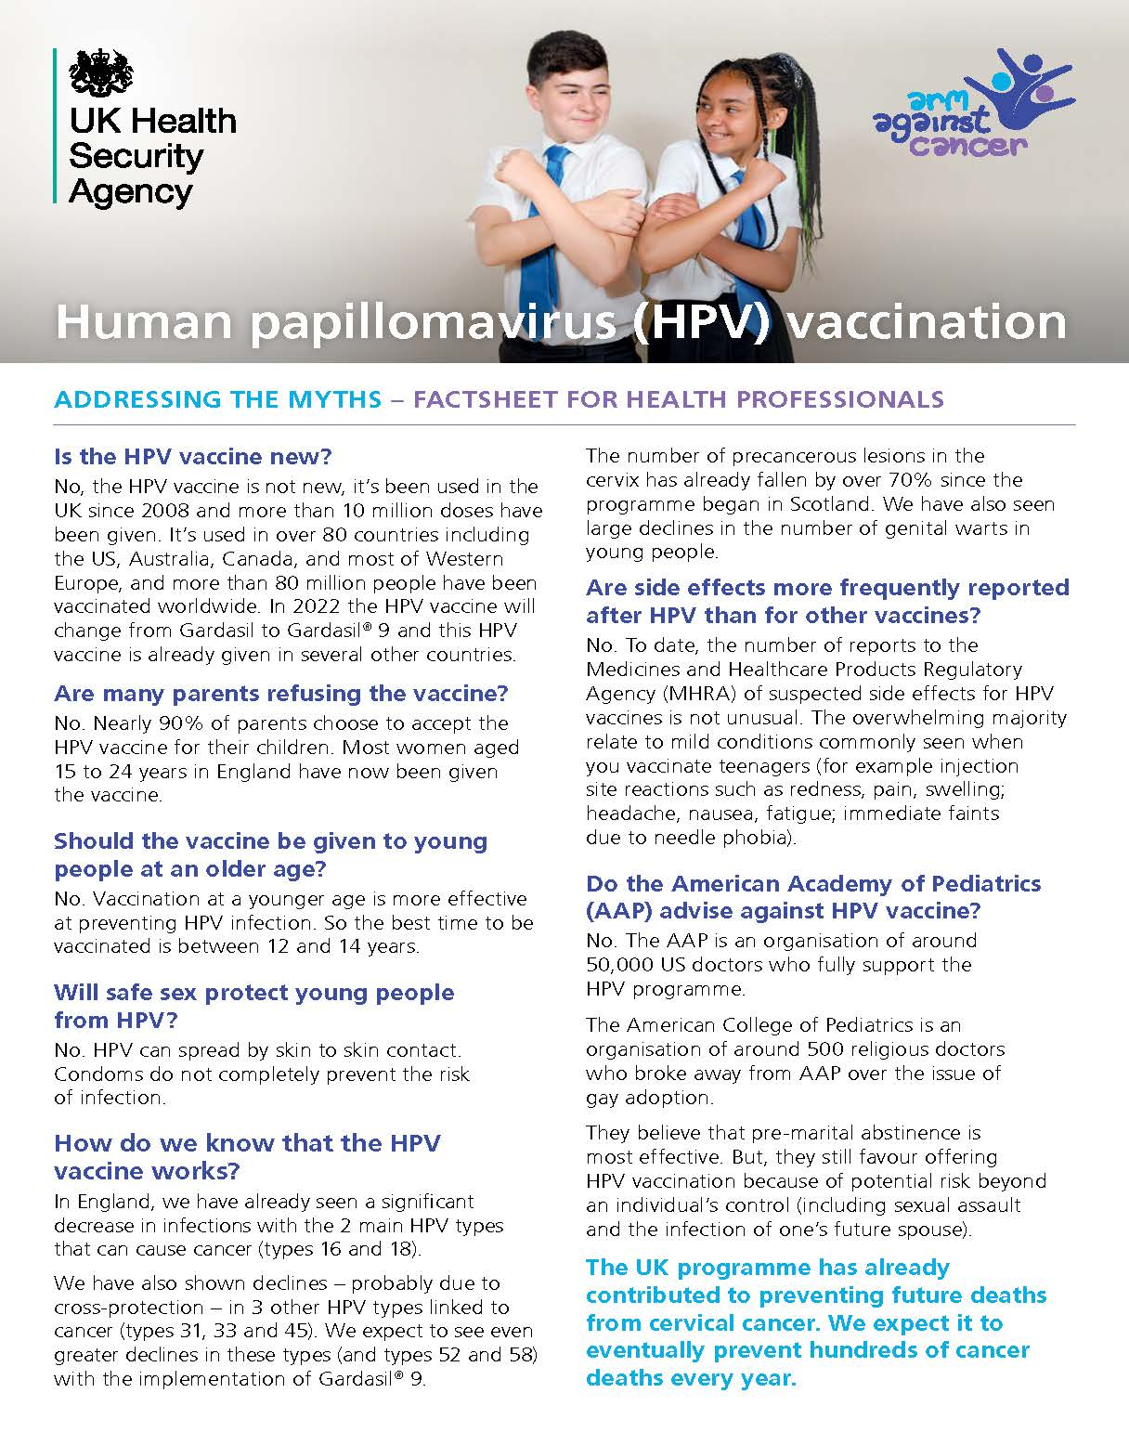
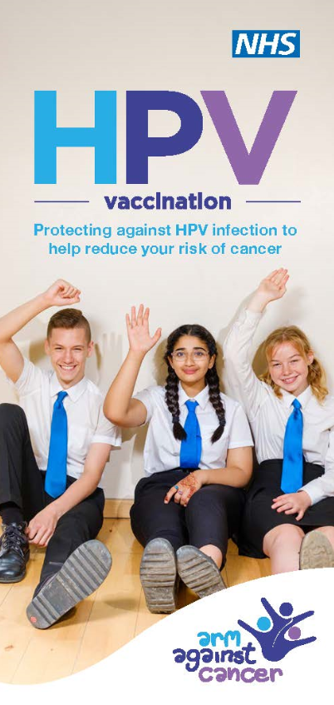
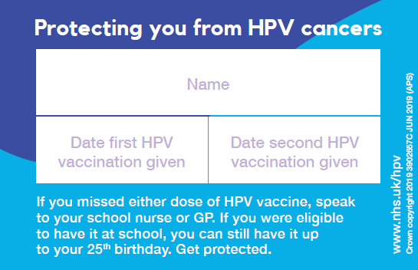
Information materials
Health professionals
Green Book HPV chapter 18a
Patient Group Direction (PGD)
factsheet
consent form
Parents and young people
posters
leaflet
record card
digital resources
Leaflets available to order at: Healthpublications.gov.uk
Notes:
www.gov.uk/government/publications/hpv-vaccine-vaccination-guide-leaflet
www.healthpublications.gov.uk/Home.html
www.gov.uk/government/publications/hpv-vaccination-and-cervical-cancer-addressing-the-myths

Slide 42
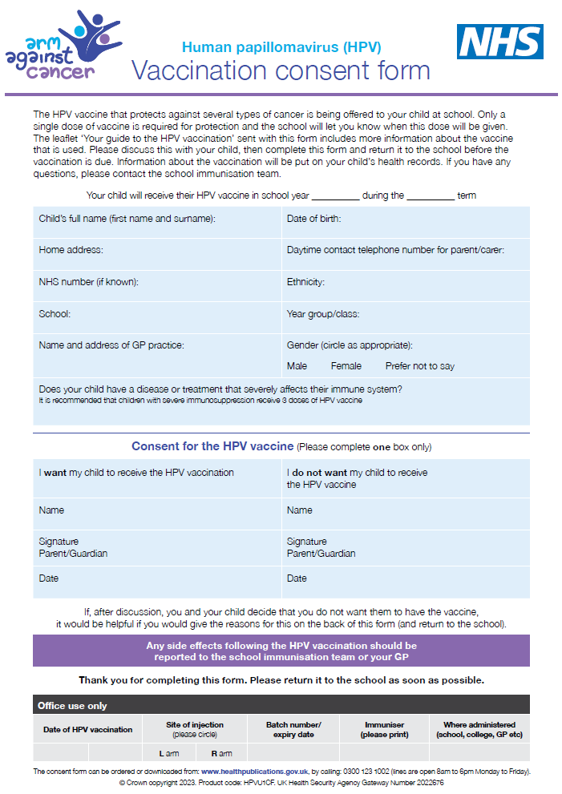
Consent form
the HPV vaccine consent form and other resources including programme guidance, vaccination record card, posters, leaflets and other programme documents can be downloaded from the HPV programme collection page on the GOV.UK website
www.gov.uk/government/publications/human-papillomavirus-hpv-vaccination-consent-form
Notes:
www.gov.uk/government/publications/human-papillomavirus-hpv-vaccination-consent-form
www.gov.uk/government/collections/hpv-vaccination-programme

Slide 43
Information resources
UKHSA and NHS England. Human Papillomavirus (HPV) Vaccination Programme: Change in schedule for the routine adolescent HPV programme and eligible men who have sex with men (MSM) under age 25 years. June 2023. www.gov.uk/government/collections/hpv-vaccination-programme
JCVI statement on a one-dose schedule for the routine HPV immunisation programme. 5 August 2022 www.gov.uk/government/publications/single-dose-of-hpv-vaccine-jcvi-concluding-advice/jcvi-statement-on-a-one-dose-schedule-for-the-routine-hpv-immunisation-programme
UKHSA Immunisation against infectious diseases The Green Book: Human papillomavirus (HPV) Chapter18a www.gov.uk/government/publications/human-papillomavirus-hpv-the-green-book-chapter-18a
HPV vaccination guidance for healthcare practitioners www.gov.uk/government/publications/hpv-universal-vaccination-guidance-for-health-professionals
Summary of Product Characteristics for Gardasil 9 www.medicines.org.uk/emc/product/7330/smpc

