Slide 1
The hexavalent DTaP/IPV/Hib/HepB combination vaccine
An update for healthcare practitioners
Updated June 2025

Slide 2
Note to trainers
this slide set contains a collection of core slides for both individual use and use or adaptation during the delivery of hexavalent DTaP/IPV/Hib/HepB immunisation training. Trainers should select the slides required depending on the background and experience of the immunisers they are training and according to the role they will have in relation to the hexavalent DTaP/IPV/Hib/HepB vaccine
the information in this slide set was correct at time of publication. From time to time, new vaccines or schedules may be introduced and current vaccines withdrawn. Updates to the slide set will be made as required, so please check online to ensure you are using the latest version
the next slide contains information on the content, which can be used to select which sections you require

Slide 3
Contents
Learning objectives 4
Pre-requisites to administering DTaP/IPV/Hib/HepB vaccines 5
Significant messages 6
The hexavalent vaccine (and introduction of the new 18-month appointment) 7
Haemophilus influenzae serotype b (Hib) 8
Hepatitis B 10
The hexavalent DTaP/IPV/Hib/HepB combination vaccine programme 19
Monitoring of vaccine coverage 37

Slide 4
Learning objectives
By the end of this session, you should be able to:
know which antigens are contained in the DTaP/IPV/Hib/HepB vaccines and be aware of the UK epidemiology
state when the DTaP/IPV/Hib/HepB vaccine is used in the UK routine immunisation schedule
describe how to correctly store, prepare and administer the hexavalent DTaP/IPV/Hib/HepB vaccines licensed in the UK
describe who should receive additional hepatitis B vaccinations as part of the selective neonatal hepatitis B immunisation programme
state when children should be vaccinated and tested as part the selective neonatal hepatitis B programme
understand the importance of timely vaccination and testing for children on the selective neonatal hepatitis B programme
communicate key facts to parents/carers about both the routine DTaP/IPV/Hib/HepB immunisation schedule and the selective neonatal hepatitis B immunisation schedule and be able to direct them to additional sources of information where required

Slide 5
Pre-requisites to administering DTaP/IPV/Hib/HepB vaccines
Before administering the hexavalent DTaP/IPV/Hib/HepB vaccine, you should have:
undertaken training in the management of anaphylaxis and Basic Life Support (BLS) (adult) as specified by the policy for your local area
undertaken any additional statutory and mandatory training as required by your employer
undertaken theoretical and practical vaccination training and been assessed as competent
undertaken specific training on the hexavalent DTaP/IPV/Hib/HepB vaccine and the UK routine immunisation schedule
accessed and familiarised yourself with the following key documents: The Green Book of immunisation against infectious disease, the UKHSA Hexavalent DTaP/IPV/Hib/HepB combination vaccine/Selective neonatal hepatitis B vaccination information for healthcare practitioners guidance and the vaccine product information in the Summary of Product Characteristics
an appropriate legal framework to supply and administer the hexavalent vaccine in place, for example a patient specific prescription, Patient Specific Direction (PSD) or Patient Group Direction (PGD)

Slide 6
Significant messages
hexavalent DTaP/IPV/Hib/HepB vaccination which includes protection against hepatitis B was introduced into the infant primary immunisation schedule in the UK from 1 August 2017
in the UK, the hexavalent vaccines Vaxelis® and Infanrix hexa® are licensed for use in the primary immunisation schedule
neither of the hexavalent vaccines are new vaccines. Both vaccines have been widely used in other countries across the world for several years
studies have shown both hexavalent vaccines to be safe and highly immunogenic for all their component toxoids or antigens
any adverse events experienced following both hexavalent vaccines are mild to moderate
the primary infant immunisation schedule is at 8,12 and16 weeks
for children born on or after 1 July 2024, a fourth dose has been introduced at 18 months of age to provide a dose of Hib-containing vaccine in the second year of life and maintain Hib control. This replaces the Hib/MenC vaccine previously given at 12 months of age
Infanrix hexa® and Vaxelis ® vaccines are considered interchangeable, but where possible and if local stock allows, it is preferable that the same DTaP/IPV/Hib/HepB vaccine be used for all 3 doses of the primary course

Slide 7
The hexavalent infant vaccine
since autumn 2017, all babies born on or after 1 August 2017 have been eligible to receive a hexavalent (6 in 1) vaccine for their primary immunisations at 8, 12 and 16 weeks
this hexavalent vaccine (DTaP/IPV/Hib/HepB) protects against diphtheria, tetanus, pertussis, poliomyelitis, hepatitis B and disease caused by Haemophilus influenzae type b (Hib)
2017 – Infanrix hexa® replaced the pentavalent (5 in 1) infant primary vaccines Infanrix®-IPV+Hib and Pediacel® and offered protection against Hepatitis B to all infants for the first time
2022 – Vaxelis® was introduced into the programme, for use in the primary immunisation schedule in addition to Infanrix hexa®
2025 – the Hib/MenC vaccine (previously given at 12 months of age) was discontinued following a commercial decision by the manufacturer. The continued need for a Hib booster during the second year of life was determined so from 1 July 2025:
  children born on or after 1 July 2024 are offered a 4th dose of hexavalent vaccine at a new 18-month appointment
  if supplies of Hib/MenC are exhausted, children born on or before 30 June 2024 should be given the hexavalent DTaP/IPV/Hib/HepB vaccine at 12 months of age (alongside their PCV13, MenB and 1st MMR)

Slide 8
Why was a 4th hexavalent dose at 18-months of age primarily to protect against Hib advised?
Hib protection is generated through a combination of direct (individual) and indirect (herd immunity) protection
all children in the UK are vaccinated against Hib at 8, 12 and 16 weeks as part of the routine immunisation schedule
in 2006, after studies showed that Hib protection waned during the second year of life, a 4th (booster) dose of Hib antigen was introduced at 12 months of age in a combined Hib/MenC vaccine
In 2022, the manufacturer of the Hib/MenC vaccine notified the JCVI of a commercial decision to discontinue the Hib/MenC vaccine. As there is no other Hib/MenC vaccine available on the UK market, JCVI discussed the changes to the routine schedule required
JCVI advised that:
    the UK has a successful adolescent MenACWY programme through which its excellent control of meningococcal C disease across the whole population can be maintained. A dose of meningococcal C containing vaccine is therefore no longer recommended in the childhood schedule at age 12 months
    there is still a continued need for a dose of Hib vaccine during the second year of life to prevent transmission in the community and maintain herd immunity
It was agreed that an additional dose of a Hib-containing vaccine (the hexavalent DTaP/IPV/Hib/HepB vaccine) should be administered at age 18 months to replace the Hib component of the Hib/MenC vaccine (Menitorix®) which was given at 12 months. This change came into effect on 1 July 2025, for children born on or after 1 July 2024

Slide 9
Use of the hexavalent vaccine in the routine childhood immunisation schedule
Routine appointment (at age) | Previous routine schedule | Routine schedule from 1 July 2024 | Changes
8 weeks | 1st DTaP/IPV/Hib/HepB 1st MenB 1st Rotavirus | 1st DTaP/IPV/Hib/HepB 1st MenB 1st Rotavirus | None
12 weeks | 2nd DTaP/IPV/Hib/HepB 1st PCV13 2nd Rotavirus | 2nd DTaP/IPV/Hib/HepB 2nd MenB 2nd Rotavirus | From 01 July 2025: Move 1st PCV13 to 16 weeks Move 2nd MenB to 12 weeks
16 weeks | 3rd DTaP/IPV/Hib/HepB 2nd MenB | 3rd DTaP/IPV/Hib/HepB 1st PCV13 | From 01 July 2025: Move 2nd MenB to 12 weeks Move 1st PCV13 to 16 weeks
one year | Hib/MenC (or DTaP/IPV/Hib/HepB if Hib/MenC no longer available) 1st MMR 2nd PCV 3rd MenB | 1st MMR 2nd PCV 3rd MenB | From 01 July 2025: Remove offer of Hib/MenC for children born on or after 01 July 2024
18 months (new appointment) |  | 4th DTaP/IPV/Hib/HepB 2nd MMR | From 01 January 2026: Introduce new 18-month appointment for 4th DTaP/IPV/Hib/HepB dose and 2nd MMR dose for children born on or after 01 July 2024
3 years 4 months | 2nd MMR dTaP/IPV | dTaP/IPV | From 01 January 2026: Move 2nd MMR dose to 18 months for children born on or after 01 July 2024
Notes:
These changes have been implemented from 1 July 2025.
Children born on or after 1 July 2024
Children born on or after 1 July 2024 will no longer be offered a Hib/MenC vaccine at 12 months of age. As they still require a dose of Hib-containing vaccine in their second year of life, these children will instead receive a 4th DTaP/IPV/Hib/HepB vaccine at a new 18-month appointment (starting 1 January 2026).
For children in this age cohort on the selective neonatal hepatitis B programme (because they are born to women living with hepatitis B), they will no longer be offered a monovalent vaccine at 12 months of age. This is because their final dose of HepB-containing vaccine is included in the hexavalent DTaP/IPV/Hib/HepB dose they will receive at 18 months of age. It is important that all children on the selective neonatal hepatitis B pathway are tested for infection at the appropriate time, ideally using the dried blood spot (DBS) test. Children born on or after 1 July 2024 should be tested at any point between one year and 18 months of age.
Children born on or before 30 June 2024
Children born on or before 30 June 2024 remain on the previous schedule and should continue to be offered their Hib/MenC vaccine at 12 months of age. However, if Hib/MenC vaccine is no longer available, children in this birth cohort should be given the hexavalent DTaP/IPV/Hib/HepB vaccine at 12 months of age (alongside their PCV13, MenB and 1st MMR)

Slide 10
What is Haemophilus influenzae serotype b (Hib)?
Hib can cause severe life-threatening disease in healthy individuals and is a major global cause of childhood meningitis, pneumonia, epiglottitis, septicaemia, cellulitis, osteomyelitis and septic arthritis
the bacteria can be carried asymptomatically in the nose and throat
most cases occur after contact with asymptomatic carriers (rather than from other cases)
transmission is airborne or occurs though droplet spread by coughing and sneezing
prior to a routine vaccination programme being introduced, most cases (over 80%) occurred in children younger than 5 years of age, with the highest attack rates in those younger than 2 years
Hib conjugate vaccine was introduced into the UK routine childhood immunisation schedule in 1992, resulting in a greater than 90% reduction in the incidence of invasive Hib disease

Slide 11
Why is a hepatitis B containing vaccine offered to all infants?
in 1992, the World Health Assembly recommended every country should have a universal hepatitis B immunisation programme
however, as the UK is a low prevalence and low incidence country for hepatitis B, introducing a universal hepatitis B programme using a monovalent hepatitis B vaccine would not have been cost-effective
the hexavalent infant combination hepatitis B-containing vaccines (which also protect against diphtheria, tetanus, polio, pertussis and Hib) became available in the UK
in 2014, the Joint Committee of Vaccination and Immunisation (JCVI) re-evaluated the benefits and cost-effectiveness of a universal hepatitis B infant immunisation programme in the UK
they subsequently recommended the use of the hexavalent DTaP/IPV/Hib/HepB combination vaccines for all infants as part of the routine immunisation programme
Children born to mothers living with hepatitis B are at risk of exposure to the virus at or around the time of birth. In addition to their routine vaccinations at 8, 12 and 16 weeks, these children require additional HepB vaccination (using a monovalent hepatitis B vaccine) as soon as possible after birth (within 24 hours), followed by a second dose at 4 weeks of age. Children born on or before 30 June 2024 will receive a third monovalent at 12 months of age. Children born on or after 1 July 2024 are on the new immunisation schedule so receive their final hepatitis B dose as part of their routine hexavalent vaccine at 18 months of age

Slide 12
What is hepatitis B?
hepatitis B is a viral infection that attacks the liver and can cause both acute and chronic disease
many new infections with hepatitis B virus (HBV) are sub-clinical or may only cause a flu-like illness
mostly asymptomatic in infants
acute HBV infection occasionally leads to sudden and severe liver damage which can be fatal
chronic HBV infection can result in progressive liver disease
this can lead to cirrhosis (development of scar tissue) and an increased risk of developing liver cancer

Slide 13
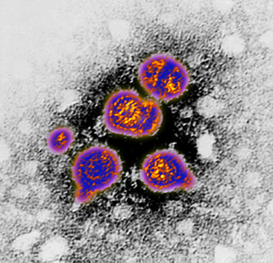
How is hepatitis B virus (HBV) transmitted?
HBV is highly transmissible through the exchange of infected blood and bodily fluids
it can survive outside the body for at least 7 days
transmission mostly occurs:
      through vaginal or anal intercourse
      as a result of blood-to-blood contact through percutaneous exposure (for example sharing of needles and other equipment by people who inject drugs or through ‘needlestick’ injuries)
      through perinatal transmission from mother to child
transmission has also followed bites from infected persons although this is rare
transfusion-associated infection is now also rare in the UK as blood donors and donations are screened

Slide 14
Hepatitis B clinical presentation
many new infections are subclinical showing no signs of infection
if symptomatic, symptoms of acute infection start insidiously and may present as flu like illness with or without mild fever or symptoms may be non-specific
anorexia, nausea, vomiting and aching in the right upper abdomen may be present
subsequent symptoms may include malaise, decreased appetite, joint pain and jaundice with progressive darkening of urine and lightening of the faeces
symptoms may last several weeks to months
in those with symptoms not suggestive of hepatitis, infection is only detected through abnormal liver function tests and/or presence of serological markers of infection, for example hepatitis B surface antigen (HBsAg)

Slide 15
Stages of hepatitis B infection
Incubation period
average incubation period is 60 to 90 days but can vary between 40 to 160 days
Infectious period
those with detectable surface antigen (HBsAg) in serum are considered able to transmit the infection to others
those who also have the e-antigen marker (HBeAg) are the most able to transmit the infection to others
Acute stage
within the first 6 months of infection
those who clear the virus during this stage will be immune for life
Chronic stage
defined as persistence of HBsAg in the serum for 6 months or longer
individuals remain able to transmit the infection to others
children less than 6 years of age who acquire hepatitis B are the most likely to develop chronic infection

Slide 16
Treatment and prevention
no specific treatment is available for acute hepatitis B
supportive treatment may be indicated for severe clinical manifestations, for example replacement of fluids lost from vomiting and diarrhoea
chronic hepatitis B infection can be treated with oral antivirals which can slow the progression of cirrhosis, reduce incidence of liver cancer and improve long term survival
hepatitis B vaccination is the most effective prevention
a completed course of vaccine induces protective antibody levels in more than 95% of infants, children and young adults
protection lasts at least 20 to 30 years
the vaccine has an excellent record of safety and effectiveness
by the end of 2023, 190 countries had introduced nationwide hepatitis B vaccination for infants. However, some countries have adopted selective vaccination strategies that target only high-risk individuals

Slide 17
Hepatitis B epidemiology: England
England is a very low-prevalence country for HepB: in 2022 there were about 270,000 people living with hepatitis B in the country (0.6% of the population)
prevalence varies across the country with 1.5% of the population in London estimated to be living with hepatitis B in 2022
higher prevalence in those born in high-endemicity countries, many of whom will have acquired infection at birth or in early childhood
incidence of acute infection is low but is higher among those with certain behavioural or occupational risk factors

Slide 18
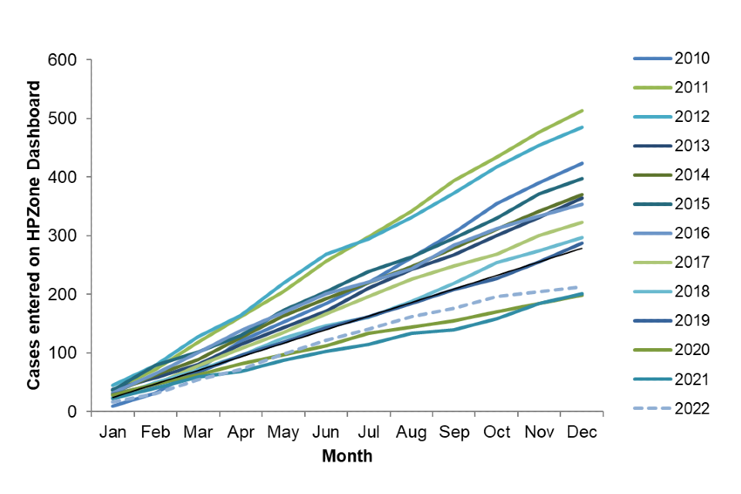
Cumulative cases of acute hepatitis B in England: 2010 to December 2022
UKHSA Acute hepatitis B: national enhanced surveillance report January to December 2022

Slide 19
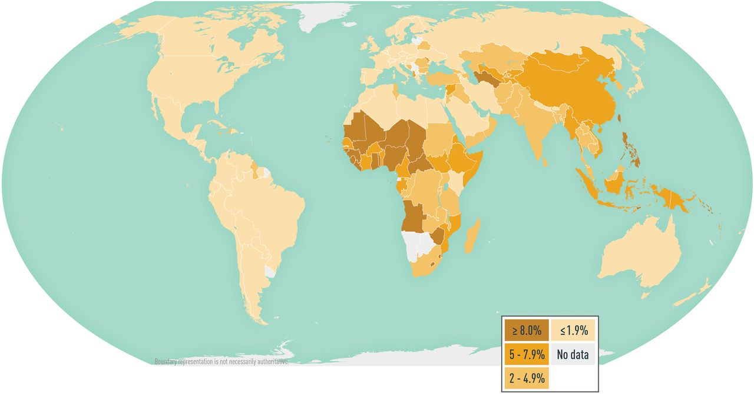
Global prevalence of hepatitis B virus infection
Globally, hepatitis B is one of the most common infectious diseases – WHO estimates around 257 million people worldwide are chronically infected
Source: CDC Health Information for International Travel 2024
Notes:
Hepatitis B is a disease of global public health importance. The World Health Organization (WHO) estimate that 257 million people are living with hepatitis B virus infection (defined as hepatitis B surface antigen positive).
In 2015, hepatitis B resulted in 887 000 deaths, mostly from complications (including cirrhosis and hepatocellular carcinoma).
The prevalence of disease varies by country. The WHO has categorised countries based upon the prevalence of HBsAg into high (more than 8%), intermediate (2 to 8%) and low (less than 2%) endemicity countries. In many high-prevalence countries, 10% or more of the population have chronic hepatitis B infection. High-prevalence regions include sub-Saharan Africa, most of Asia and the Pacific islands. Intermediate-prevalence regions include the Amazon, southern parts of Eastern and Central Europe, the Middle East and the Indian sub-continent. Low-prevalence regions include most of Western Europe and North America.

Slide 20
The hexavalent DTaP/IPV/Hib/HepB combination vaccine programme

Slide 21
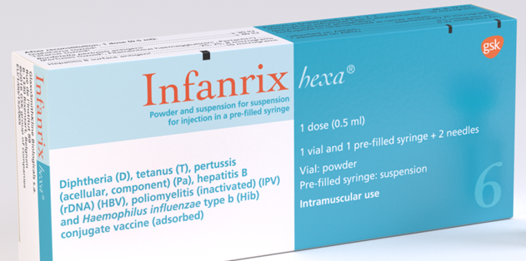
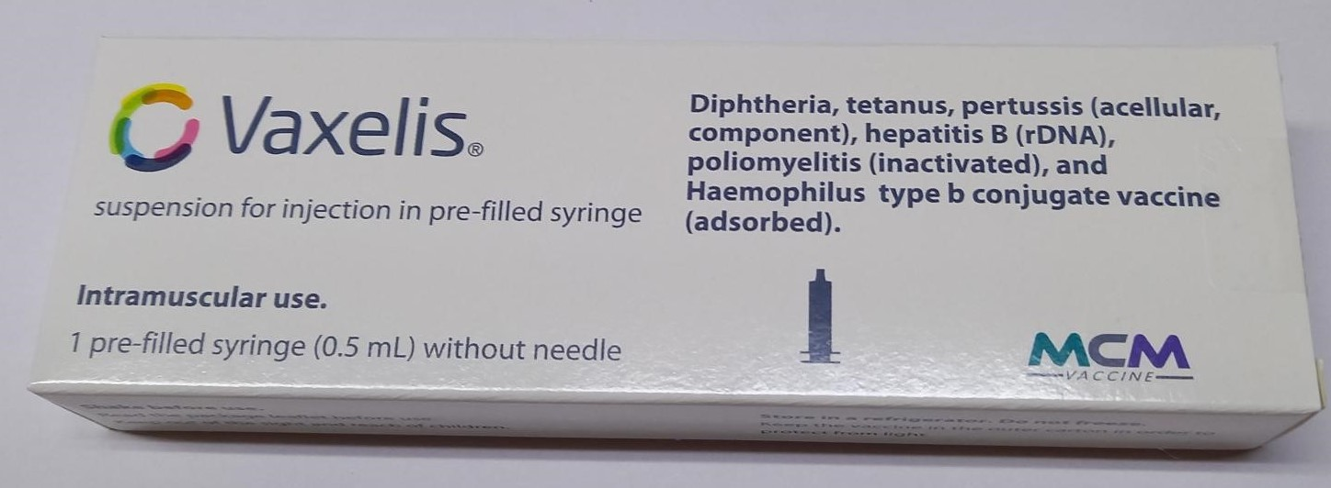
The hexavalent vaccines
brand name: Infanrix hexa®
brand name: Vaxelis ®
both vaccines are licensed for use from 6 weeks of age
routinely recommended for infants as part of the primary immunisation schedule at 8,12 and 16 weeks
from 1 July 2025, all children born on or after 1 July 2024 should be routinely offered a 4th hexavalent dose at a new 18-month appointment. (This replaces the Hib/MenC vaccine previously offered at the 12-month appointment)
Infanrix hexa® and Vaxelis® vaccines are considered interchangeable, but where possible and if local stock allows, it is preferable that the same DTaP/IPV/Hib/HepB vaccine be used for all 3 doses of the primary course
(however, vaccination should never be delayed because the vaccine used for previous doses is not known or unavailable)

Slide 22
Who is eligible to receive the hexavalent vaccines?
all babies are eligible to receive hexavalent vaccine 8 weeks after their birth
Infanrix hexa® and Vaxelis ® can also be used for catch-up immunisation for children up to their 10th birthday where these children have missed out on doses of primary immunisations
hexavalent vaccine for the routine immunisation programme is available to order online through the ImmForm website
vaccines are distributed by Movianto UK for the use in the routine childhood immunisation schedule
Notes:
Children born on or before 30 June 2024 remain on the previous schedule and should continue to be offered their Hib/MenC vaccine at 12 months of age. However, if Hib/MenC vaccine is no longer available, children in this birth cohort should be given the hexavalent DTaP/IPV/Hib/HepB vaccine at 12 months of age (alongside their PCV13, MenB and 1st MMR)

Slide 23
Safety and efficacy of the hexavalent vaccines
The safety profile of both hexavalent vaccines is excellent, and any adverse events experienced are generally mild to moderate in severity.
These may include redness, swelling and tenderness at the injection site, fever, sleepiness, irritability, loss of appetite, diarrhoea and vomiting.
Results from clinical trials show that nearly all infants given the 3-dose primary vaccination course of Infanrix hexa® at 2, 3 and 4 months of age develop protective levels of antibodies against diphtheria (100%), tetanus (100%), pertussis (100%), hepatitis B (99.5%), polio (97.8% to 100%) and Hib (96.4%).
Studies also show that when a further (4th) dose is given during the second year of life, protective levels of antibodies against all components are seen one month after receiving the dose in at least 98.4% of cases.
Similar levels of protection were seen with Vaxelis ® where protective levels of antibodies against diphtheria (99.8%), tetanus (100%), pertussis (varies by component), hepatitis B (97.8%), polio (99.8% to 100%) and Hib (98%) were seen one month after completing the 3-dose primary vaccination schedule.

Slide 24
Vaccine scheduling
the primary infant immunisation schedule remains unchanged at 8, 12 and 16 weeks of age
from 1 July 2025, children born on or after 1 July 2024 are due an additional dose of hexavalent at 18 months of age. This is to replace the Hib/MenC vaccine previously given at 12 months of age
the first dose of the hexavalent vaccine can be given from 6 weeks if required in exceptional circumstances (for example travel to an endemic country) but not before
the minimum interval between doses of the hexavalent vaccine is 4 weeks
the hexavalent vaccines can be administered at the same time as, or at any time before or after, any other vaccine
if primary course is interrupted, resume but don’t repeat, allowing an interval of 4 weeks between the remaining doses
the hexavalent vaccines should be given to premature infants at the appropriate chronological age, according to the schedule
booster doses of hepatitis B will not usually be required for children vaccinated according to the routine childhood schedule, however children born to women living with hepatitis B will require additional monovalent hepatitis B vaccines at birth and 4 weeks of age

Slide 25
Contraindications
There are very few individuals who cannot receive the hexavalent vaccines.
Infanrix hexa® and Vaxelis ® should not be administered to those who have had:
a confirmed anaphylactic reaction to a previous dose of the vaccine OR
a confirmed anaphylactic reaction to any component of the vaccine (this includes formaldehyde, neomycin and polymyxin)
Where there is doubt, instead of withholding immunisation, appropriate advice should be sought from a consultant with immunisation expertise or a member of the local screening and immunisation team.

Slide 26
Precautions
if infant has a minor illness without fever or systemic upset, immunisations can still be given
if the infant is acutely unwell (for example fever above 38.5⁰C), immunisation may be postponed until they have fully recovered. This is to avoid wrongly attributing any new symptom or the progression of symptoms to the vaccine
the presence of a neurological condition is not a contraindication to immunisation but if evidence of current neurological deterioration, deferral of DTaP/IPV/Hib/HepB vaccination may be considered to avoid incorrect attribution of any change in the underlying condition
risk of deferral should be balanced against risk of infection and vaccination should be given promptly once diagnosis and/or expected course of the condition becomes clear

Slide 27
Premature infants
very premature infants (born ≤ 28 weeks of gestation) who are in hospital should have respiratory monitoring for 48 to 72 hrs when given their first immunisation, particularly those with a previous history of respiratory immaturity
if the premature infant has apnoea, bradycardia or desaturations after the first immunisation, the second immunisation should also be given in hospital, with respiratory monitoring for 48 to 72 hrs
if the premature infant was stable at discharge and has no complex medical or/and apnoea/respiratory compromise, further vaccinations can be given in the community setting

Slide 28
Systemic and local reactions following a previous immunisation
Children who have had a systemic or local reaction following a previous immunisation with DTaP/IPV/Hib/HepB or DTaP/IPV/Hib, including:
fever, irrespective of its severity
hypotonic-hyporesponsive episodes (HHE)
persistent crying or screaming for more than 3 hours, or
severe local reaction, irrespective of extent
can continue to receive subsequent doses of DTaP/IPV/Hib/HepB vaccine

Slide 29
Infanrix hexa® vaccine composition
After reconstitution, one dose (0.5 ml) contains:
Diphtheria toxoid
Tetanus toxoid
Bordetella pertussis antigens
  Pertussis toxoid (PT)
  Filamentous Haemagglutinin (FHA)
  Pertactin (PRN)
Hepatitis B surface antigen (HBsAg)
Poliovirus (inactivated) (IPV)
  type 1 (Mahoney strain)
  type 2 (MEF-1 strain)
  type 3 (Saukett strain)
Haemophilus influenzae type b polysaccharide (polyribosylribitol phosphate, PRP)
  conjugated to tetanus toxoid as carrier protein
Adjuvants:
Aluminium hydroxide, hydrated (Al(OH)3)
Aluminium phosphate (AlPO4)
Excipients:
Lactose anhydrous
Sodium chloride (NaCl)
Medium 199 containing principally amino acids, mineral salts, vitamins
Water for injections
The vaccine may contain traces of formaldehyde, neomycin and polymyxin which are used during the manufacturing process.

Slide 30
Vaxelis® vaccine composition
Adjuvants:
Amorphous aluminium hydroxyphosphate sulfate
Aluminium phosphate
Pre-filled syringe, one dose (0.5 ml) contains:
Diphtheria toxoid
Tetanus toxoid
Bordetella pertussis antigens
  Pertussis toxoid (PT)
  Filamentous Haemagglutinin (FHA)
  Pertactin (PRN)
  Fimbriae Types 2 and 3 (FIM)
Hepatitis B surface antigen (HBs)
Poliovirus (inactivated) (IPV)
  type 1 (Mahoney strain)
  type 2 (MEF-1 strain)
  type 3 (Saukett strain)
Haemophilus influenzae type b polysaccharide (polyribosylribitol phosphate, PRP)
  conjugated to meningococcal protein
The vaccine may contain traces of glutaraldehyde, formaldehyde, neomycin, streptomycin, polymyxin B, and bovine serum albumin which are used during the manufacturing process. Vaxelis® does not contain any thiomersal or porcine gelatine.

Slide 31
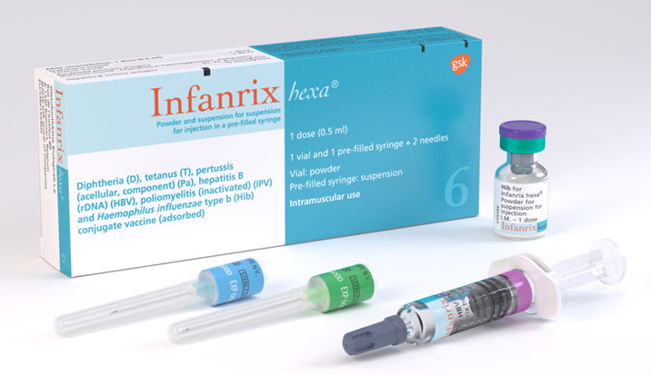
How is Infanrix hexa® vaccine presented?
the DTaP/IPV/HepB component is presented as a cloudy white suspension in a pre-filled glass syringe. Upon storage, a clear liquid and a white deposit may be observed
the lyophilised (freeze dried) Hib vaccine is presented as a white powder in a glass vial
the vaccine is supplied in single dose packs containing the syringe, vial and 2 needles
the vaccine is reconstituted by adding the entire contents of the pre-filled syringe to the vial containing the powder.
the mixture should be well shaken until the powder is completely dissolved prior to administration
the reconstituted vaccine appears as a slightly cloudier suspension than the liquid component alone. This is a normal observation.
after reconstitution, it is recommended that the vaccine is used immediately
Full instructions for vaccine preparation are available in the SPC
Do not forget to reconstitute the Hib component

Slide 32
How is Vaxelis® vaccine presented?
the DTaP/IPV/HepB/Hib component is presented as a uniform, cloudy, white to off-white suspension in a pre-filled glass syringe
prior to administration, the pre-filled syringe should be shaken gently in order to obtain a homogeneous, whitish, cloudy suspension
the suspension should be visually inspected, prior to administration, for foreign particulate matter and/or variation of physical appearance. If either is observed, discard the pre-filled syringe
Vaxelis does not require reconstitution – it is supplied ready to use
Full instructions for vaccine preparation are available in the SPC

Slide 33
Storage of the hexavalent vaccines
Infanrix hexa® and Vaxelis® should be stored between +2⁰C to +8⁰C
the vaccine must be stored in its original packaging to:
      protect it from light
      ensure the component parts are kept together
      retain the batch number and expiry date for the entire product which is printed on the outer vaccine carton

Slide 34
Legal administration of the hexavalent vaccines
Infanrix hexa® and Vaxelis ® should only be supplied and administered:
  against a prescription written manually or electronically by a registered medical practitioner or other authorised prescriber
  against a patient specific direction
  against a patient group direction (PGD)
The PGD template for the hexavalent vaccine is available on the UKHSA website.
    Those using national immunisation PGDs developed by UKHSA must ensure that each PGD is organisationally authorised and signed in Section 2 by an appropriate authorising person, in accordance with Human Medicines Regulations 2012 (HMR2012). Without such authorisation, the PGD is not legal or valid.

Slide 35
Administration of the hexavalent vaccines
Infanrix hexa® and Vaxelis® should be administered intramuscularly
the preferred site of injection for infants under one year of age is the anterolateral aspect of the thigh
should it be necessary to give more than one vaccine into the same limb, they should be given at least 2.5cm apart and the site at which each vaccine was given should be noted in the infant’s records

Slide 36
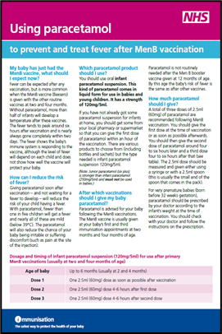
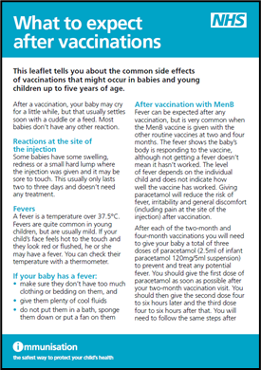
Post-immunisation care recommendations
when MenB is given alongside infant DTaP-containing combination vaccines, the rate of fever is higher than when either vaccine is administered alone
in the UK schedule from 1 July 2025, infants receive MenB vaccine the same time as the DTaP/IPV/Hib/HepB vaccine at 8 and 12 weeks of age
it is recommended that prophylactic paracetamol is given soon after infants receive their vaccinations when MenB vaccine is given at the same appointment as the hexavalent vaccine
please see MenB vaccine and paracetamol information and What to expect after vaccinations leaflet on the GOV.UK immunisation webpage for more information

Slide 37


Possible adverse reactions
most commonly reported (seen in more than one in 10 doses of the vaccine):
  loss of appetite, fever (>38ºC), abnormal crying, irritability and restlessness
  local swelling, pain and redness at the injection site
hypersensitivity reactions such as angioedema, urticaria and anaphylaxis can occur but are rare, as can convulsions (with or without fever) and hypotonic-hyporesponsive episodes (also rare)
suspected adverse reactions should be reported to the MHRA using the Yellow Card reporting scheme at https://yellowcard.mhra.gov.uk/
any adverse reaction should also be documented in accordance with local procedures
The QR code can be used for quick and easy access to the Yellow Card reporting site

Slide 38
Routine monitoring of vaccine coverage
hexavalent vaccine coverage is monitored routinely through the COVER programme alongside all other childhood immunisations COVER data are extracted from Child Health Information Systems (CHIS) at the local authority level and published quarterly as official statistics
Routine childhood programme COVER data:
percentage of eligible children in the local authority who have completed a primary course (4 doses), anytime up to 24 months of age and their fifth birthday
Selective neonatal hepatitis B programme COVER data:
percentage of eligible children in the local authority who have received 6 doses of HepB-containing vaccine anytime up to 24 months of age

Slide 39
Local monitoring of vaccine coverage data
hexavalent and monovalent HepB vaccine coverage will also be monitored via ImmForm
aggregated GP-level data will be extracted to monitor dose-specific coverage at an earlier age than the routine COVER programme
this data is for local performance-management purposes only and will not be published
Routine childhood programme ImmForm GP data:
hexavalent vaccine coverage for 1, 2 and 3 doses evaluated at 6 months of age
hexavalent vaccine coverage for 1, 2, 3 and 4 doses evaluated at 18 months and 24 months of age
Selective ‘at-risk’ infants programme ImmForm GP data:
HepB vaccine coverage for 1 and 2 doses at 5 and 9 weeks of age
AND
percentage who were tested for HBsAg at 18 months

Slide 40
Neonatal selective immunisation programme for babies at risk of hepatitis B

Slide 41
Implications for babies born to women living with hepatitis B
babies born to mothers living with chronic hepatitis B or who have had acute hepatitis B during pregnancy are at risk of acquiring hepatitis B virus (HBV)
objective of the selective neonatal hepatitis B vaccination programme is to provide post exposure immunisation to infants born to women living with hepatitis B to prevent perinatal transmission at or around the time of birth
although hepatitis B vaccine is included in the routine childhood schedule, pregnant women are also offered hepatitis B screening in pregnancy. Maternal screening:
      remains essential to identify unborn babies at risk of infection
      identifies infants at high risk because they are born to women with hepatitis B so that they can receive additional monovalent doses of HepB vaccine at birth followed by a dose at 4 weeks of age.(Children born on or before 30 June 2024 will receive a third monovalent at 12 months of age. Children born on or after 1 July 2024 are on the new immunisation schedule so receive their final hepatitis B dose as part of their routine hexavalent vaccine at 18 months of age)

Slide 42
Why do we need the selective neonatal immunisation programme if all infants routinely receive HepB vaccine?
HBV infection can be transmitted from women living with hepatitis B to their babies at or around the time of birth
babies acquiring infection at this time have a high risk of becoming chronically infected with the virus
over 90% of chronic infection from perinatal transmission in infants born to women with hepatitis B can be prevented by appropriate post-exposure vaccination starting at birth
timely vaccination at birth and at 4 weeks of age is critical to preventing infant infection
the dose that is given to all babies at 8 weeks of age (as part of the universal routine programme) would be too late to prevent infection in those born to women living with hepatitis B following exposure to the hepatitis B virus at or around birth

Slide 43
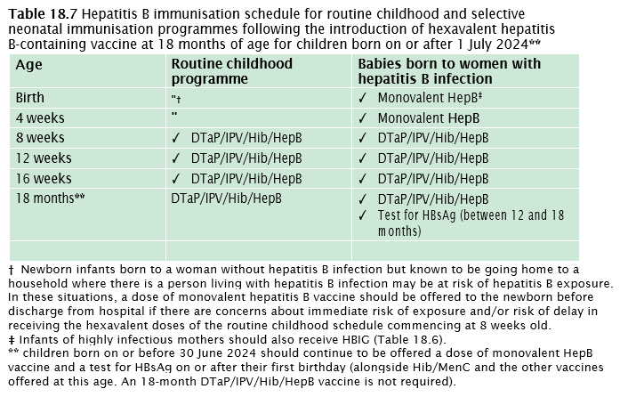
Hepatitis B vaccine schedule for the routine and selective neonatal immunisation programmes
Source: the Green Book, hepatitis B

Slide 44
Blood tests for children on the selective neonatal hepatitis B programme
although hepatitis B vaccine is highly effective at preventing infection if given at birth, a very small number of infants may still acquire infection despite vaccination and immunoglobulin
testing high risk infants at one year to 18 months of age is important to enable timely assessment of their infection status
a dry blood spot (DBS) test is available for free from UKHSA. This is a simple heel-prick test that can be performed in primary care and removes the need for the child to attend a paediatric phlebotomy clinic
finding out if the child has acquired hepatitis B infection at this point can reduce risk of long-term complications and disease in later life
the purpose of the one year to 18-month blood test is to check for infection (HBsAg), not to check or measure response to the vaccine
numerous studies have already demonstrated that infants make a protective response to a course of hepatitis B given in the first year of life
more information on blood testing available at www.gov.uk/guidance/hepatitis-b-dried-blood-spot-dbs-testing-for-infants

Slide 45
Sources of information

Slide 46
Resources available
Hexavalent DTaP/IPV/Hib/HepB information for healthcare practitioner guidance
Hepatitis B Green Book chapter 18
Patient Group Direction (PGD) template for the hexavalent vaccines
Summary of Product Characteristics for Infanrix hexa®
Summary of Product Characteristics for Vaxelis ®
Immunisation information for healthcare practitioners
Guidance on the hepatitis B antenatal screening and selective neonatal immunisation pathway

