Slide 1
The measles, mumps and rubella (MMR) vaccination programme
Notes:
This resource is designed to be used by anyone involved in advising on or delivering any aspect of the national vaccination programme.
This may include:
Care navigators and other staff scheduling appointments for vaccination
all staff advising on MMR vaccine
all staff responsible for vaccine ordering and storage
all staff administering vaccines
If this slide set is to be used for the delivery of training, not all slides will be required. Trainers should select slides depending on audience background, their role in the vaccination programme and the length of training session.

Slide 2
Aims of resource
The aims of this resource are to:
refresh the knowledge base of healthcare practitioners regarding MMR vaccine and the diseases against which it protects
support those who advise on or administer MMR vaccine by providing evidence based information
promote high coverage of MMR vaccine in those eligible by providing examples of initiatives to increase vaccine uptake
Notes:
Key roles for those who advise on or deliver the MMR vaccination programme are as follows. To:
understand the evidence base for the administration of the MMR vaccination
understand how the vaccine works and what vaccines are used
schedule appointments with the correct intervals between doses
provide individuals and/or parents/carers of those who are eligible to receive the MMR vaccine with the information necessary for them to provide informed consent
safely administer MMR vaccine
provide individuals and/or parents/carers with post vaccination advice and signpost to other sources of information
ensure those eligible to receive the vaccine can do so
understand why high vaccine coverage is required

Slide 3
Learning outcomes
On completion of this resource, users should be able to:
describe the cause, transmission, clinical presentation, course and possible complications of measles, mumps and rubella infections
understand the impact of reduced vaccination uptake
describe the available MMR vaccines, their possible side effects and the precautions and contraindications to their administration
explain the dose, schedule and eligibility for MMR vaccines
understand the importance of promoting, and providing evidence based information about MMR vaccination to the public, and be confident about doing so
identify additional professional resources and sources of public-facing information
Notes:
On completion of this resource, users should meet the stated learning outcomes. They should also be able to access the sources of additional information and know how to keep up to date with any programme changes.

Slide 4
MMR vaccination programme overview
MMR vaccine was introduced as a routine single dose schedule in 1988 and became a 2 dose schedule in 1996
the aims of the programme are to:
interrupt the spread of the diseases
reduce associated morbidity and mortality
eliminate measles and rubella from the UK population
MMR vaccine is recommended from 1 year of age as part of the routine childhood vaccination programme
infants from 6 months of age may be offered MMR vaccine as post exposure prophylaxis for measles
achieving high coverage of 2 doses of MMR vaccine is the most effective way to control measles, mumps and rubella
the burden of disease fall disproportionately on under-served communities and addressing health inequalities is therefore a key element of any drive to improve uptake and eliminate measles and rubella

Slide 5
Measles

Slide 6
Measles
measles is a highly infectious, acute, systemic viral illness caused by a morbillivirus of the paramyxovirus family
it is transmitted through the respiratory route (airborne or droplet spread) or by direct contact with the nasal or throat secretions of infected persons and is the most infectious of all diseases transmitted through the respiratory route; transmission is high amongst household contacts and other individuals with prolonged close contact
measles can be very debilitating for very young infants, adults, immunosuppressed individuals and pregnant women - who are more likely to develop complications and require hospitalisation
cases of measles are most common in children, although it can affect any age group
the incubation period is around 10 days (range 7 to 21 days)
the infectious period begins from about 4 days before the first symptoms appear (prodromal period) and lasts up to 4 days after the onset of the rash
Notes:
The following features are strongly suggestive of measles:
● rash for at least three days
● fever for at least one day, and
● at least one of the following – cough, coryza or conjunctivitis

Slide 7
Clinical course of measles
Signs and symptoms:
fever
cough
coryza
conjunctivitis
erythematous, maculopapular rash: a red blotchy rash, normally starting from the head and spreading to the trunk and limbs
malaise (irritable/ miserable child)
Day of illness
Temperature
40ºC
1
2
3
4
5
6
7
8
9
10
39ºC
38ºC
37ºC
Fever
Rash
Koplik’s spots
Conjunctivitis
Cold symptoms
Cough
10-12 days Incubation
phase
Prodromal
phase
Convalescent
phase
Rash phase
Notes:
The clinical course of measles typically begins with a prodromal phase which presents as a 2 – 4 day illness. Symptoms may include fever, which usually peaks around the time of rash onset and gradually decreases after that. Other symptoms include cough, coryzal symptoms and conjunctivitis which are more specific symptoms and can help to differentiate measles infection from other respiratory infections.
Laboratory confirmation of all suspected cases of measles is required (see later slide).

Slide 8
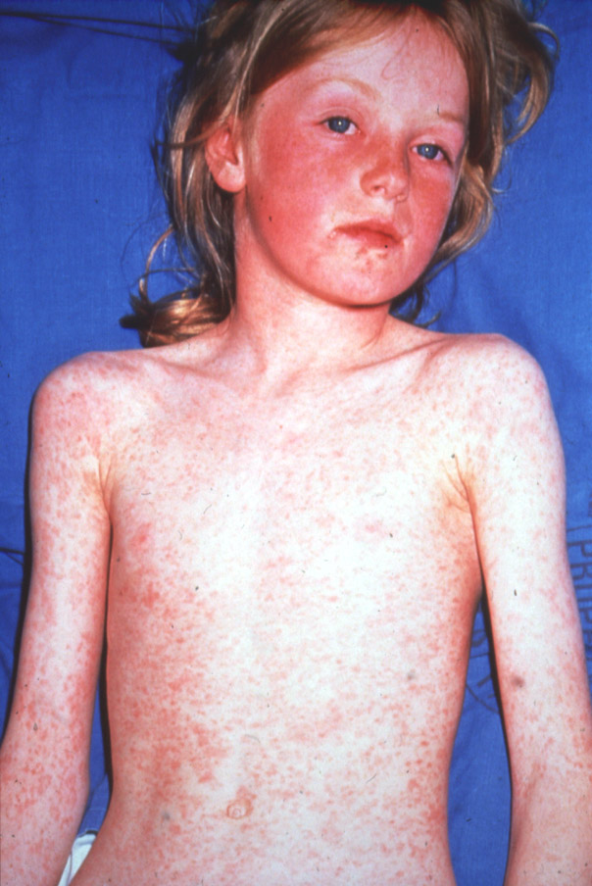
Measles rash and Koplik spots
Notes:
The measles rash presents as an erythematous, maculopapular rash and typically starts behind the ears and on the face.
The number of spots increase over a period of approximately 2 – 3 days and the distribution of them gradually expands, in some cases becoming confluent, particularly on the face and trunk although a more generalised rash can also be seen. The rash is not itchy and is non-vesicular. It usually presents as a red, blotchy, maculopapular rash and gradually fades over a 3 - 7 day period.
Koplik spots may sometimes appear on the buccal mucosa the day before the rash and can last for 2 – 3 days after the rash appears. These spots present as small white or bluish white lesions and are around 2mm – 3mm is diameter.

Slide 9
Measles complications
complications are more common and more severe in young infants and adults, immunosuppressed individuals and during pregnancy
historically, death occurred in one in 5,000 cases (100s of cases a year before immunisation was introduced); between 2000 and 2020, there were 8 deaths in children or adults in England and Wales that could have been prevented by the UK national immunisation programme, i.e., the infection was acquired in England or Wales and the individuals were eligible for a measles-containing vaccine in this country
complications include pneumonia (1-6%), otitis media (7-9%) and diarrhoea (8%)
there can also be a temporary reduction in the immune response for a few weeks following measles infection; this can increase the risk of severe secondary bacterial and viral infections.
secondary bacterial infections can lead to complications such as tracheobronchitis and pneumonia
encephalitis is rare (0.05% to 0.1% of cases)
a very rare but fatal neurological complication, called sub acute sclerosing panencephalitis (SSPE), is caused when measles virus establishes chronic infection in the brain. It happens in about one in every 25,000 cases (1 in 8,000 if aged under 2 years). This is a progressive illness with neuro-cognitive symptoms and in most cases leads to coma and death
Notes:
Measles notifications and deaths in England and Wales: 1940 to 2020 - GOV.UK (www.gov.uk)

Slide 10
National measles guidance
National measles guidance on the public health management of cases and contacts: https://www.gov.uk/government/publications/national-measles-guidelines
Measles Post Exposure Prophylaxis guidance: https://www.gov.uk/government/publications/measles-post-exposure-prophylaxis
Viral rash in pregnancy guidance: https://www.gov.uk/government/publications/viral-rash-in-pregnancy
Measles Green Book Chapter: https://www.gov.uk/government/publications/measles-the-green-book-chapter-21

Slide 11
Historical measles epidemiology and measles vaccine coverage
UK coverage of measles vaccination and measles notifications from 1950 to 2022
Notes:
Detail on following slides.
Measles and rubella elimination UK strategy January 2019
Measles and rubella elimination UK strategy - GOV.UK (www.gov.uk) https://www.gov.uk/government/publications/measles-and-rubella-elimination-uk-strategy

Slide 12
History of measles and the MMR vaccination programme in UK
1940: measles became a notifiable disease
1940 - 1968: 160,000 - 800,000 cases and ~100 deaths per year; peaks every 2 years
1968: measles vaccine introduced
1988: single dose of MMR vaccine introduced - coverage in excess of 90%, reducing transmission; case numbers fell to very low levels
1996: a second dose of MMR vaccine was added to the routine programme to maintain the control of measles; high coverage achieved and endemic transmission was interrupted
to achieve measles elimination, 95% uptake with 2 doses of the MMR vaccine across all age cohorts is needed

Slide 13
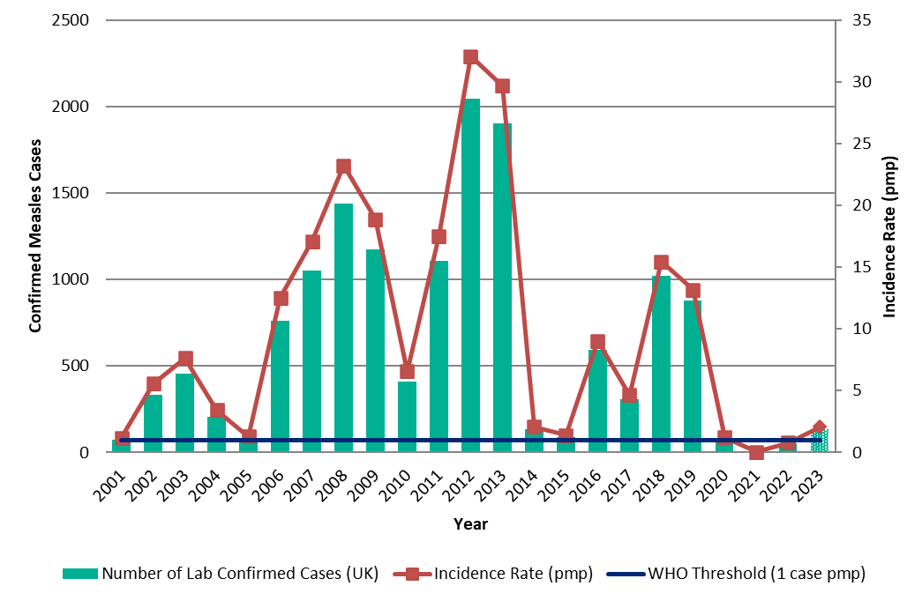
Annual number of laboratory confirmed measles cases and incidence from 2001 to 2023*
* 2023 data is provisional and only include cases up until June)

Slide 14
Confirmed measles cases 2023
Case numbers began to rise from October 2023 and a National Standard Incident was declared (see slides 58 and 59)
Notes:
1. Cases confirmed through either local or reference laboratory testing
2. Data for the past 4 weeks are provisional and subject to confirmation in the reference laboratory and are therefore depicted as dotted lines. One previously confirmed case was discarded through further testing and epidemiological analysis.
Confirmed cases of measles in England by month, age and region: 2023 - GOV.UK (www.gov.uk)

Slide 15
Mumps

Slide 16
Mumps
mumps is an acute, systemic viral illness that is moderately infectious. It is caused by the paramyxovirus, is spread in infected droplets of saliva and leads to swelling of the parotid glands
transmission occurs through direct close contact with nose and throat secretions, such as when an infected person sneezes or coughs, and the infectious period usually begins 2 days before parotid swelling until 5 days after
the incubation period is between 14 and 25 days with an average of around 17 days
most cases of mumps now occur in young adults between the ages of 16 and 30. Prolonged close contact in schools and universities provides ideal conditions for the infection to spread
cases of mumps are common in non-immune children, although several countries see outbreaks in partially vaccinated adolescents and adults
Mumps is vaccine preventable. Around 88% of people who have 2 doses of the MMR vaccine will be protected against mumps. People who are vaccinated against mumps, but still catch it, but are less likely to have serious complications or be admitted to hospital

Slide 17
Mumps symptoms
early symptoms include a headache and fever
characterised by swelling of the parotid glands which may be 1 or 2 sided.
Photo courtesy of CDC

Slide 18
Mumps complications
Mumps is rarely fatal. Serious complications are also rare but can include swelling of the ovaries (oophoritis), swelling of the testes (orchitis), aseptic meningitis, pancreatitis, neuritis, arthritis, mastitis, nephritis, thyroiditis, pericarditis and bilateral or unilateral deafness (usually transient).
Although there is no evidence that it causes foetal abnormalities, mumps in the first trimester of pregnancy may increase the rate of spontaneous abortion.

Slide 19
Mumps in England and Wales
mumps became a notifiable disease in 1988 with the introduction of MMR vaccine
before this mumps commonly occurred in school age children and was the most common cause of viral meningitis in children with 1,200 hospital admissions each year
more than 85% of adults had evidence of previous mumps infection
in 1988 a single dose of the combined measles, mumps and rubella (MMR) vaccine was introduced achieving excellent coverage in excess of 90% and notifications fell dramatically
recent epidemiology: In 2019 there was a steep rise in mumps cases largely driven by outbreaks in universities and colleges. Many of the cases in 2019 were seen in the so-called ‘Wakefield cohorts’ – young adults born in the late nineties and early 2000s who missed out on the MMR vaccine when they were children. The COVID-19 pandemic interrupted transmission and mumps activity has been very low since then

Slide 20
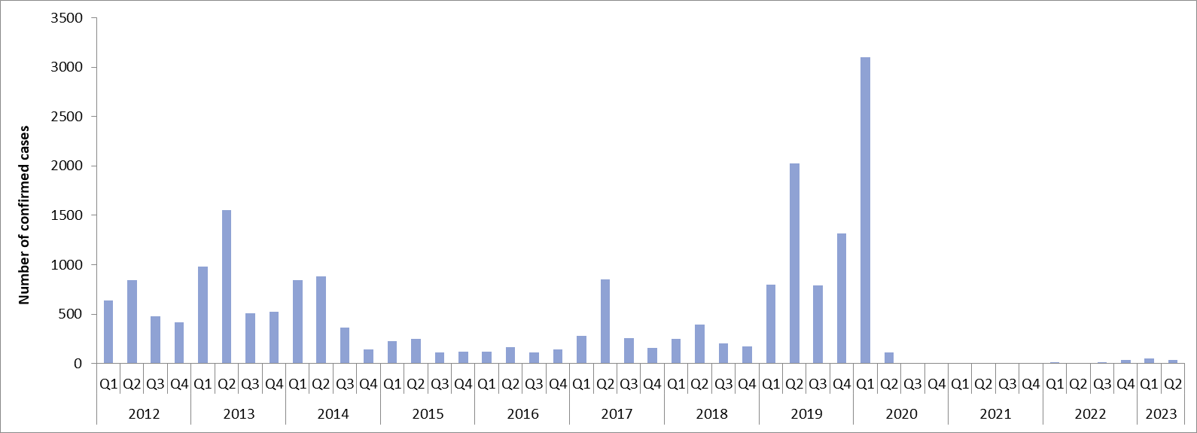
Laboratory confirmed cases of mumps by quarter, England: 2003-2023
Notes:
Laboratory confirmed cases of measles, rubella and mumps, England: October to December 2021 Health Protection Report Volume 16 Number 3 22 February 2022
Measles, mumps and rubella: lab-confirmed cases in England 2021 - GOV.UK (www.gov.uk) https://www.gov.uk/government/publications/measles-mumps-and-rubella-lab-confirmed-cases-in-england-2021

Slide 21
Rubella

Slide 22
Rubella
rubella is an acute, systemic, mild viral illness caused by a togavirus virus; it is also known as German measles
cases are most common in non-immune children and young adults. Before the introduction of rubella vaccination, more than 80% of adults had evidence of previous rubella infection
transmission occurs through direct close contact with nose and throat secretions, for example, when an infected person sneezes or coughs
the incubation period is 14 to 21 days but most of those infected develop a rash 14 to 17 days after exposure.
the infectious period begins from one week before onset of rash to 5 days after
rubella is vaccine preventable

Slide 23
Rubella symptoms
sore throat
coryza
conjunctivitis
malaise
mild fever for 2 to 3 days before appearance of macular rash
inflamed neck lymph nodes
recovery is usually rapid
persistent joint infection such as arthritis and arthralgia are common, especially in adults
Photo courtesy of CDC

Slide 24
Rubella complications
complications such as thrombocytopenia and post infectious encephalitis may occur and adults may develop arthritis and arthralgia
although rubella is usually a mild illness for those infected, in the past, rubella in pregnancy caused a significant burden in terms of terminations and babies born with congenital rubella syndrome (CRS)
between 1971 and 1975, there were an average of 48 Congenital rubella syndrome births and 742 terminations each year in the UK
from 1970 to 2017, it is estimated that rubella vaccination averted 1,300 CRS births and 25,000 terminations in the UK

Slide 25
Rubella in pregnancy
UKHSA conducts enhanced surveillance of reported cases of rubella in pregnancy (RiP) and the UKHSA Guidance on Viral Rash in Pregnancy outlines how every suspected case of RiP should be investigated.
the outcome of pregnancy and live birth (if relevant) is followed up and a range of samples (cord blood, placenta, urine and OF) are collected from mother and baby for analysis
infants with clinical features consistent with Congenital Rubella Syndrome (CRS) are classified as CRS cases
between 2003 and 2016, 31 RiP cases were diagnosed across the UK (0.23 infections per 100,000 pregnancies each year)
of the 31 infections identified in pregnancy over this 14 year period, 5 were considered to have had a reinfection and 26 were primary infections
almost all women diagnosed with a primary RiP between 2003 and 2016 were not born in the UK
Notes:
Country of origin was known for 21 out of the 27 women identified with primary infections (78%) during this period and 20 (95%) of them were non-UK born.
The origin of infection was known for 22 (81%) of the women, with 14 (64%) of them acquiring their rubella infection outside the UK.
Guidance on the investigation, diagnosis and management of viral illness, or exposure to viral rash illness, in pregnancy November 2022
https://www.gov.uk/government/publications/viral-rash-in-pregnancy https://www.gov.uk/government/publications/viral-rash-in-pregnancy
Measles and rubella elimination UK strategy January 2019
Measles and rubella elimination UK strategy - GOV.UK (www.gov.uk) https://www.gov.uk/government/publications/measles-and-rubella-elimination-uk-strategy

Slide 26
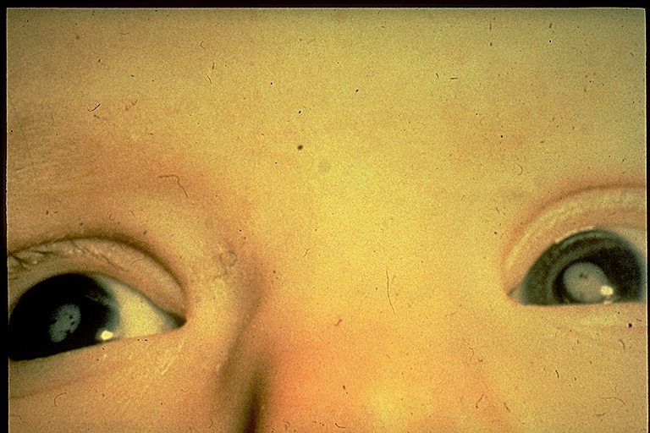
Congenital Rubella Syndrome (CRS)
Babies with congenital rubella syndrome can be born with cataracts, deafness, cardiac abnormalities, retardation of intra-uterine growth, inflamed lesions of brain, liver, lungs and bone marrow
The risk of foetal damage is estimated to be:
90% in first 10 weeks
10 to 20% by 16 weeks
Rare after 20 weeks
Photo courtesy of CDC
Notes:
Congenital rubella infection (CRI) is confirmed by detection of rubella IgM in serum or OF and/or detection of rubella RNA in body fluids. Infants with clinical features consistent with CRS are classified as CRS cases. Where possible retrospective laboratory investigations of maternal pregnancy samples are carried out for infants whose mothers were not previously diagnosed with infection in pregnancy.
The risk to the foetus of primary rubella in the first 16 weeks gestation is substantial, with major and varied congenital abnormalities being associated with infection in the first trimester.
Rubella infection between 16 and 20 weeks gestation is associated with a minimal risk of deafness only and rubella prior to the estimated date of conception or after 20 weeks carries no documented risk.

Slide 27
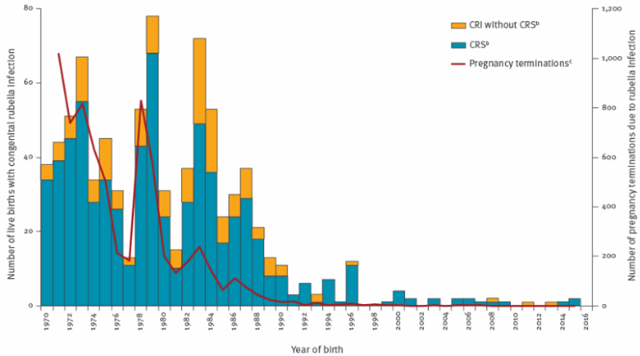
Infants with congenital rubella infection and those diagnosed with congenital rubella syndrome (live births) and pregnancy terminations due to rubella infection during pregnancy, United Kingdom, 1970 to 2016
Due to the MMR programme, congenital rubella infection (CRI) and congenital rubella syndrome (CRS) in infants and pregnancy terminations due to rubella infection are now vanishingly rare.
Notes:
An average of just over 20 CRS births a year were reported between 1986 and 1990, with 3.3 on average each year between 1991 and 2002 in Great Britain.
CRS rates fell from an average 0.17 per 100,000 live births annually between 2003 and 2009 to 0.05 per 100,000 between 2010 and 2016; a reduction of 71%. This fall was due to no babies being identified with CRS post-delivery.
Between 2003 and 2016, 31 rubella infections in pregnancy were diagnosed across the UK (0.23 infections per 100,000 pregnancies). Of these, 5 were considered to have been reinfections and 26 primary infections. Of those with primary infections, all women for whom a country of birth was available (n=20) were born outside the UK.
Of the 22 women with known place of acquisition, 14 acquired their infection abroad. A total of 12 infants were born with congenital rubella syndrome (CRS) between 2003 and 2016. Five infants were born to women diagnosed with infection during pregnancy. A further 7 infants were diagnosed with CRS at birth but with no laboratory confirmation of maternal infection in pregnancy
Rubella infection in pregnancy and congenital rubella in United Kingdom, 2003 to 2016
Eurosurveillance | Rubella infection in pregnancy and congenital rubella in United Kingdom, 2003 to 2016 https://www.eurosurveillance.org/content/10.2807/1560-7917.ES.2018.23.19.17-00381

Slide 28
Rubella in England and Wales
prior to the introduction of vaccination, rubella commonly affected school age children and more than 80% of adults had evidence of previous rubella infection
rubella infection during pregnancy is of significant public health importance as it can have serious consequences for the unborn baby which may result in foetal loss or congenital rubella syndrome (CRS)
rubella immunisation for all pre-pubertal girls and non-immune women of childbearing age was introduced in 1970 (this was discontinued with the introduction of the 2 dose MMR schedule in 1996)
the aim was to offer direct protection to women of childbearing age by increasing the proportion of those with protective antibody levels. This increased from 85% to 90% before 1970 to 97% to 98% by 1987
this approach was effective in reducing the number of cases of congenital rubella syndrome (CRS) and termination of pregnancy although cases of rubella in pregnancy continued in susceptible women, often from rubella circulating in children
rubella became a notifiable disease when a single dose of MMR was introduced in 1988 which aimed to interrupt circulation in young children so that susceptible pregnant women would be protected from exposure (A single dose of rubella containing vaccine used in the UK confers 95-100% protection)
the WHO confirmed that the UK achieved elimination status for rubella in 2016. There have been no new laboratory confirmed cases of rubella reported in the UK since 2019
antenatal testing for rubella antibodies (immunity) stopped in 2016 due to women of childbearing age being mostly immune through vaccination. As part of antenatal care MMR vaccination status should be checked for all pregnant women. Those who are not up to date with their MMR vaccines should be referred to their GP to catch-up postnatally to protect future pregnancies
Notes:
https://www.gov.uk/government/news/rubella-susceptibility-screening-in-pregnancy-to-end-in-england

Slide 29
Routine MMR immunisation programme and additional recommendations

Slide 30
UK vaccine eligibility and general principles (1)
children should be offered the MMR vaccine according to the routine schedule:
first MMR dose at 12 months of age
second MMR dose at 3 years and 4 months or soon after – this dose can be given routinely from 18 months of age
individuals with uncertain or incomplete immunisation histories should be brought up to date at the earliest opportunity
anyone who has missed out on their 2 doses of MMR vaccine can be brought up to date at any age. There are no negative effects from vaccinating people who are already immune
those born before 1970 are likely to have immunity from natural infection as this age group was highly exposed to measles before the number of cases started to decline

Slide 31
UK vaccine eligibility and general principles (2)
Making Every Contact Count (MECC): practitioners should opportunistically check MMR status and bring patients up to date where appropriate
individuals who may benefit from a review of their immunisation history include:
newly registered individuals including young people joining a practice when they move for college or university, and those who have newly migrated to the UK
members of the Charedi orthodox Jewish communities, traveller communities, anthroposophic (Steiner and Campbell) communities, and migrants - as these groups may have suboptimal vaccine uptake
those with an occupation or medical condition that might make them at higher risk from infection or the consequences of infection
other opportunities to offer catch up doses of MMR include entry into primary or secondary school, or higher education, enlistment into the armed forces, prior to foreign travel and employment or study in the healthcare sector

Slide 32
Frontline health and social care workers
Although there is no evidence that HCWs have lower MMR uptake than the general population, as they are in close contact with individuals receiving care they are at increased risk of both catching measles and spreading it to them and to colleagues.
all frontline health and social care workers with direct patient/service user contact should be checked for either 2 recorded doses of measles containing vaccine or for a positive measles and rubella IgG antibody test.
this includes staff in all NHS trusts, general practices, care homes, and domiciliary care
Employers are encouraged to :
commission a service which makes access to the vaccine easy for all staff
encourage staff to get vaccinated
The definitions in the Green Book Chapter 12 should be used to identify those eligible as part of the frontline and social care workers’ programme.
Notes:
In addition to the disease burden for individuals, outbreak management in health care settings is resource intensive.
There are also implications for staff management as unvaccinated HCWs who are exposed to measles infection have to be excluded from the workplace to protect patients and colleagues placing an additional burden on other staff.
An outbreak report from 2013 details an unvaccinated HCW who became infected with measles from an unvaccinated paediatric patient.
Following infection the health protection team identified 110 contacts including other patients, staff, and visitors. One 10 month old infant went on to develop measles.
Immunisation of healthcare and laboratory staff: the green book, chapter 12 - GOV.UK (www.gov.uk) https://www.gov.uk/government/publications/immunisation-of-healthcare-and-laboratory-staff-the-green-book-chapter-12

Slide 33
Women of childbearing age
as MMR vaccine is a live vaccine, it is not recommended to be administered during pregnancy due to a theoretical risk of vaccine virus transmission to the unborn baby
inadvertent vaccination has taken place in more than 3,500 susceptible women during the early stages of pregnancy and no cases of foetal damage or congenital rubella syndrome have been reported
unvaccinated women of childbearing age should be offered vaccine before becoming pregnant. Following vaccination, pregnancy should be avoided for one month
if it is not possible to vaccinate before pregnancy, vaccination should be deferred until the woman is no longer pregnant
services accessed by women including contraceptive services, fertility services, post natal appointments, 6 to 8 week maternal check appointments and cervical screening appointments are all opportunities to remind women of their eligibility if they have not already been vaccinated
rubella antibody levels do not need to be tested before commencing fertility treatment

Slide 34
Outbreaks
contact with suspected measles, mumps or rubella provides a good opportunity to offer MMR vaccine to previously unvaccinated individuals
as vaccine induced antibodies for measles develop more rapidly than those following natural infection, MMR vaccine should be offered to any healthy eligible unvaccinated or incompletely vaccinated individual exposed to measles who has not had it in the past
to be effective, vaccine must be administered, ideally within 3 days, but even when it is too late to provide effective post-exposure prophylaxis against measles, MMR vaccine can provide protection against future exposure to all 3 infections
if urgent protection is required against measles, for example during an outbreak, the vaccine can be given early (from 6 months of age). If given before 12 months of age, a sub-optimal response may be observed. For this reason, doses given before 12 months of age should be discounted and the routine schedule followed at the recommended ages
antibody response to the mumps and rubella components of MMR vaccine does not develop soon enough after exposure to provide effective prophylaxis
outbreaks of measles, mumps or rubella should be notified to the local health protection team who will conduct a risk assessment and advise on the response
Notes:
National measles guidelines - GOV.UK (www.gov.uk)

Slide 35
MMR vaccines

Slide 36
MMR vaccines
there are 2 MMR vaccines currently available for use: Priorix and MMRvaxPro
both vaccines contain live, modified strains of measles, mumps and rubella viruses
each of the 3 strains in the vaccines are cultured separately and then mixed before being freeze dried (lyophilised)
MMRvaxPro contains gelatine of porcine origin as a stabiliser
MMR vaccines:
do not contain thiomersal or any preservatives
are supplied as either a suspension in a pre-filled syringe OR as a freeze dried vaccine that consists of a powder and solvent and requires reconstitution
should usually be administered by intramuscular (IM) injection; the standard guidance about IM administration for individuals with bleeding disorders or taking anticoagulant therapy applies
MMR vaccines are centrally procured for the routine vaccination programme and can be ordered free of charge via ImmForm: https://portal.immform.phe.gov.uk/
Notes:
MMR vaccines should be stored and prepared in accordance with manufacturers instructions and shaken well before they are administered.
As both vaccines are licenced for subcutaneous injection, the dose does not need to be repeated if it is inadvertently given S/C.

Slide 37
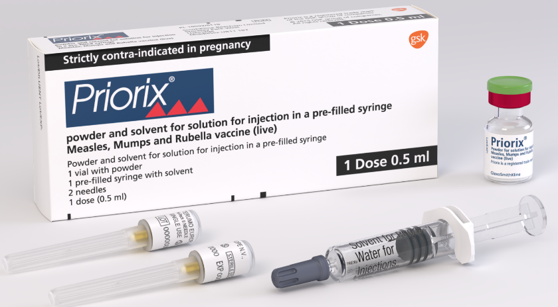
Priorix
each 0.5ml dose of Priorix should be reconstituted in accordance with the manufacturer’s recommendations and contains:
powder and solvent for solution for injection in a pre-filled syringe
live attenuated measles virus (Schwarz strain)
live attenuated mumps virus (RIT 4385 strain, derived from Jeryl Lynn strain)
live attenuated rubella virus (Wistar RA 27/3 strain)
trace amount of neomycin
Reconstituted vaccine may vary in colour from clear peach to fuchsia pink without deterioration of the vaccine potency.
As Priorix vaccine does not contain porcine gelatine it may be offered to individuals who do not wish to receive products containing components of porcine origin. Practices can preferentially order Priorix to meet the needs of their communities. Please contact the Immform helpdesk.
Priorix is indicated for use in those aged 9 months or older. It may be offered, from the age of 6 months, as post-exposure prophylaxis; this is an off-label indication.
Notes:
Priorix vaccine Summary of Product Characteristics
Priorix powder and solvent for solution for injection in a pre-filled syringe - Summary of Product Characteristics (SmPC) - (emc) (medicines.org.uk) https://www.medicines.org.uk/emc/product/1159/smpc

Slide 38
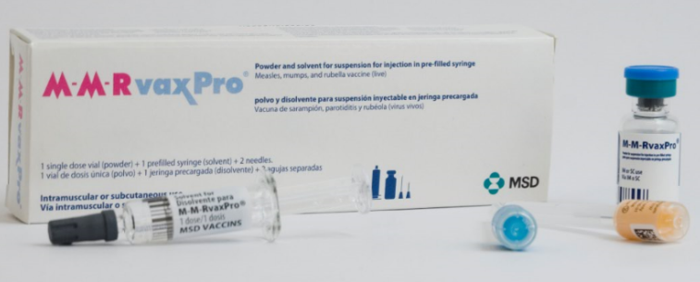
MMRvaxPro
Each 0.5ml dose of MMRvaxPro requires reconstitution in accordance with the manufacturer’s recommendations and contains:
powder with solvent for reconstitution supplied in a vial or powder with solvent for reconstitution supplied in a pre-filled syringe, for suspension for injection
measles virus Enders' Edmonston strain
mumps virus Jeryl Lynn strain
rubella virus Wistar RA 27/3 strain
may contain traces of recombinant human albumin (rHA)
trace amount of neomycin
gelatine of porcine origin as a stabiliser
Reconstituted vaccine is a clear yellow; it should only be used if it’s clear and free from particulate matter.
MMRvaxPro is indicated for use in those aged 12 months and older. It may be offered, from the age of 6 months, as post-exposure prophylaxis; this is an off-label indication.
Notes:
MMRvaxPro vaccine Summary of Product Characteristics
MMRVAXPRO - Summary of Product Characteristics (SmPC) - (emc) (medicines.org.uk) https://www.medicines.org.uk/emc/product/6307/smpc

Slide 39
MMR vaccine effectiveness
vaccine effectiveness of a single dose of MMR vaccine is around 95%. A second dose protects those who do not respond to the first - protection then increases to well above 95%
primary vaccine failure is rare however it can occur, particularly after a single dose
in settings with high levels of close interpersonal contact, such as large households or school settings, controlling measles outbreaks requires a high coverage of 2 doses of MMR vaccine
infants in their first year of life may not respond sufficiently to all components of the vaccine so doses given under 12 months of age should be discounted
individuals with immune deficiencies who have no contraindications for this vaccine may have a sub-optimal response to the vaccine

Slide 40
Breakthrough measles (reinfection)
the term ‘breakthrough measles’ (previously referred to as ‘reinfection’, or secondary vaccine failure) is used to describe a confirmed case of measles in someone who developed immunity to measles, either from natural measles or from prior receipt of measles containing vaccine, typically between 6 and 30 years after infection or immunisation
breakthrough infection is usually associated with intense and/or prolonged exposure to an infected individual, for example, directly caring for an acutely ill person, and so is generally only seen in healthcare workers or in household settings
cases of breakthrough measles are generally mild and atypical, and their infectivity is much lower and transient, unlike primary measles infection. Although PCR positive, the presence of neutralising antibodies in respiratory secretions greatly reduces the infectiveness of the virus
all evidence suggests that they do not pose a significant public health threat in the context of global measles elimination efforts

Slide 41
MMR schedule
a full course consists of 2 doses of MMR vaccine with a minimum interval of 4 weeks between doses
as MMR vaccine is a live vaccine, the risk of adverse reactions falls with an increasing number of doses
if an individual can’t recall whether they have received MMR (or MR or single vaccines) or the exact number of doses they have received, they should receive additional MMR doses up to a total of 2 documented doses with an interval of at least one month between doses
a second dose of measles-containing vaccine protects those who do not respond to the first dose and boosts antibody levels in those who did respond. In order to eliminate measles, the WHO recommends 2 doses of a measles-containing vaccine
to maintain good control of measles, a 2 dose MMR schedule is required to offer protection to those who did not respond to the first dose and to prevent accumulation of a pool of susceptible individuals that could otherwise re-establish measles transmission
Notes:
MMR vaccine is recommended as part on the national routine immunisation schedule. It is a two dose programme with the first dose being offered around the time of the first birthday and the second dose being offered at 3 years 4 months of age.
There is no upper age limit for MMR vaccine
There is no limit to the number of MMR vaccinations an individual can receive. The risk of adverse reactions falls with increasing number of doses of MMR (unlike inactivated vaccines such as tetanus) so the benefit of ensuring protection outweighs any risk of an additional dose of MMR.
https://www.gov.uk/government/publications/mumps-risk-in-pregnancy-infection-in-healthcare-settings-and-mmr-vaccine/mumps-risk-in-pregnancy-infection-in-healthcare-settings-and-mmr-vaccine

Slide 42
Timing of dose administration
the first dose is routinely administered at the age of 12 months (just after the first birthday)
a second dose is normally given before school entry (3 years 4 months of age) but can be given routinely from 18 months.
maternal antibodies may reduce the response to the first dose of vaccination up to the age of 18 months. To provide additional protection to those who fail to respond to the first dose, therefore, the second dose should not routinely be given below 18 months
doses may be given earlier in certain circumstances – extra doses may then be required (next slide)
Notes:
Immunisation before one year of age provides earlier protection in localities where the risk of measles is higher, but residual maternal antibodies may reduce the response rate to the vaccine. The optimal age chosen for scheduling children is therefore a compromise between risk of disease and level of protection.

Slide 43
Special circumstances
the first dose of MMR vaccine can be administered from the age of 6 months:
where immediate protection against measles is required, for example following exposure to the infection
prior to travel to measles endemic areas with a high incidence of measles or to an area where there is a current outbreak, if the child is likely to be mixing with the local population
as response to MMR in infants is sub-optimal, where the vaccine has been given before 12 months of age, immunisation with 2 further doses of MMR should be given at the normal ages
the interval between the first and second doses may be reduced to one month when children who have received the first dose of MMR at the routine age require immediate protection against measles or are travelling (as above)
if the child is under 15 months of age when the second dose is given, then the routine pre-school dose (a third dose) should be given at the usual time (generally 3 years and 4 months of age but in some areas routinely administered from 18 months) in order to ensure full protection
if the child is given the second dose from 15 months of age, no further routine doses are required

Slide 44
Contraindications
there are very few individuals who cannot receive MMR vaccine
where there is doubt, expert advice should be sought promptly so that the period the individual is left unvaccinated is minimised
MMR vaccines should not be given to those who have had a:
confirmed anaphylactic reaction to a previous dose of the vaccine
confirmed anaphylactic reaction to any component of the vaccine
MMR is a live vaccine. Live vaccines can, in some situations, cause severe or fatal infections in immunosuppressed individuals due to extensive replication of the vaccine strain and, for this reason, should not be given to individuals with some types of severe primary or acquired immunodeficiency. Vaccination in immunosuppressed individuals should only be conducted in consultation with an appropriate specialist. Refer to Chapter 6 of the Green Book for details.
MMR vaccine can be given to HIV-positive individuals who are not immunosuppressed or those with moderate immunosuppression as defined in Table 21.2, Chapter 21 of the Green Book.
pregnancy should be avoided for one month following vaccination
Notes:
Confirmed anaphylaxis is rare. Other allergic conditions such as rashes may occur more commonly and are not contraindications to further immunisation. A careful history of the event will often distinguish between true anaphylaxis and other events that are either not due to the vaccine or are not life threatening. In the latter circumstance, it may be possible to continue the immunisation course. Specialist advice must be sought on the vaccines and the circumstances in which they could be given. The risk to the individual of not being immunised must be taken into consideration.
The SmPCs for individual products should always be referred to when deciding which vaccine to give. When there is doubt, appropriate advice should be sought promptly from the local screening and immunisation or health protection team or the individual’s consultant so that the period the individual is left unvaccinated is minimised.

Slide 45
Co-administration with other vaccines
MMR vaccine can be given at the same time as, or at any interval before or after, other currently used live and inactivated vaccines except yellow fever vaccine and varicella and zoster vaccines: see Green Book, Chapter 11, Table 11.3 UK immunisation schedule: the green book, chapter 11)
Vaccine combinations | Recommendations
Yellow fever and MMR | A 4 week minimum interval period should be observed between the administration of these 2 vaccines. Yellow Fever and MMR should not be administered on the same day.¹
Varicella (and zoster) vaccine and MMR | If these vaccines are not administered on the same day, then a 4 week minimum interval should be observed between vaccines.²
All currently used live vaccines (BCG, rotavirus, live attenuated influenza vaccine (LAIV), oral typhoid vaccine, yellow fever, varicella, zoster and MMR) | Apart from those combinations listed above, these vaccines can be administered at any time before or after each other.
Notes:
Co-administration of these two vaccines can lead to sub-optimal antibody responses to yellow fever, mumps and rubella antigens (Nascimento et. al, 2011). Where protection is required rapidly then the vaccines should be given at any interval; an additional dose of MMR should be considered.
A study in the US (Mullooley & Black, 2001) showed a significant increase in breakthrough infections when varicella vaccine was administered within 30 days of MMR vaccine; suggesting that MMR vaccine caused an attenuation of the response to varicella vaccine. When the vaccines are given on the same day, however the responses have been shown to be adequate (Plotkin, 2018.) As the zoster (shingles) vaccine contains the same virus as varicella (chicken pox) vaccine, this recommendation has been extrapolated to MMR and zoster. Where protection from either vaccine is required rapidly then the vaccines can be given at any interval and an additional dose of the vaccine given second should be considered.

Slide 46
Intervals required following tuberculin (Mantoux) skin testing or receipt of blood products
Mantoux testing:
MMR vaccination and tuberculin skin testing can be performed on the same day
however, if a tuberculin skin test has been initiated, MMR should be delayed until the skin test has been read as the vaccine may cause a temporary depression of tuberculin skin sensitivity leading to a false negative result
if protection against measles is urgently required the vaccine can be given
if a child has had a recent MMR vaccine and requires a tuberculin skin test, a 4 week interval should be observed
Receipt of blood products:
there is a possibility of vaccine failure if MMR vaccine is given within 3 weeks of blood products such as immunoglobulin. This is due to the presence of passively acquired measles, mumps and rubella antibodies in the immunoglobulin which could prevent the live virus in the vaccine from replicating.
If urgent protection is required, MMR vaccine can be given but the dose should be repeated after 3 months to ensure long term protection
Notes:
Administering tuberculin (Mantoux) within 28 days of MMR vaccine may result in decreased reactivity of the tuberculin and the false negative reporting of results. If tuberculin testing has already been initiated, MMR should be delayed until the skin test has been read. If protection against measles is urgently required, then the benefit of protection from the vaccine outweighs the potential interference with the tuberculin test. In this circumstance, the individual interpreting the negative tuberculin test should be aware of the recent MMR vaccination when considering how to manage that individual.
See Green Book, Chapter 11, Table 11.3 UK immunisation schedule: the green book, chapter 11 - GOV.UK (www.gov.uk)

Slide 47
Inadvertent administration of MMR vaccine
if an immunosuppressed individual receives MMR vaccine, the degree of immunosuppression should be assessed as a potential exposure to measles and managed as per the UKHSA measles post-exposure guidelines
the risk assessment should be undertaken in consultation with the clinician caring for the immunosuppressed patient
if the clinical assessment is that the patient is not sufficiently immunosuppressed and can tolerate the attenuated vaccine virus, IVIG is not required
pregnant women do not require post-exposure prophylaxis against measles if they are inadvertently given MMR
the UK Vaccine in Pregnancy Surveillance programme operated by the UKHSA collected data about exposures to MMR vaccine during pregnancy to monitor the safety of such exposures
there are no safety concerns, either for the mother or the baby, when immunised with MMR or single rubella vaccine in pregnancy and they can be immediately reassured
Notes:
Measles: post-exposure prophylaxis - GOV.UK (www.gov.uk) https://www.gov.uk/government/publications/measles-post-exposure-prophylaxis
MMR (measles, mumps, rubella) vaccine: advice for pregnant women - GOV.UK (www.gov.uk) https://www.gov.uk/government/publications/vaccine-in-pregnancy-advice-for-pregnant-women/mmr-measles-mumps-rubella-vaccine-advice-for-pregnant-women

Slide 48
Adverse reactions
pain, swelling, bruising and redness at the injection site, fever >37.5oC (oral/axillary) are commonly reported reactions
rash, upper respiratory tract infection and the formation of a small painless nodule at the injection site are also reported
these symptoms usually disappear within 1 to 2 days without treatment
the frequency of adverse reactions is similar for first and second doses of vaccine although injection site pain has been found to be very common after the second dose
encephalitis has been reported post vaccination (below 1 per 10 million doses). This is far below the risk from natural disease:
Measles: 1 in 1,000 to 2,000
Mumps: 2 to 4 in 1,000 cases
Rubella: 1 in 6,000 cases
all serious suspected reactions following MMR vaccination should be reported to the Medicines and Healthcare products Regulatory Agency using the Yellow Card scheme http://yellowcard.mhra.gov.uk/
Notes:
Adverse reactions following the MMR vaccine (except allergic reactions) are due to effective replication of the vaccine viruses with subsequent mild illness. Such events are to be expected in some individuals. Events due to the measles component occur six to 11 days after vaccination. Events due to the mumps and rubella components usually occur two to three weeks after vaccination but may occur up to six weeks after vaccination. These events only occur in individuals who are susceptible to that component and are therefore less common after second and subsequent doses. Individuals with vaccine associated symptoms are not infectious to others.
Mumps: the green book, chapter 23
Mumps: the green book, chapter 23 - GOV.UK (www.gov.uk) https://www.gov.uk/government/publications/mumps-the-green-book-chapter-23

Slide 49
MMR vaccine COVER data

Slide 50
Data collection: Coverage of Vaccination Evaluated Rapidly (COVER)
“the ability to reliably measure vaccine coverage plays an essential role in evaluating the success of a vaccination programme, identifying susceptible populations for further interventions and informing future vaccine policy decisions; this is dependent on having an accurate estimate for the eligible population (denominator) and a robust method of ascertaining the number of those eligible individuals who have received a particular vaccine dose (numerator).” (Amirthalingam, G. et al 2012)
the COVER data collection and analysis programme has operated in the UK since 1987 and is nationally mandated
local authority and GP practice level immunisation coverage data for the pre-school vaccination programmes are extracted from Child Health Information Systems (CHISs) and submitted to NHS Digital’s Strategic Data Collection Service (SDCS) on a quarterly basis
the UKHSA analyses this data and produces/publishes quarterly (official statistic) and, jointly with NHS Digital, annual (national statistic) reports
COVER measures “the proportion of children aged 12 months, 24 months and 5 years who have completed courses of each routine childhood immunisation” for MMR, first dose coverage is measured at age 2 years and again at age 5 years and second dose coverage is measured at age 5 years
How COVER works (with specific reference to MMR):
first dose coverage is measured at age 2 years and again at age 5 years, and second dose coverage is measured at age 5 years
Denominator: Total number of children for whom the local healthcare system/Local Authority is responsible on the last day of a defined quarter whose second or fifth birthday falls within that quarter
Numerator: Total number of children who have completed immunisation at any time by their second or fifth birthday
Tightly defined dose/course: one dose of MMR by 24 months; one and 2 doses of MMR by 5 years
Important: First doses given before age 1 year (too early) and after the 2nd and 5th birthday, and 2nd doses given after the 5th birthday are not included, however, 2 doses of MMR vaccine are required for full, long-term protection and children should continue to receive any missed dose(s)
Notes:
Amirthalingam, G., J. White, and M. Ramsay. 2012. “Measuring Childhood Vaccine Coverage in England: The Role of Child Health Information Systems.” Eurosurveillance 17 (16): 20149. https://doi.org/10.2807/ese.17.16.20149-en
Standardised age-specific COVER data for local authority responsible populations are extracted from Child Health Information Systems (CHISs) at local authority and GP practice levels. CHIS providers use the COVER information standard to generate these data which are submitted to SDCS using the same standard template.
Rapidly = published quarterly and within 3 months of the end of the quarter. The meaning of rapidly changes and remember that “more frequent” is not synonymous with “better”

Slide 51
MMR1 coverage at 2 and 5 years of age, England 1997/98 to 2021/22 MMR2 coverage at 5 years of age, England 1997/98 to 2021/22 Source: Childhood Vaccination Coverage Statistics - 2020-21 Annual National Official Statistics, NHS Digital, UKHSA
MMR 1 at 5 yrs reached 95% in 2016

Slide 52
Impact of the COVID-19 pandemic: population immunity gaps
due to the COVID-19 pandemic, vaccine uptake rates for routine childhood programmes have fallen globally
coverage for the measles, mumps and rubella (MMR) vaccination programme in the UK has also fallen to the lowest level in a decade:
uptake for the first dose of the MMR vaccine in children aged 2 years in England is 85.6%
uptake of 2 MMR doses at age 5 years is 85.5%
this is below the 95% target set by the World Health Organization (WHO) as necessary to achieve and maintain elimination
UKHSA has been working closely with the NHS and other partners to support the recovery of the routine childhood immunisation programme and to catch-up children who missed out on their vaccinations during the COVID-19 pandemic
the UK Measles and Rubella Elimination Strategy sets out key recommendations for action including the development of local action plans that address specific population needs
in London, a polio and MMR catch-up campaign targeting unvaccinated or partially vaccinated children aged 1 to 11 years is being rolled out through GP practices, primary schools and community vaccination clinics
Notes:
HPR volume 17 issue 7: news (14 July 2023)
Updated 14 July 2023
HPR volume 17 issue 7: news (14 July 2023) - GOV.UK (www.gov.uk)
Quarterly vaccination coverage statistics for children aged up to 5 years in the UK (COVER programme): January to March 2023
Updated 27 June 2023
Quarterly vaccination coverage statistics for children aged up to 5 years in the UK (COVER programme): January to March 2023 - GOV.UK (www.gov.uk)

Slide 53
Your role in improving data quality
we all have a role to play in improving data quality which helps ensure we can generate more accurate estimates of vaccine coverage and public health risk
it is important that all vaccines are recorded in the GP record and for children also in the Child Health Information System (CHIS) record accurately
using the correct SNOMED codes will ensure the individual is categorised as immunised, fully immunised or partially immunised for age correctly on a data extract
this is especially important for movers in and newly registered patients, particularly new migrants coming into the country
UKHSA has developed a useful tool to help compare other country’s schedules to the UK schedule: https://www.gov.uk/government/publications/uk-and-international-immunisation-schedules-comparison-tool

Slide 54
Measles and rubella elimination in the UK

Slide 55
Measles and rubella elimination in the UK
all member states of the European region of the World Health Organisation (WHO), including the UK, are committed to eliminating measles and rubella from their countries
elimination is the absence of endemic measles and rubella cases for a period of at least 12 months from the last known case, due to complete interruption of endemic virus transmission, in the presence of a high-quality surveillance system that is sensitive and specific enough to detect, confirm and classify all suspected cases, and genotyping evidence that supports the interruption of endemic transmission
in 2015, the UK achieved elimination status for rubella
in 2016, the UK had eliminated measles based on data from 2014-2016
in 2018, the UK lost its measles elimination status when re-establishment of virus transmission occurred
in 2021, the UK regained elimination status based on the interruption of transmission of measles during the COVID-19 pandemic
Notes:
Measles and rubella elimination UK indicators
Measles and rubella elimination UK indicators - GOV.UK (www.gov.uk) https://www.gov.uk/government/publications/measles-and-rubella-elimination-uk
UK measles and rubella elimination indicators and status
UK measles and rubella elimination indicators and status - GOV.UK (www.gov.uk) https://www.gov.uk/government/publications/measles-and-rubella-elimination-uk/uk-measles-and-rubella-elimination
Endemic transmission - continuous transmission of indigenous or imported measles or rubella virus that persists for a period of 12 months or more in a defined geographical area
Interrupted endemic transmission - the absence of endemic measles or rubella cases in a defined geographical area for a period of at least 12 months, in the presence of a well-performing surveillance system. Regional elimination can be declared after 36 or more months of the absence of endemic measles or rubella in all Member States

Slide 56
Achieving and maintaining elimination status
to achieve and maintain elimination status, the WHO recommends 95% vaccine uptake with 2 doses of MMR by 5 years of age
UKHSA analysis suggest that population immunity levels are well below those required to interrupt measles transmission in many birth cohorts
the number of susceptible individuals is higher in young people born between 1998/99 and 2003/04
measles and rubella remain endemic in many other countries and, with large measles outbreaks occurring across Europe and in multiple countries in South Asia and Africa, imported infections pose a very real threat to the UK’s recent achievements (see slides 14 and 15 for the latest epidemiology)
current UK performance for the second dose needs to be improved to attain and maintain 95% uptake by age 5 years
recommendations on actions that need to be taken across the system to achieve and maintain measles elimination are captured in the UK Measles and Rubella elimination strategy published in 2019 here: Measles and rubella elimination UK strategy

Slide 57
Predicting outbreaks – UKHSA modelling
risk assessment of measles resurgence in the UK – published July 2023
current MMR uptake levels lowest in a decade
during pandemic - increased pool of susceptibles in younger children - around 1 in 10 children starting school at risk of measles
highest susceptibility in ‘Wakefield cohorts’ born between 1998-1999 and 2003-2004, now aged 19 to 25 years
London remains most vulnerable region (also most likely to get importations) – could sustain large outbreaks 40,000 to 160,000 cases
high risk of imported cases leading to outbreaks in:
under vaccinated communities, for example, migrant populations, traveller communities, and ultra-orthodox Jewish communities
geographies (inner-city areas) with some risk of limited spread to the wider community

Slide 58
National Measles Standard Incident
rapid increase in cases seen in late 2023
most cases in children and young people within un- and under-vaccinated communities
initially driven by a large outbreak in Birmingham
cases and clusters in other parts of the West Midlands, London and the North West
all regions had confirmed cases
National Measles Standard Incident declared in January 2024
additional guidance and resources published to raise awareness and to support healthcare professionals to identify and manage cases and outbreaks
publicity and provision of additional opportunities for MMR vaccination for un- or incompletely immunised individuals
April 2024
outbreak in Birmingham stabilised
recent rise in cases in London
smaller clusters ongoing in all regions
continued efforts to improve MMR vaccine uptake
Notes:
Measles epidemiology 2023 and 2024 - GOV.UK (www.gov.uk)
Confirmed cases of measles in England by month, age and region: 2023 - GOV.UK (www.gov.uk)
Measles outbreak could spread warns UKHSA Chief Executive - GOV.UK (www.gov.uk)
Measles: guidance, data and analysis - GOV.UK (www.gov.uk)

Slide 59
Measles epidemiology October 2023 to 2 April 2024
Cases confirmed through either local or reference laboratory testing.
Note: Data are provisional and subject to change as:
more suspected cases undergo confirmatory testing
some locally tested cases are discarded after confirmatory testing at the reference laboratory and are therefore depicted with dotted lines
The data reporting lag has greatest impact on the most recent 4 weeks which are therefore represented by dotted lines.
National Measles Standard Incident - measles epidemiology (from October 2023)

Slide 60
Achieving high immunisation uptake and addressing health inequalities

Slide 61
NICE guidance
NICE guideline 218 published 17 May 2022, includes recommendations on:
service organisation
identifying eligibility, giving vaccinations and recording vaccination status
invitations, reminders and escalation of contact
and supports the aims of the NHS Long Term Plan, which includes actions to improve immunisation coverage by GPs and support a narrowing of health inequalities
supporting tools and resources include:
visual summaries on the recommendations (identifying people eligible
for vaccination and opportunistic vaccination; invitations, reminders
and escalation of contact for different age-groups)
Quality Standard Vaccine uptake in under 19s (QS145)
audit template
Immunisation | Topic | NICE
Notes:
General guidance that should be followed on improving uptake that applies to all vaccinations including MMR

Slide 62
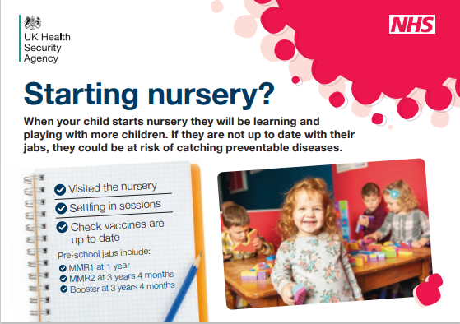
‘Use every opportunity to identify eligible people’ schools
remind/ discuss/ offer/ signpost:
starting/returning to nursery
before starting primary school
school entry – reception/year 1 age 4 to 5
school transition – year 6/7 age 10/11
‘back to school’ – before each school year
teen health review
adolescent immunisation programme – HPV, MenACWY,
Td/IPV (school leavers’ booster)
Guidance: Supporting immunisation programmes - GOV.UK (www.gov.uk)
updated 28 July 2023 with a link to
Resources for starting or returning to nursery or school (postcards/posters as shown)
see also: Immunisation
Notes:
Guidance is part of Health protection in children and young people settings, including education - GOV.UK (www.gov.uk)

Slide 63
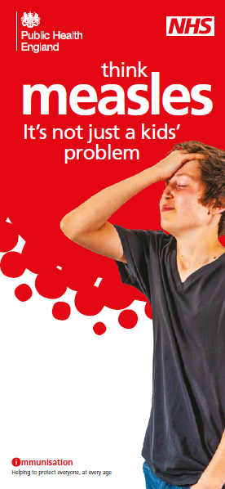
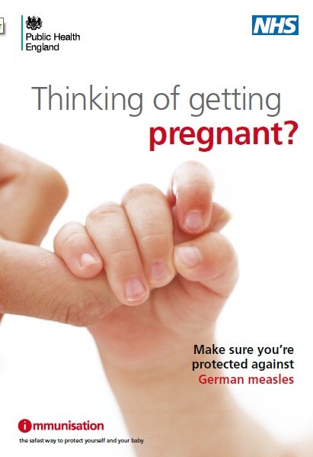
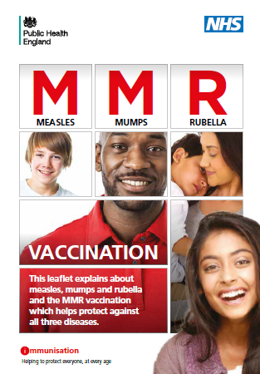
Achieving high MMR vaccine uptake across the life course
A variety of measles and MMR leaflets, posters, social media banners and other digital resources are available free to order and/ or download in several different languages and for different eligible groups, see Immunisation and Search Publications - Health Publications
Notes:
Discuss MMR vaccination pre-, ante- and post-natally; offer vaccination pre-natally (advise to avoid pregnancy for 1 month) and post-natally if the woman has not received 2 doses of MMR

Slide 64
Training for immunisers
a high level of knowledge and a positive attitude to immunisation in healthcare practitioners are widely acknowledged as being important determinants in achieving and maintaining high vaccine uptake
it is important that immunisers are confident, competent, knowledgeable and up to date
PHE published national training standards and a core curriculum for immunisers, which together with the resources now published by the UKHSA – the Green Book, Vaccine Update, training slide sets and an e-learning module - support the delivery of a high quality programme
Immunisation training standards for healthcare practitioners
Immunisation training of healthcare support workers: national minimum standards and core curriculum
Immunisation
Notes:
At the next review, the national training standards and core curriculum for immunisers will be re-published under the UKHSA corporate branding

Slide 65
Addressing health inequalities
there are inequalities in vaccine uptake by ethnicity, deprivation and geography and the burden of measles and rubella falls disproportionately on some communities
following a health equity audit of the national immunisation programmes in 2019, Public Health England (PHE – now replaced by the UKHSA) developed a strategy to address inequalities in immunisation and ensure equity in the delivery of all vaccination programmes; the audit report, strategy document and a template local action plan are all available: https://www.gov.uk/government/publications/phe-immunisation-inequalities-strategy
the UK Measles and Rubella elimination strategy was published in 2019 Measles and rubella elimination UK strategy; the document includes case-studies that highlight some of the issues and challenges faced by a number of under-vaccinated communities such as the Charedi Orthodox Jewish Community, the Anthroposophic Community, the Traveller community and new migrants.
it is essential that commissioners and providers understand the needs of the populations they serve and that they work with partners across the health care system to ensure services are accessible and acceptable to them.
the WHO/Europe developed the Guide to Tailoring Immunization Programmes (TIP) TIP: tailoring immunization programmes (who.int) to assist health care professionals, public health authorities and decision-makers to better diagnose the factors influencing vaccination intentions, decisions and behaviours and to enable tailoring of services to optimise uptake in under-served communities
The TIP approach helps immunisation programme teams to:
identify populations susceptible to VPDs
diagnose supply- and demand-side barriers and motivators to vaccination
recommend evidence-informed responses to sustain vaccination
Notes:
The Measles and Rubella elimination strategy is being reviewed/updated and will be re-published by the UKHSA.

Slide 66
Summary and further reading

Slide 67
Key messages (1)
measles, mumps and rubella are highly infectious viral infections and MMR immunisation is the most effective way to protect against these diseases
measles can lead to serious complications particularly in infants, pregnant women, and in immunosuppressed individuals
measles in pregnancy increases the risk of miscarriage, stillbirth or preterm delivery and rubella in pregnancy can lead to congenital rubella syndrome in the baby
vaccination of health and social care workers protects them and reduces the risk of them spreading measles and rubella to the susceptible individuals in their care, service users, colleagues and family members
MMR vaccination also contributes to reduction of risk of secondary bacterial infections and the need for antibiotics therefore contributing to the prevention of antibiotic resistance

Slide 68
Key messages (2)
it is important to achieve high vaccine coverage (95%) of the 2 dose MMR schedule to protect individuals and to prevent large numbers of susceptible individuals building up in the population, and thus avoid outbreaks and epidemics
NICE guidance 218 provides a robust framework for optimising immunisation services for all vaccines, including MMR with recommendations for commissioners and providers to take forward
the burden of disease and falls disproportionately on under vaccinated communities, and therefore addressing inequalities is key in order to prevent measles importations leading to outbreaks. Local place-based activity to understand the needs of communities and barriers to immunisation is essential to ensure effective tailored interventions can address these inequalities.

Slide 69
MMR resources (1)
Measles, mumps and rubella resource collection
www.gov.uk/government/collections/immunisation#measles,-mumps-and-rubella-(mmr)
Green Book measles chapter
Measles: the green book, chapter 21
National measles guidelines
National measles guidelines
National infection prevention and control manual (NIPCM) for England

Slide 70
MMR resources (2)
MMR resources for the public
Immunisation
Search Publications - Health Publications
MMR PGD
www.gov.uk/government/publications/mmr-patient-group-direction-pgd-template
ImmForm portal
https://portal.immform.phe.gov.uk/Logon.aspx?returnurl=%2f

Slide 71
MMR resources (3)
UK measles and rubella elimination status and indicators
Measles and rubella elimination UK indicators
UK measles and rubella elimination indicators and status
UK measles and rubella elimination strategy
www.gov.uk/government/publications/measles-and-rubella-elimination-uk-strategy
British Society of Immunology public resources
www.immunology.org/public-information
Post exposure prophylaxis guidance
Measles: post-exposure prophylaxis

