Slide 1
Measles: an update for maternity services
UKHSA Immunisation and Vaccine Preventable Disease Division - 2023

Slide 2
Introduction
overview, importance
MMR vaccine
measles clinical presentation and complications
risk assessment of contacts
key actions
resources

Slide 3
Overview-current situation
there has been a rise in measles cases in England in 2023
globally, activity has been increasing since 2022, with large outbreaks underway in South Asia and Africa
during the COVID-19 pandemic vaccine uptake rates fell globally
coverage for MMR in UK has fallen to the lowest level in a decade:
1st dose uptake in 2 year olds 89%, 2nd dose in 5 year olds 85.5%
to achieve and maintain measles elimination we need 95% uptake with 2 doses of the MMR vaccine by the time children turn 5 years
in Feb 2022, WHO Europe called for urgent action in all countries to catch-up children and adults who missed MMR vaccine doses, in order to prevent a resurgence of measles

Slide 4
Importance for maternity services
pregnant women are at increased risk of severe measles complications
infection in pregnancy can lead to miscarriage, preterm birth, low birth weight
Maternity service staff should:
have documented evidence of 2 doses of the MMR vaccine or have positive antibody tests for measles and rubella, according to national guidance
check MMR status of all pregnant women and refer those who are unvaccinated or partially vaccinated to their GP practice to catch-up after they deliver
take appropriate action if a pregnant woman presents with a rash or is exposed to a suspected case of measles
For further information see:
National Measles guidance (including post-exposure prophylaxis guidance): https://www.gov.uk/government/publications/national-measles-guidelines
Viral rash in Pregnancy guidance: https://www.gov.uk/government/publications/viral-rash-in-pregnancy

Slide 5
Measles: key facts
measles is caused by a virus that spreads very easily. One case of measles can infect 9 out of 10 of unvaccinated close contacts
transmitted through the respiratory route (airborne or droplet spread) or by direct contact with the nasal or throat secretions of infected persons
incubation period: 10 to 12 days from exposure to onset of symptoms, but can vary from 7 to 21 days
infectious period: 4 days before onset of rash to 4 days after onset of rash

Slide 6
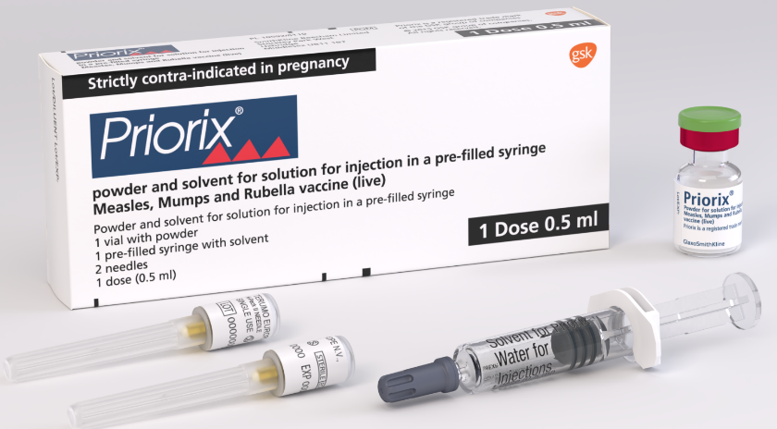
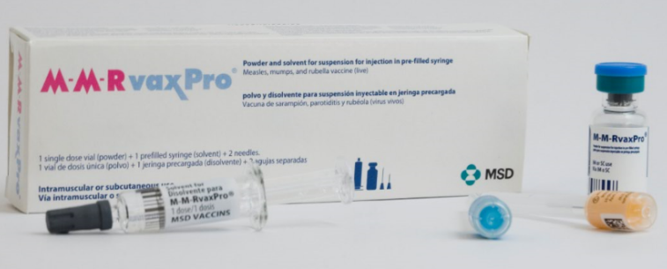
MMR vaccine
there are 2 MMR vaccines currently available for use in the NHS: Priorix and MMRVaxPro
both vaccines contain live, modified strains of measles, mumps and rubella viruses therefore they are contraindicated in pregnancy see full detail here.
MMRVaxPRO contains gelatine of porcine origin as a stabiliser
practices who serve communities who prefer porcine gelatine free products should order Priorix preferentially via Immform
MMR vaccines do not contain thiomersal or any preservatives
vaccine effectiveness of a single dose of MMR vaccine is around 95%. A second dose protects those who do not respond to the first - protection then increases to well above 95%
UK schedule:
Dose 1 at 1 year of age
Dose 2 at 3 years and 4 months
Infants from 6 months of age may be offered MMR vaccine (see Measles Green Book Chapter) as i) post exposure prophylaxis for measles or ii) if they are travelling to a measles endemic area where there is a current outbreak
Infants in their first year of life may not respond sufficiently to all components of the vaccine so doses given under 12 months of age should be discounted and repeated
Notes:
MMR vaccines for intramuscular (IM) administration are supplied either as a suspension in a pre-filled syringe or as a freeze dried powder and solution for reconstitution. They should be prepared in accordance with manufacturers instructions and shaken well before they are administered

Slide 7
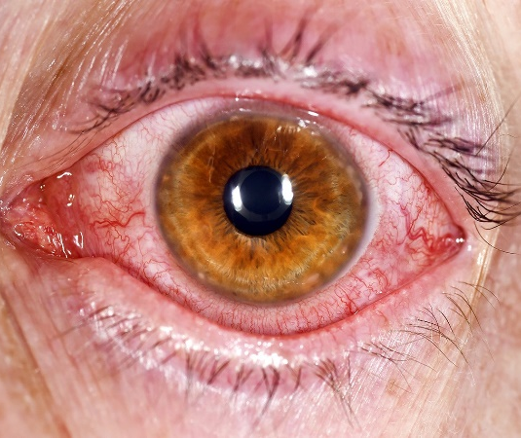
Clinical presentation: prodromal phase
2 to 4 days before the rash appears:
high fever
cough
coryza (runny nose)
conjunctivitis (pink eye)
fever typically increases, to peak around rash onset

Slide 8
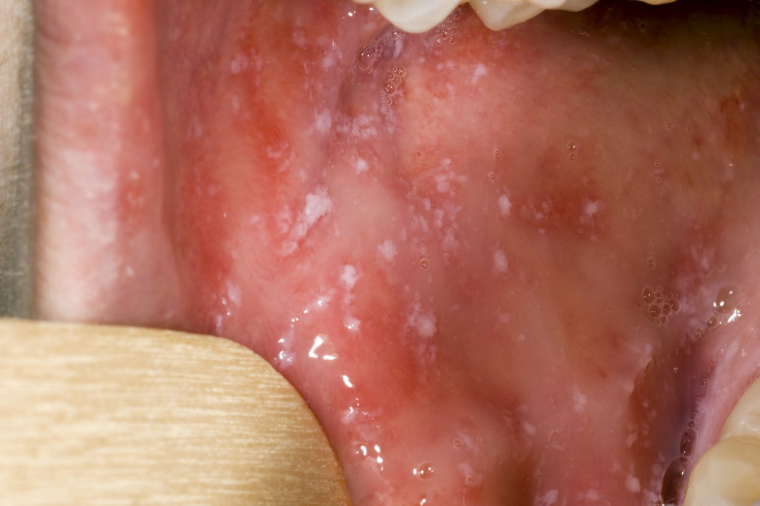
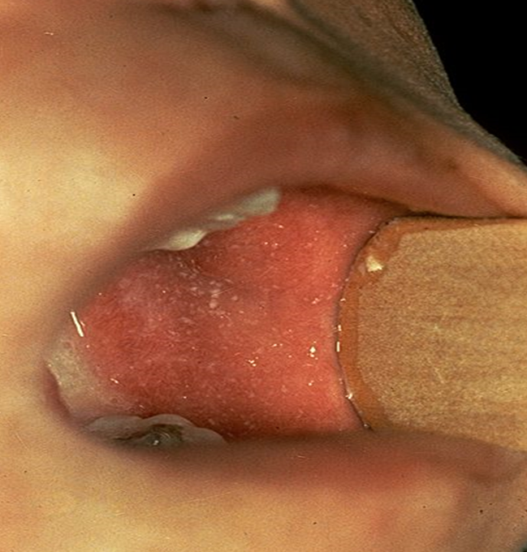
Clinical presentation: Koplik spots
Koplik spots are small white/bluish spots inside cheeks/back of the lips
they are characteristic of the prodromal phase
they may appear 1 to 4 days before the rash, but usually disappear on day 2 of the rash - so may not be present when case presents

Slide 9
Clinical presentation: rash
usually starts on the face (behind ears, on hairline)
spreads to trunk and rest of the body and can become generalised
red/brown spots
flat, with sometimes small raised bumps on top (maculopapular)
spots increase over 2 to 3 days; rash gradually expands
can join together to form blotchy patches, particularly on face and trunk
usually not itchy and no blisters
generally lasts for 3 to 7 days
more difficult to spot on dark skin

Slide 10
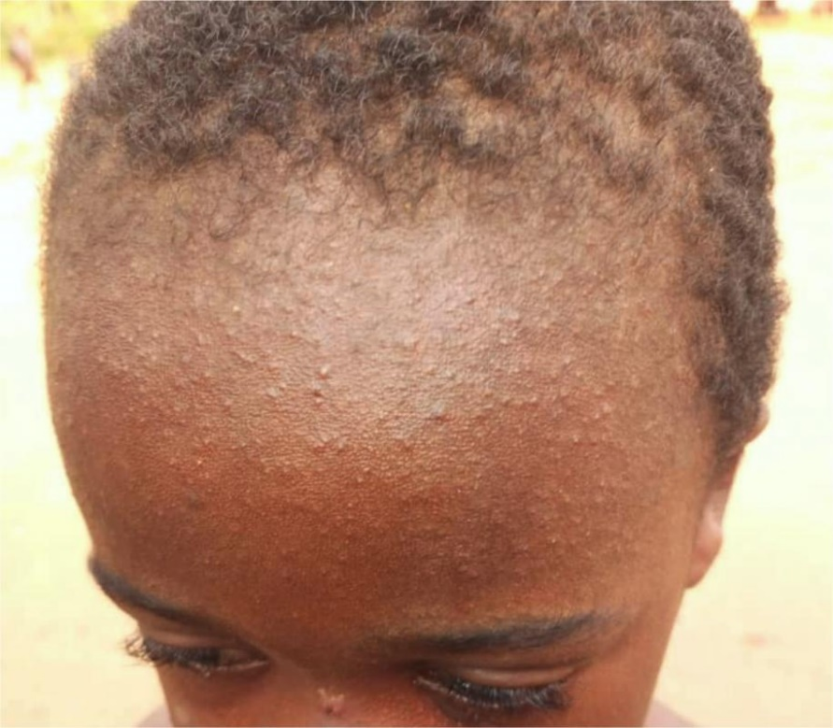
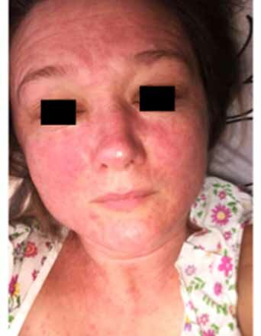
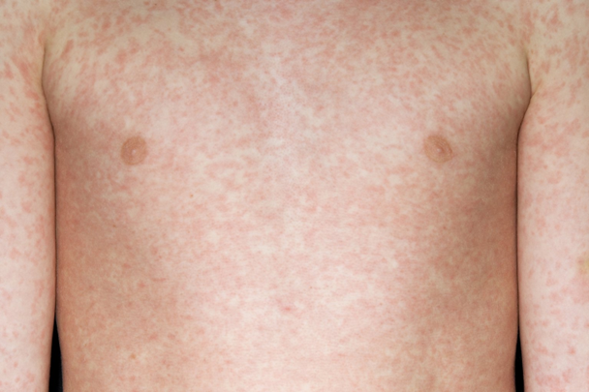
Clinical presentation-rash
Cases are infectious from 4 days before onset of rash to 4 days afterwards

Slide 11
Differential Diagnosis and risk assessment
several other common rash illnesses have similar presentations and can be considered as part of the differential diagnosis e.g. chickenpox, rubella, roseola, parvovirus infection, hand, foot and mouth disease, scarlet fever.
for further information see: Viral rash in Pregnancy guidance https://www.gov.uk/government/publications/viral-rash-in-pregnancy
in addition to the clinical presentation it is important to also consider factors that increase the likelihood of a measles diagnosis:
age: typical clinical presentation in a teenager or adult more likely to be measles
unvaccinated or partially vaccinated
contact with a confirmed or suspected case
recent travel to a measles endemic country or area
measles known to be circulating in local area
member of community with sub-optimal vaccine uptake
attended mass gatherings (e.g. festivals)

Slide 12
Complications
in pregnancy, measles can lead to miscarriage, stillbirth, premature birth or low birth weight
pregnant women, infants and immunocompromised individuals are most at risk of complications:
otitis media (7 to 9% of cases)
diarrhoea (8%)
pneumonia (1 to 6%)
convulsions (0.5%)
encephalitis (1 to 4 per 1,000 to 2,000 cases)

Slide 13
Risk assessment of contacts
Contact is defined as:
face to face contact of any length or
more than 15 minutes in a small, confined area
The most vulnerable contacts are:
infants
pregnant women
immunosuppressed individuals
If indicated, HNIG should be given as soon as possible, ideally within 72 hours and up to 6 days after exposure
Recommendations for pregnant women are based on a combination of age, vaccination history and / or antibody testing. For further information see: Measles Post-exposure Prophylaxis guidance: https://www.gov.uk/government/publications/measles-post-exposure-prophylaxis

Slide 14
Infection prevention and control: key actions
Standard Infection Control Precautions (SICPs) must be used by all healthcare workers at all times and in all settings. Comprehensive guidance and advice, including PPE, is available in the National Infection Prevention & Control Manual (NIPCM)
Staff involved in direct patient care (including anyone who has contact with patients e.g. porters, domestics, reception staff) should have documented evidence of 2 doses of the MMR vaccine or have positive antibody tests for measles, in keeping with national guidance
Transmission Based Precautions (TBPs) NHS England » Chapter 2: Transmission based precautions (TBPs) must be followed in addition to SICPs when caring for a laboratory-confirmed or suspected case of measles while they are considered to be infectious. More information can be found in appendix 11a of the NIPCM.
Measles is transmitted through the respiratory route (airborne or droplet spread) or by direct contact with the nasal or throat secretions of infected persons
Following suspected/confirmed patient vacation of the care area, allow sufficient time for clearance of infectious particles Refer to (HTM) 03-01 Specialised ventilation for healthcare buildings before cleaning/ decontaminating using either:
a combined detergent/disinfectant solution at a dilution of 1,000 parts per million available chlorine (ppm available chlorine (av.cl.)); or
a general-purpose neutral detergent in warm water followed by a solution of 1,000ppm av.cl).
a locally approved detergent and disinfectant.
Rooms/areas must be cleaned from highest to lowest points and from least to most contaminated points ensuring local policies are followed at all times.

Slide 15
Key actions
staff should have documented evidence of 2 doses of the MMR vaccine or have positive antibody tests for measles and rubella, according to national guidance
check MMR status of all pregnant women and refer unvaccinated / partially vaccinated women to their GP practice to catch-up after they deliver
direct anyone presenting with a rash in an antenatal clinic to a side room on arrival
unvaccinated pregnant contacts of a known case of measles (diagnosed by a healthcare professional) may require immunoglobulin (HNIG)
please contact your local Health Protection Team (HPT) (details can be found here https://www.gov.uk/health-protection-team) urgently for assistance with a risk assessment and advice on post exposure prophylaxis. Your HPT and Infection Prevention Control Team will also lead on a risk assessment for measles outbreak investigation and response

Slide 16
Resources:
UKHSA National Measles guidance (including post-exposure prophylaxis): https://www.gov.uk/government/publications/national-measles-guidelines
UKHSA template warn and inform letter: https://www.gov.uk/government/publications/measles-mumps-and-rubella-mmr-surveillance-form
Viral Rash in pregnancy guidance: https://www.gov.uk/government/publications/viral-rash-in-pregnancy
Measles Poster for health professionals: Measles: guidance, data and analysis - GOV.UK (www.gov.uk) (found under clinical management subheading)
Measles Green Book Chapter: https://www.gov.uk/government/publications/measles-the-green-book-chapter-21
NHS Infection Prevention and Control Manual: https://www.england.nhs.uk/publication/national-infection-prevention-and-control/
Immunisation of healthcare and laboratory staff: the green book, chapter 12: https://www.gov.uk/government/publications/immunisation-of-healthcare-and-laboratory-staff-the-green-book-chapter-12
Health and Social Care Act 2008: code of practice on the prevention and control of infections: https://www.gov.uk/government/publications/the-health-and-social-care-act-2008-code-of-practice-on-the-prevention-and-control-of-infections-and-related-guidance

Slide 17
Resources:
UK Measles and Rubella Elimination Strategy, UKHSA (formerly PHE), published January 2019: https://www.gov.uk/government/publications/measles-and-rubella-elimination-uk-strategy
MMR for all leaflet – routine programme: https://www.gov.uk/government/publications/mmr-for-all-general-leaflet
Pregnancy and immunisation leaflet: Pregnant? Immunisation helps to protect you and your baby from infectious diseases (publishing.service.gov.uk)
Measles: Protect yourself, protect others’ leaflet: https://assets.publishing.service.gov.uk/government/uploads/system/uploads/attachment_data/file/689712/Measles_adults_DL_Leaflet_03_.pdf
UKHSA Blog: What do I need to know about the MMR vaccine: https://ukhsa.blog.gov.uk/2022/02/01/what-do-i-need-to-know-about-the-mmr-vaccine/
Health Protection in children and young people settings including education: https://www.gov.uk/government/publications/health-protection-in-schools-and-other-childcare-facilities
Measles outbreaks poster and leaflets: https://www.gov.uk/government/publications/measles-outbreak

