Slide 1
Measles: update for Paediatrics and A&E
UKHSA Immunisation and Vaccine Preventable Disease Division - 2023

Slide 2
Introduction
overview, importance
prevention, MECC and Occupational Health
MMR vaccine
measles clinical presentation and complications
risk assessment of cases and contacts
key actions
resources

Slide 3
Overview-current situation
there has been a rise in measles cases in England in 2023
globally, activity has been increasing since 2022, with large outbreaks underway in South Asia and Africa
during the COVID-19 pandemic vaccine uptake rates fell globally
coverage for MMR in UK has fallen to the lowest level in a decade:
1st dose uptake in 2 year olds 89%, 2nd dose in 5 year olds 85.5%
to achieve and maintain measles elimination we need 95% uptake with 2 doses of the MMR vaccine by the time children turn 5 years
in Feb 2022, WHO Europe called for urgent action in all countries to catch-up children and adults who missed MMR vaccine doses, in order to prevent a resurgence of measles

Slide 4
Importance of Paediatrics and A&E
Patient facing staff should have documented evidence of 2 doses of the MMR vaccine or have positive antibody tests for measles and rubella, according to national guidance.
Staff need to be able to:
identify suspected cases and notify the Health Protection Team (HPT) promptly
take appropriate action to
stop onward transmission without delay
protect vulnerable contacts
Making Every Contact Count (MECC): Where appropriate, and particularly for individuals who do not engage with primary care, check if they are up to date with their MMR and vaccinate (or signpost to GP) if not

Slide 5
Prevention
signs should be placed in waiting areas advising patients with any rash illness to report to reception
A&E/Outpatient clinics receptionists / triage team should be made aware that patients with fever and a rash are potentially infectious and need to have clear instructions on the need to cohort / isolate them as soon as possible
patient facing staff should have documented evidence of 2 doses of the MMR vaccine or have positive antibody tests for measles and rubella, according to national guidance. This is important to protect themselves, their families and prevent transmission of measles in health care settings

Slide 6
MECC
Make Every Contact Count (MECC) - where appropriate, and particularly for individuals who do not engage with primary care, check if they are up to date with their MMR and vaccinate (or signpost to GP) if not
discuss (and if possible, offer) vaccination if unvaccinated
children should receive 2 doses of MMR vaccine at age 12 months and 3 years and 4 months
older children and adults who are unvaccinated or partially vaccinated should also be offered vaccination. There is no upper age limit – 2 doses should be given at least 4 weeks apart. It is safe to receive an extra MMR dose.

Slide 7
Measles: key facts
measles is caused by a virus that spreads very easily. One case of measles can infect 9 out of 10 of unvaccinated close contacts
transmitted through the respiratory route (airborne or droplet spread) or by direct contact with the nasal or throat secretions of infected persons
incubation period: 10 to 12 days from exposure to onset of symptoms, but can vary from 7 to 21 days
infectious period: 4 days before onset of rash to 4 days after onset of rash

Slide 8
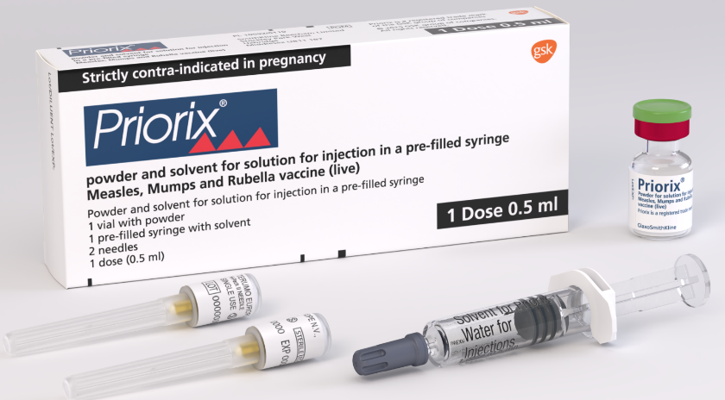
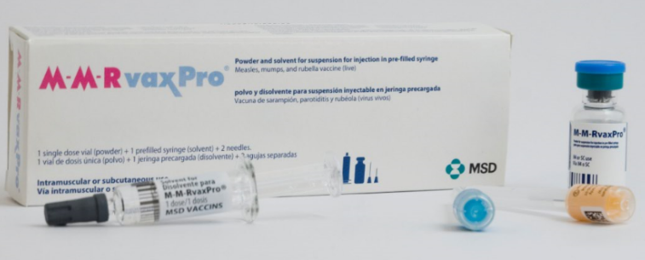
MMR vaccine
there are 2 MMR vaccines currently available for use in the NHS: Priorix and MMRVaxPro
both vaccines contain live, modified strains of measles, mumps and rubella viruses.
MMRVaxPRO contains gelatine of porcine origin as a stabiliser
practices who serve communities who prefer porcine gelatine free products should order Priorix preferentially via Immform
MMR vaccines do not contain thiomersal or any preservatives
vaccine effectiveness of a single dose of MMR vaccine is around 95%. A second dose protects those who do not respond to the first - protection then increases to well above 95%
UK schedule:
Dose 1 at 1 year of age
Dose 2 at 3 years and 4 months
Infants from 6 months of age may be offered MMR vaccine (see Measles Green Book Chapter) as i) post exposure prophylaxis for measles or ii) if they are travelling to a measles endemic area where there is a current outbreak
Infants in their first year of life may not respond sufficiently to all components of the vaccine so doses given under 12 months of age should be discounted and repeated
Notes:
MMR vaccines for intramuscular (IM) administration are supplied either as a suspension in a pre-filled syringe or as a freeze dried powder and solution for reconstitution. They should be prepared in accordance with manufacturers instructions and shaken well before they are administered

Slide 9
Transmission
measles is one of the world’s most contagious diseases
one person infected with measles can infect 9 out of 10 of unvaccinated close contacts
transmitted through the respiratory route (airborne or droplet spread) or by direct contact with the nasal or throat secretions of infected persons
transmission is high amongst household contacts and other individuals with prolonged close contact

Slide 10
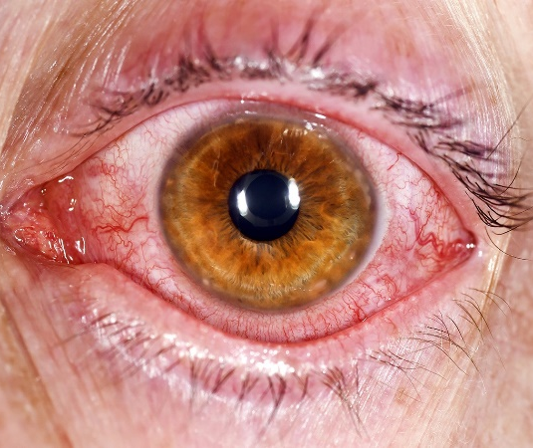
Clinical presentation: prodromal phase
2 to 4 days before the rash appears:
high fever
cough
coryza (runny nose)
conjunctivitis (pink eye)
fever typically increases, to peak around rash onset

Slide 11
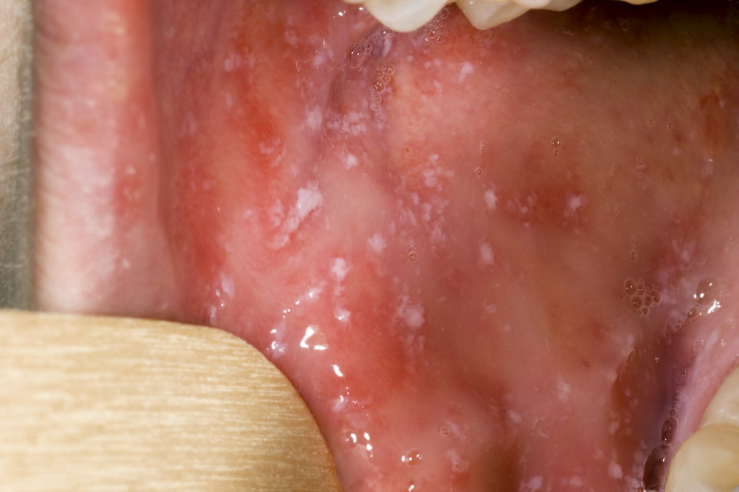
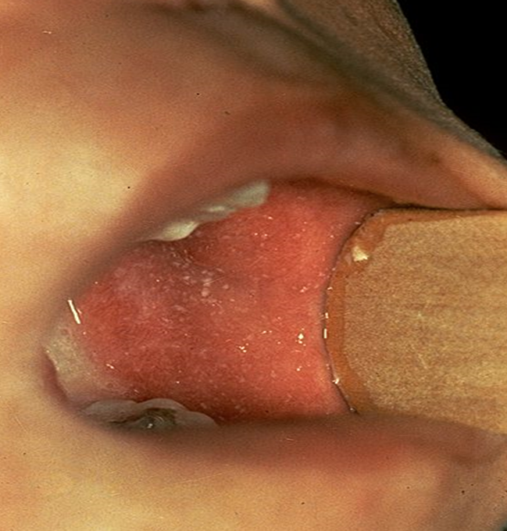
Clinical presentation: Koplik spots
Koplik spots are small white/bluish spots inside cheeks/back of the lips
they are characteristic of the prodromal phase
they may appear 1 to 4 days before the rash, but usually disappear on day 2 of the rash- so may not be present when case presents

Slide 12
Clinical presentation: rash
usually starts on the face (behind ears, on hairline)
spreads to trunk and rest of the body and can become generalised
red/brown spots
flat, with sometimes small raised bumps on top (maculopapular)
spots increase over 2 to 3 days; rash gradually expands
can join together to form blotchy patches, particularly on face and trunk
usually not itchy and no blisters
generally lasts for 3 to 7 days
more difficult to spot on dark skin

Slide 13
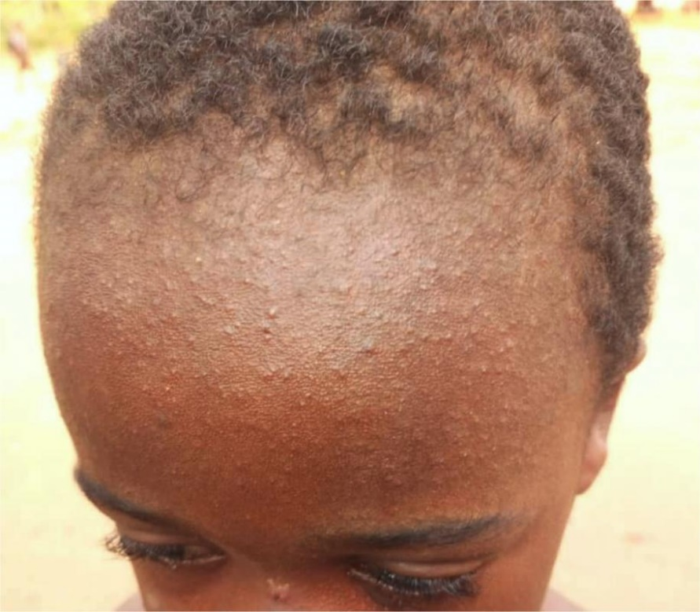
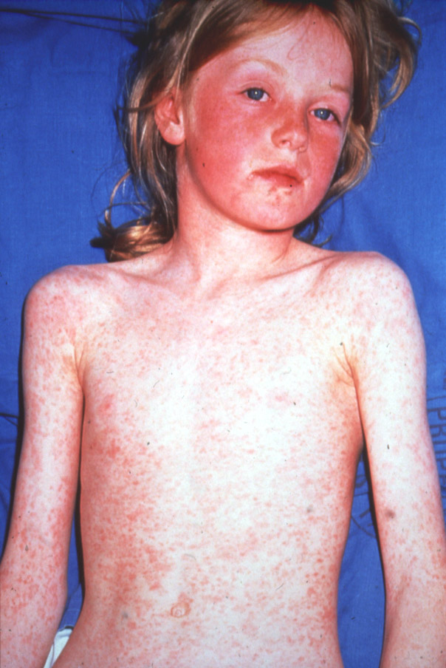
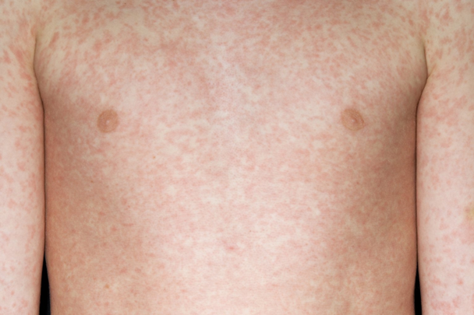
Clinical presentation-rash
Cases are infectious from 4 days before onset of rash to 4 days afterwards

Slide 14
Differential diagnosis and risk assessment
Several other common rash illnesses have similar presentations and can be considered as part of the differential diagnosis eg chickenpox, rubella, roseola, parvovirus infection, hand, foot and mouth disease, scarlet fever.
In addition to the clinical presentation it is important to also consider factors that increase the likelihood of a measles diagnosis:
age: typical clinical presentation in a teenager or adult more likely to be measles
unvaccinated or partially vaccinated
contact with a confirmed or suspected case
recent travel to a measles endemic country or area
measles known to be circulating in local area
member of community with sub-optimal vaccine uptake
attended mass gatherings (eg festivals)

Slide 15
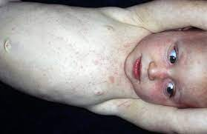
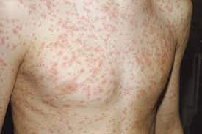
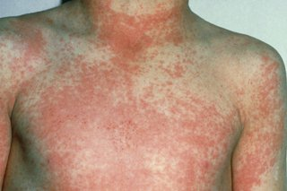
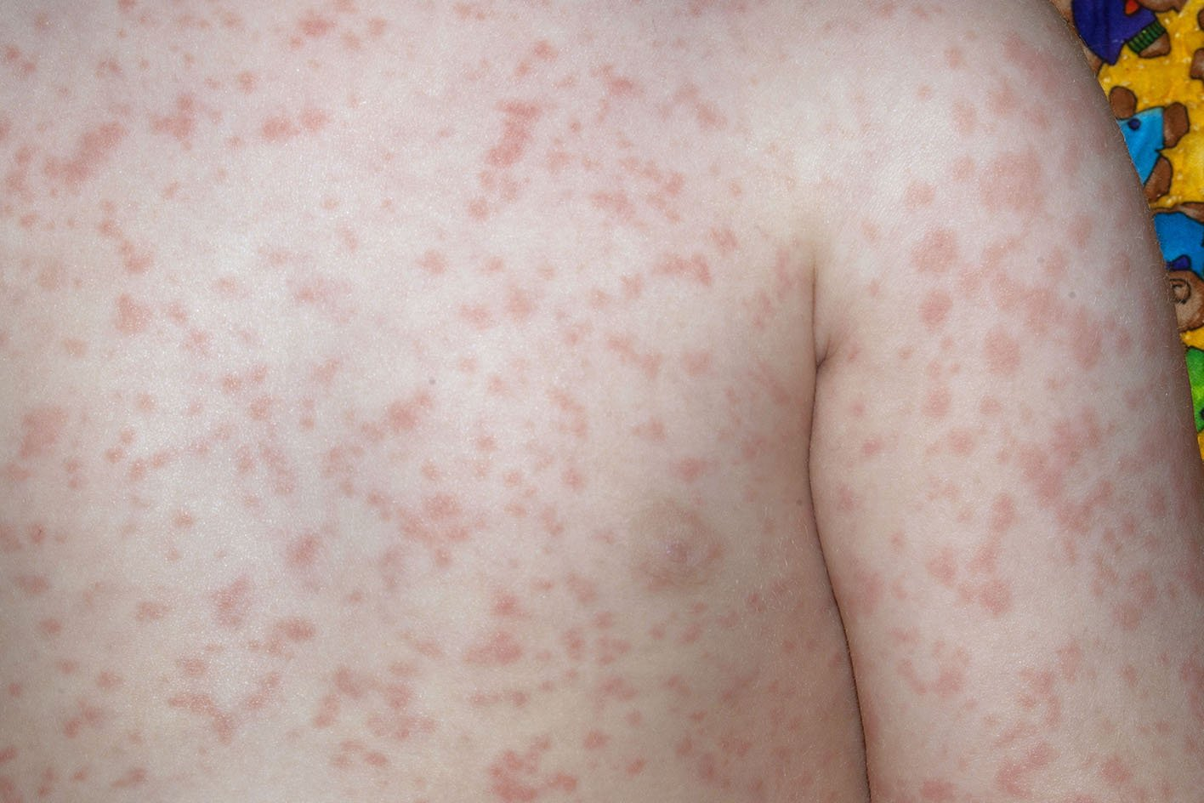
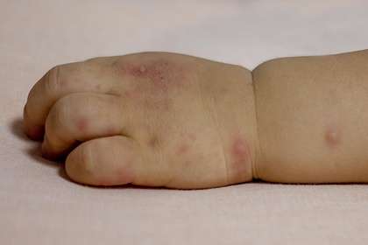
Differential diagnosis
Roseola; pinkish-red spots, patches or bumps, starts on chest, stomach and back, then spreads to face, neck and arms, not usually itchy, may be harder to see on brown or black skin
Rubella (German measles); spotty rash starts on face or behind ears, spreads to neck and body, maybe slightly itchy
Chicken pox; rash turns into itchy blisters that crust over
Scarlet fever; red blotches that turn into fine pink-red rash, feels like sandpaper; looks like sunburn, may be itchy, maybe harder to see on brown or black skin but can feel it
Parvo virus 19 (Erythema infectiosum, fifth disease); bright red ‘slapped cheek’ rash- more common in children, then light pink rash may appear on chest, stomach, arms and legs, can be itchy, may be harder to see on brown and black skin
Hand, foot and mouth; raised rash, spots on hands and feet, sometimes thighs and bottom, can look pink, red, or darker than surrounding skin, depending on skin tone, can turn into grey lighter blisters, can be painful

Slide 16
Complications
otitis media (7 to 9% of cases)
diarrhoea (8%)
pneumonia (1 to 6%)
convulsions (0.5%)
encephalitis (1 to 4 per 1,000 to 2,000 cases)
subacute sclerosing pan-encephalitis (SSPE) (in <2 year olds 1 in 8,000 cases)
in pregnancy can lead to miscarriage, stillbirth, premature birth or low birth weight
most at risk of complication are infants, pregnant and immunosuppressed

Slide 17
Risk assessment of cases
Check:
Vaccination status
Recent exposure to someone with rash/illness
Recent travel
Any contacts who are immunocompromised, vulnerable or a health care worker
face to face contact of any length or more than 15 minutes in a small, confined area is considered as exposure and will require follow up
Report any suspected case urgently via phone to your local Health Protection Team (HPT)
contact details can be found here https://www.gov.uk/health-protection-team
The HPT will conduct a risk assessment, arrange testing – routine or urgent - and advise on public health action for immunocompromised or vulnerable contacts (aged under 1, pregnant, unvaccinated)
Exclude suspected cases from nursery/educational setting/work until full 4 days after onset of rash
For further information see National Measles Guidance

Slide 18
Risk assessment of contacts
if the patient was not isolated and exposed other patients, the HPT staff will help you with a risk assessment and advise on actions
the most vulnerable groups who may require immunoglobulin are:
infants
pregnant women
Immunosuppressed individuals
if indicated, HNIG / IVIG should be given as soon as possible, ideally within 72 hours and up to 6 days after exposure
for further information see UKHSA National Measles Guidance
any health care worker who is not immune (i.e. does not have evidence of 2 doses of MMR or laboratory confirmation of measles immunity (IgG for measles)) will require exclusion from work from days 5 to 21 post exposure

Slide 19
Infection prevention and control: key actions
Standard Infection Control Precautions (SICPs) must be used by all healthcare workers at all times and in all settings. Comprehensive guidance and advice, including PPE, is available in the National Infection Prevention & Control Manual (NIPCM)
Staff involved in direct patient care (including anyone who has contact with patients e.g. porters, domestics, reception staff) should have documented evidence of 2 doses of the MMR vaccine or have positive antibody tests for measles, in keeping with national guidance
Transmission Based Precautions (TBPs) NHS England » Chapter 2: Transmission based precautions (TBPs) must be followed in addition to SICPs when caring for a laboratory-confirmed or suspected case of measles while they are considered to be infectious. More information can be found in appendix 11a of the NIPCM.
Measles is transmitted through the respiratory route (airborne or droplet spread) or by direct contact with the nasal or throat secretions of infected persons
Following suspected/confirmed patient vacation of the care area, allow sufficient time for clearance of infectious particles Refer to (HTM) 03-01 Specialised ventilation for healthcare buildings before cleaning/ decontaminating using either:
a combined detergent/disinfectant solution at a dilution of 1,000 parts per million available chlorine (ppm available chlorine (av.cl.)); or
a general-purpose neutral detergent in warm water followed by a solution of 1,000ppm av.cl).
a locally approved detergent and disinfectant.
Rooms/areas must be cleaned from highest to lowest points and from least to most contaminated points ensuring local policies are followed at all times.

Slide 20
Key actions
cohort / isolate patients presenting with a rash and a fever (especially if unvaccinated) on arrival to:
stop onward transmission without delay
protect vulnerable contacts
report suspected measles cases urgently by phone to your local Health Protection Team (HPT)
staff should have documented evidence of 2 doses of the MMR vaccine or have positive antibody tests for measles and rubella, according to national guidance
Make Every Contact Count (MECC) - where appropriate, and particularly for individuals who do not engage with primary care, check if they are up to date with their MMR and vaccinate (or signpost to GP) if not

Slide 21
Resources:
UKHSA National Measles guidance (including post-exposure prophylaxis): https://www.gov.uk/government/publications/national-measles-guidelines
Measles Poster for health professionals: Measles: guidance, data and analysis - GOV.UK (www.gov.uk) (found under clinical management subheading)
Measles Green Book Chapter: https://www.gov.uk/government/publications/measles-the-green-book-chapter-21
NHS Infection Prevention and Control Manual: https://www.england.nhs.uk/publication/national-infection-prevention-and-control/
Immunisation of healthcare and laboratory staff: the green book, chapter 12: https://www.gov.uk/government/publications/immunisation-of-healthcare-and-laboratory-staff-the-green-book-chapter-12
Health and Social Care Act 2008: code of practice on the prevention and control of infections: https://www.gov.uk/government/publications/the-health-and-social-care-act-2008-code-of-practice-on-the-prevention-and-control-of-infections-and-related-guidance

Slide 22
Resources:
UK Measles and Rubella Elimination Strategy, UKHSA (formerly PHE), published January 2019: https://www.gov.uk/government/publications/measles-and-rubella-elimination-uk-strategy
MMR for all leaflet – routine programme: https://www.gov.uk/government/publications/mmr-for-all-general-leaflet
Measles: Protect yourself, protect others’ leaflet: https://assets.publishing.service.gov.uk/government/uploads/system/uploads/attachment_data/file/689712/Measles_adults_DL_Leaflet_03_.pdf
UKHSA Blog: What do I need to know about the MMR vaccine: https://ukhsa.blog.gov.uk/2022/02/01/what-do-i-need-to-know-about-the-mmr-vaccine/
Health Protection in children and young people settings including education: https://www.gov.uk/government/publications/health-protection-in-schools-and-other-childcare-facilities
Measles outbreaks poster and leaflets: https://www.gov.uk/government/publications/measles-outbreak

