Slide 1
The 4CMenB vaccination programme against gonorrhoea
An introduction for healthcare practitioners
July 2025
Notes:
Background
Gonorrhoea is a major global public health problem, with rising incidence globally and increasing resistance to antibiotics (WHO, 2022). Caused by the bacterium Neisseria gonorrhoeae, gonorrhoea is one of the most common bacterial sexually transmitted infections (STI) in England and worldwide. If left untreated, it can cause complications such as pelvic inflammatory disease, ectopic pregnancy and infertility.
In England, gonorrhoea diagnoses have been generally increasing over time, reaching nearly 83,000 cases in 2022. Gay, bisexual and other men who have sex with men (GBMSM) are at significantly higher risk of infection than heterosexuals, accounting for nearly half of all gonorrhoea diagnoses in England in 2022.
There is currently no licensed vaccine against Neisseria gonorrhoeae. In 2013, a meningococcal B vaccine, 4CMenB (Bexsero®) was licensed in Europe for protection against group B meningococcal (MenB) disease. 4CMenB is currently used in the routine childhood programme for the prevention of meningococcal disease (meningitis and septicaemia). Although their clinical manifestations can be different, the bacterium which causes gonorrhoea (Neisseria gonorrhoeae) is very closely related to the bacterium which causes meningococcal disease (Neisseria meningitidis). This gives the potential for cross-protection against Neisseria gonorrhoeae from 4CMenB. Studies have demonstrated some protection against gonorrhoea in people at high risk of gonorrhoea infection who were offered 4CMenB for protection against MenB disease (Ladhani et al., 2024; Wang et al., 2023)
In November 2023, the Joint Committee on Vaccination and Immunisation (JCVI) advised a targeted, opportunistic vaccine programme using 4CMenB for protection against gonorrhoea primarily in GBMSM at higher risk of infection (JCVI, 2023). This was done acknowledging that, as protection against gonorrhoea is not currently a licensed indication for 4CMenB, this advice is based on off-label use of the vaccine.
Note: Meningococcal group B is commonly referred to as MenB. For the purpose of this resource MenB is used throughout this document when referring to the disease. 4CMenB is the vaccine currently in use to protect again MenB in the UK routine infant and targeted at risk programmes. Bexsero® is currently the only licensed 4CMenB vaccine.

Slide 2
Note to trainers
this slide set contains a collection of core slides for both individual use and use or adaptation during the delivery of 4CMenB vaccination programme against gonorrhoea training. Trainers should select the slides required depending upon the background and experience of the immunisers they are training and according to the role they will have in delivering the gonorrhoea vaccination programme
the information in this slide set was correct at time of publication. From time to time, new vaccines may be introduced and current vaccines withdrawn. Updates to the slide set will be made so please check online to ensure you are using the latest version
the next slide contains information on the content, which can be used to select which sections you require

Slide 3
Contents
Section/topic(s) | Slide number
Aims of this resource | 4
Learning outcomes | 5
Significant messages | 6
Gonorrhoea (clinical presentation, route of transmission and incubation period) | 7
Gonorrhoea epidemiology (disease epidemiology, antimicrobial resistance) | 11
Meningococcal B vaccine (4CMenB) and protection against gonorrhoea (background, eligibility, safety, efficacy, composition, supply, schedule, administration, co-administration, contraindications and precautions, adverse reactions, Yellow Card reporting requirements) | 34
Summary & resources (key messages, links) | 35

Slide 4
Aims of this resource
to raise awareness of the rationale for and JCVI advice about the use of the 4CMenB (a vaccine currently used in the MenB routine infant and targeted at-risk group programmes), to also protect against gonorrhoea
to support healthcare practitioners in sexual health settings involved in identifying, immunising and/or having conversations with at-risk individuals who may be eligible for vaccination as part of the vaccination programme against gonorrhoea
to support healthcare practitioner understanding of the rationale, benefits and eligibility for 4CMenB vaccination as part of the programme against gonorrhoea, enabling them to promote uptake effectively

Slide 5
Learning outcomes
By the end of this session, healthcare practitioners should be able to:​
describe the aetiology and epidemiology of gonorrhoea
explain the recommendations for use of the meningococcal vaccine 4CMenB ​for protection against gonorrhoea in populations at high risk of infection
state the correct handling, preparation and safe administration requirements of 4CMenB
access additional information

Slide 6
Significant messages
Gonorrhoea is a major global public health problem, with rising incidence and increasing resistance to all antibiotics used to treat the infection
there is currently no licenced vaccine against Neisseria gonorrhoeae
the bacterium which causes gonorrhoea (Neisseria gonorrhoeae) is genetically closely related to the bacterium which causes meningococcal disease (Neisseria meningitidis)
studies have shown that 4CMenB, which is a vaccine licensed for prevention of serogroup B (MenB) invasive meningococcal disease (IMD), also provides 30-40% protection against gonorrhoea
the Joint Committee on Vaccination and Immunisation (JCVI) advised a targeted, opportunistic vaccine programme using 4CMenB for protection against gonorrhoea primarily in GBMSM at higher risk of infection
the Government has agreed to introduce this programme, commencing 1st August 2025
Notes:
JCVI advice on the use of meningococcal B vaccination for the prevention of gonorrhoea - GOV.UK

Slide 7
Gonorrhoea

Slide 8
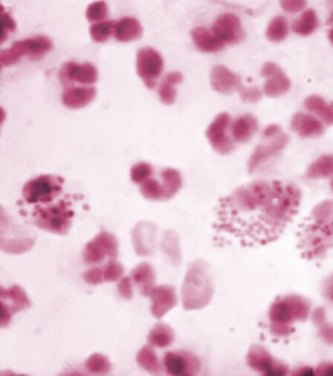
Gonorrhoea overview
gonorrhoea is caused by the bacterium Neisseria gonorrhoeae
a Gram-negative diplococcus that infects and colonises mucosal surfaces in the urethra, endocervix, rectum, pharynx and conjunctiva
it is very effective at evading the human immune response, so natural infection does not induce protective immunity, and recurrent infections are common
gonorrhoea is one of the most common bacterial sexually transmitted infections (STI) in England and worldwide
gonorrhoea is a major global public health problem, with rising incidence and increasing resistance to available antibiotics
gay, bisexual and other men who have sex with men (GBMSM) are at significantly higher risk of infection than heterosexuals, accounting for nearly half of all gonorrhoea diagnoses in England in 2022
Image source: UKHSA
Notes:
Neisseria gonorrhoeae is also known as the gonococcus
Source: the Green Book chapter: Gonorrhoea
https://www.gov.uk/government/collections/immunisation-against-infectious-disease-the-green-book

Slide 9
Gonorrhoea
Incubation period:
range 1 – 10 days post-exposure
Route of transmission:
sexually, including condomless vaginal, oral or anal sex, or genital contact with infected secretions
humans are the only known host and reservoir
Notes:
Source: the Green Book chapter: Gonorrhoea
https://www.gov.uk/government/collections/immunisation-against-infectious-disease-the-green-book

Slide 10
Gonorrhoea: clinical presentation
Signs and symptoms:
can be asymptomatic (but transmission can still occur)
thick green/yellow penile or vaginal discharge
pain on urination
Key complications:
disseminated gonococcal infection
in women, pelvic inflammatory disease, ectopic pregnancy and infertility
gonococcal conjunctivitis (or gonococcal opthalmia neonatorum in neonates)
protective immunity is not generated following infection, so recurrent infections are common
resistance to all classes of antimicrobials used to treat gonorrhoea has been observed, making treatment challenging in some cases of extensively antibiotic-resistant infections
Notes:
Symptoms are more likely to occur with urethral infections, whereas endocervical, rectal or pharyngeal infections are more likely to be asymptomatic.
Gonococcal infections can also increase the risk of acquiring other sexually transmitted infections, including HIV.
Source: the Green Book chapter: Gonorrhoea
https://www.gov.uk/government/collections/immunisation-against-infectious-disease-the-green-book
Gonococcal conjunctivitis (GC), also known as gonococcal ophthalmia neonatorum when it occurs in neonates, is an infection transmitted by contact of the eyes with infected genital secretions from a person with genital gonorrhea infection. Infection is acquired from infected mothers during passage through the birth canal.

Slide 11
Gonorrhoea epidemiology

Slide 12
Disease epidemiology
gonorrhoea surveillance commenced in the UK over 100 years ago
there has been an increasing trend in gonorrhoea diagnoses since the early 2000s, and rates have more than doubled in the last decade (31,177 in 2013 to 82,592 in 2022)
the number of diagnoses in 2022 was the highest annual number on record
between 2021 and 2022, the number of gonorrhoea diagnoses increased by 50.3% across all ages and case rates nearly doubled in young people aged 15 to 24 years
of the number diagnosed in 2022, GBMSM accounted for nearly half of all cases
Notes:
Source: Sexually transmitted infections and screening for chlamydia in England: 2022 report - GOV.UK (www.gov.uk)
Source: the Green Book chapter: Gonorrhoea https://www.gov.uk/government/collections/immunisation-against-infectious-disease-the-green-book
Diagnosis rates of gonorrhoea remain highest among specific population groups; gay, bisexual and other men who have sex with men (GBMSM) and people of black Caribbean ethnicity continue to experience disproportionately high rates of gonorrhoea. GBMSM are at significantly higher risk of infection than heterosexuals.,

Slide 13
Disease epidemiology: England
Number of new gonorrhoea diagnoses among English residents accessing sexual health services, 2013 to 2022
Notes:
Source: Sexually transmitted infections and screening for chlamydia in England: 2022 report - GOV.UK (www.gov.uk)

Slide 14
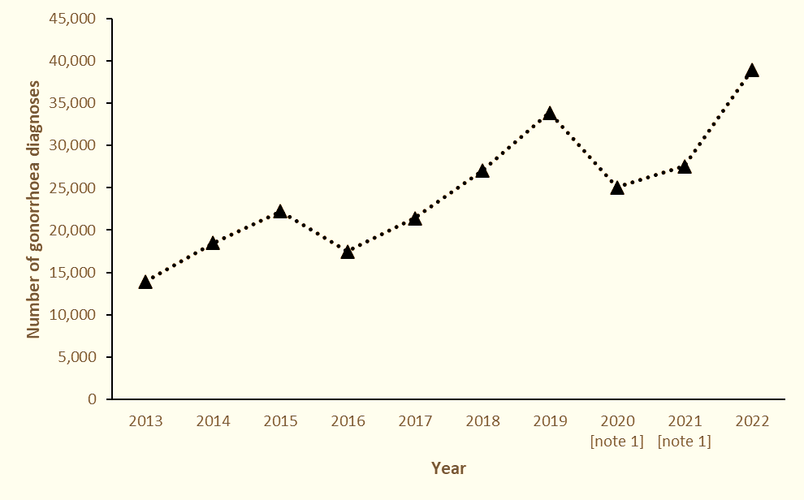
Disease epidemiology: GBMSM
Number of gonorrhoea diagnoses among GBMSM accessing sexual health services, 2013 to 2022
Note 1: Data reported in 2020 and 2021 is notably lower than previous years due to the disruption to SHSs during the national response to the COVID-19 pandemic.
Notes:
Source: the Green Book chapter: Gonorrhoea
Gonorrhoea: the green book chapter - GOV.UK

Slide 15
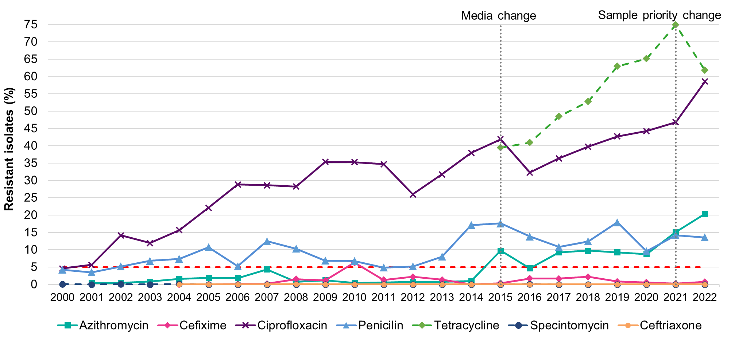
Gonorrhoea and antimicrobial resistance
Percentage of N. gonorrhoeae isolates resistant to selected antimicrobials, England and Wales, 2000 to 2022*
N. gonorrhoeae has developed resistance to all classes of antimicrobials recommended to treat gonorrhoea
Notes:
*Note: due to changes in the diagnostic sensitivity medium used to test antimicrobial susceptibility of sentinel surveillance isolates, MICs for the 2015 to 2022 collections are not directly comparable with those from previous years. Trends from 2000 to 2014 compared to 2015 to 2022 must be interpreted with caution (point of change indicated by vertical dashed black line), particularly for azithromycin and tetracycline. Source: GRASP report: data to June 2023. https://www.gov.uk/government/publications/gonococcal-resistance-to-antimicrobials-surveillance-programme-grasp-report/grasp-report-data-to-june-2023.
Gonorrhoea causes significant morbidity and remains a public health concern globally.
Increased resistance to most antibiotics used to treat gonococcal infection has been reported worldwide, with extensively resistant strains exhibiting resistance to multiple antibiotic classes.
The World Health Organization considers Neisseria gonorrhoeae to be a high priority pathogen due to this widespread antimicrobial resistance.

Slide 16
Meningococcal B vaccine (4CMenB) and protection against gonorrhoea

Slide 17
Background
there is currently no licensed vaccine against Neisseria gonorrhoeae, the bacterium which causes gonorrhoea
although they have different clinical manifestations, Neisseria gonorrhoeae is genetically closely related to the bacterium which causes meningococcal disease (Neisseria meningitidis)
following a group B meningococcal disease outbreak in New Zealand, a MenB vaccine (MeNZB) was offered universally to children and young people from 2004
post-implementation surveillance identified that, as well as protection against MenB disease, there was also a decline in gonorrhoea rates in vaccinated adolescents and young adults, indicating an additional protective effect against Neisseria gonorrhoeae
Notes:
Source: the Green Book chapter: Gonorrhoea https://www.gov.uk/government/collections/immunisation-against-infectious-disease-the-green-book
Neisseria meningitidis can be divided into antigenically distinct capsular groups. There are currently 12 identified groups, of which groups B, C, W and Y are the most common causes of invasive disease in the UK.
Meningococcal vaccines have significantly reduced the incidence of meningococcal disease in the past two decades.

Slide 18
Background
4CMenB vaccine (Bexsero^{®)} could potentially provide even greater protection against gonorrhoea than the New Zealand outbreak vaccine (MeNZB) because 4CMenB contains the MeNZB outer membrane vesicle (OMV) as well as a recombinant MenB surface protein antigen (NHBA) which is commonly found on the surface of both meningococci and gonococci
observational studies among adolescents and young adults in Canada, Australia and the USA, where 4CMenB has been used, found a 30-40% lower incidence of gonorrhoea in individuals who have received 4CMenB compared with unvaccinated individuals
no other MenB vaccine has been shown to provide this cross-protection including MenB-Fhbp, which does not contain the MeNZB outer membrane vesicle (OMV) or the NHBA antigen
Notes:
Source: the Green Book chapter: Gonorrhoea https://www.gov.uk/government/collections/immunisation-against-infectious-disease-the-green-book
Source: JCVI independent report: https://www.gov.uk/government/publications/meningococcal-b-vaccination-for-the-prevention-of-gonorrhoea-jcvi-advice-10-november/jcvi-advice-on-the-use-of-meningococcal-b-vaccination-for-the-prevention-of-gonorrhoea)

Slide 19
JCVI advice
In November 2023, JCVI considered the evidence and advised that:
a targeted programme should be initiated using the 4CMenB (Bexsero®) vaccine for the prevention of gonorrhoea in those who are at greatest risk of infection
the programme should be offered opportunistically through sexual health services
as protection against gonorrhoea isn’t currently a licensed indication for 4CMenB, this advice is based on off-label use of the vaccine
Notes:
Source: JCVI independent report: https://www.gov.uk/government/publications/meningococcal-b-vaccination-for-the-prevention-of-gonorrhoea-jcvi-advice-10-november/jcvi-advice-on-the-use-of-meningococcal-b-vaccination-for-the-prevention-of-gonorrhoea)

Slide 20
Gonorrhoea vaccination eligibility
The main group who are eligible are GBMSM at increased risk of gonorrhoea infection, attending a sexual health clinic.
For operational purposes, this GBMSM group includes those:
with bacterial sexually transmitted infection (such as gonorrhoea, chlamydia or syphilis) in the previous 12 months
reporting sex with 5 or more sexual partners in the previous 3 months
Whilst gonorrhoea incidence remains the highest in the eligible GBMSM group as defined above, sexual health clinical professionals may perform individual risk assessment and consider the offer of 4CMenB to the small number of individuals with an incidence of gonorrhoea approaching that in the eligible group, such as sex workers practicing condomless sex and others assessed as having a similar incidence as the eligible GBMSM group. Note that vaccination in these circumstances is outside the scope of the PGD and instead, a Patient Specific Direction (PSD) or a prescription must be used.
Healthcare practitioners should familiarise themselves with and follow the Gonorrhoea: the green book chapter - GOV.UK and relevant operational guidance.
Notes:
In the cost-effectiveness modelling reviewed by the JCVI, GBMSM at increased risk of gonorrhoea were defined as GBMSM diagnosed with gonorrhoea in sexual health clinics and GBMSM attending sexual health clinics who reported high-risk sexual behaviour (multiple sexual partners). Healthcare practitioners should familiarise themselves with the information in the Green Book chapter and applicable operational guidance before offering the vaccine.

Slide 21
4CMenB safety, efficacy and use
4CMenB has been widely used across the world since licensure in 2013
although primarily used for the infant vaccination schedule in the UK, it has also been given to millions of adolescents and adults worldwide
twenty countries in addition to the UK also use 4CMenB for children, adolescents and adults who are deemed to be at increased risk of disease
in the US, individuals aged 16 to 23 years can receive MenB vaccination as part of a joint clinical decision
this means there is extensive real world and clinical trial data to show that 4CMenB is safe and immunogenic in children, adolescents and adults

Slide 22
4CMenB effectiveness against gonorrhoea
observational studies carried out in adolescents and young adults in Canada, Australia and the United States of America (USA) have found lower incidence of gonorrhoea in individuals vaccinated with 4CMenB compared with unvaccinated individuals
A 2024 systematic review of published cohort and case-controlled studies estimated a pooled 4CMenB vaccine effectiveness of 33-34% (Wang et al., Journal of Infection 2024)
Real world data from South Australia, where 4CMenB is routinely offered to adolescents, estimate that the vaccine provided 46% protection against gonorrhoea for at least 4 years after vaccination (Wang et al., OFID 2024)
studies are ongoing to estimate the duration of protection and the need for any booster dose(s)
the vaccine doesn’t provide complete protection against gonorrhoea, so condoms are important to protect not only against gonorrhoea but other STIs too

Slide 23
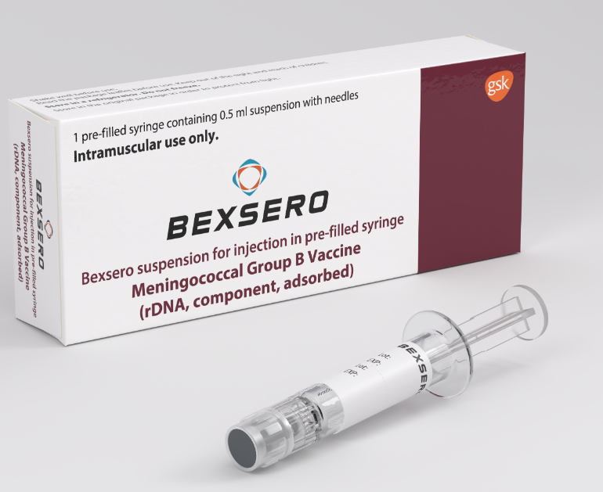
4CMenB vaccine: Bexsero®
4CMenB (Bexsero^{®):}
is the only MenB vaccine used routinely in the UK, currently in the national infant immunisation programme and for at-risk groups
is licensed for use against MenB disease, meaning use in the gonorrhoea vaccination programme is off label
is centrally supplied through ImmForm in packs of one or ten
It is important that immunisers familiarise themselves with the vaccine and its product information to avoid administration errors
Image courtesy of GSK
Notes:
Offering vaccines of-label means that, although the vaccine is authorised for use, it’s being used in a way that is slightly different from the strict terms laid down in its license. When a vaccine is being used ‘off-label’, it means that the clinical expert members of the JCVI have advised that there are clear benefits of using the vaccine in this way and that the vaccine is still considered to be safe and effective. ‘Off-label’ use of vaccines does not mean they are unlicensed – they are licensed for use in different people or to be used in a slightly different way from the license recommendation. The UKHSA produces resources on the off-label use of vaccines: Off-label vaccine: leaflets - GOV.UK

Slide 24
Composition of 4CMenB
4CMenB is a recombinant protein vaccine (meaning a small piece of meningococcal DNA is placed into bacterial or yeast cells that are then used to manufacture antigens which, when extracted and purified, are made into a vaccine thus allowing them to be injected and trigger an immune response)
It is called 4CMenB because it contains four MenB antigen components:
  recombinant Neisseria meningitidis group B NHBA fusion protein
  recombinant Neisseria meningitidis group B NadA protein
  recombinant Neisseria meningitidis group B fHbp fusion protein
  outer membrane vesicles (OMV), containing the PorA protein, from Neisseria meningitidis group B strain NZ98/254 used in the New Zealand outbreak
It also contains these excipients: sodium chloride, histidine, sucrose, water for injections
4CMenB does not contain any live organisms so cannot cause meningococcal disease
Notes:
Bexsero Meningococcal Group B vaccine for injection in pre-filled syringe - Summary of Product Characteristics (SmPC) - (emc) | 5168

Slide 25
Supply and handling of 4CMenB
the vaccines are supplied in packs sizes of one or ten, with or without needles
the vaccine is supplied in a pre-filled syringe (type I glass) with a plunger stopper (butyl rubber) and with a rubber tip cap, both made with synthetic rubber.
each vaccine has a volume of 0.5mls of suspension per syringe
during storage, the contents of the syringe may settle with off-white deposits being noticeable
before use, the pre-filled syringe must be shaken well forming a homogenous suspension that should be administered immediately
the vaccine should not be administered where there are variations in physical appearance (for example, not a homogenous suspension) or signs of foreign particulate are observed after shaking
the vaccine has a shelf life of four years when stored in its original packaging in a refrigerator at the recommended temperatures of +2ºC and +8ºC
it is important not to over-order vaccines and only order what is needed for a two-to-four-week period

Slide 26
4CMenB schedule
The 4CMenB course consists of:
two doses of 0.5ml by injection (next slide) at least 4 weeks apart
no maximum time interval limit between the two vaccine doses. Pragmatically and opportunistically, the second dose can be scheduled for the next clinic attendance, which may be after 3, 6 or 12 months
there is no need to recommence the primary immunisation schedule even after a prolonged interval between the two doses
no recommendations for 4CMenB booster doses in eligible adults who have received two doses as part of their primary immunisation
complete the patient record card and ask them to retain it and return for the second appointment.

Slide 27



UKHSA is measuring the uptake, impact and effectiveness of 4CMenB vaccination for GC using GUMCAD data
SHHAPT codes co-developed with HCPs on the BASHH/FSRH Information Group
1st dose | 2nd dose | Course completed at another SHS | Declined
MBVD1 | MBVD2 | MBVDX | MBVD0
GC – gonococcus (gonorrhoea); SHHAPT – Sexual Health and HIV Activity Property Type; HCP – Healthcare practitioner;
BASHH – British Association for Sexual Health and HIV; FSRH – Faculty of Sexual and Reproductive Health; SHS – Sexual health service
GUMCAD is the national STI surveillance system for England – https://www.gov.uk/guidance/gumcad-sti-surveillance-system
Notes:
https://www.gov.uk/government/publications/meningococcal-b-vaccination-for-the-prevention-of-gonorrhoea-jcvi-advice-10-november/jcvi-advice-on-the-use-of-meningococcal-b-vaccination-for-the-prevention-of-gonorrhoea#jcvi-advice

Slide 28
Vaccine administration
It is preferable to administer 4CMenB intramuscularly into the body of the deltoid muscle in the upper arm
For individuals with a bleeding disorder, the vaccine may instead be given by deep subcutaneous injection to reduce the risk of bleeding (see Chapter 4 and the Gonorrhoea chapter)
The Green Book chapter 4 provides advice about choice of injection site, preparation of the site, and the route, needle length/gauge and technique
Notes:
The SPC Bexsero Meningococcal Group B vaccine for injection in pre-filled syringe - Summary of Product Characteristics (SmPC) - (emc) | 5168 does not allow subcutaneous administration, but it is standard clinical practice to follow the recommendations in the Green Book Immunisation procedures: the green book, chapter 4 - GOV.UK where they differ from those in the SPC.
Note that localised reactions, are more common with subcutaneous injection

Slide 29
Co-administration
vaccinating in a timely manner when an eligible individual is present in the clinic will avoid any delay in protection and reduce the risk of the individual not returning for a later appointment
4CMenB can be administered before, at the same time as, or after all other vaccines (including but not limited to hepatitis A, hepatitis B, human papillomavirus (HPV) and mpox vaccines that are offered in sexual health clinics) without any restrictions on time intervals between different vaccines
the vaccines should be given at a separate site, preferably in a separate arm; If more than one injection is to be given in the same arm, they should be administered at least 2.5cm apart
the specific site at which each vaccine is given should be noted in the individual’s clinical record
Notes:
There are very limited data for co-administration of 4CMenB with other vaccines that may be administered to adults in sexual health clinics. First principles would suggest that any interference between co-administered vaccines with different antigenic content is likely to be limited and any potential interference is most likely to result in a slightly attenuated immune response to one of the vaccines (see Green Book gonococcal chapter and chapter 11).

Slide 30
Current or recent gonorrhoea infection
Eligible individuals attending sexual health clinics for testing and/or management of bacterial STIs, including gonorrhoea, should be offered 4CMenB at the same clinic attendance
This is to avoid delay in offering potential protection to those at highest risk of gonorrhoea who may be reinfected before their next visit to the clinic
There is no evidence of 4CMenB clearing acute gonorrhoeal infection in humans and, therefore, acute infections should be managed according to the British Association for Sexual Health and HIV (BASHH) guidelines (https://www.bashh.org/guidelines).
Notes:
There are no data on the immunogenicity or protection offered when 4CMenB is administered during active or recent gonorrhoea infection.
It is possible that acute gonorrhoea may affect immune responses to vaccination since natural infection does not confer protection against reinfection. Even if some attenuation in vaccine response did occur with the first dose, eligible individuals will receive a second dose of the same vaccine after the infection is treated. The UKHSA will closely monitor the impact of vaccination during active or recent gonorrhoea infection to inform future vaccine recommendations.
Transferred from slides

Slide 31
Vaccinated individuals presenting with a gonorrhoea infection
As the vaccine does not provide complete protection against gonorrhoea, cases will continue to occur in vaccinated individuals
There is no requirement for additional reporting of these cases (these infections are expected and, therefore, not vaccine failures) and a history of previous/recent vaccination should not alter their management
If the individual has only received one dose of 4CMenB, the 2nd dose should be administered at the appropriate interval (a minimum of 4 weeks after the first dose)

Slide 32
Previous 4CMenB vaccination in eligible individuals
individuals with human immunodeficiency virus (HIV) infection (irrespective of CD4 count), asplenia, splenic dysfunction and complement deficiency (including those on complement inhibitors) may already have received two doses of 4CMenB because of their higher risk of meningococcal disease. No further doses are recommended for these individuals.
eligible individuals who have previously received only one 4CMenB dose can be offered a second dose a minimum of 4 weeks since the first dose; there is no maximum interval between doses
further guidance for the immunisation of HIV-infected individuals is provided by the Royal College of Paediatrics and Child Health, British HIV Association and the Children’s HIV Association (see notes section)
Notes:
Royal College of Paediatrics and Child Health: RCPCH | The Royal College of Paediatrics and Child Health
The British HIV Association: Education Hub – BHIVA
The Children’s HIV Association: Chiva | Standards of Care and Clinical guidelines

Slide 33
Contraindications
4CMenB should not be administered to those who have had:
a confirmed anaphylaxis to a previous dose of the vaccine
a confirmed anaphylaxis to any constituent or excipient of the vaccine
There are very few individuals who cannot receive 4CMenB
Where there is doubt, appropriate advice should be sought rather than withholding immunisation

Slide 34
Precautions
Minor illnesses without fever or systemic upset are not valid reasons to postpone immunisation.
Pregnancy and breastfeeding
There is no data on the use of 4CMenB in pregnant women and during breastfeeding but as a precautionary measure, it is preferable to avoid the use of 4CMenB during pregnancy or breastfeeding, unless, following a risk assessment by a healthcare professional, it is felt that there is sufficient risk of exposure to meningococcal or gonococcal infection to recommend the vaccine. The benefit-risk ratio must be examined before making the decision to immunise pregnant or breast-feeding women
Notes:
Please refer to the disease specific and GB chapter 6 for information on contraindications and special precautions.

Slide 35
Potential adverse reactions
The most common local and systemic adverse reactions observed in in adolescents and adults after administration of 4CMenB are
injection site reactions including pain, swelling, induration and erythema
malaise
rash
myalgia
arthralgia
nausea
headache
A high fever is an adverse reaction observed in children following Bexsero® administration. Prophylactic liquid paracetamol is recommended for infants under 1 year of age when receiving Bexsero®. As high fever (and associated febrile convulsions) are not commonly observed in children over 2 years, adolescents and adults, there is no requirement for prophylactic paracetamol after vaccination in the gonorrhoea vaccination programme.
Notes:
Paracetamol can be taken if required (for example, if a headache or other commonly reported adverse reaction is experienced).

Slide 36

Reporting suspected adverse reactions
MHRA Yellow Card scheme
voluntary reporting system for suspected adverse reaction to medicines/vaccines
  success depends on early, complete and accurate reporting
  report even if uncertain about whether vaccine caused condition
  see the MHRA website for details
Notes:
As with all vaccine and other medicines, registered healthcare professionals and patients are encouraged to report suspected adverse reactions to the Medicines and Healthcare products Regulatory Agency (MHRA) using the yellow card reporting scheme: http://www.mhra.gov.uk

Slide 37
Significant messages
Gonorrhoea is a major global public health problem, with rising incidence and increasing resistance to available antibiotics
there is currently no licenced vaccine against Neisseria gonorrhoeae
the bacterium which causes gonorrhoea (Neisseria gonorrhoeae) is genetically closely related to the bacterium which causes meningococcal disease (Neisseria meningitidis)
studies have shown that 4CMenB, which is licensed for prevention of serogroup B (MenB) invasive meningococcal disease (IMD), also provides 30-40% protection against gonorrhoea
the Joint Committee on Vaccination and Immunisation (JCVI) advised a targeted, opportunistic vaccine programme using 4CMenB vaccine for protection against gonorrhoea primarily in GBMSM at higher risk of infection
the Government has agreed to introduce this programme, commencing 1st August 2025

Slide 38

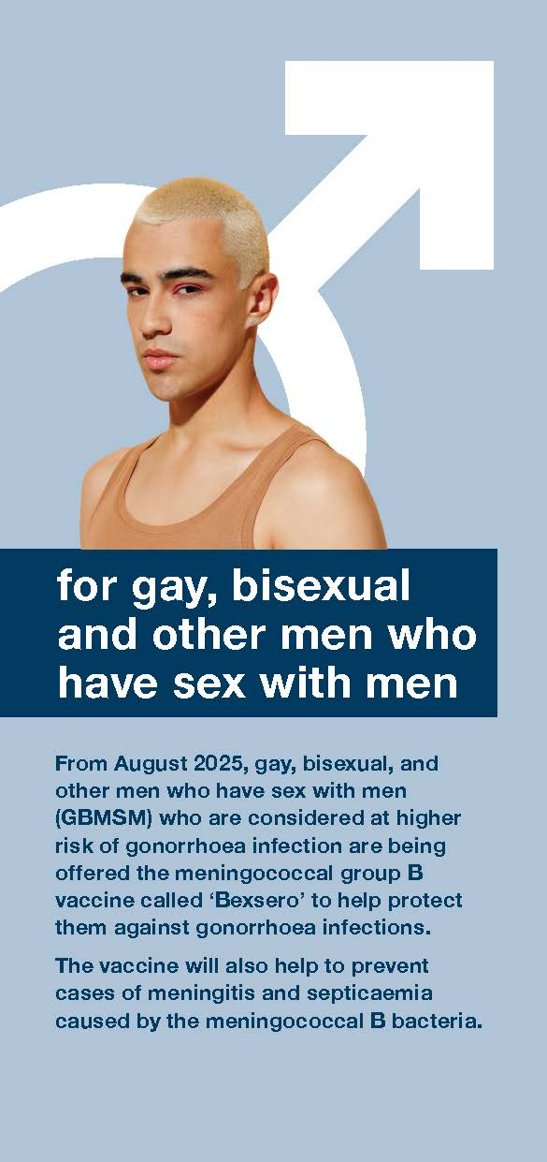
A guide to the meningococcal B vaccine for protection against gonorrhoea
Paper copies of this leaflet product code: MGB01EN
Copies are available in Bengali, Chinese simplified, French, German, Italian, Polish, Portuguese, Romanian and Spanish.

Slide 39
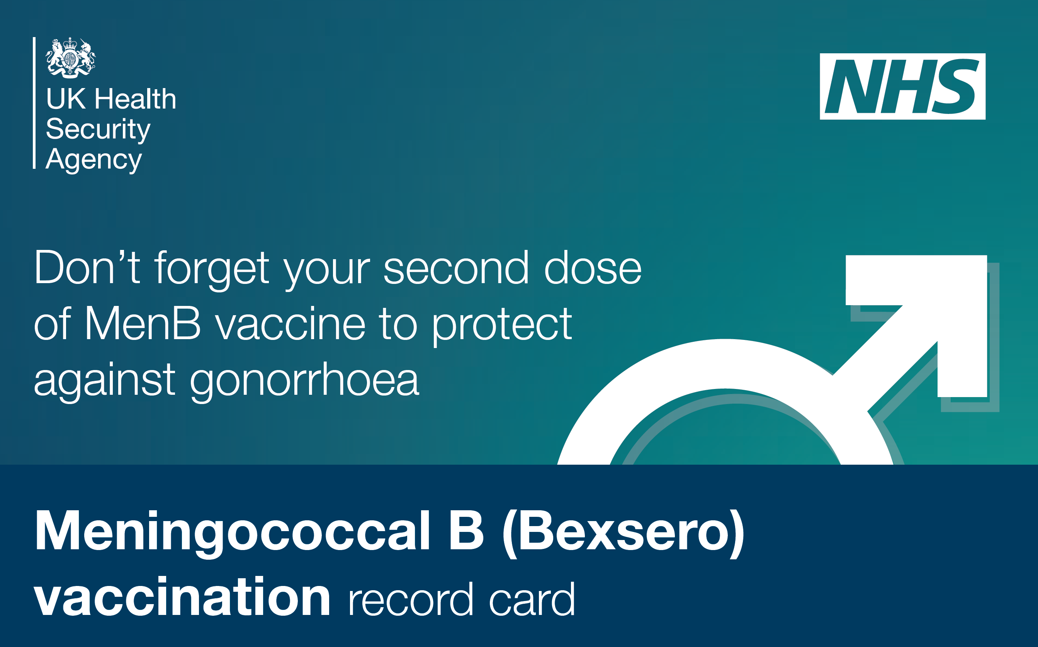
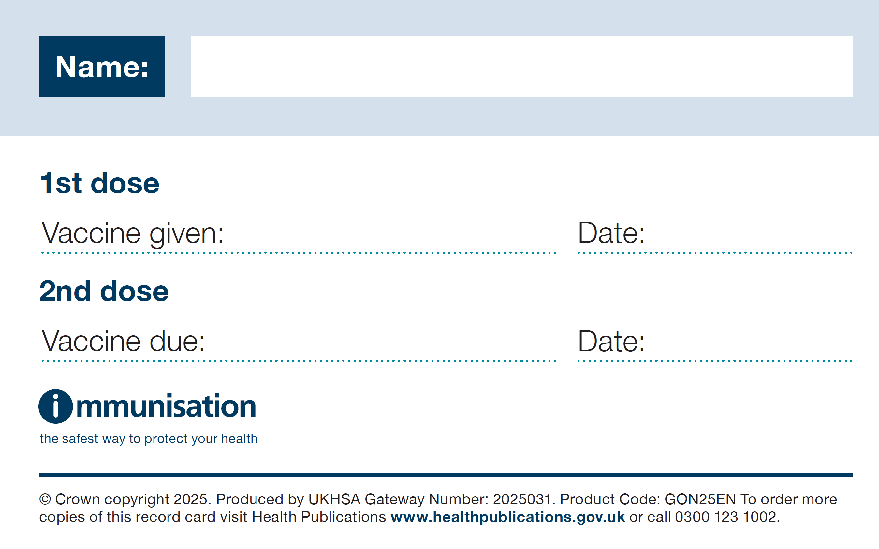
Men B record card
This is the vaccination record card which should be completed by the health professional to show the:
name of the vaccine
date it was given
date of second appointment for the final dose of Men B vaccine
record card, product code: GON25EN (weblink 27) available to download and order from the Health Publications website.

Slide 40

Meningococcal B (MenB) vaccination against gonorrhoea poster
This poster is available to promote the vaccination and should be used in sexual health clinics and other healthcare settings.
It contains a QR code and short link to the leaflet in English.
This is available to order and download from the using the product code: MGP01

Slide 41
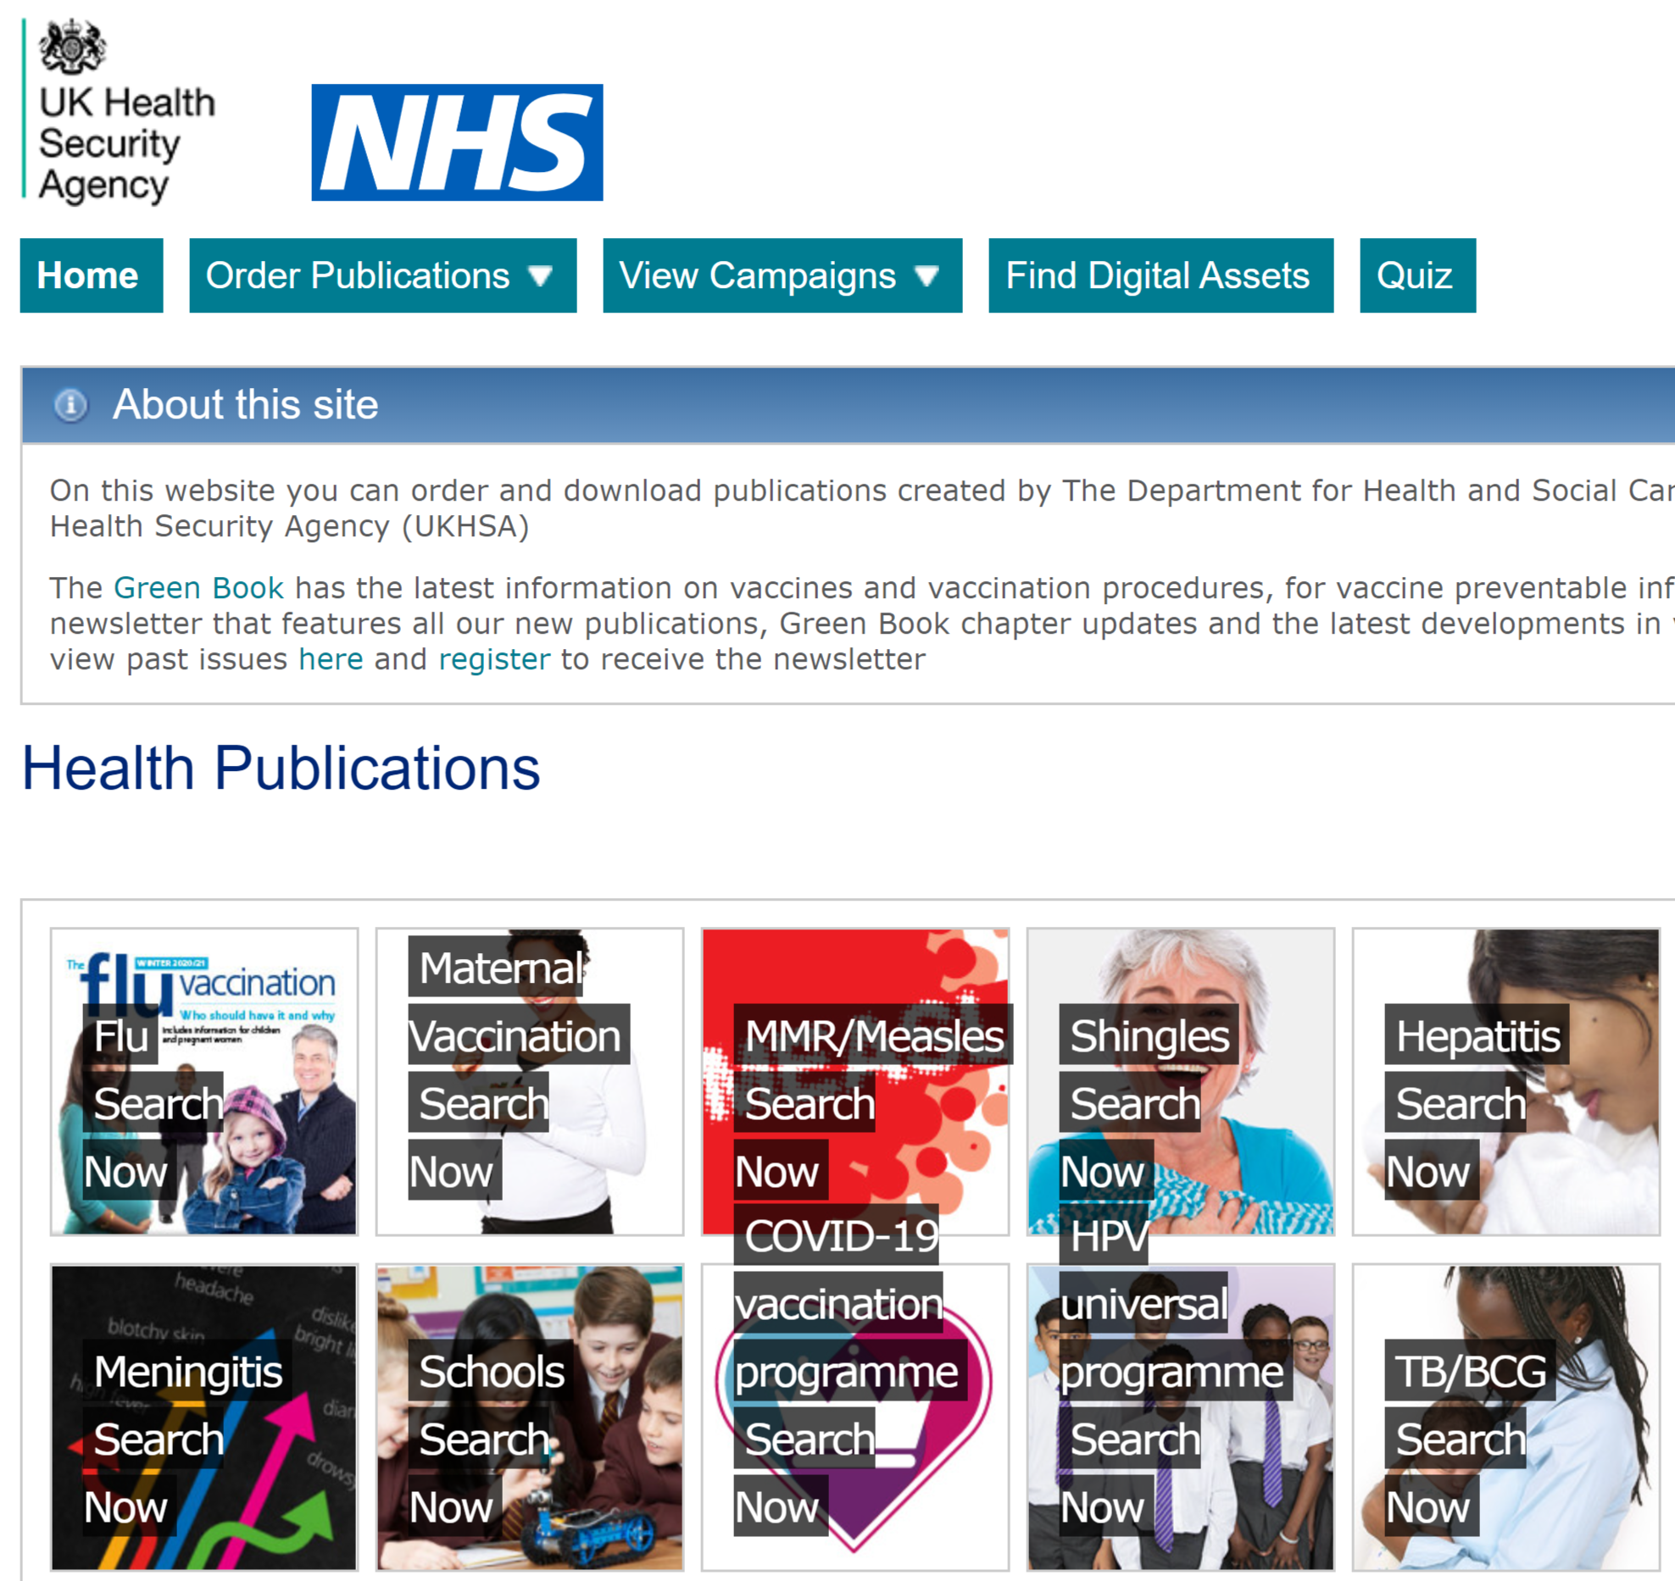
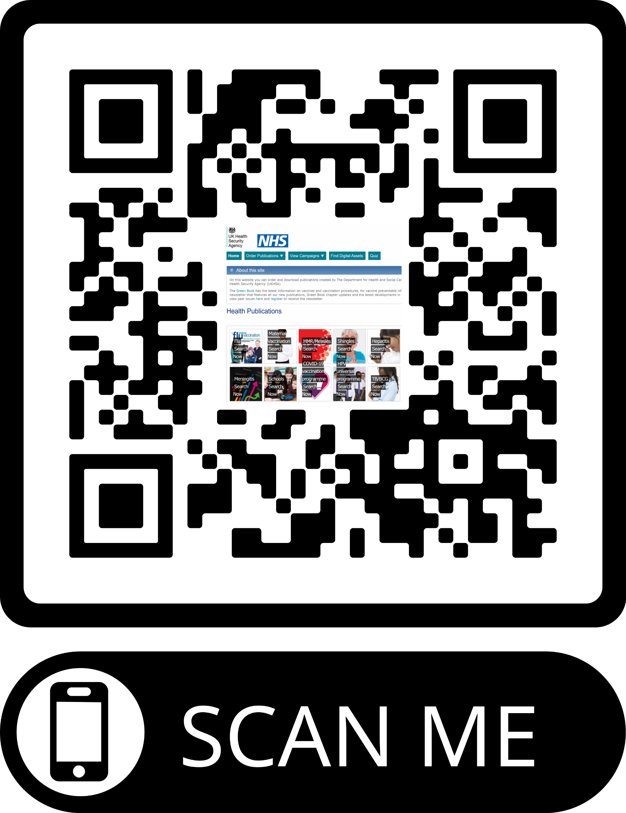
Health Publications – programme resource ordering service
Health publications website
Free service
Deliveries 3-5 working days
Short link:
https://qrco.de/healthpubs
Resources to support healthcare and associated workers for all vaccination programmes

Slide 42

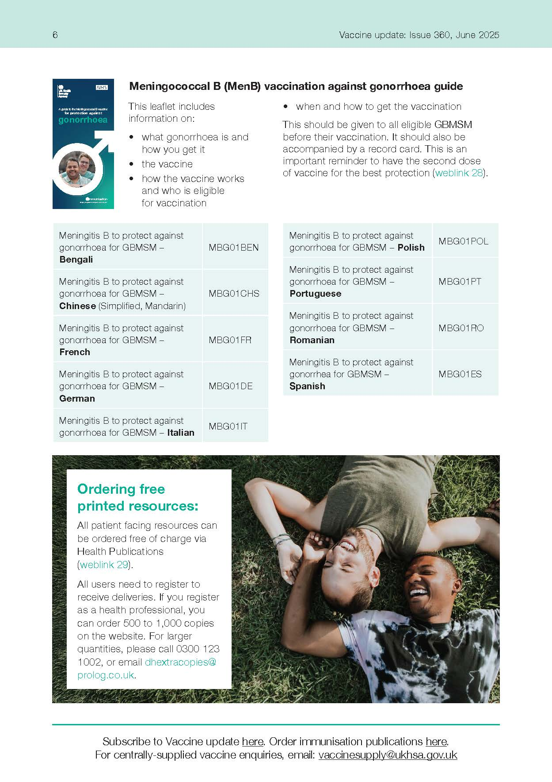
Vaccine update – 360 Mpox and Men B Special
You can view 360 back issues here
The July 4CMenB and Mpox special issue is here
Sign up to receive the Vaccine update newsletter.
And please share it with your teams, your part time and bank staff and any new starters.

Slide 43
Resources
all UKHSA resources relating to the gonorrhoea vaccination programme can be accessed: Gonorrhoea resources
These include:
  Immunisation against infectious disease: Gonorrhoea: the green book chapter - GOV.UK
  Information for healthcare practitioners
  A UKHSA template Patient Group Direction (PGD): 4CMenB for gonorrhoea vaccine
  patient leaflets, posters and record cards available to order now: 4CMenB for gonorrhoea vaccination patient resources
other resources include:
  Marketing authorisation holder’s Summary of Product Characteristics
  Medicines and Healthcare products Regulatory Agency (MHRA): reporting adverse reactions
  JCVI advice: The use of 4CMenB vaccination for the prevention of gonorrhoea
  NHS website: Gonorrhoea
  Oxford Vaccine Knowledge Project: MenB Vaccine
  UKHSA Sexually Transmitted Infection (STI) annual data tables

Slide 44
Resources: Information for Healthcare Practitioners
The information for healthcare practitioners guidance is recommended reading for anyone involved in the gonorrhoea vaccination programme
This is a practical document for healthcare practitioners administering or providing advice about 4CMenB. It includes the vaccination programme recommendations, contraindications, precautions and examples of scenarios that staff may experience when immunising

