Slide 1
Vaccination against monkeypox using the MVA-BN vaccine Training for healthcare practitioners 28 June 2022
Notes:
The content of these slides was correct at the time of publishing. Practitioners should always ensure they are accessing the most up to date information and guidance.
This resource is designed to train healthcare practitioners involved in delivering vaccination against monkeypox. Trainers should select the slides they need depending on audience background, role in the programme, length of training session and so on.
This resource does not cover vaccine administration technique. If staff require practical training for this, they should refer to their line manager for additional training.

Slide 2
Suggested pre-requisites prior to vaccine administration
Before administering MVA-BN vaccine, it is recommended that vaccinators should:​
ensure they follow local educational and clinical governance arrangements in relation to knowledge and proficiency to undertake vaccination
discuss their learning needs (including clinical skills and mandatory training) with their employer
undertake statutory and mandatory training as required by their employer for example infection prevention and control, child protection, safeguarding​, management of anaphylaxis and Basic Life Support and any additional training relevant to the age of people being vaccinated
Suggested pre-requisites include:
core immunisation training
practical training in vaccine preparation and administration​
completion and sign off of a vaccinator competency assessment (for example Immunisation Knowledge and Skills Competence Assessment Tool)
ensuring an appropriate legal framework to supply and administer the vaccine is in place for example patient specific prescription, Patient Specific Direction (PSD)
access to relevant guidance for example Green Book Smallpox and monkeypox chapter, UKHSA monkeypox guidance

Slide 3
Aim and learning outcomes
Aim:
To help equip vaccinators with the knowledge they require to safely and effectively administer the MVA-BN vaccine
Learning outcomes:
By the end of this session, vaccinators should be able to:​
describe the aetiology and current epidemiology of monkeypox
explain the recommendations for the use of the MVA-BN vaccine ​and know where to access current guidance
recognise the legal aspects of vaccine administration
describe the storage, handling and safe administration of the MVA-BN vaccine

Slide 4
Key messages
a large and increasing number of cases of cases of monkeypox are being reported across the UK and several other countries across the world
monkeypox is a rare disease caused by infection with monkeypox virus, a DNA virus of the orthopoxvirus genus
since the eradication of smallpox in 1980 and subsequent cessation of smallpox vaccination, it has emerged as the most important orthopoxvirus
community transmission is now occurring, with a high proportion of cases currently (though not exclusively) affecting gay, bisexual and men who have sex with men
thus far, the majority of cases in the UK have been in men age 20 to 50 and illness appears to be generally mild and not life-threatening

Slide 5
Key messages (continued)
as monkeypox virus is closely related to the virus that causes smallpox, vaccines designed for smallpox are expected to protect people from getting monkeypox
the MVA-BN (Imvanex) vaccine is authorised by the European Medicines Agency for active immunisation against smallpox in adults
although the vaccine is not licensed specifically for the prevention of monkeypox infection, it has been approved for this indication in the USA and has been used for this purpose in previous incidents in the UK
a single dose of MVA-BN vaccine is being advised following a confirmed or suspected exposure to monkeypox
although vaccination is thought to provide the greatest protection when given as soon as possible following contact, the vaccine may still be offered up to 14 days after the date of exposure
MVA-BN vaccine does not contain smallpox virus and cannot cause or spread smallpox

Slide 6
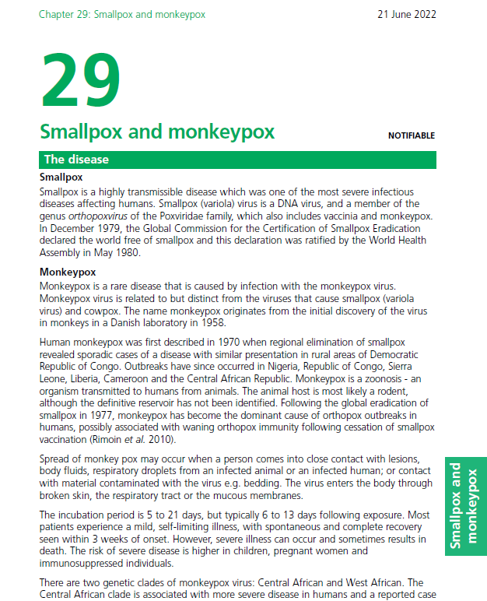
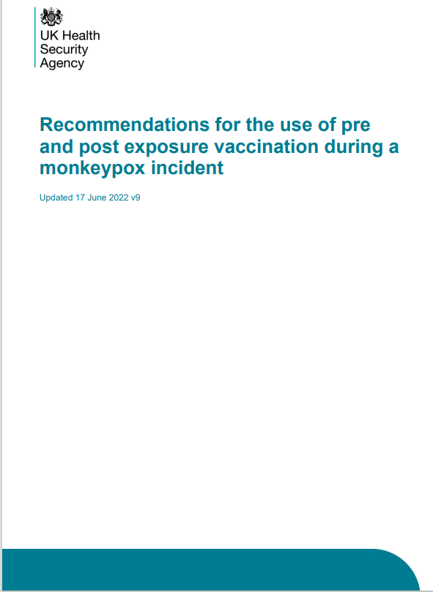
Key reading
It is strongly recommended that healthcare practitioners involved in delivering the MVA-BN vaccine read the latest versions of:
Immunisation against infectious disease Chapter 29 Smallpox and monkeypox
Recommendations for the use of pre and post exposure vaccination during a monkeypox incident
on the GOV.UK website

Slide 7
Monkeypox
monkeypox is a rare disease caused by infection with the monkeypox virus
monkeypox virus is related to, but distinct from, the viruses that cause smallpox (variola virus) and cowpox
the name monkeypox originates from the initial discovery of the virus in monkeys in a Danish laboratory in 1958
human monkeypox was first described in 1970 when regional elimination of smallpox revealed sporadic cases of a disease with similar presentation in rural areas of the Democratic Republic of Congo
outbreaks have since occurred in Nigeria, Republic of Congo, Sierra Leone, Liberia, Cameroon and the Central African Republic
monkeypox is a zoonosis – an organism transmitted to humans from animals
the animal host is most likely a rodent, although the definitive reservoir has not been identified
following the global eradication of smallpox in 1977, monkeypox has become the dominant cause of orthopox outbreaks in humans, possibly associated with waning orthopox immunity following cessation of smallpox vaccination

Slide 8
Symptoms of monkeypox
the symptoms of monkeypox are usually mild and self-limiting for most people, particularly for infections with the West African strain
however, severe illness can occur and symptoms can progress to multi-organ involvement, with bronchopneumonia, encephalitis and sepsis
the risk of severe disease is higher in children, pregnant women and immunosuppressed individuals
the illness begins with:
fever
headache
muscle aches
backache
within 1 to 5 days after the appearance of fever, a rash develops, often beginning on the face, then spreading to other parts of the body
swollen lymph nodes
chills
exhaustion

Slide 9
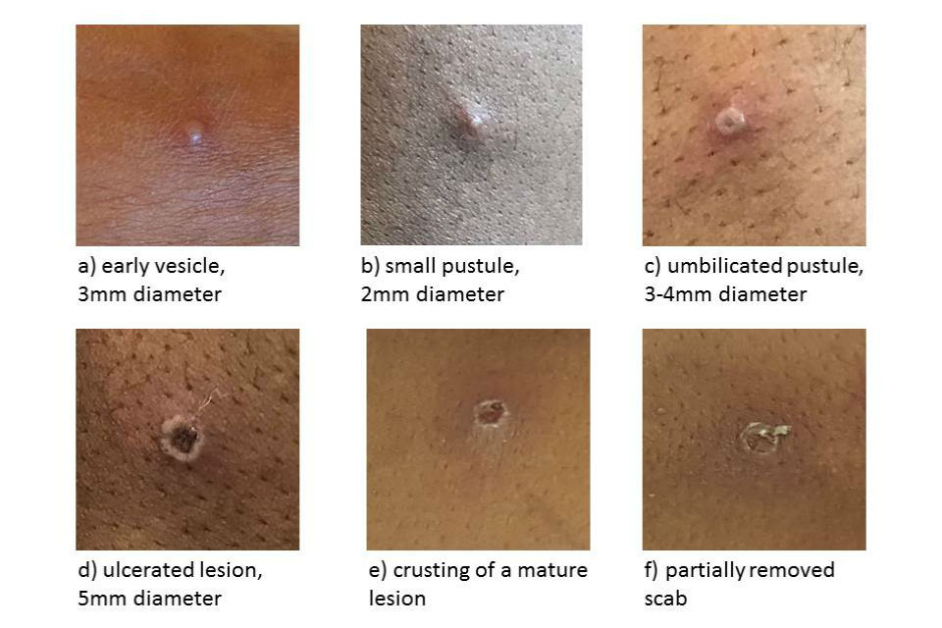
Monkeypox rash
the lesions go through several different stages
unlike chickenpox, the lesions are usually all at the same phase of development
they heal by crusting over and scabbing
the skin lesions resolve within 2 to 4 weeks
an individual is contagious until all the scabs have fallen off and there is intact skin underneath
the scabs may also contain infectious virus material

Slide 10
Transmission
monkeypox does not spread easily between people
spread of monkeypox may occur when a person comes into close contact with:
an infected animal
an infected human
materials contaminated with the virus for example bedding
the virus enters the body through broken skin (even if breaks are not visible), the respiratory tract, or the mucous membranes (eyes, nose, or mouth)
person-to-person spread is very uncommon, but may occur through:
contact with clothing or linens (such as bedding or towels) used by an infected person
direct contact with monkeypox skin lesions or scabs
close exposure to the coughs or sneezes of an individual with a monkeypox rash
the incubation period for monkeypox is between 5 and 21 days (typically 6 to 13 days) following exposure

Slide 11
Monkeypox in the UK
in 2018 there were 3 cases of monkeypox in the UK. 2 occurred in people who had recently travelled from Nigeria. The 3rd case was in a healthcare worker involved in the care of 1 of the cases and was infected following contact with contaminated bed linen
in 2019 1 case of monkeypox occurred in the UK following travel to Nigeria
in 2021 3 monkeypox cases were reported from within the same family; the index case had recent travel history to Nigeria
on 7 May 2022, a case of monkeypox was reported in a person who had recently travelled to Nigeria
on 14 May, 2 further cases, with no known links to the case announced on 7 May, were reported in individuals from the same household
on 16 May, 4 additional monkeypox cases were reported in England. These cases had no known connections with the cases reported on 7 and 14 May
by 23 June, 910 cases of monkeypox had been laboratory confirmed in the UK

Slide 12
Diagnosis and treatment
clinical diagnosis of monkeypox can be difficult as it is often confused with other infections such as chickenpox
a definite diagnosis of monkeypox requires assessment by a health professional and specific testing in a specialist laboratory
in the UK, the Rare and Imported Pathogens Laboratory (RIPL) at UKHSA Porton Down is the designated diagnostic laboratory
suspected cases should be discussed with the Imported Fever Service prior to submitting samples for laboratory testing
treatment for monkeypox is mainly supportive, the illness is usually mild and most of those infected will recover within a few weeks without treatment
smallpox vaccine, cidofovir, and tecovirimat can be used to control outbreaks of monkeypox
people vaccinated against smallpox in childhood may experience a milder disease

Slide 13
Smallpox vaccines
historically, first and second generation live smallpox vaccines have been used for population-level and targeted occupational health-related immunisation programmes in the UK
these vaccines are reactogenic and associated with risks of other serious adverse events and are no longer available in the UK
the newer third generation smallpox vaccines have a much-improved side effect profile compared with first and second generation smallpox vaccines
the modified vaccinia Ankara (MVA-BN) vaccine, a third generation smallpox vaccine was licensed in Europe (as Imvanex) for the prevention of smallpox in 2013
in September 2019, the US Food and Drug Administration (FDA) approved the MVA-BN vaccine (known in US as Jynneos) for the prevention of monkeypox as well as smallpox
although not specifically licensed for the prevention of monkeypox in Europe, MVA-BN vaccine has been used in the UK in response to previous incidents

Slide 14
MVA-BN
MVA-BN is a third generation live modified vaccinia Ankara (MVA) vaccine, manufactured by Bavarian Nordic (BN)
the virus used in the vaccine is attenuated through multiple passages in chicken embryo fibroblast cells
this leads to a substantial loss of its genome and many of the known immune evasion and virulence factors are not encoded
in human and animal studies, it demonstrates very limited replication capability and low neuropathogenicity, while retaining immunogenic properties, including protective immune responses against a variety of orthopoxviruses
as MVA-BN cannot replicate in mammalian cells, it does not produce a lesion at the site of vaccination
the vaccine virus has been modified so that it does not replicate in humans and it should be considered as an inactivated vaccine

Slide 15
Efficacy of MVA-BN vaccine
whilst the aim of MVA-BN efficacy studies have been to look at protective efficacy against smallpox, many of the licensing studies have been conducted using challenge with monkeypox virus
animal studies using MVA-BN vaccine have shown:
high efficacy against monkeypox, from 6 days after a single dose of vaccine
similar levels of neutralising antibody to first and second generation smallpox vaccines
human trials of MVA-BN suggested 2 doses of vaccine are immunogenic, generating antibody levels considered protective against smallpox, and by extrapolation, monkeypox as well
there is very limited evidence on whether the vaccine can prevent or modify disease when given post-exposure
although the full course comprises 2 doses, some immunological response to the first dose can be detected within the first 2 weeks
rapid vaccination may therefore prevent infection and/or modify disease severity for cases with longer incubation periods

Slide 16
Safety
data from multiple clinical trials shows that MVA-BN vaccine causes less adverse events than the first and second generation smallpox vaccines
although adverse events, such as local injection site reactions and influenza-like illness symptoms are common, serious adverse events are rare
the most common side effects seen following MVA-BN vaccination in clinical trials were:
headache
nausea
myalgia (muscle pain)
tiredness
injection site reactions (pain, redness, swelling, hardening and itching)
reactions were mild to moderate in intensity and resolved without intervention within 7 days following vaccination
rates of adverse events reported after 1st, 2nd or booster dose were similar, but anecdotally the frequency of adverse events, particularly local site reactions, appears to be higher in those who have received previous live smallpox vaccine

Slide 17
Experience of use of MVA-BN vaccine in previous incidents in the UK
In 2018 and 2019, several cases of imported monkey pox were reported in the UK and MVA-BN vaccine was offered as part of the incident response, including to children:
in 2018, 3 cases of monkey pox were diagnosed in the UK, and MVA-BN vaccine was offered as post exposure vaccination to 17 community contacts (5 people chose to be vaccinated). No onward transmission was identified from the first case
a total of 147 individuals at occupational risk (including healthcare workers and decontamination staff) were offered MVA-BN. One hundred and twenty-six chose to be vaccinated. One case was identified in a healthcare worker who had received post exposure vaccine 6 to 7 days after initial exposure
in 2019, following another imported case, 17 of 18 contacts accepted post exposure vaccination. In these incidents, young children, including infants received post exposure vaccine with no known adverse events

Slide 18
Vaccine recommendations for MVA-BN vaccine
Offer pre-exposure to:
workers in laboratories where pox viruses are handled
staff working in High Consequence Infectious Disease (HCID) units and those about to start to provide prolonged or close care for a patient with confirmed monkeypox
individuals regularly undertaking environmental decontamination around monkeypox cases
Additional pre-exposure recommendations for 2022 outbreak:
designated staff in hospitals being stood up to care for monkeypox patients
staff in sexual health clinics designated to assess suspected cases
gay, bisexual and other men who have sex with men (GBMSM) at highest risk of exposure
(identified amongst those who attend sexual health services, using markers of risk similar to those used to assess eligibility for HIV pre-exposure prophylaxis (PrEP), but applied regardless of HIV status. These risk criteria would include a recent history of multiple partners, participating in group sex, attending sex on premises venues or a proxy marker such as recent bacterial STI (in the past year))
staff members who work in sex on premises venues, such as saunas, if they are regularly exposed to items (for example linens) or surfaces likely to be contaminated with body fluids or skin cells
Supplementary approaches to provide outreach vaccination to high risk GBMSM who may not be in contact with sexual health services should also be considered

Slide 19
Vaccine recommendations (Pre-exposure)
the complete pre-exposure vaccine course with MVA-BN in immunocompetent individuals is 2 doses of 0.5ml given at least 28 days apart
for individuals with a history of receiving a single dose of a live smallpox vaccine, a single dose of MVA-BN is recommended
live vaccine was only used up to the 1970s, so apart from the healthcare workers vaccinated in 2003/4, vaccinated individuals will be older, and should have a distinctive scar (which normally looks like a circular 5p size dent in the left upper arm)
in the event of an incident, it is highly unlikely there will be sufficient time to offer 2 doses for those at risk of occupational exposure; in this scenario a single dose of vaccine should be offered immediately
completion of the primary course with a 2nd dose at least 28 days later should be considered on assessment of ongoing risk of exposure

Slide 20
Completing the primary vaccine course (pre-exposure)
the licensed primary course of MVA-BN comprises 2 doses, given at least 28 days apart
if there is a foreseeable risk of subsequent occupational exposure to monkeypox, HCWs, lab workers, and individuals undertaking environmental decontamination who have received 1 dose of MVA-BN either as pre or post-exposure prophylaxis, should be offered a 2nd dose at least 28 days after the first to complete the manufacturer-recommended schedule
for staff at occupational risk who have received a single dose of MVA-BN or a different smallpox vaccine at any time in the past, require only 1 further dose of MVA-BN to complete the recommended schedule, with a minimum interval of 28 days between doses. There is no requirement to restart the 2-dose schedule
the initial priority is to deliver 1st doses to as many GBMSM in the highest risk group as possible. Subject to the evolving epidemiology, a 2nd dose may be advised around 2 to 3 months later to provide longer lasting protection

Slide 21
Vaccine recommendations for MVA-BN vaccine
Offer post-exposure to:
high risk community or occupational contacts of any age of a case of monkeypox, ideally within 4 days of exposure to prevent onset of the disease
may be offered up to 14 days to those at on-going risk (for example during an outbreak) or those who are at higher risk of the complications of monkeypox (includes children below the age of 10 to 11 years, pregnant women and individuals with immunosuppression)
Individuals should only be offered post-exposure vaccination in line with current recommendations (see Recommendations for the use of pre and post exposure vaccination during a monkeypox incident on UKHSA website and the Green Book Smallpox and monkeypox chapter)

Slide 22
Vaccine recommendations (Post-exposure)
individuals should be risk assessed according to the Recommendations for the use of pre and post exposure vaccination during a monkeypox incident and offered post-exposure vaccination with a single dose of MVA-BN
vaccination should be administered as soon as possible (ideally within 4 days) after an identified exposure to prevent or attenuate infection but can be administered up to 14 days post-exposure to reduce symptoms and to protect those at high risk of ongoing exposure
if exposure has been intermittent or continuous, post-exposure vaccination should be ideally given within 4 days of the last exposure
as the vaccine may only attenuate rather than prevent disease in some cases, contacts who have been vaccinated require equivalent follow up to those contacts who remain unvaccinated
immunocompetent individuals who have previously received a 2 dose course of MVA-BN, with the second dose given in the past 2 years, do not need a further dose of vaccine after exposure
immunosuppressed individuals who have previously received a 2 dose course of MVA-BN, with the second dose given in the past 2 years, may have made a lower or less durable immune response so an additional dose can be considered after exposure

Slide 23
Completing the primary vaccine course (post-exposure)
individuals who received a single dose of vaccine as a result of community exposure do not need to be offered a 2nd dose as they do not have a foreseeable risk of further exposure to monkeypox and will be past the incubation period from the exposure that warranted post exposure vaccination

Slide 24
MVA-BN: delayed vaccination and administration with, before or after other vaccines
if the MVA-BN course is interrupted or delayed, it should be resumed using the same vaccine but the first dose does not need to be repeated
although no data for co-administration of MVA-BN vaccine with other vaccines exists, it is thought that any interference between this vaccine and other vaccines (live and inactivated) is likely to be limited
based on experience with other vaccines, any potential interference is most likely to result in a slightly attenuated immune response to one of the vaccines
there is no evidence of any safety concerns from giving other vaccines at the same time as the MVA-BN vaccine, although it may make the attribution of any adverse events more difficult
where individuals in an eligible cohort present having recently received one or more inactivated or another live vaccine, MVA-BN vaccination should still be given
the same applies where MVA-BN vaccination has been received first or where a patient presents requiring 2 or more vaccines
it is generally better for vaccination to proceed to avoid any further delay in protection and to avoid the risk of the individual not returning for a later appointment

Slide 25
Prioritisation of vaccine stock during an incident
when supplies are limited, vaccine should be prioritised according to whether it is for pre or post-exposure use, the risk and timing of exposure and the ability to benefit
vaccine should be prioritised for pre-exposure first dose use in staff
unvaccinated staff who are likely to be exposed to suspected cases during the course of an incident should be prioritised over post-exposure use
post-exposure vaccine should be offered in the order of risk exposure as summarised in “Recommendations for the use of pre and post exposure vaccination during a monkeypox incident”
for post-exposure use, vaccination should be prioritised for groups at higher risk of severe disease including children (up to primary school year age), pregnant women and immunosuppressed individuals
in addition, those at high risk of ongoing exposure, for example gay, bisexual and men who have sex with men (GBMSM) with multiple sexual partners should be prioritised for vaccine
those whose last exposure is within 4 days should be prioritised over those exposed 4 to 14 days previously because post-exposure vaccination is likely to be most effective when given as soon as possible
once post exposure vaccination has been completed and if sufficient supplies allow, vaccine should then be offered to individuals completing their second or booster dose as part of a pre-exposure vaccine course

Slide 26
Antibody persistence and boosting
there is limited data to determine the appropriate timing of booster doses
studies 2 years after the second primary dose showed a decline in antibody levels and a fall in the proportion of people with neutralising antibody
a booster dose given 2 years after the primary course increases the proportion of recipients with measurable antibody and this appears to be sustained at higher levels 2 years later
where boosting is considered necessary for those at on-going risk of exposure, or in the event of an exposure, a single dose of 0.5 ml should be administered, at least 2 years after the primary course
if a documented exposure occurs more than 2 years after the primary course, a single dose of 0.5 ml should be administered within 4 days
in individuals who have received a dose of live vaccine followed by a single dose of MVA-BN, the need for further boosting is unclear. If these individuals are at on-going risk of exposure, a booster of MVA-BN may be considered 2 years after the previous dose of MVA-BN, or, after that, at the time of an additional exposure

Slide 27
Vaccine prescribing and administration
the MVA-BN vaccine is licensed in Europe for use against smallpox
in order to be licensed, it has demonstrated safety and efficacy and is manufactured to a high standard with independent batch testing before release
current supplies of MVA-BN vaccine do not hold a UK licence – this may change in the future
as the vaccine does not have a marketing authorisation for protection against monkeypox in Europe, use for this indication would be considered ‘off-label’
off-label use of vaccines and other medicines can be undertaken on the basis of additional evidence or expert opinion
in this instance, there is no alternative UK licensed vaccine for the management of monkeypox and the US FDA approval of MVA-BN for the management of monkeypox indicates that there is a sufficient rationale for using the vaccine for this indication
furthermore, animal studies have demonstrated that vaccination with MVA-BN protected non-human primates from severe disease associated with a lethal challenge of monkeypox virus
healthcare workers can therefore be reassured that prescribing and administering MVA-BN for monkeypox in accordance with these guidelines would be in line with best practice
due to the unlicensed nature of current UK stock, a prescription or a Patient Specific Direction is required to give this vaccine

Slide 28
Contraindications
MVA-BN vaccine is contraindicated in those who have had a sudden life-threatening allergic reaction to a previous dose of, or to any components of the MVA-BN vaccine
the vaccine contains trometamol, sodium chloride and water for injections
it may also contain trace amounts of chicken protein, benzonase, gentamicin and ciprofloxacin from the manufacturing process

Slide 29
Precautions
minor illnesses without fever or systemic upset are not valid reasons to postpone immunisation
if an individual is acutely unwell, immunisation may be postponed until they have fully recovered
this is to avoid confusing the differential diagnosis of any acute illness by wrongly attributing any signs or symptoms to the adverse effects of the vaccine
individuals who are unwell should be assessed to determine whether they are displaying symptoms of monkeypox
individuals with atopic dermatitis may need to be risk assessed prior to vaccination
individuals who are pregnant or breastfeeding should discuss the benefits and risks prior to vaccination

Slide 30
Children
the MVA-BN vaccine is not licensed for and has been not been used widely in children
however, vaccines using MVA as a vector have been used in paediatric studies where they have been shown to be effective and have an acceptable safety record
the MVA-BN vaccine has been given safely to children, including infants, in the UK after previous cases
the vaccine should therefore be offered to children considered to be at risk as children, especially young children, appear to have a more severe presentation of monkeypox

Slide 31
Pregnancy
MVA-BN is not contraindicated in pregnancy
although it has not formally been evaluated in pregnancy, animal studies identified no vaccine related fetal malformations
use of MVA-BN in pregnant women is limited to fewer than 300 pregnancies but no adverse events on pregnancy were seen
as it is a non-replicating vaccine, there is no theoretical reason for concerns in pregnancy and the adverse events profile would be expected to be similar to that in non-pregnant vaccinees
whilst it is not routinely recommended for use in pregnancy, any theoretical concern needs to be weighed against the maternal risks from monkeypox in pregnancy (such as risk of more severe disease from viral infections in third trimester) and any consequent fetal risks from maternal infection in early pregnancy

Slide 32
Breastfeeding
MVA-BN is not contraindicated if breast-feeding
it is not known whether MVA-BN is excreted in human milk, but this is unlikely as the vaccine virus does not replicate effectively in humans
individuals who are breast feeding and have a significant exposure to monkeypox should therefore be offered vaccination, after discussion about the risks of monkeypox to themselves and to the breast-fed child

Slide 33
Individuals with atopic dermatitis
individuals with atopic dermatitis are known to have developed more site-associated reactions and generalised symptoms following MVA-BN vaccination
a clinical trial found that local and general reactions were all reported more frequently in participants with atopic dermatitis than in healthy participants
in vaccinated clinical trial participants with atopic dermatitis, 7% experienced exacerbation of their condition during the course of the trials
individuals in this group therefore need to have an individual risk assessment before being offered vaccination to assess the risk from exposure, the risk of side effects from vaccination and the potential use of alternative preventive interventions

Slide 34
Individuals with immunosuppression
as MVA-BN is a replication defective virus, it is considered safe in immunosuppressed individuals
however, the immune response to the vaccine could be reduced in severely immunosuppressed individuals
in clinical trials on the use of MVA-BN in immunocompromised individuals, no increase in adverse events in this group was seen
MVA-BN vaccine has been demonstrated to be safe in people with HIV infection
vaccination should generally proceed in accordance with recommendations as these individuals are at significant risk of the complications of monkeypox
however specialist advice on other measures may be required
additional doses should be considered for those at ongoing risk of exposure in this group

Slide 35
Consent
before giving any vaccine, vaccinators must ensure that they have obtained informed consent from the vaccinee
in order to be able to consent to vaccination, the vaccinee should receive an explanation of the treatment and its benefits and risks, either verbally from a clinician, or in the form of a leaflet or letter
vaccinators should be familiar with the principles of consent for immunisation as described in the Consent chapter in the Green Book
further information on prescriber responsibilities for off-label or unlicensed medicines

Slide 36
Storage and handling of MVA-BN vaccine
MVA-BN vaccine has complex storage requirements and the expiration date depends upon storage temperature
MVA-BN vaccine will be shipped from UKHSA storage sites at -20°C
it should be stored at -20°C upon receipt to keep the expiry date longer
if -20°C storage is not available, frozen vials should be immediately stored at 2°C to 8°C to thaw or may be thawed for approx 15 minutes at room temperature for immediate use
after thawing at 2°C to 8°C, MVA-BN vaccine can be stored at this temperature for up to 8 weeks
do not re-freeze a vial once it has been thawed
store in original package in order to protect from light

Slide 37
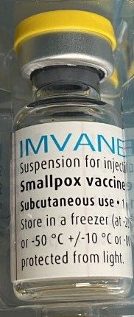
Storage and handling of MVA-BN vaccine
once the frozen vaccine has been thawed, Imvanex is a light yellow to pale white milky suspension for injection
Imvanex is provided as a suspension for injection in single dose vials (0.5 ml)
Imvanex is available in packs containing 20 single dose vials
Please note: the MVA-BN vaccine is called Imvanex (in Europe), Jynneos (in USA) and Imvamune (in Canada). These are all the same MVA vaccine manufactured by Bavarian Nordic

Slide 38
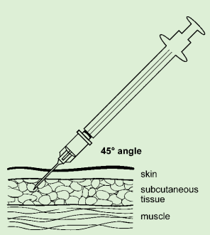
Administration of MVA-BN
the vaccine should be allowed to reach room temperature before use
swirl vial gently before use for at least 30 seconds
visually inspect the suspension prior to administration
if particles and/or discolouration or abnormal appearance are seen, the vaccine should be discarded
a single dose is 0.5 ml which should be given by deep subcutaneous (SC) injection, preferably into the deltoid region of the upper arm in adults (thigh in children under 1 year)
SC injections should be given with the needle at a 45º angle to the skin and skin should be bunched, not stretched

Slide 39
Disposal
equipment used for vaccination, including used vials, ampoules or syringes, should be disposed of by placing them in a proper, puncture-resistant ‘sharps box’ according to local authority regulations and guidance in Health Technical Memorandum 07-01: Safe management of healthcare waste (Department of Health, 2013)
MVA-BN contains genetically modified organisms (GMOs)
sharps waste and empty vials should be placed into yellow lidded waste bins and sent for incineration; there is no need for specific designation as GMO waste
an appropriate virucidal disinfectant should be available for managing spills in all settings where vaccination is administered
any potentially contaminated gloves and aprons used can be disposed in yellow/black striped bags for offensive waste

Slide 40
Recording
the following information should be recorded for each vaccine given:
vaccine name, product name, batch number and expiry date
dose administered
date immunisation given
route/site used
name and signature of vaccinator
pre-exposure vaccine given to GBMSM in sexual health clinics should be recorded in established IT systems (GUMCAD)
post-exposure vaccines given to contacts and pre- and post-exposure prophylaxis for staff should be recorded on the online form created by UKHSA to securely and systematically monitor the usage, safety and effectiveness of the MVA-BN vaccine
if the vaccine recipient is pregnant, if possible record this and the gestational age

Slide 41
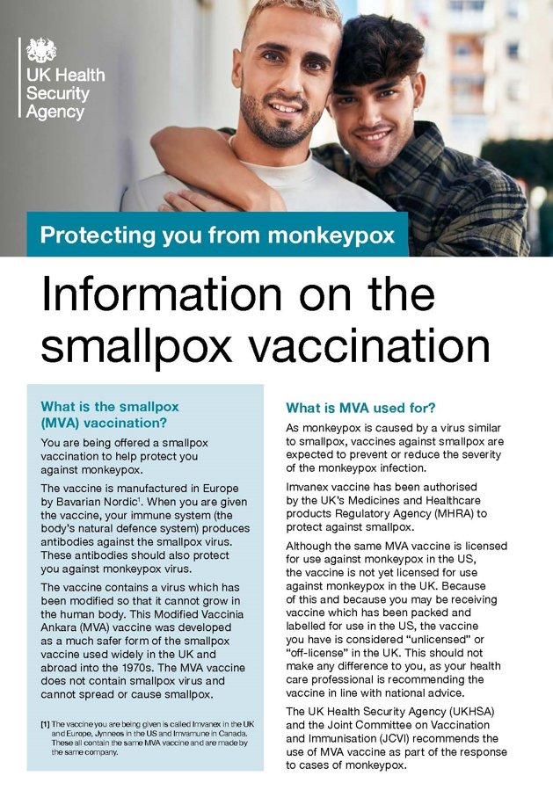
Post vaccination information
as is recommended after any vaccination, any fever following vaccination should be monitored and if individuals are concerned about their health at any time, they should seek advice from their GP or NHS111
following vaccination, vaccine recipients should be given information about possible reactions to the vaccine, how to treat these, and when and from whom to seek further advice if required
a patient information leaflet is available with the MVA-BN vaccine to be given to vaccinees
a UKHSA patient information leaflet is also available to order from or call 0300 123 1002 using the product code 2022MP1EN. Translated and Easy Read versions will become available
information on monkeypox also available from NHS UK

Slide 42
Reported reactions to MVA-BN
Very common (may affect more than 1 in 10 people) | Common (may affect up to 1 in 10 people) | Uncommon (may affect up to 1 in 100 people) | Rare (may affect up to 1 in 1000 people)
headache | chills | nose and throat infection, upper respiratory tract infection | sinus infection
aching muscles | fever | swollen lymph nodes underarm swelling, pain in the armpit | influenza-like illness
feeling sick | joint pain, pain in extremities | abnormal sleep | hives (nettle rash)
tiredness | loss of appetite | dizziness, abnormal skin sensations | skin discolouration, bruising, lump
pain, redness, swelling, hardness or itching at the injection site | discolouration, bruising or warmth at the injection site | muscle stiffness | sweating and night sweats
 |  | sore throat, runny nose, cough | muscle cramps, pain and weakness
 |  | diarrhoea, vomiting, abdominal pain, dry mouth | swelling of the ankles, feet, fingers, face, mouth and throat
 |  | rash, itch, skin inflammation, skin discolouration, bruising flushing, feeling unwell chest pain | faster heart beat back, neck, abdominal pain ear and throat ache dry mouth spinning sensation (vertigo) migraine nerve disorder causing weakness, tingling or numbness, drowsiness blisters at injection site weakness, feeling unwell pink eye

Slide 43
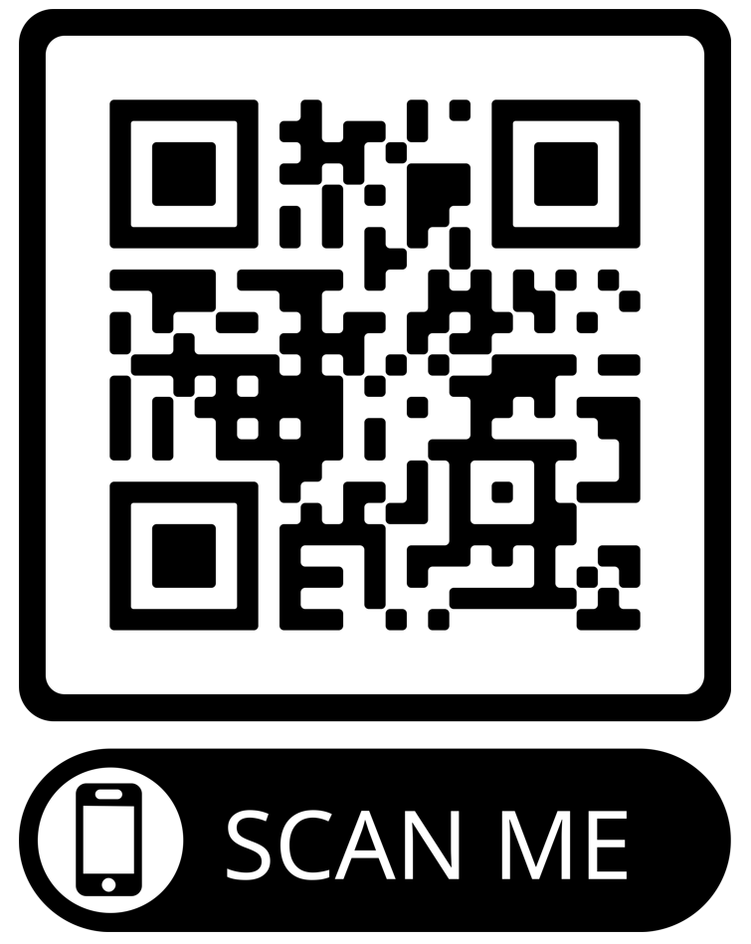
Reporting adverse events
as this vaccine is labelled with a black triangle ( ), all suspected adverse reactions occurring in individuals of any age after MVA-BN vaccination should be reported to the MHRA using the Yellow Card scheme
anyone (patients and HCWs) can make a Yellow Card report, even if they are uncertain as to whether a vaccine caused the condition/side effect
vaccinees should be advised that they can report any adverse reactions to the MHRA using the online Yellow Card scheme, by downloading the Yellow Card app or by calling the Yellow Card scheme on 0800 731 6789 9am to 5pm Monday to Friday
please record and provide vaccinees with details of the vaccine brand and batch if possible so this can be included in the Yellow Card report
The QR code can be used for quick and easy access to the Yellow Card reporting site

Slide 44
Useful resources
Smallpox and monkeypox: the Green Book Chapter 29
Monkeypox outbreak: vaccination strategy UKHSA's vaccine strategy in response to the UK monkeypox outbreak
Monkeypox: guidance Information and advice for healthcare professionals and the general public including background information, case definitions, contact tracing, testing and other guidance documents
Monkeypox: background information Guidance and information about the epidemiology, transmission, clinical features, diagnosis, treatment, infection prevention and control and management of monkeypox virus infections
Recommendations for the use of pre and post exposure vaccination during a monkeypox incident
Monkeypox cases confirmed in England – latest updates
Imvanex vaccine Summary of Product Characteristics (SPC)

