Slide 1
The national flu vaccination programme
2025 to 2026
Training for healthcare practitioners
Notes:
This resource is designed to update health care practitioners involved in delivering the national flu immunisation programme for the 2025 to 2026 flu season and includes information about both the inactivated vaccines and the live attenuated influenza vaccine used for the childhood flu programme.
This resource is designed to be used by anyone involved in the flu programme. Not all slides will be required for training – trainers should select slides depending on audience background, role in the programme and length of training session.
This resource does not cover vaccine administration technique. If staff are required to deliver flu vaccinations, they should refer to their line manager for additional training.
Note: For the purposes of this resource, the term ‘influenza’ will be replaced by the term ‘flu’ unless it relates to a specific virus/strain.

Slide 2
Flu vaccine programme 2025 to 2026
Seasonal flu vaccination is a critically important public health intervention to reduce morbidity and mortality in those most at risk including older people, pregnant women and those in clinical risk groups
Vaccinating health and care workers also plays an important role in helping to prevent transmission of flu, protecting both the worker and those they care for
The key changes to the flu vaccination programme for the 2025 to 2026 flu season are:
  change to the inactivated influenza vaccines (IIV) from quadrivalent (QIV) to trivalent (TIV) vaccines
  after not being available for the 2024 to 2025 flu vaccination programme, the recombinant influenza vaccine (IIVr) will again be available for the 2025 to 2026 season and can be offered as a first line vaccine for those aged 18 years and over in a clinical risk group and those aged 65 years and over
  the adjuvanted inactivated influenza vaccine (aIIV) is now licensed from 50 years of age, so can be offered as a first line vaccine to those aged 50 years and over in a clinical risk group and those aged 65 years and over
overall flu activity was higher in the 2024 to 2025 season than was seen in the previous 2023 to 2024 flu season, demonstrating that flu is unpredictable and infection can be serious; it is therefore important that all those eligible are offered vaccine to provide protection against it

Slide 3
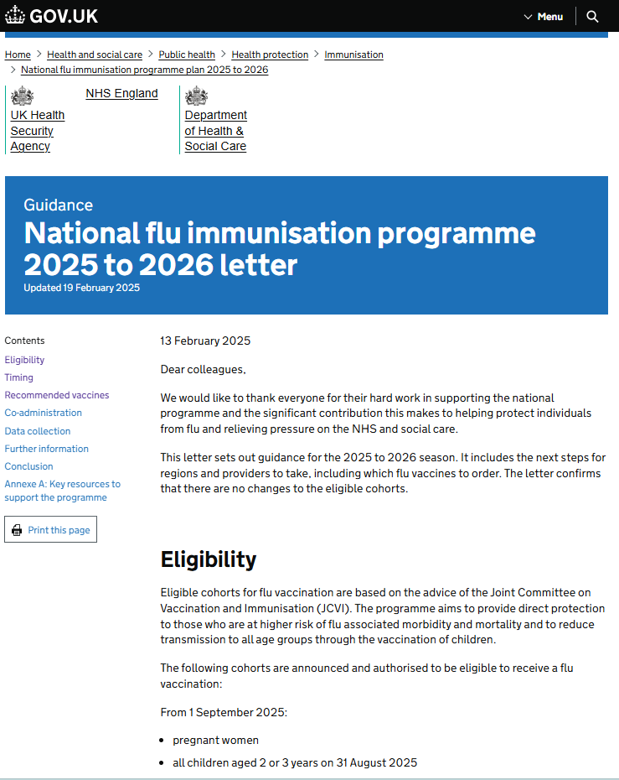
Essential further reading
please ensure that you read the national flu immunisation programme 2025 to 2026 letter (published 13 February 2025) and amendment letter (published 28 July 2025)
this letter provides key information about this year’s flu programme
it is recommended that you regularly check the UKHSA ‘Annual flu programme’ webpage during the flu vaccination period as any further information that becomes available about the programme will be published there
also read the latest Green Book Influenza chapter

Slide 4
Key messages
flu immunisation is one of the most effective interventions we can provide to reduce harm from flu and pressures on health and social care services during the winter
it is important to increase flu vaccine uptake in clinical risk groups because of increased risk of death and serious illness if people in these groups catch flu
flu during pregnancy may be associated with perinatal mortality, prematurity, smaller neonatal size, lower birth weight and increased risk of complications for the mother
vaccination of health and social care workers protects them and reduces the risk of them spreading flu to their patients, service users, colleagues and family members
by preventing flu infection through vaccination, secondary bacterial infections such as pneumonia are prevented. This reduces the need for antibiotics and helps prevent antibiotic resistance
for a number of years, only around half of patients aged 6 months to under 65 years in clinical risk groups have been vaccinated
the childhood flu programme should reduce the impact of seasonal flu on children and reduce transmission of flu within the community
by reducing transmission of flu, it should also avert many cases of severe flu and flu-related deaths in older adults and people in clinical risk groups
Notes:
Morbidity and mortality attributed to flu is a key factor in NHS winter pressures and a major cause of harm to individuals, especially vulnerable people. The annual flu immunisation programme helps to reduce GP consultations, unplanned hospital admissions and pressure on A&E and is therefore a critical element of the system-wide approach for delivering robust and resilient health and care services during the winter.

Slide 5
Aims of resource
The purpose of this training resource is to:
develop the knowledge base of healthcare practitioners regarding the 2025 to 2026 seasonal flu vaccination programme
support healthcare practitioners involved in discussing flu vaccination with those eligible by providing evidence-based information
promote high uptake of flu vaccination in all eligible groups by increasing the knowledge of those involved in delivering the vaccination programme
provide information on the administration of flu vaccines

Slide 6
Learning outcomes
On completion of this resource, healthcare practitioners will be able to:
describe the cause of flu
understand how flu is transmitted and the possible effects of flu
understand the evidence base for the administration of flu vaccination to those in clinical risk groups, pregnant women, children and those aged 65 years and over
explain which vaccines should be used and the precautions and contraindications to the administration of these
explain the sequence of steps in flu vaccine administration
explain the possible side effects from flu vaccines
understand the importance of their role in promoting and providing evidence-based information about flu vaccination to patients
identify sources of additional information

Slide 7
Key roles of healthcare practitioners
Key roles of healthcare practitioners in relation to the flu programme are to:
be able to describe the evidence base for the administration of the flu vaccination to all eligible groups
advise individuals (or their parents or carers) who are eligible to receive the flu vaccination why it is strongly recommended that they are vaccinated against flu
safely administer flu vaccines in accordance with the vaccine schedule
ensure any adverse effects are managed and reported appropriately

Slide 8
Evolution of UK flu vaccination programme
Late 1960s: annual flu immunisation recommended to directly protect those in clinical risk groups who are at a higher risk of influenza associated morbidity and mortality
2000: flu vaccine policy extended to include all people aged 65 years or over
2010: pregnancy added as a clinical risk category for routine flu immunisation
2013: phased introduction of an annual childhood flu vaccination programme for all children aged 2 to 16y began with vaccine offered to all children aged 2 and 3 years and 7 geographical pilots in primary school aged children
2014: phased introduction of childhood flu vaccination programme continued with vaccine offered to all children aged 2, 3 and 4 years and geographical pilots in primary and secondary school aged children
2015: in addition to vaccinating 2, 3, and 4 year olds in primary care, the programme began nationally in primary schools in a phased roll-out starting with the youngest school-aged children first
Between 2016 and 2019: phased introduction of childhood flu vaccination programme continued with a year on year addition of the next school year
2020: offer to all children aged 2 to school year 7 and extended to those aged 50 to 64 years
  2021 and 2022: programme extended to offer to all those aged 50 to 64 years and to all children from age 2 up school year 11 (in 2021) and age 2 up to school year 9 (in 2022) because of concerns over co-circulation of flu and COVID-19
  2023, 2024 and 2025: flu vaccine programme to offer to clinical risk groups, all aged 65 years and over, and all children aged 2 to 15 years old (up to school year 11)
Notes:
Following a recommendation in 2012 by the Joint Committee on Vaccination and Immunisation (JCVI) that the routine annual flu vaccination programme should be extended to include children, a phased introduction of this extension began in 2013. In 2013, flu vaccine was offered to all 2 and 3 year old children, and to 4 to 10 year olds (up to and including pupils in school year 6) in 7 different geographical pilot areas.
For the 2014 to 2015 flu season, flu vaccine was offered to all 4 year old children as well as to all 2 and 3 year old children. The geographical pilots of primary school aged children started in 2013 to 2014 continued and there were also several different geographical pilots in secondary school aged children in Years 7 and 8.
In 2015 to 2016, flu vaccine was offered to all 2, 3 and 4-year-olds, to children of school year 1 and 2 age and to all primary school-aged children in areas that participated in previous primary school pilots.
In 2016 to 2017, flu vaccine was offered to all 2, 3 and 4-year-olds, to children of school year 1, 2 and 3 age and to all primary school-aged children in areas that participated in previous primary school pilots.
In 2017 to 2018, flu vaccine was offered to all 2, 3 and 4-year-olds, to children of school year 1, 2 , 3 and 4 age and to all primary school-aged children in areas that participated in previous primary school pilots. This was the first flu season that Reception Year children (aged 4 to 5 years) were offered flu vaccination in their reception class, rather than through general practice
In the 2018 to 2019 flu season, flu vaccine was offered to all children aged 2 to 9 years old (but not 10 years or older) on 31 August 2018 and to all primary school-aged children in former primary school pilot areas.
In the 2019 to 2020 flu season, flu vaccine was offered to all children aged 2 to 10 years (but not 11 years or older) on 31 August 2019. It was also offered to children from 6 months of age in clinical risk groups.
During the 2020 to 2021 season, the national programme was extended to include children of Year 7 (aged 11 rising to 12 years old)
In the 2021 to 2022 flu season, in addition to 2 and 3 year olds and primary school aged children, children in School Year 7 to 11 in secondary school were also offered the vaccine.
For the 2022 to 2023 flu season, flu vaccine was offered to all children aged 2 or 3 years on 31 August 2022, to all primary school aged children (from Reception to Year 6) then to secondary school-aged children up to and including Year 9. If there was remaining vaccine Year 10 and 11 were vaccinated. Vaccine was also offered to those aged 50 to 64 years old not in clinical risk groups (including those who turn 50 by 31 March 2023).
For the 2023/24, 2024/25 and 2025/26 flu seasons, flu vaccine offer for those in clinical risk groups, all aged 65 years and over, and all children aged 2 to 15 years old (up to school year 11)

Slide 9
Influenza overview
flu is an acute viral infection of the respiratory tract (nose, mouth, throat, bronchial tubes and lungs)
it is a highly infectious illness which spreads rapidly in communities
even people with mild or no symptoms can infect others
most flu activity occurs from mid-November and typically peaks in late December, January or February, but this can be later
Notes:
2015 to 16 season saw flu peak at Easter. For timings of flu seasons since 1988 to 1989 season see: https://www.gov.uk/government/publications/respiratory-virus-circulation-england-and-wales/timing-of-influenza-seasons

Slide 10
Influenza viruses
There are 3 types of influenza virus which affect humans: types A, B and C.
Types A and B are responsible for most disease.
A viruses
cause outbreaks most years and are the usual cause of epidemics and pandemics
live and multiply in many different animals and may spread between them
birds, particularly wildfowl, are the main animal reservoir
B viruses
tend to cause less severe disease and smaller outbreaks
predominantly found in humans
burden of disease mostly in children

Slide 11

Flu A virus
Genetic material (RNA) in the centre
Two surface antigens:
Haemagglutinin (H) (blue)
Neuraminidase (N) (red)
There are 18 different types of H and 11 different types of N
The role of haemagglutinin is to bind to the cells of the infected person
The role of neuraminidase is to release the virus from the cell surface
The different types of H and N are identified by numbers, hence H1N1 or H3N2 for example
Notes:
Schematic model of a flu A virus.
There are 2 antigens on the surface, as illustrated.
The role of the H antigen is to bind to the cells of the host. There are 18 different types of H.
The role of the N antigen is to release the virus from the cell surface. There are 11 different types of N.
The different types of H and N are identified by numbers, hence H1N1 or H3N2 for example.

Slide 12
Genetic changes in the flu virus – what this means
Changes in the surface antigens (H and N) result in the flu virus constantly changing
antigenic drift: minor changes (natural mutations) in the genes of flu viruses that occur gradually over time
antigenic shift: when 2 or more different strains combine. This abrupt major change results in a new subtype. Immunity from previous flu infections/vaccinations may not protect against the new subtype, potentially leading to a widespread epidemic or pandemic
Because of the changing nature of flu viruses, WHO monitors their epidemiology throughout the world. Each year WHO makes recommendations about the strains of influenza A and B which are predicted to be circulating in the forthcoming winter.
These strains are then included in the flu vaccine developed each year
Notes:
The World Health Organization (WHO) convenes a group that reviews the global influenza situation (once each year for the northern hemisphere and once for the southern hemisphere) and recommends which flu strains should go in the seasonal vaccine to be produced by manufacturers for the following season 6 to 8 months later. This recommendation is based on information about the circulating viruses and epidemiological data from around the world at that time.

Slide 13
Features of flu
  easily transmitted by large droplets, small-particle aerosols and by hand to mouth/eye contamination from a contaminated surface or respiratory secretions of an infected person
  people with mild or no symptoms can still infect others
  incubation period 1 to 5 days (average 2 to 3 days) though may be longer especially in people with immune deficiency
  Common symptoms include:
  sudden onset of fever, chills, headache, muscle and joint pain and extreme fatigue
  dry cough, sore throat and stuffy nose
  in young children, gastrointestinal symptoms such as vomiting and diarrhoea may be seen
Notes:
Serological studies in healthcare professionals have shown that approximately 30 to 50% of flu infections can be asymptomatic but the proportion of flu infections that are asymptomatic may vary depending on the characteristics of the influenza strain.
In healthy individuals, flu is usually unpleasant but self-limiting with recovery within 5-7 days.

Slide 14
Possible complications of flu
Common:
  bronchitis
  otitis media (children), sinusitis
  secondary bacterial pneumonia
Less common:
  meningitis, encephalitis, meningoencephalitis
  primary influenza pneumonia
Risk of most serious illness is higher in:
      children under 6 months
      older people
      those with underlying health conditions such as respiratory disease, cardiac disease, long-term neurological conditions or immunosuppression
      pregnant women (flu during pregnancy may be associated with perinatal mortality, prematurity, smaller neonatal size and lower birth weight)
Notes:
The risk of serious illness from flu is higher among children under 6 months of age, older people and those with underlying health conditions such as respiratory disease, cardiac disease or immunosuppression, as well as pregnant women. These groups are at greater risk of complications from flu such as bronchitis or pneumonia.

Slide 15
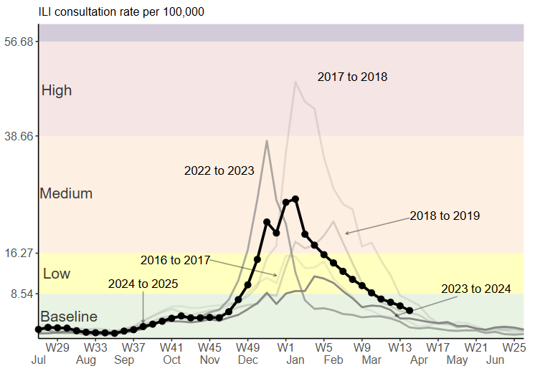
Flu epidemiology
Weekly GP influenza-like illness consultation rates per 100,000 from the RCGP RSC network, England, by season
most flu activity usually occurs between mid-November and March
during the 2024 to 2025 season, flu circulated above baseline levels from December 2024 to early March 2025, peaking at new year
influenza activity was higher in the 2024 to 2025 season than in the 2023 to 2024 season
hospital flu admissions and intensive care and high-dependency unit admissions were higher than in the previous flu season
modelling of influenza-attributable mortality in England estimated approximately 7,800 deaths due to flu in 2024 to 2025 flu season, compared to approx 3,600 in the previous season
Notes:
The impact of flu on the population varies from year to year and is influenced by changes in the virus that, in turn, influence the proportion of the population that may be susceptible to infection and the severity of the illness.
The main messages from the 2024 to 2025 season are:
the season started in the second half of November 2024 with rising influenza A(H1N1)pdm09 activity that peaked just before the start of the new year (2025) and declined after; influenza B activity started in January, leading to a slow decline of overall influenza activity
overall activity was higher than in the 2023 to 2024 season. Compared to the 2022 to 2023 season the peak was similar in both intensity as well as timing, but the 2024 to 2025 season had a slower overall decline due to the late influenza B activity
despite overall activity being higher, mortality estimates in the 2024 to 2025 season were lower than in the 2022 to 2023 season
further modelling estimated that, in England, the vaccination programme averted between 96,000 and 120,200 hospital admissions due to influenza
Influenza in the UK, annual epidemiological report: winter 2024 to 2025 - GOV.UK

Slide 16
When to vaccinate older people and risk groups
based on the evidence that the effectiveness of flu vaccine can wane over time in adults, in 2024, the JCVI advised moving the start of the flu vaccination programme for most adults to the beginning of October
this is on the understanding that the majority of the vaccinations will be completed by the end of November, closer to the time that the flu season commonly starts
it is preferable to vaccinate individuals closer to the time when the flu virus is likely to circulate (which typically peaks in December or January), as this will provide optimal protection during the highest risk period
the exceptions to this are children, pregnant women and people who are about to become immunosuppressed (see next slides)

Slide 17
When to vaccinate pregnant women
pregnant women are an exception to the advice on a later start date
vaccination of pregnant women should begin from 1 September 2025 in order to protect the baby in the first few months of life
pregnant women are not expected to lose protection as rapidly as the elderly population
therefore starting vaccination (particularly in those women who are in the later stages of pregnancy) earlier than for those in other clinical risk groups, will still offer protection to women themselves in the peak season
commencing vaccination early will ensure that as many newborn babies as possible are protected during the flu season and help to optimise uptake

Slide 18
When to vaccinate children (1)
as flu circulation in children normally precedes that in adults, the JCVI recommends that the children’s programme should continue to start in September as early as delivery and supply allows
protection from the vaccine lasts much longer in children, therefore the priority is to start vaccinating all children (including those in clinical risk groups) from 1 September, or as soon as vaccine becomes available
this should both provide early protection to children and reduce transmission to the wider population as the public health impact of vaccination is greater in younger children
where possible, school-aged immunisation providers are encouraged to schedule vaccination of primary school children early in the season
for school-aged cohorts, vaccination should be completed by the second Friday in December (12 December 2025)

Slide 19
When to vaccinate children (2)
parents of any child at risk from flu because of an underlying medical condition can choose to receive flu vaccination in general practice, especially if
  the parent would prefer this
  the child missed the session at school
  they do not want their child to have to wait for the school vaccination session
GP practices should invite these children for vaccination, making it clear to their parents that they have the option to have their child vaccinated in general practice (and that if they receive it there, they will not then require a dose in school)
some special educational needs (SEN) schools cater for individuals up to 25 years of age. Any young person over 17 years of age in a clinical risk group and in a SEN school can be
vaccinated with their peers, using LAIV or IIVc as appropriate

Slide 20
Rollout of the childhood flu vaccination programme in England
Extension of the seasonal flu vaccination programme to children aims to lower the public health impact of flu by:
providing direct protection by preventing cases of flu infection in children
providing indirect protection by lowering flu transmission from children to other children, adults and to those in the clinical risk groups of any age
Reducing flu transmission in the community averts many cases of severe flu and flu-related deaths in older adults and people with clinical risk factors
Studies have shown that administration of flu vaccine to children has reduced GP consultations for influenza-like illness, swab positivity in primary care, laboratory confirmed hospitalisations and percentage of respiratory emergency department attendances
the flu vaccination programme for all children has been phased in over a number of years beginning in 2013 with additional age groups being added each year
    in the 2025 to 2026 flu season, all children aged 2 to 3 years on 31 August 2025, and school aged children from Reception to Year 11 are eligible for vaccination
    children aged 6 months to 2 years in a clinical risk group are eligible due to their underlying medical condition or treatment
Notes:
In July 2012, the JCVI recommended extending the annual flu programme to include healthy children aged 2 to their seventeenth birthday in order both to lower the potentially serious impact of flu in vaccinated children and also to have a more profound effect on flu transmission. Children are the main source of transmission in the population, and extending the flu programme to include healthy children should therefore reduce the spread of infection from children to other children, to adults and to those in clinical risk groups of any age. JCVI recognised that implementation of this programme would be challenging and due to the scale of the programme it was phased in.
The children’s programme began in 2013/14 with all 2 and 3-year-olds being offered vaccination through general practice and geographic pilots in primary school-aged children. In 2014/15 this offer was extended to 4-year-olds through general practice, with pilots in primary and secondary school-aged children (in years 7 and 8). In 2015/16 the programme was extended to include children of appropriate age in school years 1 and 2 and in 2016/17, the offer of flu vaccine to extended to children in school year 3. In 2017/18, children in reception class and school years 1 to 4 were offered flu vaccine in school and pre-school age children (2y and 3y) were offered flu vaccine in primary care. In 2018/19, children in reception class and school years 1 to 5 were offered flu vaccine in school and pre-school age children (2y and 3y) continued to be offered the vaccine in primary care. In 2019/20, children in school year 6 were offered the vaccine. In the past 3 flu seasons, the childhood flu vaccination programme was extended to include more children in secondary schools. During the 2020 to 2021 flu season, children in year 7 were eligible, in the 2021 to 2022 flu season children in year 7 to year 11 were eligible, and in the 2022 to 2023 flu season, children in year 7 to year 9 were eligible.
For the 2025 to 2026 flu season, flu vaccine will be offered to all children aged 2 or 3 years on 31 August 2025, and all primary and secondary school aged children (from reception to year 11).
An analysis of data comparing the level of flu-related demand on NHS services in 2014/15 primary school pilot areas with non-pilot areas indicates that immunisation of children does have a significant impact. Results were obtained from a range of surveillance indicators including GP consultations for influenza-like illness, swab positivity in primary care, laboratory confirmed hospitalisations and percentage of respiratory emergency department attendances. The key findings were:
• the GP consultation rate for ‘influenza-like illness’ among primary school aged children was 94% lower compared to non-pilot areas
• A&E respiratory attendances by primary school aged children were 74% lower
• hospital admissions of primary school aged children caused by confirmed influenza were 93% lower
• a positive impact could also be measured among the adult population. The GP consultation rate for ‘influenza-like illness’ among adults was 59% lower compared to non-pilot areas
Children of school age that are in a clinical risk group can also access the vaccine in primary care.

Slide 21
Flu vaccine eligibility: 2025 to 2026 flu season
From 1 September 2025:
pregnant women
all children aged 2 or 3 years on 31 August 2025
primary school aged children (from Reception to Year 6)
secondary school aged children (from Year 7 to Year 11)
all children in clinical risk groups aged from 6 months to less than 18 years
From October 2025:
those aged 65 years and over
those aged 18 years to under 65 years in clinical risk groups (as defined in Green Book, Influenza Chapter 19)
those in long-stay residential care homes
carers in receipt of carer’s allowance, or those who are the main carer of an elderly or disabled person
close contacts of immunocompromised individuals
frontline workers in a social care setting without an employer led occupational health scheme
Notes:
“Carers” are those who are eligible for a carer’s allowance, or those who are the sole or primary carer of an elderly or disabled person whose welfare may be at risk if the carer falls ill
Vaccination should also be offered to close contacts of immunocompromised individuals, specifically individuals who expect to share living accommodation on most days over the winter and, therefore, for whom continuing close contact is unavoidable. Child contacts of very severely immunocompromised individuals should be given inactivated vaccine rather than the live vaccine that would normally be recommended for children under 18 years.
Organisations should vaccinate all frontline health care workers and social care workers, in order to meet their responsibility to protect their staff and patients and ensure the overall safe running of services. There are limited circumstances where social care workers without access to an employer led occupational health scheme can access the vaccine on the NHS.
Frontline workers in a social care setting without employer led occupational health schemes including those working for:
a registered residential care or nursing home
registered domiciliary care providers
voluntary managed hospice providers
those that are employed by those who receive direct payments (personal budgets) or Personal Health Budgets, such as Personal Assistants
The list on the slide above is not exhaustive, and the healthcare practitioner should ensure they are aware of all eligible groups listed in the flu programme letter and apply clinical judgement to take into account the risk of flu exacerbating any underlying disease that a patient may have, as well as the risk of serious illness from flu itself. Flu vaccine should be offered in such cases even if the individual is not in the clinical risk groups specified above

Slide 22
Clinical risk groups
increasing flu vaccine uptake in clinical risk groups is important because of increased risk of death and serious illness if people in these groups catch flu
for a number of years only around half of patients aged 6 months to under 65 in clinical risk groups have been vaccinated
vaccine uptake for all clinical risk groups needs to improve
providers are expected to deliver a 100% offer to eligible groups and aim to equal or improve uptake rates in 2025 to 2026 uptake particularly in health and social care workers, clinical risk groups, children aged 2 and 3 years old, and pregnant women
strategies to improve vaccine uptake should be tailored to each risk group to ensure optimum uptake of vaccine in each of them
providers should also ensure they have robust plans in place to identify and address health inequalities for all underserved groups, reduce unwarranted variation and improve uptake

Slide 23
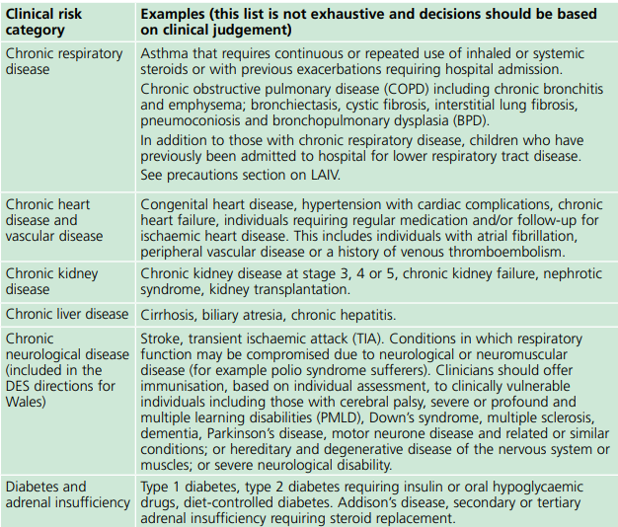
Clinical risk groups who should receive flu vaccine (1)
Notes:
Flu vaccine should be offered to the eligible groups set out in the table.
[Note to trainers: Although difficult to read the detail on this slide in a lecture theatre/classroom situation, this table is presented here in order to show immunisers that under each risk group category, individual conditions are listed and detailed. Healthcare practitioners should refer to the latest Green Book influenza chapter for further detail about clinical risk groups included in the national flu immunisation programme. This chapter is regularly updated, sometimes during the flu season, and can be found at: www.gov.uk/government/collections/immunisation-against-infectious-disease-the-green-book]

Slide 24
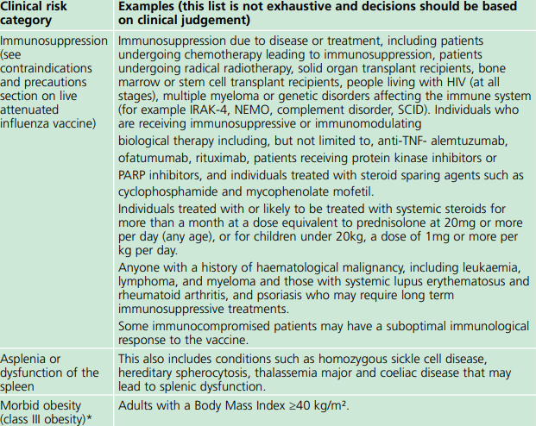
Clinical risk groups who should receive flu vaccine (2)

Slide 25
Why vaccinate these risk groups?
Influenza-related population mortality rates and relative risk of death among those aged 6 months to under 65 years by clinical risk group in England, September 2010 to May 2011
 | Number of fatal flu cases (%) | Mortality rate per 100,000 population | Age-adjusted relative risk
In a risk group | 213 (59.8) | 4.0 | 11.3 (9.1-14.0)
Not in any risk group | 143 (40.2) | 0.4 | Baseline
Chronic renal disease | 19 (5.3) | 4.8 | 18.5
Chronic heart disease | 32 (9.0) | 3.7 | 10.7 (7.3-15.7)
Chronic respiratory disease | 59 (16.6) | 2.4 | 7.4 (5.5-10.0)
Chronic liver disease | 32 (9.0) | 15.8 | 48.2 (32.8-70.6)
Diabetes | 26 (7.3) | 2.2 | 5.8 (3.8-8.9)
Immunosuppression | 71 (19.9) | 20.0 | 47.3 (35.5-63.1)
Chronic neurological disease (excluding stroke/transient ischaemic attack) | 42 (11.8) | 14.7 | 40.4 (28.7-56.8)
Total | 378 | 0.8
Notes:
Increasing flu vaccine uptake in clinical risk groups is important because of the increased risk of serious illness should people in these groups catch flu. The table above shows flu mortality by clinical risk group and the increased risk of death for those in these groups.

Slide 26
Flu vaccine uptake in England (%)
Target group | 2024/25 | 2023/24 | 2022/23 | 2021/22 | 2020/21 | 2019/20 | 2018/19
Patients aged 65 years and over | 74.9 | 77.8 | 79.9 | 82.3 | 80.9 | 72.4 | 72
Patients aged 6 months to under 65 years in risk groups | 40.0 | 41.4 | 49.1 | 52.9 | 53 | 44.9 | 48
Pregnant women in a clinical risk group* | 44.9 | 41.4 | 33.2 | 51.8 | 57.7 | 65.9 | 60.2
Pregnant women not in a clinical risk group | 33.6 | 30.1 | 47.8 | 36 | 41.5 | 42.1 | 43.7
All pregnant women | 35.0 | 32.1 | 35.0 | 37.9 | 43.6 | 43.7 | 45.2
Frontline healthcare workers | 37.8 | 42.8 | 49.9 | 60.5** | 76.8 | 74.3 | 70.3

Slide 27
Flu vaccine uptake by individual clinical risk group in 2024 to 2025 (%) GP registered patients aged 6 months to under 65 years
Risk group | 6 months to under 2 years | 2 years to under 5 years | 5 years to under 16 years | 16 years to under 65 | Total under 65 years
Patients with Diabetes | 10.6 | 44.3 | 51.1 | 49.7 | 49.7
Patients with Chronic Kidney Disease | 14.8 | 40.1 | 44.3 | 48.1 | 48.0
Patients with immunosuppression | 9.8 | 38.3 | 46.1 | 47.4 | 47.2
Patients with Chronic Neurological Disease (including Stroke/TIA, Cerebral Palsy or MS) | 12.6 | 41.2 | 47.8 | 44.5 | 44.6
Patients with Chronic Respiratory Disease | 16.0 | 49.4 | 54.1 | 43.4 | 44.6
Patients with Chronic Heart Disease | 11.2 | 40.8 | 49.8 | 41.1 | 41.4
Patients with Chronic Liver Disease | 16.1 | 41.1 | 42.0 | 33.7 | 33.8
Patients with Asplenia or dysfunction of the spleen | 16.9 | 48.5 | 54.2 | 42.8 | 43.9
Patients with morbid obesity (BMI>=40) (no other risk factor) | - | - | - | 34.2 | 34.2
vaccine uptake for those with an underlying clinical risk factor varies widely between the individual risk groups and by age category
uptake for all those in clinical risk groups needs to improve since, despite continued efforts, only around half of those in most of the clinical risk groups are being immunised
uptake in the youngest risk groups (6 months to 2 years) is around 10-15%

Slide 28
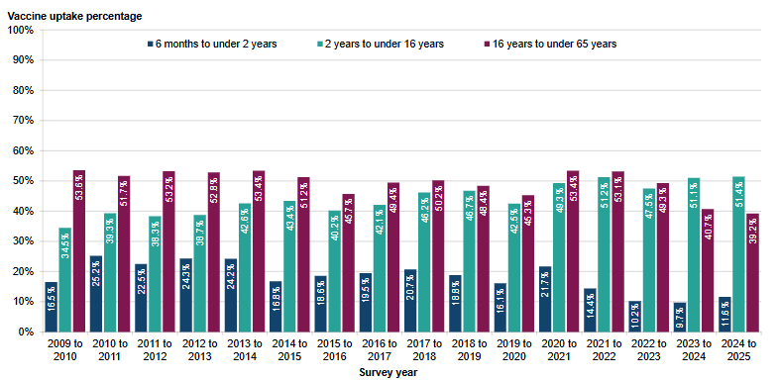
Vaccine uptake for children in a clinical risk group 2024 to 2025
vaccine uptake is particularly low in the younger age groups with clinical conditions that put them at most risk of complications from flu
vaccine uptake in children in clinical risk groups is higher in the age group where all children (healthy and clinical risk group) have been offered flu vaccination
uptake in those aged 6 months to under 2 years remains the lowest in uptake by age band
immunisers should make sure that all children in a clinical risk group have the opportunity to receive flu vaccine
Vaccine uptake (%) in the under 65s in clinical risk groups by age group in England in the 2024 to 20245 season compared with previous survey seasons
Notes:
Parents of children in a clinical risk group who are eligible to receive vaccine at school can choose to receive vaccine in general practice, especially if school session is later in the year and parent does not want their child to wait
Children in a risk group who become 6m during the flu season should be offered vaccination

Slide 29
2024 to 2025 childhood flu vaccine uptake
In the 2024 to 2025 season:
all 2 and 3 year olds were offered vaccination through GP surgeries
  uptake for all GP-registered 2 year olds was 41.7% (44.1% in 2023 to 2024)
  uptake for all GP-registered 3 year olds was 43.5% (44.6% in 2023 to 2024)
  combined uptake for 2 and 3y olds was 42.6% (44.4% in 2023 to 2024)
flu vaccine programme included all school age children from Reception to Year 11
  primary school age (age 4 to 11 years old) uptake was 54.1%
  secondary school age children (age 11 to 16 years old) uptake was 44.6%
  overall uptake in school age children (4 to 16y) was 50.2%
School age group | 2024 to 2025 Percentage vaccine uptake | 2023 to 2024 Percentage vaccine uptake
Reception (age 4 to 5 years) | 54.7 | 55.9
Year 1 (age 5 to 6 years) | 55.6 | 56.4
Year 2 (age 6 to 7 years) | 55.3 | 55.6
Year 3 (age 7 to 8 years) | 54.6 | 55.8
Year 4 (age 8 to 9 years) | 54.6 | 55.1
Year 5 (age 9 to 10 years) | 54.1 | 54.1
Year 6 (age 10 to 11 years) | 52.9 | 53.3
Year 7 (age 11 to 12 years) | 50.0 | 49.1
Year 8 (age 12 to 13 years) | 46.0 | 45.0
Year 9 (age 13 to 14 years) | 44.5 | 42.5
Year 10 (age 14 to 15 years) | 42.5 | 41.6
Year 11 (age 15 to 16 years) | 40.0 | 35.7
All primary school age (age 4 to 11 years) | 54.5 | 55.1
Secondary school Years 7 to 7 (age 11 to 16 years) | 44.6 | 42.8
All eligible school age (age 4 to 16 years) | 50.2 | 49.9
Vaccine uptake in children of school age generally decreases with increasing age
Notes:
Seasonal influenza vaccine uptake in GP patients in England: winter season 2023 to 2024 - GOV.UK (www.gov.uk)
Seasonal influenza vaccine uptake in children of school age in England: winter season 2023 to 2024 - GOV.UK (www.gov.uk)

Slide 30
Health and social care workers
vaccination of health and social care workers protects them and reduces the risk of spreading flu to their patients, service users, colleagues and family members
evidence that vaccination of health and social care workers significantly lowers rates of flu-like illness, hospitalisation and mortality in the elderly in long-term healthcare settings
reduces transmission of flu to vulnerable patients, some of whom may have impaired immunity and may not respond well to their own immunisation
frontline health and social care workers have a duty of care to protect their patients and service users from infection
vaccination of frontline workers also helps reduce sickness absences and contributes to keeping the NHS and care services running through winter pressures
NHS and social care bodies have a responsibility to ensure, as far as is reasonably practicable, that health and social care workers are free of, and are protected from exposure to infections that can be caught at work (Health and Social Care Act 2008, Code of Practice on the prevention and control of infections)
Notes:
Frontline health and social care workers have a duty of care to protect their patients and service users from infection. This includes getting vaccinated against flu.
Flu outbreaks can occur in health and social care settings with both staff and their patients/service users being affected when flu is circulating in the community. It is important that health and social care workers protect themselves by having the flu vaccine, and, in doing so, they reduce the risk of spreading flu to their patients, service users, colleagues and family members.
Vaccination of healthcare workers against flu has been shown to significantly lower rates of flu-like illness, hospitalisation and mortality in the elderly in long-term healthcare settings. Vaccination of staff in acute care settings may provide similar benefits. Flu immunisation of frontline health and social staff care staff may reduce the transmission of infection to vulnerable patients, some of whom may have impaired immunity, increasing their risks of flu and who may not respond well to immunisation.
Vaccination of health and social care workers also helps reduce the level of sickness absenteeism that can jeopardise the NHS and care services. This is essential in the winter when pressures on these services increase and will contribute to keeping the NHS and care services running. This is particularly important when responding to winter pressures.
Immunisation should be provided to healthcare and social care workers in direct contact with patients/clients to protect them and to reduce the transmission of flu within health and social care premises, to contribute to the protection of individuals who may have a suboptimal response to their own immunisations, and to avoid disruption to services that provide their care.
All frontline health and social care workers with direct patient/service user contact should be provided with flu vaccination by their employer. This includes staff in all NHS trusts, general practices, care homes, and domiciliary care.
Employers are encouraged to commission a service which makes access to the vaccine easy for all staff, encourage staff to get vaccinated and to monitor the delivery of their programme.
The definition of healthcare workers from the Green Book chapter 12 should be used to identify those eligible as part of the frontline and social care workers programme.

Slide 31
Vaccine uptake for frontline healthcare workers
in the 2024 to 2025 season, 37.8% of frontline HCWs were vaccinated
  51.5% of frontline HCWs in GP practices received a vaccine
  37.5% of frontline HCWs in NHS trusts received a vaccine
this is the fourth consecutive season to show a decrease in the vaccination of frontline HCWs and the lowest uptake since the 2010 to 2011 flu season
all frontline health and social care workers should be offered a flu vaccine as part of the organisations’ policy
employers have a responsibility to help protect their staff and patients or clients and ensure the overall safe running of services
employers should commission or implement a service which makes access to the vaccine easy for all frontline staff, encourages staff to get vaccinated, and monitors the delivery of their programme
in some circumstances, frontline staff, employed by specific social care providers without access to employer led occupational health schemes, can access the vaccine through the NHS free of charge

Slide 32
Pregnant women
All pregnant women, in each pregnancy, are recommended to receive an inactivated flu vaccine irrespective of their stage of pregnancy
pregnant women are at increased risk from complications if they contract flu
having flu during pregnancy may be associated with premature birth and smaller birth size and weight
flu vaccination during pregnancy provides passive immunity against flu to infants in the first few months of life
studies on safety of flu vaccine in pregnancy show that inactivated flu vaccine can be safely and effectively administered during any trimester of pregnancy
no study to date has demonstrated an increased risk of either maternal complications or adverse fetal outcomes associated with inactivated flu vaccine
Notes:
All pregnant women are recommended to receive the inactivated flu vaccine irrespective of their stage of pregnancy.
There is good evidence that pregnant women are at increased risk from complications if they contract flu. In addition, there is evidence that having flu during pregnancy may be associated with premature birth and smaller birth size and weight and that flu vaccination may reduce the likelihood of prematurity and smaller infant size at birth associated with an influenza infection during pregnancy. Furthermore, a number of studies show that flu vaccination during pregnancy provides passive immunity against flu to infants in the first few months of life. A review of studies on the safety of flu vaccine in pregnancy concluded that inactivated flu vaccine can be safely and effectively administered during any trimester of pregnancy and that no study to date has demonstrated an increased risk of either maternal complications or adverse fetal outcomes associated with inactivated influenza vaccine.

Slide 33
Influenza vaccines and their components
Two main types of flu vaccine available:
  inactivated – given by injection
  live attenuated – given by nasal application
None of the flu vaccines can cause clinical influenza in those that can be vaccinated
the inactivated flu vaccines are trivalent vaccines – they contain 2 subtypes of Influenza A and 1 type B lineage
the inactivated vaccines are recommended for people aged 18+, children in clinical risk groups aged 6 months to 2 years and for children aged 2 to 18 years who cannot receive live attenuated vaccine
the live attenuated flu vaccine is also a trivalent vaccine – it contains 2 subtypes of Influenza A and one B lineage
the live attenuated vaccine is licensed for children aged 2 up to 18 years
Notes:
Inactivated flu vaccines given by intramuscular injection have been used in the UK for many years. The live intranasal influenza vaccine (LAIV) was introduced into the UK schedule in 2013. However, a live intranasal flu vaccine called FluMist (same vaccine as Fluenz, different trade name) was introduced in the US schedule in 2003 so there is over 20 years’ experience of widespread use of the vaccine in the US and over 12 flu seasons use of LAIV in the UK.

Slide 34
Changes to the flu vaccines from quadrivalent to trivalent for the 2025 to 2026 vaccination programme
flu vaccines used to be trivalent and contain 2 type A and 1 type B influenza virus strains
in 2013, in order to extend protection against flu, both B strains were included in flu vaccines and these quadrivalent vaccines were then offered up until the last flu season (with the exception of LAIV which became a trivalent vaccine for the 2024 to 2025 flu season)
in 2023, the WHO recommended that the B/Yamagata lineage antigen should be excluded from future flu vaccines as there have been no confirmed naturally occurring B/Yamagata lineage virus detections after March 2020
as the B/Yamagata lineages are no longer circulating and are unlikely to cause future epidemics, the inclusion of a B/Yamagata antigen as a component of flu vaccines is no longer necessary
WHO stated that every effort should be made to exclude this B strain as soon as possible, across all vaccine types, so for the 2025 to 2026 flu vaccination programme, all flu vaccines will be trivalent vaccines once again
the trivalent vaccines will offer the same level of protection against the 2 A and 1 B flu virus strains in them as the quadrivalent vaccine
Notes:
Originally, most influenza vaccines were trivalent, containing 2 subtypes of influenza A and one B virus but then quadrivalent vaccines with an additional B virus were developed and used in recent years to improve the match of the vaccine and offer wider protection against circulating influenza B viruses. The first authorised quadrivalent flu vaccine was made available for use in the UK in 2013. From then, up until this forthcoming flu season (2025 to 2026), all the flu vaccines recommended for use in the UK were quadrivalent vaccines.
Every year JCVI reviews the latest evidence on flu vaccines and advises the type of vaccine to be offered to different age groups. Their advice for 2025 to 2026 noted that the World Health Organization (WHO) has concluded that B/Yamagata lineages are no longer circulating and are unlikely to cause future epidemics, and that inclusion of a B/Yamagata antigen as a component of flu vaccines is no longer warranted. WHO stated that every effort should be made to exclude this as soon as possible, across all vaccine types. Therefore, for the 2025 to 2026 flu vaccination programme, all flu vaccines will be trivalent vaccines again.

Slide 35
Change to terminology
previously, the flu vaccines have been referred to as QIV (quadrivalent influenza vaccine) or TIV (trivalent influenza vaccine)
from now on, the more generic IIV (inactivated influenza vaccine) will be used to denote all inactivated influenza vaccines, regardless of how many virus strain antigens are included in the vaccine
however, for some of the vaccines, the manufacturers have included ‘trivalent’ or ‘TIV’ in the name of the vaccine
all vaccines used for the 2025 to 2026 season are trivalent

Slide 36
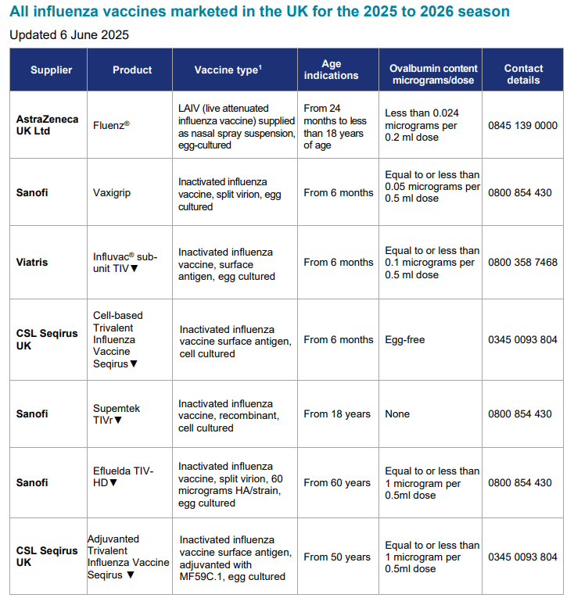
Influenza vaccines available for 2025 to 2026
Several different flu vaccines are available for the 2025 to 2026 flu season
A poster detailing the age indication and the ovalbumin content of these is available from the GOV.UK website:
www.gov.uk/government/publications/influenza-vaccines-marketed-in-the-uk
Notes:
There are a number of different flu vaccines available each year and it is important to be aware of the age indications for each of them and the ovalbumin content for those where the flu viruses are grown on hens eggs.

Slide 37
Flu vaccine presentation and dosage
inactivated influenza vaccines are for intramuscular (IM) administration and are supplied as suspensions in pre-filled syringes containing a 0.5ml dose
the live intranasal flu vaccine is supplied as a nasal spray suspension in a single use, pre-filled, nasal applicator with a divider clip. No reconstitution or dilution is required and each vaccine contains 0.2ml (administered as 0.1 ml per nostril)
some flu vaccines are restricted for use in particular age groups
the annual flu letter and the Summary of Product Characteristics (SmPC) for individual products should always be referred to when ordering vaccines for particular patients
Notes:
Inactivated flu vaccine for intramuscular (IM) administration is supplied as a suspension in a pre-filled syringe.
The LAIV is supplied as a single use prefilled nasal applicator that is ready to use. No reconstitution or dilution is required.
All but one of the flu vaccines available in the UK are inactivated, do not contain live viruses and cannot cause clinical influenza. In previous years, most of the available flu vaccines were prepared from viruses grown in embryonated hens eggs. For 2025/26, flu vaccines are available that are cell cultured, or egg cultured.
The flu vaccines available in the UK for the 2025/26 flu season are listed in the National flu immunisation programme 2025 to 2026 letter

Slide 38
Inactivated influenza vaccine
For the 2025 to 2026 flu season (northern hemisphere winter), the WHO have recommended that flu vaccines contain the following:
Egg-cultured vaccines
an A/Victoria/4897/2022 (H1N1)pdm09-like virus
an A/Croatia/10136RV/2023 (H3N2)-like virus
a B/Austria/1359417/2021 (B/Victoria lineage)-like virus
Cell-cultured or recombinant vaccines
an A/Wisconsin/67/2022 (H1N1)pdm09-like virus
an A/District of Columbia/27/2023 (H3N2)-like virus
a B/Austria/1359417/2021 (B/Victoria lineage)-like virus
This vaccine composition differs from the 2024 to 2025 vaccine composition as the B/Yamagata lineage is no longer included in the vaccines and one of the influenza A virus strains has also been replaced

Slide 39
Egg cultured influenza vaccine (IIVe)
the most common way to make flu vaccines is the egg-cultured manufacturing process
flu viruses are injected into fertilised hen’s eggs and incubated for several days to allow the viruses to replicate
the fluid containing the virus is harvested from the eggs and then, for inactivated flu vaccines, the vaccine viruses are inactivated (killed) and the virus antigen is purified
the egg-cultured trivalent influenza vaccines (IIVe) protect against 3 strains of flu: 2 A types and 1 B lineage
this vaccine can be considered for use in pregnant women and adults in clinical risk groups aged less than 65 years only if the IIVc and IIVr vaccines are not available
also for eligible children from 6 months if IIVc is unavailable and LAIV is not suitable (in children from 2 years)
Notes:
Providers of immunisation services should procure the JCVI preferred vaccines. IIVe should only be offered when every attempt to obtain and give the vaccine recommended for age or risk group has been exhausted. Evidence of this may be requested by the commissioner before reimbursement is agreed.

Slide 40
Adjuvanted influenza vaccine (aIIV)
adjuvanted trivalent influenza vaccine (aTIV) was used in the UK in the 2018 to 2019 and 2019 to 2020 flu seasons in the 65y and over age group and has been given in other countries for a number of years
this adjuvanted vaccine became a quadrivalent vaccine for the 2021 to 2022 flu season onwards but for 2025 to 2026, will become a trivalent vaccine again
aIIV contains 2 subtypes of Influenza A (H3N2 and H1N1pdm09) and 1 B virus lineage
adjuvanted vaccines have higher immunogenicity and effectiveness than non-adjuvanted, standard dose vaccines in older people
the adjuvant, known as MF59, has been added to the vaccine to enhance the immune response to counter the effect of immunosenescence (age related reduction in immune response)
MF59 adjuvant is an oil-in-water emulsion including squalene oil which is a naturally occurring substance found in humans, animals and plants. In humans, it is made in the liver and circulates in the bloodstream
the squalene used in pharmaceutical products and vaccines is commercially extracted from fish oil and is then highly purified during the manufacturing process
aIIV is made using an egg-cultured manufacturing process
it is now licensed from 50 years of age

Slide 41
Cell cultured influenza vaccine (IIVc)
IIVc was licenced in the US in 2016 and in the UK in December 2018
IIVc is a trivalent vaccine containing 2 subtypes of Influenza A (H3N2 and H1N1pdm00) and 1 B virus lineage
IIVc has a similar safety profile to other flu vaccines (similar rate and type of adverse reactions reported). Hundreds of millions of doses of cell-cultured vaccine have been administered worldwide with no serious safety concerns
the cell-cultured vaccine manufacturing process uses an animal cell line (Madin-Darby Canine Kidney, or MDCK cells) to grow the influenza virus rather than the traditional egg cultured manufacturing methods
this manufacturing process eliminates the risk of egg-adaptation and may result in the vaccine containing virus that is a closer match to wild-type circulating flu viruses
IIVc is licenced for use from age 6 months and is egg free
Notes:
Egg adaptation: Previously, virtually all flu vaccines had been cultured in fertilised chicken eggs but when flu vaccine viruses are grown this way, the viruses adapt to live in the egg. This can lead to changes in the viruses during the manufacturing process which means the egg-derived virus used in the vaccine is then not a complete antigenic match to the original wild-type strain recommended by the WHO. This means the vaccine virus may not match the circulating flu strain as closely and the vaccines produced may therefore not be as effective. Although this ‘egg adaptation’ has been known about for a long time, it has become more of a problem in the last decade, particularly for the A(H3N2) virus which appears to be more affected by egg adaptation than the other flu A and B viruses.

Slide 42
Recombinant influenza vaccine (IIVr)
IIVr is a trivalent flu vaccine made using recombinant DNA technology
it does not require the use of, or growth of flu virus during the manufacturing process which means that the antigen in the vaccine cannot adapt or mutate and should therefore be an exact match to the flu A and B strains contained in the vaccine
it also contains 3 times the amount of flu virus haemagglutinin antigen contained in standard inactivated flu vaccines in order to enhance the immune response made to it
the type and rates of local and systemic reactions following vaccination with IIVr are similar to those seen following vaccination with other flu vaccines (injection site tenderness, headache, fatigue, muscle ache and joint pain)
since eggs are not required to grow the flu virus, cell-cultured flu vaccines (IIVc and IIVr) contain no egg and they also do not contain any live virus, antibiotics or gelatine
first used in the UK 2021 to 2022 flu season, IIVr is licensed from 18 years of age

Slide 43
Recombinant vaccine technology
to make recombinant vaccine, the manufacturers take the DNA (genetic instructions) for making the surface protein, haemagglutinin, found on flu viruses
the haemagglutinin DNA is then combined with a baculovirus (a virus that infects invertebrates); this results in a ‘recombinant’ baculovirus
the role of the baculovirus is to help transport the DNA instructions for making the haemagglutinin antigen into a host cell
once the recombinant virus enters the host cell line (an insect cell line in which the baculovirus grows well), it instructs the cells to rapidly produce the haemagglutinin antigen
this antigen is grown in bulk, collected, purified, and then packaged as recombinant flu vaccine
when the vaccine is injected, the haemagglutinin antigen in it triggers the immune system to create antibodies that specifically target the flu virus

Slide 44
High dose inactivated influenza vaccine (IIV-HD)
the high dose inactivated vaccine (IIV-HD) was licenced in the US in 2009 and in the UK in 2019 (initially as a trivalent vaccine, then as a quadrivalent vaccine)
the IIV-HD that will be used in the UK in 2025 to 2026 is a trivalent vaccine containing 2 subtypes of Influenza A and 1 B lineage
IIV-HD contains 4 times the amount of antigen contained in standard-dose inactivated influenza vaccines
the additional antigen content is intended to enhance the immune response made by people aged from 60 years and provide them with better protection against flu
IIV-HD has been proven to be effective and have a good safety profile
IIV-HD is made using an egg-cultured manufacturing process
it is licensed from 60 years of age
Notes:
The inactivated split virion high dose inactivated influenza vaccine (IIV-HD) contains four times the amount of antigen that standard dose flu vaccines contain (60 micrograms of haemagglutinin of each of the virus strains per dose compared to 15 micrograms of each in the inactivated influenza standard dose vaccines).The higher dose of antigen in the vaccine is intended to enhance the immune response made by people aged from 60 years and therefore, provide them with better protection against flu. Studies have shown that IIV-HD is more effective in older adults and that they made higher antibody levels following receipt of IIV-HD than they made to a standard dose flu vaccine.

Slide 45
Inactivated influenza vaccine for children who cannot receive LAIV
children in clinical risk groups for whom LAIV is unsuitable, and healthy children whose parents object to LAIV on the grounds of its porcine gelatine content, should be offered IIVc
IIVc is recommended to be offered to children in clinical risk groups aged 6 months to 2 years
where IIVc vaccine is unavailable, IIVe could be offered (unless contraindicated) but IIVe has not been procured by UKHSA
if the inactivated vaccine (IIVc) supplied by UKHSA is not used, please be aware that not all inactivated flu vaccines are licensed for children and some contain too much ovalbumin for egg allergic children
always check the manufacturer’s SmPC for vaccine suitability before administration
Notes:
The inactivated flu vaccines are interchangeable; the second dose, if indicated, should be given at least 4 weeks after the first dose in accordance with the manufacturer’s SmPC for that vaccine.

Slide 46
Live attenuated influenza vaccine (LAIV)
a live attenuated (weakened) influenza vaccine (LAIV) given intranasally is the recommended vaccine for the childhood flu programme
LAIV has been shown to be more effective in children compared with inactivated influenza vaccines
it may offer some protection against strains not contained in the vaccine as well as to those that are and has the potential to offer better protection against virus strains that have undergone antigenic drift
since this vaccine is comprised of weakened whole live virus, it replicates natural infection which induces better immune memory (thereby offering better long-term protection to children)
in addition to being attenuated, the live viruses in LAIV have been adapted to cold so that they cannot replicate efficiently at body temperature
LAIV has a good safety profile in children aged 2 years and older
Notes:
Fluenz is a live attenuated vaccine (a weakened form of flu virus which cannot cause disease but which protects against flu). It is a cold adapted virus which means it cannot replicate at body temperature.
This is a nasal vaccine and must not be injected.
It is supplied in a box containing 10 prefilled nasal applicators.
Live attenuated influenza vaccine (Fluenz) is the preferred flu vaccine for children aged 2 to less than 18 years.
It became available in the UK for the 2012/13 flu season. It has been used in USA (same vaccine but under the name FluMist) for many years and millions of doses have been given both in the UK (over 30 million) and worldwide .

Slide 47
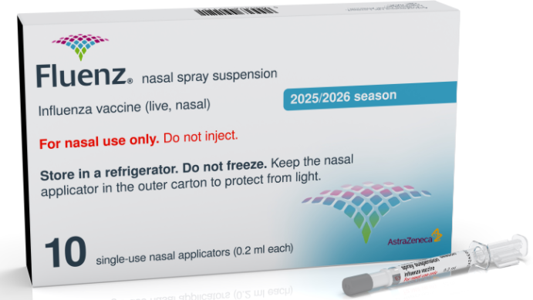
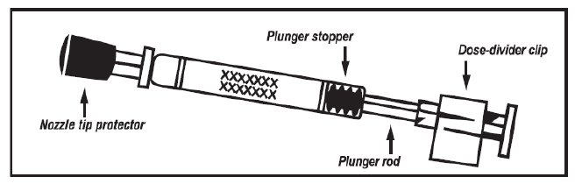
The LAIV used in the UK is Fluenz
  licensed from 2 years to less than 18 years of age
  nasal spray (suspension) in a prefilled nasal applicator
  the suspension is colourless to pale yellow, clear to opalescent and small white particles may be present
  supplied in a pack containing 10 doses (single use prefilled nasal applicators)
  ready to use (no reconstitution or dilution required)
  each applicator contains 0.2ml (administered as 0.1ml per nostril)
  the applicator has a divider clip to enable one application in each nostril.The dose divider clip should not be removed until the first half dose has been administered

Slide 48
Porcine gelatine
the LAIV contains a highly purified form of gelatine derived from pigs
gelatine is used in LAIV as a stabiliser – it protects the live viruses from the effects of temperature
gelatine is commonly used in a range of pharmaceutical products, including many capsules and some vaccines
there is no other live attenuated flu vaccine available that does not contain porcine gelatine. The manufacturer of LAIV (Fluenz) tested 40 potential stabilisers – gelatine was chosen because without it, stability was significantly reduced
for eligible children whose parents refuse LAIV due to the porcine gelatine content, the injectable cell-cultured flu vaccine (IIVc) should be ordered from ImmForm

Slide 49
2025 to 2026 flu vaccine recommendations for those aged 65 years and over
For those aged 65 years and over in the 2025 to 2026 flu season (and those who become 65 years of age before 31 March 2026), the following inactivated vaccines should be offered:
  adjuvanted influenza vaccine (aIIV)
  high dose influenza vaccine (IIV-HD)
  recombinant influenza vaccine (IIVr)
  or, if these vaccines are not available, cell-cultured influenza vaccine (IIVc)
the JCVI have advised that aIIV, IIV-HD and IIVr are considered equally suitable for use in 2025 to 2026 and that they should be considered as equivalent
if aIIV, IIV-HD and IIVr are not available (and every attempt to obtain them has been exhausted), IIVc is considered to be an acceptable alternative for use in this age group

Slide 50
2025 to 2026 flu vaccine recommendations for adults aged under 65 years in a clinical risk group and pregnant women
adults in clinical risk groups and pregnant women, aged 18 to less than 65 years old should be offered:
  cell-cultured influenza vaccine (IIVc)
  recombinant influenza vaccine (IIVr)
  adjuvanted influenza vaccine (aIIV) (for those aged from 50 years only*)
  high dose influenza vaccine (IIV-HD) (for those aged from 60 years only)
  or, if these vaccines are not available, egg-cultured influenza vaccine (IIVe)
limited evidence shows there is a potential advantage to using cell-cultured flu vaccines compared with egg-cultured flu vaccines, due to the possible impact of ‘egg-adaption’ on vaccine effectiveness, particularly against A(H3N2) strains.
however, IIVe can also be given to this age group if the recommended vaccines are not available and every attempt to obtain them has been exhausted
*aIIV is not currently recommended for women who are pregnant and or breastfeeding

Slide 51
Flu vaccine for children
children in clinical risk groups aged 6 months to 2 years: offer IIVc
children in clinical risk groups aged 2 years up to 18th birthday: offer live attenuated influenza vaccine (LAIV) unless contraindicated or otherwise unsuitable*
children aged 2 and 3 years on 31 August 2025 and all eligible school aged children (from Reception to Year 11) should be offered LAIV unless contraindicated or otherwise unsuitable*
* if LAIV is contraindicated or otherwise unsuitable, offer IIVc

Slide 52
Number of doses
2 doses of the inactivated flu vaccines are required to achieve adequate antibody levels in younger children
however, a single dose of LAIV should provide protection to previously unvaccinated healthy children and only modest additional protection is provided by a second dose of LAIV
only children aged 2 years to less than 9 years who are in clinical risk groups, or who are a close/household contact of an immunosuppressed individual, who have not received flu vaccine previously should be offered a 2nd dose of LAIV, given at least 4 weeks apart (if no contraindications – otherwise offer inactivated vaccine e.g. if child or household contact is severely immunosuppressed)
healthy children aged 2 years to under 9 years who cannot receive LAIV due to contraindications and those whose parents request they receive IIV instead of LAIV should be offered a single dose, even if they have not previously received influenza vaccine

Slide 53
Influenza vaccine effectiveness
vaccine effectiveness (VE) varies from one season to the next. Overall effectiveness has been estimated at between 30% to 60% (adults aged 18 to 65 years) for flu infection in primary care
there is lower effectiveness in older people although immunisation can provide important protection against flu GP consultation and severe disease/flu confirmed hospital admission
in the last decade, there has generally been a good match between the strains of flu in the vaccine and those circulating but there has often been poorer effectiveness against influenza A (H3N2), particularly in the elderly, where burden of infection from that strain is highest
potential explanations for the low effectiveness against influenza A(H3N2) include
        immunosenescence (age related reduction in immune response)
        genetic drift of the circulating viral strain (compared to the vaccine strain, as happened in 2014 to 2015 flu season)
        egg adaptation (in recent seasons, changes to the virus during the manufacturing process have arisen with A(H3N2) strain when flu vaccine strains are propagated in eggs which means that the vaccines do not work as well)
for the 2024 to 2025 flu season, estimates of VE against laboratory confirmed influenza in primary care across age groups ranged between 37% and 56%. Effectiveness against hospitalisation ranged from 41% in those aged 65 and above to 62% in those between 2 and 17 years

Slide 54
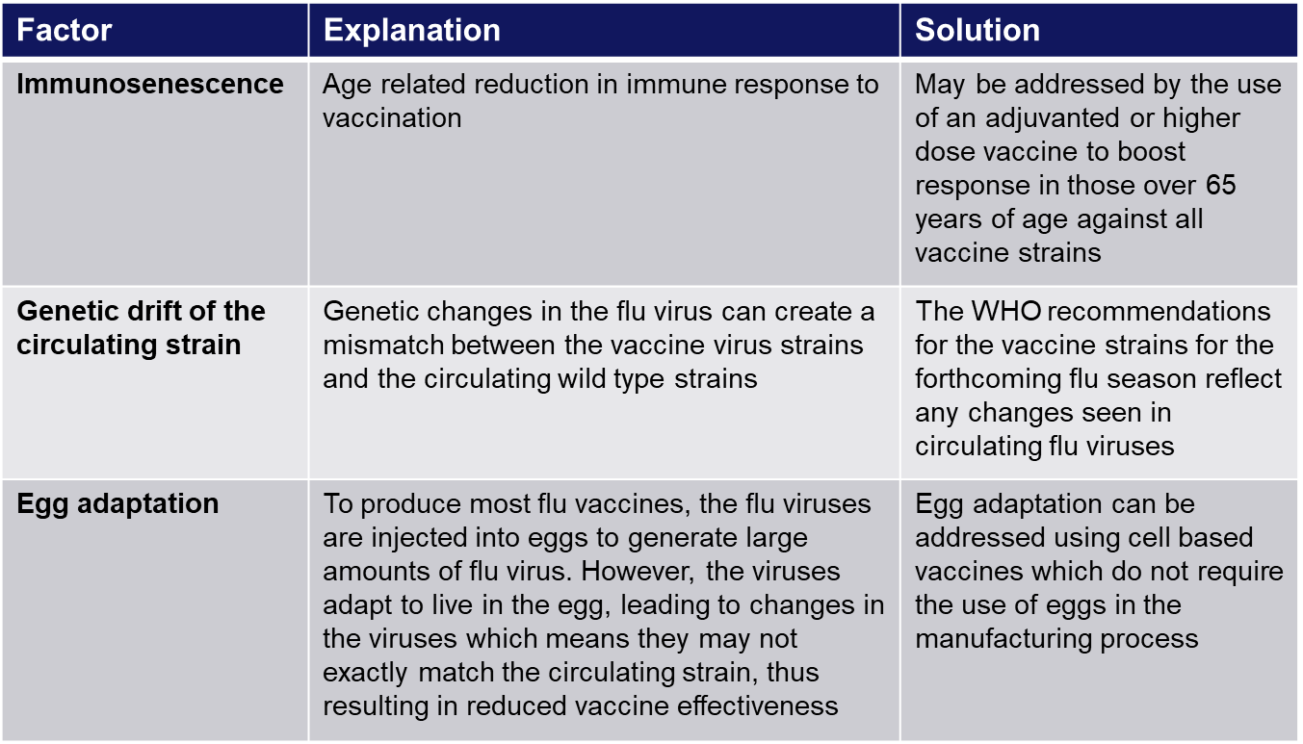
Improving vaccine effectiveness
There are a number of potential factors which can lead to reduced vaccine effectiveness

Slide 55
LAIV effectiveness
overall adjusted vaccine effectiveness (VE) for 2023 to 2024 for 2 to 17 year olds against flu receiving LAIV specifically was 64% (VE for LAIV 2024/25 not yet available)
the results from research¹ into the first 3 years of the children’s flu programme showed a positive impact on flu transmission from vaccinating children of primary school age
these include reductions in: GP consultations for influenza-like illness, swab positivity in primary care, laboratory confirmed hospitalisations and percentage of respiratory emergency department attendances
a further study² of 4 seasons’ use of LAIV across the UK and Republic of Ireland confirmed that LAIV vaccination of primary school age children is associated with population-level benefits, particularly in reducing infection incidence in primary care
1. Pebody R and others. 21 June 2018. ‘Uptake and impact of vaccinating primary school-age children against influenza: experiences of a live attenuated influenza vaccine programme, England, 2015 to 2016’. Eurosurveillance; 21 June 2018: volume 23, issue 25
2. Sinnathamby MA and other. An intercountry comparison of the impact of the paediatric attenuated influenza vaccine (LAIV) programme across the UK and the Republic of Ireland (ROI), 2010 to 2017. Influenza Other Respir Viruses. 2023 Feb 13;17(2):e13099.doi: 10.1111/irv.13099

Slide 56
Contraindications to flu vaccination
there are very few individuals who cannot receive any flu vaccine
where LAIV cannot be given to a child, it is likely that inactivated vaccine could be given instead
where there is doubt, expert advice should be sought promptly so that the period the individual is left unvaccinated is minimised
Contraindications for all flu vaccines:
confirmed anaphylactic reaction to a previous dose of flu vaccine
confirmed anaphylactic reaction to a component of flu vaccine (other than ovalbumin -see slide on egg allergy)
Additional contraindications for LAIV :
        clinically severely immunocompromised due to a condition or immunosuppressive therapy such as:
          acute and chronic leukaemias
          lymphoma
          HIV infection not suppressed by antiretroviral therapy
          cellular immune deficiencies
          high dose corticosteroids
        receiving salicylate therapy (systemic aspirin therapy)
        known to be pregnant
also contraindications for children with acute and severe asthma - see specific slide
Notes:
Confirmed anaphylaxis is rare. Other allergic conditions such as rashes may occur more commonly and are not contraindications to further immunisation. A careful history of the event will often distinguish between true anaphylaxis and other events that are either not due to the vaccine or are not life threatening. In the latter circumstance, it may be possible to continue the immunisation course. Specialist advice must be sought on the vaccines and the circumstances in which they could be given. The risk to the individual of not being immunised must be taken into account.
The live attenuated influenza vaccine (Fluenz) should not be given to children or adolescents who are clinically severely immunodeficient due to conditions or immunosuppressive therapy such as: acute and chronic leukaemias; lymphoma; HIV infection not suppressed by antiretroviral therapy; cellular immune deficiencies; and high dose corticosteroids. It is not contraindicated for use in children or adolescents living with HIV infection who are receiving antiretroviral therapy and attaining viral suppression; or who are receiving topical/inhaled corticosteroids or low-dose systemic corticosteroids or those receiving corticosteroids as replacement therapy, e.g. for adrenal insufficiency.
The SmPC for LAIV lists salicylate use among children and adolescents as a contraindication for LAIV because of reports of the association of Reye’s syndrome with salicylates and wild-type influenza infection. No direct association between salicylate therapy and LAIV and Reye’s syndrome has been described, and is included on the SmPC on theoretical grounds only. As a precaution children and adolescents receiving salicylate therapy that has been associated with Reye’s syndrome (such as systemic aspirin therapy) should not be offered LAIV, however, LAIV can be offered to children and adolescents receiving salicylates that are not associated with Reye’s syndrome such as salicylates given for topical treatment of localised conditions or aminosalicylates for inflammatory bowel disease.
Safety data for the live attenuated flu vaccine when given in pregnancy is limited. Whilst there is no evidence of risk with live attenuated flu vaccine, inactivated flu vaccines are preferred for those who are pregnant. There is no need, however, to specifically test eligible girls for pregnancy or to advise avoidance of pregnancy in those who have been recently vaccinated.
The SmPCs for individual products should always be referred to when deciding which vaccine to give. There are very few individuals who cannot receive any flu vaccine. When there is doubt, appropriate advice should be sought promptly from the local screening and immunisation or health protection team or the patient’s consultant so that the period the individual is left unvaccinated is minimised.

Slide 57
Precautions to flu vaccination
acutely unwell/severe febrile illness:
  defer until recovered
heavy nasal congestion:
  defer live intranasal vaccine until resolved or, if the child is in a risk group, consider inactivated flu vaccine to provide protection without delay
children with cochlear implants can be given LAIV safely although ideally not in the week prior to implant surgery or for 2 weeks afterwards, or if there is evidence of on-going cerebrospinal fluid leak
children with unrepaired craniofacial malformations where there may be a potential portal of entry to the brain / central nervous system, or where there are particular concerns around absorption may require IIV instead
use with antiviral agents against flu:
    LAIV should not be administered at the same time or within 48 hours of cessation of treatment with flu antiviral agents
    administration of flu antiviral agents within 2 weeks of administration of LAIV may adversely affect the effectiveness of the vaccine
Notes:
Minor illnesses without fever or systemic upset are not valid reasons to postpone vaccination. If the individual is acutely unwell, immunisation may be postponed until they have recovered. This is to avoid confusing the differential diagnosis of acute illness by wrongly attributing any signs or symptoms to the adverse effects of the vaccine.
There are no data on the effectiveness of LAIV when given to children with heavily blocked or runny nose (rhinitis) attributable to infection or allergy. As heavy nasal congestion might impede delivery of the vaccine to the nasopharyngeal mucosa, deferral of administration until resolution of the nasal congestion should be considered or an appropriate alternative intramuscularly administered influenza vaccine should be considered.
Children with cochlear implants can be given LAIV safely although ideally not in the week prior to implant surgery or for 2 weeks afterwards, or if there is evidence of on-going cerebrospinal fluid leak
Children with unrepaired craniofacial malformations where there may be a potential portal of entry to the brain / central nervous system, or where there are particular concerns around absorption may require an IIV injection instead
There is a potential for influenza antiviral agents to lower the effectiveness of the live attenuated influenza vaccine. Therefore, influenza antiviral agents and LAIV should not be administered concomitantly. LAIV should be delayed until 48 hours following the cessation of treatment with influenza antiviral agents. Administration of influenza antiviral agents within 2 weeks of administration of LAIV may adversely affect the effectiveness of the vaccine.

Slide 58
Acute and severe asthma
children with asthma on inhaled corticosteroids may safely be given LAIV irrespective of the dose prescribed
however, LAIV is not recommended for children and adolescents currently experiencing an acute exacerbation of symptoms including
  - those who have had increased wheezing and/or
  - needed additional bronchodilator treatment in the previous 72 hours
Such children should be offered a suitable inactivated influenza vaccine to avoid a delay in protection
children who require regular oral steroids for maintenance of asthma control, or have previously required intensive care for asthma exacerbation should only be given LAIV on the advice of their specialist
as these children may be at higher risk from influenza infection, those who cannot receive LAIV should receive a suitable inactivated influenza vaccine
children with significant asthma and aged under 9 years who have not been previously vaccinated against influenza will require a second dose (of either LAIV or IIV as appropriate)
Notes:
In 2019, JCVI advised that, on the basis of recent data, children with asthma on inhaled corticosteroids may safely be given LAIV, irrespective of the dose prescribed. LAIV is not recommended for children and adolescents currently experiencing an acute exacerbation of symptoms including those who have had increased wheezing and/or needed additional bronchodilator treatment in the previous 72 hours. Such children should be offered a suitable inactivated influenza vaccine to avoid a delay in protection.
There are limited safety data in children who require regular oral steroids for maintenance of asthma control, or have previously required intensive care for asthma exacerbation – such children should only be given LAIV on the advice of their specialist. As these children may be at higher risk from influenza infection, those who cannot receive LAIV should receive a suitable inactivated influenza vaccine. Children with significant asthma and aged under 9 years who have not been previously vaccinated against influenza will require a second dose (of either LAIV or inactivated vaccine as appropriate).

Slide 59
Egg allergy in adults
for many years, most flu vaccines have been prepared from flu viruses grown in embryonated hens’ eggs and the final vaccine product contains varying amounts of egg protein as ovalbumin
the ovalbumin content for the 2025 to 2026 flu vaccines is published on the GOV.UK Annual flu programme webpage
for the 2025 to 2026 season, those aged 18 years and over are recommended to receive IIVc and IIVr which are egg free
adults with egg allergy can be immunised in any setting using the cell-cultured or recombinant inactivated egg-free vaccines (IIVc or IIVr)
  IIVe should only be offered if it is not possible to give IIVc or IIVr. If IIVe is given, it must have an ovalbumin content less than 0.12 micrograms/ml (equivalent to <0.06 micrograms per 0.5ml dose)
adults with severe anaphylaxis to egg which has previously required intensive care should be offered an egg-free vaccine or referred to a specialist for assessment with regard to receiving immunisation in hospital if this is not possible
NB: aIIV and IIV-HD are both egg-cultured vaccines and contain ovalubumin

Slide 60
Egg allergy in children
children with an egg allergy (including those with previous anaphylaxis to egg) can be safely vaccinated with LAIV in any setting (including primary care and schools)
however, children who have required admission to intensive care for a previous severe anaphylaxis to egg should be given LAIV in the hospital setting
children with both egg allergy and a clinical risk factor that contraindicates LAIV (for example immunosuppression) should be offered an egg-free inactivated flu vaccine with no ovalbumin (IIVc) or, if this is not possible, an IIVe with a very low ovalbumin content (less than 0.12micrograms/ml) (if the egg allergy has previously required intensive care for anaphylaxis, then this should be given in hospital)
eligible children from 6 months of age with egg allergy can also be given the cell-cultured inactivated egg-free vaccine IIVc
children aged 6 months to under 9 years in a clinical risk group who have not been previously vaccinated against influenza will require a second dose (of either LAIV (over 2 years) or IIV as appropriate)

Slide 61

Ovalbumin content
The ovalbumin content of the flu vaccines available for 2025 to 2026 is given in the table available on the GOV.UK website www.gov.uk/government/publications/influenza-vaccines-marketed-in-the-uk.
It is also stated in the individual vaccine’s SmPC

Slide 62
Salicylate therapy and LAIV
the SmPC for LAIV lists salicylate use among children and adolescents as a contraindication for LAIV because of reports of the association of Reye’s syndrome with salicylates and wild-type influenza infection
Reye's syndrome is a very rare disorder that can cause serious liver and brain damage. If not treated promptly, it may lead to permanent brain injury or death
no direct association between salicylate therapy and LAIV and Reye’s syndrome has been described, and it is included on the SmPC on theoretical grounds only
as a precaution children and adolescents receiving salicylate therapy that has been associated with Reye’s syndrome (such as systemic aspirin therapy) should not be offered LAIV (they should be offered an inactivated vaccine (IIVc) instead)
however LAIV can be offered to children and adolescents receiving salicylates that are not associated with Reye’s syndrome such as salicylates given for topical treatment of localised conditions or aminosalicylates for inflammatory bowel disease
Notes:
The SmPC for LAIV lists salicylate use among children and adolescents as a contraindication for LAIV because of reports of the association of Reye’s syndrome with salicylates and wild-type influenza infection. No direct association between salicylate therapy and LAIV and Reye’s syndrome has been described and is included on the SmPC on theoretical grounds only. As a precaution children and adolescents receiving salicylate therapy that has been associated with Reye’s syndrome (such as systemic aspirin therapy) should not be offered LAIV, however, LAIV can be offered to children and adolescents receiving salicylates that are not associated with Reye’s syndrome such as salicylates given for topical treatment of localised conditions or aminosalicylates for inflammatory bowel disease.

Slide 63
Inadvertent administration of LAIV
if an immunocompromised individual receives LAIV, the degree of immunosuppression should be assessed
if the individual is severely immunocompromised, antiviral prophylaxis should be considered
otherwise, they should be advised to seek medical advice if they develop flu-like symptoms in the 4 days following administration of the vaccine
if antivirals are used for prophylaxis or treatment, the individual should also be offered inactivated flu vaccine in order to maximise their protection (this can be given straight away)

Slide 64
LAIV and ‘viral shedding’
    LAIV does not create an external mist of vaccine virus in the air when children are being vaccinated and others in the room should not be at risk of ‘catching’ the vaccine virus
    administration of the intranasal vaccine delivers just 0.1ml of fluid straight into each nostril and almost all the fluid is immediately absorbed into the child’s nose
    although vaccinated children are known to shed virus a few days after vaccination, the vaccine virus that is shed is less able to spread from person to person than natural flu infection
    the amount of virus shed is normally below the levels needed to pass on infection to others and the virus does not survive for long outside of the body. This is in contrast to natural flu infection, which spreads easily during the flu season

Slide 65
Risk of transmission of live vaccine virus
there is a theoretical potential for transmission of live attenuated flu virus to very severely immunocompromised contacts for 1 to 2 weeks following vaccination
following extensive use of LAIV in the US, there have been no reported instances of illness or infections from the vaccine virus among immunocompromised patients inadvertently exposed to vaccinated children
however, if close contact with very severely immunocompromised patients (such as bone marrow transplant patients requiring isolation) is likely or unavoidable (for example other household members) consider an appropriate inactivated flu vaccine instead
Notes:
There is a theoretical potential for transmission of live attenuated influenza virus in the LAIV to immunocompromised contacts for 1 to 2 weeks following vaccination. In the US, where there has been extensive use of the live attenuated influenza vaccine, there have been no reported instances of illness or infections from the vaccine virus among immunocompromised patients inadvertently exposed. Where close contact with very severely immunocompromised patients (such as bone marrow transplant patients requiring isolation) is likely or unavoidable (for example, household members), however, appropriate alternative inactivated influenza vaccines should be considered.

Slide 66
Exposure of healthcare professionals to live attenuated influenza vaccine viruses
theoretically there may be some low-level exposure to the vaccine viruses for those administering LAIV and/or from recently vaccinated patients
in the US, where there has been extensive use of LAIV, there have not been any reported instances of illness or infections from the vaccine virus among healthcare professionals inadvertently exposed
risk of acquiring vaccine viruses from the environment is unknown but probably low
the vaccine viruses are cold-adapted and attenuated and therefore unlikely to cause symptomatic flu
as a precaution, very severely immunosuppressed individuals should not administer LAIV
other healthcare workers who have less severe immunosuppression or are pregnant, should follow normal clinical practice to avoid inhaling the vaccine and ensure that they themselves are appropriately vaccinated

Slide 67
Vaccine ordering
UKHSA procures and supplies the flu vaccines (live and inactivated) for the children’s flu programme including:
        LAIV for eligible children aged 2 to 18 years
        IIVc for children aged 2 years to less than 18 years where LAIV is contraindicated or otherwise unsuitable (for example, children whose parents object to LAIV on the grounds of its porcine gelatine content)
        IIVc for children aged 6 months to less than 2 years in clinical risk groups (LAIV is not to be used in this age group)
flu vaccines for children can be ordered through the ImmForm website as for other centrally purchased vaccines
providers are responsible for ordering sufficient flu vaccine for all other eligible patients aged 18 years and older directly from manufacturers
providers should ensure they are able to offer the most effective vaccine for each eligible group consistent with national guidance
provided a patient is offered a recommended vaccine for their age, providers are not expected to have to offer a choice between vaccines
initial batches of vaccine may be subject to delay, or fewer doses than planned may be available initially
for this reason, providers should remain flexible when scheduling vaccination sessions and be prepared to reschedule if necessary
it is important not to order or hold more than 2 weeks’ worth of LAIV as stockpiling increases the risk of significant loss if there are cold chain failures and also increases the risk of out-of-date vaccine being used as the LAIV has a short shelf life

Slide 68
Storage of flu vaccine
  Efficacy, safety and quality may be adversely affected if vaccines are not stored at the temperatures specified in the licence
All flu vaccines, inactivated and LAIV, must be stored in accordance with manufacturer’s instructions:
  store between +2⁰C and +8⁰C
  do not freeze
  store in original packaging
  protect from light
Check expiry dates regularly:
  the LAIV has an expiry date 15 weeks after manufacture – this is much shorter than inactivated flu vaccines
  it is important that the expiry date on the nasal spray applicator is checked before use
Notes:
Vaccines should be stored in the original packaging at +2°C to +8°C and protected from light. All vaccines are sensitive to some extent to heat and cold. Heat speeds up the decline in potency of most vaccines, thus reducing their shelf life. Efficacy, safety and quality may be adversely affected if vaccines are not stored at the temperatures specified in the licence. Freezing may cause increased reactogenicity and loss of potency for some vaccines.
LAIV has a shelf life of 15 weeks that starts at the point of release from the manufacturer. This is a shorter shelf life than other influenza vaccines and some of this time will have passed when the vaccine reaches the place where it is to be administered. It is important that the expiry date on the nasal spray applicator is checked before use. If the expiry date has passed, arrangements should be made to have the vaccine disposed of safely.
The vaccine should be stored in the original packaging. This makes it easy to identify in the vaccine fridge and to check batch numbers and expiry dates. The original packaging also provides some protection against fluctuation of temperature and protection from light.
Vaccines are expensive and it is important to minimise wastage through inappropriate storage.

Slide 69
Legal framework for vaccination
A range of mechanisms can be used for the supply and administration of vaccines, including:
Patient prescription written manually or electronically by a registered medical practitioner/other authorised prescriber
Patient Specific Direction (PSD)
Patient Group Direction (PGD)
National Protocol (NP)
Written instruction (WI)
PGD templates for the administration of the live and inactivated flu vaccines are available on the GOV.UK website: www.gov.uk/government/collections/immunisation-patient-group-direction-pgd
National protocol for inactivated influenza vaccine: www.gov.uk/government/publications/national-protocol-for-inactivated-influenza-vaccine
    Those using national immunisation PGDs developed by UKHSA must ensure that each PGD is organisationally authorised and signed in section 2 by an appropriate authorising person, in accordance with Human Medicines Regulations 2012 (HMR2012). Without such authorisation, the PGD is not legal or valid.

Slide 70
Vaccine administration (inactivated flu vaccines)
inactivated flu vaccines should be given intramuscularly into the deltoid muscle in the upper arm of those aged 12 months or older and into the anterolateral aspect of the thigh in infants aged 6 months to one year of age
due to the presence of adjuvant and therefore increased potential for more local reactions if administered by subcutaneous injection, aIIV should only be administered intramuscularly using a 25mm length needle
in larger adults, a longer length needle (e.g. 38mm) may be required for administration of flu vaccine - an individual assessment should be made
the cell-cultured (IIVc) and recombinant (IIVr) vaccines are also not licensed for subcutaneous administration so should only be administered intramuscularly
if given at the same time, different vaccines should be given at separate sites, preferably in a different limb. If given in the same limb, they should be given at least 2.5cm apart

Slide 71
Patients taking anticoagulants or with a bleeding disorder
Individuals on stable anticoagulation therapy (including individuals on warfarin who are up-to-date with their scheduled INR testing and whose latest INR was below the upper threshold of their therapeutic range) can receive intramuscular vaccination
if in any doubt, consult with the clinician responsible for prescribing or monitoring the individual’s anticoagulant therapy
Individuals with bleeding disorders may be vaccinated intramuscularly if, in the opinion of a doctor familiar with the individual's bleeding risk, vaccines or similar small volume intramuscular injections can be administered with reasonable safety by this route
if the individual receives medication/treatment to reduce bleeding, for example treatment for haemophilia, intramuscular vaccination can be scheduled shortly after such medication/treatment is administered
a fine needle (equal to 23 gauge or finer calibre) should be used for the vaccination, followed by firm pressure applied to the site (without rubbing) for at least 2 minutes and the individual, parent or carer should be informed about the risk of haematoma from the injection.
influenza vaccines licensed for intramuscular or subcutaneous administration may alternatively be administered by the subcutaneous route but IIVc and aIIV are not licensed for subcutaneous administration so should only be administered intramuscularly

Slide 72
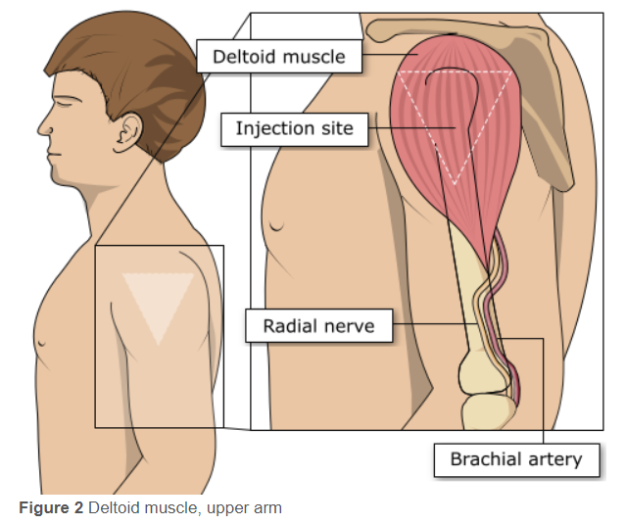
Injection site for IIV
For older infants and adults:
deltoid area of upper arm generally preferred
the vaccinator should place their index finger on the vaccine recipient’s acromion process (the highest point on the shoulder) and their thumb on the vaccine recipient’s deltoid tuberosity (the lower deltoid attachment point)
the injection site is midway between these 2 anatomical landmarks
the vaccine should be injected into the densest and thickest part of the muscle, which is usually in line with the axilla (level with armpit)
anterolateral aspect of thigh can also be used if deltoid not available or insufficient muscle mass

Slide 73
Consequences of incorrect injection technique
it is essential that the correct site and injection technique are used to administer vaccines
injecting too high into the upper arm could result in the vaccine being deposited in the shoulder capsule rather than the deltoid muscle
if this happens, inflammation can occur, leading to a shoulder injury or a frozen shoulder
  this leads to pain, weakness and a limited range of motion that can last for months
injecting too far to the side of the arm or too low on the arm risks injecting into the axillary nerve or the radial nerve
  this can cause a burning or shooting pain during the procedure and can lead to nerve damage (neuropathy/paralysis)
to avoid shoulder injury or nerve damage, always assess the limb before administering the vaccine to identify the correct site for injection

Slide 74
Co-administration of flu vaccine with other vaccines
flu vaccine can be given at the same time as, or at any interval from the COVID-19, shingles, pneumococcal, pertussis-containing Tdap vaccine and other live and inactivated vaccines
NB: flu vaccine should not routinely be scheduled to be given on the same day as the RSV vaccine to older adults as it may reduce the immune response made to both vaccines (although can be given if it is thought that the individual is unlikely to return for a 2nd appointment or immediate protection is necessary)
however, flu vaccine can be given at the same time as the RSV vaccine to pregnant women
if not given on the same day, no specific interval is required between administering the RSV and flu vaccines
Notes:
For older adults: Influenza vaccine and RSV vaccines
There is some data which shows that in older adults, administering the RSV vaccine, Abrysvo, at the same time as seasonal influenza vaccine may reduce the immune response to the RSV vaccine. There is also data that suggests that the response to the influenza A(H3N2) component of seasonal influenza vaccine (the influenza subtype which most severely affects older adults) may be diminished when RSV and seasonal influenza vaccine are co-administered to older adults.
The clinical significance of any reduced response is unknown, but influenza immune response is known to correlate with protection against infection, and there is emerging data that RSV immune response also correlates with clinical protection. It is therefore recommended that these vaccines should not routinely be scheduled to be given at the same appointment or on the same day. No specific interval is required between administering the vaccines.
If it is thought that the individual is unlikely to return for a second appointment or immediate protection is necessary, Abrysvo can be administered at the same time as the influenza vaccine.
For pregnant women: Influenza vaccine and RSV vaccines
The RSV vaccine, Abrysvo, can be given at the same time as the inactivated influenza vaccine to pregnant women. Similarly, there are no safety or effectiveness concerns around giving Abrysvo to pregnant teenagers who are due to have or who have recently had a live attenuated influenza vaccine nasal spray.

Slide 75
Administration of Live Attenuated Influenza vaccine (LAIV)
  LAIV is different from other flu vaccines – it is a live attenuated nasal vaccine and must not be injected
  do not attempt to attach a needle
  LAIV can be administered at the same time as, or at any interval from other currently used vaccines including live vaccines
  the applicator has a divider clip to enable one application in each nostril
  the vaccinee should breathe normally - they do not need to actively inhale or sniff
  the vaccine is rapidly absorbed so there is no need to repeat either half of the dose if the patient sneezes, blows their nose or their nose drips following administration

Slide 76
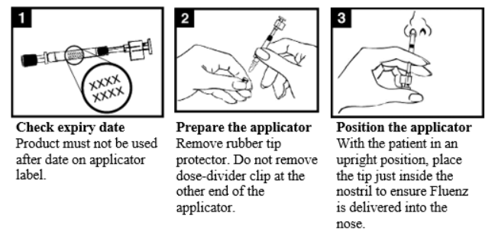
Administration of LAIV (1)

Slide 77
Administration of LAIV (2)

Slide 78

LAIV administration video
a video for healthcare practitioners on how to administer LAIV has been produced by NHS Education for Scotland and Public Health Scotland
it is available to view at https://vimeo.com/100497077
please note that this video was made when Fluenz Tetra was in use but although the name of the vaccine has changed to reflect the reformulation of the vaccine from a quadrivalent vaccine to a trivalent vaccine, the method of administration shown in the video is unchanged. Please note however, that the expiry date is now 15 weeks from production

Slide 79
Commonly reported adverse reactions
Following inactivated flu vaccine:
commonly reported symptoms are: pain, swelling or redness at the injection site, low grade fever, malaise, shivering, fatigue, headache, myalgia and arthralgia
these symptoms usually disappear within 1 to 2 days without treatment
due to the MF59 adjuvant, a higher incidence of mild post-immunisation reactions has been reported with aIIV, compared to non-adjuvanted influenza vaccines
in clinical trials, some side effects were reported slightly more frequently after vaccination with IIV-HD than after standard-dose inactivated flu vaccines
Following live attenuated flu vaccine:
commonly reported symptoms include nasal congestion/rhinorrhoea, reduced appetite, feeling generally unwell, myalgia and headache
Rarely, after live or inactivated vaccine, immediate reactions such as urticaria, angio-oedema, bronchospasm and anaphylaxis can occur

Slide 80
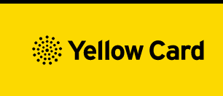
Reporting adverse events
All serious suspected reactions following flu vaccination should be reported to the Medicines and Healthcare products Regulatory Agency (MHRA) using the Yellow Card scheme
5 of the flu vaccines recommended for use during the 2025 to 2026 flu season carry a black triangle symbol (▼) to encourage reporting of all serious suspected adverse reactions
anyone (patients and HCWs) can make a Yellow Card report, even if they are uncertain as to whether a vaccine caused the condition/side effect
vaccinees should be advised that they can report any adverse reactions using the MHRA’s online Yellow Card scheme (https://yellowcard.mhra.gov.uk/), by downloading the Yellow Card app or by calling the Yellow Card scheme on 0800 731 6789 9am to 5pm Monday to Friday

Slide 81
Recording flu vaccine given
As a wide variety of influenza vaccines are available in the UK each year, it is especially important that the following information is accurately recorded:
vaccine name, product name, batch number and expiry date
dose administered
date immunisation given
route/site used
name and signature of vaccinator
This information should be recorded in:
patient's GP record (or other patient record, depending on location)
personal Child Health Record (the ‘Red Book’) if a child
practice computer system
Child Health Information System if a child
Information on flu vaccines administered outside general practice (for example maternity providers, pharmacies, schools) must be passed back to the patient’s GP practice in a timely manner so patient records can be updated and avoid duplicate vaccination
Notes:
As a wide variety of influenza vaccines are available in the UK each year, it is especially important that the exact brand of vaccine, batch number and site at which each vaccine is given is accurately recorded in the patient records. Where the vaccine is given for occupational reasons, it is recommended that the employer keep a vaccination record. It is important that vaccinations given either at a general practice or elsewhere (for example, at community pharmacies, or antenatal clinics) are recorded on appropriate health records for the individual (using the appropriate clinical code) in a timely manner, including the relevant Child Health Information System. If given elsewhere, a record of vaccination should be returned to the patient’s general practice to allow clinical follow up and to avoid duplicate vaccination.

Slide 82
Data collection
flu vaccine uptake data is collected via the web-based ImmForm system (www.immform.ukhsa.gov.uk) where it is managed and published by UKHSA
over 95% of GP practices are able to make automated data returns where the number of their patients vaccinated is directly extracted from their IT system and put into ImmForm
for data to be accurate and complete, it is critical that any vaccines given outside the surgery, such as those given in pharmacies or antenatal units, are reported to the patient’s GP
data is collected and published monthly on all the groups for whom flu vaccine is indicated at national, regional and local authority level to enable performance to be reviewed and time to take action if needed
flu vaccine uptake data is published at: www.gov.uk/government/collections/vaccine-uptake
Notes:
As in previous years, flu vaccine uptake data collections will be managed using the ImmForm website. UKHSA coordinates the data collection and will issue further details of the collection and guidance on the data collection process for the 2025 to 2026 programme. This guidance will be available at: www.gov.uk/government/collections/vaccine-uptake which is where flu vaccine uptake data is also published. Queries concerning data collection content or process should be emailed to influenza@ukhsa.gov.uk. Queries concerning ImmForm login details and passwords should be emailed to helpdesk@immform.org.uk

Slide 83
Vaccine uptake ambitions for 2025 to 2026
In the 2025 to 2026 flu programme, providers:
  are expected to demonstrate a 100% offer to eligible groups
  should have plans to equal or improve uptake rates achieved in previous years, particularly in health and social care workers, clinical risk groups, children aged 2 and 3 years old, and pregnant women
  should ensure they have robust plans in place to identify and address health inequalities for all underserved groups, reduce unwarranted variation and improve uptake

Slide 84
Achieving high flu vaccine uptake
many of the groups who are vulnerable to flu are also more vulnerable to COVID-19. Not only is it important to help protect those most at risk of flu, it is also important to protect the health of those who are vulnerable to hospitalisation and death from COVID-19 by ensuring they do not get flu
it is essential to increase flu vaccination levels for those living in the most deprived areas, from ethnic minorities and other underserved communities to have as high uptake as the population as a whole
high quality, dedicated and interculturally competent engagement with local communities, employers, faith and advocacy groups is required
providers should ensure they have robust plans in place for tackling health inequalities for all underserved groups to ensure equality of access to the flu vaccine

Slide 85

Increasing flu immunisation uptake among children
Best practice guidance for general practice
The UKHSA have produced a summary of key strategies to help to increase flu vaccine uptake in pre-school children (from 2 years) which consider the following areas:
staff responsibilities
practice goals
identifying eligible children
inviting/contacting parents
ordering vaccines and clinics and appointments
promoting the vaccine offer to parents
ideas to sustain and promote uptake during flu season
recommendations for end of flu season review
Notes:
Note to trainers:
The content of the Best Practice Guidance for Increasing flu immunisation uptake among pre-school children is set out on the next 7 slides for those trainers who wish/are able to spend time discussing strategies for maximising uptake. Many of the ideas can also be used or adapted for older adult/clinical risk patient flu clinics
Available at Increasing influenza immunisation uptake among pre-school children - Best practice guidance for general practice (publishing.service.gov.uk)

Slide 86
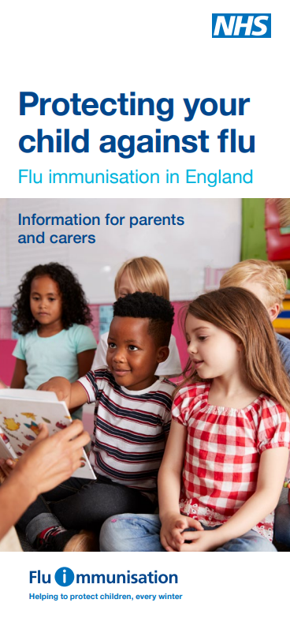
Increasing flu immunisation uptake among children
Best practice guidance for general practice
Staff responsibilities
every practice should have a lead member of staff with responsibility for running the flu immunisation campaign and all staff should know who the lead person is
all staff should understand the reason for the programme, have up to date training and access to UKHSA flu resources
every member of the practice should know their role and responsibilities
get all staff involved in promoting the vaccine message to parents
hold regular meetings so that all staff know the practice plan and progress
include health visitors, midwives, pharmacists and other healthcare professionals linked to your practice in your planning

Slide 87
Increasing flu immunisation uptake among children
Best practice guidance for general practice
Practice goals
set a higher goal than the previous season
create computer searches to measure uptake and assess progress towards the goal
calculate practice income depending on uptake
advertise the practice goal and have a ‘Blue Peter’ style ‘Totaliser’
Identifying eligible children
the lead member of staff to identify eligible children
check accuracy of searches and coding to ensure all eligible children are identified
make sure the correct flu vaccination codes are in your system and that staff are aware –don’t let hard work go unmeasured
create IT system reminders so that opportunistic immunisation happens
create a system for opportunistic identification of eligible children attending the practice for other clinics or with parents and siblings – use flags to alert staff. Don’t send a child away unimmunised

Slide 88
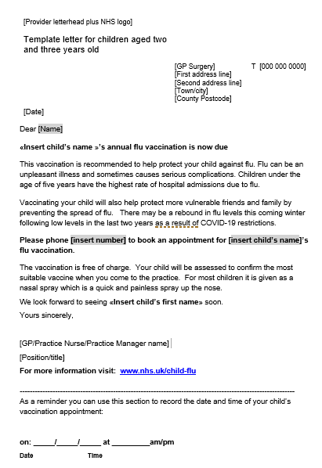
Increasing flu immunisation uptake among children
Best practice guidance for general practice
Invitation/contacting parents
send a personalised invitation to eligible children – use the parent’s and child’s names, sign your name at the bottom
phone calls can be more effective than letters; try text messages for reminders
ensure that staff phoning patients have a script but can also answer questions and address concerns
plan phone calls after 4pm when more working parents might be available
send letters if telephone contact is not possible
be tenacious – make multiple contacts until child is immunised or an active refusal is received

Slide 89
Increasing flu immunisation uptake among children
Best practice guidance for general practice
Ordering vaccines
centrally procured flu vaccines for children will be available to order via https://portal.immform.ukhsa.gov.uk
LAIV should be offered unless medically contraindicated or otherwise unsuitable (including objection to LAIV because of its porcine gelatine content). In such cases, a suitable IIV should be offered
order small and frequent quantities of flu vaccines, throughout the flu vaccination period
remember that you can order weekly and receive weekly deliveries
hold no more than 2 to 3 weeks stock in your practice fridge to reduce the risk of stock loss through cold chain failures or expiry before use
remember that stock ordered later will have a later expiry date
ordering will be subject to controls and the most up to date information on these will be available on ImmForm news throughout the ordering period

Slide 90
Increasing flu immunisation uptake among children
Best practice guidance for general practice
Clinics and appointments
plan to have completed all routine immunisation activity by Christmas
use time after Christmas to mop-up unimmunised children, particularly children in clinical risk groups. If clinically indicated vaccination can be given up to the end of March
decide whether you will give timed appointments, run an open access clinic or invite parents to make appointments
allow online booking for appointments
consider family friendly clinic/appointment times such as after school 3.30pm – 6.30pm, Saturday mornings, or October half term – consider health fairs or parties – incorporating flu vaccination with other vaccines, health checks, health visitor advice
create a child friendly environment; including room for pushchairs
consider other clinics and busy waiting rooms

Slide 91
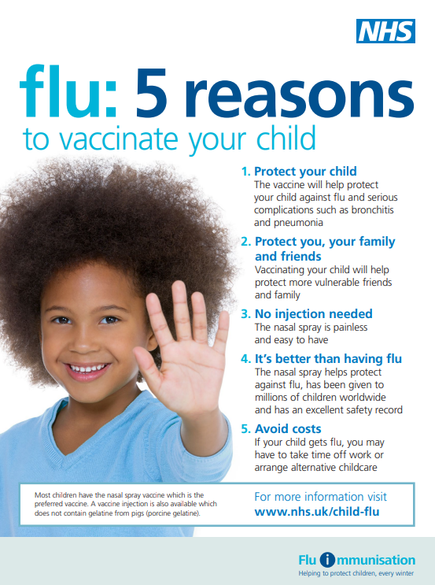
Increasing flu immunisation uptake among children
Best practice guidance for general practice
Promote the vaccination offer to parents
ensure every parent has a personalised invitation for their child
display UKHSA child flu immunisation posters and leaflets in the reception and waiting rooms
create attractive displays in waiting rooms. Consider posters or banners outside the practice – on a notice board, walls or even on the roof
place prominent information about the child flu immunisation programme on the practice website
engage with the local primary school – ask if they can give leaflets to parents with preschool age children and/or display posters on school/parent notice boards
engage with local pre-school nurseries, children’s centres, libraries, toddler groups in your area. Ask staff to put up posters and issue leaflets to parents of children who are 2 years old and older. Highlight the benefits of their children being immunised to these preschool groups and nurseries

Slide 92
Increasing flu immunisation uptake among children
Best practice guidance for general practice
During the season
Increasing resources in-season is difficult so comprehensive preparation and planning is critical. There are things you can do to help sustain efforts and uptake:
review your uptake against your goals and financial plan; celebrate/promote success as the programme progresses
remain tenacious – re-run searches for eligible children
continue to offer vaccination, even once you have achieved your practice and campaign goals
keep staff engaged and enthused – consider incentives, promoting staff competition
ensure all practice staff have their flu jab – it is powerful to be able to say to patients “I’ve had mine”
Post season
review your campaign, measure and celebrate success – thank everyone involved
share the review of your campaign with your stakeholders, patient focus group and partners who helped you achieve your goals
capture lessons learnt and adapt next year’s plan – aim for higher uptake next year

Slide 93
Key messages to health and social care workers
    getting vaccinated against flu can help protect you, your patients and family
    everyone is susceptible to flu, even if you are in good health and eat well
    you can be infected with the virus and have no symptoms but can still pass flu virus to others including patients or residents
    good infection control measures reduce spread of flu and other acute respiratory infections in healthcare settings but are not sufficient alone to prevent them
    throughout the last 10 years there has generally been a good to moderate match between the strains of flu virus in the vaccine and those that subsequently circulated
    impact of flu on frail and vulnerable patients can be fatal and outbreaks can cause severe disruption in communities, care homes and hospitals
    flu vaccine has a good safety record and will help protect you. It cannot give you flu. Having the vaccination can encourage your colleagues to do likewise
    staff act as positive role models for patients aged 65 and over, those with long-term health conditions and pregnant women to take up the offer too
    duty of care as professionals to patients or residents to do everything in your power to protect them against infection, including being immunised against flu

Slide 94
Key messages
flu immunisation is one of the most effective interventions we can provide to reduce harm from flu and pressures on health and social care services during the winter
it is important to increase flu vaccine uptake in clinical risk groups because of increased risk of death and serious illness if people in these groups catch flu
influenza during pregnancy may be associated with perinatal mortality, prematurity, smaller neonatal size, lower birth weight and increased risk of complications for mother
vaccination of health and social care workers protects them and reduces the risk of them spreading flu to their patients, service users, colleagues and family members
by preventing flu infection through vaccination, secondary bacterial infections such as pneumonia are prevented. This reduces the need for antibiotics and helps prevent antibiotic resistance
for a number of years, only around half of patients aged 6 months to under 65 years in clinical risk groups have been vaccinated
the childhood flu programme should reduce the impact of seasonal flu on children and reduce transmission of flu within the community
by reducing transmission of flu, it should also avert many cases of severe flu and flu-related deaths in older adults and people in clinical risk groups

Slide 95
Resources
Letters detailing 2025 to 2026 flu programme
Available at: www.gov.uk/government/publications/national-flu-immunisation-programme-plan-2025-to-2026
Green Book Influenza chapter Available at: www.gov.uk/government/publications/influenza-the-green-book-chapter-19
Leaflets, posters, information materials and other resources to support the annual flu programme Available at: www.gov.uk/government/collections/annual-flu-programme
A flu elearning programme is freely available to access https://www.e-lfh.org.uk/programmes/flu-immunisation/
PGD templates for flu vaccines www.gov.uk/government/collections/immunisation-patient-group-direction-pgd
A video for health professionals on how to administer the LAIV vaccine produced by NHS Education for Scotland is available at https://learn.nes.nhs.scot/14743/immunisation/seasonal-flu#video
Summaries of Product Characteristics (SmPC) for flu vaccines are available at www.medicines.org.uk/emc/
Leaflets and posters prepared specifically for the flu programme. Available at: www.gov.uk/government/collections/annual-flu-programme and www.healthpublications.gov.uk/Home.html

Slide 96

Resources (continued)
Flu vaccination guidance and resources for schools www.gov.uk/government/publications/flu-vaccination-in-schools
Flu immunisation: toolkit for programme extension to children www.gov.uk/government/publications/flu-immunisation-toolkit-for-programme-extension-to-children
Increasing flu immunisation uptake among children: Best Practice Guidance for General Practice
www.gov.uk/government/publications/flu-vaccine-best-practice-guide-for-gps
The national flu immunisation programme 2025 to 2026

