Slide 1
The rotavirus vaccination programme
Information for healthcare practitioners
Updated May 2024

Slide 2
Key messages
in July 2013, the UK introduced rotavirus vaccination into the routine childhood immunisation schedule to protect infants aged from 8 weeks against rotavirus infection
the programme was introduced in all parts of the UK to reduce the incidence of rotavirus gastroenteritis in young infants
rotavirus is a highly infectious virus and the most common cause of gastroenteritis in young children
infections are recurrent; most children will have at least one episode by the age of 5 years
in young infants, gastroenteritis can be serious and may cause dehydration resulting in hospital admission
Notes:
Joint letter from DH, PHE and NHS England April 2013:
“Important changes to the national immunisation programme in 2013/14: introduction of rotavirus vaccination for babies at 2 and 3 months”
www.gov.uk/government/organisations/public-health-england/series/immunisation

Slide 3
Aims of this training resource
to support staff involved in discussing immunisation against rotavirus with parents/carers by providing evidence-based information
to raise awareness of rotavirus epidemiology and the benefits of rotavirus immunisation for young infants
to provide guidance on the administration of the oral vaccine, including contraindications, precautions and potential adverse reactions
to highlight the impact of the rotavirus immunisation programme since its introduction into the UK schedule
Notes:
The key roles of healthcare professionals in relation to immunisation against rotavirus are to:
strongly recommend the vaccine to parents or carers of children and outline the importance of their child being protected against the disease
explain what rotavirus infection is, its potential complications and that immunisation will provide protection to young infants against the main strains of rotavirus
explain which vaccine will be used, the contraindications and possible side effects to immunisation and the evidence for the immunisation programme
safely administer the oral vaccine to young infants
ensure immunisation is administered according to the schedule
ensure any adverse events are managed and reported appropriately
ensure immunisation is recorded appropriately, along with other infant immunisations

Slide 4
Learning outcomes
After using this training resource, healthcare practitioners will be able to:
describe the aetiology and epidemiology of rotavirus
understand how rotavirus is transmitted and the potential complications of infection in infants
discuss the importance of immunisation against rotavirus
have a knowledge of the contraindications for rotavirus immunisation
safely administer the vaccine
understand potential adverse reactions and how to report these
be aware of sources of additional information

Slide 5
Contents
rotavirus overview
rotavirus vaccination programme
Rotarix vaccine
severe combined immunodeficiency (SCID), HIV, immunosuppression and other considerations
data management (call and recall)
impact of the infant rotavirus immunisation programme
role of healthcare practitioners in the infant rotavirus immunisation programme
resources

Slide 6
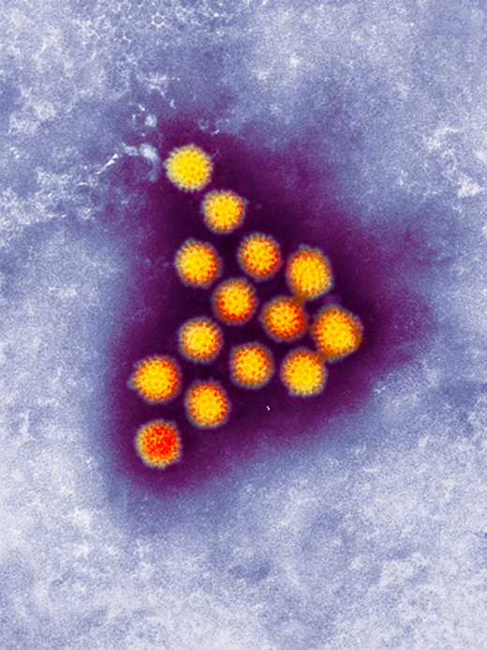
Rotavirus
rotavirus is a virus that causes gastroenteritis in infants and young children
prior to the introduction of the vaccination programme, it was estimated that all children would become infected with rotavirus at least once by the time they reached 5 years old
it is estimated that rotavirus causes around half of all gastroenteritis cases in children aged under 5 years
virtually all unvaccinated children living in industrialised or developing countries will be infected
Image courtesy of UKHSA/SPL
Notes:
Rotavirus is a leading cause of gastroenteritis in infants and children throughout the world.
Gastroenteritis can have a number of possible causes, including norovirus infection or food poisoning. However, rotavirus is the leading cause in children.
It is a ubiquitous virus, virtually all children, rich or poor, living in the industrialised or developing world will become infected with rotavirus at least once by the time they are five years old. Individuals can have repeat infections, but the repeat infections tend to be less severe than the original infection.
Bernstein DI, Ward RL, Rotavirus. In Feigin RD, Cherry JD, editors. Textbook of Pediatric Infectious Diseases. 5th edition Volume 2. Philadelphia, Pa: Saunders; 2004, 4, pages 2,110-2,133
Rotavirus is so named because of its wheel-like appearance under the electron microscope – the name rotavirus being derived from the Latin rota, meaning wheel.
There are a number of different strains of rotavirus. The vaccine protects against the most common circulating strains.
https://assets.publishing.service.gov.uk/government/uploads/system/uploads/attachment_data/file/457263/Green_Book_Chapter_27b_v3_0.pdf

Slide 7
Incubation period and infectious period
Incubation period
approximately 2 days
Infectious period
shedding of the virus in faeces may begin before the onset of major symptoms and may continue for several days after symptoms have resolved
Notes:
Rotavirus is very infectious as the shedding of the virus in faeces may begin before the onset of major symptoms and may continue for several days after symptoms have resolved.
Bishop RF (1996) Natural history of human rotavirus infection. Archives of Virology 12 (Supplement) 119-128
Raebel MA, Ou BS. Rotavirus disease and its prevention in infants and children. Pharmacotherapy 1999: volume 19, pages 1,279-1,295

Slide 8
Clinical presentation of rotavirus
rotavirus infection usually begins with symptoms of diarrhoea and vomiting
the child may experience a fever (high temperature) of 38ºC or above and/or abdominal pain
vomiting usually resolves within 1 to 2 days. In most children, vomiting will not last longer than 3 days
diarrhoea usually resolves within 5 to 7 days. In most children, diarrhoea will not last longer than 2 weeks
Notes:
More information on the clinical presentation is available at https://www.nhs.uk/conditions/vaccinations/rotavirus-vaccine/#what-is-rotavirus

Slide 9
Rotavirus complications
rotavirus can cause dehydration as absorption of water from digested food is disrupted
dehydration from rotavirus infection can require hospitalisation for intravenous rehydration
prior to vaccine introduction:
approximately 12,700 children in England and Wales annually were estimated to be hospitalised with rotavirus
almost all babies were expected to get rotavirus within the first 5 years of life. Of these, about 1 in every 5 would need medical attention and about 1 in 10 would be hospitalised
it was estimated there were likely to be approximately 3 to 4 deaths per year (although deaths from rotavirus in the UK are rare and difficult to quantify accurately)
Notes:
Rotaviruses affect one of the main functions of the intestines – the absorption of water from digested food into the body. This is why one of the common symptoms is diarrhoea.
The combination of the symptoms of vomiting, diarrhoea and fever can lead to dehydration, requiring admission to hospital for intravenous rehydration.
Before the introduction of the vaccine, almost all babies were expected to get rotavirus within the first five years of life. Of those, about one in every five would need medical attention and about one in ten would be admitted to hospital with illnesses caused by the infection.
Approximately 12,700 children were estimated to be admitted to hospital each year with rotavirus in England and Wales before the introduction of the vaccine.
Although deaths from rotavirus in the UK are rare and are difficult to quantify accurately, there are likely to be approximately 3 to 4 a year in the UK.
Jit M, Pebody R, Chen M and others. ‘Estimating the number of deaths with rotavirus as a cause in England and Wales’ Human Vaccines and Immunotherapeutics 2007: volume 3, issue 1, pages 23-6
https://assets.publishing.service.gov.uk/government/uploads/system/uploads/attachment_data/file/457263/Green_Book_Chapter_27b_v3_0.pdf

Slide 10
Transmission of rotavirus
Rotavirus is highly infectious
as few as 10 to 100 virus particles may cause disease
transmission is mainly via the faecal-oral route
traces of infected faeces on surfaces or utensils (for example from insufficient handwashing after using the toilet) can lead to transmission
respiratory transmission can occur (that is small droplets of aerosolised infected faeces are inhaled)
Notes:
Rotavirus is a very infectious pathogen and infants with rotavirus gastroenteritis can shed 100 billion infectious particles per gram of faeces but the infectious dose for humans may be as low as 10 infectious particles.
Studies have also shown that in addition to being stable in most environmental conditions, rotavirus is also relatively resistant to most commonly used soaps and disinfectants. This allows the virus to persist in the environment and retain the potential to cause infection for significant periods of time.
Ansari SA, Springthorpe VS, Satter SA. ‘Survival and vehicular spread of human rotaviruses: Possible relation to seasonality of outbreaks’ Research and Reviews of Infectious Diseases 1991: volume 13, pages 448-461
Bishop RF. ‘Natural history of human rotavirus infection’ Archives of Virology 1996: volume 12 (supplement), pages 119-128

Slide 11
Rotavirus infection by age (prior to vaccine programme implementation)
most cases occurred in children under 5 years of age
about two thirds occurred in children less than 2 years old
highest incidence in children under one year
Confirmed rotavirus infections in children under 5 years of age, 2000 – 2011 (England and Wales)
Notes:
This graph shows the age of the laboratory confirmed cases of rotavirus in England and Wales between 2000 and 2012. Most of these occurred in children under 5 years of age and about two thirds of these were in children less than 2 years old.
This graph shows confirmed rotavirus infections in children under 5 years of age by age in months, showing clearly that the highest incidence of infection is in children under one year, with most infections occurring in children between one month and four years of age. The case numbers shown in this graph are just the tip of the iceberg as most cases won’t be laboratory confirmed.
Children under one year and, in particular, those younger than six months are at increased risk of dehydration.
Infection in newborns is common but tends to be either mild or asymptomatic because of protection from circulating maternal antibodies.
Grillner L, Broberger U, Chrystie I and others. ‘Rotavirus infections in newborns: an epidemiological and clinical study’ Scandinavian Journal of Infectious Diseases 1985: volume 17, issue 4, pages 349-355
Bishop RF. ‘Natural history of human rotavirus infection’ In: Kapikian AZ (editor) Viral infections of the gastroenteritis tract. New York: Marcel Dekker 1994: pages 131-67
Source of data: Rotavrius LabBase, Health Protection Agency. The Green Book. Chapter 27b (publishing.service.gov.uk)

Slide 12
Rotavirus laboratory reports in England by week during 2021-to-2022 and 2022-to-2023 seasons, compared to 5-season average
rotavirus infection in the UK is seasonal, occurring mostly in winter and early spring (January to March)
Notes:
Rotavirus infection in the UK is seasonal, occurring mostly in winter and early spring (January to March), although there are also a small number of cases during the summer months.
https://www.gov.uk/government/statistics/national-norovirus-and-rotavirus-surveillance-reports-2022-to-2023-season/national-norovirus-and-rotavirus-report-week-28-report-data-up-to-week-26-2-july-2023

Slide 13
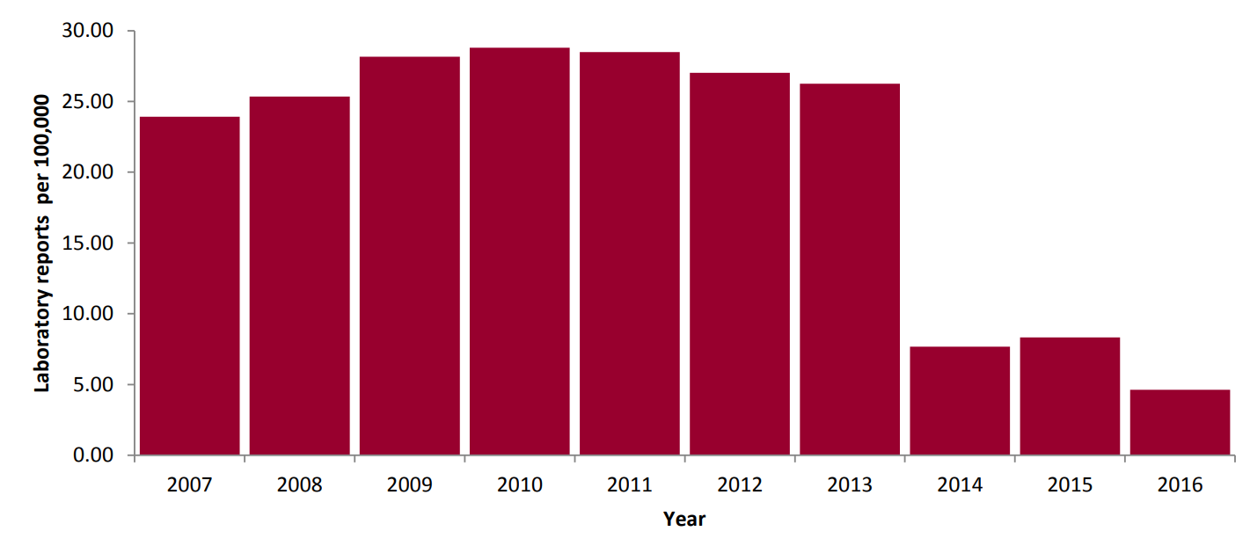
Epidemiology of rotavirus in England and Wales prior to and following introduction of the vaccination programme
Vaccination programme introduced in 2013
Laboratory reports of rotavirus (rate per 100,000) in England and Wales (2007 – 2016)
Notes:
This graph shows that between 2007 and 2012, in England and Wales, between 13,000 and 17,000 people were laboratory-confirmed with rotavirus each year. Vaccination was introduced in 2013 and the number of lab confirmed cases dropped to 4,000 to 5,000 in 2014 and 2015. Rotavirus data 2007 to 2016, May 2018 (publishing.service.gov.uk)
Most cases of rotavirus do not require a stool sample to be submitted for testing so these laboratory confirmed cases are just the tip of the iceberg. In 2012, 15,289 laboratory confirmed cases of rotavirus were reported in England and Wales.

Slide 14
Impact of the rotavirus vaccination programme
A study conducted by Gower and others (2022) in England found sustained declines in rotavirus infection in vaccinated and unvaccinated individuals in the 5 years since rotavirus vaccine was introduced.
The study looked at laboratory reports of confirmed rotavirus cases from 2000 to 2018 and found in the 5 years since the vaccine was introduced:
69 to 83% reduction in laboratory-confirmed rotavirus infection in all age groups
77 to 88% reduction in cases in infants under one year of age
11,386 to 11,633 cases averted annually
large and sustained declines in both laboratory-confirmed rotavirus and all-cause hospitalisations for gastroenteritis across all age groups
Notes:
Study: Gower and others. ‘Sustained Declines in Age Group-Specific Rotavirus Infection and Acute Gastroenteritis in Vaccinated and Unvaccinated Individuals During the 5 Years Since Rotavirus Vaccine Introduction in England’ Clinical Infectious Diseases 2022: 11 February, volume 74, issue 3, pages 437-445. doi: 10.1093/cid/ciab460
This study shows the impact of the rotavirus vaccination programme since it was introduced in England in 2013. The study also showed a significant reduction in acute gastroenteritis hospitalisations across all age groups, including older adults. This shows strong evidence of indirect (herd) protection and a sustained reduction in the number of rotavirus cases since the vaccination programme was introduced.

Slide 15
Recommendation from JCVI for rotavirus vaccination
the Joint Committee on Vaccination and Immunisation (JCVI) is the UK’s independent panel of immunisation experts
in 2009, the JCVI considered all the available evidence on the burden of rotavirus infection and advised that the licensed rotavirus vaccine would have a significant impact on reducing the incidence of rotavirus gastroenteritis in young children
in November 2012, the vaccine (Rotarix) was procured at a cost-effective price and was introduced into the routine childhood immunisation schedule in July 2013
the UK routine immunisation schedule includes two doses of vaccine; one at 8 and one at 12 weeks of age (coinciding with other primary immunisations due at these ages)
Notes:
JCVI statement on Rotavirus 2009
[ARCHIVED CONTENT] (nationalarchives.gov.uk)

Slide 16
Rotarix vaccine effectiveness
very effective at protecting against the most common strains of rotavirus
very effective in protecting against severe rotavirus infection requiring hospitalisation
 | 1st year of life Rotarix N=2572 Placebo N=1302 | 2nd year of life Rotarix N=2554 Placebo N=1294
Vaccine efficacy (%) against rotavirus gastro-enteritis requiring medical attention [95% CI]
Circulating rotavirus strains | 91.8 [84;96.3] | 76.2 [63.0;85.0]
Vaccine efficacy (%) against hospitalisation due to rotavirus gastro-enteritis [95% CI]
Circulating rotavirus strains | 100 [81.8;100] | 92.2 [65.6;99.1]
Notes:
Rotarix, the current Rotavirus vaccine used in the UK has been shown to be very effective in protecting against the most common strains of rotavirus and severe rotavirus infection (infection resulting in hospitalisation). Rotavirus vaccine will not prevent diarrhoea or vomiting caused by other pathogens.
Efficacy of human rotavirus vaccine against rotavirus gastroenteritis during the first 2 years of life in European infants: randomised, double-blind controlled study - The Lancet Vesikari and others (2—7) doi: 10.1016/S0140-6736(07)61744-9

Slide 17
Effectiveness of rotavirus vaccination
over 85% effective at protecting against severe rotavirus gastroenteritis in the first 2 years of life
used to routinely vaccinate children in the USA and many other countries
in the USA, studies have shown that rotavirus-related hospital admissions for young children have been cut by more than two thirds since rotavirus immunisation was introduced
in England and Wales, it is estimated that 10,884 laboratory-confirmed infections and 50,427 all-cause acute gastroenteritis (AGE) associated hospital admissions were averted in 2013 to 2014 because of rotavirus vaccination
in infants, there was a 77% decline in laboratory-confirmed rotavirus infections and a 26% decline in all-cause AGE-associated hospitalisations in 2013 to 2014, compared with the pre-vaccination era, with large reductions also being observed in older children, adults, and older adults
Notes:
The vaccine is over 85% effective at protecting against severe rotavirus gastroenteritis in the first 2 years of life.
Rotavirus vaccines, including the Rotarix vaccine which is used in the UK, are also used to routinely vaccinate children in the USA and many other countries. In the USA, studies have shown that rotavirus-related hospital admissions for young children have been cut by more than two thirds since rotavirus immunisation was introduced.
In England and Wales, it is estimated that 10,884 laboratory-confirmed infections and 50,427 all-cause acute gastroenteritis (AGE) associated hospital admissions were averted in 2013 to 2014. In infants, there was a 77% decline in laboratory-confirmed rotavirus infections and a 26% decline in all-cause AGE-associated hospitalizations in 2013 to 2014, compared with the prevaccination era, with large reductions also being observed in older children, adults, and older adults.
Tate JE, Cortese MM, Payne DC, Curns AT, Yen C, Esposito DH, Cortes JE, Lopman BA, Gentsch JR, Parachar UD. ‘Uptake, impact, and effectiveness of rotavirus vaccination in the United States: review of the first 3 years of postlicencsure data’ The Pediatric Infectious Disease Journal 2011: volume 30 (1 supplement) S56-60
Jit M, Edmunds WJ. ‘Evaluating rotavirus vaccination in England and Wales. Part II. The potential cost-effectiveness of vaccination’ Vaccine 2007: volume 25, pages 3,971-9
Anderson EJ, Shippee DB, Weinrobe MH and others. ‘Indirect protection of adults from rotavirus by pediatric rotavirus vaccination’ Clinical Infectious Diseases 2013: volume 56, issue 6, pages 755-760
https://www.ncbi.nlm.nih.gov/pubmed/26232438

Slide 18
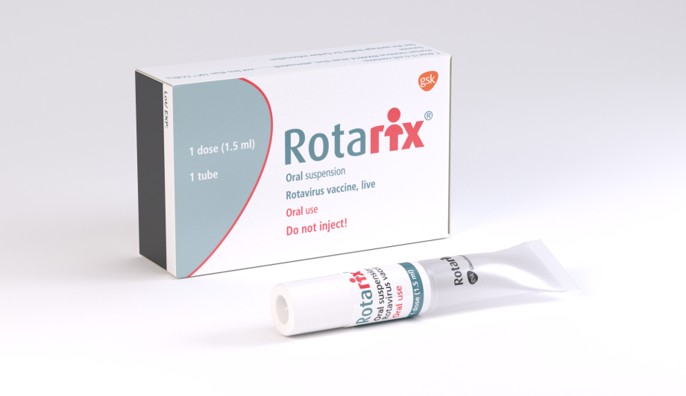
Immunisation against rotavirus: use of Rotarix vaccine
generic name: rotavirus vaccine, live attenuated
marketed by GlaxoSmithKline
licensed from 6 weeks to 24 weeks
oral suspension in a prefilled tube
Notes:
Rotarix is a live attenuated vaccine (a weakened form of virus which cannot cause disease but which protects against rotavirus).
This is an oral vaccine and must not be injected.
The packaging is similar in size to many currently used childhood vaccines at 87mm x 53mm x 25mm.

Slide 19
Rotarix composition
Active ingredient
human rotavirus RIX4414 strain
not less than 10^{6.0} CCID50
Excipients
sucrose (to improve the taste for infants)
Di-sodium Adipate (an acidity regulator)
Dulbecco’s Modified Eagle Medium (cell culture medium)
sterile water
Rotarix does not contain any antibiotic traces, formaldehyde or preservatives.
Rotarix is a live attenuated vaccine (contains a weakened form of virus which cannot cause disease, but which protects against rotavirus).
Notes:
The live attenuated virus in Rotarix is Human rotavirus RIX4414 strain which is produced on vero cells (monkey cell line). The virus was initially isolated from the stool of a 15-month-old child and then attenuated (weakened) by serial cell culture passage.
Each dose contains not less than 10⁶ Cell Culture Infectious Dose50 (the amount of virus required to produce an effect in 50% of inoculated tissue culture cells).
There are relatively few excipients. Disodium Adipate is an acidity regulator and Dulbecco’s Modified Eagle Medium is a cell culture medium.
Rotarix does not contain any antibiotic traces, formaldehyde or preservatives such as thiomersal.
https://www.medicines.org.uk/emc/product/2739/smpc

Slide 20
Rotarix presentation
prefilled, ready to use tube
oral suspension
each dose contains 1.5ml of clear colourless liquid
During 2017, presentation of the Rotarix vaccine changed to a squeezable tube.
Notes:
Rotarix is presented as a prefilled tube containing 1.5ml of oral suspension.
The tube is ready to use and does not require reconstitution or dilution.
The oral suspension should be a clear colourless liquid, free of visible particles. Before administration, the vaccine should be visually inspected for particulate matter and/or abnormal physical appearance. In the event of either being observed the vaccine should be discarded.

Slide 21
Storage of Rotarix
Rotarix must be stored in accordance with manufacturer’s instructions.
Cold chain management
store between +2⁰C and +8⁰C
store in original packaging
protect from light
If a temperature excursion means the vaccine is stored outside of the recommended conditions, manufacturer advice should be sought to inform any risk assessment.
Notes:
Rotarix must be stored in accordance with the manufacturer’s instructions. As with other vaccines, Rotarix should be stored between +2°C and +8°C.
The vaccine should be stored in the original packaging. This makes it easy to identify in the vaccine fridge, provides some protection against fluctuation of temperature and will protect it from light. The vaccine expiry date is displayed on the outer carton.
Vaccines are expensive and it is important to minimise wastage through inappropriate storage.

Slide 22
Rotarix dosage and schedule
Two-dose schedule:
first dose: 8 weeks of age
second dose: 12 weeks of age (minimum 4 week interval between doses)
full course (2 doses) completed before 16 weeks of age is preferable, however
Rotarix must be given by 23 weeks and 6 days
the first dose must be given by 14 weeks and 6 days of age
rotavirus vaccination should not be initiated after 15 weeks of age
if the course is interrupted, it should be resumed but not repeated, provided that the second dose can be given before 24 weeks of age
if a majority of the dose is spat out/regurgitated during an appointment, a replacement dose may be given at same visit
Notes:
Objective is to provide 2 doses of rotavirus vaccine to infants before 24 weeks (that is by age 23 weeks and 6 days) of age to protect against rotavirus infection
A full course is 2 doses with an interval of at least 4 weeks between doses (Rotavirus. Green Book Chapter)
https://www.gov.uk/government/organisations/public-health-england/series/immunisation-against-infectious-disease-the-green-book
The routine programme offers a first dose at the 8 week visit when an infant receives their other first primary immunisations. The second dose should be given at least four weeks after the first dose, ideally at the second visit for the primary immunisations which are due when they are 12 weeks old.
Both doses of Rotarix must be given by 24 weeks of age but ideally before 16 weeks of age.
Immunisation should not be initiated after 15 weeks of age (that is 14 weeks and 6 days).
As they get older, some infants (about 120 per 100,000) develop intussusception. The background risk of intussusception increases to peak at around 5 months of age. Research from some countries suggests that Rotarix may be associated with a very small increased risk of intussusception within seven days of immunisation, possibly up to six cases per 100,000 first doses given. The benefits of immunisation in preventing the consequences of rotavirus infection outweigh this small potential risk in young children. Because of the potential risk, and to reduce the likelihood of a temporal association with rotavirus vaccine, the first dose of vaccine should not be given after 15 weeks of age (that is it can be given up to and including 14 weeks and 6 days).

Slide 23
Administration of Rotarix
as a live oral vaccine, Rotarix must not be injected or given intranasally
Rotarix can be administered at the same time as other childhood vaccines
Rotarix can also be given at any time as, or at any interval before or after BCG vaccine
Rotarix administration prior to any intramuscular vaccines is recommended, as any subsequent injections may unsettle the infant
Notes:
Rotarix can be given at the same time as the other vaccines administered as part of the routine childhood immunisation programme, and so should ideally be given at the scheduled 8-week and 12-week immunisation visits.
Rotavirus. Green Book Chapter
www.gov.uk/government/organisations/public-health-england/series/immunisation-against-infectious-disease-the-green-book

Slide 24
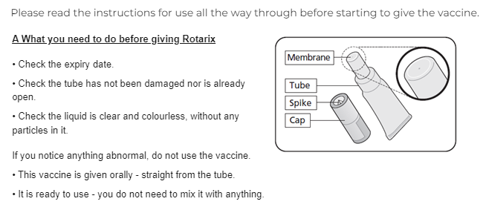
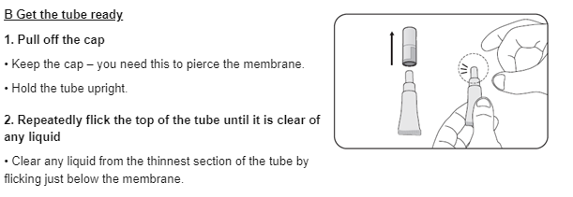
Manufacturer instructions on Rotarix administration
Notes:
Check the expiry date on the vaccine and that the tube is not damaged in any way. Check that the appearance of the vaccine is clear and colourless with no visible particles. If the appearance of the vaccines does not match the manufacturers description, discard the vaccine.
Pull off the cap and put the cap in a safe place, you will need it later to pierce the tube. Hold the tube upright and clear the top of the tube by flicking it until it is clear of liquid.

Slide 25
Manufacturer instructions on Rotarix administration
Notes:
In one hand, hold the tube upright, in your other hand, turn the cap upside down and place it over the tube, insert the small spike positioned inside the top of the cap in the centre of the tube to piece the membrane then lift off the cap.
Check that there is a hole at the top of the membrane. If it has not been pierced, repeat the previous steps.
Ensure that the child is in a seated position and leaning slightly backwards before administering.
Once the tube is open, check the liquid is clear and has no particles in it. If you notice anything abnormal about the appearance of the vaccine, discard it and prepare a new one.

Slide 26
Manufacturer instructions on Rotarix administration
Notes:
Administer the vaccine orally by squeezing the liquid gently into the side of the child’s mouth – towards the inside of their cheek. Ensure that all the vaccine is given, you may need to squeeze the tube a few times to get it all out. If a drop remains in the tip of the tube, this is ok.
Discard the empty tube and cap in accordance with local requirements.
If the infants spits out or regurgitates most of the vaccine, a single replacement dose may be given at the same immunisation visit.
If the child has left the premises and vomits, the dose does not need to be repeated as the vaccine is very quickly absorbed.
There are no restrictions on infant’s feeding before or after immunisation.
Based on evidence generated in clinical trials, breast-feeding does not reduce the protection against rotavirus gastroenteritis afforded by Rotarix. Therefore, breast-feeding may be continued during the immunisation schedule (see Rotarix SPC - http://www.medicines.org.uk/emc/medicine/2739)

Slide 27
Contraindications
infants under 6 weeks of age
infants presenting for their first dose of Rotarix aged 15 weeks of age or older
infants aged 24 weeks of age or over (beyond 23 weeks and 6 days)
babies born to mothers who received immunomodulating biologics during pregnancy
infants with severe combined immunodeficiency (SCID) disorder
infants with a confirmed anaphylactic reaction to a previous dose of the vaccine
infants with a confirmed anaphylactic reaction to any components of the vaccine
infants with a previous history of intussusception
infants with a malformation of GI tract that could predispose to intussusception
rare hereditary problems of fructose intolerance, glucose-galactose malabsorption or sucrose-iso-maltose insufficiency
immunosuppressed or on systemic (oral or parental) immunosuppressive treatment
There are very few infants who cannot receive rotavirus vaccine; where there is doubt seek advice.
Notes:
Although the vaccine is a live attenuated virus, the benefit from immunisation may exceed any risk from forms of immunosuppression not included in this list. The vaccine is contraindicated for infants with severe combined immune-deficiency (SCID), and it is recommended that infants born to mothers using biological medicines during pregnancy, such as Infliximab should not receive live vaccines during the first six months of life. This means that these infants will not receive immunisation to protect against rotavirus but they should benefit from herd immunity.
There are very few infants who cannot receive rotavirus vaccine. Where there is doubt, appropriate advice should be sought from your local screening and immunisation team or Consultant in Public Health Medicine rather than withholding immunisation.
Vaccination should be delayed in infants suffering from acute severe febrile illness and/or acute diarrhoea or vomiting. The presence of a minor infection is not a contra-indication for immunisation.

Slide 28
Severe Combined Immunodeficiency (SCID) and rotavirus vaccine
Although it is important that infants receive rotavirus vaccine in early life to protect against gastrointestinal illness, rotavirus vaccine is a live vaccine and SCID is a major contraindication to rotavirus vaccination.
Bakari and others described reports of severe gastroenteritis and prolonged viral shedding involving the vaccine strain in immunocompromised infants.
Gower and others conducted a prospective national surveillance study which described infants with acute gastroenteritis symptoms in primary and secondary care who also had Rotarix vaccine derived rotavirus strain in their stools. Those infants with the vaccine-derived rotavirus strain that were identified more than 7 weeks after being given rotavirus vaccine were often found to have underlying SCID.

Slide 29
SCID screening
Introduced in September 2021, SCID screening is part of the day-5 routine newborn screening tests performed in many areas.
All babies attending for their 8 week immunisations should have their records checked for SCID screening results before rotavirus vaccine is administered.
Results will be available to GPs and parents by 42 days of age. Babies in areas where SCID screening is not performed will be assigned a ‘SCID screening not offered’ result.
If SCID is suspected, parents and GPs should be contacted by the local immunology team (although the absence of any communication should not be taken as a negative result and records must still be checked prior to rotavirus vaccination).
In areas where SCID screening is not offered routine, immunisers need to be aware that there may be movers-in who have been tested and have a results available from another area.

Slide 30
SCID screening: checking results
Immunisers should make reasonable efforts to ascertain SCID screening outcomes before administering the rotavirus vaccine. This would include checking the GP record, CHIS screening outcome information, the child’s Red Book or checking with the parent or caregiver.
In areas where SCID screening is not routinely offered, immunisers should be aware that newly registered infants may have moved in from a SCID screening area and every effort should be made to confirm whether any SCID screening outcome is available before administering rotavirus vaccine.
If a child has their newborn screening tests late (for example because they have recently arrived in the UK), vaccinators should wait for the results of the SCID screening test before giving the rotavirus vaccine. As the first dose of rotavirus vaccine should not be given once the child reaches 15 weeks of age, it is important to flag the child’s notes to check for the test results so the dose can be given (between age 8 weeks and 14 weeks 6 days if SCID screening is negative) as soon as the results become available.
In the absence of an abnormal result or if no result can be found, vaccination can proceed in line with the rotavirus vaccine and SCID newborn screening guidance.

Slide 31
SCID screening outcomes and rotavirus vaccination
It is important that SCID screening results are reviewed prior to rotavirus vaccination:
if the SCID screening result is reported as ‘SCID not suspected’, rotavirus vaccine can be administered
if a SCID screening was not offered or a result is not available, rotavirus vaccine can be administered (provided all reasonable efforts to ascertain the SCID screening outcome have been made)
infants for whom SCID screening was declined can be vaccinated with rotavirus vaccine
if the SCID screening result is reported as ‘SCID suspected’, the baby will be referred to an immunology team. Following further assessment, parents and GP practices will receive a direct communication from the immunology team to inform them whether a child has been confirmed to have a significant immunological disorder and this will include information on which vaccines should not be given
An algorithm describing this process is available in the rotavirus vaccine and SCID newborn screening guidance.

Slide 32
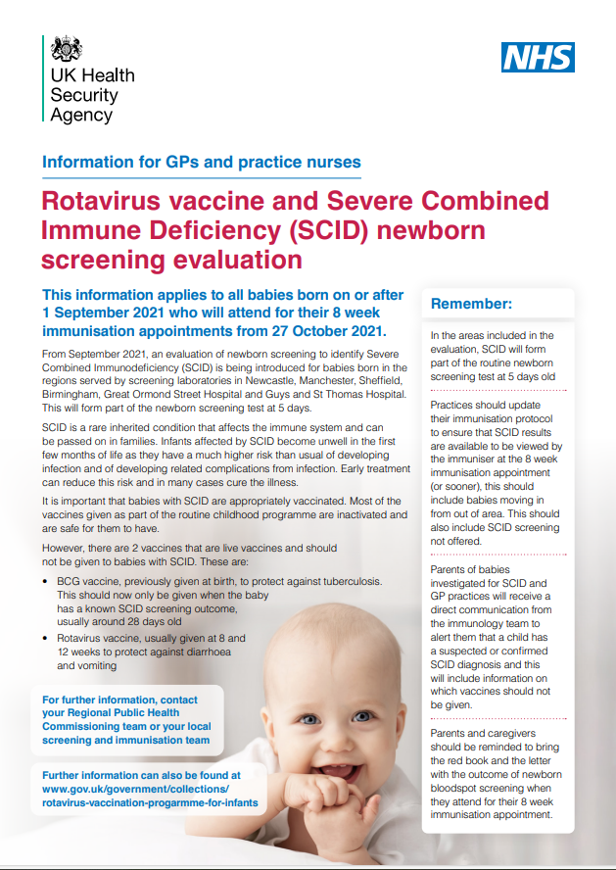
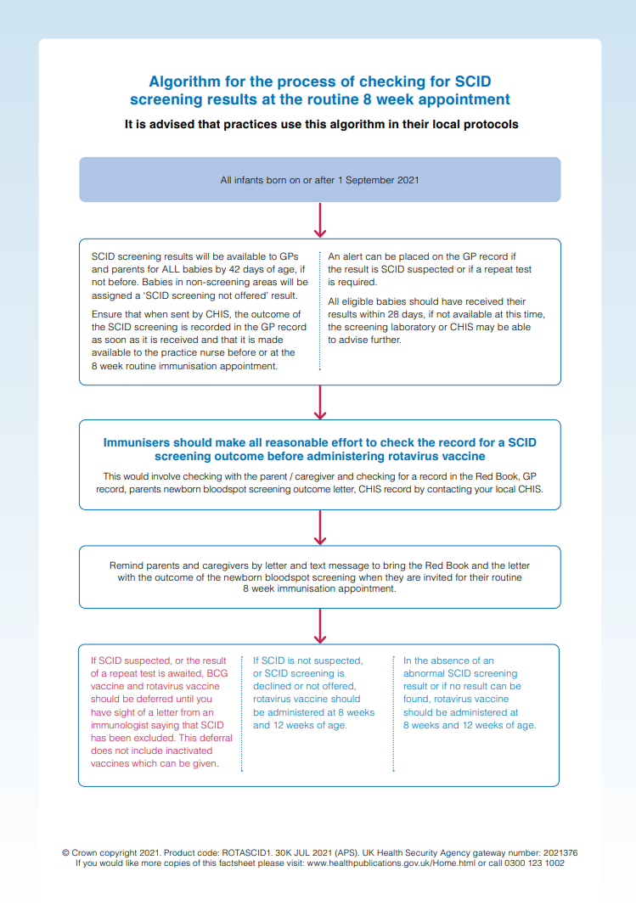
Notes:
An algorithm for the process of checking for SCID screening results at the routine 8-week appointment is available at https://www.gov.uk/government/collections/rotavirus-vaccination-progarmme-for-infants
Immunisers should make all reasonable effort to check the record for a SCID screening outcome before administering rotavirus vaccine. SCID is a contraindication for rotavirus vaccine.

Slide 33
Immunosuppression and HIV
Rotarix should not be administered to infants:
known to have severe combined immunodeficiency disorder (SCID)
whose mothers have received immunomodulating biologics, (such as monoclonal antibodies or receptor antagonists which interfere with the immune system, for instance anti-TNF agents), during pregnancy
For infants with other immunosuppressive disorders, rotavirus immunisation should be considered in collaboration with the clinician dealing with the child’s underlying condition.
Rotarix immunisation is advised in HIV infected infants. Additionally, infants with unknown HIV status but born to HIV positive mothers should be offered vaccination.
Notes:
Rotavirus immunisation should not be administered to infants known to have Severe Combined Immunodeficiency Disorder (SCID) or to infants whose mothers used biological medicines, such as Infliximab, during pregnancy.
There is a lack of safety and efficacy data on the administration of rotavirus to infants with other immuno-suppressive disorders. Given the high risk of exposure to natural rotavirus, however, the benefits of administration is likely to outweigh any theoretical risks and therefore should be actively considered, if necessary, in collaboration with the clinician dealing with the child’s underlying condition.
In a clinical study, 100 infants with HIV were administered Rotarix lyophilised formulation or placebo. The safety profile was similar between Rotarix and placebo recipients. Therefore, immunisation is supported in HIV infected infants. Additionally, infants with unknown HIV status, but born to HIV positive mothers, should be offered immunisation.
Rotavirus. Green Book Chapter
https://www.gov.uk/government/organisations/public-health-england/series/immunisation-against-infectious-disease-the-green-book
Steele AD, Madhi SA, Louw CE and others. ‘Safety, Reactogenicity, and Immunogenicity of human rotavirus vaccine RIX4414 in Human Immunodeficiency Virus positive infants in South Africa’ The Pediatric Infectious Disease Journal 2011: volume 30, issue 2, pages 125-30

Slide 34
Immunosuppression and maternal biological medicines
rotavirus vaccine should not be given to infants whose mothers received immunomodulating biologics (such as monoclonal antibodies or receptor antagonists which interfere with the immune system, for instance anti-TNF agents) in pregnancy
it is recommended that immunisation with live vaccines should be delayed until 6 months of age in children born to mothers who were on immunosuppressive biological therapy (TNFα antagonists and other biological medicines such as Infliximab) during pregnancy due to the potential postnatal influence on the infants’ immune status
as Rotarix vaccine is contraindicated in infants presenting for the first dose after 15 weeks of age (beyond 14 weeks and 6 days), infants whose mothers received such treatment during pregnancy will therefore not be eligible to receive the vaccine, but they should benefit from herd (indirect) protection
Notes:
https://www.gov.uk/drug-safety-update/live-attenuated-vaccines-avoid-use-in-those-who-are-clinically-immunosuppressed
https://www.gov.uk/government/publications/contraindications-and-special-considerations-the-green-book-chapter-6

Slide 35
Precautions
Vaccination should be deferred in infants with acute severe febrile illness and/or acute diarrhoea or vomiting until the infant has recovered.
Minor illnesses without fever or systemic upset are not valid reasons to postpone immunisation.
Notes:
Minor illnesses without fever or systemic upset are not valid reasons to postpone immunisation. If infant is acutely unwell the immunisation may be deferred until they have recovered – this is to avoid confusing the differential diagnosis of acute illness by wrongly attributing signs or symptoms as adverse effects of the vaccine.
In infants with acute diarrhoea or vomiting the vaccine may be postponed until they have recovered – this is to make sure the vaccine is not regurgitated or passed through GI tract too quickly which could reduce the effectiveness of the vaccine.

Slide 36
Vaccine virus transmission
there is potential for transmission of live attenuated vaccine virus from infants to severely immunocompromised contacts through faecal matter for 14 days post immunisation
cases of transmission of the excreted vaccine virus to seronegative contacts of vaccinees have been observed without causing clinical symptoms
immunisation of the infant will offer protection to household contacts from wild-type rotavirus disease and outweigh any risk from transmission of vaccine virus to any immunocompromised close contacts
those in close contact with recently vaccinated infants should observe good personal hygiene and hand washing techniques
Notes:
There is a potential for transmission of the live attenuated virus in Rotarix from the infant to severely immunocompromised contacts through faecal material for at least 14 days. However, immunisation of the infant will offer protection to household contacts from wild-type rotavirus disease and outweigh any risk from transmission of vaccine virus to any immunocompromised close contacts.
Those in close contact with recently immunised infants should observe good personal hygiene, for example washing their hands after changing a child’s nappy.
Rotavirus. Green Book Chapter
https://www.gov.uk/government/organisations/public-health-england/series/immunisation-against-infectious-disease-the-green-book
Anderson EJ. ‘Rotavirus vaccines: viral shedding and risk of transmission’ Lancet Infectious Diseases 2008: volume 8, issue 10, pages 642-9

Slide 37
Adverse reactions
A full list of the adverse reactions associated with Rotarix vaccine are described in the Summary of Product Characteristics (SPC).
Common adverse reactions
diarrhoea | irritability
Other known reactions
vomiting | fever
abdominal pain | loss of appetite
flatulence | regurgitation of food
skin inflammation
Notes:
The full list of adverse reactions associated with Rotarix is available in the marketing authorisation holder’s Summary of Product Characteristics.
Anaphylaxis is a very rare side effect of most vaccines and facilities for its recognition and management must be available.
Rotarix SPC - https://www.medicines.org.uk/emc/product/2739

Slide 38
Intussusception
intussusception is a naturally occurring condition of the intestines with a background annual incidence of around 120 cases per 100,000 children under one year
intussusception occurs when a section of the bowel folds in on itself, like a telescope closing, typically at the junction of the ileum and the colon
symptoms are episodes of pain, pallor and vomiting which may lead to disruption of blood supply
some research suggests that Rotarix may be associated with a very small increased risk (between one and 6 cases per 100,000) of intussusception within 7 days of immunisation
even with this small potential risk, the benefits of immunisation in preventing the consequences of rotavirus infection outweigh any possible side effects
to reduce the likelihood of a temporal association with rotavirus vaccine, the first dose of Rotarix should not be administered after 15 weeks of age (that is by age 14 weeks and 6 days)
parents should be advised that if the infant develops severe vomiting, abdominal pain and passes what looks like redcurrant jelly in their stools they should contact their doctor immediately
Notes:
Research from some countries suggests that Rotarix may be associated with a very small increased risk of intussusception within seven days of immunisation, possibly up to 6 cases per 100,000 first doses given. The benefits of immunisation in preventing the consequences of rotavirus infection outweigh this small potential risk in young children. Because of the potential risk, and to reduce the likelihood of a temporal association with rotavirus vaccine, the first dose of vaccine should not be given after 16 weeks of age.
Parents should be advised that if the infant develops severe vomiting, abdominal pain and passes what looks like redcurrant jelly in their stools they should contact their doctor immediately.
Rotavirus. Green Book Chapter
https://www.gov.uk/government/organisations/public-health-england/series/immunisation-against-infectious-disease-the-green-book

Slide 39
Reporting suspected adverse reactions
MHRA Yellow Card scheme:
voluntary reporting system for suspected adverse reaction to medicines or vaccines
success depends on early, complete and accurate reporting
report even if uncertain about whether vaccine caused condition
see the MHRA website for details
Notes:
As with all vaccine and other medicines registered healthcare professionals and patients are encouraged to report suspected adverse reactions to the Medicines and Healthcare products Regulatory Agency (MHRA) using the yellow card reporting scheme.
Medicines and Healthcare products Regulatory Agency (MHRA)
http://www.mhra.gov.uk

Slide 40
Data management – call and recall
infants are called for their rotavirus immunisation at the same time as their other routine primary immunisations at 8 and 12 weeks via the local CHIS or GP surgery
administered rotavirus vaccines should be recorded in the same way as other infant immunisations
infants aged 15 weeks or older attending late for their primary immunisations should not be offered Rotarix vaccine but should still continue to receive other routine primary immunisations
Notes:
Infants are called for their rotavirus vaccine at the same time as their other infant immunisations offered at 8 and 12 weeks of age, via the local Child Health Computer System or their GP surgery (whichever is the usual method of call/recall used in the area). Rotavirus vaccination should be recorded in the same way as the other infant immunisations.
Note:
If an infant attends late for their vaccines due at 8 and 12 weeks, it is important to remember that both doses of Rotarix vaccine should be given by 24 weeks (that is up to age 23 weeks and 6 days) of age but preferably before 16 weeks of age. Infants who have not received a first dose by 15 weeks of age (ie up to age 14 weeks and 6 days) should not be offered Rotarix. This does not apply to the other routine infant immunisations which can be given if the infant presents late.

Slide 41
Impact of the infant rotavirus immunisation programme

Slide 42
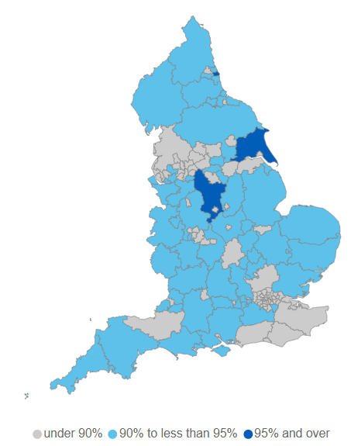
Vaccine coverage
Childhood Vaccination Coverage Statistics dashboard
high vaccine coverage was rapidly achieved following the introduction of the rotavirus immunisation programme in England in July 2013
in 2022 to 2023, 88.7% of children in England were reported to have received 2 doses of the rotavirus vaccine as measured at 12 months which represents a decrease from a peak of 90.2% in 2022 to 2021
rotavirus vaccine uptake in 3 (out of 149) local authorities met the 95% target in 2022 to 2023
Notes:
Source: COVER interactive dashboard Childhood Vaccination Coverage Statistics - NHS Digital
https://digital.nhs.uk/data-and-information/publications/statistical/nhs-immunisation-statistics

Slide 43
The impact of the infant rotavirus immunisation programme
in July 2016 there had been an 84% decrease in lab reports compared with the 10-season average for the same period (seasons 2003, 2004 to 2012 and 2013)
a sustained period of unusually low activity from March of the 2019 to 2020 season continued into the 2020 to 2021 season, not returning to the overall seasonal trend observed pre-pandemic until the latter part of the 2021 to 2022 season
the COVID-19 pandemic led to many changes that likely had a negative effect on surveillance indicators, but which also likely resulted in reduced rotavirus transmission
this means more recent data is difficult to interpret, but overall trends continue to show that the programme has been highly successful in reducing cases of rotavirus, indicated by the substantial decline in the number of laboratory reports of cases since the implementation of the vaccination programme
Notes:
The impact of the rotavirus immunisation programme can be seen on the next slide
https://www.gov.uk/government/statistics/national-norovirus-and-rotavirus-surveillance-reports-2022-to-2023-season/national-norovirus-and-rotavirus-report-week-28-report-data-up-to-week-26-2-july-2023

Slide 44
Seasonal comparison of laboratory reports of rotavirus in England and Wales (2011/12 to 2019/20)
Notes:
Rotavirus infection in the UK is seasonal, occurring mostly in winter and early spring (January to March), although there are also a small number of cases during the summer months.
Rotavirus particularly contributes to reported diarrhoea and vomiting illness in children aged under 5 years. In the first season following the introduction of the rotavirus vaccine in July 2013, a 77% decline in laboratory-confirmed rotavirus infections in infants was observed (Atchison and others, 2016) .The total number of laboratory-confirmed rotavirus infections each season has since remained low compared to the pre-vaccine period.
https://assets.publishing.service.gov.uk/government/uploads/system/uploads/attachment_data/file/878578/Norovirus_update_2020_weeks_12_to_13.pdf
https://www.gov.uk/government/statistics/norovirus-and-rotavirus-summary-of-surveillance-2019-to-2020

Slide 45
Laboratory reports of Rotavirus by week and age group 2009 to 2020 (England and Wales)
Notes:
The number of laboratory confirmed reports of Rotavirus infections in infants has remained low each season compared to the pre-vaccine period.
The rotavirus season runs from week 27 in year one to week 26 in year 2, that is week 27, 2017 to week 26, 2018, July to June. This is to capture the winter peak of rotavirus activity in one season for reporting purposes.
https://assets.publishing.service.gov.uk/government/uploads/system/uploads/attachment_data/file/878578/Norovirus_update_2020_weeks_12_to_13.pdf
https://www.gov.uk/government/statistics/norovirus-and-rotavirus-summary-of-surveillance-2019-to-2020

Slide 46
The healthcare professionals’ key role
to provide clear and concise information to parents/guardians regarding immunisation against rotavirus
to check for any contraindications before giving the vaccine
to safely administer the oral vaccine to infants according to the schedule

Slide 47
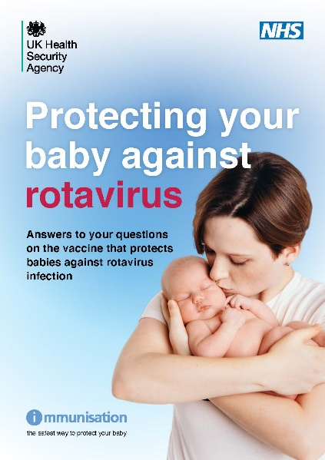
Resources
all resources relating to the rotavirus vaccination programme can be accessed in the UKHSA rotavirus immunisation programme for infants' collection. These include the ‘information for healthcare practitioners’ document, rotavirus training slide set, protecting your baby against rotavirus flyer, protecting your baby against rotavirus leaflet and rotavirus vaccine and SCID newborn screening evaluation guidance (containing the algorithm for checking SCID screening results)
Marketing authorisation holder’s Summary of product characteristics
Medicines and Healthcare products Regulatory Agency (MHRA): reporting adverse reactions
Immunisation against infectious disease: Rotavirus Green Book chapter (27b)
UKHSA Patient Group Direction (PGD): Rotarix vaccine
parental leaflet: Guide to immunisation for babies up to 13 months of age
NHS website: Diarrhoea and vomiting
NHS Website: UK rotavirus vaccination programme
Oxford Vaccine Knowledge Project: Rotavirus vaccine
UKHSA norovirus and rotavirus epidemiology and surveillance webpages
British Society for Immunology: Public information materials

Slide 48
Resources: Information for Healthcare Practitioner Guidance
The information for healthcare practitioners guidance available on the UKHSA rotavirus immunisation programme for infants' collection is recommended reading for anyone involved in rotavirus immunisation
This is a practical document for healthcare practitioners administering or providing advice about the rotavirus vaccine. It includes the vaccination programme recommendations, contraindications, precautions and examples of scenarios that staff may experience when immunising.

Slide 49
Key messages
rotavirus is the most common cause of gastroenteritis in young children
most children, irrespective of demographics or socioeconomic conditions, living in industrialised or developing countries will experience at least one infection with rotavirus by the time they are 5 years old
rotavirus gastroenteritis can cause dehydration which may lead to hospitalisation for intravenous rehydration
an oral vaccine against rotavirus was introduced in July 2013 into the infant immunisation programme at the 8- and 12-week appointments to reduce the incidence of disease
to date, rotavirus immunisation has been shown to significantly reduce the incidence of rotavirus gastroenteritis in young children
during 2017, the manufacturer changed the applicator for Rotarix vaccine so all immunisers should ensure they are familiar with the manufacturer instructions for oral administration

