Slide 1
Changes to the routine childhood immunisation programme in 2025 and 2026
1 May 2025

Slide 2
Note to trainers
this slide set contains a collection of core slides for use by trainers for the delivery of training about the changes to the childhood vaccination programmes in 2025 and 2026
trainers should select the slides required depending on the background and experience of the vaccinators they are training and according to the role they will have in delivering the childhood vaccination programme
the information in this slide set was correct at time of publication but as updates to the slide set will be made when necessary, please check online to ensure you are using the latest version

Slide 3
Aim and learning outcomes
Aim
To provide healthcare practitioners with information about the changes to the childhood immunisation schedule in 2025 and 2026
Learning outcomes
By the end of this session, learners should be able to describe:​
what changes are being made to the childhood immunisation schedule in 2025 and 2026 and why they are being made
how the changes to the schedule at 12 and 16 weeks should be delivered
which children are eligible for the new 18-month hexavalent vaccine appointment
when the second dose of MMR vaccine should be given
how the changes will affect children on the selective neonatal hepatitis B pathway
where to find further information about the changes

Slide 4
Contents
Slide number
6 to 9
10 to 20
21 to 22
23 to 27
background to and overview of the changes to the vaccination schedule in the first year of life
background to and overview of the changes to the vaccination schedule in the second year of life
infants eligible for the selective Hepatitis B vaccination programme
overall summaries of the 2025 and 2026 changes to the routine childhood vaccination programme

Slide 5
Significant messages
manufacturing of the Hib/MenC (Menitorix®) vaccine has been discontinued and stock of this vaccine will be depleted by mid-2025
whilst vaccination against MenC in early childhood is no longer considered necessary, vaccination against Hib in the second year of life needs to continue
the JCVI therefore recommended that an additional dose of a Hib-containing vaccine (DTaP/IPV/Hib/HepB vaccine) should be administered at a new vaccination appointment at age 18 months
this new 18-month appointment also provides an opportunity for the second dose of MMR vaccine to be moved from 3 years 4 months to 18 months of age
from 1 July 2025 Menitorix® will no longer be offered at 12 months and from 1 January 2026, an additional dose of DTaP/IPV/Hib/HepB vaccine will be offered at a new 18-month appointment
additionally, from 1 July 2025, the order of vaccines in the infant schedule will change: MenB vaccine will be given at 8 and 12 weeks and PCV13 will be given at 16 weeks

Slide 6
Background to and overview of the changes to the vaccination schedule in the first year of life

Slide 7
Changes to the infant schedule
From 1 July 2025, changes are being made to the infant schedule at 8, 12 and 16 weeks of age:
the meningococcal B vaccine, previously offered at 8 and 16 weeks will be offered at 8 and 12 weeks of age
the pneumococcal conjugate vaccine (PCV13) previously offered at 12 weeks of age will be offered at 16 weeks of age

Slide 8
Rationale for the changes to the infant schedule
meningococcal serogroup B is responsible for the majority of UK invasive meningococcal disease (IMD) cases
following introduction of the routine MenB vaccination programme, peak age of infection has shifted from 5 to 6 months to 1 to 3 months of age
a substantial proportion of cases were occurring before infants gained protection from their second dose of vaccine given at 16 weeks
the change in epidemiology of IMD means it would be beneficial to move the second dose of MenB vaccine to 12 weeks of age to provide earlier protection
moving the PCV dose to 16 weeks avoids increasing the number of injections at the second vaccination appointment at 12 weeks
young children will be protected by very high levels of herd immunity against the pneumococcal vaccine serotypes until they receive their dose of PCV13 at 16 weeks
although previously an 8-week interval between doses of MenB vaccine was recommended, evidence from a recent study showed a good response was made when the 2 doses were given 4 weeks apart

Slide 9
Implementing the changes to the infant schedule
From 1 July 2025:
children who have not yet received their 12-week vaccinations by 1 July 2025, should be vaccinated as per the new schedule timings (second MenB at 12 weeks and first PCV13 at 16 weeks)
children who have already received their 12-week PCV13 vaccination prior to 1 July 2025 should remain on the previous schedule and be invited for their second MenB vaccine at 16 weeks of age

Slide 10
Background to and overview of the changes to the vaccination schedule in the second year of life

Slide 11
Background
manufacturing of Hib/MenC (Menitorix®) vaccine has been discontinued
  this is a commercial decision made by the manufacturer (GSK)
  as this is the only Hib/MenC vaccine available, changes to the routine infant schedule are necessary
  the UKHSA estimates that the central stock of this vaccine will be depleted by mid-2025
in light of this, after thorough consideration, the JCVI has advised that MenC vaccine is no longer required in the childhood schedule
  this is due to the success of Meningococcal C containing vaccine programmes and the subsequent decline of invasive Meningococcal C disease
  current excellent control of meningococcal C disease can be maintained through the adolescent MenACWY vaccine programme
  there is still a continued need for a dose of Hib vaccine during the second year of life

Slide 12
Group C meningococcal vaccine
the introduction of the MenC vaccination programme in 1999 led to a significant reduction in the number of cases of invasive meningococcal C disease
the adolescent MenACWY programme commenced in 2015 and has been successful in further reducing the incidence of Men C disease (as well as cases of meningococcal W disease)
alongside this programme, a further significant decline in the spread and detection of invasive meningococcal disease (IMD) was seen because of the implementation of social distancing and lockdown measures as part of the response to the COVID-19 pandemic
modelling work found that indirect protection against MenC disease in infants is sustained by the adolescent MenACWY programme

Slide 13
Group C meningococcal vaccine
over time the adolescent vaccination programme is expected to reduce carriage prevalence of groups C, W and Y to near elimination levels (group A carriage has already been almost undetectable for many years in the UK)
  (carriage prevalence refers to how many adolescents are carrying the meningococcal bacteria in their nose and throat)
due to the reduction in carriage prevalence of these meningococcal serogroups, it has been predicted that by the time Menitorix® is no longer available there will be very few IMD cases caused by meningococcus groups A, C, W and Y each year, and consequently very few cases which could be prevented by a MenC containing vaccine in infancy
further information is available in the JCVI statement on changes to the childhood immunisation schedule (30 November 2022)

Slide 14
Hib disease and vaccination
prior to the introduction of the Haemophilus influenzae type B (Hib) vaccine, about 1 in 600 children developed Hib disease prior to their fifth birthday
in the pre-vaccine era, the most common presentation of invasive Hib disease was meningitis (60% of all cases), but it also presented as epiglottitis (15%), bacteraemia (10%), septic arthritis, osteomyelitis, cellulitis, pneumonia and pericarditis
individuals can carry Hib bacteria in their nose and throat without showing signs of the disease – before Hib vaccine was introduced, 4% of pre-school children carried the Hib organism
the Hib vaccine stops children from carrying the organism in their nose and throat and transmitting the infection to others – after the vaccine was introduced, carriage rates fell below the level of detection
as a result, since the introduction of the highly successful Hib immunisation programme in the UK in 1992, disease incidence has fallen in all age groups, not just in those who have been vaccinated
however, as immunity following a 3-dose primary course of Hib vaccination in infancy wanes, a fourth (booster) dose during the second year of life is needed to continue to prevent transmission in the community and maintain herd immunity

Slide 15
Replacement Hib vaccine
The JCVI considered multiple factors in relation to the timing of the administration of the additional Hib-containing vaccine:
  the overarching aim of the Hib programme is to attain herd immunity in the population. If the aim of the programme was individual protection, giving the vaccine at 12 months might be considered preferable as this would boost individual protection at an earlier age
  however, due to the success of the Hib immunisation programme (3 infant doses followed by a single booster at age 12 months), there is minimal Hib disease currently circulating in the UK and boosting an individual child’s level of protection is less necessary
  modelling shows that Hib transmission is primarily driven by children aged 2 to 4 years, therefore vaccination at any time before then should prevent transmission
  a dose of a multivalent Hib-containing vaccine at 18 months will also boost the child’s protection against other infections such as pertussis and polio

Slide 16
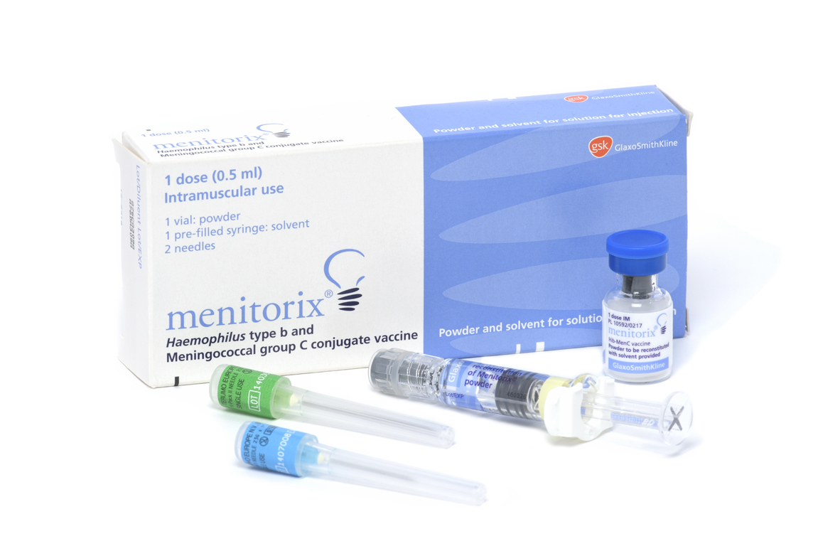
Current vaccine and schedule to 30th June 2025
Menitorix® vaccine provides protection against Haemophilus influenzae type b (Hib) and invasive capsular group C meningococcal (MenC) disease
since 2006, this vaccine has been given at 12 months of age
it is the fourth Hib-containing vaccine given to children
the prior 3 doses of Hib antigen are given as a component of the hexavalent vaccine (DTaP/IPV/Hib/HepB) administered at 8, 12 and 16 weeks of age
this is currently the only remaining dose of MenC vaccine in the childhood schedule other than the MenACWY vaccine given at 14 years of age

Slide 17
JCVI advice
The JCVI advised that the following changes should come into effect nationally once the current supply of Menitorix® vaccine has been exhausted:
  an additional dose of a Hib-containing multivalent vaccine (the hexavalent DTaP/IPV/Hib/HepB vaccine which is given in infancy) should be administered at age 18 months
  this replaces the Hib component of the Hib/MenC (Menitorix®) vaccine given at 12 months
  it requires the introduction of a new appointment at 18 months of age
  the new 18 months appointment provides an opportunity for the second dose of MMR vaccine to be brought forward from 3 years 4 months to 18 months of age
  it will also boost protection to the other antigens in the hexavalent vaccine
The JCVI will keep emerging evidence, including ongoing epidemiology and disease incidence, under review.

Slide 18
Moving the second dose of MMR
the new 18 months appointment provides an opportunity for the second dose of MMR vaccine to be brought forward from 3 years 4 months to 18 months of age
  the main reason for bringing the second dose of MMR forward is to improve coverage and reduce the likelihood of measles outbreaks
  in areas of London where the second dose of MMR was brought forward in response to local measles outbreaks in the 2000s, second dose coverage increased by an average of 3.3%*
  several London boroughs have continued to administer the second MMR at age 18 months to improve their vaccine uptake
the JCVI considers the likely added benefit of increasing uptake of second MMR further justifies the additional routine immunisation appointment
if the second MMR is not received at 18 months, there is a further opportunity to give it at 3 years and 4 months with the dTaP/IPV booster vaccine
*Lacy J and others (2022). ‘Impact of an accelerated measles-mumps-rubella (MMR) vaccine scheduled on vaccine coverage: an ecological study among London children, 2012-2018’ Vaccine: volume 40, issue 3, pages 444 to 449

Slide 19
New schedule from 1st July 2025
as the Menitorix® vaccine will no longer be available for the routine schedule, but a booster dose of Hib vaccine is still required, the JCVI recommended a booster dose of the Hib-containing DTaP/IPV/Hib/HepB vaccine be given at 18 months of age
infants will continue to be offered 3 doses of DTaP/IPV/Hib/HepB vaccine at 8, 12 and 16 weeks of age
those born from 1 July 2024 should then be offered a fourth dose of DTaP/IPV/Hib/HepB at a new vaccination appointment at 18 months
this will replace the Hib component of the Hib/MenC (Menitorix®) vaccine previously given at 12 months
a dose of PCV13, MenB and first MMR vaccine should continue to be given at one year of age
second dose of MMR should be given at 18 months

Slide 20
Implementing the changes: timeline and eligibility
All children who have their first birthday on or after 1 July 2025 (DOB on/after 01/07/24):
should still be offered first MMR, second PCV13 and third MenB at their one-year-of-age vaccination appointment but will not be offered Hib/MenC (Menitorix®)
should be offered a hexavalent (DTaP/IPV/Hib/HepB) booster dose at a new 18-month routine vaccination appointment (starting from 1 January 2026)
will be offered their second dose of MMR at the 18-month appointment
should then attend at 3 years 4 months of age for their dTaP/IPV booster vaccine

Slide 21
Implementing the changes: timeline and eligibility
Children who turned one year of age on or before 30 June 2025 (DOB on/before 30/06/24):
should continue to be offered Menitorix® at their one-year-of-age vaccination appointment as per the previous schedule along with their first MMR, second PCV13 and third MenB
if the national supply of Menitorix® is exhausted before children in this birth cohort receive it (for children who are late coming for their one-year vaccines), these children should be offered a hexavalent vaccine instead of Menitorix® (alongside their PCV13, MenB and first MMR)
These children should then be offered their booster dose of dTaP/IPV vaccine at 3 years 4 months, along with their second dose of MMR.

Slide 22
Infants eligible for the selective Hepatitis B vaccination programme

Slide 23
Infants eligible for the selective Hepatitis B vaccination programme
As a result of the introduction of a fourth hexavalent vaccine at 18 months from 1 January 2026, the JCVI have also recommended a change to the selective hepatitis B vaccination programme for children born to mothers who test positive for hepatitis B:
Children born on or after 1 July 2024 who are on the selective hepatitis B vaccination programme will no longer be offered a monovalent vaccine at 12 months of age as they will now receive a further dose of hepatitis B vaccine as part of the hexavalent vaccine being offered at 18 months.
However, it is important that these children are tested for infection using the Dried Blood Spot (DBS) test. DBS testing can be undertaken at any time between one year and 18 months of age, for example at an opportunistic healthcare attendance or at a routine appointment.
Children born on or before 30 June 2024 who are on the selective hepatitis B vaccination programme should continue to be offered a dose of monovalent hepatitis B vaccine with their other one-year vaccinations (Hib/MenC, MenB, MMR and PCV13) as per the previous schedule
(if Hib/MenC no longer available, give DTaP/IPV/Hib/HepB and monovalent HepB vaccine would not be required)
This age cohort should continue to be tested for infection from 12 months of age.

Slide 24
Overall summaries of the 2025 and 2026 changes to the routine childhood vaccination programme

Slide 25
Summary of changes for 2025 and 2026
from 1 July 2025, in the infant schedule, MenB vaccine should be given at 8 and 12 weeks and PCV13 should be given at 16 weeks
due to the success of the adolescent MenACWY programme in controlling meningococcal C disease across the population, a dose of men C-containing vaccine will no longer be recommended at age 12 months
protection against meningococcal infection will be maintained by the MenACWY adolescent vaccination programme
For children born on or after 1 July 2024:
an additional dose of Hib-containing hexavalent vaccine (DTaP/IPV/Hib/HepB) should be given at age 18 months (instead of Hib/MenC at 12 months)
the second dose of MMR vaccine should be brought forward from 3 years 4 months to 18 months of age

Slide 26
Summary of the changes to the routine childhood schedule from 1 July 2025
From | Change to be implemented
1 July 2025 | First PCV13 dose moved from 12 weeks of age to 16 weeks of age. Second MenB dose brought forward from 16 weeks of age to 12 weeks of age Cessation of routine Hib/MenC (Menitorix®) offer to those turning 12 months for those born on or after 1 July 2024 Removal of monovalent HepB dose at one year for infants on the selective HepB pathway schedule born on or after 1 July 2024
1 January 2026 | Introduction of an additional (fourth dose) of DTaP/IPV/Hib/HepB (hexavalent) vaccine at a new routine appointment at 18 months for children born on or after 1 July 2024
1 January 2026 | Second MMR dose moved from 3 years 4 months to the new routine 18-month appointment for children born on or after 1 July 2024

Slide 27
Routine appointment (at age) | Old routine schedule | New routine schedule | Changes
8 weeks | 1st DTaP/IPV/Hib/HepB 1st MenB 1st Rotavirus | 1st DTaP/IPV/Hib/HepB 1st MenB 1st Rotavirus | None
12 weeks | 2nd DTaP/IPV/Hib/HepB 1st PCV13 2nd Rotavirus | 2nd DTaP/IPV/Hib/HepB 2nd MenB 2nd Rotavirus | From 1 July 2025: Move 1st PCV13 to 16 weeks Move 2nd MenB to 12 weeks
16 weeks | 3rd DTaP/IPV/Hib/HepB 2nd MenB | 3rd DTaP/IPV/Hib/HepB 1st PCV13 | From 1 July 2025: Move 2nd MenB to 12 weeks Move 1st PCV13 to 16 weeks
one year | Hib/MenC 1st MMR 2nd PCV 3rd MenB | 1st MMR 2nd PCV 3rd MenB | From 1 July 2025: Remove offer of Hib/MenC for children born on or after 01 July 2024
18 months (new appointment) |  | 4th DTaP/IPV/Hib/HepB 2nd MMR | From 1 January 2026: Introduce new 18-month appointment for 4th DTaP/IPV/Hib/HepB dose and 2nd MMR dose for children born on or after 01 July 2024
3 years 4 months | 2nd MMR dTaP/IPV | dTaP/IPV | From 1 January 2026: Move 2nd MMR dose to 18 months for children born on or after 01 July 2024

Slide 28
General information
there are no new vaccine products in the amended schedule – the hexavalent vaccine administered at age 18 months is the same vaccine that is given at 8, 12 and 16 weeks of age
hexavalent vaccines for the 18-month appointment should be ordered via the ImmForm website
monovalent Hepatitis B vaccine for children on the selective HepB pathway should be ordered directly from the manufacturer
the UKHSA will publish PGD templates updated in line with the changes to the childhood schedule (will be available to download from the Immunisation PGD templates collection webpage)

Slide 29
Resources
all changes detailed in the UKHSA/NHSE letter: ‘Changes to the routine childhood vaccination schedule and the selective hepatitis B vaccination programme from 1 July 2025’
also, in the Joint Committee on Vaccination and Immunisation (JCVI) statement on changes to the childhood immunisation schedule November 2022
range of resources and guidance for healthcare practitioners, parents and carers will be published on GOV.UK webpage
all relevant Green Book chapters, PGDs and existing resources will be updated
further information about potential issues or questions that may arise will be available in the ‘2025 and 2026 childhood immunisation schedule changes Information for healthcare practitioner’ guidance on GOV.UK

