Slide 1
Vaccination against shingles (Herpes Zoster)
Training for healthcare practitioners
August 2021
Notes:
Background
The Joint Committee on Vaccination and Immunisation reviewed all the available medical, epidemiological and economic evidence as well as vaccine safety and efficacy relevant to offering a universal vaccination programme for shingles.
As part of the review, age-specific incidence of shingles and associated disease burden were taken into account. Disease burden was measured in terms of those that developed secondary complications as a result of shingles infection, those that required hospitalisation and those that eventually resulted in or contributed to an individual’s death. The JCVI concluded that the incidence of shingles is closely associated with older age groups, with the severity and disease burden increasing as the individual gets older.
As a result, a routine shingles vaccination programme for people aged 70 years old, with a catch-up immunisation programme for people aged 78 and 79 years. was introduced from 1 September 2013
Rationale for resource
This resource is designed to support healthcare practitioners involved in discussing routine vaccination against shingles
This resource does not cover the actual administration techniques involved in vaccinating against shingles. If staff are required to deliver vaccinations they should refer to their line manager for additional training.
Note: shingles is also known as herpes zoster. Shingles is used throughout this slide set.

Slide 2
Learning outcomes
After completing this training, immunisers will be able to:
describe the aetiology and epidemiology of shingles
describe the relationship between shingles and chickenpox (varicella zoster) and the severity of the disease in those 70+ years of age
discuss the important role of vaccination against shingles
identify sources of additional information
Notes:
Content
Shingles infection
Epidemiology
Shingles vaccine
National shingles vaccination programme
Resources

Slide 3
Shingles infection
shingles is a viral infection of the nerve cells and surrounding skin
after a person recovers from chickenpox infection (caused by the varicella zoster virus), the virus remains dormant in the nerve cells and can reactivate at a later stage when the immune system is weakened
reactivation of the dormant virus leads to the clinical manifestation of shingles
reactivation can be associated with older age, malignancy, immunosuppressant therapy or HIV infection
Image courtesy of PHE/SPL
Notes:
Shingles (herpes zoster) is caused by the reactivation of a latent varicella zoster virus (VZV) infection, generally decades after the primary infection
Following primary VZV infection, the virus enters the sensory nerves and travels along the nerve to the sensory dorsal root ganglia and establishes a permanent latent infection
Increasing incidence of shingles infection amongst older age groups is thought to be associated with a decline in cell mediated immunity to varicella zoster virus
Although rare, it is possible to have shingles more than once
Shingles is not caused by the same virus that causes genital herpes

Slide 4
Clinical presentation of shingles
Prodromal phase - the first signs of shingles may include:
abnormal skin sensations and pain in the affected area of skin
headache
feeling generally unwell
photophobia
malaise
fever (although this is less common)
A prodromal illness is experienced by 80% of individuals with shingles and can last up to 72 hours before the rash appears
Notes:
Images Shingles available NHS site: https://www.nhs.uk/conditions/shingles/

Slide 5
Clinical presentation of shingles (2)
Acute stage
a rash of fluid filled blisters develops after a few days, commonly on one side of the face or body, usually within the distribution of a dermatome (an area of skin that is supplied by a single nerve)
the rash often causes intense pain, burning, tingling, itching or numbness in the area of the affected nerve
the rash forms blisters that typically scab over in 7 to 10 days, this eventually clears within 2 to 4 weeks
in individuals with weakened immune systems, a more disseminated rash covering multiple dermatomes may occur and this may appear similar to the chickenpox rash
Notes:
Shingles can affect any part of the body, although most commonly affected areas include face (including eyes) chest and abdomen.
Individuals may also experience pain in the arms and legs and may feel exhausted.
A dermatome can be defined as an area of skin that is supplied by a single nerve. Shingles can affect one or more isolated dermatomes.

Slide 6
Possible complications of shingles
Shingles is more likely in adults 50 years of age and over, with the severity of the illness increasing with age
Most common complications are:
post herpetic neuralgia (PHN)
secondary bacterial skin infections
Less common complications can include:
ophthalmic zoster (leading to keratitis, corneal ulceration, conjunctivitis, retinitis, optic neuritis and/or glaucoma)
peripheral motor neuropathy
In severe cases, shingles can lead to hospitalisation and death
Notes:
Shingles can cause a number of secondary complications and the severity of these can be dependent on how weak the individual’s immune system is.
Most commonly reported complications in the older age groups include secondary bacterial infections at the site of the rash (that may require antibiotic therapy) and post herpetic neuralgia.
Other less common complications can include ophthalmic shingles and peripheral motor neuropathy. Ophthalmic shingles affects the facial nerve (trigeminal) and can cause ulceration and scarring of the eye and uveitis (inflammation of the inner eye). Ophthalmic shingles can also cause loss of vision if untreated and is often associated with long term pain. Estimates show between 10-20% of shingles cases result in ophthalmic zoster with approximately 4% of these cases resulting in long term sequelae
Peripheral motor neuropathy is more common in the elderly population and results in temporary nerve damage (peripheral motor nerve) that controls movement (peripheral motor nerve) of limbs such as the arm or leg, causing paralysis in the associated limb. This effect is temporary and individuals can make a good recovery.

Slide 7
Post Herpetic Neuralgia (PHN)
Post herpetic neuralgia (PHN) is a common complication of shingles in older adults:
PHN is a pain at the rash site that persists for, or appears more than 90 days after the onset of the shingles rash
on average PHN lasts from 3 to 6 months, but can persist for longer
severity of pain may be constant, intermittent or triggered by stimulation of affected area such as a breeze on the face
the pain may be a burning, itching, stabbing or aching pain which is extremely sensitive to touch and not generally relieved by common painkillers
PHN is more likely to develop, and is more severe, in people over the age of 50, with one third of sufferers over the age of 80 experiencing intense pain
Notes:
PHN is defined as an intense pain that persists for, or develops after 90 days following the onset of the shingles rash and can persist between for 3 and 6 months in 50% of those affected. This pain can last longer and is dependent on the individual’s immune system.
As the pain can be intense and is not generally relieved by common pain killers, PHN can have a negative impact on the individuals quality of life. PHN can contribute to fatigue, insomnia, depression, anxiety and can impair the basic activities of daily living for the individual.

Slide 8
Infectious period
a person with shingles is only infectious when the rash is present and fluid filled vesicles are present
a person is not infectious before the rash is present or when the rash has crusted
Shingles is less infectious than chickenpox and covering the rash will greatly reduce the risk of exposure to those non-immune to chickenpox.

Slide 9
Transmission
shingles cannot be transmitted from one person to another
a person exposed to shingles will not develop shingles
a person exposed to chickenpox will not develop shingles
a person who has not had chickenpox may develop chickenpox as a result of exposure to the shingles virus through direct contact with the fluid filled blisters
the varicella virus that causes shingles (herpes zoster) is the same virus that causes chickenpox (varicella zoster)
Shingles is not spread through coughing, sneezing or casual contact.
Notes:
Infection with varicella zoster (chickenpox) is a pre-requisite for the development of shingles
You do not develop shingles from being in contact with chickenpox
Shingles cannot be transmitted from one person to another, although it can cause chickenpox in individuals who have not previously had the disease and who have direct contact with the fluid from the shingles vesicles

Slide 10
Incidence of shingles
over 50,000 cases of shingles occur in people aged 70 years and over each year in England and Wales
of these,14,000 develop post herpetic neuralgia (PHN)
1,400 cases of shingles result in hospitalisation
one in 1,000 cases of shingles in people 70 years of age and over are estimated to result in death
the risk of shingles is higher in individuals with lupus, rheumatoid arthritis, diabetes and granulomatosis with polyangiitis (an auto immune disease leading to small vessel vasculitis)
Notes:
Data from GP-based studies in England and Wales; Green Book Shingles Chapter 28a

Slide 11
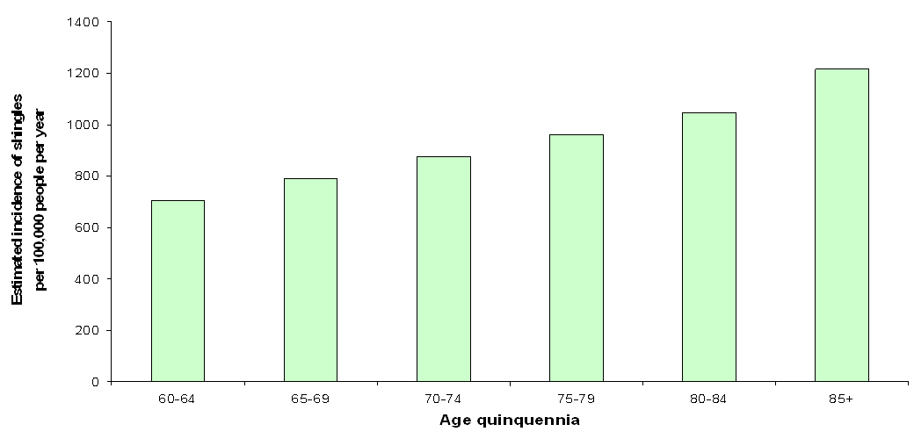
Epidemiology of shingles in England and Wales
Notes:
The above graph shows the estimated annual age-specific incidence of shingles per 100, 000 per year in the immunocompetent population (Y- axis) against the age quinquennia (x-axis).
The graph shows a continued increase in age related shingles, confirming that the incidence of shingles is largely associated with older age who are more at risk of developing the disease.
Age-specific incidence rates of shingles have been estimated using a number of different primary care derived data sources including: the Royal College of General Practitioners (RCGP) Weekly Returns Service; the fourth Morbidity Survey in General Practice (MSGP-4), and the General Practice Research Database
These are estimates (based on available data sources) as shingles is only clinically diagnosed, thus no lab confirmation of this is available. Actual figures may be much higher.

Slide 12
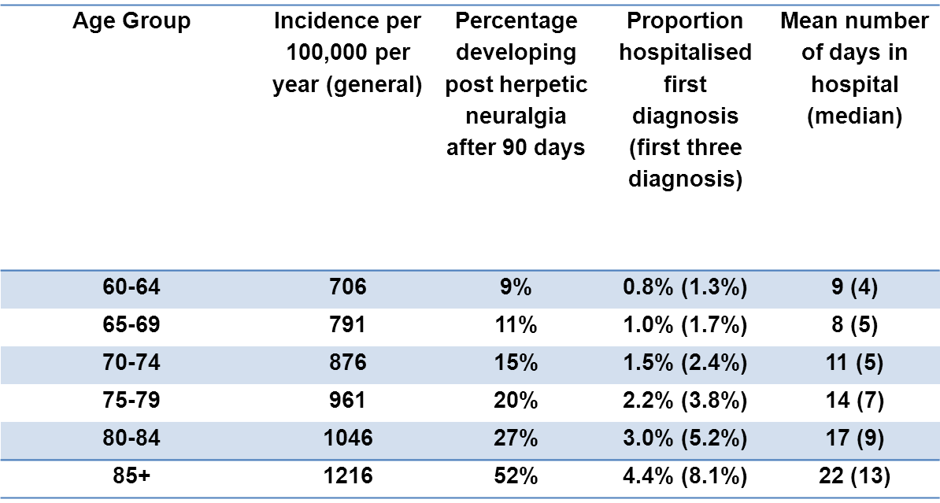
Epidemiology of shingles in England and Wales
Estimated annual age-specific incidence, hospitalisation rate, length of inpatient stay, Burden of disease in the immunocompetent population England and Wales. (Data taken from van Hoek et al, 2009).
Notes:
This table again shows the estimated annual age specific incidence per 100,000 with the associated burden of disease for each of the age quinquennia.
The burden of disease is measured in this table as the percentage developing post herpetic neuralgia (PHN) after 90 days, proportion of those hospitalised after the first diagnosis and the mean number of days spent in hospital.
The table shows the association between the incidence of age related shingles and the burden of disease. In particular, those individuals above 75 years of age account for a higher percentage of those developing PHN after 90 days. They are more likely to be hospitalised as a result of the disease and stay the longest when admitted to hospital.
As shown in the table, the burden of disease is closely related to age with those in the older age groups experiencing severe forms of the illness.
The severity of the disease burden is markedly increased in those individuals aged 75-85+ years. Individuals aged 85 years and over account for 4.4% of hospital admissions after the first diagnosis and 8.1% of hospital admissions within the first 3 diagnoses. They account for 52% of individuals developing PHN after 90 days and as a result of the disease, require a minimum of 22 days in hospital. This highlights the severity and impact of the disease in this age group and emphasises the importance of offering vaccination to older individuals.

Slide 13
Shingles vaccine coverage data: England
shingles vaccination was successfully introduced in England during September 2013
since then, there has been a year on year decline in vaccine uptake (coverage) in both the routine (70-year-old) and catch-up (78-year-old) cohorts
*different methodology and eligibility criteria was adopted from this year onwards
**data up to Quarter 3 only. This year concludes the catch-up cohorts for the shingles vaccine at 78 years old
** data in 2020 /21 has dropped and is most likely due to the COVID-19 pandemic
*
 | Year 1 (2013/14) | Year 2 (2014/15) | Year 3 (2015/16) | Year 4 (2016/17 | Year 5 (2017/18) | Year 6* (2018/19) | Year 7 (2019/20) | Year 8** (2020/21)
Routine (70y) | 61.8% | 59.0% | 54.9% | 48.3% | 44.4% | 31.9% | 26.5% | 22.9%
Catch up (78y) | NA | 57.8% | 55.5% | 49.4% | 46.2% | 32.8% | 25.8% | NA
Notes:
It is important that general practices consider how they can optimise the uptake of shingles vaccine in eligible patients in order to reduce the significant burden of disease associated with shingles among older adults
Shingles vaccine coverage report (adults eligible from April to December 2020 and vaccinated to March 2021) - England:
Herpes zoster (shingles) immunisation programme 2020 to 2021: evaluation reports - GOV.UK (www.gov.uk)
Evaluation of the seventh year of the shingles vaccination programme in England from 2019 to 2020:
www.gov.uk/government/publications/herpes-zoster-shingles-immunisation-programme-2019-to-2020-evaluation-reports

Slide 14
Vaccination against shingles (Herpes Zoster)

Slide 15
Shingles vaccine
Two vaccines are available in England for shingles:
Zostavax: - live attenuated vaccine
- offered to all immunocompetent individuals from 70 to - 79 years of age
- requires one dose of vaccine
Shingrix: - recombinant adjuvanted (non-live) subunit vaccine
- only available for individuals 70 to 79 years of age clinically contraindicated for Zostavax, for example due to immunocompromised status
- 2 dose schedule
Notes:
Supplies for the routine programme should be ordered from ImmForm
Vaccines for private prescriptions, occupational health or travel are NOT provided free of charge and should be ordered directly from the manufacturer

Slide 16
Zostavax vaccine
Brand name: Zostavax
Generic name: Varicella Zoster vaccine
Marketed by: Merck Sharp & Dohme MSD
live attenuated (that is a weakened live organism)
licensed for use from 50 years of age and above
recommended for adults aged 70 to 79 years of age
Notes:
The aim of the national shingles immunisation programme is to lower the incidence and severity of shingles in older people. It is recommended that it be routinely offered to people 70 to 79 years of age. The vaccine can be given to individuals until their 80th birthday.
Vaccination for individuals over the age of 80 years is not recommended due to the decreased efficacy of the vaccine in this age group. The economic analysis suggested that the vaccine would not be cost effective in individuals over 80 years of age.

Slide 17
Vaccine efficacy
In clinical trials, a one dose schedule of Zostavax was assessed in 17,775 adults aged 70 years and over
The incidence of shingles was reduced by 38% and provided protection for at least 5 years
For those vaccinated but who later developed shingles:
the burden of illness was significantly reduced by 55%
the incidence of PHN was significantly reduced by 66.8%
Notes:
In a clinical trial, one dose of Zostavax was assessed in 38,546 adults aged 60 years and over of whom 17,775 were aged 70 years or over.
The Zostavax vaccine reduced the incidence of shingles in those aged 70 years and over by 38%⁷, and the incidence of PHN by 66.8%
The vaccine is expected to provide protection against shingles for at least 5 years and at this time, a one dose schedule of the vaccine is recommended with no requirement for a second/booster vaccine.

Slide 18
Evaluation of the shingles vaccination programme
In the first 5 years of the routine programme in England, there were an estimated:
40,500 fewer herpes zoster GP consultations
1,840 fewer herpes zoster hospitalisations
due to the vaccination programme
Notes:
https://bmjopen.bmj.com/content/bmjopen/10/7/e037458.full.pdf
Impact of the herpes zoster vaccination programme on hospitalised and general practice consulted herpes zoster in the 5 years after its introduction in England: a population-based study
Andrews N, Stowe J, Kuyumdzhieva G, Sile B, Yonova I, de Lusignan S, Ramsay M, Amirthalingam G

Slide 19
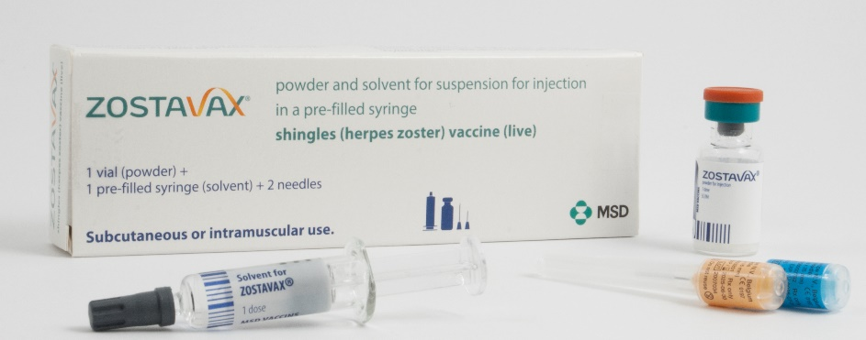
Zostavax presentation
Zostavax with solvent for reconstitution supplied in a pre-filled syringe
the powder in the glass vial is a white to off-white, compact crystalline plug
the diluent in the pre-filled syringe is a clear colourless liquid
when mixed together, Zostavax is a semi-hazy to translucent, off white to pale yellow liquid
Zostavax pack contains:
x1 Zostavax vial
x1 pre-filled syringe
x2 separate needles

Slide 20
Zostavax composition
Composition
Varicella-zoster virus, Oka/Merck strain (live, attenuated) not less than 19400 PFU*
produced in human diploid (MRC-5) cells
* PFU = Plaque-forming units
Excipients
Powder:
Sucrose
Hydrolysed gelatin
Sodium chloride
Potassium dihydrogen phosphate
Potassium chloride
Monosodium L-glutamate monohydrate
Disodium phosphate
Sodium hydroxide (to adjust pH)
Urea
Solvent:
Water for injection
Residual substances
This vaccine may contain traces of neomycin

Slide 21
Zostavax reconstitution instructions
separate needles should be used for the reconstitution and administration of the vaccine
to reconstitute the vaccine, inject the entire content of the solvent syringe into the vial containing the powder
gently agitate to dissolve completely
withdraw the entire content of the reconstituted vaccine into the syringe for injection
change the needle and push the new needle onto the extremity of the syringe and rotate a quarter of a turn (90⁰) to secure the connection
vaccine should be administered immediately after reconstitution
reconstituted vaccine should not be used if you notice any particulate matter or if the appearance of the solvent or of the reconstituted vaccine differs from that described in the SPC (a semi-hazy to translucent, off white to pale yellow liquid)
Notes:
It is recommended that the vaccine be administered immediately after reconstitution. Discard reconstituted vaccine if it is not used within 30 minutes
Zostavax is provided with one or two unattached needles in the pack (as sent from the manufacturer).
Vaccinators would need to supply their own green needle for reconstituting the vaccine and then select the most appropriate needle length for the patient.
For I/M injections the needle needs to be sufficiently long to ensure that the vaccine is injected into muscle, so longer length needles would be recommended for morbidly obese individuals.

Slide 22
Administration of Zostavax
a single dose of 0.65ml should be given by intramuscular injection, preferably in the deltoid region of the upper arm
intramuscular injection is the preferred route of administration as injection-site reactions significantly less frequent in those who received the vaccine via this route
for individuals with a bleeding disorder – see PGD for full details
if more than one vaccine is given at the same appointment – give at separate sites, preferably in different limbs. If given in the same limb, they should be given at least 2.5cm apart
record the site each vaccine has been given in the individual’s records
Notes:
Individuals with bleeding disorders may be vaccinated intramuscularly if, in the opinion of a doctor familiar with the individual's bleeding risk, vaccines or similar small volume intramuscular injections can be administered with reasonable safety by this route. If the individual receives medication/treatment to reduce bleeding, for example treatment for haemophilia, intramuscular vaccination can be scheduled shortly after such medication/treatment is administered. Individuals on stable anticoagulation therapy, including individuals on warfarin who are up to date with their scheduled INR testing and whose latest INR was below the upper threshold of their therapeutic range, can receive intramuscular vaccination. A fine needle (equal to 23 gauge or finer calibre such as 25 gauge) should be used for the vaccination, followed by firm pressure applied to the site (without rubbing) for at least 2 minutes. If in any doubt, consult with the clinician responsible for prescribing or monitoring the individual’s anticoagulant therapy.
PHE PGD Templates: www.gov.uk/government/collections/immunisation-patient-group-direction-pgd
Zostavax: www.gov.uk/government/publications/shingles-vaccine-zostavax-patient-group-direction-pgd-template

Slide 23
Administration of Zostavax (2)
Zostavax can be administered at the same time as inactivated vaccines such as influenza and 23-valent pneumococcal polysaccharide vaccine (PPV)
Zostavax can be administered at the same time as, or before or after other live vaccines except MMR (Green Book Chapter 11 Table 11.3)
where MMR and Zostavax are not administered at the same time, a 4 week minimum interval should be observed between vaccines
a 7day interval should ideally be observed after COVID-19 vaccination before giving Zostavax (and vice versa) due to the potential for a reduced response to the live shingles virus
Zostavax should not be administered to patients currently receiving oral or intravenous antivirals such as acyclovir or who are within 48 hours after cessation of treatment as the therapy may reduce the response to the vaccine
Notes:
See Green Book shingles chapter for more detail about co-administration of shingles vaccines with other vaccines

Slide 24
Zostavax cautions
individuals who are acutely unwell should postpone immunisation until they have recovered
immunosuppressed individuals should have a clinical risk assessment for suitability for Zostavax (or Shingrix vaccine)
individuals under highly specialist care would need full review of their treatment and clinical history; vaccination with Zostavax should not proceed until the advice of their specialist or an immunologist has been sought
primary healthcare professionals with concerns about the nature of their patient’s prescribed therapies or their degree of immunosuppression, should contact the relevant specialist for advice about shingles vaccination
Notes:
Zostavax is a live vaccine it is essential to check that the recipient has no contraindications to receiving this vaccine
If the individual is under highly specialist care, and it is not possible to obtain full information on that individual’s treatment history, then vaccination should not proceed until the advice of the specialist or a local immunologist has been sought.
Specialists with responsibility for patients in the vaccine eligible cohorts should include a statement of their opinion on the patient’s suitability for Zostavax in their correspondence with primary care. If primary healthcare professionals administering the vaccine have concerns about the nature of therapies or the degree of immunosuppression they should contact the relevant specialist for advice

Slide 25
Zostavax - contraindications
Contraindications to Zostavax:
confirmed anaphylactic reaction to a previous dose of varicella-containing vaccine or any component of the vaccine
pregnancy (Zostavax is not indicated in women of childbearing age and women who are pregnant should not receive Zostavax)
immunosuppression due to underlying condition or treatment as defined in the Green Book Shingles chapter
Notes:
Green Book Chapter 28a Shingles
https://www.gov.uk/government/publications/shingles-herpes-zoster-the-green-book-chapter-28a

Slide 26
HIV infection
the safety and efficacy of Zostavax have not been conclusively established in adults who are known to be infected with HIV with or without evidence of immunosuppression
individuals with CD4 counts of 200 cells/ul or higher can be offered Zostavax
seek advice from patient’s specialist
refer Green Book Shingles Chapter 28a

Slide 27
Patients anticipating immunosuppressive therapy
eligible individuals anticipating immunosuppressive therapy should ideally be assessed for vaccine eligibility before starting treatment that may contraindicate future Zostavax vaccination
individuals are not currently eligible for pre-treatment vaccination with Shingrix as supply of this vaccine is currently limited and so vaccine supplied via the national programme should not be used for this indication
eligible individuals who have not received Zostavax should receive a single dose of vaccine at the earliest opportunity and at least 14 days before starting immunosuppressive therapy, although leaving one month would be preferable if a delay is possible

Slide 28
Current or recent shingles infection
shingles vaccine is not recommended for treatment of shingles or post herpetic neuralgia (PHN)
individuals who have shingles or PHN should wait until symptoms have ceased before being considered for shingles immunisation
natural boosting that occurs following an episode of shingles makes the benefit of offering Zostavax vaccine immediately following recovery limited
immunocompetent individuals who develop shingles should have their shingles vaccination delayed for one year or up until just before their 80th birthday so they can still benefit from the programme (this may mean giving vaccine at less than one year interval)
patients who have 2 or more episodes of shingles in one year should have immunological investigation prior to vaccination
Notes:
Immunisation of individuals who are acutely unwell should be postponed until they have recovered fully. This is to avoid confusing the diagnosis of any acute illness by wrongly attributing any sign or symptoms to the adverse effects of the vaccine.
For those aged between 79 and 80 years at the time of natural shingles infection, it is acceptable to reduce the interval from recovery to vaccination from one year to enable shingles vaccine to be administered as part of the national programme before the 80th birthday.
As there is very little data on waning antibodies following natural infection, particularly beyond 6 months, there is currently no recommendation for revaccination if shingles vaccine is administered with a less than one year interval from natural infection
For a patient in the group being offered Shingrix vaccine, as a preference for Zostavax, Shingrix can be given as long as the individual has recovered from acute infection and they have no active vesicles (as Shingrix is being used to protect immunocompromised individuals).

Slide 29
Transmission of vaccine virus
transmission of vaccine virus following Zostavax vaccination may occur rarely between recently vaccinated individuals who develop a varicella-like rash and susceptible contacts
any person who develops a vesicular rash after receiving Zostavax should ensure the rash area is kept covered when in contact with a susceptible (chickenpox naïve) person until the rash is dry and crusted
if the person who received the vaccine is themselves immunosuppressed, they should avoid contact with susceptible people until the rash is dry and crusted, due to the higher risk of virus shedding
prophylactic acyclovir can be considered in vulnerable patients exposed to a varicella-like rash in a recent vaccinee
if a varicella (widespread) or shingles-like (dermatomal) rash develops post-Zostavax, a vesicle fluid sample should also be sent for analysis to determine whether the rash is vaccine associated or wild type
Notes:
Post-marketing experience with varicella vaccines suggests that transmission of vaccine virus may occur rarely between those vaccinated who develop a varicella-like rash and susceptible contacts, although there has been no evidence of transmission of vaccine virus between vaccinees and susceptible contacts in the pre-licensure clinical trials of Zostavax.
As a precautionary measure, any person who develops a vesicular rash after receiving Zostavax should ensure the rash area is kept covered when in contact with a susceptible (chickenpox naïve) person until the rash is dry and crusted. If the person who received the vaccine is themselves immunosuppressed, they should avoid contact with susceptible people until the rash is dry and crusted, due to the higher risk of virus shedding. Prophylactic acyclovir can be considered in vulnerable patients exposed to a varicella like rash in a recent vaccinee.
Testing of post-vaccination rashes
In the event of a person developing a varicella (widespread) or shingles-like (dermatomal) rash post-Zostavax, a vesicle fluid sample should also be sent for analysis to confirm the diagnosis and determine whether the rash is vaccine associated or wild type. This service is available at the Virus Reference Department (VRD) at Public Health England, Colindale.
Transmission of vaccine virus from varicella vaccine recipients without VZV-like rash has not been confirmed. Whilst there remains a theoretical risk, therefore, in those who develop a rash following zoster vaccination of transmitting the attenuated vaccine virus to a susceptible individual , this risk should be weighed against the reduced risk of developing natural shingles and the much higher risk of transmission from the circulating wild type VZV in the community.

Slide 30
Zostavax - possible adverse reactions
Most commonly reported (1:10 of people vaccinated)
Pain, redness, tenderness, pruritus, swelling at the injection site
Less commonly reported (≥ 1/100 to < 1/10)
Headache, rash, arthralgia, myalgia, pain in extremity
Injection site: induration, haematoma, warmth, rash, pyrexia
(less reaction reported in those ≥ 60 years of age)
Uncommon (≥ 1/1,000 to < 1/100)
Lymphadenopathy (cervical, axillary); nausea
Rare (≥ 1/10,000 to < 1/1,000)
Hypersensitivity reactions including anaphylactic reactions, injection site urticaria
Very rare (< 1/10,000)
Varicella, Herpes zoster (vaccine strain); necrotizing retinitis (patients on immunosuppressive therapy)
Notes:
A full list of side effects can be found in the Zostavax summary of product characteristics.
https://www.medicines.org.uk/emc/product/6101/smpc

Slide 31
Inadvertent vaccination - Zostavax
Most individuals under 50 years of age are likely to be immune to varicella so inadvertent vaccination is unlikely to result in serious adverse reactions
Immunosuppressed individuals inadvertently given Zostavax
Individuals that develop a varicella rash should be urgently assessed and given prompt treatment with IV high-dose aciclovir, given the risks and severity of disseminated zoster
advice should be sought from the patient’s consultant or virologist
adverse events should be reported to MHRA via the Yellow Card scheme
Pregnancy
Urgently assess susceptibility and treat in the same way as a natural exposure to chickenpox infection

Slide 32
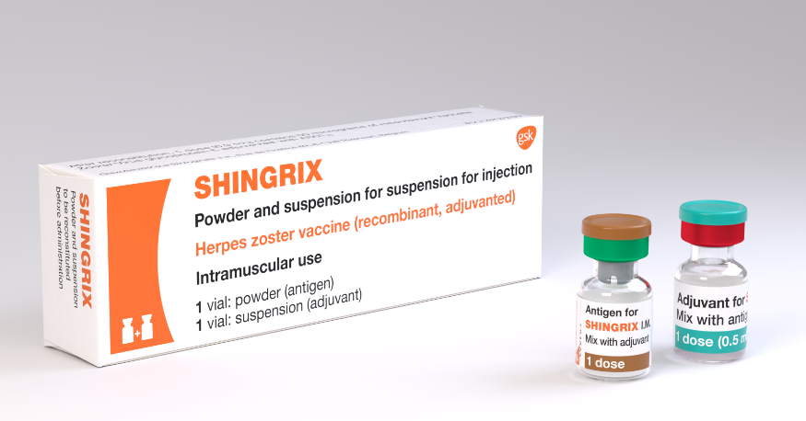
Shingrix vaccine
Brand name: Shingrix
Generic name: Varicella Zoster vaccine
Marketed by: GlaxoSmithKline UK
Herpes zoster vaccine, recombinant, adjuvanted
available from September 2021 for individuals 70 to 79 years of age who are clinically contraindicated to receive Zostavax due to immunocompromised status
Notes:
Shingrix vaccine introduced to ensure immunosuppressed individuals, eligible for vaccine under the current programme, develop a similar level of protection to those who are not immunocompromised
Zostavax should continue to be offered to immunocompetent eligible patients
Individuals who reach their 80th birthday are no longer eligible for a shingles vaccination due to the reducing efficacy of the vaccine as age increases

Slide 33
Shingrix vaccine (2)
Shingrix is a recombinant adjuvanted subunit shingles vaccine
it does not contain the live varicella-zoster virus
it contains a single protein glycoprotein E found in the outer shell of the herpes zoster virus, and an adjuvant to enhance the body's immune response to an antigen
by combining the VZV specific antigen (gE) with an adjuvant system (AS01B), Shingrix is designed to induce antigen-specific cellular and humoral immune responses in individuals with pre-existing immunity against VZV
it does not contain latex, thiomersal or gelatine
the rubber stopper does not contain natural rubber latex

Slide 34
Shingrix vaccine (3)
Shingrix vaccine was approved for use in adults 50 years of age or over in the US, Canada and Australia in 2017, and for use in the European Union and Japan in 2018
A real-world effectiveness study found vaccine effectiveness of 70% against herpes zoster and 76% against post herpetic neuralgia in individuals 65+ years of age given 2 doses of vaccine
Notes:
Izurieta HS, Wu X, Forshee R, Lu Y, Sung HM, Agger PE, Chillarige Y, Link-Gelles R, Lufkin B, Wernecke M, MaCurdy TE, Kelman J, Dooling K
Recombinant Zoster Vaccine (Shingrix) real-world effectiveness in the first two years post licensure
Clin Infect Dis. 2021 Feb 13:ciab125. doi: 10.1093/cid/ciab125. Online ahead of print.

Slide 35
Shingrix Composition
Composition
After reconstitution 0.5ml contains:
Varicella Zoster Virus glycoprotein E antigen^{2,3} 50mcgs
² adjuvanted with AS01_{B} containing:
plant extract Quillaja saponaria Molina, fraction 21 (QS-21) 50 mcgs
3-O-desacyl-4'-monophosphoryl lipid A (MPL) from Salmonella Minnesota 50 mcgs
³ glycoprotein E (gE) produced in Chinese Hamster Ovary cells by recombinant DNA technology
Excipients
Powder (gE antigen):
Sucrose
Polysorbate 80 (E 433)
Sodium dihydrogen phosphate dihydrate (E 339)
Dipotassium phosphate (E 340)
Suspension (AS01_{B} Adjuvant System):
Dioleoyl phosphatidylcholine (E 322)
Cholesterol
Sodium chloride
Disodium phosphate anhydrous (E 339)
Potassium dihydrogen phosphate (E 340)
Water for injections
Notes:
https://www.medicines.org.uk/emc/product/12054#EXCIPIENTS

Slide 36
Shingrix – possible adverse reactions
Most commonly reported (1:10 of people vaccinated)
Pain, redness, swelling at the injection site;
headache; gastrointestinal symptoms lasting 1-3 days, nausea, vomiting
myalgia, fatigue
Generally lower in those 70 years of age and above
Less commonly reported (≥1/100 to <1/10)
Injection site pruritus, malaise
Uncommon (≥1/1,000 to <1/100)
Lymphadenopathy, arthralgia
Rare (≥1/10,000 to <1/1,000)
Hypersensitivity reactions including rash, urticaria, angioedema (from spontaneous reporting)
Notes:
A full list of side effects can be found in the Shingrix summary of product characteristics
https://www.medicines.org.uk/emc/product/12054/smpc

Slide 37
Shingrix – dosage and schedule
after reconstitution Shingrix should be administered as a 0.5ml dose
the schedule consists of 2 doses of vaccine with the second dose administered 2 months after the first dose (2 to 6 months)
there is no recommendation for a booster dose
Storage: Shingrix should be stored in a refrigerator +2ºC to +8ºC
Notes:
The second dose can be given 6 months after the first dose but as Shingrix vaccine is being offered to immunocompromised individuals they should be protected with a full course as soon as possible
The need for, and the timing of a booster dose, for Shingrix has not yet been determined therefore no booster is currently recommended.

Slide 38
Shingrix – reconstitution
One vial contains the powder
One vial contains the suspension (adjuvant)
The powder and the suspension must be reconstituted prior to administration

Slide 39
Shingrix – preparation
withdraw the entire contents of the vial containing the suspension into the syringe
add the entire contents of the syringe into the vial containing the powder
shake gently until the powder is completely dissolved
withdraw the entire contents of the vial containing the reconstituted vaccine into the syringe
change the needle so that you are using a new needle to administer the vaccine

Slide 40
Shingrix – appearance
reconstituted vaccine is an opalescent, colourless to pale brownish liquid
if any foreign particulate matter and/or variation of appearance is observed vaccine should not be administered
after reconstitution, the vaccine should be used promptly
Notes:
If not used promptly the vaccine should be stored in a refrigerator (+2 to 8C). If not used within 6 hours it should be discarded

Slide 41
Shingrix – contraindications
Contraindications to Shingrix
systemic allergic reaction (including immediate-onset anaphylaxis) to
a previous dose of Shingrix vaccine or
any component (excipient) of Shingrix

Slide 42
Specific groups that should be offered Shingrix in preference to Zostavax
individuals with primary or acquired immunodeficiency states due to specific conditions
Individuals on immunosuppressive or immunomodulating therapy
Refer to the Green Book Shingles Chapter 28a for full details
Notes:
Green Book Chapter 28a Shingles:
www.gov.uk/government/publications/shingles-herpes-zoster-the-green-book-chapter-28a

Slide 43
Prescription only medication (POM)
Zostavax and Shingrix should only be administered by:
prescription written manually or electronically by a registered medical practitioner or other authorised prescriber
patient specific direction (PSD)
patient group direction (PGD)
A PGD template to support the national shingles vaccination programme for eligible adults is available on the PHE website.
NB: Local authorisation is required before PHE PGD templates can be used

Slide 44
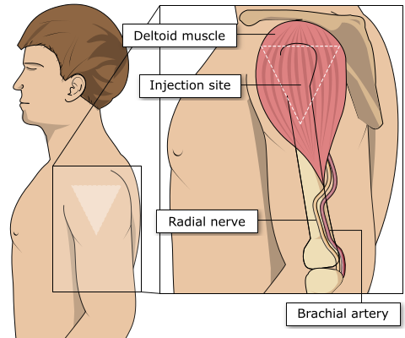
Site of administration
Shingles vaccine should be injected into the deltoid muscle in the upper arm
injecting too high into the upper arm might result in a shoulder injury or a frozen shoulder. This leads to pain, weakness and a limited range of motion that can last for months
injecting too low or too far to the side of the arm risks injecting into the axillary nerve or the radial nerve
to avoid shoulder injury, always assess the limb before administering the vaccine to identify the correct site for injection
Notes:
Shingles vaccine should preferably be injected into the deltoid muscle in the upper arm (or anterolateral aspect of thigh if not possible to use the deltoid muscle)
Injecting too high into the upper arm might result in the vaccine being deposited in the shoulder capsule rather than the deltoid muscle.
This can cause inflammation that can lead to a shoulder injury or a frozen shoulder leading to pain, weakness and a limited range of motion that can last for months.
Injecting too far to the side of the arm or too low on the arm risks injecting into the axillary nerve or the radial nerve.
This can cause a burning or shooting pain during the procedure and can lead to nerve damage (neuropathy/paralysis).
To avoid shoulder injury, the limb should be assessed before administering the vaccine to identify the correct site for injection.

Slide 45
Reporting suspected adverse reactions
Serious suspected adverse reactions to Zostavax and Shingrix should be reported to the Medical and Healthcare products Regulatory Agency (MHRA) using the Yellow Card reporting scheme
Yellow Card scheme
voluntary reporting system for suspected adverse reaction to medicines/vaccines
success depends on early, complete and accurate reporting
report even if uncertain about whether vaccine caused condition
reporting site for the Yellow Card scheme
see chapter 8 of Green Book for details
Notes:
Healthcare professionals and patients are encouraged to report suspected adverse reactions to the Medicines and Healthcare products Regulatory Agency (MHRA) using the yellow card reporting scheme

Slide 46
The national shingles immunisation programme

Slide 47
Vaccine coverage
since the introduction of the Shingles vaccination programme in 2013 there has been a year on year decline in vaccine uptake
efforts to identify and vaccinate all eligible individuals are needed to achieve a continuing reduction in the number of cases of this debilitating and painful condition
all those advising on or administering the shingles vaccine should take every opportunity to offer vaccine to eligible patients as soon as they become eligible to help to protect them from this serious illness
Notes:
Refer earlier slide ‘Shingles vaccine coverage data: England’

Slide 48
Key messages
shingles can lead to a severe painful illness in older people that can persist for several months or even years
the severity of the illness increases with age and those 70 years of age and over are at an increased risk
over 50,000 cases of shingles occur in people aged 70 years and over each year in England and Wales with approximately 50 cases resulting in death
Zostavax is offered routinely to patients 70 to 79 years of age to reduce the incidence and severity of shingles and shingles related complications
Shingrix is available as an alternative vaccine for eligible patients where Zostavax is clinically contraindicated such as immunosuppression
It is important that healthcare professionals encourage and offer vaccination to all eligible patients.

Slide 49
Resources
PHE Immunisation against infectious disease (the Green Book) Shingles (herpes zoster) chapter 28a
PHE Shingles vaccination: guidance for healthcare professionals
PHE Patient Group Direction templates
Notes:
Please note: To open hyperlinks from the slide set, right click on your mouse on the link and select ‘open hyperlink’
PHE and NHS England Letter Shingles immunisation programme: www.gov.uk/government/publications/shingles-immunisation-programme-letter

Slide 50
About Public Health England
Public Health England exists to protect and improve the nation’s health and wellbeing, and reduce health inequalities. We do this through world-leading science, research, knowledge and intelligence, advocacy, partnerships and the delivery of specialist public health services. We are an executive agency of the Department of Health and Social Care, and a distinct delivery organisation with operational autonomy. We provide government, local government, the NHS, Parliament, industry and the public with evidence-based professional, scientific and delivery expertise and support.
Public Health England Wellington House
133-155 Waterloo Road London SE1 8UG Tel: 020 7654 8000 www.gov.uk/phe Twitter: @PHE_uk
Facebook: www.facebook.com/PublicHealthEngland
© Crown copyright 2021 You may re-use this information (excluding logos) free of charge in any format or medium, under the terms of the Open Government Licence v3.0. To view this licence, visit OGL. Where we have identified any third party copyright information you will need to obtain permission from the copyright holders concerned.
Updated August 2021
PHE publications gateway number: GOV-9509

