Slide 1
Mpox vaccination programme and the MVA-BN vaccine
Vaccination in response to an outbreak or incident
Information for healthcare practitioners
Updated March 2025
Notes:
The content of these slides was correct at the time of publishing. Practitioners should always ensure they are accessing the most up to date information and guidance.
Rationale of resource
This resource is designed to support and inform healthcare professionals about mpox disease, the mpox virus, recent epidemiology and case rates (particularly in the UK). This slide set focusses on vaccination response to an outbreak or incident and post-exposure mpox vaccination as per current guidance.
Note: Mpox was previously known as monkeypox.

Slide 2
Note to trainers
this slide set contains a collection of core slides for both individual use and use or adaptation during the delivery of mpox vaccination training. Trainers should select the slides required depending on the background and experience of those they are training and according to the role they will have in mpox vaccination
the information in this slide set was correct at time of publication. Updates to the slide set will be made in response to any changes made to the mpox vaccination programme so please check online to ensure you are using the latest version
please note that this slide set is for use in relation to mpox vaccination during outbreaks and incidents or for vaccination of identified individuals’ following exposure to mpox virus (MPXV). This slide set should not be used for training in relation to the routine mpox immunisation programme
Notes:
The content of these slides was correct at the time of publishing. Practitioners should always ensure they are accessing the most up to date information and guidance.
This resource is designed to train healthcare practitioners involved in delivering vaccination against mpox. Trainers should select the slides they need depending on audience background, role in the programme, length of training session and so on. Some slides may appear repetitive, but this is because trainers are encouraged to use the slides relevant to their audience and should remove any slides which they do not feel are required for their training session.
This resource does not cover the practical aspects of vaccine administration technique. If staff require practical training for this, they should refer to their line manager for additional training.

Slide 3
Pre-requisites and further training requirements
Before administering MVA-BN vaccine, it is recommended that vaccinators should:​
ensure they follow local educational and clinical governance arrangements in relation to knowledge and proficiency to undertake vaccination
discuss their learning needs (including clinical skills and mandatory training) with their employer
undertake statutory and mandatory training as required by their employer, for example infection prevention and control, child protection, safeguarding​, management of anaphylaxis and basic life support and any additional training relevant to the age of people being vaccinated
Suggested pre-requisites include:
core immunisation training
practical training in vaccine preparation and administration​ by the recommended vaccination routes
completion (including sign-off) of a vaccinator competency assessment tool (such as the Immunisation Knowledge and Skills Competence Assessment Tool)
ensuring an appropriate legal framework to supply and/or administer the vaccine is in place, for example a patient specific prescription, Patient Specific Direction (PSD) or Patient Group Direction (PGD)
access to relevant guidance, for example Green Book Smallpox and mpox chapter, UKHSA mpox guidance

Slide 4
Aim and learning outcomes
Aim
  To provide healthcare practitioners involved in mpox vaccination during an outbreak or incident with the requisite background awareness and programme knowledge to support the safe and effective administration of the MVA-BN vaccine
Learning outcomes
By the end of this session, learners should be able to:​
describe the aetiology and recent epidemiology of mpox (both clade I and clade II)
explain the MVA-BN vaccine recommendations for use in an incident/outbreak or post-exposure ​and know where to access current guidance
recall the legal aspects of vaccine administration
state the storage, handling and safe administration requirements of the MVA-BN vaccine

Slide 5
Contents
mpox overview
epidemiology
MVA-BN vaccine
vaccine storage and preparation
vaccine administration
vaccine dosage and schedule
recommendations for the use of MVA-BN vaccine
vaccine precautions, contra-indications and considerations
documentation and post-vaccination information
recommended reading and resources

Slide 6
Significant background information
mpox is a disease caused by infection with the monkeypox virus. Monkeypox virus (MPXV) is related to but distinct from the viruses that cause smallpox (variola virus) and cowpox (vaccinia virus)
there are 2 genetic groups of MPXV: clade I (previously known as Central African or Congo Basin Clade) and Clade II (previously known as West African Clade)
between 2018 and 2022 the UK experienced a small number of clade II cases, all associated with travel to or from countries in west Africa where mpox is endemic and in 2022, a clade II outbreak in England mainly affecting gay, bisexual and other men who have sex with men (GBMSM), resulted in over 3,500 lab confirmed cases in the UK, predominantly in London
in Nov 2023 JCVI recommended that vaccination should be offered to GBMSM at highest risk and following a policy decision, planning is underway to stand up the mpox routine programme in sexual health services across the UK

Slide 7
Significant background information continued.
in August 2024, a public health emergency of internal concern (PHEIC) was declared by WHO following identification of a new clade Ib variant, initially in the Democratic Republic of Congo, which has spread across the African region with cases seen in areas and demographics (primarily children) not previously seen. Cases have also been reported outside of Africa. To date (Dec 24), all clade I cases reported outside of Africa have been associated with travel to affected areas in Africa
separate to a routine vaccination programme, identification of an imported case of MPXV clade I or a cluster/outbreak of mpox may mean Incident Management Teams and/or Health Protection Teams identify individuals or groups who should also be offered vaccination
the third-generation smallpox vaccine, Modified vaccinia Ankara (MVA-BN), is licensed for use against mpox
MVA-BN vaccine does not contain smallpox virus and cannot cause/spread smallpox disease or mpox
ordinarily MVA-BN is administered subcutaneously or off-label intramuscularly; smaller doses (fractional dosing) can be effectively administered via the intradermal route to minimise wastage and during periods of supply constraints

Slide 8
Mpox (formerly monkeypox)

Slide 9
Mpox overview
mpox is a rare disease caused by infection with the monkeypox virus (MPXV)
MPXV is related to, but distinct from the viruses that cause smallpox (variola virus) and cowpox (vaccinia virus), which are all members of the orthopoxvirus family
the name monkeypox originates from the initial discovery of the virus in monkeys in a Danish laboratory in 1958
human mpox was first described in 1970 when regional elimination of smallpox revealed sporadic cases of a disease with similar presentation in rural areas of the Democratic Republic of Congo (DRC)
outbreaks have since occurred in Nigeria, Republic of Congo, Sierra Leone, Liberia, Cameroon and the Central African Republic
following the global eradication of smallpox in 1977, mpox has become the dominant cause of orthopox outbreaks in humans, possibly associated with waning orthopox immunity following cessation of smallpox vaccination

Slide 10
Mpox overview
mpox is a zoonosis – an organism transmitted to humans from animals
the animal host is most likely a rodent, although the definitive reservoir has not been identified
there are 2 genetic groups of MPXV:
  clade I (previously known as Central African or Congo Basin Clade)
  clade II (previously known as West African Clade)
MPXV disease was previously classified as a high consequence infectious disease (HCID) in 2018
in Jan 2023, based on evidence supporting low case fatality rate, and a mild to moderate severity illness, the Advisory Committee on Dangerous Pathogens (ACDP) advised that clade II mpox no longer met the criteria for a HCID
in March 2025, the ACDP assessed the evidence for Clade I mpox and advised that it also no longer met the criteria for a HCID. This means that all mpox (clade I and clade II) is no longer classed as an HCID, but remains a serious infection for some individuals
Notes:
MPXV disease was classified as a high consequence infectious disease (HCID) in 2018 meaning that all cases were managed via HCID pathways in healthcare settings. Evidence supporting low case fatality rate, and a mild to moderate severity illness accumulated for Clade IIb, and in January 2023, and the Advisory Committee on Dangerous Pathogens (ACDP) advised that clade II mpox no longer met the criteria for a HCID. In March 2025, it was announced that the ACDP had recently assessed evidence gathered by UKHSA for Clade I mpox and advised that it also no longer met the criteria of a HCID. It remains a serious infection for some individuals.
There is further information on the HCID status of mpox available.

Slide 11
Mpox transmission
mpox does not spread easily between people without very close contact
the virus is transmitted through:
  skin-to-skin contact
  inhalation of the virus through respiratory droplets
  contact with mucous membranes (eyes, nose, mouth, genitals)
person-to-person spread may occur through:
  direct contact with skin lesions or scabs (including during sexual contact, kissing, cuddling or other skin-to-skin contact)
  close exposure to someone with mpox while they are coughing or sneezing
  contact with clothing or linens (such as bedding or towels) used by an infected person
spread of mpox may also occur when a person comes into close contact with an infected animal, human, or materials contaminated with the virus

Slide 12
Mpox clinical presentation
signs and symptoms
  fever, headache, muscle aches, backache, swollen lymph nodes, chills, exhaustion, joint pain
  1 to 5 days post initial symptoms onset – rash, often beginning on the face, spreading to other parts, including soles of feet, palms of hands, mouth, genitals and anus
  rash is not always widespread (genital lesions only in some cases)
  lesions may be blisters/vesicles, scabs or ulcers
incubation period
  5 to 21 days (typically 6 to 13 days post exposure)

Slide 13
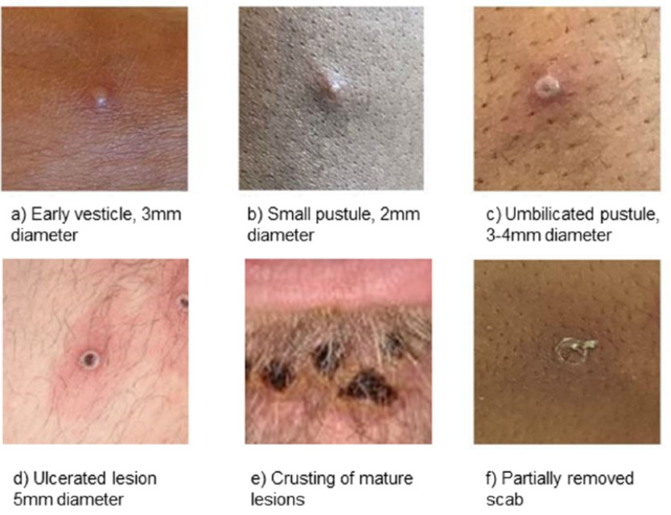
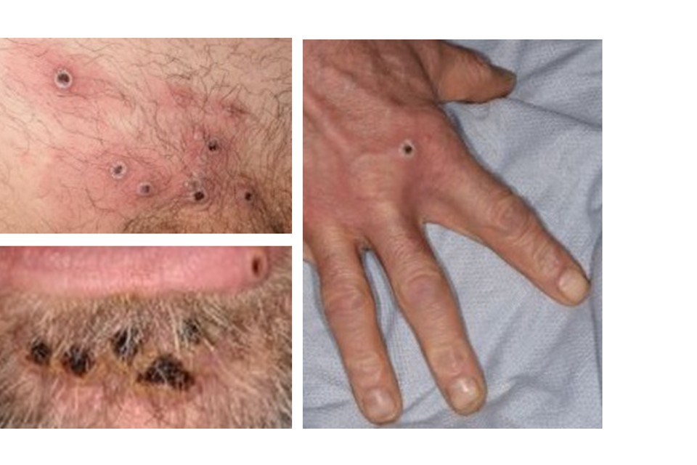
Mpox clinical presentation: rash and lesions
Lesions:
go through several different stages
are usually all at the same phase of development
heal by crusting over and scabbing
resolve within 2 to 4 weeks
Infectious period:
individuals are contagious until all scabs have fallen off leaving intact skin underneath
scabs may also contain infectious virus material
Notes:
Image source: https://www.gov.uk/guidance/monkeypox

Slide 14
Mpox complications
mpox is mostly a mild, self-limiting illness, usually with spontaneous and complete recovery within 3 weeks of onset.
Possible complications:
  multi-organ involvement, with bronchopneumonia, encephalitis and sepsis
  death
the risk of severe disease is higher in young children, pregnant women and severely immunosuppressed individuals

Slide 15
Diagnosis
clinical diagnosis of mpox can be difficult as it is often confused with other infections such as chickenpox
case definitions for possible, probable, highly probable and confirmed cases have been developed, along with guidance on infection control
a definite diagnosis of mpox requires assessment by a health professional and specific testing in a specialist laboratory
samples from individuals testing positive for MPXV must be sent for clade differentiation as part of ongoing surveillance and management of risk to the UK from mpox. In England, this is available from the UKHSA Rare and Imported Pathogens Laboratory (RIPL)
Notes:
More information is available on the mpox guidance pages (https://www.gov.uk/guidance/monkeypox) and the mpox collection page (https://www.gov.uk/government/collections/monkeypox-guidance)
Infection specialists may wish to discuss possible mpox cases with the UKHSA Imported Fever Services (IFS) on 0844 778 8990 for clinical advice, for example in a patient who is severely immunocompromised, paediatric, pregnant or from a high risk setting such as shared accommodation.

Slide 16
Mpox treatment
mainly supportive
mpox is usually mild to moderate and most of those infected will recover within a few weeks without treatment
antivirals (such as cidofovir or tecovirimat) can be used to treat severe disease (or those at risk of severe disease)
people vaccinated against smallpox in childhood may experience a milder disease

Slide 17
Mpox epidemiology

Slide 18
Mpox epidemiology in the UK: clade II
between 2018 and 2021, 7 cases of mpox (4 imported, 2 household contacts and one healthcare worker caring for an imported case) were seen in the UK – all clade II and associated with travel to or from countries in West Africa where mpox is endemic
rapid diagnosis, isolation, care of cases in HCID centres and quarantine/surveillance of close contacts limited further spread
post-exposure vaccination of contacts was advised
no serious consequences of disease occurred
prior to 2022, no documented community transmission of mpox had been observed in the UK
in May 2022, domestically acquired mpox cases, largely affecting gay, bisexual and other men who have sex with men (GBMSM) led to declaration of a national incident
in June 2022 an outbreak response pre-exposure vaccination programme targeting GBMSM at higher risk was introduced through sexual health services
by 31 December 2022, 3,732 confirmed and highly probable cases had been detected in the UK, mainly in males under 45 years of age in London – all clade II
no reported deaths in the UK but significant morbidity in the majority of those admitted to hospital for clinical care, including severe pain and complications due to secondary bacterial infection
following behaviour modification and vaccination, the outbreak declined by September 2022, with low levels of cases continuing, both domestic and travel associated (286 cases between 1 January 2023 and 31 July 2024)
Notes:
Source:

Slide 19
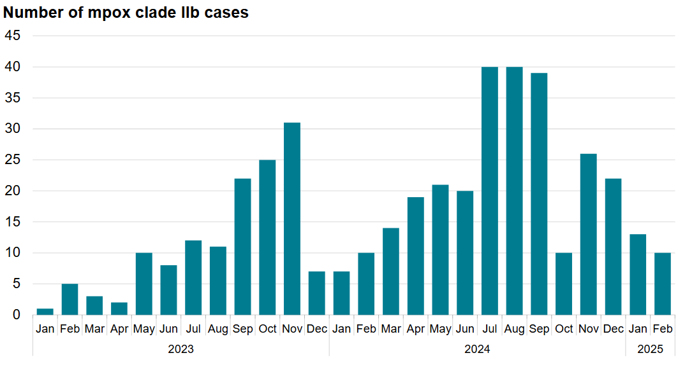
Mpox epidemiology in the UK: clade II
graph shows the monthly number of cases in England in 2023 to 2025, where there were between one and 41 cases per month, (compared to the monthly high of 1,339 cases in Jul 2022)
updated data is published regularly and available on the mpox outbreak: epidemiological overview webpage
Number of confirmed and highly probable clade IIb cases in England by month in 2023 to 2025
Notes:
Source: Mpox epidemiological overview: https://www.gov.uk/government/publications/monkeypox-outbreak-epidemiological-overview

Slide 20
Mpox epidemiology: clade I outbreak
2023: DRC reported geographical expansion of mpox cases, the highest annual number of MPXV clade I cases yet and the first report of sexually transmitted MPXV clade I.
2024: case rates in DRC increased further, including cases in female sex workers.
New MPXV clade Ib variant identified.
MPXV clade I cases reported in East Africa (previously only seen in Central Africa), including in children and heterosexual individuals.
13 Aug 24: mpox public health emergency of international concern declared.
15 Aug 24: first case of MPXV clade Ib in Europe reported in an individual in Sweden who had recently returned from an area of Africa experiencing large numbers of cases.
23 Aug 24: first case of MPXV clade Ib in Asia reported in an individual in Thailand who had recently returned from an affected African country.
Sept 24: first confirmed MPXV clade Ib case in India (following recent travel to UAE but not to the affected countries in Africa).
as of 6 March 25, there have been 10 cases in England, of which all cases have direct or indirect links to travel to countries where mpox clade Ib is circulating. Further cases with travel links to affected areas are expected to occur
Notes:
DRC: Democratic Republic of Congo
Clade I treatment, management and response includes all clade I variants, including clade Ib.

Slide 21
Modified vaccinia Ankara (MVA-BN) vaccine

Slide 22
Smallpox vaccines
First and second generation live smallpox vaccines have historically been used for population-level and targeted occupational health-related immunisation programmes for smallpox in the UK.
These vaccines are no longer available in the UK and have been replaced by newer, third generation smallpox vaccines, including the modified vaccinia Ankara (MVA-BN) which have a much-improved safety profile.
MVA-BN vaccine licensed in Europe (as Imvanex®) by the European Medicines Agency EMA for the prevention of smallpox in 2013.
September 2019: the US Food and Drug Administration (FDA) approved MVA-BN vaccine (known in US as Jynneos®) for the prevention of mpox as well as smallpox.
September 2022: MVA-BN vaccine approved by the Medicines and Healthcare products Regulatory Agency (MHRA) for immunisation against mpox (regardless of MPXV clade).
September 2024: MVA-BN license extended by EMA in Europe to include vaccination against mpox and for adolescents from 12 years of age.
MVA-BN vaccine has been used in the UK in response to previous mpox incidents.

Slide 23
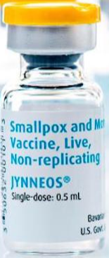
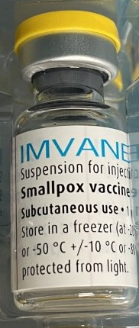
MVA-BN vaccine
product name: Imvanex® (European brand name) or Jynneos® (US brand name)
vaccine type: live modified vaccinia Ankara (MVA) vaccine
manufacturer: Bavarian Nordic (BN)
pharmaceutical form: suspension for injection (light yellow to pale white, milky suspension)
route and volume: 0.5ml intramuscular (IM) or subcutaneous (SC). Fractional doses of 0.1ml intradermally (ID) during periods of supply constraints as per the Green Book chapter 29
presentation: 0.5ml vial
storage: after thawing, store for up to 8 weeks at 2°C to 8°C in the original package to protect from light
Notes:
* Most vaccines are given by intramuscular (IM) injection (see chapter 4), but the MVA-BN Summary of Product Characteristics (SmPC) advises that the vaccine should be administered by the deep sub-cutaneous (SC) route. As there is published evidence suggesting an adequate immunological response (Vollmar et al, 2006) and extensive experience of using MVA containing vaccines given by the IM route, UKHSA advised that intra-muscular administration is an acceptable alternative. For adults, the preferred sites for both IM and SC immunisation is the deltoid area of the upper arm; for small children the anterolateral aspect of the thigh is preferred
Storage: MVA-BN is supplied frozen in packs of 20 vials. The remaining shelf life at clinic level will depend on previous storage temperature, please refer to documentation on the product. Frozen vials should be transferred to 2°C to 8°C to thaw or may be thawed for 15 minutes at room temperatures for immediate use. After thawing, vaccine can be stored for up to 8 weeks at 2°C to 8°C. Store in the original package in order to protect from light. Where fractional doses are being used (see below), the contents of the vial can remain at room temperature for up to one hour whilst the 5 doses are used. Each dose should be drawn up and given immediately.
During the 2022 mpox incident, both Imvanex and Jynneos were supplied for use in the UK depending on availability

Slide 24
MVA-BN vaccine product excipients
Active ingredient: Modified Vaccinia Ankara – Bavarian Nordic Live virus
Other ingredients:
trometamol
sodium chloride
water for injections
Trace residues of chicken protein, benzonase, gentamicin and ciprofloxacin may also be present from the manufacturing process
Notes:
Although the vaccine contains live modified vaccinia Ankara virus, the vaccine virus has been modified so that it does not replicate in humans so it should be considered as an inactivated vaccine

Slide 25
MVA-BN vaccine
the virus used in the vaccine is attenuated (weakened) through multiple passages (repeated growth cycles of the cells on a culture) in chicken embryo fibroblast cells
this leads to a substantial loss of its genome (genetic information) and many of the known immune evasion (ability to avoid detection by the immune system) and virulence (ability of the virus to cause damage in the body) factors are not encoded
in human and animal studies, it demonstrates very limited replication capability and low neuropathogenicity, while retaining immunogenic properties, including protective immune responses against a variety of orthopoxviruses
as MVA-BN cannot replicate in mammalian cells, it does not produce a lesion at the site of vaccination
the vaccine virus has been modified so that it does not replicate in humans and it should be considered as an inactivated vaccine

Slide 26
MVA-BN vaccine efficacy and use
Estimates of real-world vaccine effectiveness (VE) in preventing mpox infection have been mainly generated during the 2022 outbreak and reviewed in meta-analyses. In these studies:
VE was estimated to be around 76% and 82% respectively for one and 2 doses of MVA-BN vaccine
there was some uncertainty about whether VE is affected by immune competence (for example living with HIV or an immunocompromising condition may lower it)
Studies also suggest durability of immunity, with duration of protection of 5 years for one dose and 10 years for 2 doses of vaccine, fitting best with the observed data in 2023.
Notes:
Source and further information: The Green Book chapter 29
Berry MT, Khan SR, Schlub TE, Notaras A, Kunasekaran M, Grulich AE, MacIntyre CR, Davenport MP, Khoury DS. Predicting vaccine effectiveness for mpox. Nat Commun. 2024 May 8;15(1):3856. doi: 10.1038/s41467-024-48180-w
Mason LMK, Betancur E, Riera-Montes M, Lienert F, Scheele S. MVA-BN Vaccine Effectiveness: A Systematic Review of Real-World Evidence in Outbreak Settings. medRxiv 24306078, 2024 April 26 Doi.org/10.1101/2024.04.25.24306078.
Pischel L, Martini BA, Yu Y, Cacesse D, Tracy M, Kharbanda K, Ahmed N, Patel K, Grimshaw AA, Malik AA, Goshua G, Omer SB. Vaccine effectiveness of 3rd generation mpox vaccines against mpox infection and disease severity: A systematic review and meta-analysis. Vaccine, 2024 https://doi.org/10.1016/j.vaccine.2024.06.021
Charles H, Thorley K, Turner C, et al. Post-peak mpox in England: epidemiology, reinfection, and vaccine effectiveness – data from 2023. medRxiv 2024 24303362 [accessed 2024 June 18] https://www.medrxiv.org/content/10.1101/2024.02.26.24303362v1
Yeganeh N, Yin S, Moir O, Danza P, Kim M, Finn L, Fisher R, Kulkarni S, Perez M, Poortinga K, Garland W, Foo C, Haddix M, Archer R, Frey N, Balter S, Singhal R, Kim A. Effectiveness of JYNNEOS vaccine against symptomatic mpox disease in adult men in Los Angeles County, August 29, 2022 to January 1, 2023. Vaccine. 2024 Aug 13;42(20):125987. Doi.org/10.1016/j.vaccine.2024.05.035.
Dalton AF, Diallo AO, Chard AN, Moulia DLet al. Estimated Effectiveness of Jynneos Vaccine in Preventing Mpox: A Multijurisdictional Case-Control Study — United States, August 19, 2022-March 31, 2023. MMWR Morb Mortal Wkly Rep. 2023 May 19;72(20):553-558. Doi.org/10.15585/mmwr.mm7220a3. www.cdc.gov/mmwr/volumes/72/wr/pdfs/mm7220a3-H.pdf
Guagliardo SA, Kracalik I, Carter RJ, Braden C, Free R, Hamal M, Tuttle A, McCollum AM, Rao AK. Monkeypox Virus Infections After 2 Preexposure Doses of JYNNEOS Vaccine — United States, May 2022–May 2024. MMWR Morb Mortal Wkly Rep 2024;73:460– 466.
Hazra A, Zucker J, Bell E, et al. Mpox in people with past infection or a complete vaccination course: a global case series. Lancet Infect Dis. 2024 Jan;24(1):57-64. doi.org/10.1016/S1473-3099(23)00492-9
Eustaquio PC, Salmon-Trejo LAT, McGuire LC, Ellington SR. Epidemiologic and Clinical Features of Mpox in Adults Aged >50 Years—United States, May 2022-May 2023. MMWR Morb Mortal Wkly Rep. 2023;72:893-6. www.cdc.gov/mmwr/volumes/72/wr/mm7233a3.htm
Kröger ST, Lehmann MC, Treutlein M, Fiethe A, Kossow A, Küfer-Weiß A, Nießen J, Grüne B. Mpox outbreak 2022: an overview of all cases reported to the Cologne Health Department. Infection. 2023 Oct;51(5):1369-1381. doi: 10.1007/s15010-023-01997-x. Epub 2023 Feb 14. PMID: 36787016; PMCID: PMC9926425.

Slide 27
MVA-BN vaccine efficacy and use post-exposure
There is evidence that although MVA-BN has low effectiveness in preventing infection when given post-exposure, vaccination may modify disease, reducing severe presentations, body regions affected by a rash and/or hospitalisation.
Given the relatively short incubation period, any protection that is made is likely only where vaccine is given at a short interval after exposure.
To maximise the chance of preventing infection, MVA-BN should be administered within 4 days from the date of exposure to MPXV.
Notes:
Source and further information: The Green Book chapter 29
Pittman PR, Hahn M, Lee HS, Koca C, Samy N, Schmidt D and others. ‘Phase 3 efficacy trail of modified vaccinia ankara as a vacine against smallpox.’ 2019, New England Journal of Medicine 2019: volume 381, pages 1,897 to 1,908
Hazra A, Zucker J, Bell E, et al. Mpox in people with past infection or a complete vaccination course: a global case series. Lancet Infect Dis. 2024 Jan;24(1):57-64. doi.org/10.1016/S1473-3099(23)00492-9
Merad Y, Gaymard A, Cotte L, et al. Outcomes of post-exposure vaccination by modified vaccinia Ankara to prevent mpox (formerly monkeypox): a retrospective observational study in Lyon, France, June to August 2022. Euro Surveill. 2022 Dec;27(50):2200882. doi.org/10.2807/1560-7917.ES.2022.27.50.2200882.
Thy M, Peiffer-Smadja N, Mailhe M, Kramer L, Ferré VM, Houhou N, Tarhini H, Bertin C, Beaumont AL, Garé M, Le Pluart D, Perrineau S, Rahi M, Deconinck L, Phung B, Mollo B, Cortier M, Cresta M, De La Porte Des Vaux C, Joly V, Lariven S, Rioux C, Somarriba C, Lescure FX, Charpentier C, Yazdanpanah Y, Ghosn J. Breakthrough Infections after Postexposure Vaccination against Mpox. N Engl J Med. 2022 Dec 29;387(26):2477-2479. doi.org/10.1056/NEJMc2211944.
Bertran M, Andrews N, Davison C, Dugbazah B, Boateng J, Lunt R, Hardstaff J, Green M, Blomquist P, Turner C, Mohammed H, Cordery R, Mandal S, Campbell C, Ladhani SN, Ramsay M, Amirthalingam G, Bernal JL. Effectiveness of one dose of MVA-BN smallpox vaccine against mpox in England using the case-coverage method: an observational study. Lancet Infect Dis. 2023 Jul;23(7):828-835. doi.org/10.1016/S1473-3099(23)00057-9.
Rosen JB, Arciuolo RJ, Pathela P, Boyer CB, Baumgartner J, Latash J, Malec L, Lee EH, Reddy V, King R, Edward Real J, Lipsitch M, Zucker JR. Jynneos™ effectiveness as post-exposure prophylaxis against mpox: Challenges using real-world outbreak data. Vaccine. 2024 Jan 25;42(3):548-555. doi.org/10.1016/j.vaccine.2023.12.066

Slide 28
MVA-BN vaccine storage and preparation

Slide 29
MVA-BN vaccine storage
MVA-BN vaccine is supplied frozen in packs of 20 vials
MVA-BN vaccine will be shipped from UKHSA storage sites frozen at -20°C
remaining shelf life at clinic level will depend on previous storage temperature so refer to documentation on the product
the vaccine should be stored at -20°C upon receipt to keep the expiry date longer but if -20°C storage is not available, frozen vials should be stored straight away in the fridge at 2°C to 8°C to thaw (or may be thawed for approx. 15 mins at room temperature for immediate use)
after thawing at 2°C to 8°C, MVA-BN vaccine can be stored at this temperature for up to 8 weeks; add a post-thaw expiry label
do not re-freeze a vial once it has been thawed
store in original packaging to protect from light
do not use after expiry date shown on the vial label or after the 8-week post-thaw expiry date (whichever is sooner)
vials used to deliver multiple doses (up to 5 doses) through fractional intradermal administration must be used within one hour of removal from fridge
Notes:
Storage information is also available in the produce information as well as the Green Book chapter: https://www.gov.uk/government/publications/smallpox-and-vaccinia-the-green-book-chapter-29
and the PGD: https://www.gov.uk/government/publications/smallpox-vaccine-pgd-template

Slide 30
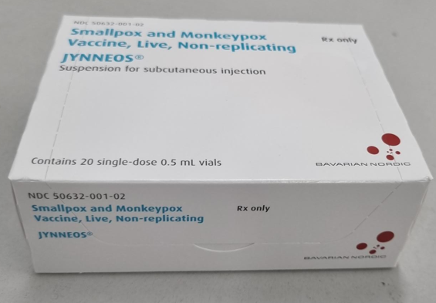
MVA-BN vaccine preparation
MVA-BN vaccine is supplied in packs containing 20 single dose vials (0.5ml in each)
once the frozen vaccine has been thawed, it is a light yellow to pale white milky suspension for injection
the vaccine should be allowed to reach room temperature before use
swirl vial gently before use for at least 30 seconds
visually inspect the suspension prior to administration
if particles, discolouration and/or abnormal appearance are seen, the vaccine should be discarded
administration is usually via the subcutaneous or intramuscular route (0.5ml)
during periods of supply constraint, a fractional dose may be administered by the intradermal route (0.1ml)
Notes:
Image of Jynneos packaging (US branded MVA-BN vaccine) supplied by Bavarian Nordic

Slide 31
Fractional dosing of MVA-BN vaccine
during the 2022 clade II mpox incident in the UK, following the emergency use approval by the US Food and Drug Administration, in Sept 2022 JCVI endorsed the use of a fractional dose (0.1ml) of MVA-BN vaccine given by intradermal injection during periods of supply constraints
studies show that a 0.1ml dose administered intradermally to immunocompetent adults appears to be immunologically non-inferior (comparable) to a 0.5ml subcutaneous dose
fractional dosing therefore maximised the number of doses that could be administered without compromising immunity during periods of supply constraints
Notes:
JCVI statement on vaccine dose prioritization in response to the monkeypox outbreak: https://www.gov.uk/government/publications/monkeypox-outbreak-jcvi-statement-on-vaccine-dose-prioritisation-september-2022/jcvi-statement-on-vaccine-dose-prioritisation-in-response-to-the-monkeypox-outbreak
Source and further information: The Green Book chapter 29
Frey SE, Wald A, Edupuganti S, et al. Comparison of lyophilized versus liquid modified vaccinia Ankara (MVA) formulations and subcutaneous versus intradermal routes of administration in healthy vaccinia-naïve subjects. Vaccine 2015;33:5225-5234.
Brooks JT, Marks P et al. Intradermal Vaccination for Monkeypox — Benefits for Individual and Public Health. The New England Journal of Medicine 2022; DOI: 10.1056/NEJMp2211311, www.nejm.org/doi/full/10.1056/NEJMp2211311
Dalton AF, Diallo AO, Chard AN, Moulia DLet al. Estimated Effectiveness of Jynneos Vaccine in Preventing Mpox: A Multijurisdictional Case-Control Study — United States, August 19, 2022-March 31, 2023. MMWR Morb Mortal Wkly Rep. 2023 May 19;72(20):553-558. Doi.org/10.15585/mmwr.mm7220a3. www.cdc.gov/mmwr/volumes/72/wr/pdfs/mm7220a3-H.pdf

Slide 32
MVA-BN vaccine preparation - additional requirements for fractional dosing
fractional dosing is the administration of smaller volumes of the vaccine taken from a single dose vial. Each MVA-BN single dose vial will yield a maximum of 5 x 0.1ml doses. These smaller doses should only be administered vial the intradermal route
only complete 0.1ml doses should be administered; in some cases, only 4 x 0.1ml doses can be extracted from each vial so using a low dead-space volume syringe increases the likelihood of obtaining 5 doses from each vial
if the vial yields less than 5 full doses then any residual volume of less than 0.1ml should be discarded; pooling of residual volume from several vials is not permitted
vials of vaccine used for fractional dosing are subject to additional preparation and handling requirements - follow the guidance in the Green Book, chapter 4, Immunisation procedures on the use of multi-dose vials

Slide 33
MVA-BN vaccine preparation - additional requirements for fractional dosing (cont.)
once a vial of thawed vaccine is removed from the fridge, note the time, swirl the contents and withdraw the first 0.1ml dose
the contents of the vial can remain at room temperature for up to one hour whilst the 5 doses are used; each dose should be given immediately once drawn up
appropriate infection control and aseptic techniques should be used at all times; this is particularly important when using multi-dose vials and even more so when a single-dose vial is being used as a multi-dose vial; use a new sterile syringe and needle for each separate dose drawn from the vial
to minimise the risk of coring, as far as is practicable pierce the bung in a different place each time a dose is being drawn up; inspect the contents before every withdrawal and discard the vial if particulates are present (as this may indicate coring of the bung has taken place)
discard vaccine promptly after one hour has elapsed to avoid accidental administration of time-expired vaccine

Slide 34
MVA-BN vaccine fractional dosing: operational considerations of intradermal administration
Fractional dosing by intradermal administration may be considered for administration to eligible individuals during periods of supply constraints, however appropriate operational considerations and planning are required to maximise safety and to minimise vaccination errors and vaccine wastage.
Staff must have received specific, appropriate training to administer vaccine via the intradermal route.
Stability data only supports use of the contents of the vial within one hour of removal from the fridge; the vial can remain at room temperature during this time but adhering to this time limit will minimise the risk of microbial contamination/proliferation. Once the vial is removed from cold storage, the time should be recorded as the vial contents will need to be used as quickly as possible. Any doses remaining after one hour will need to be discarded.
In order to avoid cycling temperature and to adhere to these recommendations therefore, fractional dosing is only useful in high throughput clinics.

Slide 35
MVA-BN vaccine administration

Slide 36
Infection control considerations for vaccination clinics
pre-exposure vaccination should be managed in the same way as routine vaccination using standard infection prevention and control (IPC) precautions
for post-exposure vaccination, guidance on mpox: reducing risk of transmission at vaccination clinics should be followed in conjunction with the national IPC manual

Slide 37
Consent
before giving any vaccine, vaccinators must ensure that they have obtained informed consent from the vaccinee
to enable valid consent, the vaccinee should receive an explanation of disease against which the vaccine protects as well as the benefits and risks of vaccination (either verbally from a clinician, or in the form of a leaflet or letter)
vaccinators should be familiar with the principles of consent for immunisation as described in chapter 2 of the Green Book
a consent form and healthcare professional pre-vaccination checklist (including a parental/carer consent form) are available
the UKHSA intradermal leaflet should be provided to individuals being offered an intradermal dose
further information on prescriber responsibilities for off-label or unlicensed medicines is available, including in the PGD

Slide 38
Legal frameworks for MVA-BN vaccine administration
use of MVA-BN for vaccination against mpox may be via a prescription, Patient Specific Direction (PSD) or a Patient Group Direction (PGD), depending on the vaccine being supplied and the route of administration
Imvanex® is UK licensed and Jynneos® (US licensed Batch FDP00072) has been approved for use in the UK by the MHRA
where Jynneos® is the local vaccine available at time of administration, the PGD only enables the use of Jynneos® vaccine: batch number FDP00072 (expiry date 31 July 2025)
if there are any programme changes, these may not be immediately reflected in the PGD so a prescription or PSD should be used in the interim
Notes:
While Imvanex® is the name of the European product, Jynneos® is the name of the US-licensed version, both of which are developed by Bavarian Nordic
To ensure sufficient vaccine was available, Jynneos® was urgently procured in the UK to manage the 2022 clade II mpox outbreak the MHRA granted a ‘batch specific variation’ for the FDP00072 batch (expiry date 31 July 2025) of Jynneos® which enabled importation into the UK for use. This is the only batch of Jynneos® that can be used under the national mpox vaccine PGD. Any batch of Imvanex® can be used under the PGD

Slide 39
Preparation and administration
Appropriate infection control and aseptic techniques should be used at all times and is particularly important when using multi-dose vials (for example when administering fractional doses).
The following guidance regarding preparation of the vaccination site applies irrespective of the route used for administration:
  if the skin is clean, no further cleaning is necessary. Only visibly dirty skin needs to be cleaned. It is not necessary to disinfect the skin (the green book, chapter 4)
  routine use of gloves for immunisation is not recommended; follow national IPC guidance

Slide 40
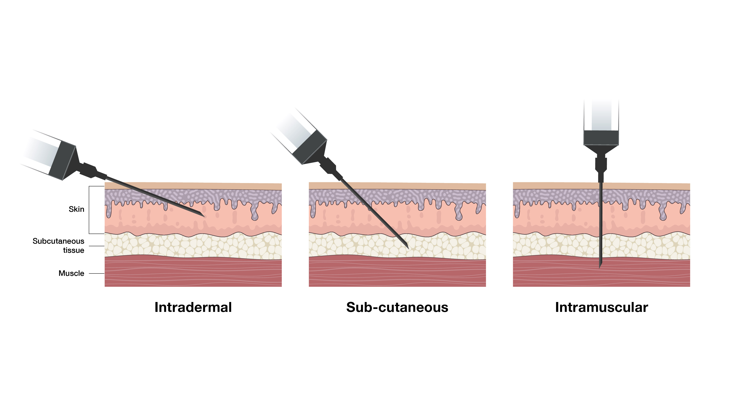
MVA-BN vaccine administration – intradermal, subcutaneous and intramuscular technique
MVA-BN vaccine administration is usually via the subcutaneous or intramuscular route (0.5ml)
during periods of supply constraint a fractional dose may be administered by the intradermal route (0.1ml)
the required needle insertion angle and depth of tissue penetration for each technique is different
additional training is required for intradermal injection

Slide 41
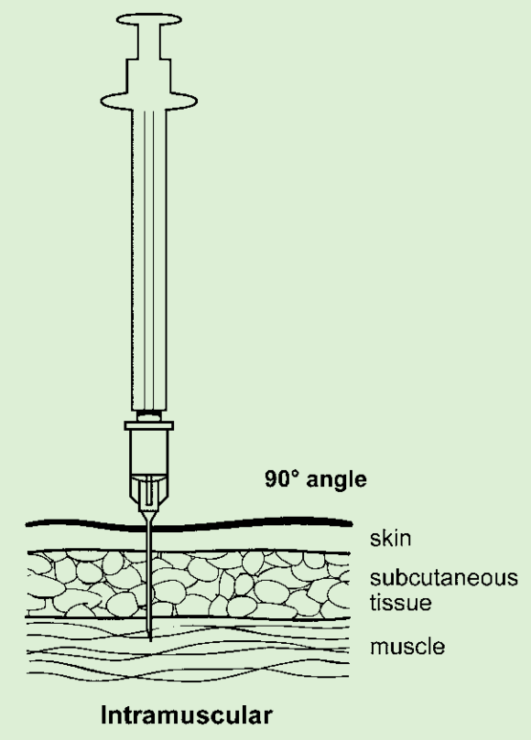
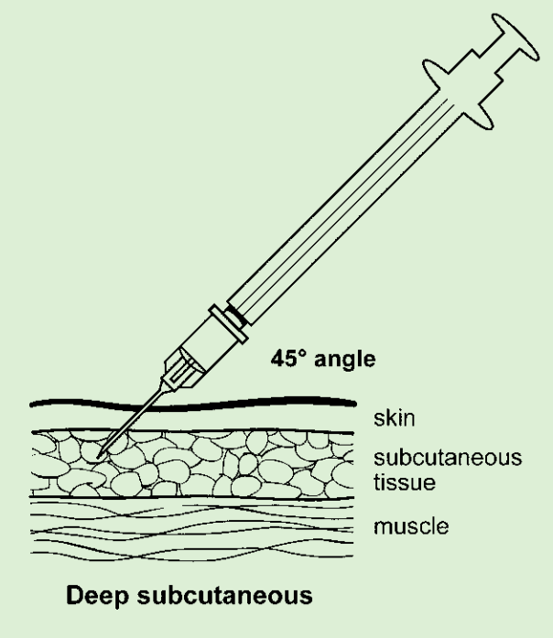
MVA-BN vaccine – intramuscular (IM) or subcutaneous (SC) administration
the MVA-BN Summary of Product Characteristics (SmPC) advises that the vaccine should be administered by the deep SC route
as there is published evidence suggesting an adequate immunological response and extensive experience of using MVA-containing vaccines given by the IM route, UKHSA advised that IM administration is an acceptable alternative
for adults, the preferred sites for both IM and SC immunisation is the deltoid area of the upper arm; for small children the anterolateral aspect of the thigh is preferred
IM injections should be given with the needle at a 90° angle to the skin and the skin should be stretched, not bunched
deep SC injections should be given with the needle at a 45° angle to the skin and the skin should be bunched, not stretched
vaccinators should be familiar with the information about vaccine administration in the Green Book chapter 4
Notes:
Image source: chapter 4 of the Green Book: https://www.gov.uk/government/publications/immunisation-procedures-the-green-book-chapter-4

Slide 42
MVA-BN vaccine – fractional dosing and intradermal (ID) administration
During periods of supply constraint, a fractional dose (0.1ml) ID injection for MVA-BN may be administered:
  over the area of the deltoid muscle (the same site recommended for BCG, see Green Book chapters 32 and 4)
  on the volar aspect (palm side) of the forearm around 2 to 4 inches (5 to 10cm) below the ante-cubital fossa (the same site as normally used for Mantoux testing)
Although the initial study in the USA was conducted using the forearm site, other vaccines (including influenza and rabies) have been tested with fractional intradermal dosing over the area of the deltoid muscle, which has been found to be the more acceptable site for healthcare practitioners and vaccinees in pilot site studies.
If an individual is due to have BCG, preferably avoid using the left deltoid as this is the usual site for BCG injection. Additionally, if BCG has been given in the last 3 months, a different limb should be used for any other vaccination, including MVA-BN vaccine.

Slide 43
Indications for fractional dosing and intradermal administration of MVA-BN vaccine
MVA-BN vaccine should preferably be given SC or IM (except in local outbreaks or during supply constraints when ID fractional doses may be given).
Intradermal administration is only suitable for immunocompetent adults so is not recommended for individuals who are immunosuppressed (as defined in the Green Book chapter 7).
ID administration is also not recommended for individuals with a history of keloid scarring.
Administration of MVA-BN vaccine in children and young people under 18 years should ideally be through the subcutaneous or intramuscular route as there is no evidence on the use of intradermal fractional doses in children (although the exception is where wider vaccination is being offered in a localised outbreak setting and during supply constraints, when intradermal fractional doses may be given).
NB: individuals living with HIV who are virally suppressed and have a CD4 count of more than 200 cells/mm³ are not considered immunosuppressed for the purposes of this guidance and may receive MVA-BN vaccine intradermally.

Slide 44
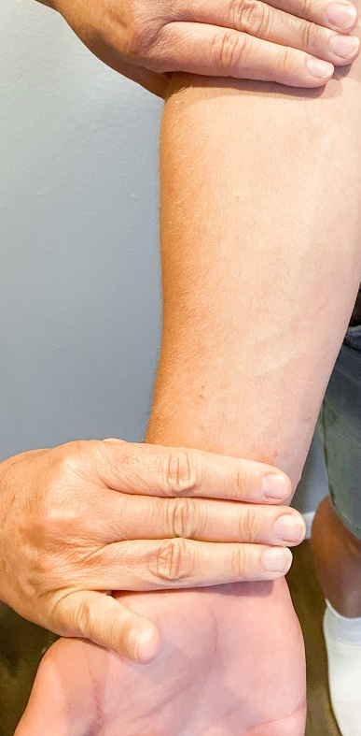
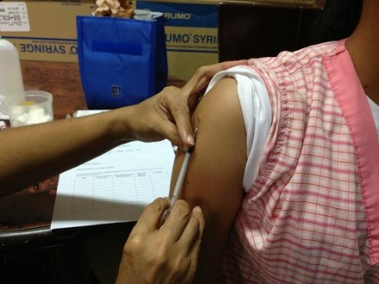
Intradermal injection sites
Volar aspect (palm side) of the forearm, around 2 to 4 inches (5 to 10cm) below the ante-cubital fossa
Intradermal injection in the deltoid area

Slide 45

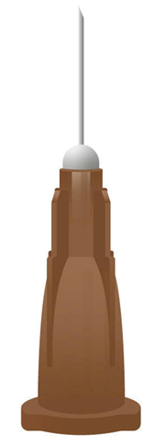
Intradermal injection and needle selection
It is recommended that the following are used to correctly administer the MVA-BN vaccine intradermally:
a 1ml graduated syringe
a 25G or 26G needle between 9 and 12mm in length, ideally with a short bevel
The Green Book chapter 4.

Slide 46
MVA-BN vaccine – intradermal administration
the needle must be attached firmly and the intradermal injection administered with the bevel facing up
the immuniser should stretch the skin between the thumb and forefinger of one hand and with the other slowly insert the needle, with the bevel upwards, about 3mm into the superficial layers of the dermis almost parallel with the surface
the needle can usually be seen through the epidermis
a correctly given intradermal injection results in a tense, blanched, raised of around 7mm diameter following a 0.1ml intradermal injection
if little resistance is felt when injecting and a diffuse swelling occurs as opposed to a tense blanched bleb, the needle is too deep - if this occurs, the needle should be withdrawn and the full dose repeated immediately at least 5cm away from the original site

Slide 47
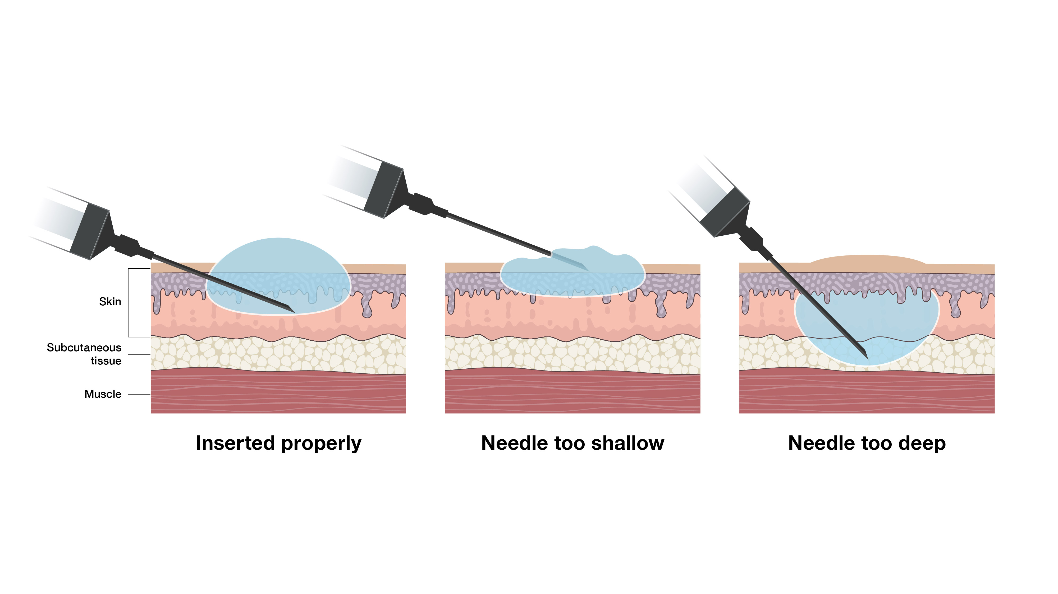
Intradermal administration – technique
The skin should be stretched between the thumb and forefinger of one hand, the needle slowly inserted with the other hand, bevel upwards, about 3mm into the superficial layers of the dermis almost parallel with the surface; the needle can usually be seen through the epidermis.
A correctly given intradermal injection results in a tense, blanched, raised bleb of around 7mm diameter following a 0.1ml intradermal injection.
If little resistance is felt when injecting and a diffuse swelling occurs as opposed to a tense blanched bleb, the needle is too deep.

Slide 48
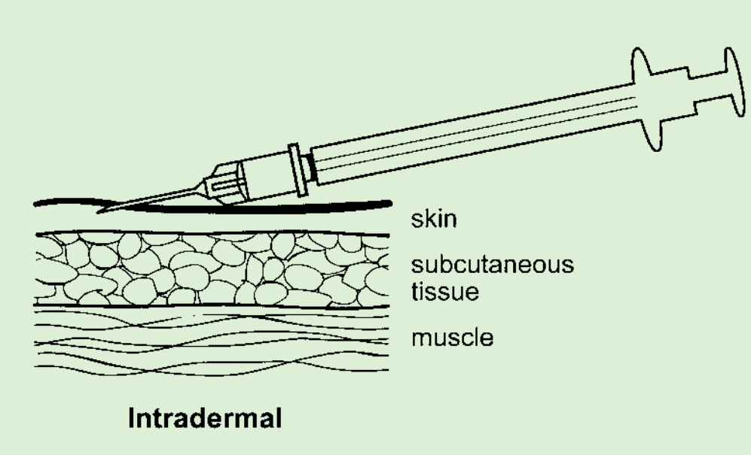
Intradermal injection – technique
Photograph of injection bleb
source: CDC Public Health Image Library(PHIL)
Notes:
Image source: chapter 4 of the Green Book: https://www.gov.uk/government/publications/immunisation-procedures-the-green-book-chapter-4

Slide 49
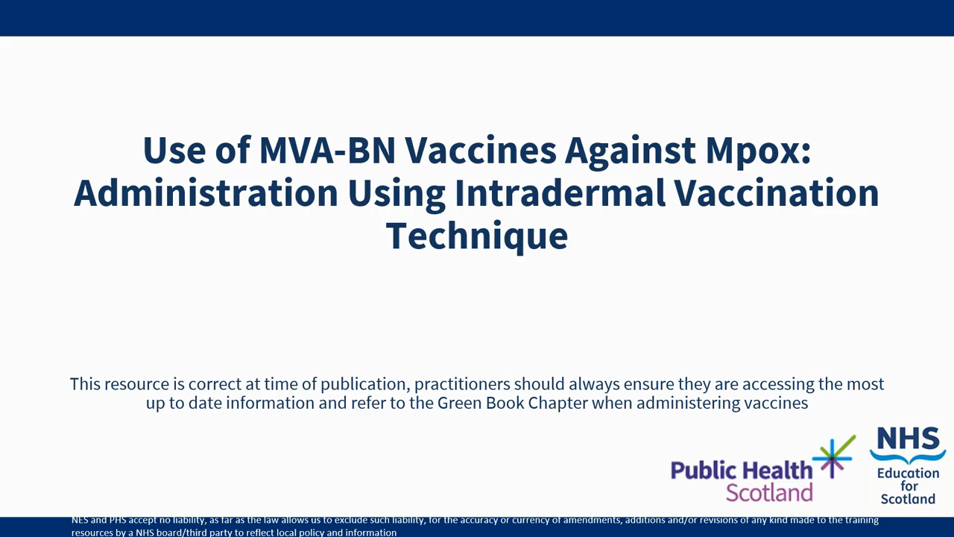
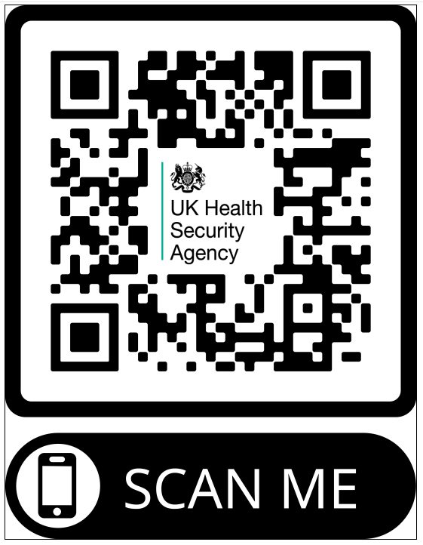
Intradermal injection – technique
Reproduced with kind permission of Public Health Scotland
Also available on the UKHSA
Mpox vaccination guidance page
Notes:
The video is available on the Health Publications website : https://www.healthpublications.gov.uk/ViewArticle.html?sp=Sintradermalinjectiontechniqueformvabnvaccinesagainstmpox

Slide 50
MVA-BN dosage and schedule

Slide 51
Mpox vaccination dosage and schedule: routine pre-exposure vaccination
The dosage and schedule for mpox vaccination using MVA-BN will vary depending on previous vaccination history and why an individual is being vaccinated.
Information on the rationale for vaccination is in the ‘recommendations for the use of the MVA-BN vaccine’ section
pre-exposure vaccination of individuals previously not vaccinated against smallpox is a course of 2 doses of MVA-BN with at least a 28-day interval between doses​
pre-exposure vaccination of individuals previously vaccinated against smallpox is a single dose
when a large cohort needs vaccinating rapidly, priority should be to achieve high first dose coverage in those eligible. This is because in the event of an outbreak or incident, it is highly unlikely that there will be sufficient time to offer pre-exposure vaccination with 2 doses for those at risk of occupational exposure. In this scenario, a single dose of vaccine should be offered immediately. Completion of the primary course with a second dose at least 28 days later should be considered if the individual is in an eligible group with clear ongoing risk of exposure

Slide 52
Recommended schedule for use of MVA-BN
 | Individuals previously not vaccinated against smallpox | Individuals previously vaccinated against smallpox
Immunocompetent individuals (including people with atopic dermatitis)* | 0.5 ml subcutaneous / intramuscular injection OR 0.1ml intradermal injection (during supply constraints) AND 0.5 ml subcutaneous / intramuscular injection any time from 28 days OR 0.1ml intradermal injection at any time from 28 days | 0.5 ml subcutaneous / intramuscular injection OR 0.1ml intradermal injection (during supply constraints)
Individuals who are immunosuppressed adults** and those with a history of keloid scarring | 0.5 ml subcutaneous / intramuscular injection AND 0.5 ml subcutaneous / intramuscular injection at any time from 28 days | 0.5 ml subcutaneous / intramuscular injection
Children under 18 years | 0.5 ml subcutaneous / intramuscular injection*** AND 0.5 ml subcutaneous / intramuscular injection at any time from 28 days*** | 0.5 ml subcutaneous / intramuscular injection
Table from Green Book Smallpox and mpox chapter)
*This includes individuals living with HIV who are virally suppressed and have a CD4 count above 200 cells/mm3
**Immunosuppressed adults as defined in chapter 28a of the Green Book
***0.1ml intradermal vaccination is an acceptable alternative for localized outbreak use in children under 18 years during periods of supply constraints

Slide 53
Mpox vaccination dosage and schedule: post-exposure vaccination (for individuals with known exposure)
post exposure vaccination is a single dose of vaccine unless individuals are assessed to be at ongoing risk (in which case a second dose administered a minimum interval of 28 days after the initial dose is required)
to maximise the chance of preventing infection, MVA-BN should be administered within 4 days from the date of exposure to MPXV, although in certain groups at higher risk of complications (including children (below the age of 5 years), pregnant women and individuals with severe immunosuppression), this may be extended to 14 days from exposure to potentially modify disease
based on current evidence, immunocompetent individuals who have previously received a
2-dose course of MVA-BN, with the second dose given less than 2 years ago, do not need a further dose after an exposure event. If their last dose was given more than 2 years ago, a further dose of vaccine should be offered after a recognised significant exposure. In individuals who are severely immunosuppressed, (as defined in chapter 28a), who may have a lower or less durable immune response, a post-exposure dose can be considered from 6 months after their second dose
Notes:
The green book chapter advises that ‘If in an eligible exposure category, post exposure vaccination with MVA-BN should be given within 4 days of exposure, although it may be offered up to 14 days post exposure to potentially modify disease in those who are at higher risk of the complications of mpox – this includes children (below the age of 5 years), pregnant women and individuals with severe immunosuppression (see chapter 28a). People living with HIV who are virally suppressed and have a CD4 count greater than 200 cells/mm3, are not considered to be severely immunosuppressed for this purpose.’

Slide 54
Mpox vaccination dosage and schedule: vaccination in outbreaks or incidents
post-exposure vaccination of individuals of any age is a single 0.5ml SC/IM dose (or a 0.1ml intradermal dose of MVA-BN where appropriate/indicated)
individuals who are not eligible for routine pre-exposure immunisation against mpox but who have received a single dose of vaccine as a result of community exposure do not need to be offered a second dose as they do not have a foreseeable risk of further exposure to monkeypox and will be past the incubation period from the exposure that warranted post exposure vaccination
in contrast, if unvaccinated individuals who are eligible for pre-exposure vaccination, (for example GBMSM at risk of mpox and certain health care workers) are identified post-exposure, this may be an opportunity to offer a first or second dose of vaccine so completing the 2-dose programme should be considered where possible

Slide 55
Mpox vaccination dosage and schedule: reinforcing doses
There is currently insufficient evidence to support routine boosters in immunocompetent individuals, so a booster dose may only be considered in limited specific circumstances:
where boosting is considered necessary a single dose should be administered at least 2 years after the primary course. If boosting is following a significant exposure a single dose of vaccine should be administered within 4 days
if a booster dose is required, administer 0.5ml SC/IM dose or a 0.1ml ID dose of MVA-BN

Slide 56
Previous incomplete vaccination
The UK vaccination schedules incorporate the minimum intervals between subsequent doses of the same vaccine.
This means, for individuals who have been identified as eligible for a 2-dose course of vaccine:
if the MVA-BN course is interrupted or delayed, it should be resumed
the first dose does not need to be repeated or the course restarted
For individuals eligible for a 2-dose course of vaccine who are being vaccinated post-exposure, this is still the case because those who have been primed with a single dose of MVA-BN should make a more rapid response to a dose given after exposure. Exposed individuals should be given another dose of MVA-BN within the relevant period provided it is at least 28 days since they received their first dose. This post-exposure dose can be considered their completing (second) dose.

Slide 57
Mpox vaccination programme: recommendations for the use of the MVA-BN vaccine

Slide 58
Recommendations for the use of MVA-BN vaccine as a routine pre-exposure vaccination programme
This resource focusses on vaccination post-exposure or during outbreaks and incidents. Routine pre-exposure vaccination is also recommended for adults at high-risk of exposure. The rationale and subsequent recommendations vary due to the different vaccination strategies used for these programmes.
Rationale for routine pre-exposure vaccination
to provide protection to adults at high risk of exposure to mpox or other orthopoxviruses (for example individuals who identify as gay, bisexual or a man who has sex with other men (GBMSM) at high risk of exposure or healthcare staff in specialist roles, as described in the Green Book chapter 29)
Notes:
Routine pre-exposure vaccination may include people at occupational risk of exposure, such as healthcare workers in specialist roles such as labs where pox viruses are handled, staff working in HCID units and those undertakings environmental decontamination around cases of mpox. It is likely that GBMSM at high risk of exposure who attend sexual health services may also be eligible for routine vaccination in due course.
This training slide set is for healthcare practitioners who will be involved in administration of MVA-BN vaccine as an outbreak control measure during an outbreak or incident, or who will be involved in administration of post exposure MVA-BN vaccination.
Routine pre-exposure vaccination is not covered in detail in this slide set. Separate training resources will be available for healthcare practitioners involved in delivery of the routine programme.

Slide 59
Recommendations for the use of MVA-BN vaccine post-exposure (for individuals with known exposure)
Rationale for-post exposure vaccination
to provide protection against infection and to modify disease severity in exposed individuals following an identified exposure
there is growing evidence that post-exposure vaccination has low effectiveness in preventing symptomatic mpox, but vaccination is offered to exposed individuals as it may reduce disease severity
post-exposure vaccination of high-risk community or occupational contacts should be offered to those with the highest exposure risks defined in the mpox contract tracing guidance and the Green Book chapter 29
at the time of publication, vaccine is offered to individuals who have been risk assessed as a category 3 (high risk) exposure to clade I or clade II MPXV, or category 2 exposure to clade I. (However, in periods of severe supply constraints, post exposure vaccination may be restricted to category 3 exposures only)
Notes:
Routine pre-exposure vaccination may include people at occupational risk of exposure, such as healthcare workers in specialist roles such as labs where pox viruses are handled, staff working in HCID units and those undertakings environmental decontamination around cases of mpox. It is likely that GBMSM at high risk of exposure who attend sexual health services may also be eligible for routine vaccination in due course.
This training slide set is for healthcare practitioners who will be involved in administration of MVA-BN vaccine as an outbreak control measure during an outbreak or incident, or who will be involved in administration of post exposure MVA-BN vaccination.
Routine pre-exposure vaccination is not covered in detail in this slide set. Separate training resources will be available for healthcare practitioners involved in delivery of the routine programme.

Slide 60
Recommendations for the use of MVA-BN vaccine post-exposure: exposure category
The mpox contract tracing guidance, Green Book chapter 29 and PGD all provide guidance on post-exposure eligibility. Following assessment, individuals are eligible for post-exposure vaccination if the individual has been risk assessed as a category 3 (high risk) exposure to clade I or clade II MPXV (or, when the supply chain is unaffected, a category 2 (medium risk) exposure to clade I) and either:
they present within 4 days of the last exposure
or
they present within 14 days of the last exposure and are in a group at higher risk of complications, for example they are aged under 5 years, are pregnant or are living with HIV and who have a CD4 count of less than 200 cells per mm³ or are otherwise severely immunosuppressed (as defined in chapter 28a of the Green Book)
or
they present after 4 days, but the ongoing exposure level is high or has increased over the elapsed period since the original exposure
or
an immunocompetent adult presents after 4 days, so are identified too late for effective post exposure intervention. In this situation vaccination should be considered for household members of the exposed individual (to prevent tertiary cases), particularly if the exposure is significant and if the household member is at higher risk of complications (as above)

Slide 61
Recommendations for the use of MVA-BN vaccine during outbreaks and incidents
Key outbreak response measures include prompt detection, diagnosis, isolation and treatment of patients, tracing of contacts, effective personal protective equipment for healthcare workers and other frontline staff. Vaccination is in addition to these measures.
Rationale for vaccination in outbreaks or incidents and strategies used
reactive immunisation to provide protection to adults and children at higher risk of exposure following an imported case of MPXV clade I or a cluster/outbreak of mpox to prevent or control wider spread
post-exposure vaccination of close contacts of cases should be conducted to prevent secondary spread
where clade I infection has been introduced or in situations of on-going community transmission, vaccination of a wider population group at potential risk may occur following expert public health advice
Notes:
Routine pre-exposure vaccination may include people at occupational risk of exposure, such as healthcare workers in specialist roles such as labs where pox viruses are handled, staff working in HCID units and those undertakings environmental decontamination around cases of mpox. It is likely that GBMSM at high risk of exposure who attend sexual health services may also be eligible for routine vaccination in due course.
This training slide set is for healthcare practitioners who will be involved in administration of MVA-BN vaccine as an outbreak control measure during an outbreak or incident, or who will be involved in administration of post exposure MVA-BN vaccination.
Routine pre-exposure vaccination is not covered in detail in this slide set. Separate training resources will be available for healthcare practitioners involved in delivery of the routine programme.

Slide 62
Recommendations for the use of MVA-BN vaccine during outbreaks and incidents: ring vaccination
the vaccination strategy may be expanded to include people such as household contacts of individuals who have had significant exposure to clade I MPXV
this aims to prevent tertiary cases and further waves of transmission in a population and is known as ‘ring’ vaccination
ring vaccination is a mix of pre and post exposure vaccination in a defined network or group
ring vaccination is a mix of post-exposure and pre-exposure vaccination and is a feasible approach when the incidence remains low. By targeting the wider “ring” in which the case occurred, the strategy aims to prevent tertiary cases and further waves of transmission
Populations that may be considered for a ring vaccination approach include:
members of a sexual network with multiple casual sexual partners
individuals in on-going regular attendance at venues where close contact is expected (for example schools)
individuals in congregate closed settings (for example prisons)
members of a geographically defined area with a documented high risk of exposure.

Slide 63
Vaccination during outbreaks and incidents: determining the response
Following detection of a case or cluster of clade I MPXV, the incident management team or health protection team will undertake a risk assessment to determine the most appropriate response option.
this will include identifying any wider group that should be offered vaccination and should be based on available epidemiological data and an assessment of whether standard infection control measures (such as self-isolation, contact tracing and monitoring):
  is challenging (for example in pre-school settings)
  are likely to be ineffective (for example where there are multiple unidentified and/or anonymous contacts)
where most of the exposed population is vulnerable to severe disease (such as children under 5 years of age), and/or marginalised and less able to access care (such as people experiencing homelessness), the threshold for intervention may be lower

Slide 64
Recommendations for reinforcing vaccination
There is currently insufficient evidence to support routine boosters in immunocompetent individuals. Based on current available evidence, immunocompetent individuals who have previously received a 2-dose course of MVA-BN vaccine, with the second dose given within the past 2 years, no further dose of vaccine after exposure is needed.
Until further evidence is available a booster dose may only be considered in limited specific circumstances:
immunocompetent individuals who received their second dose more than 2 years ago should be offered a further dose of vaccine post-exposure
a booster dose may be considered for immunocompetent eligible health care workers at ongoing risk whose primary course was completed more than 10 years ago
severely immunosuppressed (as defined in chapter 28a) individuals eligible for pre-exposure immunisation whose primary course was completed more than 2 years ago. People living with HIV who have a current CD4 count of less than 200 cells/mm3 or who are not virally suppressed, are considered to be severely immunosuppressed

Slide 65
MVA-BN vaccine precautions, contraindications, considerations and adverse reactions

Slide 66
Contraindications
The vaccine should not be routinely given to individuals who:
have had a confirmed anaphylactic reaction to a previous dose of MVA-BN vaccine or to any component of the vaccine (including trace residues from the manufacturing process such as chicken protein, benzonase, gentamicin and ciprofloxacin)

Slide 67
Precautions
minor illnesses without fever or systemic upset are not valid reasons to postpone immunisation
if an individual is acutely unwell, immunisation may be postponed until they have fully recovered
this is to avoid confusing the differential diagnosis of any acute illness by wrongly attributing any signs or symptoms to the adverse effects of the vaccine
individuals with atopic dermatitis need to be risk assessed prior to vaccination
individuals with a history of keloid scarring or who are immunosuppressed should be offered a 0.5ml SC or IM dose of MVA-BN vaccine in preference to an intradermally administered fractional dose
individuals who are pregnant or breastfeeding should discuss the benefits and risks prior to vaccination
Notes:
Please refer to the disease specific chapter (chapter 29) and chapter 6 of the Green Book for information on contraindications and special precautions.

Slide 68
Current or previous mpox infection
if an individual is acutely unwell with symptoms or signs of possible mpox infection, immunisation should be postponed until they have fully recovered - to reduce the risks of exposing others and to avoid wrongly attributing any signs or symptoms to the adverse effects of the vaccine
whether prior mpox infection protects against future infection is unclear but based on analogy from smallpox infection and from live smallpox vaccine, it is likely that re-infection will be unusual, particularly in the short term
although previous mpox infection is not a contra-indication to vaccination, when there is limited vaccine supply, it is recommended that vaccination of confirmed cases is deferred
if supply allows, vaccination may be considered in those at on-going risk once fully recovered
Notes:
A very small number of possible reinfections have been reported globally (Hasra et al, 2024, Li et al, 2024).
Hazra A, Zucker J, Bell E, et al. Mpox in people with past infection or a complete vaccination course: a global case series. Lancet Infect Dis. 2024 Jan;24(1):57-64. doi.org/10.1016/S1473-3099(23)00492-9
Li T, Li Z, Xia Y, Long J, Qi L. Mpox reinfection: A rapid systematic review of case reports. Infect Med (Beijing). 2024 Feb 25;3(1):100096. doi: 10.1016/j.imj.2024.100096. PMID: 38586545; PMCID: PMC10998266.

Slide 69
Children and young people
Imvanex® is licensed for use in adults and adolescents aged 12 years and older by the EMA. Jynneos® is licensed by the FDA for use in people aged 18 years and over
vaccines using MVA as a vector have been used in paediatric studies where they have been shown to be effective and have a reassuring side effect profile
the MVA-BN vaccine has been given safely to children, including infants, in the UK previously (including 87 English children during the 2022 mpox clade II outbreak)
mpox is known to be more serious in young children so the JCVI recommend the use of the MVA-BN vaccine (either Imvanex® or Jynneos®) in all individuals who are eligible, regardless of age. This means MVA-BN vaccine should be given to adolescents, children and babies when indicated as per the Green Book chapter 29
administration of MVA-BN vaccine in children and young people is off-label but the PGD can still be used as it includes vaccination of eligible individuals regardless of age
administration of MVA-BN vaccine in children and young people under 18 years should ideally be through the subcutaneous or intramuscular route as there is no evidence on the use of intradermal fractional doses in children; the exception is where wider vaccination is being offered in a localised outbreak setting and during supply constraints, when intradermal fractional doses may be given
Notes:
During the 2022 mpox clade II outbreak, 87 English children (median age 5 years) received one MVA–BN dose as post-exposure vaccination. None developed any serious adverse events or developed mpox disease after vaccination. Of survey respondents, 36% reported no symptoms, 40% reported injection-site reactions only, and 24% reported systemic symptoms with or without local reactions (Ladhani et al, 2023).
Ladhani SN, Dowell AC, Jones S, Hicks B, Rowe C, Begum J, Wailblinger D, Wright J, Owens S, Pickering A, Shilltoe B, McMaster P, Whittaker E, Zuo J, Powell A, Amirthalingam G, Mandal S, Lopez-Bernal J, Ramsay ME, Kissane N, Bell M, Watson H, Ho D, Hallis B, Otter A, Moss P, Cohen J. Early evaluation of the safety, reactogenicity, and immune response after a single dose of modified vaccinia Ankara-Bavaria Nordic vaccine against mpox in children: a national outbreak response. Lancet Infect Dis. 2023 Sep;23(9):1042-1050. doi.org/10.1016/S1473-3099(23)00270-0.

Slide 70
Pregnancy
MVA-BN vaccine is not contraindicated in pregnancy
although it has not formally been evaluated in pregnancy, animal studies identified no vaccine related fetal malformations
use of MVA-BN vaccine in pregnant women is limited to fewer than 300 pregnancies but no adverse effects on pregnancy were seen
as it is a non-replicating vaccine, there is no theoretical reason for concerns in pregnancy and the adverse events profile would be expected to be similar to that in non-pregnant vaccinees
whilst it is not routinely recommended for use in pregnancy, any theoretical concern needs to be weighed against the maternal risks from mpox in late pregnancy (such as risk of more severe disease from viral infections in third trimester) and any consequent fetal risks from maternal infection in early pregnancy

Slide 71
Breastfeeding
the MVA-BN vaccine is not contraindicated if breastfeeding
it is not known whether MVA-BN is excreted in human milk, but this is unlikely as the vaccine virus does not replicate effectively in humans
individuals who are breastfeeding and have a significant exposure to mpox should therefore be offered vaccination after discussion about the risks of mpox to themselves and to the breast-fed child

Slide 72
Underlying medical conditions – atopic dermatitis
individuals with atopic dermatitis are known to have developed more site-associated reactions and generalised symptoms following MVA-BN vaccination
individuals in this group therefore need to have an individual risk assessment before being offered vaccination to assess the risk from exposure, the risk of side effects from vaccination and the potential use of alternative preventive interventions
individuals with a history of developing keloid scarring should be offered a 0.5ml SC or IM dose of MVA-BN in preference to a fractional dose intradermally

Slide 73
Underlying medical conditions – immunosuppression, including HIV infection
as MVA-BN vaccine contains a replication-defective virus (does not replicate), it is considered safe in those who are immunosuppressed (although the immune response to the vaccine could be reduced in severely immunosuppressed individuals)
in clinical trials on the use of MVA-BN vaccine in immunosuppressed individuals, no increase in adverse events in this group was seen
MVA-BN vaccine has been demonstrated to be safe in people with HIV infection
individuals living with HIV who are virally suppressed and have a CD4 count above 200 cells/mm³ are not considered immunosuppressed for the purposes of this vaccination guidance
vaccination should proceed in accordance with recommendations as individuals with immunosuppression and HIV are at significant risk of the complications of mpox
specialist advice on other measures may also be required
additional doses should be considered for those at ongoing risk of exposure in this group
as there is no data on intradermal administration in this group, vaccination should be given via the SC or IM routes
Notes:
Pischel L, Martini BA, Yu Y, Cacesse D, Tracy M, Kharbanda K, Ahmed N, Patel K, Grimshaw AA, Malik AA, Goshua G, Omer SB. Vaccine effectiveness of 3rd generation mpox vaccines against mpox infection and disease severity: A systematic review and meta-analysis. Vaccine,
2024 https://doi.org/10.1016/j.vaccine.2024.06.021
Yeganeh N, Yin S, Moir O, Danza P, Kim M, Finn L, Fisher R, Kulkarni S, Perez M, Poortinga K, Garland W, Foo C, Haddix M, Archer R, Frey N, Balter S, Singhal R, Kim A. Effectiveness of JYNNEOS vaccine against symptomatic mpox disease in adult men in Los Angeles County, August 29, 2022 to January 1, 2023. Vaccine. 2024 Aug 13;42(20):125987. Doi.org/10.1016/j.vaccine.2024.05.035.
Dalton AF, Diallo AO, Chard AN, Moulia DLet al. Estimated Effectiveness of Jynneos Vaccine in Preventing Mpox: A Multijurisdictional Case-Control Study — United States, August 19, 2022-March 31, 2023. MMWR Morb Mortal Wkly Rep. 2023 May 19;72(20):553-558. Doi.org/10.15585/mmwr.mm7220a3. www.cdc.gov/mmwr/volumes/72/wr/pdfs/mm7220a3-H.pdf

Slide 74
Co-administration with other vaccines
although no data for co-administration of MVA-BN vaccine with other vaccines exists, it is thought that any interference between this vaccine and other vaccines (live and inactivated) is likely to be limited
based on experience with other vaccines, any potential interference is most likely to result in a slightly attenuated (weakened) immune response to one of the vaccines
there is no evidence of any safety concerns from giving other vaccines at the same time as the MVA-BN vaccine, (although it may make the attribution of any adverse events more difficult)
where individuals in an eligible cohort present having recently received one or more inactivated or another live vaccine, MVA-BN vaccination should still be given
the same applies where MVA-BN vaccination has been received first or where a patient presents requiring 2 or more vaccines
it is generally better for vaccination with all required vaccines (including MVA-BN, hepatitis A, hepatitis B and HPV) to proceed to avoid any further delay in protection and to avoid the risk of the individual not returning for a later appointment
Notes:
Currently, there are no data on administering MVA-BN at the same time as other vaccines. However, it can be co-administered with other vaccines in accordance with Chapter 29.

Slide 75
Potential adverse reactions to MVA-BN vaccine
Data from multiple trials shows that MVA-BN vaccine causes less adverse events than the first and second generation smallpox vaccines.
Most common adverse reactions reported in clinical trials (≥1/10):
  headache
  nausea
  myalgia (muscle pain)
  fatigue
  injection site reactions (pain, redness, swelling, hardening and/or itching)
Reactions were mild to moderate in intensity, resolving within 7 days without intervention
Although adverse events such as injection site reactions and influenza-like symptoms are common, serious adverse events are rare.
Notes:
WHO 2013, Frey et al, 2007, Vollmar et al, 2006, von Krempelhuber et al, 2010, Greenberg et al, 2013
World Health Organisation (WHO) (2013) Summary report on first, second and third generation smallpox vaccines. Geneva
Frey SE, Newman FK, Kennedy JS et al. (2007) Clinical and immunologic responses to multiple doses of IMVAMUNE(R) (Modified Vaccinia Ankara) followed by Dryvax(R) challenge. Vaccine. 25: 8562-73
Vollmar J, Arndtz N, Eckl KM et al. (2006) Safety and immunogenicity of Imvamune, a promising candidate as a third generation smallpox vaccine. Vaccine. 24: 2065-70
Von Krempelhuber A, Vollmar J, Prokorny R et al. (2010) A randomized, double-blind, dose-finding Phase II study to evaluate immunogenicity and safety of the third generation smallpox vaccine candidate IMVAMUNE. Vaccine. 28: 1209-16
Greenberg RN, Overton ET, Haas DW et al. (2013) Safety, immunogenicity, and surrogate markers of clinical efficacy for modified vaccinia Ankara as a smallpox vaccine in HIV-infected subjects. J. Infect. Dis. 207: 749-58

Slide 76
Potential adverse reactions to MVA-BN
Very common (may affect more than 1 in 10 people) | Common (may affect up to 1 in 10 people) | Uncommon (may affect up to 1 in 100 people) | Rare (may affect up to 1 in 1000 people)
headache | chills | nose and throat infection, upper respiratory tract infection | sinus infection
aching muscles | fever | swollen lymph nodes underarm swelling, pain in the armpit | influenza-like illness
feeling sick | joint pain, pain in extremities | abnormal sleep | hives (nettle rash)
tiredness | loss of appetite | dizziness, abnormal skin sensations | skin discolouration, bruising, lump
pain, redness, swelling, hardness or itching at the injection site | discolouration, bruising or warmth at the injection site | muscle stiffness | sweating and night sweats
 |  | sore throat, runny nose, cough | muscle cramps, pain and weakness
 |  | diarrhoea, vomiting, abdominal pain, dry mouth | swelling of the ankles, feet, fingers, face, mouth and throat
 |  | rash, itch, skin inflammation, skin discolouration, bruising flushing, feeling unwell chest pain | faster heart beat back, neck, abdominal pain ear and throat ache dry mouth spinning sensation (vertigo) migraine nerve disorder causing weakness, tingling or numbness, drowsiness blisters at injection site weakness, feeling unwell pink eye
Notes:
Source: EMA Ivamex product information: https://www.ema.europa.eu/en/documents/product-information/imvanex-epar-product-information_en.pdf

Slide 77
Potential adverse reactions after intradermal vaccination using MVA-BN vaccine
Clinical studies of intradermal administration of 0.1ml of MVA-BN found that, compared to subcutaneous injection:
  it was associated with a higher rate of itchiness and local reactions such as redness and induration
  pain at the injection site was less common
  some of the local reactions persisted for longer
  some subjects developed small nodules or discoloration at the injection site that persisted for 6 months after the injection
  systemic reactions were generally similar
Notes:
Frey SE. Wald A, Edupuganti S et al. Comparison of lyophilized versus liquid modified vaccinia Ankara (MVA) formulations and subcutaneous versus intradermal routes of administration in healthy vaccinia-naïve subjects. Vaccine 2015 33: 5225-5234. https://doi.org/10.1016/j.vaccine.2015.06.075.
Frey et al 2023

Slide 78

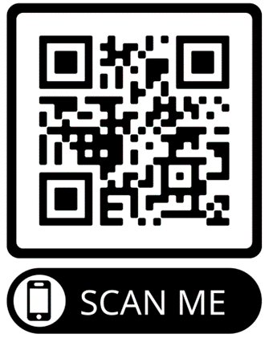
Potential adverse reactions to MVA-BN vaccine
rates of adverse events reported after 1st, 2nd or booster dose were similar, but anecdotally the frequency of adverse events, particularly local site reactions, appears to be higher in those who have received previous live smallpox vaccine
as this vaccine is labelled with a black triangle, all adverse reactions occurring in individuals of any age after vaccination should be reported to the MHRA using the Yellow Card Scheme
anyone can report a suspected adverse reaction to the Medical and Healthcare products Regulatory Agency (MHRA) using the Yellow Card reporting scheme (www. yellowcard.mhra.gov.uk)
any adverse reaction should also be documented in accordance with local procedures
The QR code can be used for quick and easy access to the Yellow Card reporting site
Notes:
WHO 2013, Frey et al, 2007, Vollmar et al, 2006, von Krempelhuber et al, 2010, Greenberg et al, 2013
World Health Organisation (WHO) (2013) Summary report on first, second and third generation smallpox vaccines. Geneva
Frey SE, Newman FK, Kennedy JS et al. (2007) Clinical and immunologic responses to multiple doses of IMVAMUNE(R) (Modified Vaccinia Ankara) followed by Dryvax(R) challenge. Vaccine. 25: 8562-73
Vollmar J, Arndtz N, Eckl KM et al. (2006) Safety and immunogenicity of Imvamune, a promising candidate as a third generation smallpox vaccine. Vaccine. 24: 2065-70
Von Krempelhuber A, Vollmar J, Prokorny R et al. (2010) A randomized, double-blind, dose-finding Phase II study to evaluate immunogenicity and safety of the third generation smallpox vaccine candidate IMVAMUNE. Vaccine. 28: 1209-16
Greenberg RN, Overton ET, Haas DW et al. (2013) Safety, immunogenicity, and surrogate markers of clinical efficacy for modified vaccinia Ankara as a smallpox vaccine in HIV-infected subjects. J. Infect. Dis. 207: 749-58

Slide 79
Documentation and post-vaccination information

Slide 80
Disposal
equipment used for vaccination, including used vials, ampoules or syringes, should be disposed of by placing them in a proper, puncture-resistant ‘sharps box’ according to local authority regulations and guidance in Health Technical Memorandum 07-01: Safe management of healthcare waste (Department of Health, 2013)
sharps waste and empty vials should be placed into yellow lidded waste bins and sent for incineration
there is no designation as GMO waste

Slide 81
Documenting vaccination
The following information should be recorded for each vaccine given:
  vaccine name, product name, batch number and expiry date
  dose administered
  route and anatomical site of administration
  date immunisation given
  name and signature of vaccinator
  if the vaccine recipient is pregnant, document pregnancy and gestational age if possible
This information should be recorded in the patient’s GP record or other patient record, depending on location. Vaccinations administered in the sexual health setting should be coded in accordance with the service specification and reported to UKHSA with routine GUMCAD STI Surveillance returns. When the vaccine is administered to individuals under 19 years of age, notify the local Child Health Information Service (CHIS) using the appropriate documentation or pathway as required by any local or contractual arrangement. The incident management team or health protection team involved in the incident or outbreak will advise if additional records are required. Vaccination record cards are available for order.
Notes:
All records should be clear, legible and contemporaneous.
Where the provider is a Sexual Health Service (SHS), the offer and uptake of mpox vaccination should be coded in sexual health services’ electronic patient records management system and, in accordance with the service specification, reported to UKHSA with routine GUMCAD STI Surveillance returns.
It is important that vaccinations are recorded in a timely manner on appropriate health care records for the individual. A mpox vaccination card should be completed and given to the individual.
When the vaccine is administered to individuals under 19 years of age, notify the local Child Health Information Service (CHIS) using the appropriate documentation or pathway as required by any local or contractual arrangement.
A record of all individuals receiving treatment under the national PGD should also be kept for audit purposes in accordance with local policy.

Slide 82
Post vaccination information
the marketing authorisation holder’s patient information leaflet (PIL) which is provided with the vaccine should be offered. For individuals receiving the Jynneos® vaccine, the package insert included in the outer packaging should be offered
vaccine recipients should be given information about possible reactions to the vaccine, how to treat these, and when and from whom to seek further advice if required
encourage recipients to report adverse reactions to the MHRA Yellow Card Scheme
patient information leaflets are available on the UKHSA mpox vaccination resources page
information on mpox also is available from NHS UK

Slide 83
Observation following vaccination
there is no routine requirement for observation following MVA-BN vaccine administration but individuals should be observed for any immediate reactions whilst they are receiving any verbal post vaccination information and exiting the vaccination venue
as for all vaccines, facilities for management of anaphylaxis should be available at all vaccination sites (as per chapter 8 of the Green Book)
as fainting can occur following vaccination, all those vaccinated with MVA-BN should be advised to not drive for 15 minutes after vaccination

Slide 84
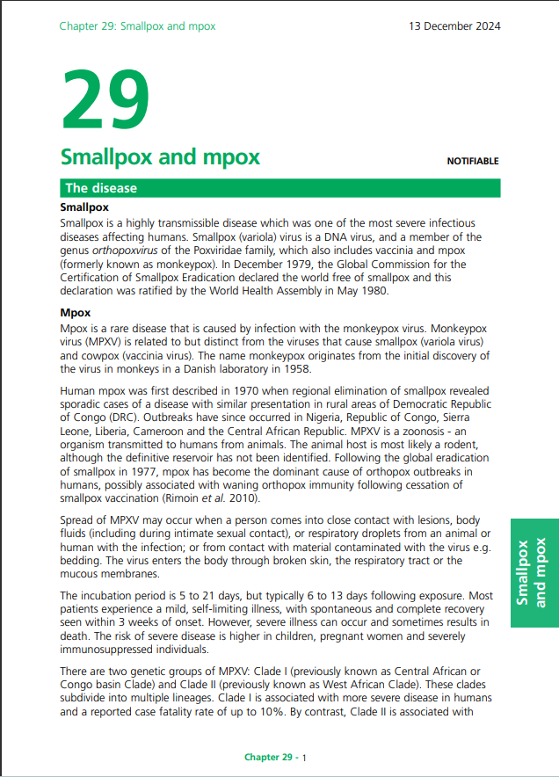
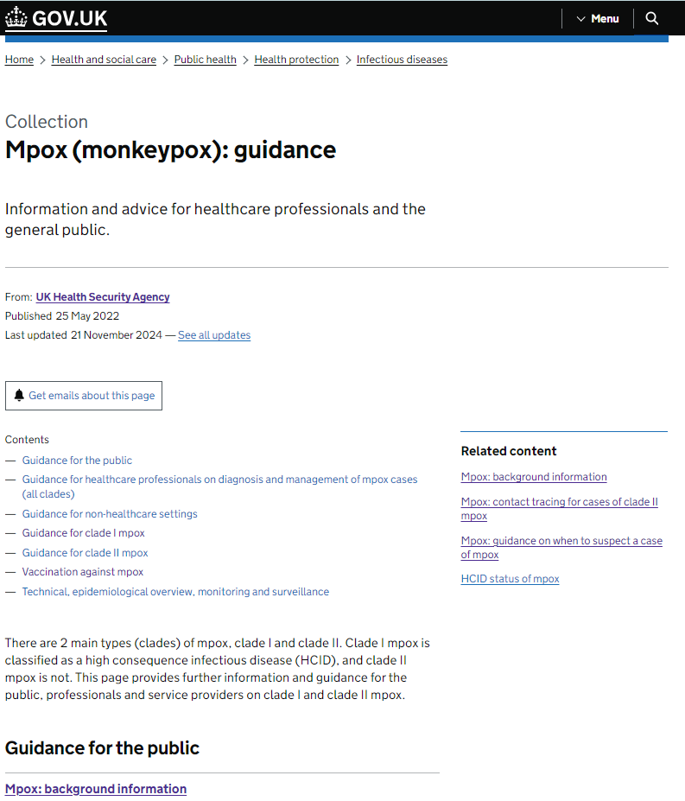
Recommended reading
It is strongly recommended that healthcare practitioners involved in delivering the MVA-BN vaccine read the latest version of the Green Book Smallpox and mpox chapter, and identify the relevant resources on the mpox guidance collection page.
During an incident, it is likely that contents on the collection page may be updated regularly so practitioners are reminded to ensure they are always using the most current documents.

Slide 85
Resources
UKHSA resources relating to Mpox and vaccination can be accessed in the UKHSA Mpox: guidance collection page. These include guidance for health professionals and service providers on case definitions, diagnostic testing and other health protection guidance. The vaccination guidance section contains links to this training slide set, the Green Book chapter and other relevant vaccination resources. Guidance for the general public and epidemiological overviews are also available. This collection page should be reviewed regularly to ensure the most up to date guidance is accessed.
UKHSA Patient Group Direction (PGD): mpox vaccine
UKHSA mpox contact tracing guidance
UKHSA mpox vaccination resources (including patient information leaflets)
UKHSA MVA-BN consent forms (child and adult)
Marketing authorisation holder’s Summary of Product Characteristics: Imvanex vaccine
FDA Package Insert (summary of product characteristics) and information: Jynneos vaccine
Public Health Scotland video: use of MVA-BN vaccines against mpox: administration using the intradermal vaccination technique
Medicines and Healthcare products Regulatory Agency (MHRA): reporting adverse reactions
Immunisation against infectious disease, the Green Book: Smallpox and mpox (chapter 29)
NHS website: mpox

