Slide 1
Diphtheria Laboratory slide deck Recent epidemiology and laboratory investigations November 2023

Slide 2
Slide deck content
background / epidemiology of diphtheria
clinical presentations
laboratory investigations
executive summary

Slide 3
Diphtheria Background / epidemiology

Slide 4
Background
Organism
Corynebacterium diphtheriae, C. ulcerans and C. pseudotuberculosis
Distribution
endemic in many countries, highest in low-income/areas with low vaccine uptake. UK acquired cases linked to pet ownership, under vaccinated populations, possible wanning immunity. Imported cases have recently been association with people seeking asylum.
Source
C. diphtheriae - nose or throat of human case or carrier. In tropics infected skin lesions are common, increasing UK presentation of cutaneous lesions or non-healing ulcers.
C. ulcerans - historically cattle, now companion animals/pets
Spread
C. diphtheriae – person-to-person/close contact with infected secretions
C. ulcerans – contact with animals (including pets), milk borne, possible person-to-person
Notes:
Organism
Diphtheria is caused by Corynebacterium diphtheriae, C. ulcerans and C. pseudotuberculosis which carry and express the diphtheria toxin gene (tox)
Distribution
Endemic in many countries; rare in countries with effective immunisation programmes
Source
C.diphtheriae - nose or throat of human case or carrier. In tropics infected skin lesions are common
C. ulcerans - historically cattle, now companion animals
Spread
C. diphtheriae – person-to-person, close contact with infected secretions
C. ulcerans – milk borne, contact with animals, possible person-to-person

Slide 5
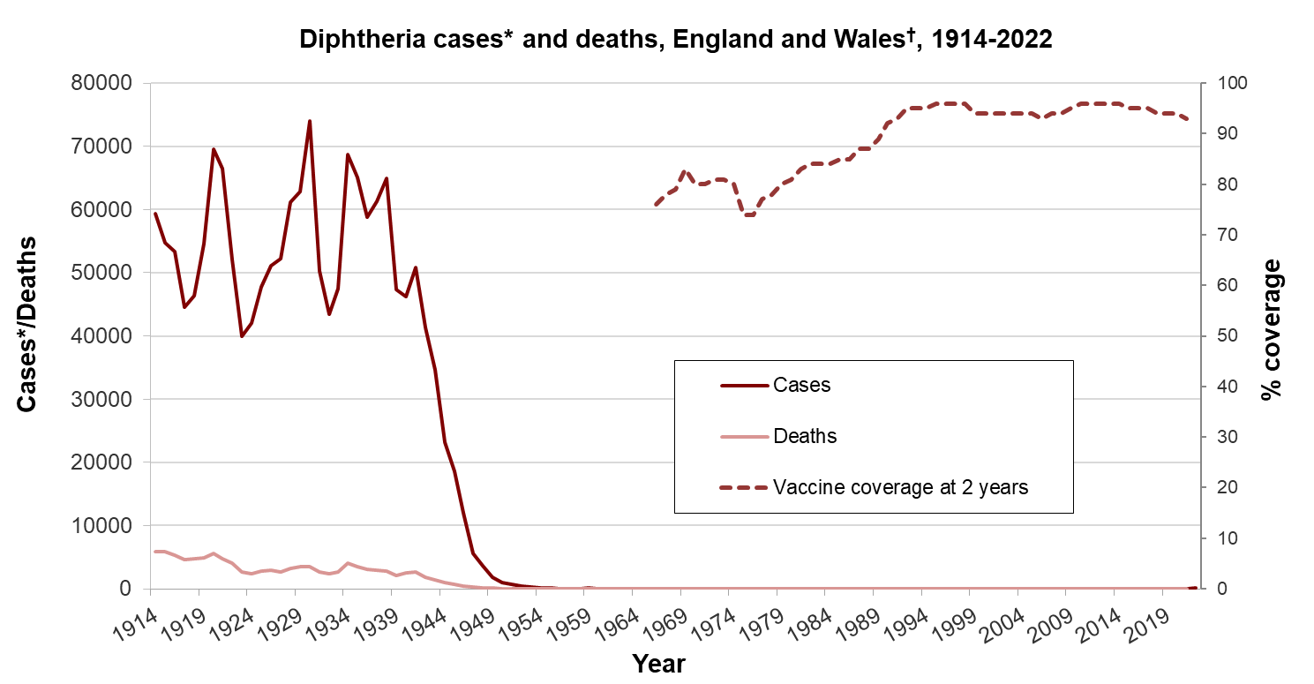
Epidemiology - vaccine
Routine vaccination (1942)
* notifications up to 1985, laboratory confirmed cases 1986-2006, † from 2016 onwards, data is from England only
Notes:
Notifiable disease and organisms
61,000 cases and over 3,000 deaths in 1940 – feared childhood disease pre-vaccination era
Significant drop in deaths following introduction of vaccine programme
Vaccine is made from inactivated diphtheria toxin (toxoid) and protects individual from effects of the toxin.
Primary imms and then pre-school and school leaving boosters i.e. 5 doses in childhood.
Boosters – maternal pertussis programme and for travel
AND any CRM containing vaccine administered

Slide 6
Epidemiology, 2000 to 2022
Increase in C. diphtheriae cases; approx. 5 -10 % of UK isolates from UK population are toxigenic and approx. 80-90 % isolates from asylum seeking populations are toxigenic
can be cutaneous &/or respiratory, most commonly seen in poorly vaccinated populations, travel associated, people seeking asylum with a history of travel along migrant routes
Increase in C. ulcerans; approx. 50-80 % of strains are toxigenic
can be cutaneous &/or respiratory, most commonly associated with animal exposures
MALDI-TOF MS* provides good discrimination for C. diphtheriae and C. ulcerans
increasing use by local laboratories to identify gram-positive coryneforms may be partly responsible for increase in number of referred isolates to the National Reference Laboratory
absence of clinical details may reduce likelihood of speciation / use of MALDI-ToF
*Matrix Assisted Laser Desorption/Ionization – Time of Flight Mass Spectrometry
Notes:
Due to a highly successful and effective vaccination programme, diphtheria has been extremely rare in England, with <10 confirmed cases per year between 2009-2017. However, increases in toxigenic cases of C. ulcerans, primarily presenting as cutaneous lesions, were observed in England from 2018.
Since late 2021, there has been an increase in toxigenic cases of C. ulcerans and C. diphtheriae in England. This has raised significant concerns regarding further transmission as society begins to open-up and mixing patterns return to pre-pandemic levels. As a result, a National Standard Incident has been declared to coordinate the public health response to the changing epidemiology.
Since 2015 52% of tox diphtheria infections have been cutaneous, and cases of C. diphtheriae more likely to present as cutaneous infections
Increases in toxigenic cases of C. ulcerans, primarily presenting as cutaneous lesions, have been observed in England since 2018. This is, in part thought to be due to changes in local laboratory testing practices with increasing use of MALDI-TOF. In 2020, during the COVID-19 pandemic, there was a notable decrease in case numbers with only one case of toxigenic C. ulcerans reported. Since late 2021 cases for both C. ulcerans (n=8) and C. diphtheriae (n=3) have increased again across England.
Cases of C. ulcerans are predominantly occurring in adults aged over 45 and most cases appear to be linked to domestic pet exposure (primarily dogs and cats) raising questions about waning immunity from routine vaccination and animal-related risk factors. In late 2021, there were two deaths in older adults with confirmed toxigenic C. ulcerans infections.
Cases of toxigenic C. ulcerans are now also being regularly reported in animals without an associated human case. These situations require a joint public health and animal health investigation to ensure that transmission to close human contacts does not occur.
In addition to an increase of C. ulcerans cases observed across the country, a cluster of toxigenic C. diphtheriae cases in the Yorkshire and Humber region has been confirmed since late 2021, with the same bacterial strain that was identified in a previous cluster of indigenous cases from 2018. To date in 2022, there have been four confirmed diphtheria cases in England, including one toxigenic C. diphtheriae case with epidemiological links to the Yorkshire and Humber cluster and three toxigenic C. ulcerans cases including one cases presenting with classical respiratory diphtheria and a membrane, requiring DAT treatment.

Slide 7
Number of cases of toxigenic C. ulcerans and toxigenic C. diphtheriae in humans and animals, England, 2012 to 2022

Slide 8
Number of toxigenic C. ulcerans human index and toxigenic C. diphtheriae cases, England, 2012 to 2022

Slide 9
Diphtheria Clinical presentation

Slide 10
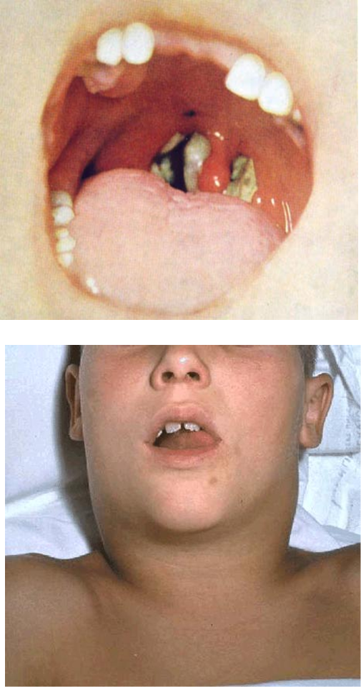
Diphtheria – clinical presentation
Classical respiratory diphtheria
inflammatory pseudomembrane on tonsils, oropharynx and pharynx
“bull neck”
sore throat, fever, fatigue
potentially death
Laryngeal diphtheria
hoarseness – stridor
Nasal diphtheria
mild or chronic nasal discharge – clear to bloody
Notes:
Classic respiratory diphtheria is now rare in UK and no longer easily diagnosed.
Mild respiratory cases resemble Streptococcal pharyngitis and classical pseudo membrane my not develop, particularly in vaccinated individuals.
Classical respiratory diphtheria
toxin-mediated disease of upper respiratory tract
generally characterised by presence of inflammatory pseudomembrane on tonsils, oropharynx and pharynx causing sore throat, high temperature and potentially death
enlarged anterior cervical lymph nodes and oedema of surrounding soft tissue, giving rise to the ‘bull neck’ appearance
Laryngeal diphtheria
hoarseness – stridor
Nasal diphtheria
mild/chronic – nasal discharge – clear to bloody

Slide 11
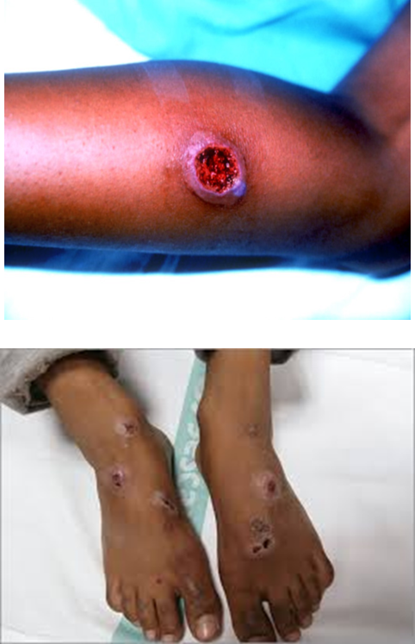
Diphtheria – clinical presentation
Cutaneous diphtheria
usually on exposed limbs
lesions start as vesicles - form small, clearly demarcated, sometimes multiple
note: ulcers may be difficult to distinguish from impetigo
lesions usually covered with an eschar, a hard slightly raised bluish-grey membrane
infected chronic skin wounds, burns, insect bites also common in asylum seeking population
Notes:
Cutaneous diphtheria
usually on exposed limbs (legs)
lesions start as vesicles - form small, clearly demarcated, sometimes multiple, ulcers may be difficult to distinguish from impetigo
classic description of diphtheritic lesions usually covered with an eschar, a hard bluish-grey membrane slightly raised

Slide 12
Diphtheria: toxin complications
More likely after respiratory diphtheria
Cardiac - myocarditis
Neurological - polyneuropathies (may mimic Guillain-Barre)
palatal palsy
ocular muscle palsies
limb weakness
diaphragmatic palsy
Respiratory - airway obstruction
Immunisation protects against toxic manifestations reducing severity of disease but not necessarily against acquisition of infection or carriage.
Notes:
Secretion of exotoxin can cause local tissue necrosis
Absorption into bloodstream may lead to demyelinating peripheral neuritis and myocarditis
Immunisation does not prevent carriage

Slide 13
Diphtheria transmission
C. diphtheriae:
droplet spread
contact with cutaneous lesions/infected secretions
C. ulcerans:
contact with infected/colonised animals including pets
consumption of unpasteurised dairy products
contact with cutaneous lesions/infected secretions of human cases
cases and contacts of cutaneous diphtheria (both C. diphtheriae and C. ulcerans) may develop respiratory diphtheria
incubation 2 to 5 days (up to 10 days)
close prolonged contact
Notes:
Respiratory diphtheria
• diphtheria toxin is absorbed into the mucous membranes and causes destruction of epithelium and a superficial inflammatory response.
• the symptoms of diphtheria involving the respiratory tract develop after 2 to 4 days incubation period.
• organisms multiply locally on epithelial cells in the pharynx or adjacent surfaces and initially cause localized damage as a result of exotoxin activity.
• the onset is sudden, with malaise, sore throat, exudative pharyngitis, and a low-grade fever.
• the exudate evolves into a thick pseudomembrane composed of bacteria, lymphocytes, plasma cells, fibrin, and dead cells that can cover the tonsils, uvula, and palate and can extend up into the nasopharynx or down into the larynx
• the regional lymph nodes in the neck enlarge, and there may be marked edema of the entire neck, with distortion of the airway, often referred to as “bull neck” clinically.
• in critically ill patients, cardiac (necrosis of heart muscles) and neurologic complications (demylenation) is most significant.
• neurotoxicity is proportional to the severity of the primary disease, which is influenced by the patient’s immunity.
• the majority of patients with severe primary disease develop neuropathy, initially localized to the soft palate and pharynx, later involving oculomotor and ciliary paralysis, with progression to peripheral neuritis.
Cutaneous diphtheria
• cutaneous diphtheria is acquired through skin contact with other infected persons.
• the organism colonizes the skin and gains entry into the subcutaneous tissue through breaks in the skin.
• a papule develops first and then evolves into a chronic, non-healing ulcer, sometimes covered with a grayish membrane
• systemic signs can develop.
droplet spread (C. diphtheria) or direct contact with cutaneous lesions, infected secretions
contact with infected animals or consumption of unpasteurised dairy products (C. ulcerans)
both cases and contacts of cutaneous diphtheria may develop respiratory diphtheria
incubation usually 2-5 days (up to 10 days)
close prolonged contact e.g. household, greater risk

Slide 14
Diphtheria Laboratory investigations / considerations

Slide 15
Laboratory investigation – primary testing
Primary testing – potential for missed/delayed diagnosis due to:
few labs routinely culture all pharyngeal swabs for corynebacteria so inclusion of clinical details / history important to trigger testing
care should be taken when interpreting presence of diphtheroids as representing co-incidental commensals when history of sample collected from person seeking asylum, under vaccinated population (e.g. Gypsy, Roma, Traveller Group, specific religious groups, people chosen not to be vaccinated), animal exposures
lack of clinical details can reduce prospect of corynebacteria identification / MALDI-ToF analysis
wound swabs may contain additional causative organisms (e.g. S. aureus, Group A Streptococcus) plus a toxigenic corynebacteria
potential for laboratory staff exposures when lab not informed of potential risks
Notes:
Local lab – some potential for missed or delayed diagnosis
culture, bacterial isolation and preliminary identification as C. diphtheriae, ulcerans or pseudotuberculosis
not all labs routinely culture pharyngeal swabs for corynebacteria
care should be taken when interpreting presence of diphtheroids as representing co-incidental commensals
wound swabs may contain additional causative organisms
isolates, rather than the original sample, should be sent to the ref lab for toxigenicity testing

Slide 16
Details which increase likelihood of toxigenic corynebacteria recovery from clinical samples:
SMI B11 (Investigation of swabs from skin and superficial soft tissue infections)
https://assets.publishing.service.gov.uk/government/uploads/system/uploads/attachment_data/file/766634/B_11i6.5.pdf
suspected cutaneous diphtheria (consider for foreign travel with <10 d and non healing ulcers)
swabs from chronic non-healing ulcers or skin lesions with one of the following risk factors reported should be tested for Corynebacterium species:
travel abroad to high risk area within the last 10 days
contact with someone who has been to a high risk area within the last 10 days
the patient works in a clinical microbiology laboratory, or similar occupation, where Corynebacterium species may be handled
Corynebacterium diphtheriae, Corynebacterium ulcerans and Corynebacterium pseudotuberculosis can cause diphtheria and have been isolated from the skin of patients with chronic skin infections
Notes:
Local lab – some potential for missed or delayed diagnosis
culture, bacterial isolation and preliminary identification as C. diphtheriae, ulcerans or pseudotuberculosis
not all labs routinely culture pharyngeal swabs for corynebacteria
care should be taken when interpreting presence of diphtheroids as representing co-incidental commensals
wound swabs may contain additional causative organisms
isolates, rather than the original sample, should be sent to the ref lab for toxigenicity testing

Slide 17
Details which increase likelihood of toxigenic corynebacteria recovery from clinical samples:
SMI B9 (Investigation of throat related specimens)
https://assets.publishing.service.gov.uk/government/uploads/system/uploads/attachment_data/file/423204/B_9i9.pdf
Membrane formation or membranous pharyngitis/tonsillitis
Foreign travel to high risk area
Notes:
Local lab – some potential for missed or delayed diagnosis
culture, bacterial isolation and preliminary identification as C. diphtheriae, ulcerans or pseudotuberculosis
not all labs routinely culture pharyngeal swabs for corynebacteria
care should be taken when interpreting presence of diphtheroids as representing co-incidental commensals
wound swabs may contain additional causative organisms
isolates, rather than the original sample, should be sent to the ref lab for toxigenicity testing

Slide 18
Details which increase likelihood of toxigenic corynebacteria recovery from clinical samples:
SMI ID2 (Identification of Corynebacterium species)
https://assets.publishing.service.gov.uk/government/uploads/system/uploads/attachment_data/file/371490/ID_2i4.1.pdf
In the reporting section:
Inform the medical microbiologist of presumptive and confirmed C. diphtheriae, C. ulcerans or C. pseudotuberculosis species. The medical microbiologist should also be informed if the request bears relevant information e.g:
• suspected case of contact with diphtheria or foreign travel
• membranous/Pseudomembranous tonsillitis
• ulcerating skin lesions acquired overseas
The medical microbiologist should be aware of possible factors from overseas protocols that could influence results:
• any of the above, with neurological or cardiological manifestations
• history of farming or veterinary work
• any foreign travel to a high risk area, particularly Indian subcontinent, South East Asia, Africa, South America, former Soviet States and Eastern Europe
Notes:
Local lab – some potential for missed or delayed diagnosis
culture, bacterial isolation and preliminary identification as C. diphtheriae, ulcerans or pseudotuberculosis
not all labs routinely culture pharyngeal swabs for corynebacteria
care should be taken when interpreting presence of diphtheroids as representing co-incidental commensals
wound swabs may contain additional causative organisms
isolates, rather than the original sample, should be sent to the ref lab for toxigenicity testing

Slide 19
Findings from laboratory survey – throat swabs:
clinical details essential for selecting a Hoyles plate for a throat swab sample
clinical presentation is likely to trigger testing
less likely to test if person is from a poorly vaccinated community (migrant population, GRT) and animal contacts)
Triggers for selecting Hoyles plate (when processing a throat swab) | N | %
On request from clinician | 58 | 80.6
Contact with human case | 55 | 76.4
Membrane formation | 55 | 76.4
Contact with animal infection | 52 | 72.2
Recent foreign travel outside Europe | 44 | 61.1
Clinical presentation AND foreign travel outside Europe | 43 | 59.7
Exposure to high risk setting | 26 | 36.1
Member of migrant population | 21 | 29.2
Exposure to raw dairy products | 12 | 16.7
Contact with livestock | 13 | 18.1
History of farming | 11 | 15.3
History of veterinary work | 11 | 15.3
Member of Gypsy Roma Traveller (GRT) community | 6 | 8.3
Pet owner | 5 | 6.9
Vaccination status | 5 | 6.9
Pet bite or scratch | 2 | 2.8
Other* | 21 | 29.2

Slide 20
Findings from laboratory survey – Skin lesion swabs:
clinical details essential for selecting a Hoyles plate for a throat swab sample
clinical presentation is likely to trigger testing
less likely to test if person is from a poorly vaccinated community (migrant population, GRT) and animal contacts)
Triggers for Hoyles plate (wound / skin lesion swab) | N | %
On request from clinician | 64 | 88.9
Contact with human case | 54 | 75.0
Contact with animal infection | 53 | 73.6
Clinical presentation AND foreign travel outside Europe | 36 | 50.0
Recent foreign travel outside Europe | 34 | 47.2
Presence of non-healing lesion/ulcer | 25 | 34.7
Exposure to high risk setting | 17 | 23.6
Member of migrant population | 11 | 15.3
History of veterinary work | 10 | 13.9
Contact with livestock | 9 | 12.5
History of farming | 9 | 12.5
Exposure to raw dairy products | 6 | 8.3
Vaccination status | 4 | 5.6
Member of GRT community | 3 | 4.2
Pet bite or scratch | 2 | 2.8
Pet owner | 1 | 1.4
Other* | 19 | 26.4

Slide 21
Clearance
Clearance samples:
all confirmed cases should undergo microbiological clearance
clearance is achieved with appropriate antibiotic therapy and should be confirmed from 24 h after antibiotic treatment has been completed.
collect 2 x nose and throat swabs (or nose, throat and skin swabs for cutaneous cases) for culture at least 24 hours apart, 24 hours after stopping antibiotics
asymptomatic carriers of toxigenic strains should be treated with same antibiotic regime as cases with appropriate swabs taken on completion of therapy to ensure eradication
if microbiological clearance is not achieved an additional 10 day course of antibiotics should be discussion with local microbiologists

Slide 22
Diphtheria: laboratory investigations PCR
laboratory confirmation informs public health action - offered at the national reference lab in Colindale – note isolates (not original samples) should be sent for toxigenicity testing
to decrease time to result, a real-time PCR (qPCR) assay developed for confirmation of both identification of C. diphtheriae and C. ulcerans/C. pseudotuberculosis, and detection of the diphtheria toxin gene (April 2014)
target genes:
RNA polymerase beta-subunit-encoding gene (rpoB)
a subunit of the diphtheria toxin gene (tox)
green fluorescent protein DNA (gfp) as an internal process control
Elek immunoprecipitation test used to confirm expression of diphtheria toxin in qPCR toxin gene (tox) positive isolates
Notes:
laboratory confirmation informs public health action
to decrease time to result, a real-time PCR (qPCR) assay developed for confirmation of both identification of Corynebacterium diphtheriae and Corynebacterium ulcerans/Corynebacterium pseudotuberculosis and detection of the diphtheria toxin gene (April 2014)
target genes:
RNA polymerase beta-subunit-encoding gene (rpoB)
a subunit of the diphtheria toxin gene (tox)
green fluorescent protein DNA (gfp) as an internal process control
Elek immunoprecipitation test used to confirm expression of diphtheria toxin in qPCR toxin gene (tox) positive isolates

Slide 23
Diphtheria: laboratory investigation PCR
time to result: 3 to 4 hours after receipt of isolate
high diagnostic sensitivity and specificity
Limitations:
inability to distinguish between C. ulcerans and C. pseudotuberculosis
presence of toxin gene may not always predict toxin expression
therefore, confirmation of expression of diphtheria toxin in qPCR tox gene positive isolates is always determined using the phenotypic Elek test
Notes:
time to result: 3-4 hr after receipt of isolate
high diagnostic sensitivity and specificity
limitations:
inability to distinguish between C. ulcerans and C. pseudotuberculosis
presence of toxin gene may not always predict toxin expression
therefore, confirmation of expression of diphtheria toxin in qPCR tox positive isolates is always determined using the phenotypic Elek test

Slide 24
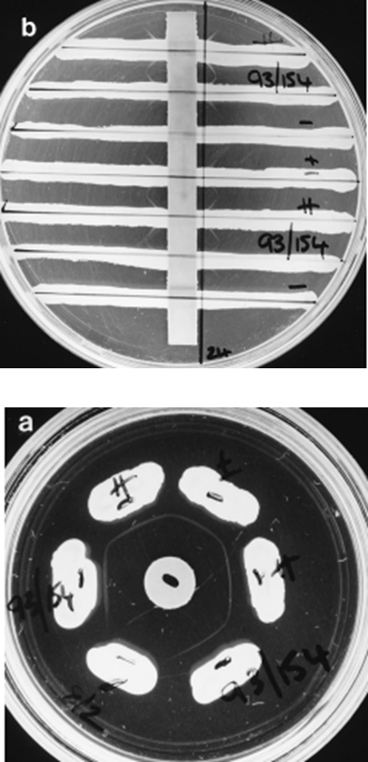
Diphtheria: laboratory investigation Elek test
Conventional Elek test
large standard petri dish size (9 cm)
time to result 48 hours
nonspecific lines of precipitation
‘Modified’ Elek test
small petri dish (4.5 cm)
reduced amounts of anti-toxin used
time to result 24 hours (usually)
easier to read

Slide 25
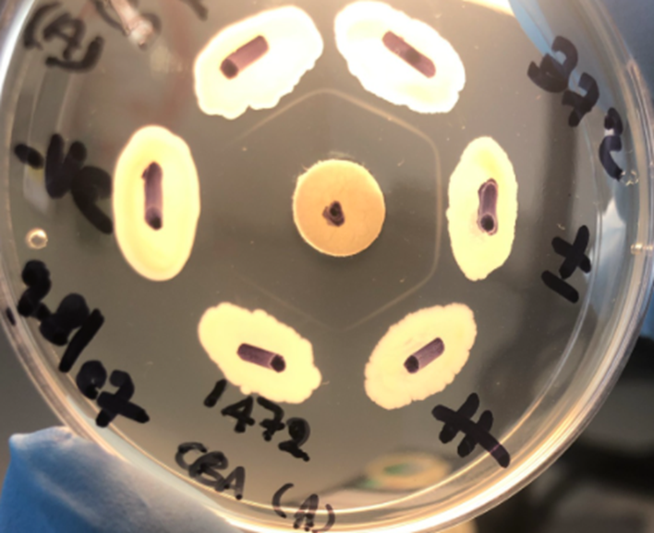
Modified Elek Test
TEST
TEST strain = positive
Immunoprecipitation line forms where diphtheria anti-toxin from disc meets diphtheria toxin from organism
C. diphtheriae strong positive
C. diphtheriae toxin negative
C. diphtheriae weak positive
C. diphtheriae strong positive
TEST

Slide 26
Non-toxigenic toxin-gene bearing bacteria (NTTB)
qPCR tox gene positive; Elek negative
most have mutations in coding region of diphtheria toxin gene
NTTB do not express diphtheria toxin
NTTB in UK sporadic cases
cluster in hospital setting (skin clinic in a London hospital) 2014
investigation of a cluster with transmission of NTTB over a 7-year period reassures us there is no evidence of reversion to diphtheria toxin expression
now considered highly unlikely NTTB will gain the ability to become toxigenic
no public health action is required for individuals with non-toxigenic strains or NTTB C. diphtheriae or C. ulcerans

Slide 27
Diphtheria Reference laboratory service
What the reference laboratory expects:
Pure cultures of isolates on slopes submitted with the R3 request form Vaccine preventable bacteria section request form - GOV.UK (www.gov.uk)
with provisional identification of:
C. diphtheriae
C. ulcerans
C. pseudotuberculosis
What the reference laboratory likes to know:
Method of identification (and score for MALDI-ToF)
Matrix assisted laser desorption ionization time of flight (MALDI-ToF)
API Coryne (BioMèrieux)
VITEK (BioMèrieux)

Slide 28
Diphtheria Reference laboratory service
Monday to Friday: normal working hours
Isolates received by midday result by close
Isolates received late* afternoon (*depends how late) results by close or next day
Saturday service (Bank Holiday) out of hours
Isolates received by midday result by close
For queries out of hours, check UKHSA CSA/CMA out of hours on call rota which will provide contact details of diphtheria Senior Scientist on call

Slide 29
Diphtheria Reference laboratory service - contacts
Bacteriology reference department (BRD)
UK Health Security Agency 61 Colindale Avenue London NW9 5EQ
Telephone 020 8327 7887 (staffed from 9am to 5.30pm, Monday to Friday)
DX address UKHSA Colindale Bacteriology, DX 6530002
submission guidelines can be found in the BRD user manual.
Respiratory and Vaccine Preventable Bacterial Infections general enquiries: rvpbruqueries@ukhsa.gov.uk
Monday to Friday: David Litt (Clinical Scientist)
david.litt@ukhsa.gov.uk
020 8327 7476
Saturday out of hours: Senior Scientist team
David Litt, Baharak Afshar, Juliana Coelho
Saturday out of hours: Biomedical/Healthcare Scientist team
John Duncan, Hanshi Parmar, Fu Li

Slide 30
Vaccination for laboratory staff
Immunisation for laboratory staff
Recommendations for immunisation to protect against diphtheria are as per Green Book
Chapter 12: Immunisation of healthcare and laboratory staff.
Recommended diphtheria antitoxin antibody levels of 0.1 IU/mL for those handling or regularly exposed to toxigenic strains
Note: these antibody levels and interpretive criteria are based on those described by the World Health Organization’s recommendations using a functional (toxin neutralisation) assay

Slide 31
Diphtheria Executive summary

Slide 32
Diphtheria –summary
affects upper respiratory tract and/or skin
caused by action of diphtheria toxin produced by toxigenic Corynebacterium diphtheriae or Corynebacterium ulcerans
rare in the UK since 1940s (introduction of vaccination)
C. diphtheria cases often travel related
epidemiology is changing with cases increasingly presenting with cutaneous disease and an increase in cases of C. ulcerans
animal contacts important risk for C. ulcerans cases
high prevalence of C. diphtheriae in newly arriving asylum seekers arriving via small boats
clinical details are essential to trigger targeted testing
Notes:
an acute infectious disease of humans that affects the upper respiratory tract and/or skin, caused by the action of diphtheria toxin produced by toxigenic Corynebacterium diphtheriae or Corynebacterium ulcerans
diphtheria is now rare in the UK since routine vaccination of babies and children began in 1940s
cases are often travel related but the epidemiology is changing
cases of acute respiratory diphtheria require early diagnosis and prompt, life-saving administration of diphtheria anti-toxin
Health protection teams play an important role in the risk assessment of toxigenic cases; the management of contacts to minimise onward transmission; the investigation of likely source and in outbreak management

Slide 33
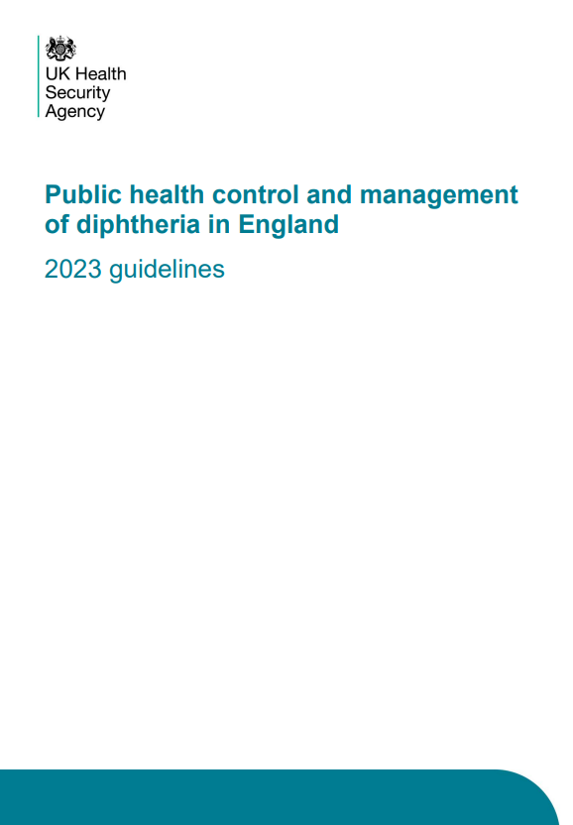
Thank you
Any questions?
Resources:
Public health control and management of diphtheria in England – 2023 guidelines
Diphtheria anti-toxin: clinical guidance
DAT: Information for healthcare professionals
Public health management of toxigenic C. ulcerans in animals (pending publication)

