Slide 1
Diphtheria
Recent epidemiology, investigation and management
November 2023

Slide 2
Content
executive summary
key guidance changes
background and clinical presentations
laboratory investigations
epidemiology of diphtheria
management of cases and contacts
zoonotic aspects
case review and scenarios

Slide 3
Diphtheria – executive summary
affects upper respiratory tract and/or skin
caused by action of diphtheria toxin produced by toxigenic Corynebacterium diphtheriae or Corynebacterium ulcerans
rare in the UK since 1940s
cases often travel related but epidemiology is changing
acute respiratory diphtheria requires early diagnosis and prompt, life-saving administration of diphtheria anti-toxin
HPTs play an important role in the risk assessment of toxigenic cases:
  contact tracing and management
  investigation of source
  outbreak management
Notes:
an acute infectious disease of humans that affects the upper respiratory tract and/or skin, caused by the action of diphtheria toxin produced by toxigenic Corynebacterium diphtheriae or Corynebacterium ulcerans
diphtheria is now rare in the UK since routine vaccination of babies and children began in 1940s
cases are often travel related but the epidemiology is changing
cases of acute respiratory diphtheria require early diagnosis and prompt, life-saving administration of diphtheria anti-toxin
Health protection teams play an important role in the risk assessment of toxigenic cases; the management of contacts to minimise onward transmission; the investigation of likely source and in outbreak management

Slide 4
National guidance updates
Guidance update 2015 prompted by:
  increasing toxigenic C. ulcerans cases
  introduction of real-time PCR of potentially tox isolates by ref lab
  circulating non-toxigenic tox gene-bearing (NTTB) strains of C. diphtheriae
Guidance updates 2022 and 2023 following:
  audit of clinical, lab and PH management following the introduction of 2015 revised guidance
  revised risk assessment of NTTB strains
Updates include:
  Supplementary guidance to support the management of diphtheria in Asylum Seeker (AS) accommodation settings
  Updated case definitions as applied to AS population
  Principles of management of macrolide resistant infections
  Updated recommendation for general control measures

Slide 5
Key changes to guidance
emphasis on prompt administration of diphtheria anti-toxin (DAT) for confirmed and probable cases if appropriate
updated recommendations on antibiotic treatment
management of NTTB as non-toxigenic
management of zoonotic sources in collaboration with the Animal and Plant Health Agency (APHA)
Notes:
emphasis on prompt administration of diphtheria anti-toxin (DAT) for confirmed and probable cases if appropriate
updated recommendations on antibiotic treatment
management of NTTB as non-toxigenic
management of zoonotic sources in collaboration with the Animal and Plant Health Agency (APHA) – additional guidance document pending publication

Slide 6
Background
Organism
  Corynebacterium diphtheriae, C. ulcerans and C. pseudotuberculosis
Distribution
  endemic in many countries, highest in low-income/areas with low vaccine uptake
Source
  C. diphtheriae - nose or throat of human case or carrier. In tropics infected skin lesions are common
  C. ulcerans - historically cattle, now companion animals
Spread
  C. diphtheriae – person-to-person/close contact with infected secretions
  C. ulcerans – milk borne, contact with animals, possible person-to-person
Notes:
Organism
Diphtheria is caused by Corynebacterium diphtheriae, C. ulcerans and C. pseudotuberculosis which carry and express the diphtheria toxin gene (tox)
Distribution
Endemic in many countries; rare in countries with effective immunisation programmes
Source
C.diphtheriae - nose or throat of human case or carrier. In tropics infected skin lesions are common
C. ulcerans - historically cattle, now companion animals
Spread
C. diphtheriae – person-to-person, close contact with infected secretions
C. ulcerans – milk borne, contact with animals, possible person-to-person

Slide 7
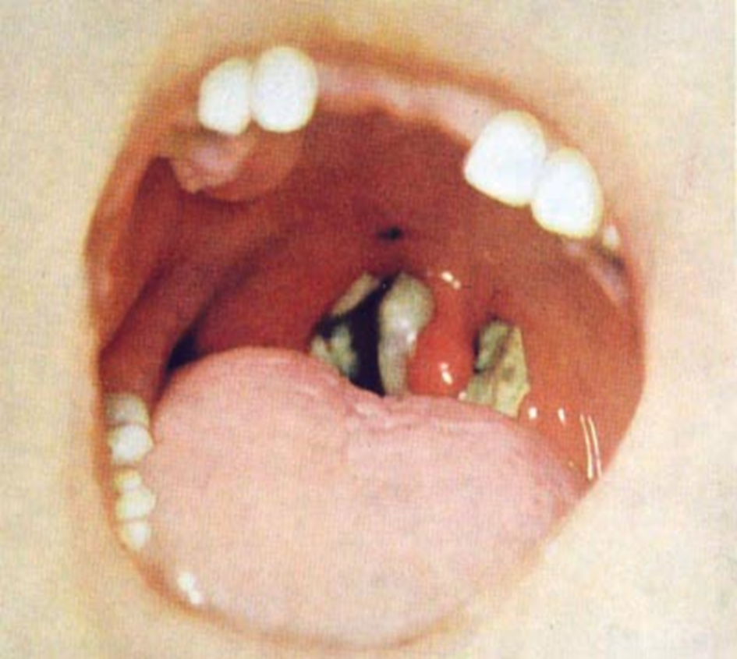
Diphtheria – clinical presentation
Classical respiratory diphtheria
  inflammatory pseudomembrane on tonsils, oropharynx and pharynx
  “bull neck”
  sore throat, fever
  potentially death
Laryngeal diphtheria
  hoarseness – stridor
Nasal diphtheria
  mild or chronic nasal discharge – clear to bloody
Notes:
Classic respiratory diphtheria is now rare in UK and no longer easily diagnosed.
Mild respiratory cases resemble Streptococcal pharyngitis and classical pseudo membrane my not develop, particularly in vaccinated individuals.
Classical respiratory diphtheria
toxin-mediated disease of upper respiratory tract
generally characterised by presence of inflammatory pseudomembrane on tonsils, oropharynx and pharynx causing sore throat, high temperature and potentially death
enlarged anterior cervical lymph nodes and oedema of surrounding soft tissue, giving rise to the ‘bull neck’ appearance
Laryngeal diphtheria
hoarseness – stridor
Nasal diphtheria
mild/chronic – nasal discharge – clear to bloody

Slide 8
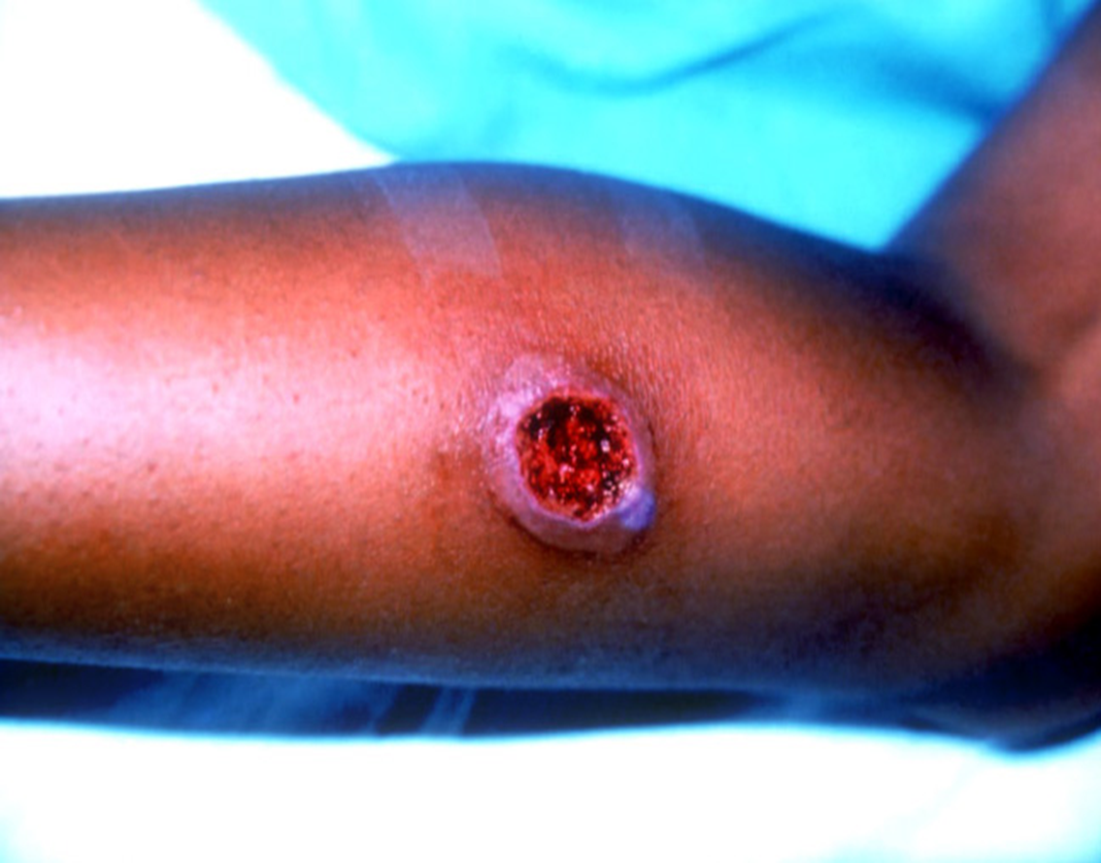
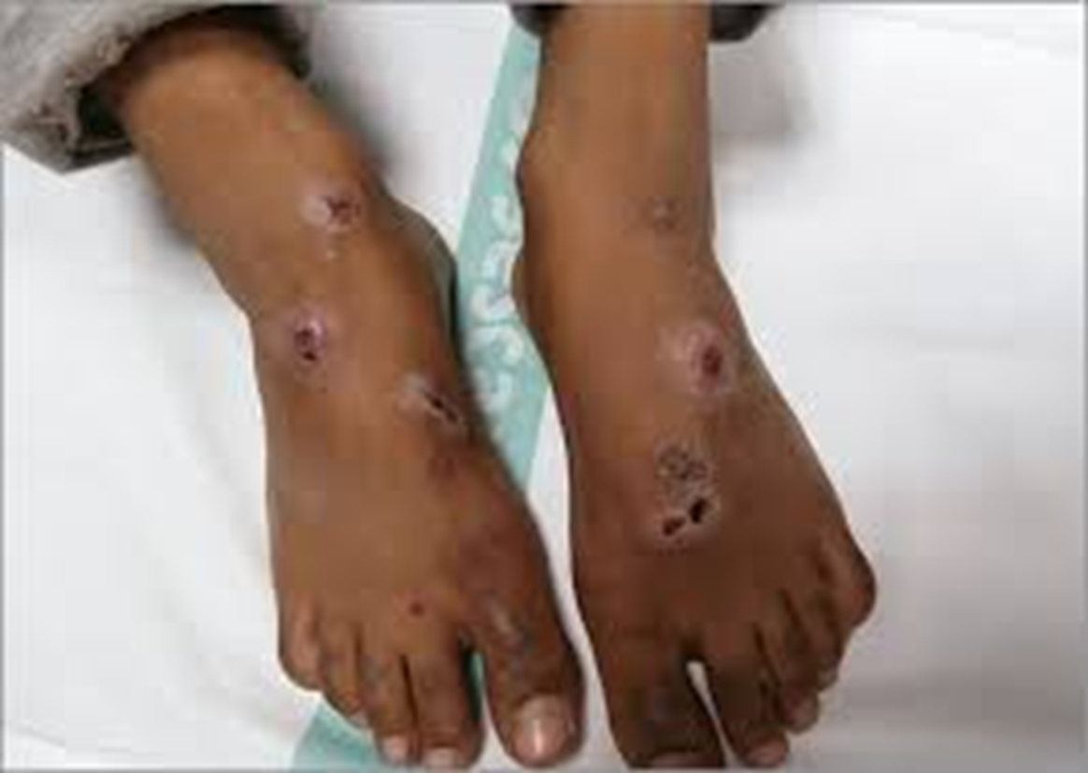
Diphtheria – clinical presentation
Cutaneous diphtheria
usually on exposed limbs
lesions start as vesicles - form small, clearly demarcated, sometimes multiple,
  note: ulcers may be difficult to distinguish from impetigo
lesions usually covered with an eschar, a hard slightly raised bluish-grey membrane
Notes:
Cutaneous diphtheria
usually on exposed limbs (legs)
lesions start as vesicles - form small, clearly demarcated, sometimes multiple, ulcers may be difficult to distinguish from impetigo
classic description of diphtheritic lesions usually covered with an eschar, a hard bluish-grey membrane slightly raised

Slide 9
Diphtheria: toxin complications
More likely after respiratory diphtheria
Cardiac – myocarditis
Neurological – polyneuropathies (may mimic Guillain-Barre)
                palatal palsy
                ocular muscle palsies
                limb weakness
                diaphragmatic palsy
Respiratory – airway obstruction
Immunisation protects against toxic manifestations but not necessarily against acquisition of infection.
Notes:
Secretion of exotoxin can cause local tissue necrosis
Absorption into bloodstream may lead to demyelinating peripheral neuritis and myocarditis
Immunisation does not prevent carriage

Slide 10
Diphtheria transmission
  C. diphtheriae:
    droplet spread
    contact with cutaneous lesions/infected secretions
  C. ulcerans:
    contact with infected animals
    consumption of unpasteurised dairy products
  cases and contacts of cutaneous diphtheria (both C. diphtheriae and C. ulcerans) may develop respiratory diphtheria
  incubation 2 to 5 days (up to 10 days)
  close prolonged contact
Notes:
Respiratory diphtheria
• diphtheria toxin is absorbed into the mucous membranes and causes destruction of epithelium and a superficial inflammatory response.
• the symptoms of diphtheria involving the respiratory tract develop after 2 to 4 days incubation period.
• organisms multiply locally on epithelial cells in the pharynx or adjacent surfaces and initially cause localized damage as a result of exotoxin activity.
• the onset is sudden, with malaise, sore throat, exudative pharyngitis, and a low-grade fever.
• the exudate evolves into a thick pseudomembrane composed of bacteria, lymphocytes, plasma cells, fibrin, and dead cells that can cover the tonsils, uvula, and palate and can extend up into the nasopharynx or down into the larynx
• the regional lymph nodes in the neck enlarge, and there may be marked edema of the entire neck, with distortion of the airway, often referred to as “bull neck” clinically.
• in critically ill patients, cardiac (necrosis of heart muscles) and neurologic complications (demylenation) is most significant.
• neurotoxicity is proportional to the severity of the primary disease, which is influenced by the patient’s immunity.
• the majority of patients with severe primary disease develop neuropathy, initially localized to the soft palate and pharynx, later involving oculomotor and ciliary paralysis, with progression to peripheral neuritis.
Cutaneous diphtheria
• cutaneous diphtheria is acquired through skin contact with other infected persons.
• the organism colonizes the skin and gains entry into the subcutaneous tissue through breaks in the skin.
• a papule develops first and then evolves into a chronic, non-healing ulcer, sometimes covered with a grayish membrane
• systemic signs can develop.
droplet spread (C. diphtheria) or direct contact with cutaneous lesions, infected secretions
contact with infected animals or consumption of unpasteurised dairy products (C. ulcerans)
both cases and contacts of cutaneous diphtheria may develop respiratory diphtheria
incubation usually 2-5 days (up to 10 days)
close prolonged contact e.g. household, greater risk

Slide 11
Laboratory investigation
Local lab – some potential for missed or delayed diagnosis
  not all labs routinely culture pharyngeal swabs for corynebacteria
  care should be taken when interpreting presence of diphtheroids as representing co-incidental commensals
  wound swabs may contain additional causative organisms
  isolates – not original sample – should be sent to the national reference lab for toxigenicity testing
Notes:
Local lab – some potential for missed or delayed diagnosis
culture, bacterial isolation and preliminary identification as C. diphtheriae, ulcerans or pseudotuberculosis
not all labs routinely culture pharyngeal swabs for corynebacteria
care should be taken when interpreting presence of diphtheroids as representing co-incidental commensals
wound swabs may contain additional causative organisms
isolates, rather than the original sample, should be sent to the ref lab for toxigenicity testing

Slide 12
Diphtheria: laboratory investigations
PCR
laboratory confirmation informs public health action
to decrease time to result, a real-time PCR (qPCR) assay developed for confirmation of both identification of C. diphtheriae and C. ulcerans/C. pseudotuberculosis, and detection of the diphtheria toxin gene (April 2014)
target genes:
  RNA polymerase beta-subunit-encoding gene (rpoB)
  a subunit of the diphtheria toxin gene (tox)
  green fluorescent protein DNA (gfp) as an internal process control
Elek immunoprecipitation test used to confirm expression of diphtheria toxin in qPCR toxin gene (tox) positive isolates
Notes:
laboratory confirmation informs public health action
to decrease time to result, a real-time PCR (qPCR) assay developed for confirmation of both identification of Corynebacterium diphtheriae and Corynebacterium ulcerans/Corynebacterium pseudotuberculosis and detection of the diphtheria toxin gene (April 2014)
target genes:
RNA polymerase beta-subunit-encoding gene (rpoB)
a subunit of the diphtheria toxin gene (tox)
green fluorescent protein DNA (gfp) as an internal process control
Elek immunoprecipitation test used to confirm expression of diphtheria toxin in qPCR toxin gene (tox) positive isolates

Slide 13
Diphtheria: laboratory investigation
PCR
time to result: 3 to 4 hours after receipt of isolate
high diagnostic sensitivity and specificity
Limitations:
inability to distinguish between C. ulcerans and C. pseudotuberculosis
presence of toxin gene may not always predict toxin expression
therefore, confirmation of expression of diphtheria toxin in qPCR tox gene positive isolates is always determined using the phenotypic Elek test
Notes:
time to result: 3-4 hr after receipt of isolate
high diagnostic sensitivity and specificity
limitations:
inability to distinguish between C. ulcerans and C. pseudotuberculosis
presence of toxin gene may not always predict toxin expression
therefore, confirmation of expression of diphtheria toxin in qPCR tox positive isolates is always determined using the phenotypic Elek test

Slide 14
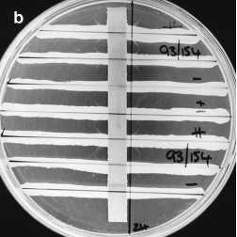
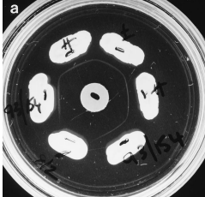
Diphtheria: laboratory investigation
Elek test
Conventional Elek test
large standard petri dish size (9 cm)
time to result 48 hours
nonspecific lines of precipitation
‘Modified’ Elek test
small petri dish (4.5 cm)
reduced amounts of anti-toxin used
time to result 24 hours (usually)
easier to read

Slide 15
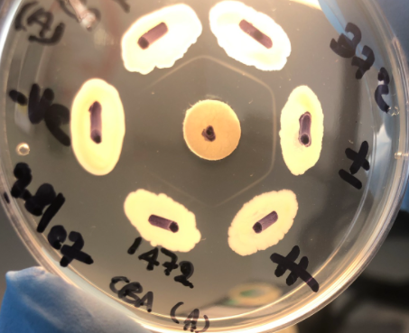
Modified Elek Test
TEST
TEST strain = positive
Immunoprecipitation line forms where diphtheria anti-toxin from disc meets diphtheria toxin from organism
C. diphtheriae strong positive
C. diphtheriae toxin negative
C. diphtheriae weak positive
C. diphtheriae strong positive
TEST

Slide 16
Non-toxigenic toxin-gene bearing bacteria (NTTB)
qPCR tox gene positive; Elek negative
most have mutations in coding region of diphtheria toxin gene
do not express diphtheria toxin
in UK sporadic cases from London and Manchester
cluster in hospital setting (skin clinic in a London hospital) 2014
investigation of a cluster with transmission of NTTB over a 7-year period reassures us there is no evidence of reversion to diphtheria toxin expression
now considered highly unlikely NTTB will gain the ability to become toxigenic
no public health action is now required for individuals with non-toxigenic strains or NTTB C. diphtheriae or C. ulcerans

Slide 17
Diphtheria laboratory service
What the reference laboratory expects:
Pure cultures of isolates on slopes submitted with our R3 request form
with provisional identification of:
C. diphtheriae
C. ulcerans
C. pseudotuberculosis
What the reference laboratory likes to know:
Method of identification (and score for MALDI)
Matrix assisted laser desorption ionization time of flight (MALDI-TOF)
API Coryne (BioMèrieux)
VITEK (BioMèrieux)

Slide 18
Diphtheria laboratory service
Monday to Friday: normal working hours
Isolates received by midday result by close
Isolates received late* afternoon (*depends how late) results by close or next day
Saturday service (Bank Holiday) out of hours
Isolates received by midday result by close
For queries out of hours, check UKHSA CSA/CMA out of hours on call rota which will provide contact details of diphtheria Senior Scientist on call

Slide 19
Diphtheria Reference Laboratory service – contacts
Vaccine Preventable Bacteria Section (VPBS)
Respiratory and Vaccine Preventable Bacteria Reference Unit (RVPBRU)
Bacteriology Reference Department (BRD)
UK Health Security Agency
61 Colindale Avenue
London
NW9 5EQ
DX address UKHSA Colindale Bacteriology, DX 6530002
Submission guidelines for samples can be found in the BRD user manual on www.gov.uk
Submit samples with the R3 request form
Please contact the lab to let them know you are sending a sample!
Monday to Friday:
BRD telephone 020 8327 7887 (staffed from 9am to 5.30pm, Monday to Friday)
Enquiries by email: rvpbruqueries@ukhsa.gov.uk
Head of VPBS
David Litt, david.litt@ukhsa.gov.uk (Clinical Scientist)
020 8327 7476
Saturday out of hours service:
Initial/clinical queries, contact the Colindale Duty Doctor via 020 8200 4400
For results, contact the Diphtheria Senior Scientist on call – as listed in the UKHSA CSA/CMA out of hours on call rota

Slide 20
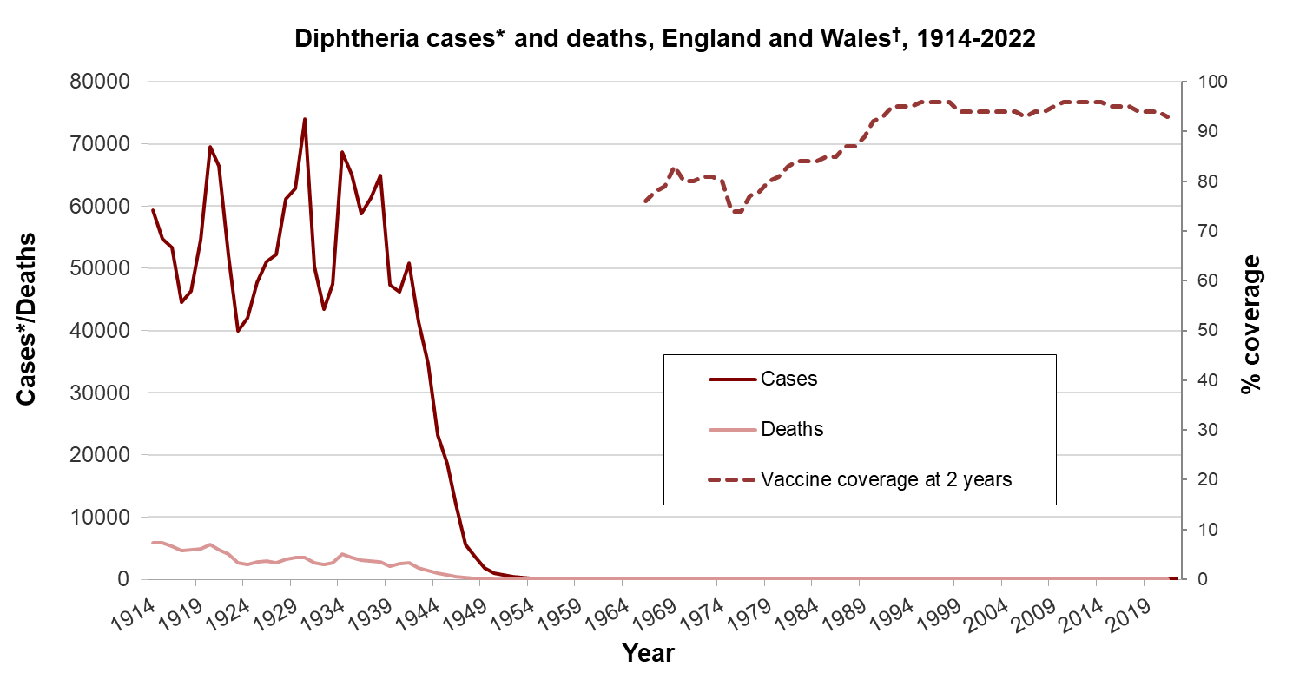
Epidemiology
Routine vaccination (1942)
* notifications up to 1985, laboratory confirmed cases 1986-2006, † from 2016 onwards, data is from England only
Notes:
Notifiable disease and organisms
61,000 cases and over 3,000 deaths in 1940 – feared childhood disease pre-vaccination era
Significant drop in deaths following introduction of vaccine programme
Vaccine is made from inactivated diphtheria toxin (toxoid) and protects individual from effects of the toxin.
Primary imms and then pre-school and school leaving boosters i.e. 5 doses in childhood.
Boosters – maternal pertussis programme and for travel
AND any CRM containing vaccine administered

Slide 21
Epidemiology, 2000 to 2023
increase in C. diphtheriae - travel associated, mostly cutaneous, may be vaccinated
C. ulcerans mostly associated with pets; lower % of non-toxigenic strains
  MALDI-TOF MS* is increasingly being used by local laboratories to identify gram-positive coryneforms
    may be partly responsible for increase in number of referred isolates and confirmed toxigenic isolates from skin or wound sites to the National Reference Laboratory
  National Standard Incident, March 2022
*Matrix Assisted Laser Desorption/Ionization – Time of Flight Mass Spectrometry
Notes:
Due to a highly successful and effective vaccination programme, diphtheria has been extremely rare in England, with <10 confirmed cases per year between 2009-2017. However, increases in toxigenic cases of C. ulcerans, primarily presenting as cutaneous lesions, were observed in England from 2018.
Since late 2021, there has been an increase in toxigenic cases of C. ulcerans and C. diphtheriae in England. This has raised significant concerns regarding further transmission as society begins to open-up and mixing patterns return to pre-pandemic levels. As a result, a National Standard Incident has been declared to coordinate the public health response to the changing epidemiology.
Since 2015 52% of tox diphtheria infections have been cutaneous, and cases of C. diphtheriae more likely to present as cutaneous infections
Increases in toxigenic cases of C. ulcerans, primarily presenting as cutaneous lesions, have been observed in England since 2018. This is, in part thought to be due to changes in local laboratory testing practices with increasing use of MALDI-TOF. In 2020, during the COVID-19 pandemic, there was a notable decrease in case numbers with only one case of toxigenic C. ulcerans reported. Since late 2021 cases for both C. ulcerans (n=8) and C. diphtheriae (n=3) have increased again across England.
Cases of C. ulcerans are predominantly occurring in adults aged over 45 and most cases appear to be linked to domestic pet exposure (primarily dogs and cats) raising questions about waning immunity from routine vaccination and animal-related risk factors. In late 2021, there were two deaths in older adults with confirmed toxigenic C. ulcerans infections.
Cases of toxigenic C. ulcerans are now also being regularly reported in animals without an associated human case. These situations require a joint public health and animal health investigation to ensure that transmission to close human contacts does not occur.
In addition to an increase of C. ulcerans cases observed across the country, a cluster of toxigenic C. diphtheriae cases in the Yorkshire and Humber region has been confirmed since late 2021, with the same bacterial strain that was identified in a previous cluster of indigenous cases from 2018. To date in 2022, there have been four confirmed diphtheria cases in England, including one toxigenic C. diphtheriae case with epidemiological links to the Yorkshire and Humber cluster and three toxigenic C. ulcerans cases including one cases presenting with classical respiratory diphtheria and a membrane, requiring DAT treatment.

Slide 22
All isolates tested at PHE/UKHSA from England, 2012 to 2022
*includes isolates from animals
2017 to 2022 † (human, UK Residents Only):
Average 6% C. diphtheriae
toxigenic
Average 60% C. ulcerans toxigenic
† excludes 2020

Slide 23
Diphtheria cases by clinical presentation,
England, 2000 to 2022
PCR service commences April 2014

Slide 24
Number of cases of toxigenic C. ulcerans and toxigenic C. diphtheriae in humans and animals, England, 2012 to 2022

Slide 25
Number of toxigenic C. ulcerans human index and toxigenic C. diphtheriae cases, England, 2012 to 2022

Slide 26
Summary of human cases with toxigenic C. ulcerans
11 cases of toxigenic C. ulcerans reported in 2022
  Presentation:
    4 cutaneous lesions
    1 classic respiratory with membrane
    1 cutaneous & respiratory
    4 asymptomatic – all of whom were contacts of confirmed cases
    1 pleural fluid
  Risk factors identified
    all had contact with domestic pets in a household setting
    1 had reported a history of foreign travel but symptoms pre-dated travel
    1 reported consumption of unpasteurised dairy products as well as animal contact (pet)
  Two family/household clusters
Notes:
Can present as respiratory diphtheria
May have severe outcomes
Case to case transmission not definitely recognised but case studies suggest this is a possibility, including in UK.
Chemoprophylaxis therefore recommended for contacts of cases of toxigenic C ulcerans

Slide 27
Summary of animal cases with toxigenic C. ulcerans 2014 to 2021
Since 2017, 14 animal index cases detected in England:
7 were dogs, 6 cats and one horse
8 presented with cutaneous lesions and 7 with respiratory signs
all PCR positive for C. ulcerans and toxin gene
all Elek positive
over 130 human contacts (household, veterinary and other) identified and swabbed
  all negative for C. ulcerans
over 30 animal contacts identified
  all animals were clinically well
  swabs, where available, were all negative for toxigenic C. ulcerans
close collaborative working with APHA has been vital to the management of these case
 | Total cases | Cutaneous | Respiratory
Dog | 7 | 4 | 3
Cat | 6 | 4 | 2
Horse | 1 | 0 | 1
Notes:
2022: 4 animal cases: 2 dogs, 2 cats

Slide 28
Outbreak of C. diphtheriae among asylum seekers, 2022
During 2022, 73 cases of diphtheria were identified among asylum seekers arriving by small boats to the UK; a similar increase in cases among migrants was reported across Europe. The majority of cases were of Afghani origin (78%) and reported extensive travel across Europe before arriving to the UK. Most cases were identified in the South East region of England.
Cases were predominantly presenting with infected skin lesions with onset prior to arrival in England (n=36). However, respiratory infections were also common including:
3 cases with severe respiratory diphtheria requiring hospitalisation, 2 of whom received treatment with diphtheria anti-toxin and 1 fatality in individual with C. diphtheriae detected on throat swab
10 cases with mild respiratory symptoms
20 cases with respiratory carriers
2 cases with both cutaneous and respiratory symptoms
2 cases with other presentations

Slide 29
Management of suspected case of diphtheria
Risk assess possible or probable
PROBABLE and CONFIRMED cases require public health action
POSSIBLE cases – public health action may be delayed unless concerning features
  Epi factors increasing likelihood of toxigenicity:
    immunisation history
    occupation
    travel or contact with traveller
    contact with animals
    raw dairy produce consumption
? high public health risk
  for example: healthcare worker, unimmunised, recent travel
ensure isolates sent to UKHSA RVPBRU
isolate patient / barrier nurse
consider antibiotic treatment on clinical grounds
Notes:
risk assess and classify as possible or probable
probable and confirmed cases require initiation of public health action
possible cases – public health action may be delayed unless concerning features
epidemiological factors increase likelihood of toxigenicity
immunisation history
occupation
travel or contact with traveller
contact with animals
raw dairy produce consumption
high public health risk e.g. healthcare worker, unimmunised and recent travel
toxigenicity results will be delayed over 24 hours
ensure isolates sent to UKHSA RVPBRU
if in hospital, isolate, barrier nurse. If at home, restrict contact.
consider antibiotic treatment on clinical grounds

Slide 30
Management of cases
If PCR toxin gene positive and confirmed Elek positive (that is, toxigenic)
admit, isolate and institute droplet and/or contact precautions (unless very well or asymptomatic)
consider antitoxin (DAT)
give antibiotic treatment for 14 days (7 to 10 days if azithromycin)
identify and manage close contacts
convene an IMT (include APHA if C. ulcerans)
provide written info and advice including exclusion from high risk occupation until clearance confirmed
If PCR toxin gene positive and Elek negative (NTTB strain), stop public health actions.

Slide 31
Management of cases
after completion of antibiotic treatment take a single swab from each site – nose, throat and wound (where applicable)
  swabs should be taken at least 24 hours after stopping antibiotics and repeated again after (at least) a further 24 hours
if swabs are positive for a toxigenic strain, discuss further 10 days of antibiotics with microbiologist
asymptomatic carriers of toxigenic strains should be treated with same antibiotic regime as cases with appropriate swabs taken on completion of therapy to ensure eradication

Slide 32
Management of cases
If a dose of diphtheria-containing vaccine has not been given in the last 12 months to:
immunised children up to 10 years of age – one injection of adsorbed diphtheria containing vaccine (either Td/IPV, dTaP/IPV or DTaP/IPV)
immunised children aged 10 years and over, and adults – one injection of adsorbed low-dose diphtheria-containing vaccine for adults (for example, Td/IPV)
unimmunised children under 10 years of age – 3 injections of adsorbed full dose diphtheria-containing vaccine (for example DTaP/IPV/Hib/HepB) at monthly intervals
unimmunised children aged 10 years and over, and adults – 3 injections of adsorbed low-dose diphtheria-containing vaccine (for example, Td/IPV) at monthly intervals
a person with immunisation status unknown – where there is no reliable history of previous immunisation, it should be assumed that they are unimmunised and follow as above

Slide 33


Diphtheria anti-toxin (DAT)
mortality rates for clinical diphtheria frequently exceeded 50% in pre-anti-toxin era
dramatic declines in mortality in those treated (mortality 3.3% in treated compared with 12.2% in untreated in one clinical trial)
early treatment critical
discuss with ID clinician
  DAT only for confirmed or probable cases
  give DAT without waiting for laboratory confirmation for classical respiratory diphtheria presentations
DAT is extracted from horse serum – check for allergies
SUPPLIES ARE LIMITED
Notes:
Mortality increased progressively within the interval from onset of illness to treatment, with a sharp increase from 4% mortality in those treated with antitoxin within 24-48 hours to 16.1% in those treated on the third day of illness". USE OF DIPHTHERIA ANTITOXIN (DAT) FOR SUSPECTED DIPHTHERIA CASES (cdc.gov) - Naiditch MJ, Bower AG. Diphtheria. A study of 1433 cases observed during a ten year period at the Los Angeles Count
mortality rates for clinical diphtheria frequently exceeded 50% in pre-antitoxin era
dramatic declines in mortality in those treated (mortality 3.3% in treated compared with 12.2% in untreated in one clinical trial)
early treatment critical (protection inversely related to duration of clinical illness preceding administration)
toxin fixes to susceptible cells early in disease and fixed toxin not neutralised by DAT
discussion with ID clinician
DAT only for confirmed or probable cases
Give DAT without waiting for laboratory confirmation for classical respiratory diphtheria presentations
DAT is based on horse serum – check allergies
Anaphylaxis occurs more commonly than with human immunoglobulin products
SUPPLIES ARE LIMITED
Hospital. Am J Med. 1954;17:229-45

Slide 34
Management of close contacts – who?
household type setting
kissing or sexual contacts
childminder or carer with regular contact for 6 hours or more
exposure to respiratory droplets or secretions
exposure to undressed wound of cutaneous case
healthcare and outreach workers should be risk assessed (considering PPE use)
  minimum PPE = disposable gloves and aprons for wound care and, depending on the situation, either a fluid repellent surgical face mask or a FFP3 mask for any aerosol generating procedures
    if no gloves were worn during wound assessment but there was likely no splash or droplet contamination and prompt hand washing occurred, may not be considered as close contacts
  for respiratory cases, health care workers who have given mouth to mouth resuscitation to or intubated the index case (without appropriate PPE) would normally be considered as close contacts

Slide 35
Management of close contacts – actions
inform contact (and GP, Occupational health as appropriate)
  advise self-monitoring for 10 days from date of last contact with case
nose and throat swabs as well as swabs of any skin lesions (if present)
offer chemoprophylaxis with antibiotics according to national guidance
exclude from high-risk occupations until bacteriological clearance is confirmed
immunise as appropriate
if the contact becomes symptomatic then arrange urgent clinical assessment
if a contact is positive for a toxigenic strain, then manage them as a confirmed case
If the index case is discarded, then stop public health actions

Slide 36
Management of contacts of C. ulcerans
perform risk assessment of potential animal source in collaboration with APHA
  nature of contact
  symptoms in animal
consider need to determine carriage in animal via testing
APHA advise on appropriate antibiotic treatment for animals found to be positive for C. ulcerans
confirm clearance in the animal, testing 5 to 7 days following completion of antibiotics

Slide 37
Challenges in zoonotic investigations
natural history of toxigenic C. ulcerans in animals not well understood
      may be too late after the animal-human exposure period
      it is difficult to take nose/throat swabs from animals!
not every veterinary lab may be aware of the public health implications so may not send samples for toxin testing
      RVPBRU, Colindale is the only lab in the country offering diphtheria toxin and Elek testing for isolates from humans and animals
      considering further awareness raising for vets/veterinary labs
    risks of overwhelming specialist service with animal samples, not human ones
    costs of animal testing
payment for repeat swabbing and follow up of other animals
treatment of animals in the household
    important to consider treatment even if animal swabs negative as a negative swab does not exclude C. ulcerans carriage in an animal
Notes:
Natural history of toxigenic C. ulcerans in animals is not well understood
Negative swabs do not rule out the animal as a potential source of infection
May be too late after the animal-human exposure period
It is difficult to take nose/throat swabs from animals!
Need to better understand risk factors for transmission to humans
There could be more cases in animals, but not every veterinary lab may be aware of the public health implications so may not send samples for toxin testing
RVPBRU, Colindale is the only lab in the country offering diphtheria toxin and Elek testing for animals?
Considering further awareness raising for vets/veterinary labs
Risks of overwhelming specialist service with animal samples, not human ones
Costs of animal testing
Payment for repeat swabbing and follow up of other animals
How best to manage incidents where owners can’t afford this or refuse
Treatment of animals in the household
May be difficult to get agreement for antibiotic treatment if animals tests negative on swabbing If they test negative on swabbing, would you still give antibiotics?

Slide 38
Case study
Call to the Colindale duty doctor on a Sunday 2.11pm:
87 year old female, normally fit - lives alone
admitted to hospital unwell few days ago with nasal congestion, sore throat and difficulty swallowing over 5 days
noted to have stridor, CT showed diffuse pharyngeal swelling, deteriorated
now in respiratory distress and so ventilated on ICU on inotropic support
on bronchoscopy, large amount white adherent material - no pictures taken
no history, trying to find daughter
What could this be?
How would you classify the case and what would you do next?

Slide 39
Case definition and initial actions
Probable case:
classic respiratory diphtheria (URTI with sore throat, low grade fever, adherent membrane of tonsils, pharynx or nose) + no epi-link + no lab confirmation
As per guidance, actions for confirmed and probable cases:
notification
organise IMT
isolation (for droplet borne infection and/or direct contact measures-side room, gloves, apron, surgical mask )
specialist referral
anti-toxin
antibiotics

Slide 40
Next steps
arranged to deliver Diphtheria anti-toxin (DAT) same evening
patient improving
local team decides to treat once the anti-toxin arrives if deteriorates (prior to any microbiological test result), or if positive culture
What is the recommended timing for DAT administration?
What are the implications of waiting for lab confirmation?

Slide 41
Guidance
Guidance:
  patients with suspected respiratory diphtheria should be placed in strict isolation and treated on clinical grounds; therapy should not be delayed until bacteriologic confirmation
  anti-toxin is mainstay of therapy – early treatment essential for best outcomes
  neutralizes only circulating toxin not yet bound to tissue- prompt administration is critical
  treat with appropriate antibiotics (as per national guidance) to eradicate organism, terminate toxin production and decrease likelihood of transmission
Patient went into atrial fibrillation (AF) again and received anti-toxin same night.

Slide 42
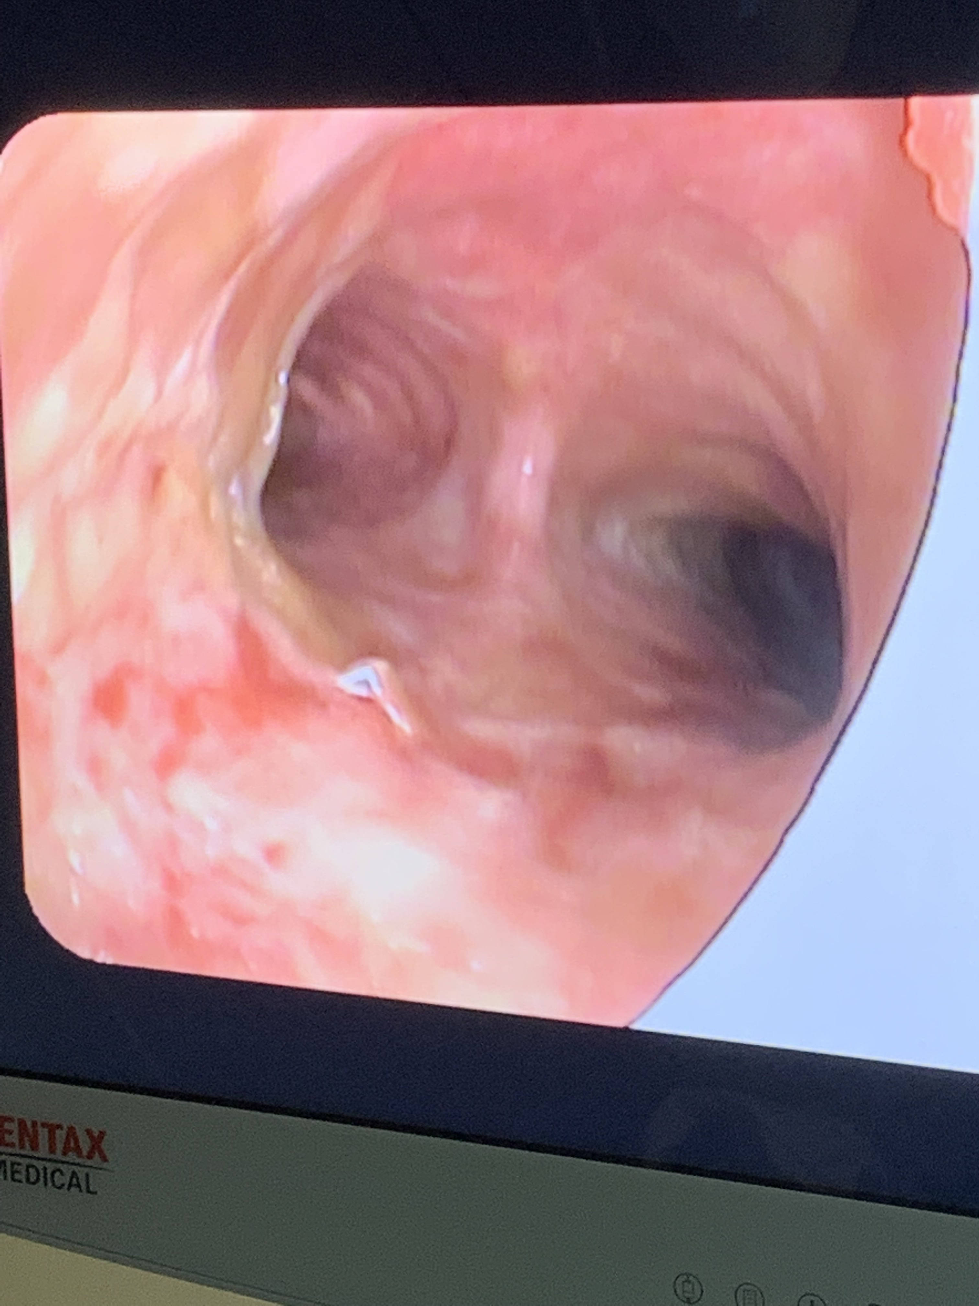
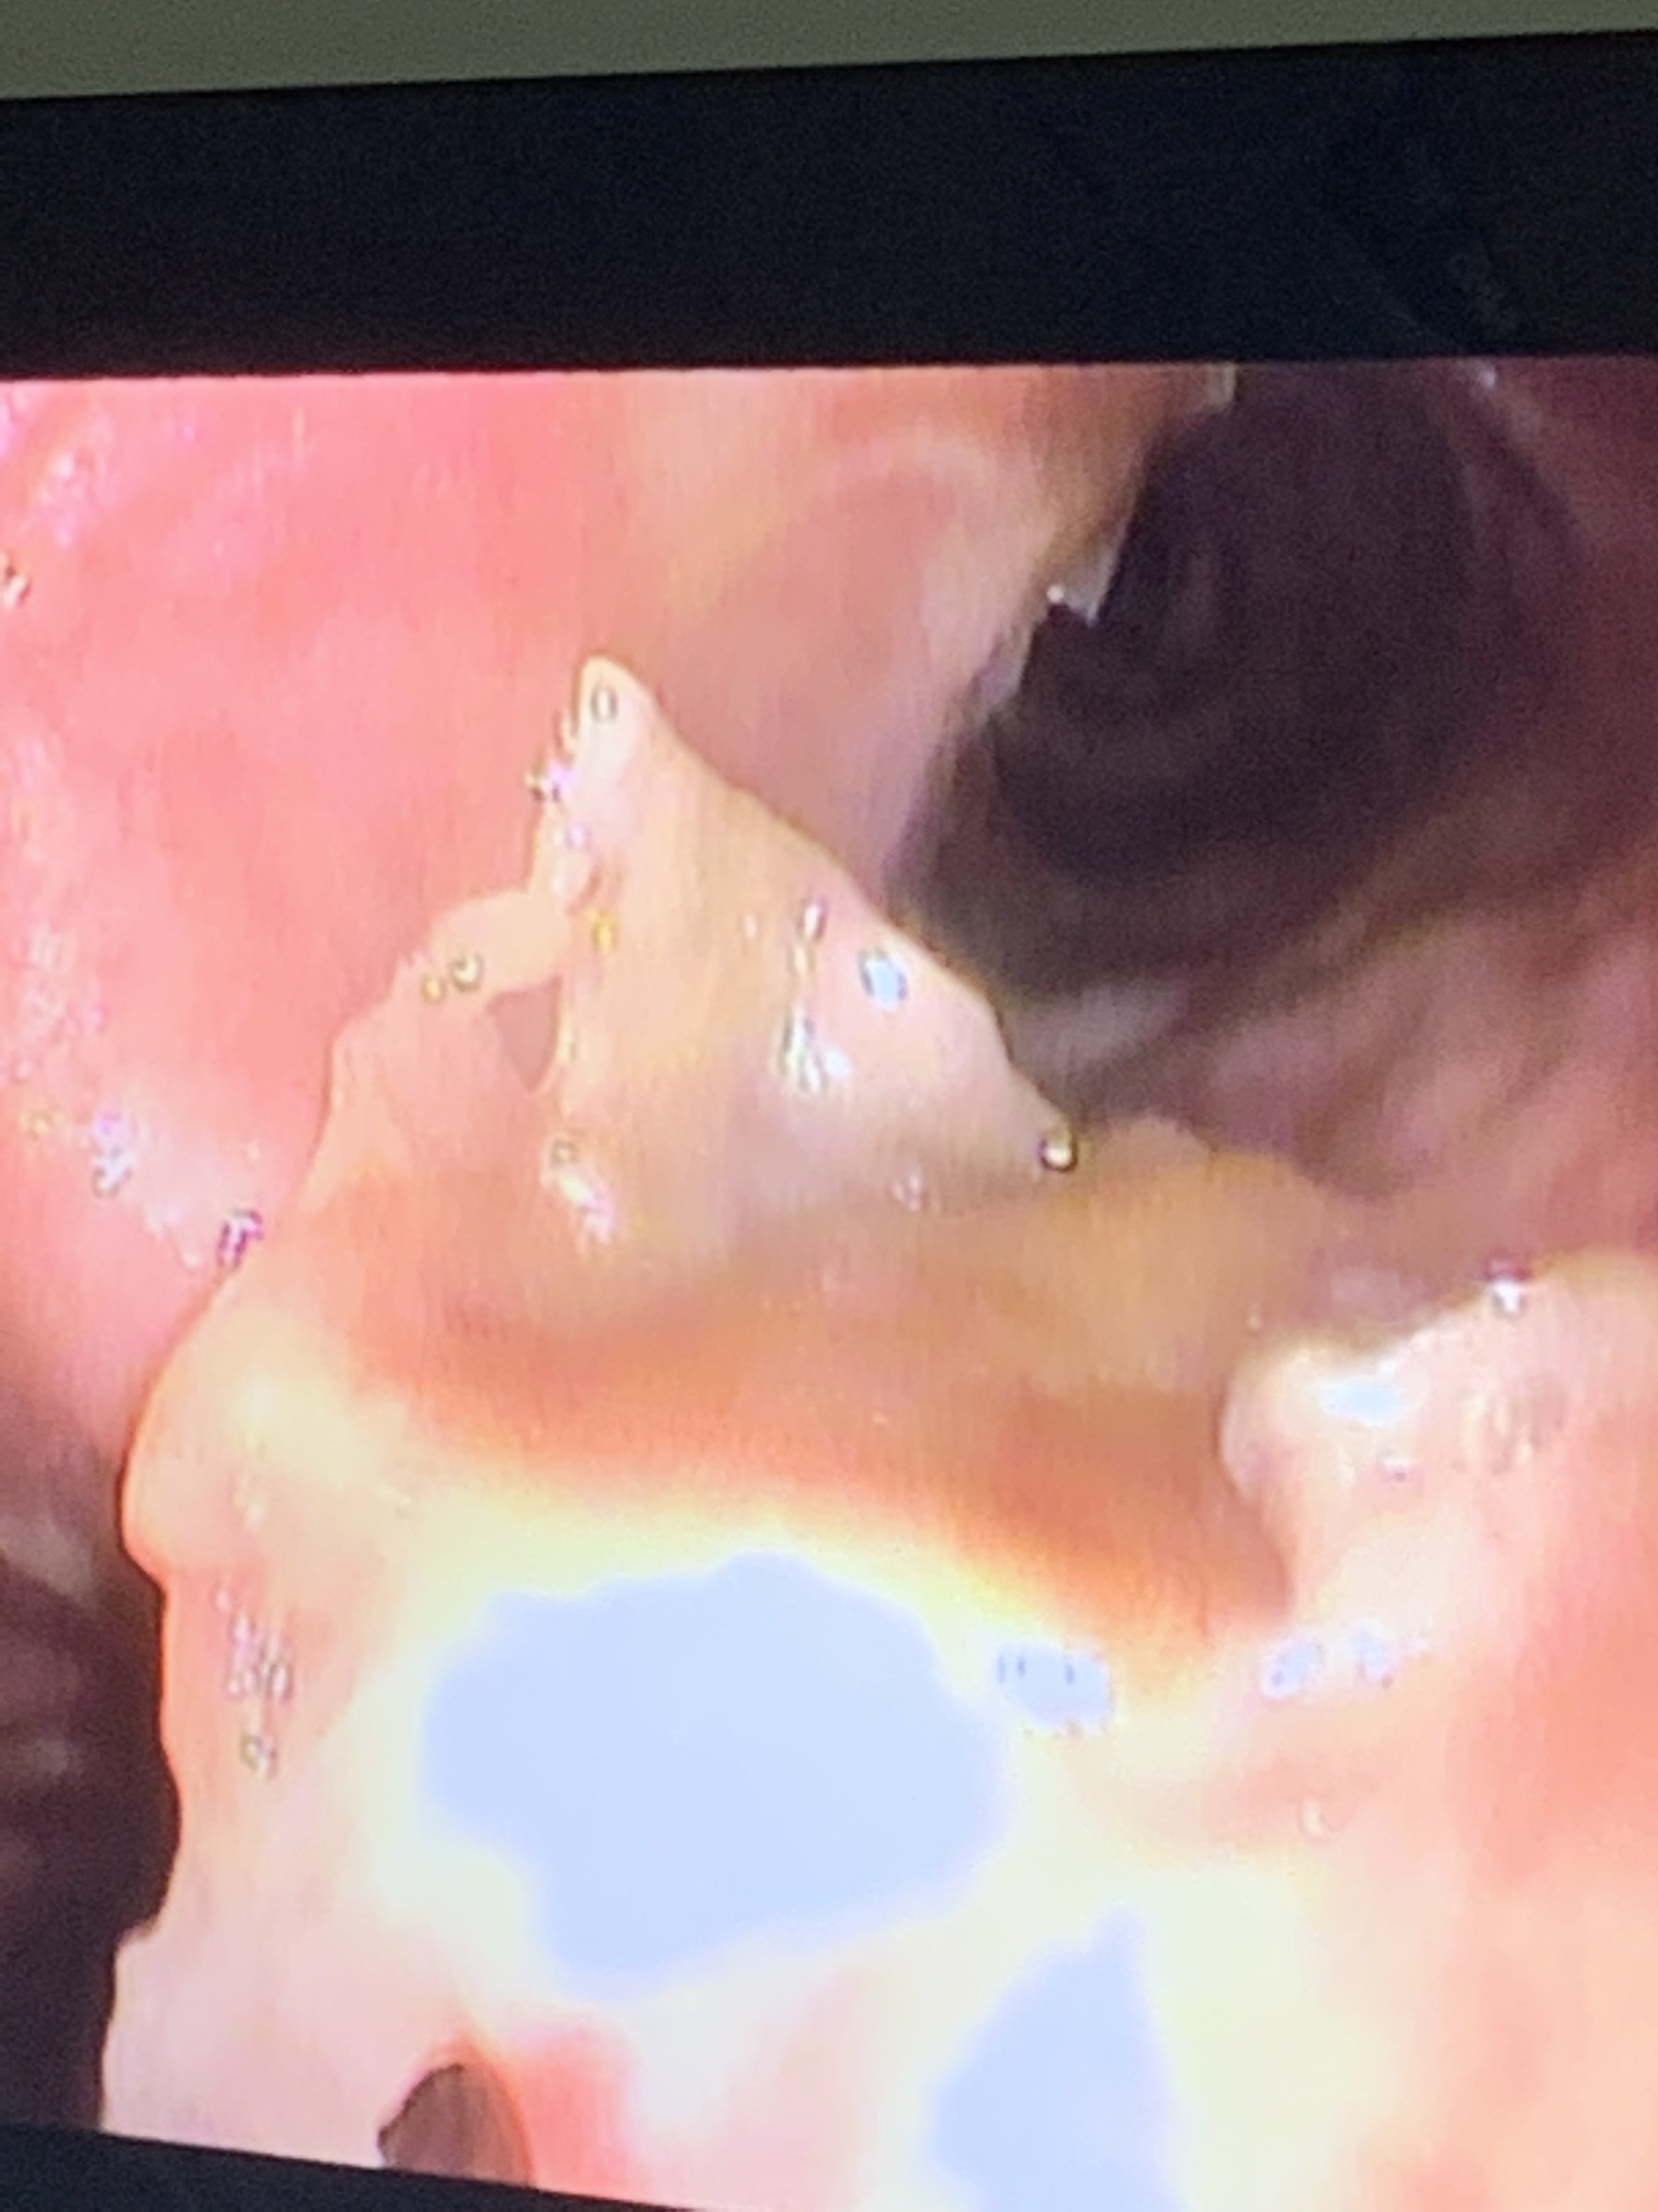
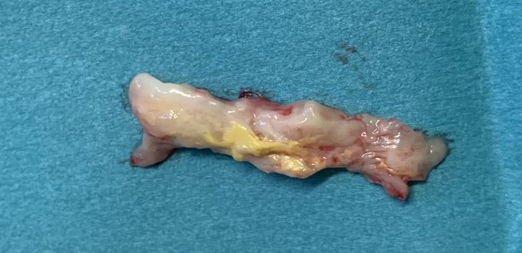
Bronchoscopy

Slide 43
Additional history
case lives alone
no travel history or overnight stays for 10 days prior to onset of symptoms
no pets or known contact with any cases
looked after daughter’s dog 4 days before onset for approximately 2 hours. Dog remains well
not been in contact with anyone except immediate family, who are all clinically well
What laboratory results do you expect?

Slide 44
Laboratory results
Local laboratory
  cultured membrane - Corynebacterium ulcerans grown
RVPBRU, Colindale
  Corynebacterium ulcerans/ pseudotuberculosis PCR positive
  toxin gene PCR positive
  Elek test positive
What should be done next?

Slide 45
Management of close contacts
3 doctors involved in intubation - no PPE
close contacts of confirmed/probable cases/asymptomatic carriers in high-risk occupations should be excluded from work, swabbed and started on chemoprophylaxis
  food handlers (especially milk production)
  health and social care workers
  those who work with unimmunised children
exclusion 48 hours, if swabs clear and on antibiotics can go back to work.
if swabs positive need to complete treatment and have clear nose and throat swabs before returning
In this case – 7 days azithromycin, swabs negative at 48 hours, resumed work and had another swab 24 hours after completed antibiotics.
What else needs to be considered?

Slide 46
Consider source of infection
Identify any history of exposure to animals or unpasteurised dairy products
Consider:
  domestic settings - companion animals
  farms - potential for contact with multiple animals or species
arranged for daughter’s dog to have a throat swab – negative
a second dog in the family was also swabbed and tested negative
daughter’s vaccination status checked and advised on signs and symptoms
What else should be considered as part of the overall management of case and contacts?

Slide 47
Vaccination
Immunisation for contacts
  health professionals –
    for those appropriately immunised for age but no vaccination within the last 12 months, to be given a booster vaccination
    for those who are not appropriately immunised, a diphtheria-containing dose should be given immediately, and the schedule completed according to the guidelines available on vaccination of individuals with uncertain or incomplete vaccination history
    Vaccination of individuals with uncertain or incomplete immunisation status
Immunisation for case
  cases should be immunised once clinically stable
  recommendations for immunisations are based on vaccination history

Slide 48
Recommended immunisations according to age and status for cases of confirmed or probable diphtheria
If a dose of diphtheria-containing vaccine has not been given in the last 12 months to:
immunised children up to 10 years of age – one injection of adsorbed diphtheria containing vaccine (either Td/IPV, dTaP/IPV or DTaP/IPV)
immunised children aged 10 years and over, and adults – one injection of adsorbed low-dose diphtheria-containing vaccine for adults (for example, Td/IPV)
unimmunised children under 10 years of age – 3 injections of adsorbed full dose diphtheria-containing vaccine (for example DTaP/IPV/Hib/HepB) at monthly intervals
unimmunised children aged 10 years and over, and adults – 3 injections of adsorbed low-dose diphtheria-containing vaccine (for example, Td/IPV) at monthly intervals
a person with immunisation status unknown – where there is no reliable history of previous immunisation, it should be assumed that they are unimmunised and follow as above

Slide 49
UK immunisation schedule (diphtheria)
Age due | Disease protected against | Vaccine given (Trade name)
8 weeks | Diphtheria, tetanus, pertussis (whooping cough), polio and Haemophilus influenzae type b (Hib) and hepatitis B | DTaP/IPV/Hib/HepB (Infanrix hexa or Vaxcelis)
12 weeks | Diphtheria, tetanus, pertussis, polio, Hib and hepatitis B | DTaP/IPV/Hib/HepB (Infanrix hexa or Vaxcelis)
16 weeks | Diphtheria, tetanus, pertussis, polio, Hib and hepatitis B | DTaP/IPV/Hib/HepB (Infanrix hexa or Vaxcelis)
3 years 4 months or soon after | Diphtheria, tetanus, pertussis and polio | DTaP/IPV (Boostrix-IPV)
14 years old (school year 9) | Tetanus, diphtheria and polio | Td/IPV (Revaxis)

Slide 50
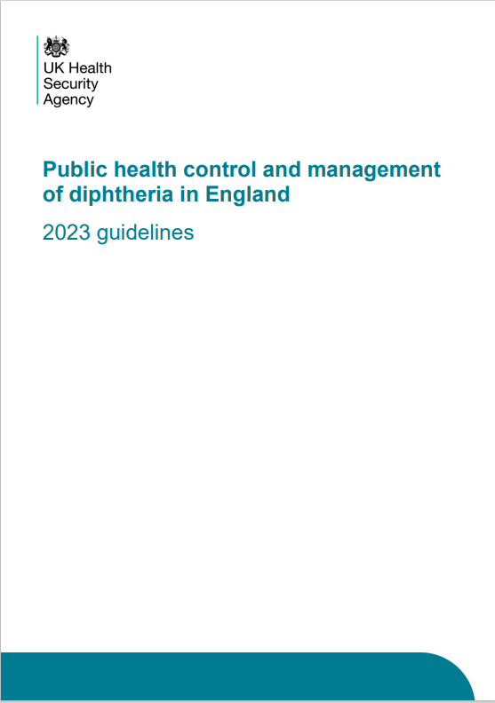
Thank you
Any questions?
Resources:
Public health control and management of diphtheria in England – 2023 guidelines
Supplementary guidance for cases and outbreaks in asylum seeker accommodation settings
Diphtheria anti-toxin: clinical guidance
DAT: Information for healthcare professionals
Public health management of toxigenic C. ulcerans in animals

