Slide 1
TB awareness training for healthcare staff in prisons and places of detention
Public Health England group developing national prisons TB resources
March 2021

Slide 2
Using this slide pack
This slide pack can be used for presenting to a group or for your own learning.
You can add to or amend the information to make the slides specific to your local needs
You can use the notes provided in a few sections below the slides to assist with your script
Notes:
If presenting to a group:
You can use the notes section below the slides to assist with your script.
You can add further information to the slides specific to your organisation.
Don’t forget to delete this slide beforehand.
If you are reading the slides for your own learning:
Make sure you read the notes section below the slides for further information about the bullet points on the slides.
To print out slides with the notes - go to
‘File’ then ‘Print’
Under ‘Settings’ in the ‘Slides’ menu click the drop-down arrow next to ‘Full Page Slides’
Under ‘Print Layout’, click ‘Notes Pages’
Then click the ‘Print’ button

Slide 3
Learning objectives
Strengthen knowledge of TB and Latent TB infection
Describe key principles of detecting TB in PPDs
Understand what to do if a prisoner has or is suspected of having TB:
  Management and support of the patient
  Infection control and appropriate isolation
  Discharge/release or transfer planning
  Principles and importance of contact tracing

Slide 4
Suggested professionals who could deliver these slide sets
TB nurses
Healthcare professionals in prison
Staff in local health protection teams

Slide 5
Glossary of acronyms
CXR Chest X-ray
ECG Electrocardiogram
DOT Directly Observed Therapy
FFP3 Filtering Face Piece with an assigned protection factor (20)
IGRA Interferon Gamma Release Assay
LTBI Latent TB Infection
MDR/XDR Multi-drug resistance / extremely drug resistant
NOK Next of Kin
TB Tuberculosis
  TST Tuberculin Skin Test
  PPD Prisons and Places of Detention

Slide 6
Overview
Quiz
What is TB?
How is TB spread?
Active or Latent TB
Symptoms of TB
Risk factors for TB
Diagnosis
Treatment
What happens when a case of TB is transferred to or diagnosed in PPD
Discharge/release or transfer planning
Contact screening
Duty of care for healthcare prison and health care staff
Summary

Slide 7

Test your knowledge about TB!
Question | True | False
TB is a disease that only occurs in the lungs
Latent TB infection is not infectious
If someone with TB coughs, those around them will automatically catch the infection
You can catch TB by sharing eating utensils with an infected person
TB can be passed from person to person via coughs/sneezes
Someone can have TB of the lungs or throat with minimal risk of passing the infection on to others
Only certain groups of people develop TB
Most people with TB will die as a result of the infection

Slide 8
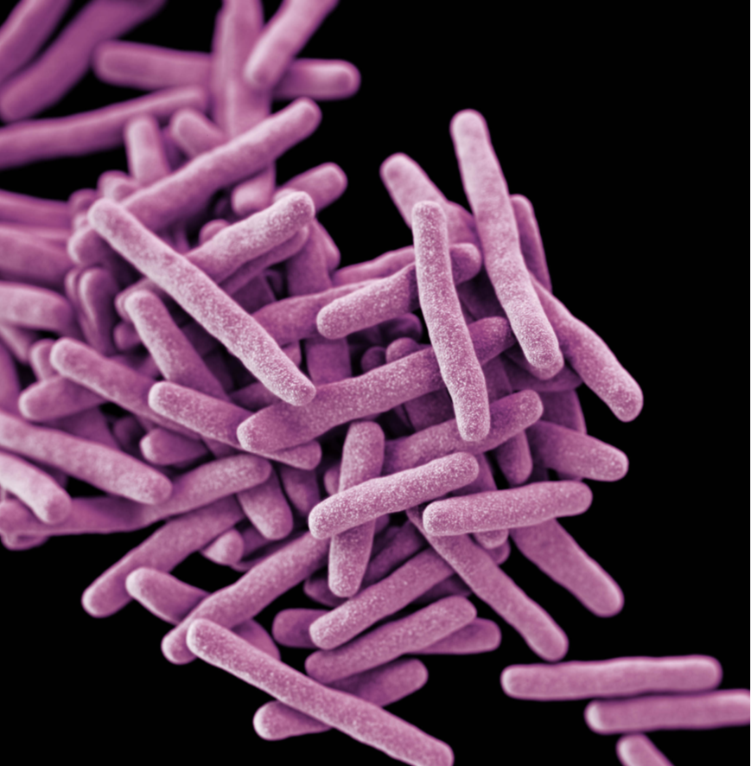
What is TB?
Tuberculosis (TB) is a bacterial infection
(caused by Mycobacterium tuberculosis)
TB most commonly affects the lungs but occurs in any part of the body, including the abdomen, bones and brain – this is referred to as ‘Active TB’
Only pulmonary, laryngeal or tonsillar TB including miliary TB is infectious
Delays in treatment can cause serious illness and even death, if left untreated
Most people exposed never develop symptoms. The bacteria can live in an inactive form in the body – this is referred to as ‘Latent TB Infection’(LTBI)
Courtesy CDC
Notes:
New cases of TB in England have fallen to their lowest levels since records began in 1960.
44% drop in new diagnosis from 2011 to 2018.

Slide 9
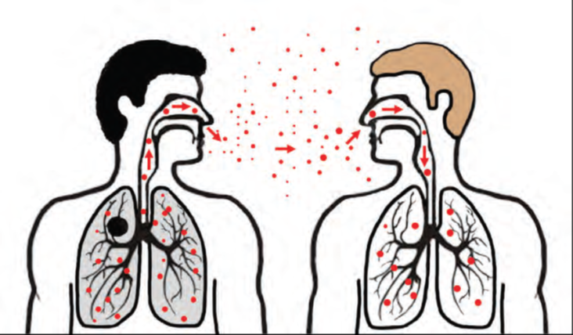
How is TB spread?
Generally only tonsillar, laryngeal and pulmonary TB are infectious.
TB is spread from person to person through the air. The TB bacteria are put into the air when a person with TB disease of the lungs or throat coughs, speaks or sings. People nearby may breathe in these bacteria and become infected.
https://www.youtube.com/watch?app=desktop&v=IGZLkRN76Dc&ab_channel=M%C3%A9decinsSansFronti%C3%A8res%2FDoctorsWithoutBorders

Slide 10


Cycle of transmission
TB exposure
TB infection*
Latent TB infection**
Active TB disease
70-90% No TB infection
*Around 5-10% of people infected develop active TB straight away
** The rest develop LTBI. Around 10% of people with LTBI will go on to develop Active TB at some point during their lifetime if untreated.
10-30%
10 TB awareness training for healthcare staff in prisons and places of detention

Slide 11
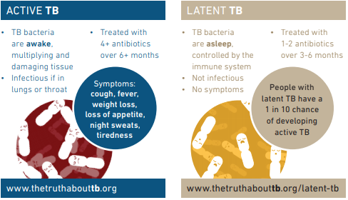
Active or Latent TB
11 TB awareness training for healthcare staff in prisons and places of detention
TB awareness training for healthcare staff in prisons and places of detention
Notes:
This slide demonstrates the differences between Active TB and Latent (LTBI) TB.
Active: infectious, has symptoms and requires long treatment with specific antibiotics
Latent: NOT infectious, no symptoms and can be treated with specific antibiotics usually over a short time. Can ‘reactivate’ and become Active TB, so important to identify those with LTBI and treated accordingly.

Slide 12




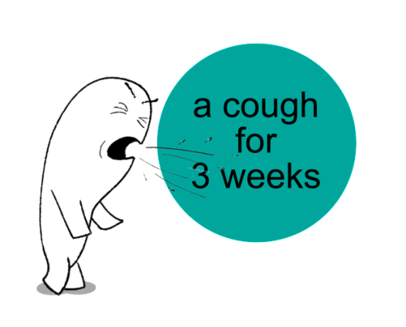

Symptoms
    General symptoms of TB disease: Weight loss, fatigue, malaise, fever and night sweats
    Pulmonary: Coughing, pain in chest, coughing up sputum or blood
    Extrapulmonary: Depends on the part of the body that is affected by the disease. For example, TB of the spine may cause pain in the back; TB of
    the kidney may cause blood in the urine.

Slide 13
Latent vs. TB Disease
Person with LTBI | Person with TB Disease (in the lungs)
Sputum smears and cultures negative | Sputum smears and cultures may be positive
Consider treatment for LTBI to prevent TB disease | Needs treatment for TB disease
Does not require isolation | May require respiratory isolation
Not a case of TB | A case of TB
Notes:
Review each row of the table, comparing LTBI and TB disease
Refer participants to p. 12 to follow along
LTBI vs. TB Disease – Module 1, p. 12

Slide 14
Latent vs. TB Disease
Person with LTBI | Person with TB Disease (in the lungs)
Has a small number of TB bacteria alive, but under control | Has a large number of active TB bacteria in his or her body
Cannot spread TB to others | May spread TB bacteria to others
Does not feel sick, but may become sick | May have symptoms such as cough, fever, or weight loss
Blood tests positive | Blood tests positive
Chest X-ray usually normal | Chest X-ray usually abnormal
Notes:
Review each row of the table, comparing LTBI and TB disease
Refer participants to p. 12 to follow along
LTBI vs. TB Disease – Module 1, p. 12

Slide 15
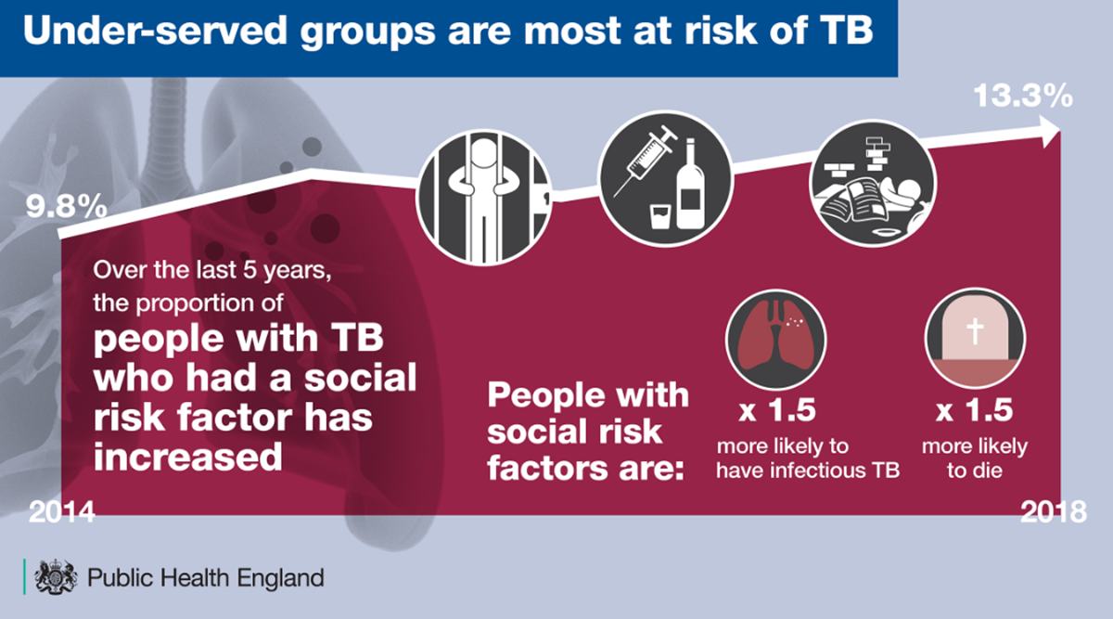
Risk groups for TB infection
Certain groups are more at risk of being exposed to TB including people with social risk factors including history of substance misuse, imprisonment
and homelessness.
The infographic below shows how proportion of TB cases in England with a
social risk factor has increased in the past 5 years.
People who have lived in high incidence countries are also more at risk of TB infection.

Slide 16
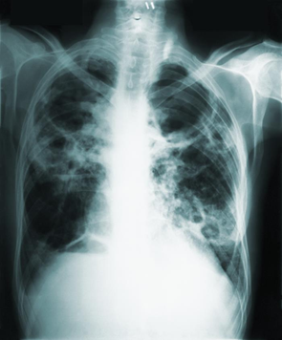
Risk groups for developing active infection
Certain groups of people with latent TB infection are at increased risk of going on to develop active TB, including people who (NICE, 2016):
      are HIV-positive
      are younger than 5 years
      have excessive alcohol intake
      are injecting drug users
      have diabetes
      have had solid organ transplantation
      have a haematological malignancy
      are having chemotherapy
      have had a jejunoileal bypass
      have chronic kidney disease or receive haemodialysis
      have had a gastrectomy
      are having treatment with anti-tumour necrosis factor-alpha or other biologic agents
      have silicosis
courtesy CDC

Slide 17
Diagnosis
TB is diagnosed using a combination of tests as well as medical history.
This includes:
Tests for TB infection – this measures immune response and does not differentiate between active and latent.
  - IGRA Interferon Gamma Release Assay
  - Tuberculin skin test (TST) / Mantoux
    Microbiology
    - Bacteriologic examinations
    - Genetic sequencing: WGS (Whole Genome Sequencing)
    Medical history
    Physical examination
    Radiology (Chest X-ray and CT scan)

Slide 18
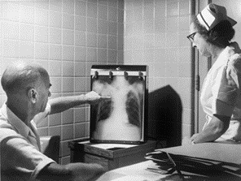
Healthcare team in PPDs can assist with the diagnosis
Symptom check in healthcare reception
If you suspect a prisoner has TB:
  make medical assessment including symptom check
  take 3 sputum specimens for AFB (acid fast bacilli) and culture on consecutive days. At least one should be an early morning specimen. Ensure good quality specimens and careful labelling to avoid delayed diagnosis
  carry out chest X-ray - this may be onsite or arranged via the local hospital
courtesy CDC
If TB is suspected or confirmed contact the local TB service and Public Health England Health Protection Team

Slide 19
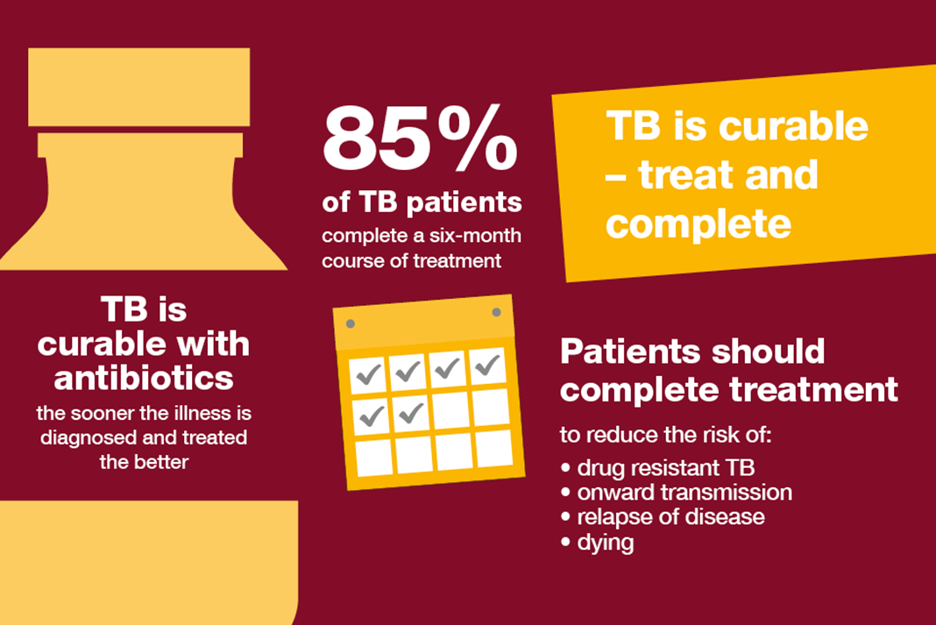
About Active TB
TB is curable
Generally people stop being infectious 2 weeks after completing treatment
Generally people stop being infectious 2 weeks after compliant treatment, but the following should be taken into account: resolution of cough, clinical improvement in symptoms, the initial smear status and extent of disease (NICE guidance) https://www.nice.org.uk/guidance/ng33

Slide 20
Active TB treatment
TB treatment lasts for 6 months or longer. Standard TB treatment is:
  - 2 months of quadruple therapy: initial treatment phase (Isoniazid, Rifampicin, Pyrazinamide, Ethambutol)
      - followed by 4 months of dual therapy: continuation phase (Isoniazid and Rifampicin)
      - other regimens may be required
Ensure patient is aware of any side effects of medications. Liaise with the local TB nurses if the patient experiences side effects
Multidrug-resistant TB requires a much longer course of antibiotics; between 9 to 24 months depending on the strain. Multidrug-resistant TB tends to have less favourable outcomes than standard TB

Slide 21
Opiate substitute therapy and TB
Rifampicin increases the metabolism of methadone via enzyme induction and leads to increased methadone requirements. This varies between 30% and 100% of baseline.
The subsequent withdrawal symptoms are not only unpleasant but may lead to increased use of illicit drugs and decreased adherence to anti-tuberculosis drugs.
ECG monitoring for individuals on high doses of methadone (80mls and above) and TB medication to monitor for QT interval.

Slide 22
Alcohol and TB
Rifampicin increases the metabolism via enzyme induction and individuals who are alcohol dependent should have LFT checked prior to commencing TB medications and within the first 2 months of treatment
Individuals who are alcohol dependent should avoid alcohol, and this can cause issues with adherence with their TB medications

Slide 23
Active TB treatment
Patients must comply with their treatment as prescribed to prevent drug resistance.
Drug resistant TB can be more difficult to treat.
Where infectious MDR/XDR (multi-drug resistance or extremely drug resistant) TB is suspected/confirmed, transfer to NHS hospital care is the preferred option as PPDs are generally not equipped to manage cases of this complexity.

Slide 24
Directly observed therapy (DOT) & treatment monitoring
All prisoners MUST be observed taking medication.
Anti TB drugs must never be given ‘in possession’
Treatment should be taken on an empty stomach 1 hour before breakfast - it is very important for prisoners to have their treatment on time
A named nurse to review medication compliance throughout treatment and liaise with TB nurse
Non compliance should be reported immediately to the TB nurse/service

Slide 25
Isolation: when?
Prisoners should be isolated when there is:
  high clinical suspicion of pulmonary/laryngeal/tonsillar TB
  abnormal chest X-ray with suspicion of TB
  confirmed pulmonary TB and compliant with treatment, for at least the first 2 weeks of treatment and subject to agreement with the local TB service
  confirmed pulmonary TB and non-compliant with treatment, for as long as deemed necessary by the local TB service and Public Health England
Patients with pulmonary smear positive TB should be asked to wear a surgical mask when leaving isolation for at least the first 2 weeks of treatment
If a patient is on bed watch and there is extensive contact with a patient during the infectious period, additional measures may be required
Prisoners with LTBI or non infectious types of TB do not need to be isolated as there is no risk of infection

Slide 26
Unfit for court / medical hold
Whilst in isolation the prisoner must be made ‘unfit for court’ but can attend via a video link if this is acceptable to the court and s/he is well enough.
The prisoner should be placed on medical hold by the healthcare team until s/he is fit to attend court and is no longer considered to be infectious to others.

Slide 27
Personal protective equipment and infection control for staff
Staff in contact with suspected or confirmed cases of TB:
The wearing of masks, gowns or gloves by prison staff would usually not necessary (PPE) when going about their normal activities
If a patient is on bed watch with long periods of close contact with a patient then a risk assessment is required to include PPE
Staff and visitors should wear filtering face piece (FFP3) masks during contact with a person with suspected or known multidrug‑resistant TB while the person is thought to be infectious
Prison staff should not enter the cells of prisoners with active infectious / suspected TB unless absolutely necessary and should consult healthcare if they need to spend time in the prisoner’s cell
During transfer to hospital, prisoners with suspected or confirmed infectious TB should wear a surgical mask if they are within the infectious period

Slide 28
Prisoners arriving in the prison already on treatment
A prisoner who comes into the prison already on TB treatment should be admitted to a single cell and then assessed as to whether isolation precautions are necessary as soon as possible.
The local NHS TB service should be informed within one working day of any case of TB who is transferred into the prison. The following should be recorded:
      Name, date of birth and prison number of the patient
      Site of TB disease, and culture and antibiotic sensitivity results
      When started treatment and where
      Whether they have been on treatment for 2 weeks or more (especially for pulmonary cases)
      Whether they have been compliant with directly observed therapy (DOT)
      Whether there are any risk factors for MDR TB (if full sensitivities not available)

Slide 29
Care planning and management of TB patients
Patients with symptoms of TB may be identified at the reception health care screen or subsequently during their stay in the PPD
Appropriate follow up and infection control measures should be put in place as discussed on slides 24 and 26
Patient should be referred to local TB service and the local Public Health England Health Protection Team notified
Case manager within healthcare to be identified for the patient
Hepatitis B, C and HIV test should be done, if no record of recent test is available - as recommended by NICE guidance
TB nurse will arrange to visit the prison to review the patient and start contact tracing procedures
Any problems with the index case should be discussed with the local TB service

Slide 30
Discharge/release or transfer
Discharge planning should be part of the care plan and the patient should be aware of the importance of contacting TB service on release.
Notify TB service if planning release or transfer to another facility
Patient to have at least one week’s supply of medication
Patient to be given the details of local TB service covering discharge address if known
May be possible to obtain contact details for Next Of Kin (NOK) if required - this may be beneficial for patients in a local prison as more likely to be released without notice
Patients under investigation for TB may have court visit and possible imminent release. Information regarding these patients should be passed to the appropriate local TB service.

Slide 31
Contact tracing
Contact tracing is important to help identify the possible source of infection and to identify and prevent further cases.
Transmission most often occurs in household contacts and very close contacts. TB team will undertake a risk assessment with PHE to decide who requires screening
Screening strategy employs a stone in a pond principle – start with close contacts (ie cell mates). Widening of screening to others would depend on whether there has been any evidence of transmission in the closest contacts
Close contacts of infectious cases of TB will require screening which is overseen by the local TB nurses
In order to do this, they will require information from the prison including who the case shared a cell/room with whilst infectious and information on other close contacts within the PPD

Slide 32
Apply Caldicott principles of confidentiality
Please ensure that patient confidentiality is maintained at all times.
Justify the purpose(s) for using personal confidential data.
Don’t use it unless it is absolutely necessary.
Use the minimum necessary for the purpose.
Access on a strict need-to-know basis.
Ensure those with access are aware of their responsibilities.
Comply with the law.
The duty to share information can be as important as the duty to protect patient confidentiality.

Slide 33
How can we reduce TB in prison settings?
Identify individuals with TB as early as possible (including screening of close contacts)
Isolate any prisoner with TB/suspected TB in the lungs in single cell until advised further
Ensure the person takes TB medication every day as prescribed
Follow local clinical isolation and infection control procedures and guidelines (ie hand hygiene, respiratory isolation)

Slide 34
All prison staff: everyone has a duty of care
Healthcare staff:
Identify cases early (symptom check, sputum and CXR)
Inform the TB service and HPT of any suspected or confirmed TB cases as soon as possible
Provide information about cell contacts and other contacts
Identify a lead nurse for TB/case manager for each TB incident/case
Liaise with TB service and jointly develop a care plan/pathway for cases of TB or LTBI
Manage cases in conjunction with TB services on day-to-day basis
Formulate isolation plan and inform prison staff
Prison officers/detention officers:
Look out for signs and symptoms in prisoners
Refer symptomatic prisoners to healthcare for medical assessment and inform healthcare in person
Facilitate and enable healthcare to deliver plan of care and treatment - enable access to medication
Follow case-specific isolation plan

Slide 35

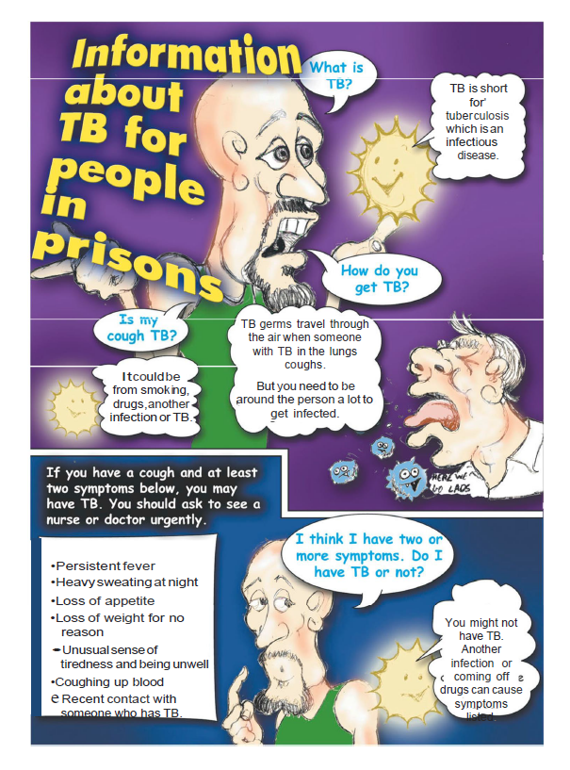
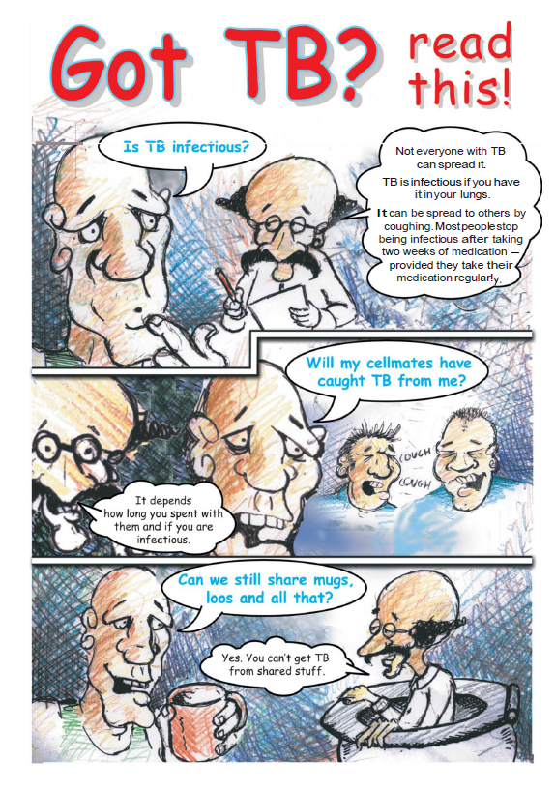
Resources available for TB in prisons
(developed by PHE, HMPPS and NHS)
Tuberculosis: information for prisons and immigration removal centre staff
Information on TB for people in prison provides general information on TB to raise awareness in prisons.
Got TB? Read This!
for those in prison with TB

Slide 36
Summary (1)
TB is not an easy infection to catch
Active TB of the lungs, larynx and tonsils is potentially infectious
People with active TB stop being infectious usually after about 2 weeks of appropriate treatment
It is crucial that people with TB receive their ongoing treatment every day as prescribed even after transfer or release

Slide 37
Summary (2)
TB transmission can be prevented by early diagnosis and implementation of infection control and respiratory isolation procedures
The use of personal protection equipment by prison officers
is usually not required unless advised otherwise by the clinical team
Collaboration between prison healthcare, prison staff, TB services and PHE Health Protection Team is paramount

Slide 38
Test your knowledge about TB! (answers)
Question | True | False
TB is a disease that only occurs in the lungs |  | x it can occur anywhere in the body
Latent TB infection is not infectious | x
If someone with TB coughs, those around them will automatically catch the infection |  | x
You can catch TB by sharing eating utensils with an infected person |  | x
TB can be passed from person to person via coughs/sneezes | x
Someone can have TB of the lungs or throat with minimal risk of passing the infection on to others | x (eg if on effective treatment)
Only certain groups of people develop TB |  | x anyone can develop TB, however, some groups are more at risk
Most people with TB will die as a result of the infection |  | x there is very effective treatment available

Slide 39
Acknowledgements
Authors
Clare Humphreys, Anita Turley, Olabisi Williams and Anjana Roy
Contributors
Abi Bartlett, Bridget Langstaff, Diane Fiefield, Emma Threadgold, Grainne Nixon, Jane DeBurgh, June Chambers, Paul Moore, Sarah Dowle, Simone Thorn Heathcock and Sophia Makki
TB Alert, national TB team for infographics, Stephanie Dennis(admin support)
Sign off
National Health & Justice Network PHE, chaired by Éamonn O'Moore
Publishing reference
PHE publishing gateway number GW-1121

