Slide 1
Adverse Weather and Health Plan (AWHP) 2026/27
Launch Webinar
AWHP Implementation Team
UKHSA Centre for Climate and Health Security
v1.0 – 26/03/2026

Slide 2
Key products
Aim and Learning outcomes
Aim - To describe the major updates to the AWHP Programme of Work for 2026 to 2027
Learning outcomes - By the end of the session, you will be able to identify the key updates of the AWHP Plan, including:
  Overview of the AWHP 2026 to 2027 objectives
  How the AWHP links evaluation with planning
  Overview of the guidance update process

Slide 3
AWHP Micro Teach
Recording: https://khub.net/documents/d/phe-national/awhp-microteach-course-2627-20260325_094442utc-meeting-recording
Slides: https://khub.net/documents/d/phe national/20260325_awhp_microteach_v3

Slide 4
AWHP Programme of Work
2026 to 2027 Update highlights
Agostinho Moreira de Sousa – Head of EEHP
Paul Coleman – Consultant in Public Health - EEHP
UKHSA Centre for Climate and Health Security

Slide 5
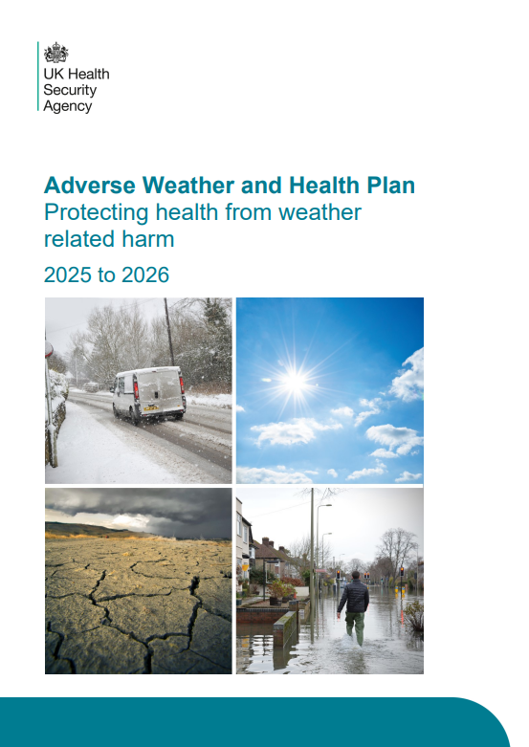
The Adverse Weather and Health Plan
National Adaptation Programme commitment delivered in April 2023
Protect individuals and communities from the health effects of adverse weather and to build community resilience
Source: Adverse Weather and Health Plan - GOV.UK

Slide 6
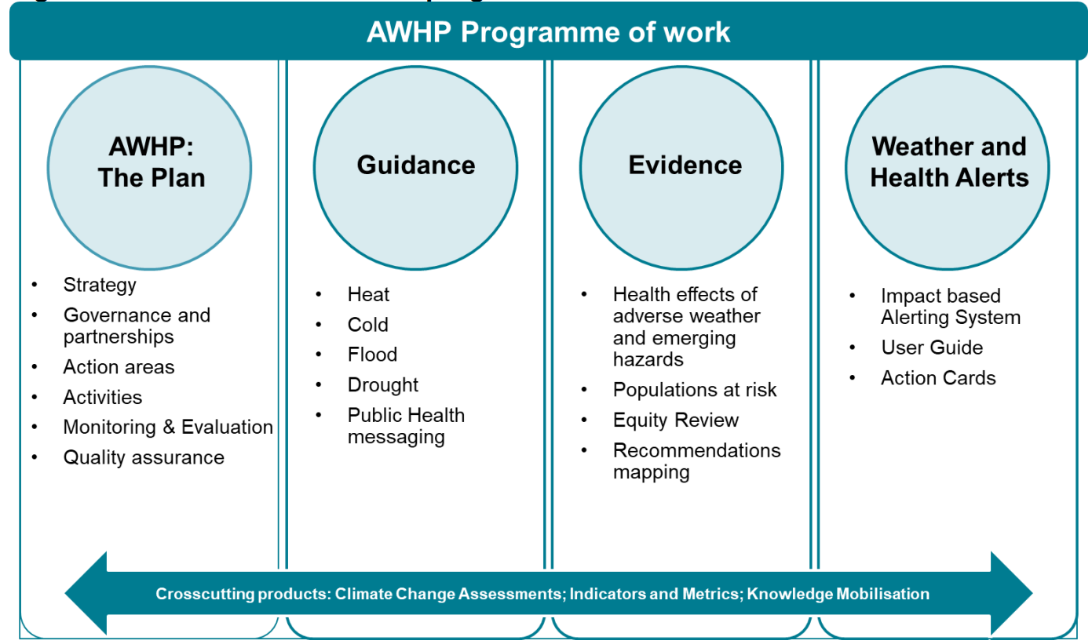
AWHP Programme of Work
6

Slide 7
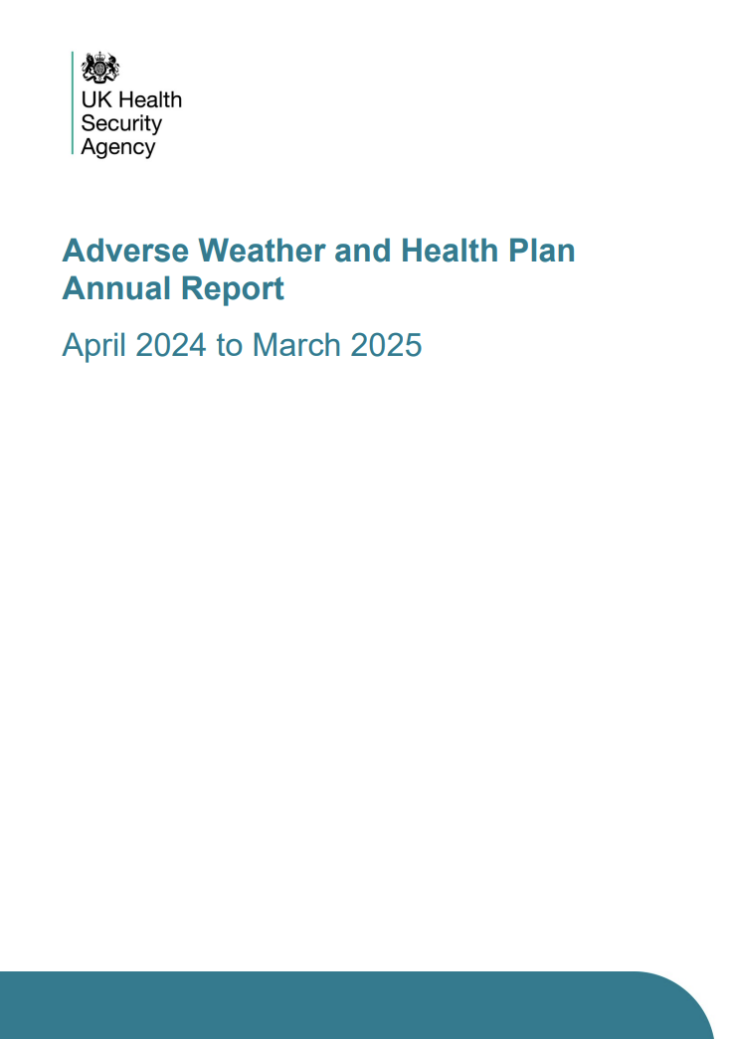
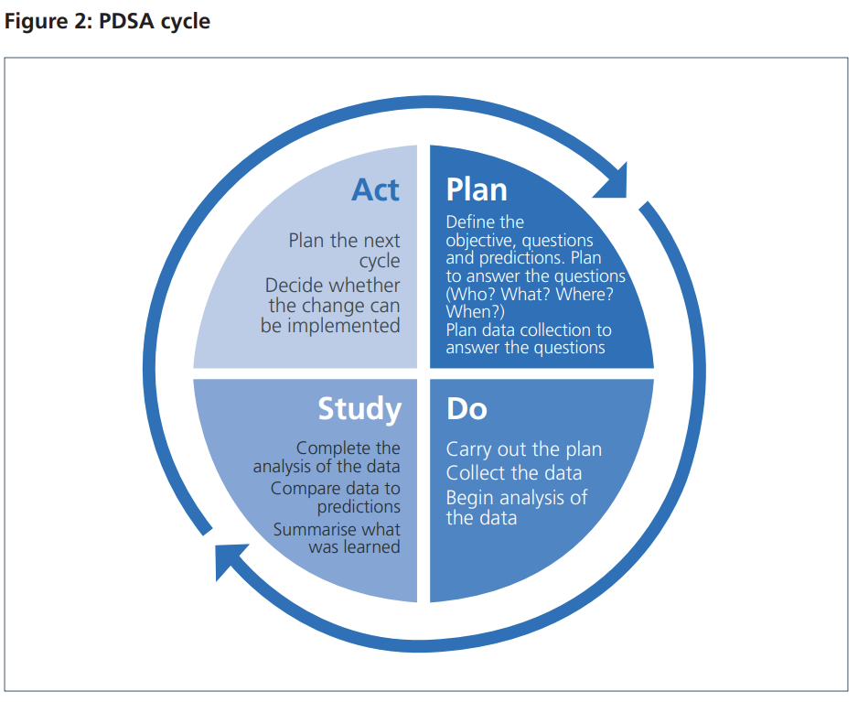
From evaluation to planning
Monitoring activities and impacts
  AWHP Annual Report
  Heat and Cold Mortality Monitoring Reports
Surveys
  Capacity building events
  Weather-Health Alerts
Workshops and meetings
  AWHP Steering Group
  AWHP Implementation Team
EPRR
  Lessons identified
  Exercises
  Debriefs
Audits and compliance
Reference 1: NHS England and NHS Improvement - Plan, Do, Study, Act (PDSA) cycles and the model for improvement
Reference 2: Adverse Weather and Health Plan Annual Report 2024 to 2025
7

Slide 8
Key changes
Inclusion of Wildfires and Poor Air Quality to the AWHP framework
Clarification on the broader role of the AWHP Implementation team (UKHSA cross-collaboration)
Inclusion of the recommendations from the AWHP IT workshops
Focus on engagement with Steering Group partners (SG workshops)
Commitment to include a short indicator analysis in the next iteration of the annual report

Slide 9
Key changes
Trial newly developed methodological framework and Standard Operating Procedure (SOP) for evidence updates that incorporate recommendations from the SED audit
Trial newly developed Standard Operating Procedures for developing guidance and incorporating new evidence that integrates recommendations from the guidance audit
Analyse post-alert survey data for both summer 2025 and winter 2025/26
Prioritise improvement of the WHA platform (geographic resolution and 5-day view of alerting situation)

Slide 10
9 Objectives
O1. Service delivery – commence review of drought guidance as per the new framework for updating and reviewing guidance and evidence
O2. Capacity building – deliver a series of capacity building events to support actions within the public health, healthcare and social care sectors
O3. Organisational arrangements – share lessons identified and learned on adverse weather and health on ResilienceDirect
10

Slide 11
9 Objectives
O4. Communication – analyse and publish post-alert user survey data from summer 2025 and winter 2025 to 2026
O5. Risk management – create a community risk register toolkit on adverse
weather hazards and their impact on health
O6. Early warning systems – Begin the processing of aligning the UKHSA Weather-Health Alert System with Common Warnings Framework
11

Slide 12
9 Objectives
O7. Research and data analysis – to publish official statistics on annual heat-associated and cold-associated mortality
O8. Quality assurance – conduct a mock internal audit of the AWHP Quality Management System (ISO 9001:2015)
O9. Policy development and accountability – confirm whole-of-society arrangements with the first AWHP Steering Group Workshops
12

Slide 13
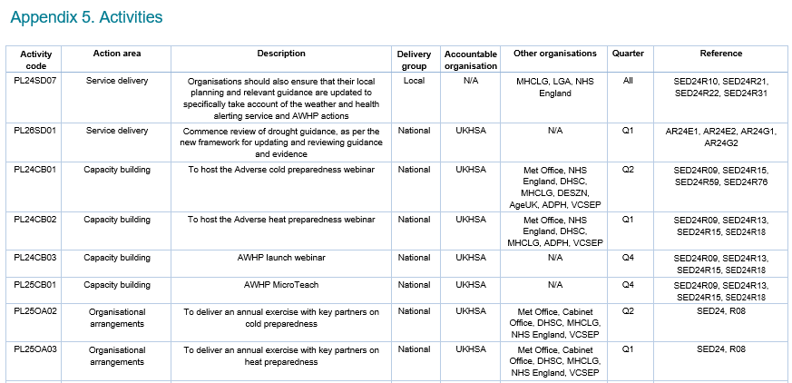
48 Activities – Appendix 5
13

Slide 14
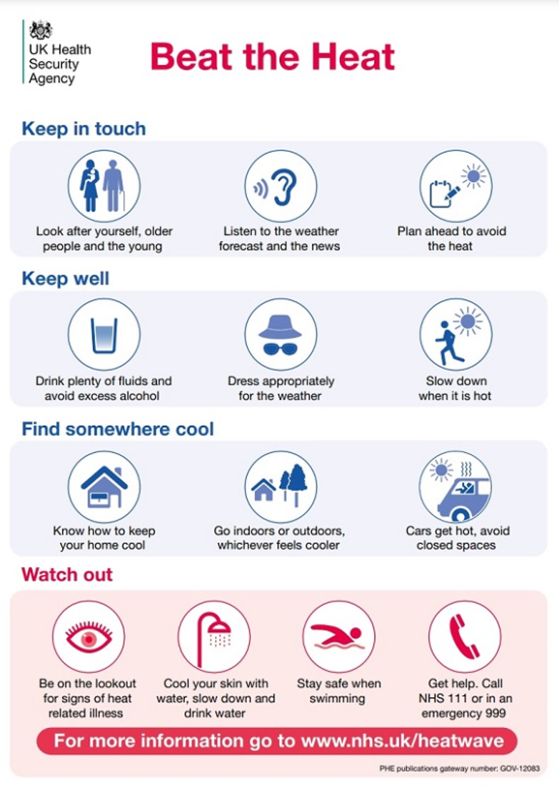
Guidance documents
37 guidance products, including 17 guidance documents, 10 action cards, and 10 summary action cards
Key public-facing materials, such as the "Beat the Heat" guidance, have been translated into 11 commonly spoken languages and are available in "easy-read" and British Sign Language versions for accessibility
The guidance materials address the health impacts of adverse weather, identifying vulnerable groups and outlining actionable steps
Resources include measures for national, regional, and local organizations, as well as health and social care professionals
The action cards and user guides, align with the WHA system to support stakeholders in responding effectively to adverse weather events

Slide 15
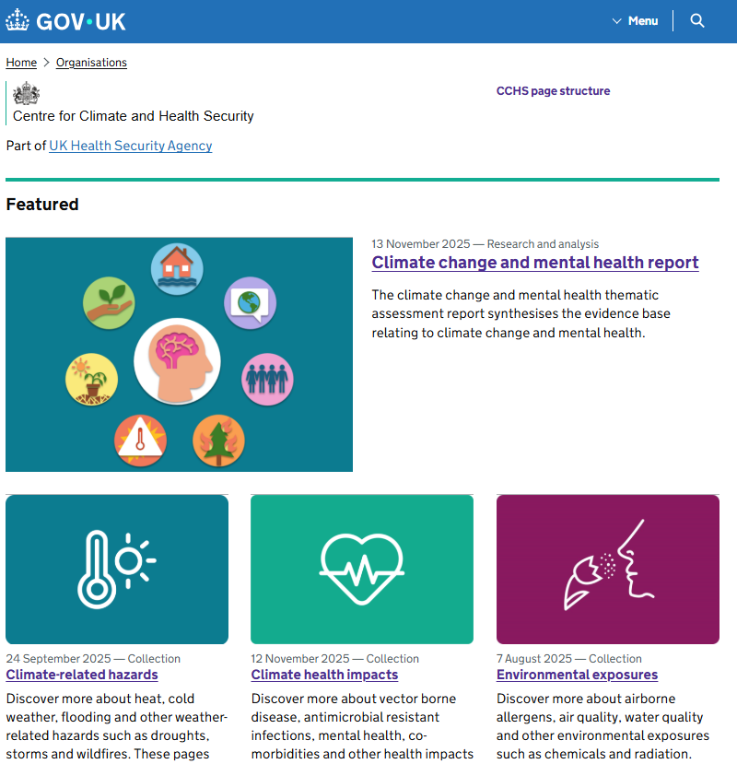
Centre for Climate and Health Security page
Dedicated go-to resource now brings all UKHSA climate and health information into one place.
Trusted, scientifically robust climate-health information. Topics include:
  Heat, cold, mental health, vector borne disease (and more..!)
Provides actionable tools for risk assessment, adaptation planning, and public health protection.
Helping professionals stay up-to-date with emerging climate-health threats and evolving evidence: Centre for Climate and Health Security - GOV.UK

Slide 16
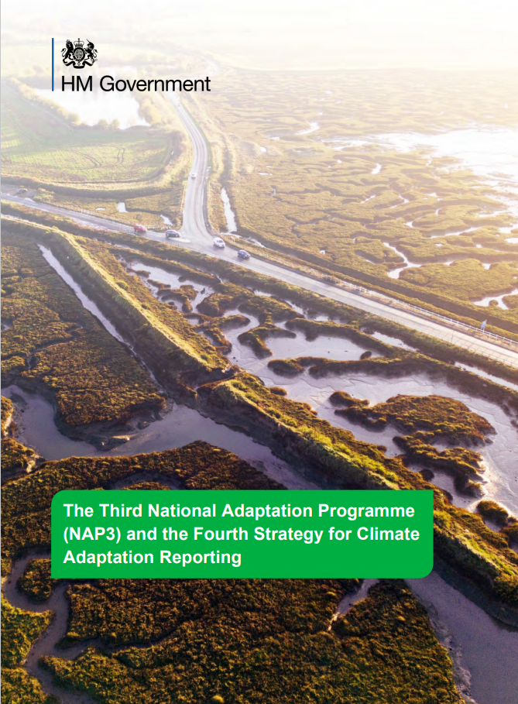
Long-term resilience
The government will address the risks posed by climate change to health, communities and the built environment through the following:
Adverse Weather and Health Plan | UKHSA
National Planning Policy Framework | MHCLG
Building regulations | MHCLG
Flood and Coastal Erosion Risk Management Strategy, Policy Statement and Roadmap | Environment Agency
Publicly Available Specification 2030-2035 | TrustMark
16

Slide 17
AWHP Evaluations and Future Guidance Updates

Slide 18
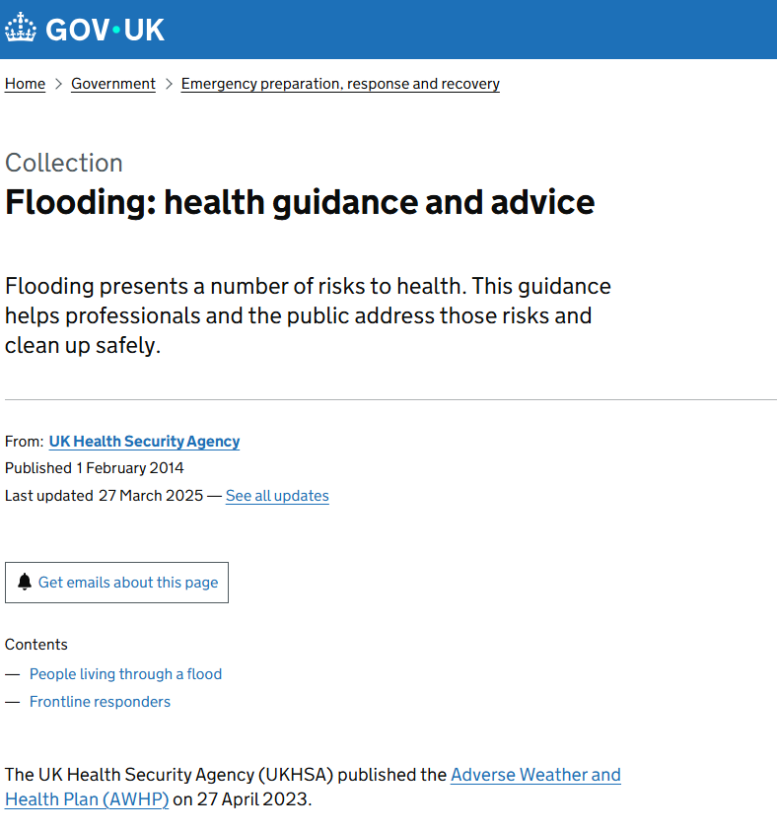
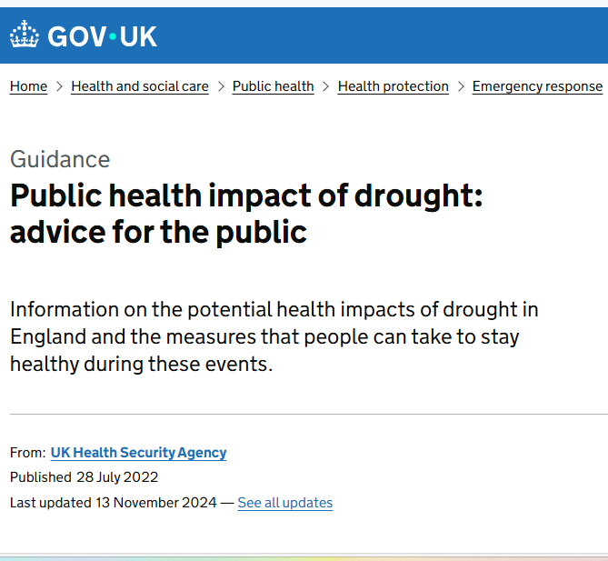
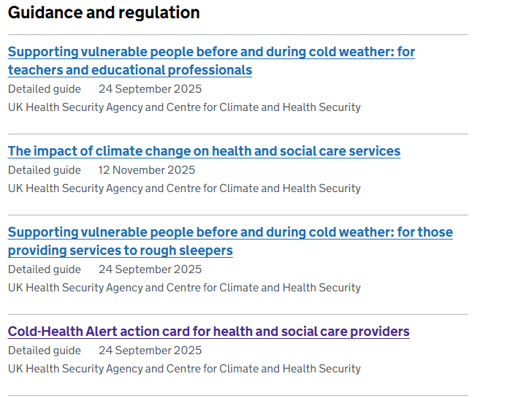
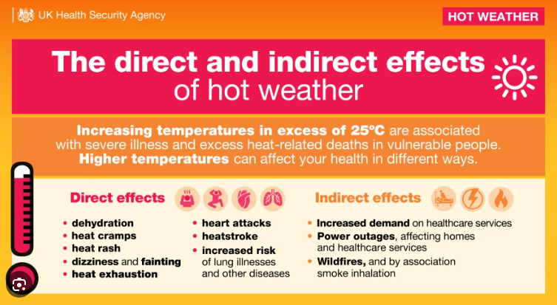
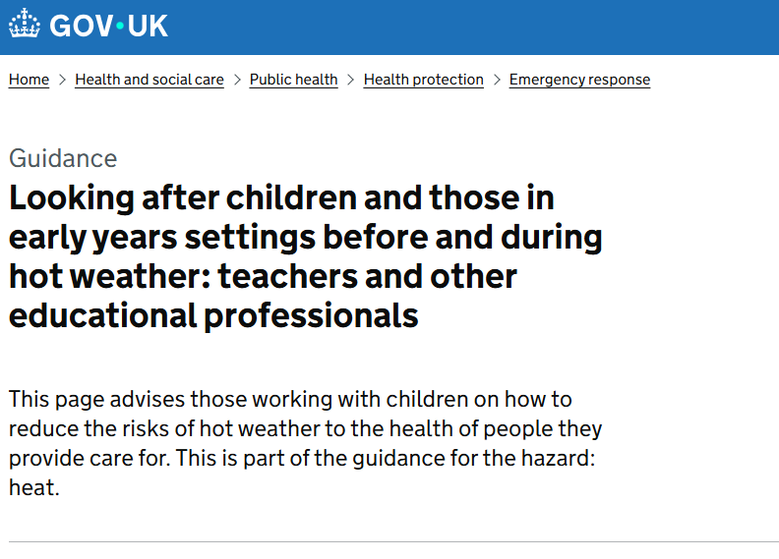
Guidance Associated with the AWHP
There are 37 guidance documents, 10 actions cards and 10 summary action cards associated with the AWHP

Slide 19
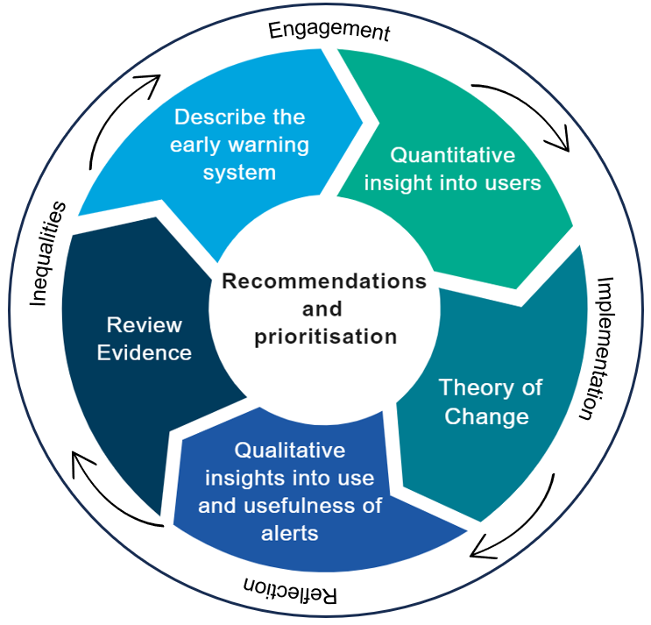
Monitoring and Evaluation Framework
UKHSA developed a monitoring and evaluation framework for impact-based alerting:
  Identify what data we should be collecting
  Identify relevant evaluation questions to ask to allow us to demonstrate impact of the WHA
Spans both quantitative and qualitative
  User insight – public and professionals
  Registration/platform usage
  Impact data
    Qualitative studies
    Epidemiology
List of prioritised recommendations

Slide 20
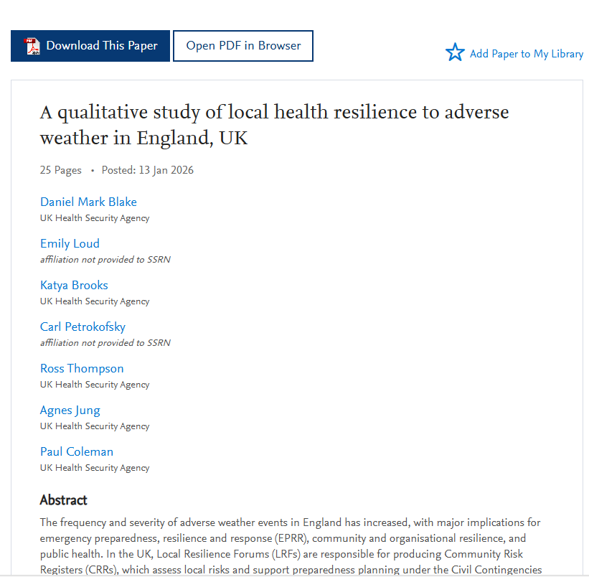
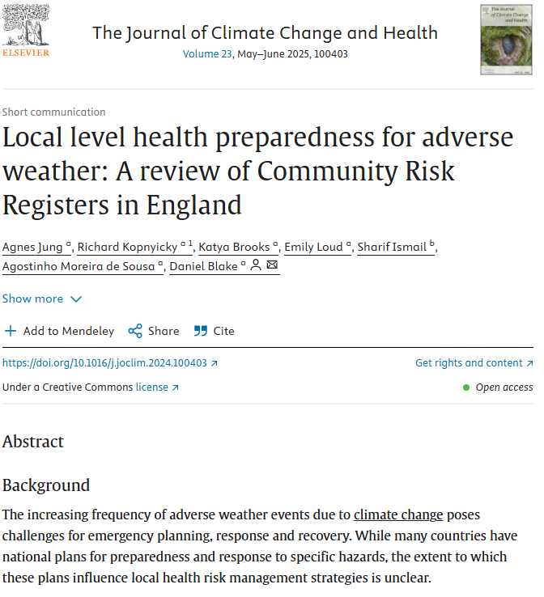
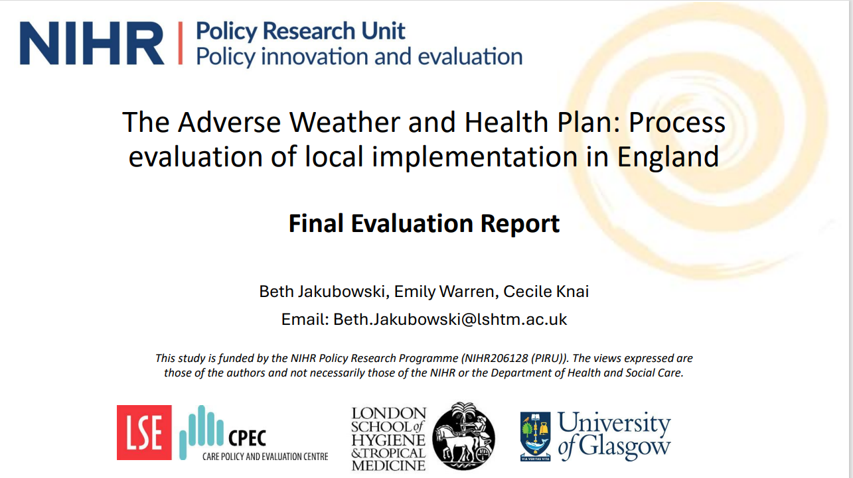

Evaluating Guidance Associated with the AWHP

Slide 21

New Guidance Development Framework
Aim: To establish a systematic, transparent, and evidence-based approach for updating UKHSA’s Adverse Weather and Health Plan (AWHP) guidance.
Objective: Ensures materials (Heat, Cold, Flooding, etc.) remain accurate, current, and aligned with national policy and scientific developments.
Guiding Principles: Updates must be evidence-based, stakeholder-informed, timely, and equitable (utilising the EHEA tool and CORE20PLUS approach).
Approach: Based on global best practices (NICE, WHO etc)

Slide 22
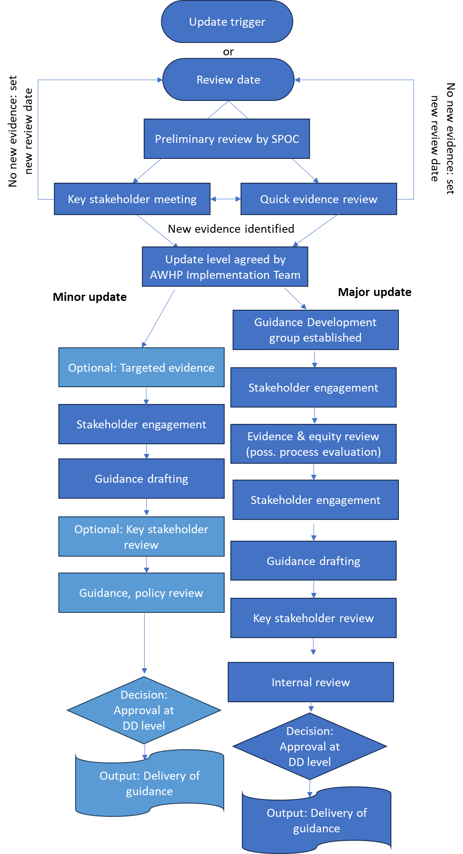
Guidance Development Process
Triggers & Assessment: Reviews initiated by scheduled dates (typically every five years), horizon scanning or feedback
Preliminary Review: SPOC conducts an initial evaluation
AWHP IT agree on update level: No Update, Minor, or Major
Major Update Initiation: For major updates, Guidance Development Group established
Evidence & Equity Core: Formal academic evidence review, Health Equity Impact Assessment (EHEA tool)
Co-Production: Three Stakeholder Advisory Group sessions ensure the guidance is shaped by end users
Drafting & Testing: The SPOC and working group draft the guidance
Governance & Sign-Off: The final version undergoes internal technical review
Publication: Guidance published on GOV.UK

Slide 23
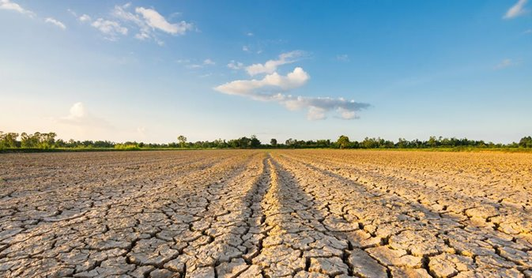
Next Steps
To pilot revised guidance and evidence update process:
Drought guidance
Ahead of updating heat and cold guidance
Alongside:
In conjunction with CCHS Climate and Health (Living) Evidence Synthesis System (CHESS) review pilots

Slide 24
Heat mortality monitoring report, England: 2025
Ross Thompson – Principal Environmental Public Health Scientist – EEHP
UKHSA Centre for Climate and Health Security

Slide 25
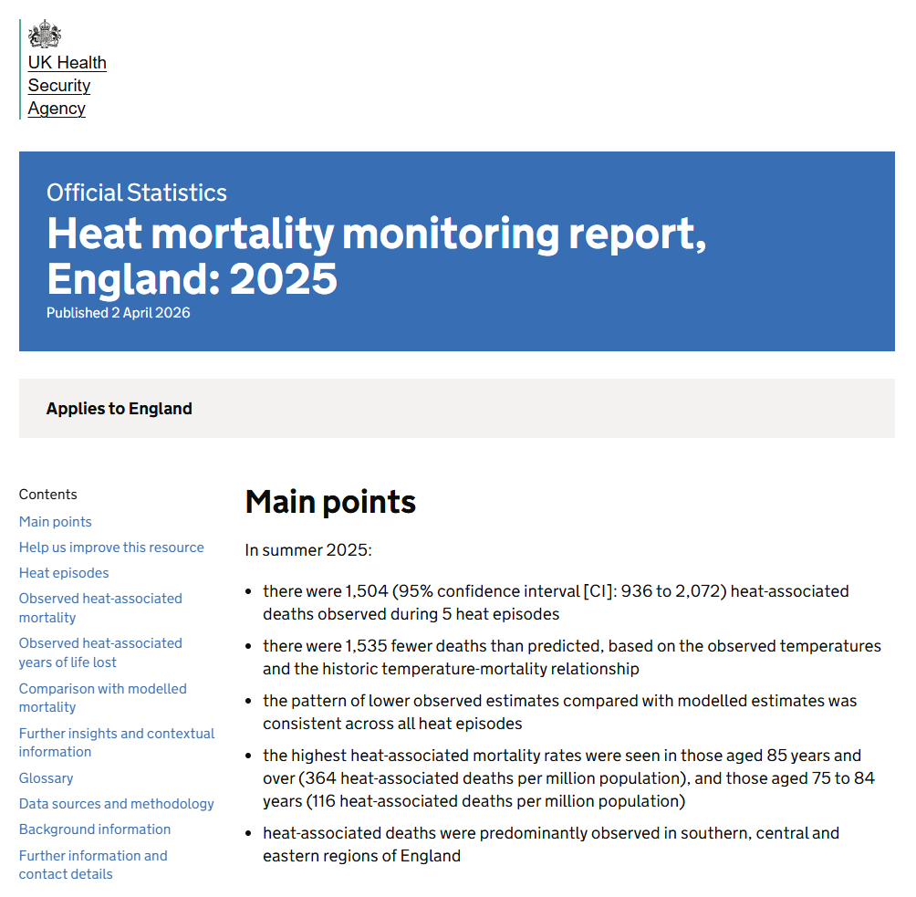
Official Statistics on Heat-Associated Mortality in England; 2025
Annual Heat Mortality Monitoring Report – now badged as Official Statistics ​
  Observed all-cause mortality
    Age​
    Sex​
    Region​
    Years of Life Lost​
    Local Resilience Forum area (emergency planning geography)​
    Place of death (care homes, hospital, at home, hospice and “elsewhere”)​
    Underlying cause of death (ICD-10)​
  Comparison of observed heat-associated deaths to modelled estimates: per heat event and seasonal total, based on historical temperature-mortality relationships
Heat mortality monitoring report, England: 2025 - GOV.UK

Slide 26
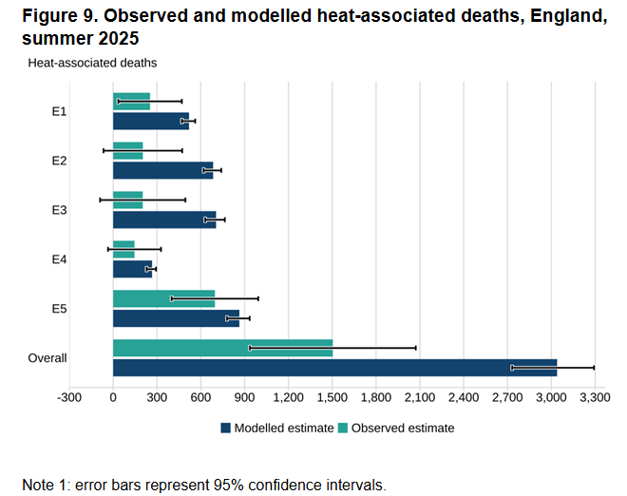
Heat-associated mortality Summer 2025: Key figures
1,504 heat-associated deaths observed during 5 heat episodes
Over 50% fewer deaths than expected
Lower observed estimates compared with modelled estimates consistent across all heat episodes
The highest heat-associated mortality rates were seen in older age groups
Heat-associated deaths were observed in care homes, hospitals and in peoples own homes
Circulatory system, Alzheimer’s and Dementia and Cancer as underlying cause of deaths all observed significant increases in deaths during heat episodes
Notes:
Mention Confidence Intervals

Slide 27
Future events

Slide 28

Summer Preparedness
Save the dates - Summer Preparedness Webinar
16th April 2026 – Pre-recorded presentations
23rd April 2026 – Live Q&A session
28
Notes:
Please also mark your diaries for our summer preparedness webinar on 9 May, which will cover changes made to the heat health guidance in this cycle, and also involve a live question and answer session – how can people sign up? ADD DETAIL

Slide 29
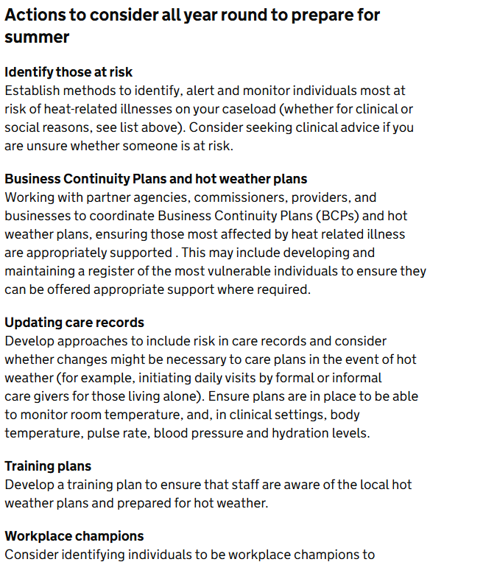
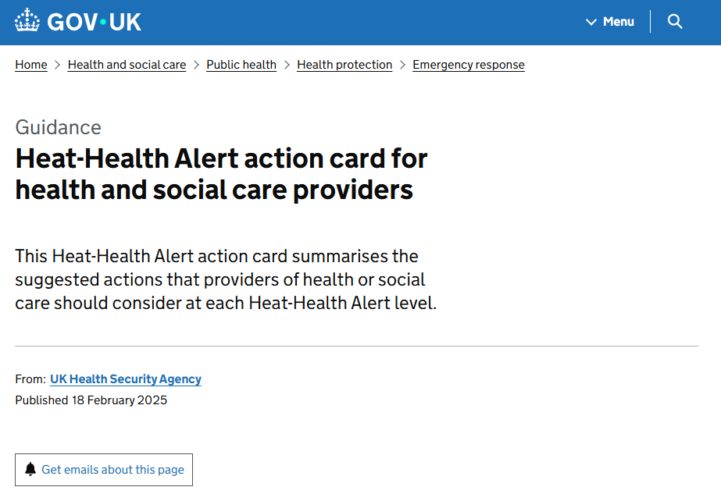
Reminder
29

Slide 30
Q&A

