Slide 1
Cold weather health risks: actions to prevent harm
UKHSA - Extreme Events and Health Protection

Slide 2
Cold weather health risks
Date of issue: 31 October 2022
Version 02.01
Author: Extreme Events and Health Protection, UKHSA
Amendment history
Version | Date | Amendments made
01.01 | 13 October 2021 | 1 version
02.01 | 31 October 2022 | 2 version

Slide 3
Background
For specific information on cold-related health risks, refer to the current Cold Weather Plan for England and associated resources. The plan recommends a series of steps to reduce the risks to health from cold weather for:​
the NHS, local authorities, social care, and other public agencies​
professionals working with people at risk​
individuals, local communities and voluntary groups​
The ‘Cold Weather Plan for England’ is underpinned by the Met Office’s Cold Weather Alert service which runs annually from 1 November to 31 March.​
Register for email updates from the Cold Weather Alert Service now.

Slide 4
Contents
Health impacts of cold weather​
Cold weather health risks ​
Preventing cold-related harm​
Cold weather risks: recommendations​
key recommendations for all​
commissioners of health and social care (all settings) and local authority directors of public health​
providers – health and social care staff in all settings (primary and community care, hospitals and care homes)​
community and voluntary sector and individuals​
national level: NHS England, UKHSA, DHSC, Met Office​
Resources ​
References

Slide 5
Health impacts of cold weather​

Slide 6
How does cold weather impact health?
The human body responds in several different ways to exposure to cold weather, even at temperatures which might be considered relatively mild.
Exposure to cold temperatures has a range of physiological effects including:
increased blood pressure
increased risk of clotting
suppression of the immune system
diminished capacity of the lungs to fight off infection
increased airway constriction and mucus production in the lungs

Slide 7
How does cold weather impact health – morbidity and mortality?
Although exposure to extreme cold can kill directly through hypothermia, this is not the main cause of cold-related illness and death.
The health impacts of cold weather can have direct and indirect effects.
Direct health effects
Heart attack
Stroke
Respiratory disease
Influenza
Falls and injuries
Hypothermia
Indirect health effects
Mental health effects from depression
Reduced educational and employment attainment
Risk of carbon monoxide poisoning

Slide 8
What happens during cold weather?
Deaths caused by cardiovascular conditions peak first followed by stroke and then respiratory
Snow and ice also cause:
disruption to service provision
reduction in access to essential services
increase in the risk of falls and injuries

Slide 9
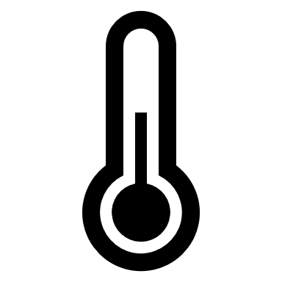
Which temperatures have an impact?
The health impacts of cold weather can be seen even at temperatures which might be considered relatively mild (4°C to 8°C)
Although the risk of death increases as temperatures fall, the higher frequency of days at moderate temperatures in an average winter means the greatest health burden in absolute numbers of deaths, occurs at more moderate temperatures
Temperature | Health impacts
18ºC | minimal risks to health for a sedentary person wearing suitable clothing
Under 18ºC | may increase blood pressure and risk of cardiovascular disease
Under 16ºC | may diminish resistance to respiratory diseases
4 to 8ºC | increased risk of death observed at population level
At or below 5ºC | high risk of hypothermia

Slide 10
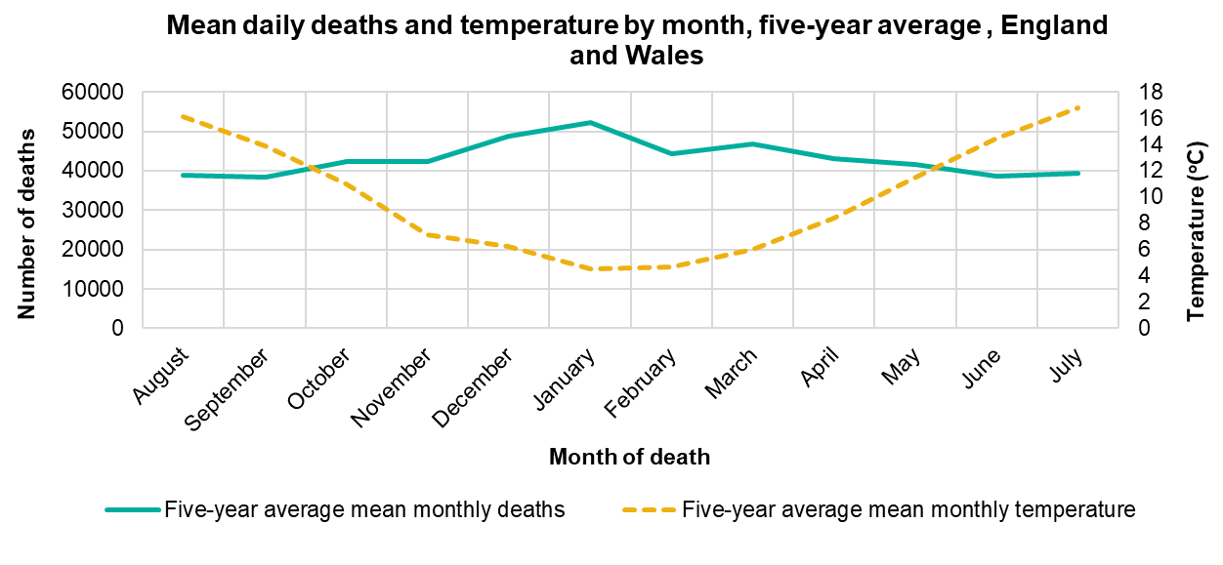
Deaths over the year
more people die in the winter than in the summer
excess winter deaths (EWDs) = winter deaths - average non-winter deaths
80% aged 75+ (but not only the very old are affected by cold)
large variation in EWD numbers year on year

Slide 11
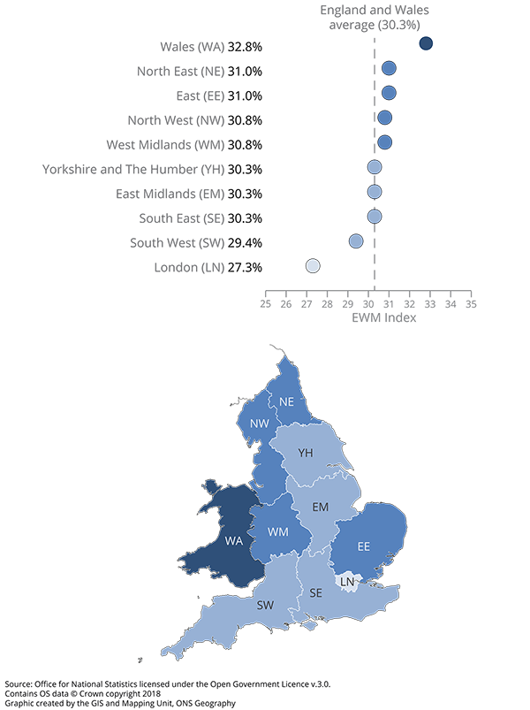
Where do these impacts occur?
the Excess Winter Mortality (EWM) index is calculated as excess winter deaths (EWD) divided by the average non-winter deaths, expressed as a percentage
the North East, North West, West Midlands, and East of England experienced a higher EWM index than the rest of England

Slide 12
Who is affected?
EWDs are seen throughout England – all regions are affected
Whilst the burden of EWDs is primarily seen in older age groups, EWDs are seen in all age groups
EWDs represent an important health inequality – people who experience greater socioeconomic deprivation are more likely to be affected
There are a number of factors which contribute to EWDs:
seasonal factors: weather, respiratory infections
individual vulnerability to health effects of cold
attitudes to cold and associated behaviours
household income
cost of fuel
energy efficiency of the home
housing and economic factors

Slide 13
Preventing cold-related harm

Slide 14
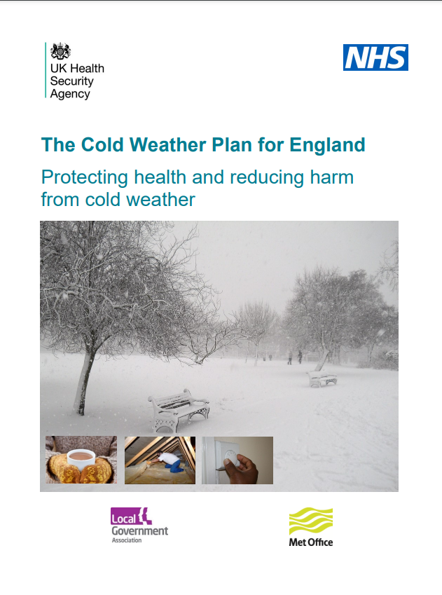
Preventing cold-related harm: resources
NICE guidelines (NG6) for reducing the risk of death and ill health associated with living in cold homes aims to improve the health and wellbeing of people vulnerable to the cold.
The Cold Weather Plan recommends a series of steps to reduce the risks to health from cold weather for:
the NHS, local authorities, social care, and other public agencies, professionals working with people at risk, individuals, local communities and voluntary groups
CWP action cards can be found here: https://www.gov.uk/government/publications/cold-weather-plan-action-cards-for-cold-weather-alert-service
Sign up for alerts here: https://public.govdelivery.com/accounts/UKMETOFFICE/subscriber/topics?qsp=PHE
Near real-time data is also produced throughout the year to support planning and prevention of EWDs.

Slide 15
What does this mean for the NHS (1)?
NICE guidelines provide specific recommendations for the NHS. These cannot happen in isolation and require action by, and collaboration with, local authority and other stakeholders
Health and Wellbeing Boards, clinical commissioning groups, and wider NHS:
develop a strategy to address the health consequences of cold homes
provide a single-point-of contact health and housing referral service for people living in cold homes to provide tailored solutions
raise awareness among practitioners and the public about how to keep warm at home
train health and social care practitioners to help people whose homes may be too cold

Slide 16
What does this mean for the NHS (2)?
Primary healthcare practitioners:
Identify people at risk of ill health from living and working in a cold home*
Make every contact count by assessing the heating needs of people who use primary health and home care services
Secondary healthcare practitioners:
Identify people at risk of ill health from living in a cold home*
Discharge vulnerable people from health or social care settings to a warm home
*advice on how to identify people at risk is provided in the NICE guidelines

Slide 17
What can local authorities do?
The health consequences of living in a cold home should be included in the Joint Strategic Needs Assessment (JSNA) process
Reducing EWDs
Identify people at risk
Make Every Contact Count
Discharge vulnerable people from care settings to a warm home
Raise awareness about how to keep warm at home
Train people to help individuals whose homes may be too cold
Provide a single-point-of-contact for help
Develop a strategy
Ensure buildings meet standards
A summary of the recommendations from the NICE guidance is outlined here. For further information see NICE guidance NG6
Requires collaboration of primary health and home care practitioners, Adult Social Care and relevant LA departments
Where professionals and public can go to get more information and support
Social care practitioners
Housing professionals
Faith and voluntary sector workers
Heating engineers, meter installers and those providing building insulation
Health and home care practitioners, and non-health and social care workers should assess the heating needs of people who use their services

Slide 18
Cold weather risks and recommendations

Slide 19
Cold weather preparedness and response
The guidance and good practice recommendations in the Cold Weather Plan for England should to be followed.
The following slides detail specific considerations for:
commissioners of health and social care (all settings) and local authority directors of public health
providers – health and social care staff in all settings (community, hospitals and care homes)
community and voluntary sector
individuals
national level: NHS England, UKHSA, DHSC, Met Office

Slide 20
Key recommendations for all
All local authorities, NHS commissioners and their partner organisations, including health and social care providers, should consider the ‘Cold Weather Plan for England’ and satisfy themselves that the suggested actions and the cold weather alert service are understood across their locality, and potential additional need has been considered in surge capacity plans. Register for the Cold Weather Alert Service.
People at risk from cold weather may also be vulnerable to respiratory infections and vice versa. This can be due to concurrence of both clinical and environmental or socio-economic factors. Identify those at greatest risk this winter, taking into account intersecting risks. Ask about living in a cold home, and support vulnerable individuals to access existing resources to keep warm.

Slide 21
Commissioners of health and social care (all settings) and local authority directors of public health (1)
In addition to actions set on the CWP for England:
ensure there is a single point of contact to provide tailored advice for people living in cold homes
train social care, housing and other professionals who may make home visits to identify those most at risk, taking into account the intersection of cold and respiratory infections, and integrate these risk assessments to target information and support to vulnerable households
engage the community and voluntary sector to identify and support those most at risk, especially those who are socially isolated
work across STPs/ ICSs to utilise existing structures such as primary care networks; social prescribing networks; community pharmacists; local authority social care and crisis support teams to identify and support vulnerable individuals to access resources to keep warm
consider potential measures which could be implemented to reduce the cold-related risks faced by individuals who are clinically extremely vulnerable or self-isolating

Slide 22
Commissioners of health and social care (all settings) and local authority directors of public health (2)
Increase the resilience of partners to any concurrent risks of cold and respiratory infections:
work with partner agencies, providers and businesses to raise awareness about the concurrent risk of cold weather and respiratory infections
support local health and social care organisations in protecting vulnerable residents and ensuring staff welfare (for example, mutual aid, PPE supply, mental health)
Local Health Resilience Partnerships may wish to satisfy themselves that there is adequate review across local health and social care systems of usual plans for surge capacity in cold weather in light of possible staff absences and to ensure staff welfare
ensure care homes and hospitals are aware of the cold weather plan and are preparing for cold weather and concurrent risk with respiratory infections
ensure other institutional establishments (for example, prisons, schools) are aware of cold weather guidance
ensure adequate provision of emergency shelters for homeless people and other vulnerable groups and ensure capacity to scale up provision

Slide 23
Providers – health and social care staff in all settings (primary and community care, hospitals and care homes) (1)
In addition to actions set out on the CWP for England:
review who may be at high risk – identify those at greatest risk this winter, taking into account intersecting risks; ask about living in a cold home
provision of care and support during winter will be particularly important in the context of additional risks and vulnerabilities related to respiratory infections (such as protecting BAME staff) and cold weather
encourage staff to sign up to cold weather alerts, communicate alerts to staff, ensure staff know what to do when the weather gets cold, and get their flu vaccinations

Slide 24
Providers – health and social care staff in all settings (primary and community care, hospitals and care homes) (2)
more people receiving personal care, particularly in domiciliary settings, may be at higher risk than usual from cold due to potential for concurrent respiratory infections
ensure a minimum temperature of 18°C is kept and patients are comfortably warm
ensure safe discharge (for example, patients are not discharged to cold homes) including regular post-discharge support (which may need to be increased) and use of multi-disciplinary approaches such as hospital-at-home and reablement services

Slide 25
Community and voluntary sector and individuals
In addition to actions set on the CWP for England:
have plans in place to be able to check on others safely in advance of the cold weather (for example, over the phone)
develop clear messaging to the public to encourage them to begin winter preparedness, for example, checking eligibility for assistance with heating costs, checking heating appliances, and checking on vulnerable neighbours and relatives
encourage those who may find it more difficult to cope in cold weather to request help through volunteer networks, for example, the Royal Voluntary Service website
advise those at risk that they should continue to seek medical help if they are feeling unwell and that plans are in place to deliver services safely

Slide 26
National Level: NHS England, UKHSA, DHSC, Met Office (1)
In addition to actions set on the CWP for England:
ahead of cold weather, NHS England should consider the impact of cold weather on workforce capacity and wellbeing
NHS England should satisfy themselves that alerts are cascaded widely and promptly, including to patient-facing and clinical staff
UKHSA Regions should be aware of the Cold Weather Plan and note the new Keep Warm, Keep Well resource, and provide support to directors of public health and other local stakeholders as appropriate

Slide 27
National Level: NHS England, UKHSA, DHSC, Met Office (2)
UKHSA surveillance systems to provide early warning of the potential health impacts of cold weather will continue throughout winter 2022 to 2023.
UKHSA and the Met Office will work closely within the cold weather alerting system to ensure the earliest possible issuing of cold weather alerts and the maximum possible warning time.

Slide 28
Resources
Cold Weather Plan for England
Cold Weather Plan for England: Action Cards
Keep Warm, Keep Well leaflet
E-learning on helping people living in cold homes
Simply energy advice website
Guidance on coronavirus (COVID-19)

Slide 29
References (1)
Slide 3
‘Cold Weather Plan for England: protecting health and reducing harm from cold weather’, available at: https://www.gov.uk/government/collections/cold-weather-plan-for-england
Slide 8
‘2009 Annual Report of the Chief Medical Officer.’ Original source: Donaldson GC, Keatinge WR. ‘Early increases in ischaemic heart disease mortality dissociated from and later changes associated with respiratory mortality after cold weather in South-East England.’ Journal of Epidemiological Community Health 1997 December: volume 51, issue 6, pages 643 to 648
Slide 9
Hajat S and others. ‘Public health vulnerability to wintertime weather: time-series regression and episode analyses of national mortality and morbidity databases to inform the Cold Weather Plan for England.’ Public Health 2016: issue 137, pages 26 to 34
Slide 10
‘Cold Weather Plan for England: protecting health and reducing harm from cold weather’, available at: https://www.gov.uk/government/collections/cold-weather-plan-for-england
Slide 11
UK Health Security Agency Training slide sets ‘Excess winter deaths in the winter 2019 to 2020.’ 2021. available at: https://www.gov.uk/government/collections/cold-weather-plan-for-england

Slide 30
References (2)
Slide 18
The UK Sepsis Trust. ‘Recovery After Critical Illness: What you should know after leaving a critical care unit.’ 2020 https://sepsistrust.org/wp-content/uploads/2020/06/Critical-Care-Booklet.pdf
Slide 27
NICE Guidance (NG6) ‘Excess winter deaths and illness and the health risks associated with cold homes.’ Available at: https://www.nice.org.uk/guidance/ng6/chapter/1-Recommendations

Slide 31
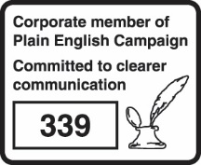
About the UK Health Security Agency
The UK Health Security Agency is an executive agency, sponsored by the Department of Health and Social Care
UK Health Security Agency, Nobel House, 17 Smith Square London SW1P 3JR Tel: 020 7654 8000 www.gov.uk/ukhsa Twitter: @UKHSA
For enquiries relating to this document, please contact: extremeevents@phe.gov.uk
Published: October 2022 UKHSA publications gateway number: GOV-13567
© Crown copyright 2022
You may re-use this information (excluding logos) free of charge in any format or medium, under the terms of the Open Government Licence v3.0. To view this licence, visit OGL. Where we have identified any third party copyright information you will need to obtain permission from the copyright holders concerned.
UKHSA supports the UN Sustainable Development Goals

