Slide 1
Annual epidemiological spotlight on HIV in London: 2019 data
Field Service
PHE publications gateway number: GOV-8630

Slide 2
About Public Health England
Public Health England exists to protect and improve the nation’s health and wellbeing and reduce health inequalities. We do this through world-leading science, research, knowledge and intelligence, advocacy, partnerships and the delivery of specialist public health services. We are an executive agency of the Department of Health and Social Care, and a distinct delivery organisation with operational autonomy. We provide government, local government, the NHS, Parliament, industry and the public with evidence-based professional, scientific and delivery expertise and support.
Public Health England 133-155 Waterloo Road Wellington House London SE1 8UG Tel: 020 7654 8000 www.gov.uk/phe Twitter: @PHE_uk Facebook: www.facebook.com/PublicHealthEngland
Prepared by: Josh Forde and Paul Crook, Field Service, South East & London.
For queries relating to this document, please contact josh.forde@phe.gov.uk
© Crown copyright 2021
You may re-use this information (excluding logos) free of charge in any format or medium, under the terms of the Open Government Licence v3.0. To view this licence, visit OGL. Where we have identified any third-party copyright information you will need to obtain permission from the copyright holders concerned.
Published June 2021
PHE publications gateway number: GOV-8630

Slide 3
Summary of 2019 data for London residents
Estimated 38,940 people living with HIV in London (diagnosed & undiagnosed)
1,510 new HIV diagnoses in London residents in 2019 (40% of all England diagnoses)
This represents a fall of 5% from 2018
61% of new diagnoses were in men who have sex with men (MSM)
The number of new diagnoses in MSM fell by 7% from 2018 to 2019.
20% of new diagnoses were in black Africans
38% of diagnoses were late (2017-2019)
36,884 people live with diagnosed HIV in London
Thirty two local authorities in London had a diagnosed HIV prevalence in excess of 2 per 1,000 population aged 15-59 years in 2019, which the threshold for expanded HIV testing. The only LA in London with a diagnosed prevalence below this level was Kingston upon Thames (2.0).
An estimated 7% of people living with HIV in London remain undiagnosed
98% of those living with diagnosed HIV in London are on antiretroviral therapy (ART)
97% of those on ART are virally suppressed

Slide 4
Figure 1: New HIV diagnosis per 100,000 population aged 15 years or older by PHE centre of residence, 2019
Source: Public Health England, HIV and Aids New Diagnosis Database (HANDD); Office for National Statistics (ONS) revised 2019 population estimates (6 May 2020). The number of new diagnoses will depend on accessibility of testing as well as infection transmission.

Slide 5
Figure 2: New HIV diagnoses per 100,000 population aged 15 years or older by local authority of residence, London residents, 2019
Source: Public Health England, HIV and Aids New Diagnosis Database (HANDD); Office for National Statistics (ONS) revised 2019 population estimates (6 May 2020). The number of new diagnoses will depend on accessibility of testing as well as infection transmission. City of London has been merged with Hackney.

Slide 6
Figure 3: New HIV diagnoses and deaths, London residents, 2010 to 2019
Source: Public Health England, HIV and Aids New Diagnosis Database (HANDD). The number of new diagnoses will depend on accessibility of testing as well as infection transmission. *Numbers may rise as further reports are received. This will impact on interpretation of trends in more recent years.

Slide 7
Figure 4: New HIV diagnoses by probable exposure category (adjusted for missing information), London residents, 2010 to 2019
Source: Public Health England, HIV and Aids New Diagnosis Database (HANDD). The number of new diagnoses will depend on accessibility of testing as well as infection transmission.

Slide 8
Figure 5: Number of new HIV diagnoses by age group and gender (A) and probable exposure category in males (B), London residents, 2019
(A)
(B)
Source: Public Health England, HIV and Aids New Diagnosis Database (HANDD). The number of new diagnoses will depend on accessibility of testing as well as infection transmission.

Slide 9
Figure 6: Number of new HIV diagnoses by ethnic group (adjusted for missing ethnic group information), London residents, 2010-2019
Source: Public Health England, HIV and Aids New Diagnosis Database (HANDD). The number of new diagnoses will depend on accessibility of testing as well as infection transmission.

Slide 10
Figure 7: Number of new HIV diagnoses by world region of birth (adjusted for missing information), London residents, 2010-2019
Source: Public Health England, HIV and Aids New Diagnosis Database (HANDD). The number of new diagnoses will depend on accessibility of testing as well as infection transmission.

Slide 11
Figure 8: Number of MSM London residents diagnosed with HIV by whether born in the UK or abroad : 2010-2019
Source: Public Health England, HIV and Aids New Diagnosis Database (HANDD). The number of new diagnoses will depend on accessibility of testing as well as infection transmission.

Slide 12
Figure 9: Percentage of new HIV diagnoses that were diagnosed late by local authority of residence, London, aged 15 years and over, 2017 to 2019*
Source: Public Health England, HIV and AIDS New Diagnosis Database, HIV & AIDS Reporting System * Only includes new diagnoses for which CD4 count was reported within 91 days of diagnosis; late diagnosis defined as CD4 count <350 cells/mm3. The underlying population will impact on the proportion diagnosed late, e.g. MSM are less likely to be diagnosed late. City of London has been merged with Hackney.
.

Slide 13
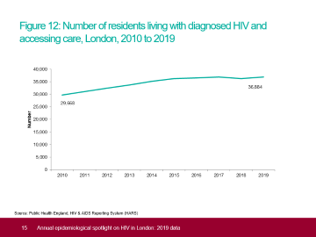
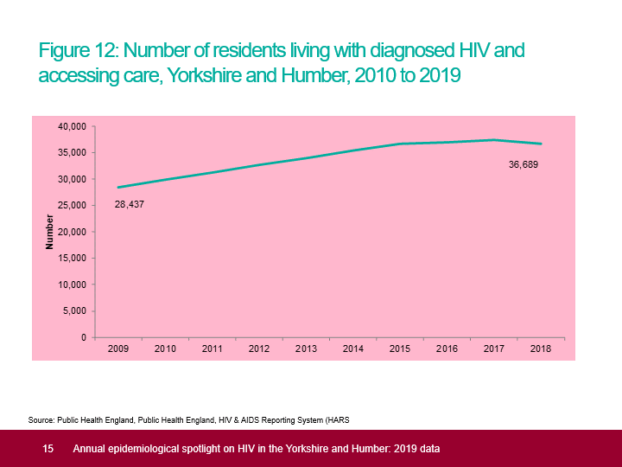
Figure 10: Percentage of new HIV diagnoses that were diagnosed late by probable exposure category (A) and ethnic group (B), London residents, aged 15 years and over, 2017-2019*
(A)
(B)
Source: Public Health England, HIV and AIDS New Diagnosis Database, HIV & AIDS Reporting System
* Only includes new diagnoses for which CD4 count was reported within 91 days of diagnosis; late diagnosis defined as CD4 count <350 cells/mm3.

Slide 14
Figure 11: Diagnosed HIV prevalence per 1,000 residents aged 15 to 59 years by PHE Centre, 2019
Source: Public Health England, HIV & AIDS Reporting System (HARS); Office for National Statistics (ONS) revised 2019 population estimates (6 May 2020).

Slide 15
Figure 12: Number of residents living with diagnosed HIV and accessing care, London, 2010 to 2019
Source: Public Health England, HIV & AIDS Reporting System (HARS)

Slide 16
Figure 13: Number of residents living with diagnosed HIV and accessing care by probable route of transmission (adjusted for missing information), London, 2019
Source: Public Health England, HIV & AIDS Reporting System (HARS).

Slide 17
Figure 14: Percentage of residents with diagnosed HIV and accessing care by age group, London, 2010 and 2019
Source: Public Health England, HIV & AIDS Reporting System (HARS).

Slide 18
Figure 15: Diagnosed HIV prevalence per 1,000 residents by ethnic group (aged 15 to 59 years), London, 2019
Source: Public Health England, HIV & AIDS Reporting System (HARS); Office of National Statistics (ONS) population estimates by ethnicity (2011).

Slide 19
Figure 16: Diagnosed HIV prevalence per 1,000 residents aged 15 to 59 years by local authority, London, 2019
Source: Public Health England, HIV & AIDS Reporting System (HARS); Office for National Statistics (ONS) revised 2019 population estimates (6 May 2020).

Slide 20
Figure 17: Diagnosed HIV prevalence per 1,000 residents aged 15-59 years by local authority, London, 2019
Source: Public Health England, HIV & AIDS Reporting System (HARS); Office for National Statistics (ONS) revised 2019 population estimates (6 May 2020).

Slide 21
Figure 18: Diagnosed HIV prevalence per 1,000 residents (all ages) by middle super output area, London, 2019
Source: Public Health England, HIV & AIDS Reporting System (HARS); Office for National Statistics (ONS) revised 2019 population estimates (6 May 2020).

Slide 22
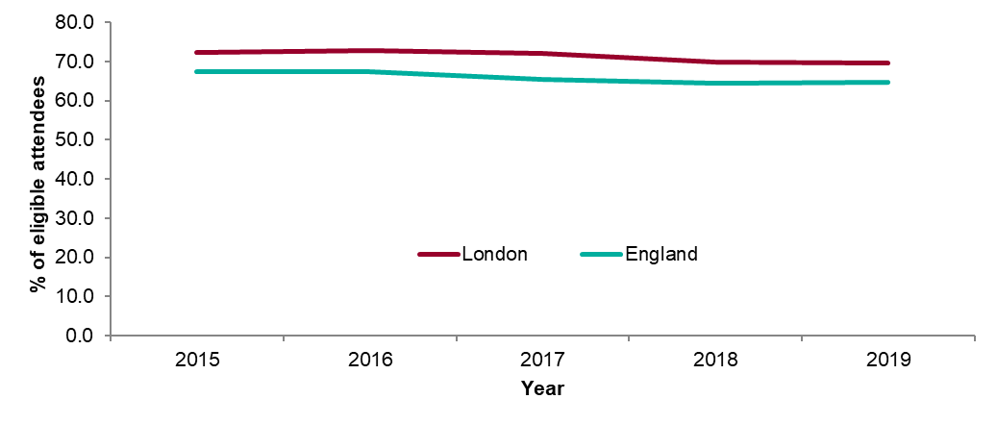
Figure 19: HIV test coverage: London residents, 2015-2019
Source: Public Health England, GUMCAD *‘Eligible attendee’ is defined as a patient attending a specialist sexual health service (SHS) at least once during a calendar year. Patients known to be HIV positive1, or for whom a HIV test was not appropriate2, or for whom the attendance was related to Sexual and Reproductive Health (SRH) care only3 are excluded.

Slide 23
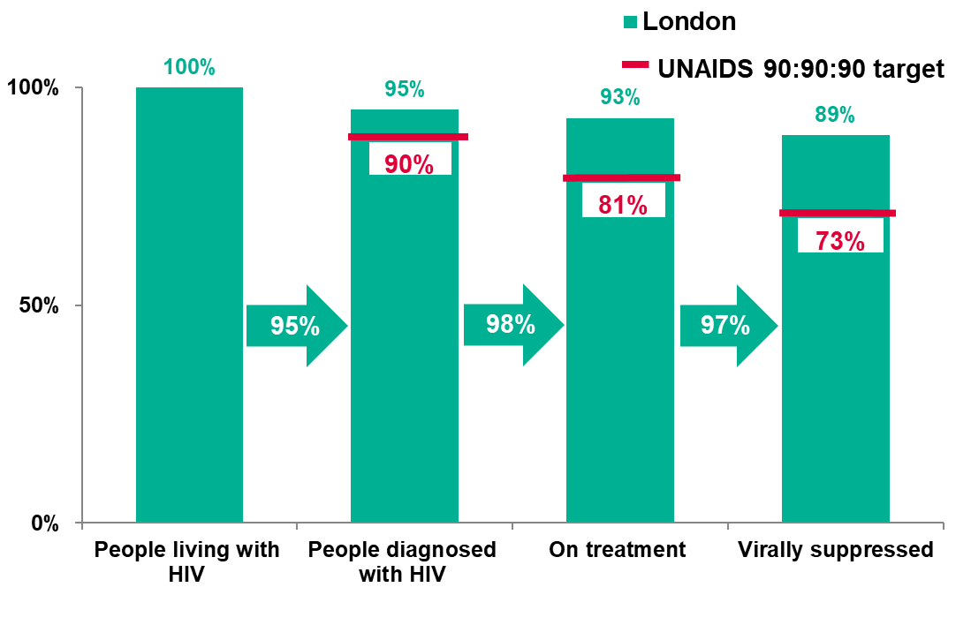
Figure 20: HIV treatment cascade among adults living with HIV, London, 2019
Source: Public Health England, HIV & AIDS Reporting System (HARS), Multi-parameter evidence synthesis (MPES)

Slide 24
Acknowledgements
Spotlight report produced by Josh Forde, Geraldine Leong, Rosalind Douglas, National HIV surveillance team, Paul Crook from Public Health England.
Local sexual health and HIV clinics for supplying the HIV data.
Institute of Child Health.
PHE Centre for Infectious Disease Surveillance and Control (CIDSC) HIV and STI surveillance teams for collection, analysis and distribution of data.

Slide 25
Further information
‘Small numbers’ are defined as sub-five non-zero counts relating to populations of less than 10,000 or for late new HIV diagnoses any proportion where the numerator and/or denominator is sub-five and non-zero.
Please access the online ‘Sexual and Reproductive Health Profiles’ for further information on a whole range of sexual health indicators: fingertips.phe.org.uk/profile/sexualhealth
For more information on local sexual health data sources please access the PHE guide:
www.gov.uk/government/uploads/system/uploads/attachment_data/file/576052/PHE_SH_data_guide_December_2016_FINALNB081216.pdf
For more information on STIs in London please access: https://www.gov.uk/government/publications/sexually-transmitted-infections-london-data
For the national HIV report: 2019 data, please access:
www.gov.uk/government/publications/hiv-in-the-united-kingdom
For more information please contact Field Services at fes.seal@phe.gov.uk

