Slide 1
Annual Epidemiological Spotlight on STIs in London: 2016 data
Field Epidemiology Services
PHE publications gateway number: 2017281

Slide 2
Summary of 2016 data for London residents
  Over 117,500 new STIs diagnosed
  New STI diagnosis rate: 1,355 diagnoses per 100,000 population
  17/20 LAs in England with the highest rates of STIs are in London
  Diagnoses of gonorrhoea fell by 19% 2015-16, but syphilis diagnoses rose by 2%
  Chlamydia detection rate in those aged 15-24 was 2,309 per 100,000 pop. (aim = 2,300)
  Diagnoses in GUM: 27% of new STI diagnoses were in men who have sex with men (MSM) (90% of syphilis, 64% of gonorrhoea)
  15-24 year olds accounted for 37% of new STI diagnoses
  9% of new STI diagnoses were in black Caribbeans, who have the highest rate (2,815 per 100,000 pop.)
  White ethnic group has the highest numbers of new STIs (57%)
  Majority of those diagnosed with a new STI are UK-born (57%)

Slide 3
Figure 1: New STI diagnosis per 100,000 population by PHE centre of residence, 2016
Source: Public Health England, GUMCAD and CTAD

Slide 4
Figure 2: Number of diagnoses of the five main STIs: London residents, 2012-2016
Any increase in gonorrhoea diagnoses may be due to the increased use of highly sensitive nucleic acid amplification tests (NAATs) and additional screening of extra-genital sites in MSM.
Any decrease in genital wart diagnoses may be due to a moderately protective effect of HPV-16/18 vaccination.
Any increase in genital herpes diagnoses may be due to the use of more sensitive NAATs.
Increases or decreases may also reflect changes in testing practices.
Source: Public Health England, GUMCAD and CTAD

Slide 5
Figure 3: Diagnosis rates of the five main STIs: London residents, 2012-2016
Any increase in gonorrhoea diagnoses may be due to the increased use of highly sensitive nucleic acid amplification tests (NAATs) and additional screening of extra-genital sites in MSM.
Any decrease in genital wart diagnoses may be due to a moderately protective effect of HPV-16/18 vaccination.
Any increase in genital herpes diagnoses may be due to the use of more sensitive NAATs.
Increases or decreases may also reflect changes in testing practices.
Source: Public Health England, GUMCAD and CTAD

Slide 6
Table 1: Percentage change in new STI diagnoses: London residents
Please see notes for Figure 3.
Source: Public Health England, GUMCAD and CTAD
.

Slide 7
Figure 4: Rate of new STIs per 100,000 residents by age group in London, 2016
Source: Public Health England, GUMCAD and CTAD

Slide 8
Figure 5: Rates by ethnicity per 100,000 population of London residents diagnosed with a new STI: 2016
Source: Public Health England, GUMCAD and CTAD

Slide 9
Table 2: Proportion of London residents diagnosed with a new STI by ethnicity: 2016
Source: Public Health England, GUMCAD and CTAD

Slide 10
Figure 6: Proportions of London residents diagnosed with a new STI in specialist SHCs by world region of birth: 2016
Source: Public Health England, GUMCAD

Slide 11
Figure 7: Diagnoses of the five main STIs among MSM in specialist SHCs: London residents, 2012-2016
GUMCAD started in 2009. Reporting of sexual orientation is less likely to be complete for earlier years, so rises seen may be partly artefactual.
Any increase in gonorrhoea diagnoses may be due to the increased use of highly sensitive nucleic acid amplification tests (NAATs) and additional screening of extra-genital sites in MSM.
Any decrease in genital wart diagnoses may be due to a moderately protective effect of HPV-16/18 vaccination.
Any increase in genital herpes diagnoses may be due to the use of more sensitive NAATs.
Any increase or decrease may reflect changes in testing.
Source: Public Health England, GUMCAD (level 3 services).

Slide 12
Table 3: Percentage change in new STI diagnoses in men who have sex with men (MSM) diagnosed in specialist SHCs: London residents
Please see notes for Figure 7.
Source: Public Health England, GUMCAD

Slide 13
Figure 8a: Rate of new STI diagnoses per 100,000 population among London residents by local authority of residence: 2016
Source: Public Health England, GUMCAD and CTAD

Slide 14
Figure 8b: Rate of new STI diagnoses (excluding chlamydia diagnoses in persons aged 15-24 years) per 100,000 population aged 15-64 years among London residents by local authority of residence: 2016
Source: Public Health England, GUMCAD and CTAD

Slide 15
Figure 9: Chlamydia detection rate per 100,000 population aged 15-24 years in London by upper tier local authority of residence: 2016
PHE recommends that local areas should be working towards achieving a chlamydia detection rate of at least 2,300 per 100,000 among individuals aged 15 to 24 years.
Source: Public Health England, GUMCAD and CTAD

Slide 16
Figure 10: Rate of gonorrhoea diagnoses per 100,000 population in London by upper tier local authority of residence: 2016
Source: Public Health England, GUMCAD

Slide 17
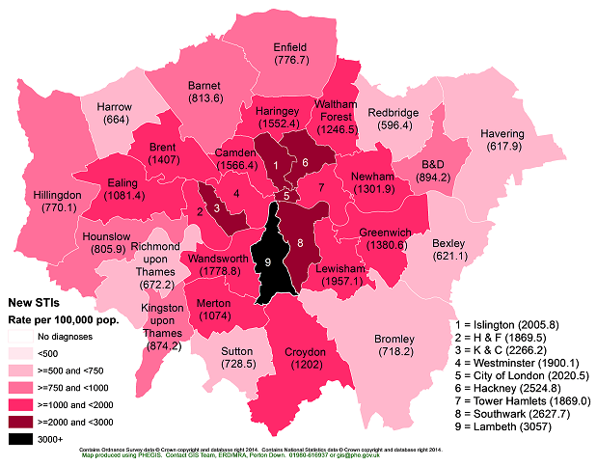
Figure 11: Map of new STI rates per 100,000 residents by upper tier local authority in London: 2016
Source: Public Health England, GUMCAD and CTAD

Slide 18
Table 4: Number of diagnoses of new STIs by PHEC of residence, data source and data subset: 2016
Source: Public Health England, GUMCAD and CTAD

Slide 19
Table 5: Number of diagnoses of the 5 main STIs in London by STI, data source and data subset: 2016
Source: Public Health England, GUMCAD and CTAD

