Slide 1
Annual Epidemiological Spotlight on STIs in London: 2018 data
Field Service
PHE publications gateway number: GW-635

Slide 2
Summary of 2018 data for London residents
Over 130,000 new STIs diagnosed
New STI diagnosis rate: 1,490 diagnoses per 100,000 population
17/20 LAs in England with the highest rates of STIs are in London
Diagnoses of gonorrhoea rose by 23% 2017-18 and syphilis diagnoses rose by 1%
Chlamydia detection rate in those aged 15-24 was 2,610 per 100,000 pop. (aim = 2,300)
32% of new STI diagnoses were in men who have sex with men (MSM) (89% of syphilis, 63% of gonorrhoea) – (GUMCAD data only)
15-24 year olds accounted for 36% of new STI diagnoses
11% of new STI diagnoses were in black Caribbeans, who have the highest rate (3,545 per 100,000 pop.)
White ethnic group has the highest numbers of new STIs (56%)
Majority of those diagnosed with a new STI are UK-born (58%)

Slide 3
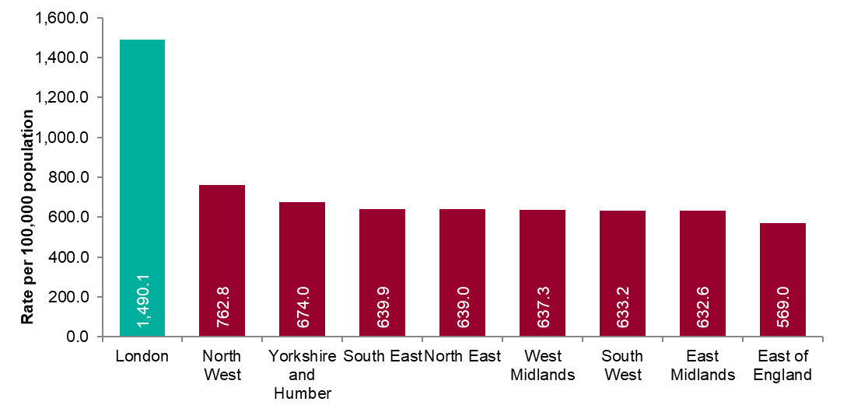
Figure 1: New STI diagnosis per 100,000 population by PHE centre of residence, 2018
Source: Public Health England, GUMCAD and CTAD

Slide 4
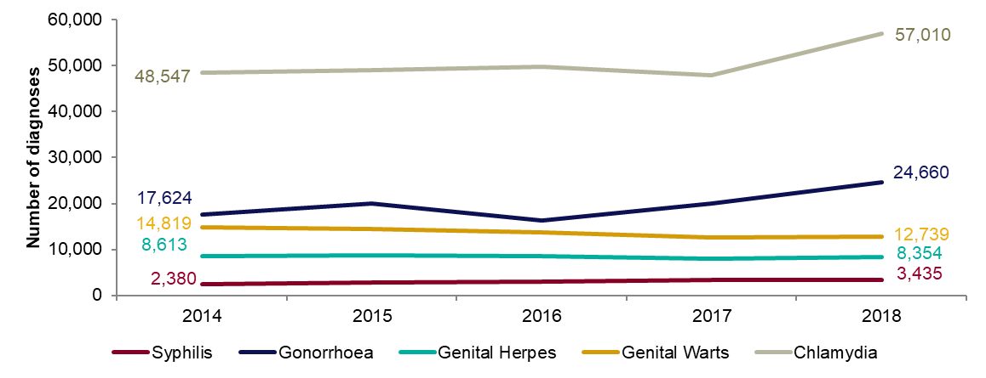
Figure 2: Number of diagnoses of the 5 main STIs: London residents, 2014-2018
Any increase in gonorrhoea diagnoses may be due to the increased use of highly sensitive nucleic acid amplification tests (NAATs) and additional screening of extra-genital sites in MSM.
Any decrease in genital wart diagnoses may be due to a moderately protective effect of HPV-16/18 vaccination.
Any increase in genital herpes diagnoses may be due to the use of more sensitive NAATs.
Increases or decreases may also reflect changes in testing practices.
Source: Public Health England, GUMCAD and CTAD

Slide 5
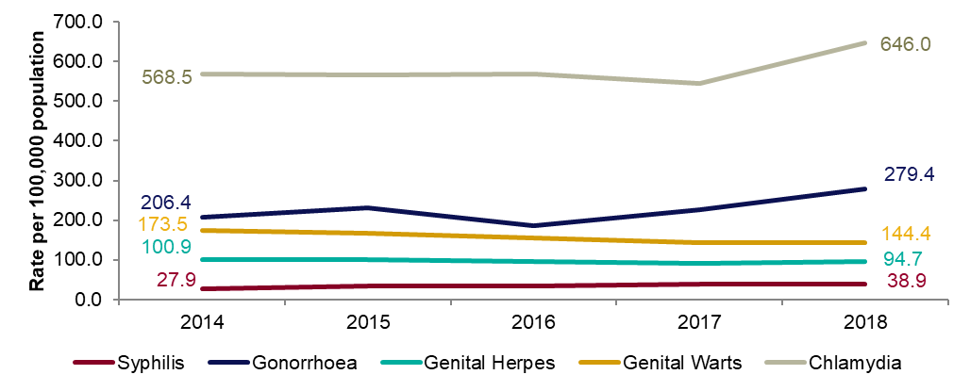
Figure 3: Diagnosis rates of the 5 main STIs: London residents, 2014-2018
Any increase in gonorrhoea diagnoses may be due to the increased use of highly sensitive nucleic acid amplification tests (NAATs) and additional screening of extra-genital sites in MSM.
Any decrease in genital wart diagnoses may be due to a moderately protective effect of HPV-16/18 vaccination.
Any increase in genital herpes diagnoses may be due to the use of more sensitive NAATs.
Increases or decreases may also reflect changes in testing practices.
Source: Public Health England, GUMCAD and CTAD

Slide 6
Table 1: Percentage change in new STI diagnoses: London residents
Please see notes for Figure 3.
Source: Public Health England, GUMCAD and CTAD
.

Slide 7
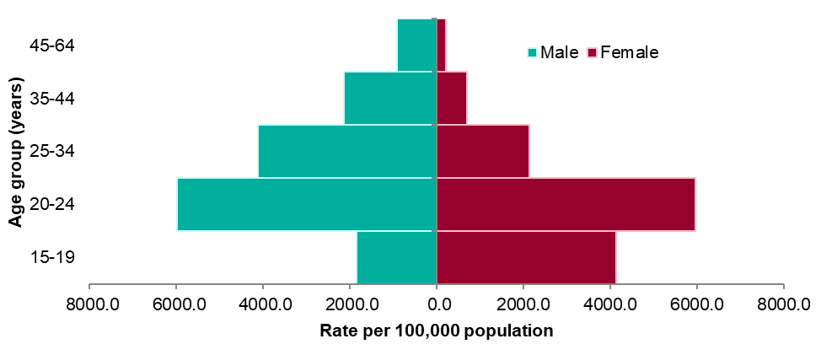
Figure 4: Rate of new STIs per 100,000 residents by age group in London, 2018
Source: Public Health England, GUMCAD and CTAD

Slide 8
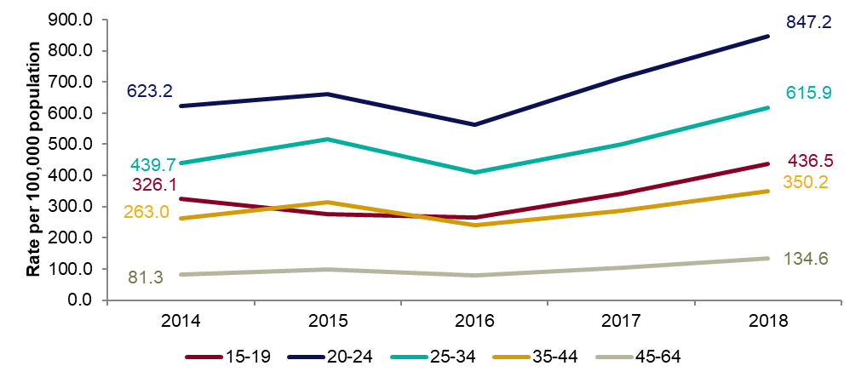
Figure 5: Rates of gonorrhoea per 100,000 residents by age group in London: 2014-2018

Slide 9
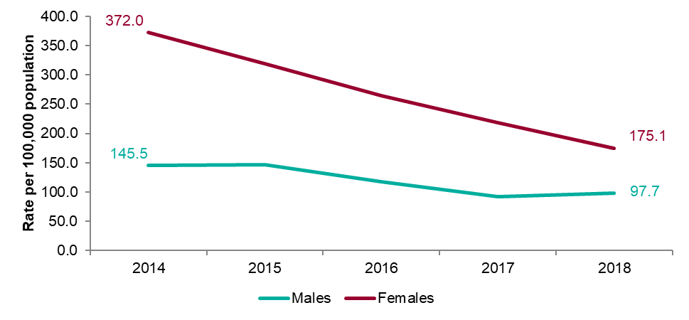
Figure 6: Rates of genital warts per 100,000 residents aged 15-19 years by gender: 2014-2018

Slide 10
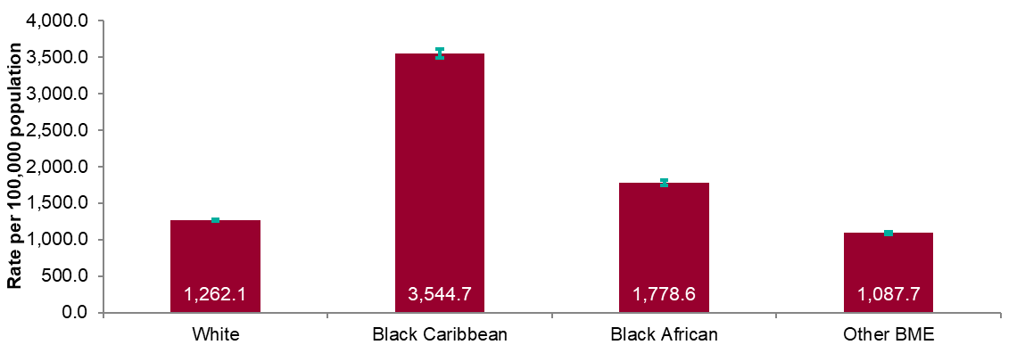
Figure 7: Rates by ethnicity per 100,000 population of London residents diagnosed with a new STI: 2018
Source: Public Health England, GUMCAD and CTAD

Slide 11
Table 2: Proportion of London residents diagnosed with a new STI by ethnicity: 2018
Source: Public Health England, GUMCAD and CTAD

Slide 12
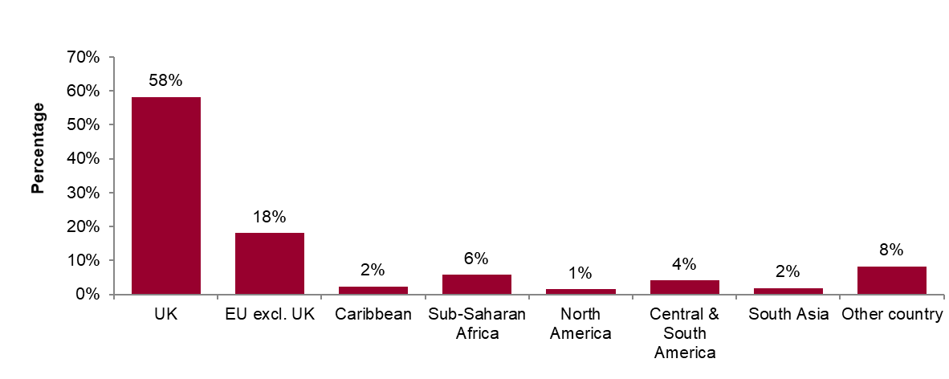
Figure 8: Proportions of London residents diagnosed with a new STI by world region of birth*: 2018
*Data on country of birth is not collected by CTAD. All information about world region of birth is based on diagnoses made in specialist and non-specialist services which report to GUMCAD.
Source: Public Health England, GUMCAD

Slide 13
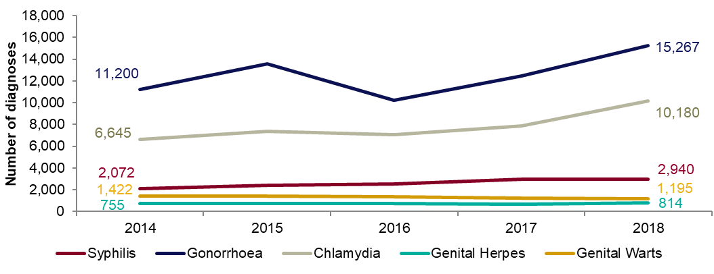
Figure 9: Diagnoses of the 5 main STIs among MSM*: London residents, 2014-2018
* Data on sexual orientation is not collected by CTAD. All information about MSM is based on diagnoses made in specialist and non-specialist services which report to GUMCAD
GUMCAD started in 2009. Reporting of sexual orientation is less likely to be complete for earlier years. So rises seen may be partly artefactual.
Any increase in gonorrhoea diagnoses may be due to the increased use of highly sensitive nucleic acid amplification tests (NAATs) and additional screening of extra-genital sites in MSM.
Any decrease in genital wart diagnoses may be due to a moderately protective effect of HPV-16/18 vaccination.
Any increase in genital herpes diagnoses may be due to the use of more sensitive NAATs.
Any increase or decrease may reflect changes in testing.
Source: Public Health England, GUMCAD (level 3 services).

Slide 14
Table 3: Percentage change in new STI diagnoses in men who have sex with men (MSM)*: London residents
*Please see notes for Figure 9.
Source: Public Health England, GUMCAD

Slide 15
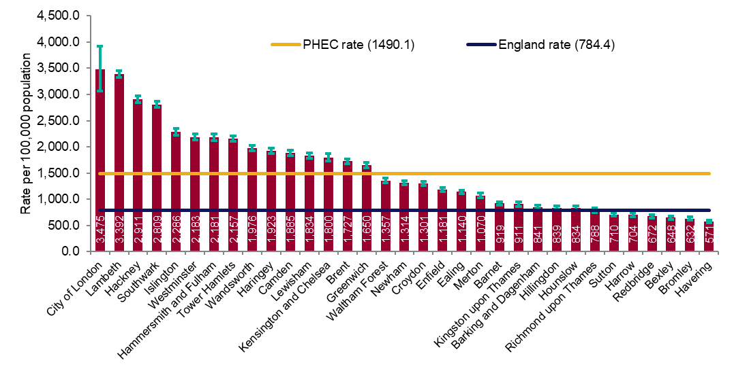
Figure 10a: Rate of all new STI diagnoses per 100,000 population among London residents by local authority of residence: 2018
Source: Public Health England, GUMCAD and CTAD

Slide 16
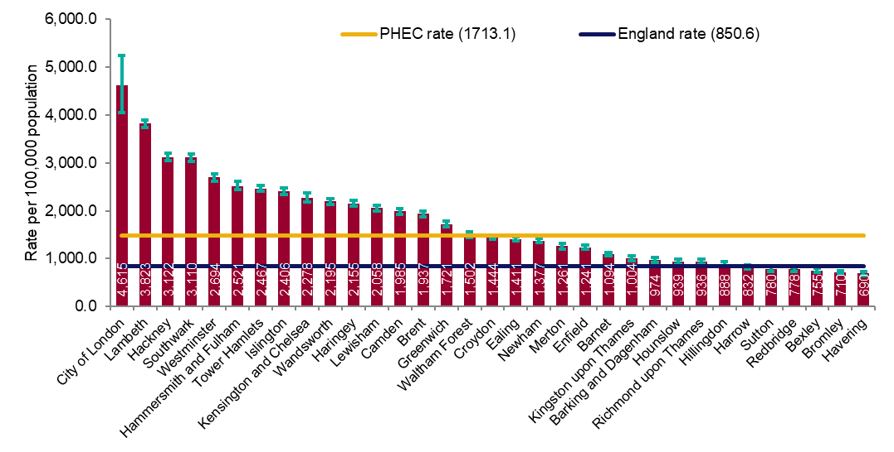
Figure 10b: Rate of new STI diagnoses (excluding chlamydia diagnoses in persons aged 15-24 years) per 100,000 population aged 15-64 years among London residents by local authority of residence: 2018
Source: Public Health England, GUMCAD and CTAD

Slide 17
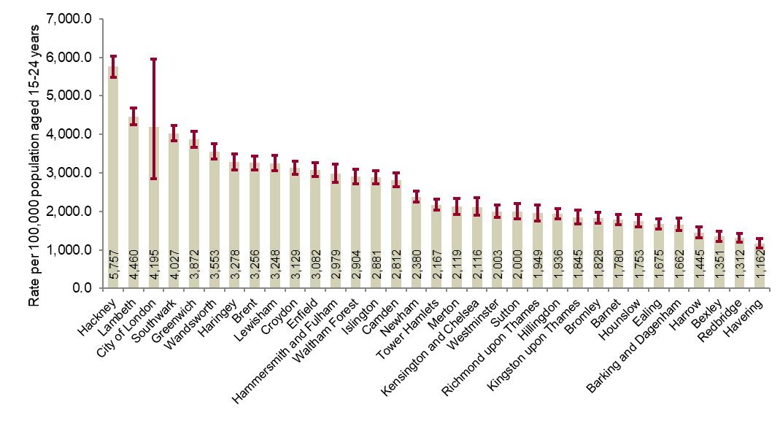
Figure 11: Chlamydia detection rate per 100,000 population aged 15-24 years in London by local authority of residence: 2018
PHE recommends that local areas should be working towards achieving a chlamydia detection rate of at least 2,300 per 100,000 among individuals aged 15 to 24 years.
Source: Public Health England, GUMCAD and CTAD

Slide 18
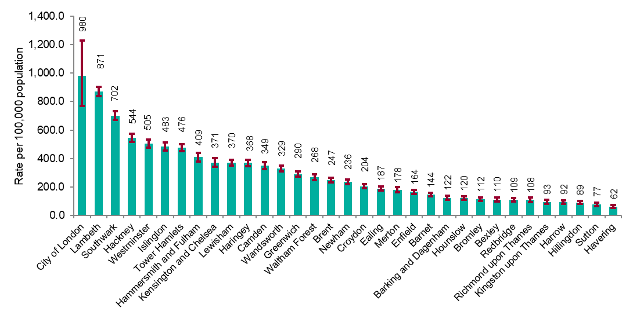
Figure 12: Rate of gonorrhoea diagnoses per 100,000 population in London by local authority of residence: 2018
Source: Public Health England, GUMCAD

Slide 19
Figure 13: Map of new STI rates per 100,000 residents by upper tier local authority in London: 2018
Source: Public Health England, GUMCAD and CTAD

Slide 20
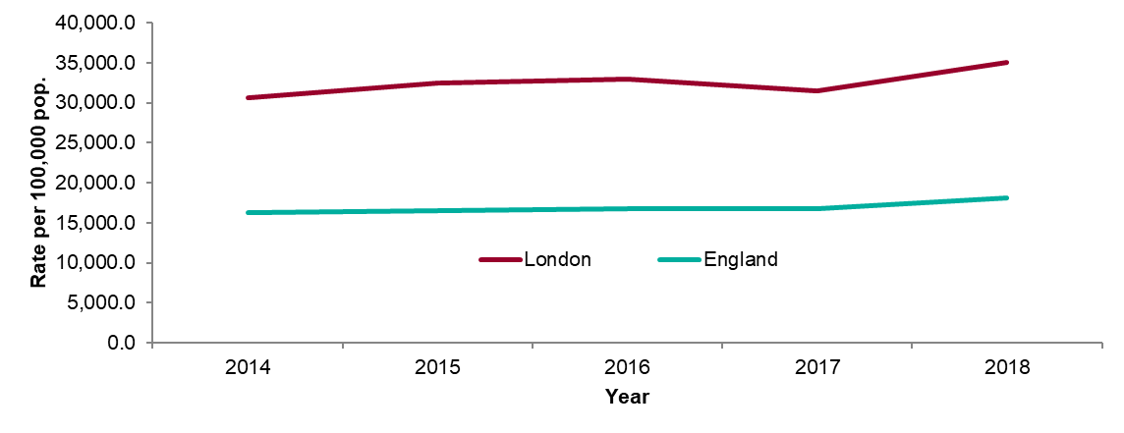
Figure 14: STI testing rate (excluding chlamydia in under 25 year olds) per 100,000 population in London residents aged 15 to 64: 2014-2018
Source: Public Health England, GUMCAD

Slide 21
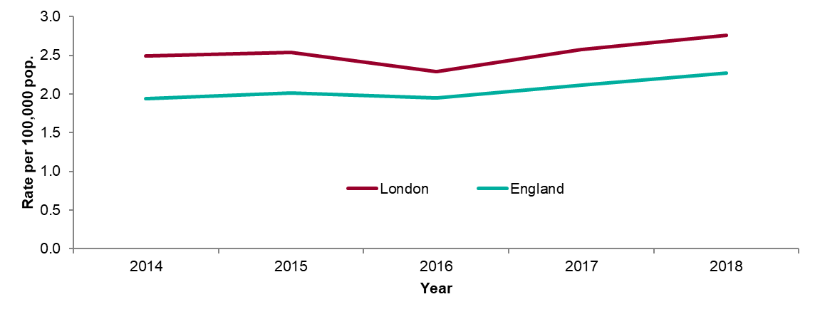
Figure 15: STI testing positivity rate (excluding chlamydia in under 25 year olds) in London residents: 2014-2018
Source: Public Health England, GUMCAD

Slide 22
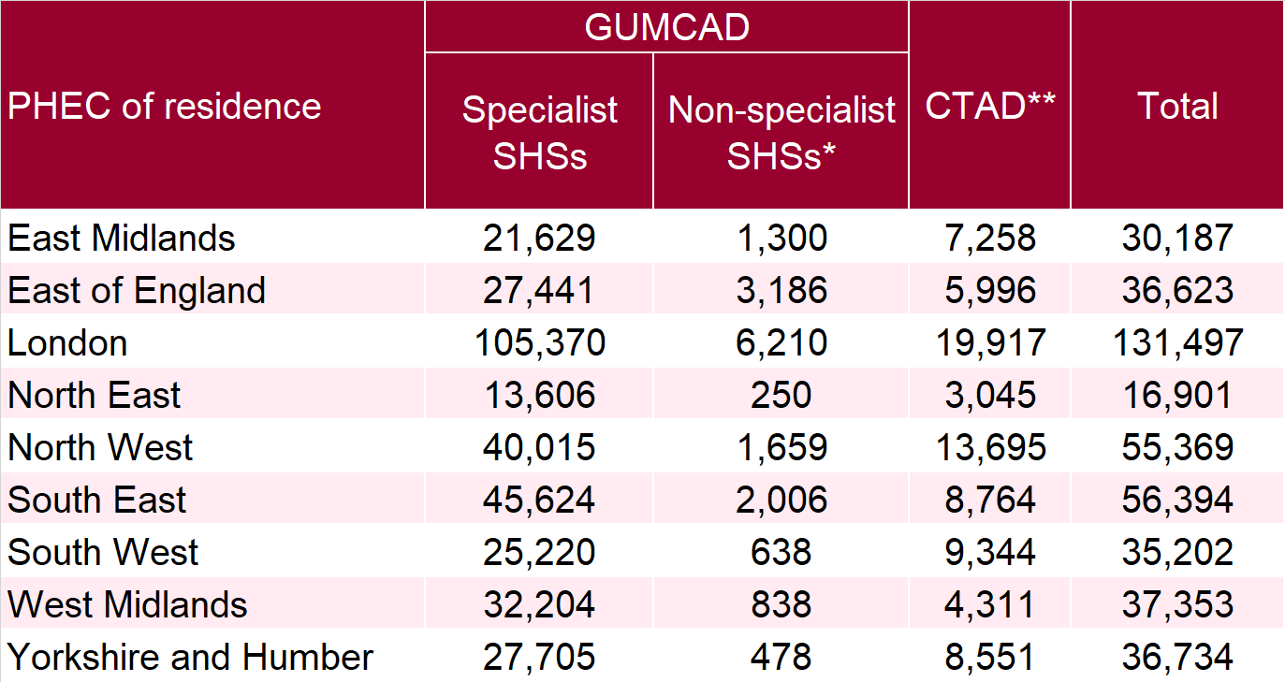
Table 4: Number of diagnoses of new STIs by PHEC of residence, data source and data subset: 2018
* New STI diagnoses from enhanced GPs reporting to GUMCAD are included in the ‘Non-specialist sexual health services (SHSs)’ total. For London residents, 1,311 / 6,210 diagnoses from non-specialist SHSs were reported via the e-Service
** Including site type 12 chlamydia from GUMCAD.
Source: Public Health England, GUMCAD and CTAD

Slide 23
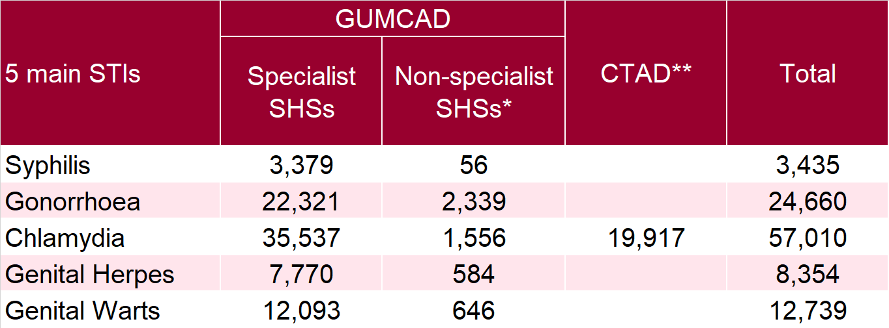
Table 5: Number of diagnoses of the 5 main STIs in London by STI, data source and data subset: 2018
* Diagnoses from enhanced GPs reporting to GUMCAD are included in the ‘Non-specialist sexual health services (SHSs)’ total. For gonorrhoea, 1,311 diagnoses from non-specialist SHSs were reported via the e-Service
** Including site type 12 chlamydia from GUMCAD.
Source: Public Health England, GUMCAD and CTAD

