Slide 1
Annual Epidemiological Spotlight on STIs in the South East: 2018 data
Field Service
PHE publications gateway number: GW-629

Slide 2
Summary of 2018 data for South East residents
Over 56,300 new STIs diagnosed
New STI diagnosis rate: 640 diagnoses per 100,000 population
Diagnoses of gonorrhoea rose by 34% from 2017 to 2018 and syphilis diagnoses rose by 13%
Chlamydia detection rate in those aged 15-24 was 1,589 per 100,000 pop. (aim = 2,300)
14% of new STI diagnoses were in MSM, 71% of syphilis, 47% of gonorrhoea (GUMCAD only)
15-24 year olds accounted for 50% of new STI diagnoses
White ethnic group has the highest numbers of new STIs (87% of total)
1% of new STI diagnoses are in black Caribbeans, however they have the highest rate (2,274 per 100,000 pop.)
84% percent of new STI diagnoses are in people born in the UK.

Slide 3
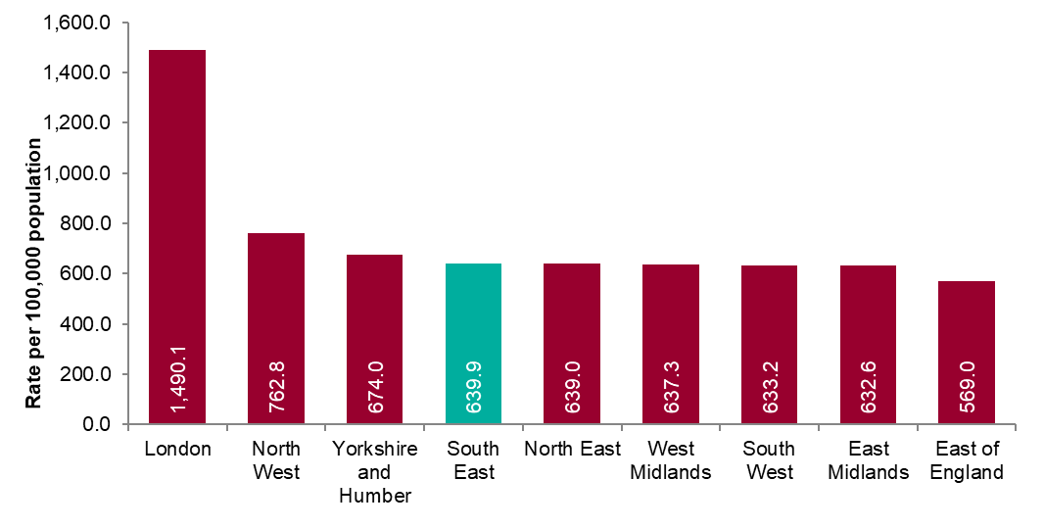
New STI diagnosis per 100,000 population by PHE centre of residence, 2018
Source: Public Health England, GUMCAD and CTAD

Slide 4
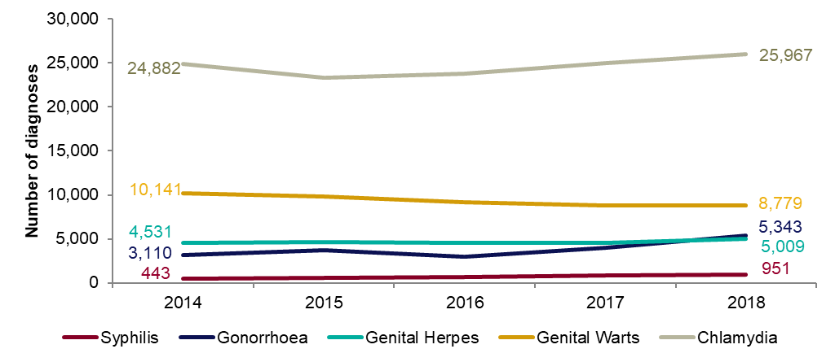
Figure 2: Number of diagnoses of the five main STIs: South East residents, 2014-2018
Any increase in gonorrhoea diagnoses may be due to the increased use of highly sensitive nucleic acid amplification tests (NAATs) and additional screening of extra-genital sites in MSM.
Any decrease in genital wart diagnoses may be due to a moderately protective effect of HPV-16/18 vaccination.
Any increase in genital herpes diagnoses may be due to the use of more sensitive NAATs.
Increases or decreases may also reflect changes in testing practices.
Potential over-reporting of syphilis by one large specialist sexual health service is currently being investigated which may impact on recent trends in syphilis
Source: Public Health England, GUMCAD and CTAD

Slide 5
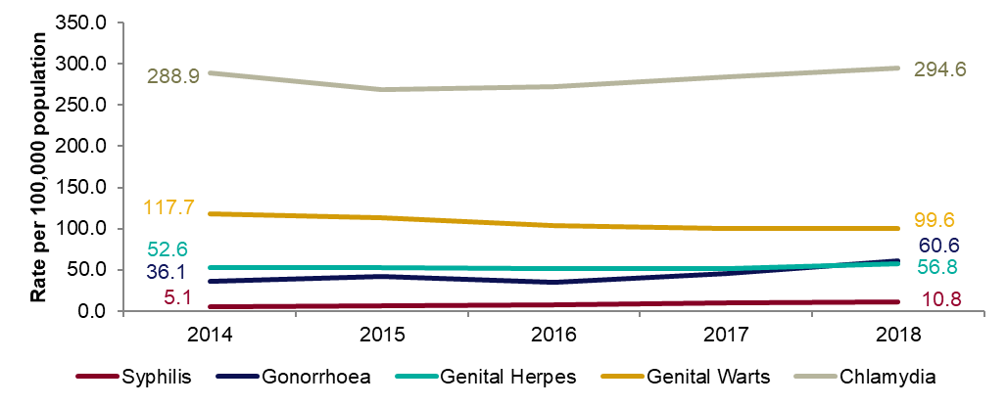
Figure 3: Diagnosis rates of the five main STIs: South East residents, 2014-2018
Any increase in gonorrhoea diagnoses may be due to the increased use of highly sensitive nucleic acid amplification tests (NAATs) and additional screening of extra-genital sites in MSM.
Any decrease in genital wart diagnoses may be due to a moderately protective effect of HPV-16/18 vaccination.
Any increase in genital herpes diagnoses may be due to the use of more sensitive NAATs.
Increases or decreases may also reflect changes in testing practices.
Potential over-reporting of syphilis by one large specialist sexual health service is currently being investigated which may impact on recent trends in syphilis
Source: Public Health England, GUMCAD and CTAD

Slide 6
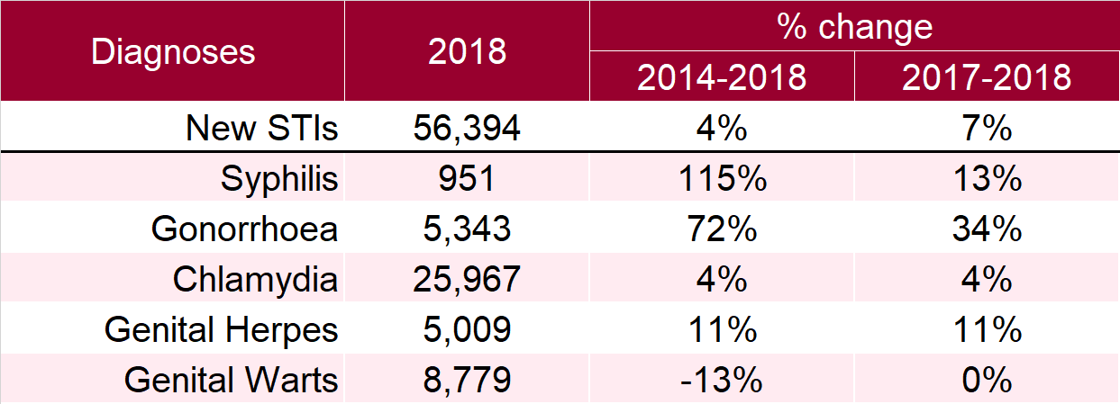
Table 1: Percentage change in new STI diagnoses: South East residents
Please see notes for Figure 3.
Source: Public Health England, GUMCAD and CTAD

Slide 7
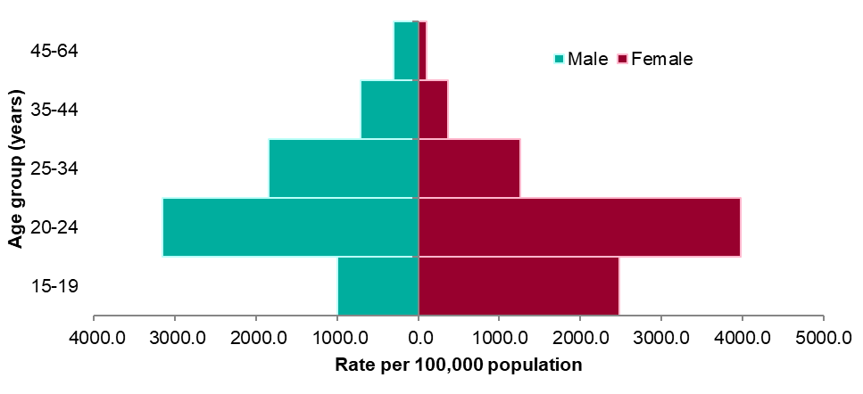
Figure 4: Rate of new STIs per 100,000 residents by age group in the South East, 2018
Source: Public Health England, GUMCAD and CTAD

Slide 8
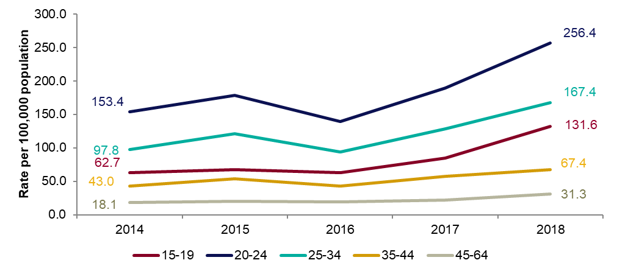
Figure 5: Rates of gonorrhoea per 100,000 residents by age group in the South East, 2014-2018
Source: Public Health England, GUMCAD

Slide 9
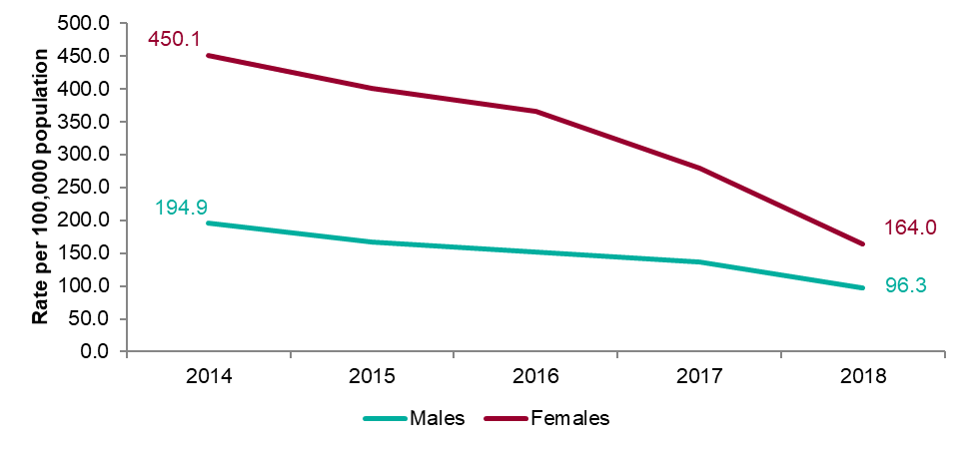
Figure 6: Rates of genital warts per 100,000 residents aged 15-19 years by gender in the South East, 2014-2018
Source: Public Health England, GUMCAD

Slide 10
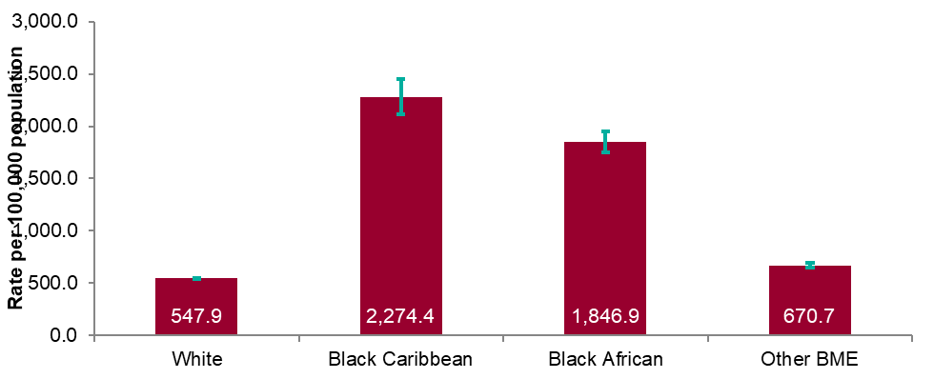
Figure 7: Rates by ethnicity per 100,000 population of South East residents diagnosed with a new STI: 2018
Source: Public Health England, GUMCAD and CTAD

Slide 11
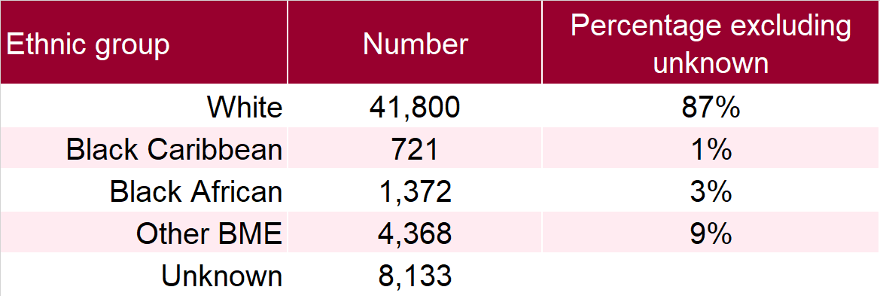
Table 2: Proportion of South East residents diagnosed with a new STI by ethnicity: 2018
Source: Public Health England, GUMCAD and CTAD

Slide 12
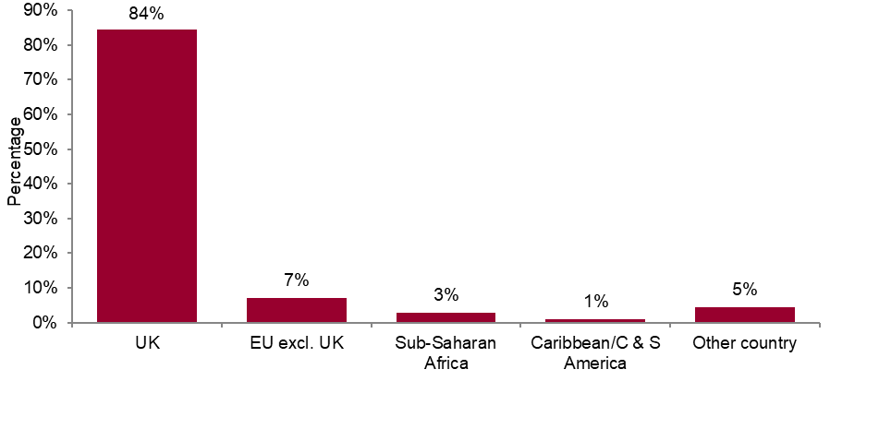
Figure 8: Proportions of South East residents diagnosed with a new STI by world region of birth: 2018
*Data on country of birth is not collected by CTAD. All information about world region of birth is based on diagnoses made in specialist and non-specialist services which report to GUMCAD.
Source: Public Health England, GUMCAD

Slide 13
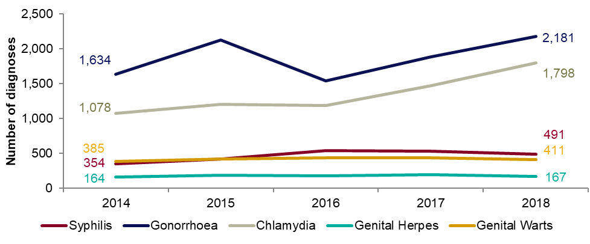
Figure 9: Diagnoses of the five main STIs among MSM* : South East residents, 2014-2018
*Data on sexual orientation is not collected by CTAD. All information about MSM is based on diagnoses made in specialist and non-specialist services which report to GUMCAD.
*Sexual orientation is subject to increasing issues of missing sexual orientation in recent years in the South East. In 2014 this was missing for 4.2% of specialist SHS new STI diagnoses in males, in 2017 for 7.3% and in 2018 for 13.1%. CTAD does not collect sexual orientation and data from that system is not included in this chart. Please see related footnote for table 3 for more detail.
Potential over-reporting of syphilis by one large specialist sexual health service is currently being investigated which may impact on recent trends in syphilis
Any increase in gonorrhoea diagnoses may be due to the increased use of highly sensitive nucleic acid amplification tests (NAATs) and additional screening of extra-genital sites in MSM.
Any decrease in genital wart diagnoses may be due to a moderately protective effect of HPV-16/18 vaccination.
Any increase in genital herpes diagnoses may be due to the use of more sensitive NAATs.
Any increase or decrease may reflect changes in testing.
The proportion of diagnoses reported in males of unknown sexual orientation has varied over time. Please see next slide for details.
Source: Public Health England, GUMCAD

Slide 14
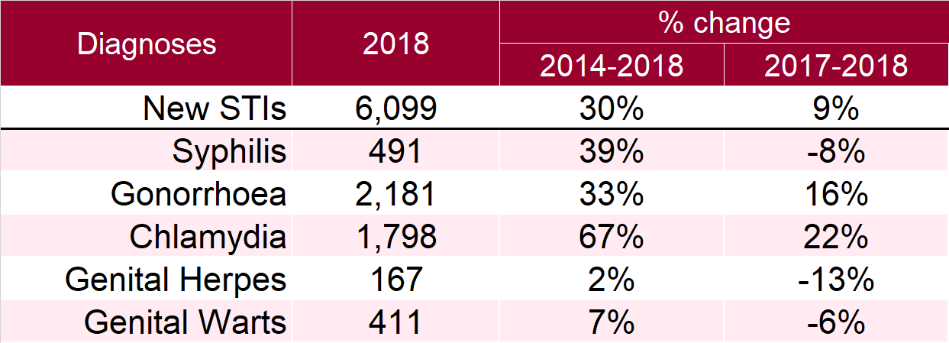
Table 3: Percentage change in new STI diagnoses in MSM* : South East residents
*Data on sexual orientation is not collected by CTAD. All information about MSM is based on diagnoses made in specialist and non-specialist services which report to GUMCAD *Sexual orientation is subject to increasing issues of missing sexual orientation in recent years in the South East. In 2014 this was missing for 4.2% of specialist SHS new STI diagnoses in males, in 2017 for 7.3% and in 2018 for 13.1%. In 2018, 28.2% of syphilis diagnoses in males, 14.9% of gonorrhoea diagnoses in males, 10.7% of specialist SHS chlamydia diagnoses in males, 14.7% of genital herpes diagnoses in males and 9.1% of genital warts diagnoses in males.
Potential over-reporting of syphilis by one large specialist sexual health service is currently being investigated which may impact on recent trends in syphilis
Please see notes for Figure 9 additionally.
Source: Public Health England, GUMCAD

Slide 15
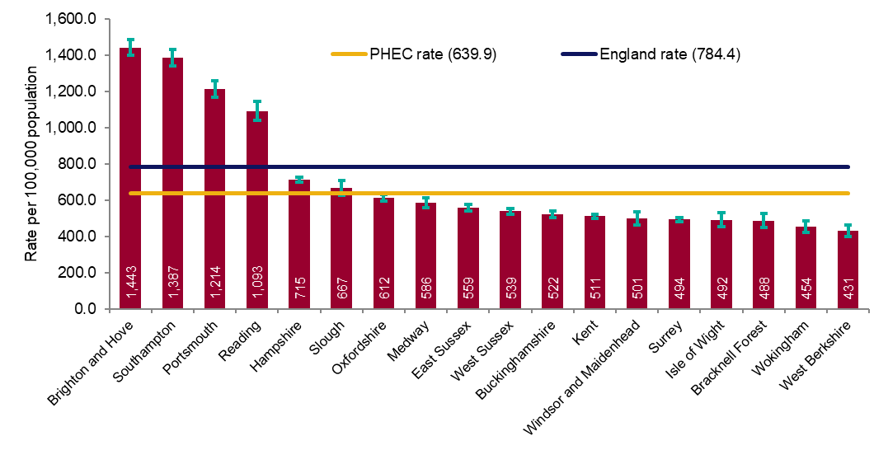
Figure 10a: Rate of new STI diagnoses per 100,000 population among South East residents by upper tier local authority of residence: 2018
Source: Public Health England, GUMCAD and CTAD

Slide 16
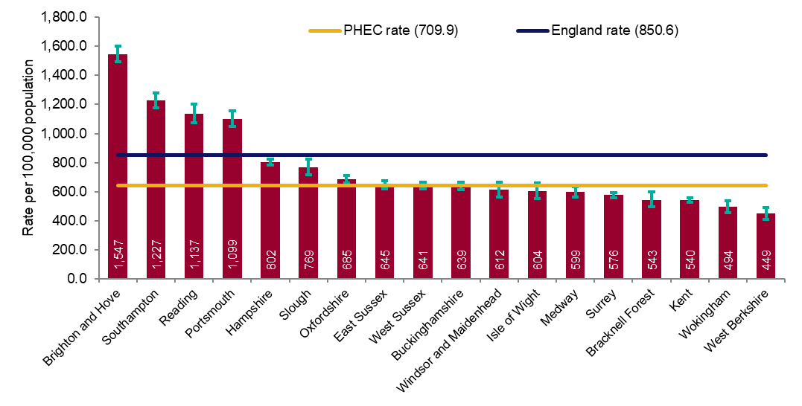
Figure 10b: Rate of new STI diagnoses (excluding chlamydia diagnoses in persons aged 15-24 years) per 100,000 population aged 15-64 years among South East residents by upper tier local authority of residence: 2018
Source: Public Health England, GUMCAD and CTAD

Slide 17
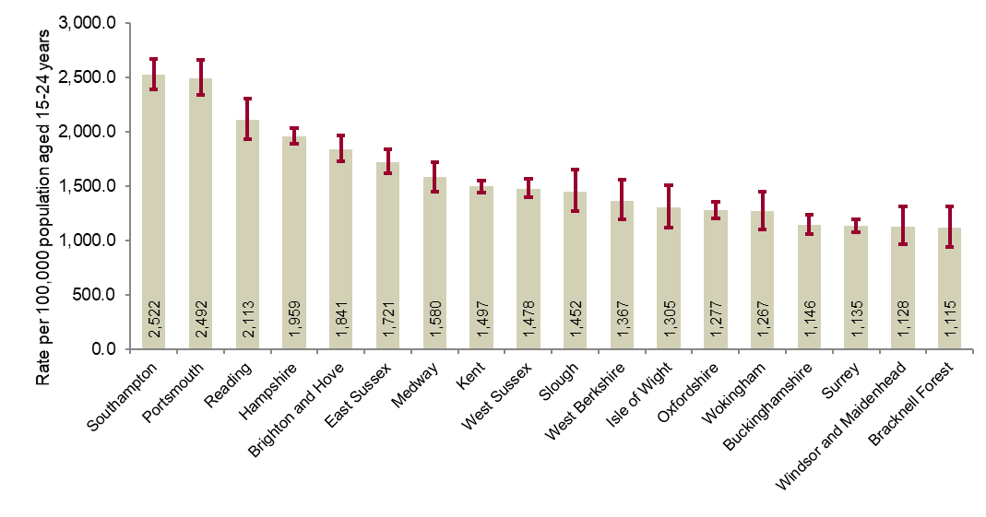
Figure 11: Chlamydia detection rate per 100,000 population aged 15-24 years in the South East by upper tier local authority of residence: 2018
PHE recommends that local areas should be working towards achieving a chlamydia detection rate of at least 2,300 per 100,000 among individuals aged 15 to 24 years.
Source: Public Health England, GUMCAD and CTAD

Slide 18
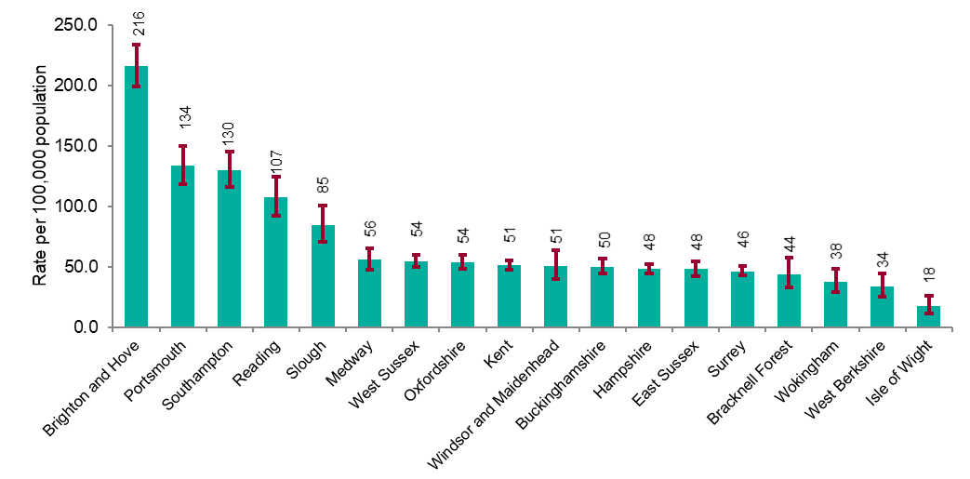
Figure 12: Rate of gonorrhoea diagnoses per 100,000 population in the South East by upper tier local authority of residence: 2018
Source: Public Health England, GUMCAD

Slide 19
Figure 13: Map of new STI rates per 100,000 residents by upper tier local authority in the South East: 2018
Source: Public Health England, GUMCAD and CTAD

Slide 20
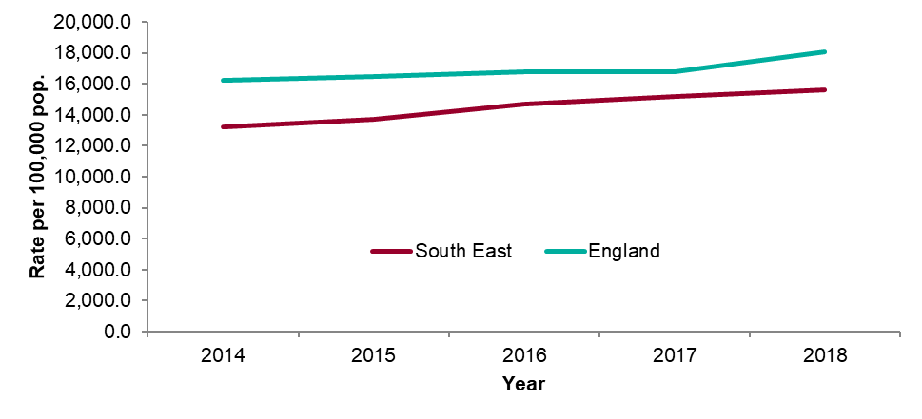
Figure 14: STI testing rate (excluding chlamydia in under 25 year olds) per 100,000 population in South East residents aged 15 to 64: 2014-2018
Source: Public Health England, GUMCAD

Slide 21
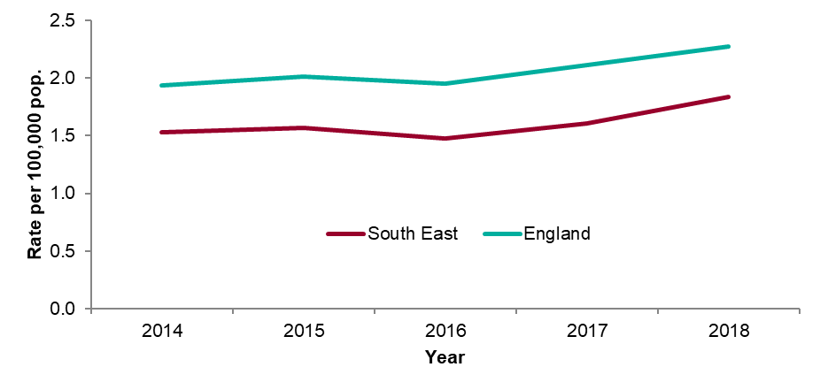
Figure 15: STI testing positivity rate* (excluding chlamydia in under 25 year olds) in South East residents: 2014-2018
* The numerator for the STI testing positivity rate now only includes infections which are also included in the denominator. These are: chlamydia (excluding diagnoses in those aged under 25 years), gonorrhoea, syphilis and HIV. Up to 2018 (data for 2017) it included all new STIs.
Source: Public Health England, GUMCAD

Slide 22
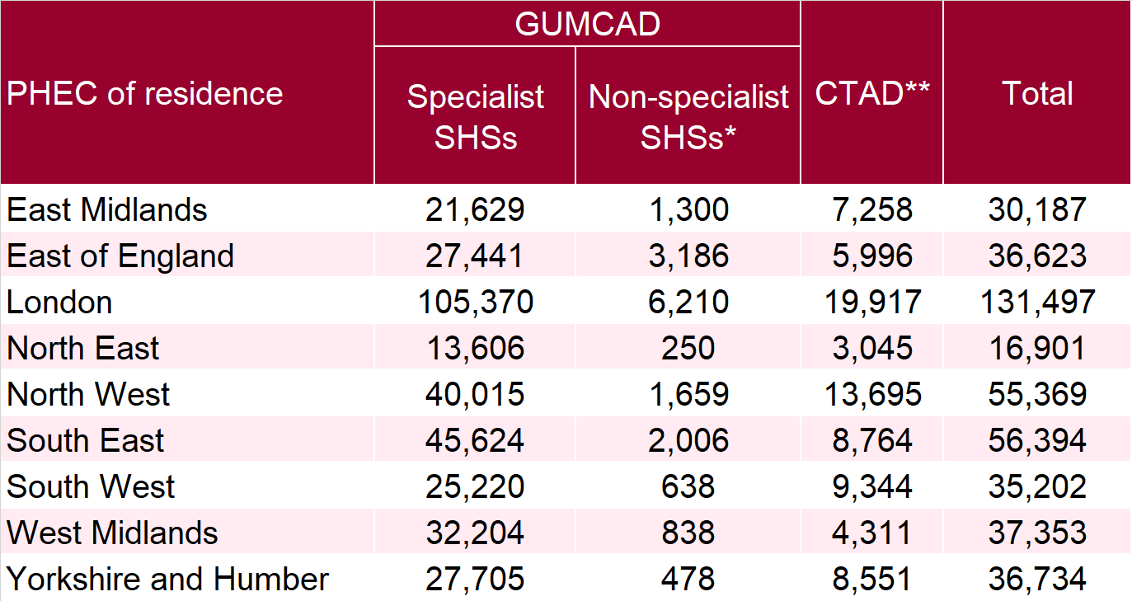
Table 4: Number of diagnoses of new STIs by PHEC of residence, data source and data subset: 2018
* Diagnoses from enhanced GPs reporting to GUMCAD are included in the ‘Non-specialist sexual health services (SHSs)’ total
** Including site type 12 chlamydia from GUMCAD
Source: Public Health England, GUMCAD and CTAD

Slide 23
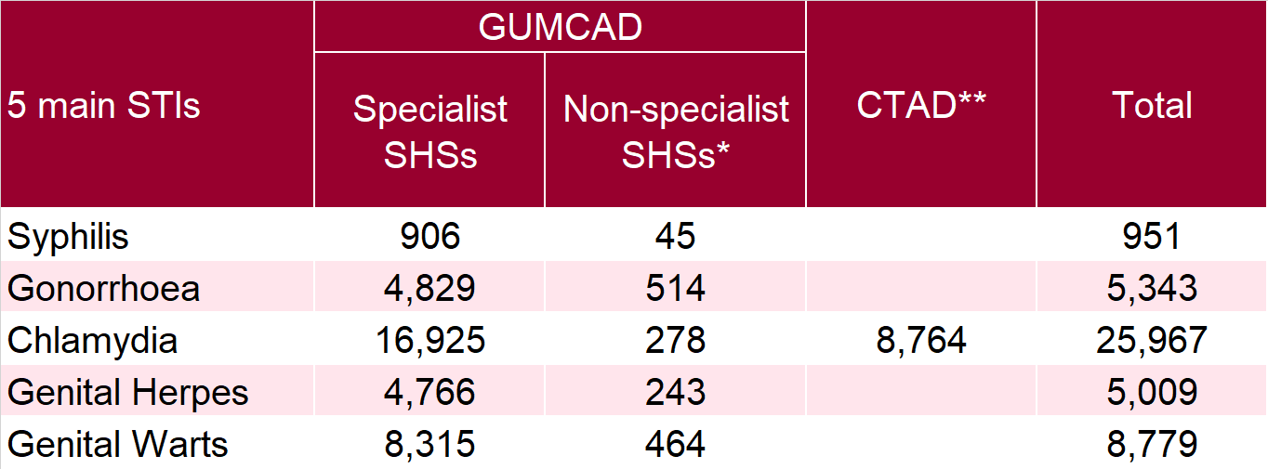
Table 5: Number of diagnoses of the 5 main STIs in the South East by STI, data source and data subset: 2018
* Diagnoses from enhanced GPs reporting to GUMCAD are included in the ‘Non-specialist sexual health services (SHSs)’ total
** Including site type 12 chlamydia from GUMCAD
Potential over-reporting of syphilis by one large specialist sexual health service is currently being investigated which may impact on recent trends in syphilis
Source: Public Health England, GUMCAD and CTAD

