Slide 1
Annual Epidemiological Spotlight on STIs in the South East: 2019 data
Field Service
PHE publications gateway number: GW-1957

Slide 2
About Public Health England
Public Health England exists to protect and improve the nation’s health and wellbeing, and reduce health inequalities. We do this through world-leading science, research, knowledge and intelligence, advocacy, partnerships and the delivery of specialist public health services. We are an executive agency of the Department of Health and Social Care, and a distinct delivery organisation with operational autonomy. We provide government, local government, the NHS, Parliament, industry and the public with evidence-based professional, scientific and delivery expertise and support.
Public Health England 133-155 Waterloo Road Wellington House London SE1 8UG Tel: 020 7654 8000 www.gov.uk/phe Twitter: @PHE_uk Facebook: www.facebook.com/PublicHealthEngland
Prepared by: Josh Forde and Paul Crook, Field Service, South East & London. For queries relating to this document, please contact josh.forde@phe.gov.uk
© Crown copyright 2021
You may re-use this information (excluding logos) free of charge in any format or medium, under the terms of the Open Government Licence v3.0. To view this licence, visit OGL. Where we have identified any third party copyright information you will need to obtain permission from the copyright holders concerned.
Published March 2021
PHE publications gateway number: GW-1957

Slide 3
Summary of 2019 data for South East residents
Over 58,200 new STIs diagnosed
New STI diagnosis rate: 653 diagnoses per 100,000 population
Diagnoses of gonorrhoea rose by 28% 2018-2019 and syphilis diagnoses rose by 21%
Chlamydia detection rate in those aged 15-24 was 1,760 per 100,000 pop. (aim = 2,300)
16% of new STI diagnoses (excl. chlamydia reported via CTAD) were in men who have sex with men (MSM) (75% of syphilis, 45% of gonorrhoea)
15-24 year olds accounted for 50% of new STI diagnoses
2% of new STI diagnoses were in black Caribbeans, who have the highest rate (2,511 per 100,000 pop.)
White ethnic group has the highest numbers of new STIs (85%)
Majority of those diagnosed with a new STI are UK-born (83%)

Slide 4
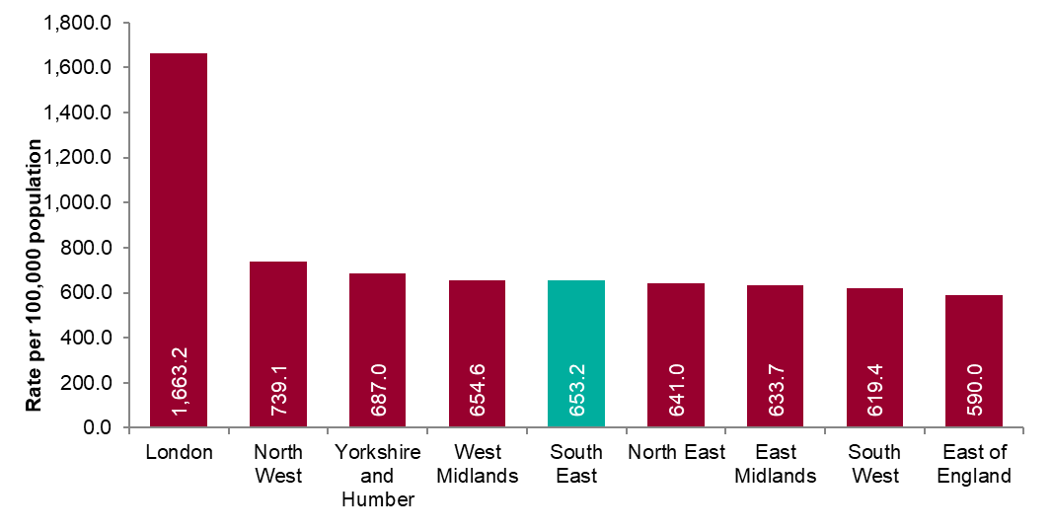
Figure 1: New STI diagnosis per 100,000 population by PHE centre of residence, 2019
Source: Public Health England, GUMCAD and CTAD

Slide 5
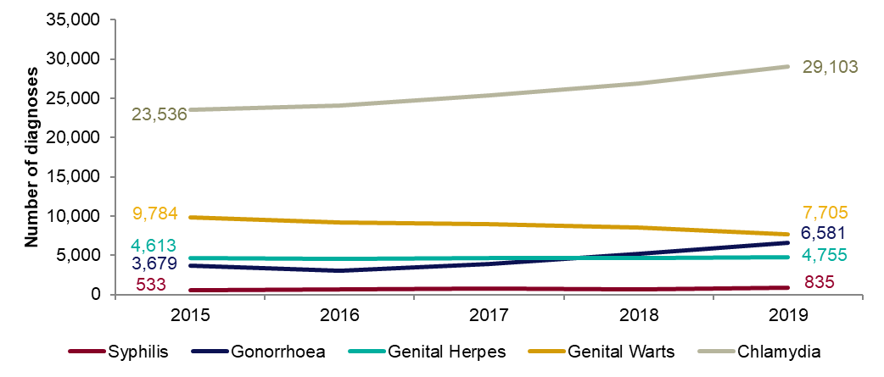
Figure 2: Number of diagnoses of the 5 main STIs: South East residents, 2015-2019
Any increase in gonorrhoea diagnoses may be due to the increased use of highly sensitive nucleic acid amplification tests (NAATs) and additional screening of extra-genital sites in MSM.
Any decrease in genital wart diagnoses may be due to a moderately protective effect of HPV-16/18 vaccination.
Any increase in genital herpes diagnoses may be due to the use of more sensitive NAATs.
Increases or decreases may also reflect changes in testing practices.
Source: Public Health England, GUMCAD and CTAD

Slide 6
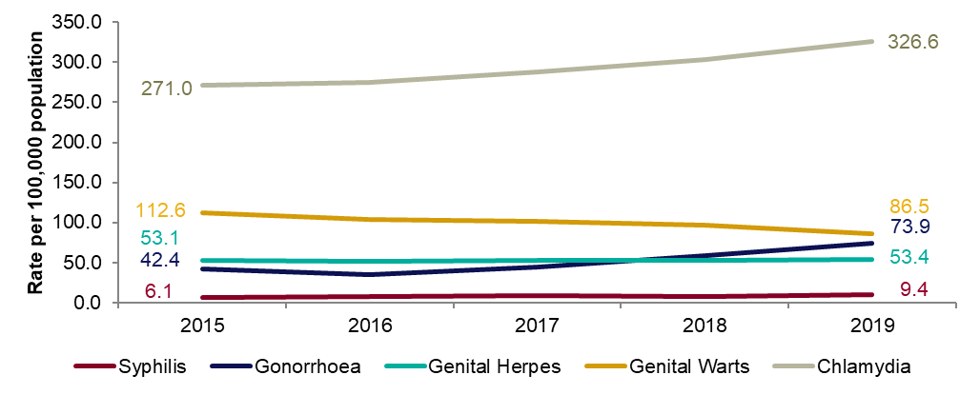
Figure 3: Diagnosis rates of the 5 main STIs: South East residents, 2015-2019
Any increase in gonorrhoea diagnoses may be due to the increased use of highly sensitive nucleic acid amplification tests (NAATs) and additional screening of extra-genital sites in MSM.
Any decrease in genital wart diagnoses may be due to a moderately protective effect of HPV-16/18 vaccination.
Any increase in genital herpes diagnoses may be due to the use of more sensitive NAATs.
Increases or decreases may also reflect changes in testing practices.
Source: Public Health England, GUMCAD and CTAD

Slide 7
Table 1: Percentage change in new STI diagnoses: South East residents
Please see notes for Figure 3.
Source: Public Health England, GUMCAD and CTAD
.

Slide 8
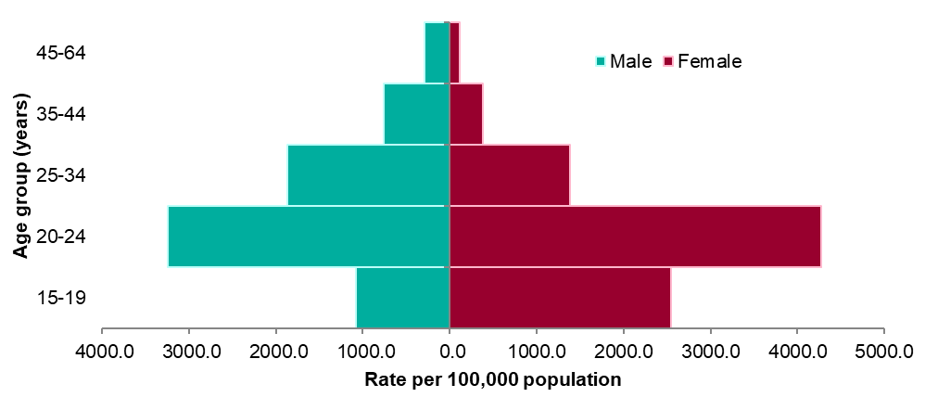
Figure 4: Rates of new STIs per 100,000 residents by gender and age group in South East, 2019
Source: Public Health England, GUMCAD and CTAD

Slide 9
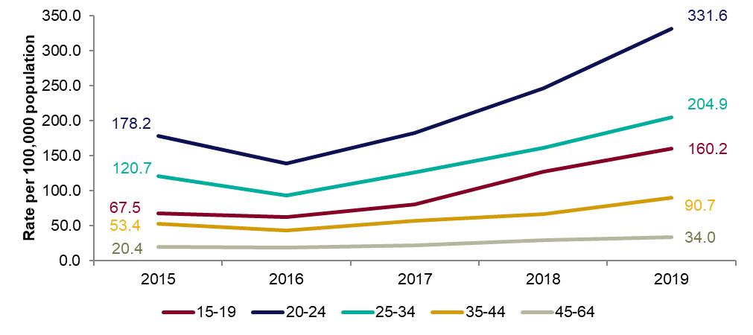
Figure 5: Rates of gonorrhoea per 100,000 residents by age group in South East: 2015-2019

Slide 10
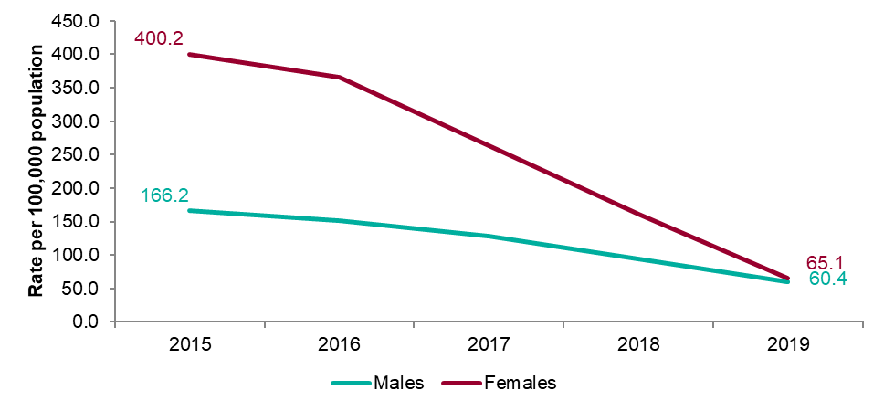
Figure 6: Rates of genital warts per 100,000 residents aged 15-19 years by gender: 2015-2019

Slide 11
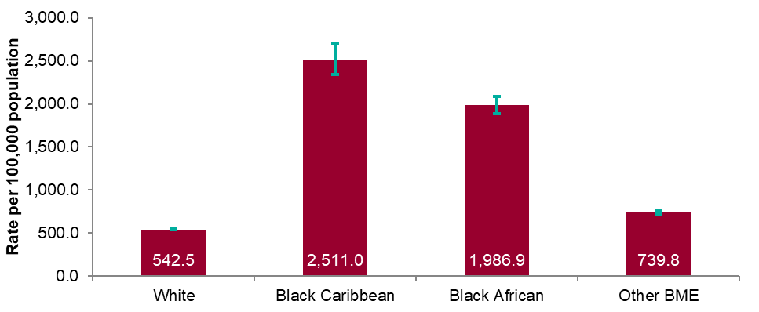
Figure 7: Rates by ethnicity per 100,000 population of South East residents diagnosed with a new STI: 2019
Source: Public Health England, GUMCAD and CTAD

Slide 12
Table 2: Proportion of South East residents diagnosed with a new STI by ethnicity: 2019
Source: Public Health England, GUMCAD and CTAD

Slide 13
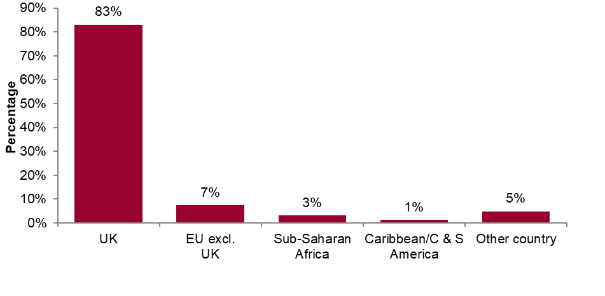
Figure 8: Proportions of South East residents diagnosed with a new STI by world region of birth*: 2019
*Data on country of birth is not collected by CTAD. All information about world region of birth is based on diagnoses made in specialist and non-specialist services which report to GUMCAD.
Source: Public Health England, GUMCAD

Slide 14
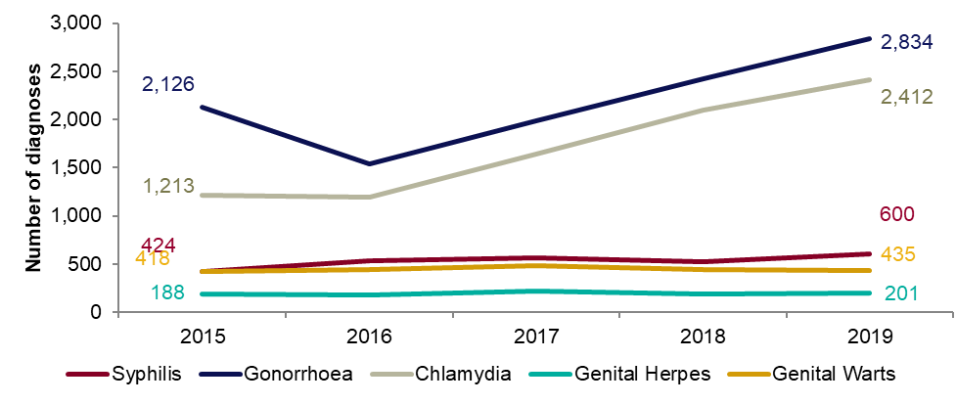
Figure 9: Diagnoses of the 5 main STIs among MSM*: South East residents, 2015-2019
* Data on sexual orientation is not collected by CTAD. All information about MSM is based on diagnoses made in specialist and non-specialist services which report to GUMCAD
GUMCAD started in 2009. Reporting of sexual orientation is less likely to be complete for earlier years. So rises seen may be partly artefactual.
Any increase in gonorrhoea diagnoses may be due to the increased use of highly sensitive nucleic acid amplification tests (NAATs) and additional screening of extra-genital sites in MSM.
Any decrease in genital wart diagnoses may be due to a moderately protective effect of HPV-16/18 vaccination.
Any increase in genital herpes diagnoses may be due to the use of more sensitive NAATs.
Any increase or decrease may reflect changes in testing.
Source: Public Health England, GUMCAD (level 3 services).

Slide 15
Table 3: Percentage change in new STI diagnoses in men who have sex with men (MSM)*: South East residents
*Please see notes for Figure 9.
Source: Public Health England, GUMCAD

Slide 16
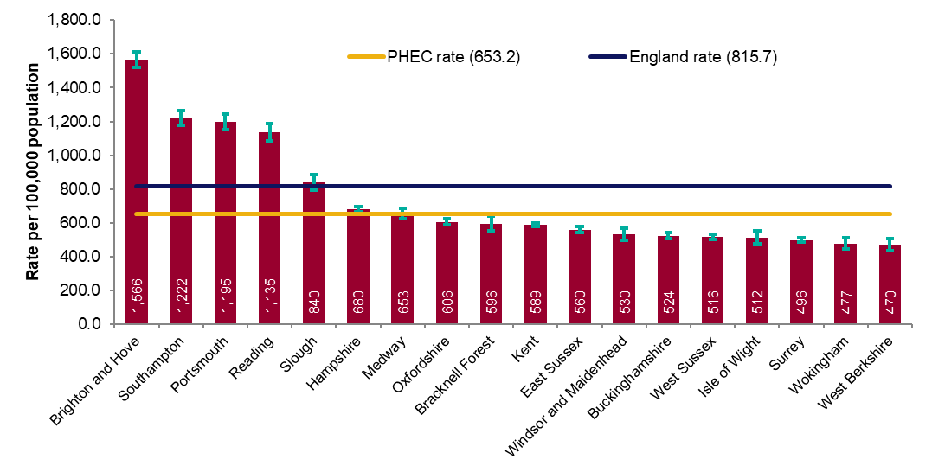
Figure 10a: Rate of all new STI diagnoses per 100,000 population among South East residents by local authority of residence: 2019
Source: Public Health England, GUMCAD and CTAD

Slide 17
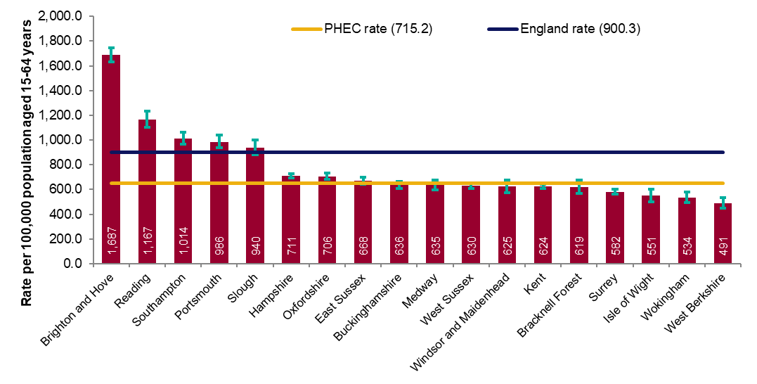
Figure 10b: Rate of new STI diagnoses (excluding chlamydia diagnoses in persons aged 15-24 years) per 100,000 population aged 15-64 years among South East residents by local authority of residence: 2019
Source: Public Health England, GUMCAD and CTAD

Slide 18
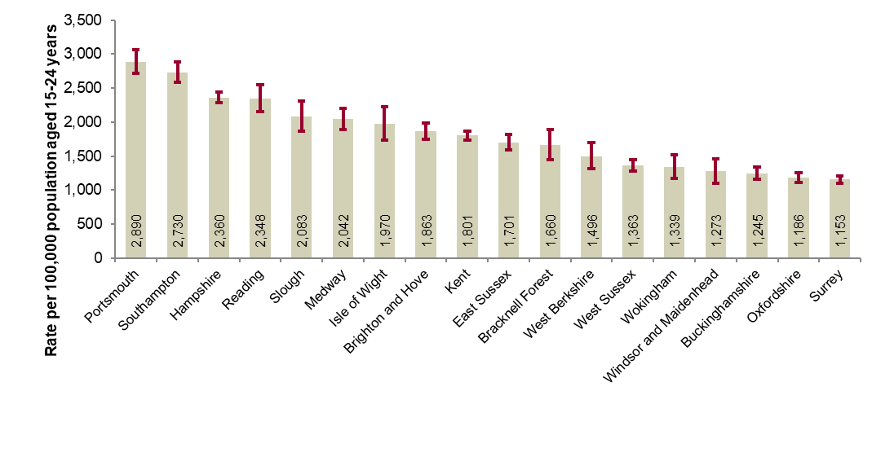
Figure 11: Chlamydia detection rate per 100,000 population aged 15-24 years in South East by local authority of residence: 2019
PHE recommends that local areas should be working towards achieving a chlamydia detection rate of at least 2,300 per 100,000 among individuals aged 15 to 24 years.
Source: Public Health England, GUMCAD and CTAD

Slide 19
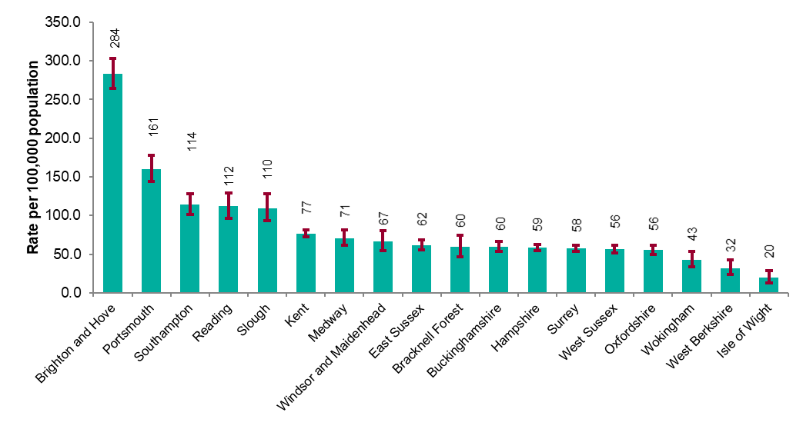
Figure 12: Rate of gonorrhoea diagnoses per 100,000 population in South East by local authority of residence: 2019
Source: Public Health England, GUMCAD

Slide 20
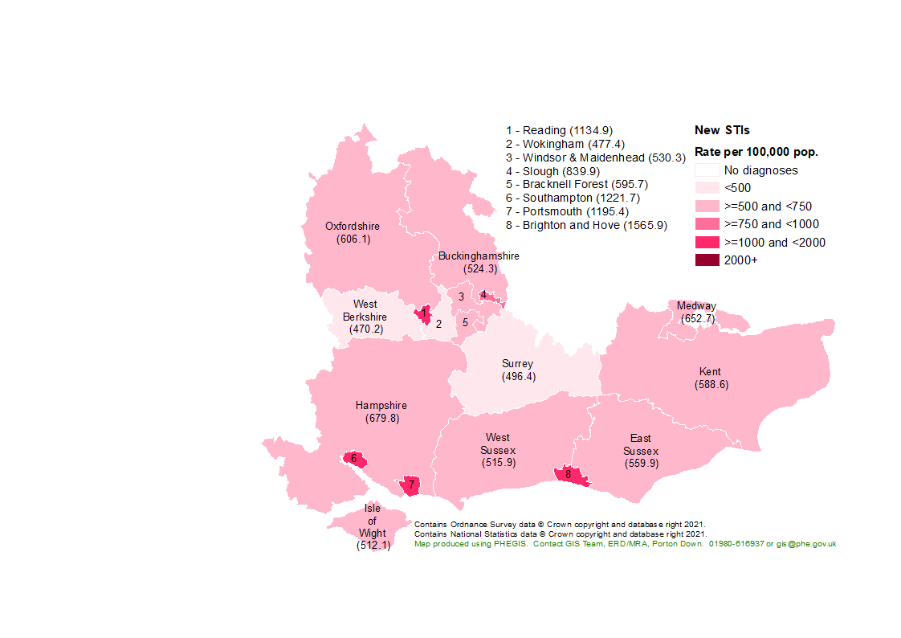
Figure 13: Map of new STI rates per 100,000 residents by upper tier local authority in South East: 2019
Source: Public Health England, GUMCAD and CTAD

Slide 21
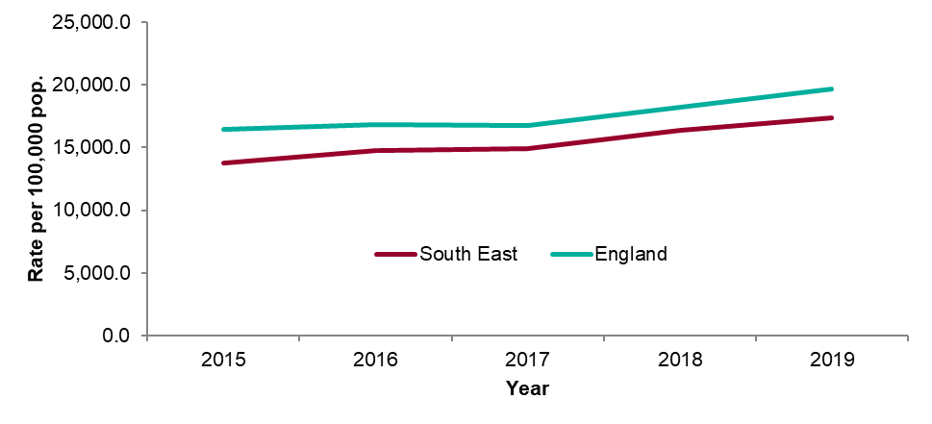
Figure 14: STI testing rate (excluding chlamydia in under 25 year olds) per 100,000 population in South East residents aged 15 to 64: 2015-2019
Source: Public Health England, GUMCAD

Slide 22
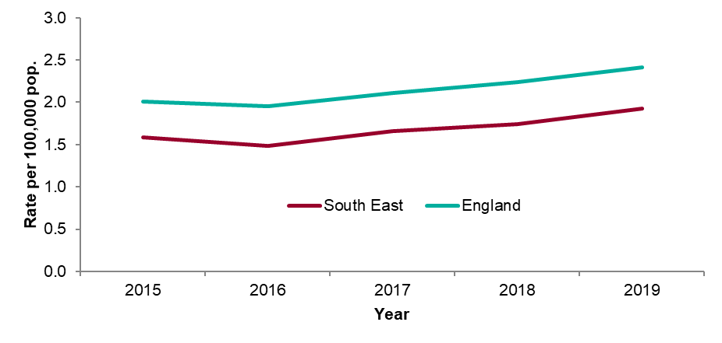
Figure 15: STI testing positivity rate (excluding chlamydia in under 25 year olds) in South East residents: 2015-2019
Source: Public Health England, GUMCAD

Slide 23
Table 4: Number of diagnoses of new STIs by PHEC of residence, data source and data subset: 2019
* New STI diagnoses from enhanced GPs reporting to GUMCAD are included in the ‘Non-specialist sexual health services (SHSs)’ total.
** Including site type 12 chlamydia from GUMCAD.
Source: Public Health England, GUMCAD and CTAD

Slide 24
Table 5: Number of diagnoses of the 5 main STIs in the South East by STI, data source and data subset: 2019
* Diagnoses from enhanced GPs reporting to GUMCAD are included in the ‘Non-specialist sexual health services (SHSs)’ total.
** Including site type 12 chlamydia from GUMCAD.
Source: Public Health England, GUMCAD and CTAD

