Slide 1
Human papillomavirus (HPV) vaccination
Universal HPV adolescent immunisation programme
Last updated September 2021

Slide 2
Aims of Resource
to provide information for healthcare practitioners involved in advising on and delivering the HPV vaccination programme
to raise awareness of the current epidemiology of HPV
to describe the programme details including administration of the vaccine, eligibility, recommended dosage and schedule, contraindications, precautions and potential adverse reactions
to raise awareness of the impact of the HPV vaccination programme

Slide 3
Learning Outcomes
After completing this resource immunisers will be able to:
describe the aetiology and epidemiology of HPV
understand the rationale and evidence base for the HPV vaccination programme
discuss the benefits of vaccination against HPV
safely administer the vaccine
identify sources of additional information

Slide 4
Key messages
Human papillomavirus (HPV) is detectable in over 99% of cervical cancers. There is also evidence of an association between HPV infection and anogenital and oropharyngeal cancers
since the HPV vaccine programme for girls was introduced, the number of diagnoses of genital warts has fallen sharply in both girls and boys, indicative of herd protection, and substantial declines in HPV16 and HPV18 in 16 to 21 year old females
the HPV vaccination programme was extended to include adolescent boys from September 2019 in England
this programme will help to prevent more cases of HPV-related cancers in boys and girls and will also strengthen herd protection
Notes:
Munoz N, Castellsague X, de Gonzalez AB et al. (2006) Chapter 1: HPV in the etiology of human cancer. Vaccine 24S3 S1-S10
Minutes of the HPV Sub-Committee of the Joint Committee on Vaccination and Immunisation, 18 May 2018 Available at: https://app.box.com/s/600veu6zr6s3gjvx8mkt/file/305789906344 [Accessed on 24/05/2019]

Slide 5
Human Papillomavirus (HPV)
DNA virus
infects skin and mucosal sites (squamous epithelium) through skin-to-skin contact
HPVs are a large group of related viruses. Each virus in the group is given a number, which is called an HPV type
HPV infections are often asymptomatic
infection can resolve spontaneously:
- 70% new high-risk infections will clear within a year
- 90% new infections clear within 2 years
persistent infection with high risk HPV types such as types 16 and 18 can lead to cancer – most notably cervical cancer in women as well as cancer of the anus, oropharyngeal and the penis
other types of HPV such as 6 and 11 cause genital warts
Notes:
HPV is the abbreviation for the humanpapillomavirus. This is a double stranded DNA virus that infects the deepest layer of the skin or mucosae of the upper respiratory and anogenital tracts.
The majority of HPV infections do not cause any symptoms and infection is usually cleared by the body’s own immune system without the need for other treatment. Around 70% of new infections will clear within one year and approximately 90% will clear within two years.
Persistent infection with high risk HPV types such as types 16 and 18 can lead to cancer – most notably cervical cancer in women as well as cancer of the anus, oropharyngeal and in men, cancer of the penis. Other types of HPV such as 6 and 11 cause genital warts
Immunisation against infectious disease (the Green book), Chapter 18a (HPV), Available at www.gov.uk/government/publications/human-papillomavirus-hpv-the-green-book-chapter-18a

Slide 6
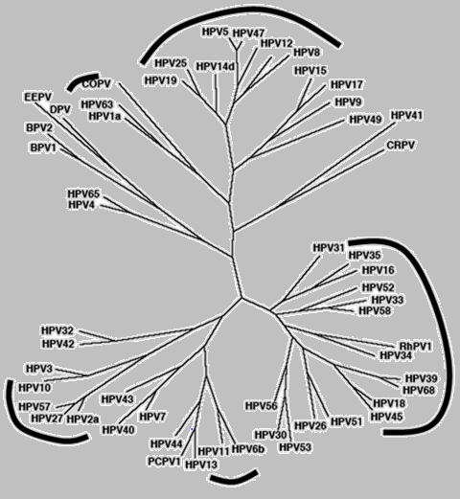
HPV Genotypes
Plantar Warts
Cutaneous (mostly asymptomatic)
Genital mucosa (cancer–associated)
Common and flat warts
External genital warts
De Villiers and others. Classification of papillomaviruses. Virology, 2004
Notes:
There are over 100 types of HPV virus

Slide 7
Human Papillomavirus (HPV)
Of the 100+ different types of HPVs:
  over 40 types affect genital area
  high risk types (include HPV 16,18,31,33,45,52,58) cause cancer
  low risk types (HPV 6,11) cause genital warts
  HPV16:
  HPV18:
  HPV6:
  HPV11:
together account for around 70% of all cervical cancers
also associated with most cases of cancer of the anus, penis, oropharyngeal, vagina & vulva
90% of cases of genital warts are due to HPV 6 and 11
Notes:
There are over 100 different types of HPV of which around 40 infect the genital area.
Genital HPVs are categorised as either High risk types - known to be associated with cancer or Low risk types- known to lead to the development of genital warts.
HPV16 and HPV18 responsible for between 70%-80% of all cervical cancers.
Types 16 and 18 are also associated with the majority of HPV related cancers of the anus, penis, oropharyngeal, vagina and vulva.
HPV infection is associated with 80-90% of all anal squamous cell cancers and HPV types 16 and 18 are found in the majority of HPV-related anal cancers.
Around 90% of cases of genital warts are thought to be due to HPV type 6 and 11. Although they do not cause cancer, genital warts can be difficult to treat. Some individuals may also experience frequent recurrent episodes which may cause significant distress to the individual and substantial costs to healthcare.

Slide 8
Transmission
HPV is one of the most common sexually transmitted infections in the UK
nearly all sexually active people get infected with HPV at some point in their lives
the risk of acquiring infection increases with the:
number of previous sexual partners
introduction of a new sexual partner
sexual history of partners
you can still have HPV even if it has been years since you were sexually active
Notes:
The transmission of genital HPV’s are primarily by sexual contact with an infected partner, particularly through sexual intercourse but also by non-penetrative genital contact, including oral sex. Infection usually occurs after sexual debut and almost 40% of women are infected within two years

Slide 9
HPV Vaccination in England
the National HPV Immunisation Programme for girls in school Year 8 began in September 2008 (throughout the UK)
Cervarix vaccine (HPV types 16,18) was used between 2008 and 2012
Gardasil vaccine (HPV types 6,11,16,18) was introduced in September 2012
in 2016, a successful pilot programme offered HPV vaccine to gay, bisexual and other men who have sex with men (MSM) at selected local sexual health services in England
on 1 April 2018, a national HPV vaccination programme for MSM began in which MSM aged up to and including 45-years-old are offered HPV vaccine through Specialist Sexual Health Services (SSHS) and/or HIV clinics
in September 2019 the HPV vaccine programme was extended to include boys as well as girls
in 2022 Gardasil 9 vaccine will become available as the HPV vaccine for the routine programme (HPV types 6,11,16,18,31,33,45,52,58)
Notes:
The national HPV Immunisation Programme was introduced for girls in September 2008 and has been delivered throughout the UK to help prevent cervical cancer.
The programme offers vaccination to school year 8 (age 12-13 years) with a catch up for those eligible up to 25 years of age.
Since September 2012 the quadrivalent vaccine Gardasil has been used for the national programme, which also provides protection against HPV types 6 and 11, the HPV types that cause genital warts, in addition to the cancer causing types 16 and 18.
Since September 2019 the programme has included boys as well as girls
In 2021/2022 Gardasil 9 will be introduced as the HPV vaccine in the routine programme containing 9 HPV types.

Slide 10
HPV and cervical cancer
persistent infection by high risk HPV types is detectable in more than 99% of all cervical cancers
cervical cancer is the most common cancer among women under the age of 35
in the UK:
  over 3000 women are diagnosed with cervical cancer every year
  around 900 women die from cervical cancer every year
Notes:
Munoz N, Castellsague X, de Gonzalez AB et al. (2006) Chapter 1: HPV in the etiology of human cancer. Vaccine 24S3 S1-S10.
https://pubmed.ncbi.nlm.nih.gov/16949995/

Slide 11
Other HPV associated cancers
HPV is also associated with:
anal and cervical cancers (more than 90%)
vaginal and vulvar cancers (about 70%)
oropharyngeal cancers (70%)
more than 60% of penile cancers
Cancer research UK (CRUK) suggests that the proportion of cancer cases linked to HPV is rising and that in Europe:
73% of oropharangeal cancer cases are HPV positive
12% of oral cavity, hypopharynx and larynx cancer cases are HPV-positive
laryngeal squamous cell carcinoma (SCC) risk is 5.4 times higher in people with HPV infection
the cancer risk for oropharyngeal, tonsil, and base of tongue is higher in people with more past sexual partners, people who started having sex at a younger age, and men who have ever had sexual contact with men
Notes:
https://www.ncbi.nlm.nih.gov/pmc/articles/PMC4830161/
https://www.cancerresearchuk.org/about-cancer/causes-of-cancer/infections-eg-hpv-and-cancer/does-hpv-cause-cancer?_ga=2.107067074.1715641418.1562227587-1516946824.1550596213
https://www.cancerresearchuk.org/health-professional/cancer-statistics/statistics-by-cancer-type/head-and-neck-cancers/risk-factors#ref-10

Slide 12
Eligibility
routine programme for adolescents aged 12 to 13 years (school Year 8)
MSM up to and including 45 years of age attending Specialist Sexual Health Services and/or HIV clinics regardless of risk, sexual behaviour or disease status
other individuals with a similar risk profile to that seen in the MSM population who may benefit from vaccination. This includes – MSM over 45 years of age, HIV+ve men and women, transgender individuals – where HPV vaccine may be considered on a case-by-case basis and can be offered following a clinical assessment of the patient. Vaccines should be purchased from the manufacturer or pharmaceutical wholesaler in this instance
eligible girls and boys (eligible boys born after 1st September 2006 can continue to be caught up until their 25th birthday)
Notes:
The vaccine is recommended for:
all adolescents aged 12 – 13 years / in school Year 8
MSM up to and including 45 years of age, attending Specialist Sexual Health Services and/or HIV clinics, regardless of risk, sexual behaviour or disease status.
Non–eligible individuals requesting vaccine should be assessed on case-by-case basis. Clinicians are able to offer vaccinations outside of the national programme using individual clinical judgement, however in these instances, vaccine should be purchased directly from the manufacturer.
Other individuals with a similar risk profile to that seen in the 16 – 45 year old MSM population may also benefit from vaccination.

Slide 13
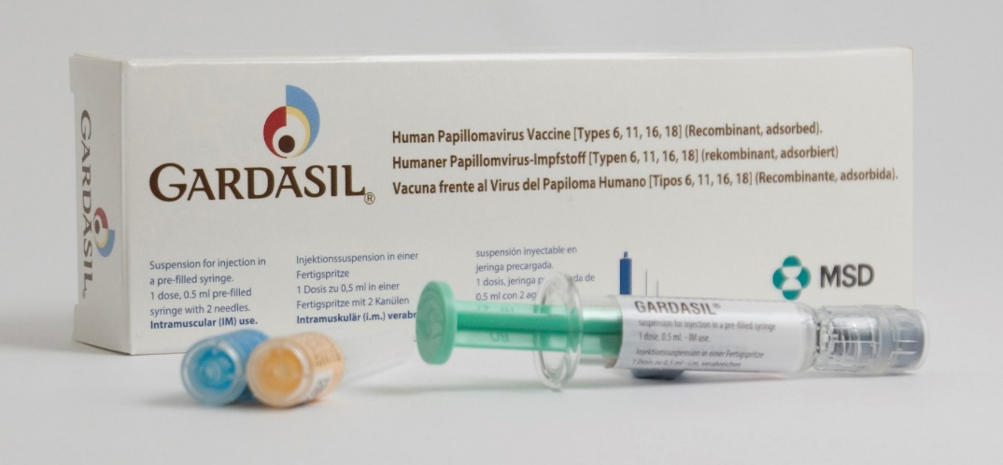
Gardasil
Brand name: Gardasil
Generic Name: Human Papillomavirus Vaccine
[Types 6, 11, 16, 18]
Type of vaccine: Recombinant, adsorbed
Marketed by: MSD
Licensed from: 9 years of age
Notes:
Gardasil provides protection against four HPV strains: HPV-16 and HPV-18, the two high risk HPV types that can lead to cancer; and HPV-6 and HPV-11, the two HPV types that cause approximately 90 per cent of all anogenital warts in males and females.
SPC for Gardasil: https://www.medicines.org.uk/emc/product/261/smpc

Slide 14
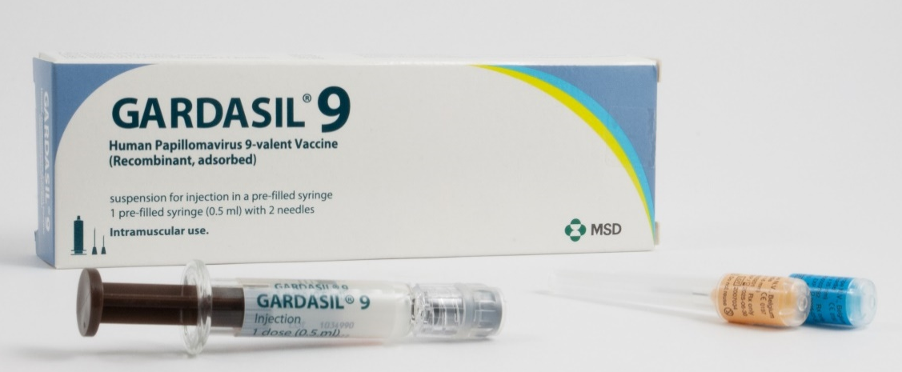
Gardasil 9
Brand name: Gardasil 9
Generic Name: Human Papillomavirus Vaccine
[Types 6, 11, 16, 18, 31, 33, 45, 52, 58]
Type of vaccine: Recombinant, adsorbed
Marketed by: MSD
Licensed from: 9 years of age
Notes:
Gardasil 9 provides protection against Types 6, 11, 16, 18, 31, 33, 45, 52, 58.
The additional Types 31, 33, 45, 52, 58 although less common than types 16 and 18, are also considered high-risk HPV types.
Gardasil 9 is expected to prevent the majority of cervical, vaginal and vulvar cancers and premalignant lesions, as well as genital warts associated with HPV
SPC for Gardasil 9: https://www.medicines.org.uk/emc/product/7330/smpc

Slide 15
HPV Vaccine interchangeability
in early 2022 Gardasil 9 Vaccine will be introduced into the programme and supplied for those eligible for the HPV vaccine
as the programme transitions from Gardasil to Gardasil 9 individuals might receive a mixed schedule
both Gardasil and Gardasil 9 vaccines should be considered as interchangeable
vaccination should not be delayed due to preference for either vaccine

Slide 16
HPV Vaccines
made from the proteins of the outer coat of the virus types
inactivated vaccine so cannot cause the diseases against which it protects
highly immunogenic
clinical trials show very high efficacy and well tolerated
  over 99% effective at preventing pre-cancerous lesions associated with HPV types 16 and 18. Gardasil 9 offers protection against 5 additional types of HPV (31, 33, 45, 52, 58) which although less common than types 16 and 18, are also considered high-risk
  99% effective at preventing genital warts associated with vaccine types in young women
a clinical trial of Gardasil in men indicated that it can prevent anal cell changes caused by persistent infection and genital warts
may boost immunity and prevent re-infection or reduce reoccurrences in people with previously treated high-grade anal intraepithelial neoplasia established diseases
Notes:
Gardasil vaccine is made from the proteins that make up the outer coat of the virus types. These proteins assemble into small spheres that are called virus-like particles (VLPs). VLPs are not infectious and cannot cause HPV-associated cancers or genital warts as they do not contain the virus’s DNA. VLPs are however very immunogenic, which means that they induce high levels of antibody production by the body.
As with many other immunisations, when a person is vaccinated, their immune system mounts a response against these VLPs. When a person is then exposed to the live virus, the body’s immune system reacts quickly to stop the infection.
In clinical trials in young women with no previous history of HPV infection, vaccine was 99% effective at preventing pre-cancerous lesions associated with HPV types 16 and 18.
Gardasil is also 99% effective at preventing genital warts associated with vaccine types in young women.
A clinical trial of Gardasil in men indicated that it can prevent anal cell changes caused by persistent infection, and genital warts
HPV vaccines have not been shown to have an impact on an existing infection or any of the outcomes of an existing HPV infection, such as anogenital warts but may boost immunity and prevent re-infection or reduce reoccurrences in people with previously treated high-grade anal intraepithelial neoplasia.
Swedish KA, Factor SH, Goldstone SE. Prevention of recurrent high-grade analneoplasia with quadrivalent human papillomavirus vaccination of men who have sexwith men: a nonconcurrent cohort study. Clin Infect Dis. 2012;54:891-8.Available at https://www.ncbi.nlm.nih.gov/pubmed/22291111 [Accessed on 29th May 2019]

Slide 17
The HPV vaccine
the HPV vaccine is used in over 100 countries around the world including the USA, Australia, Canada and most of Western Europe. More than 100 million people have been vaccinated worldwide
in the UK since the start of the programme in 2008, more than 10.5 million doses of HPV vaccine have been given
most women aged 15 to 24 years in England have now been given the vaccine
in time it is expected that the vaccine will save hundreds of lives every year in the UK

Slide 18
Safety of HPV vaccine
the safety of HPV vaccine has been established through rigorous testing in clinical trials, followed by use of many millions of doses across the world
some people may experience a mild side effect, but these are generally of short duration and are far outweighed by the expected benefits of the vaccine
the US health authorities have posted clear advice on their website supporting the safety of HPV vaccine: www.cdc.gov/vaccinesafety/vaccines/hpv-vaccine.html
Notes:
https://www.who.int/news/item/31-10-2019-major-milestone-reached-as-100-countries-have-introduced-hpv-vaccine-into-national-schedule
https://www.gavi.org/types-support/vaccine-support/human-papillomavirus
Safety Information for HPV Vaccine | Vaccine Safety | CDC

Slide 19
Gardasil and Gardasil 9 dosage and schedule
Individuals under 15 years of age:
2 dose schedule of 0.5ml at 0 and 6 to 12 months
second dose should be administered at least 6 months after the first dose 6 to 24 months is clinically acceptable
as long as the first dose was received before the age of 15 years the 2 dose schedule can be followed
Individuals 15 years of age and older:
3 dose schedule of 0.5 ml at 0, 2 and 6 months
second dose should be administered at least 1 month after the first dose
third dose should be administered at least 3 months after the second dose
all 3 doses should ideally be given within 1 year, within a 24 month period is clinically acceptable
Notes:
For individuals under 15 years of age, any interval between doses of between 6 and 24 months is clinically acceptable
Provided the first dose of vaccine was received before the age of 15 years the two dose schedule can be followed. For example, if first dose given aged 14 years but patient does not re-present in clinic until aged 17 years, only one further dose need be given.
Current studies suggest that protection is maintained for at least ten years. Based on the immune responses, it is expected that protection will be extended further; long-term follow-up studies are in place to evaluate this and will determine the need for any subsequent boosters.

Slide 20
Gardasil and Gardasil 9 dosage and schedule (2)
studies indicate that for individuals under 15 years of age, a two dose course given a minimum of 6 months apart induces the same protection as a 3 dose course
prior infection with 1 HPV type does not diminish the efficacy of the vaccine against other HPV types included in the vaccine
to get the best protection, it is important the full course of vaccination is received
current studies show protection is maintained for at least 10 years although protection is expected to last longer

Slide 21
Administration of HPV vaccine
Gardasil and Gardasil 9 are prescription only medicines and should only be administered using 1 of the following:
prescription written manually or electronically by a registered medical practitioner or other authorised prescriber
Patient Specific Direction (PSD)
Patient Group Direction (PGD)
UKHSA have developed a national PGD template which should be reviewed and authorised locally before use.
Providers may choose to use this to source their own PGDs locally or prescribe the vaccination on an individual patient basis using a Patient Specific Direction (PSD).
Notes:
UKHSA Immunisation PGD template:
www.gov.uk/government/publications/human-papillomavirus-hpv-vaccine-pgd-template

Slide 22
Preparation of HPV vaccine
Gardasil and Gardasil 9 are both available for injection in a pre-filled syringe
shake syringe well before use to form a cloudy white suspension
discard the vaccine if particulates are present and/or it appears discoloured
select the appropriate needle length to ensure an intramuscular (IM) administration depending on the patient's size and weight
attach the needle by twisting in a clockwise direction until the needle fits securely onto the syringe
administer the entire 0.5ml dose as per standard protocol, preferably into the deltoid muscle of the arm
the vaccine can be given at the same time as other national schedule vaccines
Notes:
Healthcare professionals are encouraged to read the Summary of Product Characteristics (SPC) to ensure accurate reconstitution and delivery of the product.
A small air bubble may be visible in the prefilled syringe. This is not harmful and should not be removed prior to administration. This small bolus of air injected following administration of medication clears the needle and prevents a localised reaction from the vaccination. To try to expel it risks accidently expelling some of the vaccine and therefore not giving the patient the full dose.
HPV vaccine can be given at same time as other vaccines. The vaccines should be given at a separate site, preferably in a different limb. The sites at which each vaccine was given should be noted in the individual’s health records.
Individuals with bleeding disorders may be vaccinated intramuscularly if a doctor familiar with the individual's bleeding risk advises vaccines or similar small volume intramuscular injections can be administered with reasonable safety by this route. If the individual receives medication/treatment to reduce bleeding, for example treatment for haemophilia, intramuscular vaccination can be scheduled shortly after such medication/treatment is administered.
Individuals on stable anticoagulation therapy, including individuals on warfarin who are up to date with their scheduled INR testing and whose latest INR was below the upper threshold of their therapeutic range, can receive intramuscular vaccination. A fine needle (equal to 23 gauge or finer calibre such as 25 gauge) should be used for the vaccination, followed by firm pressure applied to the site (without rubbing) for at least 2 minutes.
If in any doubt, consult with the clinician responsible for prescribing or monitoring the individual’s anticoagulant therapy. See details specific vaccine PGD.

Slide 23
Contraindications and Precautions
Contraindications
Gardasil and Gardasil 9 should not be administered to those who have had:
  a confirmed anaphylaxis to a previous dose of the vaccine
  a confirmed anaphylaxis to any constituent or excipient of the vaccine
Yeast allergy is not a contraindication to the HPV vaccine.
Even though Gardasil is grown in yeast cells, the final vaccine product does not contain any yeast.
Notes:
There are very few individuals who cannot receive HPV vaccines. Where there is doubt, instead of withholding immunisation, appropriate advice should be sought from a consultant with immunisation expertise, a member of the screening and immunisation team or from the local health protection team.
A mild fever or upper respiratory infection (for example cold) itself is not a reason to delay vaccination.
If acutely unwell, the immunisation may be deferred until the individual has recovered – this is to avoid confusing the differential diagnosis of acute illness by wrongly attributing signs or symptoms as adverse effects of the vaccine.
For the composition and full list of excipients of the vaccine, please refer to the manufacturer’s Summary of Product Characteristics (SPC).

Slide 24
Possible adverse reactions
Gardasil and Gardasil 9
Most Common:
pain, redness and swelling at the injection site
headache, fever, nausea, dizziness
These adverse reactions are usually mild or moderate in intensity and short lasting.
Full details available from the manufacturer’s SPC:
Gardasil
Gardasil 9
Notes:
The full list of adverse reactions associated with HPV vaccine is available in the marketing authorisation holder’s ‘Summary of Product Characteristics’
In clinical vaccine trials, the most common adverse reaction observed were injection-site reactions (Gardasil: 77.1% of vaccinees and Gardasil 9: 84.8% of vaccines within 5 days following any vaccination visit). These include mild to moderate short-lasting pain at the injection site, immediate localised stinging sensation and redness at the injection site. Other reactions commonly reported are headache, myalgia, fatigue, and low grade fever. These adverse reactions are usually mild or moderate in intensity.

Slide 25
Postural Orthostatic Tachycardia Syndrome (POTS)
in recent years in the UK and other European countries, parents and pressure groups have raised safety concerns linking the HPV vaccine to a condition called Postural Orthostatic Tachycardia Syndrome (POTS)
in June 2015, the JCVI concluded that it had no concerns about the safety of the HPV vaccine
the European Medicines Agency (EMA) independent review concluded evidence does not support a causal link between the vaccine and the condition www.ema.europa.eu/en/news/review-concludes-evidence-does-not-support-hpv-vaccines-cause-crps-pots
Notes:
Postural tachycardia syndrome (PoTS) is an abnormal increase in heart rate after sitting or standing up. It typically causes dizziness, fainting, sweating and other symptoms
In June 2015, the JCVI concluded that it had no concerns about the safety of the HPV vaccine. The European Medicines Agency has also conducted an independent review and, in line with findings from the UK’s Medicine and Healthcare Regulatory Agency (MHRA), concluded that available evidence does not support a causal link between the vaccine and the condition. (http://www.ema.europa.eu/ema/index.jsp?curl=pages/news_and_events/news/2015/11/news_detail_002429.jsp&mid=WC0b01ac058004d5c1)

Slide 26
Immunosuppression and HIV infection
individuals with Human Immunodeficiency Virus (HIV) infection in the eligible cohort should be given a 3 dose schedule of HPV vaccine regardless of CD4 count, antiretroviral therapy use or viral load
HPV vaccines are known to be safe and immunogenic for individuals infected with HIV although the immune response and its effectiveness may be less than that observed among those who are not HIV infected
individuals known to be immunocompromised at the time of vaccination should be offered a 3 dose course of vaccine
Notes:
Evidence suggests individuals with HIV infection are at increased risk of acquiring HPV and persistent infection, as well as frequent carriage of multiple HPV types and increased risk of HPV related rapidly progressive malignancies
HPV vaccines are known to be safe and immunogenic when given to individuals infected with HIV . There is however no data to support giving fewer than 3 doses among HIV-infected individuals, therefore only a 3-dose schedule should be offered to those with HPV or known to be immunocompromised at the time of immunisation

Slide 27
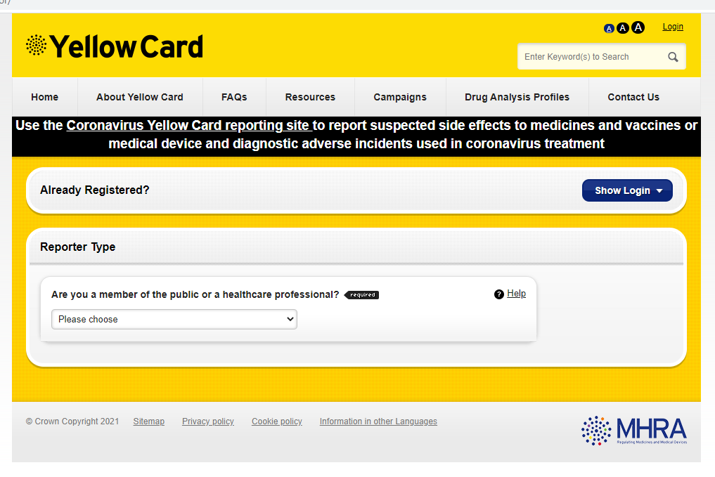
Reporting suspected adverse reactions
any suspected side effects following vaccine administration should be reported to the MHRA Yellow Card Scheme
report even if uncertain about whether vaccine caused condition
https://yellowcard.mhra.gov.uk
see Green Book Chapter 9 for detailed guidance on reporting vaccine reactions
Notes:
Healthcare professionals and patients are encouraged to report suspected adverse reactions to the Medicines and Healthcare Products Regulatory Agency (MHRA) using the yellow card reporting scheme

Slide 28
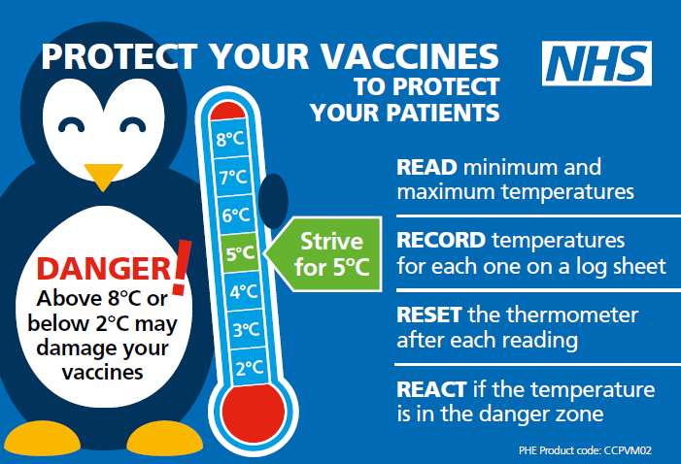
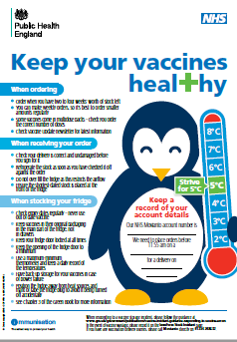
Storage of HPV vaccine
store between +2 and +8ºC
store in original packaging
protect from light
use as soon as possible after removing from fridge
Effectiveness cannot be guaranteed for vaccines unless the cold chain has been maintained and vaccine has been monitored as per national recommendations.
Notes:
Gardasil and Gardasil 9 must be stored in accordance with the manufacturer’s instructions and stored between +2°C and +8°C.
The vaccine should be stored in the original packaging. This makes it easy to identify in the vaccine fridge, provides some protection against fluctuation of temperature and will protect from light.
Vaccines are expensive and it is important to minimise wastage through inappropriate storage.
Further information on the storage and handling of vaccines is included in chapter 3 of the green book.
www.gov.uk/government/publications/storage-distribution-and-disposal-of-vaccines-the-green-book-chapter-3
The vaccine incident guidance document provides further information on actions to take in the event of a vaccine storage event
www.gov.uk/government/publications/vaccine-incident-guidance-responding-to-vaccine-errors

Slide 29
Vaccine stock management
All providers should:
review available fridge space to ensure adequate storage capacity before ordering new vaccine
ensure that there is enough stock for 2 to 4 weeks of use and not over order
have local protocols in place to reduce vaccine wastage to a minimum and protect vaccines in the event of a cold chain incident
report any cold chain failures or vaccine wastage through the ImmForm website on the stock incident page
Small percentage reductions in vaccine wastage have a major impact on the financing of vaccine supplies.
Notes:
Effective management of vaccines throughout the supply chain is essential to reduce vaccine wastage and it is recommended that healthcare professionals order only what they need for a 2-4 week period rather than over-ordering or stockpiling vaccines.
Providers should review available fridge space to ensure adequate storage capacity before ordering and the delivery of vaccine.
All providers should have emergency vaccine storage and handling plans which clearly outline the actions to take in the event of out of range temperature excursions or refrigerator break down.
Cold chain failures must be documented and reported through the ImmForm website on the stock incident page.

Slide 30
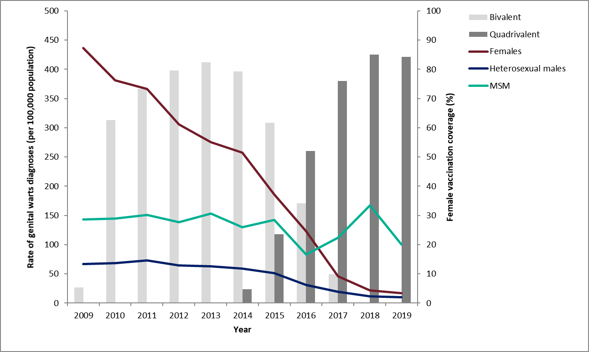
Declines in genital warts diagnoses in England: 2009 to 2019
Notes:
Latest data on declines in GW diagnoses in England.
As reported in latest STI report (https://assets.publishing.service.gov.uk/government/uploads/system/uploads/attachment_data/file/914184/STI_NCSP_report_2019.pdf): In 2019, the rate of genital warts diagnoses among girls aged 15 to 17 years attending SHSs, most of whom would have been offered the quadrivalent HPV vaccine (protecting against HPV types 16,18, 6 and 11) when aged 12 to 13 years old, was 91% lower compared to 2015 (16.9 vs 193.5 per 100,000 population). A decline of 81% (10.0 vs 53.3 per 100,000 population) was seen in same aged heterosexual boys over the same period, suggesting substantial herd protection.

Slide 31
Changes in post-vaccination HPV prevalence in England: 16 to 18 year old females
The prevalence of HPV 16 and/or 18 has decreased within the post-vaccination period from 8.2% in 2010 to 1.6% in 2016.
In 2018, 10 years after vaccination was introduced, no HPV16/18 infections were detected in 16 to 18 year olds.
P-value (trend) < 0.001
Unpublished data
Notes:
This figure shows data on HPV 16 AND/OR 18 prevalence in 16-18 year old females, in the post-vaccination period over time, to 2016.
The prevalence of HPV 16 and/or 18 has decreased within the post-vaccination period over time, from 8.2% in 2010 to 1.6% in 2016. These decreases were strongly associated with the increasing estimated vaccination coverage.

Slide 32
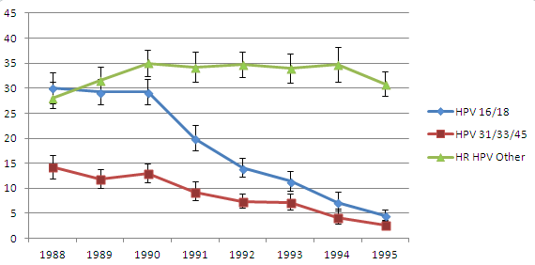
Scotland: Pre- and post-vaccine HPV prevalence in 20 year old females entering the cervical screening programme
Percentage of women positive for any HPV
Using a clinically-validated assay, of the 58 HPV 16/18 positive samples, only 7 were 16/18 positive (0.5%)
Birth cohort
HPV 16/18 prevalence reduced from 30.0% (26.9, 33.1%) in 1988 cohort to 4.5% (3.5, 5.7%) in the 1995 (routine) cohort
HPV 31/33/45 prevalence reduced from 14.2% (12-16.7%) in the 1988 cohort to 2.6% (95% CI: 1.9-3.6%) in the 1995 (routine) cohort
Other HR-HPV - no significant changes
Notes:
Results from Scotland show a reduction in prevalence from 30% in the 1988 cohort to 4.5% in the 1995 cohort for HPV types 16 and 18
There was also a reduction in prevalence of HPV types 31/33/45 from 14.2% in the 1988 cohort to 2.6% in the 1995 cohort
Kavanagh K, Pollock KG, Cuschieri K, Palmer T, Cameron RL, Bhatia R, Moore C, Cubie H, Cruickshank M, Robertson C. Lancet Infect Dis. 2017 Sep 28. pii: S1473-3099(17)30468-1

Slide 33
Impact of vaccination on HPV infection
evidence from surveillance consistent with:
      very high vaccine effectiveness among those vaccinated
      a substantial herd protection effect with lower HPV16 and 18 prevalence over time in unvaccinated women
      cross-protection – declines in HPV types 31, 33 and 45 in the post-vaccination period
no evidence of non-vaccine type replacement
similar findings in Scotland, Denmark, Australia and systematic reviews

Slide 34
Impact on anogenital warts (AGW)
the incidence of AGW diagnoses in 15 to 17 year old girls was 91% lower in 2019 compared to 2015
there is also strong evidence of herd protection from the high coverage female programme
in young heterosexual males up to age 24 years there were:
      declines in incidence of AGW similar to same aged females
      the incidence of AGW diagnoses in 15 to 17 year olds was 81% lower in 2019 compared to 2015
Notes:
One of the key successes of the programme is that we are seeing strong evidence of herd protection from the high coverage female vaccination programme.
For example, in young heterosexual males up to age 24, we are seeing declines in genital warts incidence that are similar to those seen in same aged females. The incidence of genital warts in 15-17 year old males was 62% lower in 2016 when compared to 2009.

Slide 35
Impact on cervical disease
the full impact of the HPV vaccination programme on cervical cancer is yet to be fully realised as the first cohort of routinely vaccinated adolescent girls only became eligible for cervical screening in England in 2016
  emerging global evidence using population-based surveillance suggests that vaccination is strongly associated with a reduction in both low and high grade cervical abnormalities (CIN of grade 1 or worse) in young women
new modelling study suggests that vaccinated women may only need three cervical screens in their lifetime (rather than the current 12 lifetime screens offered in England) therefore information on vaccination status is essential

Slide 36
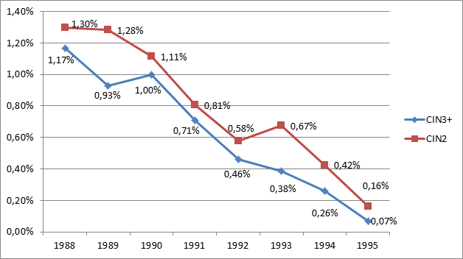
Percentage of 20 year old women diagnosed with
CIN 2 / CIN3+ by birth cohort year
In Scotland:
HPV Vaccine associated with 88% and 94% reduction in CIN2 and 3+ at population level
Biggest reduction in disease in more deprived women
1.0
4.2
35.6
65.2
69.3
70.1
86.5
Vaccine uptake 3-doses (%)
Notes:
Pollock KG, Kavanagh K, Potts A et al. Reduction of low- and high-grade cervical abnormalities associated with high uptake of the HPV bivalent vaccine in Scotland. Br J Cancer 2014;111:1824–1830. doi: 10.1038/bjc.2014.479

Slide 37
Dose 1 (priming) HPV vaccine coverage by NHS England Local Team for the routine female cohort (Year 8) in academic years 2014/15 to 2019/20: England
Notes:
Year 8 coverage for dose 1

Slide 38
Dose 2 (completed course) HPV vaccine coverage in females (Year 9) by NHS England Local Team in 2015/16 to 2019/20 (2-dose administered across 2 years): England

Slide 39
National coverage and impact on coverage due to COVID-19
due to the COVID-19 pandemic, all educational settings were closed from the 23 March 2020 and the delivery of the 2019/20 school immunisation programmes was paused
by 20 March 2020 HPV programme delivery was:
      fully complete in 8 out of 150* Local Authorities (LAs)
      partially complete in 116/150 LAs
      not yet started in 26/150 LAs
from 1 June 2020 some schools partially re-opened for some year groups for a mini summer term and all schools fully re-opened for the 2020 to 2021 academic year
in 2019 to 2020, 64.7% of Year 9 females completed the 2 dose HPV vaccination course in 2019 to 2020, compared with 83.9% in 2018 to 2019
HPV vaccine coverage for the priming dose in 2019 to 2020 was 59.2% in Year 8 females (compared with 88.0% in 2018 to 2019) and 54.4% in Year 8 males
Notes:
All NHS England and NHS Improvement (NHSEI) commissioned school aged providers were asked to implement HPV vaccination restoration and recovery plans with some catch-up already undertaken by all providers
www.gov.uk/government/publications/hpv-vaccination-coverage-in-adolescent-females-and-males-in-england-2019-to-2020

Slide 40
Dose 1 (priming) HPV vaccine coverage by NHS England Local Team for female and male cohorts (Year 8) in academic year 2019/20: England

Slide 41
Why data flow matters
HPV vaccination status on the CHIS and GP records should be used to ensure eligible individuals who are not up to date are caught up before their 25th birthday
NHS Screening Committee: age at first screen and interval between screens will be determined by HPV vaccination status. The first catch-up cohort entered the screening programme in 2016 (age 25 years)
reducing the number of cervical screenings required as a result of the HPV vaccination programme will prevent unnecessary interventions and will be financially resource saving
this is dependent on correct HPV vaccination status being recorded on the cervical screening call/recall system

Slide 42
HPV programme delivery
A qualitative service evaluation was conducted in 2017 to determine whether any service-related factors may have contributed to the downward trend in HPV vaccination coverage seen since 2014:
39 participants (19 South West / 20 Central Midlands) completed individual and team semi-structured interviews. Observations of immunisation sessions also took place. The transcripts were analysed thematically
The results from this evaluation indicated that several factors were essential for the successful delivery of a HPV vaccination programme. These included:
effective planning and data management
close collaboration between commissioners, service providers and data system managers
a team skill mix with experienced staff
pro-active engagement with schools and service providers who were able and equipped to respond to parental concerns
Notes:
A service evaluation of HPV programme delivery was conducted to determine service related factors that may have contributed to the downward trend in HPV vaccine coverage and to provide recommendations to commissioners and providers on how to address these
Paterson P et al, 2019, 2019, Journal of Public Health, Strengthening HPV vaccination delivery: findings from a qualitative service evaluation of the adolescent girls' HPV vaccination programme in England, DOI: 10.1093/pubmed/fdz061
www.researchgate.net/publication/333930541_Strengthening_HPV_vaccination_delivery_findings_from_a_qualitative_service_evaluation_of_the_adolescent_girls'_HPV_vaccination_programme_in_England/citations

Slide 43
Attitudinal tracking survey of teenagers and their parents (2020)
What do teenagers and their parents think about immunisation
An online survey was conducted across England to explore the attitudes of young people aged 13 to 15 years and their parents during November to December 2020:
  4,503 young people (school Years 9 and 10)
  1,686 parents

Slide 44
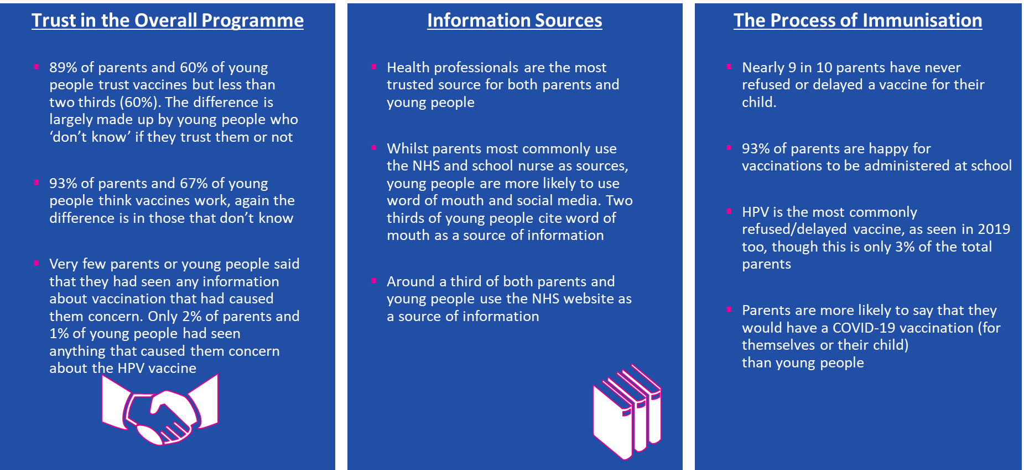

Key Findings

Slide 45
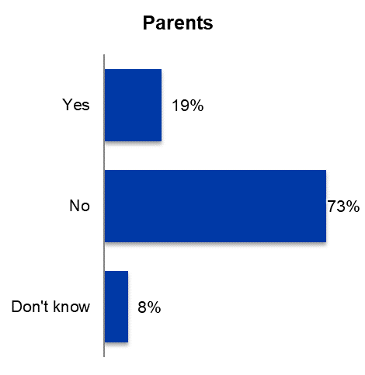
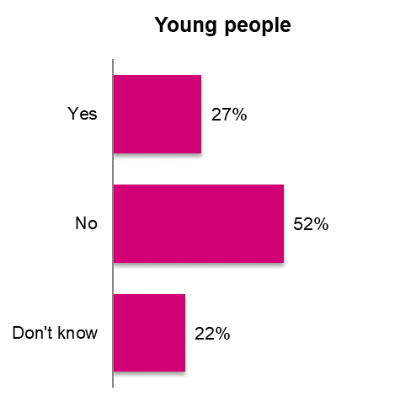
Most young people and their parents are not accessing immunisation information on social media
Have you seen anything on social media about vaccination for teenagers in the last 12 months? Base: All Parents and All Young People

Slide 46
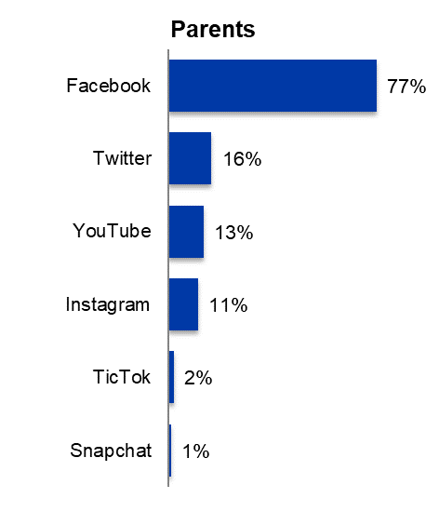
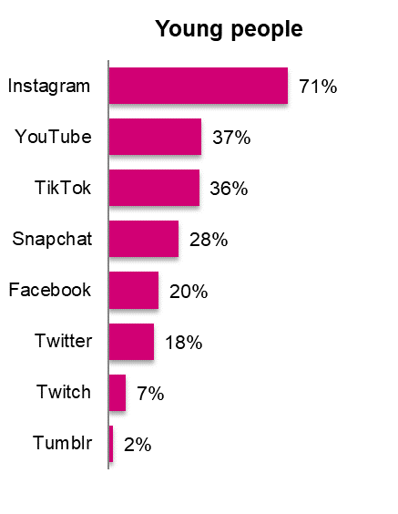
Sources of immunisation information on social media
Where have seen or heard about immunisations/ vaccinations on social media
Parents (294) and Young People (1,194)

Slide 47
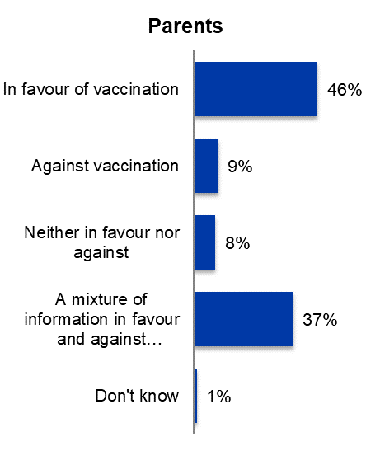
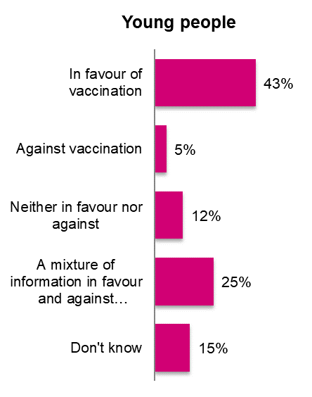
Most immunisation information seen on social media was in favour of vaccination, or mixed
Notes:
The previous slide shows the social media sources that the 294 parents and 1194 young people used and
this slide is a breakdown of whether the information was positive, negative or mixed

Slide 48
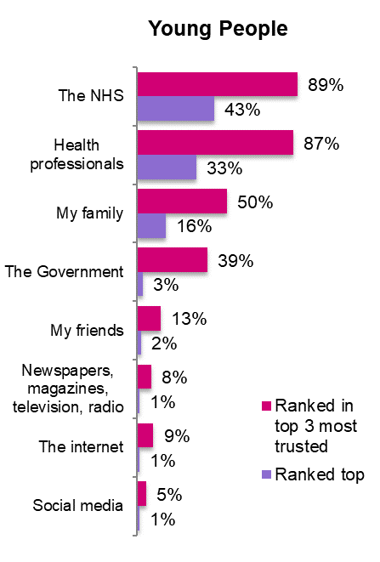
What sources of information do young people trust?
Base: all Young People (4,495)

Slide 49
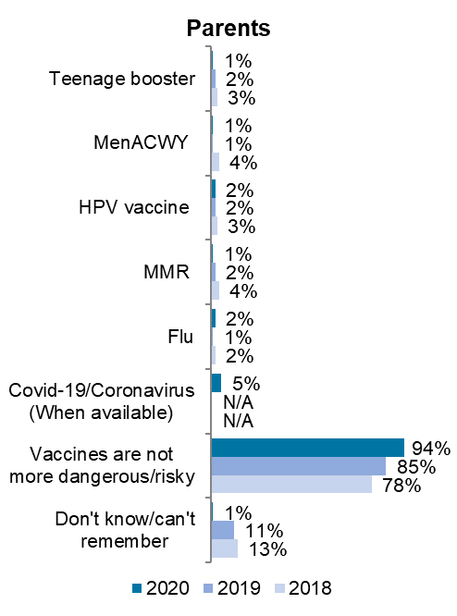
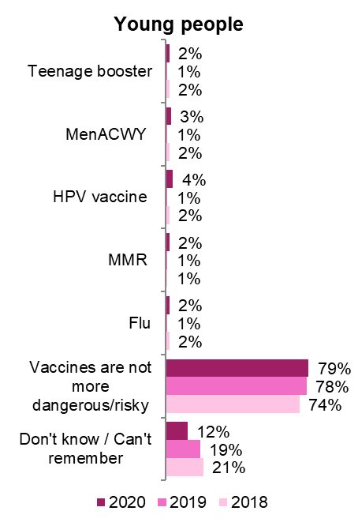
Most parents and young people think all vaccines are less risky than the diseases they prevent

Slide 50
Vaccine safety monitoring
Medicines and Healthcare products Regulatory Agency (MHRA):
  monitors safety of vaccination programmes
  volume of suspected side effects reported via the Yellow Card Scheme for HPV is not unusual. Overwhelming majority relate to possible side-effects that might result from any adolescent vaccination programme e.g. injection site reactions, rashes, mild allergic events, nausea, dizziness, fatigue, immediate faints due to needle phobia, etc
  a Yellow Card report is not proof of a side effect, but a suspicion by the reporter that the reaction may have been caused by the vaccine

Slide 51
Vaccine safety reviews
JCVI carried out a routine review of HPV vaccine safety in 2015 and concluded that it had no concerns about the safety of the HPV vaccine:
extensive reviews of HPV vaccine safety have also been undertaken by various independent health bodies and authorities worldwide
  MHRA
  World Health Organization’s Global Advisory Committee on Vaccine Safety
  European Medicines Agency
  US Centre for Disease Control and Prevention
  Health Canada
All concluded that the evidence does not support a link between HPV vaccine and the development of a range of chronic illnesses.

Slide 52
Key messages
HPV vaccine is not a new vaccine
there has been a high uptake of the HPV vaccine in over 80 countries around the world to date and millions of doses have been given
emerging evidence from the UK and around the world that high coverage of HPV vaccine in girls is providing substantial herd protection in unvaccinated girls and boys
in 2018, no HPV16 and/or 18 infections detected in 16 to 18 year old girls indicating both direct and indirect protection
in 2019, the rate of genital warts among 15 to 17 year old girls was 91% lower compared to 2015
the COVID-19 pandemic and subsequent school closures impacted delivery of the HPV vaccine programme in the 2019 to 2020 and 2020 to 2021 academic years and affected children should be caught up as soon as possible. School-based delivery of the HPV programme (including catch-up) is associated with higher vaccine uptake and lower inequalities
Notes:
Surveillance of type-specific HPV in sexually active young females in England, to end 2018:
https://assets.publishing.service.gov.uk/government/uploads/system/uploads/attachment_data/file/858872/hpr0220_HPV_2018.pdf
Sexually transmitted infections and screening for chlamydia in England, 2020:
https://assets.publishing.service.gov.uk/government/uploads/system/uploads/attachment_data/file/914184/STI_NCSP_report_2019.pdf

Slide 53



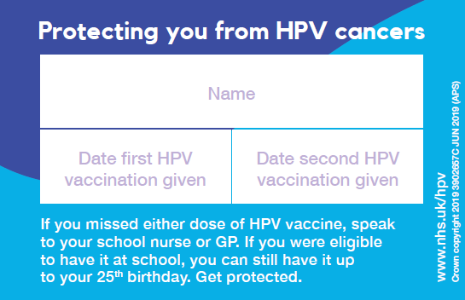
Information materials
        Health professionals
        Green Book HPV chapter 18a
        Patient Group Direction (PGD)
        factsheet
        consent form
        Parents and young people
        posters
        leaflet
        record card
        digital resources
Leaflets available to order at: Healthpublications.gov.uk
Notes:
www.gov.uk/government/publications/hpv-vaccine-vaccination-guide-leaflet
www.healthpublications.gov.uk/Home.html
www.gov.uk/government/publications/hpv-vaccination-and-cervical-cancer-addressing-the-myths

Slide 54
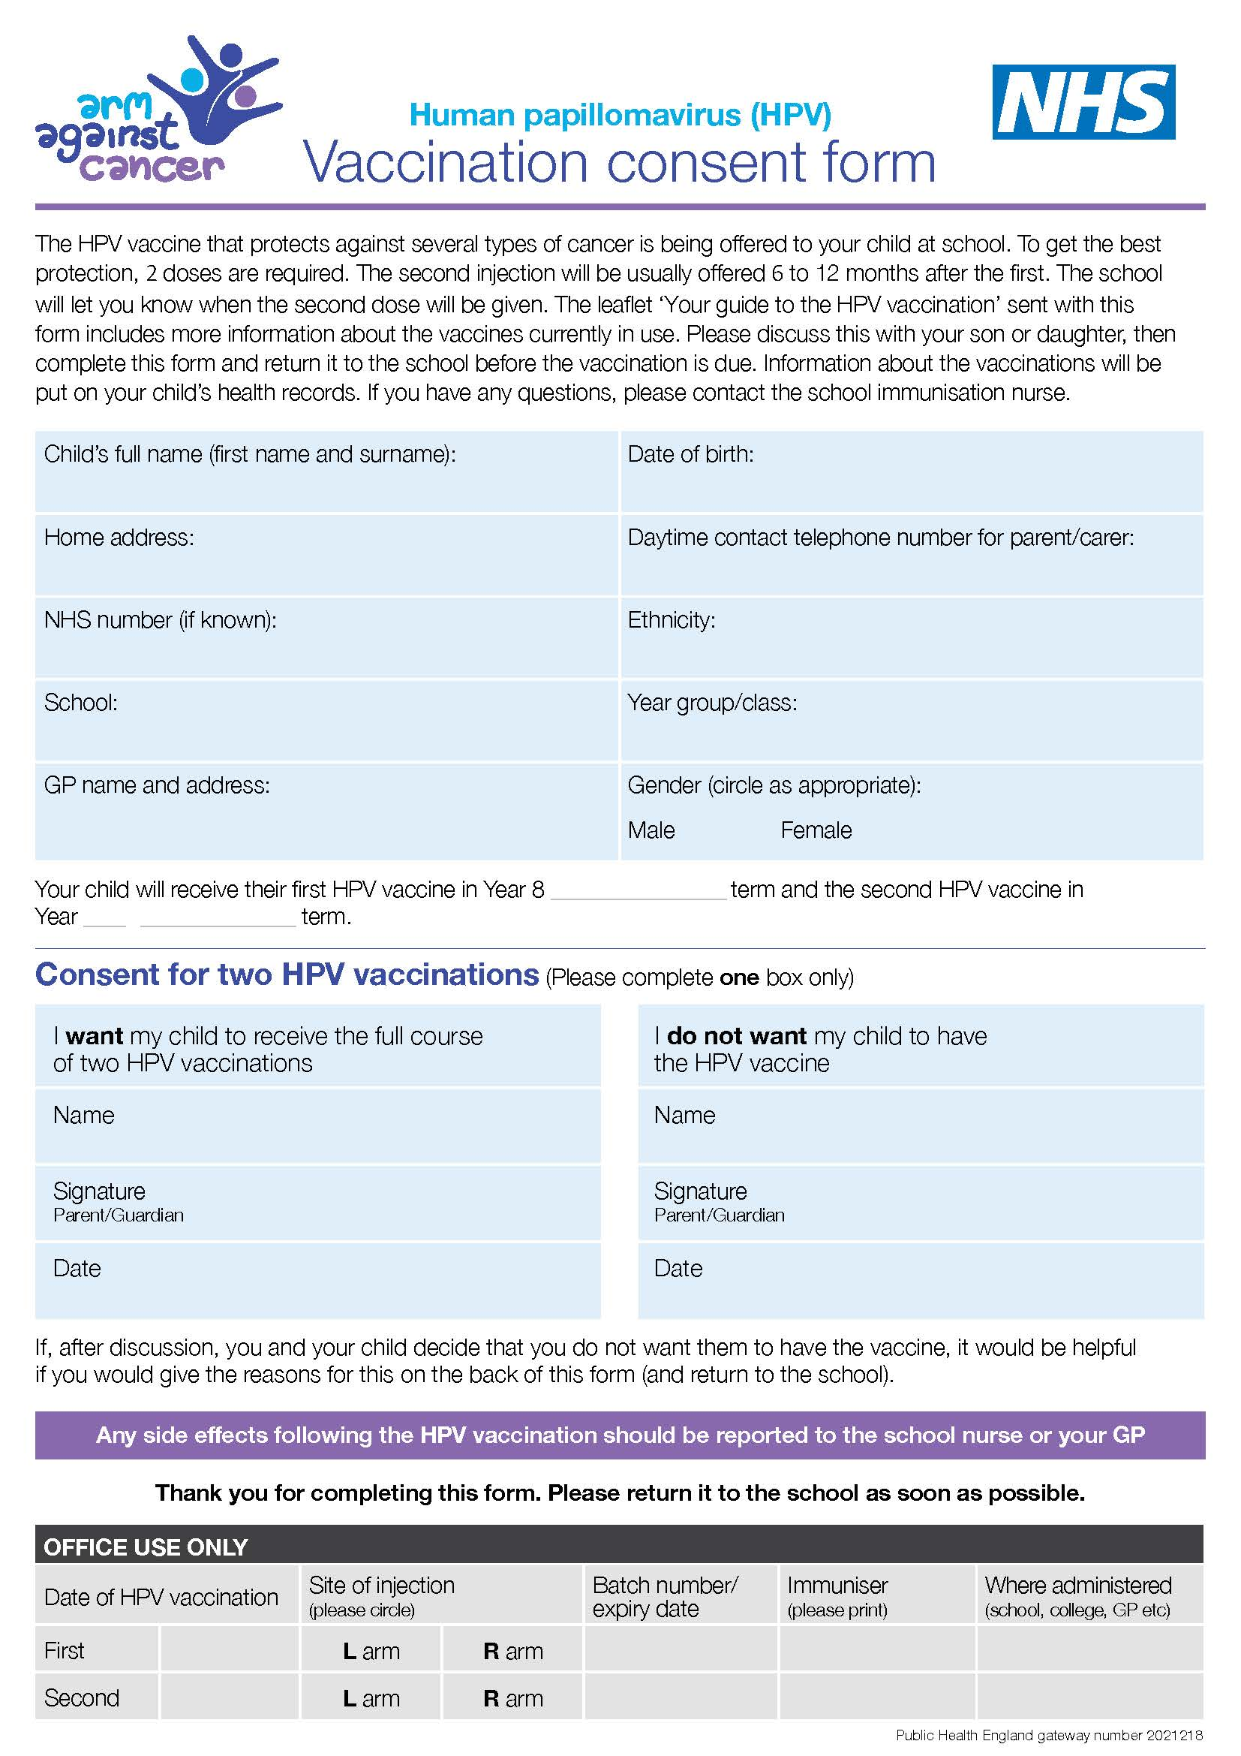
Consent Form
the HPV vaccine consent form and other resources including programme guidance, vaccination record card, posters, leaflets and other programme documents can be downloaded from the HPV programme collection page on the GOV.UK website
www.gov.uk/government/publications/human-papillomavirus-hpv-vaccination-consent-form
Notes:
www.gov.uk/government/publications/human-papillomavirus-hpv-vaccination-consent-form
www.gov.uk/government/collections/hpv-vaccination-programme

Slide 55
Resources
1) UKHSA Immunisation against infectious diseases The Green Book: Human papillomavirus (HPV) Chapter18a
www.gov.uk/government/publications/human-papillomavirus-hpv-the-green-book-chapter-18a
2) HPV guidance for healthcare practitioners
www.gov.uk/government/publications/hpv-universal-vaccination-guidance-for-health-professionals
3) Summary of Product Characteristics for Gardasil
www.medicines.org.uk/emc/product/261/smpc
4) Summary of Product Characteristics for Gardasil 9
www.medicines.org.uk/emc/product/7330/smpc
5) UKHSA HPV vaccination programme for men who have sex with men (MSM)
www.gov.uk/government/collections/hpv-vaccination-for-men-who-have-sex-with-men-msm-programme
6) JCVI statement on HPV vaccination of men who have sex with men
November 2015
www.gov.uk/government/publications/jcvi-statement-on-hpv-vaccination-of-men-who-have-sex-with-men
7) HPV universal immunisation programme: introduction of Gardasil 9 letter
www.gov.uk/government/publications/hpv-immunisation-programme-introduction-of-gardasil-9-letter
Notes:
1. Ho GY, Bierman R, Beardsley L et al. (1998) Natural history of cervicovaginal papillomavirus infection in young women. N Engl J Med 338(7): 423-8
2. Franco EL, Villa LL, Sobrinho JP et al. (1999) Epidemiology of acquisition and clearance of cervical human papillomavirus infection in women from a high-risk area for cervical cancer. J Infect Dis 180(5): 1415-23.
3. McCance DJ (2004) Papillomaviruses. In: Zuckerman AJ, Banatvala JE, Pattison JR, Griffiths P and Schoub B (eds) Principles and practice of clinical virology. 5th edition. Wiley & Sons Ltd.
4. Li N, Franceschi S, Howell-Jones R, et al. (2011) Human papillomavirus type distribution in 30,848 invasive cervical cancers worldwide: variation by geographical region, histological type and year of publication. Int J Cancer 28:27–35.
5. Mesher D, Cuschieri K, Hibbitts S, et al. (2015) Type-specific HPV prevalence in invasive cervical cancer in the UK prior to national HPV immunisation programme: baseline for monitoring the effects of immunisation. J Clin Pathol 68:135–40.
6.Munoz N, Castellsague X, de Gonzalez AB et al . (2006) Chapter 1:HPV in the etiology of human cancer. Vaccine 24 S3/1-10
7. Lacey CJ, Lowndes CM, Shah KV. (2006) Chapter 4: Burden and management of non-cancerous HPV-related conditions: HPV-6/11 disease. Vaccine 24(Suppl 3):S3/35-41.
8. Chow EP et al (2015) Ongoing decline in genital warts among young heterosexuals seven years after the Australian human papillomavirus (HPV) vaccination programme. Sexually Transmitted Infections 91 (3):214-219.
9. Giuliano AR, Nyitray AG, Kreimer AR, Pierce Campbell CM et al. (2014) EUROGIN 2014 roadmap: Differences in human papillomavirus infection natural history, transmission and human papillomavirus-related cancer incidence by gender and anatomic site of infection. Int J Cancer Jul 17. doi:10.1002/ijc.29082
10. Kreimer AR, Clifford GM, Boyle P, Franceschi S. (2005) Human Papillomavirus Types in Head and Neck Squamous Cell Carcinomas Worldwide: A Systematic Review. Cancer Epidemiol Biomarkers Prev; 14:467-75
11. Chin-Hong PV, Vittinghoff E, Cranston RD, Buchbinder S et al. (2004) Age-Specific prevalence of anal human papillomavirus infection in HIV-negative sexually active men who have sex with men: the EXPLORE study. J Infect Dis 190:2070-6
12. Daling JR, Weiss NS, Hislop TG, Maden C et al. (1987) Sexual practices, sexually transmitted diseases, and the incidence of anal cancer. N Engl J Med 317:973-7
13. Ault KA and FUTURE II Study Group (2007) Effect of prophylactic human papillomavirus L1 virus-like-particle vaccine on risk of cervical intraepithelial neoplasia grade 2, grade 3, and adenocarcinoma in situ: a combined analysis of four randomised clinical trials. Lancet 369(9576): 1861-8; 14. Lu B et al. (2011) Efficacy and safety of prophylactic vaccines against cervical HPV infection and diseases among women: a systematic review and meta-analysis. BMC Infectious Diseases 11: 13; 15. Harper DM et al. (2006) Sustained efficacy up to 4.5 years of a bivalent L1 virus-like particle vaccine against human papillomavirus types 16 and 18: follow-up from a randomised control trial. Lancet 367(9518): 1247-55; 16. Barr E and Tamms G (2007) Quadrivalent human papillomavirus vaccine. Clin Infect Dis 45(5): 609-17; 17. Giuliano AR et al. (2011) Efficacy of quadrivalent HPV vaccine against HPV Infection and disease in males. New England Journal of Medicine, 364(5):401-411; 18. Swedish KA et al (2012) Prevention of recurrent high-grade anal neoplasia with quadrivalent human papillomavirus vaccination of men who have sex with men: a nonconcurrent cohort study. Clin Infect Dis.54:891-8; 19. Miltz A, Price H, Shahmanesh M, Copas A, Gilson R. (2014) Systematic review and meta-analysis of L1-VLP-based human papillomavirus vaccine efficacy against anogenital pre-cancer in women with evidence of prior HPV exposure. PLoS One 9:e90348.; 20. BHIVA guidelines on the use of vaccines in HIV-positive adults (2015) chapter 9 HUMANPAPILLOMAVIRUS.http://www.bhiva.org/documents/Guidelines/Vaccination/2015- Vaccination-Guidelines.pdf

Slide 56
Additional information
NHS choices: www.nhs.uk/conditions/vaccinations/pages/hpv-human-papillomavirus-vaccine.aspx
Jo’s Cervical Cancer Trust: www.jostrust.org.uk/about-cervical-cancer
Teenage Cancer Trust: Lesson Plans: www.teenagecancertrust.org/about-us/what-we-do/cancer-awareness/resources#cervicalcancer
WHO Immunization Resource Centre: www.euro.who.int/en/health-topics/disease-prevention/vaccines-and-immunization/vaccine-preventable-diseases/human-papillomavirus-hpv2
  How to respond to vocal vaccine deniers in public (2016): www.who.int/immunization/sage/meetings/2016/october/8_Best-practice-guidance-respond-vocal-vaccine-deniers-public.pdf

