Slide 1
Annual Epidemiological Spotlight on STIs in the North West: 2019 data
Field Service
PHE publications gateway number: GOV-8069

Slide 2
Summary of 2019 data for North West residents
Over 54,200 new sexually transmitted infections (STIs) diagnosed
New STI diagnosis rate: 739 diagnoses per 100,000 population
Diagnoses of gonorrhoea rose by 20% 2018 to 2019 and syphilis diagnoses rose by 13%
Chlamydia detection rate in those aged 15 to 24 was 1,990 per 100,000 population (aim = 2,300)
17% of new STI diagnoses (excluding chlamydia reported via CTAD) were in men who have sex with men (MSM) (65% of syphilis, 41% of gonorrhoea)
15 to 24 year olds accounted for 52% of new STI diagnoses
1% of new STI diagnoses were in black Caribbeans, who have the highest rate (2,283 per 100,000 population)
White ethnic group has the highest numbers of new STIs (88%)
Majority of those diagnosed with a new STI are UK-born (88%)

Slide 3
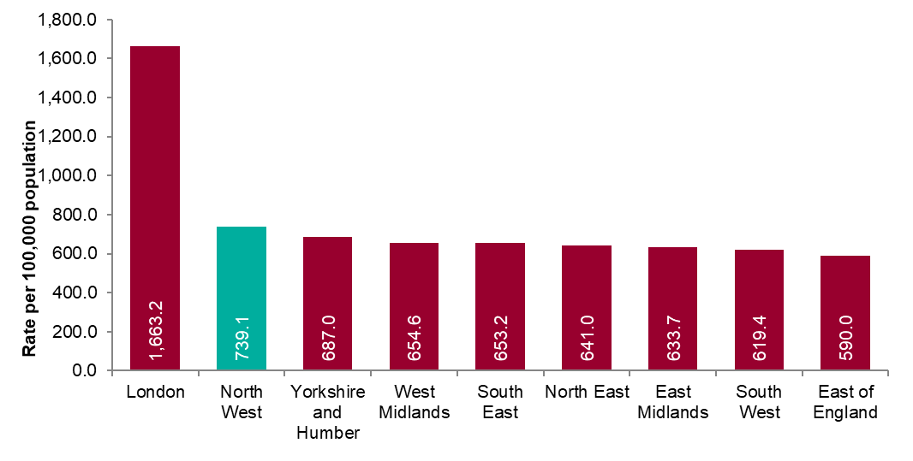
Figure 1: New STI diagnosis per 100,000 population by PHE centre of residence, 2019
Source: Public Health England, GUMCAD and CTAD

Slide 4
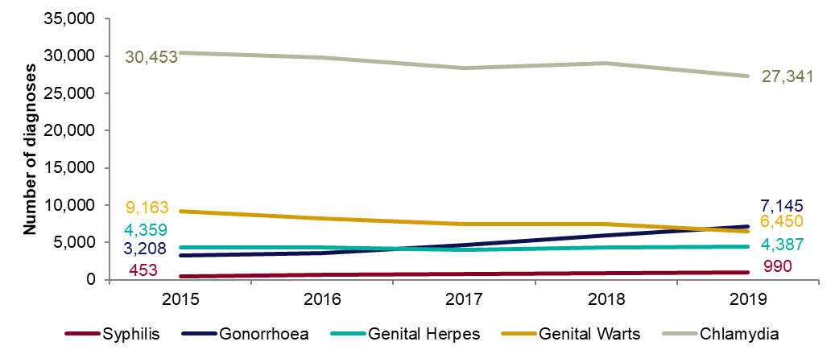
Figure 2: Number of diagnoses of the 5 main STIs: North West residents, 2015 to 2019
Any increase in gonorrhoea diagnoses may be due to the increased use of highly sensitive nucleic acid amplification tests (NAATs) and additional screening of extra-genital sites in MSM.
Any decrease in genital wart diagnoses may be due to a moderately protective effect of HPV-16/18 vaccination.
Any increase in genital herpes diagnoses may be due to the use of more sensitive NAATs.
Increases or decreases may also reflect changes in testing practices.
Source: Public Health England, GUMCAD and CTAD

Slide 5
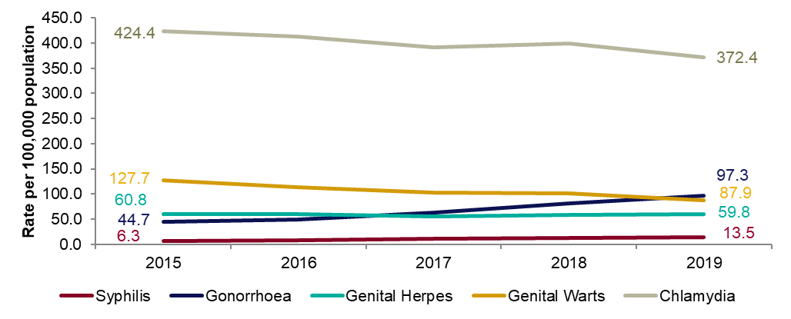
Figure 3: Diagnosis rates of the 5 main STIs: North West residents, 2015 to 2019
Any increase in gonorrhoea diagnoses may be due to the increased use of highly sensitive nucleic acid amplification tests (NAATs) and additional screening of extra-genital sites in MSM.
Any decrease in genital wart diagnoses may be due to a moderately protective effect of HPV-16/18 vaccination.
Any increase in genital herpes diagnoses may be due to the use of more sensitive NAATs.
Increases or decreases may also reflect changes in testing practices.
Source: Public Health England, GUMCAD and CTAD

Slide 6
Table 1: Percentage change in new STI diagnoses: North West residents
Please see notes for Figure 3.
Source: Public Health England, GUMCAD and CTAD
.

Slide 7
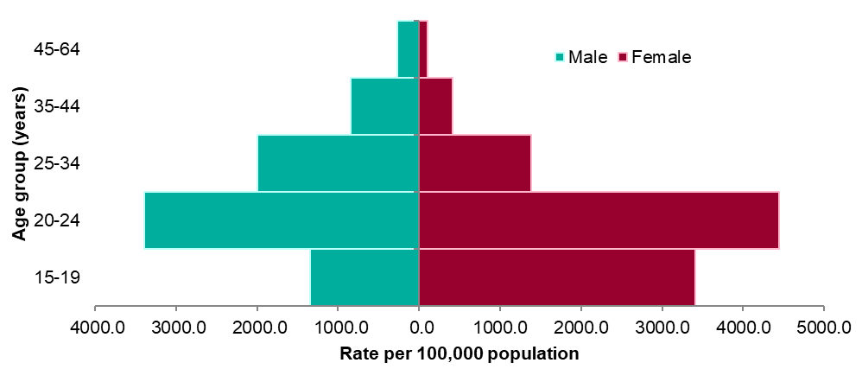
Figure 4: Rates of new STIs per 100,000 residents by gender and age group in North West, 2019
Source: Public Health England, GUMCAD and CTAD

Slide 8
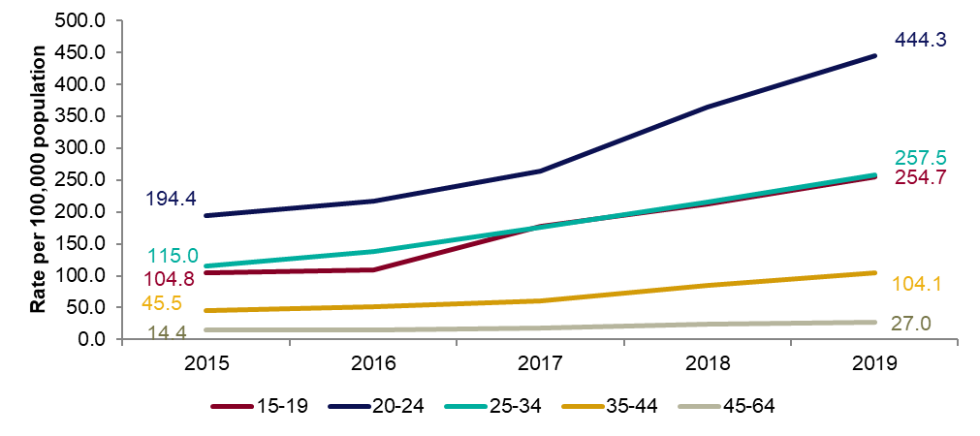
Figure 5: Rates of gonorrhoea per 100,000 residents by age group in North West: 2015 to 2019

Slide 9
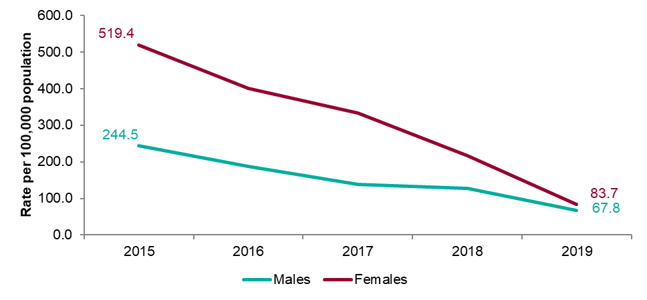
Figure 6: Rates of genital warts per 100,000 residents aged 15-19 years by gender: 2015 to 2019

Slide 10
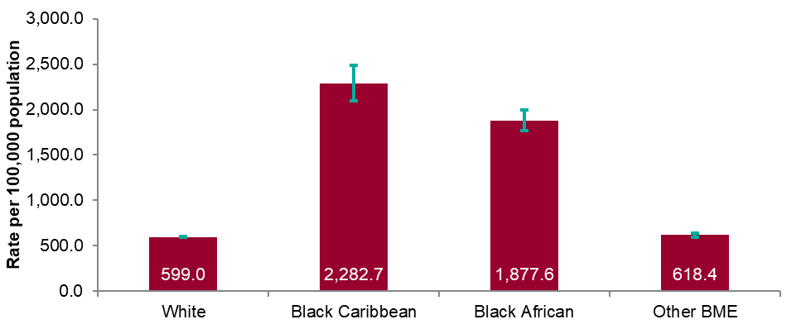
Figure 7: Rates by ethnicity per 100,000 population of North West residents diagnosed with a new STI: 2019
Source: Public Health England, GUMCAD and CTAD

Slide 11
Table 2: Proportion of North West residents diagnosed with a new STI by ethnicity: 2019
Source: Public Health England, GUMCAD and CTAD

Slide 12
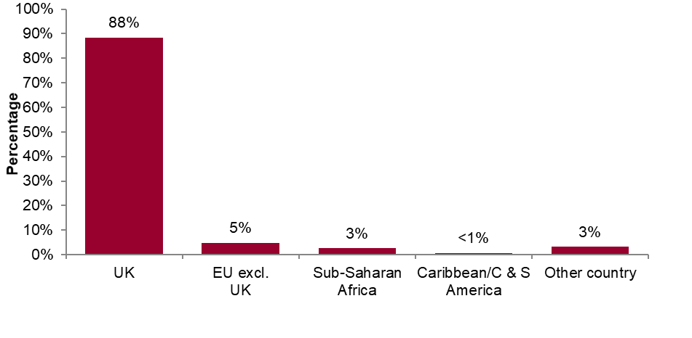
Figure 8: Proportions of North West residents diagnosed with a new STI by world region of birth*: 2019
*Data on country of birth is not collected by CTAD. All information about world region of birth is based on diagnoses made in specialist and non-specialist services which report to GUMCAD.
Source: Public Health England, GUMCAD

Slide 13
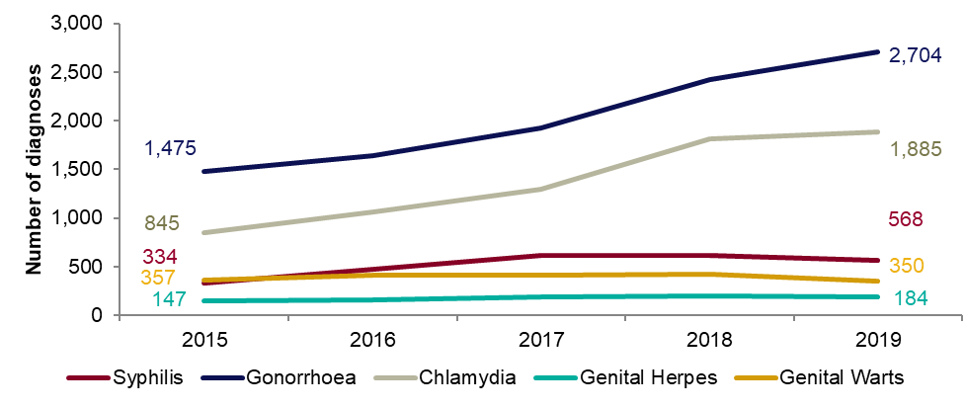
Figure 9: Diagnoses of the 5 main STIs among MSM*: North West residents, 2015 to 2019
* Data on sexual orientation is not collected by CTAD. All information about MSM is based on diagnoses made in specialist and non-specialist services which report to GUMCAD
GUMCAD started in 2009. Reporting of sexual orientation is less likely to be complete for earlier years. So rises seen may be partly artefactual.
Any increase in gonorrhoea diagnoses may be due to the increased use of highly sensitive nucleic acid amplification tests (NAATs) and additional screening of extra-genital sites in MSM.
Any decrease in genital wart diagnoses may be due to a moderately protective effect of HPV-16/18 vaccination.
Any increase in genital herpes diagnoses may be due to the use of more sensitive NAATs.
Any increase or decrease may reflect changes in testing.
Source: Public Health England, GUMCAD (level 3 services).

Slide 14
Table 3: Percentage change in new STI diagnoses in men who have sex with men (MSM)*: North West residents
*Please see notes for Figure 9.
Source: Public Health England, GUMCAD

Slide 15
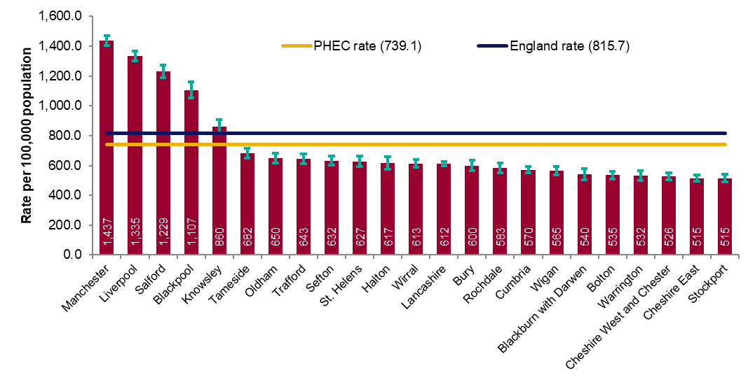
Figure 10a: Rate of all new STI diagnoses per 100,000 population among North West residents by local authority of residence: 2019
Source: Public Health England, GUMCAD and CTAD

Slide 16
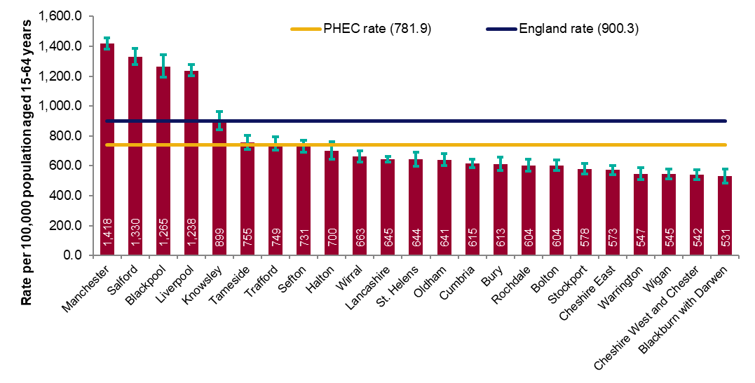
Figure 10b: Rate of new STI diagnoses (excluding chlamydia diagnoses in persons aged 15 to 24 years) per 100,000 population aged 15-64 years among North West residents by local authority of residence: 2019
Source: Public Health England, GUMCAD and CTAD

Slide 17
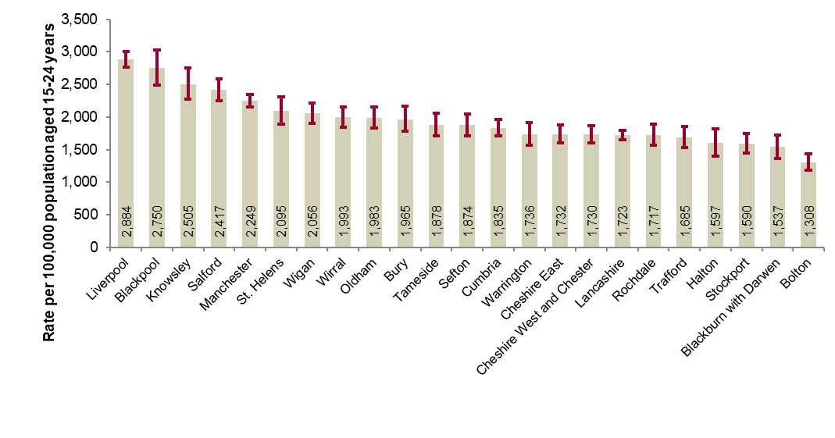
Figure 11: Chlamydia detection rate per 100,000 population aged 15 to 24 years in North West by local authority of residence: 2019
PHE recommends that local areas should be working towards achieving a chlamydia detection rate of at least 2,300 per 100,000 among individuals aged 15 to 24 years.
Source: Public Health England, GUMCAD and CTAD

Slide 18
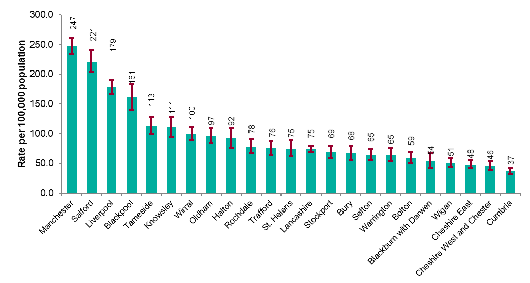
Figure 12: Rate of gonorrhoea diagnoses per 100,000 population in North West by local authority of residence: 2019
Source: Public Health England, GUMCAD

Slide 19
Figure 13: Map of new STI rates per 100,000 residents by upper tier local authority in North West: 2019
Source: Public Health England, GUMCAD and CTAD

Slide 20
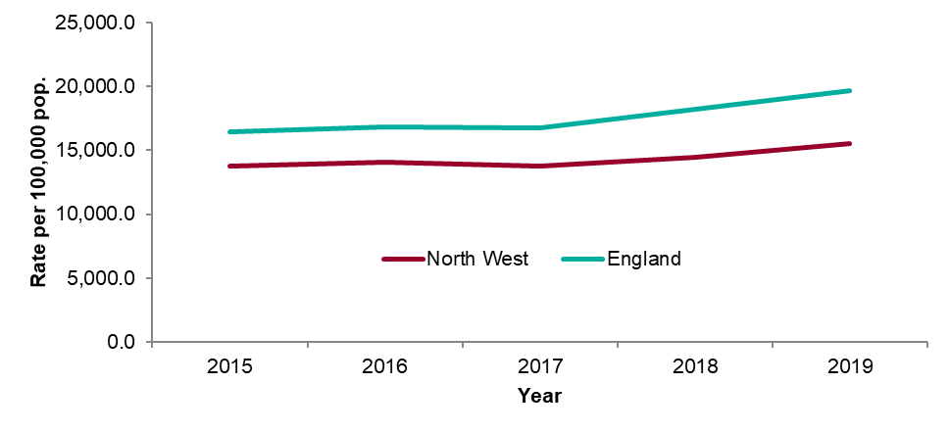
Figure 14: STI testing rate (excluding chlamydia in under 25 year olds) per 100,000 population in North West residents aged 15 to 64: 2015 to 2019
Source: Public Health England, GUMCAD

Slide 21
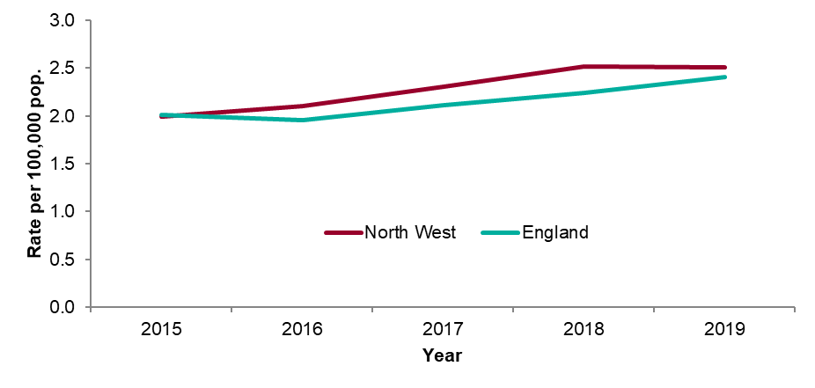
Figure 15: STI testing positivity rate (excluding chlamydia in under 25 year olds) in North West residents: 2015 to 2019
Source: Public Health England, GUMCAD

Slide 22
Table 4: Number of diagnoses of new STIs by PHEC of residence, data source and data subset: 2019
* New STI diagnoses from enhanced GPs reporting to GUMCAD are included in the ‘Non-specialist sexual health services (SHSs)’ total.
** Including site type 12 chlamydia from GUMCAD.
Source: Public Health England, GUMCAD and CTAD

Slide 23
Table 5: Number of diagnoses of the 5 main STIs in the North West by STI, data source and data subset: 2019
* Diagnoses from enhanced GPs reporting to GUMCAD are included in the ‘Non-specialist sexual health services (SHSs)’ total.
** Including site type 12 chlamydia from GUMCAD.
Source: Public Health England, GUMCAD and CTAD

