Slide 1
Annual Epidemiological Spotlight on STIs in the South West: 2019 data
Field Service
For queries relating to this document, please contact fes.southwest@phe.gov.uk
PHE publications gateway number: GOV-7840

Slide 2
Summary of 2019 data for South West residents
There were over 34,800 new STIs diagnosed in the South West
The new STI diagnosis rate was 619 diagnoses per 100,000 population
In the period 2018 to 2019, diagnoses of gonorrhoea rose by 24%, while syphilis diagnoses fell by 2%
The chlamydia detection rate in those aged 15 to 24 was 1,856 per 100,000 population. Public Health England recommends that local areas should be working towards achieving a chlamydia detection rate of at least 2,300 per 100,000 among individuals aged 15 to 24 years
13% of new STI diagnoses (excl. chlamydia reported via CTAD), 74% of new syphilis diagnoses and 42% of new gonorrhoea diagnoses were in men who have sex with men (MSM)
15 to 24 year olds accounted for 54% of new STI diagnoses
The white ethnic group had the highest numbers of new STIs (91%)
Although <1% of new STI diagnoses were in the black Caribbean ethnic group, this ethnic group had the highest rate (1,943 per 100,000 population)
Majority of those diagnosed with a new STI are UK-born (88%)

Slide 3
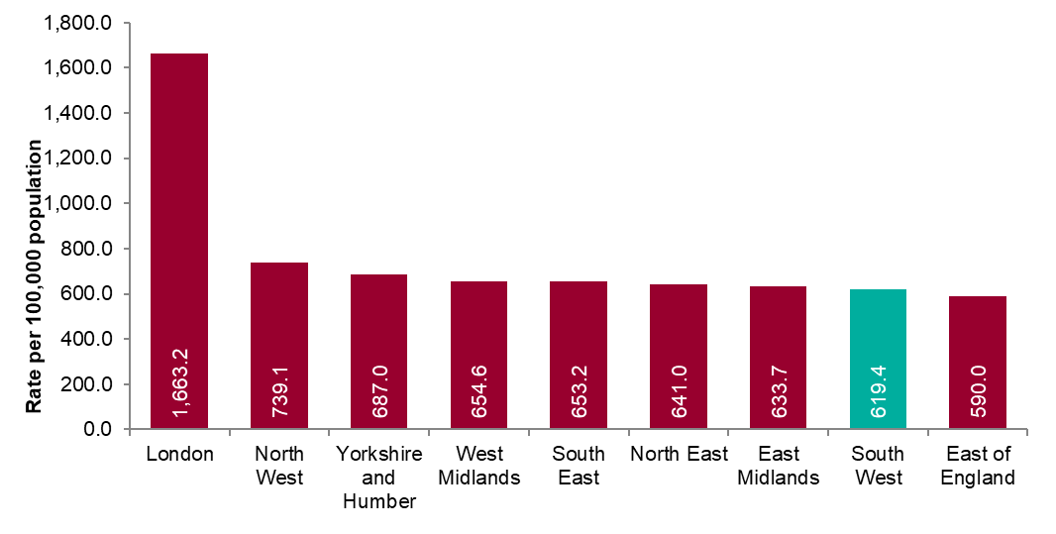
Figure 1: New STI diagnosis per 100,000 population by PHE centre of residence, 2019
Source: Public Health England, GUMCAD and CTAD

Slide 4
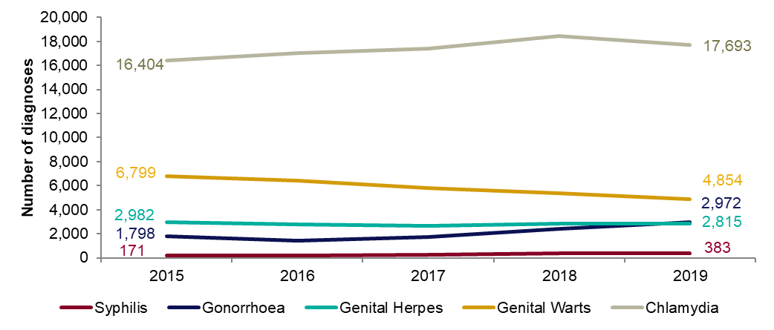
Figure 2: Number of diagnoses of the 5 main STIs –South West residents, 2015 to 2019
Any increase in gonorrhoea diagnoses may be due to the increased use of highly sensitive nucleic acid amplification tests (NAATs) and additional screening of extra-genital sites in MSM.
Any decrease in genital wart diagnoses may be due to a moderately protective effect of HPV-16/18 vaccination.
Any increase in genital herpes diagnoses may be due to the use of more sensitive NAATs.
Increases or decreases may also reflect changes in testing practices.
Source: Public Health England, GUMCAD and CTAD

Slide 5
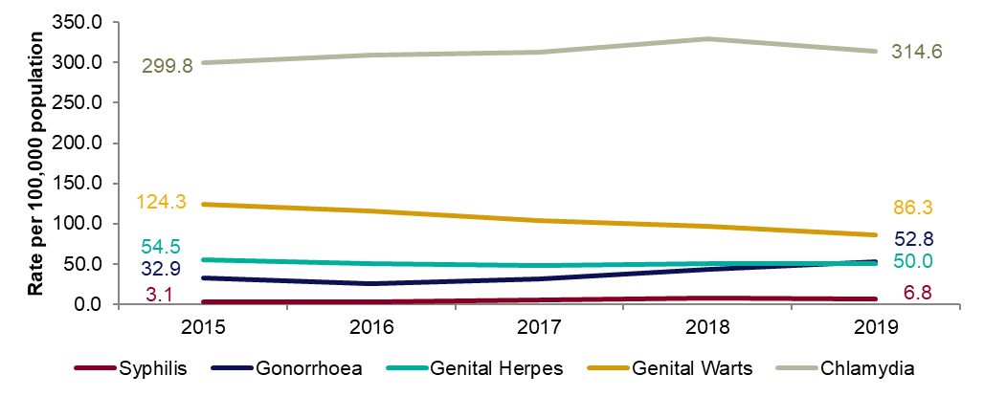
Figure 3: Diagnosis rates of the 5 main STIs – South West residents, 2015 to 2019
Any increase in gonorrhoea diagnoses may be due to the increased use of highly sensitive nucleic acid amplification tests (NAATs) and additional screening of extra-genital sites in MSM.
Any decrease in genital wart diagnoses may be due to a moderately protective effect of HPV-16/18 vaccination.
Any increase in genital herpes diagnoses may be due to the use of more sensitive NAATs.
Increases or decreases may also reflect changes in testing practices.
Source: Public Health England, GUMCAD and CTAD

Slide 6
Table 1: Percentage change in new STI diagnoses – South West residents
Please see notes for Figure 3.
Source: Public Health England, GUMCAD and CTAD
.

Slide 7
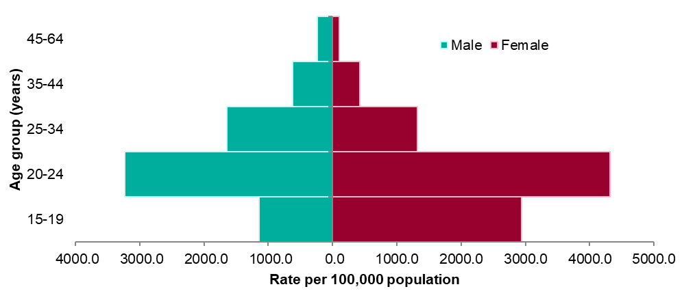
Figure 4: Rates of new STIs per 100,000 residents by gender and age group in South West, 2019
Source: Public Health England, GUMCAD and CTAD

Slide 8
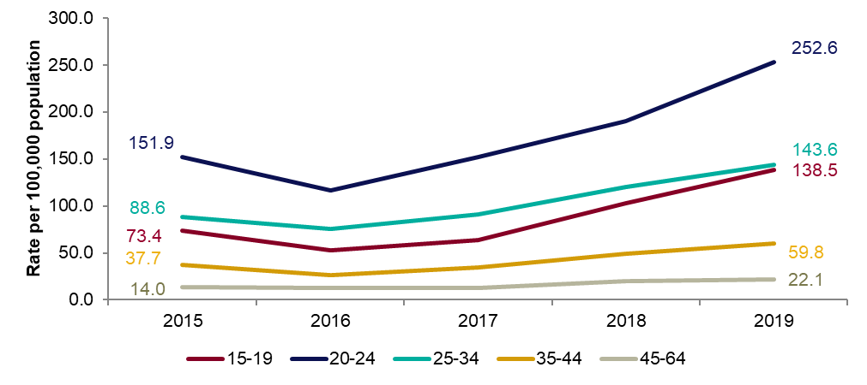
Figure 5: Rates of gonorrhoea per 100,000 residents by age group in South West, 2015 to 2019

Slide 9
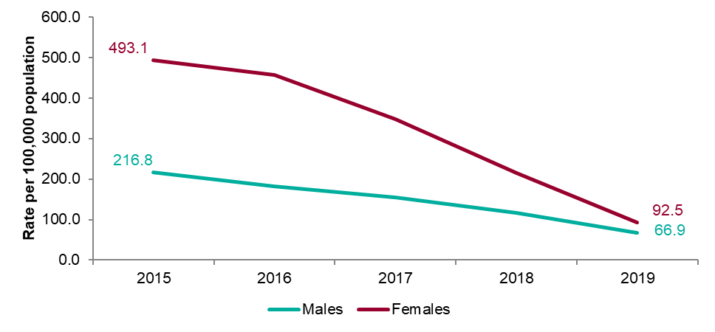
Figure 6: Rates of genital warts per 100,000 residents aged 15 to19 years by gender, 2015 to 2019

Slide 10
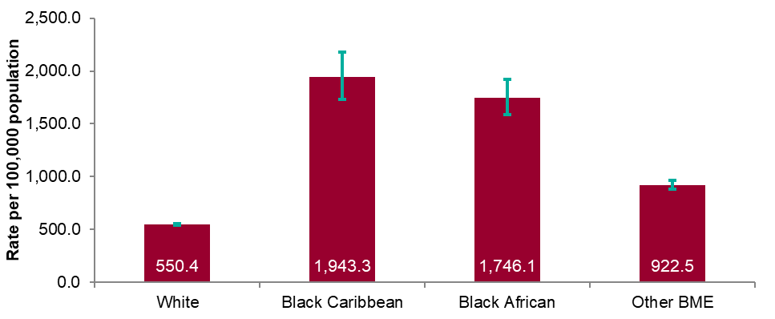
Figure 7: Rates by ethnicity per 100,000 population of South West residents diagnosed with a new STI, 2019
Source: Public Health England, GUMCAD and CTAD

Slide 11
Table 2: Proportion of South West residents diagnosed with a new STI by ethnicity, 2019
Source: Public Health England, GUMCAD and CTAD

Slide 12
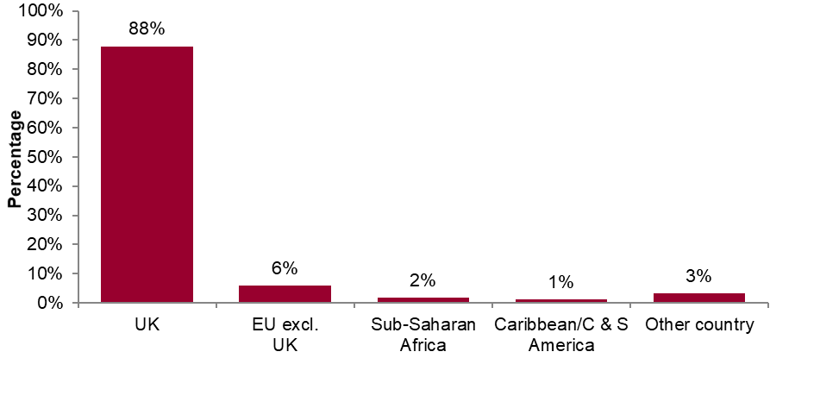
Figure 8: Proportions of South West residents diagnosed with a new STI by world region of birth*, 2019
*Data on country of birth is not collected by CTAD. All information about world region of birth is based on diagnoses made in specialist and non-specialist services which report to GUMCAD.
Source: Public Health England, GUMCAD

Slide 13
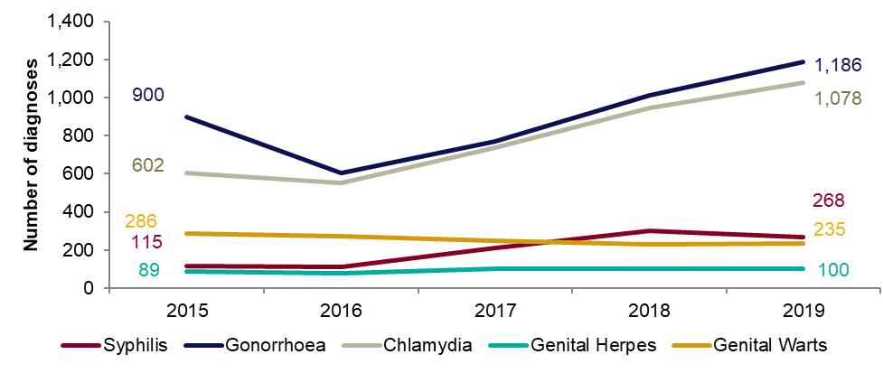
Figure 9: Diagnoses of the 5 main STIs among MSM*, South West residents, 2015 to 2019
* Data on sexual orientation is not collected by CTAD. All information about MSM is based on diagnoses made in specialist and non-specialist services which report to GUMCAD
GUMCAD started in 2009. Reporting of sexual orientation is less likely to be complete for earlier years. So rises seen may be partly artefactual.
Any increase in gonorrhoea diagnoses may be due to the increased use of highly sensitive nucleic acid amplification tests (NAATs) and additional screening of extra-genital sites in MSM.
Any decrease in genital wart diagnoses may be due to a moderately protective effect of HPV-16/18 vaccination.
Any increase in genital herpes diagnoses may be due to the use of more sensitive NAATs.
Any increase or decrease may reflect changes in testing.
Source: Public Health England, GUMCAD (level 3 services).

Slide 14
Table 3: Percentage change in new STI diagnoses in men who have sex with men (MSM)*, South West residents
*Please see notes for Figure 9.
Source: Public Health England, GUMCAD

Slide 15
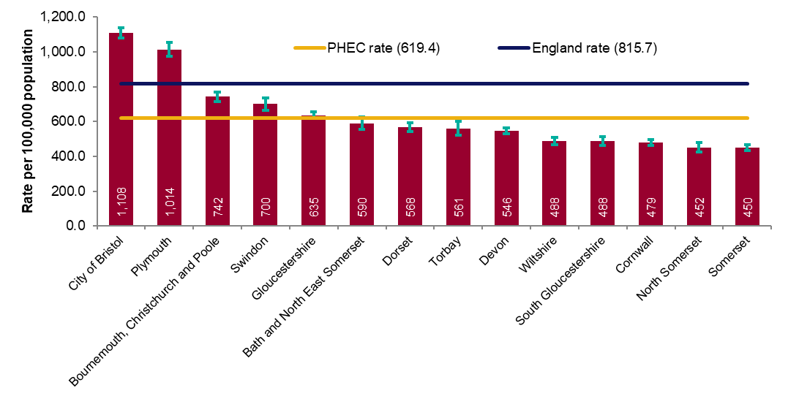
Figure 10a: Rate of all new STI diagnoses per 100,000 population among South West residents by local authority of residence, 2019
Source: Public Health England, GUMCAD and CTAD

Slide 16
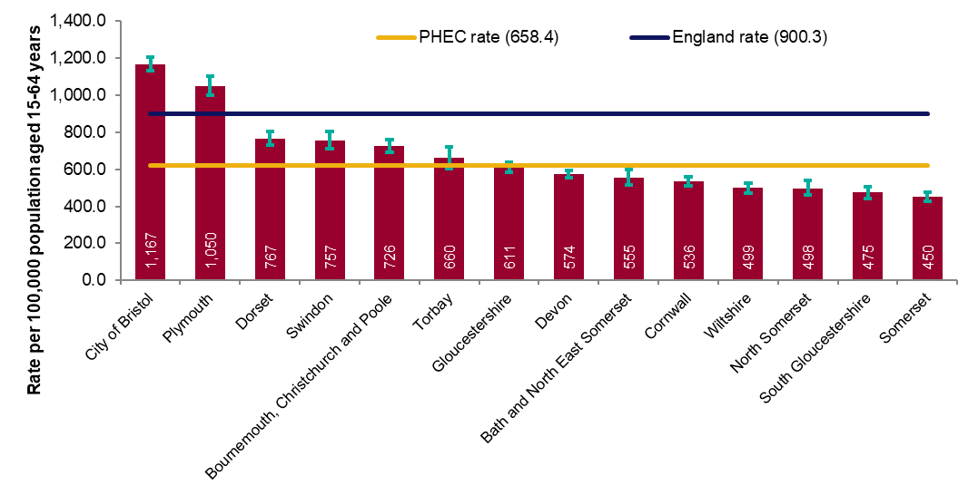
Figure 10b: Rate of new STI diagnoses (excluding chlamydia diagnoses in persons aged 15 to 24 years) per 100,000 population aged 15 to 64 years among South West residents by local authority of residence, 2019
Source: Public Health England, GUMCAD and CTAD

Slide 17
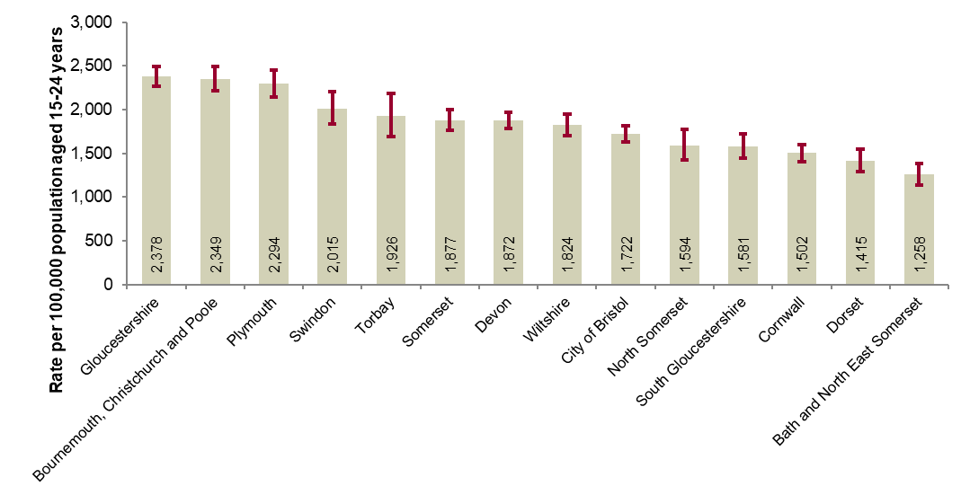
Figure 11: Chlamydia detection rate per 100,000 population aged 15 to 24 years in South West by local authority of residence, 2019
PHE recommends that local areas should be working towards achieving a chlamydia detection rate of at least 2,300 per 100,000 among individuals aged 15 to 24 years.
Source: Public Health England, GUMCAD and CTAD

Slide 18
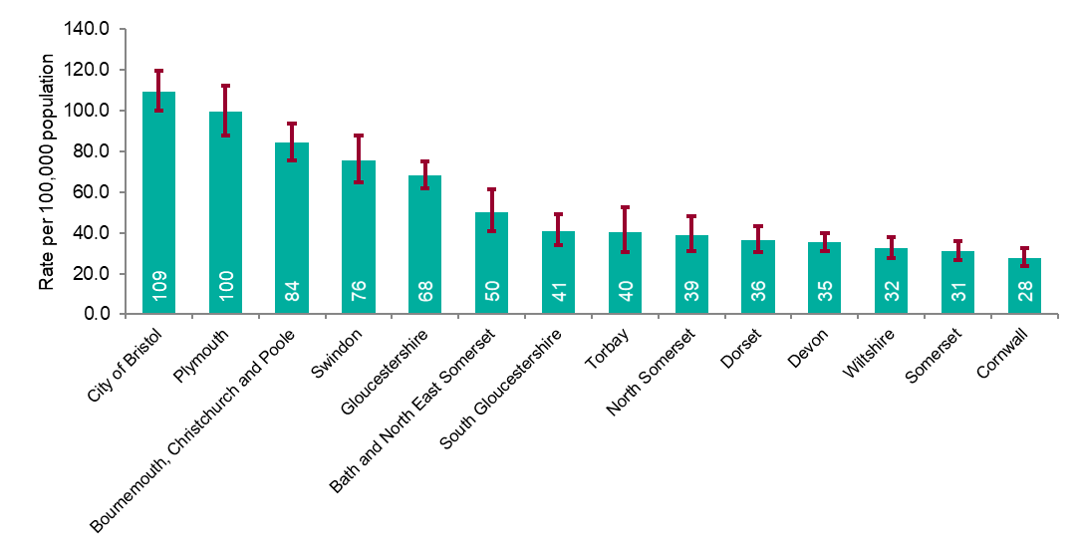
Figure 12: Rate of gonorrhoea diagnoses per 100,000 population in South West by local authority of residence, 2019
Source: Public Health England, GUMCAD

Slide 19
Figure 13: Map of new STI rates per 100,000 residents by upper tier local authority in South West, 2019
Source: Public Health England, GUMCAD and CTAD

Slide 20
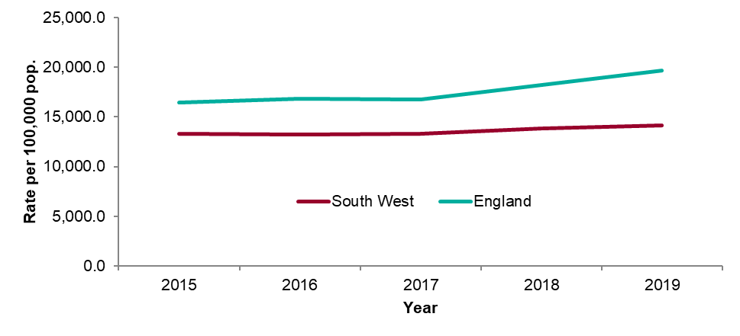
Figure 14: STI testing rate (excluding chlamydia in under 25 year olds) per 100,000 population in South West residents aged 15 to 64, 2015 to 2019
Source: Public Health England, GUMCAD

Slide 21
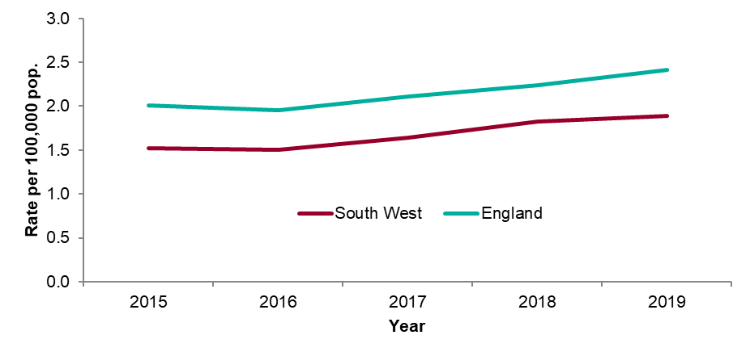
Figure 15: STI testing positivity rate (excluding chlamydia in under 25 year olds) in South West residents, 2015 to 2019
Source: Public Health England, GUMCAD

Slide 22
Table 4: Number of diagnoses of new STIs by PHEC of residence, data source and data subset, 2019
* New STI diagnoses from enhanced GPs reporting to GUMCAD are included in the ‘Non-specialist sexual health services (SHSs)’ total.
** Including site type 12 chlamydia from GUMCAD.
Source: Public Health England, GUMCAD and CTAD

Slide 23
Table 5: Number of diagnoses of the 5 main STIs in the South West by STI, data source and data subset, 2019
* Diagnoses from enhanced GPs reporting to GUMCAD are included in the ‘Non-specialist sexual health services (SHSs)’ total.
** Including site type 12 chlamydia from GUMCAD.
Source: Public Health England, GUMCAD and CTAD

