Slide 1



BASCD Trainers’ Pack for
Caries Prevalence Studies
Updated: June 2022
for UK Training & Calibration Exercise
Permanent Dentition

Slide 2
Prepared by*
Helen Paisley, Cynthia Pine and Girvan Burnside
Administrative assistance by
Lucy Fish
Tom Jirat
Rebecca Byrne
Clinical photographs by
Christopher Deery
Fadi Jarad
George Lee
Iain Pretty
Additional photographs from NDIP Scotland Training Pack by
Nicola Innes
Amid Ismail
Kim Ekstrand

Slide 3
Background*
The British Association for the Study of Community Dentistry (BASCD) has co-ordinated and provided the standards for a programme of dental health surveys for many years.
The collected resources and guidance are available at www.gov.uk/government/collections/oral-health via the K-hub link

Slide 4
This presentation is designed to support the training of dental examiners in the assessment of dental caries undertaken in the surveys.

Slide 5
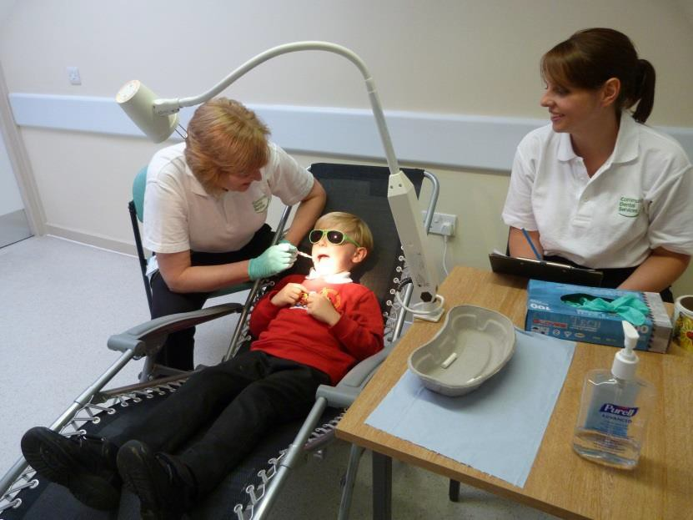
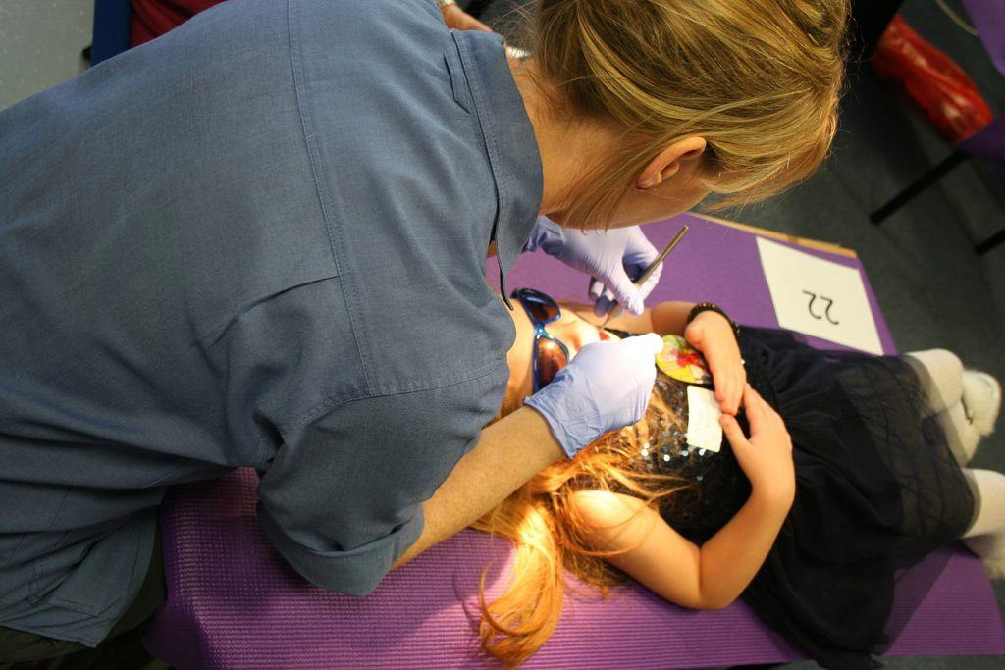
The Examination
Dentist seated behind child
Child lying supine on table covered with soft mat and water proof covering
Child wears shaded glasses
Recorder seated next to dentist
Dentist can clearly see
chart

Slide 6
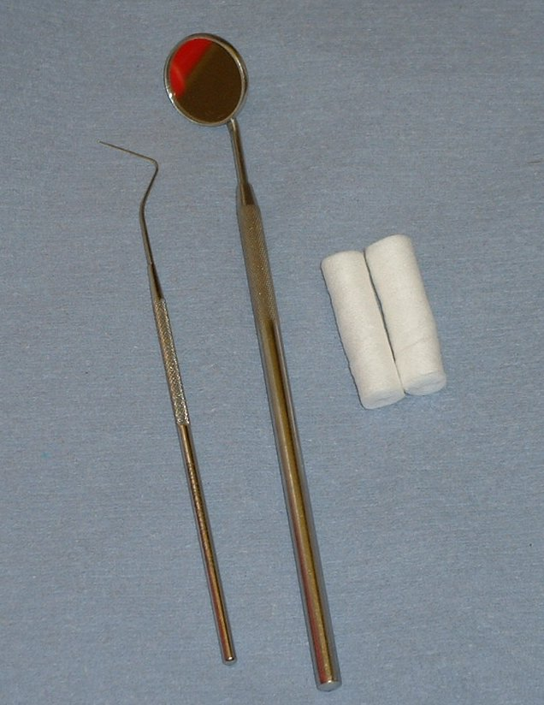
Dental instruments
Recommended dental instruments are:
Plane mouth mirror
Blunt ball-ended probe (CPITN) with an end diameter of 0.5 mm.
Cotton wool rolls or cotton buds for drying teeth
Fresh set of previously sterilised instruments for each subject.

Slide 7
Lights
BASCD recommend a purpose built inspection light yielding 4000 lux at 1 metre
Example of acceptable lights is:
Daray X100E (X100 LED custom epidemiology light)
with PivotD2 desk clamp

Slide 8
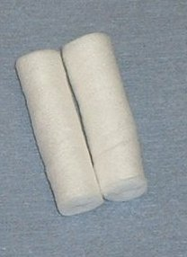
Drying Teeth
BASCD recommend cotton wool rolls, gauze or cotton wool buds.
For caries and fissure sealant diagnosis drying is recommended wherever diagnosis is in doubt and surfaces are obscured with saliva.

Slide 9
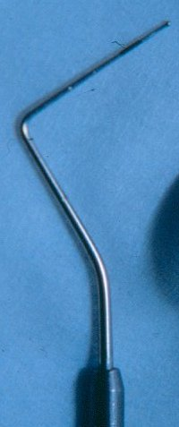
Use of Probe
NOT a diagnostic aid.
Probe is used for:
Removing plaque and debris
Checking for fissure sealants and tooth coloured fillings

Slide 10
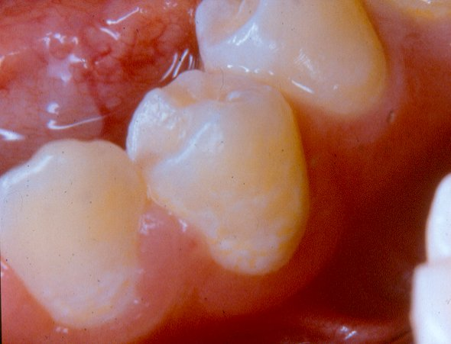
Plaque Removal

Slide 11
Plaque Removal
LL3 and LL4 –buccal surfaces of these teeth covered with plaque
Visibility is obscured
Therefore, plaque should be gently removed with the blunt ball-ended probe.

Slide 12
Conventions exercise

Slide 13
Caries examination*
Conventions for surveys of year 6 or 12 year old children
To facilitate accurate recording, examine and score teeth in a consistent order. Only permanent teeth are scored
Many year 6 or 12 year old children will still be in the mixed dentition. When any deciduous tooth is still present the permanent tooth is coded Tooth Code 8 - indicating the permanent tooth is unerupted, congenitally missing or missing due to reason unknown
If the deciduous tooth is not present and no permanent successor is present in the space the examiner needs to assess whether the permanent tooth is Tooth code 8- unerupted, congenitally missing or missing due to reason unknown OR extracted due to caries (Tooth code 6), extracted for orthodontic reasons (Tooth code 7) or missing due to trauma (code T)

Slide 14
Caries examination*
Conventions for surveys of year 6 or 12 year old children
Tooth code 6 – extracted due to caries
The tooth has been extracted due to caries. Missing first permanent molars are predominantly assumed extracted for caries
Tooth code 7 – extracted for orthodontic reasons
This applies when the tooth in the opinion of the examiner has been extracted for orthodontic reasons. This predominantly applies to premolars. Unless there is overwhelming evidence to the contrary, after questioning the child, missing first permanent molars will be recorded as extracted due to caries.
This judgement is made by the clinical examination taking into account the stage of dental development and questioning the child

Slide 15
Caries examination*
Conventions for surveys of year 6 or 12 year old children
A tooth is deemed to have erupted when any part of it is visible in the mouth. Unerupted surfaces of an erupted tooth will be regarded as sound
The presence of supernumery teeth will not be recorded. If a tooth and a supernumery resemble one another then the distal of the two will be regarded as the supernumery. Code the mesial tooth

Slide 16
Caries examination*
Conventions - all children
If only a partial examination can be achieved any surfaces or teeth that cannot be seen should be coded – (code 9) as assessment cannot be made
Carious roots are coded 3 for all surfaces
Caries takes precedence over non-carious defects, e.g. Trauma
Threshold for recording lesions as caries is dentine involvement (D₃)
If in doubt score low
Discoloured, non-vital incisors, without caries or fractures should be scored T for trauma all surfaces

Slide 17
The next set of slides show different tooth and surface conditions and the associated codes used in surveys

Slide 18
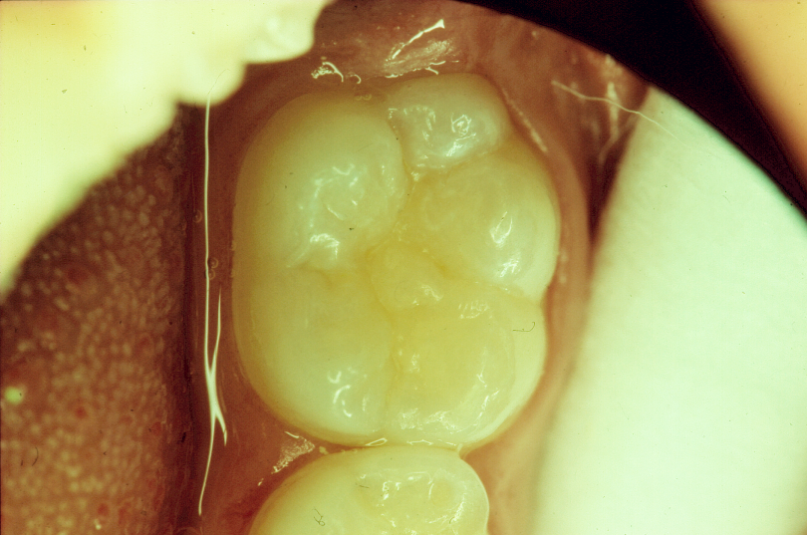
Surface boundaries viewed from occlusal
distal
Junction of buccal & distal surfaces
lingual
buccal
mesial

Slide 19
Surface boundaries viewed from occlusal
Single Surface Filling

Slide 20
Surface boundaries viewed from occlusal
Two Surface Filling

Slide 21
Surface boundaries viewed from occlusal
Three Surface Filling

Slide 22
The next series of slides presents examples of teeth which would be coded as trauma (code T)

Slide 23
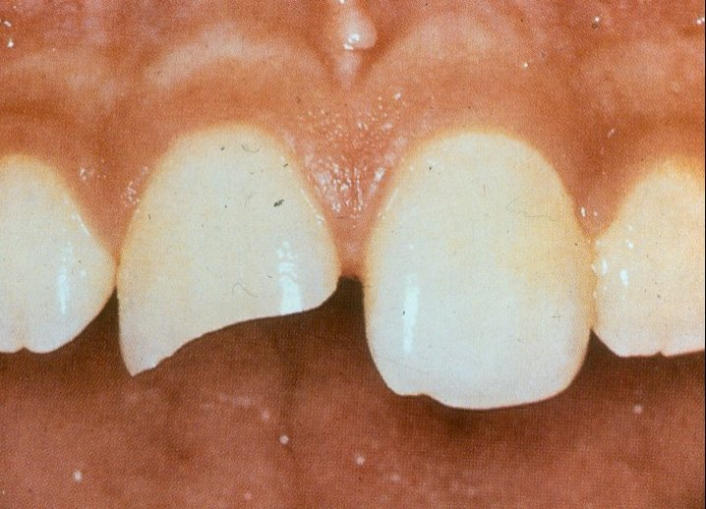
Surface code T – trauma

Slide 24
Surface code T – trauma
UR1 – mesial and buccal surfaces are fractured.
Fracture involves dentine
View from all sides to determine which other surfaces are traumatised
Surface code is T - trauma.
NB. If caries into dentine was also present on these traumatised surfaces, surfaces would be coded for caries as appropriate.

Slide 25
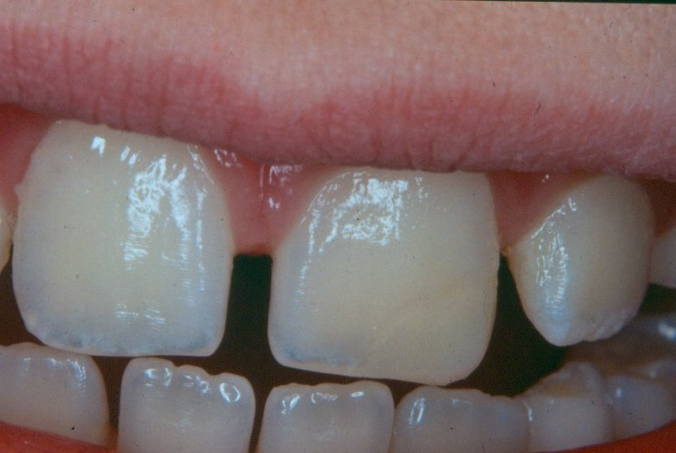
Surface code T – trauma

Slide 26
Surface code T – trauma *
UL1 –tooth has been traumatised and repaired
Restoration involves the distal and buccal surfaces (visible on the slide).
These surfaces would be coded as T.
NB. Surface code T includes both untreated and treated trauma. Trauma code only used in absence of treated or untreated caries

Slide 27
Surface code T – trauma *
Where an examiner is confident a tooth is missing due to trauma, all surfaces should be coded T
Discoloured, non-vital incisors, without caries or fractures should be scored T for trauma on all surfaces
At present the BASCD standardised criteria does not discriminate between these trauma codes

Slide 28
The next series of slides present examples of teeth which would be coded as sound (code 0)

Slide 29
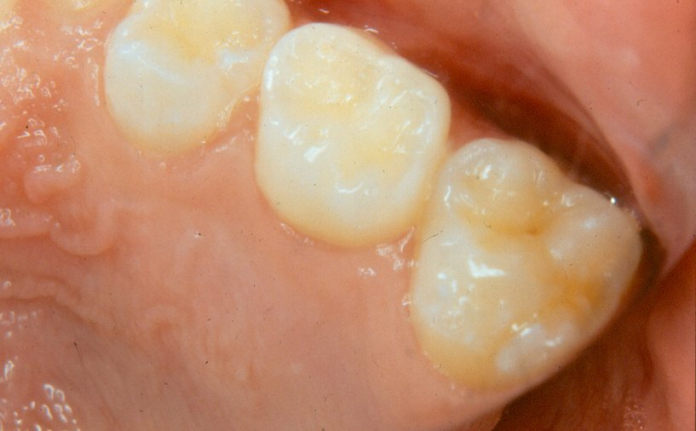
Surface code 0 – present and "sound"

Slide 30
Surface code 0 – present and "sound"
ULE –occlusal surface is sound and is coded as 0.

Slide 31
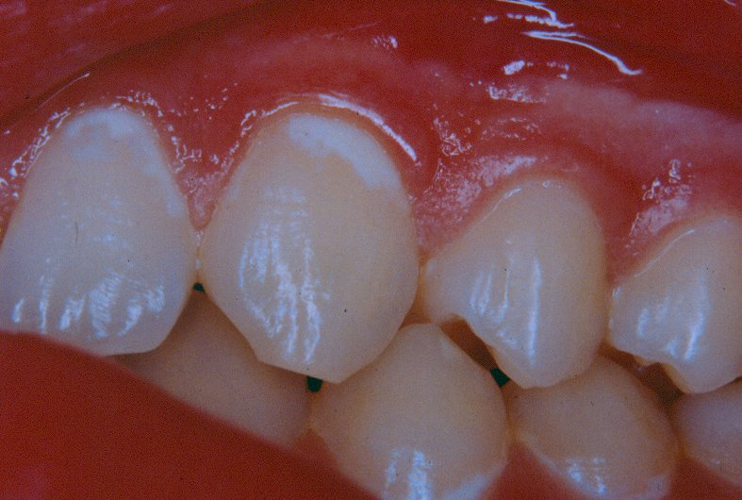
Surface code 0 – present and "sound"

Slide 32
Surface code 0 – present and "sound"
UL2 & UL3 buccal surfaces –white spot lesions in a band around the gingival 3rd
NB. These lesions represent one of the early stages of caries and are excluded from the caries scores, which record at the "caries into dentine" diagnostic threshold, therefore, these surfaces are scored as sound.

Slide 33
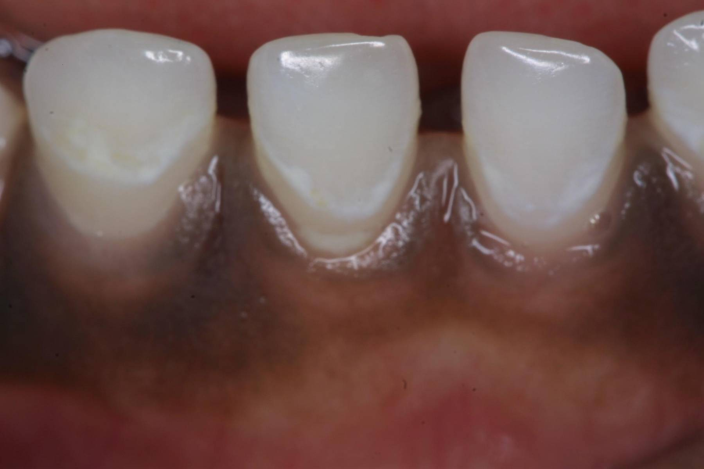
Surface code 0 – present and "sound"

Slide 34
Surface code 0 – present and "sound"
In these deciduous teeth, the demineralised areas probably correspond with plaque coverage at the original gingival margin.

Slide 35
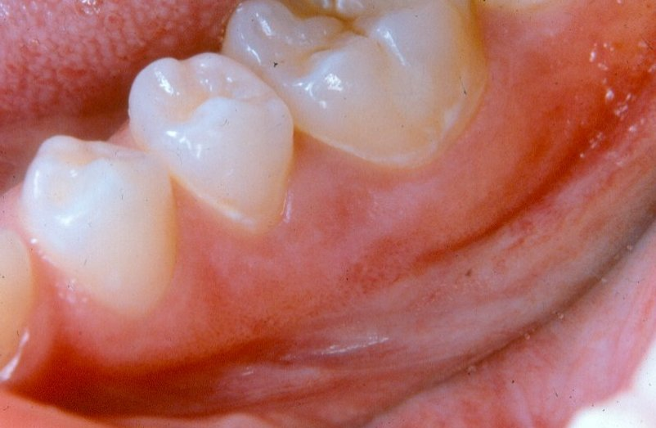
Surface code 0 – present and "sound"

Slide 36
Surface code 0 – present and "sound"
LL5 & LL6 buccal surfaces –white spot lesions around the necks of the teeth giving a band-like appearance.
Surfaces are scored as sound.

Slide 37
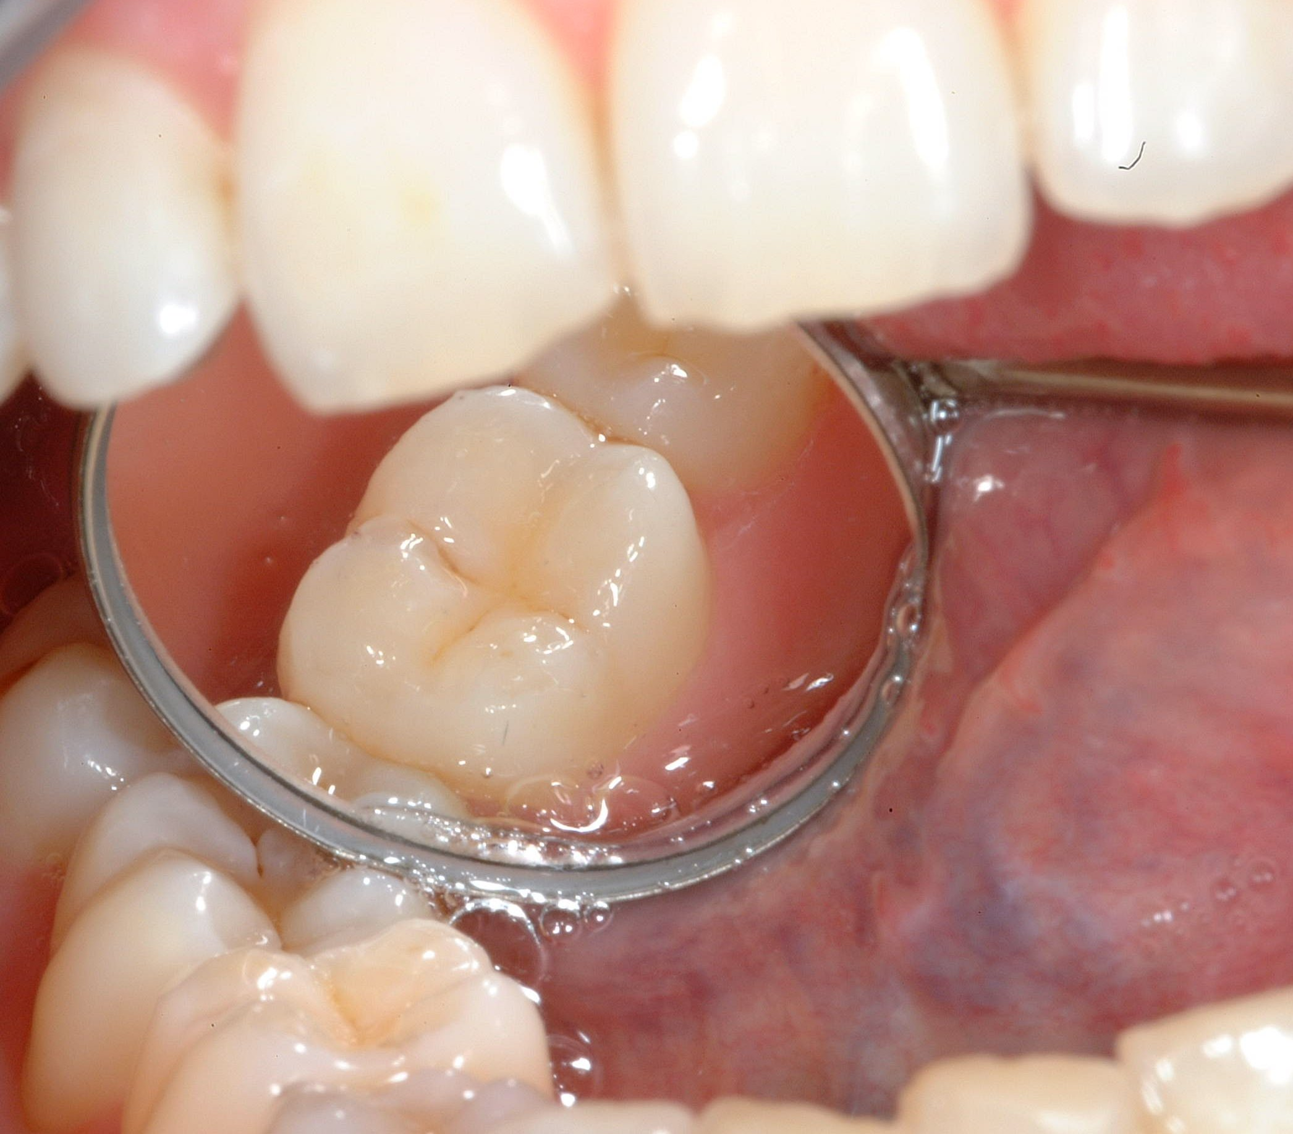
Surface code 0 – present and "sound"

Slide 38

Surface code 0 – present and "sound"
Stained fissure/enamel caries
Stained pits or fissures in the enamel not associated with a carious lesion into dentine are coded as sound.

Slide 39
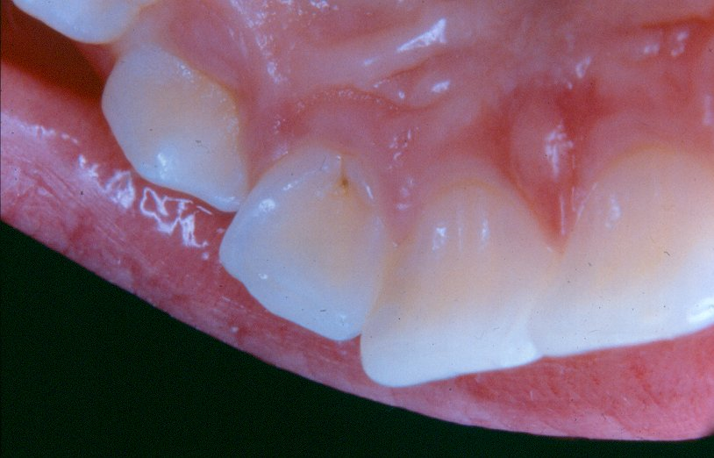
Surface code 0 – present and "sound"

Slide 40
Surface code 0 – present and "sound"
UL2 – lingual surface has stained pit.
No visible evidence of caries into dentine
Surface scored as sound.

Slide 41
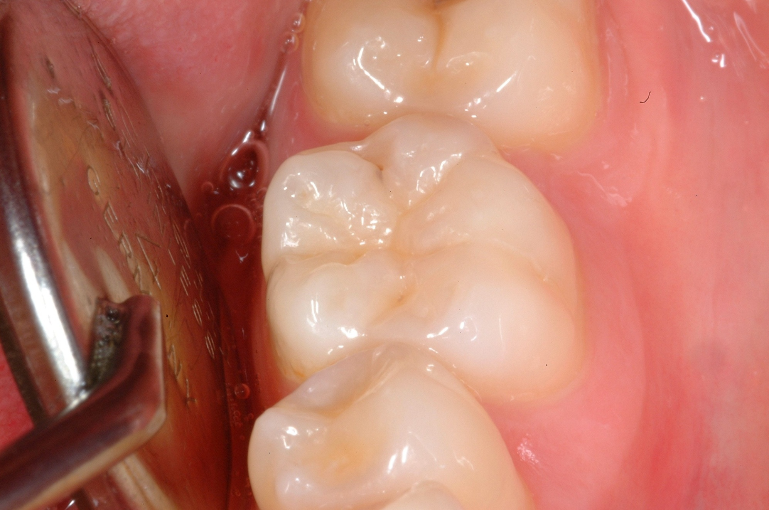
Surface code 0 – present and "sound"

Slide 42

Surface code 0 – present and "sound"
Distal fissure of molar has a small carious lesion in enamel
No visual evidence of dentine involvement
Scored as sound

Slide 43
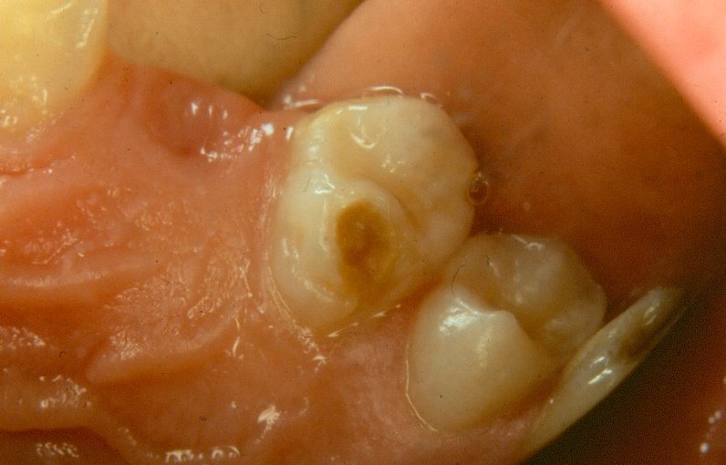
Surface code 0 – present and "sound"

Slide 44
Surface code 0 – present and "sound"
UL4 –lingual surface has enamel loss and an orange/brown lesion.
This is hypoplasia, a developmental defect of the enamel.
Surface is scored sound.

Slide 45
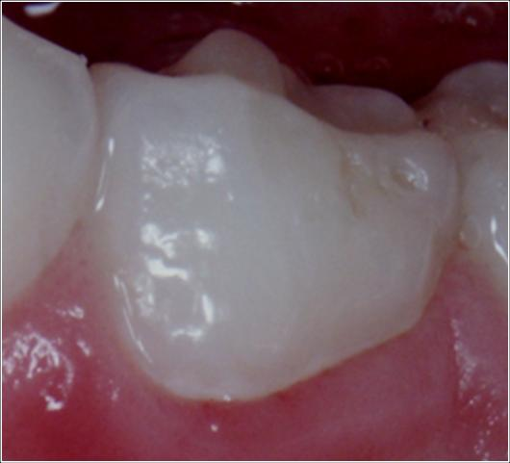
Surface code 0 – present and "sound"

Slide 46
Surface code 0 – present and "sound"
Deciduous molar has a hypoplastic pit on the buccal surface.
This is scored sound.

Slide 47
The next series of slides illustrate surfaces with decay

Slide 48
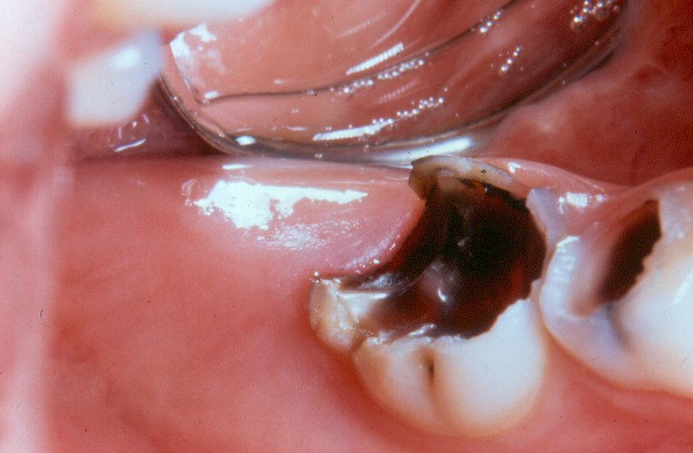
Surface code 1 – arrested dentinal decay

Slide 49
Surface code 1 – arrested dentinal decay
URE –occlusal surface has arrested dentinal caries
Distal, lingual and buccal surfaces would also be coded as 1.

Slide 50
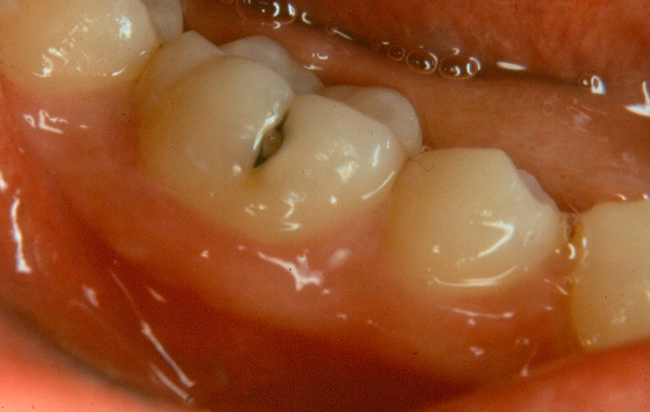
Surface code 2 – decayed into dentine

Slide 51
Surface code 2 – decayed into dentine
LR6 –buccal surface has a visible carious lesion within fissure
Surface is cavitated into dentine
Creamy shadowing beneath enamel (mesial aspect)
Grey shadowing beneath enamel (distal aspect)
Both areas are undermined enamel indicating extent of carious lesion into dentine.

Slide 52
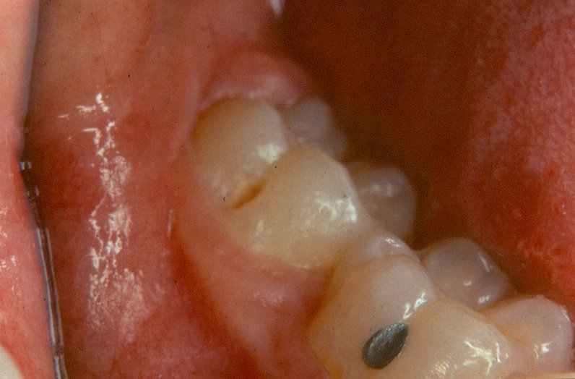
Surface code 2 – decayed into dentine

Slide 53
Surface code 2 – decayed into dentine
LR7 - buccal surface has an oval lesion at the base of the fissure.
Lesion extends into dentine and is coded 2.
LR6 –buccal surface has intact filling in fissure with no decay or loss in adequacy of filling material
This surface would be coded as 5 – filled with no decay

Slide 54
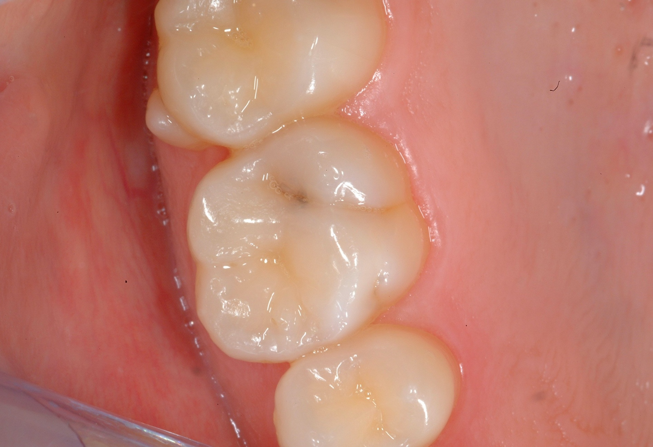
Surface code 2 – decayed into dentine

Slide 55

Surface code 2 – decayed into dentine
Distal fissure has
  Break in enamel
  Widened fissure
  Grey shadow beneath the enamel
Lesion scored as 2 – decayed into dentine

Slide 56
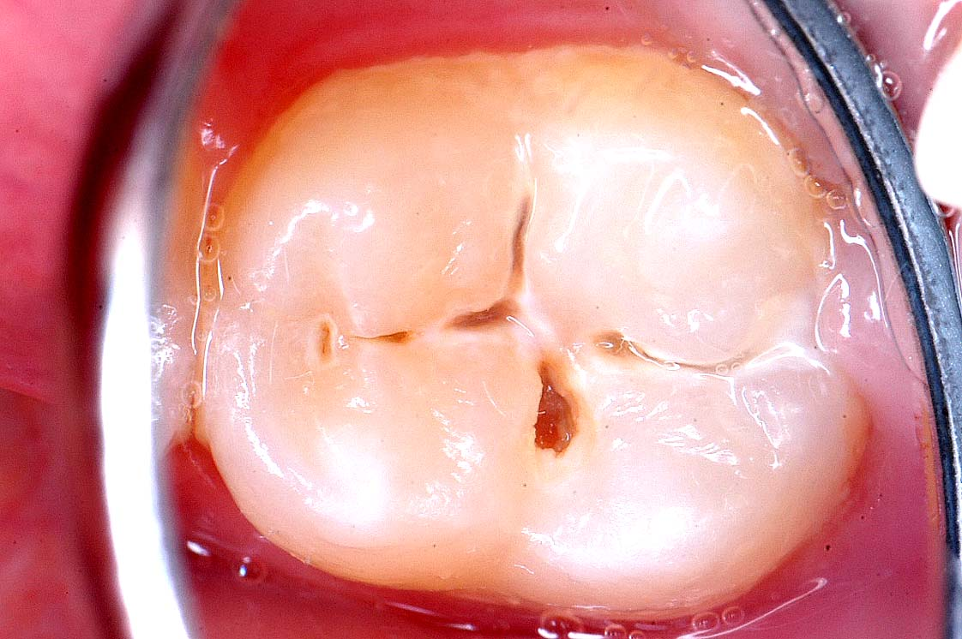
Surface code 2 – decayed into dentine

Slide 57
Surface code 2 – decayed into dentine
Molar has several areas of cavitation extending into dentine

Slide 58
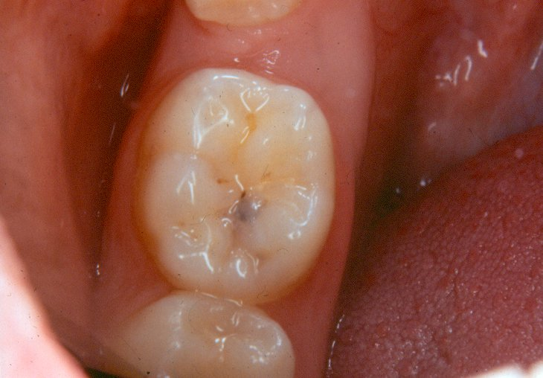
Surface code 2 – decayed into dentine

Slide 59
Surface code 2 – decayed into dentine
LL6 –occlusal surface has no evident cavitation but has grey shadow beneath the enamel
This lesion would be scored as code 2 – decayed.

Slide 60
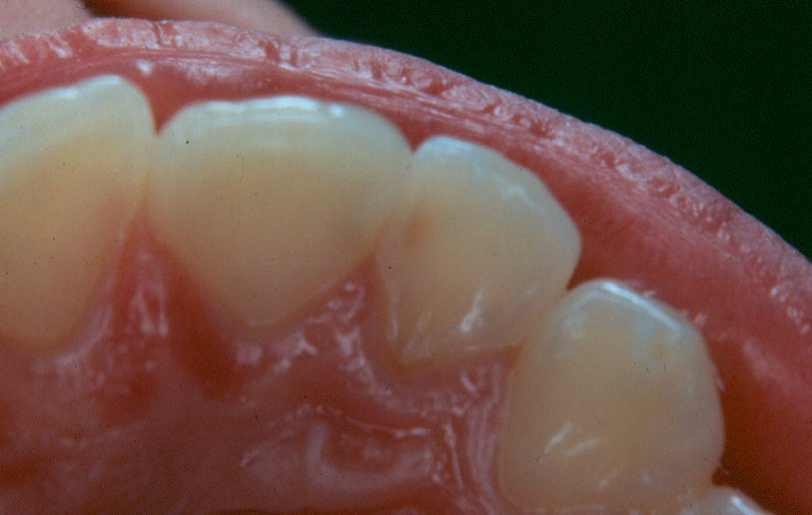
Surface code 2 – decayed into dentine

Slide 61
Surface code 2 – decayed into dentine
UL2 mesial surface –dark shadow beneath the enamel
Shadowing continues beyond the ADJ and into the dentine
This surface would be coded as 2.

Slide 62
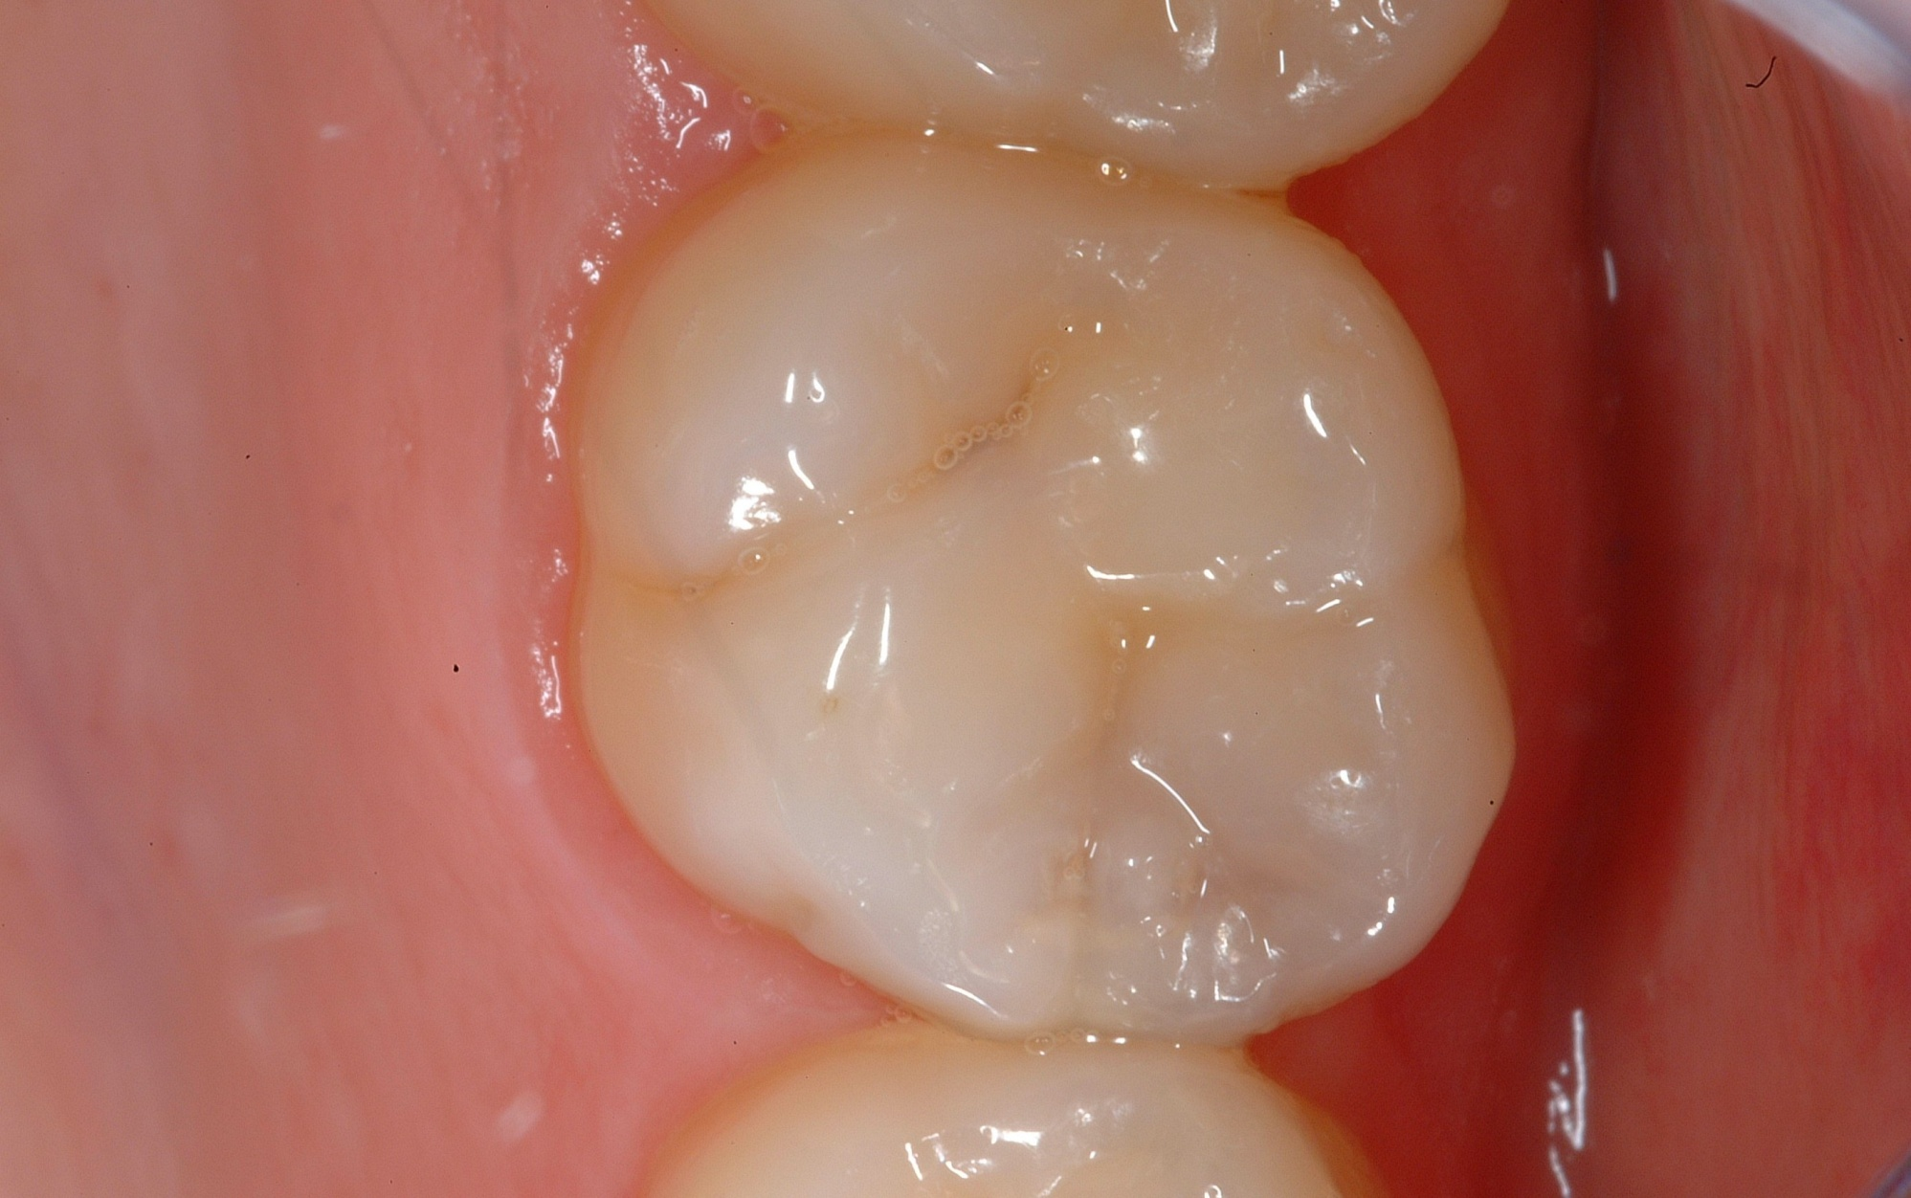
Surface code 2 – decayed into dentine - discuss

Slide 63

Surface code 2 – decayed into dentine - Discuss
Surface needs to be dried
Grey opacity beneath the mesial marginal ridge
Creamy opacity along ADJ
Appears to be caries into dentine
Occlusal and mesial surfaces both scored 2

Slide 64
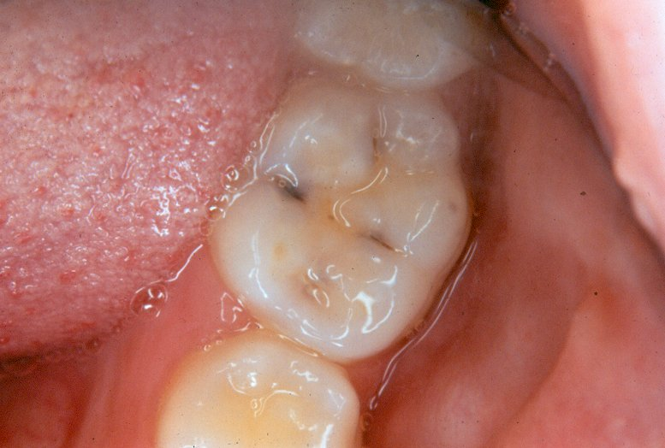
Surface code 2 – decayed into dentine

Slide 65
Surface code 2 – decayed into dentine
NB Surface is covered with saliva which can make diagnosis more difficult. Examiners are encouraged to dry surfaces with gauze, cotton wool rolls or cotton wool buds when visibility is obscured.

Slide 66
Surface code 2 – decayed into dentine
LL6 occlusal surface –lingual aspect has deeply stained fissure and dark shadowing beneath the enamel.
Mesial and distal aspects of the occlusal surface have lesions with cream and grey shadows beneath the enamel surface.
Surface would be coded as caries into dentine code 2
Smaller lesion into dentine also present on buccal aspect of the occlusal surface.

Slide 67
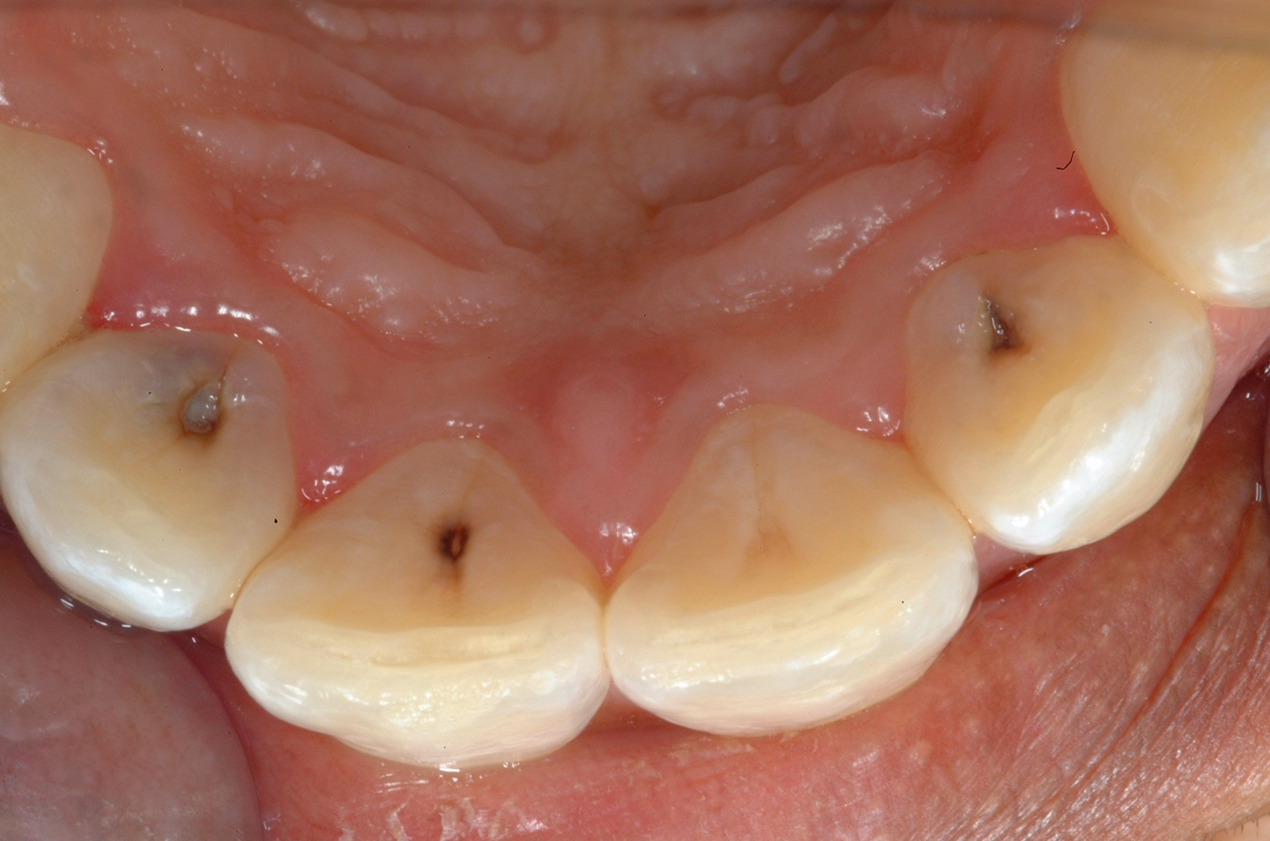
Surface code 2 – decayed into dentine

Slide 68

Surface code 2 – decayed into dentine
Carious lesions involving dentine on lingual surfaces of upper lateral incisors
Upper left central incisor has heavily stained pit
No apparent break in enamel of UL1, no opacities beneath enamel which are present in lesions on laterals

Slide 69
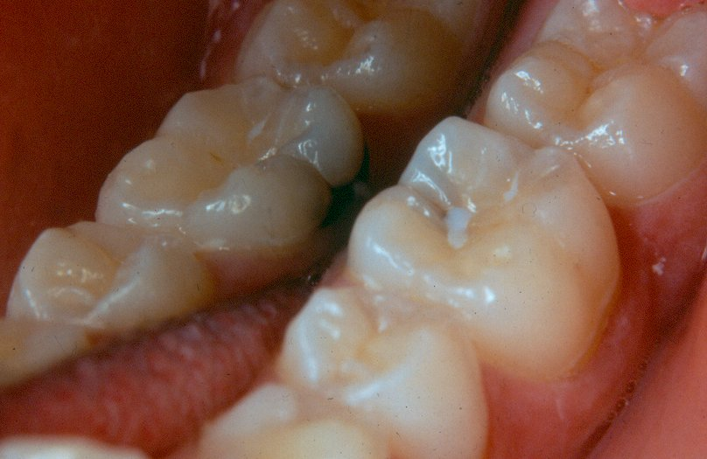
Surface code 2 – decayed into dentine

Slide 70
Surface code 2 – decayed into dentine
LL6 lingual and occlusal surfaces – look at lingual surface in mirror view first
Large carious lesion within the gingival 3rd extending around base of lingual surface
Presents as dark lesion cavitated into dentine with large associated area of grey shadowing beneath the enamel
Continued on next slide

Slide 71
Surface code 2 – decayed into dentine
Grey shadowing extends to involve the occlusal surface.
Occlusal surface has remnants of fissure sealant, but caries takes precedence and both lingual and occlusal scored as code 2.

Slide 72
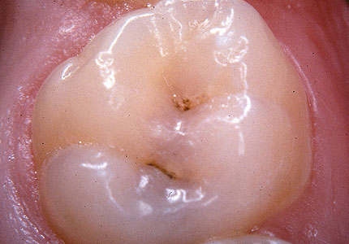
Surface code 2 – decayed into dentine

Slide 73
Surface code 2 – decayed into dentine
On the occlusal surface there is a grey shadow extending across into the distal
Both surfaces scored as code 2

Slide 74
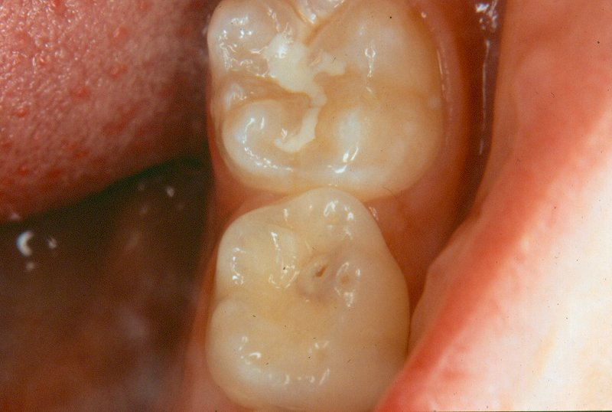
Surface code 2 – decayed into dentine

Slide 75
Surface code 2 – decayed into dentine
LLE –occlusal surface has a carious lesion into dentine
Lesion presents with small cavitated area in the centre surrounded by cream and grey shadowing beneath the enamel
Note that the tip of the cusp is worn and this would be regarded as normal.
Continued on next slide

Slide 76
Surface code 2 – decayed into dentine
LL6 – occlusal surface has a fissure sealant in place
Sealant is incomplete in that the distal part of the fissure is un-sealed.
However, as no caries into dentine or fillings are present, this surface would be coded as "$ - sealed surface, type unknown"

Slide 77
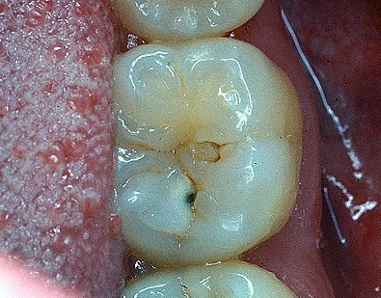
Surface code 2 – decayed into dentine

Slide 78
Surface code 2 – decayed into dentine
LL6 occlusal surface has a break in the enamel extending into dentine and a creamy shadowing
Occlusal code 2

Slide 79
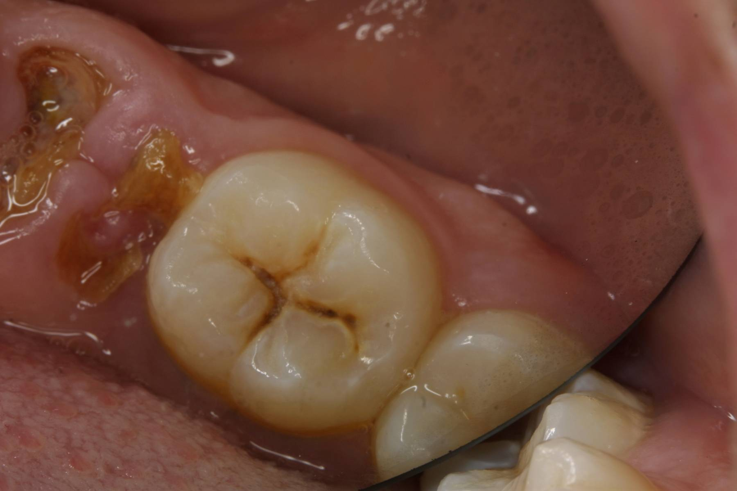
Surface code 2 – decayed into dentine

Slide 80
Surface code 2 – decayed into dentine
LLE is retained roots
LL6 has fissures which are widened due to carious breakdown
Occlusal scored 2

Slide 81
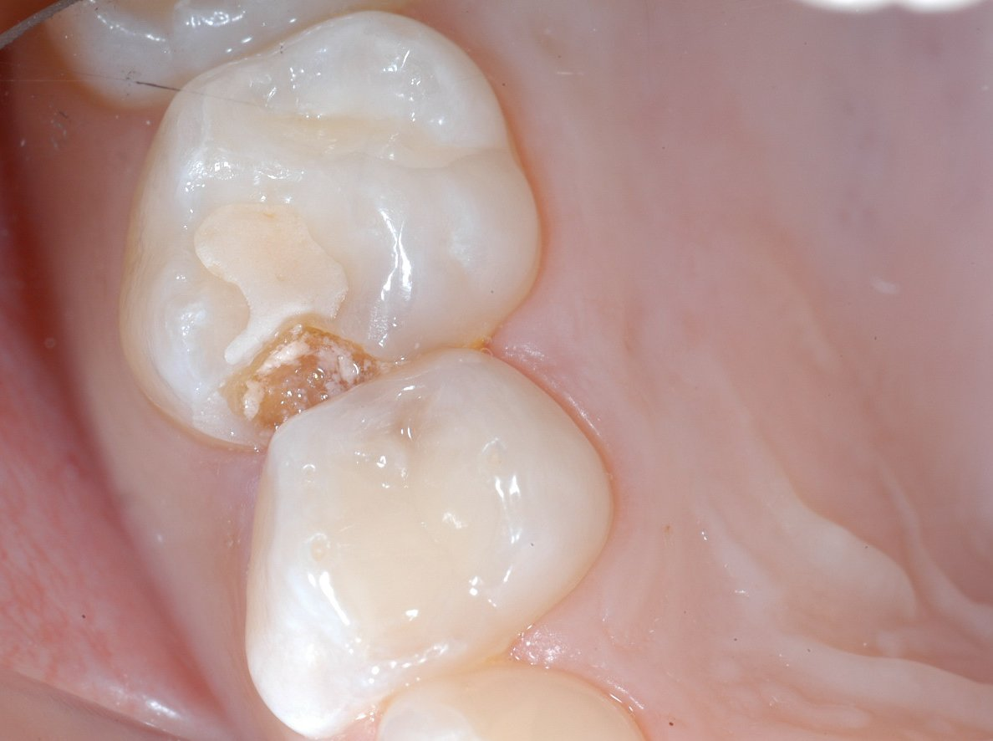
Surface code 2 – decayed into dentine

Slide 82
Surface code 2 – decayed into dentine
URE - glass ionomer material on the occlusal surface
fissure sealant + large carious lesion into dentine
occlusal and mesial both code 2 - decayed
URD has grey shadow within distal surface, dry and check before coding

Slide 83
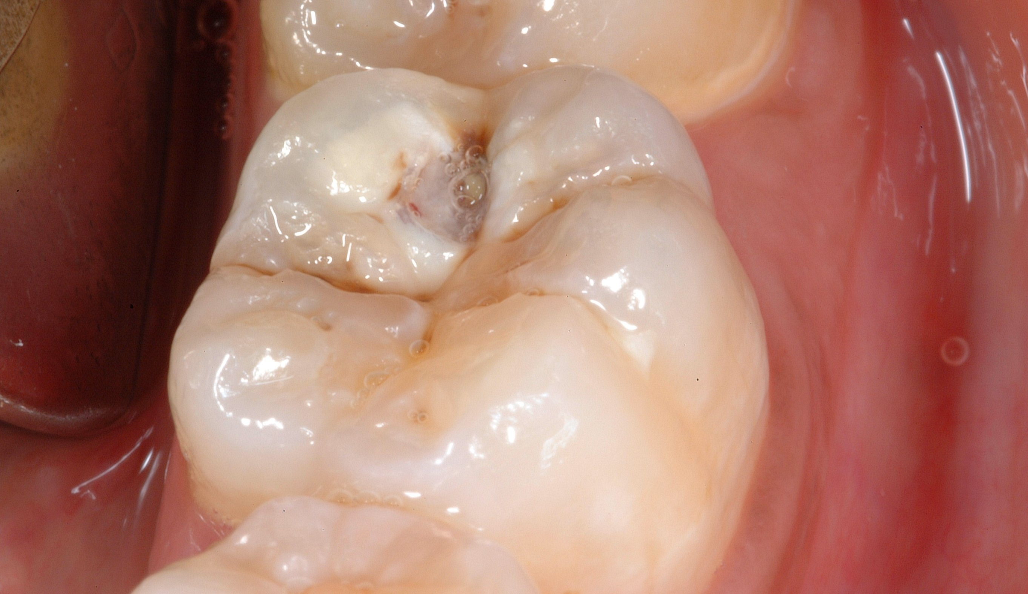
Surface code 2 into dentine OR code 3 decay with pulpal involvement ?- Discuss

Slide 84

Surface code 2 into dentine OR code 3 decay with pulpal involvement? - Discuss
Very large carious lesion into dentine
Large area of cavitation
Creamy opacity on lingual occlusal aspect
Grey shadowing involving most of disto-buccal cusp

Slide 85
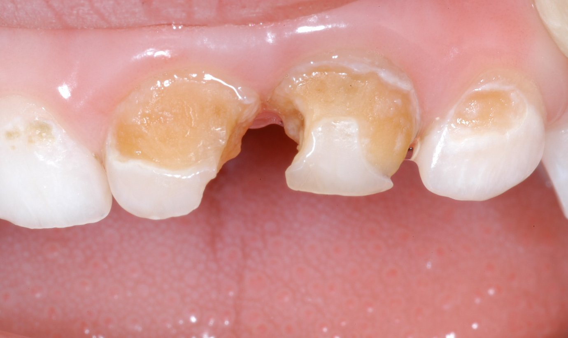
Surface code 3 – decay with pulpal involvement

Slide 86

Surface code 3 – decay with pulpal involvement
Upper anterior deciduous teeth decayed into dentine
Mesial surfaces of central incisors likely to be decayed with pulpal involvement, Code 3

Slide 87
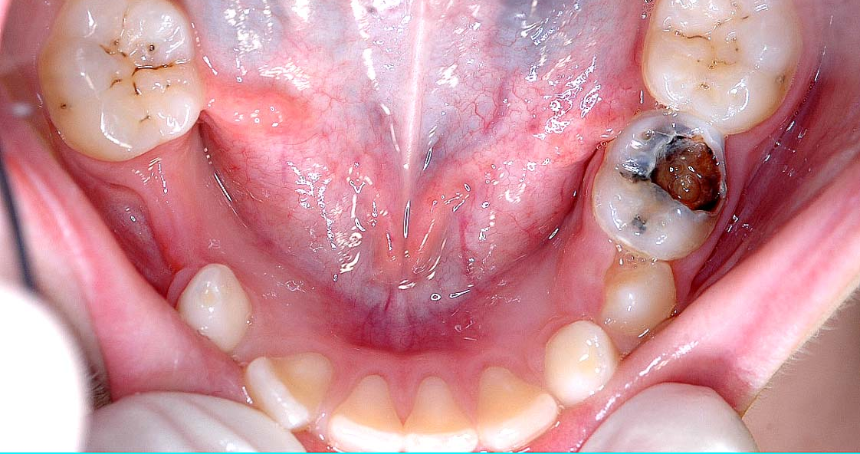
Surface code 3 – decay with pulpal involvement

Slide 88
Surface code 3 – decay with pulpal involvement
LLE is extensively decayed
Occlusal, buccal and distal code 3

Slide 89
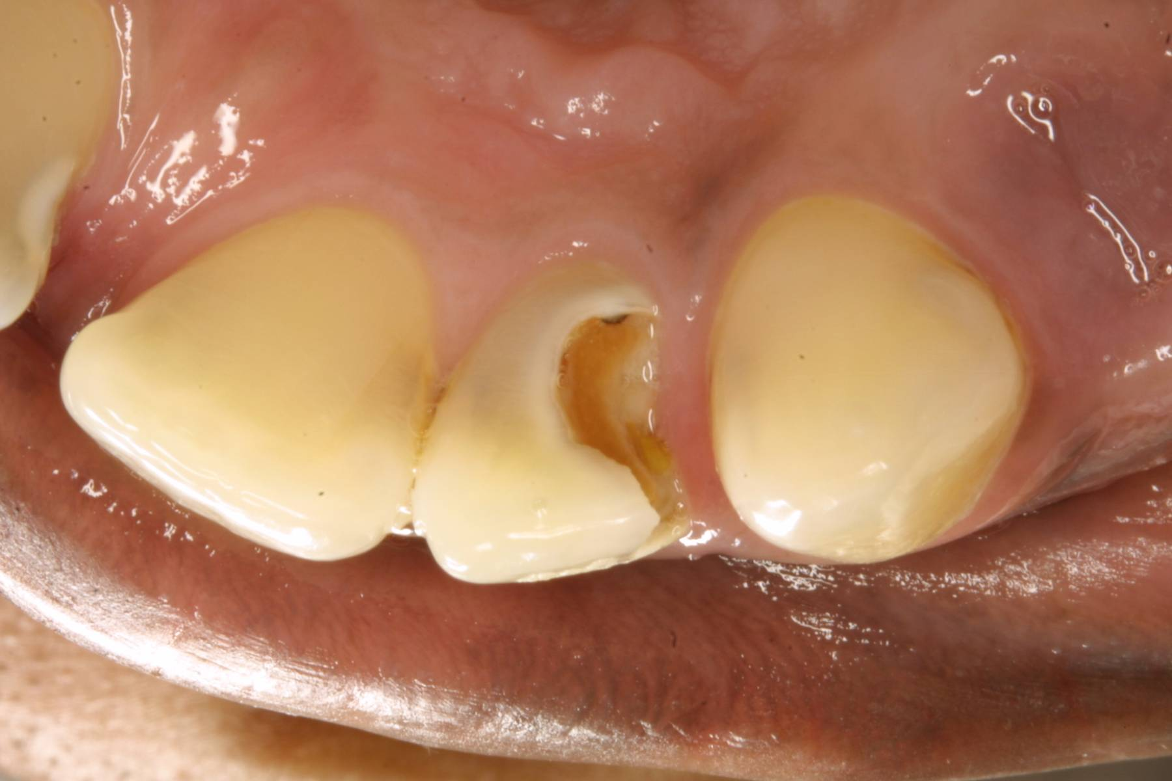
Surface code 3 – decay with pulpal involvement

Slide 90
Surface code 3 – decay with pulpal involvement
UR2 has a large carious lesion on the lingual and distal surfaces, code 3
Caries into dentine is present on adjacent teeth

Slide 91
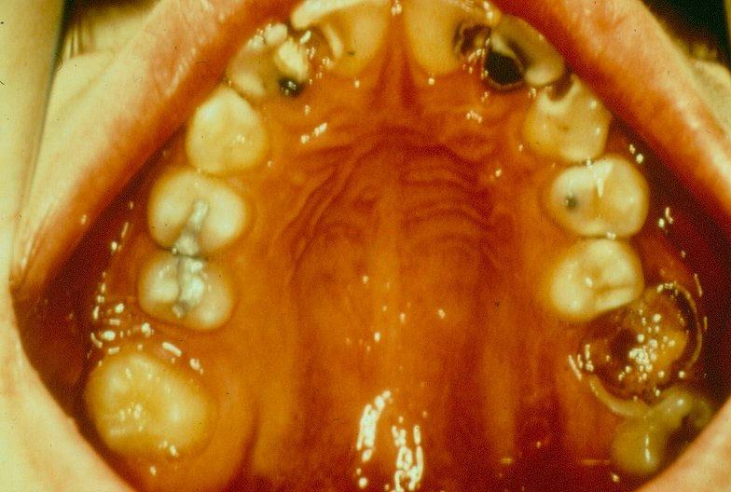
Surface code 3 – decay with pulpal involvement *

Slide 92
Surface code 3 – decay with pulpal involvement *
UR2, UR1, UL1 & UL2
surfaces all have large
carious lesions
involving the pulp.

Slide 93
Surface code 3 – decay with pulpal involvement *
Additional features to note:-
UR2 - mesial surface has large temporary dressing.
Caries is so extensive on this surface that code 3 would be assigned.
However, if temporary dressing was present without caries, surface would have been coded R – filled needs replacing.

Slide 94
Surface code 3 – decay with pulpal involvement *
Distal surface of UR2 has large carious lesion into dentine with no apparent surface destruction of enamel, characterised by a large creamy shadow beneath the enamel.
A similar lesion can be seen on the mesial of the UL4.
UR4 and UR5 are examples of tooth surfaces filled that have no decay and would be coded 5

Slide 95
Surface code 3 – decay with pulpal involvement *
UL6 would be coded as all surfaces 3.
UR6 has been extracted due to caries and is assigned tooth code 6.

Slide 96
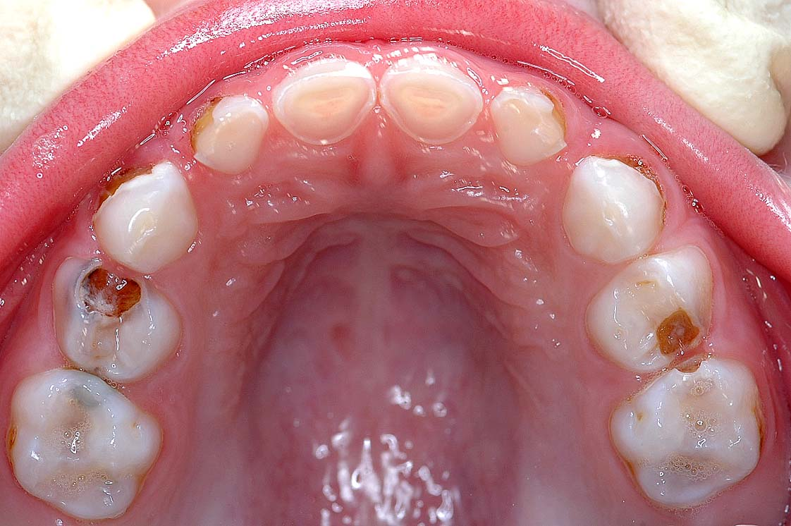
Surface code 3 – decay with pulpal involvement

Slide 97
Surface code 3 – decay with pulpal involvement
URD occlusal and mesial code 3
Discuss the many carious lesions on other teeth

Slide 98
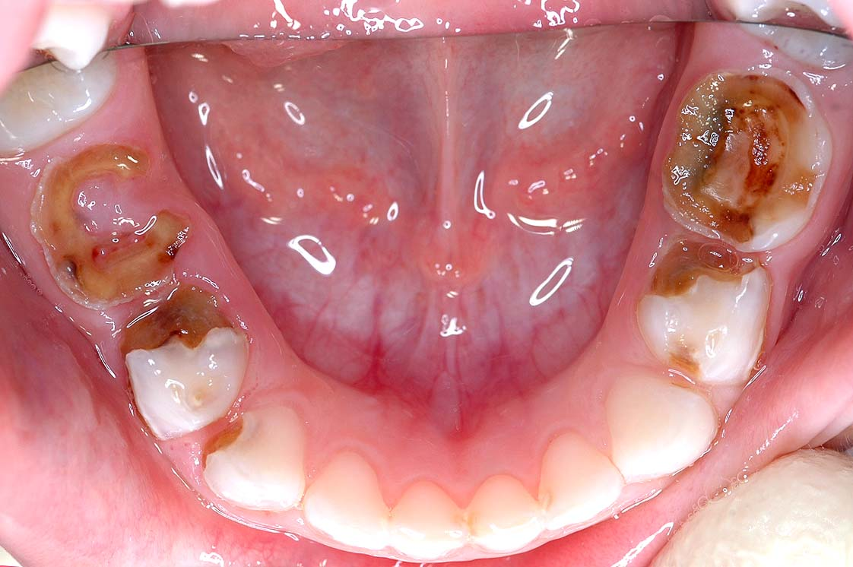
Surface code 3 – decay with pulpal involvement

Slide 99
Surface code 3 – decay with pulpal involvement
Lower molars all have lesions with pulpal involvement
Several lower incisors have approximal caries

Slide 100
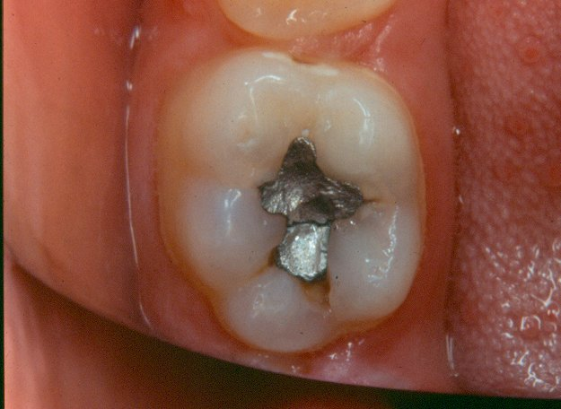
Surface code 4 – filled and decayed

Slide 101
Surface code 4 – filled and decayed
LL6 occlusal surface has been restored with amalgam which is fractured
There are 4 separate areas of secondary caries, i.e. caries associated with the filling.
Two of the carious areas are in the distal and disto-buccal parts of the fissure and are characterised by cavitation into dentine.
Continued on next slide

Slide 102
Surface code 4 – filled and decayed
Lingual aspect of occlusal surface has caries associated with the filling
This stained fissure has creamy shadowing beneath the enamel
Buccal aspect of occlusal filling has a cavitated area of secondary caries.
Surface is coded 4 – filled and decayed.
NB. If no caries was present and this filling presented with the complete fracture, the surface would have been coded R, which is filled needs replacing.

Slide 103
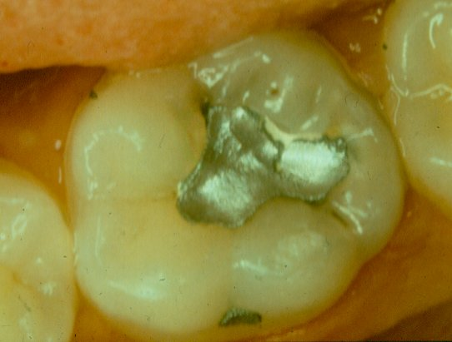
Surface code 4 – filled and decayed

Slide 104
Surface code 4 – filled and decayed
LL6 –occlusal surface is filled with amalgam.
Amalgam is chipped and fractured to expose the cement lining.
Lingual aspect of occlusal surface has creamy shadowing adjacent to the lost amalgam
Secondary caries associated with the filling – code 4

Slide 105
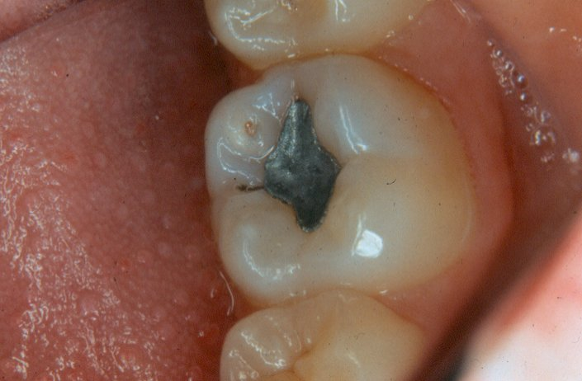
Surface code 4 – filled and decayed

Slide 106
Surface code 4 – filled and decayed
LL6 –occlusal surface has an amalgam filling
Filling is intact and there has been a separate second attack of caries on this surface
There is a small cavitated area with a cream shadow beneath the enamel indicating the extent of the lesion into dentine
Surface will be coded 4 – filled and decayed

Slide 107
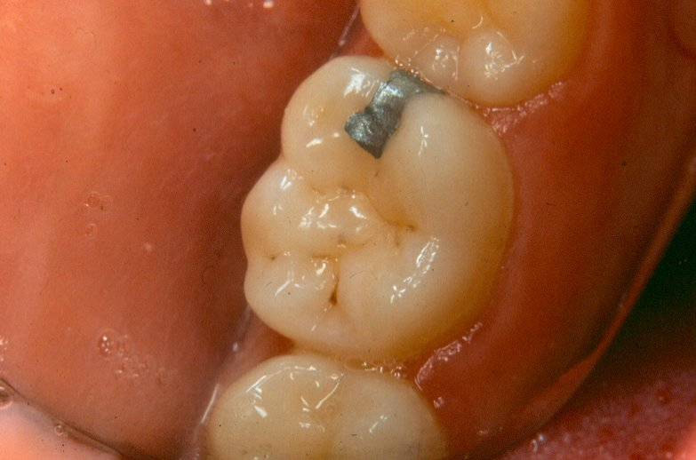
Surface code 5 – filled with no decay

Slide 108
Surface code 5 – filled with no decay
LL6 –amalgam filling on the mesial and occlusal surfaces
Filling is intact and there is no evidence of secondary caries.
Occlusal fissure system has areas of staining only.

Slide 109
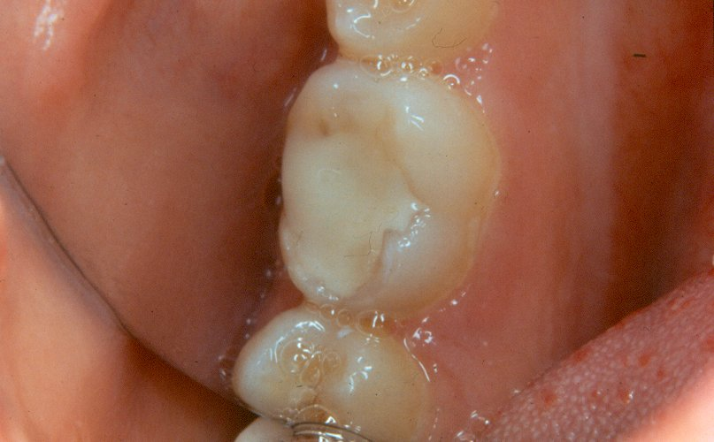
Surface code 5 – filled with no decay

Slide 110
Surface code 5 – filled with no decay
LR6 –occlusal surface has a conventional tooth coloured filling.
No evidence of decay and filling appears intact.
Occlusal surface will be coded 5.
Filling extends on to buccal surface but from this view, no judgement could be made as to the state of the filling and this surface would need to be viewed and scored separately.

Slide 111
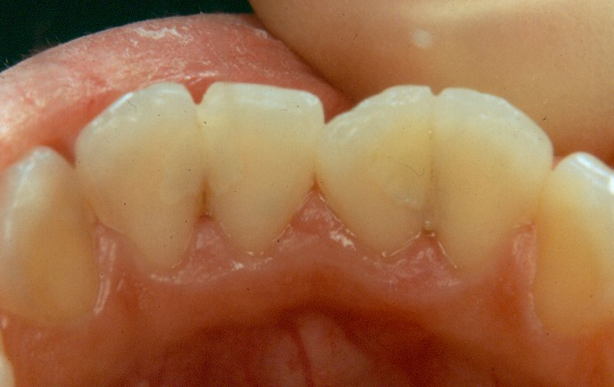
Surface code 5 – filled with no decay

Slide 112
Surface code 5 – filled with no decay
LR2, LR1, LL1 & LL2 – several intact tooth coloured fillings are present
e.g. mesial of LL2, distal of the LL1, distal of the LR1.
NB This slide should be used to emphasise the need for a careful systematic examination to avoid missing tooth coloured fillings and the call of “3 to 3 all surfaces sound” should be discouraged.

Slide 113
Surface code R – filled, needs replacing (not carious)
A filled surface which is judged to need replacing (not carious) is recorded as code R
Temporary dressings, with no decay into dentine present, are recorded as code R
Temporary dressings, with decay into dentine present, are recorded as code 4, filled and decayed

Slide 114
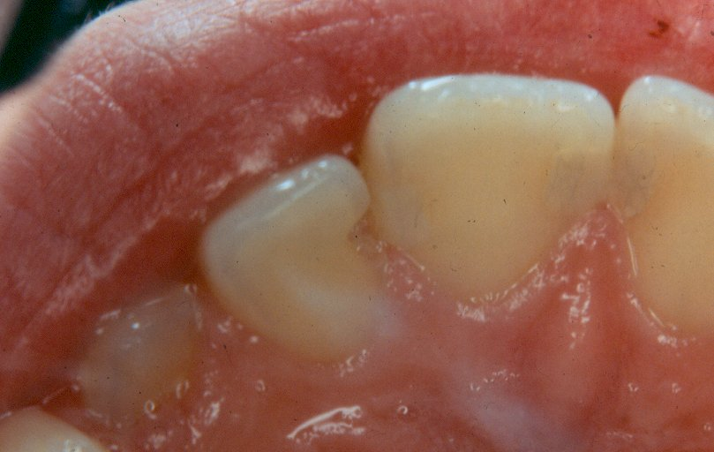
Surface code R – filled, needs replacing (not carious)

Slide 115
Surface code R – filled, needs replacing (not carious)
UR2 –mesial surface has had a filling which is completely lost
This is the most extreme form of a “defective” filling and would be scored as code R.
Additional features on this slide:
UR3 – all surfaces coded as sound.
UR1 – has a composite restoration on mesial surface -careful examination is needed to avoid missing these restorations.

Slide 116
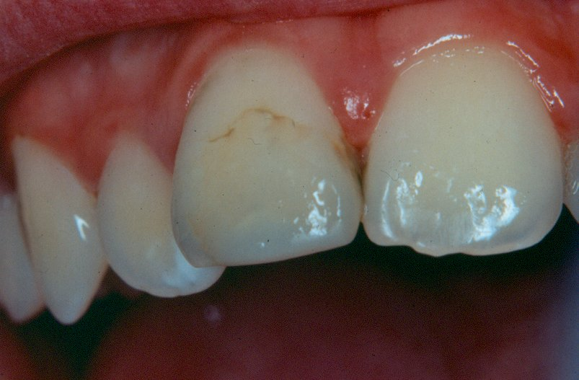
Surface code R – filled, needs replacing (not carious) or filled with no decay?*

Slide 117
Surface code R – filled, needs replacing (not carious) or filled with no decay?*
UR1 buccal surface – there is a stained edge to the incisal aspect of this tooth coloured filling.
Edge could probably be polished to achieve satisfactory aesthetics without replacement of the restoration.
Code R should really be used for restorations where the majority of dentists would agree replacement was indicated.
Advise surface is coded 5

Slide 118
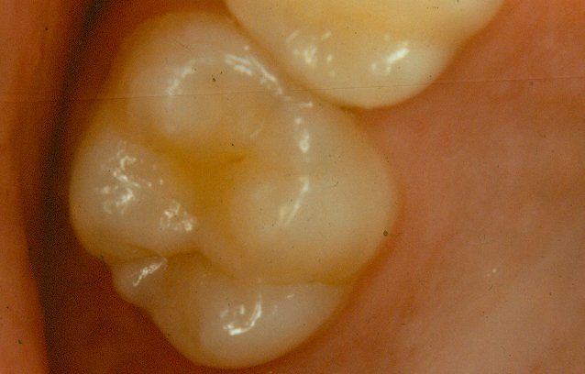
Surface code $ - sealed surface, type unknown

Slide 119
Surface code $ - sealed surface, type unknown
UR6 –anterior part of the occlusal fissure has been sealed with a tinted sealant
Surface would be coded $
Sealant appears to be lost from the posterior occlusal fissure.
NB Sealants can be difficult to distinguish from enamel and diagnosis may be aided by the use of drying and/or tactile use of the ball-ended probe.

Slide 120

Surface code $ - sealed surface, type unknown

Slide 121
Surface code $ - sealed surface, type unknown
UL4 &UL5 –occlusal surfaces have been sealed
Surfaces would be scored $
It is impossible to be certain from a visual examination that no caries was removed before placement of the sealant.
However, there is no evidence of a defined cavity margin and therefore, the surfaces are coded $.

Slide 122

Surface code $ - sealed surface, type unknown

Slide 123
Surface code $ - sealed surface, type unknown
UL6 –occlusal surface would be scored as $ because there is evidence of a sealant in part of the anterior fissure
In the distal part of the occlusal fissure, staining is evident
However, there is no evidence of caries into dentine and occlusal surface would therefore be scored as $.

Slide 124

Surface code N – obvious sealant restoration

Slide 125
Surface code N – obvious sealant restoration
LL6 –occlusal surface has a sealant restoration
Anterior part of occlusal fissure has a tooth coloured filling material which has been placed and there is evidence of a defined cavity margin.
The rest of the fissure system is sealed.
NB Mesial surface has a carious lesion into dentine and would be scored as 2. Lesion presents as cream shadow beneath the enamel extending from the marginal ridge. Physical cavitation can be seen at base of lesion on the mesial aspect.

Slide 126
Code C, crown
Crowned teeth are scored all surfaces code C
This is irrespective of the reasons leading to the placement of the crown
A tooth covered with a stainless steel crown is recorded as all surfaces Code C, not Code 5

Slide 127

Code C, crown/advanced restorative care

Slide 128

Code C, crown/advanced restorative care
UL6 UR6 full metal crowns
all surfaces code C

Slide 129

Code 9, unrecordable

Slide 130
Code 9, unrecordable
UR3 –lingual surface of forms the retainer for the pontic, replacing the UR2
Lingual surface of UR3 is coded as 9
UR2 – missing code 8 or T
The other surfaces are coded separately according to their caries status.

Slide 131
Plaque examination
Ask child to bite together
Lift upper lip
Look at buccal surfaces of upper canine to upper canine
Only record easily visible plaque
Ignore food debris

Slide 132

Plaque
Code 0 : Teeth appear clean Code 1 : ≤⅓ labial surfaces
Code 2 : >⅓ and ≤⅔ labial surfaces Code 3 : >⅔ labial surfaces
Code 9 : No assessment could be made

Slide 133


pufa/PUFA – Pulp
Monse B, Heinrich-Weltzien R, Benzian H, Holmgren C, van Palenstein
Helderman W. PUFA – An index of clinical consequences of untreated dental
caries. Community Dent Oral Epidemiol 2010; 38: 77–82.

Slide 134


pufa/PUFA - Ulceration
Monse B, Heinrich-Weltzien R, Benzian H, Holmgren C, van Palenstein
Helderman W. PUFA – An index of clinical consequences of untreated dental
caries. Community Dent Oral Epidemiol 2010; 38: 77–82.

Slide 135


pufa/PUFA - Fistula
Monse B, Heinrich-Weltzien R, Benzian H, Holmgren C, van Palenstein
Helderman W. PUFA – An index of clinical consequences of untreated dental
caries. Community Dent Oral Epidemiol 2010; 38: 77–82.

Slide 136


pufa/PUFA - Abcess
Monse B, Heinrich-Weltzien R, Benzian H, Holmgren C, van Palenstein
Helderman W. PUFA – An index of clinical consequences of untreated dental
caries. Community Dent Oral Epidemiol 2010; 38: 77–82.

Slide 137
Diffuse Symmetrical White Patches
Calibration for the most commonly used tooth/surface measures of dental fluorosis usually takes days
For this survey, we are interested to pragmatically collect information to estimate obvious dental fluorosis
Examiners will record a simple ‘yes’ or ‘no’ to indicate whether a child has obvious diffuse and symmetrical white patches in line with the presentation of dental fluorosis

Slide 138

Diffuse Symmetrical White Patches
These white patches have distinct edges (ie not diffuse) and are not symmetrical (ie don’t appear on both central incisors)

Slide 139

Diffuse Symmetrical White Patches
No obvious diffuse symmetrical white patches present
Notes:
In this image there are no obvious diffuse and symmetrical white patches and this would be recorded as a ‘no’.
With good lighting and with the image magnified as you might see it now in training you might be able to see very light striated white patches near the incisal edges. However, just like for the recording of dental caries, where we record only obvious dentinal caries in this survey, we are interested to record only where there are clear and obvious diffuse symmetrical white patches. As with caries, if in doubt score low and record a ‘yes’ only where you are certain.
So, compare this picture with that in the next slide which shows obvious white patches which are diffuse and symmetrical in line with the presentation of dental fluorosis.

Slide 140

Diffuse Symmetrical White Patches
This slide shows mild fluorosis. The white patches are seen on both sides of the mouth (ie symmetrical presentation)
Notes:
In comparison to the last slide, here you can see much more clear and obvious white patches on the front teeth which appear on both sides of the mouth symmetrically (they do not need to be identical on both sides). This is a typical presentation of mild fluorosis and would be recorded as a ‘yes’ in answer to the question about the presence of diffuse symmetrical white patches. It is worth noting that in less mild cases of fluorosis there may be white and brown patches of affected enamel.

Slide 141

Diffuse Symmetrical White Patches
Diffuse white patches and lines can be seen across most of the labial surfaces of the upper central incisors
Notes:
Diffuse white patches and lines can be seen across most of the labial surfaces of the upper central incisors in this image. In this case the presentation of mild fluorosis is striated, with lots of fine white lines as well as diffuse patches. It is mild in nature but can be seen in multiple teeth on both sides of the mouth.
In this image you can also see a few well-demarcated white spots, on the central incisor on the left side of the image, as well as on the two lower central incisors. These are not related to fluorosis so it should be remembered that fluorosis can co-exist on tooth surfaces with other conditions.

Slide 142

The examination completed
Please remember that at the end of every diagnostic decision on every tooth is a child
Call the child by their name, thank the child and as the examination is completed, talk to the child until the next examiner is ready

Slide 143

The examination completed

