Slide 1
HIV in the United Kingdom 2019 slide set a Slide set to accompany: - Annual HIV data tables (published online September 2019) - Annual HIV report (published online January 2020)
HIV and AIDS Reporting Section
National Infection Service
Public Health England
Notes:
1

Slide 2
HIV prevalence, incidence and care

Slide 3
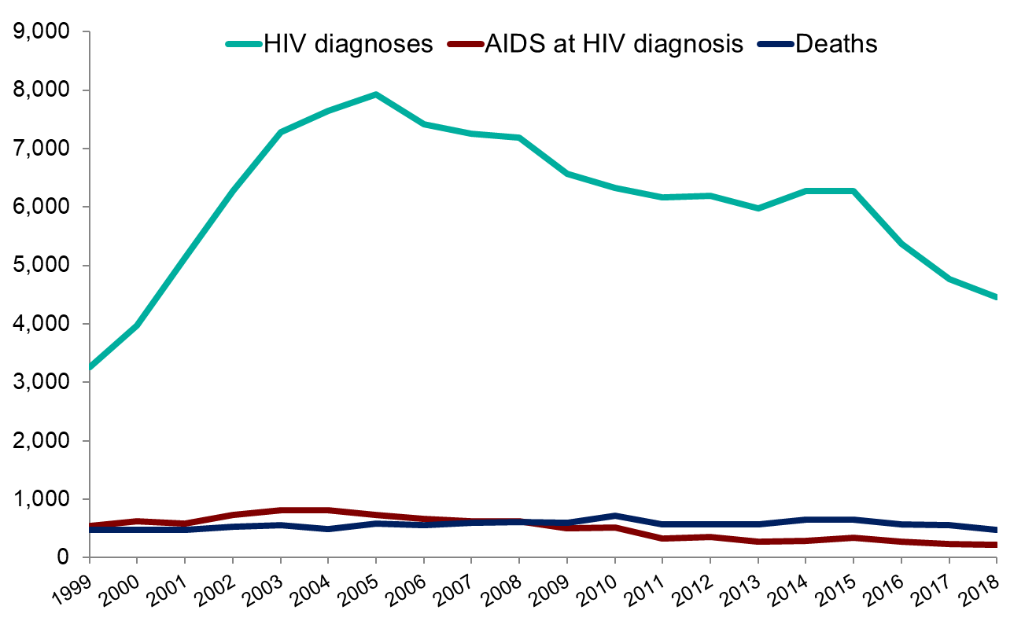
Number of people newly diagnosed with HIV and AIDS, and all-cause deaths: United Kingdom, 1999 to 2018
3
Notes:
In 2018, 4,453 people (3,266 men and 1,185 women) were newly diagnosed with HIV in the United Kingdom (UK). The number of new diagnoses in the UK has continued to decline since a peak in 2005 (7,929). This is largely due to fewer diagnoses among gay and bisexual men in the most recent years. Reports of AIDS and all-cause deaths among people diagnosed with HIV have remained low since the introduction of effective antiretroviral therapy in the mid-1990s.
3

Slide 4
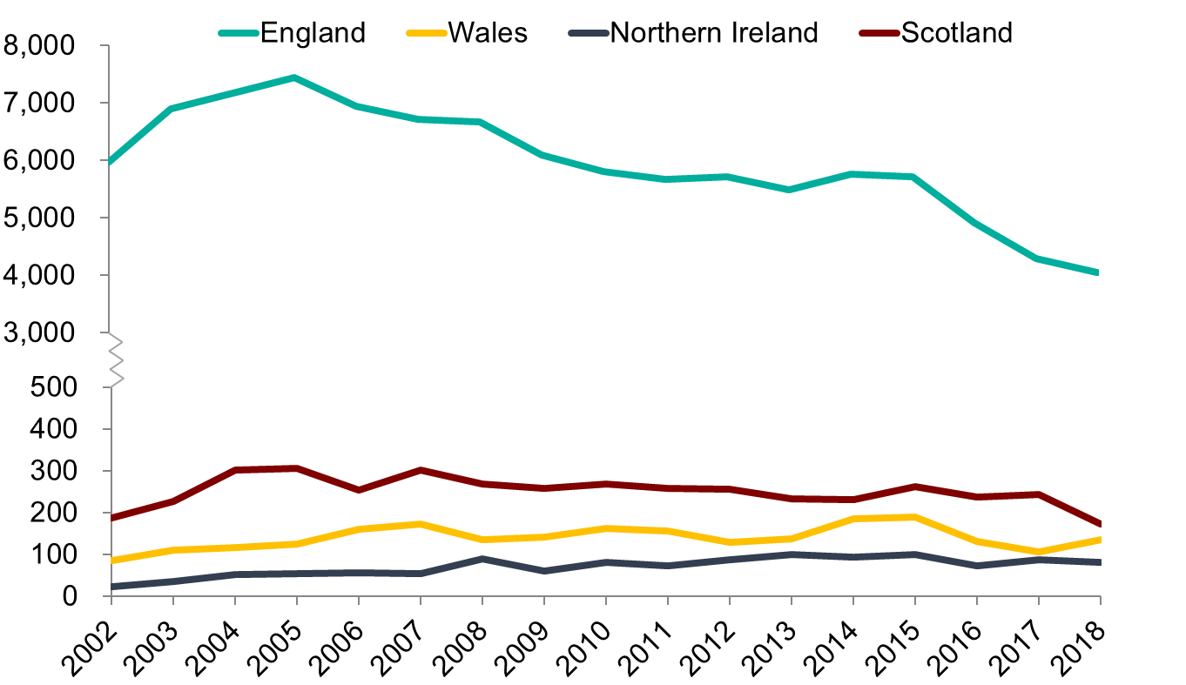
Number of people newly diagnosed with HIV by country of residence: United Kingdom, 2002 to 2018
4
Notes:
The number of people newly diagnosed with HIV in England has steadily declined since 2005, with a more rapid decrease being observed between 2015 and 2018. Outside of England, numbers remain low, but decreases in the number of people newly diagnosed with HIV were also seen in Wales and Scotland.
4

Slide 5
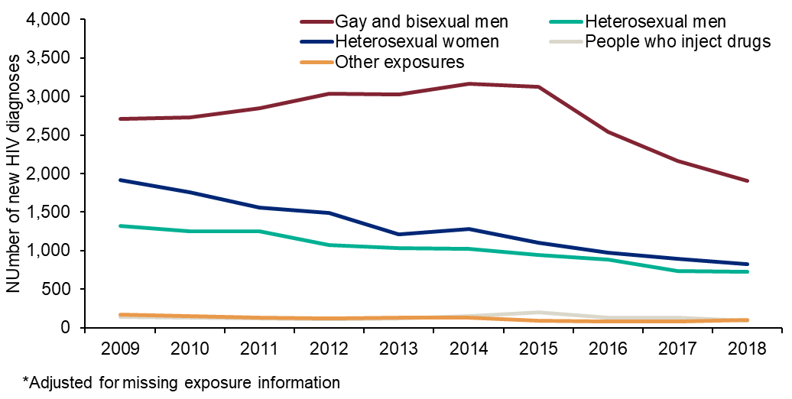
Number of people newly diagnosed with HIV by exposure-group¹: United Kingdom, 2009 to 2018
¹ Figures have been adjusted for missing exposure information
5
Notes:
The total of 4,453 HIV new diagnoses in 2018 represent a 32% decline over the last decade from the 6,565 diagnoses reported in 2009 . This decline is due to a continued sharp decrease in diagnoses in GBM from 2015, and a more gradual decline in diagnoses in both men and women who acquired HIV heterosexually.
5

Slide 6
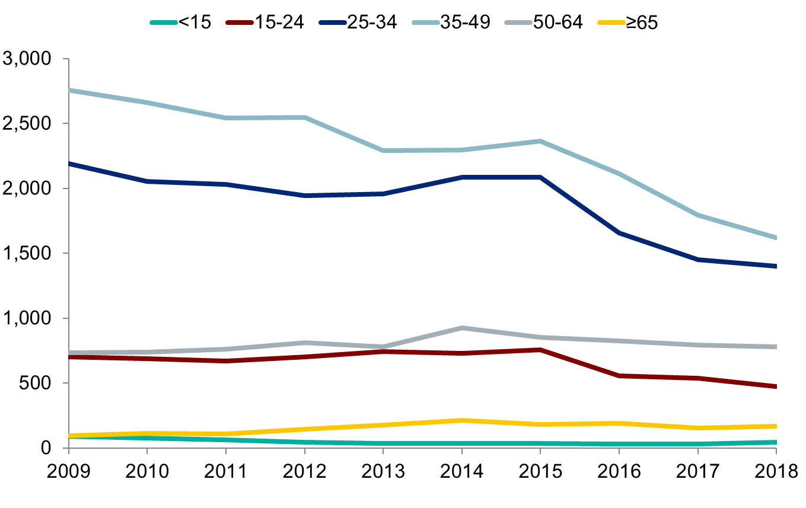
Number of people newly diagnosed with HIV by age-group: United Kingdom, 2009 to 2018
6
Notes:
Over the past decade, most people newly diagnosed with HIV were aged between 25 and 49 years. Large declines in the number of diagnoses in the 25-34 age group were observed between 2015 and 2018, decreasing from 2,085 to 1,393. The number of diagnoses among people aged 35-49 years saw a similar decline in these years, from 2,363 to 1,607. While numbers remain low, the number of new HIV diagnoses in aged 65 years and above has increased from 96 in 2009 to 166 in 2018.
6

Slide 7
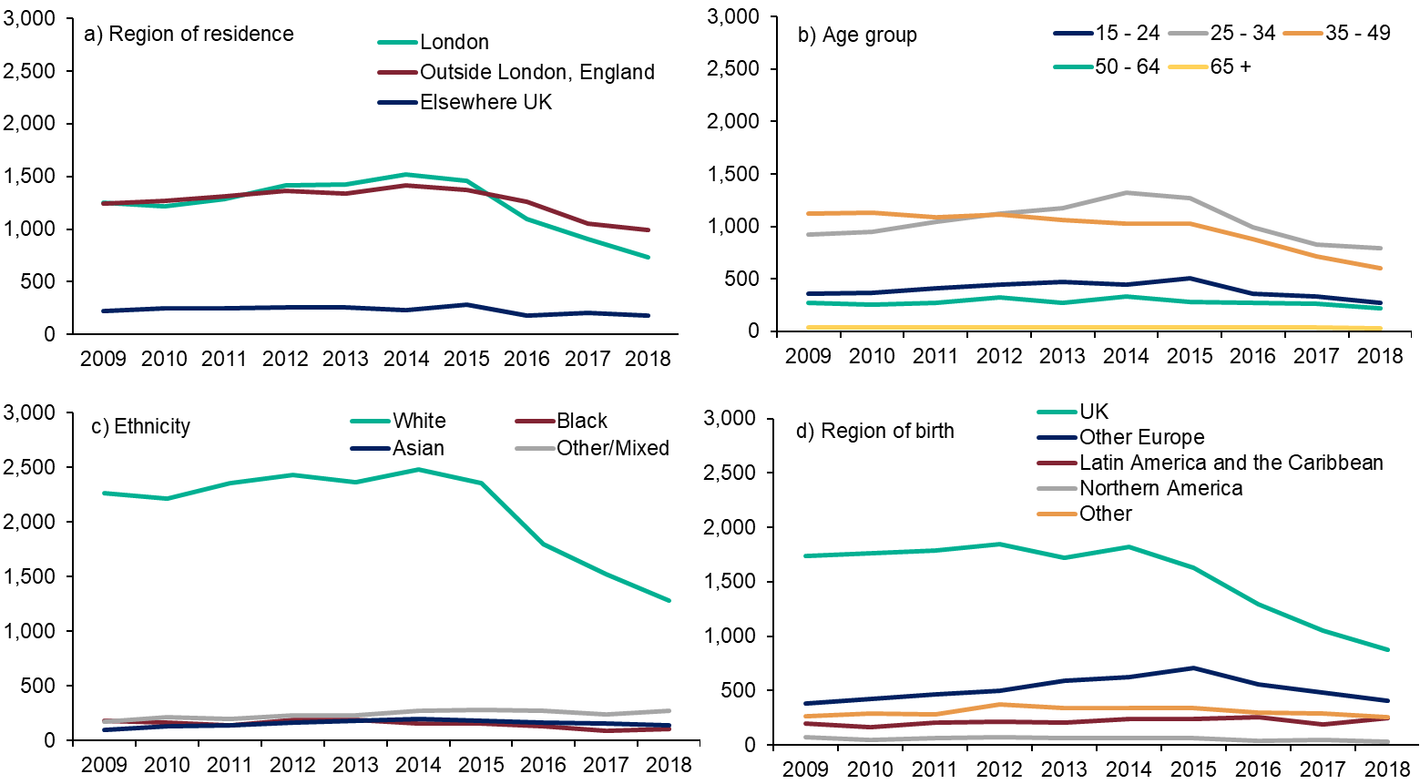
Number of HIV diagnoses among Gay and Bisexual men, by population characteristics: UK, 2009 to 2018
7
Notes:
While a decline in new HIV diagnoses among gay and bisexual men have been observed in in the majority of areas of the UK, the sharpest decline was observed in London where numbers have fallen from 904 in 2017 to 736 in 2018. The drop in the new HIV diagnoses among gay and bisexual men in London has had a significant impact on the overall numbers of new HIV diagnoses in the most recent years (Figure a).
Almost three-quarters of GBM newly diagnosed in 2018 were aged 25 to 49 years (73%, 1,393/1,908) with a median age at diagnosis of 33 years (inter-quartile range (IQR) 27 to 43); this has not changed substantially over the past 10 years. Across age groups, between 2014 and 2018, the steepest decline in HIV diagnoses among GBM was observed among those aged 15 to 24 years (47%, 505 to 269), followed by 35 to 49 years (42%, 1,027 to 597), 25 to 34 years (37%, 1,269 to 796), 65+ (25%, 40 to 30) and 50-64 (23%, 280 to 216) (Figure b).
In 2018, 71% of newly diagnosed GBM were of white ethnicity, and the observed number of new diagnoses among white GBM declined by 46% since 2015 (2,353 to 1,276). The overall numbers of black, Asian and minority ethnic (BAME) GBM newly diagnosed with HIV were lower, and declines were also observed relative to 2015 among black men (35%, 156 to 101) and Asian men (23%, 176 to 136). New diagnoses among GBM of other/mixed ethnicity has remained stable (1.4%, 277 to 273) (Figure c).
Almost three quarters (71%, 1,276/1807) of newly diagnosed GBM in 2018 were born in the UK or elsewhere in Europe. Both groups experienced a decline in HIV diagnoses since 2015; 1,627 to 873 (46%) in UK-born men and 705 to 403 (40%) among men born elsewhere in Europe. New diagnoses among GBM born in Northern America declined from 67 to 27 since 2015 (60%), by 42% among GBM born in Oceania (50 to 29), by 25% among GBM born in Asia (203 to 153) and by 9% among GBM born in Africa (85 to 77). New HIV diagnoses among GBM born in Latin America and the Caribbean has remained stable since 2015 and compromised 14% (245) of diagnoses among GBM in 2018 (Figure d).
7

Slide 8
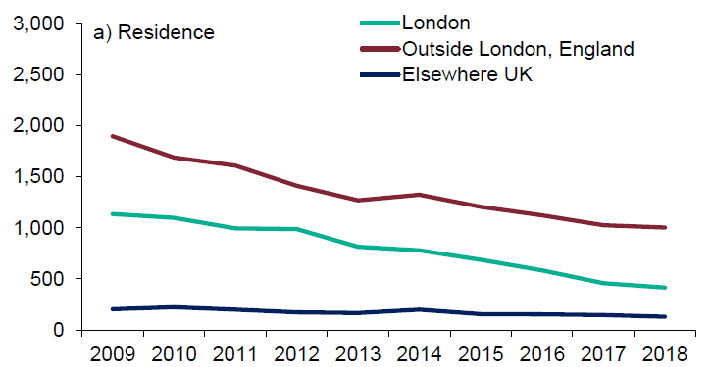
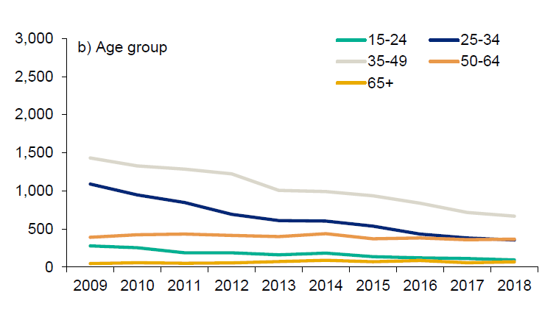
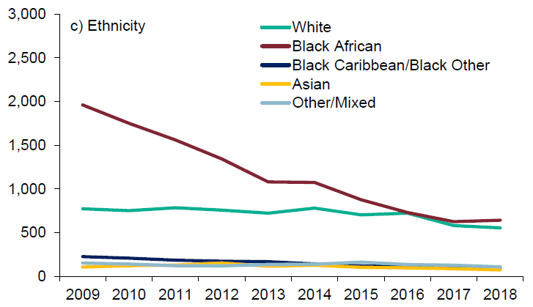
Number of HIV diagnoses* among men and women who acquired HIV heterosexually, by population characteristics: UK, 2009 to 2018
*Observed data, not adjusted for missing information
8
Notes:
The decline over the last decade was particularly steep among residents in London (63%, from 1,135 to 416) (Figure a).
The steepest decline in new HIV diagnoses over the last decade was observed among men and women who acquired HIV heterosexually aged 25 to 34 years (67%, 1,089 to 355), followed by 15-24 year olds (66%, 278 to 94). The median age at diagnosis in 2018 was 45 years (IQR: 36 to 53 years) among men and 39 years (IQR: 31 to 49 years) among women. In 2009, the median age at diagnosis was 40 years (IQR: 33 to 47 years) and 34 years (IQR: 29 to 41 years) respectively. Overall, in 2018, 34% (246/724) of men were aged 50 years or over at the time of their diagnosis, in comparison to 23% (187/826) of women. These figures compare to 19% (253/1,320) and 10% (184/1,916) in 2009, respectively (Figure b).
Black African men and women comprised 44% (643/1,477) of new HIV diagnoses among adults who acquired HIV heterosexually in 2018, compared to 61% (1,961/3,219) of new diagnoses in 2009, representing a 67% decline (643 to 1,961). However, it should be noted that the decline has levelled off since 2017 (626) and 2018 (643). Over the same time, diagnoses among black Caribbean men and women who acquired HIV heterosexually also declined, from 141 in 2009 to 46 in 2018 (67% fall). Men and women who acquired HIV heterosexually and were of white ethnicity comprised 38% (555/1,477) of new diagnoses in 2018, compared to 24% (773/3,219) in 2009 (Figure c).
In 2018, almost half (47%, 698/1,475) of men and women diagnosed with HIV in the UK who acquired HIV heterosexually were born in a country of high HIV prevalence (Appendix X); 31% (452) were born in the UK. The equivalent figures for 2009 were 63% (1,989/3,137) and 23% (731) respectively. Most people diagnosed in 2018 and born in a high prevalence country were of black African ethnicity (81%, 550/678); the majority of those born in the UK were white (83% 366/439) (Figure d).
8

Slide 9
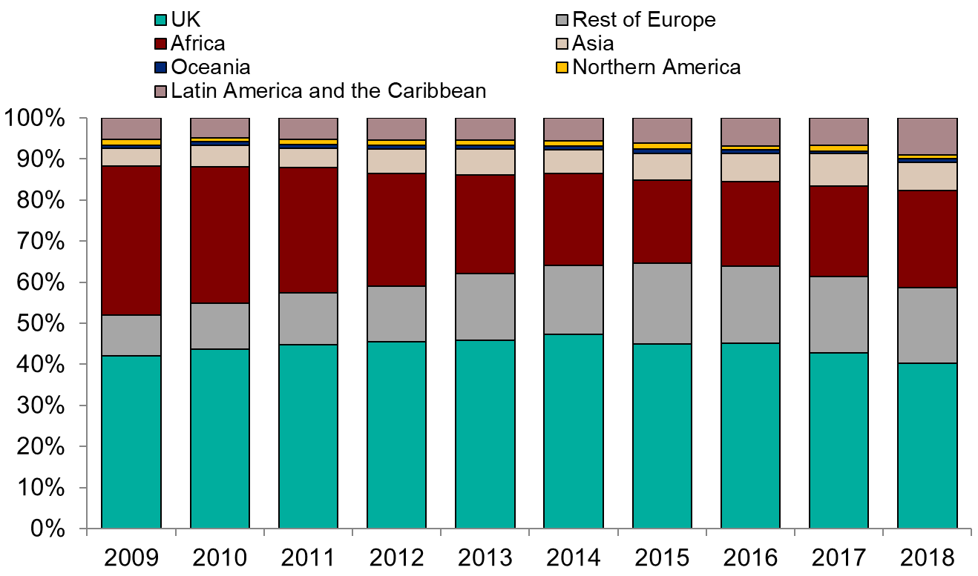
Proportion of people newly diagnosed with HIV by world region of birth: United Kingdom, 2009 to 2018
9
Notes:
While overall numbers have decreased in all groups, the proportion of people newly diagnosed with HIV who were born in the UK has slightly decreased from 2,767 in 2014 to 1,530 in 2018. Over the past decade, there has been a continued decline in the number of new HIV diagnoses among people born in Africa (from 2,281 in 2009 to 903 in 2018).
Over the past decade, the proportion of people newly diagnosed with HIV who were born in the UK has slightly decreased from 42% (2,644/6,293) of all diagnoses in 2009 to 40% (1,530/3,799) in 2018, although overall numbers have fallen (figures exclude those with missing country of birth information). Over the same time period, the proportion of people newly diagnosed with HIV who were born in Africa decreased from 36% (2,281/6,293) in 2009 to 24% (903/3,799) in 2018
9

Slide 10
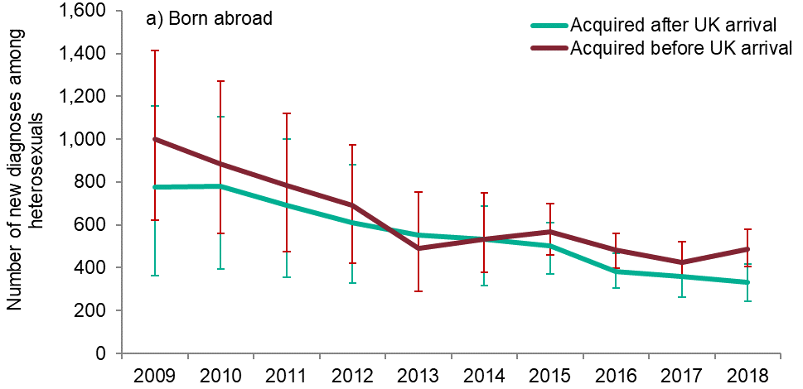
Estimated number of new diagnoses among men and women who acquired HIV heterosexually, by those who acquired in the UK and abroad and born abroad: UK, 2009 to 2018
10
Notes:
By assigning probable country of infection based upon information on CD4 decline and year of UK arrival, the number people who acquired HIV heterosexually and who are likely to have acquired HIV after arrival to the UK can be estimated (14). The model estimated a decline in infections acquired post migration among those born abroad from 777 (uncertainty range 364 to 1,155) in 2009 to 332 (uncertainty range 242 to 417) in 2018 and a decline of infection acquired before UK arrival from 1,000 (uncertainty range 622 to 1,413) to 489 (uncertainty range 404 to 579) over the same time
10

Slide 11
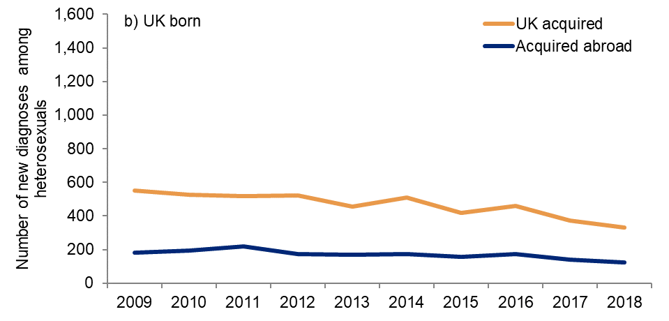
Estimated number of new diagnoses among men and women who acquired HIV heterosexually, by those who acquired in the UK and abroad and born in the UK: UK, 2009 to 2018
11
Notes:
Among those UK born, infections acquired abroad remained low and stable while a decline was observed from 550 in 2008 to 330 in 2017 for UK-acquired infections.
11

Slide 12
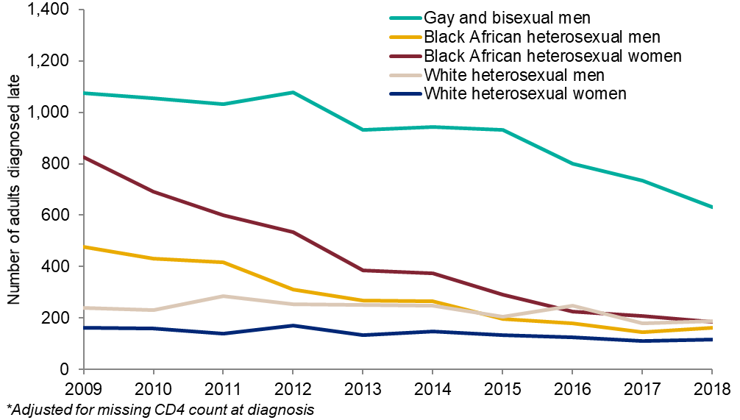
Adjusted* number of people diagnosed late by exposure group: UK, 2009 to 2018
12
Notes:
. The number of late diagnoses among all men and women who acquired HIV heterosexually has more than halved between 2009 and 2018 (from 2,000 to 836) and in 2018 the proportion diagnosed late among this group was 54% (836/1,550). The decline in the number of late diagnoses was most marked among black African women (78% decline, from 827 to 185) and men (66%, from 476 to 164) who acquired HIV heterosexually, although the proportion diagnosed late still remained high in these groups in 2018 (47%, 185/390 and 65%, 164/253, respectively). In contrast, the number of white men and women who acquired HIV heterosexually diagnosed late has declined less steeply over the past decade (22%, 241 to 187 and 28%, 161 to 116, respectively) and the proportions of late diagnoses among white men and women who acquired HIV heterosexually in 2018 were 59% (187/318) and 49% (116/237) respectively. Between 2009 and 2018, late diagnoses declined by 35% among PWID (71 to 46) and in 2018, 58% were diagnosed late. A 63% decline in GBM diagnosed late was observed over the same period (1,703 to 631), and in 2018, a third (631/1,908) were diagnosed late.
12

Slide 13
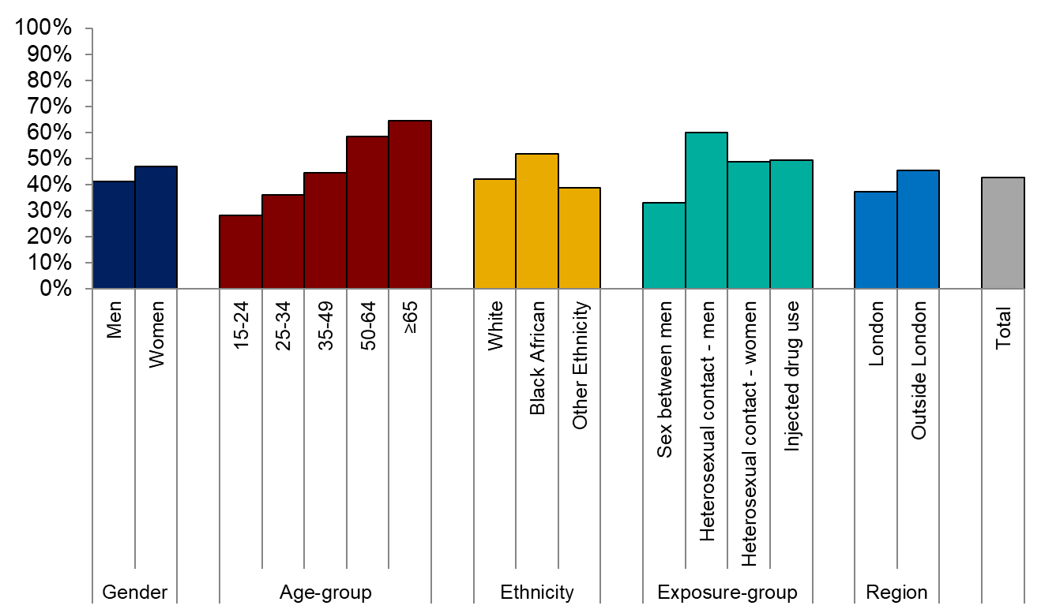
Proportion of people¹ diagnosed late with HIV by gender, age-group, ethnicity, exposure-group and area of residence: United Kingdom, 2018
¹ Includes people aged 15 and older
13
Notes:
Late HIV diagnosis is defined as a CD4 count <350 cells/mm³ within three months of diagnosis. Data for 2018 show that women, older age-groups (aged 50+) and people of black African ethnicity were more likely to be diagnosed at a late stage compared to men, younger age groups (aged 15-49) and people of white or other ethnicity.
In 2018, 60% of men exposed through heterosexual contact and 49% of women exposed through heterosexual contact were diagnosed at a late stage compared to 33% of gay and bisexual men.
13

Slide 14
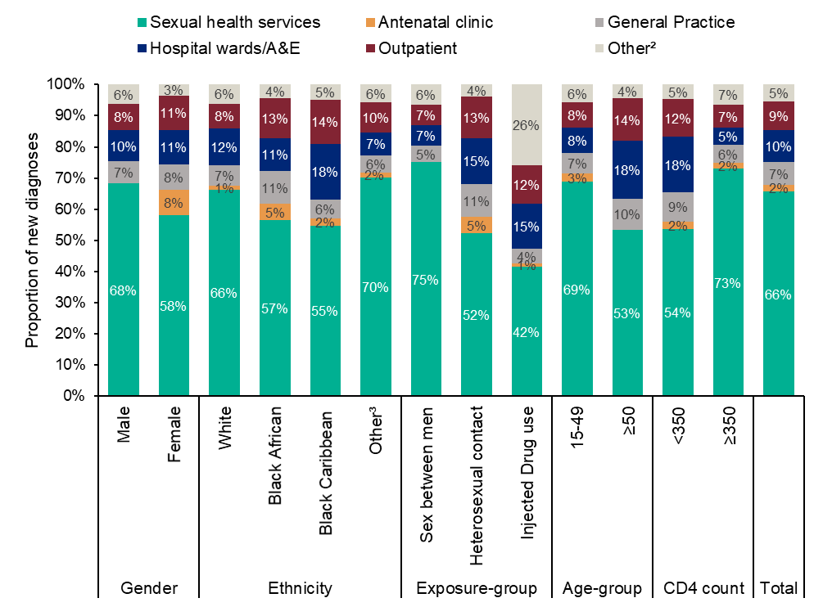
Setting of first positive test among adults newly diagnosed with HIV by population group¹: UK, 2018
¹ Among new HIV diagnoses with setting of diagnosis reported (n=4,019)
² Other diagnoses settings include: drug misuse services, prisons, blood transfusion service, community service, self-testing, self-sampling, private medical clinics and other services not specified.
³ Other ethnic groups include: black - other, Asian, mixed and other ethnicity.
14
Notes:
The setting of first positive test was reported for 91% (4,019/4,409) of adults (aged ≥ 15 years) newly diagnosed with HIV in the UK in 2018. Most adults (66%, 2,641/4,019) in the UK continue to have their first positive HIV test in sexual health services (SHS), followed by hospital wards/accident and emergency (A&E) (10%, 415/4,019), general practice (7%, 294/4,019) and outpatient services (8%, 303/4,019) (Figure 8). Key groups most likely to have been diagnosed outside of SHS include: women (42%, 432/1,030), people of black Caribbean ethnicity (45%, 38/84), PWID (58%, 52/89), people aged 50 years and above (47%, 376/807) and people diagnosed late with HIV (46%, 658/1,411).
14

Slide 15
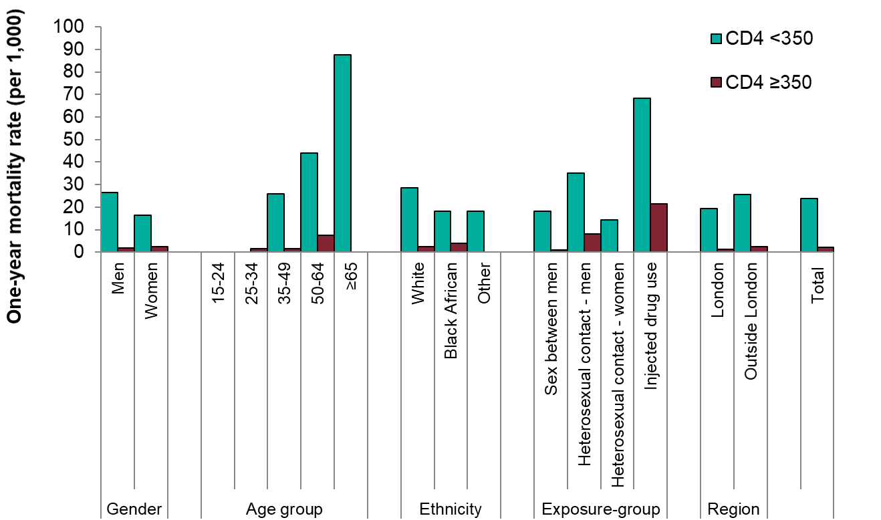
One-year mortality (per 1,000) among people¹ newly diagnosed with HIV by CD4 count at diagnosis: United Kingdom, 2018
¹ Includes people aged 15 and older
15
Notes:
The rate of one year mortality was 24 per 1,000 among those diagnosed late compared to 2 per 1,000 among those diagnosed promptly. The impact of late HIV diagnosis on one-year mortality was particularly marked among people aged 65 years and over.
15

Slide 16
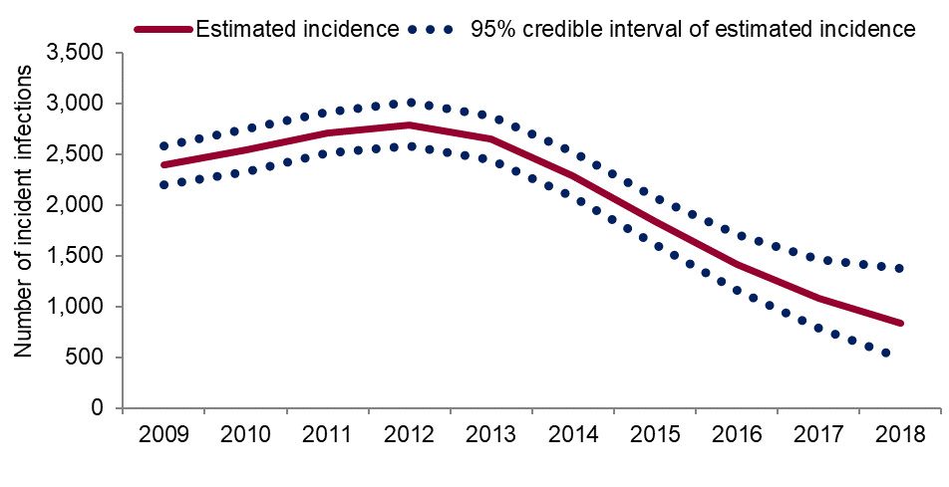
Estimates of HIV incidence in gay and bisexual men: England, 2009 to 2018
16
Notes:
A CD4 back-calculation model is used to estimate HIV incidence among GBM living in England; the model has now been extended to account for the increased probability of diagnosis following acquiring infection. The estimated number of new infections acquired per year rose from around 2,400 infections (95% credible interval (CrI) 2,200 to 2,500) in 2009, to a peak of 2,800 (CrI 2,600 to 3,000) in 2012, before falling to 800 (CrI 500 to 1,400) in 2018. Over the past five years the number of incident infections has declined by 65% from an estimated 2,300 in 2014 to 800 in 2018.
16

Slide 17
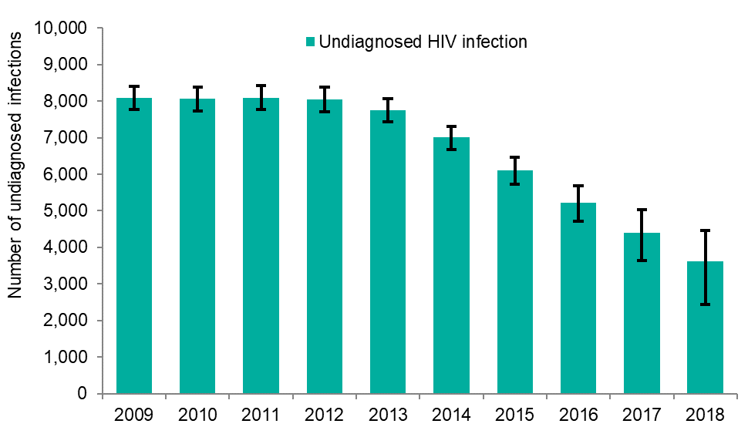
Estimates of undiagnosed HIV infection in gay and bisexual men using a CD4 back calculation method: England, 2009 to 2018
17
Notes:
The CD4 back-calculation model is also used to estimate undiagnosed HIV infections among GBM. The model has been refined to exclude men who probably acquired HIV and were first diagnosed prior to arrival in the UK. Following this adjustment, the number of GBM estimated to be living with an undiagnosed HIV infection in England was 3,600 (95% CrI 2,800 to 4,800). This is a 50% decline from the peak of 7,000 (CrI 6,700 to 7,300) in 2014.
17

Slide 18
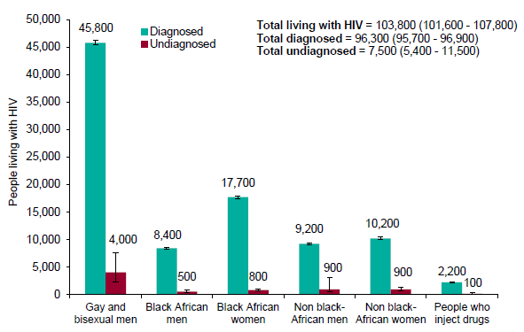
Estimated number of people living with HIV (diagnosed and undiagnosed), all ages: UK, 2018
18
Notes:
In 2018, an estimated 103,800 (CrI 101,600 to 107,800) people were living with HIV infection in the UK. The overall prevalence of HIV in England in 2018 was 2.3 per 1,000 (CrI 2.2 to 2.4) among people aged 15-74 years.
A total of 49,800 (CrI 48,000 to 53,400) GBM were estimated to be living with HIV in the UK in 2018. The overall prevalence of HIV was 88 (CrI 77 to 102) per 1,000 among GBM in England aged 15 to 74 years and was higher in London compared with the rest of England (127 per 1,000 (CrI 110 to 147) and 71 per 1,000 (CrI 59 to 85) respectively).
There were 29,500 (CrI 29,000 to 30,000) women who acquired HIV heterosexually and 19,100 (CrI 18,500 to 21,100) men who acquired HIV heterosexually estimated to be living with HIV in the UK, of whom 18,500 (CrI 18,200 to 18,800) and 8,900 (CrI 8,700 to 9,200) were black African women and men respectively. The estimated prevalence of HIV among heterosexual women and men aged 15 to 74 years in England was low (1.10 per 1,000 (CrI 1.08 to 1.15), and greater among black African adults (36.6 per 1,000 (CrI 36 to 37)
18

Slide 19
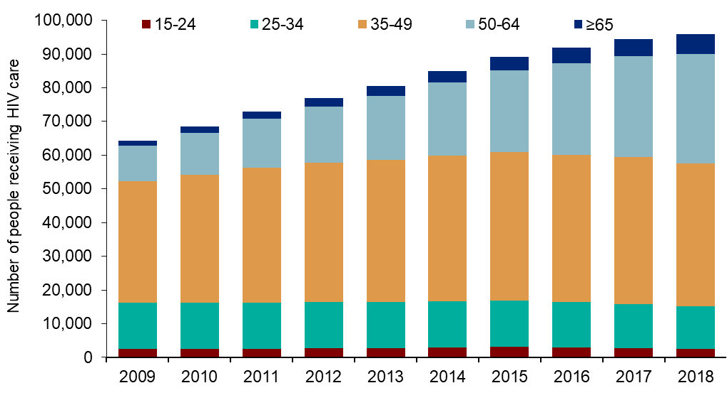
Number of people¹ seen for HIV care by age-group: United Kingdom, 2009 to 2018
¹ Includes people aged 15 and older
19
Notes:
In the United Kingdom, the number of people seen for HIV care has steadily increased over the past decade, from 65,249 in 2009 to 96,142 in 2018. The age distribution of people seen for HIV care is changing, with older age-groups increasing both in number and proportion. In 2018, over one third (40%) of adults (aged 15+) seen for HIV care in the UK were aged 50 years or older, compared with 18% in 2009. This rise is due to effective treatment leading to fewer HIV-related deaths, and improved survival, as well as on-going diagnoses.
19

Slide 20
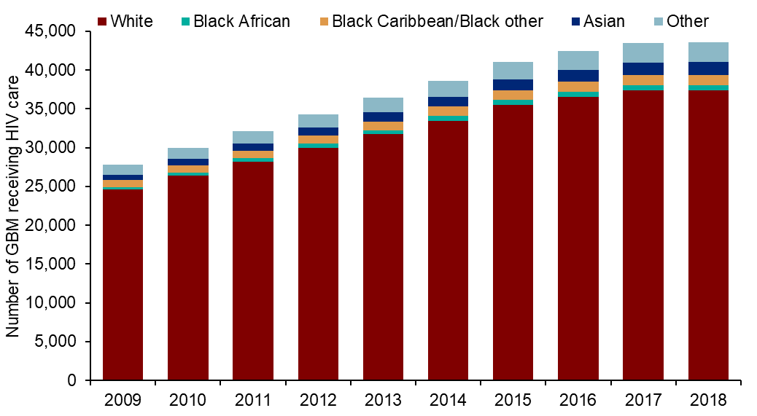
Number of Gay and bisexual men seen for HIV care, by ethnic group: UK, 2009 to 2018
20
Notes:
In 2018, 14% (6,201/43,570) of GBM receiving HIV care were from BAME groups, a similar proportion to that in 2009 (12%, 3,280/27,843).
20

Slide 21
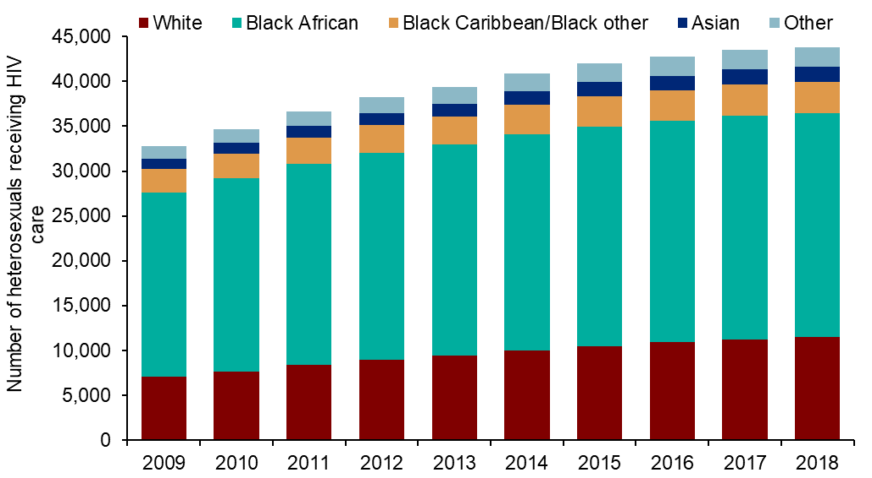
Number of Men and women diagnosed with HIV receiving care and who acquired HIV heterosexually, by ethnic group: UK, 2009 to 2018
21
Notes:
Among men and women who acquired HIV heterosexually, those of black African ethnicity accounted for the greatest proportion of those receiving care (57%; 24,966/43,850), 26% (11,470/43,850) were of white ethnicity compared to 21% (7,037/32,773) in 2009. In 2018, 152 trans people were receiving care in the UK; 64% were of white ethnicity and 39% were aged between 35-49 years.
21

Slide 22
Diagnosed HIV prevalence (per 1,000 population aged 15 to 59 years): England, 2018
22
Notes:
In 2018, 21% (66/317) of English local authorities had a diagnosed HIV prevalence between 2 and 5 per 1,000 population aged 15-59 years (high diagnosed prevalence), whilst 6% (19/317) had a prevalence greater than 5 per 1,000 (extremely high diagnosed prevalence). All 33 local authorities in London had a diagnosed HIV prevalence greater than 2 per 1,000 and 52% (17/33) had a prevalence greater than 5 per 1,000. Outside London, the five local authorities with the highest diagnosed HIV prevalence were: Brighton and Hove, Manchester, Salford, Blackpool and Luton.
22

Slide 23
HIV testing
Notes:
23

Slide 24
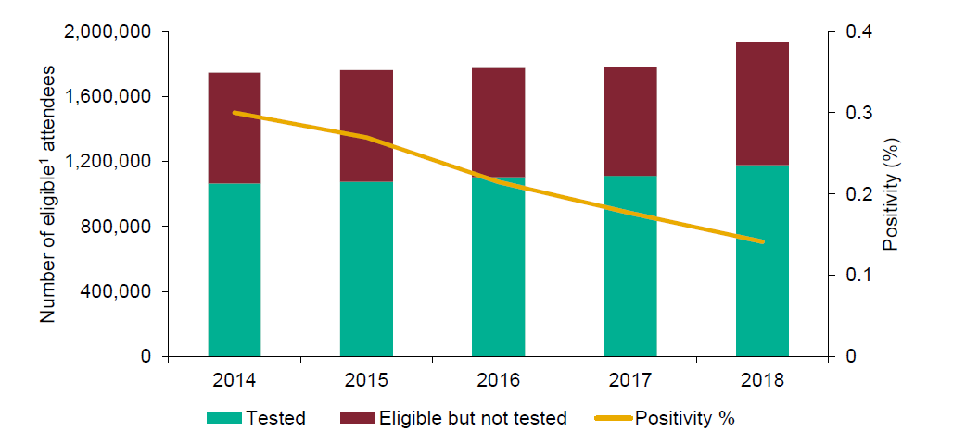
Number of eligible¹ attendees, number tested and positivity in all SHS attendees: England, 2014 to 2018
¹ Eligible SHS attendee: any patient attending a SHS at least once during a calendar year; excluding those patients known to be HIV positive or for whom an HIV test was not appropriate, or for whom the attendance was reported as being and related for reproductive health care only.
24
Notes:
In 2018, over 1.9 million people attended SHS who were eligible for HIV testing. Over 1.1 million of these attendees were tested for HIV, an increase of 6% since 2017 (Appendix 8).
The overall increase in people testing in SHS masked a 2% fall in the number of people testing at a specialist SHS (from 1,012,674 in 2017 to 987,537 in 2018). This was compensated by an increase in people testing in non-specialist SHS and was largely driven by a three-fold rise in the number of people tested for HIV through eSexual Health Services (43,890 in 2017 to 129,687 in 2018).
Overall test positivity in SHS has continued to fall from 0.2% in 2017 to 0.1% in 2018. In 2018, testing SHS attendees identified 41% (1,661/4,005) of new adult (15 years and over) diagnoses of HIV in England.
24

Slide 25
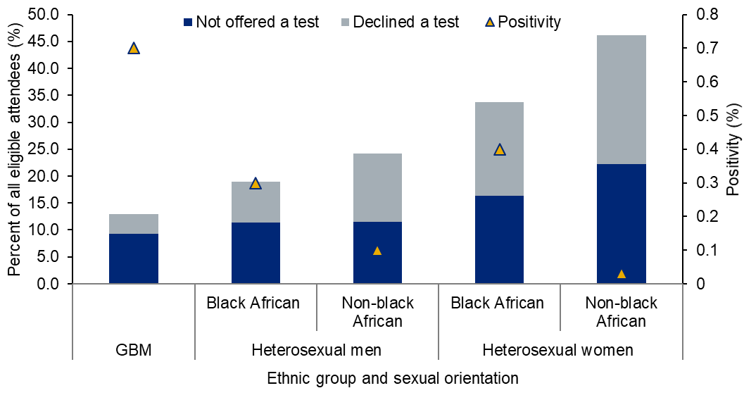
Missed opportunities among eligible¹ attendees not offered or declined an HIV test at all SHS by ethnic group and sexual orientation: England, 2018
¹ Eligible SHS attendee: any patient attending a SHS at least once during a calendar year; excluding those patients known to be HIV positive or for whom an HIV test was not appropriate, or for whom the attendance was reported as being and related for reproductive health care only.
25
Notes:
HIV test coverage was 61% in SHS overall, with 760,031 eligible attendees reported as not being tested for HIV. Over half (421,160/760,031) of these attendees were not offered a test despite being eligible for testing. These included 229,883 (22%) heterosexual female attendees, 64,478 (12%) heterosexual male attendees and 13,621 (9%) GBM attendees (Appendix 8).
25

Slide 26
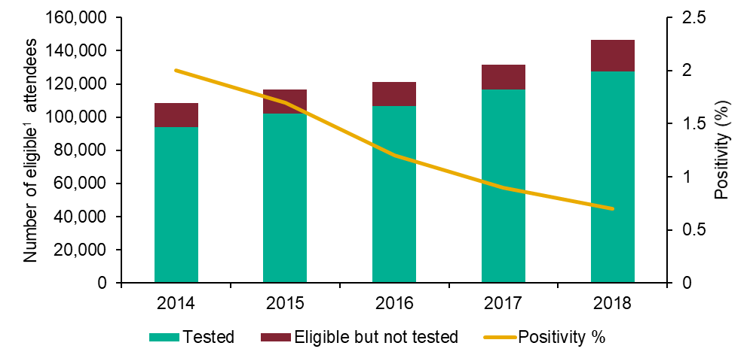
Trends in eligible¹ attendees, HIV tests and positivity for gay and bisexual male attendees at all SHS: England, 2014 to 2018
¹ Eligible SHS attendee: any patient attending a SHS at least once during a calendar year; excluding those patients known to be HIV positive or for whom an HIV test was not appropriate, or for whom the attendance was reported as being and related for reproductive health care only.
26
Notes:
In 2018, 11% (127,633/1,176,990) of people tested in SHS were GBM and 54% (898/1,661) of new diagnoses made in SHS were in this group (Appendix 8). The number of GBM attending SHS has continued to increase over the past 5 years, as has the number tested for HIV. In 2018, 127,633 GBM were tested for HIV in SHS, a 9% increase from the previous year (116,642 in 2017). Test positivity among GBM has continued to fall, from 0.9% in 2017 to 0.7% in 2018.
26

Slide 27
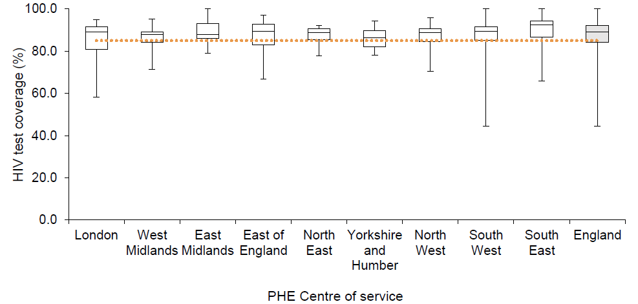
Proportion of specialist SHS¹ meeting or exceeding BASHH standards (85%) in eligible² GBM attendees by PHE Centre of service³: England, 2018
¹ Specialist SHS: referring to level 3 sexual health services (including genitourinary medicine (GUM) and integrated GUM/sexual and reproductive health (SRH)).
² Eligible SHS attendee: any patient attending a SHS at least once during a calendar year; excluding those patients known to be HIV positive or for whom an HIV test was not appropriate, or for whom the attendance was reported as being for and related to reproductive health care only.
³ Service data: Data represent STI tests & diagnoses made in services in England, regional breakdowns represent service location. Data include non-England residents as well as England residents, therefore numbers will differ from other GUMCAD data presented.
27
Notes:
The BASHH standards state that clinics should test 85% of all attendees (with needs relating to STIs) for HIV at their first attendance (31). In 2018, 71% (156/219) of specialist SHS met this target among GBM attendees. This proportion ranged from 58% in Yorkshire and Humber to 80% in the South East. Figure 22 shows the distribution of HIV test coverages at individual specialist clinics for GBM attendees. Each boxplot shows the median test coverage of clinics in a PHE Centre of service and extends to the minimum and maximum coverage of a single clinic in that centre.
27

Slide 28
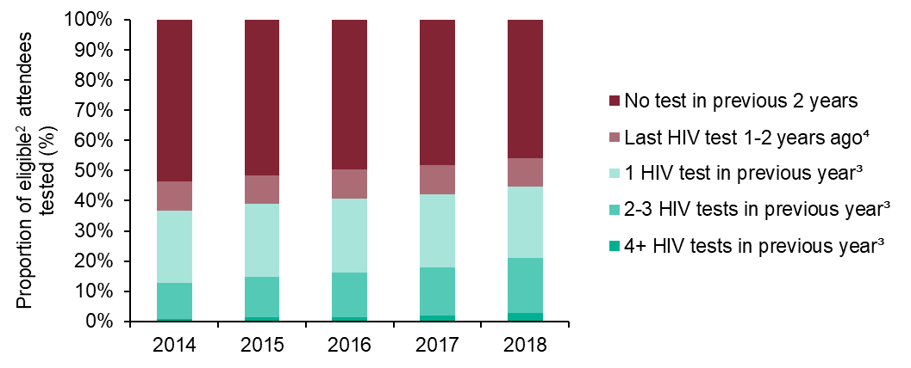
Gay and bisexual men testing for HIV at specialist SHS¹: previous HIV tests at the same clinic: England, 2014 to 2018
¹ Specialist SHS: referring to level 3 sexual health services (including genitourinary medicine (GUM) and integrated GUM/sexual and reproductive health (SRH)).
² Eligible SHS attendee: any patient attending a SHS at least once during a calendar year; excluding those patients known to be HIV positive or for whom an HIV test was not appropriate, or for whom the attendance was reported as being for and related to reproductive health care only.
³ Previous year: 43 - 365 days before the last test in a calendar year or date of new diagnosis
⁴ 1-2 years ago: at least one test in the 366 - 730 days and no tests in the 43 - 365 days before the last test in a calendar year or date of new diagnosis
28
Notes:
In 2018, 45% (49,627/110,766) of GBM who were tested for HIV were reported as having had one or more HIV tests during the previous year (at the same specialist SHS). This was an increase from 42% (45,980/109,284) in 2017.
The proportion of GBM tested for HIV, who had frequently tested for HIV (two or more HIV tests during the previous year, at the same specialist SHS) also increased, from 18% (19,489/109,284) in 2017 to 21% (23,193/110,766) in 2018. Despite this, nearly half (46%, 50,740/110,766) of GBM who tested at a specialist SHS in 2018 had not been tested in the previous two years (at the same service).
28

Slide 29
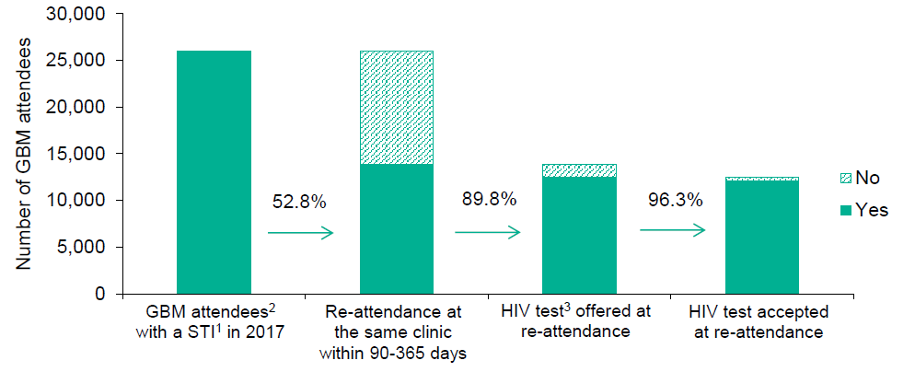
HIV testing cascade among gay and bisexual men who had a STI¹ in the past year attending specialist SHS: England, 2017 to 2018
¹ GBM with an anogenital STI diagnosis in 2017
² Excludes GBM attendees previously diagnosed with HIV
³ Offered an HIV test at least once in the 90 - 365 days after STI diagnosis
29
Notes:
GBM with an anogenital bacterial STI diagnosis subsequently have a high incidence of HIV infection. Of the 26,031 GBM diagnosed with an anogenital bacterial STI in 2017, 46% (12,035/26,031) were tested at the same service for HIV in the year following their STI diagnosis (Figure 24). These tests identified 584 new diagnoses of HIV, a positivity of 4.9%. One new HIV diagnosis was made for every 21 men tested in this group (Appendix 14).
Nearly half of this group (47%, 12,125/26,031) did not re-attend the same specialist SHS. Of those who did return to the same service, 10% (1,413/13,906) were not offered a test and 4% (458/12,493) were offered but declined a test.
29

Slide 30
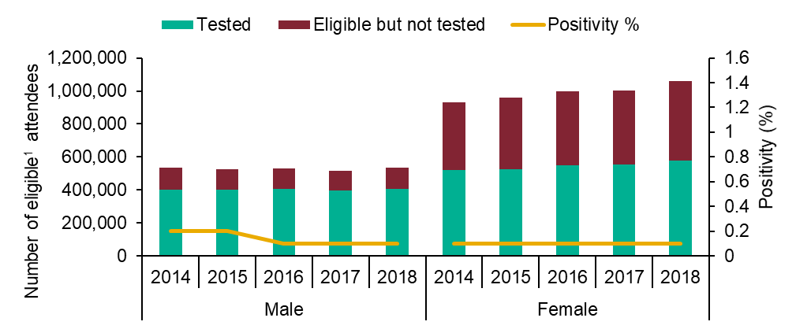
Trends in number of heterosexual attendees tested at all SHS by gender: England, 2014 to 2018
¹ Eligible SHS attendee: any patient attending a SHS at least once during a calendar year; excluding those patients known to be HIV positive or for whom an HIV test was not appropriate, or for whom the attendance was reported as being for and related to reproductive health care only.
30
Notes:
The number of heterosexual men and women tested for HIV in all SHS has stayed stable since 2014 (Figure 25). In 2018, test coverage among heterosexual women (55%, 578,424/1,059,934) remained lower than among heterosexual men (76%, 404,435/534,476) (Appendix 15). Test coverage among all heterosexuals was lower in non-specialist SHS (51%, 137,631/269,337) than in specialist SHS (64%, 845,238/1,325,703). In 2018, 8% (88,292/1,059,934) of all heterosexual female SHS attendees attended a sexual reproductive health (SRH) service, where HIV test coverage was 32% (28,447/88,292) (Appendix 9).
30

Slide 31
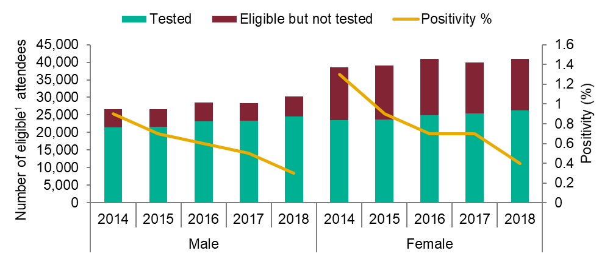
Trends in number of black African heterosexual attendees tested at all SHS by gender: England, 2014 to 2018
¹ Eligible SHS attendee: any patient attending a SHS at least once during a calendar year; excluding those patients known to be HIV positive or for whom an HIV test was not appropriate, or for whom the attendance was reported as being for and related to reproductive health care only.
31
Notes:
The number of black African heterosexual men and women tested for HIV in 2018 at SHS increased by 5% and 4% respectively from 2017. HIV test coverage was higher among black African heterosexual men and women (81% and 64%) than among heterosexual men and women overall (76% and 55%) (Appendix 17).
Over the past 5 years, HIV test positivity has continued to fall in this group. In 2014, positivity was 0.9% in men and 1.3% in women, whereas in 2018, positivity was 0.3% in men and 0.4% in women (Figure 26).
31

Slide 32
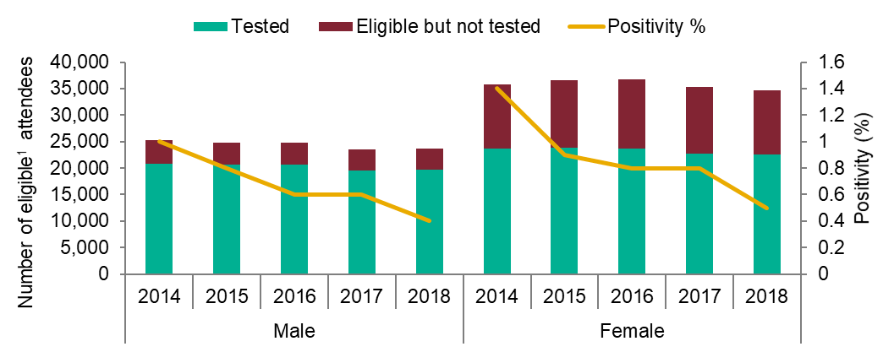
Trends in number tested among heterosexual attendees born in a high prevalence country at all SHS by gender: England, 2014 to 2018
¹ Eligible SHS attendee: any patient attending a SHS at least once during a calendar year; excluding those patients known to be HIV positive or for whom an HIV test was not appropriate, or for whom the attendance was reported as being for and related to reproductive health care only.
32
Notes:
The number of heterosexual attendees born in a country with high HIV prevalence who were tested for HIV in SHS has remained stable since 2014, as has HIV test coverage. Coverage among heterosexual male and female attendees born in a country with high HIV prevalence (83% and 65%) was higher than among heterosexual men and women overall (76% and 55%). HIV test positivity has fallen among heterosexuals born in a country with high HIV prevalence since 2017; from 0.6% to 0.4% among men, and from 0.8% to 0.5% among women (Figure 28) (Appendix 19). A full list of countries with high HIV prevalence can be found in Appendix 2.
32

Slide 33
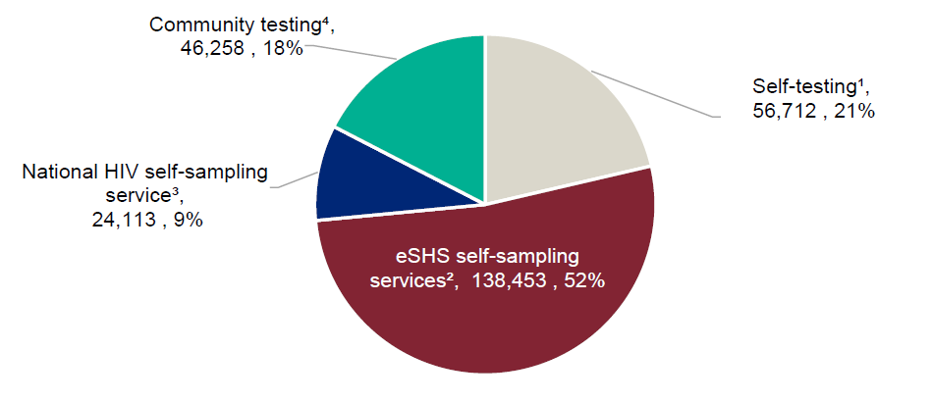
HIV tests carried out through self-testing, self-sampling schemes and community testing services: England, 2018
¹ Self-tests purchased privately online and distributed via retail pharmacies. Data provided by Biosure and Biolytical.
² Tests returned to self-sampling services which report to the GUMCAD STI Surveillance System. These are also included in the overall SHS HIV testing data.
³ Tests returned to the National HIV self-sampling service.
⁴ Tests reported through the national Survey of HIV testing in Community Settings.
33
Notes:
In 2018, 265,536 HIV tests were carried out, sold or distributed in community and home settings in England. This included 138,453 tests provided through eSHS and 127,083 other online or community-based tests (Figure 34).
The 127,083 other online and community-based HIV tests included 24,113 self-sampling test kits returned via the national HIV self-sampling service; 56,712 self-testing HIV kits sold to individuals (39,003) or distributed via retailers (17,709); and 46,258 HIV tests reported through PHE’s ‘Survey of HIV Testing in Community Settings’. A list of the organisations who participated in the survey can be found in Appendix 22.
33

Slide 34
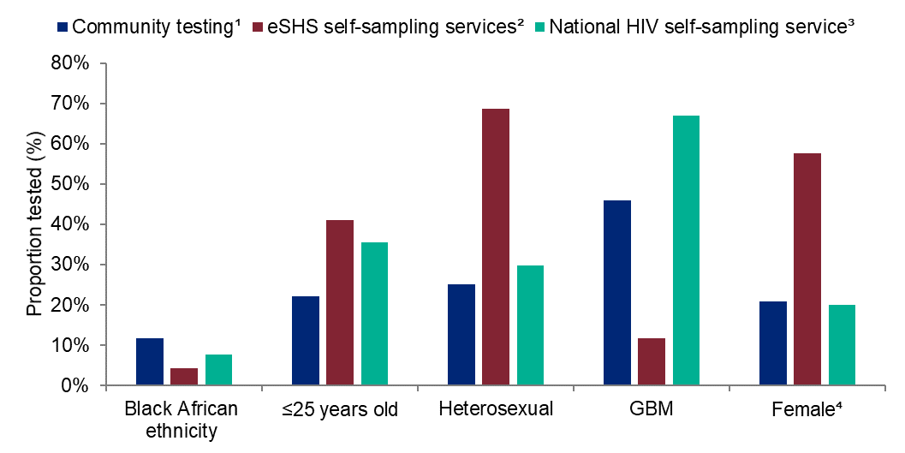
Characteristics of persons tested through community testing services and self-sampling schemes: England, 2018
¹ Tests reported through the national survey of community testing.
² Tests returned to self-sampling services which report to the GUMCAD STI Surveillance System. These are also included in the overall SHS HIV testing data.
³ Tests returned to the National HIV self-sampling service.
⁴ Includes cis and trans female.
34
Notes:
Community testing, eSHS self-sampling and national HIV self-sampling services are used by different population groups (Figure 35). The proportion of tests carried out among those of black African ethnicity was higher in community testing services (12%) compared to the national HIV self-sampling service (8%) or eSHS self-sampling services (4%). The proportion of tests carried out in GBM was higher in the national HIV self-sampling service (67%) than in community services (46%) or eSHS self-sampling services (12%) (Appendix 23).
34

Slide 35
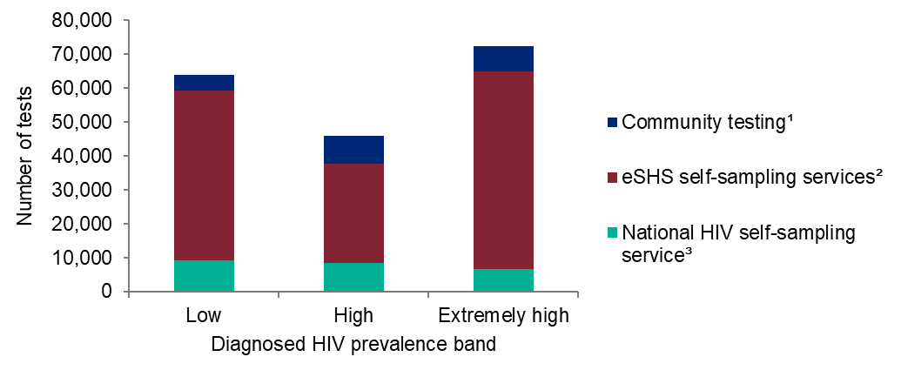
HIV tests carried out through self-sampling schemes and community testing services: diagnosed prevalence band: England, 2018
¹ Tests reported through the national survey of community testing
² Tests returned to self-sampling services which report to the GUMCAD STI Surveillance System
³ Tests returned to the National HIV self-sampling service
35
Notes:
The number of HIV tests carried out in online and community testing services varied by diagnosed HIV prevalence band. In 2018, 25% of these tests were reported from high prevalence areas, and 40% from extremely high prevalence areas.
35

Slide 36
Clinical Care and Treatment as prevention (TasP)
Notes:
36

Slide 37
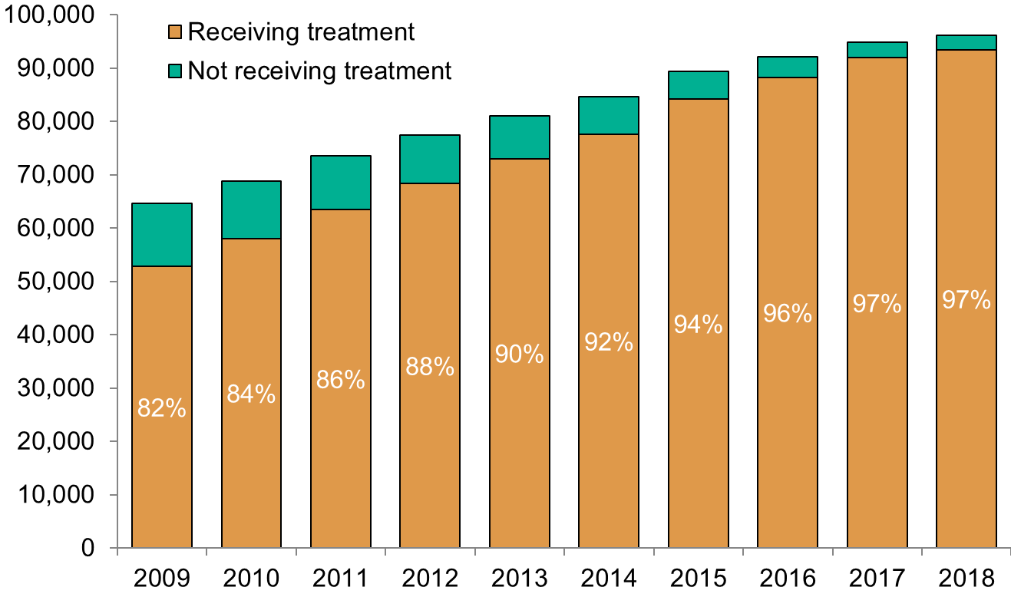
Number of people¹ seen for HIV care by ART coverage: United Kingdom, 2009 to 2018
¹ Includes people aged 15 and older
37
Notes:
UNAIDS has set a target of 90% of those diagnosed to be receiving treatment. Overall in 2018, 97% of the 96,142 people living with a diagnosed HIV infection in the UK received ART, compared to 82% in 2009.
37

Slide 38
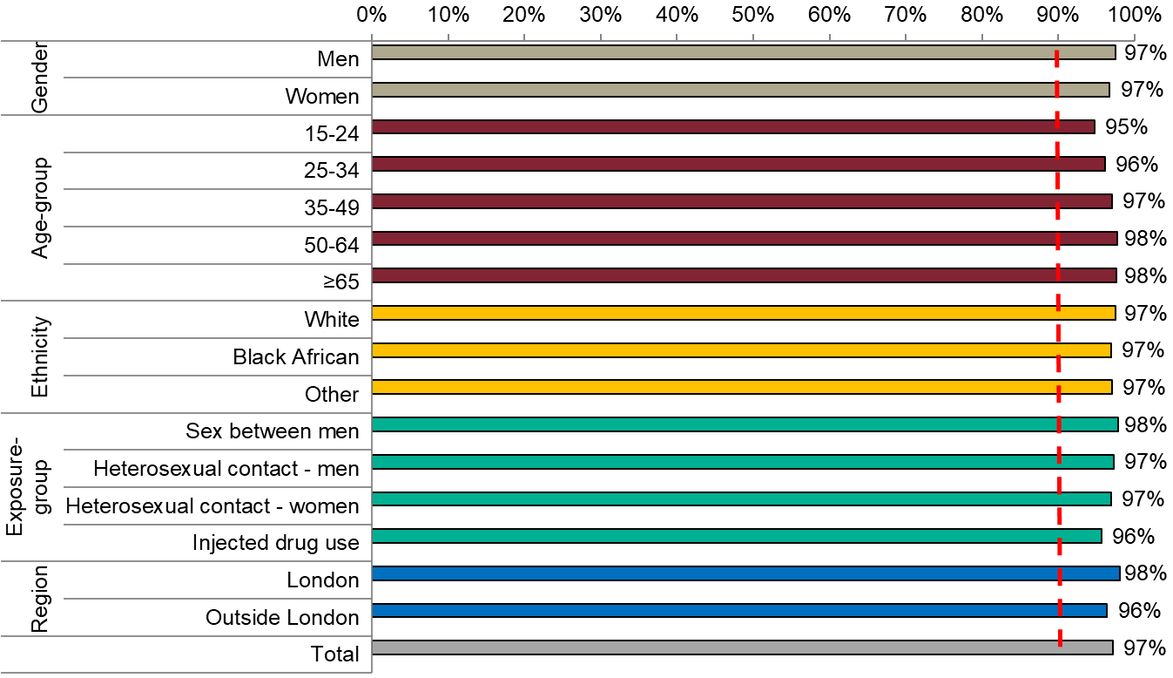
Proportion of people¹ receiving antiretroviral treatment (ART): United Kingdom, 2018
UNAIDS 90% target
¹ Includes people aged 15 and older
38
Notes:
Treatment coverage was high in all geographies and across exposure-groups. However, there was variation in treatment coverage by age, with slightly lower coverage rates among people aged 15-24, 95% (2,405/2,537) compared to those aged 50 and above, 98% (37,325/38,193).
There were no substantial differences between exposure-groups in terms of treatment coverage, with the slight exception of younger people.
38

Slide 39
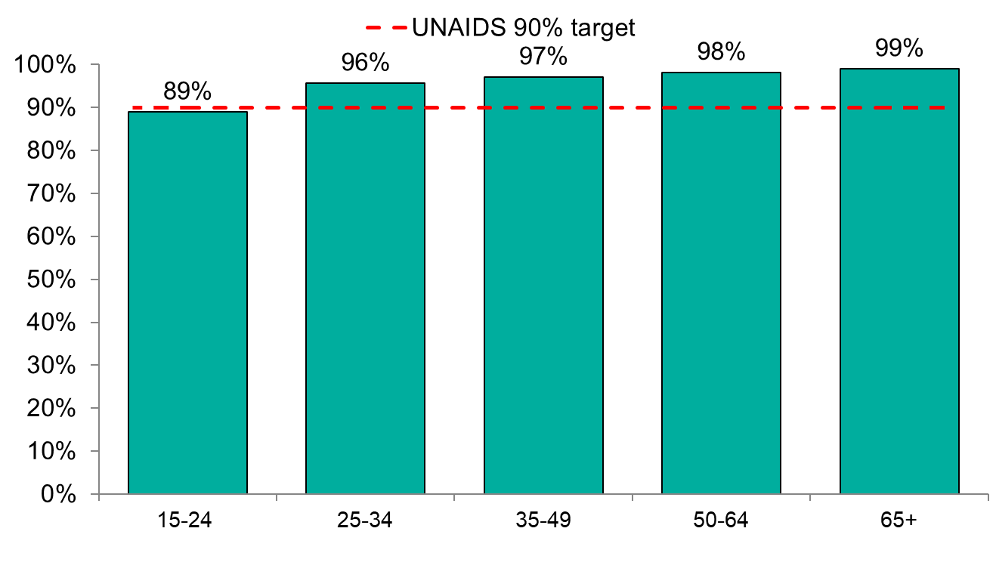
Proportion of people¹ on antiretroviral therapy with a viral load <200 copies/mL by age-group: England, 2018
¹ Includes people aged 15 and older
39
Notes:
In 2018, there was some variation by age-group for people receiving antiretroviral therapy with a viral load <200 copies/mL, with more than 95% of those on treatment having a viral load <200 copies/mL among those aged 25 and older. However, viral suppression rates were lowest and below the UNAIDS target in people aged 15-24 at 87%.
39

Slide 40
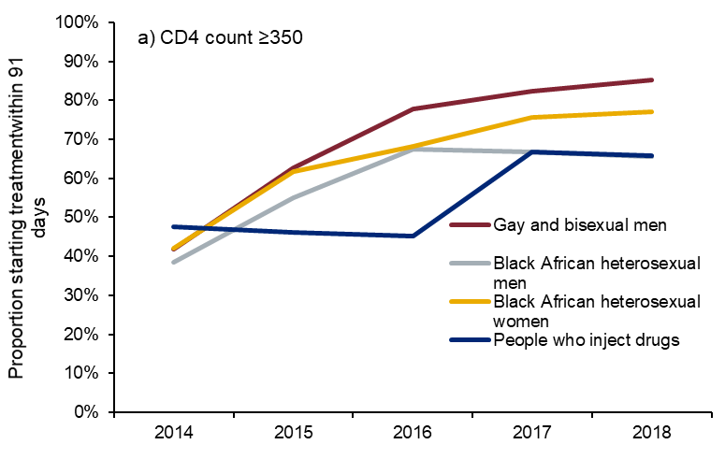
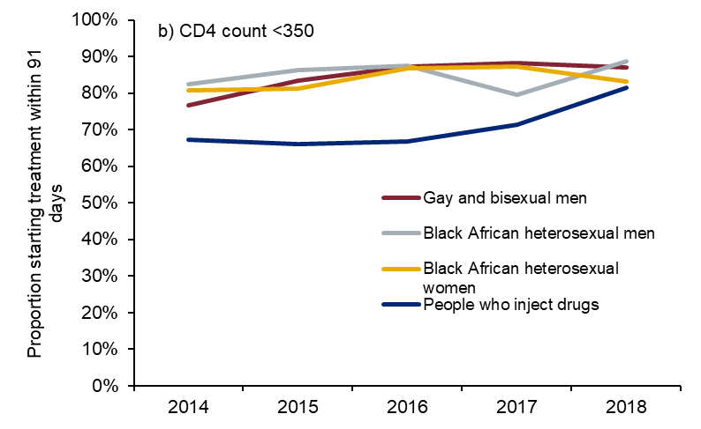
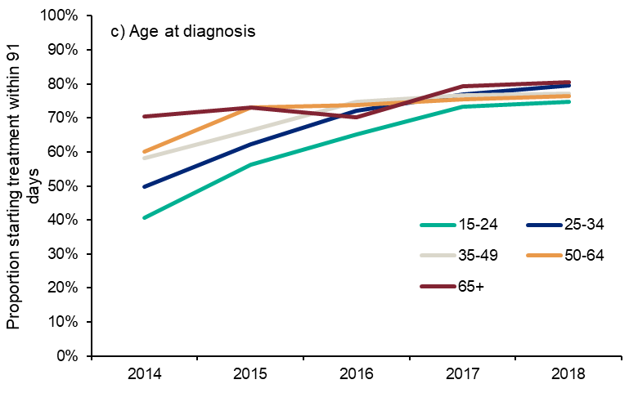
Proportion of new HIV diagnoses initiating treatment within 91 days by exposure group: United Kingdom, 2014 to 2018
40
Notes:
The proportion of people diagnosed late (CD4 <350 cells/mm³) who started treatment within 3 months of diagnosis has remained consistently high at around 80% over the past 5 years. In contrast, this proportion increased among people diagnosed promptly (CD4 ≥350 cells/mm³) from 41% (1,094/2,652) in 2014 to 81% (1,483/1,834) in 2018 (a), which reflects the changes in treatment recommendations and subsequent NHS policy. A trend in earlier treatment initiation is observed among all persons diagnosed promptly regardless of exposure category. However, uptake of treatment among PWID (70% 65/93) and people aged 15-24 (75%; 309/413) remains lower than other groups in 2018.
Overall, an estimated 95% of people newly diagnosed and linked to HIV care attained viral suppression within a year of diagnosis.
40

Slide 41
PrEP
Notes:
41

Slide 42
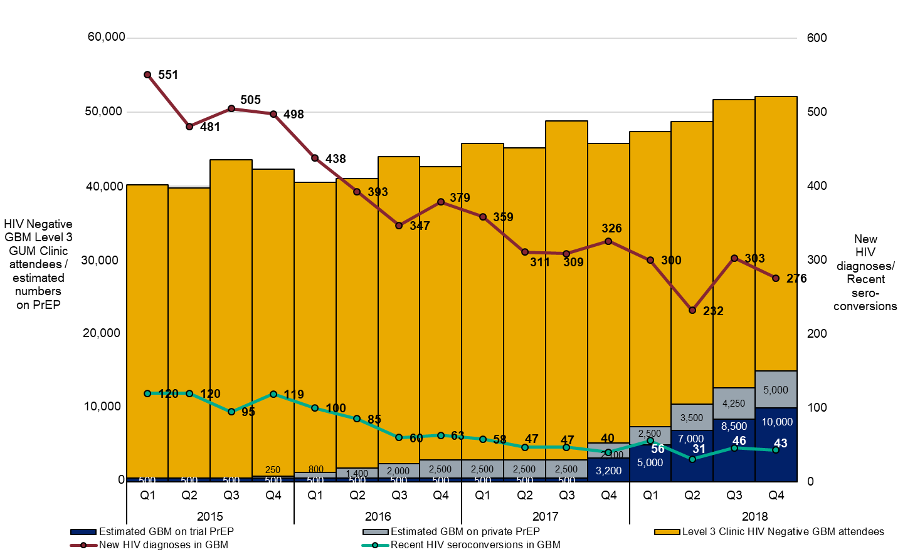
Monitoring population effectiveness of PrEP in GBM in England 2015 – 2018: Comparing trends of estimated numbers on PrEP, new HIV diagnoses and recent seroconversions among level 3 GUM clinic GBM attendees
42
Notes:
It is very probable that the scale-up of PrEP use, especially during 2018, will have had a substantial effect at reducing underlying HIV incidence, in addition to the effect of intensified HIV testing combined with immediate treatment initiation in those newly diagnosed with HIV. By the end of 2018, there were an estimated 10,000 GBM on trial PrEP and up to another 5,000 accessing PrEP through other means. Nevertheless, this level of PrEP uptake has yet to have an observable effect on the numbers of recorded recent seroconversions in GBM clinic attendees, which during 2018 was between 31 and 56 in each quarter. Equally, the 2018 quarterly numbers of new HIV diagnoses in GBM clinic attendees has stayed between 200 and 300. Follow-up of these individuals who have recently seroconverted through the SHARE surveillance system has shown that almost all were not taking PrEP, and the circumstances of the few who were, are under investigation.
42

Slide 43
Acknowledgements
We gratefully acknowledge the continuing collaboration of people living with HIV, as well as clinicians, microbiologists, immunologists, public health practitioners, occupational health doctors, nurses and other colleagues who contribute to the surveillance of HIV and STIs and the monitoring of HIV care in the UK.
Further information
Blood Safety, Hepatitis, Sexually Transmitted Infection (STI) and HIV Service
National Infection Service
Public Health England
61 Colindale Avenue
London
NW9 5EQ
Email: harsqueries@phe.gov.uk
Website: www.gov.uk/phe
43

Slide 44
About Public Health England
Public Health England exists to protect and improve the nation’s health and wellbeing, and reduce health inequalities. We do this through world-leading science, knowledge and intelligence, advocacy, partnerships and the delivery of specialist public health services. We are an executive agency of the Department of Health and Social Care, and a distinct delivery organisation with operational autonomy. We provide government, local government, the NHS, Parliament, industry and the public with evidence-based professional, scientific and delivery expertise and support.
Public Health England Wellington House
133-155 Waterloo Road
London SE1 8UG Tel: 020 7654 8000
www.gov.uk/phe Twitter: @PHE_uk
Facebook: www.facebook.com/PublicHealthEngland
© Crown copyright 2020
You may re-use this information (excluding logos) free of charge in any format or medium, under the terms of the Open Government Licence v3.0. To view this licence, visit OGL. Where we have identified any third party copyright information you will need to obtain permission from the copyright holders concerned.
PHE publications gateway number: GW-920 PHE supports the UN Sustainable Development Goals
44

