Slide 1
Patterns and trends in adult obesity
A presentation of the latest data on adult obesity in England
February 2020
Notes:
These PowerPoint slides present key data and information on adult obesity in clear, easy to understand charts and graphics. They have been produced by the Population Health Analysis team in the Health Improvement Directorate and can be used freely with acknowledgement to ‘Public Health England’.
These slides should be useful to practitioners and policy makers working to tackle adult obesity at local, regional and national level. For example they are regularly used to make the case for tackling obesity in presentations to health and wellbeing boards, other committees and to elected members as well as in regional and national conference and workshop presentations.

Slide 2
Contents
Adult body mass index classification (slide 3)
Latest prevalence by BMI category (slides 4-6)
Perception of own weight (slide 7)
Trends by BMI category (slides 8-10)
Latest prevalence of obesity by age (slides 11-12)
Latest prevalence of obesity by region (slide 13)
Latest prevalence of obesity by socioeconomic status and ethnicity (slides 14-16)
Waist circumference latest prevalence and trends (slides 17-20)
Trends by health risk categories for BMI and waist circumference (slides 21-23)
Prevalence of multiple risk factors (slides 24-25)
Data sources (slide 26)
Further information (slide 27)

Slide 3
Adult body mass index classification
In this presentation of data body mass index (BMI) is classified according to the following table, using BMI thresholds for adults recommended by the National Institute for Health and Care Excellence (NICE).
BMI Range | BMI Category
Less than 18.5kg/m² | Underweight
18.5 to <25kg/m² | Healthy weight
25 to <30kg/m² | Overweight
30 to <40kg/m² | Obese
40kg/m² or more | Severely obese
https://www.nice.org.uk/guidance/cg189/ifp/chapter/Obesity-and-being-overweight

Slide 4
Overweight and obesity among adults
Health Survey for England 2018
Almost 7 out of 10 men are overweight or obese (66.9%)
Almost 6 out of 10 women are overweight or obese (59.7%)
Adult (aged 16+) overweight including obesity: BMI ≥ 25kg/m²
Notes:
Prevalence of excess weight (overweight including obesity) among adults, Health Survey for England 2018.
The published Health Survey for England data used to produce this graphic is available from: https://digital.nhs.uk/data-and-information/publications/statistical/health-survey-for-england/2018

Slide 5
Obesity among adults
Health Survey for England 2018
Almost 3 out of 10 men are obese (26.2%)
Almost 3 out of 10 women are obese (29.2%)
Adult (aged 16+) obesity: BMI ≥ 30kg/m²
Notes:
Prevalence of obesity among adults, Health Survey for England 2018.
The published Health Survey for England data used to produce this graphic is available from: https://digital.nhs.uk/data-and-information/publications/statistical/health-survey-for-england/2018

Slide 6
Adult BMI status by sex
Health Survey for England 2018
Adult (aged 16+) BMI thresholds:
Underweight: <18.5kg/m² Healthy weight: 18.5 to <25kg/m² Overweight: 25 to <30kg/m² Obese: ≥30kg/m²
Notes:
Healthy weight prevalence is lower for men than for women. Although obesity prevalence is marginally higher for women than for men, there is a higher prevalence of overweight among men than women.
Due to rounding, percentages may not sum to 100%.
The published Health Survey for England data used to produce these charts is available from: https://digital.nhs.uk/data-and-information/publications/statistical/health-survey-for-england/2018

Slide 7
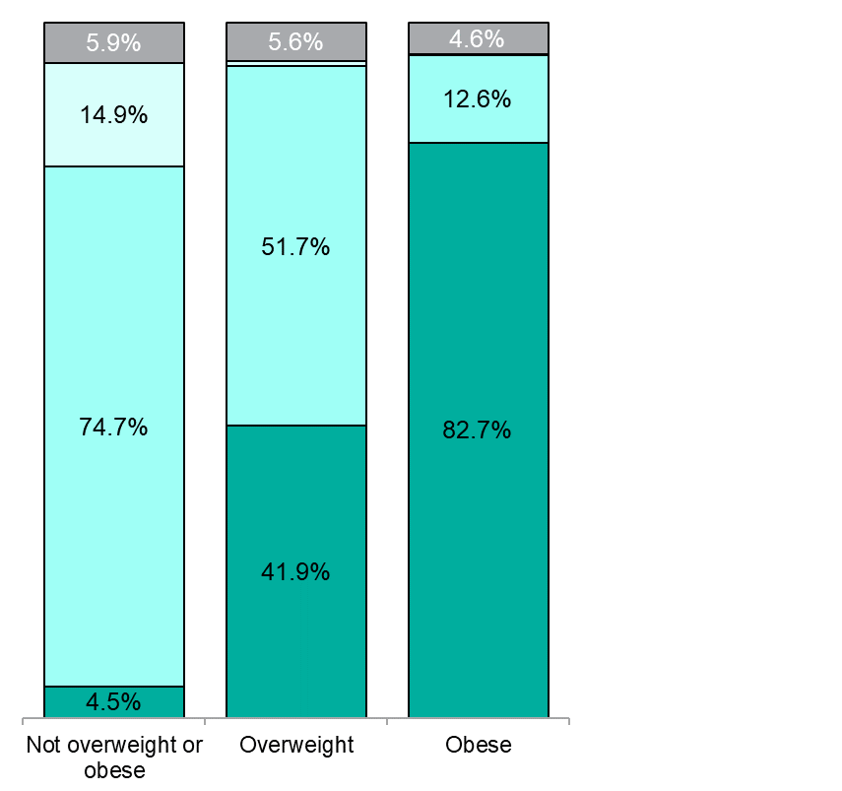
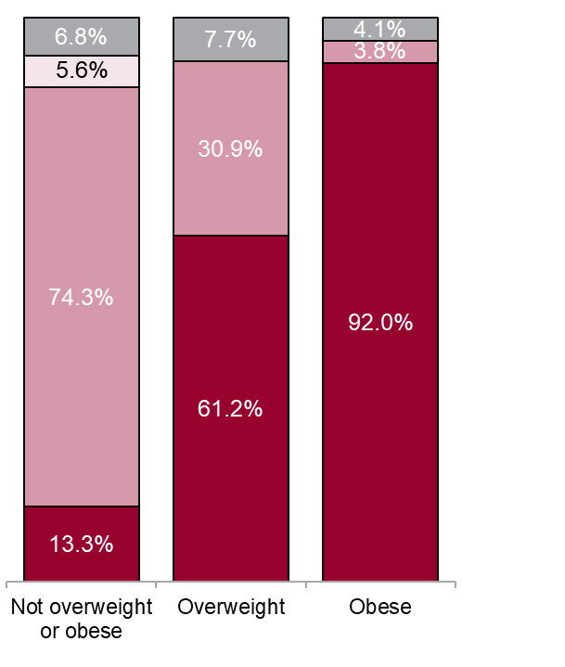
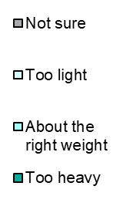
Perception of own weight
Health Survey for England 2016
Men
0.7%
Women
Adult (aged 16+) BMI thresholds:
Underweight: <18.5kg/m² Healthy weight: 18.5 to <25kg/m² Overweight: 25 to <30kg/m² Obese: ≥30kg/m²
Notes:
This chart displays the proportion of people in each BMI category that described themselves as either “too heavy”, “about the right weight”, “too light” or said that they were not sure. More overweight and obese women are able to identify themselves as having excess weight compared with men, despite more men than women being categorised as overweight and obese, as seen on the previous slide. This question was not asked in the 2017 and 2018 surveys.
Due to rounding, percentages may not sum to 100%.
The published Health Survey for England data used to produce these charts is available from: https://digital.nhs.uk/data-and-information/publications/statistical/health-survey-for-england/health-survey-for-england-2016

Slide 8
Trend in obesity prevalence among adults
Health Survey for England 1993 to 2018 (three-year averages)
Adult (aged 16+) obesity: BMI ≥ 30kg/m²
Notes:
The chart shows the three-year averages for obesity prevalence in England from 1993-2018.
Obesity prevalence continues to rise, particularly among women.
Women have generally had a higher prevalence of obesity, but the gap between men and women appears to have narrowed slightly over time.
Three-year averages have been used to smooth out any unusually high or low prevalence values from individual years, so the overall trend over time can be better understood.
Data before 2003 are unweighted; whereas from 2003, the data has been weighted for non-response.
The published Health Survey for England data used to produce these charts is available from: https://digital.nhs.uk/data-and-information/publications/statistical/health-survey-for-england/2018

Slide 9
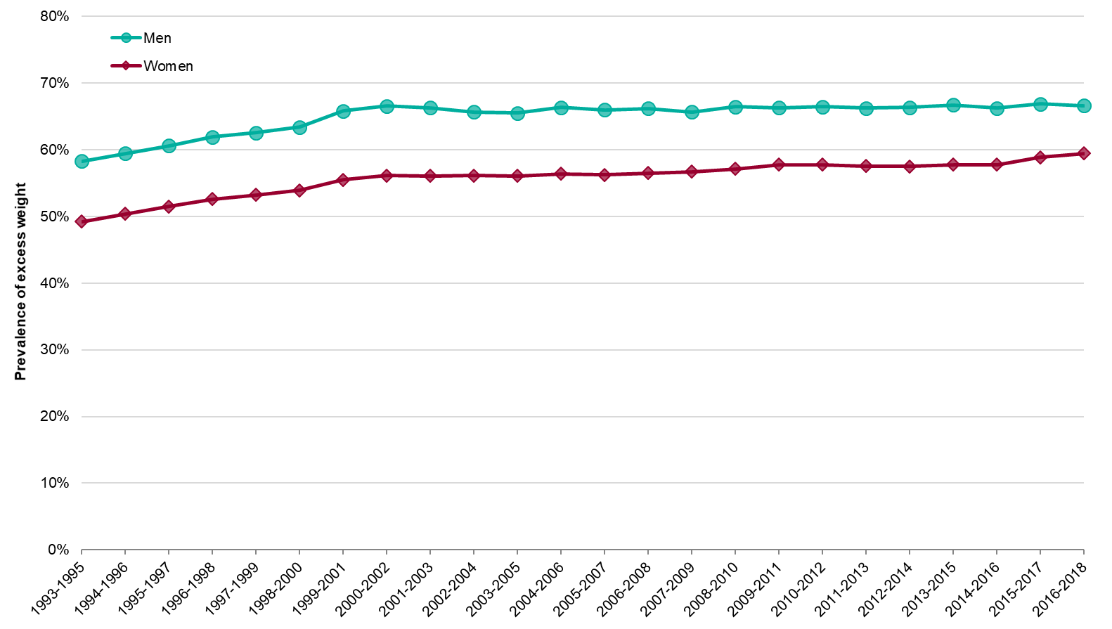
Trend in excess weight among adults
Health Survey for England 1993 to 2018 (three-year average)
Adult (aged 16+) overweight including obesity: BMI ≥ 25kg/m²
Notes:
The prevalence of excess weight (overweight including obesity) rose substantially between 1993 and 2002, but has increased much more slowly in both men and women since that time.
Unlike for obesity, prevalence of excess weight is much higher among men than women.
Three-year averages have been used to smooth out any unusually high or low prevalence values from individual years, so the overall trend over time can be better understood.
Data before 2003 are unweighted; whereas from 2003, the data has been weighted for non-response.
The published Health Survey for England data used to produce these charts is available from: https://digital.nhs.uk/data-and-information/publications/statistical/health-survey-for-england/2018

Slide 10
Trend in severe obesity among adults
Health Survey for England 1993 to 2018 (three-year average)
Adult (aged 16+) severe obesity: BMI ≥ 40kg/m²
Notes:
The prevalence of severe obesity (BMI ≥40kg/m²) has increased since 1993 for both men and women. Overall, a very small proportion of the population are severely obese but the rise in prevalence has been substantial since 1993-1995; a 7 fold increase for men (increasing from 0.3% to 2.1% in 2016-2018) and a 2.9 fold increase for women (increasing from 1.5% to 4.3% in 2016-2018). Severe obesity prevalence is much higher for women than men.
Three-year averages have been used to smooth out any unusually high or low prevalence values from individual years, so the overall trend over time can be better understood.
Data before 2003 are unweighted; whereas from 2003, the data has been weighted for non-response.
The published Health Survey for England data used to produce these charts is available from: https://digital.nhs.uk/data-and-information/publications/statistical/health-survey-for-england/2018

Slide 11
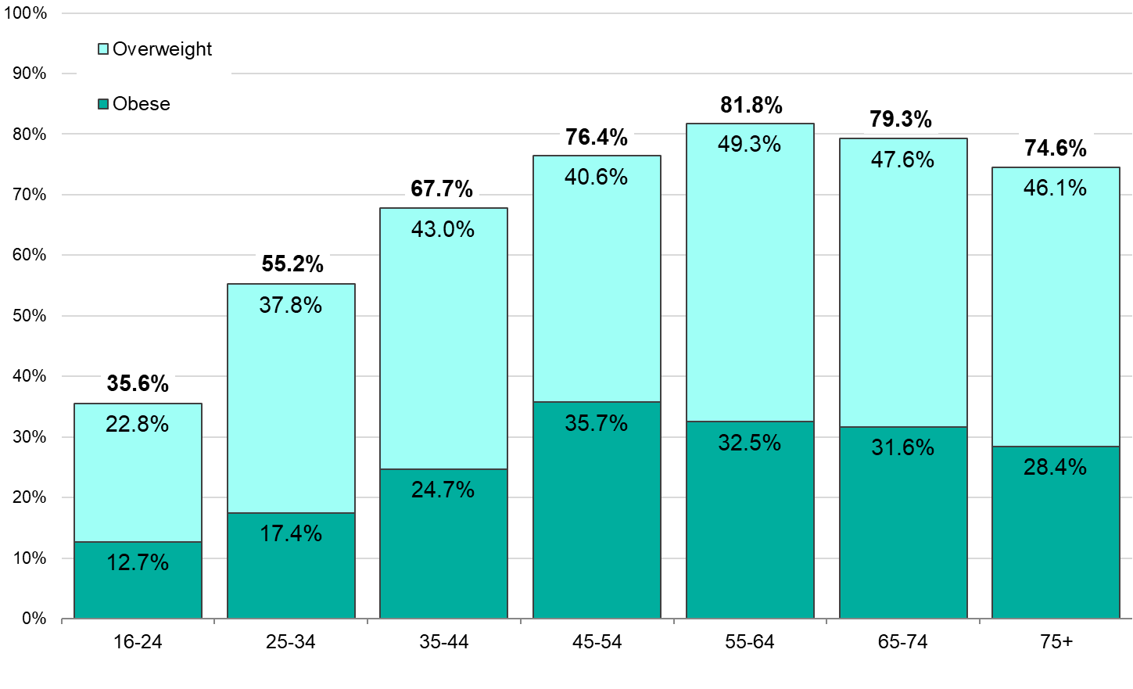
Prevalence of overweight and obesity by age: men
Health Survey for England 2018
Adult (aged 16+) BMI thresholds: Overweight: 25 to <30kg/m²; Obese: ≥30kg/m²
Notes:
This chart shows how the prevalence of obesity and overweight among men changes with age. The values above the bars show the total prevalence of excess weight (overweight including obesity).
Prevalence of overweight and obesity combined is lowest in the 16 to 24 age group, increases with age until the 35 to 44 age group and then, due to wide and overlapping confidence intervals (not displayed), remains steady into the older age groups. Obesity prevalence also increases between the younger age groups and the 35-44 age group, then, due to wide and overlapping confidence intervals (not displayed), prevalence remains similar between all following age groups.
Due to rounding, the percentages may not sum correctly.
The published Health Survey for England data used to produce these charts is available from: https://digital.nhs.uk/data-and-information/publications/statistical/health-survey-for-england/2018

Slide 12
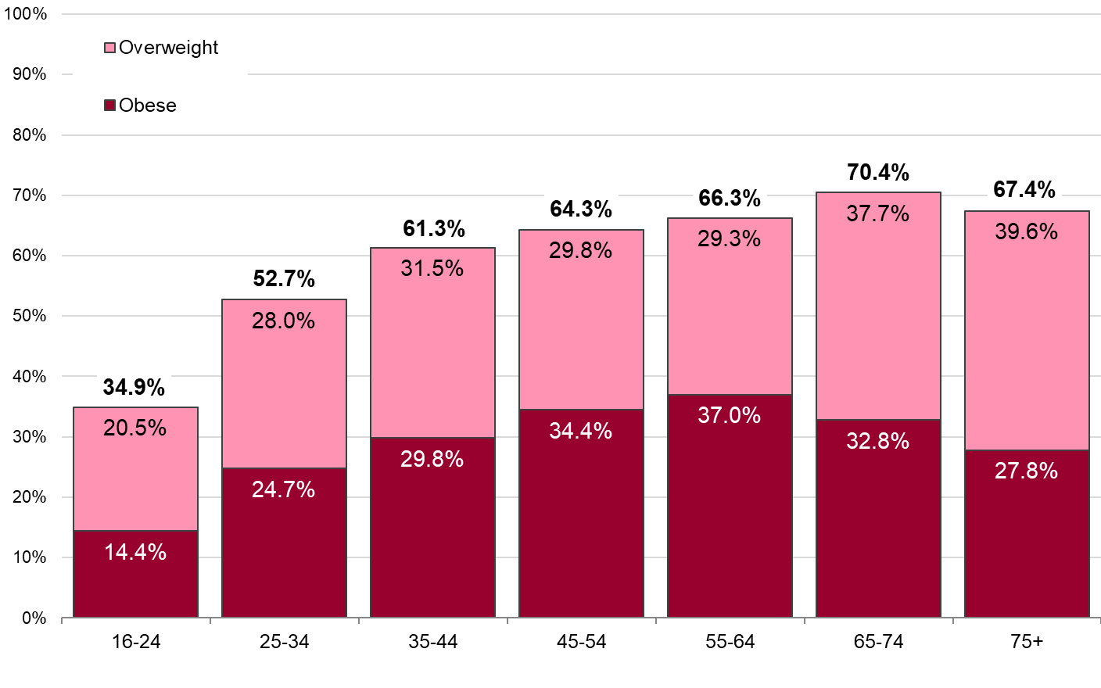
Prevalence of overweight and obesity by age: women
Health Survey for England 2018
Adult (aged 16+) BMI thresholds: Overweight: 25 to <30kg/m²; Obese: ≥30kg/m²
Notes:
This chart shows how the prevalence of obesity and overweight among women changes with age. The values above the bars show the total prevalence of excess weight (overweight including obesity).
Prevalence of overweight and obesity is lowest in the 16 to 24 age group and increases to the 45 to 54 age group and then, due to overlapping confidence intervals (not displayed), remains steady in the older age groups. Obesity prevalence also increases with age and remains steady after 45 to 54 years, due to wide and overlapping confidence intervals (not displayed).
Due to rounding, percentages may not sum correctly.
The published Health Survey for England data used to produce these charts is available from: https://digital.nhs.uk/data-and-information/publications/statistical/health-survey-for-england/2018

Slide 13
Prevalence of adult obesity by region
Health Survey for England 2018
95% confidence intervals are shown
Adult (aged 16+) obesity: BMI ≥ 30kg/m²
Obesity prevalence is age standardised
Notes:
Adult (aged 16+ years) age standardised obesity prevalence by English region.
Prevalence of obesity among adults varies by region in England. The confidence intervals indicate the level of uncertainty about each value. Wider intervals mean more uncertainty. If confidence intervals overlap we cannot be sure that the two values are significantly different from each other.
The published Health Survey for England data used to produce these charts is available from: https://digital.nhs.uk/data-and-information/publications/statistical/health-survey-for-england/2018

Slide 14
Adult obesity prevalence by income
Health Survey for England 2017
95% confidence intervals are shown
Adult (aged 16+) obesity: BMI ≥ 30kg/m²
Obesity prevalence is age standardised
Notes:
Adult (aged 16+ years) age standardised obesity prevalence by equivalised household income quintile.
Equivalised household income is a measure that takes account of the number of adults and dependent children in the household as well as the overall household income. For this analysis, households were split into five equal-sized groups banded by income level (income quintiles).
Obesity varies by household income in women. Obesity is more than twice as common among low income women as in women in the highest household income quintile (37.6% compared with 18.3%).
In men there is a smaller decrease in obesity prevalence from the lowest income quintile to the highest, however this decrease does not appear to be significantly different across income quintiles.
Confidence intervals indicate the level of uncertainty about each value. Wider intervals mean more uncertainty. If confidence intervals overlap we cannot be sure that the two values are significantly different from each other.
The published Health Survey for England data used to produce these charts is available from: https://digital.nhs.uk/data-and-information/publications/statistical/health-survey-for-england/2017

Slide 15
Adult obesity prevalence by deprivation
Health Survey for England 2018
95% confidence intervals are shown
Adult (aged 16+) obesity: BMI ≥ 30kg/m²
Obesity prevalence is age standardised
Notes:
Adult (aged 16+ years) age standardised obesity prevalence by Index of Multiple Deprivation 2015 quintile.
The Indices of Multiple Deprivation 2015, which measure and rank local levels of deprivation, are calculated by the Department for Communities and Local Government. The indices are based on 37 indicators, across seven domains (income deprivation; employment deprivation; health deprivation and disability; education, skills and training deprivation; crime; barriers to housing and services; and living environment). The Index of Multiple Deprivation measures the overall deprivation experienced by those living in an area.
Women and men living in the most deprived areas are more likely to be obese than those living in the least deprived areas.
Confidence intervals indicate the level of uncertainty about each value. Wider intervals mean more uncertainty. If confidence intervals overlap we cannot be sure that the two values are significantly different from each other.
The published Health Survey for England data used to produce this chart is available from: https://digital.nhs.uk/data-and-information/publications/statistical/health-survey-for-england/health-survey-for-england-2018

Slide 16
Adult obesity prevalence by ethnic group
Health Survey for England 2017
95% confidence intervals are shown
Adult (aged 16+) obesity: BMI ≥ 30kg/m²
Obesity prevalence is age standardised
Notes:
Adult (aged 16+ years) age standardised obesity prevalence by broad ethnic group and sex. Prevalence of obesity is higher in women compared with men for Black and Asian ethnic groups. Asian men have the lowest prevalence of obesity, whereas Black women have the highest.
Data for specific ethnic categories is not published as part of the Health Survey for England report.
Prevalence figures for these broad ethnic groups should be interpreted with caution as real differences between specific groups within these categories may be hidden by the averages.
Confidence intervals indicate the level of uncertainty about each value. Wider intervals mean more uncertainty. If confidence intervals overlap we cannot be sure that the two values are significantly different from each other.
The analysis for this chart was produced using Health Survey for England data from: https://digital.nhs.uk/data-and-information/publications/statistical/health-survey-for-england/2017

Slide 17
Adult mean waist circumference
Health Survey for England 2018
Adults aged 16+
Notes:
There has been an increase in mean waist circumference among both men and women since 1993.
There are well documented links between high levels of central adiposity in adults, as measured by waist circumference, waist-to-height or waist-to-hip ratio and risk of obesity-related conditions including type 2 diabetes, hypertension and heart disease. These links remain even once BMI is adjusted for, demonstrating that measures of central adiposity are independent predictors of future obesity-related ill health.
For more information on waist circumference and other measures of central adiposity see:
https://khub.net/documents/31798783/32039025/Measures+of+central+adiposity+as+an+indicator+of+obesity/4c335064-07d8-4203-9c61-c64bc50e7ee6
The published Health Survey for England data used to produce this chart is available from: https://digital.nhs.uk/data-and-information/publications/statistical/health-survey-for-england/2018

Slide 18
Adult very high waist circumference
Health Survey for England 2018
Adults aged 16+
Very high waist circumference is taken to be greater than 102cm in men and greater than 88cm in women
Notes:
The prevalence of very high waist circumference is much higher among women than men. Both sexes have seen a large increase since 1993.
There are well documented links between high levels of central adiposity in adults, as measured by waist circumference, waist-to-height or waist-to-hip ratio and risk of obesity-related conditions including type 2 diabetes, hypertension and heart disease. These links remain even once BMI is adjusted for, demonstrating that measures of central adiposity are independent predictors of future obesity-related ill health.
For more information on waist circumference and other measures of central adiposity see:
https://khub.net/documents/31798783/32039025/Measures+of+central+adiposity+as+an+indicator+of+obesity/4c335064-07d8-4203-9c61-c64bc50e7ee6
The published Health Survey for England data used to produce this chart is available from: https://digital.nhs.uk/data-and-information/publications/statistical/health-survey-for-england/2018

Slide 19
Adult very high waist circumference by age
Health Survey for England 2018
Adults aged 16+. 95% confidence intervals are shown
Very high waist circumference is taken to be greater than 102cm in men and greater than 88cm in women
Notes:
The prevalence of very high waist circumference increases with age for both men and women. There is a greater prevalence of very high waist circumference among women compared with men across all age groups.
There are well documented links between high levels of central adiposity in adults, as measured by waist circumference, waist-to-height or waist-to-hip ratio and risk of obesity-related conditions including type 2 diabetes, hypertension and heart disease. These links remain even once BMI is adjusted for, demonstrating that measures of central adiposity are independent predictors of future obesity-related ill health.
For more information on waist circumference and other measures of central adiposity see:
https://khub.net/documents/31798783/32039025/Measures+of+central+adiposity+as+an+indicator+of+obesity/4c335064-07d8-4203-9c61-c64bc50e7ee6
Confidence intervals indicate the level of uncertainty about each value. Wider intervals mean more uncertainty. If confidence intervals overlap we cannot be sure that the two values are significantly different from each other.
The published Health Survey for England data used to produce this chart is available from: https://digital.nhs.uk/data-and-information/publications/statistical/health-survey-for-england/2018
The confidence intervals for this data are available at the same link located in Table A2 of the Adult and Child overweight and obesity tables.

Slide 20
Trend in very high waist circumference among adults
Health Survey for England 1993 to 2018
Adults aged 16+. 95% confidence intervals are shown
Very high waist circumference is taken to be greater than 102cm in men and greater than 88cm in women
Notes:
Increasing proportions of both men and women who have very high waist circumference can be seen in the trend. Waist circumference data was not collected for the whole HSE sample in 1995, 1996, 1999, 2000 and 2004 (as indicated by the dashed lines above).
Data before 2003 are unweighted; whereas from 2003, the data has been weighted for non-response.
There are well documented links between high levels of central adiposity in adults, as measured by waist circumference, waist-to-height or waist-to-hip ratio and risk of obesity-related conditions including type 2 diabetes, hypertension and heart disease. These links remain even once BMI is adjusted for, demonstrating that measures of central adiposity are independent predictors of future obesity-related ill health.
Confidence intervals indicate the level of uncertainty about each value. Wider intervals mean more uncertainty. If confidence intervals overlap we cannot be sure that the two values are significantly different from each other.
The published Health Survey for England data used to produce this chart is available from: https://digital.nhs.uk/data-and-information/publications/statistical/health-survey-for-england/2018

Slide 21
Health risk categories
Health Survey for England/NICE
Notes:
Both raised BMI and very high waist circumference are thought to be independent predictors of future obesity related ill heath. Both National Institute of Health and Care Excellence (NICE) and the World Health Organization (WHO) have recommended the use of combined BMI and waist circumference categories for identifying an individual’s risk of obesity related ill health, varying from; ‘No increased risk’, ‘Increased risk’, ‘High risk’ to ‘Very high risk’. In particular, this includes classifying an individuals risk of type 2 diabetes and cardiovascular disease.
In the chart Obesity I has a BMI range of 30 to less than 35kg/m2. Obese II has a BMI range of 35 to less than 40kg/m2 and Obese III has a BMI range of 40kg/m2 or more.
This table shows how such categories indicate level of health risk.
Note that NICE recommends using lower BMI thresholds (23 kg/m2 to indicate increased risk and 27.5 kg/m2 to indicate high risk) to trigger action to prevent type 2 diabetes among Asian (South Asian and Chinese) populations and Black African and African-Caribbean populations
https://www.nice.org.uk/guidance/ph46/chapter/recommendations#recommendation-1-preventing-type-2-diabetes
The International Diabetes Federation strategy for type 2 diabetes prevention considers that Asian (South Asian and Chinese) men with a waist circumference greater than 90 cm and women with a waist circumference greater than 80 cm should be considered at increased risk.
https://onlinelibrary.wiley.com/doi/full/10.1111/j.1464-5491.2007.02157.x
Adapted from:
National Institute of Health and Care Excellence. Obesity: the prevention, identification, assessment and management of overweight and obesity in adults and children (https://www.ncbi.nlm.nih.gov/pubmed/22497033) and National Institute of Health and Care Excellence. BMI: preventing ill health and premature death in black, Asian and other minority ethnic groups (https://www.nice.org.uk/guidance/ph46/chapter/recommendations#recommendation-1-preventing-type-2-diabetes)

Slide 22
Trend in prevalence of health risk categories
Using BMI and waist circumference: Health Survey for England 2018
Adults aged 16+. Using combined waist circumference and BMI classification, as recommended by NICE
Notes:
This chart shows the change in the England adult population’s risk of future obesity related ill health between 1993 and 2018 using the combined BMI and waist circumference categories. There has been a steady increase in the proportion of adults with a very high risk of obesity-related ill-health since 1993.
Waist circumference was not collected for the whole HSE sample in 1995, 1996, 1999, 2000 and 2004, indicated by the gaps in the chart above.
Data before 2003 are unweighted; whereas from 2003, the data has been weighted for non-response.
Due to rounding, percentages may not sum to 100%.
The published Health Survey for England data used to produce this chart is available from: https://digital.nhs.uk/data-and-information/publications/statistical/health-survey-for-england/2018

Slide 23
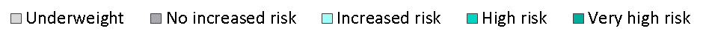
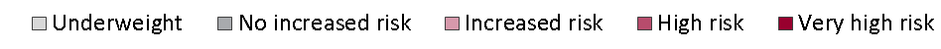
Change in prevalence of health risk categories
Using BMI and waist circumference
Health Survey for England 2018
1993-1994
2017-2018
Adults aged 16+. Using combined waist circumference and BMI classification, as recommended by NICE
Notes:
This chart shows the change in the England adult population’s risk of future obesity related ill-health using combined data for 1993 and 1994 as well as 2017 and 2018.
Using the combined BMI and waist circumference categories, a larger proportion of the adult population are now at increased, high, or very high risk of obesity-related ill-health than in 1993 to 1994. The proportion of men now at very high risk has more than doubled (from 11.3% to 22.9%), while for women the proportion at very high risk has nearly doubled (from 14.8% to 28.2%).
The published Health Survey for England data used to produce this chart is available from: https://digital.nhs.uk/data-and-information/publications/statistical/health-survey-for-england/2018

Slide 24
Prevalence of multiple risk factors: Obese men
Health Survey for England 2016 and 2017
Obesity (BMI ≥ 30kg/m²) plus one or more of:
Being a current cigarette smoker
Drinking >14 units of alcohol per week
Consuming <5 fruit and vegetables per day
Spending <30 minutes per week engaged in moderate-to-vigorous intensity physical activity
Adult (aged 16+) obesity: BMI ≥ 30kg/m²
Notes:
This chart shows the prevalence of other measured risk factors associated with poor health which are some of the leading modifiable causes of non-communicable diseases (NCDs) worldwide. It shows the proportion of men with obesity that also have other risk factors and the number of risk factors they have. The chart uses data from the Health Survey for England 2016 and 2017.
Obesity is one of the identified risk factors in the Multiple Risk Factors, Health Survey for England 2017 release. Alongside obesity the other risk factors that have been included for this release include:
Smoking: current cigarette smoker
Alcohol: drinking more than 14 units of alcohol per week
Fruit and Veg: consuming fewer than five portions of fruit and vegetables per day
Physical activity: spending less than 30 minutes per week engaged in moderate-to-vigorous intensity physical activity
The chart shows that the vast majority of men that are obese do have at least one other modifiable risk factor that will negatively influence their health. 47.9% of obese men have 3 or more risks (including obesity). It is important to note that the high proportion of obese men with multiple risk factors is mostly due to many of these individuals (85%) not eating at least 5 portions of fruit and vegetables per day. Other risk factors were less prevalent.
Due to rounding, percentages may not sum correctly.
The published Health Survey for England data used to produce this chart is available from: https://digital.nhs.uk/data-and-information/publications/statistical/health-survey-for-england/2017

Slide 25
Prevalence of multiple risk factors: Obese women
Health Survey for England 2016 and 2017
Obesity (BMI ≥ 30kg/m²) plus one or more of:
Being a current cigarette smoker
Drinking >14 units of alcohol per week
Consuming <5 fruit and vegetables per day
Spending <30 minutes per week engaged in moderate-to-vigorous intensity physical activity
Adult (aged 16+) obesity: BMI ≥ 30kg/m²
Notes:
This chart shows the prevalence of other measured risk factors associated with poor health which are some of the leading modifiable causes of non-communicable diseases (NCDs) worldwide. It shows the proportion of women with obesity that also have other risk factors and the number of risk factors they have. The chart uses data from the Health Survey for England 2016 and 2017.
Obesity is one of the identified risk factors in the Multiple Risk Factors, Health Survey for England 2017 release. Alongside obesity the other risk factors that have been included for this release include:
Smoking: current cigarette smoker
Alcohol: drinking more than 14 units of alcohol per week
Fruit and Veg: consuming fewer than five portions of fruit and vegetables per day
Physical activity: spending less than 30 minutes per week engaged in moderate-to-vigorous intensity physical activity
The chart shows that the vast majority of women that are obese do have at least one other modifiable risk factor that will negatively influence their health. 40.7% of obese women have 3 or more risks (including obesity). It is important to note that the high proportion of obese women with multiple risk factors is mostly due to many of these individuals (87.4%) not eating at least 5 portions of fruit and vegetables per day. Other risk factors were less prevalent.
Due to rounding, percentages may not sum correctly.
The published Health Survey for England data used to produce this chart is available from: https://digital.nhs.uk/data-and-information/publications/statistical/health-survey-for-england/2017

Slide 26
Data sources
Health Survey for England (HSE)
https://digital.nhs.uk/data-and-information/publications/statistical/health-survey-for-england
The HSE is a cross-sectional survey which samples a representative proportion of the population. The next report on the HSE 2019 is due to be published online in December 2020. The data should be available from the UK Data Archive in the summer following publication of the report.

Slide 27
For more information
PHE Obesity Intelligence Knowledge Hub
Register on https://khub.net/ and join the PHE Obesity Intelligence group
PHE Obesity Intelligence Knowledge Hub public library (no need to join)
https://khub.net/web/phe-obesity-intelligence/public-library
PHE Web
https://www.gov.uk/guidance/phe-data-and-analysis-tools#obesity-diet-and-physical-activity
Adult BMI data by local authority
https://fingertips.phe.org.uk/profile/public-health-outcomes-framework/supporting-information/further-info#obesity
Adult overweight and obese indicator (Public Health Outcomes Framework)
https://fingertips.phe.org.uk/profile/public-health-outcomes-framework/data#page/3/gid/1000042/pat/6/par/E12000007/ati/102/are/E09000002/iid/93088/age/168/sex/4
Email: obesity-riskfactorsintelligence@phe.gov.uk
Twitter: @PHE_Obesity

Slide 28
About Public Health England
Public Health England exists to protect and improve the nation's health and wellbeing, and reduce health inequalities. We do this through world-leading science, knowledge and intelligence, advocacy, partnerships and the delivery of specialist public health services. We are an executive agency of the Department of Health and Social Care, and a distinct delivery organisation with operational autonomy. We provide central government, local government, the NHS, Parliament, industry and the public with evidence-based professional, scientific and delivery expertise and support.
Public Health England
Wellington House
133-155 Waterloo Road
London SE1 8UG
Tel: 020 7654 8000
www.gov.uk/phe
Twitter: @PHE_uk
Facebook: www.facebook.com/PublicHealthEngland
© Crown copyright 2020
You may re-use this information (excluding logos) free of charge in any format or medium, under the terms of the Open Government Licence v3.0. To view this licence, visit https://www.nationalarchives.gov.uk/doc/open-government-licence/version/3/ or email psi@nationalarchives.gsi.gov.uk. Where we have identified any third party copyright information you will need to obtain permission from the copyright holders concerned.
Published February 2020
PHE publications gateway number: GW-1091

