Slide 1
Patterns and trends in child obesity in London
A presentation of the latest data on child obesity at regional level Februrary 2020

Slide 2
National Child Measurement Programme
The data in this slide pack is from the National Child Measurement Programme (NCMP).
The NCMP is an annual programme that measures the height and weight of children in Reception (aged 4 to 5 years) and Year 6 (aged 10 to 11 years) in England. Although the NCMP only covers certain age groups, it includes the majority of children in those year groups.
The number of children measured in London in 2018/19 was 92,786 in Reception, and 93,704 in Year 6. The participation rate in London in 2018/19 was 95.2% for children in Reception and 95.4% for children in Year 6.
NCMP website:
http://content.digital.nhs.uk/ncmp
2 Patterns and trends in child obesity in London

Slide 3
Child BMI classification definitions for population monitoring
For population monitoring purposes body mass index (BMI) is classified according to the following image using the British 1990 growth reference (UK90 ). This helps examine patterns in children’s weight status across the country and over time.
1
1 Cole TJ, Freeman JV, Preece MA. Body mass index reference curves for the UK, 1990. Archives of Disease in Childhood 1995 73:25-29.
3 Patterns and trends in child obesity in London

Slide 4
Child obesity in London
Prevalence of excess weight by sex and age
2018/19
Around 1 in 5 children in Reception (aged 4-5 years) are overweight or obese (21.8%)
Boys: 22.5%
Girls: 21.0%
Around 2 in 5 children in Year 6 (aged 10-11 years) are overweight or obese (37.9%)
Boys: 41.1%
Girls: 34.7%
4 Patterns and trends in child obesity in London

Slide 5
Child obesity in London
Prevalence of obesity by age and sex
2018/19
Around 1 in 10 children in Reception (aged 4-5 years) are obese (10.2%)
Boys: 10.8%
Girls: 9.5%
Over 1 in 5 children in Year 6 (aged 10-11 years) are obese (23.2%)
Boys: 26.2%
Girls: 20.2%
5 Patterns and trends in child obesity in London

Slide 6
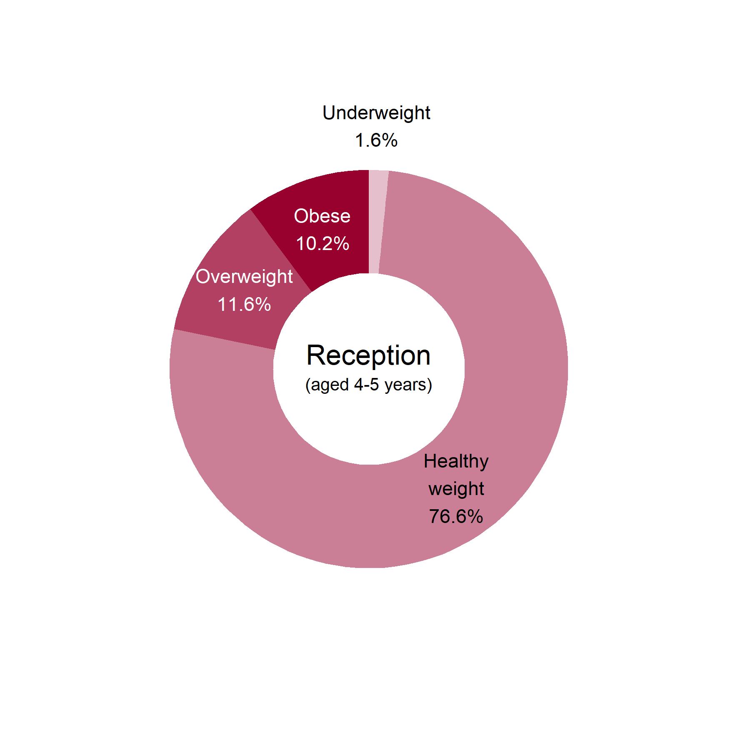
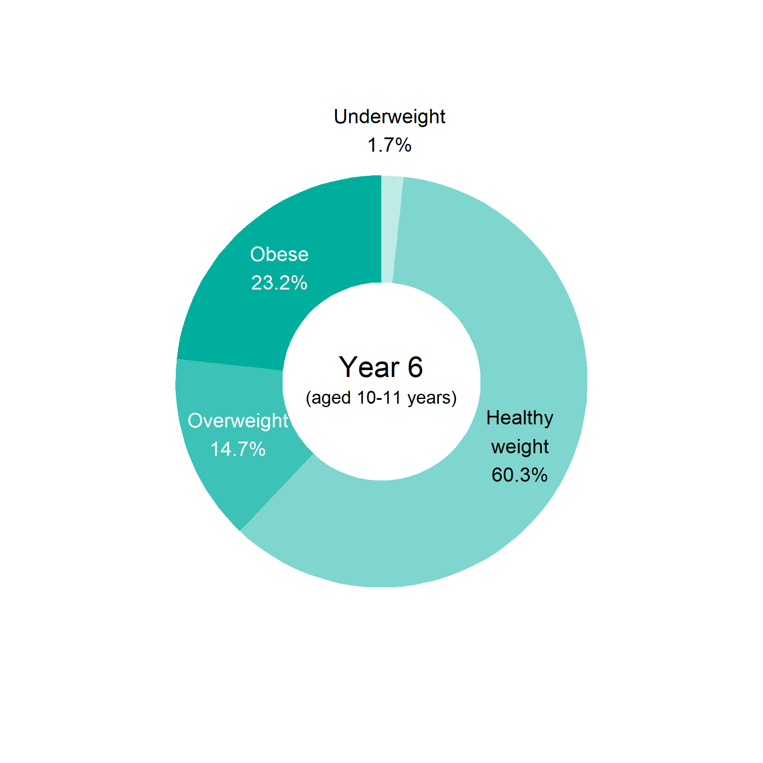
Child obesity in London
BMI status of children by age
2018/19
6 Patterns and trends in child obesity in London

Slide 7
Child obesity in London
BMI status of children by age
2018/19
Reception
Year 6
7 Patterns and trends in child obesity in London

Slide 8
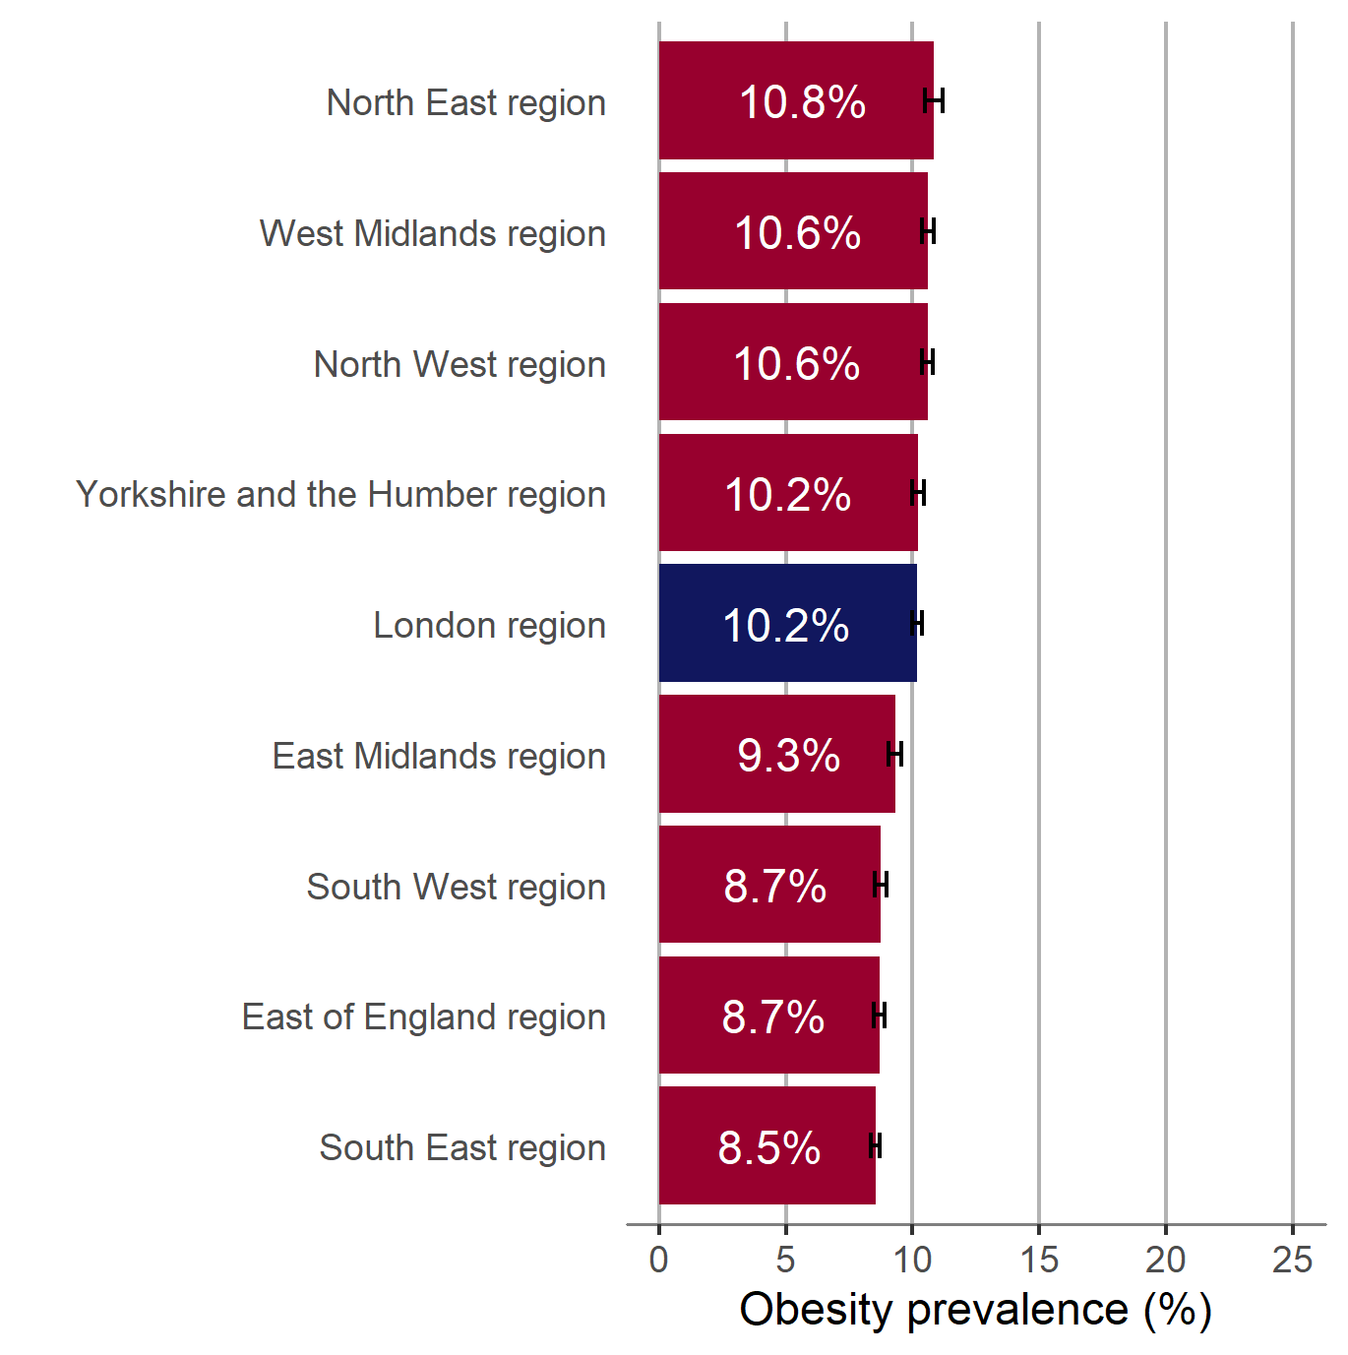
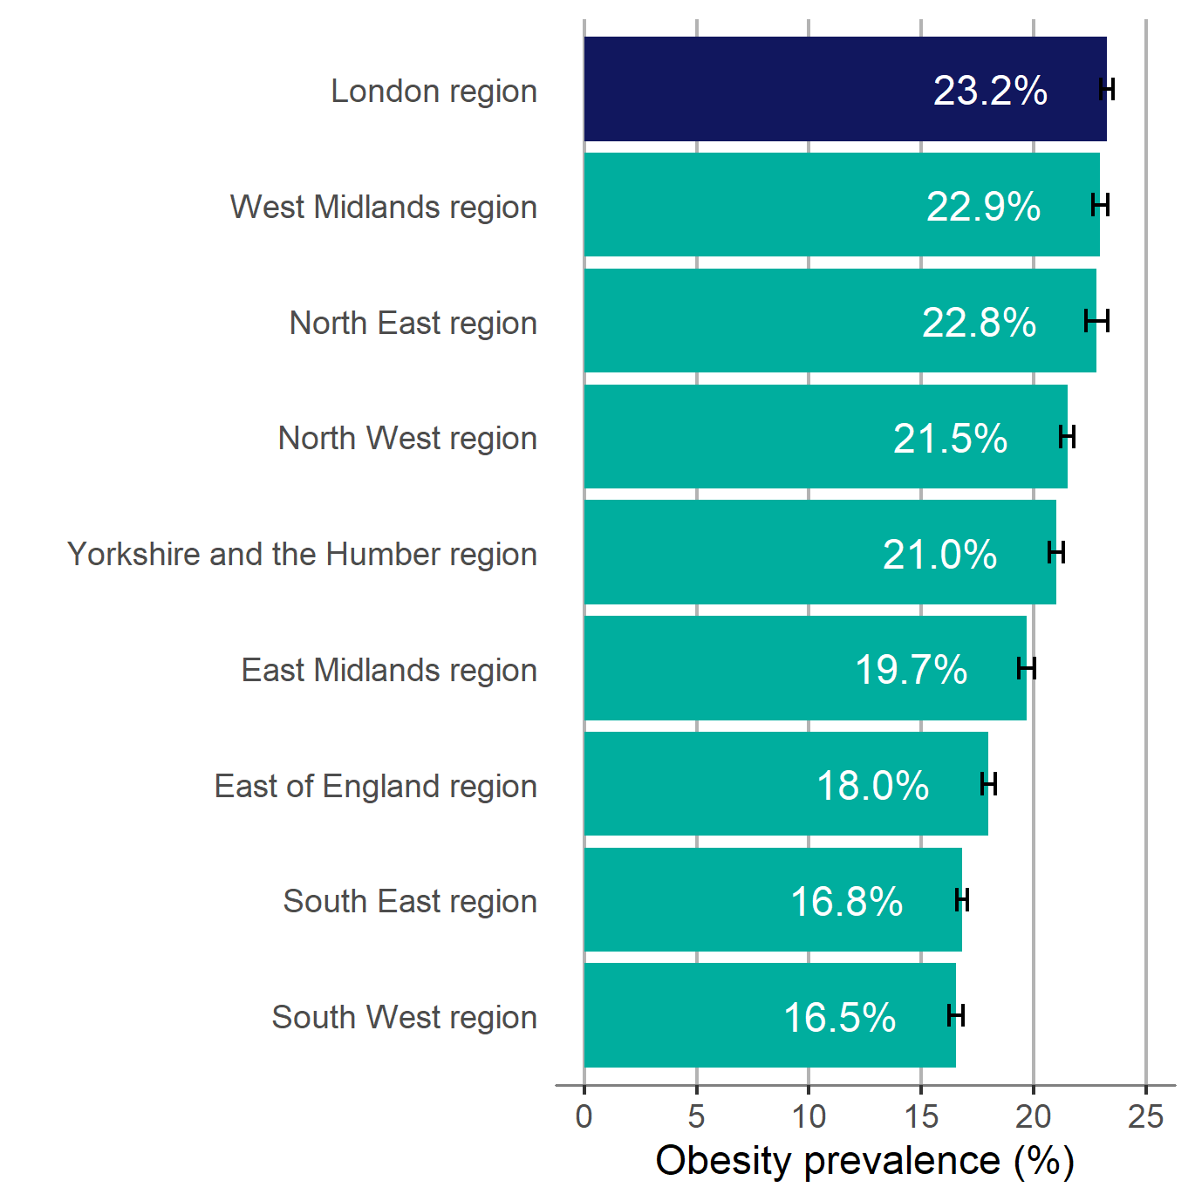
Child obesity in London
Prevalence of obesity by region and age
2018/19
Children in Reception (aged 4-5 years)
Children in Year 6 (aged 10-11 years)
95% confidence intervals are shown
8 Patterns and trends in child obesity in London

Slide 9
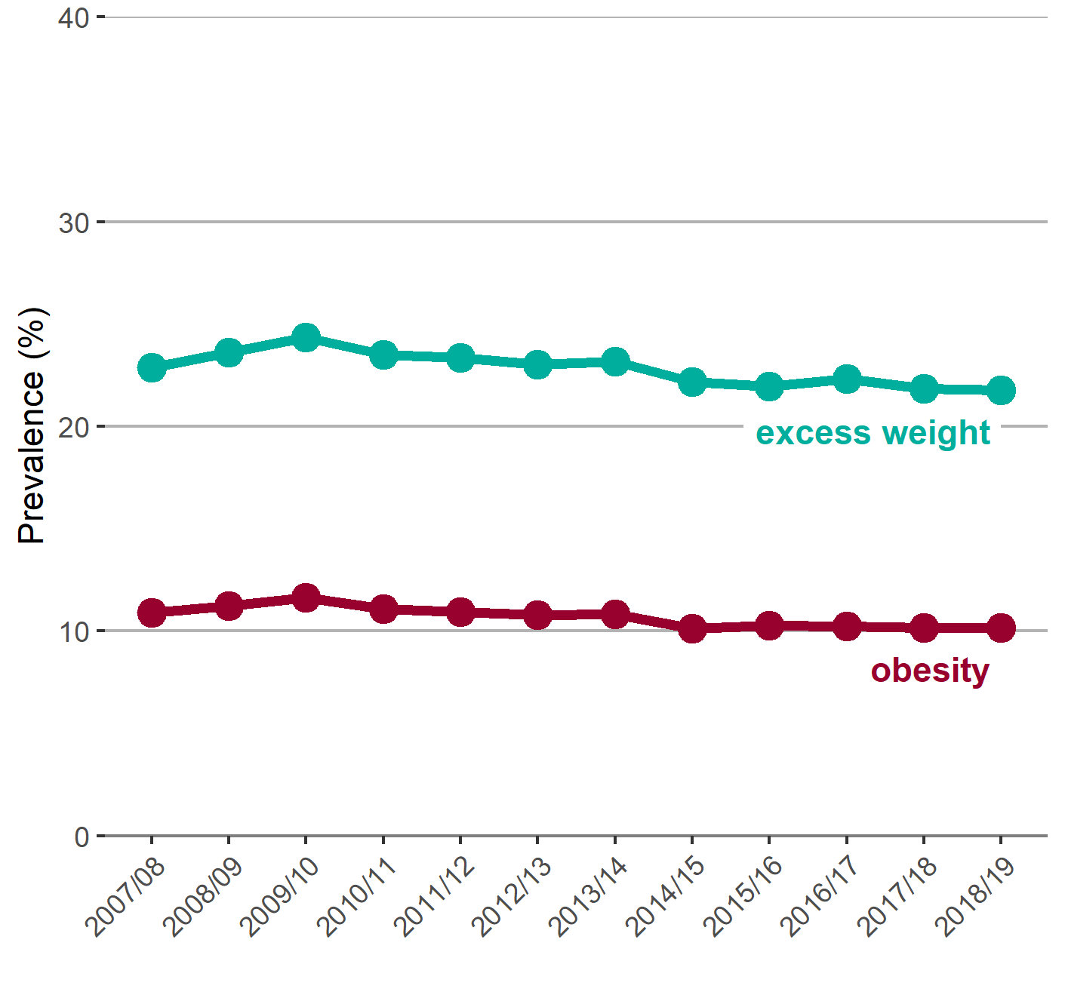
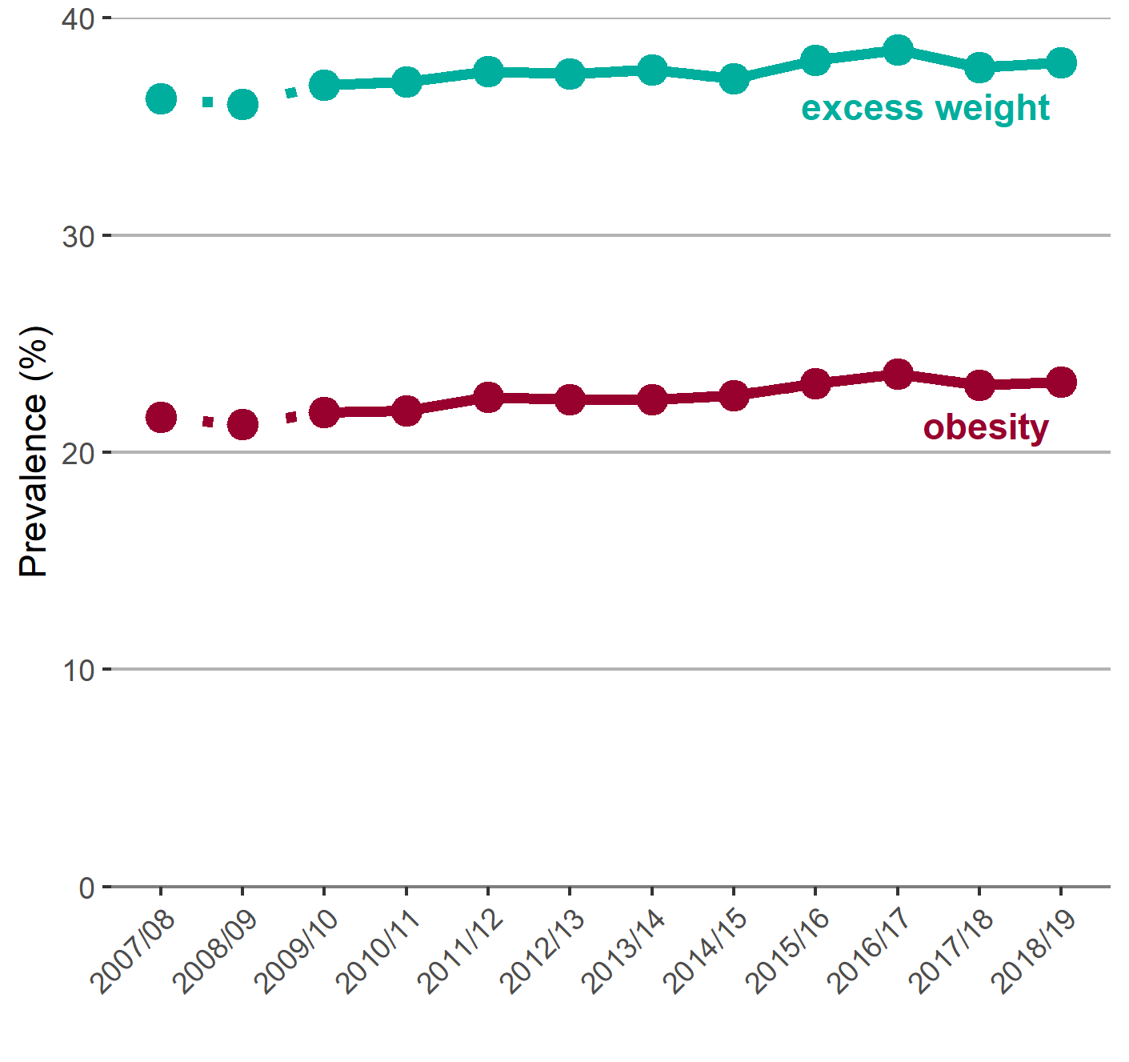
Child obesity in London
Trend in the prevalence of obesity and excess weight by age
Children in Reception (aged 4-5 years)
Children in Year 6 (aged 10-11 years)
Note: for Year 6, comparisons are not possible with the first years of the NCMP (2006/07 to 2008/09) as low participation levels led to underestimation of obesity prevalence
9 Patterns and trends in child obesity in London

Slide 10
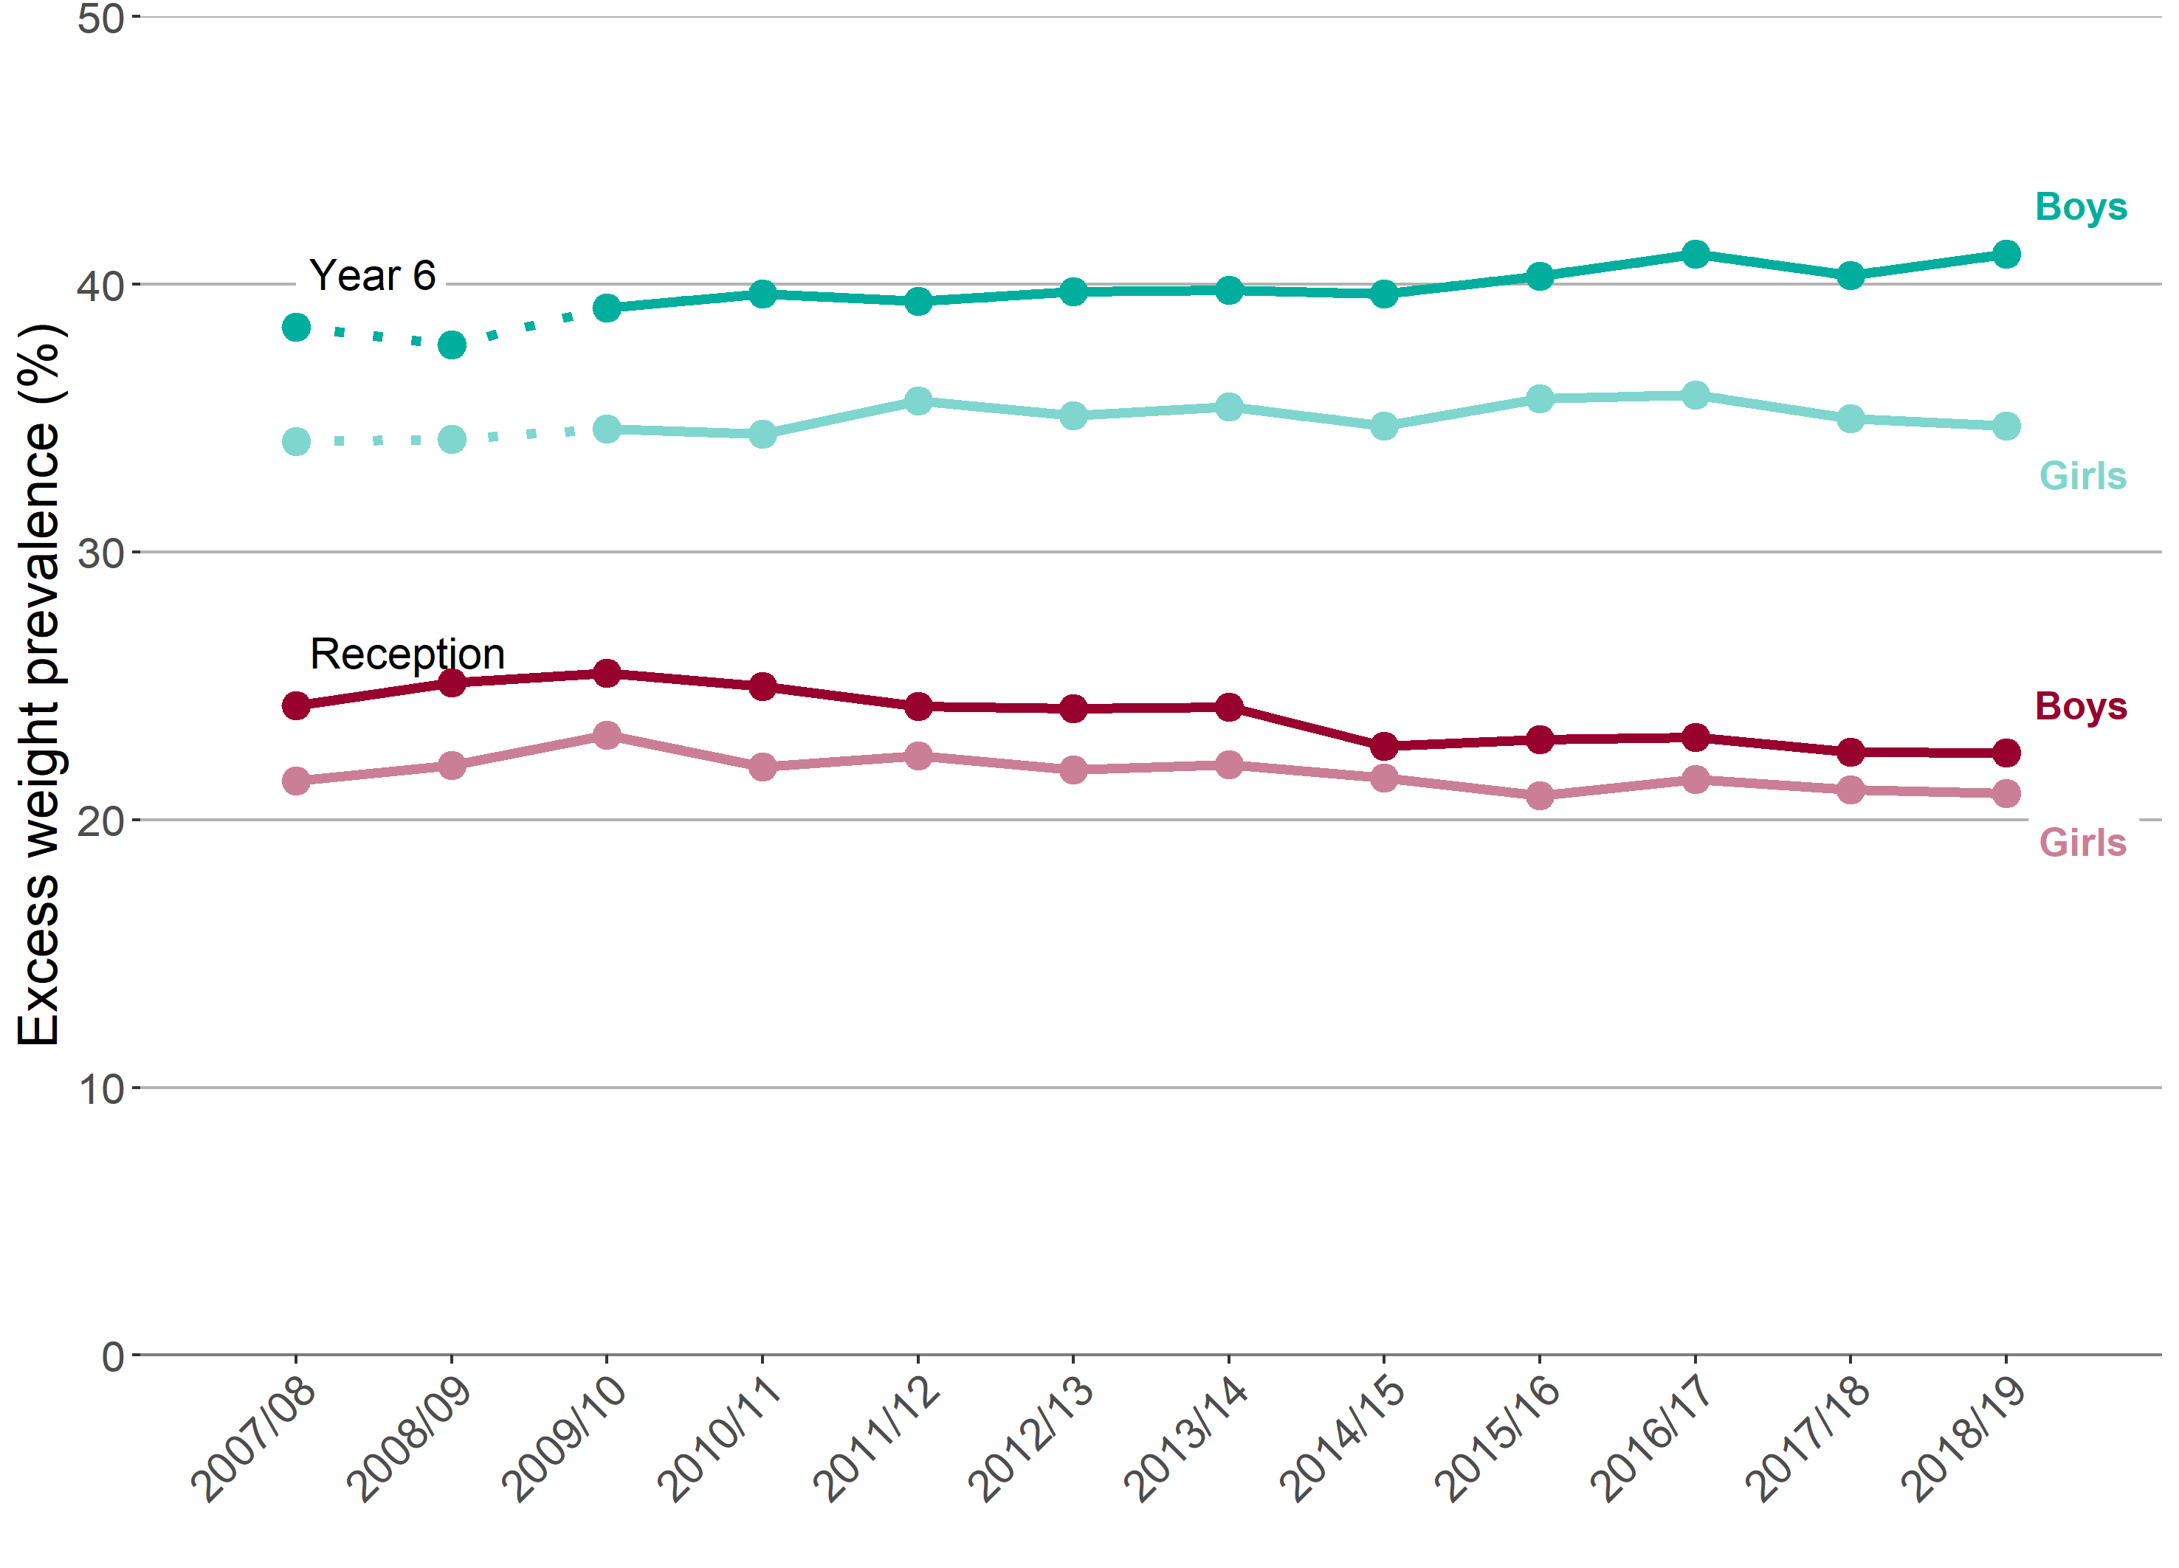
Child obesity in London
Trend in the prevalence of excess weight by sex and age
Reception (aged 4-5 years) and Year 6 (aged 10-11 years)
Note: for Year 6, comparisons are not possible with the first years of the NCMP (2006/07 to 2008/09) as low participation levels led to underestimation of obesity prevalence
10 Patterns and trends in child obesity in London

Slide 11
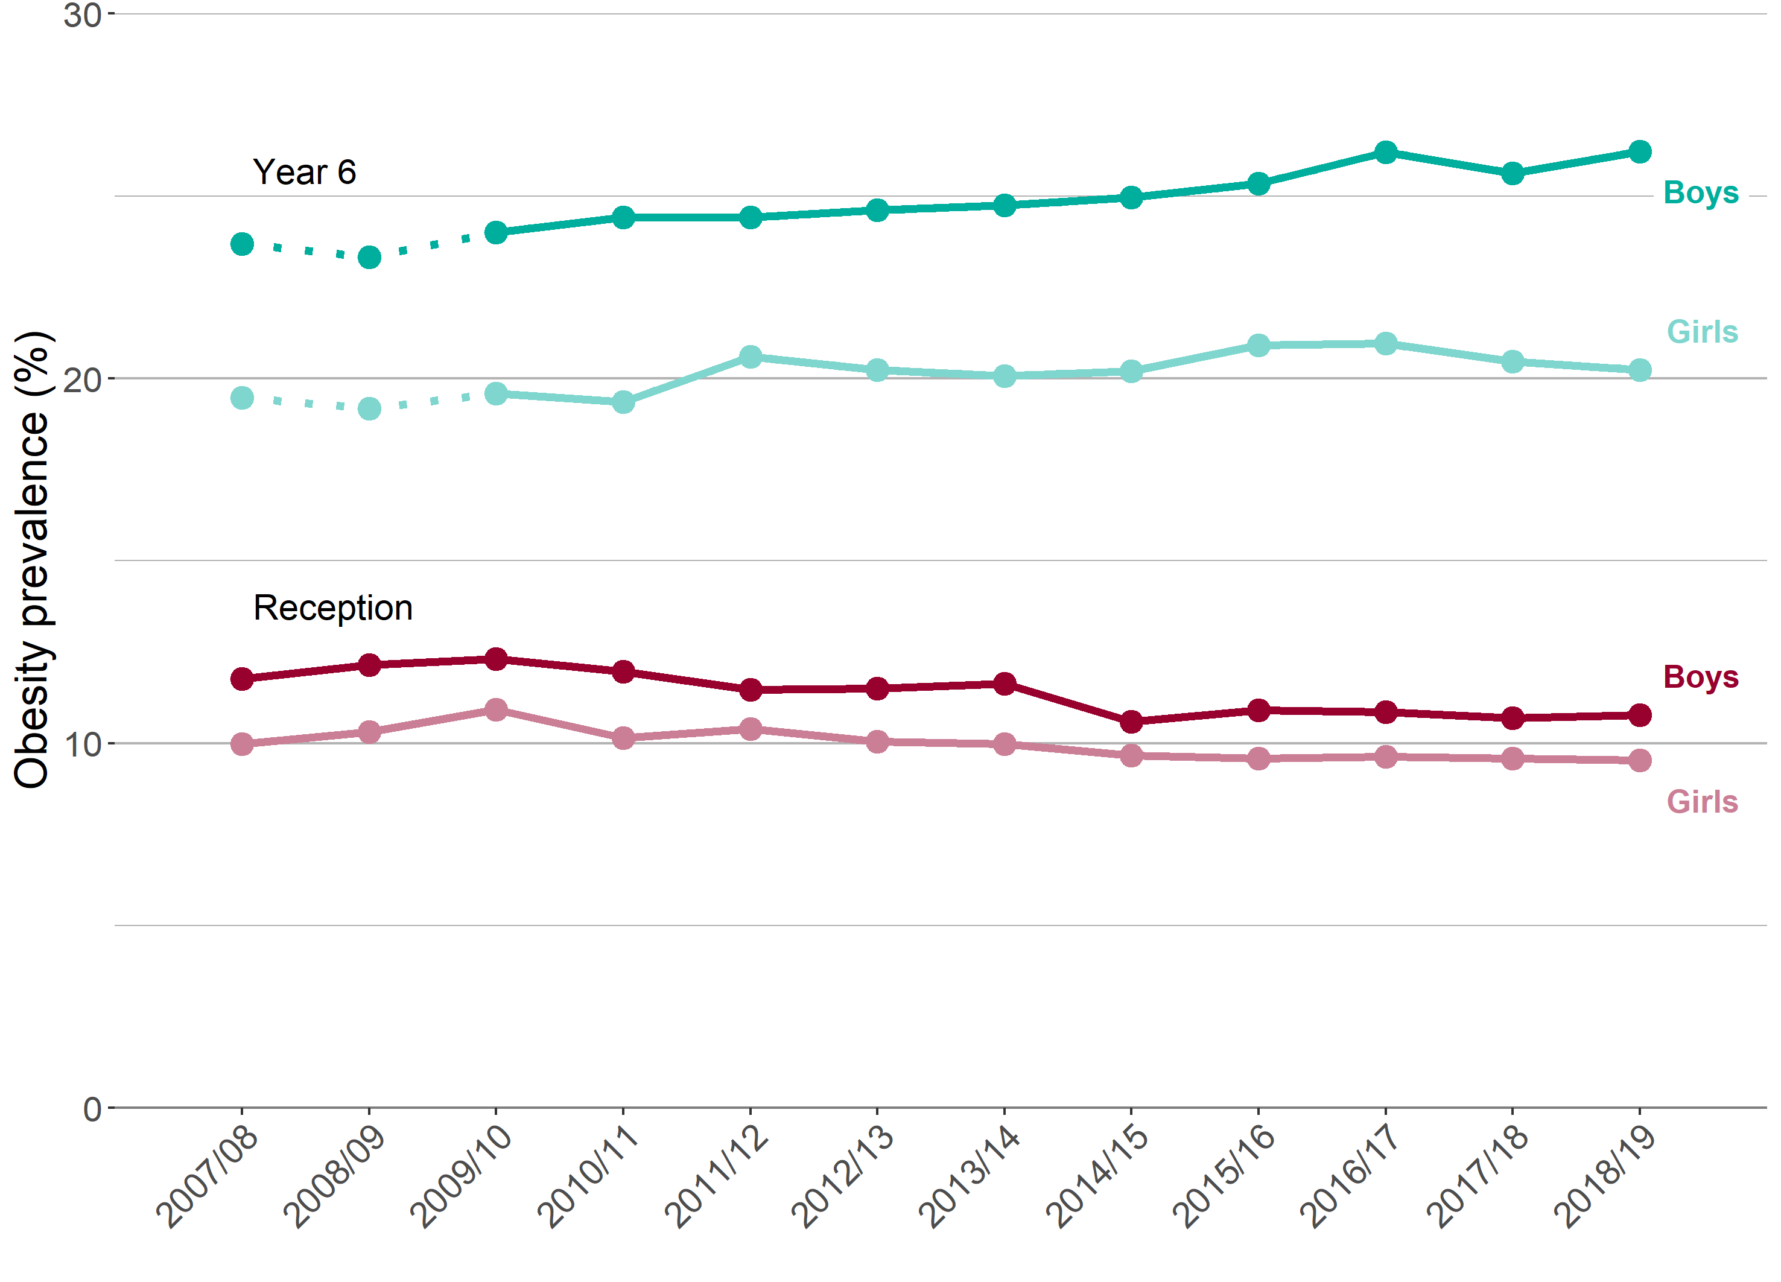
Child obesity in London
Trend in the prevalence of obesity by sex and age
Reception (aged 4-5 years) and Year 6 (aged 10-11 years)
Note: for Year 6, comparisons are not possible with the first years of the NCMP (2006/07 to 2008/09) as low participation levels led to underestimation of obesity prevalence
11 Patterns and trends in child obesity in London

Slide 12
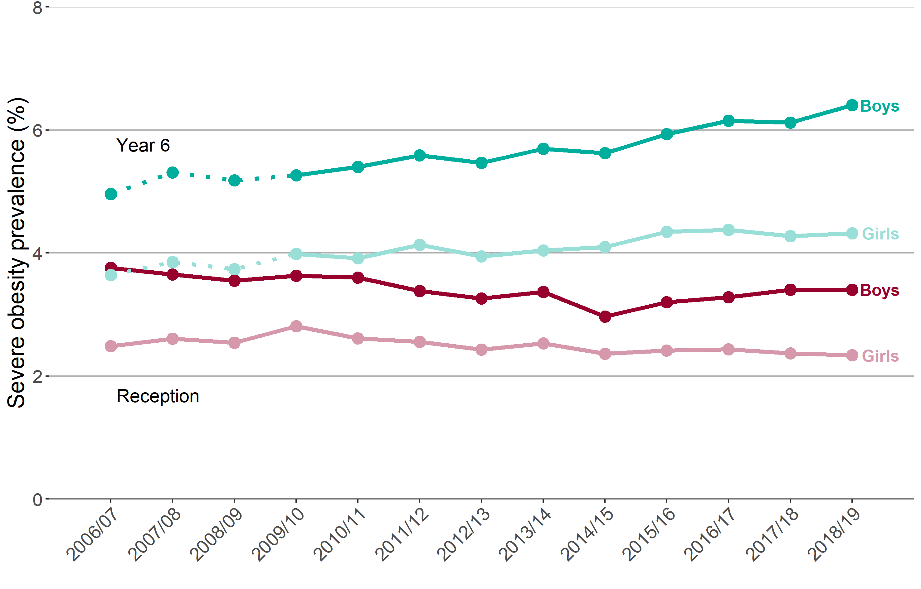
Child obesity in London
Trend in the prevalence of severe obesity by age and sex
Reception (aged 4-5 years) and Year 6 (aged 10-11 years)
Note: for Year 6, comparisons are not possible with the first years of the NCMP (2006/07 to 2008/09) as low participation levels led to underestimation of obesity prevalence
12 Patterns and trends in child obesity in London

Slide 13
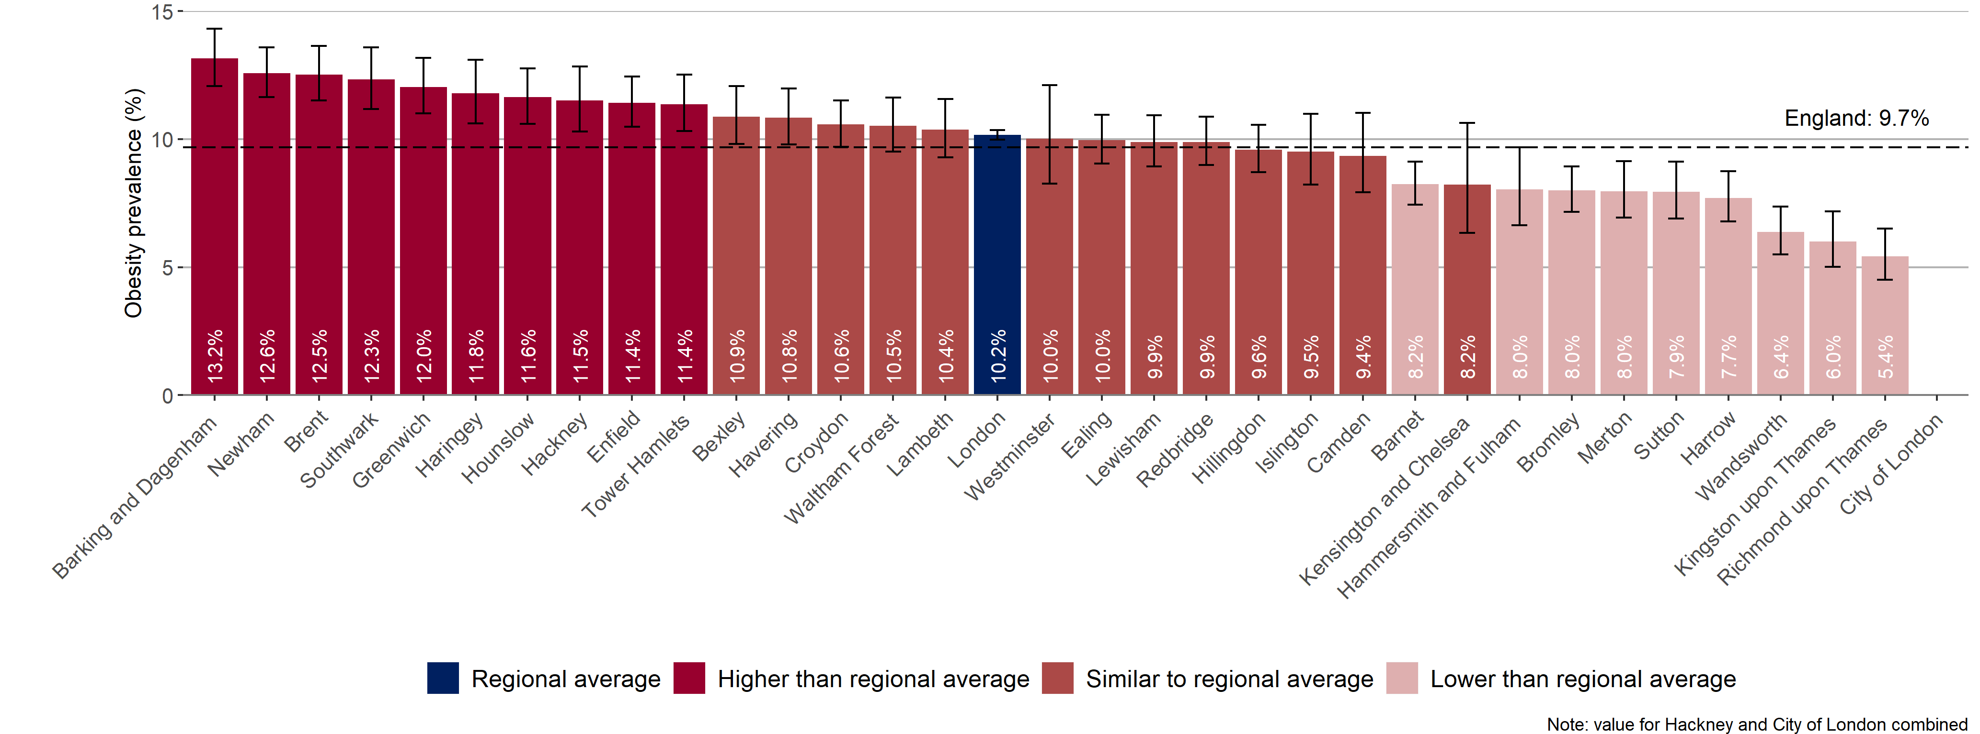
Child obesity in London
Prevalence of obesity, 2018/19
London District and Unitary Authorities
Children in Reception (aged 4-5 years)
95% confidence intervals are shown
13 Patterns and trends in child obesity in London

Slide 14
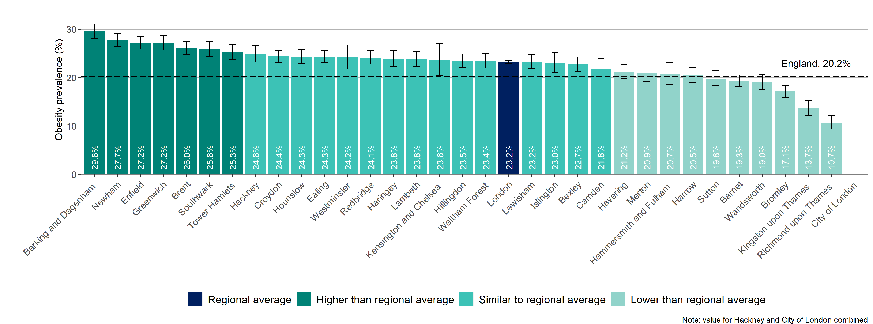
Child obesity in London
Prevalence of obesity, 2018/19
London District and Unitary Authorities
Children in Year 6 (aged 10-11 years)
95% confidence intervals are shown
14 Patterns and trends in child obesity in London

Slide 15
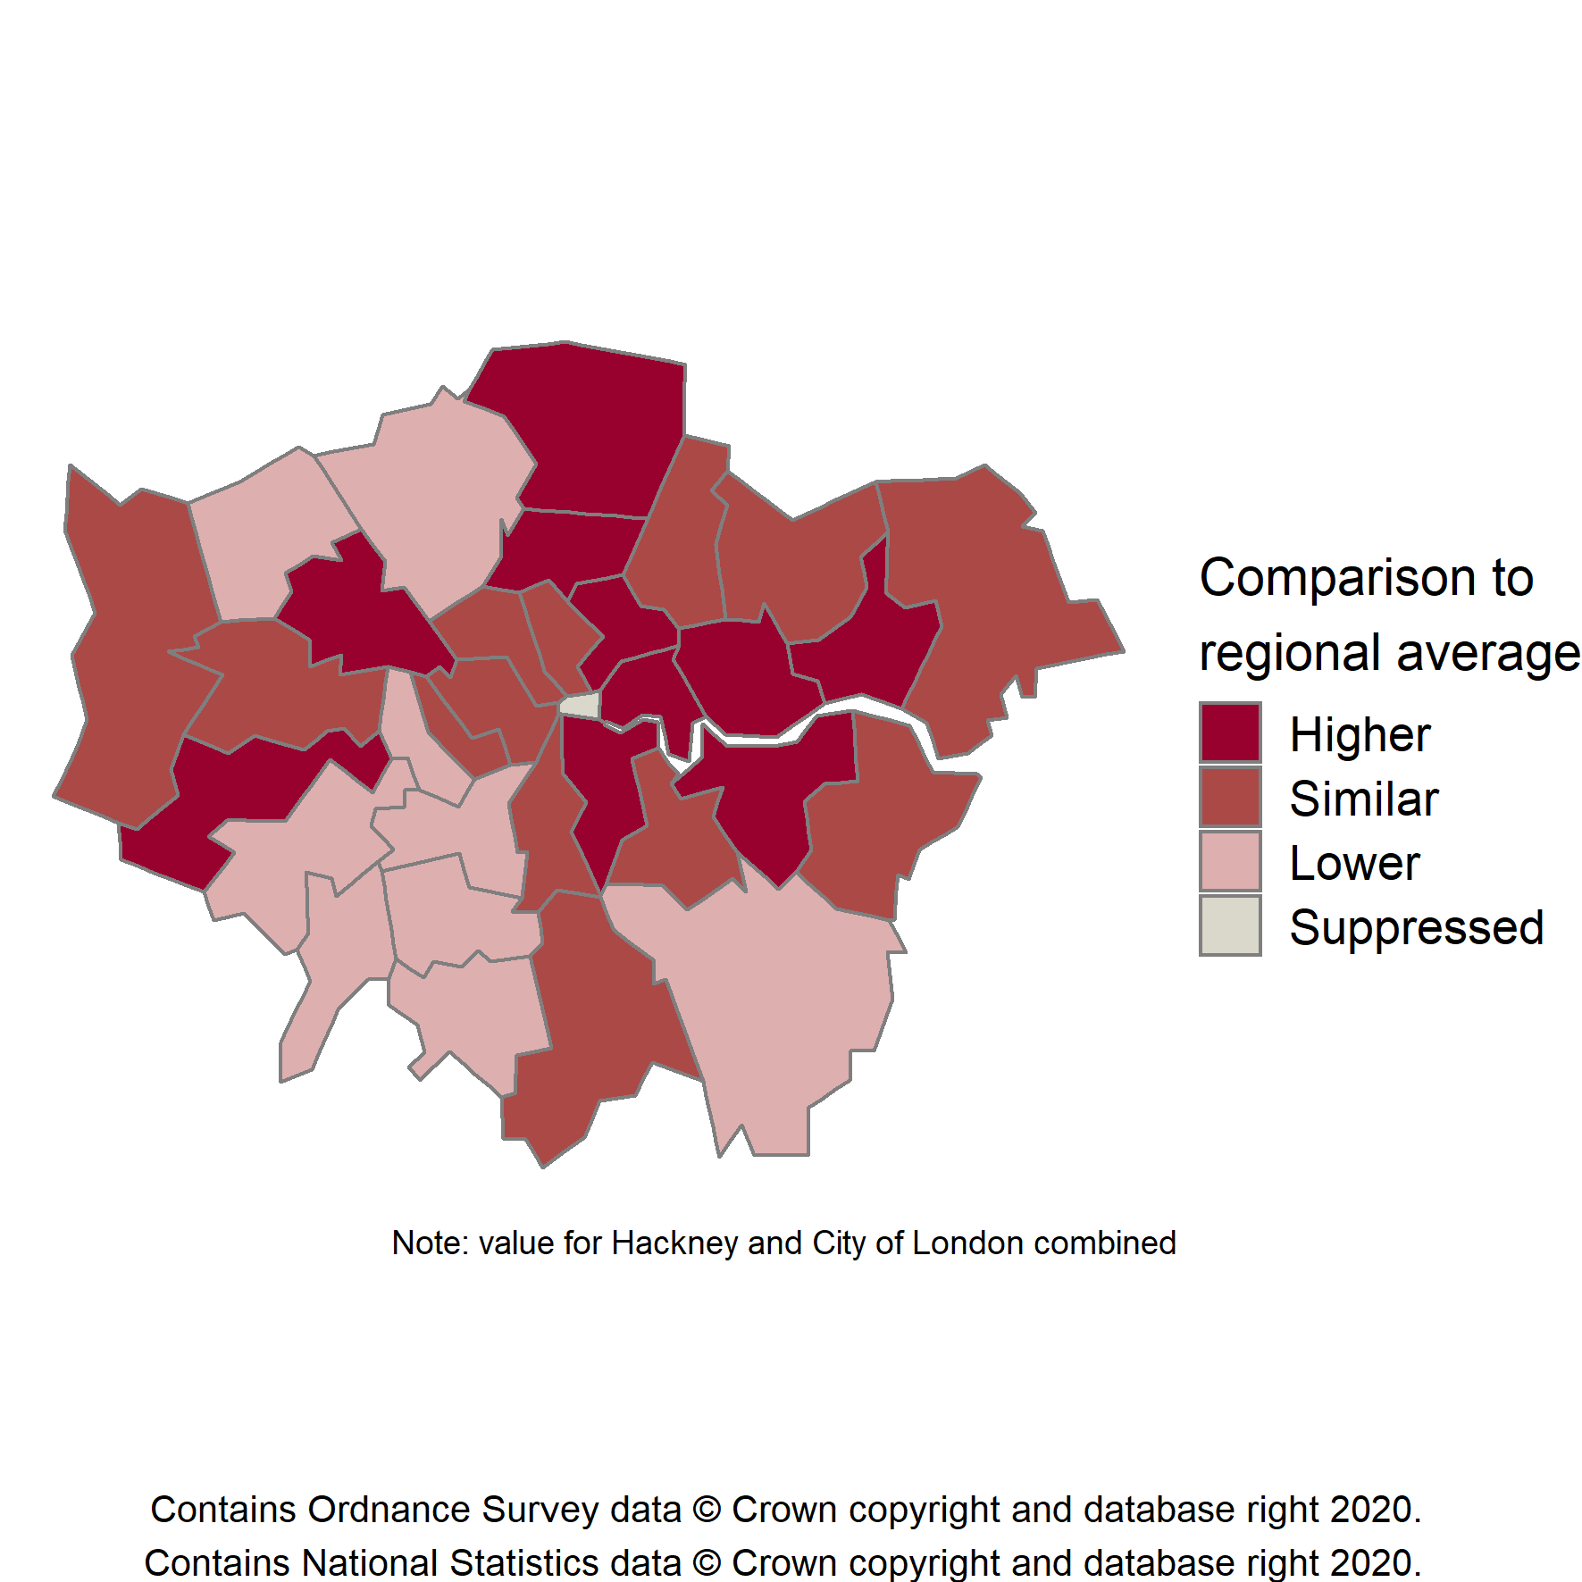
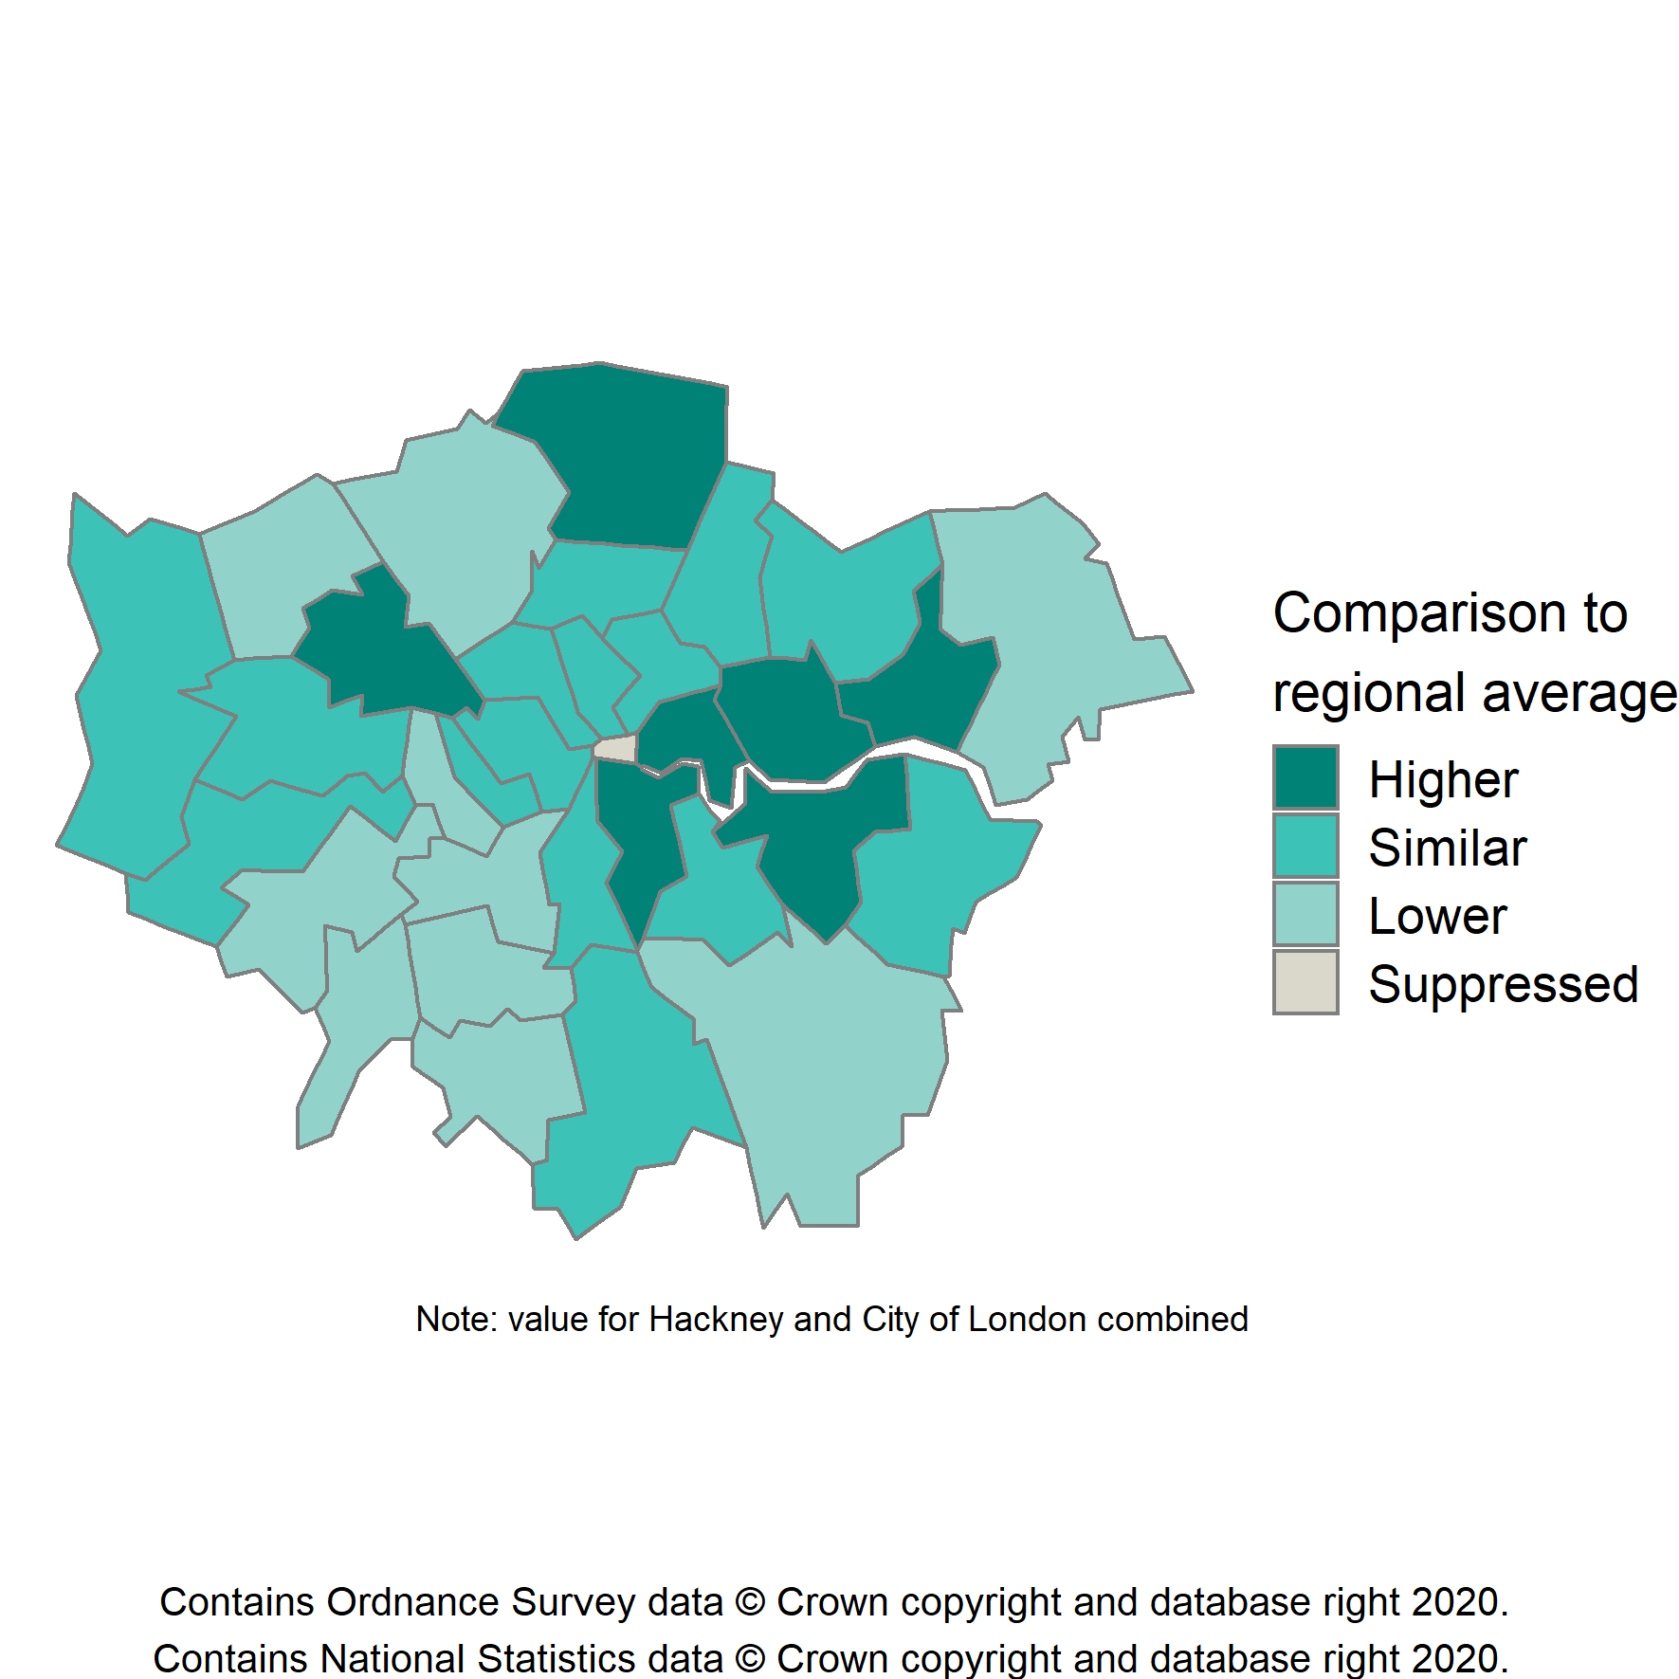
Child obesity in London
Prevalence of obesity by age, 2018/19
London District and Unitary Authorities
Children in Reception (aged 4-5 years)
Children in Year 6 (aged 10-11 years)
15 Patterns and trends in child obesity in London

Slide 16
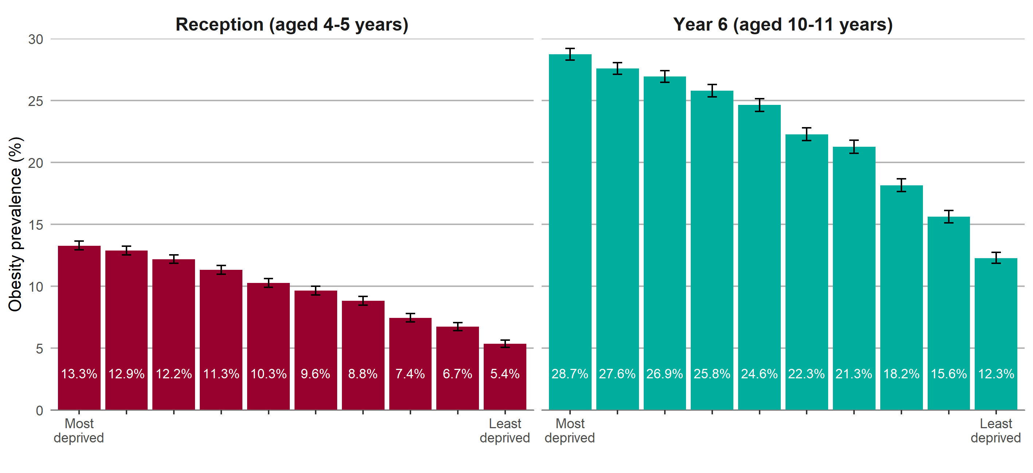
Child obesity in London
Obesity prevalence by regional deprivation and age
Data grouped over 3 years ( 2016/17-2018/19 ) Region-specific deprivation deciles displayed (IMD 2015) 95% confidence intervals are shown
16 Patterns and trends in child obesity in London

Slide 17
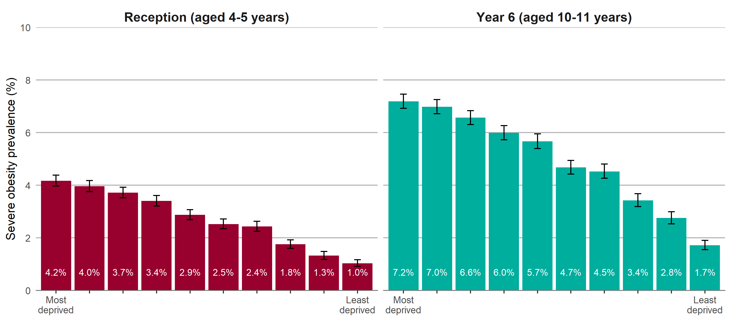
Child obesity in London
Severe obesity prevalence by regional deprivation and age
Data grouped over 3 years ( 2016/17-2018/19 ) Region-specific deprivation deciles displayed (IMD 2015) 95% confidence intervals are shown
17 Patterns and trends in child obesity in London

Slide 18
Slope Index of Inequality
The Slope Index of Inequality (SII) is a measure of the social gradient in an indicator and shows how much the indicator varies with deprivation (by deprivation decile).
It takes account of inequalities across the whole range of deprivation within each region and summarises this into a single number.
The higher the value of the SII, the greater the inequality within an area. The SII is greater in Year 6 children than in Reception.
Increasing SII over time indicates widening inequality.
For further information on the SII see: Regidor E. Measures of health inequalities: part 2. Journal of Epidemiology & Community Health 2004 –58:900-903.
18 Patterns and trends in child obesity in London

Slide 19
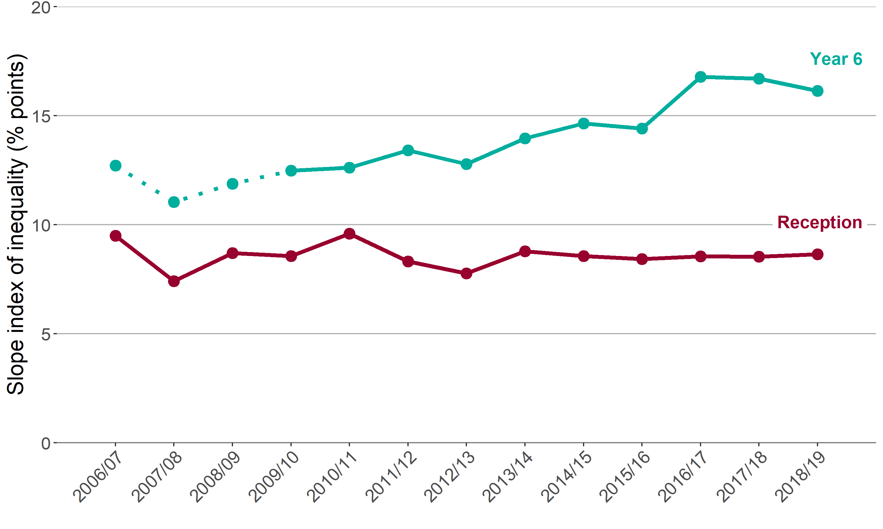
Child obesity in London
Trend in the slope index of inequality by age
Reception (aged 4-5 years) and Year 6 (aged 10-11 years)
Note: for Year 6, comparisons are not possible with the first years of the NCMP (2006/07 to 2008/09) as low participation levels led to underestimation of obesity prevalence
19 Patterns and trends in child obesity in London

Slide 20
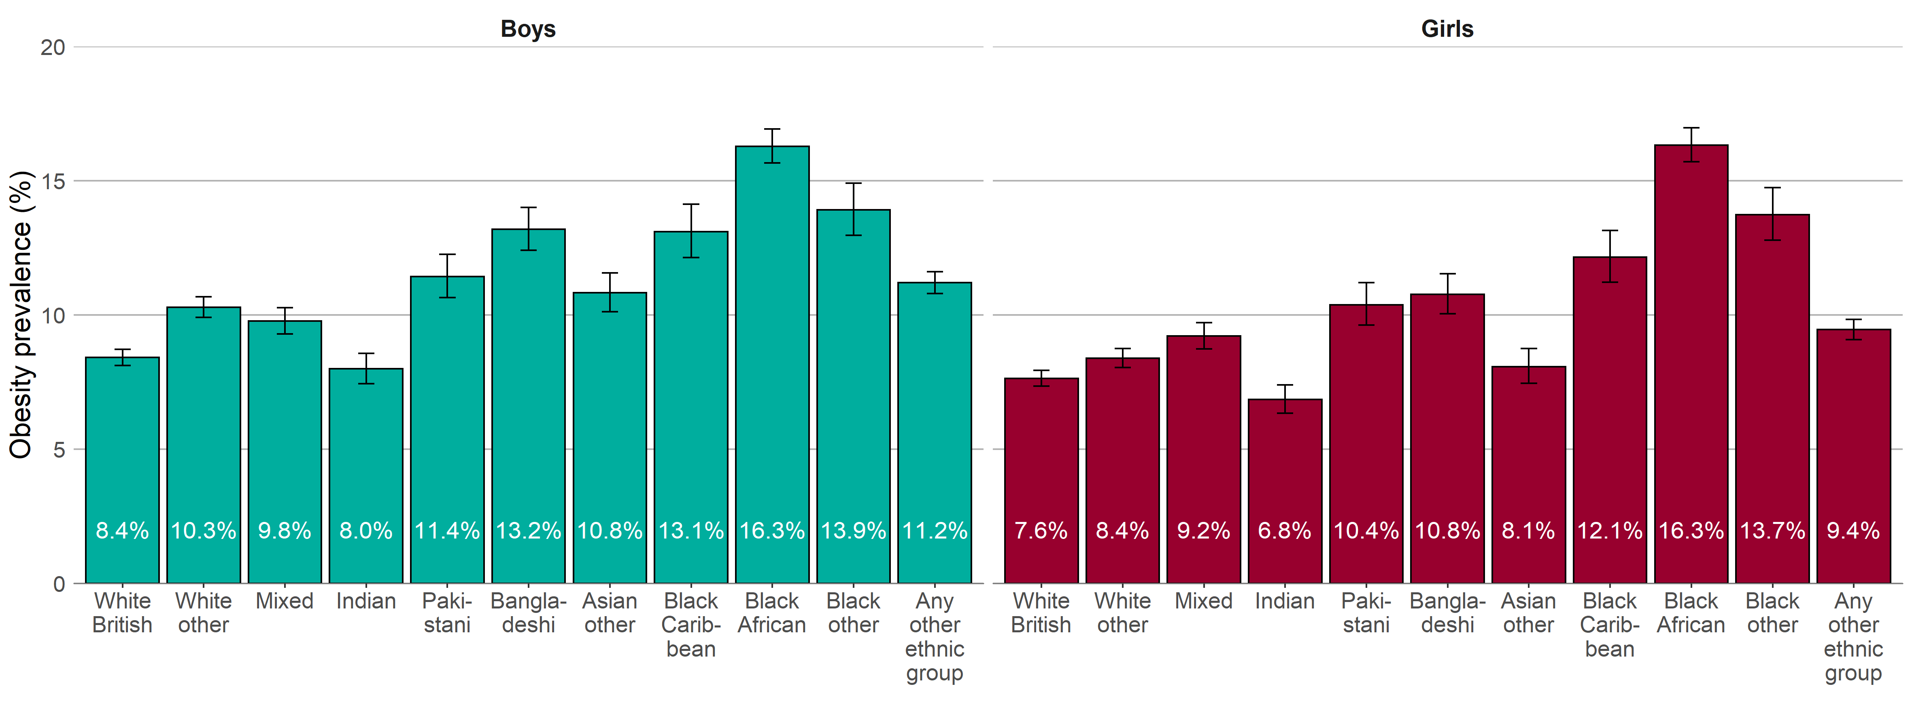
Child obesity in London
Obesity prevalence by ethnic group and sex
Children in Reception (aged 4-5 years)
Data grouped over 3 years ( 2016/17-2018/19 ) 95% confidence intervals are shown
20 Patterns and trends in child obesity in London

Slide 21
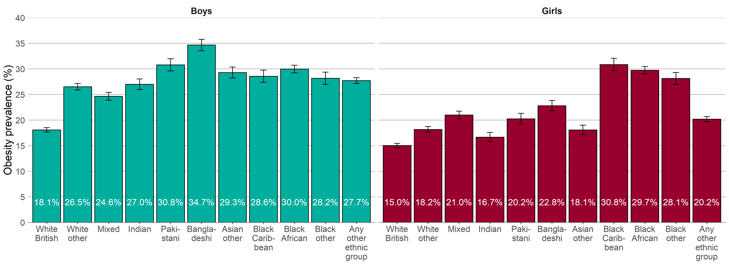
Child obesity in London
Obesity prevalence by ethnic group and sex
Children in Year 6 (aged 10-11 years)
Data grouped over 3 years ( 2016/17-2018/19 ) 95% confidence intervals are shown
21 Patterns and trends in child obesity in London

Slide 22
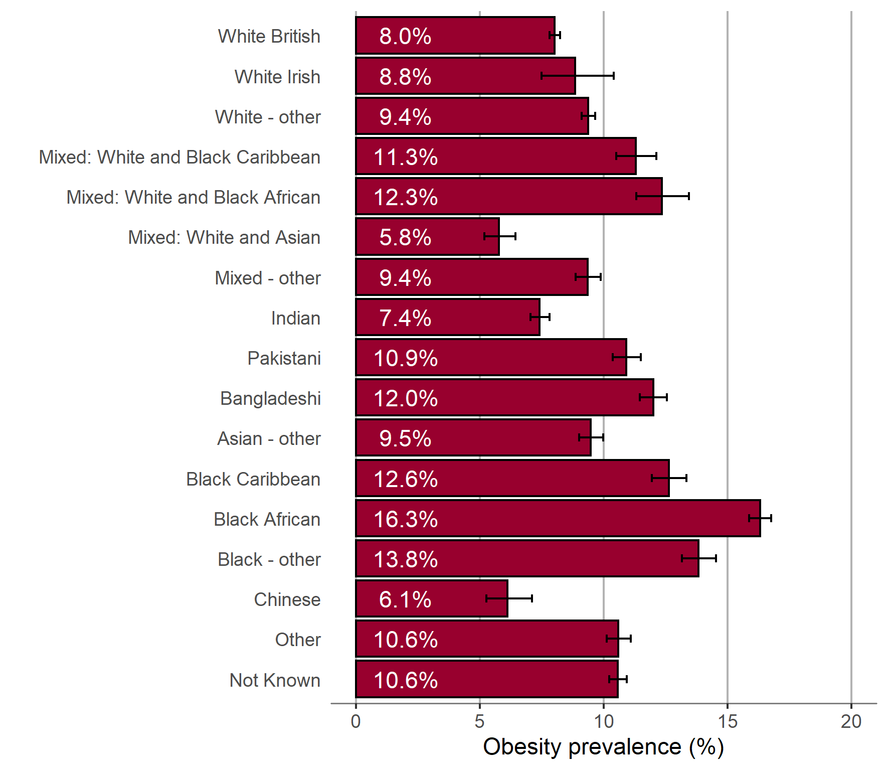
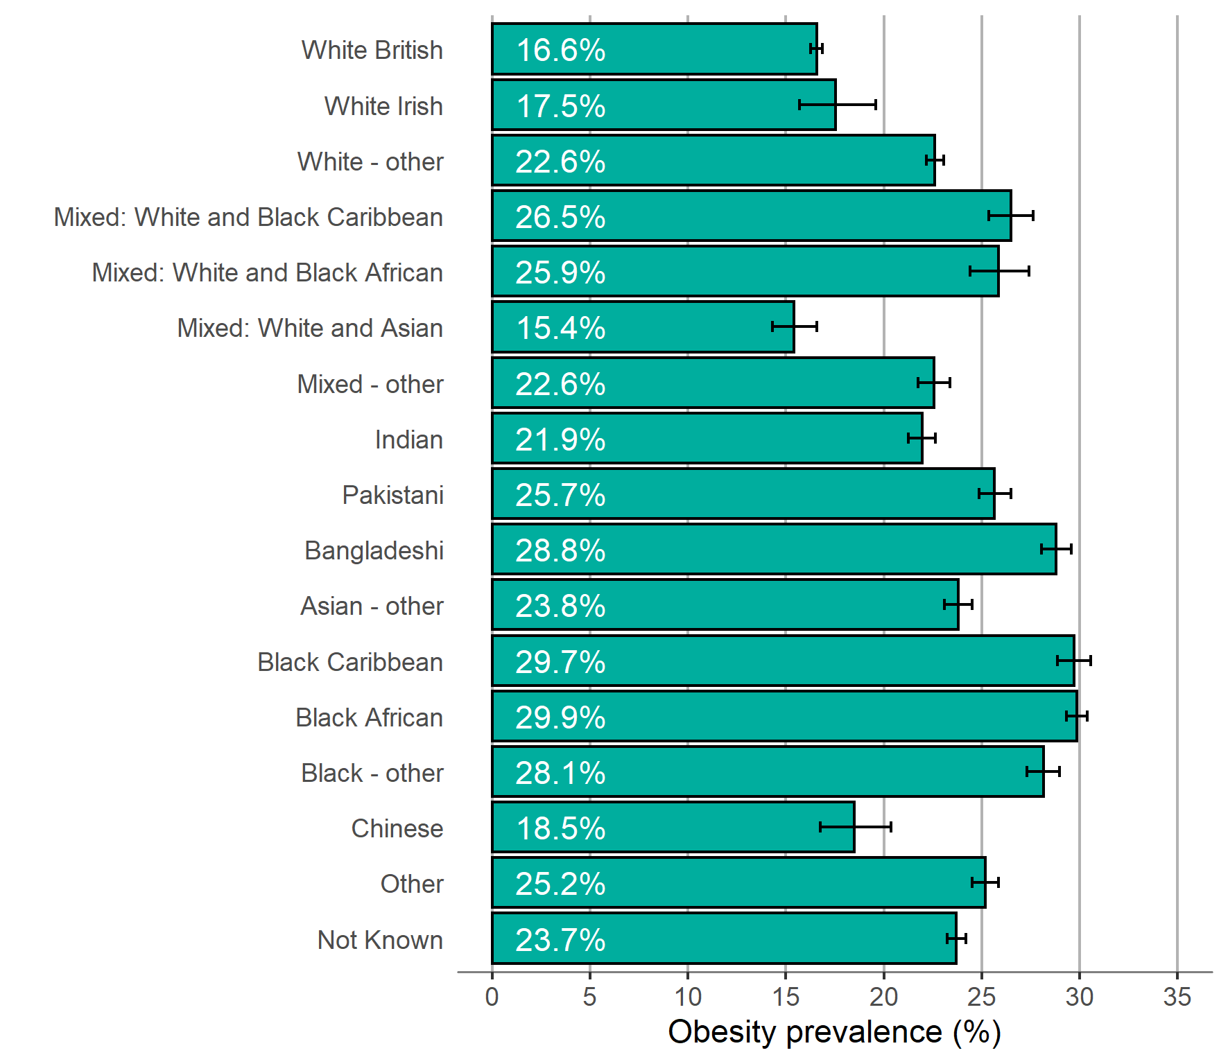
Child obesity in London
Obesity prevalence by ethnic group and age
Children in Reception (aged 4-5 years)
Children in Year 6 (aged 10-11 years)
Data grouped over 3 years ( 2016/17-2018/19 ) 95% confidence intervals are shown
22 Patterns and trends in child obesity in London

Slide 23
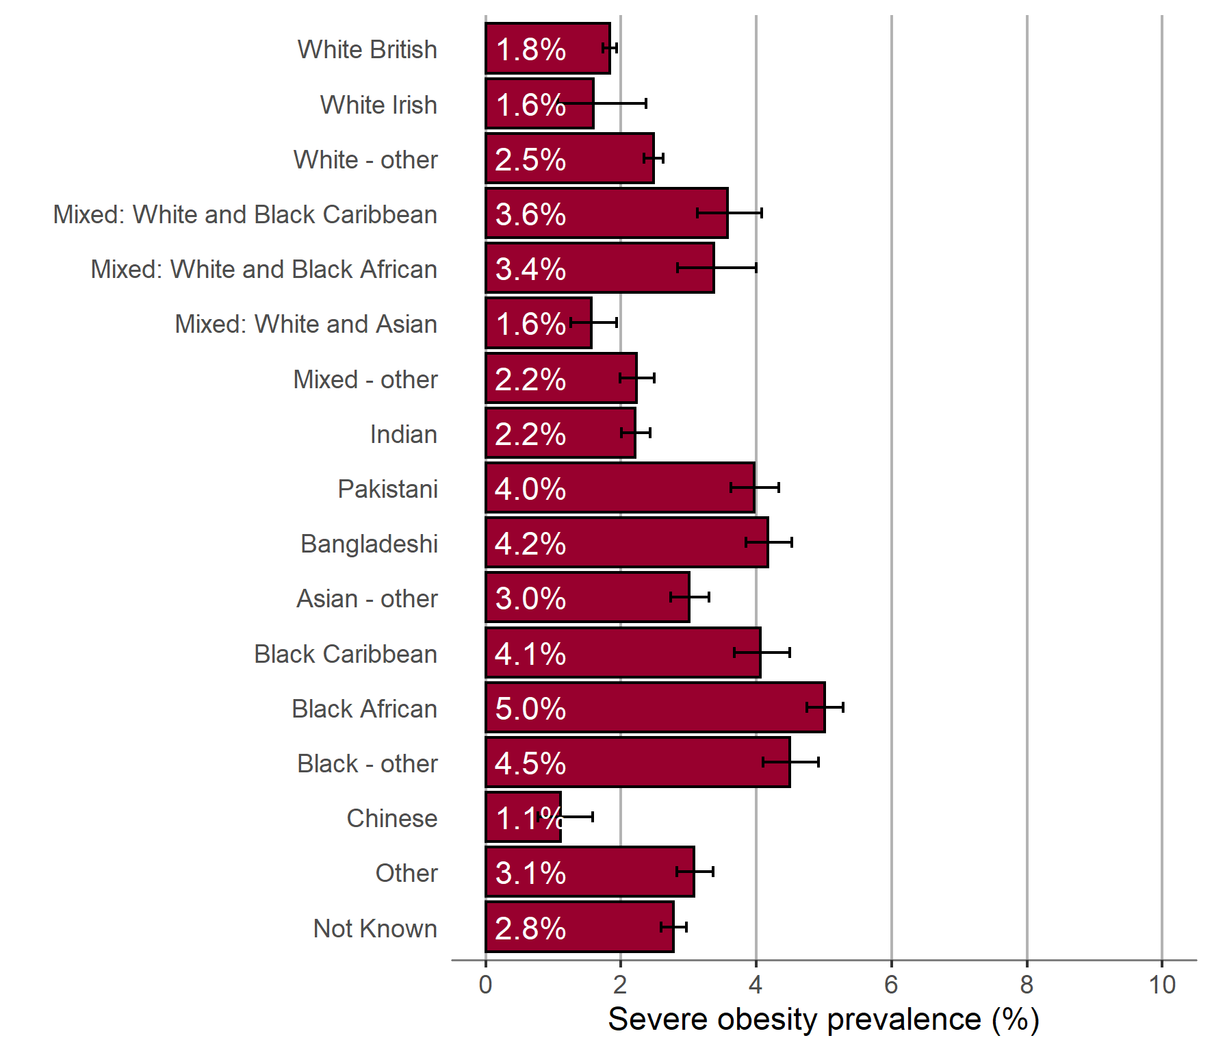
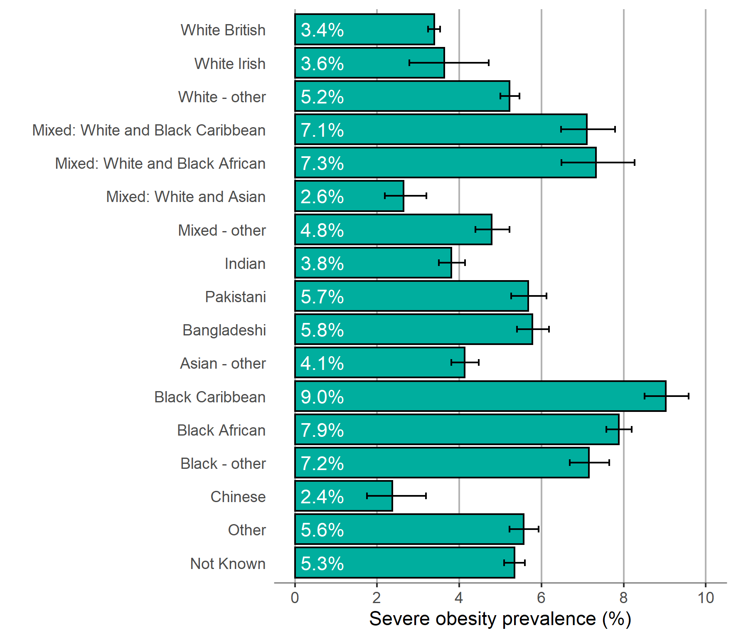
Child obesity in London
Severe obesity prevalence by ethnic group and age
Children in Reception (aged 4-5 years)
Children in Year 6 (aged 10-11 years)
Data grouped over 3 years ( 2016/17-2018/19 ) 95% confidence intervals are shown
23 Patterns and trends in child obesity in London

Slide 24
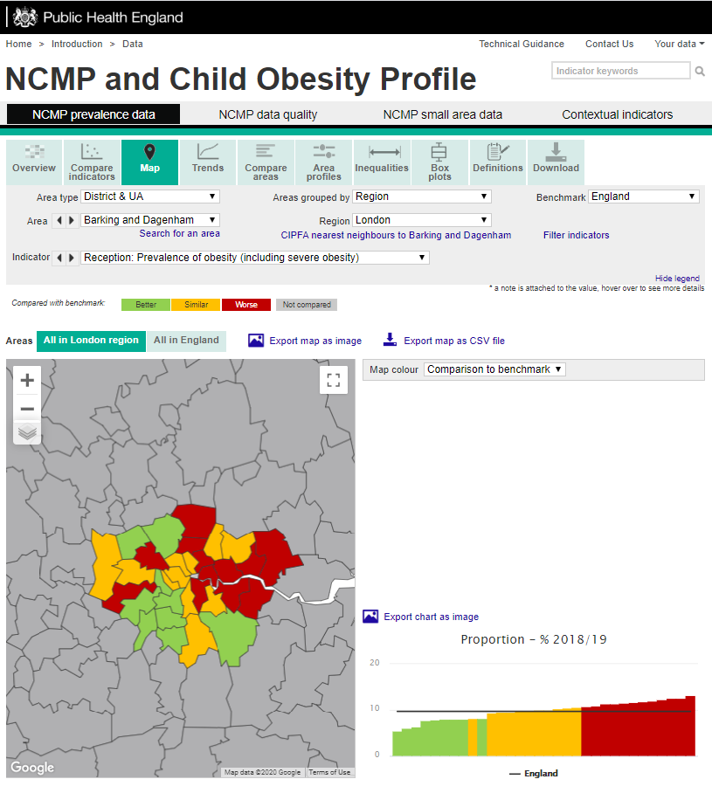
NCMP and Child Obesity Profile - an online tool
Child obesity data from the NCMP 2006/07 to 2018/19 is available in an online tool. The tool provides local authority level child data (underweight, healthy weight, overweight, obesity, excess weight - overweight including obesity, severe obesity) for Reception (aged 4-5 years) and Year 6 (aged 10-11 years). The tool also presents trend data and enables easy comparison of local authority data, allowing users to compare regional neighbours and local authorities with similar characteristics. Inequalities data (sex, deprivation and ethnic group) is also available by local authority. View the online tool:
http://fingertips.phe.org.uk/profile/national-child-measurement-programme
Screenshot of webpage
24 Patterns and trends in child obesity in London

Slide 25
Further information:
PHE Obesity Intelligence Knowledge Hub:
Sign up on https://khub.net/ and join the PHE Obesity Intelligence group
PHE Obesity Intelligence Knowledge Hub public library (no need to join):
https://khub.net/web/phe-obesity-intelligence/public-library
PHE Web:
https://www.gov.uk/guidance/phe-data-and-analysis-tools#obesity-diet-and-physical-activity
Email:
ncmp@phe.gov.uk
Twitter:
@PHE_Obesity
25 Patterns and trends in child obesity in London

Slide 26
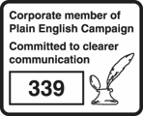
About Public Health England
Public Health England exists to protect and improve the nation’s health and wellbeing, and reduce health inequalities. We do this through world-leading science, knowledge and intelligence, advocacy, partnerships and the delivery of specialist public health services. We are an executive agency of the Department of Health and Social Care, and a distinct delivery organisation with operational autonomy. We provide government, local government, the NHS, Parliament, industry and the public with evidence-based professional, scientific and delivery expertise and support.
Public Health England, Wellington House, 133-155 Waterloo Road, London SE1 8UG Tel: 020 7654 8000
www.gov.uk/phe
Twitter:
@PHE_uk
Facebook:
www.facebook.com/PublicHealthEngland
© Crown copyright 2020 You may re-use this information (excluding logos) free of charge in any format or medium, under the terms of the Open Government Licence v3.0. To view this licence, visit https://www.nationalarchives.gov.uk/doc/open-government-licence/version/3/ Where we have identified any third party copyright information you will need to obtain permission from the copyright holders concerned.
Published February 2020 PHE publications gateway number: GW-1091
26 Patterns and trends in child obesity in London

