Slide 1
Patterns and trends in child obesity
A presentation of the latest data on child obesity in England
Updated February 2020
Notes:
These PowerPoint slides present key data and information on child obesity and excess weight in clear, easy to understand charts and graphics. They have been produced by the Population Health Analysis team in the Health Improvement Directorate and can be used freely with acknowledgement to ‘Public Health England’.
These slides should be useful to practitioners and policy makers working to tackle child obesity at local, regional and national level. For example they are regularly used to make the case for tackling obesity in presentations to health and wellbeing boards, other committees and to elected members as well as in regional and national conference and workshop presentations.

Slide 2
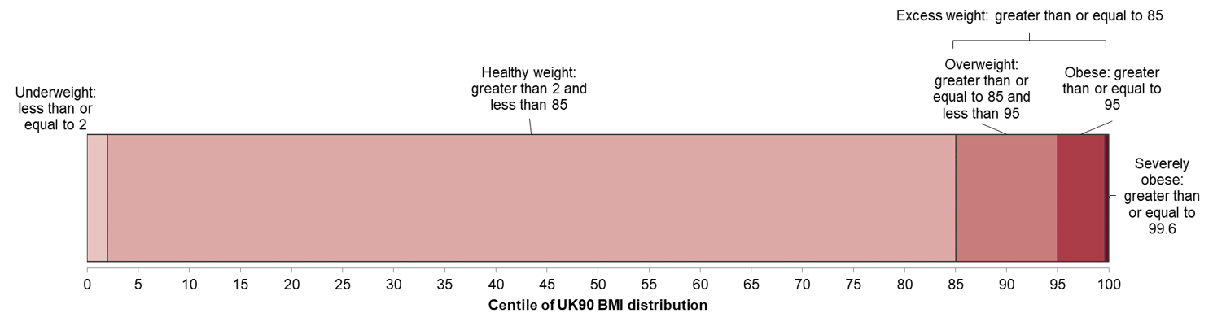
Child body mass index classification
Definitions for population monitoring
For population monitoring purposes body mass index (BMI) is classified according to the following image using the British 1990 growth reference (UK90). This helps examine patterns in children’s weight status across the country and over time.
¹ Cole TJ, Freeman JV, Preece MA. Body mass index reference curves for the UK, 1990. Archives of Disease in Childhood 1995 73:25-29.
Patterns and trends in child obesity
Notes:
Assessing the BMI of children is more complicated than for adults because a child’s BMI changes as they mature. Growth patterns differ between boys and girls, so both the age and sex of a child needs to be taken into account when estimating whether BMI is too high or too low. In England the British 1990 growth reference (UK90) for BMI is commonly used to determine weight status according to a child’s age and sex. Each child’s BMI is calculated and compared with the BMI distribution for children of their age and sex from the UK90 growth reference.

Slide 3
Latest data showing overweight and obesity by age and sex

Slide 4

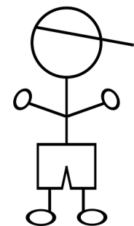

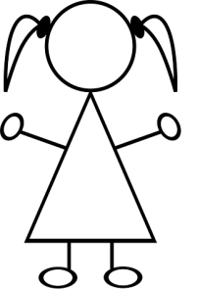
Prevalence of excess weight among children
National Child Measurement Programme 2018 /19
More than 1 in 5 children in Reception (aged 4-5 years) is overweight or obese
(boys 23.0%, girls 22.2%, all children 22.6%)
Notes:
The National Child Measurement Programme (NCMP) measures the height and weight of over 1 million children (aged 4-5 and 10-11 years) each year in primary schools in England.
National Child Measurement Programme data source: NHS Digital https://digital.nhs.uk/services/national-child-measurement-programme/

Slide 5
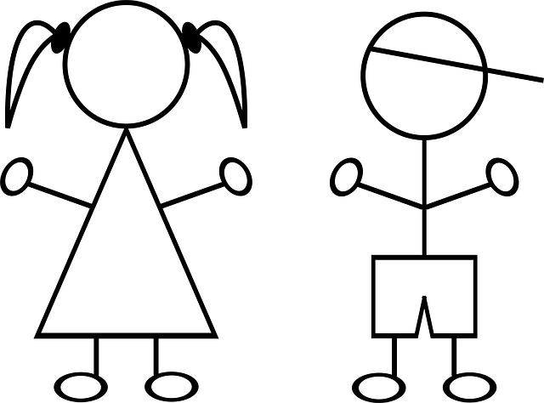
Prevalence of excess weight among children
National Child Measurement Programme 2018 /19
More than 1 in 3 children in Year 6 (aged 10-11 years) is overweight or obese
(boys 36.7%, girls 31.8%, all children 34.3%)
Notes:
The National Child Measurement Programme (NCMP) measures the height and weight of over 1 million children (aged 4-5 and 10-11 years) each year in primary schools in England.
National Child Measurement Programme data source: NHS Digital https://digital.nhs.uk/services/national-child-measurement-programme/

Slide 6
Prevalence of obesity among children
National Child Measurement Programme 2018/19
Around 1 in 10 children in Reception (aged 4-5 years) is obese
(boys 10.0%, girls 9.4%, all children 9.7%)
Notes:
The actions in the government’s ‘Childhood obesity: a plan for action’ (2016) aim to significantly reduce England’s rate of childhood obesity within the next 10 years. See
https://www.gov.uk/government/publications/childhood-obesity-a-plan-for-action
Chapter 2 of the government’s plan for action (2018) outlines the actions the government will take towards its goal of halving childhood obesity and reducing the gap in obesity between children from the most and least deprived areas by 2030. https://www.gov.uk/government/publications/childhood-obesity-a-plan-for-action-chapter-2
National Child Measurement Programme data source: NHS Digital https://digital.nhs.uk/services/national-child-measurement-programme/

Slide 7
Prevalence of obesity among children
National Child Measurement Programme 2018/19
Around 1 in 5 children in Year 6 (aged 10-11 years) is obese
(boys 22.5%, girls 17.8%, all children 20.2%)
Notes:
The actions in the government’s ‘Childhood obesity: a plan for action’ (2016) aim to significantly reduce England’s rate of childhood obesity within the next 10 years. See
https://www.gov.uk/government/publications/childhood-obesity-a-plan-for-action
Chapter 2 of the government’s plan for action (2018) outlines the actions the government will take towards its goal of halving childhood obesity and reducing the gap in obesity between children from the most and least deprived areas by 2030. https://www.gov.uk/government/publications/childhood-obesity-a-plan-for-action-chapter-2
National Child Measurement Programme data source: NHS Digital https://digital.nhs.uk/services/national-child-measurement-programme/

Slide 8
BMI status of children by age
National Child Measurement Programme 2018/19
Notes:
National Child Measurement Programme data source: NHS Digital https://digital.nhs.uk/services/national-child-measurement-programme/

Slide 9
BMI status of children by age
National Child Measurement Programme 2018/19
Reception (age 4-5 years)
Obese 9.7%
Obese 20.2%
Year 6 (age 10-11 years)
Notes:
National Child Measurement Programme data source: NHS Digital https://digital.nhs.uk/services/national-child-measurement-programme/

Slide 10
Prevalence of overweight and obesity
Health Survey for England 2017 and 2018
Notes:
Prevalence of overweight and obesity increases with age among girls and boys.
The Health Survey for England is an annual survey that measures the height and weight of a sample of the population aged 2-15 years. Child measurements are available from 1995.
The published Health Survey for England data used to produce this chart are available from:
https://digital.nhs.uk/pubs/hse2018

Slide 11
Trends in child overweight and obesity

Slide 12
Trends by BMI category – Reception
National Child Measurement Programme 2006/07 to 2018/19
Notes:
No statistically significant change has occurred in the prevalence of obesity (including severe obesity) or prevalence of severe obesity among children in Reception between 2006/07 and 2018/19. Prevalence of underweight has seen a small, but statistically significant, decrease over this period.
Public Health England publishes a slide set annually which examines trends in underweight, overweight, and obesity prevalence among children using data from the National Child Measurement Programme:
https://www.gov.uk/government/statistics/national-child-measurement-programme-ncmp-trends-in-child-bmi
National Child Measurement Programme data source: NHS Digital https://digital.nhs.uk/services/national-child-measurement-programme/

Slide 13
Trends by BMI category – Year 6
National Child Measurement Programme 2006/07 to 2018/19
Note: for Year 6, comparisons are not possible with the first years of the NCMP (2006/07 to 2008/09) as low participation levels led to underestimation of obesity prevalence
Notes:
Analysis of trend using NCMP data from 2009/10 to 2018/19 shows an overall increasing trend in both obesity (including severe obesity) prevalence and severe obesity prevalence among children in Year 6. Prevalence of underweight has shown no statistically significant change during this period.
Public Health England publishes a slide set annually which examines trends in underweight, overweight, and obesity prevalence among children using data from the National Child Measurement Programme:
https://www.gov.uk/government/statistics/national-child-measurement-programme-ncmp-trends-in-child-bmi
National Child Measurement Programme data source: NHS Digital https://digital.nhs.uk/services/national-child-measurement-programme/

Slide 14
Trend in the prevalence of obesity
Children aged 2-10 and 11-15 years; Health Survey for England
1995-2018
95% confidence intervals are displayed on the chart
Notes:
The pattern of increase in obesity between 1995 and 2004 was similar among both younger and older children (aged 2-10 and 11-15 respectively). Since then, the proportion of children who are obese has remained broadly steady. It is important to exercise caution in interpreting this data due to the relatively small sample sizes.
The actions in the government’s 2018 publication, Childhood obesity: a plan for action, chapter 2 aim to "halve childhood obesity and to significantly reduce the gap in obesity between children from the most and least deprived areas by 2030”. See https://www.gov.uk/government/publications/childhood-obesity-a-plan-for-action-chapter-2
The published Health Survey for England data used to produce this chart are available from:
https://digital.nhs.uk/pubs/hse2018

Slide 15
Trend in the prevalence of excess weight
Children aged 2-10 and 11-15 years; Health Survey for England
1995-2018
95% confidence intervals are displayed on the chart
Notes:
The prevalence of child excess weight (overweight including obesity) increased between 1995 and 2004. Since then, there is some evidence of a levelling of child excess weight prevalence for 2-10 and 11-15 year-olds. It is important to exercise caution in interpreting this data due to the relatively small sample sizes.
The published Health Survey for England data used to produce this chart are available from:
https://digital.nhs.uk/pubs/hse2018

Slide 16
Trend in the prevalence of obesity and excess weight
Children aged 2-15 years; Health Survey for England 1995-2018
95% confidence intervals are displayed on the chart
Notes:
The prevalence of child excess weight and child obesity increased between 1995 and 2004. Since 2004 there is some evidence of a levelling of both child obesity and excess weight prevalence for 2-15 year-olds. It is important to exercise caution in interpreting this data due to the relatively small sample sizes.
The published Health Survey for England data used to produce this chart are available from:
https://digital.nhs.uk/pubs/hse2018

Slide 17
Prevalence of obesity by age and sex
National Child Measurement Programme 2006/07 to 2018/19
Note: for Year 6, comparisons are not possible with the first years of the NCMP (2006/07 to 2008/09) as low participation levels led to underestimation of obesity prevalence
Notes:
Analysis of trend using NCMP data from 2006/07 to 2018/19 shows an overall downward trend in obesity prevalence among boys in Reception (4-5 year-olds) while the trend among girls of this age appears to be relatively stable over time. Obesity prevalence among boys and girls in Year 6 (10-11 year-olds) shows an upward trend.
Public Health England publishes a slide set annually which examines trends in underweight, overweight, and obesity prevalence among children using data from the National Child Measurement Programme:
https://www.gov.uk/government/statistics/national-child-measurement-programme-ncmp-trends-in-child-bmi
National Child Measurement Programme data source: NHS Digital https://digital.nhs.uk/services/national-child-measurement-programme/

Slide 18
Prevalence of excess weight by age and sex National Child Measurement Programme 2006/07 to 2018/19
Note: for Year 6, comparisons are not possible with the first years of the NCMP (2006/07 to 2008/09) as low participation levels led to underestimation of obesity prevalence
Notes:
Analysis of trends using NCMP data from 2006/07 to 2018/19 shows a downward trend in excess weight (overweight including obesity) prevalence among boys in Reception (4-5 year-olds), while the trend among girls of this age is showing a very small, but statistically significant, increase. Excess weight prevalence among boys and girls in Year 6 (10-11 year-olds) shows an upward trend.
Public Health England publishes a slide set annually which examines trends in underweight, overweight, and obesity prevalence among children using data from the National Child Measurement Programme:
https://www.gov.uk/government/statistics/national-child-measurement-programme-ncmp-trends-in-child-bmi
National Child Measurement Programme data source: NHS Digital https://digital.nhs.uk/services/national-child-measurement-programme/
Prevalence of excess weight using NCMP data is being monitored by local authorities as part of the Public Health Outcomes Framework (PHOF)
https://www.gov.uk/government/publications/public-health-outcomes-framework-2016-to-2019
https://www.gov.uk/government/consultations/public-health-outcomes-framework-proposed-changes-2019-to-2020
https://fingertips.phe.org.uk/profile/public-health-outcomes-framework

Slide 19
Prevalence of severe obesity by age and sex National Child Measurement Programme 2006/07 to 2018/19
Note: for Year 6, comparisons are not possible with the first years of the NCMP (2006/07 to 2008/09) as low participation levels led to underestimation of obesity prevalence
Notes:
Analysis of trends using NCMP data from 2006/07 to 2018/19 show no statistically significant change in severe obesity prevalence among boys or girls in Reception (4-5 year-olds). Severe obesity prevalence among boys and girls in Year 6 (10-11 year-olds) shows an upward trend.
Public Health England publishes a slide set annually which examines trends in underweight, overweight, and obesity prevalence among children using data from the National Child Measurement Programme:
https://www.gov.uk/government/statistics/national-child-measurement-programme-ncmp-trends-in-child-bmi
National Child Measurement Programme data source: NHS Digital https://digital.nhs.uk/services/national-child-measurement-programme/

Slide 20
BMI distribution by age and sex

Slide 21
BMI distribution – Reception children
National Child Measurement Programme 2018/19
Notes:
This chart shows the distribution of BMI z score for boys and girls in Reception year (4-5 year-olds) compared to the British 1990 (UK90) growth reference baseline. BMI z score is a standard deviation score which adjusts BMI for age and sex of children based on the UK90 growth reference. The centiles for population monitoring (85th and 95th) and clinical (91st, 98^{th,} and 99.6th) definition for overweight, obesity, and severe obesity are marked as vertical lines on the chart. BMI below the 2nd centile is commonly used for underweight classification for both clinical and population monitoring.
For both boys and girls the whole curve has shifted slightly to the right since 1990, however the shape of the distribution is very similar. This shows that the rise in BMI since 1990 is spread across the whole population, meaning that on average Reception aged children are slightly heavier. The average BMI centile has increased among Reception children from the 50th in the UK90 reference population to the 59th centile in 2018/19.
National Child Measurement Programme data source: NHS Digital https://digital.nhs.uk/services/national-child-measurement-programme/

Slide 22
BMI distribution – Year 6 children
National Child Measurement Programme 2018/19
Notes:
This chart shows the distribution of BMI z score for boys and girls in Year 6 (10-11 year-olds) compared to the British 1990 (UK90) growth reference baseline. BMI z score is a standard deviation score which adjusts BMI for age and sex of children based on the UK90 growth reference. The centiles for population monitoring (85th and 95th) and clinical (91st, 98^{th,} and 99.6th) definition for overweight, obesity, and severe obesity are marked as vertical lines on the chart. BMI below the 2nd centile is commonly used for underweight classification for both clinical and population monitoring.
The shape of the distribution has changed considerably since the 1990 baseline. The curve is now more skewed, with a higher proportion of children in Year 6 at the right hand side of the chart with higher BMI values, above the 85th centile (classed as overweight or obese). The average BMI centile has increased among Year 6 children from the 50th in the UK90 reference population to the 62nd centile in 2018/19.
National Child Measurement Programme data source: NHS Digital https://digital.nhs.uk/services/national-child-measurement-programme/

Slide 23
BMI distribution 2006/07 to 2018/19 – Reception
National Child Measurement Programme
Notes:
This chart shows the distribution of BMI z score for children in Reception year (4-5 year-olds) in 2006/07 and 2018/19 with a comparison to the British 1990 (UK90) growth reference baseline. BMI z score is a standard deviation score which adjusts BMI for age and sex of children based on the UK90 growth reference. The centiles for population monitoring (85th and 95th) and clinical (91st, 98^{th,} and 99.6th) definition for overweight, obesity, and severe obesity are marked as vertical lines on the chart. BMI below the 2nd centile is commonly used for underweight classification for both clinical and population monitoring.
For Reception children there has been very little change to the distribution between 2006/07 and 2018/19. The whole curve has shifted slightly to the right since 1990, and the shape of the distribution is very similar. This shows that the rise in BMI since 1990 is spread across the whole population, meaning that on average all Reception aged children are slightly heavier.
National Child Measurement Programme data source: NHS Digital https://digital.nhs.uk/services/national-child-measurement-programme/

Slide 24
BMI distribution 2006/07 to 2018/19 – Year 6
National Child Measurement Programme
Notes:
This chart shows the distribution of BMI z score for children in Year 6 (10-11 year-olds) in 2006/07 and 2018/19 with a comparison to the British 1990 (UK90) growth reference baseline. BMI z score is a standard deviation score which adjusts BMI for age and sex of children based on the UK90 growth reference. The centiles for population monitoring (85th and 95th) and clinical (91st, 98^{th,} and 99.6th) definition for overweight, obesity, and severe obesity are marked as vertical lines on the chart. BMI below the 2nd centile is commonly used for underweight classification for both clinical and population monitoring.
The shape of the distribution has changed slightly between 2006/07 and 2018/19, and a large change has occurred since the 1990 baseline. The curve is now slightly more skewed compared to 2006/07, with a higher proportion of children in Year 6 at the right hand side of the chart with higher BMI values, above the 95th centile (classed as obese or severely obese).
National Child Measurement Programme data source: NHS Digital https://digital.nhs.uk/services/national-child-measurement-programme/

Slide 25
Obesity and deprivation

Slide 26
Obesity prevalence and deprivation
National Child Measurement Programme 2018/19 – Year 6 children
Local authorities in England
Notes:
Child obesity prevalence is strongly correlated with socioeconomic status and is highest among children living in the most deprived local authorities.
This slide shows the pattern for children in Year 6 (10-11 year-olds), but a very similar pattern is seen in the Reception year (4-5 year-olds).
The data represents the local authority of residence for the children measured.
National Child Measurement Programme data source: NHS Digital https://digital.nhs.uk/services/national-child-measurement-programme/

Slide 27
Obesity prevalence by deprivation decile
National Child Measurement Programme 2018/19
Notes:
Child obesity prevalence is closely associated with socioeconomic status. More deprived populations tend to have higher obesity prevalence.
Obesity prevalence in the most deprived 10% of areas in England is more than twice the prevalence in the least deprived 10%.
The deprivation deciles in this analysis have been assigned using the lower super output area (LSOA) of residence of children measured.
National Child Measurement Programme data source: NHS Digital https://digital.nhs.uk/services/national-child-measurement-programme/
PHE produces tools providing data on health inequalities at England and local authority levels. (1) The Health Inequalities Dashboard provides information to monitor progress on reducing inequalities within England. It presents measures of inequality for 18 key indicators, each drawn from the Public Health Outcomes Framework. (2) The Segment Tool provides information on the causes of death and age groups that are driving inequalities in life expectancy at local area level. https://fingertips.phe.org.uk/profile/inequality-tools

Slide 28
Severe obesity prevalence by deprivation decile
National Child Measurement Programme 2018/19
Notes:
Child severe obesity prevalence is closely associated with socioeconomic status. More deprived populations tend to have higher severe obesity prevalence.
Among Year 6 children, severe obesity prevalence in the most deprived 10% of areas in England is more than 4 times the prevalence in the least deprived 10%, and among Reception children nearly 4 times the prevalence in the least deprived 10%.
The deprivation deciles in this analysis have been assigned using the lower super output area (LSOA) of residence of children measured.
National Child Measurement Programme data source: NHS Digital https://digital.nhs.uk/services/national-child-measurement-programme/

Slide 29
Obesity prevalence by deprivation decile – Reception
National Child Measurement Programme 2006/07 to 2018/19
Notes:
The inequalities gap in child obesity is widening among children in Reception. Prevalence of obesity is decreasing at the fastest rate among the least deprived children in Reception year (4-5 year-olds) while among the most deprived children it showed little sign of change between 2006/07 and 2014/15 and an increasing trend in the most recent years (2015/16 to 2018/19).
The deprivation deciles in this analysis have been assigned at the time of measurement using the lower super output area (LSOA) of residence of children measured. Deprivation is measured using the 2015 Index of Multiple Deprivation.
Data for other deprivation deciles is available in our Fingertips tool: https://fingertips.phe.org.uk/profile/national-child-measurement-programme
National Child Measurement Programme data source: NHS Digital https://digital.nhs.uk/services/national-child-measurement-programme/

Slide 30
Obesity prevalence by deprivation decile – Year 6
National Child Measurement Programme 2006/07 to 2018/19
Note: for Year 6, comparisons are not possible with the first years of the NCMP (2006/07 to 2008/09) as low participation levels led to underestimation of obesity prevalence
Notes:
The inequalities gap in child obesity is widening among children in Year 6. Prevalence of obesity shows a pattern of increase over time among the most deprived Year 6 children (10-11 year-olds) whereas prevalence has remained relatively stable among the least deprived children.
The deprivation deciles in this analysis have been assigned at the time of measurement using the lower super output area (LSOA) of residence of children measured.
Data for other deprivation deciles is available in our Fingertips tool: https://fingertips.phe.org.uk/profile/national-child-measurement-programme
National Child Measurement Programme data source: NHS Digital https://digital.nhs.uk/services/national-child-measurement-programme/

Slide 31
Trend in slope index of inequality – obesity prevalence
National Child Measurement Programme 2006/07 to 2018/19
Notes:
The Slope Index of Inequality (SII) is a measure of the social gradient in an indicator and shows how much the indicator varies with deprivation (by deprivation decile). This is a better measure of changes in inequalities compared to looking at the gap between the most and least deprived deciles as the SII takes account of inequalities across the whole range of deprivation within England and summarises this into a single number. The higher the value of the SII, the greater the inequality within an area. The SII is greater in Year 6 children than in Reception, and has been widening at a faster rate in Year 6 than in Reception.
National Child Measurement Programme data source: NHS Digital https://digital.nhs.uk/services/national-child-measurement-programme/

Slide 32
Obesity and ethnicity

Slide 33
Obesity prevalence by ethnic group
National Child Measurement Programme 2018/19
Children in Reception (aged 4-5 years)
Children in Year 6 (aged 10-11 years)
Notes:
Obesity prevalence in Reception aged children (4-5 year-olds) is highest among children from Black African, Black other, and Mixed: White and Black African ethnic groups.
Children in Year 6 (10-11 year-olds) from most minority ethnic groups (with the exception of Mixed: White and Asian, and White Irish) are more likely to be obese than White British children.
The ‘Not stated’ category includes records that have no ethnic group given (where ethnic coding is blank).
Some of these differences may be due to the influence of other factors such as area deprivation.
National Child Measurement Programme data source: NHS Digital https://digital.nhs.uk/services/national-child-measurement-programme/

Slide 34
Severe obesity prevalence by ethnic group
National Child Measurement Programme 2018/19
Children in Reception (aged 4-5 years)
Children in Year 6 (aged 10-11 years)
Notes:
Severe obesity prevalence in Reception aged children (4-5 year-olds) is highest among children from Black other, Black African, and Bangladeshi ethnic groups.
In Year 6 (10-11 year-olds) severe obesity prevalence is highest among children from Black Caribbean, Black other, Mixed: White and Black African, and Black African ethnic groups.
The ‘Not stated’ category includes records that have no ethnic group given (where ethnic coding is blank).
Some of these differences may be due to the influence of other factors such as area deprivation.
National Child Measurement Programme data source: NHS Digital https://digital.nhs.uk/services/national-child-measurement-programme/

Slide 35
Obesity prevalence by region

Slide 36
Obesity prevalence by region – Reception
National Child Measurement Programme 2018/19
Notes:
The prevalence of obesity among children in Reception (4-5 year olds) varies by region across England. In 2018/19 obesity prevalence was highest in the North East and lowest in the South East.
In this analysis postcode of child has been used to calculate regional data. England total includes records where the child could not be assigned to a local authority/region due to no child postcode or an invalid child postcode being provided. In 2018/19 99.9% of records included a valid child postcode.
PHE has also published regional child obesity slide sets showing customised data on the patterns and trends in child obesity for each region from the NCMP, in clear, easy to understand charts and graphics.
Regional patterns and trends in child obesity: presentations: https://www.gov.uk/guidance/phe-data-and-analysis-tools#obesity-diet-and-physical-activity
National Child Measurement Programme data source: NHS Digital https://digital.nhs.uk/services/national-child-measurement-programme/

Slide 37
Obesity prevalence by region – Year 6
National Child Measurement Programme 2018/19
Notes:
The prevalence of obesity among children in Year 6 (10-11 year-olds) varies by region in England. In 2017/18 obesity prevalence was highest in London and lowest in the South West.
In this analysis postcode of child has been used to calculate regional data. England total includes records where the child could not be assigned to a local authority/region due to no child postcode or an invalid child postcode being provided. In 2018/19 99.9% of records included a valid child postcode.
PHE has also published regional child obesity slide sets showing customised data on the patterns and trends in child obesity for each region from the NCMP, in clear, easy to understand charts and graphics.
Regional patterns and trends in child obesity: presentations: https://www.gov.uk/guidance/phe-data-and-analysis-tools#obesity-diet-and-physical-activity
National Child Measurement Programme data source: NHS Digital https://digital.nhs.uk/services/national-child-measurement-programme/

Slide 38
Child overweight and obesity by parents BMI status and parent’s perception of child’s BMI status

Slide 39
Child overweight and obesity by mother’s BMI status and sex of child
Health Survey for England 2017 and 2018
Notes:
Children’s BMI status was associated with their mother’s BMI status. Obesity was most common in children with obese mothers (26%), less common in children whose mothers were overweight but not obese (16%) and was least common in children whose mothers were neither overweight nor obese (7%).
The published Health Survey for England data used to produce this chart are available from:
https://digital.nhs.uk/pubs/hse2018
Text in notes adapted from: https://files.digital.nhs.uk/3F/6971DC/HSE17-Adult-Child-BMI-rep.pdf
Copyright © 2018 NHS Digital

Slide 40
Child overweight and obesity by father’s
BMI status and sex of child
Health Survey for England 2017 and 2018
Notes:
Children’s BMI status was also associated with their father’s BMI status. Over one-fifth (22%) of children with obese fathers were obese, compared to 14% of children whose fathers were overweight but not obese, and 9% of children whose fathers were neither overweight nor obese.
The published Health Survey for England data used to produce this chart are available from:
https://digital.nhs.uk/pubs/hse2018
Text in notes adapted from: https://files.digital.nhs.uk/3F/6971DC/HSE17-Adult-Child-BMI-rep.pdf
Copyright © 2018 NHS Digital

Slide 41
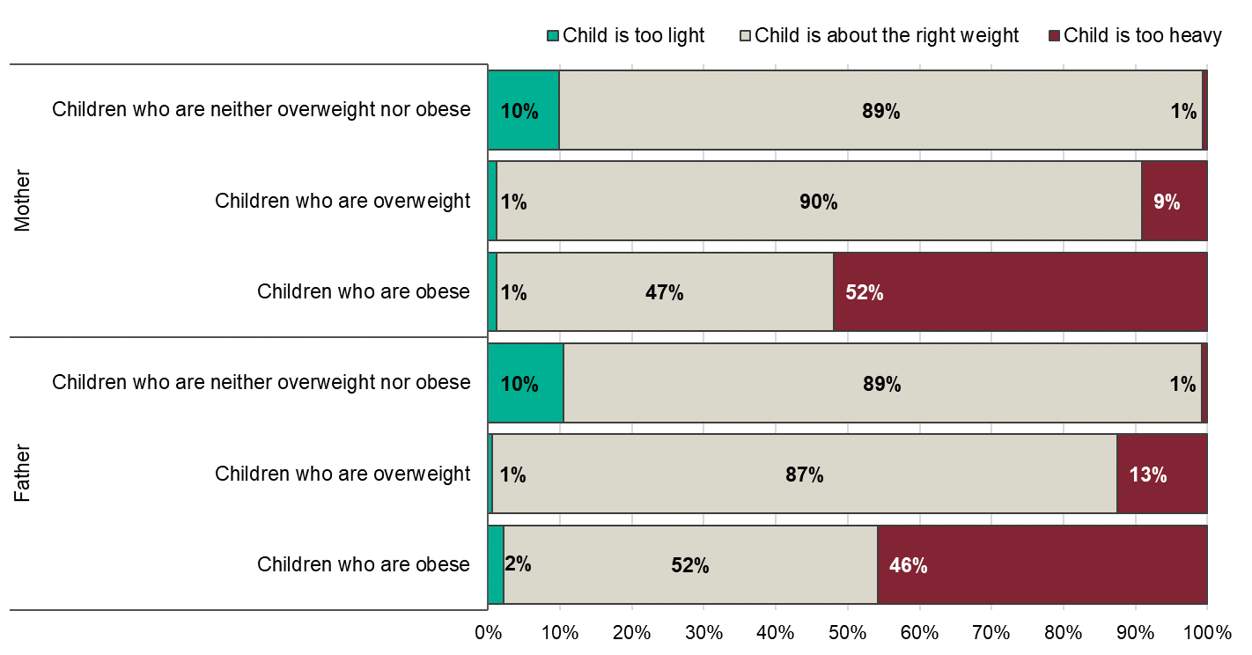
Parents' perception of child's weight, by child's BMI status
Health Survey for England 2015 and 2016
Notes:
In 2015 and 2016 (but not in 2017 or 2018), parents were asked to give their opinion on the weight of each of their children. Overall, the majority of parents believed their child was about the right weight. 84% of children aged 2 to 15 were described by their mother as being about the right weight, 9% of children were described as too heavy and 8% were described as too light. Similarly, 84% of children aged 2 to 15 were described by their father as being about the right weight, 8% were reported as too heavy and 8% were felt to be too light.
The majority (89%) of mothers and fathers of children who were neither overweight nor obese described them as being about the right weight.
The majority of overweight children were also described as being about the right weight by their mothers (90%) and fathers (87%). A small proportion of parents of overweight children described their child as being too heavy (9% of mothers and 13% of fathers). Around half of parents of obese children (47% of mothers and 52% of fathers) said their child was about the right weight. But similar proportions, 52% of mothers and 46% of fathers of obese children, described their child as too heavy.
The published Health Survey for England data used to produce this chart are available from:
https://digital.nhs.uk/pubs/hse2017
Text in notes from: https://files.digital.nhs.uk/3F/6971DC/HSE17-Adult-Child-BMI-rep.pdf
Copyright © 2018 NHS Digital

Slide 42
Further information

Slide 43
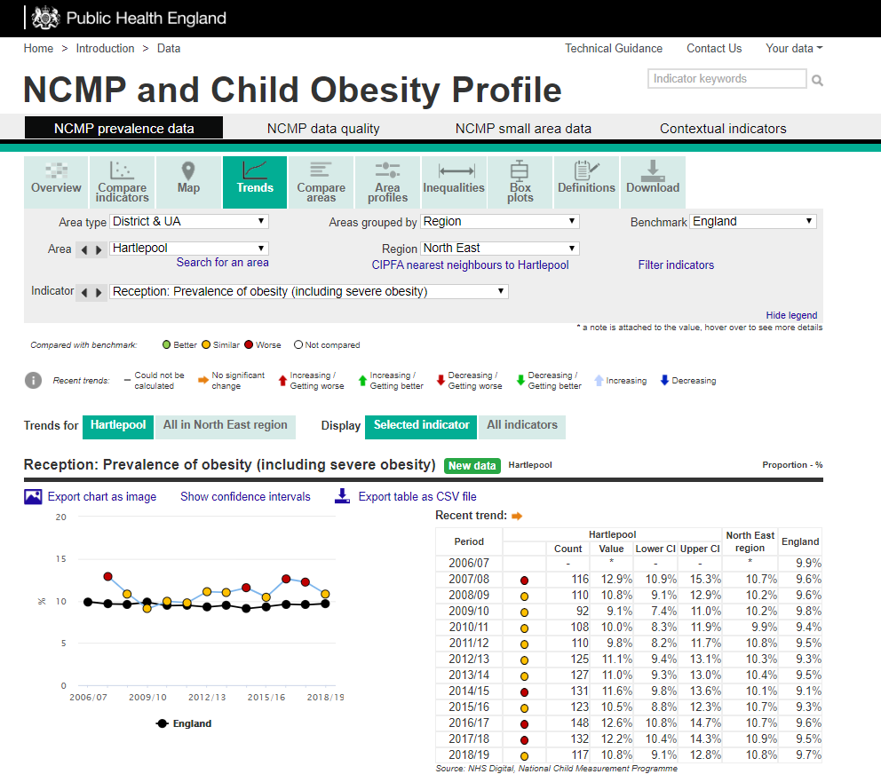
Screenshot of webpage
http://fingertips.phe.org.uk/profile/national-child-measurement-programme
Notes:
Local authority level data from the National Child Measurement Programme is available in an online tool. Users can examine data on prevalence of underweight, healthy weight, overweight, obesity, excess weight (overweight including obesity) and severe obesity. Data can be compared between local authorities and over time for individual local authorities. The tool also includes inequalities data (sex, deprivation, ethnic group) for child obesity by local authority.
http://fingertips.phe.org.uk/profile/national-child-measurement-programme

Slide 44
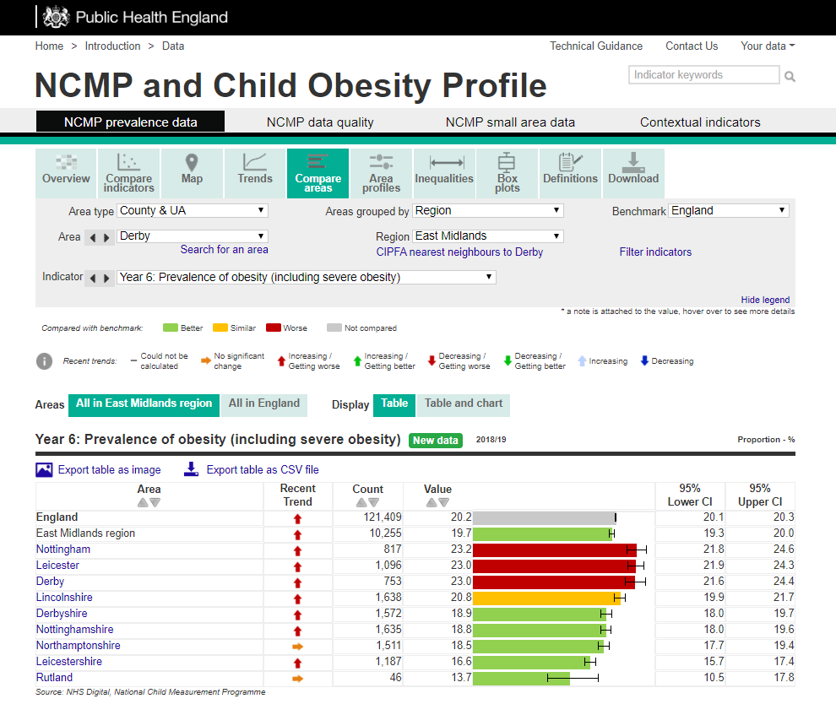
Screenshot of webpage
http://fingertips.phe.org.uk/profile/national-child-measurement-programme
Notes:
Local authority level data from the National Child Measurement Programme is available in an online tool. Users can examine data on prevalence of underweight, healthy weight, overweight, obesity, excess weight (overweight including obesity) and severe obesity. Data can be compared between local authorities and over time for individual local authorities. The tool also includes inequalities data (sex, deprivation, ethnic group) for child obesity by local authority.
http://fingertips.phe.org.uk/profile/national-child-measurement-programme

Slide 45
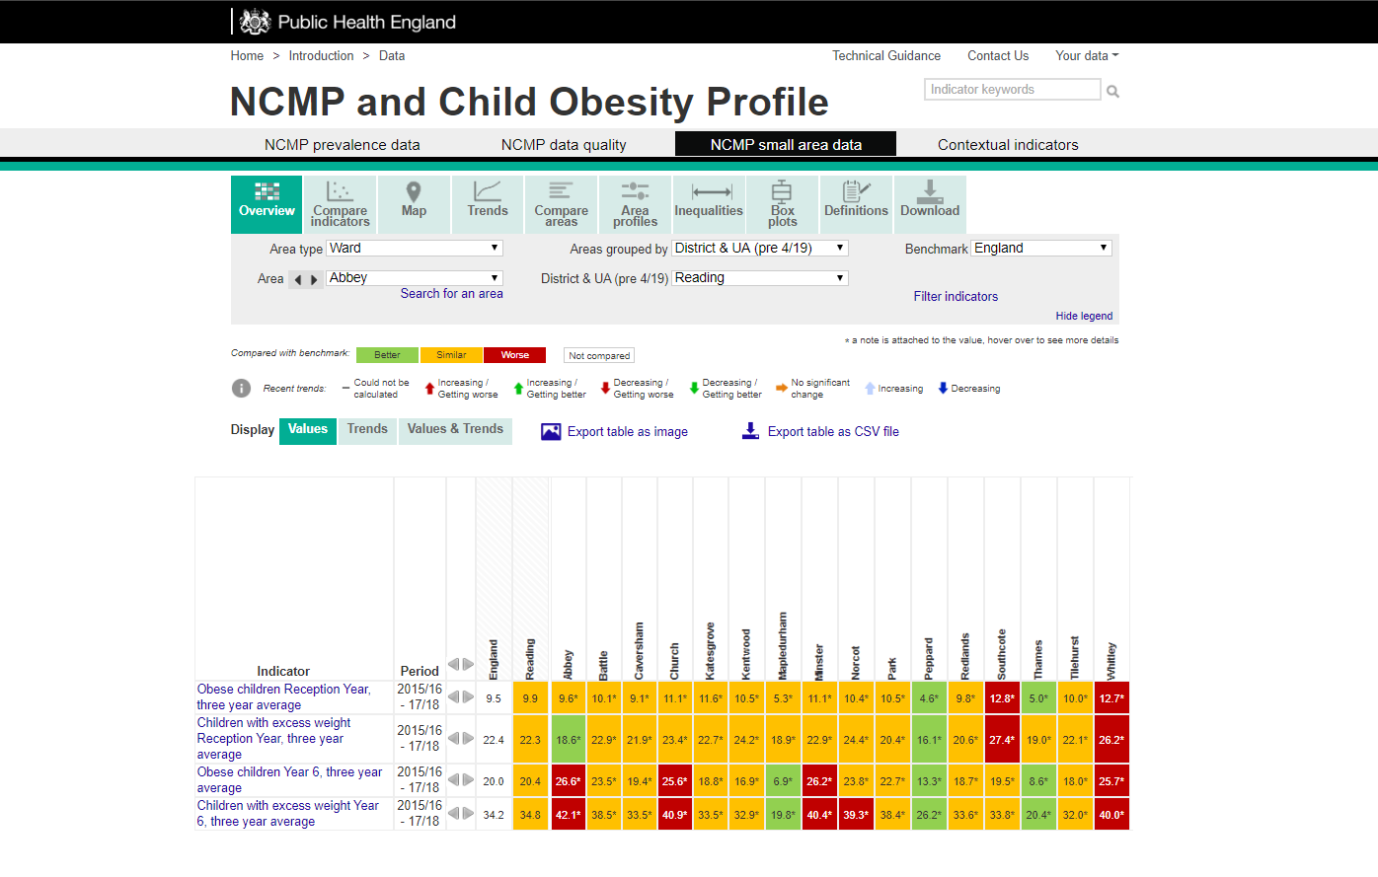
Screenshot of webpage
http://fingertips.phe.org.uk/profile/national-child-measurement-programme
Notes:
To help understand some of the diversity within local authorities and examine pockets of high child obesity prevalence, Public Health England produces data by Middle Super Output Area (MSOA) and Ward for all of England. A new domain has been added to the NCMP and Child Obesity Profile to display trend data on the prevalence of excess weight (overweight including obesity) and obesity. Data from the NCMP is presented for MSOAs, Electoral Wards, Clinical Commissioning Groups (CCG), local authorities, and England.
http://fingertips.phe.org.uk/profile/national-child-measurement-programme

Slide 46
Data sources
Health Survey for England (HSE)
https://digital.nhs.uk/data-and-information/areas-of-interest/public-health/health-survey-for-england-health-social-care-and-lifestyles
The HSE is a cross-sectional survey which samples a representative proportion of the population. The next report on the HSE 2019 is due to be published online in December 2020. The data should be available from the UK Data Archive during the year following publication of the report.
National Child Measurement Programme (NCMP)
https://digital.nhs.uk/services/national-child-measurement-programme/
The NCMP is an annual programme that measures the height and weight of children in Reception (aged 4-5 years) and Year 6 (aged 10-11 years) in England. Although the NCMP only covers certain age groups, it includes the majority of children in those year groups. The participation rate in 2018/19 was 95%. NHS Digital will report NCMP data for the 2019/20 school year in October 2020.

Slide 47
Useful resources
NCMP trends report:
https://www.gov.uk/government/publications/national-child-measurement-programme-ncmp-trends-in-child-bmi
NCMP and child obesity data profile:
http://fingertips.phe.org.uk/profile/national-child-measurement-programme
NCMP regional slide sets:
https://app.box.com/s/og3q86aqejc99okxe9xyvpfvo21xai21/folder/45752850527
NCMP Guidance for Analysis and Data Sharing:
https://www.gov.uk/government/publications/national-child-measurement-programme-data-sharing-and-analysis

Slide 48
For more information:
PHE Web:
https://www.gov.uk/guidance/phe-data-and-analysis-tools#obesity-diet-and-physical-activity
PHE Obesity Intelligence Knowledge Hub public library (no need to join):
https://khub.net/web/phe-obesity-intelligence/public-library
PHE Obesity Intelligence Knowledge Hub:
Register on https://khub.net/ and join the PHE Obesity Intelligence group
Email: ncmp@phe.gov.uk
Twitter: @PHE_Obesity

Slide 49


About Public Health England
Public Health England exists to protect and improve the nation’s health and wellbeing, and reduce health inequalities. We do this through world-leading science, knowledge and intelligence, advocacy, partnerships and the delivery of specialist public health services. We are an executive agency of the Department of Health and Social Care, and a distinct delivery organisation with operational autonomy. We provide government, local government, the NHS, Parliament, industry and the public with evidence-based professional, scientific and delivery expertise and support.
Public Health England
Wellington House
133-155 Waterloo Road
London SE1 8UG
Tel: 020 7654 8000
www.gov.uk/phe
Twitter: @PHE_uk @PHE_Obesity
Facebook: www.facebook.com/PublicHealthEngland
© Crown copyright 2020
You may re-use this information (excluding logos) free of charge in any format or medium, under the terms of the Open Government Licence v3.0. To view this licence, visit OGL. Where we have identified any third party copyright information you will need to obtain permission from the copyright holders concerned.
Published February 2020
PHE publications gateway number: GW-1091

