Slide 1
Heat-health risks and COVID-19: actions to prevent harm
Heatwave and summer preparedness 2021

Slide 2
Heat-health risks and COVID-19: actions to prevent harm
Date of issue: April 2021
Version: 02.00
Author: Extreme Events and Health Protection, PHE
Amendment History:
Version | Date | Amendments made
2.0 | XX/04/2021 | Changed to widescreen format Updated with additional information on observed 2020 heatwave mortality/morbidity and details of cooling interventions

Slide 3
Background
Refer to the Heatwave Plan for England and associated resources for information on heat-health risks.
The Heatwave Plan has not been updated and will remain extant while a full review is undertaken as part of the National Adaptation Programme commitment to develop a single adverse weather plan for England.
This slide set provides an interim update to reflect the concurrent risk of heat and COVID-19
Broken hyperlinks have been fixed and are correct as of May 2021
The Heatwave Plan for England is underpinned by the Heat-Health alerting system. To sign up for the alerts, please register HERE
The plan recommends a series of steps to reduce the risks to health from severe heat for:
The NHS, local authorities, social care, and other public agencies
Professionals working with people at risk
Individuals, local communities and voluntary groups

Slide 4
Outline
Health impacts of hot weather
Heat-health risks and COVID-19
Summer 2020
Heatwave Plan for England: additional actions for summer 2021
Commissioners of health and social care (all settings) and local authority Directors of Public Health
Providers – health and social care staff in all settings (community, hospitals and care homes)
Community and voluntary sector and individuals
Key messages
Resources

Slide 5
Health impacts of hot weather

Slide 6
Health impacts of hot weather
2020 concluded the earth’s warmest 10-year period on record; 2020 was the second warmest year in the 170 year series [1]
There are around 2000 heat-related deaths per year in the UK
A range of mild to severe health impacts can result from exposure to high temperatures
There are specific heat-related health effects and illnesses including:
Heat cramps, heat rash, heat oedema, heat syncope, heat exhaustion, heatstroke
increased numbers of admissions to hospital and consultations with GPs, and additional demands placed on the emergency services
fatalities, particularly among the vulnerable and older people
The main causes of illness and death during a heatwave are exacerbation of respiratory and cardiovascular illness
Notes:
The HadCRUT5 global temperature series, produced by the Met Office, University of East Anglia and UK National Centre for Atmospheric Science, shows that the average for 2020 as a whole was 1.28±0.08°C above pre-industrial levels, taken as the average over the period 1850-1900. This makes 2020 nominally the second warmest year in the dataset’s record (Met Office, 2021)
The main causes of illness and death during a heatwave are respiratory and cardiovascular diseases. Additionally, there are specific heat-related illnesses including:
• heat cramps – caused by dehydration and loss of electrolytes, including after exercise
• heat rash – small, red, itchy papules all over the body
• heat oedema – swelling, particularly in the ankles, due to dilation of blood vessels and retention of fluid
• heat syncope – dizziness and fainting, due to dehydration and vasodilation, worsened by cardiovascular disease and certain medications
• heat exhaustion which occurs as a result of dehydration, with non-specific symptoms such as malaise, vomiting and circulatory collapse. It occurs when the core body temperature is between 37ºC and 40ºC. Left untreated, heat exhaustion may evolve into heatstroke
• heatstroke - a more severe illness in which the body’s thermoregulation mechanism fails. Heatstroke is a medical emergency, with symptoms of confusion, disorientation, convulsions, unconsciousness and hot dry skin. It occurs when core body temperature exceeds 40ºC for over 45 minutes and can result in cell death, organ failure, brain damage or death. Heat stroke can be either classical or exertional (heat stroke that results from strenuous exercise)
Hot weather can happen with little warning and illness and deaths occur within the first couple of days. By the time hot weather arrives, the window of opportunity for effective action is often very short indeed. This means that advanced and long-term planning and preparedness are essential.
The main causes of illness and death during a heatwave are respiratory and cardiovascular diseases. 2 years after the introduction of the Heatwave Plan for England in 2004, there was another significant event. It is estimated that there were about 680 excess deaths in summer 2006 compared to similar periods in previous years. In summer 2006, it was estimated that 75 extra deaths occurred per week with each one degree increase in temperature. Part of this rise in mortality may be attributable to air pollution, which makes respiratory symptoms worse. The other main contributor is the effect of heat on the cardiovascular system.
In order to keep cool, large quantities of extra blood are circulated to the skin. This causes strain on the heart, which for elderly people and those with chronic health problems can be enough to cause heart attacks.
Reference:
1: Met Office, 2021: https://www.metoffice.gov.uk/about-us/press-office/news/weather-and-climate/2021/2020-ends-earths-warmest-10-years-on-record

Slide 8
Heat-health risks and COVID-19

Slide 9
Heat and COVID-19: headlines
Coronavirus (COVID-19) amplifies the risks of hot weather
Fear of COVID-19 should not prevent action to tackle the risks from hot weather and heatwaves
It is critical that actions to prevent health harms from high temperatures continue, with necessary adaptations in line with COVID-19 guidance to keep everyone safe

Slide 10
Heat and COVID-19: potential risks
Potential increase in adverse outcomes amongst the same population groups affected by both high temperatures and COVID-19. For example, older people and those with comorbidities such as cardio-respiratory diseases
Increase in exposure to indoor overheating and increased social isolation as those at higher risk spend more time at home to avoid contact with others.
System-level risks related to concurrency of impacts. For example, increased demand on social care services to prevent both heat and COVID-19 related harms.
Changes in health-seeking behaviours e.g. emergency care
Reduced access to cool public spaces for respite due to COVID-19 restrictions

Slide 11
Heat: individual vulnerability
EVERYBODY can be affected by high temperatures, but there are certain factors that increase an individual’s risk during a heatwave. These include:
older age: especially those over 75 years old, or those living on their own and who are socially isolated, or those living in a care home
chronic and severe illness: including heart or lung conditions, diabetes, renal insufficiency, Parkinson’s disease or severe mental illness
inability to adapt behaviour to keep cool: babies and the very young, having a disability, being bed bound, consuming too much alcohol, having Alzheimer’s disease
environmental factors and overexposure: living in a top floor flat, being homeless, activities or jobs that are in hot places or outdoors and include high levels of physical exertion
Notes:
People with long-term or severe illness are likely to be at particular risk. Medications that potentially affect renal function, sweating, thermoregulation or electrolyte balance can make this group more vulnerable to the effects of heat. This includes the following conditions:
• respiratory disease
• cardiovascular and cerebrovascular conditions
• peripheral vascular conditions
• diabetes and obesity
• severe mental illness
• Parkinson’s disease and difficulties with mobility
• renal insufficiency
• Alzheimer’s or related diseases

Slide 12
Heat/COVID-19: individual vulnerability
We still have much to learn about how COVID-19 affects the body, but both heat and COVID-19 infections put a strain on the heart and lungs, the kidneys and are linked with inflammation in the body.
Clinical vulnerabilities that have been linked with worse outcomes from COVID-19 that are also risks for heat related harms are:
high blood pressure
chronic obstructive pulmonary disease
heart and lung conditions (cardiovascular disease)
conditions that affect the flow of blood in the brain (cerebrovascular disease)
kidney disease

Slide 13
Heat: environmental risks
Environmental risk factors for increased exposure to heat include:
Living in urban areas
This can be due to the urban heat island¹, poor access to green space and/or housing of a type that overheats
Dwelling types prone to overheating (such as south-facing top-floor flats)
1 in 5 homes in England are prone to overheating
Few (less than 3%) have air conditioning²
Local air pollution (i.e. particulate matter) may exacerbate the health impacts of heat
.
Notes:
In towns and cities, air temperatures are often higher than in surrounding rural areas, particularly at night. This Urban Heat Island (UHI) effect can exacerbate health impacts associated with heat exposure.
[1] Macintyre HL, Heaviside C. Potential benefits of cool roofs in reducing heat-related mortality during heatwaves in a European city. Environ Int. 2019 Jun;127:430-441. doi: 10.1016/j.envint.2019.02.065. Epub 2019 Apr 5. PMID: 30959308.
[2] Kovats, R.S., and Osborn, D., (2016) UK Climate Change Risk Assessment Evidence Report: Chapter 5, People and the Built
Environment. Contributing authors: Humphrey, K., Thompson, D., Johns. D., Ayres, J., Bates, P., Baylis, M., Bell, S.,
Church, A., Curtis, S., Davies, M., Depledge, M., Houston, D., Vardoulakis, S., Reynard, N., Watson, J., Mavrogianni, A.,
Shrubsole, C., Taylor, J., and Whitman, G. Report prepared for the Adaptation Sub-Committee of the Committee on
Climate Change, London.

Slide 14
Heat/COVID-19: higher risk groups
Specific populations at increased risk of exposure to heat due to the context in which they live include:
Homeless people (whether sleeping rough or in shelters)
People resident in specific institutional settings (e.g. prisons, barracks, inpatient psychiatric units)
Some occupations, workplaces and schools – particularly those involving significant manual exertional, heat generation (e.g. cooking, some manufacturing roles) and in buildings prone to overheating and without air conditioning.
Many of these settings have controls in place to reduce COVID-19 transmission – additional considerations will be needed to ensure that plans are in place should a heatwave occur.

Slide 15
Heat/COVID-19: indoor overheating
Many of us are spending more time at home due to COVID-19
People who are vulnerable to COVID-19 may continue to take precautions to protect themselves even when fully vaccinated as no vaccine is 100% effective. This may include limiting their social contact with others
People who are not able to vaccinated will continue to limit their social contacts, whilst others who are vaccinated may remain anxious or concerned about their potential risk and prefer to limit their contact with others by staying at home
More people are working from home, if they can
People will continue to have to self-isolate if they have had a positive test for COVID-19 or have been in close contact with someone else who has had a positive test for COVID-19

Slide 16
Indoor overheating: recommended actions
It is important to identify people who are vulnerable to the harms of indoor overheating and who may also be living in a home that is likely to overheat
Beat the Heat: keep cool at home checklist
The approach to cooling for any indoor environment should take account of the effectiveness, cost, feasibility, ease of use and sustainability of the different options in that context – in some settings, a combination of options may work best
Use the cooling hierarchy on the next slide as a guide, prioritising those that are easiest to implement and have limited associated potential harms
Notes:
Evidence suggest that implementation of individual cooling interventions and approaches should form part of a whole systems approach with a holistic, “ongoing, dynamic and flexible way of working.” Implementation should also consider a hierarchy, or pyramid of interventions which takes into account effectiveness, feasibility, acceptability, sustainability, cost and other considerations whilst prioritising those which are easiest to implement and cause least potential harms.
Interventions should be implemented in an approximate sequence from the base to top as illustrated in the conceptual model in the next slide, whilst recognising there may be situation where it is necessary to apply multiple individual interventions at once or where it is not possible to implement a passive intervention (e.g. due to security concerns).
As outlined by the Heatwave Plan and WHO (2021), formal identification of vulnerable groups, the definition of specific public health response measures and active health and social care surveillance schemes should be enhanced during extreme events. Monitoring of the health status and impacts of heat among vulnerable groups should be undertaken to account for potential changes over time and ensure that prevention and response measures are tailored to their needs, thereby minimising the health burden.
References:
Public Health England, Community-centred public health – Taking a whole system approach: briefing of research findings. 2020, London: Public Health England.
Public Health England, Whole systems approach to obesity: a guide to support local approaches to promoting a healthy weight. 2019, London: Public Health England.
World Health Organisation, Heat and health in the WHO European Region: updated evidence for effective prevention. 2021, Copenhagen: WHO Regional Office for Europe.

Slide 17
Indoor overheating: recommended actions
4. Use mechanical ventilation
e.g. use air conditioning units or systems
Priority for implementation
3. Employ passive / natural ventilation
e.g. open windows when the air feels cooler outside than inside (i.e. at night), where it is safe, secure & feasible to do so
2. Keep out the heat / minimise solar heat gain
e.g. shade or cover windows exposed to direct sunlight
Minimise internal heat gains
e.g. turn off central heating, electrical equipment and lights not in use
Notes:
Minimise internal heat gains. Intervention examples include: turn off central heating, electrical equipment and lights not in use.
Keep out the heat / minimise solar heat gain. Intervention examples include:
Shade or cover windows exposed to direct sunlight
External shutters or shades are very effective, whole
Internal blinds or curtains are less effective but cheaper
Metallic blinds and dark curtains can make a room hotter
Employ passive / natural ventilation. Intervention examples include:
Open windows when the air feels cooler outside than inside (i.e. at night) and where it is safe, secure and feasible to do so.
Increase air flow through buildings wherever possible.
Use mechanical ventilation:
Air conditioning units or systems
If an air conditioning system is in place, we advise the following:
Good ventilation is encouraged to address infection protection and control, including COVID-19
If you use a centralised ventilation system that removes and circulates air to different rooms, it is recommended that you turn off recirculation and use a fresh air supply
You do not need to adjust other types of air conditioning systems
If unsure, speak to your heating ventilation and air conditioning (HVAC) engineers or advisers.
Electric fans
Advice regarding use of electric fans as a cooling intervention during hot weather assumes that individuals with COVID-19 are self-isolating/cohorted away from others in line with national guidance:
Natural ventilation can help keep a space cool whilst also reducing the risk of COVID-19.
There is some limited evidence that the use of fans at very high temperatures (>35ºC) can increase the risk of overheating by increasing convective heat gain. This may be a particular risk for older people as they do not sweat as effectively. Therefore, where ambient temperatures are above 35ºC fans should be used with caution. They should not be aimed directly at the person and extra care should be taken to ensure that they remain sufficiently hydrated.

Slide 18
Summer 2020: Heat and COVID-19 as concurrent risks

Slide 19
Heatwave events of summer 2020
There were three episodes of hot weather which met the standard PHE definition of heatwave in summer 2020:
23-27 June: East Midlands, West Midlands, East of England, London, South East and South West of England were issued a Level 3 Heat-Health Alert (HHA) and Central England Temperature (CET) reached 20C
30 July-1 August: No region was issued a Level 3 HHA, however CET reached 20C
5-15 August: North West, East Midlands, West Midlands, East of England, London, South East and South West of England were issued a Level 3 HHA and CET reached 20C
Notes:
PHE Heatwave period definition
The PHE criteria used to define a heatwave period for analysis of excess heatwave mortality is:
at least one region in England is issued a Level 3 Heat Health Alert, or
Central England Temperature (CET) reaching 20C
During summer 2020 there were three periods that met PHE’s definition for Heatwave mortality analysis:
episode 1 (E1) lasted 5 days which corresponds to 23 to 27 June where East Midlands, West Midlands, East of England, London, South East and South West of England were issued a Level 3 HHA and CET reached 20C;
episode 2 (E2) lasted 3 days and occurred 30 July to 1 August. No region was issued a Level 3 HHA however CET reached 20C; and
episode 3 (E3) lasted 11 days and occurred 5 to 15 August where North West, East Midlands, West Midlands, East of England, London, South East and South West of England were issued a Level 3 HHA and CET reached 20C.
Over summer 2020 there were 19 days in total which met our heatwave criteria. This value is close to the median number (n18) of heatwave days per year since 2003.
Summer 2020 temperatures
The highest temperature of the summer, 37.8°C, was recorded at Heathrow Airport on 31st July 2020; this made it the third hottest day ever recorded in England.
There was significant hot weather in the first two weeks of August in England. Temperatures reached 36.4°C at Heathrow and Kew Gardens on the 7th and 34°C was exceeded at a location in England on six consecutive days. There were five nights on 8th, 10th, 11th, 12th, and 13th where night-time temperatures locally remained above 20°C, defined by the Met Office as a ‘tropical night’.

Slide 20
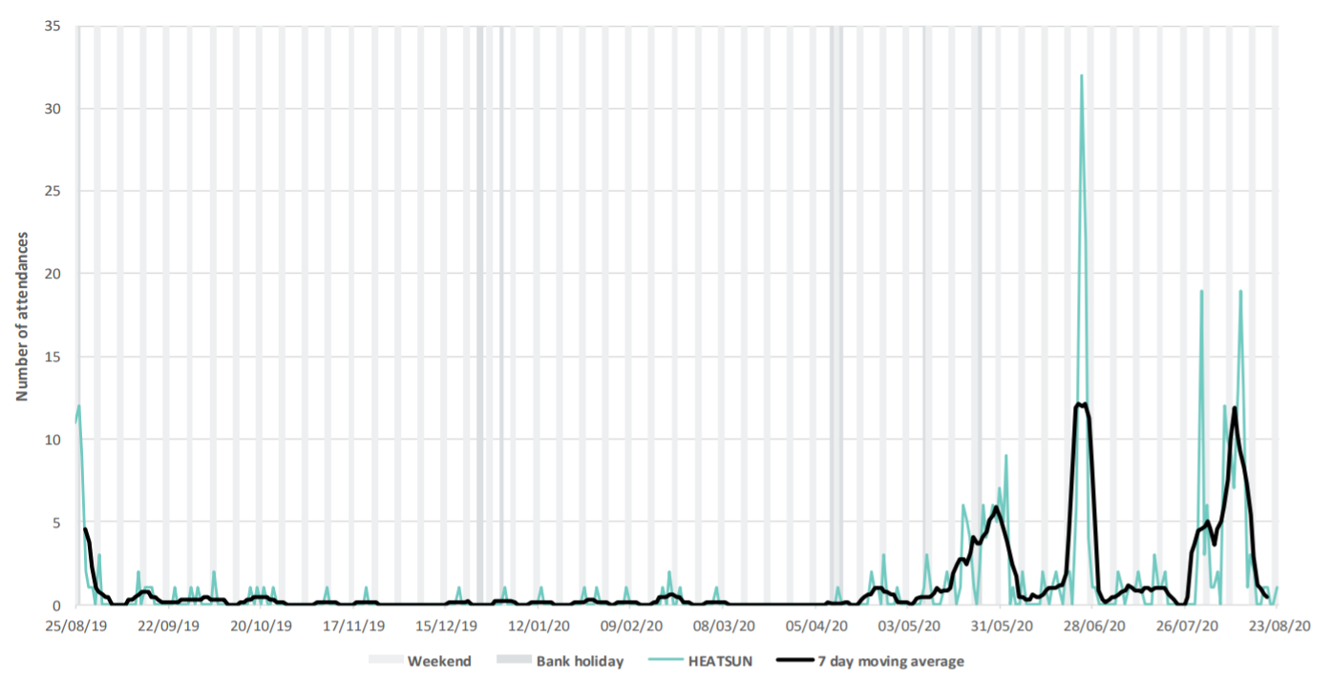
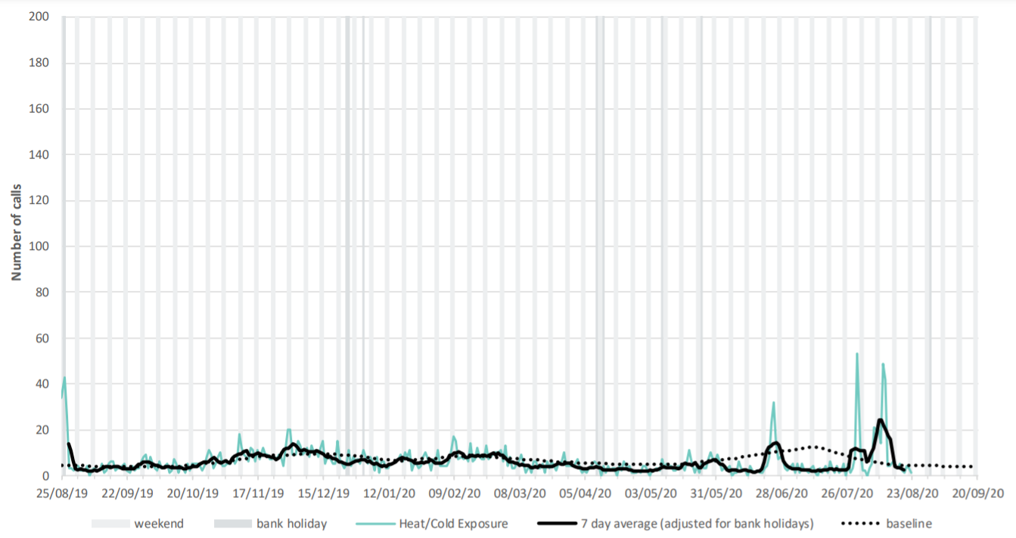
Heat-health impacts, 2020: morbidity
Emergency Department (ED) Syndromic Surveillance System – heat stroke/exhaustion
- Daily ED attendances
PHE National Ambulance Syndromic Surveillance System – heat/cold impact
- Daily ambulance call out
Heat-health impacts were observed across PHE Syndromic Surveillance Systems during episodes of hot weather but should be interpreted with caution due to the wider impact of the COVID-19 pandemic on the surveillance systems
Source: https://www.gov.uk/government/publications/syndromic-surveillance-weekly-summaries-for-2020
Notes:
The wider impact of the COVID-19 pandemic on the surveillance systems routinely used to monitor the health impact of heatwaves added complexity to the surveillance outputs making their interpretation difficult.
While there were changes in help seeking behaviours observed during the pandemic, heat impacts associated with the three episodes of hot weather were observed across PHE’s Syndromic Surveillance Systems, as shown on the slide.
While the impacts on healthcare usage were visible, the absolute values are relatively small compared to the total volume of attendances and ambulance call outs respectively. For example, during the third episode of heat daily total emergency department attendance ranged between approximately 15,000 and 18,000, where as the highest daily value for the Heat/sun stroke indicator during the same heat period was below 20.

Slide 21
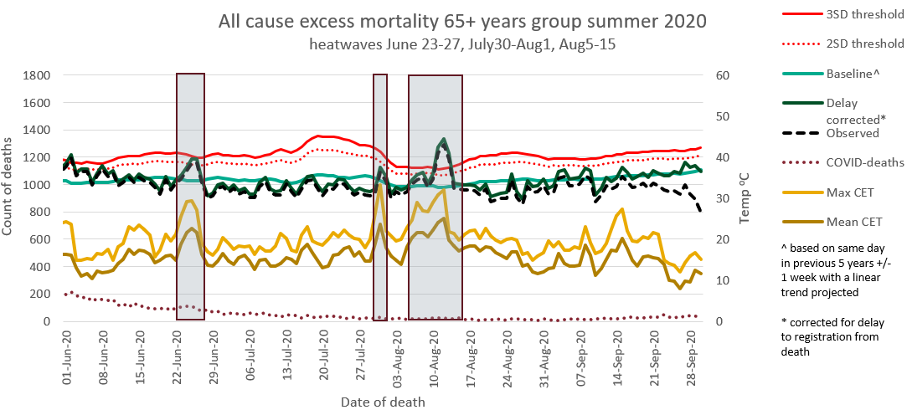
Heat-health impacts, 2020: mortality
The time series illustrates the very rapid increase in deaths once temperatures start to rise; therefore, the window of opportunity for preventative action is short. During each episode of heat in summer 2020, a corresponding peak can be observed in all cause mortality among the 65+ years group
Source: Heatwave mortality monitoring report: 2020
Notes:
Shaded areas on the figure highlight periods which meet PHE heatwave criteria for estimating all-cause excess mortality and were analysed by age and region. From top to bottom these are:
3 and 2 standard deviation (SD) thresholds indicating significance (solid and dashed red lines)
daily corrected mortality count (dark green solid line)
observed mortality counts (black dashed line)
baseline mortality count (light green solid line)
maximum Central England Temperature (CET) (solid light gold line)
average CET (solid dark gold line)
COVID-deaths (purple dashed line)
The timeseries shown illiterates the almost sudden timeframe in which we see impacts on mortality from the onset of high temperatures. Meaning that the window of opportunity for public health intervention is relatively short. During each episode of heat in summer 2020, a corresponding peak can be observed in all cause mortality among the 65+ years group.

Slide 22
Heat-health impacts, 2020: All-cause excess mortality by age
Heatwave Period | June23-27 | Jul30-Aug1 | Aug5-15 | Total
All | 576 (384-768) | 246 (103-389) | 1734 (1401-2066) | 2556 (2139-2926)
0 to 24 | -2 (-21-16) | 6 (-9-21) | 16 (-17-49) | 19 (-24-55)
25 to 44 | 6 (-24-37) | -15 (-37-7) | 12 (-42-67) | 4 (-63-64)
45 to 64 | 27 (-41-96) | 42 (-10-94) | 219 (100-338) | 288 (128-411)
65 to 74 | 161 (78-243) | 18 (-40-76) | 225 (88-361) | 403 (228-554)
75 to 84 | 172 (69-274) | 17 (-59-92) | 479 (300-659) | 668 (464-886)
85+ | 213 (96-329) | 178 (89-267) | 782 (578-986) | 1173 (938-1421)
0 to 64 | 31 (-46-109) | 33 (-26-92) | 247 (113-382) | 311 (126-446)
65+ | 545 (369-721) | 213 (82-343) | 1486 (1183-1790) | 2244 (1887-2606)
Notes:
All-cause excess mortality during the heatwave episodes were calculated by subtracting the average number of deaths from all-causes (corrected for registration delay) on heatwave days from the average number of deaths on the 7 non-heatwave days before and after the heatwave, after subtracting the estimated COVID deaths.
In total, summer 2020 observed 2,556 all-cause excess deaths during episodes of heat across all ages and all three episodes. This is the highest heatwave associated all-cause excess mortality observed since the introduction of the Heatwave Plan for England in 2004.
Each episode of heat observed a significant all-cause excess in deaths, with the most notable being episode 3, where England observed 1,734 total all-cause excess deaths.
During episode 3 all regions except the North East of England and Yorkshire and the Humber observed an excess in all-cause excess mortality.
In addition, it was not just the over 65’s group which overserved a significant excess in all-cause deaths during episode 3, but also the 45 to 64 years group. This differs from previous years where this age group did not observe significant excess associated with heat episodes at the national level.

Slide 23
Heat-health impacts, 2020: cause of death & place of death
Cause of death: statistically significant increases in mortality due to circulatory and respiratory causes, as well as Alzheimer’s and dementia, was observed in the over 65 years group in all three heat episodes compared to non-heatwave periods
Place of death: Statistically significant increases in deaths occurring at home and in care homes was observed among those aged over 65 years, across all three heatwave episodes when compared to non-heatwave periods. Statistically significant increases in deaths occurring in hospitals was also observed during the first and third heatwave episodes for the over 65 years group when compared to non-heatwave periods
A statistically significant increase in deaths occurring at home and in hospital for those aged less that 65 years was also observed during episode 3 when compared to non-heatwave days in 2020.
Notes:
Initial analysis of underlying cause of death and location of death during each heat episode during summer 2020 suggest:
Underlying cause of death categories of circulatory deaths, respiratory deaths and Alzheimer’s and Dementia deaths all observed significant excess mortality across all three heat periods in the 65+ years group
Deaths at home and in care homes increased significantly during all three heat episodes for 65+ years group when compared to non-heatwave days in 2020.
Deaths in hospitals increased significantly during the first and third heat episodes in the 65+ years group.
Deaths at home and in hospitals increased significantly in the <65 years group during episode 3 when compared to non-heatwave days in 2020.
A general trend observed during summer 2020 in the weekly excess mortality reports from PHE (https://fingertips.phe.org.uk/static-reports/mortality-surveillance/excess-mortality-in-england-latest.html) show that number of deaths occurring at home have increased while deaths occurring in all other settings have decreased to varying degrees when compared to the previous five years during summer 2020.

Slide 24
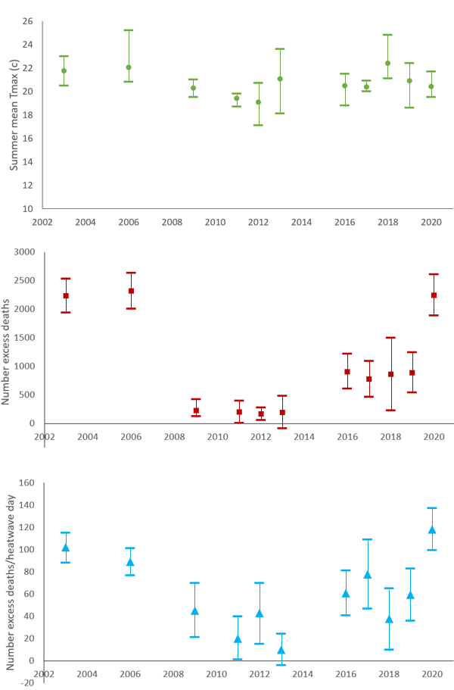
How did summer 2020 compare to previous seasons?
Green circles represent mean Central England Temperatures - no notable difference (overlapping 95% confidence intervals)
Red squares represent all-cause heatwave deaths in the 65+ years group per year – 2020 comparable with 2003 and 2006, not comparable to other years.
Blue triangles represent the average number all-cause heatwave deaths in the 65+ years group per Heatwave day – 2020 observed the highest number since introduction of Heatwave Plan for England in 2004
Note: Error bars on chart represent the 95% confidence intervals
Notes:
Updating the analysis of Green et al (2016) permits comparison of 2020 to recent heatwave seasons in terms of estimated excess mortality amongst the 65+ years group.
This slide shows:
2020 was not particularly extreme in terms of average temperatures across England (green circles). This metric however, omits peak temperatures and does not account for regional variability.
2020 is comparable to 2003 and 2006 in terms of total Heatwave excess mortality among the 65+ years group (red squares)
Considering average number of deaths per Heatwave day, 2020 was higher than all previous years, including 2003 and 2006 (blue triangles). However it is worth noting that the lower 95% confidence interval for 2020 does over lap with 2003, 2006 and 2017.
Whilst the third episode of a heatwave in the summer was prolonged, with very high temperatures recorded (day and night time), the severity and intensity of the heatwave alone may not fully explain the magnitude of the impacts observed. Further work is required to explore how the concurrent risk of COVID-19 and heatwaves may have intersected to amplify these impacts, however establishing causality may be very difficult.

Slide 25
Heat-health impacts, 2020: Key messages
The number of excess all-cause deaths associated with heatwave events in summer 2020 is the highest since the introduction of the Heatwave Plan for England in 2004
Recorded temperatures in summer 2020 were not record breaking; however, the heatwave event in August was prolonged and night-time temperatures remained high, e.g. “tropical nights” with local temperatures remaining above 20C
Of the total estimated deaths, 68% occurred during the third episode of heat (5-15 August 2020)
Additional analyses of place and cause of death associated with heatwave events illustrate the need for cross-system preparedness and a multisectoral approach to prevention, along with effective risk communication with the public.

Slide 26
Heatwave Plan for England:
additional actions for summer 2021

Slide 27
COVID-19: hot weather preparedness and response
The guidance and good practice recommendations in the Heatwave Plan for England set out in Figures 3.1 to 3.4 should continue to be followed with some additional considerations to mitigate and manage the concurrent COVID-19 risks
The following slides detail specific considerations for:
Commissioners of health and social care (all settings) and local authority Directors of Public Health
Providers – health and social care staff in all settings (community, hospitals and care homes)
Community and voluntary sector and individuals
NHS England, PHE, DHSC, Met Office
All actions should also consider current COVID-19 specific guidance: https://www.gov.uk/coronavirus

Slide 28
Commissioners of health and social care (all settings) and local authority Directors of Public Health (1)
In addition to the actions set out in Page 20 of the Heatwave Plan for England:
Local Health Resilience Partnerships may wish to satisfy themselves that there is surge capacity across local health and social care systems to respond to a heatwave event along with additional COVID-19 pressures and possible COVID-19 related staff absence
Local Resilience Fora should consider the impact of hot weather on the existing operational response to COVID-19 and vice versa
work with partner agencies, providers and businesses to raise awareness about the concurrent risk of hot weather and COVID-19
encourage partners to sign up to the heat-health alert system and communicate the public messages around heat if hot weather is forecast

Slide 29
Commissioners of health and social care (all settings) and local authority Directors of Public Health (2)
ensure care homes and hospitals are aware of the Heatwave Plan and are preparing for heatwave as a concurrent risk with COVID-19
engage the community and voluntary sector to support those most at risk, especially those who are socially isolated
ensure other institutional establishments (i.e. prisons, schools) are aware of heatwave guidance
work with local partners to facilitate equitable and flexible access to green public spaces during hot weather, eg extended opening hours

Slide 30
Providers – health and social care staff in all settings (community, hospitals and care homes)
In addition to the actions set out in Page 22 of the Heatwave Plan for England:
review who may be at high risk
more residents of care homes and people receiving domiciliary care may be at risk from heat due to COVID-19 ill-health and social isolation due to COVID-19
review your usual plans for surge capacity in hot weather in light of possible COVID-19 related staff absence and to ensure staff welfare
communicate alerts to staff and ensure they know what to do when the weather gets hot – use the PHE COVID-19 ‘Beat the Heat’ leaflet and checklist for Care Homes
fans should only be used in single rooms for residents who do not have COVID-19 and have not been identified as a close contact of a confirmed case. Air should not be directed at their face or directed towards doors or openings that lead to other indoor spaces. Fans are best used in a room which also has good ventilation.

Slide 31
Community and voluntary sector and individuals
In addition to the actions set out in Page 24 of the Heatwave Plan for England:
have plans in place to be able to check on others safely in advance of the hot weather (i.e. over the phone)
follow advice in the PHE resource ‘Coping with heat and COVID-19’
encourage those who may find it more difficult to cope in hot weather to request help through the volunteer networks, for example, the Royal Voluntary Service website
advise those at risk that they should continue to seek medical help if they are feeling unwell and that plans are in place to deliver services safely despite COVID-19

Slide 32
National Level: NHS England, PHE, DHSC, Met Office (1)
In addition to the actions set out in Page 26 of the Heatwave Plan for England:
ahead of hot weather, NHS England should consider the impact of hot weather on workforce capacity and wellbeing, particularly with regard to PPE use in higher temperatures
NHS England should satisfy themselves that alerts are cascaded widely, including to patient-facing and clinical staff
PHE Regions should be aware of the Heatwave Plan and note the new resources on heat and COVID-19, and provide support Directors of Public Health and other local stakeholders as appropriate
PHE surveillance systems to provide early warning of the potential health impacts of hot weather will continue throughout summer 2021; however, the wider impact of the COVID-19 pandemic on the surveillance systems routinely used to monitor the health impact of heatwaves adds complexity to the surveillance outputs making their interpretation difficult this year

Slide 33
National Level: NHS England, PHE, DHSC, Met Office (2)
PHE and the Met Office will be hypervigilant within the heat-health warning system to ensure the earliest possible issuing of heat health alerts and the maximum possible warning time
Situational awareness will be supported through tri-weekly updates with the Met Office. Cross-Government coordination will be provided though the National Summer Resilience Network chaired by the Civil Contingency Secretariat, Cabinet Office

Slide 34
Key messages
In light of the guidance and good practice recommendations made in the Heatwave Plan for England, and the current COVID-19 risks, there are 3 key messages:
All local authorities, NHS commissioners and their partner organisation, including health and social care providers, should consider the Heatwave plan for England and satisfy themselves that the suggested actions and the heatwave alert service are understood across their locality
People at risk from high temperatures may also be vulnerable to COVID-19 infection and vice versa. This can be due to concurrence of both clinical and environmental/socio-economic factors
Fear of COVID-19 should not prevent actions to reduce the harms to health from hot weather but should take into account any COVID-19 related policy and guidance

Slide 35
Resources
Heatwave Plan for England:
https://assets.publishing.service.gov.uk/government/uploads/system/uploads/attachment_data/file/801539/Heatwave_plan_for_England_2019.pdf
Beat the Heat – Coping with heat and COVID-19 (poster): https://assets.publishing.service.gov.uk/government/uploads/system/uploads/attachment_data/file/888247/Beat_the_Heat_2020.pdf
Beat the Heat – Coping with heat and COVID-19 (leaflet): https://assets.publishing.service.gov.uk/government/uploads/system/uploads/attachment_data/file/888252/Beat-the-Heat_Leaflet_Coping_with_heat_and_COVID-19.pdf
Beat the Heat – Keep residents safe and well during COVID-19 (poster and checklist):
https://assets.publishing.service.gov.uk/government/uploads/system/uploads/attachment_data/file/888249/Heat_flier_Residents_2020.pdf
Specific advice and guidance on coronavirus (COVID-19):
https://www.gov.uk/coronavirus

Slide 36
About Public Health England
Public Health England exists to protect and improve the nation’s health and wellbeing, and reduce health inequalities. We do this through world-leading science, knowledge and intelligence, advocacy, partnerships and the delivery of specialist public health services. We are an executive agency of the Department of Health and Social Care, and a distinct delivery organisation with operational autonomy to advise and support government, local authorities and the NHS in a professionally independent manner.
Public Health England, Wellington House, 133-155 Waterloo Road, London SE1 8UG Tel: 020 7654 8000 www.gov.uk/phe Twitter: @PHE_uk Facebook: www.facebook.com/PublicHealthEngland
For enquiries relating to this document, please contact: extremeevents@phe.gov.uk
© Crown copyright 2018 You may re-use this information (excluding logos) free of charge in any format or medium, under the terms of the Open Government Licence v3.0. To view this licence, visit: www.nationalarchives.gov.uk/doc/open-government-licence/version/3/ Where we have identified any third party copyright information you will need to obtain permission from the copyright holders concerned.
Published: May 2020. PHE publications gateway number: GW-1289

