Slide 1
The health impacts of hot weather and the Heatwave Plan for England
Training for the health and social care system and the voluntary sector
Notes:
The purpose of the heatwave plan is to reduce summer deaths and illness by raising public awareness and triggering actions in the NHS, public health, social care and other community and voluntary organisations to support people who have health, housing or economic circumstances that increase their vulnerability to heat.
It recommends a series of steps to reduce the risks to health from prolonged exposure to severe heat for:
• the NHS, local authorities, social care, and other public agencies
• professionals working with people at risk
• individuals, local communities and voluntary groups
The heatwave plan was first published in 2004, following the devastating pan European heatwave in 2003 that resulted in ~70,000 excess deaths. The plan builds on many years of experience of developing and improving the ability of the health sector and its partners to deal with significant periods of hot weather.

Slide 2
Outline of this presentation
Health impacts of hot weather
Heatwaves and hot weather
Heat risk and climate change
Overheating in buildings
The Heatwave Plan for England
Heat-health Watch alerting system
Key messages
Resources
Notes:
Rational of resource
This resource is designed to raise awareness of the public health consequences of hot weather and the actions people can take to protect health before and during a heatwave. This resource introduces the Heatwave Plan for England, its associated public and professional resources and the heat-health alerting system for England. The slide set can be used as a complete presentation lasting approximately 1-hour or as separate chapters. It has been designed for those across the health and social care system and those in the voluntary sector with a role in planning for, or responding to, a heatwave event in England.
Presentation outline:
Health impacts of hot weather (slide 4)
Heatwaves and hot weather (slide 16)
Heat risk and climate change (slide 19)
Overheating in buildings (slide 23)
The Heatwave Plan for England (slide 31)
Heat-health Watch alerting system (slide 43)
Key messages (slide 55)
Resources (slide 57)

Slide 3
Key messages
High temperatures have significant health consequences and are associated with increased mortality and increased morbidity.
Certain groups are more vulnerable to the health consequences of high temperatures but everybody can be affected.
The harm to health associated with high temperatures is not inevitable. There are things we can do all year round and in the emergency response context to minimise the impact on human health.
Everybody has a role. The impact of high temperatures requires a cross sectoral response (eg the Heatwave Plan for England).
High temperatures and overheating are not just problems for the future, but are problems now. A changing climate is set to increase the future risk.
Notes:
On completion of this resource, participants will be able to:
Demonstrate the risks to health of hot weather, overheating and heatwave events.
Understand the role and responsibilities of the health and social care sector in reducing the harm to health from hot weather including resilience, preparedness, response and recovery and the important role the voluntary sector can play.

Slide 4
Health impacts of hot weather

Slide 6
Health impacts of hot weather
a range of mild to severe health impacts can result from exposure to high temperatures. Especially when temperatures remain high for prolonged periods
the main causes of illness and death during a heatwave are respiratory and cardiovascular
there are specific heat-related health effects and illnesses including:
Heat cramps, heat rash, heat oedema, heat syncope, heat exhaustion, heatstroke
Notes:
The main causes of illness and death during a heatwave are respiratory and cardiovascular diseases. Additionally, there are specific heat-related illnesses including:
• heat cramps – caused by dehydration and loss of electrolytes, including after exercise
• heat rash – small, red, itchy papules all over the body
• heat oedema – swelling, particularly in the ankles, due to dilation of blood vessels and retention of fluid
• heat syncope – dizziness and fainting, due to dehydration and vasodilation, worsened by cardiovascular disease and certain medications
• heat exhaustion which occurs as a result of dehydration, with non-specific symptoms such as malaise, vomiting and circulatory collapse. It occurs when the core body temperature is between 37ºC and 40ºC. Left untreated, heat exhaustion may evolve into heatstroke
• heatstroke - a more severe illness in which the body’s thermoregulation mechanism fails. Heatstroke is a medical emergency, with symptoms of confusion, disorientation, convulsions, unconsciousness and hot dry skin. It occurs when core body temperature exceeds 40ºC for over 45 minutes and can result in cell death, organ failure, brain damage or death. Heat stroke can be either classical or exertional (heat stroke that results from strenuous exercise)

Slide 7
Health impacts of hot weather
The impacts of hot weather on health include:
the health impacts of hot weather increase as temperatures increase
increased numbers of admissions to hospital and consultations with GPs, and additional demands placed on the emergency services
fatalities, particularly among the vulnerable and elderly
it is estimated that there are 75 extra deaths per week for each degree of increase in temperature
Notes:
Hot weather can happen with little warning and illness and deaths occur within the first couple of days. By the time hot weather arrives, the window of opportunity for effective action is often very short indeed. This means that advanced and long-term planning and preparedness are essential.
The main causes of illness and death during a heatwave are respiratory and cardiovascular diseases. 2 years after the introduction of the Heatwave Plan for England in 2004, there was another significant event. It is estimated that there were about 680 excess deaths in summer 2006 compared to similar periods in previous years. In summer 2006, it was estimated that 75 extra deaths occurred per week with each one degree increase in temperature. Part of this rise in mortality may be attributable to air pollution, which makes respiratory symptoms worse. The other main contributor is the effect of heat on the cardiovascular system.
In order to keep cool, large quantities of extra blood are circulated to the skin. This causes strain on the heart, which for elderly people and those with chronic health problems can be enough to cause heart attacks.

Slide 8
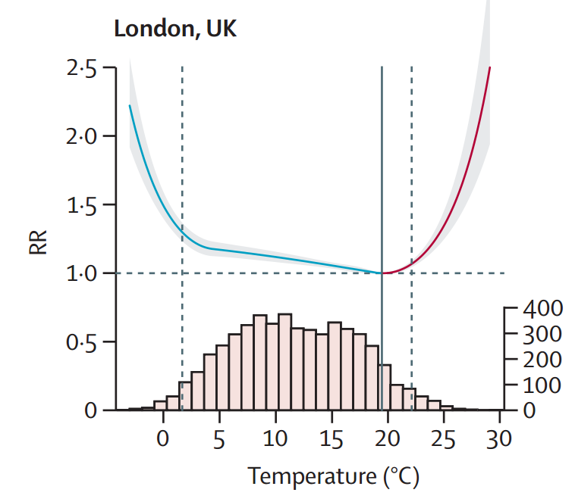
Health impacts of hot weather
Cumulative exposure–response association between temperature and mortality for London
Gasparrini et al., 2015
Notes:
The health impacts of heat start at relatively moderate temperatures. This chart illustrates the relative risk for both cold and hot temperatures in London with related temperature distributions. The grey line demarks the minimum mortality temperature and dashed grey lines are the 2·5th and 97·5th percentiles – the temperature axis is mean daily temperature. The temperature distributions emphasise how the hot temperature range, although characterised by a high relative risk, consists of only a small proportion of days.
We can see that the relative risk for all-cause mortality starts to increase well before heatwave levels for London (threshold max 32/18/32).
Sourced from: Gasparrini A, Guo Y, Hashizume M, Lavigne E, Zanobetti A, Schwartz J, et al. (2015). Mortality risk attributable to high and low ambient temperature: a multicountry observational study. Lancet, Volume 386, Number 9991: 369-375.

Slide 9
At-risk groups
EVERYBODY can be affected by high temperatures, but there are certain factors that increase an individual’s risk during a heatwave. These include:
• older age: especially those over 75 years old, or those living on their own and who are socially isolated, or those living in a care home
• chronic and severe illness: including heart or lung conditions, diabetes, renal insufficiency, Parkinson’s disease or severe mental illness
• inability to adapt behaviour to keep cool: babies and the very young, having a disability, being bed bound, consuming too much alcohol, having Alzheimer’s disease
• environmental factors and overexposure: living in a top floor flat, being homeless, activities or jobs that are in hot places or outdoors and include high levels of physical exertion
Notes:
People with long-term or severe illness are likely to be at particular risk. Medications that potentially affect renal function, sweating, thermoregulation or electrolyte balance can make this group more vulnerable to the effects of heat. This includes the following conditions:
• respiratory disease
• cardiovascular and cerebrovascular conditions
• peripheral vascular conditions
• diabetes and obesity
• severe mental illness
• Parkinson’s disease and difficulties with mobility
• renal insufficiency
• Alzheimer’s or related diseases

Slide 10
Potential wider hazards of hot weather
air pollution, ground level ozone and low atmospheric ozone
ultraviolet radiation
wildfires
thunderstorms (and asthma)
algal blooms – inland and marine
food poisoning
Behavioural
swimming in open water – drowning
drought and public water scarcity
Notes:
Air pollution, ground level ozone and low atmospheric ozone
Hot weather is often associated with still weather conditions, which may trap air pollutants or add them to a higher background concentration which can lead to higher concentrations of nitrogen dioxide and particulate matter. Hot sunny weather may also generate higher levels of ozone. Air pollution increases the level of cardio-respiratory deaths (Committee on the Medical Effects of Air Pollutants, 2006). Heatwave conditions often lead to increased ozone levels following interactions of other pollutants with sunlight. Information on the latest pollution levels and the air quality forecast can be found on the UK-Air website (Defra).
Ultraviolet radiation
Ultraviolet (UV) radiation may cause harm when people are exposed to the sun, including during heatwaves. While small doses of UV from the sun help the body produce vitamin D, excessive exposure is damaging to human health. Excessive exposure may have consequences ranging from premature ageing of the skin to skin cancer.
Wildfires:
The risk of wildfire during a heatwave can be greater because the vegetation will be that much drier than usual. The smoke and other risks from wildfire can contribute to local and regional air pollution. Wildfire smoke contains toxins and particulate matter which can cause adverse respiratory, cardiovascular and eye effects. Burn injuries can affect those in close contact with the fires and psychological morbidity relating to the trauma of exposure to the event and loss of life, health or material goods can occur.
Thunderstorms (and asthma):
Thunderstorm asthma is a term used to describe any observed increase in acute bronchospasm cases following the occurrence of thunderstorms in the local vicinity, placing increased pressures on health services. Although thunderstorm asthma doesn’t occur after every thunderstorm, it is important that professionals and the general public are aware of the potential risks over the summer period.
Algal blooms
Some algal blooms and their surface scums, which grow on open waters and are often blown onto shorelines, can release toxins which adversely affect human and animal health. Symptoms following ingestion of contaminated water during recreational activities include gastro intestinal effects (e.g. abdominal pain, nausea, vomiting and diarrhoea) and respiratory features (eg sore throat and cough). Symptoms following recreational exposure include skin and eye irritation, respiratory features, and hay fever/asthma-like symptoms. Water treatment removes algal bloom contamination from drinking water.
Food Poisoning
Higher temperatures can lead to increases in BBQ cooking and/or difficulties storing food. This can lead to an increase in the cases of food poisoning and diarrhoeal illness. These illnesses can lead to further dehydration and exacerbation of the symptoms of heat exhaustion.
Drought and public water scarcity:
The public health impacts associated with drought include disruption to public water supplies. Water companies have plans in place to deal with failure in the supply of mains water or sewerage services – these plans are regularly reviewed and tested by the water companies and are independently certified every year. Drought can also be difficult for those whose livelihood or lifestyle depends on water, leading to mental health and wellbeing impacts due to stress, financial worries and employment uncertainty.

Slide 11
Health impacts of the 2003 heatwave
~70,000 deaths in Europe
15,000 deaths in France
Particularly significant in Paris:
  temperature extremes: high minimum temperature
  limited meteorological forecast and alerting
  institutional failures: hospital and care home staff on holiday
  limited surveillance and scientific monitoring
  critical communication issues: between organisations, media and public
  limited sense of emergency: no public health measures
  Lagadec (2004)
Notes:
In a moderate heatwave, it is mainly at-risk groups who are affected, however, during an extreme heatwave such as the one affecting France in 2003, fit and healthy people can also be affected. During the summer, heatwave in Northern France in August 2003, unprecedentedly high day and night-time temperatures for a period of three weeks resulted in 15,000 excess deaths. The period of extreme heat is thought to have been the warmest for up to 500 years and was a wake up call for many European countries.
Sourced from: Lagadec, P. (2004). Understanding the French 2003 Heat Wave Experience: Beyond the heat, a Multi-layered Challenge. Journal of contingencies and crisis management, Volume 12, Number 4: 160-169.

Slide 12
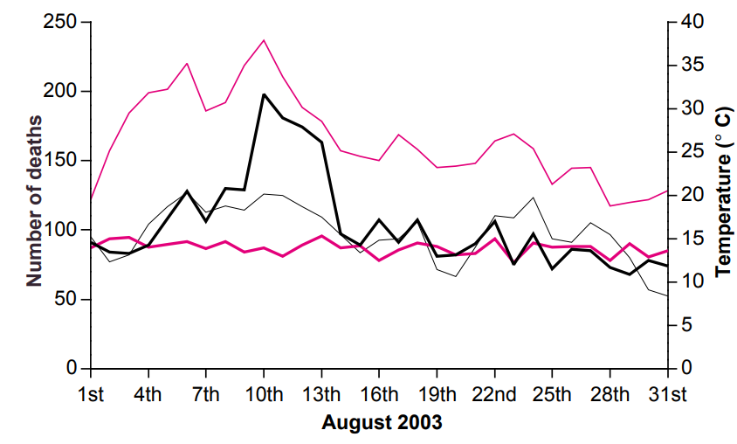
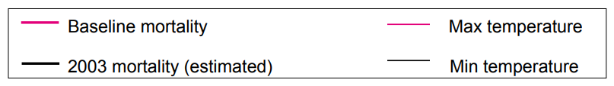
Daily mortality in London, August 2003
Daily mortality, London, 75 years and over
Johnson et. al. (2005)
Notes:
In England that year, there were over 2,000 excess deaths over the 10 day heatwave period which lasted from 4 to 13 August 2003, compared to the previous five years over the same period. Temperature records were broken in England, with Brogdale near Faversham (Kent) recording England's highest temperature with 38.5°C on 10 August 2003. Worst affected were people over the age of 75 years, with 522 additional deaths recorded in London alone.
Sourced from: Johnson H, Kovats RS, McGregor G, Stedman J, Gibbs M, Walton H, Cook L. Black E. (2005). The impact of the 2003 heat wave on mortality and hospital admissions in England. Health Stat Q. 2005 Spring;(25):6-11

Slide 13
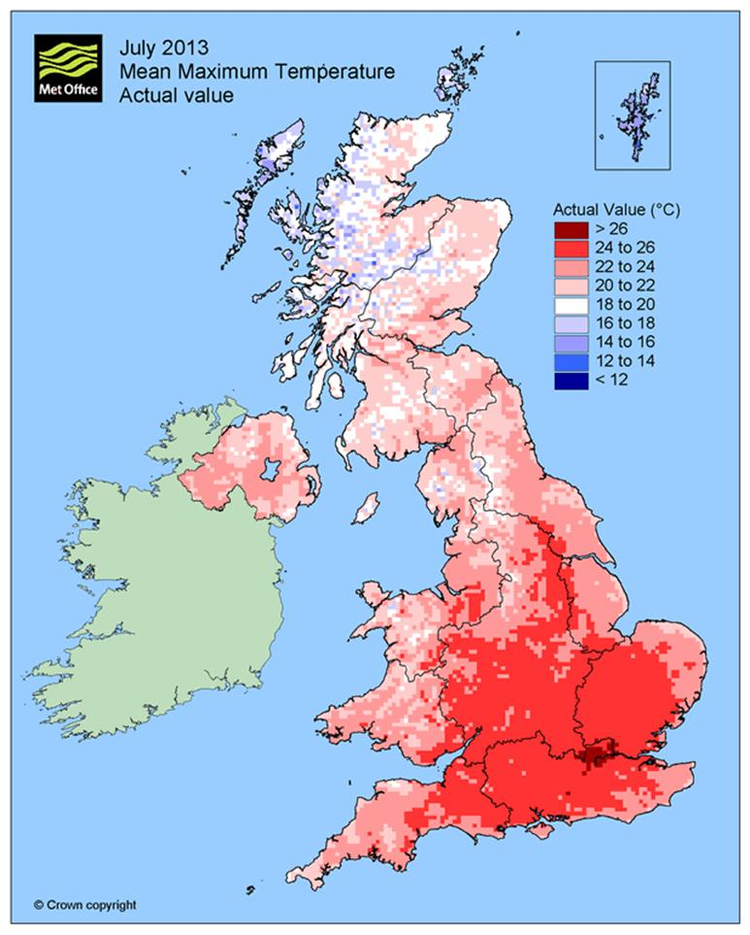
July 2013 hot weather
Notes:
From 3 to 23 July 2013, the UK again experienced hot, dry, sunny weather. Daily max temperatures exceeded 28°C widely every day from 13 to 19 July inclusive, and again on 22 July across London, the Southeast, the Midlands, the Southwest and East Anglia. 30°C was recorded in London and the Southeast on 7 consecutive days from 13 to 19 July, and again on 22 July.

Slide 14
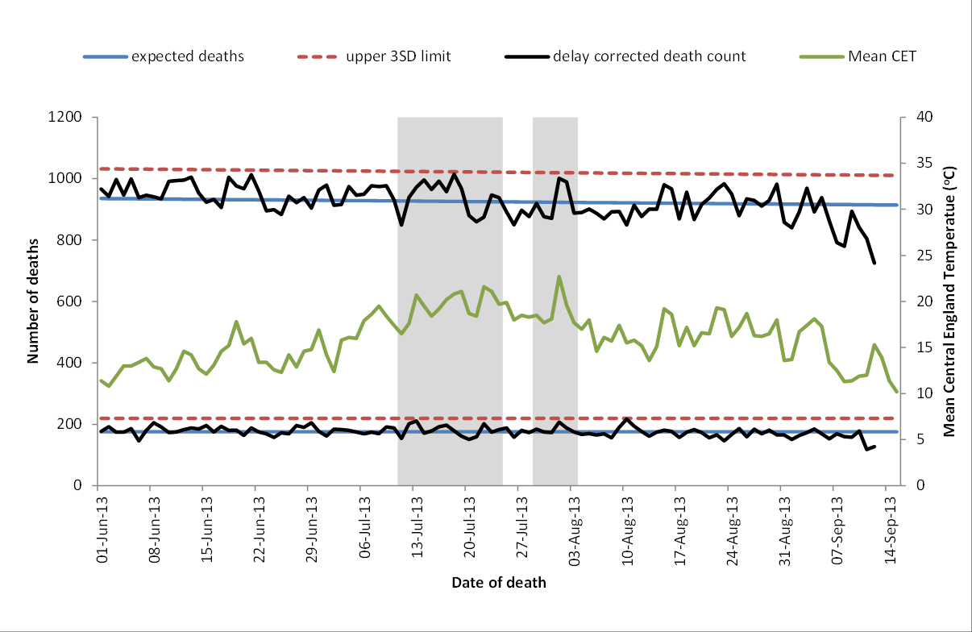
Daily Mortality (June to September 2013)
a
b
Daily number of deaths in <65yr olds (a) and 65+yr olds (b) compared to expected number (blue line) and upper 3SD significance limit (red line) with daily maximum Central England Temperature (⁰C, green line), England, 2013. Grey shading: heatwave defined as Met office alert or mean CET >20degC (Green et. al. 2016).
Notes:
The daily number of deaths in 65+yr olds was consistently above the number of expected deaths (light blue line) from 12 to 19 July and 1 to 2 August, the periods when hot weather alerts were issued.
Sourced from Green HK, Andrews N, Armstrong B, Bickler G, Pebody R (2016). Mortality during the 2013 heatwave in England – How did it compare to previous heatwaves? A retrospective observational study. Environmental Research. Volume 147: 343–349.
Full article available at: http://www.sciencedirect.com/science/article/pii/S0013935116300706

Slide 15
GP heat/sun stroke consultations, July 2013
GP in hours daily heat illness consultations (7-day moving average) by age group during the 2013 Heat-Health Watch period (1 June – 15 September 2013). Heat alert periods (heat health alert levels 2/3) for 2013 are indicated by hashed grey bars; weekends are indicated by solid grey bars. GP, general practitioner (Smith et. al. 2016).
Notes:
In July 2013, a rapid increase in the GP consultations and ED attendances was seen for heat illness. This occurred with the onset of hot weather during July. GP In-hours consultations increased across all age groups. The highest rates were in school children and those aged ≥75 years, with the latter persisting beyond the end of the heatwave, up to the beginning of August.
An estimated 1166 GP in-hours consultations took place over the summer. This was double the number observed during a non-heatwave year.
Sourced from Smith S, Elliot AJ, Hajat S et al. (2016). Estimating the burden of heat/sun stroke in England during the 2013 summer heatwave using syndromic surveillance. Journal of Epidemiology and Community Health, Volume 70, Issue 0.
Full article available at:
jech.bmj.com/content/70/5/459

Slide 16
Heatwaves and hot weather

Slide 17
Heatwaves and hot weather
The term heatwave can be used to describe an extended period of hot weather relative to the expected conditions of the area at that time of year.
There is no formal definition of a heatwave in the UK, but the Met Office expect to arrive at one in Summer 2018.
Many people enjoy hot weather but there can be serious health consequences from too much heat and vulnerable groups are particularly at-risk in prolonged hot spells.
Hot weather, especially when prolonged, with warm nights, can have effects on people's health and on national infrastructure. To aid preparation and awareness before and during a prolonged hot spell, the heatwave plan has been created by Public Health England in association with other partners. It recommends a series of steps to reduce the risks to health from prolonged exposure to severe heat.

Slide 18
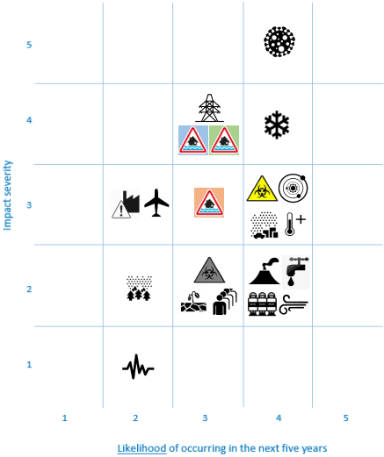
National Risk Register 2017
Notes:
The National Risk Register of Civil Emergencies 2017 edition provides an updated government assessment of the likelihood and potential impact of a range of different civil emergency risks (including naturally and accidentally occurring hazards and malicious threats) that may directly affect the UK over the next 5 years. The risk to human health posed by heatwaves is included in the National Risk Assessment. In the National Risk Register, how serious the risk of an emergency is depends both on the likelihood of it happening over the next five years and on the consequences or impacts that people will feel if it does. When identifying risks for the National Risk Register, a ‘reasonable worst case’ is chosen which represents a challenging manifestation of the scenario.
The 2017 National Risk Register of Civil Emergencies considers heatwaves a similar risk to that posed by emerging infectious diseases, poor air quality and space weather.
The National Risk Register of Civil Emergencies can be found using the following link:
https://www.gov.uk/government/publications/national-risk-register-of-civil-emergencies-2017-edition

Slide 19
Heat risk and climate change

Slide 20
Future heat risk
an increase in the frequency and intensity of hot weather is one of the most likely impacts of climate change
the UK Government is required under the 2008 Climate Change Act to publish a UK-wide Climate Change Risk Assessment every five years
the 2017 Climate Change Risk Assessment identifies risks to health, wellbeing and productivity from high temperatures as a priority where more action is needed
Notes:
Under the 2008 Climate Change Act, the UK Government is required to publish a UK-wide Climate Change Risk Assessment every five years. The Act stipulates that the Government must assess the risks for the UK from the current and predicted impacts of climate change. The first Climate Change Risk Assessment was published in 2012.
The 2017 Climate Change Risk Assessment is available at:
www.theccc.org.uk/uk-climate-change-risk-assessment-2017/introduction-to-the-ccra/

Slide 21
Future heat-related mortality
Hajat et. al. 2014
Notes:
The number of heat-related deaths in the UK are projected to increase by around 250% by the 2050s, due to climate change and an ageing and growing population. The number of heat-related deaths per year is predicted to be >12,500 by the 2080s.
Sourced from Hajat S, Vardoulakis S, Heaviside C, et. al. (2014). Climate change effects on human health: projections of temperature-related mortality for the UK during the 2020s, 2050s and 2080s. Journal of Epidemiology and Community Health, Volume 68:641-648.

Slide 22
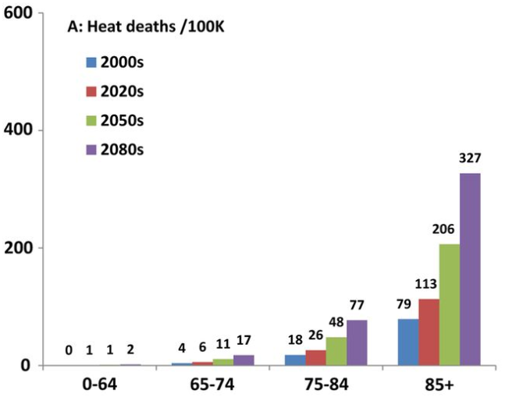
Future heat-related mortality
Hajat et. al. 2014
Notes:
The ageing population, as well as increase in average temperatures, may also result in more heat deaths. As shown, in the coloured chart, the greatest burden of these deaths will occur in the older age groups. These results are normalised per 100 000 people in the population as the size of the age groups varied widely. The results provide a strong indication that the burden of heat remains much higher in 75–84 year olds and in particular those over 85 years.
These results indicate that action to protect health from hot weather will become increasingly necessary this century. Better general health and wellbeing of elderly individuals may help to alleviate some of the large burdens expected. However, the future pace of ageing may have hitherto unrecognised consequences for healthcare. Changes in household size and living patterns may also be important modifiers of future risk among the elderly (Hajat et al. 2014).
Sourced from Hajat S, Vardoulakis S, Heaviside C, et. al. (2014). Climate change effects on human health: projections of temperature-related mortality for the UK during the 2020s, 2050s and 2080s. Journal of Epidemiology and Community Health, Volume 68:641-648.

Slide 23
Overheating in buildings

Slide 24
Overheating risk – an overview
higher temperatures will increase the risk of overheating in houses, schools, hospitals, care homes, prisons, and other types of buildings, leading to adverse impacts on health
there is evidence that people lack a basic understanding of the risks to health from indoor high temperatures, and are therefore less likely to take measures to safeguard their and their dependents’ wellbeing
due to methodological challenges, there is currently no simple solution to quantify the risk and health impact of overheating in buildings
risks to health, wellbeing and productivity from high temperatures has been identified as an area where more action is needed
Notes:
Much of the increased risk of hot weather is thought to be mediated by exposure to high temperatures indoors. Homes may already be overheating even in normal summer conditions. People in developed countries typically spend over 90% of their time indoors. The risk from overheating in hospitals, care homes, schools, prisons and places of work in England is unknown. There is currently no agreed definition of building overheating in the UK. Several different guideline temperatures in health and safety and building design exist, but are based on thermal comfort for healthy people in offices.
Safe upper temperature thresholds for health are difficult to establish; most research to date has used outdoor temperatures to characterise the relationship between temperature and mortality and morbidity. An indoor temperature threshold of around 25-26°C is recommended in several health documents. This is thought to have originated from an expert consensus view at a World Health Organization meeting.

Slide 25
Overheating in hospitals
patients in hospital may be more vulnerable and less able to adapt:
      older age groups, unwell
      disordered thermoperception
      immobile, difficulty adjusting bedding, windows, accessing fluids
unpublished data indicate that around 90% of UK hospital wards are of a type prone to overheating, and the ability to control temperatures is often limited
environmental factors affect staff satisfaction and patient health
influenced by attempts to improve energy efficiency in hospitals
building designers can estimate internal temperatures at which occupants are likely to feel comfortable
Notes:
The Climate Change Adaptation Sub-Committee report 90% of the UK hospital buildings are vulnerable to overheating. Temperatures in some wards can exceed 30˚C even when external temperatures are 22˚C. Newly built hospitals are found to overheat during periods of hot weather, whereas 1920s blocks with open ‘Nightingale’ wards and 1960s blocks were shown to be more resilient to heat.
An evaluation of the 2006 Heatwave Plan also found that 34% of Primary Care Trusts reported lists of vulnerable people to contact during a heatwave were incomplete or missing, and reported logistical issues associated with the large number of people classed as vulnerable. Failures to reach vulnerable people early enough during a heatwave increases the chance that a case of overheating escalates and emergency measures such as installing portable air conditioning units are taken (Adaptation Sub-Committee 2014).
Source:
Adaptation Sub-Committee Progress Report 2014 “Managing climate risks to wellbeing and the economy”. Full report is available at:
www.theccc.org.uk/wp-content/uploads/2014/07/Final_ASC-2014_web-version.pdf

Slide 26
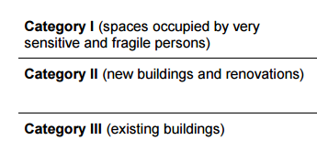
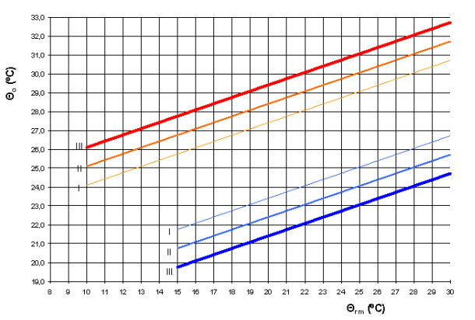
Overheating in hospitals
Notes:
Acceptable ‘summer’ indoor temperatures (cooling season) for buildings without mechanical cooling systems as a function of the exponentially-weighted running mean of the outdoor temperature. The operative temperatures in this figure are valid for office buildings and other buildings of similar type used for human occupancy with mainly sedentary activities and dwellings, where there is easy access to operable windows and occupants may freely adapt their clothing to the indoor and/or outdoor thermal conditions. Θrm = outdoor running mean temperature ˚C and Θo = operative temperature ˚C. These limits apply when 10˚C <Θrm < 30˚C for upper limit and 15˚C <Θrm < 30˚C for lower limit. Above 25˚C the graphs are based on a limited database.
Category I is intended for spaces occupied by very sensitive and fragile persons. It has the narrowest acceptable temperature range as it is assumed that people are unable to change their clothing, be active and that air movement cannot be used (see Adaptive thermal comfort and sustainable thermal standards for buildings). This is broadly relevant to the many hospital patients who have limited ability to adjust their clothing, hydrate themselves or open the windows. However, even within the strict criteria of Category I it is still possible to reach internal temperatures that are harmful to patients’ health. Heatwave conditions would normally be required for this to occur, but high internal temperatures have also been observed in NHS hospital wards outside of heatwave periods.
Source: Standards Institution (BSI – www.bsigroup.com). Source: BS EN15251:2007 Indoor environmental input parameters for design and assessment of energy performance of buildings addressing indoor air quality, thermal environment, lighting and acoustics.
Useful tools, support and guidance:
"Department of Health consultation on HBN 00-07: ‘Emergency Preparedness, resilience and response: planning for the healthcare estate’" www.gov.uk/government/uploads/system/uploads/attachment_data/file/306367/HBN_00-07-250414.pdf
Also HTM 07-02:
www.gov.uk/government/uploads/system/uploads/attachment_data/file/416635/HTM_07-02_Part_A_FINAL.pdf

Slide 27
Overheating in hospitals
Existing standards/recommendations:
temperatures from 18˚C to 28˚C in general wards, and 18˚C to 25˚C for more sensitive areas, such as birthing and recovery rooms
calculations are also needed to ensure that internal temperatures do not exceed 28˚C dry bulb temperature for more than 50 hours per year¹
ward temperatures from 22˚C to 24˚C during the winter and from 23˚C to 25˚C during the summer for air conditioned buildings, assuming specific clothing and activity levels²
hospitals provide cool areas below 26 ˚C for use during heatwaves³
1. Health Technical Memorandum 03- 01: Specialised ventilation for healthcare premises-Part A: Design and validation.
2. CIBSE Guide A: Environmental Design.
3. Heatwave Plan for England.

Slide 28
Overheating in healthcare facilities
Percentage excess mortality by place of death and age group during 2003 heatwave
Kovats et. al. 2006
Notes:
The heatwave in 2003 was associated with a marked short-term increase in mortality in the elderly in the first 2 weeks of August. The graph shows the impact of the heatwave by place of death for two age groups. In the elderly (75 and over age group), the excess mortality as a proportional increase was fairly evenly distributed between deaths at home, deaths in hospital, and deaths in nursing or residential homes. The excess was greatest in nursing homes where deaths increased by 42 per cent during the heatwave, compared to an overall increase of 33 per cent. Among under 75s (black bars) more of the excess was distributed in residential and nursing homes and ‘other placesʼ than would have been expected from the distribution of deaths in the baseline period (Kovats et. al. 2006).
Information from care homes indicate that overheating risk may due to building design and management issues. One study based on four care homes in England found that there was a risk of summertime overheating, especially during short-term heatwaves (2-4 days) with indoor temperatures rising to nearly 30ºC in communal areas and resident rooms. Non-structural factors that affected overheating risk include fixed daily routines of care home residents making it difficult to accommodate periods of intense heat; management structures and systems which do not always allow for front line staff to alter temperatures; and a culture which focuses on cold as the main climate risk so that high indoor temperatures are not always considered by residents or staff to be undesirable (Gupta et al., 2016).
Sources:
Kovats, SR., Johnson, H., and Griffiths, C. (2006). Mortality in southern England during the 2003 heat wave by place of death. Health Statistics Quarterly, Volume 29.
Gupta, R., Walker, G., Lewis, A., et. al. (2016). Care provision fit for a future climate. Full report available at: https://www.jrf.org.uk/report/care-provision-fit-future-climate.

Slide 29
Overheating in domestic settings
The risk of overheating in homes is influenced by many factors including location, the presence of the Urban Heat Island, dwelling design, age, type and tenure which may influence an individual’s ability to adapt their home.
As we get better at building and retrofitting homes to prevent heat losses in the winter, we may inadvertently increase the risk of overheating in warmer months. Recent evidence suggests that around 20% of homes in England already experience overheating even during relatively cool summers.
Occupancy patterns greatly influence exposure to overheating. Individuals in their homes during the day are more likely to be inside at the times of highest external and internal temperatures, and may add to internal heat gains (eg from using appliances).
Notes:
An Urban Heat Island is a metropolitan area that’s a lots warmer then the rural areas surrounding it. Heat is created by energy from all the people, cars, buses, and trains in big cities (https://www.nationalgeographic.org/encyclopedia/urban-heat-island/)
Some homes are more vulnerable than others to overheating. Recent research suggests that:
• top floor 1960s flats can experience over six times the overheating of ground floor flats, depending on orientation, and almost nine times that of Victorian terraced houses
• other risk factors include poor protection from solar gains, such as unshaded south and south west facing windows, and east facing windows for rooms occupied in the mornings such as homes of the elderly
• light-weight buildings with heavily glazed facades, including flats with lack of access to cool space, may also be vulnerable
Further information and resources are available from the Tackling Overheating in Buildings section of the Zero Carbon Hub website: www.zerocarbonhub.org/current-projects/tackling-overheating-buildings

Slide 30
Overheating – actions to tackle the risk
Insulation – thermal insulation to walls and roofs helps prevent solar gain. However, external wall insulation is problematic for solid wall construction. Insulation of pipes, reduction of boiler flow temperatures, ventilation of service voids should all be considered
Shading, reflection and protection – Various options to provide shading to limit heat gain. Internal shutters can provide some protection, as can curtains, but external protection (eg awnings) are preferable. Providing light-coloured finish to flat roofs and introducing green roofs can reduce solar gain
Ventilation – Ideally, ventilation should be passive to avoid additional energy consumption needed for fans and air conditioning. However, window opening may not be appropriate in all circumstances (eg security concerns or homes in noisy locations)
Occupant behaviour – Taking steps to mitigate overheating is essential. This includes shading from the sun and understanding appropriate day and night ventilation
Notes:
Sources of further information:
Dengel, A., Swainson, M., Ormandy, D., Ezratty, V. 2016. Overheating in dwellings. BRE Guidance Document. Available at www.bre.co.uk/filelibrary/Briefing%20papers/116885-Overheating-Guidance-v3.pdf
Taylor, J., Wilkinson, P., Picetti, R., Symonds, P., Heaviside, C., Macintyre, H.L., Davies, M., Mavrogianni, A., Hutchinson, E. (2018) Comparison of built environment adaptations to heat exposure and mortality during hot weather, West Midlands region, UK. Environment International 111, 287-294.
Taylor, J., Symonds, P., Wilkinson, P., Heaviside, C., Macintyre, H., Davies, M., Mavrogianni, A., Hutchinson, E. (2018) Estimating the Influence of Housing Energy Efficiency and Overheating Adaptations on Heat-Related Mortality in the West Midlands, UK. Atmosphere 9, 190.

Slide 31
The Heatwave Plan for England

Slide 32
The Heatwave Plan for England
The objective of the Heatwave Plan for England is to protect the population from heat-related harm to health. It recommends a series of steps, to be taken throughout the year by:
  the NHS, local authorities, social care, and other public agencies
  professionals working with people at risk
  individuals, community and voluntary sector
The plan is an important component of long term and emergency planning, which will become increasingly relevant in adapting to the impacts of climate change.
Notes:
The Heatwave plan for England intends to protect the population from the health consequences of hot weather. It supports the NHS, social care and local authorities, by providing guidance on how to prepare for and respond to a heatwave which can affect everybody’s health, but particularly the most vulnerable people in society.

Slide 33
PHE strategic aims in hot weather
to provide technical and specialist advice, particularly to partners at national and local level, including the Cabinet Office, the Department of Health, NHS England, and other government departments
to raise public awareness of the potential risks and consequences before and during a heatwave event, and to provide public and professional guidance and reassurance
to monitor the impact on health through real-time syndromic and other health surveillance
to maintain business continuity through the provision of mutual aid from unaffected areas as appropriate

Slide 34
The Heatwave Plan for England
The purpose of the heatwave plan is to reduce summer deaths and illness by raising public awareness and triggering actions in the NHS, public health, social care and other community and voluntary organisations to support people who have health, housing or economic circumstances that increase their vulnerability to heat.
Communities can also help their neighbours, friends and relatives to protect against avoidable harm to health this summer. This plan builds on many years of experience of developing and improving the ability of the health sector and its partners to deal with significant periods of hot weather. It is up to each locality to consider the actions in this plan and to adapt and incorporate them in local plans as appropriate to the local situation.
Notes:
The Heatwave Plan for England specifically aims to:
develop the knowledge base of healthcare practitioners regarding the Heatwave Plan for England and the risks associated with hot weather
ensure all local organisations consider the Heatwave Plan for England and satisfy themselves that the suggested actions and heat-health watch alerts are understood across the system
enable Local Health Resilience Partnerships (LHRPs) to use the Heatwave Plan for England to review their own heatwave plans and that local plans are adapted as appropriate to the local context
ensure NHS, social care and local authority commissioners, together with local resilience forums (LRFs) and LHRPs, satisfy themselves that the distribution of heat-health watch alerts will reach those that need to take action
identify opportunities for closer partnership working with the voluntary, community and private sectors to help reduce vulnerability and to support the planning and response to heatwaves

Slide 35
Core elements of the plan
Strategic planning
The climate is changing and current analysis in the national UK climate change risk assessment suggests that summers are going to get hotter in the future. Long-term planning now is essential to support:
      co-ordinated long-term planning between agencies to protect people and infrastructure from the effects of severe hot weather and thus reduce excess summer illness and death
      long-term multi-agency planning to adapt to and reduce the impact of climate change, including ‘greening the built environment’, building design (eg increasing shading around and insulation of buildings), increasing energy efficiency (eg reducing carbon emissions); and transport policies
Notes:
As part of the long-term and strategic planning, we recommend that heatwaves and hot weather are considered by Health and Wellbeing Boards and included in Joint Strategic Needs Assessments and Joint Health and Wellbeing Strategies, in order to inform commissioning.

Slide 36
Core elements of the plan
Heatwave and summer preparedness
The following elements need to be in place locally:
  • agreement on a lead body at local and sub-national level is required to co-ordinate multi-agency collaboration and to direct the response
  • other elements which local NHS, public health and social care organisations will oversee:
    – action to reduce indoor heat exposure (medium and short term)
    – particular care for vulnerable population groups
    – preparedness of the health and social care system
    – staff training and planning
Notes:
Agreement on a lead body at local or sub-national level may be for example, NHS-England whose role, in collaboration with Clinical Commissioning Groups, will be to ensure that local providers of NHS commissioned care have the capacity and capability to deliver their functions as laid out in this plan - NHS England hold the providers of NHS commissioned care to account for implementation, in co-ordination with Clinical Commissioning Groups as appropriate.

Slide 37
Core elements of the plan
Communicating with the public
Working with the media to get advice to people quickly, both before and during a heatwave is a key part of the Heatwave Plan:
    the Civil Contingencies Act 2004 provides a duty on category 1 responders to warn and inform the public before, during and after an emergency
    there should be a local heat-related health information plan – specifying what is communicated, to whom, when and why
    this should raise awareness of how excessive exposure to severe heat affects health and what preventive action people can take, both throughout the year and during heatwaves to stay cool
    attention should especially be given to ensuring that key public health messages reach vulnerable groups and those who care for them (eg caregivers of the chronically ill, parents of infants) in a suitable and timely way

Slide 38
Core elements of the plan
Working with service providers
Recommended actions across primary care settings:
advise hospitals, care, residential and nursing homes to provide cool areas and monitor indoor temperatures to reduce the risk of heat-related illness and death in the most vulnerable populations
help GPs and district nurses and social workers to identify vulnerable patients and clients on their practice lists by providing them with heatwave information and good practice
ensure that health and social care organisations and voluntary groups implement measures to protect people in their care and reduce heat-related illness and death in those most at risk

Slide 39
Core elements of the plan
Working with service providers – continued
recommending health visitors and school nurses provide advice to parents and childcare providers and schools and young people respectively regarding behaviours to protect health during hot weather (eg fluid intake, reducing excessive sun exposure, avoiding diving into cold water)
working with registered providers of housing to encourage wardens/caretakers to keep an eye out for vulnerable tenants during heatwaves, and to consider measures to promote environmental cooling such as tree planting on their estates and building design
supporting staff to remain fit and well during spells of hot weather

Slide 40
Core elements of the plan
Engaging the community
Providing extra help, where possible, to care for those most at risk, including isolated older people and those with a serious illness or disability. This could come from local authorities, health and social care services, the voluntary sector, communities and faith groups, families and others. This is determined locally as part of the person’s individual care plan and will be based on existing relationships between statutory and voluntary bodies.
Additional help to ensure that people are claiming their entitlements to benefits.

Slide 41
Professional resources
Heatwave Plan for England
Heatwave Plan for England: easy read version
Making the case: the impact of heat on health – now and in the future
Advice for health and social care professionals: supporting vulnerable people before and during a heatwave
Advice for care home managers and staff: supporting vulnerable people before and during a heatwave
Looking after children and those in early years settings during heatwaves: guidance for teachers and professionals
Beat the heat: keep care home residents safe and well
Notes:
There are a suite of resources that form part of the plan:
Heatwave Plan for England
Heatwave Plan for England: easy read version
Making the case: the impact of heat on health – now and in the future
Advice for health and social care professionals: supporting vulnerable people before and during a heatwave
Advice for care home managers and staff: supporting vulnerable people before and during a heatwave
Looking after children and those in early years settings during heatwaves: guidance for teachers and professionals
Beat the heat: keep care home residents safe and well

Slide 42
Public resources
Beat the heat: staying safe in hot weather (leaflet)
Beat the heat (poster)
Beat the heat: keep cool at home (checklist)

Slide 43
Heat-Health Watch alerting system
Notes:
The Heatwave Plan for England is underpinned by the Heat-Health Watch alerting system commissioned by PHE and operated by the Met Office. The Heat-Health Watch alerting system is designed to help healthcare professionals in the event of periods of extreme temperature. The service acts as an early warning system forewarning of periods of high temperatures, which may affect the health of the public.
The Met Office forecasts day-time and night-time maximum temperatures, which are monitored regionally. When certain heat thresholds are passed, a warning is issued and sent to relevant health professionals and people working in social care as well as displayed on the Met Office website. This enables health professionals to take action to minimise the impact of the heat on people's health.

Slide 44
Heat-Health Watch alerting system levels
The Met Office in collaboration with Public Health England issues heatwave alerts from 1 June to 15 September. There are 5 levels:
      Level 0 (long-term planning, all year)
      Level 1 (heatwave and summer preparedness, 1 June to 15 September)
      Level 2 (heatwave is forecast – alert and readiness)
      Level 3 (heatwave action)
      Level 4 (major incident – emergency response, declared by central government)
    For new registrations and amendments to existing registrations please contact the Met Office using Enquiries@metoffice.gov.uk providing your name, organisation and email address (.nhs or .gov or provide organisation type).
Notes:
Level 0: Long-term planning (all year)
Level 0 is year round long term planning, so that longer term actions (such as those linked to spatial planning and housing) are taken to reduce the harm to health of severe heat when it occurs.
Level 1: Heatwave and summer preparedness (1 June to 15 September)
The heatwave plan will remain at Level 1 unless a higher alert is triggered. During the summer months, social and healthcare services need to ensure that awareness and background preparedness are maintained by implementing the measures set out in the heatwave plan.
Level 2: Alert and readiness
This is triggered as soon as the Met Office forecasts that there is a 60 per cent chance of temperatures being high enough on at least two consecutive days to have significant effects on health. This will normally occur 2 to 3 days before the event is expected. As death rates rise soon after temperature increases, with many deaths occurring in the first two days, this is an important stage to ensure readiness and swift action to reduce harm from a potential heatwave.
Level 3: Heatwave action
This is triggered as soon as the Met Office confirms that threshold temperatures have been reached in any one region or more. This stage requires specific actions targeted at high-risk groups.
Level 4: National emergency
This is reached when a heatwave is so severe and/or prolonged that its effects extend outside health and social care, such as power or water shortages, and/or where the integrity of health and social care systems is threatened. At this level, illness and death may occur among the fit and healthy, and not just in high-risk groups and will require a multi-sector response at national and regional levels. The decision to go to a Level 4 is made at national level and will be taken in light of a cross government assessment of the weather conditions, co-ordinated by the Civil Contingencies Secretariat (Cabinet Office).

Slide 45
Heatwave plan levels and actions
The issue of a hot weather alert should trigger a series of actions by different organisations and professionals.
The following tables illustrate the actions that can be taken by different organisations and groups in order to respond to the alert level, be it preparing for, or responding to, an actual episode of severe hot weather.
Local organisations consider the action tables and to recast the suggested actions in ways that are most appropriate for them. NHS, local authorities, Local Health Resilience Partnerships and Local Resilience Forums should assure themselves that heatwave response plans are in place for coming summers as part of wider preparedness and response plans to extreme climate events.

Slide 46
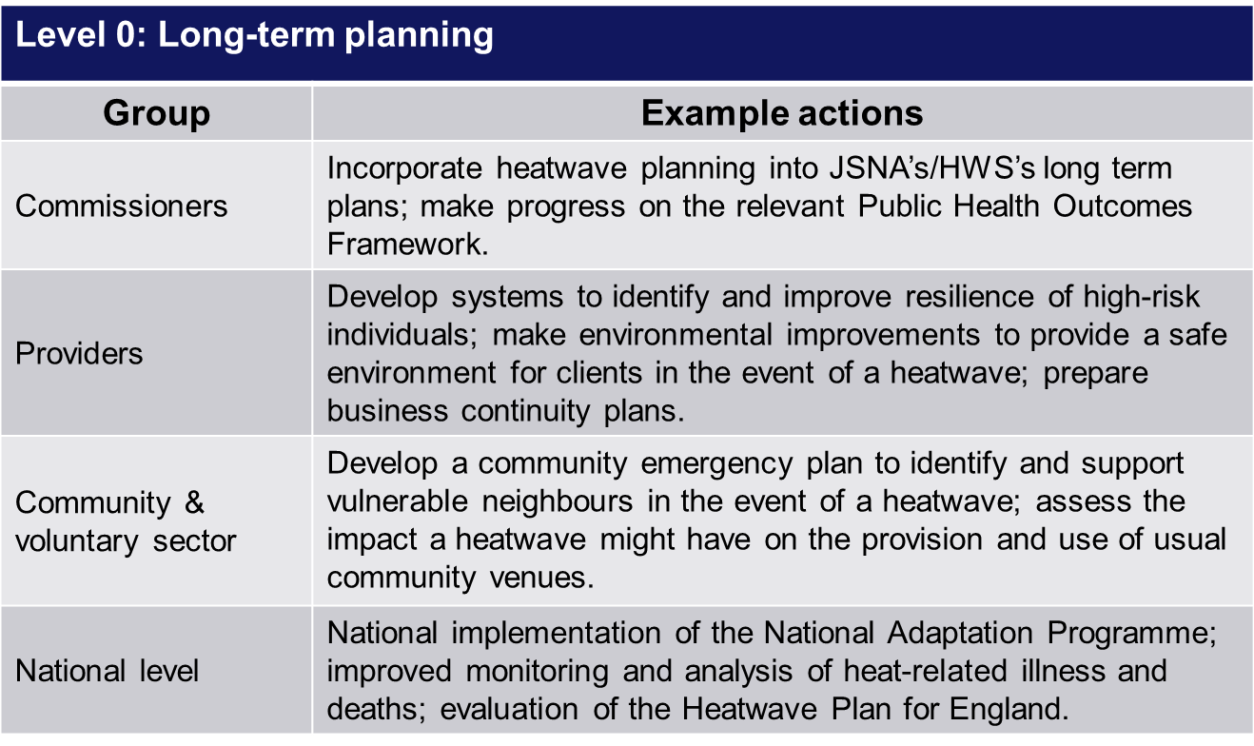
Heatwave plan levels and actions
Audience specific action cards are available in the Heatwave Plan for England

Slide 47
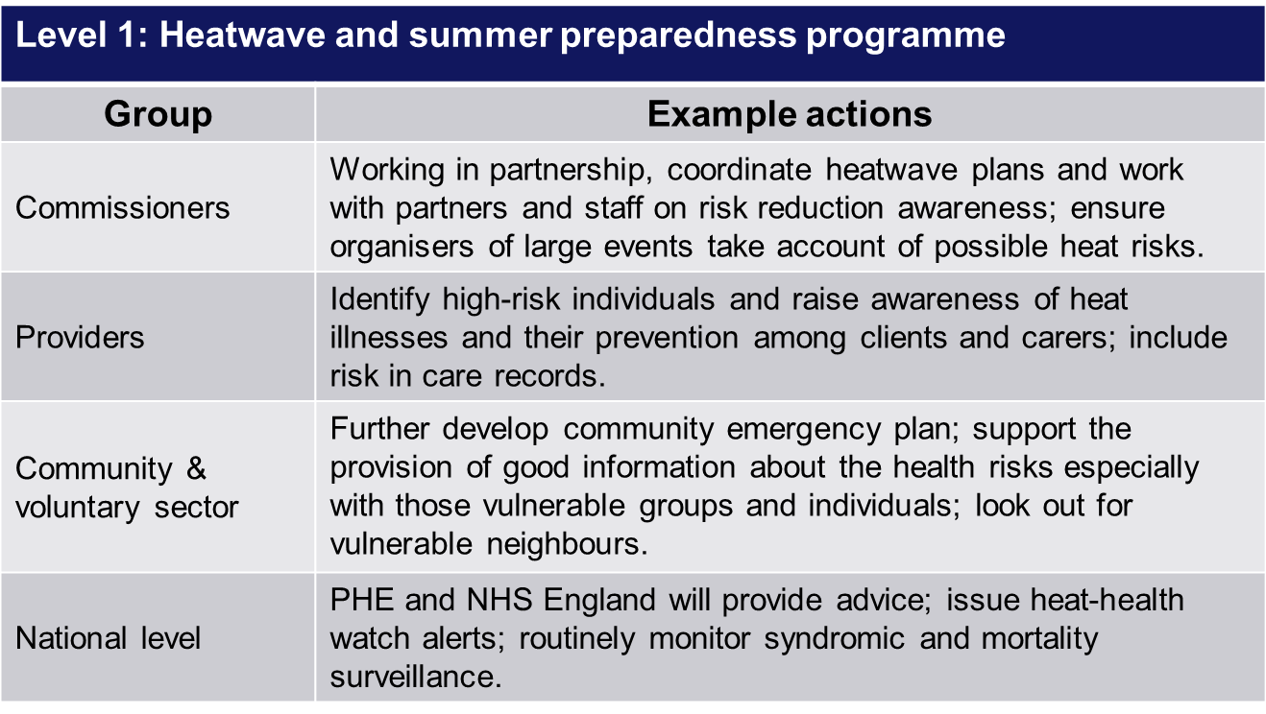
Heatwave plan levels and actions
Audience specific action cards are available in the Heatwave Plan for England

Slide 48
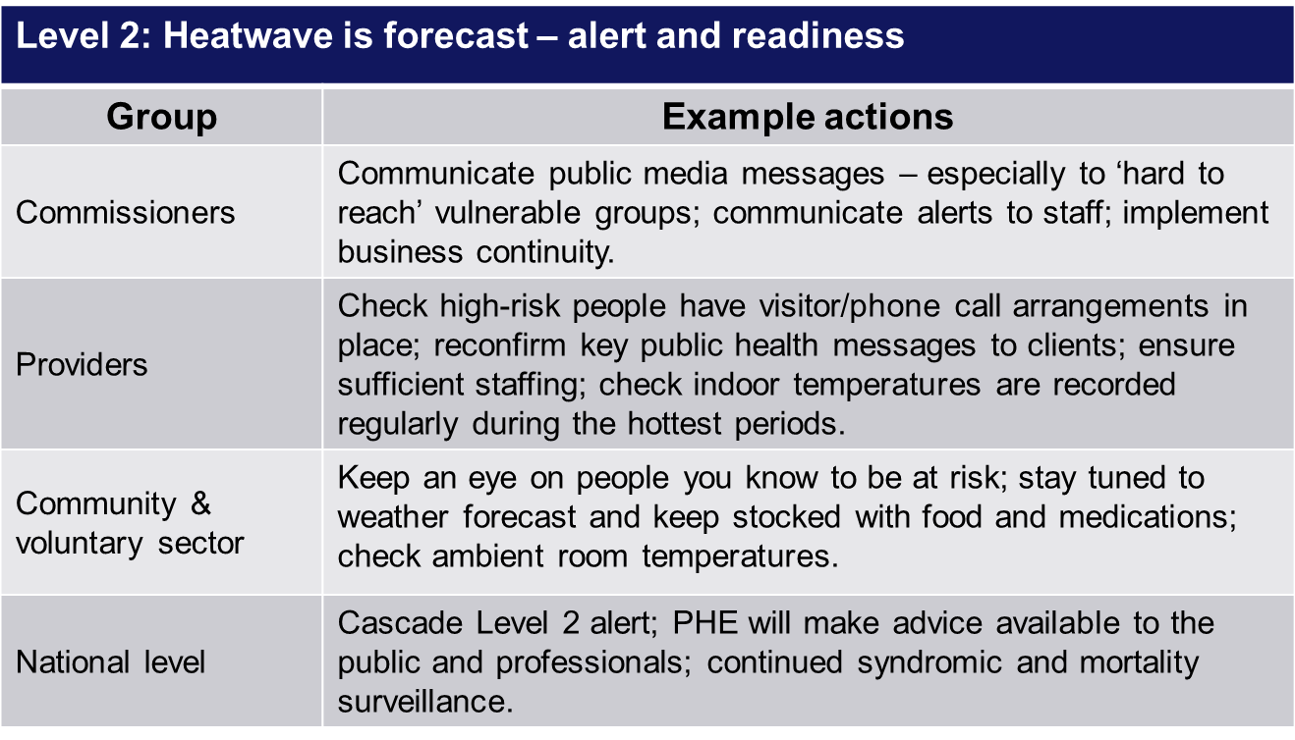
Heatwave plan levels and actions
Audience specific action cards are available in the Heatwave Plan for England

Slide 49
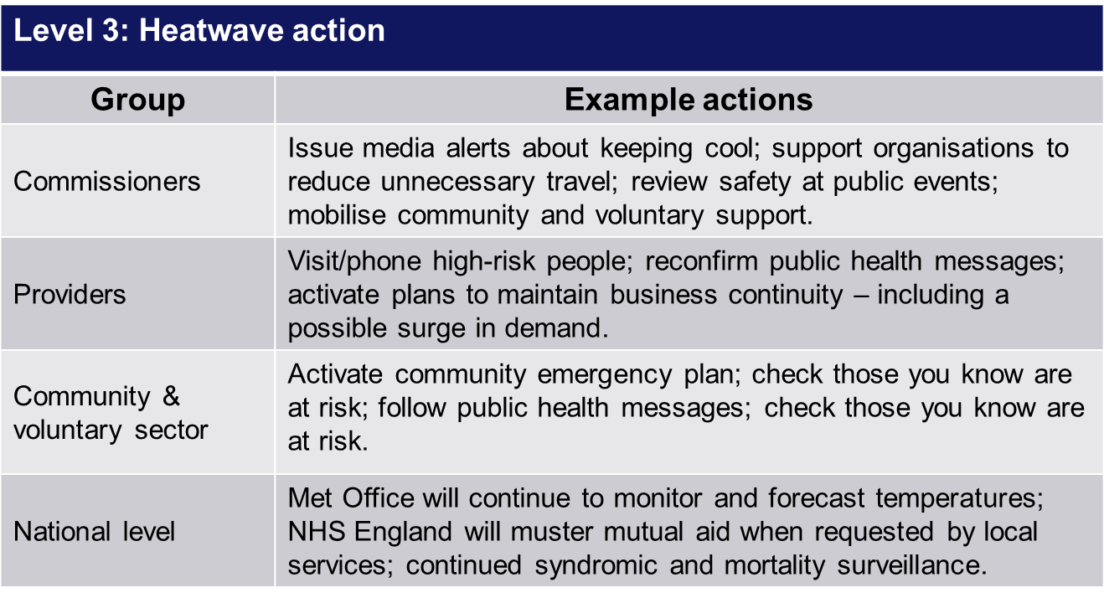
Heatwave plan levels and actions
Audience specific action cards are available in the Heatwave Plan for England

Slide 50
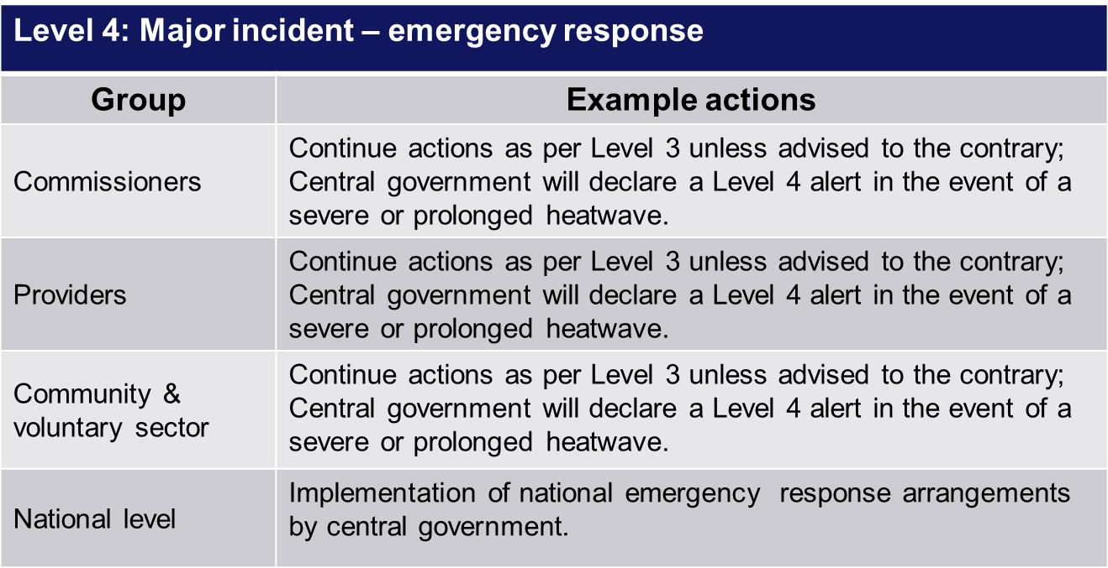
Heatwave plan levels and actions
Audience specific action cards are available in the Heatwave Plan for England

Slide 51
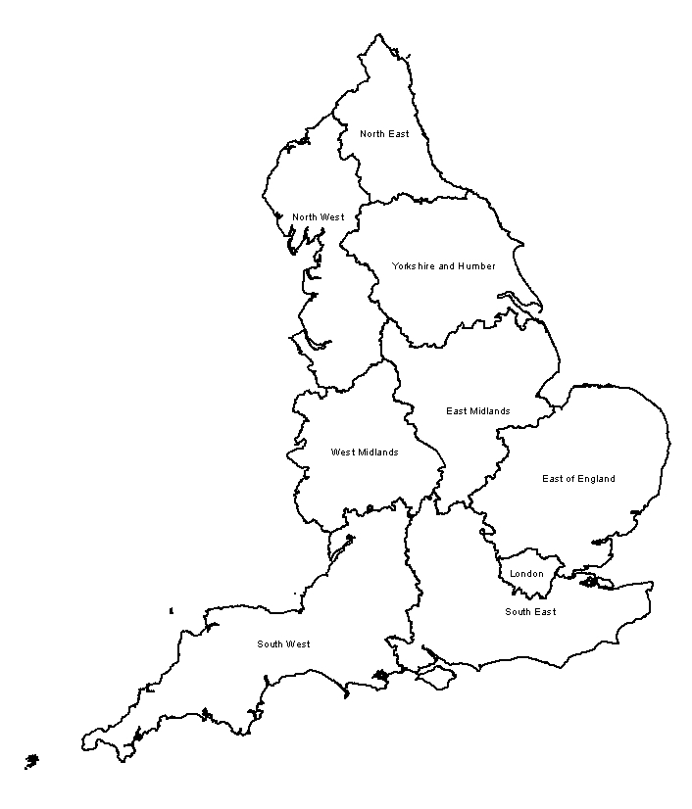
Heat-Health Watch alert temperatures by region
Local threshold temperatures
Threshold maximum day and night temperatures defined by the Met Office National Severe Weather Warning Service (NSWWS) region are set out below.
NSWWS Region | Day (ºC) | Night (ºC)
London | 32 | 18
South East | 31 | 16
South West | 30 | 15
Eastern | 30 | 15
West Midlands | 30 | 15
East Midlands | 30 | 15
North West | 30 | 15
Yorkshire and Humber | 29 | 15
North East | 28 | 15
Contains Ordnance Survey data © Crown copyright and database right 2018.
Notes:
The Heat-Health Watch system comprises 5 levels of response based upon threshold maximum daytime and minimum night-time temperatures. These thresholds vary by region, with an average threshold temperature of 30°C by day and 15 °C overnight for at least 2 consecutive days. However, overall the greatest burden to health is from temperatures that are well below what are considered to be a heatwave.
Example impacts and temperatures:
24ºC (for 3 days running) – hot weather notices and bottled water supplied on London Underground. Maintenance workers begin work to stop rails buckling. Network rail also begin additional precautions to their tracks
24.5ºC – temperature at which any excess deaths may first become apparent
36ºC – Network Rail would be experiencing railhead temperatures of 50+ºC. Extreme precautions would then be introduced. When train rails reach 52ºC and 48ºC a temporary speed restriction is introduced. Train speeds are reduced by 50% and 30% respectively
33ºC – Tarmac Roads may begin to melt
41.5ºC and 36.2ºC – Temperatures recorded on the tube and on the platform during the 2003 heatwave

Slide 52
Heat-Health Watch alerting system
Met Office service and notifications
Service | Distribution | Timing
Heatwave warning | E-mail | Alert issued as soon as agreed threshold has been reached and when there is a change in alert level. Issues between 1 June and 15 September.
Heatwave planning advice | E-mail | Twice a week (9am each Monday and Friday from 1 June to 15 September).
National Severe Weather Warning Service | E-mail, web, SMS, TV, radio | When required
General weather forecasts | Web, TV, radio | Every day
Notes:
As well as the Heat-Health Watch alerting system, other services exist. The purpose of these various services are:
Heatwave warning - To provide early warning of high temperatures.
Heatwave planning advice – To provide advice throughout the summer period relating to high temperatures.
National Severe Weather Warning Service – To provide warnings of severe or hazardous weather that has the potential to cause danger to life or widespread disruption. These warnings are issued to the public to prompt consideration od actions that they may need to take and the emergency responders to trigger their plans to protect the public.
General weather forecasts - To enable the public to make informed decisions about their day to day activities.

Slide 53
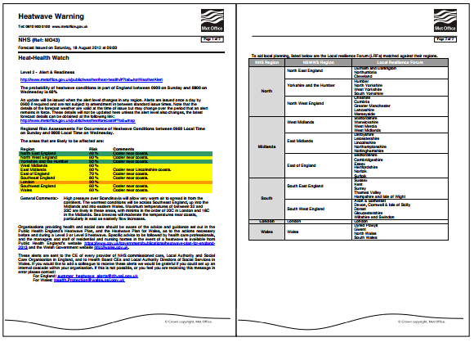
Heat-health watch alerting system
Example of a Hot Weather Alert
Notes:
Hot Weather Alerts provide an outline of the forecast, the probability of the hot weather occurring by region, and the time the alert is inforce. They are colour-coded to indicate more easily the regions affected by a change from one Heatwave Warning level to another (eg from Level 2 to Level 3) to help responders clarify what actions in turn need to be taken. Finally, the alert indicates which local resilience forum(s) are included in the alert and contain a link to the Met Office and weather pattern maps.

Slide 54
Heat-Health Watch alerting system
Hot Weather Alert cascade
hot weather alerts are issued by the Met Office in collaboration with Public Health England
alerts are cascaded via email local community and nationally (eg central government departments, PHE centres, NHS England, local authorities, the media)
Local Resilience Forums, Local Health Resilience Partnerships, and health and social care organisations will want to develop this into a specific cascade system that is appropriate for their local area
Notes:
The Heat-Health Watch Service is designed to help healthcare professionals manage during periods of hot weather. The service acts as an early warning system forewarning of periods of high temperatures, which may affect the health of the UK public. Hot Weather Warnings are sent to the Chief Executive of every provider of NHS commissioned care, Local Authority and Social Care Organisation in England.

Slide 55
Key messages
In light of the guidance and good practice recommendations made in the Heatwave Plan for England, there are 3 key messages:
1. All local authorities, NHS commissioners and their partner organisations should consider the Heatwave plan for England and satisfy themselves that the suggested actions and the heatwave alert service are understood across their locality. Local heatwave and climate change adaptation plans should be reviewed in light of this plan.

Slide 56
Key messages
2. NHS and local authority commissioners, together with Local Resilience Forums, should review or audit the distribution of the heatwave alerts across the local health and social care systems to satisfy themselves that the alerts reach those that need to take appropriate actions, immediately after issue. Local areas need to adapt these to their particular situations and ensure themselves that the cascades are working appropriately.
3. NHS and local authority commissioners, together with Local Resilience Forums, should seek assurance that organisations and key stakeholders are taking appropriate actions in light of the heatwave alert messages. It is for local areas to amend and adapt this guidance and to clarify procedures for staff and organisations in a way which is appropriate for the local situation.
Notes:
We would ask that particular care is taken to ensure independent care homes and hospitals and healthcare providers are made aware of the plan, and for care homes, of the specific risks associated with residents of homes and of the specific advice directed at care home managers and staff.
As ever, it is for professionals to use their judgement in any individual situation to ensure that they are doing the best they can for their patient or client.

Slide 57
Resources
Further heatwave health advice is available from the NHS Choices website. Available at: www.nhs.uk/livewell/summerhealth/Pages/Summerhealthhome.aspx
Further information on heat-health watch is available on the Met Office website. Available at: www.metoffice.gov.uk/public/weather/heat-health/#?tab=heatHealth
Health-related air pollution advice is available at: uk-air.defra.gov.uk/
Off the Shelf Heatwave Exercise is available from exercises@phe.gov.uk
For new registrations and amendments to existing Heat-Health Watch registrations please contact the Met Office using: Enquiries@metoffice.gov.uk providing your name, organisation and email address (.nhs or .gov or provide organisation type)
For further information, contact the Extreme Events and Health Protection team. Email: ExtremeEvents@phe.gov.uk

Slide 58


About Public Health England
Public Health England exists to protect and improve the nation’s health and wellbeing, and reduce health inequalities. We do this through world-leading science, knowledge and intelligence, advocacy, partnerships and the delivery of specialist public health services. We are an executive agency of the Department of Health and Social Care, and a distinct delivery organisation with operational autonomy to advise and support government, local authorities and the NHS in a professionally independent manner.
Public Health England, Wellington House, 133-155 Waterloo Road, London SE1 8UG
Tel: 020 7654 8000 www.gov.uk/phe Twitter: @PHE_uk Facebook: www.facebook.com/PublicHealthEngland
For enquiries relating to this document, please contact: extremeevents@phe.gov.uk
© Crown copyright 2018
You may re-use this information (excluding logos) free of charge in any format or medium, under the terms of the Open Government Licence v3.0. To view this licence, visit: www.nationalarchives.gov.uk/doc/open-government-licence/version/3/ Where we have identified any third party copyright information you will need to obtain permission from the copyright holders concerned.
Published: May 2018.
PHE publications gateway number: 2018112.

