Slide 1
Hepatitis C in England 2020 report
Working to eliminate hepatitis C as a major public health threat

Slide 3
Burden of HCV infection
Drug injection continues to be the most important documented risk factor for HCV infection in 2018, being cited as the risk in 93% of all laboratory reports where risk factors were disclosed.
In 2018, sentinel surveillance suggests that among persons who were HCV RNA tested after a positive anti-HCV test, 52% were RNA positive, of whom 42% had an HCV genotype recorded; 49% were genotype 1, with a further 43% genotype 3.
In England, chronic hepatitis C (HCV) prevalence is estimated to have fallen by around 30% since 2015, with 89,000 predicted to have chronic HCV infection in 2019.
Of those participating in the Unlinked Anonymous Monitoring (UAM) Survey, the proportion of people who inject drugs (PWID) who test HCV antibody (anti-HCV) positive has increased in recent years, from 45% in 2011 to 55% in 2018, however, chronic prevalence has remained relatively stable over this period (28% in 2018); the prevalence of cleared infection (anti-HCV positive, RNA-negative) has increased from 19% in 2011 to 27% in 2018.

Slide 4
Figure 1: Estimates of chronic prevalence of HCV in England, 2010 to 2019 (bars represent 95% credible intervals).⁽²¹⁾
Data source: Modelled estimates of chronic HCV prevalence, based on HCV prevalence data from the Unlinked Anonymous Monitoring Survey of People Who Inject Drugs; estimates of the number of people who inject drugs⁽⁴⁾; Hospital Episode Statistics (HES), NHS Digital for England. Produced by Public Health England (data on severe HCV-related liver disease); Trent cohort data (estimates of disease progression probabilities) and data on HCV treatment (IMS sales data, Sentinel Surveillance of Blood Borne Virus Testing and the NHS England Hepatitis C Patient Registry and Treatment Outcome System).

Slide 5
Figure 2: Trend in HCV prevalence* among people injecting psychoactive drugs in England: 2011 to 2018.
* Estimates for chronic and cleared HCV infection have been adjusted to take into account anti-HCV positive samples with missing RNA status. The ratio of chronic/cleared infection was applied to the anti-HCV positive samples with missing RNA status by year and region. Note: chronic prevalence in 2017 and 2018 without adjustment for insufficients was near identical at 26% and 28% respectively.
Data source: Unlinked Anonymous Monitoring Survey of people who inject drugs in contact with specialist services.⁽⁴⁾

Slide 6
Burden of HCV infection
Available data suggest significant reductions in the prevalence of chronic HCV infection in England but chronic infection remains stable among those who inject drugs.
Increasing numbers of PWID have evidence of exposure and clearance of HCV infection, suggesting that increased access to treatment, rather than improved harm reduction, is holding levels of chronic infection stable in this important group who are at risk of transmitting the virus.

Slide 7
Monitoring impact Reducing HCV-related morbidity and mortality
The proportion of all first liver transplants carried out in patients with HCV-related disease in England has halved over the last decade, from 18% in 2009 to 9% in 2018.
By 2018, the number of liver transplant registrations and transplants undertaken in those where post-HCV cirrhosis and hepatocellular carcinoma (HCC) is given as the indication for transplant, fell by 44% and 29% respectively when compared to pre-2015 levels, although both show a rise over the last year (by 19% and 13% respectively).

Slide 8
Figure 3: Number of first patient registrations in England where post-HCV cirrhosis was given as either the primary, secondary or tertiary indication for transplant and the number of first liver transplants undertaken in patients who were HCV positive (RNA or antibody) at registration and transplant: 2009 to 2018.*
* These figures are based on registry data as at 13 August 2019 and include both elective and urgent registrations.
** HCV liver registrations are defined as first transplant registrations in England where post-hepatitis C
cirrhosis was given as either the primary, secondary or tertiary indication for the liver transplant.
*** First liver transplants for patients with post-hepatitis C cirrhosis as either primary, secondary or tertiary indication for transplant at registration or transplant and/or patients who were HCV positive at registration or transplant.
Data source: NHS Blood and Transplant UK Transplant Registry

Slide 9
Monitoring impact Reducing HCV-related morbidity and mortality cont.
Deaths from HCV-related end stage liver disease (ESLD) and hepatocellular cancer (HCC) have been falling since 2014, with a decline of 20% by 2018 from the 2015 World Health Organisation (WHO) baseline.
Over the period 2015 to 2018, a 37% decline in crude mortality rates, and a 34% decline in adjusted mortality rates, is observed among those with an HCV diagnosis reported to PHE. This linkage study suggests high levels of alcohol consumption, with 60% of deaths in those with HCV reported to Public Health England (PHE) over the last 10 years also having an alcohol-related cause of death noted on the death certificate.

Slide 10
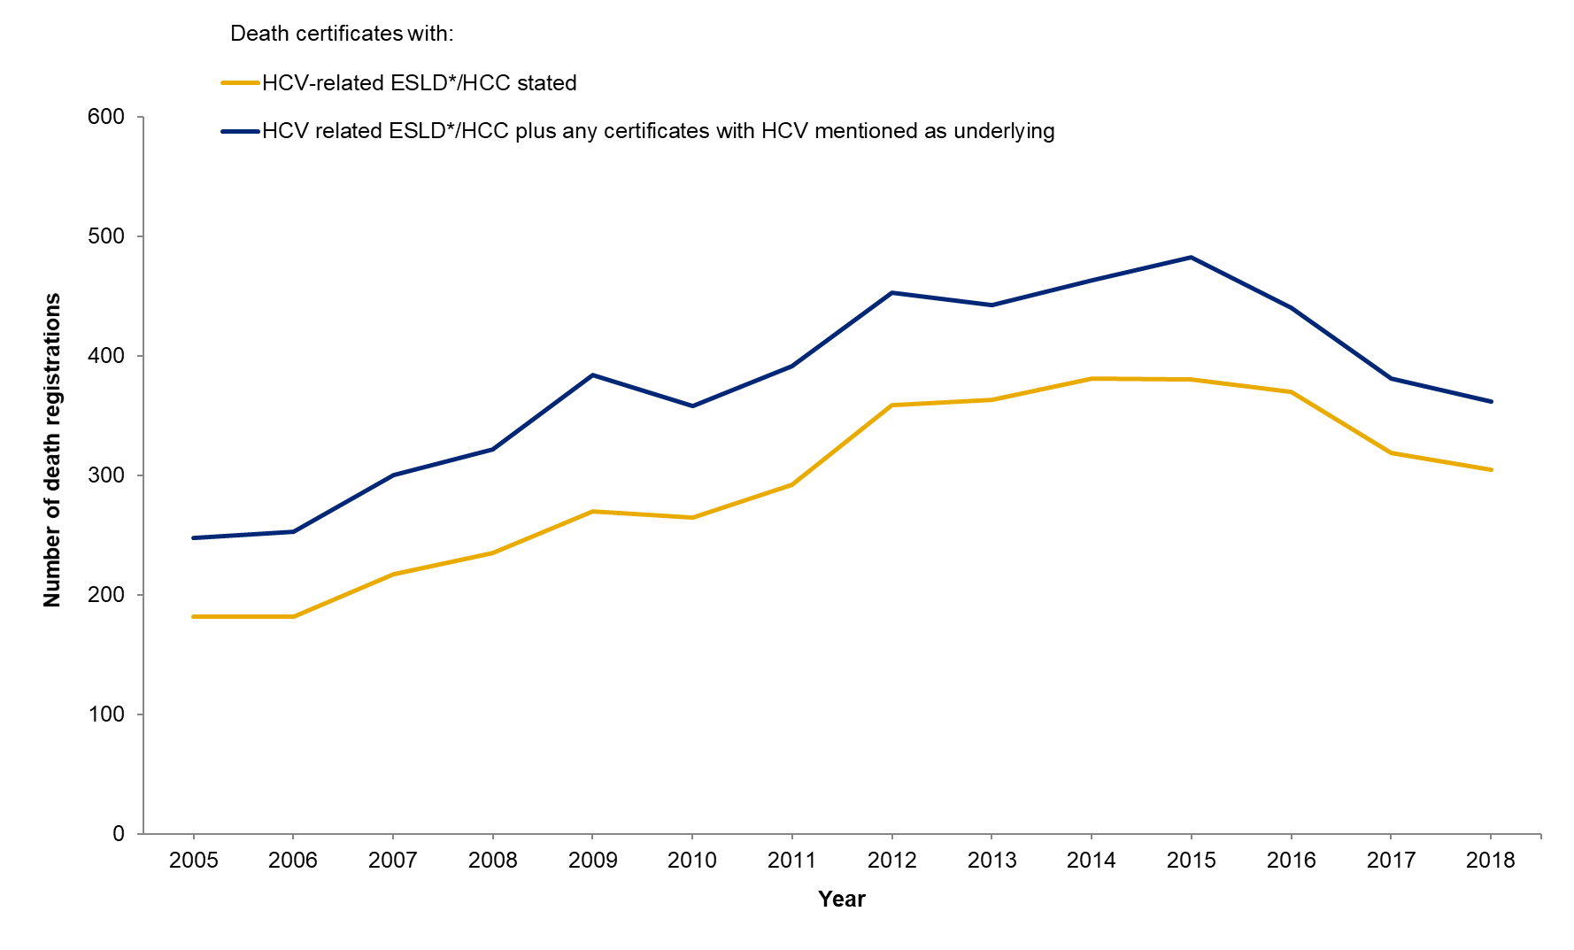
Figure 4: Death registrations for ESLD* or HCC in those with HCV mentioned on their death certificate in England: 2005 to 2018.**
* Defined by codes or text entries for ascites, bleeding oesophageal varices, hepato-renal syndrome, hepatic encephalopathy or hepatic failure.
** Excluding deaths registered in England when the deceased’s usual residence is outside England.
Data source: Office for National Statistics.⁽³⁶⁾

Slide 11
Figure 5: Crude mortality rates for HCC, ESLD and HCV in persons aged ≥15 years reported to PHE as HCV antibody positive between 1998 and 2018, for the period 2005 to 2018.
* Where HCC is not also reported on the death certificate
^ Where HCV is reported as the underlying cause of death and HCC and ESLD are not reported on the death certificate
Data source: Office of National Statistics⁽³⁶⁾ and Sentinel Surveillance.⁽⁴³⁾

Slide 12
Monitoring impact Reducing HCV-related morbidity and mortality cont.
The WHO target to reduce mortality by 10% by 2020 has been met 3 years early and was exceeded at least twofold by 2018.

Slide 13
Monitoring impact Reducing the number of new infections
UAM survey data provide no evidence for a fall in HCV incidence between 2011 and 2018.
Anti-HCV prevalence among recent initiates to injecting drug use, a proxy marker of incidence, has been relatively stable between 2011 and 2017, however, anti-HCV prevalence in 2018 (33%) is significantly higher than in 2011 (20%).

Slide 14
Figure 6: Estimated incidence of HCV among HIV negative* people injecting psychoactive drugs in England who reported injecting in the previous year, 2011 to 2018** (95% CI).
* Incidence is calculated among those anti-HCV negative. Those with HIV are excluded because they can have sub-optimal antibody responses as a result of their HIV infection.
** The 2016 estimate is based on a pooled estimated of incidence calculated by antibody avidity testing and HCV RNA testing. For the incidence calculations of avidity testing (2016) a fixed window period of 100 days was used, for RNA testing (2011 to 2018) a fixed window period of 51 days was used. Please note that the window periods of both measures are uncertain. Estimates for 2014 and 2015 are not available as RNA testing was not conducted on anti-HCV negative samples.
Data source: Unlinked Anonymous Monitoring Survey of people who inject drugs in contact with specialist services.⁽⁴⁾

Slide 15
Figure 7: Prevalence of anti-HCV among recent initiates to injecting* in England 2011 to 2018.
* Recent initiates are defined as PWID who commenced injecting drugs within the three years prior to their participation in the UAM Survey.
Data source: Unlinked Anonymous Monitoring Survey of people who inject drugs in contact with specialist services.⁽⁴⁾

Slide 16
Figure 8: Laboratory reports of HCV in young adults in England: 2009 to 2018.*
* Laboratory reports include positive test results for hepatitis C antibody and/or hepatitis C RNA; 2018 data are provisional and figures for previous years are subject to change as a result of late reporting and the associated de-duplication procedure. The nature of laboratory reporting and the associated de-duplication procedure is such that re-infections are not captured. In addition, patient identifiable data submitted by NHS laboratories is variable, particularly from sexual health and drug and alcohol services, which limits the ability to deduplicate. Results for children <1 year of age are excluded to rule out the likelihood of simply detecting maternal antibody.
** Statutory notification by diagnostic laboratories was introduced in October 2010⁽¹⁰⁰⁾
^ HCV DBS testing data from 2011 onwards has now been obtained and included from additional laboratories, resulting in an increase in the overall number of HCV reports.
Data source: CoSurv/SGSS.⁽⁵⁰⁾

Slide 17
Monitoring impact Reducing the number of new infections cont.
The WHO target to reduce the number of new infections by 30% by 2020 is unlikely to be met in England.

Slide 18
Monitoring the coverage of important services Adequacy of harm reduction
In tax year 2011 to 2012, 56% of opioid dependent PWID were receiving OST, exceeding the WHO European region target of 40% to receive OST by 2020.
In 2018, 64% of PWID participating in the UAM Survey reported adequate NSP for their needs, as the number of needles they collected met or exceeded the number of times they injected in the last month.
Low dead space syringes (LDSS) which, if shared, have a lower risk of BBV transmission when compared to traditional syringes with a high dead space, were provided by 59% of responding UAM Survey sites.
The 2018 UAM Survey shows no evidence of any decline in sharing of injecting equipment since 2012, with 18% of people currently injecting psychoactive drugs reporting sharing needles and syringes; when other injecting equipment, like mixing containers or filters, are included this figure rises to 39%.

Slide 19
Figure 9: Estimated proportion of people injecting psychoactive drugs reporting adequate* needle and syringe provision in England, 2011 to 2018.
* Needle and syringe provision is considered ‘adequate’ when the reported number of needles received, met or exceeded the number of times the individual reported injecting in the past month.
Data source: Unlinked Anonymous Monitoring Survey of people who inject drugs: people injecting psychoactive drugs.⁽⁴⁾

Slide 20
Figure 10: Trends in the sharing of injecting equipment and associated paraphernalia in the preceding four weeks among people injecting psychoactive drugs in England, 2009 to 2018.
‡ Self-reported sharing of needles and syringes in preceding four weeks.
$ Self-reported sharing of needles, syringes and other injecting paraphernalia (i.e. spoons or filters) in the preceding four weeks.
Data source: Unlinked Anonymous Monitoring Survey of people who inject drugs: people injecting psychoactive drugs^{.(4)}

Slide 21
Monitoring the coverage of important services Adequacy of harm reduction cont.
Sub-optimal NSP and the absence of any fall in direct or indirect sharing of injecting drug equipment over the last 5 years is concerning as adequate harm reduction provision is needed to prevent infection and reinfection following HCV treatment.

Slide 22
Monitoring the coverage of key services
Awareness of infection
The 2018 UAM survey data suggests that 61% of PWID were aware of their anti-HCV positive status; 53% reported that they were aware of their chronic (HCV RNA positive) infection status, a reduction from the 58% reported in the previous year.
As a marker of late diagnosis of HCV infection, just under half (45%) of those with cirrhosis at initiation of treatment in the NHS England Hepatitis C Patient Registry and Treatment Outcome System, were noted to have received their first HCV diagnosis within the previous two years (42% of those with decompensated cirrhosis and/or HCC).

Slide 23
Figure 11: Estimated proportion of people injecting psychoactive drugs testing positive for HCV who are aware of their infection, England, 2010 to 2018.
* Due to a change in the questionnaire for 2017, completion of the self-reported status question was lower, resulting in a higher proportion of missing data than seen in previous years for 2017 and 2018.
** Data regarding awareness of HCV RNA result, and therefore chronic infection status, are available for 2017 onwards due to changes in the UAM survey questionnaire.
Data source: Unlinked Anonymous Monitoring Survey of people who inject drugs: people injecting psychoactive drugs.⁽⁴⁾

Slide 24
Figure 12: Time from first diagnosis to treatment* among patients with late stage liver disease at their first recorded treatment initiation in the NHS England Hepatitis C Patient Registry and Treatment Outcome System.
* The diagnosis to treatment interval is the number of years between the year of first diagnosis and year of first recorded treatment in the Hepatitis C Patient Registry and Treatment Outcome System, displayed as the proportion of people with cirrhosis within each diagnosis to treatment interval.
** Late stage disease as defined by Maus et al.⁽⁶⁷⁾
Data Source: NHS England Hepatitis C Patient Registry and Treatment Outcome System, as of 18 October 2019

Slide 25
Monitoring the coverage of key services
Awareness of infection cont.
Free resources for the public and educational courses for professionals (for example, RCGP e-learning courses for primary care and other professionals) are available to help people recognise any risk for HCV infection and to encourage those at risk to seek testing.
Preliminary data from the 2019 UAM Survey suggest that 79% of its participants had received information regarding HCV, protective measures to take to avoid infection or information on how it is treated in the last year, short of the 90% WHO target for 2020; this fell to 73% among PWID not currently injecting.
While the first WHO target of 50% being diagnosed by 2020 has been met in England, more needs to be done if we are to reach the 90% target by 2030.

Slide 26
Monitoring the coverage of important services
Increasing testing and diagnosis
In the general population and primary care
The number of laboratory confirmed reports of HCV in England between 2009 to 2018 has increased by nearly 90%, with 16,216 reports of individuals testing positive for anti-HCV and/or HCV ribonucleic acid (RNA) in 2018.
Overall sentinel surveillance suggests that the number of individuals tested increased by 28% between 2014 to 2018, with an average of 2.7% testing anti-HCV positive; a subsequent RNA test was conducted for at least 85% of all those anti-HCV positive.
The number of individuals tested through GP surgeries captured via sentinel surveillance increased by 4.3% between 2014 and 2018, with a slight decline in the proportion testing anti-HCV positive over this period (1.8% testing positive in 2018).

Slide 27
Figure 13: Number of laboratory reports* of HCV from England: 2009 to 2018.
* Laboratory reports include positive test results for hepatitis C antibody and/or hepatitis C RNA; 2018 data are provisional and figures for previous years are subject to change as a result of late reporting and the associated de-duplication procedure. The nature of laboratory reporting and the associated de-duplication procedure is such that re-infections are not captured. In addition, patient identifiable data submitted by NHS laboratories is variable, particularly from sexual health and drug and alcohol services, which limits the ability to deduplicate. Results for children <1 year of age are excluded to rule out the likelihood of simply detecting maternal antibody.
** Statutory notification by diagnostic laboratories was introduced in October 2010⁽¹⁰⁰⁾
^ HCV DBS testing data from 2011 onwards has now been obtained and included from additional laboratories, resulting in an increase in the overall number of HCV reports.
Data source: CoSurv/SGSS.⁽⁵⁰⁾

Slide 28
Figure 14: Age and sex distribution, where reported, of laboratory reports of HCV from England: 2009 to 2018.*,**,^
* Laboratory reports include positive test results for hepatitis C antibody and/or hepatitis C RNA; 2018 data are provisional and figures for previous years are subject to change as a result of late reporting and the associated de-duplication procedure. The nature of laboratory reporting and the associated de-duplication procedure is such that re-infections are not captured. In addition, patient identifiable data submitted by NHS laboratories is variable, particularly from sexual health and drug and alcohol services, which limits the ability to deduplicate. Results for children <1 year of age are excluded to rule out the likelihood of simply detecting maternal antibody.
** Statutory notification by diagnostic laboratories was introduced in October 2010⁽¹⁰⁰⁾
^ HCV DBS testing data from 2011 onwards has now been obtained and included from additional laboratories, resulting in an increase in the overall number of HCV reports.
Data source: CoSurv/SGSS.⁽⁵⁰⁾

Slide 29
Figure 15: Age distribution of laboratory reports of HCV in England by ODN: 2018.*,**,^
* Laboratory reports include positive test results for hepatitis C antibody and/or hepatitis C RNA; 2018 data are provisional and figures for previous years are subject to change as a result of late reporting and the associated de-duplication procedure. The nature of laboratory reporting and the associated de-duplication procedure is such that re-infections are not captured. In addition, patient identifiable data submitted by NHS laboratories is variable, particularly from sexual health and drug and alcohol services, which limits the ability to deduplicate. Results for children <1 year of age are excluded to rule out the likelihood of simply detecting passively transferred maternal antibody.
** Statutory notification by diagnostic laboratories was introduced in October 2010⁽¹⁰⁰⁾
^ HCV DBS testing data from 2011 onwards has now been obtained and included from additional laboratories, resulting in an increase in the overall number of HCV reports.
Data source: CoSurv/SGSS.⁽⁵⁰⁾

Slide 30
Figure 16: Number of individuals tested for anti-HCV by year, and proportion positive, in 17 sentinel laboratories: 2014 to 2018.* †, ††
* Excludes samples collected outside routine testing such as look back studies, reference testing, renal patients, children aged <1 year, and testing through oral fluid. Patient identifiable data submitted by laboratories is variable, particularly from sexual health and drug and alcohol services, which limits the ability to de-duplicate. Data are de-duplicated subject to availability of date of birth, soundex, NHS number and first initial. All data are provisional. The proportion positive is calculated using number of individuals tested. Numbers include venous and DBS testing, with retrospective DBS data added from 2014.
** Includes all tests until a person is diagnosed positive, no tests are counted after a positive test, a person can be counted more than once.
† Trend data does not reflect cumulative data as only locations that have consistently reported during the 5 years presented are included in trend data to remove any artificial changes in testing.
†† The positive result is the first reported by participating laboratories and may not reflect an individual’s first diagnosis.
Data source: Sentinel Surveillance of Blood Borne Virus Testing.⁽⁴³⁾

Slide 31
Figure 17: Time to an RNA or antigen test among people testing positive for anti-HCV by year of anti-HCV test, in 17 sentinel laboratories: 2014 to 2018.
* No RNA recorded could reflect where an RNA test was not conducted or the RNA test was conducted in a laboratory not included within sentinel surveillance
** Reporting and processing time means that not all RNA tests conducted within 2019 have been processed, so the distribution is likely to change.
† Excludes samples collected outside routine testing such as look back studies, reference testing, renal patients, children aged <1 year, and testing through oral fluid. The distribution of time to an RNA or antigen test is dependent on the laboratories reporting to SSBBV and may not reflect the distribution of RNA and antigen testing in laboratories who are not reporting to SSBBV.
Data source: Sentinel Surveillance of Blood Borne Virus Testing.⁽⁴³⁾

Slide 32
Figure 18: Proportional distribution of the last reported RNA or antigen test within a year, in 17 sentinel laboratories: 2014 to 2018.*
*Reporting and processing time means that not all RNA tests conducted within 2019 have been processed, so the distribution is likely to change. An individual can only be counted once in a year, however can be reported within multiple years. Excludes samples collected outside routine testing such as look back studies, reference testing, renal testing, and children aged <1 year. Patient identifiable data submitted by laboratories is variable. Particularly from sexual health and drug and alcohol services, which limits the ability to de-duplicate. Data are de-duplicated subject to availability of date of birth, soundex, NHS number and first initial. All data are provisional. The proportion positive is calculated using number of individuals with an RNA or antigen test. Numbers include venous and DBS testing, with retrospective DBS data added from 2014. Service information from private laboratories testing for DBS can be limited and therefore difficult to map to geographies. Manchester Royal infirmary and Abbott (formerly Alere Toxicology PLC) conduct the majority of DBS testing, both report to SSBBV.
‘Below detection’ means that the quantitative result indicates that the result is below the lower level of quantification; it is not possible to determine whether this indicates an individual has tested negative.
Data source: Sentinel Surveillance of Blood Borne Virus Testing. ⁽⁴³⁾

Slide 33
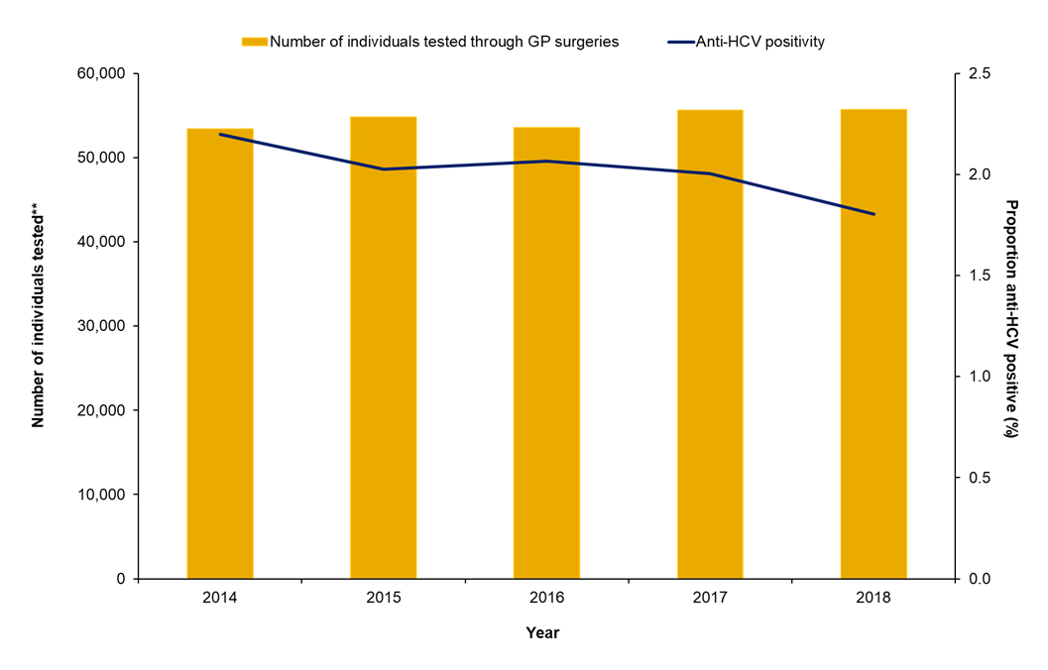
Figure 19: Number of individuals tested for anti-HCV by year, and proportion positive, through GP surgeries in 17 sentinel laboratories: 2014 to 2018.* † ††
* Excludes samples collected outside routine testing such as look back studies, reference testing and children aged <1 year. Patient identifiable data submitted by NHS laboratories is variable, particularly from sexual health and drug and alcohol services, which limits the ability to deduplicate.
** Includes all tests until a person is diagnosed positive, no tests are counted after a positive test, a person can be counted more than once.
† Trend data does not reflect cumulative data as only locations that have consistently reported during the 5 years presented are included in trend data to remove any artificial changes in testing.
†† The positive result is the first reported by participating laboratories and may not reflect an individual’s first diagnosis.
Data source: Sentinel Surveillance of Blood Borne Virus Testing.⁽⁴³⁾

Slide 34
Monitoring the coverage of important services
Increasing testing and diagnosis cont.
In sexual health services
The number of individuals tested through sexual health services captured via sentinel surveillance increased by 37% between 2014 and 2018, with the proportion testing anti-testing positive remaining stable at around 1.3%.
Diagnosis rates of HCV in s-SHS were markedly higher among gay, bisexual and other men who have sex with men (MSM) in 2018 (81 per 100,000) compared to all attendees (24 per 100,000).
Of those living with HIV and accessing HIV care in 2018, 1.5% tested positive for either an acute or chronic HCV infection, this too varied by exposure group with HCV coinfection being most common among those with an injecting risk factor alone (27%) or in combination with being MSM (6.5%).

Slide 35
Figure 20: Number of individuals tested** for anti-HCV by year, and proportion positive, through sexual health services in 17 sentinel laboratories: 2014 to 2018.* † ††
* Excludes samples collected outside routine testing such as look back studies, reference testing and children aged <1 year. Patient identifiable data submitted by NHS laboratories is variable, particularly from sexual health and drug and alcohol services, which limits the ability to deduplicate.
** Includes all tests until a person is diagnosed positive, no tests are counted after a positive test, a person can be counted more than once.
† Trend data does not reflect cumulative data as only locations that have consistently reported during the 5 years presented are included in trend data to remove any artificial changes in testing.
†† The positive result is the first reported by participating laboratories and may not reflect an individual’s first diagnosis.
Data source: Sentinel Surveillance of Blood Borne Virus Testing.⁽⁴³⁾

Slide 36
Figure 21: Rates of HCV diagnoses by HIV status in specialist sexual health clinics per 100,000 attendees, shown for all attendees (MSM inclusive) and MSM alone, England, 2014 to 2018.
* GUMCAD database retains only first known HCV diagnosis per patient. HCV test results reported to GUMCAD do not specify anti-HCV and HCV RNA tests and therefore it does not distinguish between acute and chronic infections.
** Rates of diagnoses are calculated using the number of s-SHS clinic attendees per year as the denominator and not the number tested as testing reported to GUMCAD does not distinguish between hepatitis A, B or C, and the uptake of a test could only be recorded in GUMCAD from 2015.
Data Source: GUMCAD STI Surveillance system.⁽⁷⁹⁾

Slide 37
Figure 22: Proportion of people accessing HIV care who have HCV by demographic group, England, 2018.*
* Demographic group refers to probable route of HIV acquisition. This may not reflect how a person identifies sexually.
** Proportion co-infected is calculated of all individuals attending for HIV care, including those not tested or where their testing status is unknown.
Data Source: HARS.⁽⁸⁰⁾

Slide 38
Monitoring the coverage of important services
Increasing testing and diagnosis cont.
In people who inject drugs
In both UAM (85% in 2018) and National Drug Treatment Monitoring System (NDTMS) data (84% in tax year 2018 to 2019) more than four-fifths of people who have ever injected drugs report, or were recorded as having received, a HCV test respectively. UAM Survey data also show an increase in the proportion of PWID tested in the current or previous year, from 40% in 2009 to 47% in 2019.
In Sentinel Surveillance, the number of individuals tested in drug services more than doubled during the period 2014 to 2016 (108% increase), however numbers have subsequently levelled off, with a fall of 14% between 2016 and 2018. Positivity was high among this group, with 1 in 5 people testing anti-HCV positive (2014 to 2018).

Slide 39
Figure 23: Trends in self-reported uptake of VCT for HCV infection among PWID in England: 2009 to 2018.
Data source: Unlinked Anonymous Monitoring Survey of People Who Inject Drugs: people injecting psychoactive drugs.⁽⁴⁾

Slide 40
Figure 24: Number of individuals tested for anti-HCV by year, and proportion positive, through drug services in 17 sentinel laboratories: 2014 to 2018.* † ††
* Excludes samples collected outside routine testing such as look back studies, reference testing and children aged <1 year. Patient identifiable data submitted by NHS laboratories is variable, particularly from sexual health and drug and alcohol services, which limits the ability to deduplicate.
** Includes all tests until a person is diagnosed positive, no tests are counted after a positive test, a person can be counted more than once.
† Trend data does not reflect cumulative data as only locations that have consistently reported during the 5 years presented are included in trend data to remove any artificial changes in testing.
†† The positive result is the first reported by participating laboratories and may not reflect an individual’s first diagnosis.
Data source: Sentinel Surveillance of Blood Borne Virus Testing.⁽⁴³⁾

Slide 41
Monitoring the coverage of important services
Increasing testing and diagnosis cont.
Among those homeless
Preliminary estimates suggest that the proportion of people rough sleeping with diagnosed and reported HCV infection increased from 22% in 2014 to 32% in 2017, after which a decrease is observed to 29% in 2018.
The 2018 UAM survey suggests that chronic HCV prevalence is significantly higher among PWID reporting homelessness in the last year (35%) compared to those never reporting homelessness (17%). Since 2011, chronic prevalence among those reporting homelessness in the last year has increased significantly from 29% to 35% in 2018.

Slide 42
Figure 25: Trend in HCV prevalence* among PWID reporting homelessness in the last year in England: 2011 to 2018.
* Estimates for chronic and cleared HCV infection have been adjusted to take into account anti-HCV positive samples with missing RNA status. The ratio of chronic/cleared infection was applied to the anti-HCV positive samples with missing RNA status by year and region.
Data source: Unlinked Anonymous Monitoring Survey of people who inject drugs in contact with specialist services.⁽⁴⁾

Slide 43
Figure 26: Laboratory reports* of HCV among those homeless/rough sleeping in England: 2014 to 2018.
Laboratory reports include positive test results for hepatitis C antibody and/or hepatitis C RNA; 2018 data are provisional and figures for previous years are subject to change as a result of late reporting and the associated de-duplication procedure. The nature of laboratory reporting and the associated de-duplication procedure is such that re-infections are not captured. In addition, patient identifiable data submitted by NHS laboratories is variable, particularly from sexual health and drug and alcohol services, which limits the ability to deduplicate. Results for children <1 year of age are excluded to rule out the likelihood of simply detecting maternal antibody.
** Indicators for homelessness are based on the NFA code in the NHS spine allocated to individuals at time of first diagnosis; this indicator could be subject to underreporting, misclassification and/or changes in reporting practice over time
*** People sleeping rough are defined as “People sleeping, about to bed down (sitting on/in or standing next to their bedding) or actually bedded down in the open air (such as on the streets, in tents, doorways, parks, bus shelters or encampments). People in buildings or other places not designed for habitation (such as stairwells, barns, sheds, car parks, cars, derelict boats, stations, or ‘bashes’ which are makeshift shelters, often comprised of cardboard boxes)” The definition does not include people in hostels or shelters, people in campsites or other sites used for recreational purposes or organised protest, squatters or travellers. Bedded down is taken to mean either lying down or sleeping. About to bed down includes those who are sitting in/on or near a sleeping bag or other bedding. These figures are subject to some uncertainty and should be treated as estimates of the number of people sleeping rough on a single night and an indication of trends over time. There are a range of factors that can impact on the number of people seen or thought to be sleeping rough on any given night such as the weather, where people choose to sleep, the date and time chosen, and the availability of alternatives such as night shelters.
Data source: CoSurv/SGSS⁽⁵⁰⁾; Ministry of Housing, Communities & Local Government (annual Rough Sleeping Snapshot)

Slide 44
Monitoring the coverage of important services
Increasing testing and diagnosis cont.
Among people in secure and detained settings
Across the prison estate, opt-out bloodborne virus (BBV) testing among new receptions to English prisons, shows levels of testing to have increased from 5.3% in tax year 2010 to 2011 to 32% in tax year 2018 to 2019.
In tax year 2017 to 2018, Health and Justice Indicators of Performance (HJIP) testing data suggest that, after excluding previously confirmed cases, 79% of new receptions and transfers were offered HCV testing, of these 41% were tested and, of these tests, 8% were anti-HCV positive. Of those anti-HCV positive, three quarters were tested for HCV RNA and 81% tested positive.
The number of individuals tested through prison services captured via sentinel surveillance increased by 242% between 2014 and 2018, with a decline in the proportion testing anti-HCV positive over this period from 11% to 6% as testing moved from targeted to more generalised testing.

Slide 45
Figure 27: Proportion of new receptions to English prisons tested for hepatitis C: from tax year 2010 to 2011 up to tax year 2018 to 2019*
* Figures above bars are the number of prisons providing data / total number of prisons (numbers change due to closures). HJIP data are provisional.
** Robust data currently not available for the first year following introduction of HJIPs.
Data source: Prison Health Performance Quality Indicators (PHPQIs, NHS Trust Development Agency) and Health and Justice Indicators of performance (HJIPs).

Slide 46
Figure 28: Hepatitis C testing cascade in the English prison estate, tax year 2018 to 2019* (n= 112 prisons).
* Provisional published data.⁽¹⁰¹⁾ Figures above bars represent the proportion of those eligible.
** Excluding previously confirmed cases.
Data source: NHS England - HJIPs

Slide 47
Figure 29: Number of individuals tested for anti-HCV by year, and proportion positive, through prisons in 17 sentinel laboratories: 2014 to 2018.* † ††
* Excludes samples collected outside routine testing such as look back studies, reference testing and children aged <1 year. Patient identifiable data submitted by NHS laboratories is variable, particularly from sexual health and drug and alcohol services, which limits the ability to deduplicate.
** Includes all tests until a person is diagnosed positive, no tests are counted after a positive test, a person can be counted more than once.
† Trend data does not reflect cumulative data as only locations that have consistently reported during the 5 years presented are included in trend data to remove any artificial changes in testing.
†† The positive result is the first reported by participating laboratories and may not reflect an individual’s first diagnosis.
Data source: Sentinel Surveillance of Blood Borne Virus Testing.⁽⁴³⁾

Slide 48
Monitoring the coverage of key services
Increasing testing and diagnosis cont.
In blood donors and minority ethnic populations
The number of individuals tested via sentinel surveillance has increased by 17% among the South Asian population and by 45% among those of Eastern European origin over the period 2014 to 2018. During this period, anti-HCV prevalence has declined to 1.5% among South Asian and to 3.6% among Eastern European populations in 2018.
NHS Blood and Transplant (NHSBT) testing data suggest that rates of HCV infection in blood donors remained low (12/100,000 in new donors; no infections in repeat donors) in 2018.

Slide 49
Figure 30: Number of individuals tested for anti-HCV by year, and proportion positive, in people of South Asian^ origin in 17 sentinel laboratories: 2014 to 2018.* † ††
^ Ethnicity is assigned using information from laboratory reports, and supplemented using name analysis software (Nam Pehcham⁽⁸⁶⁾ and ONOMAP⁽⁸⁷⁾) when ethnicity is not reported.
* Excludes samples collected outside routine testing such as look back studies, reference testing, renal patients and children aged <1 year. Patient identifiable data submitted by NHS laboratories is variable, particularly from sexual health and drug and alcohol services, which limits the ability to deduplicate.
** Includes all tests until a person is diagnosed positive, no tests are counted after a positive test, a person can be counted more than once.
† Trend data does not reflect cumulative data as only locations that have consistently reported during the 5 years presented are included in trend data to remove any artificial changes in testing.
†† The positive result is the first reported by participating laboratories and may not reflect an individual’s first diagnosis.
Data source: Sentinel Surveillance of Blood Borne Virus Testing.⁽⁴³⁾

Slide 50
Figure 31: Number of individuals tested for anti-HCV by year, and proportion positive, in people of Eastern European origin^ in 17 sentinel laboratories: 2014 to 2018.* † ††
^ Ethnicity is assigned using information from laboratory reports, and supplemented using name analysis software (Nam Pehcham⁽⁸⁶⁾ and ONOMAP⁽⁸⁷⁾) when ethnicity is not reported.
* Excludes samples collected outside routine testing such as look back studies, reference testing, renal patients and children aged <1 year. Patient identifiable data submitted by NHS laboratories is variable, particularly from sexual health and drug and alcohol services, which limits the ability to deduplicate.
** Includes all tests until a person is diagnosed positive, no tests are counted after a positive test, a person can be counted more than once.
† Trend data does not reflect cumulative data as only locations that have consistently reported during the 5 years presented are included in trend data to remove any artificial changes in testing.
†† The positive result is the first reported by participating laboratories and may not reflect an individual’s first diagnosis.
Data source: Sentinel Surveillance of Blood Borne Virus Testing.⁽⁴³⁾

Slide 51
Figure 32: Rate of HCV among donations from new and repeat blood donors in England: September 1991 to 2018.*
* 1991 to 1995 includes Wales, from 1995 to 2016 North Wales is included.
Data source: NHSBT/PHE Epidemiology Unit

Slide 52
Figure 33: Donations from new donors of South Asian ethnicity and proportion anti-HCV positive: England, 2010 to 2018.*
* Includes North Wales to 1 April 2016.
Data source: NHSBT/PHE Epidemiology Unit, denominator supplied by NHSBT Donor Insight

Slide 53
Figure 34: Donations from new donors of Other White Background ethnicities and proportion anti-HCV positive: England, 2010 to 2018.*
* Includes North Wales to 1 April 2016.
Data source: NHSBT/PHE Epidemiology Unit, denominator supplied by NHSBT Donor Insight

Slide 54
Monitoring the coverage of important services
Improving access to treatment
NHS England commissioning data indicate that 9,440 patients in tax year 2016 to 2017, 11,557 in tax year 2017 to 2018, and 11,756 patients in tax year 2018 to 2019 commenced HCV treatment.
NHS England commissioning data suggest that treatment provision increased by 131% by tax year 2018 to 2019 when compared to pre-2015 levels.
For the period 2014 to 2018, linkage of testing data from sentinel laboratories to the NHS England HCV Patient Registry and Treatment Outcome System, suggests that (amongst those HCV RNA positive patients that could be successfully linked to the registry dataset; 41%), 86% had commenced treatment. A treatment outcome was available for 87% of these patients, of whom 77% were reported to have achieved SVR-12, 15% were reported as lost to follow up, 4.0% were reported as either having a breakthrough, relapse, or non-response to treatment and 1.9% were reported to have died. When those who did not commence treatment, were lost to follow-up or who were known to have died prior to starting treatment were excluded, 92% achieved a SVR.
Among PWID participating in the UAM survey in 2018, 75% of those anti-HCV positive and aware of their infection reported seeing a specialist regarding their HCV infection. Of these, 52% reported being offered and accepting treatment, up from 36% reported in 2011.

Slide 55
Figure 35: Provisional estimates of numbers initiating HCV treatment in England, 2007 to tax year 2018 to 2019
*Treatment initiations include first treatments episodes (n=36,260) and subsequent treatment episodes (n=586). For treatment episodes with missing start dates (n=797) or start dates in the future (n=16), their distribution across the years was assumed to mirror that of those patients with treatment start dates and they were allocated to treatment years accordingly. Within the register there were 35 records where individuals with a first treatment recorded restarted this treatment (3 in tax year 2015 to 2016, 10 in tax year 2016 to 2017, 19 in tax year 2017 to 2018 and 3 in tax year 2018 to 2019) and there were 234 records where it was not possible to determine whether the record was a treatment restart, the same or a subsequent treatment (2 in tax year 2015 to 2016, 18 in tax year 2016 to 2017, 34 in tax year 2017 to 2018 and 180 in tax year 2018 to 2019).
Data Source: (i) NHS England for data from the hepatitis C patient registry and treatment outcome system as of 18 October 2019 (yellow bars) and for DAA drug commissioning data (blue bars) for tax years 2015 to 2016 and 2018 to 2019 (commissioning data is based on clinician intention to treat and invoicing and is subject to data quality issues and contract adjustments); (ii) Sentinel surveillance of hepatitis bloodborne virus testing for scaled estimates for the period 2012 to 2014; (iii) Estimates from Roche sales, IMS supply chain manager, and Pharmex data for 2007 to 2011 ⁽⁹¹⁾

Slide 56
Figure 36: Treatment pathway for individuals with a positive RNA or antigen test in SSBBV between 2014 and 2018.*
* RNA and antigen tests were linked to the NHS England’s Hepatitis C Patient Registry and Treatment Outcome System using NHS Number, Name, DOB, hospital number and excludes samples collected outside routine testing such as look back studies, reference testing, renal testing, and children aged <1 year. Patient identifiable data submitted by sentinel laboratories is variable, particularly from sexual health and drug and alcohol services, which limits the ability to link datasets or de-duplicate. Data are de-duplicated subject to availability of date of birth, soundex, NHS number and first initial. All data are provisional.
Data source: Sentinel Surveillance of Blood Borne Virus Testing⁽⁴³⁾ and NHS England data from the Hepatitis C Patient Registry and Treatment Outcome System as of 18 October 2019.

Slide 57
Monitoring the coverage of important services
Improving access to treatment cont.
Statistical modelling predicts that during 2020 around 5,400 people would be living with HCV-related compensated cirrhosis in England and this would reduce to around 1,300 by 2030, representing a fall of 57% by 2020 and of 90% by 2030 compared with a 2015 baseline. Incidence of HCV-related ESLD/HCC is also expected to fall, with reductions of nearly 80% by 2030 compared with 2015.

Slide 58
Figure 37: Estimated prevalence of HCV-related compensated cirrhosis and first occurrences of HCV-related ESLD/HCC (right axis); estimates from modelling the HCV epidemic and disease burden, 2015 to 2030.⁽²¹⁾
Data Source: Projections based on updated modelling, described in Ross J. Harris et al. Monitoring the HCV epidemic in England and evaluating intervention scale-up using routinely collected data. Available at: https://onlinelibrary.wiley.com/doi/epdf/10.1111/jvh.13063 Journal of Viral Hep. 2019.⁽²¹⁾ Model projections are dependent on current prevalence and estimated disease progression rates. Data on observed ESLD/HCC incidence are currently unavailable from 2017.

Slide 59
Monitoring the coverage of key services
Improving access to treatment cont.
Data from first treatments recorded in the NHS England Hepatitis C Patient Registry and Treatment Outcome System, as at 18 October 2019, have been compared to data downloaded on 30 April 2018, and indicate:
An increasing proportion (27%, compared to 16% in the earlier download) currently or recently injected drugs; most of those treated reported having acquired their infection via injecting drug use (74%).
Most patients were referred from primary care (40%), with an increasing proportion being referred by drug services (16% vs 10%) and prisons (8.8% vs 5.5%).
Prior to treatment, 38% of patients had no evidence of fibrosis and 26% had mild fibrosis; an increasing proportion of ODNs are treating people with mild disease (64% vs 58%).
Most patients (79%) were treated in secondary care, with an increasing proportion receiving treatment within drug services (11% vs 5.7%) and prisons (8.3% vs 5.1%).
Amongst those for whom it was possible to determine the outcome of treatment (n= 28,079), 95% achieved a sustained viral response (SVR) 12 weeks after completing treatment.

Slide 60
Figure 38: Distribution of patient treatment episodes, and patients yet to be treated, in the HCV Patient Registry and Treatment Outcome System, by ODN.
Data Source: NHS England data from the Hepatitis C Patient Registry and Treatment Outcome System, from tax year 2012 to 2013 up to tax year 2019 to 2020. These figures are based on data as at 18 October 2019

Slide 61
Figure 39: Distribution of injecting status (%) for patients with a treatment episode in the Hepatitis C Patient Registry and Treatment Outcome System, by ODN (n=40,938).
Data Source: NHS England data from the Hepatitis C Patient Registry and Treatment Outcome System as of 18 October 2019

Slide 62
Figure 40: Distribution of source of referral (%) for patients with a treatment episode in the Hepatitis C Patient Registry and Treatment Outcome System, by ODN (n= 40,938).
Data Source: NHS England data from the Hepatitis C Patient Registry and Treatment Outcome System as of 18 October 2019

Slide 63
Figure 41: Distribution of disease stage (%) for patients with a treatment episode in the Hepatitis C Patient Registry and Treatment Outcome System, by ODN (n=40,938).
Data Source: NHS England data from the Hepatitis C Patient Registry and Treatment Outcome System as of 18 October 2019

Slide 64
Figure 42: Distribution of treatment setting (%) for patients with a treatment episode in the Hepatitis C Patient Registry and Treatment Outcome System, by ODN (n=40,938).
Data Source: NHS England data from the Hepatitis C Patient Registry and Treatment Outcome System as of 18 October 2019

Slide 65
The impact of COVID-19 on HCV elimination
The COVID-19 pandemic poses a serious threat to our ability to meet WHO HCV elimination goals.
Delivering WHO goals depends on effective primary prevention, case ascertainment, treatment, linkage to and retention in care
Monitoring progress in meeting these objectives also requires high-quality surveillance data.
While COVID-19 may drive innovative modes of service delivery, any reduction in service capacity for prevention, testing, diagnosis and treatment will delay progress towards delivery of these goals.
Likewise, any reduction in the quality and timeliness of surveillance data will hamper our ability to monitor progress towards delivery of WHO goals, and to monitor the impact of changes in service capacity and effectiveness.
It is essential that we do not lose focus on the key actions needed to reduce incidence, increase testing and improve linkage into care if we are to eliminate HCV as a major public health threat by 2030.

Slide 66
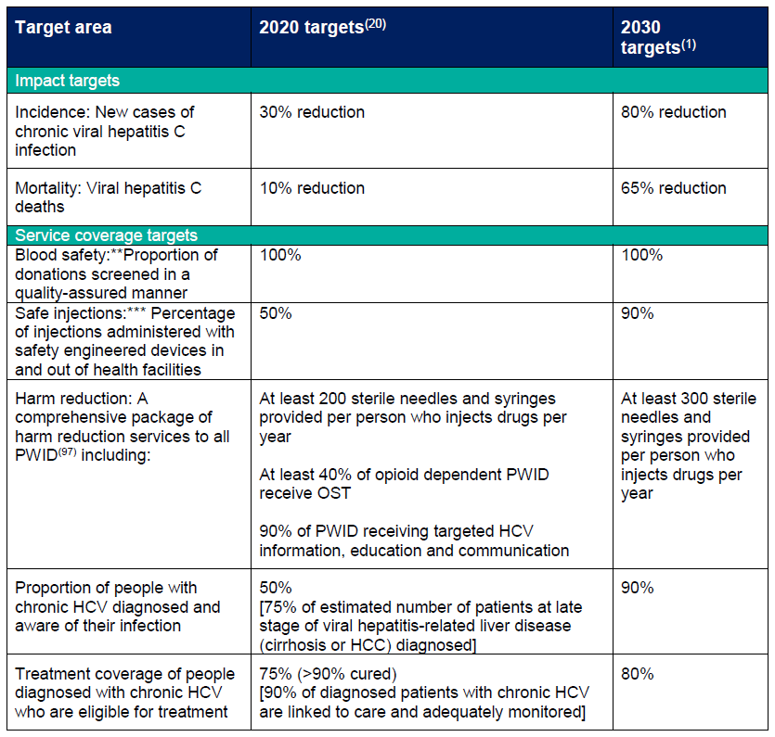
Appendix 1.* WHO GHSS targets⁽¹⁾ for viral hepatitis, relevant to HCV in the UK context, with 2020 targets updated to reflect the draft action plan for the health sector response to viral hepatitis in the WHO European Region⁽²⁰⁾
Abstracted from the WHO Global Health Sector Strategy for Viral Hepatitis(1) and modified to reflect the draft action plan for the health sector response to viral hepatitis in the WHO European Region⁽²⁰⁾
** In England, 2020 and 2030 targets are already met.⁽⁹⁸⁾
***In England, 2020 and 2030 targets are already met in the health care setting as the UK follows the EU Directive for the prevention of sharps injuries in the health care setting,⁽⁹⁹⁾ by using safety engineered devices.

Slide 67
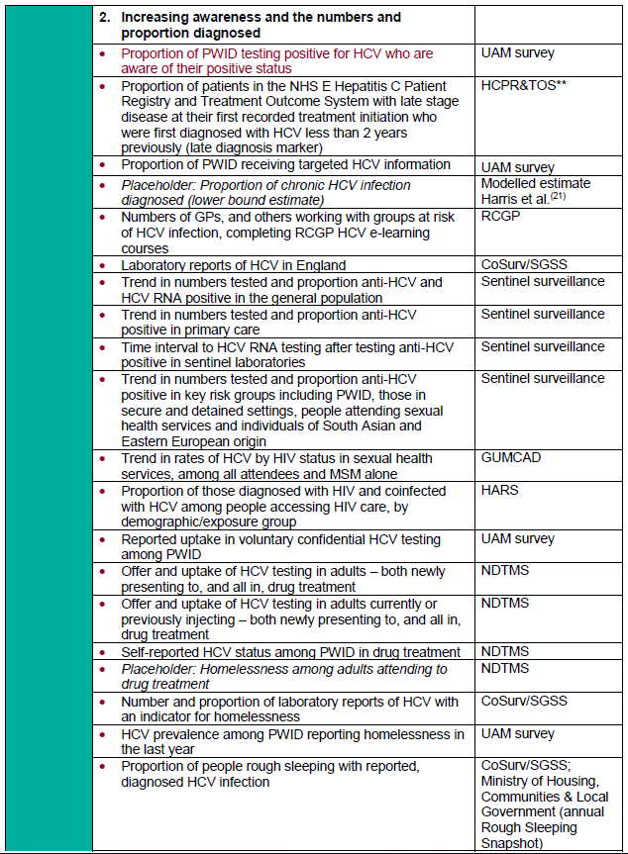
Appendix 2. Preliminary indicators to monitor the impact of important interventions to tackle hepatitis C virus in England.

Slide 68
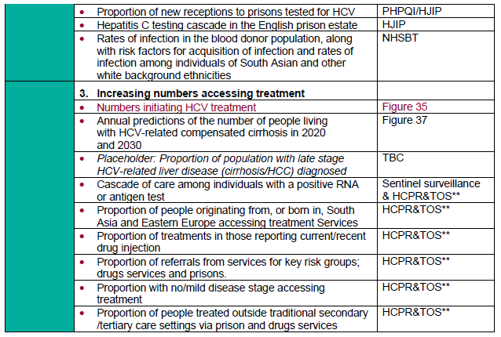
Appendix 2. Preliminary indicators to monitor the impact of important interventions to tackle hepatitis C virus in England.
Placeholders are for indictors that are not currently available/in development or are absent because key data were not available at the time of publication
** HCPR&TOS: The NHS England Hepatitis C Patient Registry & Treatment Outcome System

Slide 69
References
World Health Organization. Global health sector strategy on viral hepatitis, 2016-2021. Towards Ending Viral hepatitis. 2016. Available from: http://apps.who.int/iris/bitstream/10665/246177/1/WHO-HIV-2016.06-eng.pdf?ua=1. [Accessed: 07/05/2020].
4. Public Health England. Unlinked Anonymous Monitoring Survey of PWID in contact with Specialist Drug Services. London: PHE; 2020. Available from: www.gov.uk/government/statistics/people-who-inject-drugs-hiv-and-viral-hepatitis-monitoring [Accessed: 07/05/2020].
20. World Health Organization. Action plan for the health sector response to viral hepatitis in the WHO European Region. 2016. Available from: http://www.euro.who.int/en/about-us/governance/regional-committee-for-europe/66th-session/documentation/working-documents/eurrc6610-action-plan-for-the-health-sector-response-to-viral-hepatitis-in-the-who-european-region [Accessed: 07/05/2020].
21. Ross J. Harris HH, Sema Mandal, Mary Ramsay, Peter Vickerman, Matthew Hickman, Daniela De Angelis. . Monitoring the hepatitis C epidemic in England and evaluating intervention scale-up using routinely collected data. Journal of Viral Hep. 2019;00:1-12. Available at: https://doi.org/10.1111/jvh.13063 [Accessed: 11/05/2020].
36. Office for National Statistics. Deaths: ONS; 2020 Available from: https://www.ons.gov.uk/peoplepopulationandcommunity/birthsdeathsandmarriages/deaths [Accessed: 24/02/2020].
43. Public Health England. Sentinel Surveillance of blood borne viruses in England. London: PHE; 2018. Available from: https://www.gov.uk/government/publications/sentinel-surveillance-of-blood-borne-virus-testing-in-england-2017. [Accessed: 07/05/2020]
47. Hay G, Rael dos Santos A, Worsley J. Estimates of the Prevalence of Opiate Use and/or Crack Cocaine Use, 2011/12: Sweep 8 report. Liverpool John Moores University; 2014.
Available from: https://www.drugsandalcohol.ie/21931/1/estimates-of-the-prevalence-of-opiate-use-and-or-crack-cocaine-use-2011-12.pdf [Accessed: 08/05/2020].
50. Public Health England. Laboratory reports of Hepatitis C in England and Wales, 2008-2018: an update. London; 2020. Available from: https://assets.publishing.service.gov.uk/government/uploads/system/uploads/attachment_data/file/857919/hpr0120_HCV_update.pdf [Accessed 26/05/2020].
67.Mauss S, Pol S, Buti M, Duffell E, Gore C, Lazarus JV, et al. Late presentation of chronic viral hepatitis for medical care: a consensus definition. BMC medicine. 2017;15(1):92.

Slide 70
References
79. Public Health England. GUMCAD STI Surveillance System. London: PHE; 2013
Available from: https://www.gov.uk/guidance/gumcad-sti-surveillance-system [Accessed: 07/05/2020].
80. Public Health England. HIV surveillance systems. PHE; 2008. Available from: https://www.gov.uk/guidance/hiv-surveillance-systems#the-hiv-and-aids-reporting-system-hars [Accessed: 07/05/2020].
86. Cummins CWH, Cheng K, Maric R, Silcoks P, Varghese C,. An assessment of the Nam Pehchan computer program for the identification of names of south Asian ethnic origin. Journal of Public Health Medicine. 1999;21(4):401-6.
ONOMAP. 2012. Available from: www.onomap.org. [Accessed: 12/05/2020].
91. Harris RJ, Thomas B, Griffiths J, Costella A, Chapman R, M R. Increased uptake and new therapies are needed to advert rising hepatitis C- related end stage liver disease in England: modelling the predicated impact of treatment under different scenarios. Journal of Hepatology. 2014;61(3):530-7.
98. Joint United Kingdom (UK) Blood Transfusion and Tissue Transplantation Services Professional Advisory Committee. Guidelines for the Blood Transfusion Services in the UK. Available from: http://www.transfusionguidelines.org/ [Accessed: 08/05/2020].
99. European Agency for Safety and Health at Work. Directive 2010/32/EU - prevention from sharp injuries in the hospital and healthcare sector. 2010. Available from: https://osha.europa.eu/en/legislation/directives/council-directive-2010-32-eu-prevention-from-sharp-injuries-in-the-hospital-and-healthcare-sector. [Accessed 08/05/2020].
100. Health Protection Agency, Department of Health, Chartered Institute of Environmental Health. Health Protection Legislation (England) - Guidance 2010. 2010. Available from: www.gov.uk/government/organisations/public-health-england/about/our-governance [Accessed: 08/05/2020].

Slide 71
References
101. Public Health England. Infection Inside International; Quarterly publication from PHE on public health in prisons and other places of detention with a global focus. 2018. Available from: https://assets.publishing.service.gov.uk/government/uploads/system/uploads/attachment_data/file/731240/Infection_Inside_Vol_14_Issue_2.pdf [Accessed:12/05/2020]

