Slide 1
Pertussis (whooping cough) vaccination programme for pregnant women
An update for healthcare professionals
Updated September 2021
Notes:
This resource has been updated to align with the recently updated information document for health care practitioners: Pertussis (whooping cough) vaccination programme for pregnant women
Rationale
This resource is designed to support healthcare professionals involved in raising the issue of vaccination against pertussis with all women in the antenatal period and providing women with evidence based information about vaccination against pertussis.
This resource does not cover the actual administration techniques involved in vaccination against pertussis. If staff are required to deliver vaccinations they should refer to their line manager for alternative training.
Note: Pertussis is commonly known as whooping cough. For the purpose of this resource, pertussis is used throughout.

Slide 2
Key message
infant cases of pertussis have been dramatically reduced by the introduction of the maternal immunisation programme. However, the disease continues to circulate in older age groups
it is important for all health professionals to encourage vaccination in pregnant women from 16 weeks gestation
© NHS Scotland/Crown Copyright

Slide 3
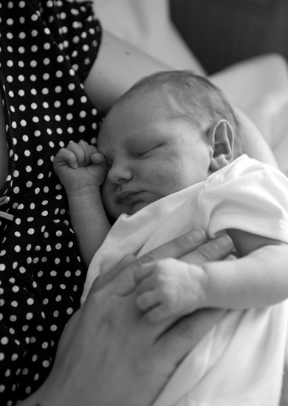
Aims of resource
to support staff involved in discussing vaccination against pertussis with pregnant women by providing evidence based information
to raise awareness of current pertussis epidemiology and the impact of pertussis on young infants
to promote uptake of vaccination against pertussis through increasing awareness amongst healthcare professionals
© NHS Scotland/Crown Copyright

Slide 4
Learning Outcomes
After completing this resource immunisers will be able to:
understand their role in raising the issue of vaccination against pertussis with all women in the antenatal period and providing women with evidence based information about this vaccination
describe the aetiology and epidemiology of pertussis
understand how pertussis is transmitted and the severity of it in young infants
discuss the important role of vaccination against pertussis during pregnancy for young infants
be aware of sources of additional information

Slide 5
Contents
pertussis
vaccinating pregnant women against pertussis
pertussis containing vaccine for pregnant women
the role of the immuniser
resources

Slide 6
Pertussis (whooping cough)

Slide 7
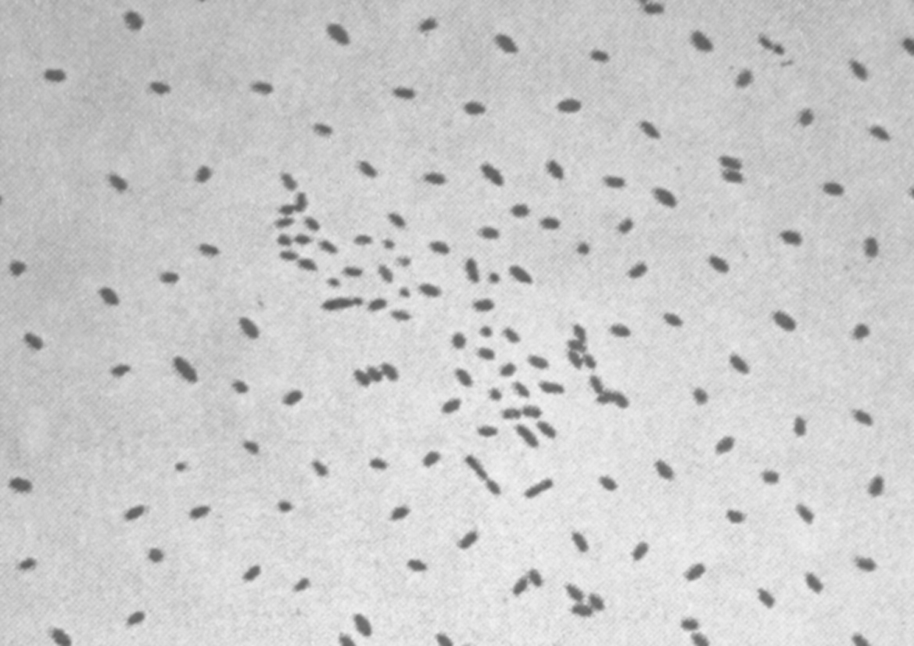
Pertussis
Pertussis is an acute bacterial infection caused by Bordetella pertussis
it is highly contagious and can be passed from person to person through droplets from the nose and throat of infected individuals when coughing and sneezing
infants and young children have the highest rates of complications
infants are the most vulnerable group and almost all deaths from pertussis occur in this age group with most occurring in those younger than 3 months of age
Photo courtesy of CDC
Notes:
Bordetella pertussis is an exclusively human pathogen that can affect people of all ages, however infants are the most vulnerable group with the highest rates of severe complications, hospitalisations and mortality. Adults and older siblings are often the source of infection for younger siblings at home.
Pertussis is a very infectious disease that is passed from one person to another. The bacteria are present in the back of the throat of an infected person and may be spread by coughing or sneezing.

Slide 8
Pertussis (cont’d)
Incubation period
the incubation period is on average 7-10 days (range 5 to 21 days)
Infectious period
patients with pertussis are most infectious in the initial catarrhal stage and during the first three weeks after the onset of cough
Photo courtesy of CDC
Notes:
A person can infect other people from 2-4 days before they start to cough to around 21 days after coughing starts.
Symptoms of pertussis usually develop 7 to 10 days after contracting the infection

Slide 9
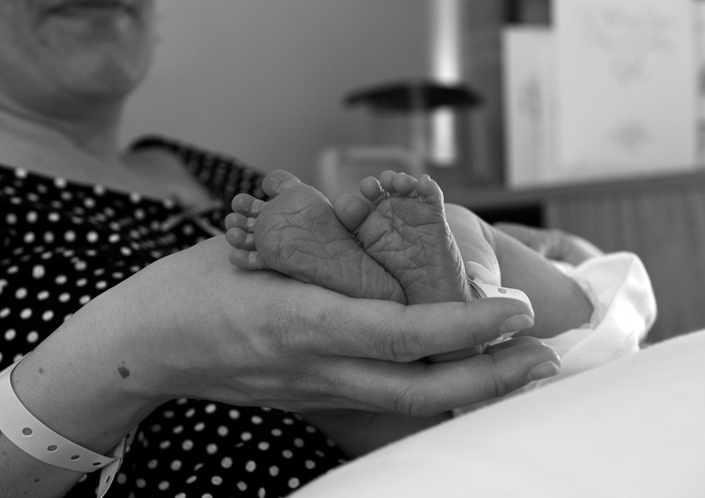
Clinical presentation of pertussis
Initial stage
Early symptoms:
are similar to those of a cold
can last for one to two weeks before becoming more severe
Second or Paroxysmal Stage
Characteristic symptoms:
intense bouts of coughing sometimes referred to as ‘paroxysms’ of coughing
a ‘whoop’ sound with each sharp intake of breath after coughing (may not occur in infants)
vomiting after coughing
© NHS Scotland/Crown Copyright
Notes:
Symptoms caused by pertussis infection tend to develop in stages, with mild symptoms occurring first, followed by a period of more severe symptoms, before improvement begins.
The initial stage /early symptoms of pertussis are often similar to those of a common cold and may include: runny or blocked nose, sneezing, watering eyes, dry irritating cough, sore throat, slightly raised temperature and feeling generally unwell. These early symptoms can last for one to two weeks before becoming more severe.
The second stage is sometimes called the paroxysmal stage and is characterised by fits of coughing which maybe followed by choking and/or vomiting. The cough often comes in short bursts (paroxysms) followed by a desperate gasp for air – when the characteristic whooping noise may be made. Pertussis doesn’t always cause the typical symptoms of the whoop sound or vomiting after coughing, particularly in older children and adults when pertussis may present as a prolonged cough.
Each bout of coughing usually lasts between one and two minutes, but several bouts may occur in quick succession.
These bouts of coughing may continue for weeks or months. Over time the episodes of coughing become less frequent and full recovery is gradual.

Slide 10
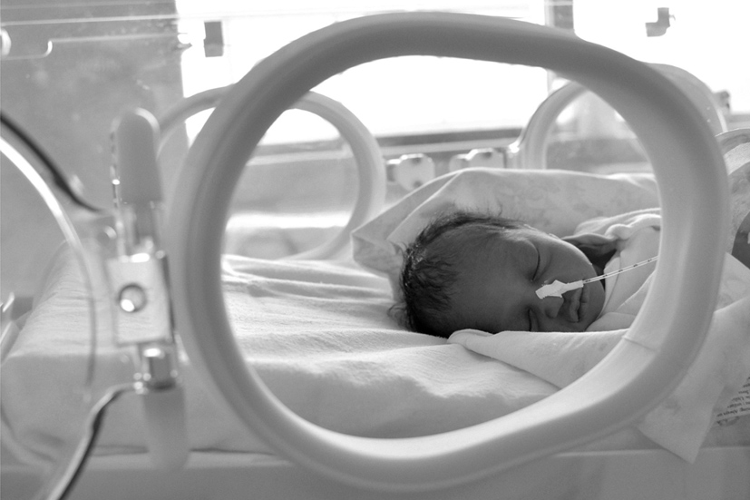
Clinical presentation of pertussis (cont’d)
Convalescent stage
Symptoms:
slowly become less severe
generally last 2 to 6 weeks but can persist for months
© NHS Scotland/Crown Copyright

Slide 11
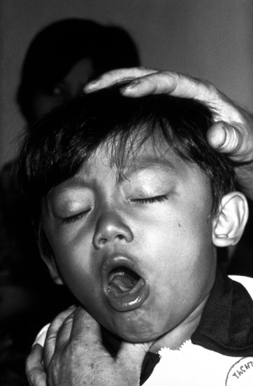
Clinical presentation of pertussis in infants and young children
infants may not make the ‘whoop’ sound after coughing, but they may start gagging or gasping and may temporarily stop breathing
young children may also seem to choke or become cyanosed when they have a bout of coughing
Photo courtesy of CDC
Notes:
In young infants the typical ‘whoop’ may never develop and coughing spasms can be followed by difficulty breathing , Apnoea (pauses in breathing) is common in young infants.
Young children may also seem to choke or become blue in the face (cyanosis) when they have a bout of coughing.
The rate of hospitalisation and complications for pertussis is much higher in young infants than it is for older children and adults.

Slide 12
Complications in infants and young children
Infants and young children are usually most severely affected and more likely to develop severe complications such as:
pneumonia
temporary pauses in breathing as a result of severe difficulty with
breathing
weight loss due to excessive vomiting
seizures or brain damage
encephalitis (an acute inflammation of the brain)
In severe cases pertussis can be fatal in infants
Notes:
Infants and young children are usually the most severely affected by pertussis and infants are most likely to develop severe potentially life threatening complications.
Young infants are much more likely to be admitted to hospital with pertussis than other age groups.

Slide 13
Complications of pertussis in older children & adults
Complications in older children and adults are usually much less serious than those in infants and young children.
These may include:
intense bouts of coughing leading to nosebleeds and burst blood vessels in the whites of the eye
bruised ribs as a result of intense coughing
hernia due to intense coughing
a swollen face
ulcers on the tongue and mouth
ear infections such as otitis media
Notes:
Serious complications, such as pneumonia and convulsions, are uncommon in older age groups but can, very occasionally, occur.
Sometimes the cough is severe enough to cause other problems such as fainting, muscle pain in the ribs (and occasionally fractured ribs), a hernia, or bleeding in the eye (conjunctival haemorrhage).

Slide 14
Vaccinating pregnant women

Slide 15
Incidence of confirmed pertussis cases at all ages, England and Wales, 1998 to 2012
Notes:
Pertussis tends to have a cyclical nature with a peak in cases every three or four years. In 2008 (the last peak before the outbreak occurred in 2012) there were 902 laboratory confirmed cases of pertussis. In 2012 there was a dramatic increase to 9711 laboratory confirmed cases. Many more cases occur that are not laboratory confirmed.
All parts of England and Wales, Scotland and Northern Ireland saw a similar dramatic increase in cases in 2012. Increases were also seen in America during 2012 with increased pertussis cases or outbreaks reported in the majority of states. As in the UK, in America the highest rate is in young infants. Similar increases in cases have also been reported in Australia, New Zealand & Canada.
Refs:
America increase: http://www.cdc.gov/pertussis/outbreaks.html
Increase in England & Wales http://www.hpa.org.uk/hpr/archives/2012/news3512.htm#prtsss

Slide 16
Age distribution of laboratory confirmed pertussis cases and rate per 100,000, England and Wales 2012
Notes:
Although the number of confirmed cases was highest in adult age groups, the actual rate of infection per 100,000 is far higher in infants under one year than in any other age group.
The incidence rate in infants under 3 months of age was estimated at nearly 240 per 100,000 in 2012. These young infants are most at risk of severe illness and complications.
As pertussis is very infectious, cases in adults and older children can pass the infection on to young infants. It is known that many cases of pertussis are not diagnosed, tested or confirmed

Slide 17
Confirmed cases in infants under 1 year, by week of age at onset (2011-end August 2012) England and Wales
Dose 1
Dose 2
Dose 3
Notes:
It is clear that a high proportion of infant cases occurred before they received their first dose of vaccine (at 8 weeks). Infants must receive all 3 doses of the vaccine (at 8, 12 and 16 weeks) in a timely manner in order to gain maximum benefit from the infant programme.
17

Slide 18
Reconciled deaths from pertussis in infants (England only)
Sources: lab confirmed cases, certified deaths, Hospital episode statistics, GP registration details
Notes:
In 2012, 14 pertussis deaths in young infants were reported- all of whom were <10 weeks of age and too young to have any protection through pertussis vaccination.
The increase in infant cases resulted in more deaths in babies with pertussis than we had seen in the last 20 years. Fourteen babies with confirmed pertussis died in 2012; these babies were all under 10 weeks old at disease onset and too young to be fully protected by routine immunisation. None had received any vaccine doses.
The high disease incidence and large number of deaths led to Public Health England declaring this to be a national outbreak in April 2012
Unfortunately we have continued to see deaths in infants with pertussis but these have not reached the levels seen in 2012. This is also against an on-going increase in the incidence of pertussis in the population. We have had 20 deaths in babies born since the introduction of the immunisation in pregnancy programme. The mothers of 18 of the 20 babies had not been immunised in pregnancy. The two mothers that had been immunised received the vaccine only a few days before delivery and therefore protection of the infants would be not be considered optimal. This further underlines the importance of ensuring that all pregnant women are given the opportunity to protect their babies from birth against pertussis through vaccination in pregnancy and the benefit of administering the vaccine at the recommended stage of pregnancy at 20 weeks

Slide 19
Routine childhood pertussis immunisation
the main aim of the childhood vaccination programme is to protect infants who are most at risk of severe disease and in whom case fatality is high
Pertussis is part of the infant vaccination programme
6-in-1 vaccine (DTaP/IPV/Hib/HepB) is offered to infants at 8, 12 and 16 weeks of age
this protects against pertussis, diphtheria, tetanus, polio, Haemophilus influenzae type b and Hepatitis B
a booster dose of pertussis containing vaccine is given to children from about three years and four months of age
Notes:
Uptake rates for the completed primary course (x3 doses) of childhood pertussis vaccination in England and Wales are usually over 95% for children aged 12 and 24 months. Effectiveness estimates have shown that even the first infant dose offers some protection against pertussis disease and timely administration of all three doses is important.
Protection from vaccination against serious pertussis infection is very high for the first few years of life, when the risk of complications is greatest. Protection is extended further by the booster dose given shortly before children go to school (usually given when children are aged about 3 years and 4 months).

Slide 20
Immunity against pertussis
vaccination against pertussis does not give life-long immunity
individuals who have previously had pertussis can become re-infected and spread infection to others
this spread of infection is important, particularly in children too young to be vaccinated
Notes:
Neither protection from natural infection or from vaccination is life long. Individuals who have had pertussis can get re-infected and spread infection to others. The same is true after pertussis vaccination. Infection in fully vaccinated individuals is normally less severe than in those who have not been vaccinated. However, as vaccinated individuals or those who have previously had pertussis can get disease, particularly as immunity wanes in adolescence and adulthood, these people may spread infection to those children who are too young to be vaccinated.

Slide 21
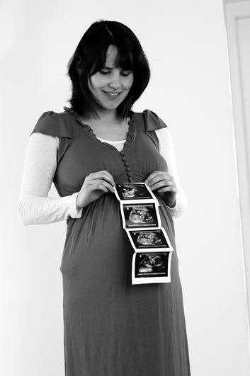
Protecting infants too young to be vaccinated
in October 2012, the Department of Health recommended that pregnant women receive one dose of pertussis containing vaccine from 28 to 38 weeks
this recommendation was updated and from April 2016, the vaccine has been offered from week 16 of pregnancy (ideally around the time of the foetal anomaly scan at 20 weeks)
the aim is to boost antibodies in vaccinated women during pregnancy so that pertussis antibodies are passed from mother to baby
this is considered the best way to provide passive protection to infants in the first weeks of life and offers women a safe way to protect their baby against this serious disease
© NHS /Crown Copyright
Notes:
In response to the dramatic increase in cases of pertussis in the UK, and the fact that infants are most severely infected, a decision was made by the Department of Health to recommend that pregnant women receive a pertussis containing vaccine. Vaccination was initially recommended from 28-38 weeks, but this recommendation was updated in April 2016. Pregnant women should now be advised to have their pertussis containing vaccine from 16 weeks of pregnancy (ideally after the foetal anomaly scan at around 20 weeks and before 32 week of pregnancy). This will increase the opportunity for the pregnant woman to have the vaccine and also limit spurious association of any developmental problems or adverse events in early pregnancy being linked to the vaccine. It also provides the opportunity for protection for preterm infants who may be particularly vulnerable to complications from pertussis infection.
Vaccination against pertussis for pregnant women is the most effective way of providing protection to infants in the first weeks of life before they are old enough to start receiving their own primary immunisations.
Women who present after 38 weeks should still be offered immunisation up to the onset of labour as indirect protection (through prevention of disease in the mother) may reduce the risk of disease in the infant and some direct protection may still be provided to the infant, depending on timing.
Vaccination may be offered to new mothers who have never previously been vaccinated against pertussis, up to when their child receives their first vaccination. A single dose of dTaP/IPV is recommended in these circumstances and should ideally be given as soon as possible following birth.

Slide 22
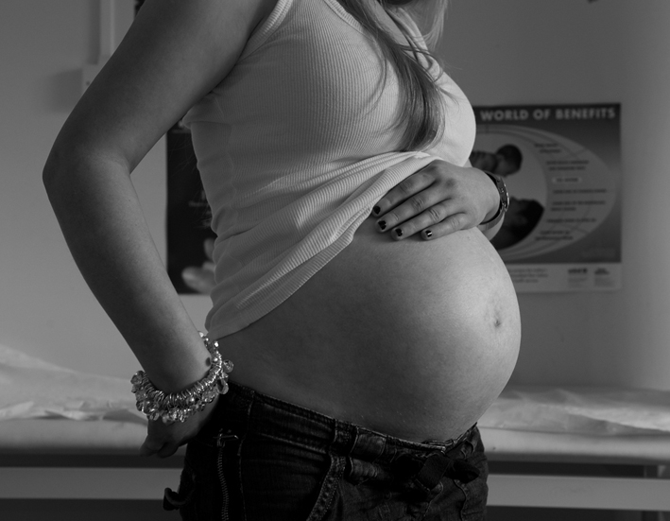
Maternal transfer of antibodies
Maternal antibodies boosted by vaccination will be passed across the placenta to the unborn baby and should provide protection in the first few weeks of life, when they are most at risk of serious complications if they become infected with pertussis
© NHS Scotland/Crown Copyright
Notes:
As discussed previously, although many women will have had pertussis vaccination themselves when they were children or have had pertussis infection in the past, the immunity from this will now have waned and there is little or no protection left to pass onto the unborn infant.
By offering a pertussis containing vaccine from week 16 of pregnancy, the mother’s levels of antibodies will be boosted and increase the amount of antibodies that can be passed onto the infant.
Once a mother has been vaccinated it takes about 2 weeks for the maximum antibody levels to be produced in the mother. The half life of transferred maternal pertussis antibodies is approximately 6 weeks which makes it important that women are immunised close to the time when transplacental antibody transfer is maximal.
When the programme was first introduced, vaccination between week 28 and 32 was recommended because it was believed that vaccination later in pregnancy would lead to higher levels of maternal antibodies during the period of optimal transplacental transfer i.e. around or after 34 weeks of gestation. However a more recent study suggests that vaccination before 28 weeks actually provides higher levels of antibodies in cord blood and the theory is that although the rate of transfer is higher later in pregnancy, there is more time for antibodies to be transferred for those vaccinated earlier in pregnancy, and therefore the cumulative amount overall is higher in these women.

Slide 23
Protecting mother and infant
maternal vaccination reduces the risk of the mother developing pertussis infection and passing it on to the young infant
infants born to mothers vaccinated at the recommended time during pregnancy should have higher levels of antibodies than those born to unvaccinated mothers, which should help protect the infant until they start receiving their own immunisations
© NHS Scotland/Crown Copyright
Notes:
The vaccination of pregnant women against pertussis in order to provide protection to the infant during the first weeks of life is also recommended in America (http://www.cdc.gov/vaccines/vpd-vac/pertussis/tdap-pregnancy-hcp.htm) & (parts of) New Zealand and South America http://www.immune.org.nz/taxonomy/term/8 .
The Green Book states that “Pertussis-containing vaccines may be given to pregnant women when protection is required without delay. There is no evidence of risk from vaccinating pregnant women or those who are breast-feeding with inactivated viral or bacterial vaccines or toxoids (Plotkin & Orenstein 2004)”
An additional benefit of vaccinating a woman during pregnancy is that she will also be protected at the time of delivery and when the infant is very young, and will be less likely to transmit pertussis to the infant.

Slide 24
Vaccine coverage and efficacy

Slide 25
Monthly pertussis vaccination coverage (%) in pregnant women: England, 2013 to 2021
Notes:
Details of coverage for the pertussis vaccination in pregnancy programme are published at: https://assets.publishing.service.gov.uk/government/uploads/system/uploads/attachment_data/file/887216/hpr1020_prtsss-vc.pdf
The coverage achieved so far has been very encouraging and is a tribute to all those who have been working to deliver the programme.
Pertussis vaccine coverage for the fourth quarter of the 2020 to 2021 financial year ranged from 67.8% to 65.8% in February. The average for the quarter was 66.7%. This was 5.5% lower than average coverage for the same quarter in 2019 to 2020 financial year https://assets.publishing.service.gov.uk/government/uploads/system/uploads/attachment_data/file/992351/hpr0921_prtsss-vc_v4.pdf
PHE have monitored how many pregnant women have received pertussis vaccination during their pregnancy in England. Health professionals have done an extremely good job of raising awareness and immunising women to protect their babies from birth. A number of other countries have introduced similar programmes, such as the United States, Australia, New Zealand, South American and other European countries. With the exception of Argentina, these countries have not published national uptake figures and where regional or local uptake is available uptake in England compares well.
It is important to give all pregnant women the opportunity to be vaccinated as we know from research that more than 90% of women indicate they would take up the offer of a vaccine that protected their baby against this potentially fatal disease from the time it was born.

Slide 26
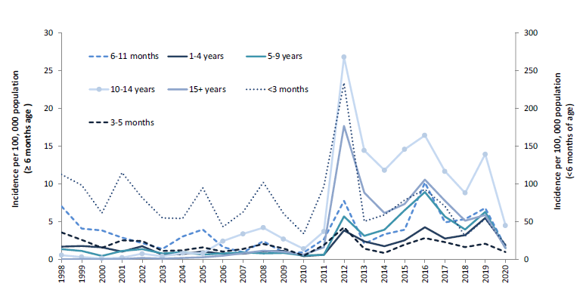
Annual age specific laboratory confirmed pertussis incidence rates, 1998 to 2020, England
Introduction of temporary vaccination
programme for pregnant women
Notes:
All age groups were affected when the incidence of pertussis peaked during 2012
In 2013, after the introduction of the pregnancy programme, pertussis incidence in infants under 1 year of age fell below the levels seen in peak years before the 2012 outbreak. Whilst the incidence also fell in older age groups, it remains higher than the levels seen prior to the 2012 outbreak. This means that pertussis activity remains high in the population and it continues to be important that all pregnant women are offered pertussis vaccine in order to protect their babies from birth.
In 2019, there were 3681 confirmed cases of pertussis reported to PHE, almost a third of these were reported July to September
The national incidence for all age groups was 7 per 100,000 in 2019
Laboratory confirmed pertussis cases in infants aged under one year, were 48% higher in 2019 (136 cases) than in 2018 (92 cases). This compares with 508 confirmed cases reported in 2012.
The annual pertussis report states:
There has been a decline in pertussis incidence in infants under 3 months of age since the introduction of the maternal vaccination programme, from 234/100,000 in 2012 to 93/100,000 in 2016 and 52/100,000 in 2019 (figure 2). The number of confirmed cases in infants <3 months in 2019 was 69% higher (83 cases) than in 2018 when 49 cases were reported, the lowest number of confirmed cases since the introduction of enhanced surveillance in 1994. Incidence does however remain highest in infants under 3 months who are at most risk of severe disease and too young to be fully vaccinated.
https://assets.publishing.service.gov.uk/government/uploads/system/uploads/attachment_data/file/881380/hpr0820_PRTSSS_annual.pdf

Slide 27
Incidence of laboratory confirmed pertussis cases, aged < 1 year, England: 1998 to 2019
Notes:
In 2013, after the introduction of the pregnancy programme, pertussis incidence in infants under 1 year of age fell below the levels seen in peak years before the 2012 outbreak. Cyclical changes in pertussis levels are expected with peaks every 3 to 4 years. However, the incidence of pertussis in infants has been retained at pre-2012 levels since the maternal programme was introduced. This is consistent with the high calculated vaccine effectiveness for the prevention of pertussis in infants under 3 months whose mothers were vaccinated.

Slide 28
Reconciled deaths from pertussis in infants, England 2001-2015
Prematurity
timing
*
Sources: lab confirmed cases, certified deaths, Hospital episode statistics, GP registration details, HPZone
* Up to 31/03/2016
Notes:
Unfortunately there have been a further 20 deaths in babies with confirmed pertussis who were born after the introduction of vaccination in pregnancy, including one infant death in 2019. These infants were all too young to be fully protected by routine infant vaccination. The mothers of 18 of these babies had not been vaccinated. The mothers of two of the babies were vaccinated too late for the baby to benefit from transfer of maternal antibodies. This underlines the importance of ensuring that all pregnant women are given the opportunity to protect their babies from birth against pertussis through vaccination in pregnancy. Ideally from week 16 pregnancy but usually around the time of the foetal anomaly scan at 20 weeks of pregnancy as prematurity may put babies at risk of more severe disease.

Slide 29
Pertussis vaccine safety
Donegan K and others, British Medical Journal 2014
~20,000 vaccinated women were identified using the Clinical Practice Research Datalink (CPRD) to 28 days post vaccination and more than 6000 women up to delivery.
No increased risk was found when compared to historical and unvaccinated controls for:
Stillbirth Neonatal death
Pre-eclampsia/eclampsia Placenta praevia
IUGR/ LBW Caesarean section
Postpartum haemorrhage Premature labour
No increase on expected rates for pregnancy outcomes within 14 days or across the whole pregnancy
No difference in the time to delivery in the vaccinated and unvaccinated cohorts
Vaccination against pertussis for pregnant women
Notes:
The Medicines and Healthcare regulatory Agency (MHRA) used a large database of patient records to identify nearly 18,000 vaccinated pregnant women in the UK followed to at least 28 days after vaccination. They compared pre-specified pregnancy outcomes that are reported in the third trimester of pregnancy with background rates of such outcomes before the vaccination in pregnancy programme had been introduced.
Over 6000 of these pregnant women had adequate follow up information and recorded pregnancy outcome. These were compared to background rates AND matched to a historical cohort of non-vaccinated women. They found no increased risk of adverse outcomes when compared to historical and unvaccinated controls and no difference in the time to delivery in vaccinated and unvaccinated women.
This large observational cohort study (http://www.bmj.com/content/bmj/349/bmj.g4219.full.pdf) found no evidence of an increased risk of stillbirth in the 14 days immediately after vaccination or later in pregnancy and found no evidence of an increased risk of any of an extensive predefined list of adverse events related to pregnancy.
Donegan K, Safety of pertussis vaccination in pregnant women in UK: observational study, BMJ, 2014;349:g4219
A review of safety by the Advisory Committee on Immunisation Practices (ACIP) in America, based upon pregnancy registries, and small studies, concluded that “the available data did not suggest any elevated frequency or unusual patterns of adverse events in pregnant women who received dTaP, and that the few adverse events reported were unlikely to have been caused by the vaccine”. Tetanus and diphtheria toxoid vaccines have been used extensively in pregnant women worldwide to prevent neonatal tetanus.

Slide 30
Vaccination against pertussis (whooping cough) dTaP/IPV
Notes:
Boostrix IPV and Repevax vaccines are equivalent in terms of protection against pertussis and either vaccine can be used for this programme.

Slide 31
The recommended vaccine:
Brand name: Boostrix-IPV or Repevax vaccine can be used
Generic Name: Diphtheria, Tetanus, Pertussis (acellular, component) and Poliomyelitis (inactivated vaccine) adsorbed (dTaP/IPV)
Inactivated vaccine (N.B. the vaccine cannot cause pertussis)
Immunisers should be familiar with the PGD which is available at:
https://www.gov.uk/government/publications/pertussis-vaccination-in-pregnancy-dtapipv-boosterix-or-repevax-pgd-template
Notes:
There is no single (monovalent) pertussis vaccine licensed in the UK. Pertussis containing vaccines are only available as combined products.
Boostrix-IPV and Repevax vaccines protect against 4 infections: Diphtheria, Tetanus, Poliomyelitis and Pertussis.
Both are inactivated vaccines and contain chemically inactivated and purified antigens – they do not contain live organisms and cannot cause the diseases against which they protect.

Slide 32
Administration of dTaP/IPV vaccine
The Green Book states that:
“Pertussis-containing vaccines may be given to pregnant women when protection is required without delay. There is no evidence of risk from vaccinating pregnant women or those who are breast-feeding with inactivated viral or bacterial vaccines or toxoids (Plotkin & Orenstein 2004)”
The advice from JCVI to use pertussis containing inactivated vaccines should be followed. There is no evidence of risk to pregnancy or the infant with inactivated vaccines such as Boostrix-IPV or Repevax.
Notes:
Healthcare professionals are reminded that in some circumstances the recommendations regarding vaccines given in the Green Book chapters may differ from those in the Summary of Product Characteristics (SPC) for a particular vaccine. When this occurs, the recommendations in the Green Book are based on current expert advice received from the JCVI and should be followed. These Green Book recommendations and/or further advice from the Department of Health should be reflected in PGDs.

Slide 33
Administration of dTaP/IPV vaccine (Cont’d)
given by intramuscular injection into the deltoid
can be given at the same time as other vaccines such as influenza
May only be administered:
against a prescription written manually or electronically by a registered medical practitioner or other authorised prescriber
against a Patient Specific Direction
against a Patient Group Direction
Notes:
Boostrix-IPV and Repevax vaccines can be given at same time as other vaccines such as influenza vaccine. The vaccines should be given at a separate site, preferably in a different limb. If more than one vaccine is given in the same limb, they should be given at least 2.5cm apart. The sites at which each vaccine was given should be noted in the individual’s health records.
More information on immunisation by nurses and other health professionals is available in chapter 5 of Green Book (Immunisation against infectious disease)

Slide 34
Contraindications and Precautions
Contraindications
a confirmed anaphylactic reaction to a previous dose of diphtheria, tetanus, pertussis or poliomyelitis containing vaccine
a confirmed anaphylactic reaction to any component of the vaccine, including neomycin and/or polymyxin
Precautions
acute illness- defer until recovered
recent immunisation against pertussis, diphtheria, tetanus and or polio- ensure an interval of 4 weeks
current neurological deterioration or encephalopathy of unknown origin within seven days of previous immunisation with pertussis- containing vaccine- follow advice in the Green Book
Notes:
There are very few individuals who cannot receive pertussis containing vaccines. When there is doubt specialist advice should be sought on the vaccine and the circumstances under which it could be given. There are very few medical reasons why Boostrix-IPV or Repevax should not be given. Boostrix-IPV or Repevax should not be given to pregnant women who have had:
a confirmed anaphylactic reaction to a previous dose of pertussis, diphtheria, tetanus or polio vaccines;
a confirmed anaphylactic reaction to any component of the vaccine
Pregnant women who have recently received immunisation against pertussis, diphtheria, tetanus and/or polio should also be offered immunisation but with a gap of at least one month between immunisations. Although cumulative doses may increase the likelihood of injection site reactions or fever, this is outweighed by the expected benefit to the infant.
In cases of pregnant women who have had encephalopathy (brain disorder) of unknown origin within seven days of previous immunisation with pertussis-containing vaccine, the advice in the Green Book should be followed. For women who have evidence of current neurological deterioration, including poorly controlled epilepsy, immunisation should be deferred and advice in the Green Book should be followed.
If the pregnant women is acutely unwell and has a fever, immunisation should be postponed until the patient has recovered. This is to avoid wrongly associating any cause of fever, or its progression, with the vaccine and to avoid increasing any pre-existing fever. Having a minor illness without a fever (e.g. a cold) is not a reason to delay immunisation.
A personal or family history of seizures is not a contraindication to immunisation.
There is no contraindication to breastfeeding after receiving Boostrix-IPV or Repevax

Slide 35
Possible adverse reactions
Most Common
erythema (redness), pain, swelling at the injection site
Less Common
pyrexia (>37.5⁰C), haematoma, induration, pruritus and warmth at the injection site
Uncommon
swelling of vaccinated limb, pyrexia (>39.5⁰C), chills, pain
Notes:
The full list of adverse reactions associated with Boostrix-IPV or Repevax vaccines are available in the marketing authorisation holder’s Summary of Product Characteristics
Anaphylaxis is a very rare side effect of most vaccines and facilities for its recognition and management must be available.

Slide 36
Reporting suspected adverse reactions
Yellow card scheme
voluntary reporting system for suspected adverse reaction to medicines/vaccines
success depends on early, complete and accurate reporting
report even if uncertain about whether vaccine caused condition
http://mhra.gov.uk/yellowcard
see chapter 8 of Green Book for details
Notes:
Healthcare professionals and patients are encouraged to report suspected adverse reactions to the Medicines and Healthcare Products Regulatory Agency (MHRA) using the yellow card reporting scheme

Slide 37
Recommendations
women who become pregnant again while the programme is in place should be offered immunisation during each pregnancy to maximise transplacental transfer of antibody
one dose of Boostrix-IPV or Repevax is recommended for women carrying twins or multiple pregnancies
vaccination may be offered to new mothers who have never previously been vaccinated against pertussis, up to when their child receives their first vaccination. A single dose of Boostrix-IPV or Repevax is recommended in these circumstances
new mothers who have never previously been vaccinated against pertussis are unlikely to have been fully vaccinated against diphtheria, tetanus and polio and should be assessed as to the need for further immunisations with Td/IPV vaccine
Notes:
There are no reasons why Boostrix-IPV or Repevax cannot be administered at the same time as influenza vaccine. However, influenza immunisation should not be delayed until week 16 or after of pregnancy in order to give Boostrix-IPV or Repevax at the same visit. Pregnant women are at risk of severe illness at any stage of pregnancy from influenza. Boostrix-IPV or Repevax can be administered at the same time as anti-D treatment.
New mothers who have never been vaccinated against pertussis are unlikely to be vaccinated against diphtheria, tetanus and polio and should be assessed as to the need for further immunisations with Td/IPV vaccine. Health professionals should be referred to PHE vaccination of individuals with incomplete or uncertain immunisation status.
https://www.gov.uk/government/publications/vaccination-of-individuals-with-uncertain-or-incomplete-immunisation-status

Slide 38
Data management
health professionals are encouraged to accurately record the brand and batch number of the vaccine in relevant data systems following the administration
the delivery date of the baby should also be recorded in the mother’s medical records
this information is essential to allow an assessment of vaccine uptake, safety and to inform any future public health actions, if required
vaccination against pertussis should be recorded in the women’s medical/maternity records and recorded in the relevant data system
vaccine uptake of dTaP/IPV for pregnant women is monitored with a monthly data collection though ImmForm

Slide 39
Providing longer term protection against pertussis
the protection the infant acquires from the mother by the transfer of antibodies across the placenta is short term
it is very important that parents ensure their infants start their immunisation schedule at the recommended 8 weeks of age and complete all three doses to receive long lasting protection
parents should ensure older brothers or sisters are up to date with their immunisations
© NHS Scotland/Crown Copyright
Notes:
Parents should be encouraged to ensure their baby starts its immunisations on time and completes all 3 doses.
Parents should ensure older brothers and sisters are up to date with their immunisations in order to reduce the chance of them passing infection onto the young infant in the household.

Slide 40
Key role for healthcare professionals
To provide clear, concise and accurate information to every pregnant woman regarding vaccination against pertussis
Every effort should be made by medical practitioners, midwives and others to maximise the uptake of pertussis-containing vaccine

Slide 41
Actions for immunisers
advise pregnant women it is strongly recommended they are vaccinated against pertussis and that the ideal time for vaccination is from 16 weeks of pregnancy or around the time of their antenatal foetal anomaly scan (usually around week 20).They should ideally have received the vaccine by week 32
explain that if the vaccine is given to pregnant women after 38 weeks of pregnancy, the infant may not receive sufficient maternal antibodies to confer protection
explain the risks of pertussis in young infants and how vaccination given during pregnancy may provide protection to young infants against pertussis
explain which vaccine will be used, the contraindications and possible side effects to vaccination and the evidence for this vaccination programme
advise women how they can arrange for vaccination and, where appropriate, facilitate the arrangements for the vaccination appointment
follow up at later antenatal appointments to establish whether the woman has had her pertussis vaccination
encourage women to ensure their babies start their primary immunisations at 8 weeks to achieve longer-term protection against pertussis and other vaccine preventable diseases

Slide 42
Key points
highest incidence of pertussis infection is in infants, followed by older children and adults with a very low incidence in the age groups covered by the existing childhood vaccination programme
vaccination in pregnancy is well-received by women offered the vaccine
all deaths in 2012 were in unvaccinated children less than three months of age,
since the introduction of the maternal programme, there has been a further 20 deaths in infants too young to be vaccinated.
18 of these no vaccine was given during pregnancy
2 of these the vaccine was given less than 10 days before birth
infant cases of pertussis have been dramatically reduced by the introduction of the maternal immunisation programme. An programme effectiveness is extremely high at preventing both disease and death in infants
coverage and acceptance of the programme has been good and no safety concerns have been detected
Every effort should continue to be made to maximise this life saving intervention for young infants

Slide 43
Resources
NHS Choices information of whooping cough:
www.nhs.uk/conditions/Whooping-cough/
Immunisation against infectious diseases (Green Book) pertussis chapter:
www.gov.uk/government/publications/pertussis-the-green-book-chapter-24
Programme resources:
www.gov.uk/government/collections/immunisation#pertussis-(whooping-cough)
PGD is available at:
www.gov.uk/government/publications/pertussis-vaccination-in-pregnancy-dtapipv-boosterix-or-repevax-pgd-template

Slide 44
© NHS Scotland/Crown Copyright

Slide 45
Acknowledgement
This resource was originally developed by NHS Education for Scotland as a national training template to support the temporary maternal pertussis vaccination programme. Their permission to adapt it for use in England is gratefully acknowledged.
Adaption for use in England undertaken by the
Immunisation and Countermeasures Division, Colindale
UK Health Security Agency (UKHSA)

