Slide 1
COVID-19 vaccination programme
Core training slideset for healthcare practitioners
Version 20
Last update: 2 June 2023

Slide 2
Note to trainers
This slide set contains a collection of core slides for use or adaptation during the delivery of COVID-19 vaccination training. Trainers should select the slides required depending on the background and experience of the immunisers they are training and according to the role they will have in delivering the COVID-19 vaccine programme.
The information in this slide set was correct at time of publication. As COVID-19 is an evolving disease, much is still being learned about both the disease and the vaccines which have been developed to prevent it. For this reason, some of the information may change. Updates will be made to this slide set as new information becomes available. Please check online to ensure you are accessing the latest version. Trainers may need to update data and any information that changes between republications of this slide set.
Slides containing vaccine specific details (such as storage and dose preparation) on the COVID-19 vaccines currently being used in the UK have been added to the end of this slide set. These slides are available at the end so that trainers can specifically select those they need for the vaccine(s) for which they are delivering training.
Details for other vaccines will be added as they receive regulatory approval.
Notes:
Further information on the SARS-Cov-2 virus and COVID-19 disease, epidemiology and the currently authorised vaccines in the COVID-19 chapter of the Green Book: COVID-19: the green book, chapter 14a - GOV.UK (www.gov.uk)

Slide 3
Content
4. Learning objectives, pre-requisites, key messages and introduction
8. International and UK COVID-19 timeline
10. Coronavirus
26. COVID-19 epidemiology
28. Developing a COVID-19 vaccine and vaccination programme
44. Introducing a new vaccination programme
46. COVID-19 vaccination programme
71. The immune response
89. Consent
99. Legal requirements for the supply and administration of COVID-19 vaccine
106. Vaccine storage
116. Vaccine administration
124. Anaphylaxis and adverse events following vaccination
131. Documentation and record keeping
133. Addressing concerns and providing information to those being vaccinated
135. Knowledge and skills
139. Supervision, accountability and delegation
141. Improving vaccine uptake
143. Further information, action plan and sources of advice

Slide 4
Learning objectives
By the end of this session, you should be able to:
explain what COVID-19 is and be aware of the UK epidemiology
understand the policy behind the COVID-19 vaccination programme
describe how vaccines work and how they are developed and trialled
identify the groups who are at high risk for COVID-19 infection and who should be prioritised to receive the COVID-19 vaccine
describe the process of consent and how this applies when giving vaccines
understand the legal mechanisms by which immunisers can supply and administer COVID-19 vaccine
recognise the differences between a prescription, a PSD, a PGD and a Protocol and understand which staff can use each of these
describe the key principles of how to correctly store, prepare and administer COVID-19 vaccines
communicate key facts in response to questions from patients and direct them to additional sources of information

Slide 5
Prerequisites to administering COVID-19 vaccine
Before administering COVID-19 vaccine, you should have:
undertaken training in the management of anaphylaxis and Basic Life Support (adult and/or paediatric) as specified by the policy for your local area
undertaken any additional statutory and mandatory training as required by your employer
received COVID-19 vaccine training through attending a taught session and/or the eLearning for Healthcare COVID-19 vaccine elearning programme
received practical training in COVID-19 vaccine preparation and administration
completed the COVID-19 vaccinator competency assessment tool
an appropriate legal framework to supply and administer COVID-19 vaccine in place for example patient specific prescription, Patient Specific Direction (PSD), Patient Group Direction (PGD) or Protocol
accessed and familiarised yourself with the following key documents: Green Book COVID-19 chapter, the UKHSA COVID-19 immunisation programme information for healthcare practitioners document and the vaccine product information in the Summary of Product Characteristics (Electronic Medicines Companion website).
Notes:
COVID-19: the green book, chapter 14a - GOV.UK (www.gov.uk)
COVID-19 vaccination: information for healthcare practitioners - GOV.UK (www.gov.uk)
Covid-19 Vaccination information - electronic medicines compendium (emc); or search ‘regulatory approval’ + product name to find the SPCs on the MHRA/gov.uk website.

Slide 6
Key messages
The ongoing global COVID-19 pandemic continues to cause hundreds of thousands of infections and thousands of deaths across the world every week. In the UK there are still thousands of infections and hundreds of deaths across the UK each week.
Vaccination to prevent COVID-19 is one of the key tools in controlling the pandemic.
Scientists across the world have worked to develop vaccines which have then been rigorously tested for safety and efficacy.
It is crucial that the COVID-19 vaccines are safely and effectively delivered to as many of those eligible as possible.
Those with a role in delivering the COVID-19 vaccine programme need to be knowledgeable, confident and competent in order to promote confidence in the vaccination programme and deliver the vaccine safely.
Notes:
WHO Coronavirus (COVID-19) Dashboard | WHO Coronavirus (COVID-19) Dashboard With Vaccination Data
Deaths in England | Coronavirus in the UK (data.gov.uk)

Slide 7
Introduction
A new virus emerged in Wuhan, China during December 2019.
This virus, which causes respiratory disease, was identified as being part of the Coronavirus family and it rapidly spread to many other countries around the world.
A wide range of symptoms have been reported: symptoms may vary by age, and depending upon the variant which has caused the infection; a high temperature (fever/chills) and a new, persistent cough have been commonly reported symptoms since the virus first emerged.
Other symptoms include: a sore throat, headache, tiredness/exhaustion and myalgia (aching muscles); shortness of breath, a blocked or runny nose, loss of appetite, diarrhoea, nausea and vomiting, and loss or change to the sense of smell and taste are among other possible symptoms.
Many infected people have no or mild symptoms; however, a small number who get COVID-19 becomes seriously ill.
Older people and those with underlying medical problems or who are pregnant are more likely to develop serious illness or die from COVID-19.
Measures to contain the virus have included the introduction of social distancing measures, travel restrictions, closure of public spaces and the wearing of face coverings.
Despite these measures, the number of positive cases and deaths at first continued to increase on a daily basis.
Notes:
Latest data can be obtained from England Summary | Coronavirus (COVID-19) in the UK (data.gov.uk) and WHO Coronavirus (COVID-19) Dashboard | WHO Coronavirus (COVID-19) Dashboard With Vaccination Data

Slide 8
International and UK COVID-19 timeline, from first case to first vaccine (< 12 months) (1)
31/12/19 | 27 cases of pneumonia of unknown aetiology reported in Wuhan
13/01/20 | First case outside China (Thailand)
21/01/20 | 293 cases in mainland China, including 15 healthcare workers and 6 deaths
25/01/20 | First confirmed case in Europe (France)
30/01/20 | WHO declares Public Health Emergency of International Concern (PHEIC)
31/01/20 | UK nationals repatriated from Wuhan. First 2 UK cases confirmed in England
05/03/20 | CMO of England announced first UK death
11/03/20 | WHO declares COVID-19 as a pandemic
12/03/20 | UK Government announce move from contain phase into delay. UK CMOs raised the risk to UK population from moderate to high
23/03/20 | FCO asks all British travellers to return to the UK and advises against non-essential international travel for 30 days. UK Government introduces new social distancing measures. i) all persons to stay at home, except for very limited purposes; ii) all non-essential businesses and venues to close; iii) no gatherings of more than 2 people in public

Slide 9
International and UK COVID-19 timeline, from first case to first vaccine (< 12 months) (2)
16/04/20 | Decision to maintain social distancing measures for further 3 weeks
13/05/20 | UK Government announce 5 level COVID-19 alert system. UK CMOs set alert to level 4
18/05/20 | Loss of or change in normal sense of taste or smell added to case definition
19/06/20 | UK CMOs lower the UK COVID-19 alert level to 3 following recommendation of Joint Biosecurity Centre
04/07/20 | Further relaxation of national restrictions (travel restrictions, social distancing, closure of public spaces updates)
24/07/20 | Face coverings become compulsory for customers in shops in England
5/11/2020 | Four week lockdown ordered in England
8/12/2020 | COVID-19 programme begins in the UK: world’s first approved COVID-19 vaccine administered in Coventry

Slide 10
COVID-19 and coronavirus
COVID-19 is the disease that is caused by infection with the SARS-CoV-2 virus which belongs to the coronavirus family:
      SARS-CoV-2 stands for Severe Acute Respiratory Syndrome (SARS), CoV for coronavirus and 2 because it is similar to the coronavirus which was responsible for SARS in 2003
      COVID-19 stands for Coronavirus Disease and 19 is from the year 2019 when it was first seen
Coronaviruses may cause illness in animals or humans and are responsible for causing infections ranging from the common cold to more severe disease such as Severe Acute Respiratory Syndrome (SARS) and Middle East Respiratory Syndrome (MERS) which have been responsible for 2 outbreaks during the past 20 years.
SARS-CoV-2 virus is the most recently discovered coronavirus and has had a global impact*.
Because of the global spread and the substantial number of people affected, the World Health Organization (WHO) declared COVID-19 a pandemic on 11 March 2020 (Pan (all) demos (people)).
Notes:
* There is no data available for either the People’s Republic of Korea (North Korea) or Turkmenistan, but all other countries have provided data to the WHO and have had confirmed cases and deaths: WHO Coronavirus (COVID-19) Dashboard | WHO Coronavirus (COVID-19) Dashboard With Vaccination Data

Slide 11
Viral infection
Viruses are much smaller than bacteria and consist of a small amount of either DNA or RNA surrounded by a protein coat called a capsid.
Viruses cannot replicate themselves, but need to seek out the replication mechanism contained within a host cell.
Examples of vaccine preventable viral diseases include measles, mumps, rubella, influenza, hepatitis A and B.
SARS-CoV-2 is an RNA virus – this means they have RNA (ribonucleic acid) as their genetic material.
Influenza viruses, which are also RNA viruses, are constantly mutating into slightly different forms, which is why we need to produce and give different flu vaccines every year.

Slide 12
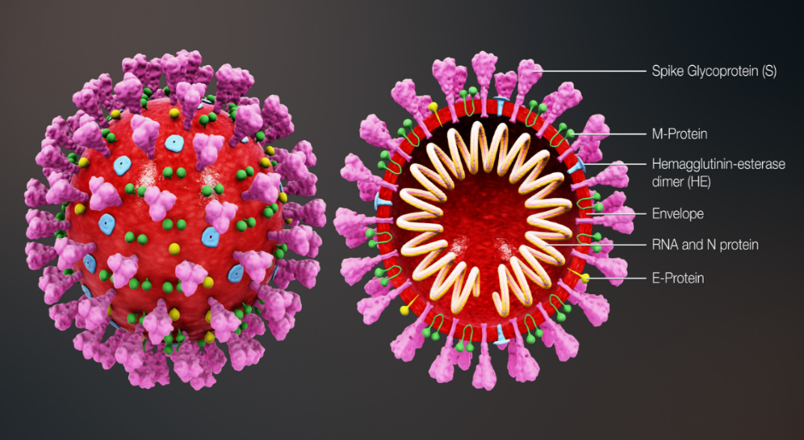
Coronavirus structure
The key parts of the coronavirus are the RNA and the spike proteins.
The RNA is surrounded by an envelope which has different roles in the life cycle of the virus. These may include the assembly of new virus and helping new virus to leave the infected cell.
The spike proteins (S) are anchored into the viral envelope and form a crown like appearance, like the solar corona, hence the name coronavirus. The spike proteins attach to the target cell and allow the virus to enter it.
The RNA is inside the envelope and acts as a template so that once it is inside the host cell, the coronavirus can replicate itself and be released into the body.
The spike protein and the RNA have been used to develop and make different vaccines to protect against SARS-CoV-2.
Notes:
Diagram of coronavirus virion structure showing spikes that form a ‘crown’ like the solar corona, hence the name
https://commons.wikimedia.org/wiki/File:3D_medical_animation_coronavirus_structure.jpg

Slide 13
Variants
All viruses change over time.
Mutations are changes to the genetic structure (RNA) of the virus and the means by which it adapts to survive.
Most mutations have little effect on the properties of the virus or its impact.
However, some mutations have the potential to:
  increase how easily the virus spreads
  cause more severe disease
  escape immunity (the immune response is in some way less effective)
  be less susceptible to the effects of the available vaccines, treatments or other public health and social measures
The original (sometimes termed wildtype or ancestral) SARS-CoV-2 virus has mutated, producing new variants, for example the Alpha, Delta, and Omicron variants.
Within a variant there may also be sub-variants, for instance, Omicron BA.1, BA.2, BA.3, BA.4 and BA.5.
Notes:
Mutations may not impact on all of the properties of the virus – for example, it may spread more easily (increased number of cases) but not necessarily cause more serious disease within the population, although certain individuals may be more vulnerable to serious illness.

Slide 14
Transmission of COVID-19 infection
For transmission to occur, the SARS-CoV-2 virus needs to be transported to a susceptible person. To do this, it needs to have:
a portal of exit (from the place where it is living and replicating)
a mode of transmission (such as coughing or sneezing) and
a portal of entry (to the susceptible host)
COVID-19 spreads primarily from person to person through small droplets from the nose or mouth which are expelled when a person with COVID-19 coughs, sneezes, or speaks.
Transmission within households, where there is unavoidable prolonged close contact, is high.
People can catch COVID-19 if they breathe in these droplets from a person infected with the virus
these droplets can also survive on objects and surfaces such as tables, doorknobs and handrails People can become infected by touching these objects or surfaces, then touching their eyes, nose or mouth, although this route now appears to play only a minor role in transmission
Notes:
Each new strain of the virus has been more infectious than its predecessor, that is has more easily been transmitted from person to person.

Slide 15
COVID-19 Chain of infection
Infectious microbe
SARS-CoV-2
Reservoir
Place where the virus lives and replicates: people, animals
Susceptible host
Non-immune person
The chain of infection refers to the interaction between the pathogen, the host and the environment
Portal of exit
How the virus leaves the reservoir
Mouth or nose through coughing, sneezing or talking
Portal of entry
Mucous membrane of the nose and mouth
Modes of transmission
Person to person, airborne, direct contact with virus on a contaminated surface

Slide 16
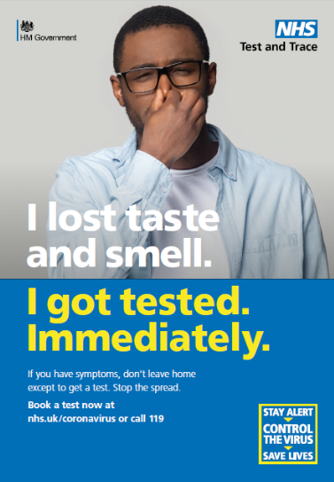
COVID-19 symptoms
The average incubation period is typically 5 to 6 days (range 1 to 11 days) but has been shorter for some variants. Transmission is greatest up to 2 days before a person develops symptoms and early in the illness. People who develop severe disease can be infectious for longer.
A wide range of symptoms have been reported. Symptoms may vary by age, and depending upon the variant which has caused the infection, but the commonly reported symptoms of coronavirus are:
a new and persistent cough
a high temperature (fever)/chills
sore throat
fatigue
headache
myalgia (aching muscles)
Other symptoms reported include:
a loss or change to sense of smell or taste; or things smell or taste different to normal*
shortness of breath
lethargy, heavy arms or legs
rhinorrhoea (runny nose)
nasal obstruction
diarrhoea and vomiting
confusion
Compared to previous variants, Omicron is less likely to cause loss of sense of smell (anosmia) and more likely to cause a sore throat.
Patients may be asymptomatic (have no symptoms)
Notes:
*Added to case definition 18 May 2020

Slide 17
COVID-19 symptom progression
Symptoms may begin gradually and are usually mild. In severe cases, COVID-19 can lead to pneumonia, acute respiratory distress syndrome, multiple organ failure and death.
The majority of people have mild or moderate disease and recover without needing hospital treatment. Some people may not develop any symptoms at all (asymptomatic).
Some people may get severe disease including pneumonia. Older people and those with underlying medical problems such as high blood pressure, heart and lung problems, diabetes, or cancer have an increased risk of severe disease.
Some people become critically unwell. This may include septic shock and/or multi-organ and respiratory failure. Although this cohort represents a relatively small percentage of the overall number of those infected, it is these individuals who require prolonged and intensive care and treatment if they are to recover.
Overall, the infection fatality rate (the proportion of deaths among all infected individuals) is estimated to be 0.9%. It is highest in those over 75 years of age.

Slide 18
Complications of COVID-19 disease
Complications from COVID-19 can be severe and fatal.
The risk of developing complications increases with age and is greater in those with underlying health conditions.
The type of complication that can develop may include:
venous thromboembolism
heart, liver and kidney problems
neurological problems
coagulation (blood clotting) failure
respiratory failure
multiple organ failure
septic shock
Notes:
Coronavirus disease 2019 (COVID-19) - Complications | BMJ Best Practice
Overview | COVID-19 rapid guideline: managing COVID-19 | Guidance | NICE

Slide 19
COVID-19 complications in pregnancy (1)
The serious risks posed to women who become infected with the SARS-CoV-2 virus during pregnancy have becoming increasingly clear as the COVID-19 pandemic has progressed.
Data from studies has shown that clinical outcomes following COVID-19 in pregnant women have worsened over the course of the pandemic as the variant has changed.
The maternal mortality ratio (number of maternal deaths during a given time period) as a result of COVID-19 significantly increased from 1.4 per 100,000 live births in the Wildtype SARS-CoV-2 dominant period to 5.4 per 100,000 live births in the Delta dominant period.
During the Delta dominant period, 6 neonatal deaths were recorded whereas no neonatal deaths were reported in previous waves.
The proportion of pregnant women hospitalised with symptomatic COVID-19 increased from Wildtype to subsequent Alpha and Delta dominant periods, and the proportion admitted to intensive care units also increased.
Notes:
Coronavirus disease 2019 (COVID-19) - Complications | BMJ Best Practice
Overview | COVID-19 rapid guideline: managing COVID-19 | Guidance | NICE
https://www.bmj.com/content/370/bmj.m3320

Slide 20
COVID-19 complications in pregnancy (2)
Pregnant and recently pregnant women with COVID-19 are more likely to be admitted to an intensive care unit, have invasive ventilation or extracorporeal membrane oxygenation (ECMO) in comparison to non-pregnant women of reproductive age.
Although the likelihood of these events has decreased since the Omicron strain achieved dominance, severity of COVID-19 infection remains higher in unvaccinated than vaccinated pregnant women.
UK studies have suggested a high rate of stillbirth in infected women and this appears to have increased during the Delta period.
Transmission of infection from mother to infant appears rare. However, the risk of preterm birth is increased two to threefold for women with symptomatic COVID-19, usually as a result of a medical recommendation to deliver early to improve maternal oxygenation.
Pregnant women are more likely to have severe COVID-19 infection if they are overweight or obese, are of black and asian minority ethnic background, have co-morbidities such as diabetes, hypertension and asthma, or are 35 years old or older.
Notes:
Coronavirus disease 2019 (COVID-19) - Complications | BMJ Best Practice
Overview | COVID-19 rapid guideline: managing COVID-19 | Guidance | NICE
https://www.bmj.com/content/370/bmj.m3320

Slide 21
Children and young people
Children are at low overall risk from the complications of COVID-19 infection; severe COVID-19 requiring hospitalisation and deaths are rare in children. The majority of children recover completely, any persistent symptoms improve with time and serious long-term complications are rare. Longitudinal follow-up studies are ongoing to assess risks and outcomes in children.
Children with underlying medical conditions such as immunosuppression, haematological malignancy, Sickle cell disease, Type 1 diabetes, congenital heart disease, severe neuro-disabilities, Down’s Syndrome, profound and multiple learning disabilities and severe learning disabilities are more at risk of being admitted and/ or requiring intensive care.
A 2020 multi-centre studied showed that:
children and young people who were admitted to hospital presented with fever (70%), cough (39%) nausea/vomiting (32%), and shortness of breath (30%). Fever and rhinorrhoea were less common with increasing age; however, nausea and vomiting, abdominal pain, headache and sore throat showed an increasing trend with age
cardiac complications were documented in 57% of cases myocarditis (heart failure)
The case fatality rate was around 1%.
Notes:
Clinical characteristics of children and young people admitted to hospital with covid-19 in United Kingdom: prospective multicentre observational cohort study | The BMJ
Although children are at low overall risk from the complications of COVID-19 infection, and severe COVID-19 requiring hospitalisation is rare in children and deaths even more so, children with underlying medical conditions such as immunosuppression, haematological malignancy, Sickle cell disease, Type 1 diabetes, congenital heart disease, severe neuro-disabilities, Down’s Syndrome, profound and multiple learning disabilities and severe learning disabilities are more at risk of being admitted and/ or requiring intensive care.

Slide 22
Complications from COVID-19 in children and young people
An extremely rare but severe multisystem inflammatory syndrome occurring 2 to 4 weeks after the onset of COVID-19 has been identified in children and adolescents.
Known as ‘Paediatric multisystem inflammatory syndrome temporally associated with SARS-CoV-2 infection’ (PIMS-TS), this severe presentation in children is extremely rare, but appears to encompass a wide range of features, including fever, gastrointestinal symptoms, rash, myocardial injury and shock.
PIMS-TS shares features with Kawasaki disease and toxic shock syndrome and can present in both the acute and convalescent phases of COVID-19 infection.
Of the children admitted to hospital, 18% required critical care. This was associated with:
  age, particularly for those less than one month old and for those age 10 to 14 years
  black ethnicity
  admission to hospital for more than 5 days before symptom onset
Notes:
MIS-C shares features with Kawasaki disease and toxic shock syndrome and can present in both the acute and convalescent phases of COVID-19 infection.
https://bestpractice.bmj.com/topics/en-us/3000168/complications

Slide 23
Long COVID
For some people, COVID-19 can cause symptoms that last weeks or months after the infection has gone. This is sometimes called post-acute sequelae of SARS-CoV-2 (PASC) or ‘long COVID’.
Although many people feel better in a few days or weeks and most will make a full recovery within 12 weeks, for some people, symptoms can last longer.
Study findings from the National Institute for Healthcare Research reported in June 2021, showed that over a third of people who tested positive for COVID-19 had symptoms that lasted for 12 weeks or longer (long COVID) and around one in 10 people reported severe long COVID symptoms.
Notes:
Up to one in 3 people who have had COVID-19 report long COVID symptoms | NIHR

Slide 24
Symptoms of Long COVID
The most commonly reported symptoms are:
extreme tiredness (fatigue)
shortness of breath
Other common symptoms include:
chest pain or tightness
problems with memory and concentration
difficulty sleeping
heart palpitations
dizziness
pins and needles
joint pain and muscle aches
depression and anxiety
tinnitus, earaches
feeling sick, diarrhoea, stomach aches, loss of appetite
a high temperature, cough, headaches, sore throat, changes to sense of smell or taste
rashes
Notes:
Reported long-term symptoms (12-16 weeks after the initial infection) are varied, involving most organ systems and affecting both physical and mental health.

Slide 25
Long COVID risk: contributory factors
Increasing age is an important factor.
Women, people who are overweight or obese, and those who smoke, live in deprived areas, or have been admitted to hospital with COVID-19 have also been reported in studies as being at greater risk.
There is still a lot to learn about long COVID and how to effectively manage it. In the UK, NHS clinics have been set up to assess long-term post-COVID-19 effects; it is an area of ongoing study.
A review conducted by the UKHSA found that having COVID-19 vaccine reduces the chances of having long COVID.
Notes:
UKHSA review shows vaccinated less likely to have long COVID than unvaccinated - GOV.UK (www.gov.uk)
There is still a lot to learn about long COVID and how to effectively manage it. In the UK, 80 NHS clinics have been set up so far to assess long-term post-COVID-19 effects. Additionally, in December2020, the National Institute for Health and Care Excellence (NICE) in partnership with the Scottish Intercollegiate Guidelines Network and the Royal College of General Practitioners published a guideline for clinicians on the management and care of people with long-term effects of COVID-19.

Slide 26
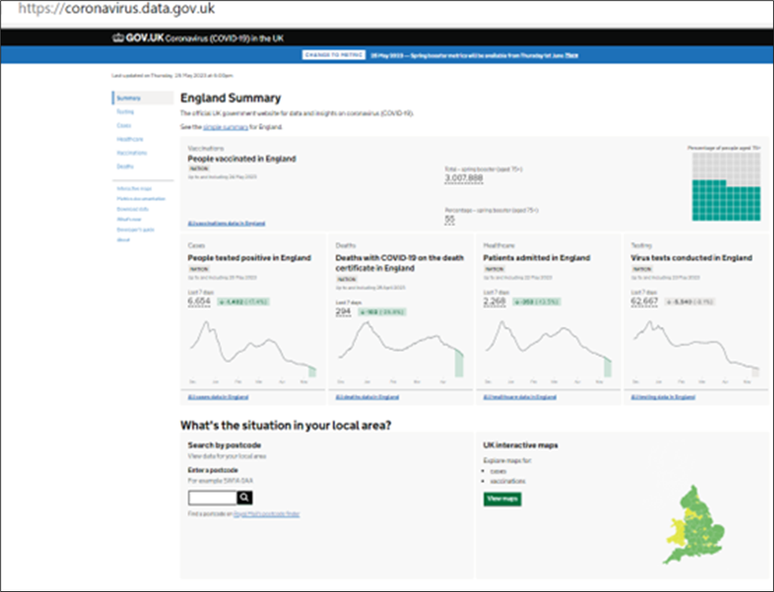
COVID-19 epidemiology
The current UK epidemiology can be seen on the GOV.UK website at Coronavirus data
This UK COVID-19 dashboard shows current
trend information for:
virus testing
people tested positive (new cases and reinfections) including geographical and demographic data
deaths within 28 days of positive test
death from COVID-19 on death certificate
patients admitted
patients in hospital
patients in ventilator beds
number of people given first, second and
booster doses of vaccine

Slide 27
COVID-19 vaccine taskforce
It quickly became apparent that as the majority of the population was susceptible (non-immune) to the SARS-CoV-2 virus and the virus spreads easily, a safe and effective vaccine delivered in a carefully thought-out and well-designed programme was needed in order to protect those most at risk from serious illness or death from COVID-19.
A COVID-19 vaccine prepares the immune system so that in the event of an exposure to the virus, it is able to respond and prevent or reduce the severity of infection
During April 2020, a UK vaccine taskforce was set up to support the development of a SARS-CoV-2 vaccine; the taskforce supported research and industry to rapidly develop and scale up the manufacture of a vaccine to protect the population.
Notes:
The VTF function has now been absorbed into UKHSA

Slide 28
COVID-19 vaccine development
Scientists, industry and other organisations have worked collaboratively across the globe to complete the different phases of vaccine development in parallel, rather than sequentially, to make a safe and effective vaccine available as soon as possible.
By knowing the genetic code for the SARS-CoV-2 virus, various methods to create vaccines can be used such as using the code itself (mRNA vaccines) or inserting part of this code into existing viruses (viral vector vaccines).
At one time, over 300 different COVID-19 vaccines were in development, in trials or in use.
Some vaccines have been made using currently used vaccine technology, others have been made using new approaches or methods used during previous emergencies such as the SARS pandemic and west African Ebola.
Notes:
For more information about COVID-19 vaccines in development, see the LSHTM COVID-19 vaccine tracker https://vac-lshtm.shinyapps.io/ncov_vaccine_landscape/.

Slide 29
Properties of an ideal vaccine
Ideally, a vaccine will:
produce the same immune protection which usually follows natural infection but without causing disease
generate long lasting immunity so that the person is protected if they are exposed to the antigen several years after vaccination
interrupt the spread of infection by preventing carriage of the organism in the vaccinated person
Vaccines need to be safe and the risk from any side effects should be much lower than the benefit of preventing deaths and serious complications of the disease.
For the COVID-19 vaccines, many of these properties can be confirmed from the clinical vaccine trials.
Longer term ongoing surveillance of the disease and of those vaccinated is informing:
how long vaccine protection is lasting and the need for booster doses
how well the vaccines protect against variants, serious illness, hospitalisation
Notes:
An antigen is any substance which the immune system perceives as being foreign or dangerous and activates it to produce antibody.

Slide 30
Stages of vaccine trials
Vaccines are extensively tested through several different phases of trials:
Pre-clinical studies using tissue-culture, cell-culture or animal studies. At this stage, safety and immunogenicity (the ability of the vaccine to produce an immune response) are assessed. If pre-clinical studies are successful, the vaccine then goes through several different phases of vaccine trials in humans.
Phase 1 clinical trials are small-scale trials in healthy adult volunteers (generally 20 to 100) to assess whether the vaccine is safe in humans and type and extent of immune response it induces .
Phase 2 clinical trials are larger (several hundred healthy volunteers) and usually carried out in the target age group(s) the vaccine is likely to be used in. They are looking mainly to assess the efficacy of the vaccine against artificial infection and clinical disease. Vaccine safety, side-effects and immune response are also studied.
Phase 3 clinical trials involve the vaccine being studied on a large scale in many hundreds or thousands of subjects across several sites to evaluate efficacy under natural disease conditions and make sure that there are no unintended side effects not detected in Phase 2 studies.
Notes:
The COVID vaccines have been rigorously tested for safety and efficacy and have been through all of these phases. However, rather than running these sequentially, some of the phases have been run in parallel in order to expediate vaccine production and protection of the population.

Slide 31
Safety (1)
Before any of the COVID-19 vaccines can be authorised for widespread use in the population, the manufacturers have to demonstrate that they are safe and effective.
Tens of thousands of people across the world received COVID-19 vaccines in clinical trials.
No serious adverse reactions to the vaccines were seen in the trial participants who received them: any reactions reported were similar to those seen following other vaccines such as pain and tenderness at the injection site and fever, headache, muscle aches and fatigue.
Post-marketing safety monitoring: once vaccines are authorised and in use, the MHRA continually monitors their safety to ensure that the benefits continue to outweigh any risks (post-marketing).
Any reported adverse reactions are thoroughly investigated and the MHRA work with their international equivalent agencies to rapidly share safety data and reports.
31

Slide 32
Safety (2)
When vaccines are being given to huge numbers of people, it is normal for potential adverse events following immunisation to occur which were not seen in clinical trials.
This does not necessarily mean that the events are linked to the vaccination itself, but they are investigated to ensure that any safety concerns are addressed quickly.
If it is thought that the adverse event may be, or is linked to vaccination, advice about use of that vaccine is carefully considered.
For example, following widespread use of the AstraZeneca COVID-19 vaccination, a rare condition involving serious thromboembolic (blood clotting) events accompanied by thrombocytopaenia (low platelets) was reported. After thorough assessment of the overall risk benefit of the use of the AstraZeneca vaccine in the UK population, the JCVI advised that adults aged under 40 without underlying health conditions that put them at higher risk of severe COVID-19 disease, should be offered an alternative COVID-19 vaccine to the AstraZeneca vaccine.
Other conditions (such as Guillain-Barré syndrome, myocarditis, pericarditis, transverse myelitis and capillary leak syndrome) have also been reported and investigated.
Notes:
In extensive vaccination campaigns such as the COVID-19 vaccination programme when vaccines are being given to huge numbers of people, it is normal for potential adverse events following immunisation to occur which were not seen in clinical trials. This does not necessarily mean that the events are linked to vaccination itself, but they must be investigated to ensure that any safety concerns are addressed quickly.

Slide 33
Effectiveness
Manufacturers of the COVID-19 vaccines need to show evidence that they will be effective by:
showing a reduction in virus levels in animal studies where the vaccines were used and that people in the trials have made an antibody response to the vaccine
comparing the number of cases of COVID-19 disease in trial participants who received the COVID-19 vaccine with the number of trial participants who received the placebo or alternative (non-COVID-19) vaccine
Those running clinical trials may look at antibody response:
      after one dose, 2 doses, booster doses
      at different dosages of the vaccine and different vaccine combinations
      with different time intervals between vaccine doses
      in different age groups
Over time, they also look at:
how long the antibodies last and the effect on antibody levels if a booster dose is given
whether the vaccine only stops people from becoming severely ill or if it also stops them spreading the virus too

Slide 34
Real world effectiveness (1)
The impact and effectiveness each vaccine and of the programme overall, on symptomatic disease, hospitalisation, death and infection rates is being actively and continuously monitored; the JCVI uses this data to inform their recommendations about changes to the programme.
As at 24 September 2021, the COVID-19 vaccination programme had been estimated to have prevented over 24.4 million infections and 127,500 deaths in the UK, and over 261,500 hospitalisations in England in those aged 45 years and over.
COVID-19 vaccine effectiveness for preventing symptomatic disease with the Delta variant following 2 doses is estimated at between 65 to 95%, with higher levels of protection against severe disease including hospitalisation and death.
Effectiveness against symptomatic disease of the primary course appears to wane over time, particularly in older adults and those with underlying medical conditions; however, overall, vaccine effectiveness against severe outcomes such as hospital admission remains high for several months.
A completed primary course of vaccine was found to greatly reduce the risk of severe illness and hospitalisation it was less effective at preventing infection caused by the heavily mutated Omicron variant and protection declined to very low levels 6 months after the primary course.
Notes:
Further information about this can be found at https://www.gov.uk/guidance/monitoring-reports-of-the-effectiveness-of-covid-19-vaccination
Lopez Bernal J and others. ‘Early effectiveness of COVID-19 vaccination with BNT162b2 mRNA vaccine and ChAdOx1 adenovirus vector vaccine on symptomatic disease, hospitalisations and mortality in older adults in England’ https://www.medrxiv.org/content/10.1101/2021.03.01.21252652v1
Hall VJ and others. ‘Effectiveness of BNT162b2 mRNA Vaccine Against Infection and COVID-19 Vaccine Coverage in Healthcare Workers in England, Multicentre Prospective Cohort Study (the SIREN Study)’ Available at SSRN: https://ssrn.com/abstract=3790399 or http://dx.doi.org/10.2139/ ssrn.3790399
Harris RJ and others. ‘Impact of vaccination on household transmission of SARS-COV-2 in England’ https://khub.net/documents/135939561/390853656/Impact+of+vaccination+on+household+transmission+of+SARS-COV-2+in+England.pdf/35bf4bb1-6ade-d3eb-a39e-9c9b25a8122a?t=1619601878136
Shrotri M and others. ‘Vaccine effectiveness of the first dose of ChAdOx1 nCoV-19 and BNT162b2 against SARS-CoV-2 infection in residents of Long-Term Care Facilities (VIVALDI study)’ medRxiv [preprint], doi: 10.1101/2021.03.26.21254391
Shah A and others. ‘Effect of vaccination on transmission of COVID-19: an observational study in healthcare workers and their households’ View ORCID Profile doi: https://doi.org/10.1101/2021.03.11.2125 3275

Slide 35
Real world effectiveness (2)
The JCVI therefore recommended that reinforcing (‘first booster’) doses were introduced from autumn 2021, at least 3 months after completion of the primary course, in order to improve both the quality and quantity of antibodies made as well as boosting the T-cell response; this booster programme provided high levels of protection against severe disease (from both Delta and Omicron variants) across the population:
  vaccine effectiveness data for Omicron confirms that protection against symptomatic disease soon after an mRNA booster dose increases to around 70-75% regardless of which vaccines were given for the primary course; however, more recent analysis confirms that protection after an mRNA booster has declined substantially by 3 months after the dose was given
  protection against hospitalisation after an mRNA booster reaches over 90% in the 2 weeks after vaccination but also declines over time
In response to these findings, additional booster doses have been advised for the groups most at risk of severe illness.
Notes:
Further information about this can be found at https://www.gov.uk/guidance/monitoring-reports-of-the-effectiveness-of-covid-19-vaccination
Lopez Bernal J and others. ‘Early effectiveness of COVID-19 vaccination with BNT162b2 mRNA vaccine and ChAdOx1 adenovirus vector vaccine on symptomatic disease, hospitalisations and mortality in older adults in England’ https://www.medrxiv.org/content/10.1101/2021.03.01.21252652v1
Hall VJ and others. ‘Effectiveness of BNT162b2 mRNA Vaccine Against Infection and COVID-19 Vaccine Coverage in Healthcare Workers in England, Multicentre Prospective Cohort Study (the SIREN Study)’ Available at SSRN: https://ssrn.com/abstract=3790399 or http://dx.doi.org/10.2139/ ssrn.3790399
Harris RJ and others. ‘Impact of vaccination on household transmission of SARS-COV-2 in England’ https://khub.net/documents/135939561/390853656/Impact+of+vaccination+on+household+transmission+of+SARS-COV-2+in+England.pdf/35bf4bb1-6ade-d3eb-a39e-9c9b25a8122a?t=1619601878136
Shrotri M and others. ‘Vaccine effectiveness of the first dose of ChAdOx1 nCoV-19 and BNT162b2 against SARS-CoV-2 infection in residents of Long-Term Care Facilities (VIVALDI study)’ medRxiv [preprint], doi: 10.1101/2021.03.26.21254391
Shah A and others. ‘Effect of vaccination on transmission of COVID-19: an observational study in healthcare workers and their households’ View ORCID Profile doi: https://doi.org/10.1101/2021.03.11.2125 3275

Slide 36
Post authorisation surveillance
On-going studies of vaccines continue after the vaccine has been authorised for use. These studies aim to assess long term efficacy and to detect any rare adverse effects because in real life administration, compared to pre-licensure trials, there will be:
some variability in preparation of the vaccine as vaccines will come from different batches
possible variability in stability and storage, for example the cold chain may not be as rigidly maintained in practice as it was in a clinical trial
use of the vaccines in different groups than in pre-authorisation studies, for example they will be given to people with underlying medical conditions who would not necessarily have been included in a pre-licensure/pre-authorisation clinical trial
mutations in the virus which may result in the vaccine being less effective

Slide 37
Variant vaccines
As the virus has evolved, many vaccine manufacturers have rapidly developed second generation vaccines that may have broader coverage against SARS-CoV-2 variants.
Most have been developed as boosters and have either replaced the spike protein from the original vaccine strain with another strain or have developed a bivalent formulation containing spike protein sequences from both the original (also called ancestral or wild type) strain and a newer variant.
Those which use a well-established format, such as mRNA vaccines, have been licensed on the basis of immunobridging – the effectiveness of the most recent version of the vaccine is inferred by comparing its immunogenicity with the immune responses to the previous version for which vaccine efficacy had already been established.

Slide 38
Regulatory approval and licencing
When a vaccine has been shown to be safe and effective in clinical trials, the manufacturer has to apply to the medical regulatory authorities for approval and a licence to market the product (this is usually referred to as ‘Marketing Authorisation’).
In the UK, the regulatory authority is the Medicines and Healthcare products Regulatory Agency (MHRA).
In arriving at its decision, the MHRA assesses all of the available safety, quality and efficacy data and considers whether the evidence supports the vaccine being granted a licence.
Notes:
An SPC provides a description of a medicine or vaccine product’s properties and the officially approved conditions attached to its use. It is written for healthcare professionals and explains how to use and prescribe the medicine/vaccine.
The PIL is the leaflet included in the pack with a medicine or vaccine. It is written for patients and gives information about taking or using a medicine

Slide 39
COVID-19 vaccines (1)
The following vaccines have been licensed by the MHRA for use in the UK and are currently being supplied for providers to administer:
COVID-19 Vaccine Pfizer-BioNTech Comirnaty bivalent Original/Omicron BA. 4-5 (15/15 micrograms)/dose
This is a bivalent mRNA vaccine licensed and recommended for primary and booster doses for eligible individuals aged 12 years and above. Comirnaty bivalent Original/Omicron BA.1 (15/15 micrograms)/dose may alternatively be supplied.
COVID-19 Vaccine Pfizer-BioNTech Comirnaty 10 micrograms/dose
This is a monovalent mRNA vaccine licensed and recommended for primary and booster doses for eligible individuals from 5 to 11 years of age, and for completing primary doses for eligible individuals aged 12 years old who commenced primary vaccination when aged 11.
COVID-19 vaccine Pfizer BioNTech Comirnaty 3 micrograms/ dose
This is a monovalent mRNA vaccine licensed for primary doses for children aged 6 months to 4 years but recommended only for primary doses for individuals of this age who are in a clinical risk group. This programme will commence in June 2023.
Notes:
https://www.gov.uk/government/publications/regulatory-approval-of-pfizerbiontech-bivalent-originalomicron-booster-vaccine
https://www.gov.uk/government/publications/regulatory-approval-of-pfizer-biontech-vaccine-for-covid-19

Slide 40
COVID-19 vaccines (2)
COVID-19 Vaccine Moderna Spikevax bivalent Original/Omicron BA.4-5 (25/25 micrograms)/dose
This is a bivalent mRNA vaccine for booster doses for individuals aged 12 years and above but is recommended for primary and booster doses only for eligible individuals aged 18 years and above. Spikevax bivalent Original/Omicron BA.1 (25/25 micrograms)/dose may alternatively be supplied.
COVID-19 vaccine Sanofi VidPrevtyn Beta
This is a monovalent recombinant adjuvanted vaccine licensed for booster doses for individuals aged 18 years and above but is recommended for booster doses only for eligible individuals aged 75 years and above and, in defined operational circumstances, for some eligible individuals aged 65 years and above.
Note that for operational reasons, some JCVI recommended vaccines may not be made available for all indications at every vaccination venue.
Notes:
https://www.gov.uk/government/publications/regulatory-approval-of-spikevax-bivalent-originalomicron-booster-vaccine
https://www.gov.uk/government/publications/regulatory-approval-of-covid-19-vaccine-vidprevtyn-beta
Not all products that are licensed are marketed/ supplied in the UK. The 5 other vaccines which have received MHRA licences for use in the UK are:
COVID-19 vaccine Novavax (Nuvaxovid) - Regulatory approval of COVID-19 vaccine Nuvaxovid - GOV.UK (www.gov.uk) (no longer supplied)
COVID-19 Vaccine AstraZeneca (Vaxzervria) - Regulatory approval of COVID-19 Vaccine AstraZeneca - GOV.UK (www.gov.uk) (no longer supplied)
COVID-19 Vaccine Janssen - Regulatory approval of COVID-19 Vaccine Janssen - GOV.UK (www.gov.uk) (never supplied)
COVID-19 Vaccine Valneva - Regulatory approval of COVID-19 Vaccine Valneva - GOV.UK (www.gov.uk) (never supplied)
COVID-19 vaccine SKYCovion - Regulatory approval of COVID-19 Vaccine SKYCovion - GOV.UK (www.gov.uk) (newly licensed, not supplied)

Slide 41
mRNA COVID-19 vaccines (Pfizer BioNTech and Moderna)
The Pfizer BioNTech (Comirnaty branded) and Moderna (Spikevax branded) COVID-19 vaccines are messenger ribonucleic acid (mRNA) vaccines.
They contain the genetic sequence (mRNA) for the spike protein which is found on the surface of the SARS-CoV-2 virus, wrapped in a lipid envelope (referred to as a nanoparticle) to enable it to be transported into the cells in the body:
the Comirnaty 10 micrograms/dose and Comirnaty 3 (THREE) micrograms/dose vaccines are monovalent: they contain only the mRNA that encodes for the spike protein of the original (wildtype) virus
Comirnaty Original/Omicron BA.4-5 (15/15 micrograms/dose) and Spikevax bivalent Original/Omicron BA.4-5 (25/25 micrograms)/dose and Comirnaty Original/Omicron BA.1 (15/15 micrograms/dose) and Spikevax bivalent Original/Omicron BA.1 (25/25 micrograms)/dose are bivalent: they contain mRNA that encodes for the spike protein of the original (wildtype) virus and mRNA that encodes for the spike protein of the BA.4-5 (or BA.1) sub-lineage of the Omicron variant
When injected, the mRNA is taken up by the host’s cells which translate the genetic information and produce the spike proteins; these are then displayed on the surface of the cell.
This stimulates the immune system to produce antibodies and activate T-cells which prepare the immune system to respond to any future exposure to the SARS-CoV-2 virus by binding to and disabling any virus encountered.
As there is no whole or live virus involved, the vaccine cannot cause disease. The mRNA naturally degrades after a few days.

Slide 42
Recombinant adjuvanted vaccine (Sanofi)
VidPrevtyn Beta contains a laboratory produced form of the SARS-CoV-2 spike protein which stimulates the immune response, and an adjuvant to help strengthen that response.
Using recombinant DNA technology the vaccine is produced from the spike (S) surface protein on the Beta variant (B.1.351 strain) of the SARS-CoV-2 virus. The genes (DNA) that encode for the S protein are inserted into bacterial cells in the laboratory and the S protein is expressed and purified to produce the antigen component of the vaccine.
The vaccine uses the AS03 adjuvant system which helps to modulate and therefore further enhance the immune response.
When administered, the antigen in the vaccine stimulates the immune system which reacts by producing antibodies and activating memory T cells to the virus without causing disease. If the virus is later encountered, the immune system should be able to respond rapidly.

Slide 43
Key factors that inform UK vaccination policy
The Joint Committee on Vaccines and Immunisation (JCVI) consider the following before making vaccination policy recommendations to the Department of Health and Social Care (DHSC):
1. Availability of a safe and effective vaccine:
  at one time, over 300 different COVID-19 vaccines were in development, in trials or in use
  vaccines undergo extensive and vigorous testing before they are licensed and authorised for use as they have to be able to demonstrate quality, efficacy and safety
2. Whether there is a need for a vaccination programme:
  SARS-CoV-2 has caused a significant public health problem, transmission is widespread and has been sustained despite various interventions
  the virus affects all age groups and there have been frequent outbreaks in nursing and residential homes, schools and communities
  there is significant morbidity and mortality in certain groups. There are multi-system complications from having the disease and there have been over 220,000 deaths from COVID-19 in the UK

Slide 44
Designing and implementing a vaccination programme
Key national bodies involved in the design and implementation of vaccination programmes include:
Department of Health and Social Care (DHSC) – responsible for vaccine policy decisions and finance for vaccine programmes
Medicines and Healthcare products Regulatory Agency (MHRA) – responsible for independent oversight of all aspects of vaccine manufacture and regulation including the licensing of vaccines and the Yellow Card adverse event reporting scheme
UK Health Security Agency (UKHSA) – responsible for the national planning, leadership, procurement and supply of vaccines used for the national vaccination schedule and for on-going surveillance to inform the programmes
National Institute for Biological Standards and Control (NIBSC) – responsible for evaluating the quality and biological activity of vaccines and for official batch release testing before release
NHS England – responsible for the commissioning, implementation and delivery of immunisation programmes through local teams
Notes:
NIBSC is now part of the MHRA

Slide 45
Other agencies
Many other agencies have a key role in the design, development and implementation of vaccination programmes at a national, regional and local level to ensure the key components of a successful vaccination programme come together.
These components include:
vaccine development
vaccine supply and delivery
surveillance of vaccine coverage
surveillance of population susceptibility to the disease
surveillance of disease in the population
adverse events and vaccine safety surveillance
monitoring attitudes to vaccination
communication
modelling to predicting the future impact of vaccination programmes

Slide 46
COVID-19 vaccine programme considerations
The overall aim of the COVID-19 vaccination programme is to protect those who are at most risk from serious illness or death.
In order to advise which groups of patients to vaccinate and in which order to prioritise vaccination of these groups, the JCVI considered all the available relevant information on:
vaccine efficacy and/or immunogenicity and the safety of administration in different age and risk groups
the effect of the vaccine on acquisition of infection and transmission
the epidemiological, microbiological and clinical characteristics of COVID-19
From this, they then made recommendations to the DHSC and planning to deliver vaccine and maximise uptake in these groups began.
Notes:
The COVID-19 vaccination programme has been implemented via a number of primary vaccination phases and booster campaigns since December 2020.
All staff involved in delivering the programme need to understand who is eligible to receive COVID-19 vaccination and the reasons why. Knowledge of the progression of the programme from its commencement will assist staff when deciding the requirements for each individual in their care.
At its commencement on December 8th, 2020, the main objective of the COVID-19 pandemic immunisation programme was to protect those who were at highest risk from serious illness or death.

Slide 47
Priority groups for COVID-19 vaccination
JCVI made recommendations as to how COVID-19 vaccine should be offered by identifying the priority groups for vaccination and the order in which they should be vaccinated.
Prioritisation ensured that those at highest risk of severe illness and death were offered vaccine early, as were those at risk of transmitting infection to multiple vulnerable persons or other staff in a health or social care setting.
The priority groups were selected based on the epidemiology of the infection observed since the start of the pandemic: their risk of severe disease, mortality and other considerations such as ethnicity, deprivation and occupation:
  evidence from the UK indicated that the risk of poorer outcomes from COVID-19 infection increased dramatically with age in both healthy adults and in adults with underlying health conditions
  those over the age of 65 years had by far the highest risk, and the risk increased with age
Full details on vaccine eligibility, with detail on the at-risk conditions, are included in the Green Book COVID-19 chapter.
Notes:
JCVI advised that the first priorities for the COVID-19 vaccination programme should be the prevention of mortality and the maintenance of the health and social care systems. As the risk of mortality from COVID-19 increased with age, prioritisation was primarily based on age. The order of priority for each group in the population corresponded with data on the number of individuals who would need to be vaccinated to prevent one death, estimated from UK data obtained from March to June 2020

Slide 48
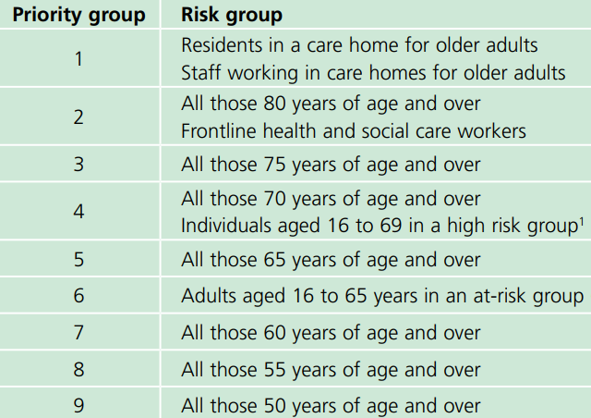
Vaccine priority groups: Phase 1
¹ Previously known as clinically extremely vulnerable
Notes:
Phase 1
In Phase 1 the focus was primary immunisation of those at greatest risk of COVID-19 specific mortality (priority groups 1 -9)
All individuals, in descending order of priority, were offered a first primary dose of vaccination and then a second primary dose 8 weeks later.
JCVI advice 30 December 2020 available at:
https://www.gov.uk/government/publications/priority-groups-for-coronavirus-covid-19-vaccination-advice-from-the-jcvi-30-december-2020/joint-committee-on-vaccination-and-immunisation-advice-on-priority-groups-for-covid-19-vaccination-30-december-2020
It is estimated that taken together, these groups represent around 99% of preventable mortality from COVID-19.
Further recommendations followed regarding the inclusion of additional groups, the number of doses required and first booster doses.
In July 2021, the JCVI published an additional statement on COVID-19 vaccination of children and young people aged 12 to 17 years. This was updated in August with a recommendation to offer a first dose of the Pfizer-BioNTech vaccine to all 16 and 17 year olds.
In September 2021, further recommendations were made to offer 3rd doses to those who were immunosuppressed at the time of their first or second vaccine, and to offer a first dose of Pfizer vaccine to all children from 12 years of age.
This was followed in mid-November 2021 with a recommendation to give a second dose of Pfizer vaccine to young people aged 16 and 17 years.
At the end of November 2021, in response to the recognition of the Omicron variant, the JCVI advised that 12 to 15 year olds should be offered a second dose of vaccine 12 weeks after their first.
In December 2021, following the recognition of pregnancy as a risk factor for severe COVID-19 infection and poor pregnancy outcomes during the Delta wave, pregnancy (at all ages and all trimesters) was added to the clinical risk groups.
On 22 December 2021, the JCVI advised hyperlink to: https://www.gov.uk/government/publications/jcvi-update-on-advice-for-covid-19-vaccination-of-children-and-young-people/jcvi-statement-on-covid-19-vaccination-of-children-and-young-people-22-december-2021 that children aged 5 to 11 years who are in a recognised clinical risk group or who are a household contact of someone who is immunosuppressed should be offered two 10 microgram doses of the Pfizer-BioNTech Comirnaty 10 Concentrate vaccine
In February 2022, the JCVI recommended a one-off, non-urgent programme to offer COVID-19 vaccination to all children aged 5 to 11 years of age (hyperlink to www.gov.uk/government/publications/jcvi-update-on-advice-for-covid-19-vaccination-of-children-aged-5-to-11/jcvi-statement-on-vaccination-of-children-aged-5-to-11-years-old ) Select the JCVI recommendations tab to continue.

Slide 49
Vaccine priority groups: Phase 2
In Phase 2 the focus was primary immunisation to protect those at risk from serious illness or death, and to protect the NHS by reducing the risks of hospitalisation and critical care admission.
This involved the extension of primary vaccination – in descending order of age to all adults (from June 2021), then to children and young people aged 5 years in clinical risk groups and then to all children aged 5 years and above with no underlying disease – whilst, at the same time, continuing efforts to maximise coverage and complete delivery of second doses amongst those prioritised in Phase 1 but who remained un- or only partially vaccinated.
As there was evidence of an increased risk of hospitalisation in males, those from certain ethnic minority backgrounds, those who are obese or morbidly obese, and those from socio-economically deprived areas, JCVI advised that specific focus should be used to promote and deliver vaccination to these groups.
Eligible individuals who were immunosuppressed at, or around the time of their first, second or both primary doses were (and continue to be) additionally offered a 3rd primary dose to maximise their primary immune response.
Notes:
In July 2021, the JCVI published an additional statement on COVID-19 vaccination of children and young people aged 12 to 17 years. This was updated in August with a recommendation to offer a first dose of the Pfizer-BioNTech vaccine to all 16 and 17 year olds.
In September 2021, further recommendations were made to offer 3rd doses to those who were immunosuppressed at the time of their first or second vaccine, and to offer a first dose of Pfizer vaccine to all children from 12 years of age.
This was followed in mid-November 2021 with a recommendation to give a second dose of Pfizer vaccine to young people aged 16 and 17 years.
At the end of November 2021, in response to the recognition of the Omicron variant, the JCVI advised that 12 to 15 year olds should be offered a second dose of vaccine 12 weeks after their first.
In December 2021, following the recognition of pregnancy as a risk factor for severe COVID-19 infection and poor pregnancy outcomes during the Delta wave, pregnancy (at all ages and all trimesters) was added to the clinical risk groups.
On 22 December 2021, the JCVI advised hyperlink to: https://www.gov.uk/government/publications/jcvi-update-on-advice-for-covid-19-vaccination-of-children-and-young-people/jcvi-statement-on-covid-19-vaccination-of-children-and-young-people-22-december-2021 that children aged 5 to 11 years who are in a recognised clinical risk group or who are a household contact of someone who is immunosuppressed should be offered two 10 microgram doses of the Pfizer-BioNTech Comirnaty 10 Concentrate vaccine
In February 2022, the JCVI recommended a one-off, non-urgent programme to offer COVID-19 vaccination to all children aged 5 to 11 years of age (hyperlink to www.gov.uk/government/publications/jcvi-update-on-advice-for-covid-19-vaccination-of-children-aged-5-to-11/jcvi-statement-on-vaccination-of-children-aged-5-to-11-years-old )
Individuals in both phases who have not yet been vaccinated remain eligible for vaccination until 30th June 2023.

Slide 50
Older adults resident in a care home
There is clear evidence that those living in residential care homes for older adults have been disproportionately affected by COVID-19.
Those living in care homes have a high risk of exposure to infection due to their close contact with staff (including bank staff) and other residents including those residents returning to the care home from hospital.
The closed setting of the care home also increases the risk of outbreaks occurring as any asymptomatic residents and staff could be potential reservoirs for on-going transmission.
Given the increased risk of outbreaks, morbidity and mortality in these closed settings, older adults in care homes are considered to be at very high risk.
JCVI have consistently advised that vaccination of care home residents should be the highest priority for vaccination; they were offered an additional booster during the spring 2022, and autumn 2022 booster campaigns, are eligible for the current spring 2023 booster dose.
Vaccination of residents and staff at the same time is considered to be a highly efficient strategy within a mass vaccination programme with the greatest potential impact; care home staff were included in the Phase 1 priority groups and offered an additional booster in autumn 2022.

Slide 51
Older adults
Older adults are considered to be at very high risk if they develop COVID-19 infection.
Evidence strongly indicates that the single greatest risk of mortality from COVID-19 is increasing age and that the risk increases exponentially with age.
Disease severity, risk of hospitalisation and mortality increase from age 50 upwards, with the highest risk in those aged 80 years and above.
Data indicates that the absolute risk of mortality is higher in those over 65 years than that seen in the majority of younger adults with an underlying health condition.
Individuals aged 75 and above were offered an additional booster during the spring 2022, and autumn 2022 booster campaigns, are eligible for the current spring 2023 booster dose.
Notes:
Vivaldi 1: COVID-19 care homes study report
Investigation of SARS-CoV-2 outbreaks in 6 care homes in London, April 2020

Slide 52
Groups with underlying health conditions
As well as age, other risk factors have been identified that place individuals at risk of serious disease or death from COVID-19. These include groups with certain underlying health conditions and may include people who have:
chronic (long-term) respiratory disease
chronic heart disease
chronic kidney disease
chronic liver disease
chronic neurological disease
diabetes
a weakened immune system due to disease or treatment
asplenia or dysfunction of the spleen
morbid obesity (defined as BMI of 40 and above)
severe mental illness
pregnancy (all trimesters)
Detailed information giving examples of conditions in each of the clinical risk groups which would make individuals eligible for vaccination is provided in the COVID-19 Green Book chapter.
Notes:
www.gov.uk/government/publications/priority-groups-for-coronavirus-covid-19-vaccination-advice-from-the-jcvi-25-september-2020/jcvi-updated-interim-advice-on-priority-groups-for-covid-19-vaccination#fn:1
When compared to persons without underlying health conditions, the absolute increased risk in those with underlying health conditions is considered generally to be lower than the increased risk in persons over the age of 65 years (with the exception of those previously classed as clinically extremely vulnerable)

Slide 53
Deprivation and ethnicity
There is clear evidence that certain black, Asian and minority ethnic groups have higher rates of infection, and higher rates of serious disease, morbidity and mortality from SARS-CoV-2 infection.
There is no strong evidence that ethnicity by itself (or genetics) is the sole explanation for observed differences in rates of severe illness and deaths.
Certain health conditions are associated with increased risk of serious disease, and these health conditions are often overrepresented in certain black, Asian and minority ethnic groups.
Good vaccine coverage in black, Asian and minority ethnic groups is therefore really important.
Societal factors, such as occupation, household size, deprivation, and access to healthcare can increase susceptibility to COVID-19 and worsen outcomes following infection.
Notes:
https://www.nature.com/articles/s41586-020-2521-4.pdf
The JCVI have advised that NHS England, the Department of Health and Social Care, the UKHSA and the devolved administrations work together to ensure that inequalities are identified and addressed in implementation. This could be through culturally competent and tailored communications and flexible models of delivery, aimed at ensuring everything possible is done to promote good uptake in Black, Asian and minority ethnic groups and in groups who may experience inequalities in access to, or engagement with, healthcare services. These tailored implementation measures should be applied across all priority groups during the vaccination programme.

Slide 54
Pregnancy (1)
COVID-19 vaccines can be administered at any stage of pregnancy to eligible women.
Given that the majority of pregnant women who have been admitted to hospital with severe COVID-19 are unvaccinated, women who are pregnant should be strongly encouraged to receive any doses for which they are eligible to protect both themselves and their baby.
In December 2021, the JCVI announced that pregnancy should be considered a clinical risk group within the COVID-19 vaccination programme.
Studies following the use of the COVID-19 vaccines in pregnant women have shown the vaccines to be safe and highly effective in preventing serious complications.
There is no known risk associated with giving non-live vaccines during pregnancy. Since these vaccines cannot replicate, they cannot cause infection in either the woman or the unborn child.
Notes:
Further information about the safety of COVID-19 vaccines when given in pregnancy is available on the GOV.UK website (www.gov.uk/government/publications/safety-of-covid-19-vaccines-when-given-in-pregnancy/the-safety-of-covid-19-vaccines-when-given-in-pregnancy)
Not all clinical risk groups are being offered a spring 2023 booster. Therefore, if they have previously completed their primary course, pregnant women are only eligible for a spring 2023 booster if they are also immunosuppressed, as defined in tables 3 and 4 of the Green Book.
Pregnant women are eligible for primary doses until 30th June 2023

Slide 55
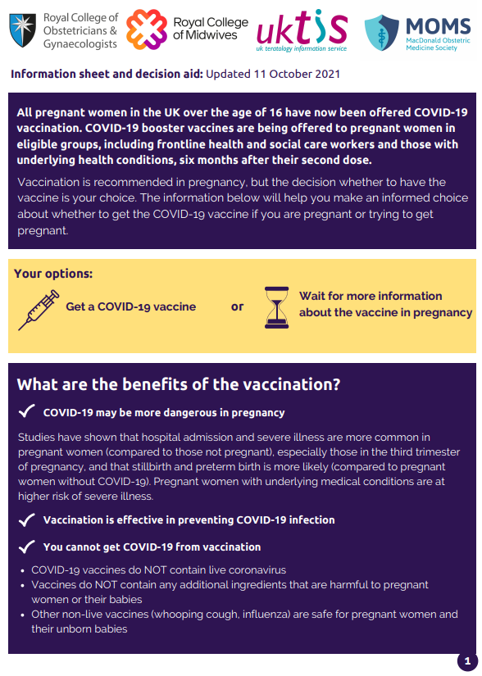
Pregnancy (2)
There is now extensive post-marketing experience of the use of the Pfizer BioNTech and Moderna vaccines in the USA and also in England, Wales and Scotland where over 180,000 pregnant women have been vaccinated.
These 2 vaccines are therefore the preferred vaccines to offer pregnant women aged 18 years and over because of more extensive experience of their use in pregnancy. Pregnant women under the age of 18 years should be offered Pfizer BioNTech vaccine.
Routine questioning about last menstrual period and/or pregnancy testing is not required before offering the vaccine.
Women who are planning pregnancy or in the immediate postpartum can be vaccinated with a suitable product for their age and clinical risk group.
If a woman finds out she is pregnant after she has started a course of COVID-19 vaccine she may complete vaccination during pregnancy using the same vaccine product.
Termination of pregnancy following inadvertent immunisation should not be recommended.
The Royal College of Obstetricians and Gynaecologists and Royal College of Midwives websites have information on COVID-19
vaccines and pregnancy

Slide 56
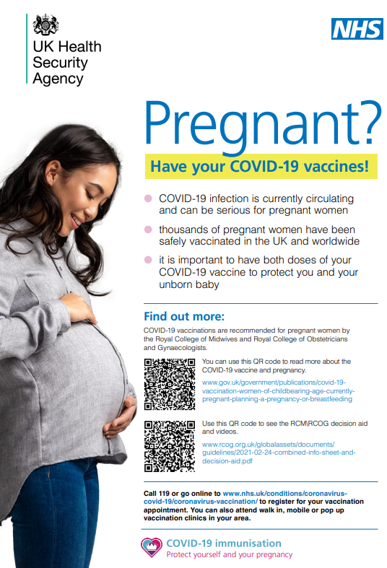
Messages for pregnant women
Although the overall risk from COVID-19 disease in pregnant women and their new babies is low, in later pregnancy some women may become seriously unwell and need hospital treatment.
Hospital admission and severe illness may be more common in pregnant women than in women of the same age who are not pregnant.
Pregnant women with COVID-19 disease are more likely to have their babies early than women without COVID-19.
Pregnant women with underlying clinical conditions are at higher risk of suffering serious complications from COVID-19.
The COVID-19 vaccines available in the UK have been shown to be effective and safe and are recommended in pregnancy.
These vaccines do not contain live coronavirus and cannot infect a pregnant woman or her unborn baby in the womb.
Vaccination is the best way to protect against the known risks of COVID-19 in pregnancy for both women and babies.
It is important that pregnant women have their vaccination as soon as they are invited and that they receive all recommended doses.

Slide 57
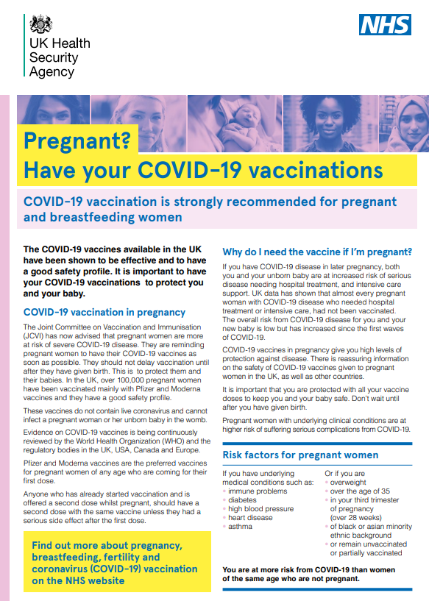
Breastfeeding
COVID-19 vaccines can be given to eligible breastfeeding women.
There is no known risk associated with giving non-live vaccines whilst breastfeeding.
JCVI advises that breastfeeding women should be offered any suitable COVID-19 vaccine.
Women should not stop breastfeeding in order to be vaccinated.
Golan and others (2021) found that mRNA vaccine was not detected in breast milk.
Juncker and others (2021) found that following vaccination with Pfizer BioNTech mRNA vaccine, protective SARS-CoV-2 specific antibody was observed in breast milk.
The developmental and health benefits of breastfeeding are clear and should be discussed with the woman, along with her clinical need for immunisation against COVID-19.
Notes:
Golan Y and others (2021) ‘COVID-19 mRNA vaccine is not detected in human milk’ 8 March 2021 https://www.medrxiv.org/content/10.1101/2021.03.05.21252998v1
Juncker H and others (2021). The Levels of SARS- CoV-2 Specific Antibodies in Human Milk Following Vaccination Journal of Human Lactation 27 June 2021 https://doi.org/10.1177/08903344211027112

Slide 58
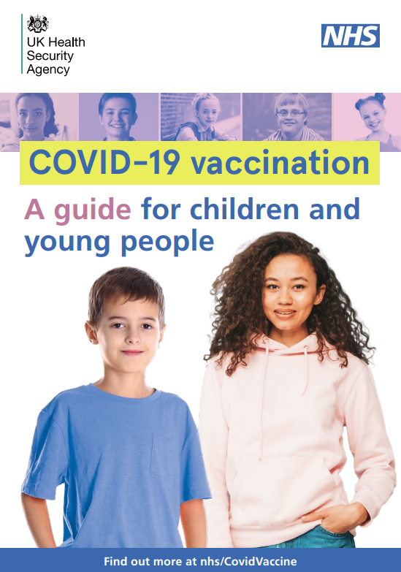
Young people aged 12 to 17 years at higher risk
Young people aged 12 to 17 years with underlying conditions that put them at increased risk of complications from COVID-19 are recommended to receive 2 doses of Pfizer-BioNTech COVID-19 vaccine 8 weeks apart.
On 22 December 2021, the JCVI advised that a booster dose of the Pfizer-BioNTech COVID-19 vaccine should be offered to children and young people aged from 12 years in at risk groups, at least 3 months from their last primary dose.
They were also eligible for an autumn 2022 booster.
Only young people who are immunosuppressed are eligible for a spring 2023 booster dose.
Notes:
https://www.gov.uk/government/publications/universal-vaccination-of-children-and-young-people-aged-12-to-15-years-against-covid-19/universal-vaccination-of-children-and-young-people-aged-12-to-15-years-against-covid-19
https://www.gov.uk/government/publications/uk-vaccine-response-to-the-omicron-variant-jcvi-advice/jcvi-advice-on-the-uk-vaccine-response-to-the-omicron-variant

Slide 59
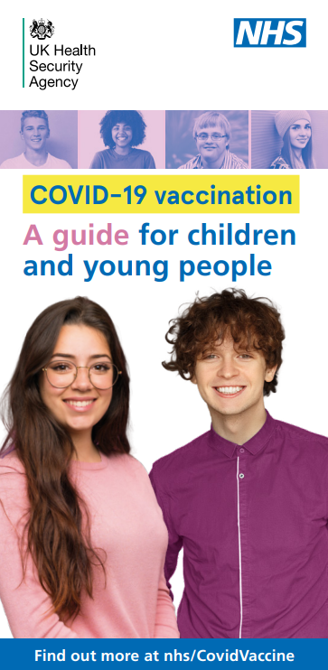
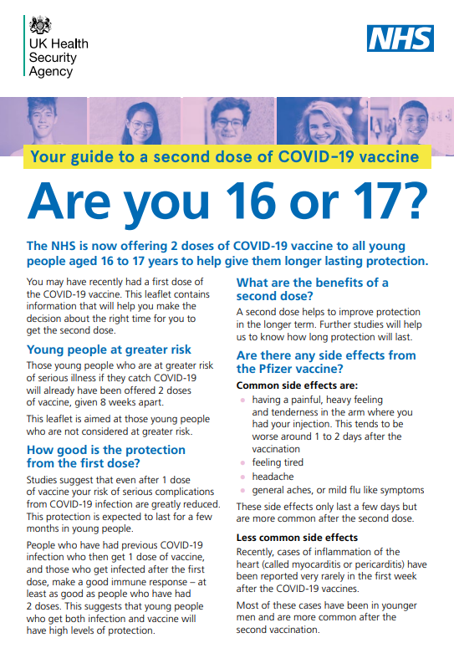
Young people aged 12 to 17 years
(not in an at risk group)
Aged 16 to 17 years
On 4 August 2021, the JCVI recommended that all 16 to 17 year olds should be offered a first dose of the Pfizer-BioNTech vaccine. This was followed by a further JCVI recommendation on 15 November 2021 that those in this age group who are not in an at-risk group should be offered a second dose.
On 22 December 2021, the JCVI advised that young people aged 16 to 17 years should be offered a booster dose of the Pfizer-BioNTech COVID-19 vaccine at least 3 months from their last primary dose. From September 2022 they have no longer been eligible for booster doses.
Aged 12 to 15 years
On 13 September 2021, the Chief Medical Officers recommended a first dose of COVID-19 vaccination for children aged 12-15 to reduce the chances of them catching COVID-19, reduce the number of outbreaks in schools, help avoid school absences and disruption to face-to-face education.
On 29 November 2021, the JCVI recommended that all young people in this age group be offered a second dose.
Notes:
https://www.gov.uk/government/publications/jcvi-statement-august-2021-covid-19-vaccination-of-children-and-young-people-aged-12-to-17-years/jcvi-statement-on-covid-19-vaccination-of-children-and-young-people-aged-12-to-17-years-4-august-2021
https://www.gov.uk/government/publications/universal-vaccination-of-children-and-young-people-aged-12-to-15-years-against-covid-19/universal-vaccination-of-children-and-young-people-aged-12-to-15-years-against-covid-19

Slide 60
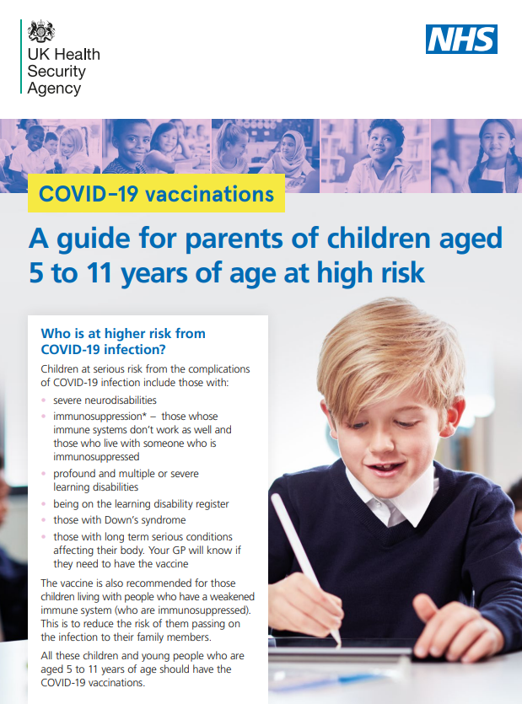
Children aged 5 to 11 years in at risk groups
On 22 December 2021, the JCVI recommended that children aged 5 to 11 years in recognised clinical risk group should be offered two 10 microgram doses of the Pfizer BioNTech Comirnaty vaccine with an interval of 8 weeks between the first and second doses:
these children are at higher risk of severe COVID-19
this includes children who are about to commence immunosuppressive treatment
only those children in this age group who are immunosuppressed are eligible for a spring 2023 booster
Notes:
www.gov.uk/government/publications/jcvi-update-on-advice-for-covid-19-vaccination-of-children-and-young-people/jcvi-statement-on-covid-19-vaccination-of-children-and-young-people-22-december-2021

Slide 61
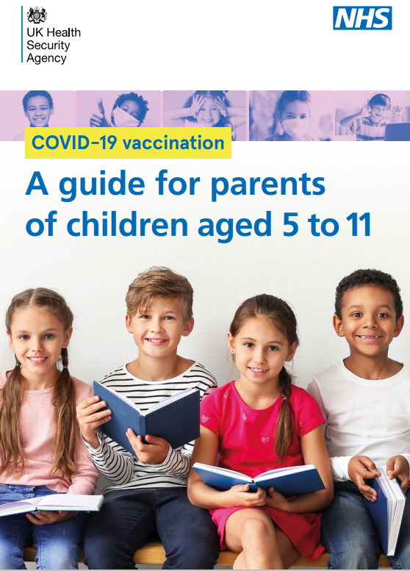
Children aged 5 to 11 years not in an at risk group
In February 2022, the JCVI advised a one-off, non-urgent programme to offer vaccination to all children aged 5 to 11 years of age.
The immediate benefits of vaccination in this age group are likely to be small because children are at low risk from COVID-19 infection, and by February 2022 almost all children in this age group will already have been infected with COVID-19.
However, although Omicron infection appears to be particularly mild, and the vaccine induced protection against mild Omicron infection is short lived, the offer is intended to increase and broaden protection against severe COVID-19 in advance of a potential future wave of COVID-19.
Two doses of the Comirnaty 10 micrograms/dose vaccine should be offered.
This one-off programme applies to those currently aged 5 to 11, including those who turn 5 years of age before the end of August 2022. Only children whose fifth birthday was on or before 31 August 2022 are eligible.
These children are not eligible for a booster dose.
Notes:
www.gov.uk/government/publications/jcvi-update-on-advice-for-covid-19-vaccination-of-children-aged-5-to-11/jcvi-statement-on-vaccination-of-children-aged-5-to-11-years-old

Slide 62
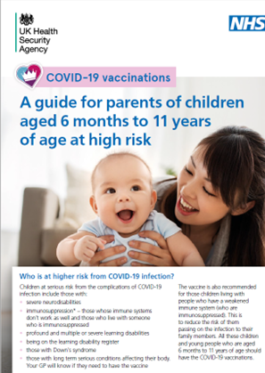
Children aged 6 months to 4 years in at risk groups
On 6 April 2022 the Government accepted the JCVI recommendation that children aged 6 months to 4 years in a clinical risk group should be offered two 3-microgram doses of the Pfizer-BioNTech Comirnaty 3 micrograms/dose (Comirnaty 3 (THREE) Concentrate) COVID-19 vaccine with an interval of 8 weeks between doses.
This programme commences in England on 12 June 2023.
The JCVI does not currently advise COVID-19 vaccination of children aged 6 months to 4 years who are not in a clinical risk group.
Notes:
COVID-19 vaccination of children aged 6 months to 4 years: JCVI advice, 9 December 2022 - GOV.UK (www.gov.uk)

Slide 63
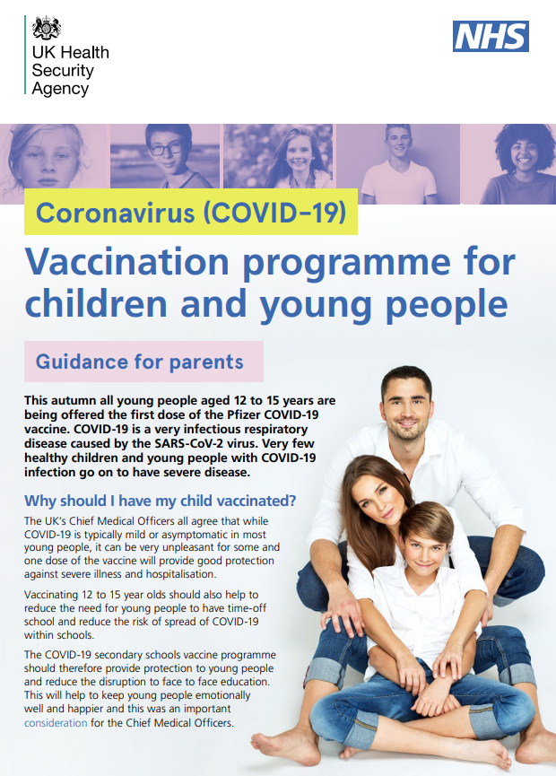
Dose interval for children and young people
For children and young people in at risk groups the recommended minimum interval between primary doses is 8 weeks.
For 5 to 17 year olds not in an at-risk group:
  a 12-week interval between doses is preferred; this interval was introduced as a precautionary measure to minimise the risk of developing myocarditis and there is evidence that a longer interval improves the immune response, but
  8 weeks is acceptable and may be necessary for operational reasons or in order to complete the course during the campaign. The benefits and risks should always be discussed with the young person and (if applicable) the individual with parental responsibility for them
The preferred interval between the last primary or booster dose and the next booster dose is 6 months, but a minimum of 3 months is acceptable.
Notes:
https://www.gov.uk/government/publications/jcvi-statement-august-2021-covid-19-vaccination-of-children-and-young-people-aged-12-to-17-years/jcvi-statement-on-covid-19-vaccination-of-children-and-young-people-aged-12-to-17-years-4-august-2021
https://www.gov.uk/government/publications/universal-vaccination-of-children-and-young-people-aged-12-to-15-years-against-covid-19/universal-vaccination-of-children-and-young-people-aged-12-to-15-years-against-covid-19

Slide 64
Vaccination of children and young people who have had SARS-CoV-2 infection
There is no specified minimum interval between COVID-19 infection and COVID-19 vaccination. Although it was previously advised that children and young people should wait a certain period of time following confirmed or suspected COVID-19 infection, this is no longer advised for any child.
However, as some individuals with COVID-19 disease can continue to develop new symptoms or experience worsening of their symptoms for up to 2 weeks after infection, vaccination should ideally be deferred until clinical recovery.
Children and young people with a previous history of COVID-19 disease (whether confirmed or suspected) can – and if eligible should – still receive COVID-19 vaccine. Vaccination in these circumstances would be expected to boost any pre-existing antibodies; it is known that hybrid immunity – a combination of natural immunity and vaccine-induced immunity – enhances protection against severe disease.
There is no evidence of any safety concerns from receiving a COVID-19 vaccine if antibodies have already been made to the disease following natural infection.
For eligible children who have developed Paediatric multisystem inflammatory syndrome temporally associated with SARS-CoV-2 infection (PIMS-TS) the advice of the paediatrician treating them should be sought with regard to the timing of their COVID-19 vaccination(s).

Slide 65
Immunosuppression and HIV infection
Individuals who have immunosuppression and HIV infection (regardless of CD4 count) should be given COVID-19 vaccine in accordance with the recommendations for this patient group, using an age-appropriate vaccine.
Individuals with immunosuppression may not make a full immune response to COVID-19 vaccination.
As there is limited evidence on response in immunosuppressed individuals there is also very little evidence upon which to base advice on the optimal timing of delivery. One study suggested immune responses were better, however, in patients with cancer who received their chemotherapy at least 2 weeks earlier.
Specialists may advise their patients based on their knowledge and understanding of their immune status and likely immune response to vaccination but should also consider the risk from COVID-19 and the patient’s likelihood of exposure.
The Green Book has further guidance about timing.

Slide 66
Third primary dose for severely immunosuppressed
On 1 September 2021, JCVI advised a third primary dose be offered to individuals aged 12 years and over who were severely immunosuppressed at the time of their first or second primary COVID-19 vaccine dose. On 22 December 2021 this was extended to include 5 to 11 year olds. Infants and young children in clinical risk groups who are eligible for primary vaccination from 12 June should also receive a third dose if they are immunosuppressed at/ around the time of their first or second dose:
definitions of severe immunosuppression and details of timings are described in the JCVI statement and in the COVID-19 chapter of the Green Book
for those aged over 18 years, mRNA vaccines (full dose Pfizer BioNTech or full dose Moderna) are recommended for the third primary dose
Pfizer BioNTech vaccine (dose as appropriate for age) should be given to 6 months to 17 year olds
Notes:
https://www.gov.uk/government/publications/third-primary-covid-19-vaccine-dose-for-people-who-are-immunosuppressed-jcvi-advice/joint-committee-on-vaccination-and-immunisation-jcvi-advice-on-third-primary-dose-vaccination

Slide 67
Booster dose following third primary dose for severely immunosuppressed
Many patients with immunosuppression do derive protection after 2 doses of vaccination but the protection from primary vaccination declines.
These individuals remain at higher risk of serious complications from COVID-19 infection and have therefore been offered regular boosters – and are expected to be eligible for future seasonal campaigns:
a first booster dose should be offered to all severely immunosuppressed individuals aged 5 years and above to extend protection from their primary course; it should be administered from 3 months after the third primary dose and ideally during a designated/seasonal vaccination campaign
those who have not yet received their third dose should be given their third dose immediately to avoid further delay (at least 8 weeks after the second primary dose). A first booster dose should then be given at least 3 months later, in line with the clinical advice on optimal timing in relation to the degree of immune suppression
if they have completed their primary course but not yet received any booster doses, they will require just one booster during the spring 2023 programme
additional boosters should be offered as recommended with a minimum 3 months intervals since the previous dose. These will be offered within seasonal campaigns
Notes:
https://www.gov.uk/government/publications/third-primary-covid-19-vaccine-dose-for-people-who-are-immunosuppressed-jcvi-advice/joint-committee-on-vaccination-and-immunisation-jcvi-advice-on-third-primary-dose-vaccination
https://www.gov.uk/government/publications/uk-vaccine-response-to-the-omicron-variant-jcvi-advice/jcvi-advice-on-the-uk-vaccine-response-to-the-omicron-variant

Slide 68
Reinforcing doses
Although a completed primary course of vaccine was found to greatly reduce the risk of severe illness and hospitalisation, it was less effective at preventing infection due to the heavily mutated Omicron variant and protection declined to very low levels 6 months after the primary course.
For this reason, reinforcing (‘first booster’) doses were introduced from autumn 2021.
This booster programme provided high levels of protection against severe disease from COVID-19 (both Delta and Omicron variants) across the population.
However, protection declined during the following months and additional booster doses were advised for the groups at most risk of severe illness, resulting in a number of booster dose campaigns.
In 2022, the JCVI recommended regular, planned and targeted boosting as the most important strategy to control COVID-19.
Notes:
Booster doses
On 14 September 2021, the JCVI advised that adults who received a primary course in Phase 1 of the COVID-19 vaccination programme (priority groups 1-9) should be offered a COVID-19 booster vaccine. On 15 November 2021, the JCVI extended their advice to recommend that those aged 40-49 years (priority group 10) should also be offered a booster dose.
On 29 November 2021, following the emergence of the Omicron variant, the JCVI further extended their recommendations for booster doses, to be given 3 months after completion of their primary course to all adults from 18 years of age, and 3 months after their third primary dose to immunosuppressed individuals
On 12 December 2021, in response to concerns about the rapid speed of the spread of the Omicron variant and the fact that 2 doses of vaccine did not appear to provide sufficient protection, the Prime Minister announced that every eligible adult over the age of 18 should be offered a booster vaccination by 31 December.
On 22 December 2021, the JCVI advised that the following cohorts of children and young people should be offered a booster dose of the Pfizer-BioNTech COVID-19 vaccine:
Children and young people aged 16 to 17 years
Children and young people aged 12 to 15 who are in a clinical risk group or who are a household contact of someone who is immunosuppressed
Children and young people aged 12 to 17 years who are severely immunocompromised and who have had a third primary dose
This included children who received primary vaccination as part of the high risk 5 to 11 year cohort once they became 12 years of age.
The JCVI recommended that booster vaccination within eligible cohorts should generally be prioritised in the order of clinical risk and descending age groups. Boosting of children in clinical risk groups should commence after the equivalent clinical risk adult groups since higher age is associated with a higher risk of complications from COVID-19 and these adults would have received their primary vaccinations earlier in the vaccine programme.
The JCVI recommended that these ‘first booster’ doses for all those eligible should be given with a minimum interval of 3 months between completion of the primary course and the booster dose.
Additional booster campaigns
Spring 2022
On 21 February 2022 (hyperlink to https://www.gov.uk/government/publications/joint-committee-on-vaccination-and-immunisation-statement-on-covid-19-vaccinations-in-2022/joint-committee-on-vaccination-and-immunisation-jcvi-statement-on-covid-19-vaccinations-in-2022-21-february-2022 ) in recognition of a small decline in observed vaccine effectiveness against hospitalisation for COVID-19 after the 1st booster dose, and the fact that protection against severe disease was expected to continue to wane, leaving them increasingly vulnerable over the summer months, a spring booster dose was offered, around 6 months after the previous dose, to individuals at higher risk of severe COVID-19 in 2022, prior to an intended booster campaign in the autumn. Those eligible were:
● adults aged 75 years and over
● residents in a care home for older adults, and
● individuals aged 12 years and over who were immunosuppressed
Autumn 2022
In 2022, the JCVI recommended regular, planned and targeted boosting as the most important strategy to control COVID-19.
The primary objective for the autumn 2022 campaign hyperlink to Joint Committee on Vaccination and Immunisation (JCVI) updated statement on the COVID-19 vaccination programme for autumn 2022 - GOV.UK (www.gov.uk)was to augment immunity in those at higher risk from COVID-19 and thereby optimise protection against severe disease, specifically hospitalisation and death, over winter 2022/23.
This was a more extensive programme than had been the case in the spring.
2022 to 2023
The following groups were offered an autumn booster dose:
residents in a care home for older adults and staff working in care homes for older adults
frontline health and social care workers
all adults aged 50 years and over
persons aged 5 to 49 years in a clinical risk group, as set out in the Green Book, chapter 14a, tables 3 and 4
persons aged 5 to 49 years who are household contacts of people with immunosuppression
persons aged 16 to 49 years who are carers, as set out in the Green Book chapter 14a, table 3
In order to optimise protection over the winter months, providers were asked to complete vaccinations by the start of December 2022. The programme prioritised delivery to those aged over 75 years and in care homes for older adults.

Slide 69
Living with COVID-19 vaccination programme
A substantial body of knowledge has been accrued about the epidemiology and characteristics of the SARS-CoV-2 virus and the coverage and effectiveness of the available COVID-19 vaccines:
the majority of the UK adult population has been vaccinated and most adults and children have been infected; natural immunity provides good protection against severe disease and this is further enhanced by vaccine-induced immunity
the current vaccines provide only modest and short-term protection against infection/ transmission; protection against mild disease is lower for the newly emerged variants and declines to negligible levels within 4 to 6 months of primary vaccination and 3 to 4 months after booster doses – although protection against more severe disease and death appears to be higher and maintained over the medium term
the Omicron variant is highly transmissible and infection can be asymptomatic or only mildly symptomatic such that many persons in hospital for non-COVID-19 reasons may be coincidentally infected with SARS-CoV-2
highly vulnerable individuals may still develop severe COVID-19 and the risk of hospitalisation for COVID-19 continues to be disproportionately greater in those from older age groups, residents in care homes for older adults, and persons with certain underlying health conditions
Whilst there is a continued need for vaccination, it is expected that there will be a transition during 2023 towards a proportionate, focussed, and sustainable programme which aims to reduce severe disease (hospitalisation and mortality) and thus also to protect NHS capacity. The approach to vaccinating this spring 2023 is in line with the refocussed ‘Living with COVID-19 vaccination programme’.
Notes:
‘Missed’ booster doses
It will be apparent from the above information that booster doses offer time-limited protection (hence the current need for additional campaigns for those at the highest risk and a particular focus on winter preparedness). Individuals who have not taken up the offer of additional doses therefore cannot be ‘caught-up’ as the dose(s) they missed were intended to protect them during a period of time that has now elapsed. If eligible they should be vaccinated during the current campaign and encouraged to take up any future offers that apply.

Slide 70
Spring 2023 vaccination campaign
To provide additional protection for the most vulnerable over the spring and summer months, the JCVI recommended that a booster dose should be given to:
adults aged 75 years and over
residents in a care home for older adults
individuals aged 5 years and over who are immunosuppressed (defined as immunosuppressed in the Green Book tables 3 and 4)
Only those individuals who are eligible for a spring booster can now receive this booster dose. The routine ‘first booster’ offer for all other eligible cohorts (aged 16 years and above) formally ended on 12 February 2023 with the closure of the Autumn 2022 booster campaign.
During the spring 2023 campaign (which ends on 30 June 2023), the offer of primary immunisation for anyone who has previously been offered vaccination but remains unvaccinated or has started but not completed a primary course remains in place.
Notes:
During 2023 there will be a move towards routinely administering primary doses for those who remain eligible only during the time-limited periods of designated campaigns (with some clinical exceptions permitted for those newly severely immunosuppressed).

Slide 71
How vaccination works
Vaccines deliver components known as antigens. These usually consist of inactivated, attenuated (weakened), modified viruses or bacteria or genetic material from the virus and they are used to prime the immune system against specific infections.
Once a vaccine enters the body, and delivers the antigen, the immune system recognises the antigens as ‘foreign’ to the body and responds to them by making antibodies and memory cells.
When memory cells meet the antigen again (either as a natural infection or in a booster dose of vaccine), specific antibodies are produced much more quickly and in greater numbers than during the first response.
This response is similar to the response made to natural infection but without the risks of the disease itself as the microorganism used in a vaccine is artificially weakened (attenuated), modified or inactivated (killed).

Slide 72
Innate and adaptive immunity
Immunity is generally described as being either innate or acquired.
Innate immunity is the body’s first line of defense. It is present from birth and includes physical barriers, chemical barriers, phagocytic cells and the complement system. Innate immunity has no memory so doesn’t provide protection against future exposure to the pathogen.
Acquired immunity (also called adaptive immunity) is the body’s second line of defense. The immune system learns to recognise specific pathogens and challenge them if they meet them again later on. This capacity is called immunological memory.
A series of short videos help to provide a basic understanding of the immune system and how vaccines work.
These can be accessed at Immunology for Immunisation.
Notes:
Note that the advice in question 6 regarding live vaccines (which doesn’t apply to COVD-19 vaccines as they are all inactivated) is now out of date; the latest guidance is in Chapter 11 of the Green Book

Slide 73
PPE and infection prevention and control
Health care practitioners should follow the recommendations for Personal Protective Equipment (PPE) that are current at the time of vaccination.
Hand hygiene is critical to prevent the spread of disease and hands should be cleansed with alcohol-based gel or soap and water before vaccine preparation, between patients, and so on.
Those preparing and administering the vaccine should maintain good hand hygiene throughout and should take care not to touch the vial bung with their fingers.
Wearing gloves is not recommended for the administration of vaccines.
73

Slide 74
Preparing the vaccine
Some of the COVID-19 vaccines may require reconstitution and are supplied in 2 parts: the active component and the diluent.
If a vaccine requires reconstitution:
only use the diluent specified by the manufacturer
use the correct volume of diluent
write the date and time of reconstitution on the reconstituted vaccine vial (or time of discard as directed in SOP)
store and use any reconstituted vaccine within the time period specified by the manufacturer
Before administration, check:
which diluent to use, the amount needed for reconstitution and the ‘use within’ time
that the colour and composition of vaccine is as specified in description in vaccine manufacturer’s instructions
when the vaccine was reconstituted and expiry date
you have drawn up the correct dose
Notes:
If too much diluent is added, the dose will be too weak to stimulate an immune response and the vaccinee will not be protected

Slide 75
Before administering a vaccine
Before administering a vaccine, the individual should be assessed to ensure that:
there are no contraindications to the vaccine being given
they have not experienced any serious reactions to a previous dose
they or their parent/carer is fully informed about the vaccine to be given and understand the vaccination procedure
they or their parent/carer are aware of possible adverse reactions to the vaccine and how to treat them
they have consented to having the vaccine
Immunisers should ensure that:
they have the appropriate knowledge and legal authority to administer the vaccine
the vaccine has been properly stored and prepared for use and that they know where and how to administer it

Slide 76
Vaccine contraindications and precautions
A contraindication is when an individual has a health condition that increases the likelihood of them having a serious adverse reaction to a vaccine. A vaccine should not be administered when the individual has a valid contraindication.
A precaution to a vaccine is when an individual has a condition that may increase the risk or severity of an adverse reaction following immunisation, that may compromise their ability to make an immune response to the vaccine or that may confuse a diagnosis.
Where there is any doubt whether it is safe to give a vaccine, seek expert advice.

Slide 77
COVID-19 vaccine contraindications
Before administering a COVID-19 vaccine, it is important to check for any relevant medical history including any allergies and any previous history of severe reaction to a vaccine or anaphylaxis with an unidentified cause.
COVID-19 vaccines may be contraindicated in those who have had a previous systemic anaphylaxis reaction to:
a previous dose of COVID-19 vaccine
any components of the vaccine
Expert advice should be sought where either contraindication is present.
There are additional contraindications specific to each COVID-19 vaccine.
Ensure you check whether any of these apply to the person you are going to vaccinate before administering the vaccine (these are listed in the Green Book COVID-19 chapter, the information provided about the vaccine by the manufacturer in the SPC and in the PGD/Protocol).
Notes:
Facilities for management of anaphylaxis should be available at all vaccination sites. Advice has also been issued by the Resuscitation Council (www.resus.org.uk/about-us/news-and-events/rcuk-publishes-anaphylaxis-guidance-vaccination-settings )

Slide 78
Vaccine-specific contraindications and precautions
As the COVID-19 vaccines have been used more widely in the general population and more has been learned about the reactions they may cause, further advice around specific contraindications or precautions to each vaccine has been developed.
Additional precautions for mRNA vaccines (Pfizer Comirnaty–branded and Moderna Spikevax-branded vaccines):
individuals with a history of immediate onset-unexplained anaphylaxis or anaphylaxis to multiple classes of drugs or an unexplained anaphylaxis
individuals who develop myocarditis or pericarditis following COVID-19 vaccination

Slide 79
Polyethylene glycol (PEG)
The Pfizer BioNTech and Moderna mRNA vaccines contain polyethylene glycol (PEG).
PEGs (also known as macrogols) are a group of known allergens commonly found in medicines, many household products and cosmetics.
Medicines containing PEG include some tablets, laxatives, depot steroid injections, and some bowel preparations used for colonoscopy.
Known allergy to PEG is rare and evidence now shows that PEG allergy is implicated in only a minority of allergic reactions reported after COVID-19 vaccines.
Patients with undiagnosed PEG allergy often have a history of immediate onset-unexplained anaphylaxis or anaphylaxis to multiple classes of drugs or an unexplained anaphylaxis.
Such individuals should not be vaccinated with the Pfizer BioNTech or Moderna vaccines, except on the expert advice of an allergy specialist or where at least one dose of the same vaccine has been tolerated previously.
Notes:
Some individuals with prior allergic reaction to PEG-containing medicines (for example, PEG-asparaginase) can tolerate the Pfizer BioNTech vaccine (although the historical reaction may have been due to a non-PEG component). Expert advice should be obtained and if a decision is made to administer an mRNA vaccine, then this should only be done in hospital under medical supervision

Slide 80
Polysorbate 80 (PS80)
The Sanofi Pasteur (VidPrevtyn Beta) vaccine does not contain PEG but does contain a related compound called polysorbate 80. Rarely, some people with PEG allergy may also be allergic to polysorbate 80.
However, polysorbate 80 is widely used in medicines and foods and is present in many medicines including monoclonal antibody preparations.
Some injected influenza vaccines (including the main vaccine used in over 65 year olds, Fluad® and the GlaxoSmithKline vaccine Fluarix®) contain polysorbate 80.
The Sanofi Pasteur vaccine contains PS80 at a higher level than these influenza vaccines, as well as small amounts of polysorbate 20 (a similar compound). Despite very limited experience with this vaccine, it is unlikely that individuals with an allergy to PEG would react to the Sanofi Pasteur vaccine, particularly if they have tolerated a previous influenza vaccine and/or an AstraZeneca or Novavax vaccine.
This is summarised in Table 5 of the Green Book chapter 14a (next slide).

Slide 81
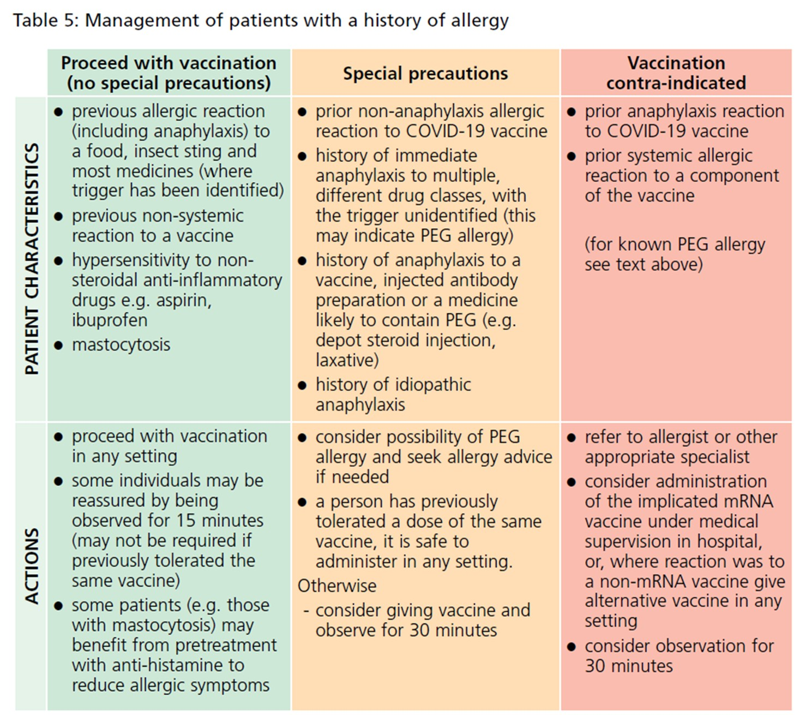
History of allergy
A very small number of individuals have experienced anaphylaxis when vaccinated with a COVID-19 vaccine.
Anyone with a history of allergic reaction to an excipient in the COVID-19 vaccine should not receive that vaccine (except with expert advice), but those with any other allergies (such as a food allergy) – including those with prior anaphylaxis – can have the vaccine.
Advice on the management of patients with allergy is summarised in table 5 (Green Book COVID-19 chapter).

Slide 82
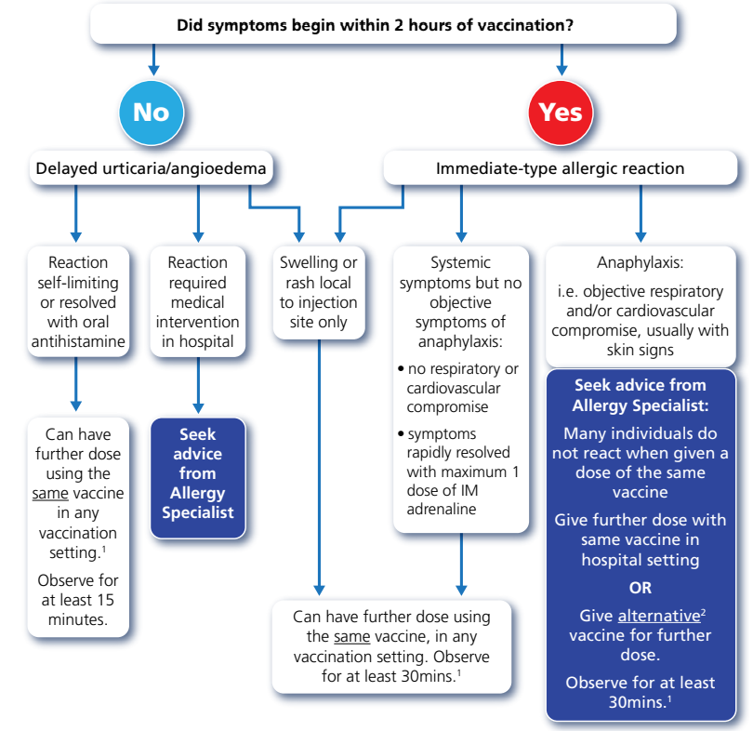
Allergic reaction to previous dose
The British Society for Allergy and Clinical Immunology (BSACI) has advised that individuals who have a reaction to the first dose of a COVID-19 vaccine may be able to receive a second dose of vaccine, as per the flowchart.
Individuals with non-allergic reactions (vasovagal episodes, non-urticarial skin reaction or non-specific symptoms) to the first dose of a COVID-19 vaccine can receive the second dose of vaccine in any vaccination setting. Observation for 15 minutes is recommended.
Flowchart for managing patients who have allergic reactions
to the first dose of COVID-19 vaccine

Slide 83
Myocarditis and pericarditis
Cases of myocarditis and pericarditis have been reported rarely in recipients of the COVID-19 vaccines.
The reported rate appears to be highest in those under 25 years of age and in males, and after the second dose.
Onset is within a few days of vaccination and most cases are mild and have recovered without any complications or longer-term consequences.
Vaccinated individuals should be advised to seek immediate medical attention should they experience new onset of chest pain, shortness of breath or feelings of having a fast-beating, fluttering, or pounding heart.
It is important to note that myocarditis has also been reported with natural COVID-19 infection.
The MHRA has advised the benefits of vaccination still outweigh any risk in most individuals.
Those who develop myocarditis or pericarditis following the first COVID-19 vaccination should be assessed by an appropriate clinician to determine whether it is likely to be vaccine related.
Subsequent doses should be deferred pending further investigation and careful consideration of the risks and benefits.
Specific information for healthcare professionals is available on the gov.uk website and in the COVID-19 Green Book chapter.
Notes:
Myocarditis is inflammation of the heart muscle
Pericarditis is inflammation of the protective thin saclike membrane around the heart (pericardium)
Symptoms can include chest pain, shortness of breath, or palpitations.
Myocarditis and pericarditis occur very rarely in the general population, and it is estimated that in the UK there are about 60 new cases of myocarditis diagnosed per million patients per year and about 100 new cases of pericarditis diagnosed per million patients per year.
https://www.gov.uk/government/publications/covid-19-vaccination-myocarditis-and-pericarditis-information-for-healthcare-professionals/information-for-healthcare-professionals-on-myocarditis-and-pericarditis-following-covid-19-vaccination

Slide 84
Blood clots
Following widespread use of the AstraZeneca vaccine, a rare condition involving serious thromboembolic events accompanied by thrombocytopenia was reported after receipt of this vaccine.
The condition presents with unusual venous thrombosis, including cerebral venous sinus thrombosis, portal vein thrombosis and sometimes arterial thrombosis with low platelet count and high D-dimer measurements.
This syndrome (otherwise known as Thrombosis and Thrombocytopenia syndrome or TTS) has affected patients of all ages and genders.
There is no evidence of any underlying risk factors in the individuals affected by this condition who have mainly been previously healthy.
The condition is rare, tends to present with unusual forms of clotting and the mechanism is believed to be an idiosyncratic reaction related to an immune response to the AstraZeneca vaccine.
Because of this likely immune mechanism, there is no reason to believe that individuals with a past history of clots or of certain thrombophilic conditions (including pregnancy or taking the contraceptive pill) would be at increased risk of this very rare condition. There have been no confirmed cases reported in pregnant women to date.
Notes:
Although the Astra Zeneca vaccine has not been supplied since 1 September 2022, individuals may still have questions and concerns that relate to this; it is therefore helpful for staff to have some knowledge:
thromboembolic: obstruction of a blood vessel by a blood clot
thrombocytopaenia: low levels of platelets in the blood. Platelets are blood cells which help the blood to clot
cerebral venous sinus thrombosis: a blood clot in the brain
portal vein thrombosis: a clot in the blood vessel that brings blood to the liver from the intestines
arterial thrombosis; blood clot in an artery
D-dimer measurements: the D-dimer test is a blood test that indicates whether blood clots are being actively formed somewhere within a person’s vascular system.
After the second dose, the reported rate is much lower, particularly in younger individuals.
There is currently no evidence to suggest these rare events occur following administration of either the Pfizer BioNTech or Moderna vaccine (Spikevax) vaccines which are available in the UK.

Slide 85
Follow up of individuals who experience blood clots
Individuals who experienced a clotting episode with concomitant thrombocytopaenia following the first dose of AstraZeneca vaccine should be properly assessed:
  if they are considered to have had the reported condition, further vaccination should be deferred until their clotting has completely stabilised
  current evidence supports a decision to complete the primary course or boost individuals with a history of TTS with an mRNA COVID-19 vaccine, provided at least 12 weeks have passed since the implicated dose of AstraZeneca vaccine
It is also important to note that thromboses (blood clots) have been reported with natural COVID-19 infection and more than a fifth of hospitalised patients with COVID-19 have evidence of blood clots.
Eligible individuals who did not take up the offer of a second primary dose of Astra Zeneca vaccine, and now wish to complete their prior course, should be offered an mRNA vaccine.
Notes:
Individuals who had received the first dose of AstraZeneca vaccine without developing this rare condition were advised to receive the second dose of the same vaccine as there is no signal of an increased risk of this condition after the second dose.

Slide 86
Capillary leak syndrome
Extremely rare reports of capillary leak syndrome have been reported after AstraZeneca and Moderna vaccines in individuals with a prior history of this condition.
Capillary leak syndrome causes fluid and proteins to leak out of tiny blood vessels (capillaries) into surrounding tissues. This may lead to very low blood pressure, low blood albumin levels and thickened blood due to a decrease in plasma volume.
Initial symptoms may include tiredness, nausea, abdominal pain, extreme thirst and sudden increase in body weight.
Complications can include general swelling, compartment syndrome, kidney failure and stroke.
This is an extremely rare relapsing-remitting condition and triggers for relapses are not well understood.
Individuals with a prior history of this condition should be carefully counselled about the risks and benefits of vaccination and advice from a specialist should be sought.

Slide 87
Guillain-Barré syndrome (GBS)
GBS is a very rare and serious condition that affects the nerves - mainly in the feet, hands and limbs, causing numbness, weakness and pain. In severe cases, GBS can cause difficulty moving, walking, breathing and/or swallowing.
Very rare reports of GBS following COVID-19 vaccination have been received - these reports have not reached the number expected to occur by chance in the immunised population; no causal mechanism with COVID-19 vaccination has been proven.
Individuals who have a history of gbs should be vaccinated as appropriate for their age and underlying risk status.
As there is evidence to suggest that a prior diagnosis of gbs does not predispose an individual to further episodes, in those who are diagnosed with gbs after the first dose of vaccine, the balance of risk benefit is in favour of completing a full covid-19 vaccination schedule.
Where gbs occurs within 6 weeks of an astra zeneca vaccine, the pfizer or moderna covid-19 vaccines can be used for any future doses.
Where gbs occurs following either pfizer or moderna, further vaccination can proceed as normal, once recovered.
Notes:
GBS can be treated and most people will eventually make a full recovery, although it can occasionally be life-threatening and some people are left with long-term problems.
The rate of GBS occurring naturally is 2 per 100 000 per year in the UK population. Cases of GBS that occur following vaccination may occur by chance.
Healthcare professionals should be alert to the signs and symptoms of GBS to ensure correct diagnosis and to rule out other causes, in order to initiate adequate supportive care and treatment.
All suspected cases of GBS should be reported to MHRA using the yellow card scheme.
https://www.gov.uk/government/publications/covid-19-vaccination-guillain-barre-syndrome-information-for-healthcare-professionals/information-for-healthcare-professionals-on-guillain-barre-syndrome-gbs-following-covid-19-vaccination

Slide 88
Immune thrombocytopenia (ITP)
Immune thrombocytopenia (ITP) is a condition where the immune system does not function correctly and attacks and destroys platelets in the blood. Platelets help the blood to clot so this can lead to bruising and bleeding. There is no accompanying thrombosis (blood clots).
There is now emerging evidence of a small risk of ITP or ITP relapse following COVID-19 vaccination.
To date, this has been reported extremely rarely and the MHRA Yellow Card summary states that this is usually short-lived and of minor severity.
In approximately 10-20% of the reports, patients had a history of ITP or an underlying condition known to be associated with ITP.
Previous ITP is not a contraindication for vaccination but guidance produced by the UK ITP Forum Working Party advises discussing the potential for a fall in platelet count in patients with a history of ITP receiving any COVID-19 vaccine and recommends a platelet count check 2 to 5 days after vaccination.
Individuals who experienced ITP in the 4 weeks after the first dose of AstraZeneca vaccine should be assessed by a haematologist and the risk benefit of further vaccination and with which product should be considered on an individual basis. If receiving further vaccination, the platelet count should be monitored.
Notes:
https://b-s-h.org.uk/about-us/news/covid-19- updates/

Slide 89
Consent (1)
Before giving COVID-19 vaccine, immunisers must ensure that they have obtained informed consent from the patient or that a best interest decision has been made if the patient does not have mental capacity at the time of vaccination.
In order to be able to consent to vaccination, the vaccinee should receive an explanation of the treatment and its benefits and risks, either verbally from a clinician, or in the form of a leaflet and letter.
When assessing capacity to consent, the immuniser should be guided by the principles of the Mental Capacity Act (2005). This Act applies to those aged 16 years and over and is designed to protect and empower people who may lack the mental capacity to make their own decisions about their care and treatment.

Slide 90
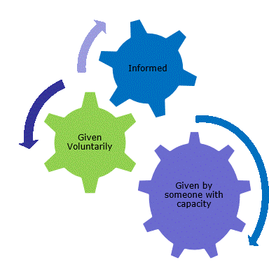
Consent (2)
Consent is a process, not a one-off discussion and must consider 3 factors:
the person giving consent must be appropriately informed: they must have the necessary information in order to make the decision
consent must be voluntary by the individual without undue pressure or coercion
the person consenting must have the capacity to make the decision

Slide 91
Consent (3)
Information to be given includes:
vaccine to be given and the disease that will be prevented
benefits/risks of immunisation versus risks of the disease
any new information that has become available since consent to previous doses of this vaccine were given if applicable
any possible vaccine reactions and what to do if these occur
follow-up/information as to any further doses required
how any personal data will be stored and kept (information governance)
How much information should you give?
This will be personal to the individual at the time, and will depend on their previous knowledge and discussions with others.
give people as much information as they need and/or want to make an informed decision
some people will just ‘trust’ what you say while others want lots of information; either is fine
how much each individual needs is up to them, no one is obliged to seek full information

Slide 92
Informed consent
The need for ‘informed consent’ is a legal requirement, and the patient’s views must be respected and consent sought.
Sufficient evidence-based information must be provided to the person to enable them to make a balanced and informed decision about their care and treatment.
As well as a general explanation of the procedure, there is also a duty to explain the risks inherent in the procedure and the risks inherent in refusing the procedure.
Consent can be given verbally, in writing or it can be implied.
However consent is given, the person must understand what they are consenting to.
If there are any issues or uncertainties with seeking or gaining consent, ask for advice from an experienced colleague rather than abandon the offer of immunisation.
Notes:
The need for ‘informed consent’ is a legal requirement and the patient’s views must be respected and consent sought.
Sufficient evidence-based information must be provided to the person to enable them to make a balanced and informed decision about their care and treatment. As well as a general explanation of the procedure, there is also a duty to explain the risks inherent in the procedure and the risks inherent in refusing the procedure.
Accessible information must be made available to each child’s parent or carer, as appropriate, before they receive the vaccine Home - Health Publications.
Consent can be given verbally, in writing (although there is no requirement for written consent or a particular consent form) or it can be implied (non-verbal consent) but however it is given, the person must understand what they are consenting to.
The consent process should not be an unnecessary barrier to immunising. If there are any issues or uncertainties with seeking or gaining consent, ask for advice from an experienced colleague rather than abandon the offer of immunisation.

Slide 93
Mental capacity and best interest decisions
All adults are considered to have capacity to consent to receiving a vaccine unless there is evidence to suggest that capacity is limited.
If an adult is able to do the following 3 things, then they should be considered to have capacity and their decision should be respected:
understand the information that you are giving them about the vaccine and any potential risks from it or from the disease it protects against
consider the information you have given them and retain it for long enough to make a decision on whether to accept or decline the offer of vaccination
communicate their decision to you

Slide 94
Actions to support decision making
There are some actions that can be taken to support and optimise a person’s ability to make a decision. These include:
making reasonable adjustments to facilitate decision making or accommodate individual needs
using communication tools such as ‘Easy Read’ leaflets
speaking with them at their best time of day
asking someone who the person knows and trusts to speak to them
If an adult does not have capacity and there is no Lasting Power of Attorney (LPA), Welfare Attorney or appointed deputy, a best interest decision will need to be made.
Lasting Power of Attorney (LPA) can be set up by adults over 18 years of age, who have capacity, in order for heath and care decisions to be made once capacity is lost.
Welfare attorney/designated decision maker is appointed by the individual to make health and personal welfare decisions on their behalf once capacity is lost.
Appointed deputy or welfare guardian from the Court of Protection.

Slide 95
Making a best interest decision
To make a best interest decision, the following must be considered:
the person who lacks capacity should be involved in the decision-making process if possible, particularly if their capacity fluctuates. If capacity does fluctuate, the healthcare professional would accept consent given at the time
any previously expressed wishes or behaviours such as previously consenting to vaccination should be acknowledged
the offer of vaccination should be discussed with those close to the patient such as their carer, relatives or anyone appointed as a Lasting Power of Attorney (LPA) for Health and Welfare, or those named by the person to be consulted on vaccination if practical
the person’s actual interests at the time the vaccine is offered
This process should be documented and the decision recorded.
It is good practice to inform nursing or care home management teams of any plans to vaccinate residents in advance of the scheduled date to allow time to address any potential issues.
Notes:
SICE guidance on best interests decision making: https://www.scie.org.uk/mca/practice/best-interests

Slide 96
Consent for children and young people
At 16 years of age, a young person is presumed in law to have the capacity to consent, so young people aged 16 or 17 years should consent to their own medical treatment and a parent cannot override that consent.
Children under 16 can consent for themselves if they have the capacity and maturity to understand what they are consenting to and fully understand what is involved in the proposed procedure (this is referred to as ‘Gillick competence’).
Although they can give their own consent, it is advised that ideally, the parents of those under 16 are involved in the consent process.
However, if a Gillick-competent child consents to vaccination, a parent cannot override that consent and if a Gillick-competent child refuses vaccination, that refusal should be accepted.

Slide 97
Gillick competence
For a young person under the age of 16 to be Gillick competent, they should have:
the ability to understand that they have a choice and that choices have consequences
the ability to understand any information given and arrive at a decision
a willingness to make a choice (including the choice that a parent or guardian should make the decision)
an understanding of the nature and purpose of vaccination
an understanding of any risks and side effects of vaccination and any risks of not being vaccinated
freedom from any undue pressure

Slide 98
Documenting informed consent
It is best practice to document on the vaccine recipient’s healthcare record that a consent discussion has taken place informed and consent has been obtained.
Providers of an immunisation service may decide, for operational purposes or in accordance with their local consent policy, that written consent should be obtained for each vaccine recipient.
Operational purposes may include assessing the numbers of vaccines required for a clinic or venue, enabling data capture for patient records or obtaining consent from someone other than the vaccinee (such as a parent or an attorney).
National consent forms and letters for local adaptation have been provided on the GOV.UK COVID-19 vaccination programme page to support those providers who do wish to obtain written consent.

Slide 99
Legal requirements for the supply and administration of vaccines
The regulation of medicines is defined under the Human Medicines Regulations 2012.
All vaccines are classified as Prescription Only Medicines (POMs).
This means that they are subject to legal restrictions and in order to give them, there needs to be an appropriate legal framework in place before they can be supplied and/or administered to eligible people.
Additionally, any person who supplies and administers a vaccine must have a legal authority to do so.

Slide 100
Legal requirements for the supply and administration of vaccines
Vaccines are Prescription Only Medicines (POMs). This means a legal framework to supply and/or administer a vaccine must be in place and can be in the form of:
a written patient specific prescription
a Patient Specific Direction (PSD): a written instruction, signed by a doctor, dentist, or non-medical prescriber for medicines to be supplied and/or administered to a named patient after the prescriber has assessed the patient on an individual basis
a Patient Group Direction (PGD): allows some registered specified health care professionals to supply and/or administer a POM directly to a patient with an identified clinical condition rather than needing an individual prescription or an instruction from a prescriber. PGDs are often used for the administration of vaccines
or another process such as a Protocol or Written Instruction
Notes:
A PSD is a written instruction, signed by a doctor, dentist, or non-medical prescriber for medicines to be supplied and/or administered to a named patient after the prescriber has assessed the patient on an individual basis. It must include the dose, route and frequency or appliance to be supplied or administered to a named patient.
A PGD provides a legal framework to allow some registered specified health care professionals for the supply and/or administration of a POM directly to a patient with an identified clinical condition rather than needing an individual prescription or an instruction from a prescriber and is often used for vaccines. It sets out the core requisites of those people who can have the medicine under the direction and those who should not. The health care professional working within the PGD is responsible for assessing that the patient fits the criteria set out in the PGD.

Slide 101
Patient Group Directions (PGD)
PGDs set out the core requisites of those people who can have the medicine under the direction and those who should not:
the document will also include details of any additional training that should have been undertaken, actions to be taken if the patient is excluded or declines the medicine, a description of the medicine(s), route of administration, doses, frequency, reporting of adverse reactions, recording, storage and disposal
the HCP working under a PGD is responsible for assessing that the patient fits the criteria set out in the PGD. The healthcare professional operating under the PGD may not delegate the role to others
PGDs must be authorised before use by a doctor and a pharmacist and by an appropriate body for example NHSE, UKHSA, NHS Trust, and so on
health professionals who will be using the PGD must be named and authorised before they use it to provide care

Slide 102
Protocols for the supply and/or administration of COVID-19 vaccine
The changes to the human medicines regulations also brought about a new regulation (247A).
While a disease is pandemic, regulation 247A permits the supply or administration of a medicinal product used for vaccination against coronavirus in accordance with a protocol that is approved by ministers.
National protocols for each of the currently authorised vaccines have been published which allows trained and competent non-registered healthcare workers as well as registered healthcare professionals, to administer COVID-19 vaccine.
The protocol specifies who can use it and includes information similar to that commonly found in pgds.
The protocol allows flexibility for different COVID-19 vaccine delivery models.
It may be followed wholly from patient assessment through to post-vaccination by a single person. Alternatively, multiple hcws may undertake different roles or stages in the patient vaccination pathway in accordance with the protocol.
The service provider is responsible for ensuring that hcws are trained and competent to safely deliver the activity they are employed to provide under the protocol.

Slide 103
‘Off label’ use of a vaccine given Marketing Authorisation
There are occasions when official recommendations for the use of a vaccine differ from those set out in the MA, for example giving the second dose of the Moderna (Spikevax) vaccine at an 8-week interval instead of 28 day interval stated in the SPC.
Giving the 2 doses at a longer interval than the 28 day interval recommended in the SPC will be an ‘off label’ use of this vaccine.
This means that, although the vaccine is authorised for use, it is being used in a way that is slightly different from the terms laid down in its MA. When a vaccine is used ‘off-label’, it means that experts (the JCVI) have advised that there are clear benefits of using the vaccine in this way and that this is considered to be safe and effective.
Vaccines can be given ‘off-label’ using a PGD or protocol where use of the vaccine in a way that is different from that which is stated in the product’s marketing authorisation is judged to be best clinical practice.

Slide 104
Ordering COVID-19 vaccines
COVID-19 vaccines are centrally procured and can be ordered via either the ImmForm Foundry system; each provider will have been advised of the appropriate route for them. Ordering is only available for pre-authorised sites.
Providers should, at the same time, order the combined preparation syringes and needles, and low-dead volume combined administration syringes and needles allocated for that vaccine. In some cases, this order will be automatically generated. Staff must check whether this is the case for them and if not, place their order manually.
A needle of a size appropriate to the individual patient should be used to ensure that the vaccine is injected into muscle.
Information about consumables and their use, and any changes to these, will be communicated as part of operational instructions to providers; practical training should be obtained locally.
Staff are encouraged to become familiar with the needles and syringes provided for preparation and administration of the vaccine in advance of ‘live’ administration to eligible children.
The Patient Information Leaflet (PIL) will also be provided with each vaccine pack. Patient vaccination record cards should be ordered directly from the Health Publications website.
Notes:
Home - Health Publications

Slide 105
Vaccine storage, preparation and administration
Vaccine storage, preparation and administration are critical components of a successful vaccination programme and are key to ensuring that vaccination is as safe and effective as possible.
If specific requirements are not followed, vaccinees may not make a response to the vaccine and so remain unprotected or, they may be at higher risk of developing a vaccine reaction.
To minimise the risk of vaccine failures and reactions:
the storage conditions of the vaccine should always be checked before administration
the person preparing the vaccine must be aware of the date and time the vaccine must be used by after thawing, removing from the fridge and first puncture of the vial
the vaccine must be reconstituted according to the manufacturer’s instructions
the correct equipment should be used to prepare the vaccine
the correct technique must be used to deliver the injection and
the vaccine must be administered in the correct anatomical site

Slide 106
Vaccine storage (1)
As vaccines are biological products, they are temperature sensitive so must be stored and transported within the recommended temperature range.
The system of transporting and storing vaccines is called the cold chain.
A cold chain breach occurs when vaccines have been stored outside of this temperature range.
Vaccines that have not been stored or transported correctly can lose potency and may not evoke a full or lasting immune response, leaving the vaccinee at risk of the disease the vaccine should have prevented.
For most vaccines, the recommended vaccine storage temperature range is between +2˚C to +8˚C.
Always check the specific recommended storage temperatures for each vaccine as each of the COVID-19 vaccines have different requirements.

Slide 107
Vaccine storage (2)
Vaccine storage recommendations are set out by the manufacturer and are part of the licensing or authorisation conditions.
Vaccines that have not been stored in the recommended temperature range are outside of those conditions. Any apparent failure of the vaccine and responsibility and liability for their use will therefore lie with the immunisation provider.
Vaccines that are not stored and transported correctly may need to be disposed of which leads to increased wastage and programme costs.
Adhering to the temperature recommendations will ensure that vaccines are in optimum condition for those individuals they are given to.

Slide 108
General principles of vaccine storage
    All vaccines must be stored in a lockable dedicated vaccine/medicine fridge between 2ºC and 8ºC (unless other storage requirements have been specified).
    Systems to prevent accidental interruption of the power supply to the fridge must be in place.
    Fridges should be situated away from radiators and other sources of heat which could affect how they work.
    Records should be kept of regular fridge servicing and thermometer calibration.
    The temperature in the fridge must be continually monitored using a current/minimum/maximum thermometer.
    Fridge temperatures should be monitored and recorded on a designated chart ideally at the beginning and end of every working day.
    Fridge alarm parameters should be set appropriately to alert to any deviations from the 2ºC to 8ºC range
    vaccines must be kept upright and stored in their original packaging.
    Vaccines with shorter expiry dates and use by dates after thawing should be placed at the front of the fridge.
    Expired stock and stock beyond the used by date should be removed from the fridge and destroyed
    take immediate action if the temperature goes outside recommended range.

Slide 109
Storage and transportation of COVID-19 vaccines
All those involved in the delivery of the COVID-19 vaccination programme have a responsibility to ensure that the cold chain is maintained and must be aware of the recommended storage requirements for the different COVID-19 vaccines.
It is critical that vaccines are stored as recommended to ensure they retain their optimum potency and to avoid any vaccine wastage.
Be very clear about your specific responsibilities for maintaining the cold chain and at what point for example transporting it, receiving a delivery, daily fridge monitoring, reconstitution, and so on.
COVID-19 vaccine must not be given if you are not confident that it has
been stored or reconstituted as recommended by the manufacturer or
as advised by a vaccine expert

Slide 110
Temperature monitoring systems
There should be a named person and a deputy responsible for COVID-19 vaccine storage.
Those responsible should be familiar with the fridge digital display readings, the functioning of the thermometer reset button and the manufacturer’s user guidelines.
Data loggers can be useful in the event of a cold chain breach as the data can be used to calculate cumulative exposure to out of range temperatures. However, they should always be used in conjunction with the integral fridge thermometer and should not be used to replace the daily temperature monitoring and recording.
A visual check of the actual temperature should also be made each time a vaccine is removed from the fridge.

Slide 111
Temperature monitoring equipment
Most vaccine and medicine fridges have integral thermometers with a digital display. Ideally, a second thermometer, independent of the main power source (for example battery operated) should be available to monitor the temperature in the event of a power failure.
Temperature probes with cables should be correctly positioned in the fridge, ensuring that the cable does not interfere with the door seal and probe is not against back or sides of the fridge.
Data loggers are recommended as a back up to visual temperature reading from integral thermometers.
Vaccines being stored or transported in portable cool bags or refrigeration devices should be monitored to the same standard as vaccines stored in vaccine fridges.
Vaccine fridges and temperature-monitoring equipment should be regularly serviced and calibrated.

Slide 112
Action to take if vaccines are stored incorrectly
If COVID-19 vaccines are stored incorrectly:
label and isolate affected vaccines and do not use until further notice
inform your team leader or manager and other vaccinators in the clinic
make alternative arrangements for immunisation clinics until resolved
seek advice from the manufacturer or a source of expert advice
be able to provide the following information:
      what monitoring has taken place (max or min or current thermometer readings)
      when the cold chain was last guaranteed
      what time periods are involved (hours or days)
      what the temperature range has been during this period
      identify all vaccines stored in the fridge, the time they have been stored there and expiry dates

Slide 113
Portable refrigeration
A medical grade cool box or bag purchased from a medical supplier must be used for storage and transportation of vaccines being used for home visits or community clinics.
All vaccines should be kept in their original packaging until use and the cool box or bag should be packed following the manufacturer’s instructions and not overfilled.
The minimum and maximum temperatures in the cool box or bag should be recorded.
The temperature should be checked before vaccines are given.
If the temperature has gone out of range, a risk assessment should be conducted before using or disposing of the vaccines.

Slide 114
Preparing and drawing up vaccine
Preparation of COVID-19 vaccines should be carried out as per SPC for each product
When drawing up the COVID-19 vaccines, it is important to follow the instructions below to minimise the risk of particles breaking off from the rubber stopper and entering the vial:
insert the needle vertically through the centre ring of the vaccine vial stopper
if the needle is not inserted vertically into the centre ring, it can result in the needle scraping rubber off the inner wall of the small channel of the stopper
do not twist or rotate the needle once inserted. If the needle is rotated or twisted during the piercing of the stopper, a particle may be cored out of the stopper
Vials must be visually inspected for appearance and particles before and after dilution and each time a dose is drawn up.

Slide 115
Vaccination site
Giving vaccine into the muscle:
leads to a better immune response to the vaccine (as the muscle contains the appropriate cells necessary to initiate the immune response)
is less likely to cause local reactions than if the vaccine is given into the skin (subcutaneously)
The needle needs to be long enough to ensure vaccine is injected into the muscle. For this reason, a 25mm needle is being provided for administration of the COVID-19 vaccine. A 38mm length needle is available if required for adults who have more fat covering their muscles.
COVID-19 vaccine should be injected into the deltoid muscle in the upper arm. If there is insufficient muscle mass in the deltoid or a particular reason the deltoid muscle is unsuitable, the vaccine should be given into the vastus lateralis muscle in the anterolateral aspect of the thigh.

Slide 116
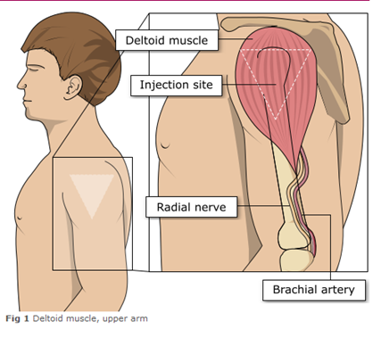
Administering vaccine into the deltoid muscle
(upper arm)
It is essential that the correct site and injection technique is used to administer vaccines.
Injecting too high into the upper arm might result in a shoulder injury or a frozen shoulder. This leads to pain, weakness and a limited range of motion that can last for months.
Injecting too low or too far to the side of the arm risks injecting into the axillary nerve or the radial nerve.
To avoid shoulder injury, always assess the limb before administering the vaccine to identify the correct site for injection.
Image adapted from the Australian Immunisation Handbook

Slide 117
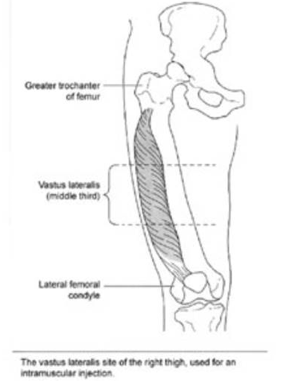
The vastus lateralis muscle (anterolateral aspect of the thigh)
Infants under one year receive their immunisations into the anterolateral aspect of the thigh because the deltoid muscle is not sufficiently well enough developed at this age.
Although the deltoid muscle is more commonly used in older children and adults as it is quicker and easier to access, the vastus lateralis muscle in the thigh can be used in these age groups if necessary.
CDC Vaccine Administration

Slide 118
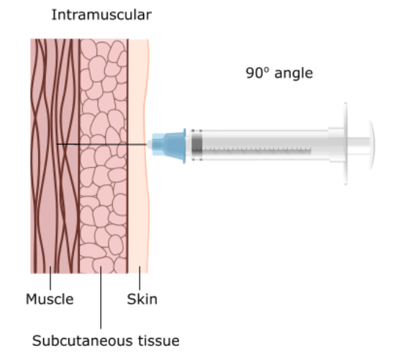
Vaccine administration continued
Skin does not need to be specially cleaned prior to vaccination. If it is visibly dirty then water is sufficient to clean it.
Intramuscular process:
identify the correct site for IM injection
stretch the skin at the site
insert the needle at a 90 degree angle far enough to ensure vaccine is delivered into muscle
depress the plunger
gently remove the needle
apply light pressure using gauze or cotton wool if bleeding occurs
Notes:
https://assets.publishing.service.gov.uk/government/uploads/system/uploads/attachment_data/file/147915/Green-Book-Chapter-4.pdf

Slide 119
Individuals with bleeding disorders or taking anticoagulation therapy
Individuals with bleeding disorders may be vaccinated intramuscularly if, in the opinion of a doctor familiar with the individual’s bleeding risk, vaccines or similar small volume intramuscular injections can be administered with reasonable safety by this route.
If the individual receives medication/ treatment to reduce bleeding, for example treatment for haemophilia, intramuscular vaccination can be scheduled shortly after such medication/ treatment is administered.
Individuals on stable anticoagulation therapy, including individuals on warfarin who are up-to-date with their scheduled INR testing and whose latest INR is below the upper level of the therapeutic range, can receive intramuscular vaccination.
A fine needle (23 or 25 gauge) should be used for the vaccination, followed by firm pressure applied to the site without rubbing for at least 2 minutes.
The individual, parent or carer should be informed about the risk of haematoma from the injection.

Slide 120
Post vaccination (1)
Following COVID-19 vaccine administration, individuals should be observed for any immediate reactions whilst you are giving them any verbal post vaccination information.
The previous 15 minute recommended observation period was at first suspended in recognition of the need to accelerate vaccine delivery in response to the emergence of the Omicron variant; it has not been reinstated.
Vaccinated individuals should be informed how to access immediate healthcare advice in the event of displaying any symptoms.
In some settings, for example domiciliary vaccination, this may require a responsible adult to be present for at least 15 minutes after vaccination.
Notes:
Individuals should be observed for any immediate adverse effects whilst receiving any verbal post vaccination information (such as possible reactions and what, if anything, to do about these). They, or their parents/carers, should also be informed that they can obtain further advice if they require it following vaccination.

Slide 121
Post vaccination (2)
Patients with a personal history of allergy will require a period of observation following vaccination (either 15 or 30 minutes depending on their clinical history).
No specific management is required for patients with a family history of allergies.
As fainting can occur following vaccination, all those vaccinated with any of the COVID-19 vaccines should either be driven by someone else or should not drive for 15 minutes after vaccination.
Facilities for management of anaphylaxis should be available at all vaccination sites and staff should have undertaken BLS and anaphylaxis training.

Slide 122
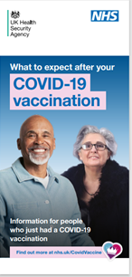
Post vaccination advice
Vaccinees should be given a copy of the patient information leaflet for the vaccine that they have received and any other relevant written information.
They should be given information about possible vaccine reactions, how to treat these, and when and from whom to seek further advice if required.
Generally symptoms post vaccination resolve within 1 to 2 days without treatment but antipyretics and/or analgesics can be taken if necessary to relieve any symptoms.
If individuals are concerned about any symptoms following vaccination, they should seek advice from their GP or NHS 111.
If a vaccinated person experiences symptoms that makes them think they may have COVID-19 infection, they should follow the current guidance for management and testing. The COVID-19 vaccine will not interfere with testing for COVID-19 infection (if or when this is still required).
Notes:
Individuals should be observed for any immediate adverse effects whilst receiving any verbal post vaccination information (such as possible reactions and what, if anything, to do about these). They, or their parents/carers, should also be informed that they can obtain further advice if they require it following vaccination.
The patient should be given a copy of the patient information leaflet (PIL) and/or any other relevant written information. Home - Health Publications.
If a further dose will be required, an appointment should be made for this and the individual should be given a record card (also available to order from Home - Health Publications) with details the first dose of vaccine and details of the appointment date and time for the second dose.
As syncope can occur following vaccination, those vaccinated should be advised to wait for 15 minutes post-vaccination before driving. There is no waiting period required for those vaccinated who are not driving.

Slide 123
Disposal of consumables
Needles should not be re-sheathed following vaccination under any circumstances because of the risk of sustaining a needlestick injury.
The needle and syringe should be disposed of immediately after use in a puncture resistant yellow sharps bin.
The yellow sharps bin should be sealed when it is two-thirds full and replaced with a new one.
Deface outer cartons using permanent black marker pens, and discard according to your local waste policy.
Any blood stained gauze should be placed in a bin for healthcare waste.
Local policy should be followed for the disposal of PPE.

Slide 124
Adverse reactions following vaccination (1)
Some people can feel unwell following an injection and some people may experience an adverse reaction.
Vaccinees should be informed of the potential expected reactions to COVID-19 vaccines.
There are 3 main types of adverse reaction following immunisation:
local reactions at the injection site such as redness, swelling or pain at the injection site
systemic reactions (reaction affecting the whole body) such as fever, headache, loss of appetite
allergic reaction such as anaphylaxis or a severe systemic allergic reaction

Slide 125
Adverse reactions following vaccination (2)
Adverse events following vaccination may occur for various reasons.
These include:
inappropriate practices in the provision of vaccinations such as giving the wrong dose of vaccine or poor injection technique
reactions caused by the vaccine or its component parts. These may be a direct effect of the vaccine or due to an underlying medical condition in the individual

Slide 126
Anaphylaxis (1)
Common causes of anaphylaxis include food, eggs, and nuts but it can also be caused by medicines or vaccines.
Anaphylaxis is a rare, potentially life-threatening event.
Data from the US indicates anaphylaxis rates of one per every 200,000 doses of the Pfizer BioNTech vaccine administered and one per 360,000 doses of the Moderna vaccine given.
Rate of anaphylaxis reported to date to the AstraZeneca vaccine is in line with the expected rate of anaphylaxis to non-COVID vaccines (less than one per million doses of vaccine given).
Onset is typically rapid, within minutes, with variable severity.
It is critically important that immunisers know how to treat anaphylaxis should it occur and equipment for treating anaphylaxis must always be available in all vaccination settings.
You must have completed Basic Life Support and anaphylaxis training prior to giving any vaccinations.
Notes:
Turner P and others. COVID-19 vaccine-associated anaphylaxis: A statement of the World Allergy Organization Anaphylaxis Committee. World Allergy Organization Journal Volume 14, Issue 2, February 2021, 100517

Slide 127
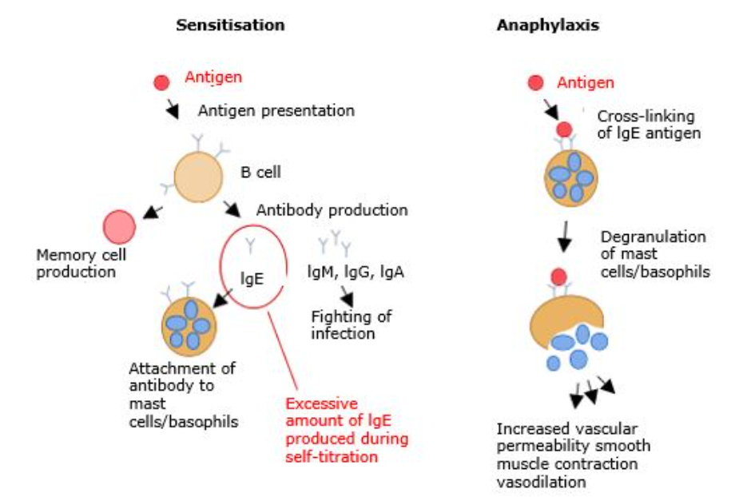
Anaphylaxis (2)
Anaphylaxis occurs as a result of
exposure to an allergen to which a person has been sensitised and previously made specific immunoglobulin E (IgE).
On re-exposure to the antigen, explosive amounts of histamine and other chemical mediators are released following the binding of the antigen to IgE coated mast cells.
This causes bronchospasm, angioedema, pulmonary oedema, cardiovascular collapse, and loss of consciousness.

Slide 128
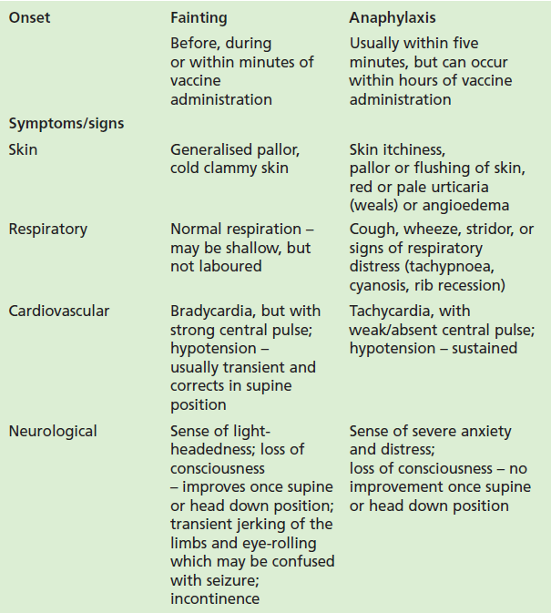
Fainting
All staff involved in vaccination should be able to distinguish an anaphylactic reaction from fainting and panic attacks.
The features listed in the table differentiate between anaphylaxis and fainting. If the diagnosis is unclear, anaphylaxis should be presumed and appropriate management given.
There should be rapid recovery from fainting. Although symptoms of malaise may persist, the patient should recover consciousness within a few minutes.
Some individuals may suffer panic attacks even before immunisation is undertaken. Symptoms include hyperventilation that may lead to numbness and tingling in the arms and legs but hypotension, pallor or wheezing should not occur in a panic attack.

Slide 129
Preparing for and minimising faints associated with vaccination
Fainting is a common event associated with the vaccination process, as are dizziness and nausea which may also follow vaccination due to ‘immunisation anxiety’.
Fainting tends to be more common in younger people, in warm weather, after queueing and where the situation is perceived as stressful.
Vaccinators need to consider the situations that make fainting more likely for example queuing, seeing others being vaccinated and so on, and how they can reduce anxiety, for example distraction techniques, chatting, encouraging deep breaths, drinking water and
so on.
Ensure people are seated whilst having the vaccination or offer a couch to people who say they are prone to fainting when having injections.
People who faint usually regain consciousness within a few seconds so lie them down and raise their legs which improves blood pressure almost immediately. They should not stand up too soon since being active can lead to another episode.

Slide 130
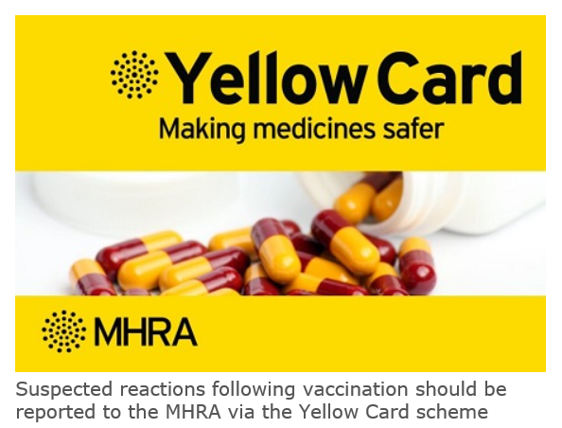
Reporting adverse reactions
Suspected adverse reactions following administration of COVID-19 vaccine should be reported to the MHRA’s Yellow CARD reporting scheme at Yellow Card | Making medicines and medical devices safer (mhra.gov.uk) (or call 0800 731 6789). As new vaccines, MHRA have a specific interest in the reporting of adverse drug reactions for these vaccines:
vaccines are carefully monitored to ensure they are safe, not causing untoward side effects and are suitable for the immunisation programme
MHRA promotes the collection and investigation of adverse reactions through the Yellow Card scheme which is a voluntary reporting system for suspected adverse reactions
anyone (patients and HCWs) can make a Yellow Card report, even if they are uncertain as to whether a vaccine caused the condition
weekly summaries of information received via Yellow Card reports for COVID-19 vaccines are published on the GOV.UK website at Coronavirus vaccine - weekly summary of Yellow Card reporting

Slide 131
Documentation and record keeping
It is essential that the information in Box 1 is recorded for all doses of vaccine given to ensure complete and accurate patient vaccination records and to enable extraction of the correct data for surveillance and vaccine coverage purposes.
If not administered at the patient's GP surgery, a record of the vaccination given should be sent to the patient's GP to avoid duplicate vaccination and so that data can be submitted to the national COVID-19 vaccine uptake data survey.
Box 1. Following vaccination, the following information should be recorded:
vaccine name
product name
batch number
expiry date
dose administered
date immunisation given
route/site used
name and signature of vaccinator
Examples of patient records where vaccination details may need to be recorded:
patient's GP record (or other patient record, depending on location)
practice computer system
occupational health record/employer's record

Slide 132
Communicating about vaccination
There are many sources of information available relating to COVID-19. Since the virus was first identified in January 2020, there have been thousands of publications globally.
When considering the information contained in written materials, consider:
the author and their expertise and background
  if the author is not named, or the source is not clear, this should raise your suspicion about the quality of the information
  does the author have a vested interest in presenting an unbalanced view?
the way the information is presented
  is it presented in an unbiased manner, or is it selected to provide only one viewpoint when there are other equally valid views?
  is the information dated? If so, there may be more recent information that is different
  if there are any uncertainties, are they mentioned?
  is it possible to follow up any information by going to the original data, for example a trial of a vaccine?

Slide 133
Addressing concerns and providing information to those being vaccinated
The COVID-19 vaccines are relatively new vaccines. Patient information leaflets are available but many patients will want additional verbal reassurance or answers.
It is important to read the information being made available to vaccinees so the information you give is consistent with this and so you know what information they have already had.
It is also important to know where to direct patients to for further information.
If people’s questions and concerns are answered accurately and appropriately, they are more likely to accept vaccination.
Notes:
As the COVID-19 vaccines will be new vaccines, it is likely that people will have a lot of questions. Although they will be provided with patient information leaflets in advance of their immunisation appointment, many may not have read this or will want additional verbal reassurance or answers from you.
Undertaking this training should give immunisers a lot of the information they will require to answer some of the questions, for example, how the vaccine is made, whether it has been thoroughly tested, how many people it has been given to in clinical trials and the possible reactions it might cause.
It is important that immunisers read the information being made available to vaccinees so the information they give is consistent with this and so they know what information they have already had. It is also important that they know where they can direct them to for further information or know where they can obtain answers to any questions that they cannot answer. See Resources section for additional sources of information about the COVID-19 vaccine programme.

Slide 134
General principles for addressing concerns
Give the patient, parent or carer time to ask questions.
Find out the basis for their concerns.
Explore the nature and sources of information they have already gathered.
Check the patient’s, parents’ or carers’ personal experience.
Provide them with other sources of information such as valid and reliable websites.
Check their understanding of the information that you provide.
Ask them if there are any more concerns.
If they decline to be vaccinated, suggest talking again in a couple of days or weeks if appropriate.
Recommend immunisation.

Slide 135
Knowledge and skills
A high level of knowledge and a positive attitude to immunisation helps to achieve and maintain high vaccine uptake.
Those being vaccinated need to feel confident that the person giving them the vaccine or advising them knows what they are doing and has the appropriate knowledge, skills and ability.
Immunisers who do not feel confident should discuss their concerns with a mentor or supervisor.

Slide 136
Knowledge and skill check
Statutory and mandatory training – should be completed as specified by your employer (including basic life support and anaphylaxis). This may also include additional sessions on infection prevention and control, information governance and other relevant topics to the patient group(s) you will be vaccinating.
Vaccine specific training (knowledge) – through e-learning, classroom-based training or a webinar.
Vaccine specific training (practical) – preparing a vaccine and intramuscular (IM) injection technique.
Competency assessment – for formal assessment and sign-off of clinical competency.
Supervision is recommended for new immunisers until both they, and their supervisor or trainer, feel confident that they have the necessary knowledge and skills to administer vaccines safely and competently.

Slide 137
Competency assessment tool
The competency assessment tool is divided into 3 areas:
knowledge
core clinical skills
the clinical process/procedure for vaccine administration
It should be completed by those who are new to or returning to immunisation before sharing with their supervisor. Experienced immunisers should use it as a self-assessment tool.
The supervisor carrying out the assessment should:
review the self-assessment, discussing any areas identified as ‘need to improve’
observe performance in the provision of immunisations or advice and indicate whether each competency is ‘met’ or ‘needs to improve’ in the ‘supervisor review’ column
if improvement is needed, help to develop an action plan to enable the achievement of the required level of competence and plan a further assessment
sign off the section at the bottom of the assessment when competency is agreed

Slide 138
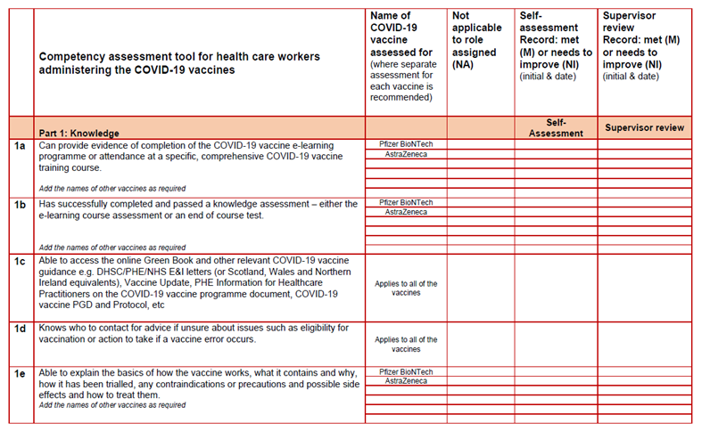
COVID-19 vaccinator competency assessment tool

Slide 139
Supervision and accountability
Supervision
Supervision for new immunisers is critical to the safe and successful delivery of the COVID-19 immunisation programme.
Supervisors must be registered, appropriately trained, experienced and knowledgeable practitioners in immunisation.
Accountability
All staff involved in immunisation are accountable for their own practice, both to their employer and to their professional regulator (where applicable).
Employers are responsible and accountable for ensuring that employees have the required training and competency and are provided with an appropriate level of supervision to safely and effectively carry out the role they have been contracted to provide.

Slide 140
Delegation
If immunisation is delegated, patient safety must be considered and not compromised in any way.
The delegation must be appropriate, safe and in the best interests of the patient.
When delegating immunisation, the delegating healthcare professional (whether nursing, medical or other independent prescriber) must ensure that:
the person they are delegating to has undergone training, has the appropriate knowledge, skills and competency
there is adequate supervision and support in place
If these conditions have been met and the role of administering an immunisation is delegated, the delegatee is accountable to the patient for their actions and decisions, and for any errors they make through civil law and to their employer.

Slide 141
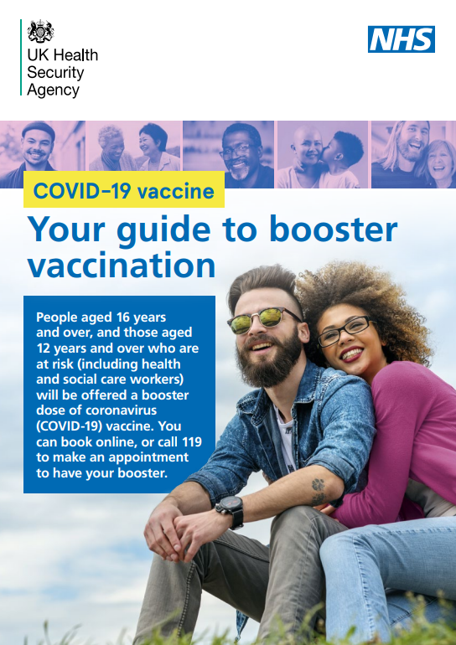
Maximising vaccine uptake
As COVID-19 vaccine may be offered in different settings, different methods of promoting the vaccine to maximise uptake may be required.
This may include:
displaying posters in areas of high footfall such as waiting rooms, train stations, shopping centres
having leaflets available for patients to read before their appointment
signposting people to online resources or resources in a suitable format, for example Easy Read, BSL, large text and translated versions
speaking confidently and positively about the vaccines and encouraging others in the vaccination clinic to do so as well
confirming an appointment has been made for the second dose
offering flexible appointments, including evening and weekend clinics
ensuring mobile staff are able to locate patient’s homes

Slide 142
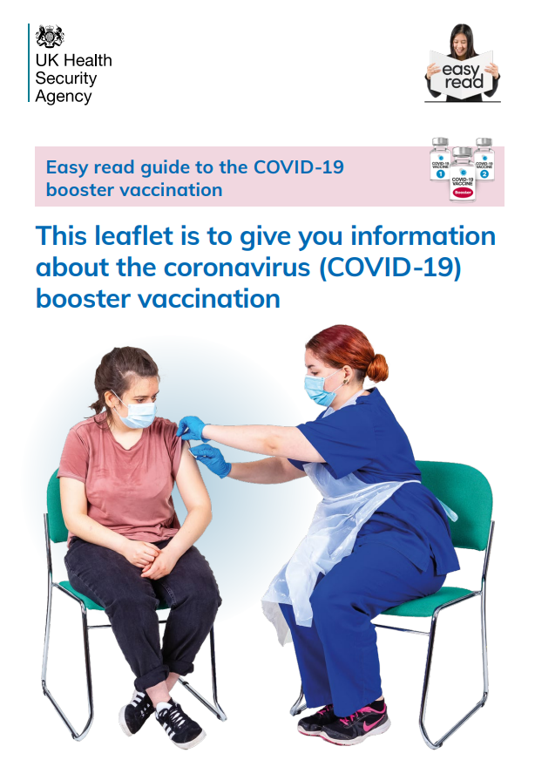
Reasonable adjustments
Learning disability, autism and other disabilities have protections under the Equality Act 2010. These include reasonable adjustments to communication and services. These should be person-centred.
Prior to the appointment, ensure you are fully aware of any reasonable adjustments that may be necessary in order to ensure appointment times and vaccines are utilised efficiently and effectively.
Reasonable adjustments can include, but are not limited to, offering:
appointment times at the start or the end of clinics when there is likely to be less of a wait
double appointment times so there is more time
the option of waiting in a quiet room, if one is available
the option of waiting in their car outside and being texted or called on their mobile when ready
the option of delivering this at home or another familiar setting if possible
Ideally avoid long waits and let people know if it is going to be a long wait.
Explain what the procedure entails and ask them whether they have any suggestions about how best to handle this.
Make use of easy-read information available.
More information is available at NHS Reasonable adjustments.

Slide 143
Further information
UK vaccine guidance can be found in the online publication commonly referred to as the Green Book. This can be found on the Immunisation page of the GOV.UK website.
Green Book recommendations are based upon JCVI’s expert opinion and should always be followed, even when they differ from those made by the vaccine manufacturer.
UKHSA COVID-19 immunisation programme Information for healthcare practitioners
This document provides additional information, answers to frequently asked questions and actions to take in the event of inadvertent errors.
It is important to read this document before you start vaccinating and also to refer to the online version regularly as it will be updated as more information becomes available and to address any issues or frequently arising questions as COVID-19 vaccines are delivered more widely.

Slide 144
Guidance on handling multiple COVID-19 vaccines
As there are now several different COVID-19 vaccines in use, it is important to ensure there are procedures in place to make certain that each person gets the right dose of the right vaccine at the right time and that the vaccine has been stored and handled as specified in the product’s authorisation documentation.
The different COVID-19 vaccines have different storage, handling and preparation requirements and different dosages. There may also be differences in the contraindications for each vaccine and in the advice that should be given about possible anticipated side effects.
Ensure you know what these are in order to minimise the risk of errors where multiple vaccines are available.
See the most recent version at COVID-19 vaccination: vaccine product information.
Notes:
The Specialist Pharmacy Service has put together guidance on safe practice for handling multiple vaccines from receipt through to administration. Vaccinators are encouraged to read through this guidance in order to minimise the risk of errors where multiple vaccines are available.
NB: Always check website for latest version of ‘Which COVID-19 vaccine’ poster as one shown on slide may not be the latest version

Slide 145
Action plan
To consolidate learning:
undertake the COVID-19 vaccine, vaccine administration, storage and legal aspects elearning sessions if required after this training session
undertake Basic Life Support and anaphylaxis training if not undertaken in the past year
complete any additional statutory and mandatory training required by your employer
undertake practical training in immunisation if required, for example IM injection technique
complete the COVID-19 competency assessment tool
visit the GOV.UK Immunisation web pages and familiarise yourself with the resources available on this site
read the UKHSA ‘COVID-19 immunisation programme information for healthcare practitioners’ document
read the vaccine product information in the ‘Summary of Product Characteristics’ and ‘Information for healthcare professionals’ documents on the MHRA website
access the Green Book online and read the COVID-19 vaccine chapter and any other chapters that are relevant for example vaccine administration, vaccine storage
subscribe to Vaccine Update to ensure that you receive this free monthly newsletter as it is published. It contains details of immunisation programme updates and changes
find out and make a note of who you can contact if you have an immunisation query or incident. This may be your local NHS England Screening and Immunisation Team or lead consultant (if working in Occupational Health, and so on)

Slide 146
Learning objectives
You should now be able to:
explain what COVID-19 is and be aware of the UK epidemiology
understand the policy behind the COVID-19 vaccination programme
describe how vaccines work and how they are developed and trialled
identify the groups who are at high risk for COVID-19 infection and who should be prioritised to receive the COVID-19 vaccine
describe the process of consent and how this applies when giving vaccines
understand the legal mechanisms by which immunisers can supply and administer COVID-19 vaccine
recognise the differences between a prescription, a PSD, a PGD and a Protocol and understand which staff can use each of these
describe the key principles of how to correctly store, prepare and administer vaccines
communicate key facts in response to questions from patients and direct them to additional sources of information

Slide 147
Resources
Green Book COVID-19 chapter Immunisation against infectious disease
UK Health Security Agency Coronavirus resources
GOV.UK Coronavirus (COVID-19) in the UK
WHO COVID-19 Worldwide Dashboard
Royal College of Nursing COVID-19 vaccination resources
MHRA guidance on coronavirus (COVID-19)
Oxford Knowledge Project COVID-19 vaccines
British Society of Immunology A guide to vaccinations for COVID-19

