Slide 1
COVID-19 Vaccination programme
Core training slideset for healthcare practitioners
Version 16
Last update: 10 February 2022

Slide 2
Note to trainers
This slide set contains a collection of core slides for use or adaptation during the delivery of coronavirus (COVID-19) vaccination training. Trainers should select the slides required depending on the background and experience of the immunisers they are training and according to the role they will have in delivering the COVID-19 vaccine programme.
The information in this slide set was correct at time of publication. As COVID-19 is an evolving disease, much is still being learned about both the disease and the vaccines which have been developed to prevent it. For this reason, some of the information may change. Updates will be made to this slide set as new information becomes available. Please check online to ensure you are accessing the latest version. Trainers may need to update data and any information that changes between republications of this slide set.
Slides containing vaccine specific details (such as storage and dose preparation) on the 4 COVID-19 vaccines currently being used in the UK have been added to the end of this slide set. These slides are available at the end so that trainers can specifically select those they need for the vaccine(s) for which they are delivering training.
Details for other vaccines will be added as they receive regulatory approval.
Notes:
Further information on the SARS-Cov-2 virus and COVID-19 disease, epidemiology and the currently authorised vaccines in the COVID-19 chapter of the Green Book.

Slide 3
Content
Learning objectives, pre-requisites, key messages and introduction
International and UK COVID-19 timeline
Coronavirus
COVID-19 epidemiology
Developing a COVID-19 vaccine and vaccination programme
Introducing a new vaccination programme
COVID-19 vaccination programme
The immune response
Consent
Legal requirements for the supply and administration of COVID-19 vaccine
Vaccine storage
Vaccine administration
Anaphylaxis and adverse events following vaccination
Documentation and record keeping
Addressing concerns and providing information to those being vaccinated
Knowledge and skills
Supervision, accountability and delegation
Improving vaccine uptake
Further information, action plan and sources of advice
Specific details for vaccines which have received regulatory approval

Slide 4
Learning objectives
By the end of this session, you should be able to:
explain what COVID-19 is and be aware of the UK epidemiology
understand the policy behind the COVID-19 vaccination programme
describe how vaccines work and how they are developed and trialled
identify the groups who are at high risk for COVID-19 infection and who should be prioritised to receive the COVID-19 vaccine
describe the process of consent and how this applies when giving vaccines
understand the legal mechanisms by which immunisers can supply and administer COVID-19 vaccine
recognise the differences between a prescription, a PSD, a PGD and a Protocol and understand which staff can use each of these
describe the key principles of how to correctly store, prepare and administer COVID-19 vaccines
communicate key facts in response to questions from patients and direct them to additional sources of information

Slide 5
Pre-requisites to administering COVID-19 vaccine
Before administering COVID-19 vaccine, you should have:
undertaken training in the management of anaphylaxis and Basic Life Support (adult and/or paediatric) as specified by policy for your local area
undertaken any additional statutory and mandatory training as required by your employer
received COVID-19 vaccine training through attending a taught session and/or the eLearning for Healthcare COVID-19 vaccine elearning programme
received practical training in COVID-19 vaccine preparation and administration
completed the COVID-19 vaccinator competency assessment tool
an appropriate legal framework to supply and administer COVID-19 vaccine in place for example patient specific prescription, Patient Specific Direction (PSD), Patient Group Direction (PGD) or Protocol
accessed and familiarised yourself with the following key documents: Green Book COVID-19 chapter, the UKHSA ‘COVID-19 immunisation programme information for healthcare practitioners’ document and the vaccine product information in the Summary of Product Characteristics or ‘Information for healthcare professionals’ documents (MHRA website)

Slide 6
Key messages
the ongoing global COVID-19 pandemic continues to cause millions of infections and has caused over 5 million deaths across the world
vaccination to prevent COVID-19 is 1 of the key tools in controlling the pandemic
scientists across the world have worked to develop vaccines which have then been rigorously tested for safety and efficacy
it is crucial that the COVID-19 vaccines are safely and effectively delivered to as many of those eligible as possible
those with a role in delivering the COVID-19 vaccine programme need to be knowledgeable, confident and competent in order to promote confidence in the vaccination programme and deliver the vaccine safely
Notes:
https://coronavirus.jhu.edu/map.html

Slide 7
Introduction
a new virus emerged in Wuhan, China during December 2019
this virus, which causes respiratory disease, was identified as being part of the Coronavirus family and it rapidly spread to many other countries around the world
common symptoms of COVID-19 include a high temperature, a continuous dry cough and loss or change to sense of smell and taste
about 80% of infected people have no or mild symptoms; 1 in every 6 people who gets COVID-19 becomes seriously ill
older people and those with underlying medical problems are more likely to develop serious illness or die from COVID-19
measures to contain the virus have included the introduction of social distancing measures, travel restrictions, closure of public spaces and the wearing of face coverings
despite these measures, the number of positive cases and deaths have continued to increase on a daily basis
Notes:
Latest data can be obtained from https://coronavirus.data.gov.uk/

Slide 8
International and UK COVID-19 timeline – the first 7 months
31/12/19 | 27 cases of pneumonia of unknown aetiology reported in Wuhan
13/01/20 | First case outside China (Thailand)
21/01/20 | 293 cases in mainland China, including 15 healthcare workers and 6 deaths
25/01/20 | First confirmed case in Europe (France)
30/01/20 | WHO declares Public Health Emergency of International Concern (PHEIC)
31/01/20 | UK nationals repatriated from Wuhan. First 2 UK cases confirmed in England
01/03/20 | 35 UK cases in total
05/03/20 | CMO of England announced first UK death
11/03/20 | WHO declares COVID-19 as a pandemic
12/03/20 | UK Government announce move from contain phase into delay. UK CMOs raised the risk to UK population from moderate to high
23/03/20 | FCO asks all British travellers to return to the UK and advises against non-essential international travel for 30 days. UK Government introduces new social distancing measures. i) all persons to stay at home, except for very limited purposes; ii) all non-essential businesses and venues to close; iii) no gatherings of more than 2 people in public
16/04/20 | Decision to maintain social distancing measures for further 3 weeks
13/05/20 | UK Government announce 5 level COVID-19 alert system. UK CMOs set alert to level 4
18/05/20 | Loss of or change in normal sense of taste or smell added to case definition
19/06/20 | UK CMOs lower the UK COVID-19 alert level to 3 following recommendation of Joint Biosecurity Centre
04/07/20 | Further relaxation of national restrictions (travel restrictions, social distancing, closure of public spaces updates)
24/07/20 | Face coverings become compulsory for customers in shops in England

Slide 9
COVID-19 and Coronavirus
COVID-19 is the disease that is caused by infection with the SARS-CoV-2 virus which belongs to the Coronavirus family
      SARS-CoV-2 stands for Severe Acute Respiratory Syndrome (SARS), CoV for coronavirus and 2 because it is similar to the coronavirus which was responsible for SARS in 2003
      COVID-19 stands for Coronavirus Disease and 19 is from the year 2019 when it was first seen
Coronaviruses may cause illness in animals or humans and they are responsible for causing infections ranging from the common cold to more severe disease such as Severe Acute Respiratory Syndrome (SARS) and Middle East Respiratory Syndrome (MERS) which have been responsible for 2 outbreaks during the last twenty years
SARS-CoV-2 virus is the most recently discovered coronavirus and has now affected many countries globally
because of the global spread and the substantial number of people affected, the World Health Organisation (WHO) declared COVID-19 as a pandemic on 11 March 2020 (Pan (all) demos (people))

Slide 10
Viral infection
viruses are much smaller than bacteria and consist of a small amount of either DNA or RNA surrounded by a protein coat called a capsid
viruses cannot replicate themselves, but need to seek out the replication mechanism contained within a host cell
examples of vaccine preventable viral diseases include measles, mumps, rubella, influenza, hepatitis A and B
SARS-CoV-2 is an RNA virus – this means they have RNA (ribonucleic acid) as their genetic material
Influenza viruses, which are also RNA viruses, are constantly mutating into slightly different forms, which is why we need to produce and give different flu vaccines every year

Slide 11
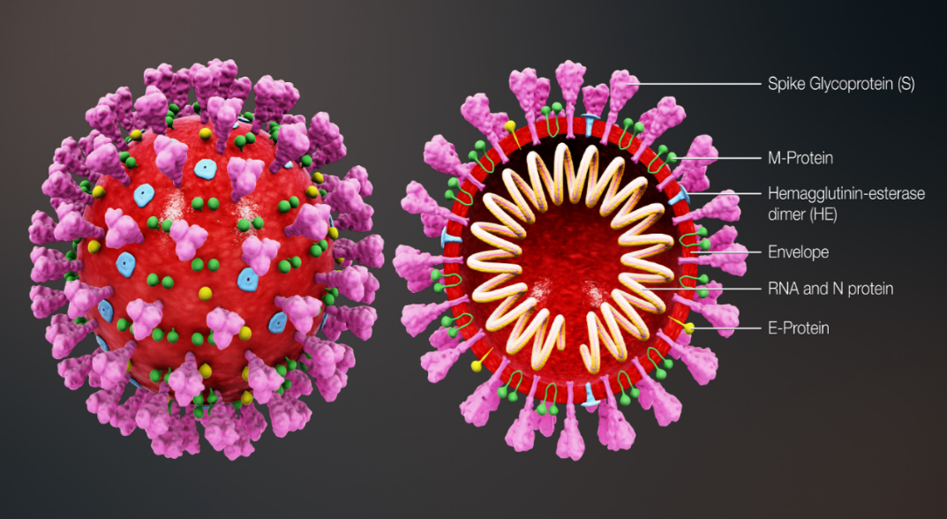
Coronavirus structure
the key parts of the coronavirus are the RNA and the spike proteins
the RNA is surrounded by an envelope which has different roles in the life cycle of the virus. These may include the assembly of new virus and helping new virus to leave the infected cell
the spike proteins (S) are anchored into the viral envelope and form a crown like appearance, like the solar corona, hence the name coronavirus. The spike proteins attach to the target cell and allow the virus to enter it
the RNA is inside the envelope and acts as a template so that once it is inside the host cell, the coronavirus can replicate itself and be released into the body
the spike protein and the RNA have been used to develop and make different vaccines to protect against SARS-CoV-2
Notes:
Diagram of coronavirus virion structure showing spikes that form a ‘crown’ like the solar corona, hence the name
https://commons.wikimedia.org/wiki/File:3D_medical_animation_coronavirus_structure.jpg

Slide 12
Transmission of COVID-19 infection
For transmission to occur, the SARS-CoV-2 virus needs to be transported to a susceptible person. To do this, it needs to have:
a portal of exit (from the place where it is living and replicating)
a mode of transmission (such as coughing or sneezing) and
a portal of entry (to the susceptible host)
COVID-19 spreads primarily from person to person through small droplets from the nose or mouth which are expelled when a person with COVID-19 coughs, sneezes, or speaks.
These droplets can also survive on objects and surfaces such as tables, doorknobs and handrails.
People can catch COVID-19 if they breathe in these droplets from a person infected with the virus or by touching contaminated objects or surfaces, then touching their eyes, nose or mouth (although this risk is now generally considered to be low)

Slide 13
COVID-19 Chain of infection
Infectious microbe
SARS-CoV-2
Reservoir
Place where the virus lives and replicates: people, animals
Susceptible host
Non-immune person
The chain of infection refers to the interaction between the pathogen, the host and the environment
Portal of exit
How the virus leaves the reservoir
Mouth or nose through coughing, sneezing or talking
Portal of entry
Mucous membrane of the nose and mouth
Modes of transmission
Person to person, airborne, direct contact with virus on a contaminated surface

Slide 14
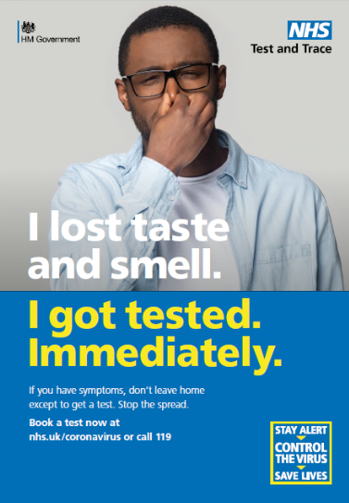
COVID-19 symptoms
The estimated incubation period is 3 to 6 days but can vary between 1 and 11 days.
Symptoms may vary by age but the key identifying symptoms of coronavirus are:
a new, continuous cough – coughing for more than an hour, or 3 or more coughing episodes in 24 hours
a high temperature
a loss or change to sense of smell or taste
Other symptoms reported include:
fatigue and lethargy
shortness of breath
headache
sore throat
aching muscles
diarrhoea and vomiting

Slide 15
COVID-19 symptom progression
Symptoms may begin gradually and are usually mild.
the majority of people (around 80%) have asymptomatic to moderate disease and recover without needing hospital treatment
around 15% may get severe disease including pneumonia
  older people and those with underlying medical problems such as high blood pressure, heart and lung problems, diabetes, or cancer are more likely to develop serious illness
around 5% become critically unwell. This may include septic shock and/or multi-organ and respiratory failure
The infection fatality rate (the proportion of deaths among all infected individuals) is estimated to be 0.9% but it varies according to age and sex. It is lower in younger people (0.5% for those 45 to 64 years) and higher in those over 75 years of age (11.6%).
Notes:
https://www.bmj.com/content/bmj/368/bmj.m800.full.pdf

Slide 16
Complications of COVID-19 disease
Complications from COVID-19 can be severe and fatal.
The risk of developing complications increases with age and is greater in those with underlying health conditions.
The type of complication that can develop may include:
venous thromboembolism
heart, liver and kidney problems
neurological problems
coagulation (blood clotting) failure
respiratory failure
multiple organ failure
septic shock
Notes:
https://bestpractice.bmj.com/topics/en-us/3000168/complications

Slide 17
COVID-19 complications in pregnancy
the serious risks posed to women who become infected with the SARS-CoV-2 virus during pregnancy have becoming increasingly clear as the COVID-19 pandemic has progressed
data from recent studies has shown that clinical outcomes following COVID-19 in pregnant women have worsened over the course of the pandemic as the variant has changed
the maternal mortality ratio (number of maternal deaths during a given time period) as a result of COVID-19 has significantly increased from 1.4 per 100,000 live births in the Wildtype SARS-CoV-2 dominant period to 5.4 per 100,000 live births in the Delta dominant period
during the Delta dominant period, six neonatal deaths were recorded whereas no neonatal deaths were reported in previous waves
the proportion of pregnant women hospitalised with symptomatic COVID-19 increased from Wildtype to subsequent Alpha and Delta dominant periods, and the proportion admitted to intensive care units also increased
Notes:
https://bestpractice.bmj.com/topics/en-us/3000168/complications
https://www.bmj.com/content/370/bmj.m3320

Slide 18
COVID-19 complications in pregnancy (cont)
pregnant and recently pregnant women with COVID-19 are more likely to be admitted to an intensive care unit, have invasive ventilation or extracorporeal membrane oxygenation in comparison to non-pregnant women of reproductive age.
UK studies have suggested a high rate of stillbirth in infected women and this appears to have increased during the Delta period.
transmission of infection from mother to infant appears rare. However, the risk of preterm birth is increased two to threefold for women with symptomatic COVID-19, usually as a result of a medical recommendation to deliver early to improve maternal oxygenation.
pregnant women are more likely to have severe COVID-19 infection if they are overweight or obese, are of black and asian minority ethnic background, have co-morbidities such as diabetes, hypertension and asthma, or are 35 years old or older
Notes:
https://bestpractice.bmj.com/topics/en-us/3000168/complications
https://www.bmj.com/content/370/bmj.m3320

Slide 19
Children and young people
fewer than 5% of COVID-19 cases are amongst children and they are more likely to have mild symptoms or asymptomatic infection
although cough and fever are the main symptoms in children, a UK study tracking children of healthcare workers showed that of those who were seropositive, gastrointestinal symptoms were also commonplace
a study of children and young people aged less than 19 years admitted to hospital with laboratory confirmed SARS-CoV-2 reported that the median age of those enrolled in the study was 4.6 years
of the 651 children and young people in the study, 42% had at least 1 other medical condition (co-morbidity). These included neurological conditions (11%), haematological, oncological or immunological conditions (8%) and asthma (7%)
Notes:
In one study, 11% of children and adolescents presented with fatigue, headache, myalgia, sore throat, lymphadenopathy and a low platelet count.
Clinical characteristics of children and young people admitted to hospital with covid-19 in United Kingdom: prospective multicentre observational cohort study
Olivia V Swann,1,2 Karl A Holden,3,4 Lance Turtle,5,6 Louisa Pollock,7 Cameron J Fairfield,8 Thomas M Drake,8 Sohan Seth,9 Conor Egan,9 Hayley E Hardwick,5 Sophie Halpin,10 Michelle Girvan,10 Chloe Donohue,10 Mark Pritchard,11 Latifa B Patel,12 Shamez Ladhani,13,14 Louise Sigfrid,15 Ian P Sinha,3,12 Piero L lliaro,15 Jonathan S Nguyen-Van-Tam,16,17 Peter W Horby,15 Laura Merson,15 Gail Carson,15 Jake Dunning,18,19 Peter J M Openshaw,19 J Kenneth Baillie,20,21 Ewen M Harrison,8 Annemarie B Docherty,8,21 Malcolm G Semple,4,5

Slide 20
Complications from COVID-19 in children and young people
an extremely rare but severe multisystem inflammatory syndrome occurring 2 to 4 weeks after the onset of COVID-19 has been identified in children and adolescents
known as ‘Paediatric multisystem inflammatory syndrome temporally associated with SARS-CoV-2 infection’ (PIMS-TS), this severe presentation in children is extremely rare, but appears to encompass a wide range of features, including fever, gastrointestinal symptoms, rash, myocardial injury and shock
PIMS-TS shares features with Kawasaki disease and toxic shock syndrome and can present in both the acute and convalescent phases of COVID-19 infection.
of the children admitted to hospital, 18% required critical care. This was associated with:
  age, particularly for those less than 1 month old and for those age 10 to14 years
  black ethnicity and
  admission to hospital for more than 5 days before symptom onset
other complications from COVID-19 in children and young people include fever, cardiac symptoms (myocarditis, heart failure) and GI symptoms (abdominal pain, diarrhoea, vomiting)
Notes:
MIS-C shares features with Kawasaki disease and toxic shock syndrome and can present in both the acute and convalescent phases of COVID-19 infection.
https://bestpractice.bmj.com/topics/en-us/3000168/complications

Slide 21
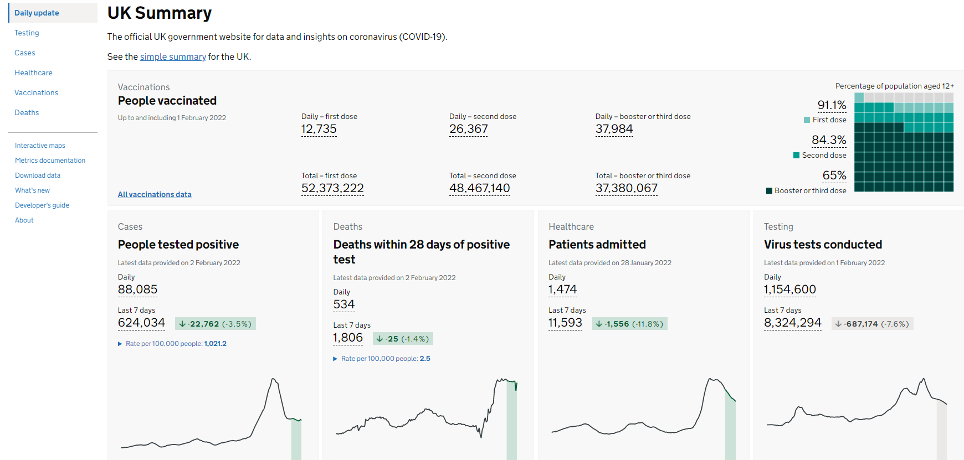
Coronavirus (COVID-19) epidemiology
The current UK epidemiology can be seen on the GOV.UK website at Coronavirus data.
This UK COVID-19 dashboard shows current
trend information for:
virus testing capacity
virus tests processed
people tested positive
deaths within 28 days of positive test
death from COVID-19 on death certificate
patients admitted
patients in hospital
patients in ventilator beds
number of people given first, second and
booster doses of vaccine
Notes:
https://coronavirus.data.gov.uk/?_ga=2.258492298.1207688930.1604066233-1632845157.1577466264

Slide 22
COVID-19 vaccine taskforce
it quickly became apparent that as the majority of the population was susceptible (non-immune) to the SARS-CoV-2 virus and the virus spreads easily, a safe and effective vaccine would be needed to prevent further cases
a COVID-19 vaccine prepares the immune system so that in the event of an exposure to the virus, it is able to respond and prevent or reduce the severity of infection
during April 2020, a UK vaccine taskforce was set up to support the development of a SARS-CoV-2 vaccine
the taskforce supported research and industry to rapidly develop and scale up the manufacture of a vaccine to protect the population

Slide 23
COVID-19 vaccine development
scientists, industry and other organisations have worked collaboratively across the globe to complete the different phases of vaccine development in parallel, rather than sequentially, to make a safe and effective vaccine available as soon as possible
by knowing the genetic code for the SARS-CoV-2 virus, various methods to create vaccines can be used such as using the code itself (mRNA vaccines) or inserting part of this code into existing viruses (viral vector vaccines)
over 300 different COVID-19 vaccines are in development, in trials or in use
some vaccines have been made using currently used vaccine technology, others have been made using new approaches or methods used during previous emergencies such as the SARS pandemic and west African Ebola
Notes:
For more information about COVID-19 vaccines in development, see the LSHTM COVID-19 vaccine tracker https://vac-lshtm.shinyapps.io/ncov_vaccine_landscape/.

Slide 24
Properties of an ideal vaccine
Ideally, a vaccine will:
produce the same immune protection which usually follows natural infection but without causing disease
generate long lasting immunity so that the person is protected if they are exposed to the antigen several years after vaccination
interrupt the spread of infection by preventing carriage of the organism in the vaccinated person
Vaccines need to be safe and the risk from any side effects should be much lower than the benefit of preventing deaths and serious complications of the disease.
For the COVID-19 vaccines, many of these properties can be confirmed from the clinical vaccine trials.
Longer term ongoing surveillance of the disease and of those vaccinated is informing:
how long vaccine protection is lasting and the need for booster doses
whether the vaccine prevents a vaccinated person from carrying and spreading the virus

Slide 25
Stages of vaccine trials
Vaccines are extensively tested through several different phases of trials
pre-clinical studies using tissue-culture, cell-culture or animal studies. At this stage, safety and immunogenicity (the ability of the vaccine to produce an immune response) are assessed. If pre-clinical studies are successful, the vaccine then goes through several different phases of vaccine trials in humans
phase I clinical trials are small-scale trials in healthy adult volunteers (generally 20 to 100) to assess whether the vaccine is safe in humans and type and extent of immune response it induces
phase II clinical trials are larger (several hundred healthy volunteers) and usually carried out in the target age group(s) the vaccine is likely to be used in. They are looking mainly to assess the efficacy of the vaccine against artificial infection and clinical disease. Vaccine safety, side-effects and immune response are also studied
phase III clinical trials involve the vaccine being studied on a large scale in many hundreds or thousands of subjects across several sites to evaluate efficacy under natural disease conditions and make sure that there are no unintended side effects not detected in phase II studies

Slide 26
Safety
before any of the COVID-19 vaccines can be authorised for widespread use in the population, the manufacturers have to demonstrate that they are safe and effective
tens of thousands of people across the world received COVID-19 vaccines in clinical trials
no serious adverse reactions to the vaccines were seen in the trial participants who received them
  any reactions reported were similar to those seen following other vaccines such as pain and tenderness at the injection site and fever, headache, muscle aches and fatigue
once vaccines are authorised and in use, the MHRA continually monitors their safety to ensure that the benefits continue to outweigh any risks
any reported adverse reactions are thoroughly investigated and the MHRA work with their international equivalent agencies to rapidly share safety data and reports
Notes:
In extensive vaccination campaigns such as the COVID-19 vaccination programme when vaccines are being given to huge numbers of people, it is normal for potential adverse events following immunisation to occur which were not seen in clinical trials. This does not necessarily mean that the events are linked to vaccination itself, but they must be investigated to ensure that any safety concerns are addressed quickly.

Slide 27
Safety (continued)
when vaccines are being given to huge numbers of people, it is normal for potential adverse events following immunisation to occur which were not seen in clinical trials
this does not necessarily mean that the events are linked to the vaccination itself, but they are investigated to ensure that any safety concerns are addressed quickly
if it is thought that the adverse event may be, or is linked to vaccination, advice about use of that vaccine is carefully considered
for example, following widespread use of the AstraZeneca COVID-19 vaccination, a rare condition involving serious thromboembolic (blood clotting) events accompanied by thrombocytopaenia (low platelets) has been reported. After thorough assessment of the overall risk benefit of the use of the AstraZeneca vaccine in the UK population, the JCVI advised that adults aged under 40 without underlying health conditions that put them at higher risk of severe COVID-19 disease, should be offered an alternative COVID-19 vaccine to the AstraZeneca vaccine.
other conditions (such as Guillain-Barré syndrome, myocarditis, pericarditis, transverse myelitis and capillary leak syndrome) have also been reported and investigated
Notes:
In extensive vaccination campaigns such as the COVID-19 vaccination programme when vaccines are being given to huge numbers of people, it is normal for potential adverse events following immunisation to occur which were not seen in clinical trials. This does not necessarily mean that the events are linked to vaccination itself, but they must be investigated to ensure that any safety concerns are addressed quickly.

Slide 28
Effectiveness
Manufacturers of the COVID-19 vaccines need to show evidence that they will be effective
they can do this by showing a reduction in virus levels in animal studies where the vaccines were used and that people in the trials have made an antibody response to the vaccine
vaccine effectiveness can be calculated by comparing the number of cases of COVID-19 disease in trial participants who received the COVID-19 vaccine with the number of trial participants who received the placebo or alternative (non-COVID-19) vaccine
Those running clinical trials may look at antibody response:
      after 1 dose, 2 doses, booster doses
      at different dosages of the vaccine and different vaccine combinations
      with different time intervals between vaccine doses
      in different age groups
Over time, they also look at:
how long the antibodies last and the effect on antibody levels if a booster dose is given
whether the vaccine only stops people from becoming severely ill or if it also stops them spreading the virus too

Slide 29
Real world effectiveness
now that COVID-19 vaccines are in general use in the UK population, the impact and effectiveness of the COVID-19 vaccination programme on symptomatic disease, hospitalisation, death and infection is being actively monitored
the COVID-19 vaccination programme in England has been estimated to have prevented between over 24.4 million infections and between 127,500 deaths in the UK up to 24 September 2021
estimates also indicate the vaccination programme has prevented over 261,500 hospitalisations in England in those aged 45 years and over
COVID-19 vaccine effectiveness for preventing symptomatic disease with the Delta variant following 2 doses is estimated at between 65 to 95%, with higher levels of protection against severe disease including hospitalisation and death
studies show the COVID-19 vaccines also have the potential to reduce transmission; one UK study showed those who do become infected 3 weeks after receiving one dose of the Pfizer BioNTech or AstraZeneca vaccine were between 38% and 49% less likely to pass the virus on to their household contacts than those who were unvaccinated
Notes:
Further information about this can be found at https://www.gov.uk/guidance/monitoring-reports-of-the-effectiveness-of-covid-19-vaccination
Lopez Bernal J and others. ‘Early effectiveness of COVID-19 vaccination with BNT162b2 mRNA vaccine and ChAdOx1 adenovirus vector vaccine on symptomatic disease, hospitalisations and mortality in older adults in England’ https://www.medrxiv.org/content/10.1101/2021.03.01.21252652v1
Hall VJ and others. ‘Effectiveness of BNT162b2 mRNA Vaccine Against Infection and COVID-19 Vaccine Coverage in Healthcare Workers in England, Multicentre Prospective Cohort Study (the SIREN Study)’ Available at SSRN: https://ssrn.com/abstract=3790399 or http://dx.doi.org/10.2139/ ssrn.3790399
Harris RJ and others. ‘Impact of vaccination on household transmission of SARS-COV-2 in England’ https://khub.net/documents/135939561/390853656/Impact+of+vaccination+on+household+transmission+of+SARS-COV-2+in+England.pdf/35bf4bb1-6ade-d3eb-a39e-9c9b25a8122a?t=1619601878136
Shrotri M and others. ‘Vaccine effectiveness of the first dose of ChAdOx1 nCoV-19 and BNT162b2 against SARS-CoV-2 infection in residents of Long-Term Care Facilities (VIVALDI study)’ medRxiv [preprint], doi: 10.1101/2021.03.26.21254391
Shah A and others. ‘Effect of vaccination on transmission of COVID-19: an observational study in healthcare workers and their households’ View ORCID Profile doi: https://doi.org/10.1101/2021.03.11.2125 3275

Slide 30
Real world effectiveness (cont)
with the emergence of the heavily mutated Omicron variant, two doses of COVID-19 vaccine appear to be less effective at preventing infection from this variant compared to the Delta variant and protection declines to very low levels six months after the primary course
importantly however, they should still greatly reduce the risk of severe illness and hospitalisation
for this reason, the JCVI recommended that all adults aged 18 years and over receive a booster dose at least 3 months after completing their two-dose primary course.
boosting should improve both the quality and quantity of antibodies made as well as boosting the T-cell response
in the UK, early studies have shown a major increase in levels of protection after the booster dose against both symptomatic disease and hospitalisation due to the Delta variant
preliminary vaccine effectiveness data for Omicron confirms that protection against symptomatic disease soon after an mRNA booster dose is around 70 to 75% regardless of which vaccines were given for the primary course
more recent analysis confirms that protection after the booster has declined substantially after 10 weeks, although additional protection against hospitalisation is clearly seen
Notes:
Further information about this can be found at https://www.gov.uk/guidance/monitoring-reports-of-the-effectiveness-of-covid-19-vaccination
Lopez Bernal J and others. ‘Early effectiveness of COVID-19 vaccination with BNT162b2 mRNA vaccine and ChAdOx1 adenovirus vector vaccine on symptomatic disease, hospitalisations and mortality in older adults in England’ https://www.medrxiv.org/content/10.1101/2021.03.01.21252652v1
Hall VJ and others. ‘Effectiveness of BNT162b2 mRNA Vaccine Against Infection and COVID-19 Vaccine Coverage in Healthcare Workers in England, Multicentre Prospective Cohort Study (the SIREN Study)’ Available at SSRN: https://ssrn.com/abstract=3790399 or http://dx.doi.org/10.2139/ ssrn.3790399
Harris RJ and others. ‘Impact of vaccination on household transmission of SARS-COV-2 in England’ https://khub.net/documents/135939561/390853656/Impact+of+vaccination+on+household+transmission+of+SARS-COV-2+in+England.pdf/35bf4bb1-6ade-d3eb-a39e-9c9b25a8122a?t=1619601878136
Shrotri M and others. ‘Vaccine effectiveness of the first dose of ChAdOx1 nCoV-19 and BNT162b2 against SARS-CoV-2 infection in residents of Long-Term Care Facilities (VIVALDI study)’ medRxiv [preprint], doi: 10.1101/2021.03.26.21254391
Shah A and others. ‘Effect of vaccination on transmission of COVID-19: an observational study in healthcare workers and their households’ View ORCID Profile doi: https://doi.org/10.1101/2021.03.11.2125 3275

Slide 31
Post authorisation surveillance
On-going studies of vaccines continue after the vaccine has been authorised for use. These studies aim to assess long term efficacy and to detect any rare adverse effects because in real life administration, compared to pre-licensure trials, there will be:
some variability in preparation of the vaccine as vaccines will come from different batches
possible variability in stability and storage, for example the cold chain may not be as rigidly maintained in practice as it was in a clinical trial
use of the vaccines in different groups than in pre-authorisation studies, for example they will be given to people with underlying medical conditions who would not necessarily have been included in a pre-licensure/pre-authorisation clinical trial
mutations in the virus which may result in the vaccine being less effective

Slide 32
Regulatory approval and licencing
in the UK, vaccine manufacturers apply to the Medicines and Healthcare products Regulatory Agency (MHRA) for a product licence but they may issue a temporary authorisation (Conditional Marketing Authorisation) ahead of the full UK product licence
in exceptional situations, the MHRA may enact Regulation 174. This enables them to temporarily authorise the supply of an unlicensed medicinal product in response to certain identified public health risks, such as the SARS-CoV-2 pandemic
the MHRA assess all of the available safety, quality and efficacy data and considers whether the evidence supports the use of the vaccine under the legal basis of regulation 174 until it can be licensed
the process involves the same level of scrutiny as the usual licensing process and this exception is only used when strictly necessary to speed up access to a potentially life-saving intervention

Slide 33
COVID-19 Vaccines
In the UK, 4 COVID-19 vaccines are currently in use in the UK national COVID-19 vaccination programme:
1) COVID-19 Vaccine Pfizer BioNTech (Comirnaty 30 micrograms/dose)
  given authorisation for temporary supply by the MHRA on 2 December 2020 and then granted Conditional Marketing Authorisation (CMA) on 9 July 2021. This vaccine is authorised for adults and adolescents from the age of 12 years
2) COVID-19 Vaccine Pfizer BioNTech (Comirnaty 10 micrograms/dose)
  granted CMA on 22 December 2022. This vaccine is authorised for children from 5 to 11 years of age
3) COVID-19 Vaccine AstraZeneca (Vaxzevria)
  given authorisation for temporary supply by the MHRA on 30 December 2020 and then granted CMA on 24 June 2021. This vaccine is authorised for adults from 18 years of age but see specific recommendations for use of this vaccine
4) COVID-19 Vaccine Moderna (Spikevax)
  given authorisation for temporary supply by the MHRA on 8 January 2021 and then granted CMA on 1 April 2021. This vaccine is authorised from 12 years of age but it is not currently recommended it is given to those under 18 years of age

Slide 34
COVID-19 mRNA vaccines (Pfizer BioNTech and Moderna)
the Pfizer BioNTech and Moderna COVID-19 vaccines are messenger ribonucleic acid (mRNA) vaccines
they contain the genetic sequence (mRNA) for the spike protein which is found on the surface of the SARS-CoV-2 virus, wrapped in a lipid envelope (referred to as a nanoparticle) to enable it to be transported into the cells in the body
when injected, the mRNA is taken up by the host’s cells which translate the genetic information and produce the spike proteins
these are then displayed on the surface of the cell. This stimulates the immune system to produce antibodies and activate T-cells which prepare the immune system to respond to any future exposure to the SARS-CoV-2 virus by binding to and disabling any virus encountered
as there is no whole or live virus involved, the vaccine cannot cause disease. The mRNA naturally degrades after a few days

Slide 35
Viral vector COVID-19 vaccine (AstraZeneca)
AstraZeneca COVID-19 vaccine is a non-replicating viral vector vaccine which uses part of a weakened adenovirus as a carrier to deliver the genetic sequence for the SARS-CoV-2 spike protein into cells
the adenovirus has been modified so that it cannot replicate in human cells and therefore cannot cause any disease
once it has delivered the SARS-CoV-2 spike protein genetic code, the adenovirus is destroyed by the body
the genes that encode for the spike protein on the SARS-CoV-2 virus have been inserted into the adenovirus's genetic code to make the vaccine
when the vaccine is injected, the modified adenovirus binds to the surface of human cells and delivers the genetic code for the spike protein. The cells then process this genetic code and manufacture the spike protein
this then stimulates the immune system which reacts by producing antibodies and memory cells to the SARS-CoV-2 virus without causing disease

Slide 36
Vaccine interchangeability
evidence from trials suggest those who receive mixed schedules of different COVID-19 vaccines make a good immune response, although rates of side effects following the second dose are higher compared to those who received the same vaccine for both doses
because of this increased risk of side effects, every effort should be made to determine which vaccine the individual received for their first dose and to complete the 2 dose course with the same vaccine (unless contraindicated)
individuals who do receive a different vaccine for their second dose should be informed that they may experience more reactions to the second dose
for individuals who started the schedule and who attend for vaccination at a site where the same vaccine is not available (for example first dose given abroad), or where the first product received is unknown, it is reasonable to offer a single dose of the locally available product if suitable and not contraindicated
this option is preferred if that individual is likely to be at immediate high risk or is considered unlikely to attend again

Slide 37
Key factors that inform UK vaccination policy
The Joint Committee on Vaccines and Immunisation (JCVI) consider the following before making vaccination policy recommendations to the Department of Health and Social Care (DHSC):
1. Availability of a safe and effective vaccine:
  there are currently over 300 COVID-19 vaccines in development, being trialled or in use
  vaccines undergo extensive and vigorous testing before they are licensed and authorised for use as they have to be able to demonstrate quality, efficacy and safety
2. Whether there is a need for a vaccination programme:
  SARS-CoV-2 has caused a significant public health problem, transmission is widespread and has been sustained despite various interventions
  the virus affects all age groups and there have been frequent outbreaks in nursing and residential homes, schools and communities
  there is significant morbidity and mortality in certain groups. There are multi-system complications from having the disease and there have been over a hundred and fifty thousand deaths from COVID-19 in the UK

Slide 38
Designing and implementing a vaccination programme
Key national bodies involved in the design and implementation of vaccination programmes include:
Department of Health and Social Care (DHSC) – responsible for vaccine policy decisions and finance for vaccine programmes
Medicines and Healthcare products Regulatory Agency (MHRA) – responsible for independent oversight of all aspects of vaccine manufacture and regulation including the licensing of vaccines and the Yellow Card adverse event reporting scheme
UK Health Security Agency (UKHSA) – responsible for the national planning, leadership, procurement and supply of vaccines used for the national vaccination schedule and for on-going surveillance to inform the programmes
National Institute for Biological Standards and Control (NIBSC) – responsible for evaluating the quality and biological activity of vaccines and for official batch release testing before release
NHS England and NHS Improvement (NHSEI) – responsible for the commissioning, implementation and delivery of immunisation programmes through local teams

Slide 39
Other agencies
Many other agencies have a key role in the design, development and implementation of vaccination programmes at a national, regional and local level to ensure the key components of a successful vaccination programme come together
These components include:
vaccine development
vaccine supply and delivery
surveillance of vaccine coverage
surveillance of population susceptibility to the disease
surveillance of disease in the population
adverse events and vaccine safety surveillance
monitoring attitudes to vaccination
communication
modelling to predicting the future impact of vaccination programmes

Slide 40
COVID-19 vaccine programme considerations
The overall aim of the COVID-19 vaccination programme is to protect those who are at most risk from serious illness or death.
In order to advise which groups of patients to vaccinate and in which order to prioritise vaccination of these groups, the JCVI considered all the available relevant information on:
vaccine efficacy and/or immunogenicity and the safety of administration in different age and risk groups
the effect of the vaccine on acquisition of infection and transmission
the epidemiological, microbiological and clinical characteristics of COVID-19
From this, they then made recommendations to the DHSC and planning to deliver vaccine and maximise uptake in these groups began.

Slide 41
Priority groups for COVID-19 vaccination
JCVI made recommendations as to how COVID-19 vaccine should be offered by identifying the priority groups for vaccination and the order in which they should be vaccinated
prioritisation ensured that those at highest risk of severe illness and death were offered vaccine early, as were those at risk of transmitting infection to multiple vulnerable persons or other staff in a health or social care setting
the priority groups were selected based on the epidemiology of the infection observed since the start of the pandemic: their risk of severe disease, mortality and other considerations such as ethnicity, deprivation and occupation
evidence from the UK indicates that the risk of poorer outcomes from COVID-19 infection increases dramatically with age in both healthy adults and in adults with underlying health conditions
those over the age of 65 years have by far the highest risk, and the risk increases with age
full details on vaccine eligibility, with detail on the at-risk conditions, are included in the Green Book COVID-19 chapter
Notes:
JCVI advises that the first priorities for the COVID-19 vaccination programme should be the prevention of mortality and the maintenance of the health and social care systems. As the risk of mortality from COVID-19 increases with age, prioritisation is primarily based on age. The order of priority for each group in the population corresponds with data on the number of individuals who would need to be vaccinated to prevent one death, estimated from UK data obtained from March to June 2020

Slide 42
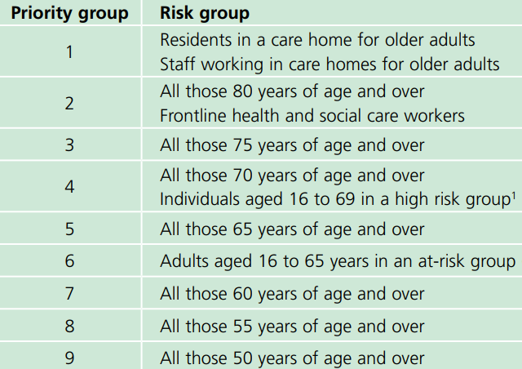
Vaccine priority groups: Phase One
¹ Previously known as clinically extremely vulnerable
Notes:
JCVI advice 30 December 2020 available at:
https://www.gov.uk/government/publications/priority-groups-for-coronavirus-covid-19-vaccination-advice-from-the-jcvi-30-december-2020/joint-committee-on-vaccination-and-immunisation-advice-on-priority-groups-for-covid-19-vaccination-30-december-2020
It is estimated that taken together, these groups represent around 99% of preventable mortality from COVID-19.

Slide 43
Phase Two
Once all 9 groups in the first phase had been offered at least 1 dose of vaccine, JCVI advised that the offer of vaccination during Phase 2 should continue to be age-based starting with the oldest adults first and proceeding in the following order:
all those aged 40 to 49 years
all those aged 30 to 39 years
all those aged 18 to 29 years
From June 2021, all adults aged 18 years and over in England were invited to book their first vaccination.
Individuals in both phases who have not yet been vaccinated remain eligible for vaccination.
Continued efforts should be made to offer them the vaccine and to complete delivery of second doses to all those given first doses.
As there is an increased risk of hospitalisation in males, those from certain ethnic minority backgrounds, those who are obese or morbidly obese, and those from socio-economically deprived areas, JCVI advises that specific focus should be used to promote and deliver vaccination to these groups.

Slide 44
Older adults resident in a care home
there is clear evidence that those living in residential care homes for older adults have been disproportionately affected by COVID-19
those living in care homes have a high risk of exposure to infection due to their close contact with staff (including bank staff) and other residents including those residents returning to the care home from hospital
the closed setting of the care home also increases the risk of outbreaks occurring as any asymptomatic residents and staff could be potential reservoirs for on-going transmission
given the increased risk of outbreaks, morbidity and mortality in these closed settings, older adults in care homes are considered to be at very high risk
JCVI advised that this group should be the highest priority for vaccination
vaccination of residents and staff at the same time is considered to be a highly efficient strategy within a mass vaccination programme with the greatest potential impact
from 11 November 2021, it became a mandatory requirement for people working in care homes to be fully vaccinated against COVID-19

Slide 45
Older adults
older adults are considered to be at very high risk if they develop COVID-19 infection
evidence strongly indicates that the single greatest risk of mortality from COVID-19 is increasing age and that the risk increases exponentially with age
disease severity, risk of hospitalisation and mortality increase from age 50 upwards, with the highest risk in those aged 80 years and above
data indicates that the absolute risk of mortality is higher in those over 65 years than that seen in the majority of younger adults with an underlying health condition
Notes:
Vivaldi 1: COVID-19 care homes study report
Investigation of SARS-CoV-2 outbreaks in six care homes in London, April 2020

Slide 46
Groups with underlying health conditions
As well as age, other risk factors have been identified that place individuals at risk of serious disease or death from COVID-19. These include groups with certain underlying health conditions and may include people who have:
chronic (long-term) respiratory disease
chronic heart disease
chronic kidney disease
chronic liver disease
chronic neurological disease
diabetes
a weakened immune system due to disease or treatment
asplenia or dysfunction of the spleen
morbid obesity (defined as BMI of 40 and above)
severe mental illness
pregnancy (all trimesters)
Detailed information giving examples of conditions in each of the clinical risk groups which would make individuals eligible for vaccination is provided in the COVID-19 Green Book chapter.
Notes:
www.gov.uk/government/publications/priority-groups-for-coronavirus-covid-19-vaccination-advice-from-the-jcvi-25-september-2020/jcvi-updated-interim-advice-on-priority-groups-for-covid-19-vaccination#fn:1
When compared to persons without underlying health conditions, the absolute increased risk in those with underlying health conditions is considered generally to be lower than the increased risk in persons over the age of 65 years (with the exception of the clinically extremely vulnerable

Slide 47
Pregnancy (1)
given that the majority of pregnant women who have been admitted to hospital with severe COVID-19 are unvaccinated, women who are pregnant should be strongly encouraged to receive both primary doses and a booster dose to protect both themselves and their baby
in December 2021, the JCVI announced that pregnancy should be considered a clinical risk group within the COVID-19 vaccination programme
studies following the use of the COVID-19 vaccines in pregnant women have shown the vaccines to be safe and highly effective in preventing serious complications
there is no known risk associated with giving non-live vaccines during pregnancy. Since these vaccines cannot replicate, they cannot cause infection in either the woman or the unborn child
Notes:
Further information about the safety of COVID-19 vaccines when given in pregnancy is available on the GOV.UK website (www.gov.uk/government/publications/safety-of-covid-19-vaccines-when-given-in-pregnancy/the-safety-of-covid-19-vaccines-when-given-in-pregnancy)

Slide 48
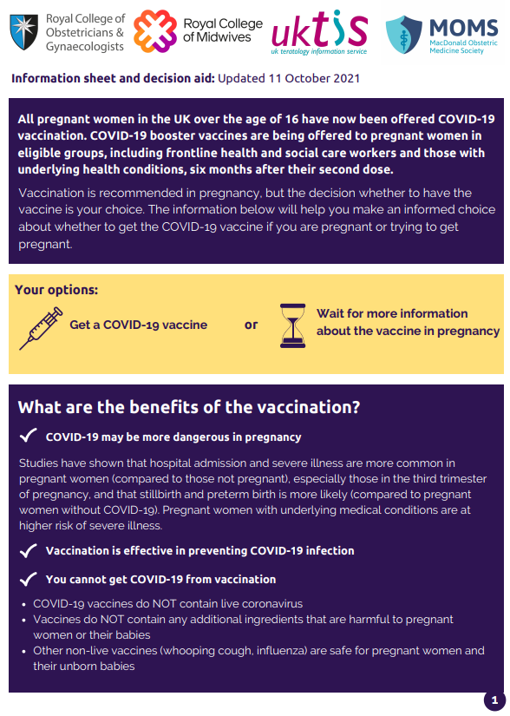
Pregnancy (2)
there is now extensive post-marketing experience of the use of the Pfizer BioNTech and Moderna vaccines in the USA and also in England, Wales and Scotland where over 100,000 pregnant women have been vaccinated
these two vaccine are therefore the preferred vaccines to offer pregnant women aged 18 years and over because of more extensive experience of their use in pregnancy. Pregnant women under the age of 18 years should be offered Pfizer BioNTech vaccine
routine questioning about last menstrual period and/or pregnancy testing is not required before offering the vaccine
women who are planning pregnancy or in the immediate postpartum can be vaccinated with a suitable product for their age and clinical risk group
if a woman finds out she is pregnant after she has started a course of COVID-19 vaccine she may complete vaccination during pregnancy using the same vaccine product
termination of pregnancy following inadvertent immunisation should not be recommended
The Royal College of Obstetricians and Gynaecologists and Royal College of Midwives websites have information on COVID-19
vaccines and pregnancy

Slide 49
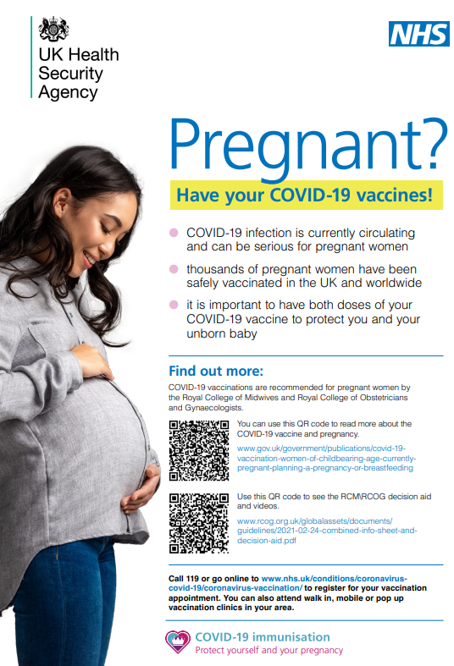
Messages for pregnant women
although the overall risk from COVID-19 disease in pregnant women and their new babies is low, in later pregnancy some women may become seriously unwell and need hospital treatment
hospital admission and severe illness may be more common in pregnant women than in women of the same age who are not pregnant
pregnant women with COVID-19 disease are more likely to have their babies early than women without COVID-19
pregnant women with underlying clinical conditions are at higher risk of suffering serious complications from COVID-19
the COVID-19 vaccines available in the UK have been shown to be effective and safe and are recommended in pregnancy
these vaccines do not contain live coronavirus and cannot infect a pregnant woman or her unborn baby in the womb
vaccination is the best way to protect against the known risks of COVID-19 in pregnancy for both women and babies
it is important that pregnant women have their vaccination as soon as they are invited and that they receive both doses

Slide 50
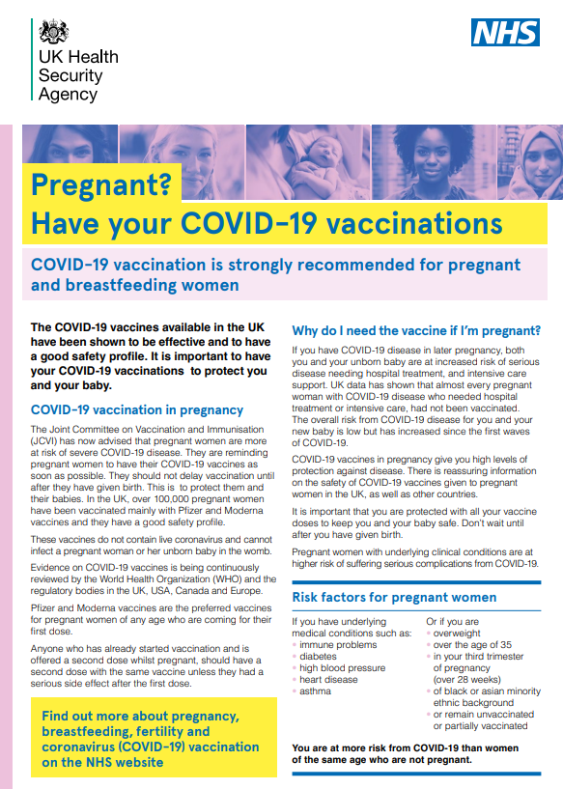
Breastfeeding
there is no known risk associated with giving non-live vaccines whilst breastfeeding
JCVI advises that breastfeeding women should be offered any suitable COVID-19 vaccine
women should not stop breastfeeding in order to be vaccinated
Golan and others (2021) found that mRNA vaccine was not detected in breast milk
Juncker and others (2021) found that following vaccination with Pfizer BioNTech mRNA vaccine, protective SARS-CoV-2 specific antibody was observed in breast milk
the developmental and health benefits of breastfeeding are clear and should be discussed with the woman, along with her clinical need for immunisation against COVID-19
Notes:
Golan Y and others (2021) ‘COVID-19 mRNA vaccine is not detected in human milk’ 8 March 2021 https://www.medrxiv.org/content/10.1101/2021.03.05.21252998v1
Juncker H and others (2021). The Levels of SARS- CoV-2 Specific Antibodies in Human Milk Following Vaccination Journal of Human Lactation 27 June 2021 https://doi.org/10.1177/08903344211027112

Slide 51
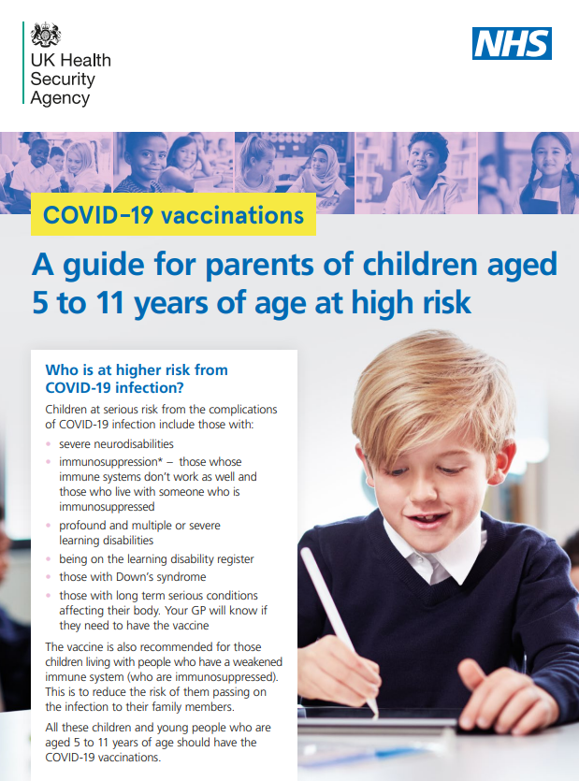
Children aged 5 to 11 years in at risk groups
On 22 December 2021, the JCVI recommended that children aged 5 to 11 years in the following two groups should be offered two 10 microgram doses of the Pfizer BioNTech Comirnaty vaccine with an interval of 8 weeks between the first and second doses:
children in a recognised clinical risk group who are at higher risk of severe
COVID-19
  this includes children who are about to commence immunosuppressive treatment
children who are a household contact of someone who is immunosuppressed
  defined as those who expect to share living accommodation on most days (and therefore for whom continuing close contact is unavoidable) with individuals of any age who are immunosuppressed
eligible children aged 5 to 11 years should receive the Pfizer BioNTech Comirnaty 10 micrograms/dose COVID-19 vaccine formulated for use in this age group
Notes:
www.gov.uk/government/publications/jcvi-update-on-advice-for-covid-19-vaccination-of-children-and-young-people/jcvi-statement-on-covid-19-vaccination-of-children-and-young-people-22-december-2021

Slide 52
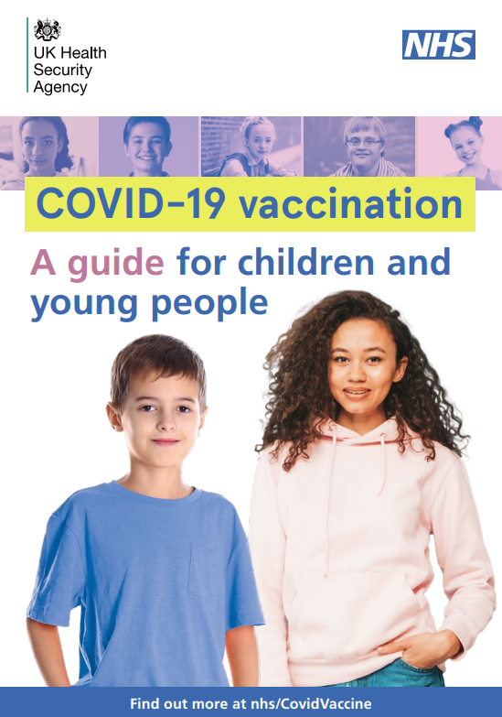
Children and young people aged 12 to 15 years
on 13 September 2021, the UK Chief Medical Officers recommended that all 12 to 15 year olds should be offered a first dose of COVID-19 vaccine to:
    reduce the chances of them catching COVID-19
    reduce the number of outbreaks in schools
    help avoid school absences
    help avoid disruption to face-to-face education
on 29 November 2021, the JCVI recommended that all young people in this age group be offered a second dose 12 weeks from the first dose
the Pfizer BioNTech Comirnaty 30 micrograms/dose vaccine should be used for those aged from 12 years
Notes:
https://www.gov.uk/government/publications/universal-vaccination-of-children-and-young-people-aged-12-to-15-years-against-covid-19/universal-vaccination-of-children-and-young-people-aged-12-to-15-years-against-covid-19
https://www.gov.uk/government/publications/uk-vaccine-response-to-the-omicron-variant-jcvi-advice/jcvi-advice-on-the-uk-vaccine-response-to-the-omicron-variant

Slide 53
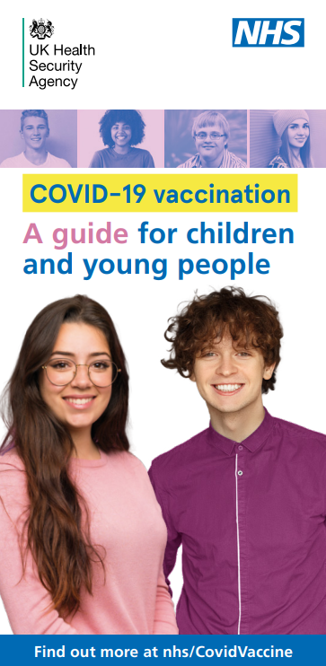
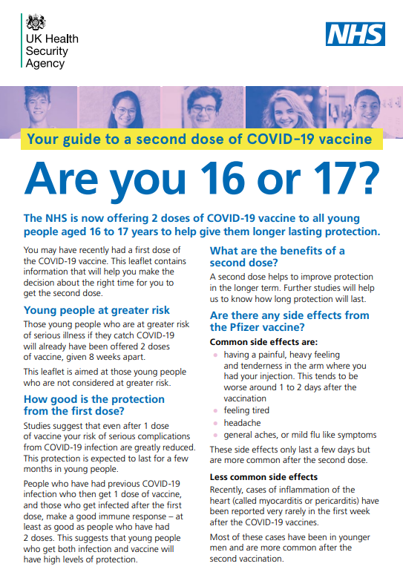
Young people aged 16 and 17 years
(not in an at risk group)
on 4 August 2021, the JCVI recommended all 16 to 17 year olds should be offered a first dose of the Pfizer BioNTech vaccine
on 15 November 2021, the JCVI recommended that those in this age group who are not in an at-risk group should be offered a second dose after an interval of at least 12 weeks
on 22 December 2021, the JCVI advised that young people aged 16 to 17 years should be offered a booster dose of the Pfizer BioNTech COVID-19 vaccine at least 3 months from their last primary dose
Notes:
https://www.gov.uk/government/publications/jcvi-statement-august-2021-covid-19-vaccination-of-children-and-young-people-aged-12-to-17-years/jcvi-statement-on-covid-19-vaccination-of-children-and-young-people-aged-12-to-17-years-4-august-2021
https://www.gov.uk/government/publications/universal-vaccination-of-children-and-young-people-aged-12-to-15-years-against-covid-19/universal-vaccination-of-children-and-young-people-aged-12-to-15-years-against-covid-19

Slide 54
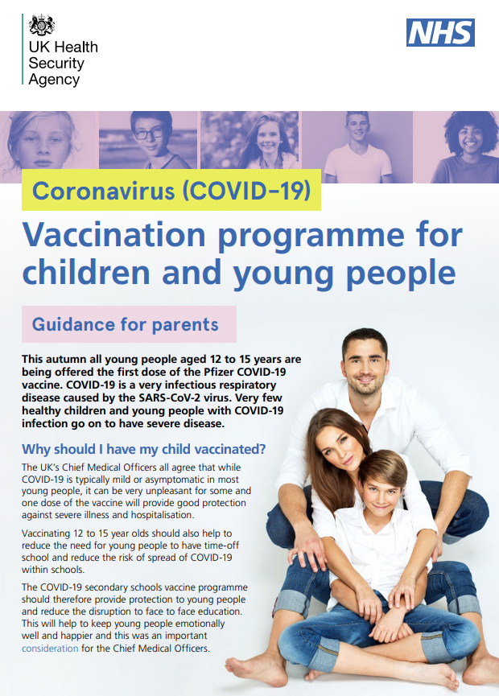
12 week dose interval for young people aged 12 to 17 years
for 12 to 17 year olds not in an at-risk group, a 12-week interval between doses is preferred
this interval reflects the strong evidence of high levels of protection against severe disease from the first dose
emerging evidence also suggests that countries with longer schedules (8 to 12 weeks) may have a lower rate of myocarditis after the second dose
although this latter evidence is limited, JCVI have taken a precautionary approach to mitigate the very rare risk of post-vaccine myocarditis
Notes:
https://www.gov.uk/government/publications/jcvi-statement-august-2021-covid-19-vaccination-of-children-and-young-people-aged-12-to-17-years/jcvi-statement-on-covid-19-vaccination-of-children-and-young-people-aged-12-to-17-years-4-august-2021
https://www.gov.uk/government/publications/universal-vaccination-of-children-and-young-people-aged-12-to-15-years-against-covid-19/universal-vaccination-of-children-and-young-people-aged-12-to-15-years-against-covid-19

Slide 55
Young people aged 12 to 17 years with underlying medical conditions
Children from 12 years in the following groups are recommended to receive 2 doses of vaccine 8 weeks apart:
Children and young people aged 12 years and over with specific underlying health conditions that put them at risk of serious COVID-19
  chronic respiratory disease, heart conditions, kidney, liver and digestive system conditions and chronic neurological disease
  endocrine disorders
  immunosuppression due to disease or treatment
  asplenia or dysfunction of the spleen
  serious genetic abnormalities that affect a number of systems
  pregnancy
Children and young people aged 12 years and over who are household contacts of immunosuppressed individuals
  who expect to share living accommodation on most days (and for whom continuing close contact is unavoidable) with individuals of any age who are immunosuppressed
a booster dose should be given 3 months after last primary dose to both of these groups
Further detail about these groups is provided in the Green Book COVID-19 chapter
Notes:
https://www.gov.uk/government/publications/jcvi-statement-august-2021-covid-19-vaccination-of-children-and-young-people-aged-12-to-17-years/jcvi-statement-on-covid-19-vaccination-of-children-and-young-people-aged-12-to-17-years-4-august-2021

Slide 56
Vaccination of children and young people who have had SARS-CoV-2 infection
it is recommended that vaccination should ideally be deferred until 12 weeks from onset (or sample date) of SARS-CoV-2 infection in children and young people under 18 years who are not in high risk groups
in younger people, protection from serious complications in those who have had infection is likely to be high for a period of months
limited evidence suggests that countries with longer intervals between primary doses (eight to twelve weeks) may have a lower rate of myocarditis after the second dose.
based on extrapolation from this limited evidence, JCVI have taken a precautionary approach to mitigate the very rare risk of post-vaccine myocarditis
current advice for children who have developed Paediatric multisystem inflammatory syndrome temporally associated with SARS-CoV-2 infection (PIMS-TS) suggests that an interval of 12 weeks should be observed, although earlier administration can be considered in those at risk of infection and/or who are fully recovered
this recommendation does not affect those aged 5 to 17 in clinical at-risk groups. These individuals should be offered COVID-19 vaccine if they are 4 weeks post a positive test

Slide 57
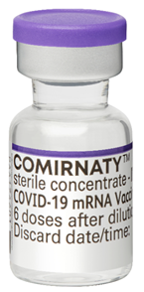
Which vaccine for young people aged 12 to 17 years?
currently, the Pfizer BioNTech Comirnaty 30 micrograms/dose vaccine is the preferred vaccine for those less than 18 years of age in the UK
although the Moderna vaccine is also approved from 12 years of age, the Pfizer vaccine is currently preferred due to a lower reported rate of myocarditis
young people aged 16 to 17 years who have had a first dose of AstraZeneca vaccine, can complete with the same vaccine or with an mRNA product (provided there are no contraindications)
Notes:
https://www.gov.uk/government/publications/jcvi-statement-august-2021-covid-19-vaccination-of-children-and-young-people-aged-12-to-17-years/jcvi-statement-on-covid-19-vaccination-of-children-and-young-people-aged-12-to-17-years-4-august-2021
https://www.gov.uk/government/publications/universal-vaccination-of-children-and-young-people-aged-12-to-15-years-against-covid-19/universal-vaccination-of-children-and-young-people-aged-12-to-15-years-against-covid-19

Slide 58
Summary table of COVID-19 vaccine recommendations for children and young people aged 5 to 17 years
Group | Recommendation
Children aged 5 to 11 with specific underlying health conditions that put them at risk of severe COVID-19 or who are household contacts of an immunosuppressed person | Offer two 10 microgram doses of the Pfizer BioNTech Comirnaty 10 microgram/dose vaccine with an interval of 8 weeks between doses Offer a third primary dose to those who had severe immunosuppression at/around the time of their first or second primary COVID-19 doses
Children aged 12 to 15 with specific underlying health conditions that put them at risk of severe COVID-19 | Offer two 30 microgram doses of the Pfizer BioNTech Comirnaty 30 microgram/dose vaccine with an interval of 8 weeks between doses Offer a booster dose at least 3 months after completion of primary course
Children and young people aged 12 years and over who are severely immunosuppressed | Offer two 30 microgram doses of the Pfizer BioNTech Comirnaty 30 microgram/dose vaccine with an interval of 8 weeks between doses Offer a third primary dose to those who had severe immunosuppression at/around the time of their first or second primary COVID-19 doses Offer a booster dose at least 3 months after completion of primary course
Children and young people aged 12 and over who are household contacts of an immunosuppressed person | Offer two 30 microgram doses of the Pfizer BioNTech Comirnaty 30 microgram/dose vaccine with an interval of 8 weeks between doses Offer a booster dose at least 3 months after completion of primary course
Young people aged 16 and 17 in a clinical risk group or who work in health and social care | Offer two 30 microgram doses of the Pfizer BioNTech Comirnaty 30 microgram/dose vaccine with an interval of 8 weeks between doses Offer a booster dose at least 3 months after completion of primary course
All other young people aged 12 to 15 not in an at risk group | Offer two 30 microgram doses of the Pfizer BioNTech Comirnaty 30 microgram/dose vaccine with an interval of 12 weeks between doses
All other young people aged 16 and 17 not in an at risk group | Offer two 30 microgram doses of the Pfizer BioNTech Comirnaty 30 microgram/dose vaccine with an interval of 12 weeks between doses Offer a booster dose at least 3 months after completion of primary course

Slide 59
Deprivation and ethnicity
there is clear evidence that certain Black, Asian and minority ethnic (BAME) groups have higher rates of infection, and higher rates of serious disease, morbidity and mortality from SARS-Cov-2 infection
there is no strong evidence that ethnicity by itself (or genetics) is the sole explanation for observed differences in rates of severe illness and deaths
certain health conditions are associated with increased risk of serious disease, and these health conditions are often overrepresented in certain BAME groups
good vaccine coverage in BAME groups is therefore really important
societal factors, such as occupation, household size, deprivation, and access to healthcare can increase susceptibility to COVID-19 and worsen outcomes following infection
Notes:
https://www.nature.com/articles/s41586-020-2521-4.pdf
The JCVI have advised that NHS England and Improvement, the Department of Health and Social Care, Public Health England and the devolved administrations work together to ensure that inequalities are identified and addressed in implementation. This could be through culturally competent and tailored communications and flexible models of delivery, aimed at ensuring everything possible is done to promote good uptake in Black, Asian and minority ethnic groups and in groups who may experience inequalities in access to, or engagement with, healthcare services. These tailored implementation measures should be applied across all priority groups during the vaccination programme.

Slide 60
Third primary dose for severely immunosuppressed
On 1 September 2021, JCVI advised a third primary dose be offered to individuals aged 12 years and over who were severely immunosuppressed at the time of their first or second primary COVID-19 vaccine dose. On 22 December 2021 this was extended to include 5 to 11 year olds
This includes individuals:
with primary or acquired immunodeficiency states at the time of vaccination due to certain conditions
on immunosuppressive or immunomodulating therapy at the time of vaccination
with chronic immune-mediated inflammatory disease who were receiving or had received immunosuppressive therapy prior to vaccination
who had received high-dose steroids (equivalent to >40mg prednisolone per day for more than a week) for any reason in the month before vaccination
definitions of severe immunosuppression and details of timings are described in the JCVI statement and in the COVID-19 chapter of the Green Book
for those aged over 18 years, mRNA vaccines (full dose Pfizer BioNTech or full dose Moderna) are recommended for the third primary dose
Pfizer BioNTech vaccine (dose as appropriate for age) should be given to 5 to 17 year olds
Notes:
https://www.gov.uk/government/publications/third-primary-covid-19-vaccine-dose-for-people-who-are-immunosuppressed-jcvi-advice/joint-committee-on-vaccination-and-immunisation-jcvi-advice-on-third-primary-dose-vaccination

Slide 61
Booster dose following third primary dose for severely immunosuppressed
those aged 12 years and above in this group will also require a booster dose to extend protection from their primary course
following recognition of the Omicron variant, JCVI advised a booster dose should be offered from 3 months after the third primary dose
those who have not yet received their third dose may be given their third dose now to avoid further delay and then given their booster dose 3 months from this third dose
for booster doses for this group, either the full dose of Pfizer BioNTech vaccine or a half dose of Moderna vaccine can be given to those aged over 18 years
a full dose of the Pfizer BioNTech 30 micrograms/dose vaccine should be given as a booster dose for those in this immunosuppressed group aged 12 to 17 years
Notes:
https://www.gov.uk/government/publications/third-primary-covid-19-vaccine-dose-for-people-who-are-immunosuppressed-jcvi-advice/joint-committee-on-vaccination-and-immunisation-jcvi-advice-on-third-primary-dose-vaccination
https://www.gov.uk/government/publications/uk-vaccine-response-to-the-omicron-variant-jcvi-advice/jcvi-advice-on-the-uk-vaccine-response-to-the-omicron-variant

Slide 62
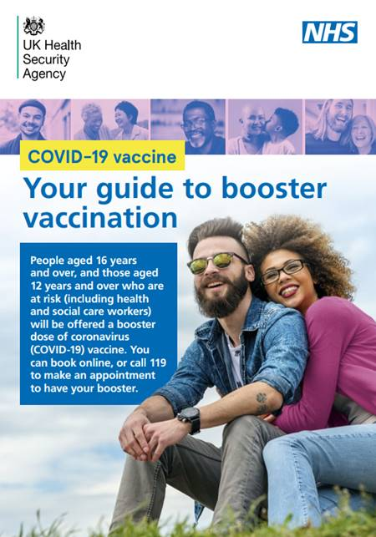
Booster programme
all aged 16 years and over are now eligible for a booster dose
the booster dose should be offered a minimum of 3 months after completion of the primary vaccine course
booster vaccination should preferably be undertaken with either
  a full dose (30 micrograms) of Pfizer BioNTech vaccine or
  a half dose (50 micrograms) of Moderna vaccine
both mRNA vaccines have been shown to substantially increase antibody levels when offered as a booster dose
booster vaccination should be offered in order of descending age groups, with priority given to the vaccination of older adults and those in a COVID-19 at-risk group
Notes:
https://www.gov.uk/government/publications/jcvi-statement-august-2021-covid-19-vaccination-of-children-and-young-people-aged-12-to-17-years/jcvi-statement-on-covid-19-vaccination-of-children-and-young-people-aged-12-to-17-years-4-august-2021
https://www.gov.uk/government/publications/covid-19-booster-vaccine-programme-for-winter-2021-to-2022-jcvi-statement-november-2021/update-to-jcvi-advice-on-booster-vaccination-in-adults-15-november-2021
On 14 September 2021, JCVI advised that adults who received a primary course in Phase 1 of the COVID-19 vaccination programme (priority groups 1 to 9) should be offered a COVID-19 booster vaccine.
On 15 November 2021, those aged 40 to 49 years were included in booster dose recommendations.
On 29 November 2021, following the emergence of the Omicron variant, the JCVI further extended their recommendations for booster doses to include all adults aged 18 years to 39 years
ttps://www.gov.uk/government/publications/uk-vaccine-response-to-the-omicron-variant-jcvi-advice/jcvi-advice-on-the-uk-vaccine-response-to-the-omicron-variant

Slide 63
Booster doses
booster dose of Pfizer vaccine is the same amount as the dose given for the priming dose (0.3ml)
booster dose of Moderna vaccine is half of the dose given for the priming dose (0.25ml instead of 0.5ml)
a half dose of Moderna vaccine is expected to be less reactogenic than a full dose when given as a booster dose
the Pfizer or Moderna mRNA vaccines should be offered as the booster dose irrespective of which vaccine product was used in the primary schedule
data from the COV-BOOST trial indicates that mRNA vaccines provide a strong booster effect regardless of whether the primary course was with the Pfizer BioNTech or the AstraZeneca vaccine

Slide 64
How vaccination works
Vaccines deliver components known as antigens. These usually consist of inactivated, attenuated (weakened), modified viruses or bacteria or genetic material from the virus and they are used to prime the immune system against specific infections.
Once a vaccine enters the body, and delivers the antigen, the immune system recognises the antigens as ‘foreign’ to the body and responds to them by making antibodies and memory cells.
When memory cells meet the antigen again (either as a natural infection or in a booster dose of vaccine), specific antibodies are produced much more quickly and in greater numbers than during the first response.
This response is similar to the response made to natural infection but without the risks of the disease itself as the microorganism used in a vaccine is artificially weakened (attenuated), modified or inactivated (killed).

Slide 65
Innate and adaptive immunity
Immunity is generally described as being either innate or acquired.
Innate immunity is the body’s first line of defense. It is present from birth and includes physical barriers, chemical barriers, phagocytic cells and the complement system. Innate immunity has no memory so doesn’t provide protection against future exposure to the pathogen.
Acquired immunity (also called adaptive immunity) is the body’s second line of defense. The immune system learns to recognise specific pathogens and challenge them if they meet them again later on. This capacity is called immunological memory.
A series of short videos help to provide a basic understanding of the immune system and how vaccines work.
These can be accessed at Immunology for Immunisation.

Slide 66
PPE and infection prevention and control
health care practitioners should follow the recommendations for Personal Protective Equipment (PPE) that are current at the time of vaccination
hand hygiene is critical to prevent the spread of disease and hands should be cleansed with alcohol-based gel or soap and water before vaccine preparation, between patients, and so on
those preparing and administering the vaccine should maintain good hand hygiene throughout and should take care not to touch the vial bung with their fingers

Slide 67
Preparing the vaccine
Some of the COVID-19 vaccines may require reconstitution and are supplied in 2 parts: the active component and the diluent.
If a vaccine requires reconstitution:
only use the diluent specified by the manufacturer
use the correct volume of diluent
write the date and time of reconstitution on the reconstituted vaccine vial
store and use any reconstituted vaccine within the time period specified by the manufacturer
Before administration, check:
which diluent to use, the amount needed for reconstitution and the ‘use within’ time
that the colour and composition of vaccine is as specified in description in vaccine manufacturer’s instructions
when the vaccine was reconstituted and expiry date
you have drawn up the correct dose
Notes:
If too much diluent is added, the dose will be too weak to stimulate an immune response and the vaccinee will not be protected

Slide 68
Before administering a vaccine
Before administering a vaccine, the individual should be assessed to ensure that:
there are no contraindications to the vaccine being given
they or their parent/carer is fully informed about the vaccine to be given and understand the vaccination procedure
they or their parent/carer are aware of possible adverse reactions to the vaccine and how to treat them
they have consented to having the vaccine
Immunisers should ensure that:
they have the appropriate knowledge and legal authority to administer the vaccine
the vaccine has been properly stored and prepared for use and that they know where and how to administer it

Slide 69
Vaccine contraindications and precautions
A contraindication is when an individual has a health condition that increases the likelihood of them having a serious adverse reaction to a vaccine. A vaccine should not be administered when the individual has a valid contraindication.
A precaution to a vaccine is when an individual has a condition that may increase the risk or severity of an adverse reaction following immunisation, that may compromise their ability to make an immune response to the vaccine or that may confuse a diagnosis.
Where there is any doubt whether it is safe to give a vaccine, seek expert advice.

Slide 70
COVID-19 vaccine contraindications
Before administering a COVID-19 vaccine, it is important to check for any relevant medical history including any allergies and any previous history of severe reaction to a vaccine or anaphylaxis with an unidentified cause.
COVID-19 vaccines may be contraindicated in those who have had a previous systemic anaphylaxis reaction to:
a previous dose of COVID-19 vaccine
any components of the vaccine
Expert advice should be sought where either contraindication is present.
There are additional contraindications specific to each COVID-19 vaccine.
Ensure you check whether any of these apply to the person you are going to vaccinate before administering the vaccine (these are listed in the Green Book COVID-19 chapter, the information provided about the vaccine by the manufacturer in the Reg174 document/SPC and in the PGD/Protocol).

Slide 71
Vaccine-specific contraindications and precautions
As the COVID-19 vaccines have been used more widely in the general population and more has been learned about the reactions they may cause, further advice around specific contraindications or precautions to each vaccine has been developed.
Pfizer (Comirnaty) and Moderna (Spikevax) vaccines
Additional precautions:
individuals with a history of immediate onset-unexplained anaphylaxis or anaphylaxis to multiple classes of drugs or an unexplained anaphylaxis
individuals who develop myocarditis or pericarditis following the first COVID-19 vaccination
AstraZeneca vaccine (Vaxzevria)
Additional contraindication:
individuals who experience a clotting episode with concomitant thrombocytopaenia following 1st dose
Additional precautions:
individuals who have a history of a previous episode of heparin induced thrombocytopenia and thrombosis
individuals with a prior history of capillary leak syndrome
individuals who developed Guillain-Barre Syndrome (GBS) within 6 weeks of a dose of AstraZeneca vaccine

Slide 72
Polyethylene glycol (PEG)
the Pfizer BioNTech and Moderna mRNA vaccines contain polyethylene glycol (PEG)
PEGs (also known as macrogols) are a group of known allergens commonly found in medicines, many household products and cosmetics
medicines containing PEG include some tablets, laxatives, depot steroid injections, and some bowel preparations used for colonoscopy
known allergy to PEG is rare but has been implicated in a minority of allergic reactions reported
patients with undiagnosed PEG allergy often have a history of immediate onset-unexplained anaphylaxis or anaphylaxis to multiple classes of drugs or an unexplained anaphylaxis
such individuals should not be vaccinated with the Pfizer BioNTech or Moderna vaccines, except on the expert advice of an allergy specialist

Slide 73
Polysorbate 80
the AstraZeneca vaccine does not contain PEG but does contain a related compound called polysorbate 80. Rarely, some people with PEG allergy may also be allergic to polysorbate 80
however, polysorbate 80 is widely used in medicines and foods and is present in many medicines including monoclonal antibody preparations
some injected influenza vaccines (including the main vaccine used in over 65 year olds) contain polysorbate 80
individuals who have tolerated injections that contain polysorbate 80 (such as Fluad and Fluarix influenza vaccines) are likely to tolerate the AstraZeneca vaccine
see table on next slide for management of individuals with a history of allergy

Slide 74
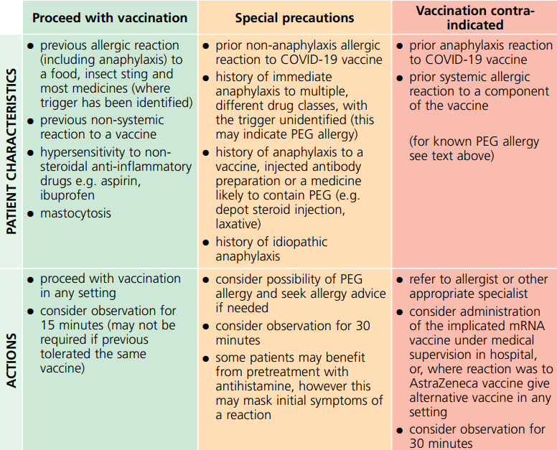
History of allergy
a very small number of individuals have experienced anaphylaxis when vaccinated with a COVID-19 vaccine
anyone with a history of allergic reaction to an excipient in the COVID-19 vaccine should not receive that vaccine (except with expert advice), but those with any other allergies (such as a food allergy) – including those with prior anaphylaxis – can have the vaccine
advice on the management of patients with allergy is summarised in the table (available in Green Book COVID-19 chapter)

Slide 75
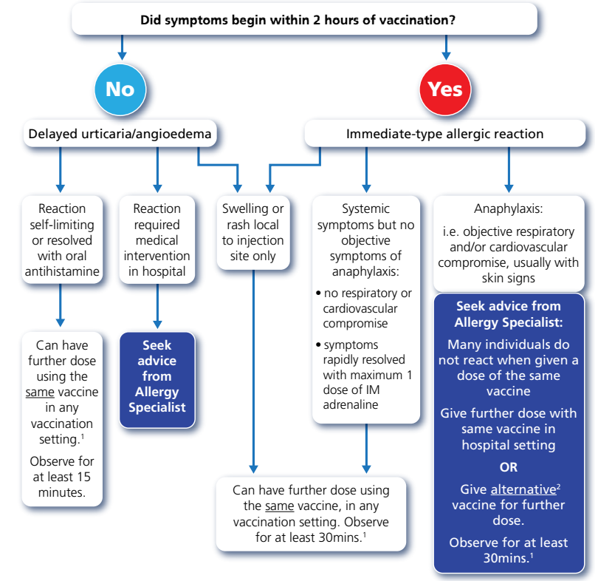
Allergic reaction to previous dose
the British Society for Allergy and Clinical Immunology (BSACI) has advised that individuals who have a reaction to the first dose of a COVID-19 vaccine may be able to receive a second dose of vaccine, as per the flowchart
individuals with non-allergic reactions (vasovagal episodes, non-urticarial skin reaction or non-specific symptoms) to the first dose of a COVID-19 vaccine can receive the second dose of vaccine in any vaccination setting. Observation for 15 minutes is recommended
Flowchart for managing patients who have allergic reactions
to the first dose of COVID-19 vaccine

Slide 76
Blood clots
following widespread use of the AstraZeneca vaccine, a rare condition involving serious thromboembolic events accompanied by thrombocytopaenia has been reported after receipt of this vaccine
the condition presents with unusual venous thrombosis, including cerebral venous sinus thrombosis, portal vein thrombosis and sometimes arterial thrombosis with low platelet count and high D-dimer measurements
this syndrome (otherwise known as Vaccine Induced Thrombosis and Thrombocytopenia syndrome or VITTs) has affected patients of all ages and genders
the majority of cases have occurred between 5 and 16 days following vaccination with the first dose
the reported rate in the UK after the first dose is around 15 cases per every million doses given, although a higher incidence is seen in younger individuals
there is no evidence of any underlying risk factors in the individuals affected by this condition who have mainly been previously healthy
the condition is rare, tends to present with unusual forms of clotting and the mechanism is believed to be an idiosyncratic reaction related to an immune response to the AstraZeneca vaccine
Notes:
thromboembolic: obstruction of a blood vessel by a blood clot
thrombocytopaenia: low levels of platelets in the blood. Platelets are blood cells which help the blood to clot
cerebral venous sinus thrombosis: a blood clot in the brain
portal vein thrombosis: a clot in the blood vessel that brings blood to the liver from the intestines
arterial thrombosis; blood clot in an artery
D-dimer measurements: the D-dimer test is a blood test that indicates whether blood clots are being actively formed somewhere within a person’s vascular system.
After the second dose, the reported rate is much lower, particularly in younger individuals
There is currently no evidence to suggest these rare events occur following administration of either the Pfizer BioNTech or Moderna vaccine (Spikevax) vaccines which are available in the UK.

Slide 77
Use of the AZ vaccine in those under 40 years of age
there appears to be a trend of increasing incidence of this rare clotting condition reported in the younger adult age groups compared to the older age groups
in contrast, the risks of serious disease associated with COVID-19 increases steeply with age, with the younger adults at the lowest risk of serious disease
based on current evidence JCVI advise a preference for an alternative vaccine for healthy people under 40 years of age, including health and social care workers, unpaid carers and household contacts of immunosuppressed individuals
all those under the age of 40 (and over 18) years who are yet to have their first dose should be preferentially offered the Pfizer BioNTech or Moderna vaccines, unless there is a clinical reason that precludes the use of either of these alternative vaccines (for example PEG allergy)
if there is a clinical reason for a person under 40 to receive the AstraZeneca vaccine, informed consent following a discussion about risks and benefits to the individual must be obtained
those in this age group who have already received a dose of AstraZeneca vaccine without experiencing this rare side-effect can complete with the same vaccine or with an mRNA vaccine (provided there are no contraindications)

Slide 78
Who can receive the AstraZeneca vaccine
individuals aged 40 years and older, those who are clinically extremely vulnerable and those in clinical risk groups who are at high risk of the complications of COVID-19 can be offered vaccination with any of the available COVID-19 vaccines, unless otherwise contraindicated
there is no evidence that those with a prior history of thrombosis or known risk factors for thrombosis are more at risk of developing this immune-mediated condition
for most of these individuals, the risk of recurrent thrombosis due to COVID-19 infection remains far greater than the risk of this rare thrombosis/thrombocytopenia condition
therefore individuals aged 40 years and over with such a history should be vaccinated with any of the available vaccines (provided they are not otherwise contra-indicated)
this also applies to those who experience common clotting episodes after the first dose of AstraZeneca vaccine but without concomitant thrombocytopaenia

Slide 79
Who should not be offered the AstraZeneca vaccine
individuals who experience a clotting episode with concomitant thrombocytopaenia following the first dose of AstraZeneca vaccine should be properly assessed
  if they are considered to have the reported condition, further vaccination should be deferred until their clotting has completely stabilised
  they should then be considered for a second dose of an alternative COVID-19 vaccine at least 12 weeks after their first dose of AstraZeneca vaccine
caution should be used when vaccinating individuals who have a history of a previous episode of heparin induced thrombocytopenia and thrombosis (HITT or HIT type 2)
the Information for Healthcare Professionals on COVID-19 Vaccine AstraZeneca advises that, as a precautionary measure, administration of the AstraZeneca vaccine in patients with a history of HITT or HIT type 2 should only be considered when the benefit outweighs any potential risks

Slide 80
Recommended vaccines for pregnant women
although pregnancy increases the risk of clotting conditions, there is no evidence that pregnant women, those in the post partum or women on the contraceptive pill are at higher risk of the specific condition of thrombosis in combination with thrombocytopaenia after the AstraZeneca vaccine
there have been no confirmed cases of this rare condition reported in pregnant women to date
the Pfizer BioNTech and Moderna vaccines are the preferred vaccines for pregnant women aged 18 years and over because of more extensive experience of their use in pregnancy. Pregnant women less than 18 years of age should receive Pfizer BioNTech vaccine
pregnant women who commenced vaccination with the AstraZeneca vaccine can complete with the same vaccine or with an mRNA product (provided there are no contraindications
Notes:
The JCVI has advised that pregnant women should be offered the COVID-19 vaccine at the same time as the rest of the population, based on their age and clinical risk group.
JCVI advises that it’s preferable for pregnant women in the UK to be offered the Pfizer BioNTech or Moderna vaccine (Spikevax) vaccines where available. This is based on real-world data from the United States where pregnant women have been vaccinated, mainly with mRNA vaccines including Pfizer BioNTech and Moderna vaccine (Spikevax), without any safety concerns being raised. There is no evidence to suggest that other vaccines are unsafe for pregnant women, but more research is needed.

Slide 81
Second doses of AstraZeneca vaccine
Individuals who experience a clotting episode with concomitant thrombocytopaenia following the first dose of AstraZeneca vaccine should be properly assessed.
if they are considered to have the reported condition, further vaccination should be deferred until their clotting has completely stabilised
they should then be considered for a second dose of an alternative (an mRNA) COVID-19 vaccine provided at least 12 weeks has elapsed from the implicated dose
Individuals of any age who received the first dose of AstraZeneca vaccine without developing thrombosis and thrombocytopaenia syndrome (TTS) are advised to receive the second dose of the same vaccine at the recommended interval (currently 8 weeks).
  to date, there is no signal of an increased risk of this condition after the second dose
  the rate of other reactions is lower following the second dose than after the first dose of this vaccine
  using an alternative product for the second dose may be more likely to lead to common side effects

Slide 82
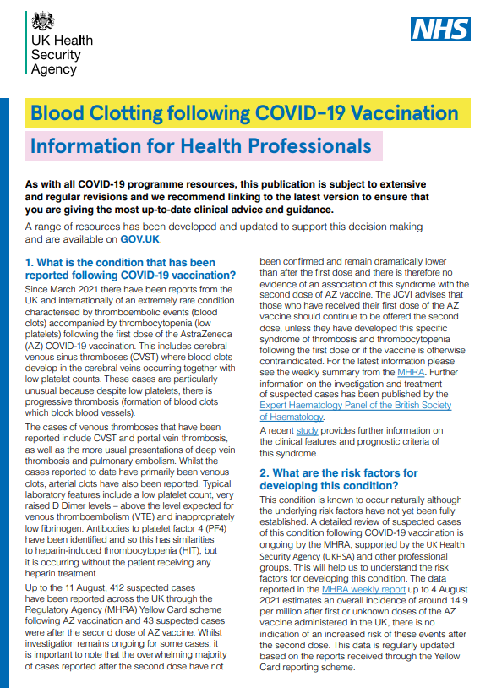
Advice for vaccine recipients
All individuals offered a COVID-19 vaccine should be fully informed about the benefits and risks of vaccination.
This should include clear information on the extremely rare thrombosis/thrombocytopenia adverse event, how to monitor for symptoms that might be related to this adverse event, and what action should be taken in the event of any symptoms arising.
Vaccinated individuals should be advised to seek immediate medical attention if they develop new symptoms from around 4 days to 4 weeks after vaccination such as:
new onset of severe headache, which is getting worse and does not respond to simple painkillers
a headache which seems worse when lying down or bending over
an unusual headache that may be accompanied by blurred vision, nausea and vomiting, difficulty with speech, weakness, drowsiness, confusion or seizures
new onset of unexplained pinprick bruising or bleeding
shortness of breath, chest pain, leg swelling or persistent abdominal pain
A range of information resources are available at COVID-19 vaccination and rare side effects
Notes:
Further detailed information is available in the Information for healthcare professionals on blood clotting following COVID-19 vaccination document

Slide 83
Capillary leak syndrome
a small number of cases of capillary leak syndrome have been reported after AstraZeneca vaccination, some of whom had a prior history of this condition
capillary leak syndrome causes fluid and proteins to leak out of tiny blood vessels (capillaries) into surrounding tissues. This may lead to very low blood pressure, low blood albumin levels and thickened blood due to a decrease in plasma volume
initial symptoms may include tiredness, nausea, abdominal pain, extreme thirst and sudden increase in body weight
complications can include general swelling, compartment syndrome, kidney failure and stroke
individuals with a prior history of this condition may be offered vaccination with an alternative COVID-19 vaccine (Pfizer BioNTech or Moderna vaccine)

Slide 84
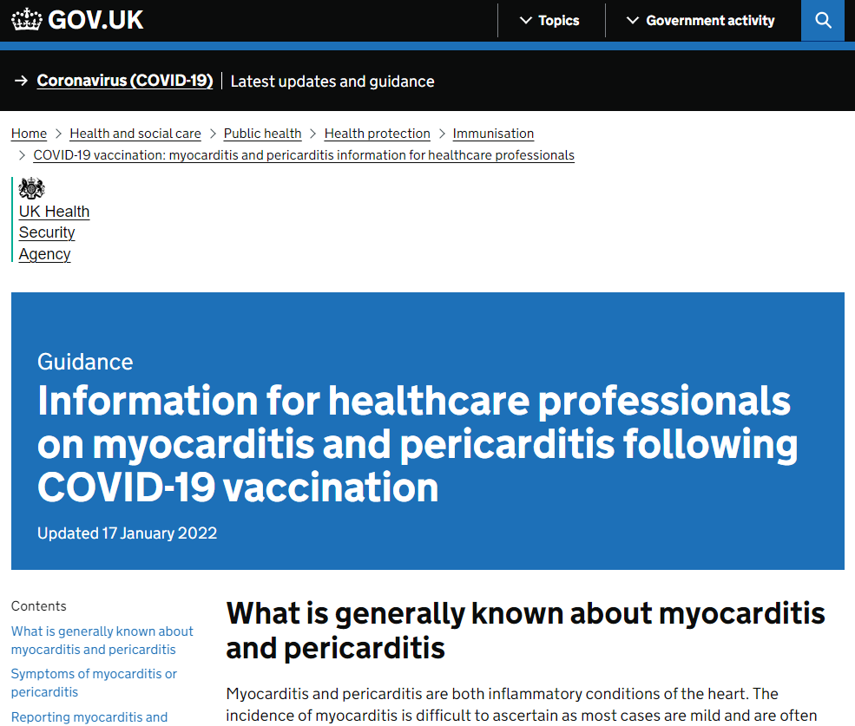
Myocarditis and pericarditis
a number of cases of myocarditis and pericarditis have been reported after the Pfizer BioNTech and Moderna COVID-19 vaccines
the reported rate appears to be highest in those under 25 years of age and in males, and after the second dose
onset is within a few days of vaccination and most cases are mild and have recovered without any sequalae
those who develop myocarditis or pericarditis following the first COVID-19 vaccination should be assessed by an appropriate clinician to determine whether it is likely to be vaccine related
subsequent doses should be deferred pending further investigation and careful consideration of the risks and benefits
specific information for healthcare professionals is available on the gov.uk website and in the COVID-19 Green Book chapter
Notes:
Myocarditis is inflammation of the heart muscle
Pericarditis is inflammation of the protective thin saclike membrane around the heart (pericardium)
https://www.gov.uk/government/publications/covid-19-vaccination-myocarditis-and-pericarditis-information-for-healthcare-professionals/information-for-healthcare-professionals-on-myocarditis-and-pericarditis-following-covid-19-vaccination

Slide 85
Guillain-Barré syndrome (GBS)
GBS is a very rare and serious condition that affects the nerves - mainly in the feet, hands and limbs, causing numbness, weakness and pain. In severe cases, GBS can cause difficulty moving, walking, breathing and/or swallowing
very rare reports of GBS following COVID-19 vaccination have been received
individuals who have a history of GBS should be vaccinated as appropriate for their age and underlying risk status
as there is evidence to suggest that a prior diagnosis of GBS does not predispose an individual to further episodes, in those who are diagnosed with GBS after the first dose of vaccine, the balance of risk benefit is in favour of completing a full COVID-19 vaccination schedule
where GBS occurs within 6 weeks of an Astra Zeneca vaccine, Pfizer or Moderna COVID-19 vaccines are preferred for any future doses
where GBS occurs following either Pfizer or Moderna, further vaccination can proceed as normal, once recovered
Notes:
https://www.gov.uk/government/publications/covid-19-vaccination-guillain-barre-syndrome-information-for-healthcare-professionals/information-for-healthcare-professionals-on-guillain-barre-syndrome-gbs-following-covid-19-vaccination

Slide 86
Immune thrombocytopenia (ITP)
Immune thrombocytopenia (ITP) is a condition where the immune system does not function correctly and attacks and destroys platelets in the blood. Platelets help the blood to clot so this can lead to bruising and bleeding
there is now emerging evidence of a small risk of ITP or ITP relapse following COVID-19 vaccination (4 reports per million doses of AstraZeneca vaccine given)
to date, this has been reported extremely rarely and the MHRA Yellow Card summary states that this is usually short-lived and of minor severity
in approximately 10 to 20% of the reports, patients had a history of ITP or an underlying condition known to be associated with ITP
previous ITP is not a contraindication for vaccination but guidance produced by the UK ITP Forum Working Party advises discussing the potential for a fall in platelet count in patients with a history of ITP receiving any COVID-19 vaccine and recommends a platelet count check 2 to 5 days after vaccination

Slide 87
Bell’s Palsy
Bell’s Palsy (BP) is a temporary weakness or paralysis affecting one side of the face that develops gradually; most people recover from this condition within a few months
BP is known to be associated with a number of infectious diseases, including the SARS-CoV-2 virus
whilst reporting of BP following COVID-19 vaccination is rare, the latest available data shows that there may be an increased risk of BP following COVID-19 vaccination
to raise awareness of this potential adverse event amongst healthcare professionals and patients, facial paralysis has been included in the product information for the AstraZeneca, Pfizer BioNTech and Moderna COVID-19 vaccines

Slide 88
Transverse myelitis
extremely rare cases of transverse myelitis have been reported following the AstraZeneca vaccine
transverse myelitis is a rare acute neurological disorder where parts of the spinal cord are inflamed
signs and symptoms include muscle weakness, localised or radiating back pain, bladder and bowel symptoms and changes in sensation
as a precaution, the SPC for the AstraZeneca vaccine now states that a further dose of this vaccine should not be given to those who have experienced symptoms of transverse myelitis after a previous dose of this vaccine

Slide 89
Consent (1)
Before giving COVID-19 vaccine, immunisers must ensure that they have obtained informed consent from the patient or that a best interest decision has been made if the patient does not have mental capacity at the time of vaccination.
In order to be able to consent to vaccination, the vaccinee should receive an explanation of the treatment and its benefits and risks, either verbally from a clinician, or in the form of a leaflet and letter.
When assessing capacity to consent, the immuniser should be guided by the principles of the Mental Capacity Act (2005). This Act applies to those aged 16 years and over and is designed to protect and empower people who may lack the mental capacity to make their own decisions about their care and treatment.

Slide 90
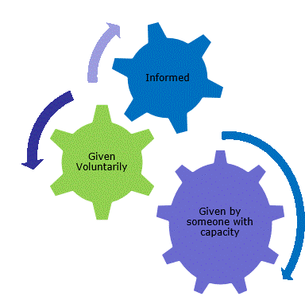
Consent (2)
Consent is a process, not a one-off discussion and must consider 3 factors:
the person giving consent must be appropriately informed: they must have the necessary information in order to make the decision
consent must be voluntary by the individual without undue pressure or coercion
the person consenting must have the capacity to make the decision

Slide 91
Consent (3)
Information to be given includes:
vaccine to be given and the disease that will be prevented
benefits/risks of immunisation versus risks of the disease
any new information that has become available since consent to previous doses of this vaccine were given if applicable
any possible vaccine reactions and what to do if these occur
follow-up/information as to any further doses required
how any personal data will be stored and kept (information governance)
How much information should you give?
This will be personal to the individual at the time, and will depend on their previous knowledge and discussions with others.
give people as much information as they need and/or want to make an informed decision
some people will just ‘trust’ what you say while others want lots of information; either is fine
how much each individual needs is up to them, no one is obliged to seek full information

Slide 92
Informed consent
the need for ‘informed consent’ is a legal requirement and the patient’s views must be respected and consent sough
sufficient evidence-based information must be provided to the person to enable them to make a balanced and informed decision about their care and treatment
as well as a general explanation of the procedure, there is also a duty to explain the risks inherent in the procedure and the risks inherent in refusing the procedure
consent can be given verbally, in writing, or it can be implied
however consent is given, the person must understand what they are consenting to
if there are any issues or uncertainties with seeking or gaining consent, ask for advice from an experienced colleague rather than abandon the offer of immunisation
Notes:
The need for ‘informed consent’ is a legal requirement and the patient’s views must be respected and consent sought
Sufficient evidence-based information must be provided to the person to enable them to make a balanced and informed decision about their care and treatment. As well as a general explanation of the procedure, there is also a duty to explain the risks inherent in the procedure and the risks inherent in refusing the procedure.
Consent can be given verbally, in writing (although there is no requirement for written consent or a particular consent form) or it can be implied (non-verbal consent) but however it is given, the person must understand what they are consenting to.
The consent process should not be an unnecessary barrier to immunising. If there are any issues or uncertainties with seeking or gaining consent, ask for advice from an experienced colleague rather than abandon the offer of immunisation.

Slide 93
Mental capacity and best interest decisions
All adults are considered to have capacity to consent to receiving a vaccine unless there is evidence to suggest that capacity is limited.
If an adult is able to do the following 3 things, then they should be considered to have capacity and their decision should be respected:
understand the information that you are giving them about the vaccine and any potential risks from it or from the disease it protects against
consider the information you have given them and retain it for long enough to make a decision on whether to accept or decline the offer of vaccination
communicate their decision to you

Slide 94
Actions to support decision making
There are some actions that can be taken to support and optimise a person’s ability to make a decision. These include:
making reasonable adjustments to facilitate decision making or accommodate individual needs
using communication tools such as ‘Easy Read’ leaflets
speaking with them at their best time of day
asking someone who the person knows and trusts to speak to them
If an adult does not have capacity and there is no Lasting Power of Attorney (LPA), Welfare Attorney or appointed deputy, a best interest decision will need to be made.
Lasting Power of Attorney (LPA) can be set up by adults over 18 years of age, who have capacity, in order for heath and care decisions to be made once capacity is lost.
Welfare attorney/designated decision maker is appointed by the individual to make health and personal welfare decisions on their behalf once capacity is lost.
Appointed deputy or welfare guardian from the Court of Protection.

Slide 95
Making a best interest decision
To make a best interest decision, the following must be considered:
the person who lacks capacity should be involved in the decision-making process if possible, particularly if their capacity fluctuates. If capacity does fluctuate, the healthcare professional would accept consent given at the time
any previously expressed wishes or behaviours such as previously consenting to vaccination should be acknowledged
the offer of vaccination should be discussed with those close to the patient such as their carer, relatives or anyone appointed as a Lasting Power of Attorney (LPA) for Health and Welfare, or those named by the person to be consulted on vaccination if practical
the person’s actual interests at the time the vaccine is offered
This process should be documented and the decision recorded.
It is good practice to inform nursing or care home management teams of any plans to vaccinate residents in advance of the scheduled date to allow time to address any potential issues.
Notes:
SICE guidance on best interests decision making: https://www.scie.org.uk/mca/practice/best-interests

Slide 96
Consent for children and young people
at 16 years of age, a young person is presumed in law to have the capacity to consent, so young people aged 16 or 17 years should consent to their own medical treatment and a parent cannot override that consent
children under 16 can consent for themselves if they have the capacity and maturity to understand what they are consenting to and fully understand what is involved in the proposed procedure (this is referred to as ‘Gillick competence’)
although they can give their own consent, it is advised that ideally, the parents of those under 16 are involved in the consent process
however, if a Gillick-competent child consents to vaccination, a parent cannot override that consent and if a Gillick-competent child refuses vaccination, that refusal should be accepted

Slide 97
Gillick competence
For a young person under the age of 16 to be Gillick competent, they should have:
the ability to understand that they have a choice and that choices have consequences
the ability to understand any information given and arrive at a decision
a willingness to make a choice (including the choice that a parent or guardian should make the decision)
an understanding of the nature and purpose of vaccination
an understanding of any risks and side effects of vaccination and any risks of not being vaccinated
freedom from any undue pressure

Slide 98
Documenting informed consent
it is best practice to document on the vaccine recipient’s healthcare record that a consent discussion has taken place informed and consent has been obtained
providers of an immunisation service may decide, for operational purposes or in accordance with their local consent policy, that written consent should be obtained for each vaccine recipient
operational purposes may include assessing the numbers of vaccines required for a clinic or venue, enabling data capture for patient records or obtaining consent from someone other than the vaccinee (such as a parent or an Attorney)
national consent forms and letters for local adaptation have been provided on the GOV.UK COVID-19 vaccination programme page to support those providers who do wish to obtain written consent

Slide 99
Legal requirements for the supply and administration of vaccines
the regulation of medicines is defined under the Human Medicines Regulations 2012
all vaccines are classified as Prescription Only Medicines (POMs)
this means that they are subject to legal restrictions and in order to give them, there needs to be an appropriate legal framework in place before they can be supplied and/or administered to eligible people
additionally, any person who supplies and administers a vaccine must have a legal authority to do so

Slide 100
Legal requirements for the supply and administration of vaccines
Vaccines are Prescription Only Medicines (POMs). This means a legal framework to supply and/or administer a vaccine must be in place and can be in the form of:
a written patient specific prescription
a Patient Specific Direction (PSD): a written instruction, signed by a doctor, dentist, or non-medical prescriber for medicines to be supplied and/or administered to a named patient after the prescriber has assessed the patient on an individual basis
a Patient Group Direction (PGD): allows some registered specified health care professionals to supply and/or administer a POM directly to a patient with an identified clinical condition rather than needing an individual prescription or an instruction from a prescriber. PGDs are often used for the administration of vaccines
or another process such as a Protocol or Written Instruction
Notes:
A PSD is a written instruction, signed by a doctor, dentist, or non-medical prescriber for medicines to be supplied and/or administered to a named patient after the prescriber has assessed the patient on an individual basis. It must include the dose, route and frequency or appliance to be supplied or administered to a named patient
A PGD provides a legal framework to allow some registered specified health care professionals for the supply and/or administration of a POM directly to a patient with an identified clinical condition rather than needing an individual prescription or an instruction from a prescriber and is often used for vaccines. It sets out the core requisites of those people who can have the medicine under the direction and those who should not. The health care professional working within the PGD is responsible for assessing that the patient fits the criteria set out in the PGD.

Slide 101
Patient Group Directions (PGD)
PGDs set out the core requisites of those people who can have the medicine under the direction and those who should not.
the document will also include details of any additional training that should have been undertaken, actions to be taken if the patient is excluded or declines the medicine, a description of the medicine(s), route of administration, doses, frequency, reporting of adverse reactions, recording, storage and disposal
the HCP working under a PGD is responsible for assessing that the patient fits the criteria set out in the PGD. The healthcare professional operating under the PGD may not delegate the role to others
PGDs must be authorised before use by a doctor and a pharmacist and by an appropriate body for example NHS EI, UKHSA, NHS Trust, CCG and so on
health professionals who will be using the PGD must be named and authorised before they use it to provide care

Slide 102
Using a Patient Group Direction (PGD) to give COVID-19 vaccine authorised under regulation 174
In response to certain public health threats, such as the current pandemic, the MHRA can temporarily authorise the supply of an unlicensed medicine or vaccine for use, under regulation 174 of The Human Medicines Regulations 2012, when it is satisfied that there is robust evidence to show the safety, quality and effectiveness of the medicine/vaccine.
in October 2020, new legislation amending The Human Medicines Regulations 2012 was passed
prior to this, PGDs could only be used for licensed medicines
the change to legislation allows medicines/vaccines which have been temporarily authorised for supply in the UK under regulation 174 to be administered in accordance with a PGD
registered HCPs who are allowed to work to a PGD may supply and administer COVID-19 vaccines, as temporarily authorised vaccines under Regulation 174, using a PGD
the workforce that can administer under PGDs has not changed
UKHSA are developing and publishing PGDs for COVID-19 vaccines

Slide 103
Protocols for the supply and/or administration of COVID-19 vaccine
the changes to the Human Medicines Regulations also brought about a new regulation (247A)
while a disease is pandemic, regulation 247A permits the supply or administration of a medicinal product used for vaccination against coronavirus in accordance with a protocol that is approved by ministers
national protocols for each of the currently authorised vaccines have been published which allows trained and competent non-registered healthcare workers as well as registered healthcare professionals, to administer COVID-19 vaccine
the protocol specifies who can use it and includes information similar to that commonly found in PGDs
the protocol allows flexibility for different COVID-19 vaccine delivery models
it may be followed wholly from patient assessment through to post-vaccination by a single person. Alternatively, multiple HCWs may undertake different roles or stages in the patient vaccination pathway in accordance with the protocol
the service provider is responsible for ensuring that HCWs are trained and competent to safely deliver the activity they are employed to provide under the protocol

Slide 104
Licensure
Following initial temporary authorisation from the MHRA under Regulation 174, the Moderna, AstraZeneca and Pfizer BioNTech COVID-19 vaccines have sought Conditional Marketing Authorisation (CMA). Marketing authorisation is often referred to as a license.
CMA is the fast-track approval of a medicine that fulfils an unmet medical need. During the COVID-19 pandemic, CMA is being used to expedite the approval of safe and effective COVID-19 vaccines.
The medicine still has to meet rigorous standards for safety, efficacy and quality but it can be approved on the basis of less comprehensive data than is normally required for full licensure. The manufacturer has to continue to provide comprehensive clinical data to the MHRA after CMA has been granted and the CMA is valid for 1 year before renewal is required.
Once a vaccine is given CMA, the ‘Information for Healthcare Professionals’ and ‘Information for UK Recipients’ documents are replaced with a ‘Summary of Product Characteristics (SPC)’ and ‘Patient Information Leaflet (PIL)’, as are required for licensed medicines.
Reg174 authorised vaccines are currently still in use for AstraZeneca but CMA vaccine will be used once supplies become available.
Notes:
An SPC provides a description of a medicine or vaccine product’s properties and the officially approved conditions attached to its use. It is written for healthcare professionals and explains how to use and prescribe the medicine/vaccine.
The PIL is the leaflet included in the pack with a medicine or vaccine. It is written for patients and gives information about taking or using a medicine

Slide 105
‘Off label’ use of a vaccine given Conditional Marketing Authorisation
There are occasions when official recommendations for the use of a vaccine differ from those set out in the CMA, for example giving the second dose of the Moderna (Spikevax) vaccine at an 8-week interval instead of 28 day interval stated in the SPC.
Giving the 2 doses at a longer interval than the 28 day interval recommended in the SPC will be an ‘off label’ use of this vaccine.
This means that, although the vaccine is authorised for use, it is being used in a way that is slightly different from the terms laid down in its CMA. When a vaccine is used ‘off-label’, it means that experts (the JCVI) have advised that there are clear benefits of using the vaccine in this way and that this is considered to be safe and effective.
Vaccines can be given ‘off-label’ using a PGD or protocol where use of the vaccine in a way that is different from that which is stated in the product’s marketing authorisation is judged to be best clinical practice.
In this situation, the JCVI have recommended that giving the COVID-19 vaccines with longer intervals between doses will enable more people to be protected more quickly whilst still providing high levels of protection to the vaccinated individual.

Slide 106
Vaccine storage, preparation and administration
Vaccine storage, preparation and administration are critical components of a successful vaccination programme and are key to ensuring that vaccination is as safe and effective as possible.
If specific requirements are not followed, vaccinees may not make a response to the vaccine and so remain unprotected or, they may be at higher risk of developing a vaccine reaction.
To minimise the risk of vaccine failures and reactions:
the storage conditions of the vaccine should always be checked before administration
the person preparing the vaccine must be aware of the date and time the vaccine must be used by after thawing, removing from the fridge and first puncture of the vial
the vaccine must be reconstituted according to the manufacturer’s instructions
the correct equipment should be used to prepare the vaccine
the correct technique must be used to deliver the injection and
the vaccine must be administered in the correct anatomical site

Slide 107
Vaccine storage
as vaccines are biological products, they are temperature sensitive so must be stored and transported within the recommended temperature range
the system of transporting and storing vaccines is called the cold chain
a cold chain breach occurs when vaccines have been stored outside of this temperature range
vaccines that have not been stored or transported correctly can lose potency and may not evoke a full or lasting immune response, leaving the vaccinee at risk of the disease the vaccine should have prevented
for most vaccines, the recommended vaccine storage temperature range is between +2˚C to +8˚C
always check the specific recommended storage temperatures for each vaccine as each of the COVID-19 vaccines have different requirements

Slide 108
Vaccine storage (continued)
vaccine storage recommendations are set out by the manufacturer and are part of the licensing or authorisation conditions
vaccines that have not been stored in the recommended temperature range are outside of those conditions. Any apparent failure of the vaccine and responsibility and liability for their use will therefore lie with the immunisation provider
vaccines that are not stored and transported correctly may need to be disposed of which leads to increased wastage and programme costs
adhering to the temperature recommendations will ensure that vaccines are in optimum condition for those individuals they are given to

Slide 109
General principles of vaccine storage
    all vaccines must be stored in a lockable dedicated vaccine/medicine fridge between 2ºC and 8ºC (unless other storage requirements have been specified)
    systems to prevent accidental interruption of the power supply to the fridge must be in place
    fridges should be situated away from radiators and other sources of heat which could affect how they work
    records should be kept of regular fridge servicing and thermometer calibration
    the temperature in the fridge must be continually monitored using a current/minimum/maximum thermometer
    fridge temperatures should be monitored and recorded on a designated chart ideally at the beginning and end of every working day
    fridge alarm parameters should be set appropriately to alert to any deviations from the 2ºC to 8ºC range
    vaccines must be kept upright and stored in their original packaging
    vaccines with shorter expiry dates and use by dates after thawing should be placed at the front of the fridge
    expired stock and stock beyond the used by date should be removed from the fridge and destroyed
    take immediate action if the temperature goes outside recommended range

Slide 110
Storage and transportation of COVID-19 vaccines
All those involved in the delivery of the COVID-19 vaccination programme have a responsibility to ensure that the cold chain is maintained and must be aware of the recommended storage requirements for the different COVID-19 vaccines.
It is critical that vaccines are stored as recommended to ensure they retain their optimum potency and to avoid any vaccine wastage.
Be very clear about your specific responsibilities for maintaining the cold chain and at what point for example transporting it, receiving a delivery, daily fridge monitoring, reconstitution, and so on.
COVID-19 vaccine must not be given if you are not confident that it has
been stored or reconstituted as recommended by the manufacturer or
as advised by a vaccine expert

Slide 111
Temperature monitoring systems
there should be a named person and a deputy responsible for COVID-19 vaccine storage
those responsible should be familiar with the fridge digital display readings, the functioning of the thermometer reset button and the manufacturer’s user guidelines
data loggers can be useful in the event of a cold chain breach as the data can be used to calculate cumulative exposure to out of range temperatures. However, they should always be used in conjunction with the integral fridge thermometer and should not be used to replace the daily temperature monitoring and recording
a visual check of the actual temperature should also be made each time a vaccine is removed from the fridge

Slide 112
Temperature monitoring equipment
most vaccine and medicine fridges have integral thermometers with a digital display. Ideally, a second thermometer, independent of the main power source (for example, battery operated) should be available to monitor the temperature in the event of a power failure
temperature probes with cables should be correctly positioned in the fridge, ensuring that the cable does not interfere with the door seal and that the probe is not up against the back or sides of the fridge
data loggers are recommended as a back up to visual temperature reading from integral thermometers
vaccines being stored or transported in portable cool bags or refrigeration devices should be monitored to the same standard as vaccines stored in vaccine fridges
vaccine fridges and temperature-monitoring equipment should be regularly serviced and calibrated

Slide 113
Action to take if vaccines are stored incorrectly
If COVID-19 vaccines are stored incorrectly:
label and isolate affected vaccines and do not use until further notice
inform your team leader or manager and other vaccinators in the clinic
make alternative arrangements for immunisation clinics until resolved
seek advice from the manufacturer or a source of expert advice
be able to provide the following information:
      what monitoring has taken place (max or min or current thermometer readings)
      when the cold chain was last guaranteed
      what time periods are involved (hours or days)
      what the temperature range has been during this period
      identify all vaccines stored in the fridge, the time they have been stored there and expiry dates

Slide 114
Portable refrigeration
a medical grade cool box or bag purchased from a medical supplier must be used for storage and transportation of vaccines being used for home visits or community clinics
all vaccines should be kept in their original packaging until use and the cool box or bag should be packed following the manufacturer’s instructions and not overfilled
the minimum and maximum temperatures in the cool box or bag should be recorded
the temperature should be checked before vaccines are given
if the temperature has gone out of range, a risk assessment should be conducted before using or disposing of the vaccines

Slide 115
Drawing up vaccine
Specific instructions for drawing up each vaccine are provided in the vaccine-specific slides.
When drawing up the COVID-19 vaccines, it is important to follow the instructions below to minimise the risk of particles breaking off from the rubber stopper and entering the vial:
insert the needle vertically through the centre ring of the vaccine vial stopper
if the needle is not inserted vertically into the centre ring, it can result in the needle scraping rubber off the inner wall of the small channel of the stopper
do not twist or rotate the needle once inserted. If the needle is rotated or twisted during the piercing of the stopper, a particle may be cored out of the stopper
Vials must be visually inspected for appearance and particles before and after dilution and each time a dose is drawn up.

Slide 116
Vaccination site
Giving vaccine into the muscle:
leads to a better immune response to the vaccine (as the muscle contains the appropriate cells necessary to initiate the immune response).
is less likely to cause local reactions than if the vaccine is given into the skin (subcutaneously)
The needle needs to be long enough to ensure vaccine is injected into the muscle. For this reason, a 25mm needle is being provided for administration of the COVID-19 vaccine. A 38mm length needle is available if required for adults who have more fat covering their muscles.
COVID-19 vaccine should be injected into the deltoid muscle in the upper arm. If there is insufficient muscle mass in the deltoid or a particular reason the deltoid muscle is unsuitable, the vaccine should be given into the vastus lateralis muscle in the anterolateral aspect of the thigh.

Slide 117
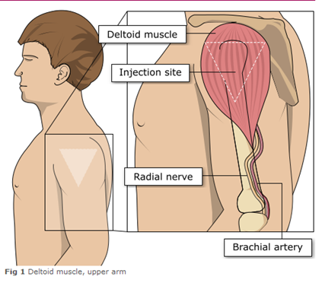
Administering vaccine into the deltoid muscle
(upper arm)
it is essential that the correct site and injection technique is used to administer vaccines
injecting too high into the upper arm might result in a shoulder injury or a frozen shoulder. This leads to pain, weakness and a limited range of motion that can last for months
injecting too low or too far to the side of the arm risks injecting into the axillary nerve or the radial nerve
to avoid shoulder injury, always assess the limb before administering the vaccine to identify the correct site for injection
Image adapted from the Australian Immunisation Handbook

Slide 118
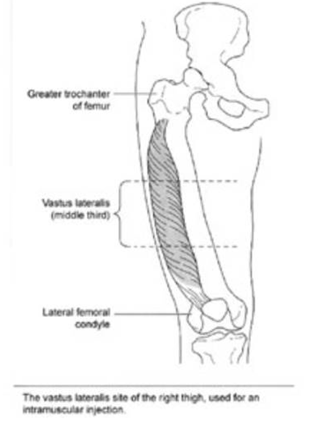
The vastus lateralis muscle (anterolateral aspect of the thigh)
Infants under 1 year receive their immunisations into the anterolateral aspect of the thigh because the deltoid muscle is not sufficiently well enough developed at this age.
Although the deltoid muscle is more commonly used in older children and adults as it is quicker and easier to access, the vastus lateralis muscle in the thigh can be used in these age groups if necessary.
CDC Vaccine Administration

Slide 119
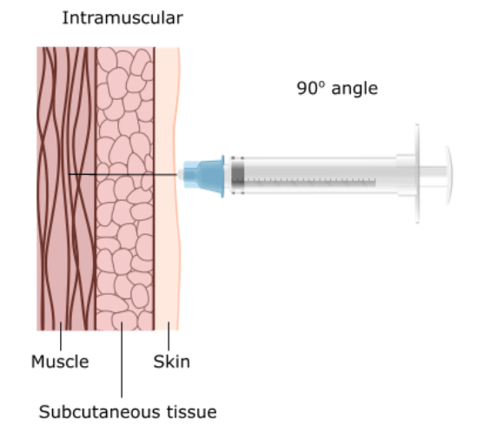
Vaccine administration continued
Skin does not need to be specially cleaned prior to vaccination. If it is visibly dirty then water is sufficient to clean it.
Intramuscular process:
identify the correct site for IM injection
stretch the skin at the site
insert the needle at a 90 degree angle far enough to ensure vaccine is delivered into muscle
depress the plunger
gently remove the needle
apply light pressure using gauze or cotton wool if bleeding occurs
Notes:
https://assets.publishing.service.gov.uk/government/uploads/system/uploads/attachment_data/file/147915/Green-Book-Chapter-4.pdf

Slide 120
Individuals with bleeding disorders or taking anticoagulation therapy
individuals with bleeding disorders may be vaccinated intramuscularly if, in the opinion of a doctor familiar with the individual’s bleeding risk, vaccines or similar small volume intramuscular injections can be administered with reasonable safety by this route
if the individual receives medication/ treatment to reduce bleeding, for example treatment for haemophilia, intramuscular vaccination can be scheduled shortly after such medication/ treatment is administered
individuals on stable anticoagulation therapy, including individuals on warfarin who are up-to-date with their scheduled INR testing and whose latest INR is below the upper level of the therapeutic range, can receive intramuscular vaccination
a fine needle (23 or 25 gauge) should be used for the vaccination, followed by firm pressure applied to the site without rubbing for at least 2 minutes
the individual/parent/ carer should be informed about the risk of haematoma from the injection

Slide 121
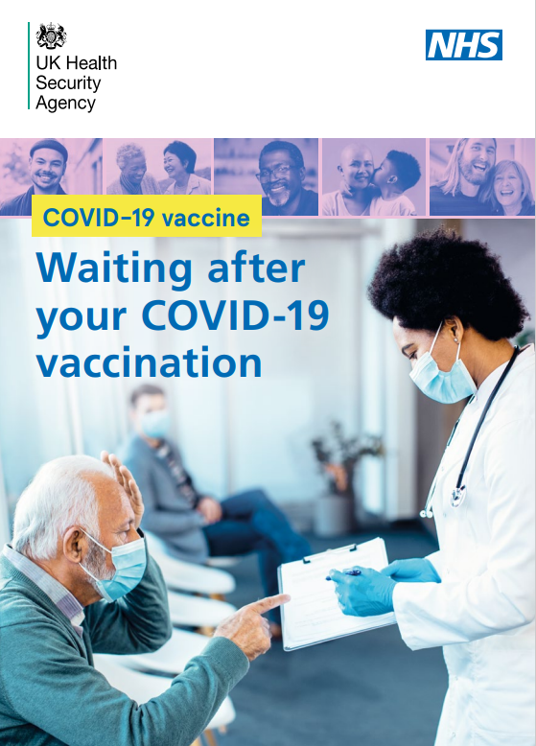
Post vaccination
following COVID-19 vaccine administration, individuals should be observed for any immediate reactions whilst you are giving them any verbal post vaccination information
the previous 15 minute recommended observation period has been suspended in recognition of the need to accelerate delivery of the programme in response to the emergence of the Omicron variant
vaccinated individuals should be informed how to access immediate healthcare advice in the event of displaying any symptoms
in some settings, for example domiciliary vaccination, this may require a responsible adult to be present for at least 15 minutes after vaccination
Notes:
Individuals should be observed for any immediate adverse effects whilst receiving any verbal post vaccination information (such as possible reactions and what, if anything, to do about these). They, or their parents/carers, should also be informed that they can obtain further advice if they require it following vaccination.

Slide 122
Post vaccination (cont)
patients with a personal history of allergy will require a period of observation following vaccination (either 15 or 30 minutes depending on their clinical history).
no specific management is required for patients with a family history of allergies
as fainting can occur following vaccination, all those vaccinated with any of the COVID-19 vaccines should either be driven by someone else or should not drive for 15 minutes after vaccination
facilities for management of anaphylaxis should be available at all vaccination sites and staff should have undertaken BLS and anaphylaxis training

Slide 123
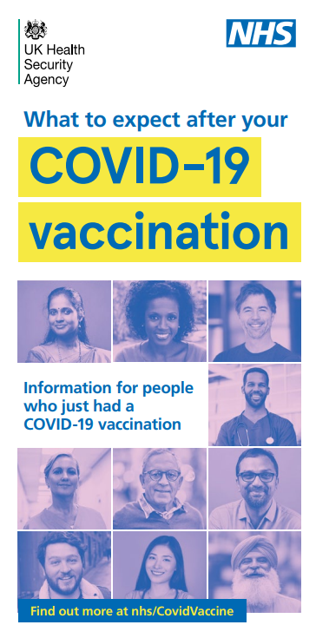
Post vaccination advice
vaccinees should be given a copy of the patient information leaflet and any other relevant written information
they should be given information about possible vaccine reactions, how to treat these, and when and from whom to seek further advice if required
generally symptoms post vaccination resolve within one to two days without treatment but antipyretics and/or analgesics can be taken if necessary to relieve any symptoms
if individuals are concerned about any symptoms following vaccination, they should seek advice from their GP or NHS 111
if a vaccinated person experiences symptoms that makes them think they may have COVID-19 infection, they should arrange to have a test. The COVID-19 vaccine will not interfere with testing for COVID-19 infection
Notes:
Individuals should be observed for any immediate adverse effects whilst receiving any verbal post vaccination information (such as possible reactions and what, if anything, to do about these). They, or their parents/carers, should also be informed that they can obtain further advice if they require it following vaccination.
The patient should be given a copy of the patient information leaflet (PIL) and/or any other relevant written information.
If a further dose will be required, an appointment should be made for this and the individual should be given a record card with details the first dose of vaccine and details of the appointment date and time for the second dose.
As syncope can occur following vaccination, those vaccinated should be advised to wait for 15 minutes post-vaccination before driving. There is no waiting period required for those vaccinated who are not driving

Slide 124
Disposal of consumables
needles should not be re-sheathed following vaccination under any circumstances because of the risk of sustaining a needlestick injury
the needle and syringe should be disposed of immediately after use in a puncture resistant yellow sharps bin
the yellow sharps bin should be sealed when it is two-thirds full and replaced with a new one
vaccine cardboard packaging should be placed in a confidential waste bag for incineration
any blood stained gauze should be placed in a bin for healthcare waste
local policy should be followed for the disposal of PPE

Slide 125
Adverse reactions following vaccination
Some people can feel unwell following an injection and some people may experience an adverse reaction.
Vaccinees should be informed of the potential expected reactions to COVID-19 vaccines.
There are 3 main types of adverse reaction following immunisation:
local reactions at the injection site such as redness, swelling or pain at the injection site
systemic reactions (reaction affecting the whole body) such as fever, headache, loss of appetite
allergic reaction such as anaphylaxis or a severe systemic allergic reaction

Slide 126
Adverse reactions following vaccination
Adverse events following vaccination may occur for various reasons.
These include:
inappropriate practices in the provision of vaccinations such as giving the wrong dose of vaccine or poor injection technique
reactions caused by the vaccine or its component parts. These may be a direct effect of the vaccine or due to an underlying medical condition in the individual

Slide 127
Anaphylaxis
common causes of anaphylaxis include food, eggs, and nuts but it can also be caused by medicines or vaccines
anaphylaxis is a rare, potentially life-threatening event
data from the US indicates anaphylaxis rates of 1 per every 200,000 doses of the Pfizer BioNTech vaccine administered and 1 per 360,000 doses of the Moderna vaccine given
rate of anaphylaxis reported to date to the AstraZeneca vaccine is in line with the expected rate of anaphylaxis to non-COVID vaccines (less than 1 per million doses of vaccine given)
onset is typically rapid, within minutes, with variable severity
it is critically important that immunisers know how to treat anaphylaxis should it occur and equipment for treating anaphylaxis must always be available in all vaccination settings
you must have completed Basic Life Support and anaphylaxis training prior to giving any vaccinations
Notes:
Turner P and others. COVID-19 vaccine-associated anaphylaxis: A statement of the World Allergy Organization Anaphylaxis Committee. World Allergy Organization Journal Volume 14, Issue 2, February 2021, 100517

Slide 128
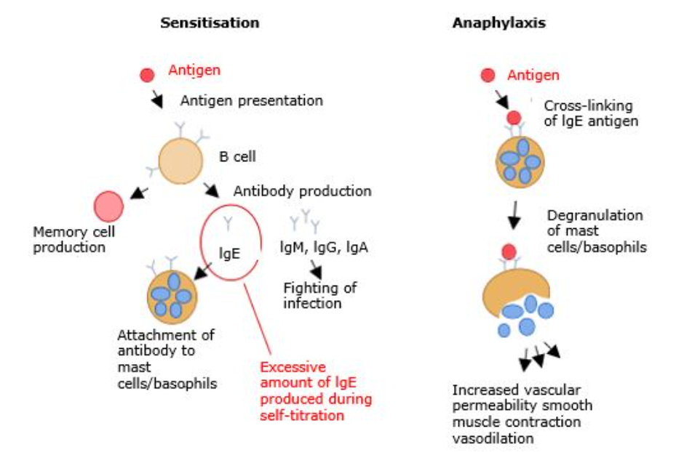
Anaphylaxis
Anaphylaxis occurs as a result of
exposure to an allergen to which a person has been sensitised and previously made specific immunoglobulin E (IgE).
On re-exposure to the antigen, explosive amounts of histamine and other chemical mediators are released following the binding of the antigen to IgE coated mast cells.
This causes bronchospasm, angioedema, pulmonary oedema, cardiovascular collapse, and loss of consciousness.

Slide 129
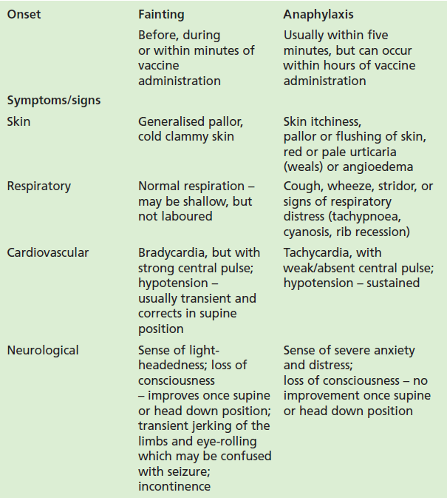
Fainting
all staff involved in vaccination should be able to distinguish an anaphylactic reaction from fainting and panic attacks
the features listed in the table differentiate between anaphylaxis and fainting. If the diagnosis is unclear, anaphylaxis should be presumed and appropriate management given
there should be rapid recovery from fainting. Although symptoms of malaise may persist, the patient should recover consciousness within a few minutes
some individuals may suffer panic attacks even before immunisation is undertaken. Symptoms include hyperventilation that may lead to numbness and tingling in the arms and legs but hypotension, pallor or wheezing should not occur in a panic attack

Slide 130
Preparing for and minimising faints associated with vaccination
fainting is a common event associated with the vaccination process, as are dizziness and nausea which may also follow vaccination due to ‘immunisation anxiety’
fainting tends to be more common in younger people, in warm weather, after queueing and where the situation is perceived as stressful
vaccinators need to consider the situations that make fainting more likely for example queuing, seeing others being vaccinated and so on, and how they can reduce anxiety for example distraction techniques, chatting, encouraging deep breaths, drinking water, and
so on
ensure people are seated whilst having the vaccination or offer a couch to people who say they are prone to fainting when having injections
people who faint usually regain consciousness within a few seconds so lie them down and raise their legs which improves blood pressure almost immediately. They should not stand up too soon since being active can lead to another episode

Slide 131
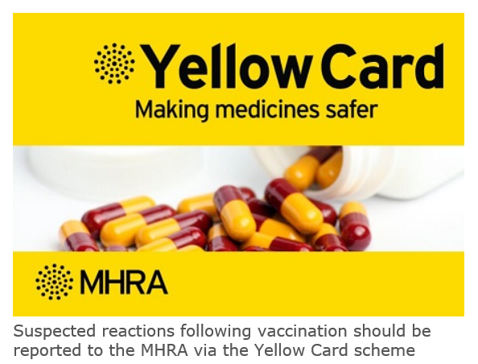
Reporting adverse reactions
Suspected adverse reactions following administration of COVID-19 vaccine should be reported to the MHRA using the specific Coronavirus Yellow Card reporting scheme (go to Coronavirus Yellow Card reporting site or call 0800 731 6789). As new vaccines, MHRA have a specific interest in the reporting of adverse drug reactions for these vaccines.
vaccines are carefully monitored to ensure they are safe, not causing untoward side effects and are suitable for the immunisation programme
MHRA promotes the collection and investigation of adverse reactions through the Yellow Card scheme which is a voluntary reporting system for suspected adverse reactions
anyone (patients and HCWs) can make a Yellow Card report, even if they are uncertain as to whether a vaccine caused the condition
weekly summaries of information received via Yellow Card reports for COVID-19 vaccines are published on the GOV.UK website at Coronavirus vaccine - weekly summary of Yellow Card reporting

Slide 132
Documentation and record keeping
it is essential that the information in Box 1 is recorded for all doses of vaccine given to ensure complete and accurate patient vaccination records and to enable extraction of the correct data for surveillance and vaccine coverage purposes
if not administered at the patient's GP surgery, a record of the vaccination given should be sent to the patient's GP to avoid duplicate vaccination and so that data can be submitted to the national COVID-19 vaccine uptake data survey
BOX 1. Following vaccination, the following information should be recorded:
vaccine name
product name
batch number
expiry date
dose administered
date immunisation given
route/site used
name and signature of vaccinator
Examples of patient records where vaccination details may need to be recorded:
patient's GP record (or other patient record, depending on location)
practice computer system
occupational health record/employer's record

Slide 133
Communicating about vaccination
There are many sources of information available relating to COVID-19. Since the virus was first identified in January 2020, there have been thousands of publications globally.
When considering the information contained in written materials, there are some key points to consider:
the author and their expertise/background
  if the author is not named, or the source is not clear, this should raise your suspicion about the quality of the information
  does the author have a vested interest in presenting an unbalanced view?
the way the information is presented
  is it presented in an unbiased manner, or is it selected to provide only one viewpoint when there are other equally valid views?
  is the information dated? If so, there may be more recent information that is different
  if there are any uncertainties, are they mentioned?
  is it possible to follow up any information by going to the original data, for example a trial of a vaccine?

Slide 134
Addressing concerns and providing information to those being vaccinated
the COVID-19 vaccines are relatively new vaccines. Patient information leaflets are available but many patients will want additional verbal reassurance or answers
it is important to read the information being made available to vaccinees so the information you give is consistent with this and so you know what information they have already had
it is also important to know where to direct patients to for further information
if people’s questions and concerns are answered accurately and appropriately, they are more likely to accept vaccination
Notes:
As the COVID-19 vaccines will be new vaccines, it is likely that people will have a lot of questions. Although they will be provided with patient information leaflets in advance of their immunisation appointment, many may not have read this or will want additional verbal reassurance or answers from you.
Undertaking this training should give immunisers a lot of the information they will require to answer some of the questions, for example, how the vaccine is made, whether it has been thoroughly tested, how many people it has been given to in clinical trials and the possible reactions it might cause.
It is important that immunisers read the information being made available to vaccinees so the information they give is consistent with this and so they know what information they have already had. It is also important that they know where they can direct them to for further information or know where they can obtain answers to any questions that they cannot answer. See Resources section for additional sources of information about the COVID-19 vaccine programme

Slide 135
General principles for addressing concerns
give the patient/parent/carer time to ask questions
find out the basis for their concerns
explore the nature and sources of information they have already gathered
check the patient/parents’/carers’ personal experience
provide them with other sources of information such as valid and reliable websites
check their understanding of the information that you provide
ask them if there are any more concerns
if they decline to be vaccinated, suggest talking again in a couple of days/weeks if appropriate
recommend immunisation

Slide 136
Knowledge and skills
a high level of knowledge and a positive attitude to immunisation helps to achieve and maintain high vaccine uptake
those being vaccinated need to feel confident that the person giving them the vaccine or advising them knows what they are doing and has the appropriate knowledge, skills and ability
immunisers who do not feel confident should discuss their concerns with a mentor or supervisor

Slide 137
Knowledge and skill check
statutory and mandatory training – should be completed as specified by your employer (including basic life support and anaphylaxis). This may also include additional sessions on infection prevention and control, information governance and other relevant topics to the patient group(s) you will be vaccinating
vaccine specific training (knowledge) – through elearning, classroom-based training or a webinar
vaccine specific training (practical) – preparing a vaccine and intramuscular (IM) injection technique
competency assessment – for formal assessment and sign-off of clinical competency
supervision is recommended for new immunisers until both they, and their supervisor or trainer, feel confident that they have the necessary knowledge and skills to administer vaccines safely and competently

Slide 138
Competency assessment tool
The competency assessment tool is divided into 3 areas:
knowledge
core clinical skills
the clinical process/procedure for vaccine administration
It should be completed by those who are new to or returning to immunisation before sharing with their supervisor. Experienced immunisers should use it as a self-assessment tool.
The supervisor carrying out the assessment should:
review the self-assessment, discussing any areas identified as ‘need to improve’
observe performance in the provision of immunisations/advice and indicate whether each competency is ‘met’ or ‘needs to improve’ in the ‘supervisor review’ column
if improvement is needed, help to develop an action plan to enable the achievement of the required level of competence and plan a further assessment
sign off the section at the bottom of the assessment when competency is agreed

Slide 139
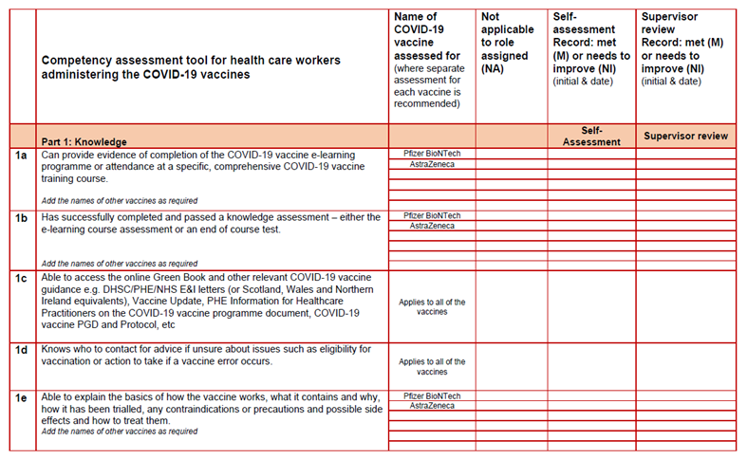
COVID-19 vaccinator competency assessment tool

Slide 140
Supervision and accountability
Supervision
supervision for new immunisers is critical to the safe and successful delivery of the COVID-19 immunisation programme
supervisors must be registered, appropriately trained, experienced and knowledgeable practitioners in immunisation
Accountability
all staff involved in immunisation are accountable for their own practice, both to their employer and to their professional regulator (where applicable)
employers are responsible and accountable for ensuring that employees have the required training and competency and are provided with an appropriate level of supervision to safely and effectively carry out the role they have been contracted to provide

Slide 141
Delegation
If immunisation is delegated, patient safety must be considered and not compromised in any way.
The delegation must be appropriate, safe and in the best interests of the patient.
When delegating immunisation, the delegating healthcare professional (whether nursing, medical or other independent prescriber) must ensure that:
the person they are delegating to has undergone training, has the appropriate knowledge, skills and competency
there is adequate supervision and support in place
If these conditions have been met and the role of administering an immunisation is delegated, the delegatee is accountable to the patient for their actions and decisions, and for any errors they make through civil law and to their employer.

Slide 142
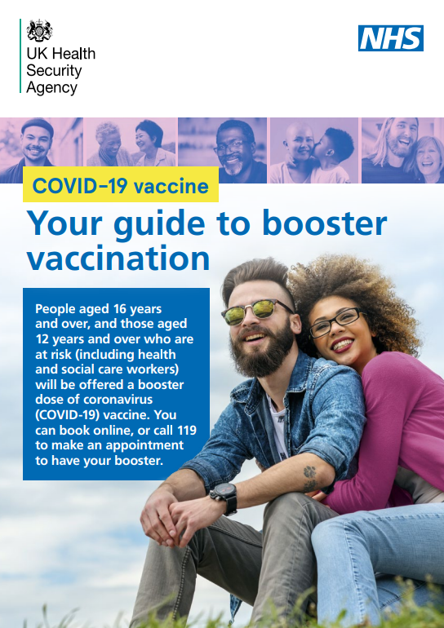
Maximising vaccine uptake
As COVID-19 vaccine may be offered in different settings, different methods of promoting the vaccine to maximise uptake may be required.
This may include:
displaying posters in areas of high footfall such as waiting rooms, train stations, shopping centres
having leaflets available for patients to read before their appointment
signposting people to online resources or resources in a suitable format, for example Easy Read, BSL, large text and translated versions
speaking confidently and positively about the vaccines and encouraging others in the vaccination clinic to do so as well
confirming an appointment has been made for the second dose
offering flexible appointments, including evening and weekend clinics
ensuring mobile staff are able to locate patient’s homes

Slide 143
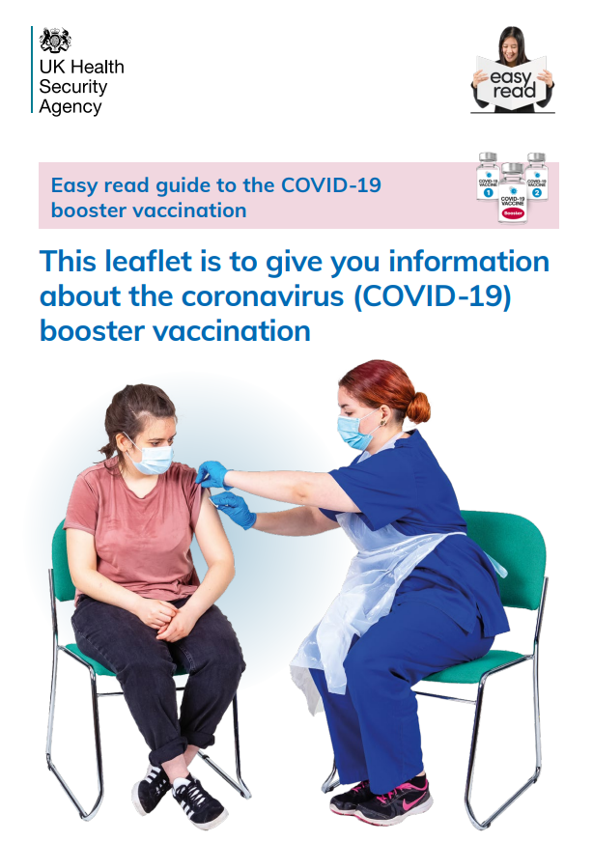
Reasonable adjustments
Learning disability, autism and other disabilities have protections under the Equality Act 2010. These include reasonable adjustments to communication and services. These should be person-centred.
Prior to the appointment, ensure you are fully aware of any reasonable adjustments that may be necessary in order to ensure appointment times and vaccines are utilised efficiently and effectively.
Reasonable adjustments can include, but are not limited to, offering:
appointment times at the start or the end of clinics when there is likely to be less of a wait
double appointment times so there is more time
the option of waiting in a quiet room, if one is available
the option of waiting in their car outside and being texted or called on their mobile when ready
the option of delivering this at home or another familiar setting if possible
Ideally avoid long waits and let people know if it is going to be a long wait.
Explain what the procedure entails and ask them whether they have any suggestions about how best to handle this.
Make use of easy-read information available.
More information is available at NHS Reasonable adjustments.

Slide 144
Further information
UK vaccine policy can be found in the online publication commonly referred to as the Green Book. This can be found on the Immunisation page of the GOV.UK website.
Green Book recommendations are based upon JCVI’s expert opinion and should always be followed, even when they differ from those made by the vaccine manufacturer.
UKHSA COVID-19 immunisation programme Information for healthcare practitioners
This document provides additional information, answers to frequently asked questions and actions to take in the event of inadvertent errors.
It is important to read this document before you start vaccinating and also to refer to the online version regularly as it will be updated as more information becomes available and to address any issues or frequently arising questions as COVID-19 vaccines are delivered more widely.

Slide 145
Vaccine product information
Licensed vaccines have a Summary of Product Characteristics (SPC) and a Patient Information Leaflet (PIL).
Initially, some of the COVID-19 vaccines have been given authorisation for temporary supply rather than a product license.
This means they will not have an SPC but all the information about the vaccine that would usually be found in an SPC is presented in an ‘Information for Healthcare Professional’ document.
The ‘Information for Healthcare Professionals’ document provides a description of the vaccine, how to use it and the conditions attached to its use.
An ‘Information for UK recipients’ document is also available which provides information for patients about the vaccine.
These documents are available on the MHRA website at Pharmacy.

Slide 146
Guidance on handling multiple COVID-19 vaccines
As there are now several different COVID-19 vaccines in use, it is important to ensure there are procedures in place to make certain that each person gets the right dose of the right vaccine at the right time and that the vaccine has been stored and handled as specified in the product’s authorisation documentation.
The different COVID-19 vaccines have different storage, handling and preparation requirements and different dosages. There may also be differences in the contraindications for each vaccine and in the advice that should be given about possible anticipated side effects.
Ensure you know what these are in order to minimise the risk of errors where multiple vaccines are available.
Notes:
The Specialist Pharmacy Service has put together guidance on safe practice for handling multiple vaccines from receipt through to administration. Vaccinators are encouraged to read through this guidance in order to minimise the risk of errors where multiple vaccines are available.
NB: Always check website for latest version of ‘Which COVID-19 vaccine’ poster as one shown on slide may not be the latest version

Slide 147
Action plan
To consolidate learning, the following actions should be completed:
undertake the COVID-19 vaccine, vaccine administration, storage and legal aspects elearning sessions if required after this training session
undertake Basic Life Support and anaphylaxis training if not undertaken in the past year
complete any additional statutory and mandatory training required by your employer
undertake practical training in immunisation if required, for example IM injection technique
complete the COVID-19 competency assessment tool
visit the GOV.UK Immunisation web pages and familiarise yourself with the resources available on this site
read the UKHSA ‘COVID-19 immunisation programme Information for healthcare practitioners’ document
read the vaccine product information in the ‘Summary of Product Characteristics’ and ‘Information for healthcare professionals’ documents on the MHRA website
access the Green Book online and read the COVID-19 vaccine chapter and any other chapters that are relevant for example vaccine administration, vaccine storage
subscribe to Vaccine Update to ensure that you receive this free monthly newsletter as it is published. It contains details of immunisation programme updates and changes
find out and make a note of who you can contact if you have an immunisation query or incident. This may be your local NHS England Screening and Immunisation Team or lead consultant (if working in Occupational Health, and so on)

Slide 148
Learning objectives
By the end of this session, you should be able to:
explain what COVID-19 is and be aware of the UK epidemiology
understand the policy behind the COVID-19 vaccination programme
describe how vaccines work and how they are developed and trialled
identify the groups who are at high risk for COVID-19 infection and who should be prioritised to receive the COVID-19 vaccine
describe the process of consent and how this applies when giving vaccines
understand the legal mechanisms by which immunisers can supply and administer COVID-19 vaccine
recognise the differences between a prescription, a PSD, a PGD and a Protocol and understand which staff can use each of these
describe the key principles of how to correctly store, prepare and administer vaccines
communicate key facts in response to questions from patients and direct them to additional sources of information

Slide 149
Resources
Green Book COVID-19 chapter Immunisation against infectious disease
UK Health Security Agency Coronavirus resources
GOV.UK Coronavirus (COVID-19) in the UK
WHO COVID-19 Worldwide Dashboard
Royal College of Nursing COVID-19 vaccination resources
MHRA guidance on coronavirus (COVID-19)
Oxford Knowledge Project COVID-19 vaccines
British Society of Immunology A guide to vaccinations for COVID-19

Slide 150
COVID-19 Vaccine Pfizer BioNTech
COVID-19 Vaccine Pfizer BioNTech Comirnaty 30 micrograms/dose

Slide 151
Contraindications to COVID-19 Pfizer BioNTech vaccine
The COVID-19 Pfizer BioNTech vaccine may be contraindicated for people who have had a previous systemic allergic anaphylaxis reaction to a previous dose of COVID-19 vaccine or to any components (excipient) of the vaccine. Expert advice should be sought where either contraindication is present.
In addition to the highly purified messenger RNA, the vaccine also contains:
ALC-0315 = (4-hydroxybutyl) azanediyl)bis (hexane-6,1-diyl)bis(2-hexyldecanoate)
ALC-0159 = 2-[(polyethylene glycol)-2000]-N*,N-ditetradecylacetamide
1,2-Distearoyl-sn-glycero-3-phosphocholine
cholesterol
potassium chloride
potassium dihydrogen phosphate
sodium chloride
disodium hydrogen phosphate dihydrate
sucrose
water for injections
sodium hydroxide (for pH-adjustment)
hydrochloric acid (for pH-adjustment)
*Polyethylene glycol (PEG) is from a group of known allergens commonly found in medicines, household goods and cosmetics. Known allergy to PEG is rare but would contraindicate receipt of the Pfizer and the Moderna vaccines

Slide 152
COVID-19 Pfizer BioNTech Comirnaty 30 micrograms/dose vaccine
the vaccine does not contain preservative
no animal products are contained in the vaccine product
the vaccine does not contain latex, milk, lactose, gluten, egg, maize/corn or peanuts
full product information about the COVID-19 Pfizer BioNTech vaccine is available at Regulatory approval of Pfizer/BioNTech vaccine for COVID-19
a video showing how to reconstitute and prepare the Pfizer BioNTech vaccine is available: www.comirnatyeducation.co.uk/

Slide 153
Adverse reactions following COVID-19 Pfizer BioNTech Comirnaty 30 micrograms/dose vaccine
The following reactions were reported by the vaccine clinical trial participants.
Local reactions
Over 80% reported pain at the injection site. Redness and swelling was also commonly reported.
Systemic reactions
The most frequently reported systemic reactions (reactions affecting the whole body) were:
tiredness (> 60%) headache (> 50%)
muscle aches (> 40%) chills (> 30%)
joint pain (> 20%) raised temperature (fever)(> 10%)
these symptoms were usually mild or moderate in intensity and resolved within a few days after vaccination
the types of reactions reported in adolescents aged 12 to 15 years who received the Pfizer BioNTech vaccine in clinical trials were the same as those reported in older individuals but were reported slightly more frequently
medicines such as paracetamol can be given for post-vaccination pain or fever if required.
inform vaccinees these symptoms normally last less than a week but if their symptoms get worse or they are concerned, they should speak to their GP or call NHS 111

Slide 154
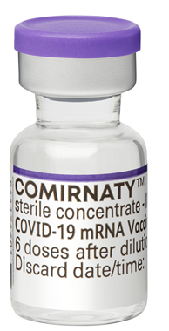
COVID-19 Vaccine Pfizer BioNTech Comirnaty 30 micrograms/dose vaccine presentation
the vaccine packs contain 195 vials of vaccine
the vaccine is contained in a multidose clear glass vial. The vial has a rubber (bromobutyl) stopper, aluminium seal and a purple flip-off plastic cap. The stopper does not contain latex
each vial contains 0.45 ml of vaccine and should be diluted with 1.8 ml of Sodium Chloride 0.9% Solution for Injection (normal saline)
if the dose-sparing needles and syringes being supplied with the vaccine are used, it should be possible to obtain 6 full 0.3ml doses from the vial. If standard syringes and needles are used, there may not be sufficient volume to extract a sixth dose from a single vial
care should be taken to ensure a full 0.3 ml dose will be administered to the patient from the same vial. If the amount of vaccine remaining in the vial cannot provide a full dose of 0.3 ml, discard the vial and any excess volume. Do not pool excess vaccine from multiple vials

Slide 155
Diluent for COVID-19 Pfizer BioNTech Comirnaty 30 micrograms/dose vaccine
only Sodium Chloride 0.9% Solution for Injection (normal saline) should be used as a diluent for this vaccine
a separate ampoule containing a minimum of 2 ml of normal saline is required for vaccine reconstitution
each ampoule of diluent is single use and any remaining diluent must be discarded after 1.8 ml has been withdrawn, regardless of the ampoule volume
there are no special storage requirements for the diluent and this can be stored with other ambient products (needles and syringes) in a dry environment away from direct sunlight

Slide 156
Ordering COVID-19 Pfizer BioNTech vaccine
pre-authorised NHS Trusts should order the Pfizer BioNTech COVID-19 vaccine via the ImmForm platform. PCN designated sites need to use the Foundry system to order vaccines. Ordering is only available for pre-authorised sites
each pack of vaccine ordered should automatically generate an order for the required number of the following for that vaccine pack:
      diluent
      combined needles and syringes for dilution
      syringes and needles for vaccine administration*
      patient information leaflets
      Patient vaccination record cards should be ordered directly from the Health Publications website
*Longer length (38mm) needles are recommended for morbidly obese individuals to ensure the vaccine is injected into muscle. These can be ordered from ImmForm when ordering vaccine if required in addition to the 25mm needles and syringes that will be supplied

Slide 157
COVID-19 Pfizer BioNTech Comirnaty 30 micrograms/dose vaccine dose and schedule
a single dose is 0.3 ml
2 doses of COVID-19 Pfizer BioNTech vaccine are required with a minimum 21-day interval between doses
currently, JCVI is recommending an interval of 8 weeks between primary doses of the Pfizer BioNTech COVID-19 vaccine (12 weeks for 12 to 17 year olds)
operationally, using the same minimum interval for all products will simplify supply and booking, and will help to ensure a good balance between achieving rapid and long-lasting protection
the main exception to the 8 week lower interval would be those about to commence immunosuppressive treatment. In these individuals, the minimal interval between doses (21 days for Pfizer) may be followed to ensure vaccine is given whilst their immune system is better able to respond
the booster vaccination dose is also 0.3ml and should be given to eligible individuals at least 3 months after completing the primary course

Slide 158
Storage and transportation of Pfizer BioNTech Comirnaty 30 micrograms/dose vaccine
For information only as those handling vaccines at ultra low temperatures should have received specific additional training for this and should be working to detailed standard operating procedures:
the vaccine will be delivered frozen to healthcare facilities with ultra low temperature (ULT) freezers
vaccine packs will be shipped inside isothermic boxes (validated boxes which will maintain a constant temperature for a specified period of time) inside a cardboard box
the isothermic box will also contain dry ice which should be disposed of carefully following local protocols
upon delivery, the vaccine packs should be removed from the isothermic box and transferred to a suitable ULT freezer to ensure ongoing storage between -90ºC to -60ºC
the vaccine should be kept upright, in its original packaging and away from prolonged light exposure
shelf-life is 9 months at -90ºC to -60ºC

Slide 159
Thawing
when required, frozen vials should be transferred to 2ºC to 8ºC to thaw; a 195 vial pack may take 3 hours to thaw at this temperature
frozen vials may be thawed at temperatures up to 30ºC for 30 minutes for immediate use. It must not be kept at room temperature (up to 30ºC) for any longer than 2 hours prior to dilution
once thawed, the vaccine should not be re-frozen

Slide 160
Storage of COVID-19 Pfizer BioNTech Comirnaty 30 micrograms/dose vaccine in a thawed state
the vaccine may be delivered to where it is going to be administered thawed but refrigerated between +2 and +8ºC
refrigerated vaccine must be transferred immediately to a vaccine fridge on arrival and stored in a carefully monitored temperature range of +2 and +8ºC
when removed from the freezer, the undiluted vaccine has a maximum shelf life of up to 1 month at +2 and +8ºC
prior to use, the unopened vaccine can be stored for up to 2 hours at temperatures up to 30ºC
the Comirnaty pack has a space on the label on the front which should state the expiry(discard) time and date on it
vaccine should be stored in the original package to protect it from light. Exposure to room light should be minimised and exposure to direct sunlight and ultraviolet light should be avoided

Slide 161
Storage and use of COVID-19 Pfizer BioNTech Comirnaty 30 micrograms/dose vaccine
the Pfizer BioNTech Comirnaty 30 micrograms/dose vaccine has very specific storage, reconstitution and 'use within' requirements
all those involved in the delivery of the COVID-19 vaccination programme must be aware of the recommended storage requirements
The vaccine must not be given if you are not confident that it has been stored or reconstituted as recommended by the manufacturer or as advised by a vaccine expert
If the vaccine is stored incorrectly:
label and isolate affected vaccines in the fridge and do not use until further notice
seek advice from the manufacturer or a source of expert advice

Slide 162
COVID-19 Pfizer BioNTech Comirnaty 30 micrograms/dose vaccine reconstitution
The following equipment is required for reconstitution:
one Pfizer BioNTech Comirnaty 30 micrograms/dose COVID-19 vaccine multidose vial
one plastic ampoule of Sodium Chloride 0.9% Solution for Injection - this will be supplied in multiple presentations (different manufacturers and different sized ampoules)
an alcohol swab and 1 of the combined needle and syringes supplied for dilution of the Pfizer BioNTech vaccine
After dilution the vaccine should be used as soon as is practically possible.
Reconstituted vaccine can be stored between +2ºC and +30ºC but must be used within 6 hours following dilution

Slide 163
Reconstituting COVID-19 Pfizer BioNTech Comirnaty 30 micrograms/dose vaccine (1)
clean hands with alcohol-based gel or soap and water
assemble 1 ampoule of Sodium Chloride 0.9% Solution for Injection, a single use alcohol swab and one of the combined needle and syringes provided for dilution
from cold storage, remove 1 vial of vaccine. Ensure it is the purple capped vial.
if removing the multidose vaccine vial directly from a ULT freezer, allow the vaccine to thaw as previously described
if removing the multidose vaccine vial from cold storage between +2 and +8ºC, check that it has not been stored there for longer than 1 month
allow the thawed vaccine to come to room temperature, then gently invert the vial 10 times prior to dilution. One inversion means turning the vial upside down and back again. Do not shake
check the expiry date and the appearance of the vaccine. Prior to dilution, the thawed vaccine may contain white to off-white opaque amorphous particulates. Return the vial to the manufacturer if the appearance of the solution does not match this description
clean the vial stopper with the single use alcohol swab and allow to air dry fully

Slide 164
Reconstituting COVID-19 Pfizer BioNTech Comirnaty 30 micrograms/dose vaccine (2)
invert the ampoule containing the Sodium Chloride 0.9% Solution for Injection diluent and withdraw 1.8ml slowly to avoid formation of bubbles
discard the diluent ampoule and any remaining diluent in it. Do not use any other type of diluent
add diluent to the vaccine vial. You may feel some pressure in the vial as you add the diluent. Equalise the vial pressure by withdrawing 1.8 ml of air into the empty diluent syringe before removing the needle from the vial
gently invert the diluted solution 10 times. Do not shake
the diluted vaccine should be an off-white solution with no particulates visible
remove the needle from the vial and dispose into yellow sharps bin
the diluted vial should be clearly labelled with the date and time of discard

Slide 165
Dose preparation of COVID-19 Pfizer BioNTech Comirnaty 30 micrograms/dose vaccine
if the vaccine has previously been reconstituted, check that it is still within the 6 hour allowed time period from when it was reconstituted
clean top of vial with a single use alcohol swab and allow to air dry fully
unwrap 1 of the 1ml combined 23g/25mm blue hub needle and syringes provided (recommended needle length depends on body mass of patient. Longer length (38mm) needles are recommended for morbidly obese individuals to ensure the vaccine is injected into muscle)
withdraw a dose of 0.3 ml of diluted product for each vaccination. Ensure correct dose is drawn up
any air bubbles should be removed before removing the needle from the vial in order to avoid losing any of the vaccine dose
the same needle and syringe should be used to draw up and administer the dose of vaccine to prevent under dosing of the vaccine to the person
the needle should only be changed between the vial and the patient if it is contaminated or damaged

Slide 166
COVID-19 Vaccine AstraZeneca
COVID-19 Vaccine AstraZeneca

Slide 167
Contraindications to COVID-19 AstraZeneca
The AstraZeneca COVID-19 vaccine may be contraindicated for people who have had a previous systemic allergic anaphylaxis reaction to a previous dose of COVID-19 vaccine or to any components (excipient) of the vaccine. Expert advice should be sought where either contraindication is present.
In addition to the recombinant, replication-deficient chimpanzee adenovirus vector encoding the SARS‑CoV‑2 Spike (S) glycoprotein, the vaccine also contains:
L-Histidine
L-Histidine hydrochloride monohydrate
Magnesium chloride hexahydrate
Polysorbate 80
Ethanol
The vaccine does not contain preservative and it does not contain any components of animal origin.
COVID-19 Vaccine AstraZeneca should also not be given to individuals who experience a clotting episode with concomitant thrombocytopaenia following first dose.
Sucrose
Sodium chloride
Disodium edetate dihydrate
Water for injections

Slide 168
Adverse reactions following COVID-19 Vaccine AstraZeneca
The following reactions were reported by the vaccine clinical trial participants:
Local reactions
64% reported tenderness at the injection site with redness, swelling, pain also being reported.
Systemic reactions
The most frequently reported systemic reactions (reactions affecting the whole body) were:
        tiredness (53%) headache (53%)
        muscle aches (44%) feeling generally unwell (44%)
        chills (32%) raised temperature (fever)(34%)
        joint pain (26%) nausea (22%)
these symptoms were usually mild or moderate in intensity and resolved within a few days
adverse reactions reported after the second dose were milder and reported less frequently than after the first dose. They were also generally milder and reported less frequently in adults ≥65 years old
medicines such as paracetamol can be given for post-vaccination pain or fever if required
inform vaccinees these symptoms normally last less than a week but if their symptoms get worse or they are concerned, they should speak to their GP or call NHS 111

Slide 169

AstraZeneca vaccine presentation
COVID-19 Vaccine AstraZeneca is presented in a multidose vial containing a solution which should be colourless to slightly brown, clear to slightly opaque and free of particles
the vial has a halobutyl rubber stopper and is sealed with an aluminium overseal with a plastic flip-off cap. There is no latex in the vial stopper (bung)
AstraZeneca COVID-19 vaccine will be delivered in packs that contain 10 vials
2 different presentations of the AstraZeneca vaccine are being provided:
  80 dose packs (ten 4 ml vials with at least 8 doses per vial)
  100 dose packs (ten 5 ml vials with at least 10 doses per vial)
the vaccine now being supplied is the 8+ doses per vial presentation but the 10+ dose vial was provided initially
vaccinators must check how many doses the vial they are using contains so that vaccine is not wasted

Slide 170
Additional doses from vaccine vial
each vial contains at least the number of doses stated
after withdrawing 8 or 10 full 0.5ml doses from the vial (depending on vial size), it may be possible to withdraw an additional full dose if the dose-sparing needles and syringes being provided with the vaccine are being used
care should be taken to ensure a full 0.5 ml dose will be administered to the patient from the same vial
where a full 0.5 ml dose cannot be extracted, the remaining contents should be discarded

Slide 171
Ordering
COVID-19 Vaccine AstraZeneca should be ordered via the ImmForm platform (pre-authorised NHS Trusts) or the Foundry system (PCN designated sites)
combined 1 ml fixed-needle (23g or 25g, 25mm length) dose-sparing syringes for administration will be available to order separately on ImmForm
syringes and longer-length (38mm) needles for administration can be ordered for those who are morbidly obese
each carton of vaccine vials will include 1 Healthcare Professional Information sheet and 1 pad of the corresponding number of the ‘Regulation 174 Information for UK recipients’ leaflets
patient vaccination record cards should be ordered directly from the Health Publications website
vaccinators are advised to read the latest administration instructions electronically

Slide 172
Storage
upon delivery, AstraZeneca vaccine should be transferred to a fridge immediately and stored between +2ºC and +8ºC
vials should be kept upright in their box and away from direct sunlight to prevent prolonged light exposure
once the vial bung is punctured, the vaccine must be used as soon as possible and within 6 hours of first puncture (during which time it can be stored between +2ºC to +25ºC)
as the vaccine does not contain preservative, any unused vaccine must be discarded if not used within this 6 hour time period

Slide 173
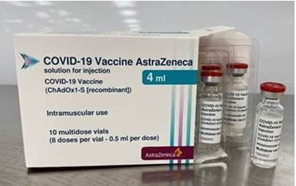
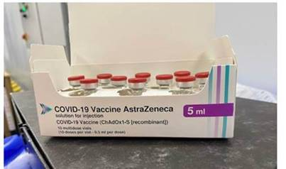
Store the vials upright
The vaccine vials must be stored upright (mulberry colour panel is the bottom).

Slide 174
Dose and schedule
the amount to be given for each dose is 0.5ml
2 doses of AstraZeneca vaccine are required with a minimum 28-day interval between doses
currently, JCVI is recommending an interval of 8 weeks between primary doses of all the AstraZeneca COVID-19 vaccine
operationally, using the same minimum interval for all products will simplify supply and booking, and will help to ensure a good balance between achieving rapid and long-lasting protection
the main exception to the 8 week lower interval would be those about to commence immunosuppressive treatment. In these individuals, the minimal interval between doses (28 days for AstraZeneca) may be followed to ensure that the vaccine is given whilst their immune system is better able to respond

Slide 175
Vaccine dose preparation (1)
COVID-19 Vaccine AstraZeneca does not require reconstitution
before drawing up a dose of vaccine from the multidose vial, clean hands with alcohol-based gel or soap and water
each multi-dose vial should be clearly labelled with the date and time of expiry (which will be 6 hours from when it was first punctured)
do not use the vaccine if the time of first puncture was more than 6 hours previously
check the appearance of the vaccine. It should be colourless to slightly brown, clear to slightly opaque and free of any particles. Discard the vaccine if particulates or discolouration are present
do not shake the vaccine vial
the vial bung should be wiped with an alcohol swab and allowed to air-dry fully

Slide 176
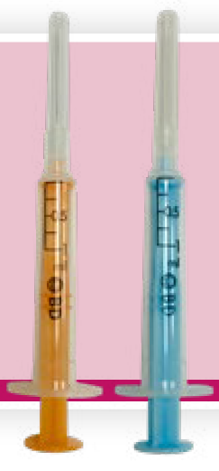
Vaccine dose preparation (2)
a 1 ml dose-sparing syringe with a 23g or 25g, 25mm fixed-needle should be used to draw up and administer the AstraZeneca vaccine (these are available to order with the vaccine)
separate 38mm length needles and syringes should be used for morbidly obese patients to ensure the vaccine can be injected into the muscle
withdraw a dose of 0.5 ml for each vaccination. Take particular care to ensure the correct dose is drawn up as a partial dose may not provide protection
any air bubbles should be removed before removing the needle from the vial in order to avoid losing any of the vaccine dose

Slide 177
COVID-19 Vaccine Moderna
COVID-19 Vaccine Moderna
(Spikevax)

Slide 178
Contraindications to COVID-19 Vaccine Moderna
(Spikevax)
COVID-19 Vaccine Moderna (Spikevax) may be contraindicated for people who have had a previous systemic allergic anaphylaxis reaction to a previous dose of COVID-19 vaccine or to any components (excipient) of the vaccine. Expert advice should be sought where either contraindication is present.
In addition to the highly purified messenger RNA, the Moderna vaccine also contains:
lipid SM-102
cholesterol
1,2-distearoyl-sn-glycero-3-phosphocholine (DSPC)
1,2-Dimyristoyl-rac-glycero-3-methoxypolyethylene glycol*-2000 (PEG2000-DMG)
trometamol (Tris)
trometamol hydrochloride (Tris HCl)
acetic acid
sodium acetate trihydrate
sucrose
water for injections
* Polyethylene glycol (PEG) is from a group of known allergens commonly found in medicines, many household goods and cosmetics. Known allergy to PEG is rare but would contraindicate receipt of this and the Pfizer vaccine

Slide 179
COVID-19 Vaccine Moderna (Spikevax)
the vaccine does not contain preservative
no animal products are contained in the vaccine
full product information about the COVID-19 Vaccine Moderna (Spikevax)

Slide 180
Adverse reactions following COVID-19 Vaccine Moderna
The following reactions were reported by the vaccine clinical trial participants.
Local reactions
92% reported pain at the injection site. Swelling (15%) and redness (10%) was also reported.
Systemic reactions
The most frequently reported systemic reactions (reactions affecting the whole body) were:
tiredness (70%) headache (65%)
muscle aches (62%) chills (46%)
joint pain (46%) raised temperature (fever)(16%)
these symptoms were usually mild or moderate in intensity and resolved within a few days
a slightly lower rate of reactions was seen in older age groups (those aged 65 years and above) than in those aged 18 to under 65 years. Reactions were more frequently reported after the second dose than the first dose
medicines such as paracetamol can be given for post-vaccination pain or fever if required

Slide 181
Local reactions at the vaccination site
the MHRA have received reports of skin reactions occurring around the vaccination site 4 to 11 days after vaccination. The majority of the reports received have been following the Moderna vaccine
the reactions are characterized by a rash, swelling and tenderness that can cover the whole upper arm and may be itchy and/or painful and warm to the touch
the reactions are usually self-limiting and resolve within a day or two, although in some patients it can take slightly longer to disappear
individuals who experience this reaction after their first dose may experience a similar reaction in a shorter timeframe following the second dose, however, none of the reports received by the MHRA have been serious and people should still receive their second dose when invited
those who experience delayed skin reactions after their COVID-19 vaccination which do not resolve within a few days should seek medical advice

Slide 182
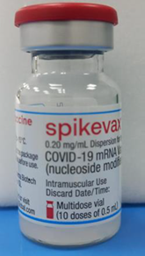
Moderna COVID-19 vaccine presentation
the vaccine packs contain 10 multidose vials of vaccine
the vaccine is contained in a multidose clear glass vial. The vial has a rubber (chlorobutyl) stopper, aluminium seal and a flip-off plastic cap. The stopper does not contain latex
if the dose-sparing needles and syringes being supplied with the vaccine are used, it should be possible to obtain at least 10 primary doses of 0.5ml or a maximum of 20 booster doses of 0.25ml from the vial

Slide 183
Ordering
Moderna COVID-19 vaccine (Spikevax) should be ordered via the ImmForm platform (pre-authorised NHS Trusts) or the Foundry system (PCN designated sites). Ordering is only available for pre-authorised sites
combined 1 ml fixed-needle (23 gauge, 25mm length) dose-sparing syringes for administration are available to order separately on ImmForm
syringes and longer-length (38mm) needles for administration can be ordered for those who are morbidly obese
Patient Information Leaflets are also provided with each vaccine pack
patient vaccination record cards should be ordered directly from the Health Publications website
vaccinators are advised to read the latest administration instructions electronically

Slide 184
Moderna vaccine (Spikevax) dose and schedule
the priming dose of Spikevax is 0.5 ml
the primary course consists of 2 doses with a minimum 28-day interval between doses
currently, JCVI is recommending an interval of 8 weeks between primary doses of Moderna COVID-19 vaccine
operationally, using the same minimum interval for all products will simplify supply and booking, and will help to ensure a good balance between achieving rapid and long-lasting protection
the main exception to the 8 week lower interval would be those about to commence immunosuppressive treatment. In these individuals, the minimal interval between doses (28 days for Moderna vaccine (Spikevax)) may be followed to ensure that the vaccine is given whilst their immune system is better able to respond
the booster dose of Spikevax is 0.25ml and this should be given to eligible individuals at least 3 months after completing the primary course

Slide 185
Storage of Moderna Spikevax vaccine
The Moderna COVID-19 vaccine (Spikevax) will be delivered frozen to healthcare facilities with the appropriate freezers to store the vaccine vials between -25ºC to -15ºC until ready for use.
thaw in refrigerated conditions between +2ºC to +8ºC for 2½ hours. Let each vial stand at room temperature for 15 minutes before administering
alternatively, thaw at room temperature between +15ºC to +25ºC for 1 hour
once thawed, the vaccine cannot be re-frozen and may be stored refrigerated at +2ºC to +8ºC, protected from light, for up to 30 days if it has not been opened and the bung has not been punctured by a needle
within the 30 day period, up to 12 hours may be used for transportation
shelf-life is 7 months at -25ºC to -15ºC
Notes:
To note: whilst the 2.5 hours thawing advice is stated in the Moderna vaccine (Spikevax) vaccine’s Summary of Product Characteristics, in practice it has been found to take significantly longer than this to thaw. The Specialist Pharmacy Service Standard Operating Procedure ‘Unpacking of frozen Moderna vaccine (Spikevax) COVID-19 Vaccine and transfer to fridges to thaw’ states that the vials may take up to 24 hours to thaw in a fridge

Slide 186
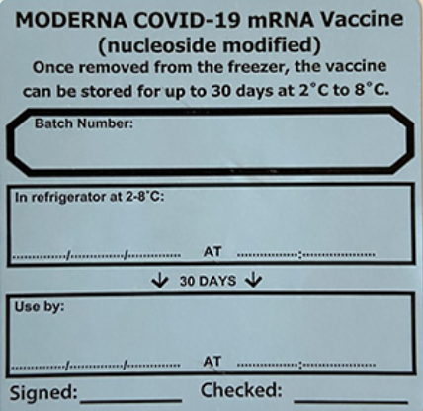
Storage of Moderna Spikevax vaccine in a thawed state
the vaccine may then be delivered to where it is going to be administered thawed but refrigerated between +2ºC and +8ºC
refrigerated vaccine must be transferred immediately to a vaccine fridge on arrival and stored in a carefully monitored temperature range of +2ºC and +8ºC
the unopened vaccine may be stored refrigerated at +2ºC to +8ºC, protected from light, for up to 30 days
the vaccine pack should have a label on the front stating the time it was removed from the freezer into storage at +2ºC to +8ºC and the date and time by which it must be discarded 30 days later if it has not been used
the unopened vaccine may be stored at +8ºC to +25ºC for up to 24 hours after removal from refrigerated conditions

Slide 187
Vaccine dose preparation (1)
Moderna COVID-19 vaccine (Spikevax) does not require reconstitution. The vaccine comes ready to use once thawed
before drawing up a dose of vaccine from the multidose vial, clean hands with alcohol-based gel or soap and water
each multidose vial should be clearly labelled with the date and time of discard (which will be 6 hours from when it was first punctured)
do not use the vaccine if the time of first puncture was more than 6 hours previously
check the appearance of the vaccine. It should be white to off-white and may contain white or translucent product-related particulates. Discard the vaccine if other particulates or discolouration are present.
swirl the vial gently after thawing and between each withdrawal. Do not shake the vaccine vial
the vial bung should be wiped with an alcohol swab and allowed to air-dry fully

Slide 188
Vaccine dose preparation (2)
a 1 ml dose-sparing syringe with a 23g, 25mm fixed-needle should be used to draw up and administer the Moderna vaccine (these are available to order with the vaccine)
separate 38mm length needles and syringes should be used for morbidly obese patients to ensure the vaccine can be injected into the muscle
withdraw a dose of 0.5 ml for each primary vaccination or 0.25ml for each booster vaccination. Take particular care to ensure the correct dose is drawn up
pierce the stopper at a different site each time a dose is withdrawn from the vial
any air bubbles should be removed before removing the needle from the vial in order to avoid losing any of the vaccine dose

Slide 189
COVID-19 Vaccine Pfizer BioNTech
COVID-19 Vaccine Pfizer BioNTech Comirnaty 10 micrograms/dose

Slide 190
Contraindications to COVID-19 Pfizer BioNTech vaccine
The COVID-19 Pfizer BioNTech vaccine may be contraindicated for people who have had a previous systemic allergic anaphylaxis reaction to a previous dose of COVID-19 vaccine or to any components (excipient) of the vaccine. Expert advice should be sought where either contraindication is present.
In addition to the highly purified messenger RNA, the vaccine also contains:
ALC-0315 = (4-hydroxybutyl) azanediyl)bis (hexane-6,1-diyl)bis(2-hexyldecanoate)
ALC-0159 = 2-[(polyethylene glycol)-2000]-N*,N-ditetradecylacetamide
1,2-Distearoyl-sn-glycero-3-phosphocholine
cholesterol
potassium chloride
potassium dihydrogen phosphate
sodium chloride
disodium hydrogen phosphate dihydrate
sucrose
water for injections
sodium hydroxide (for pH-adjustment)
hydrochloric acid (for pH-adjustment)
*Polyethylene glycol (PEG) is from a group of known allergens commonly found in medicines, household goods and cosmetics. Known allergy to PEG is rare but would contraindicate receipt of the Pfizer vaccine – seek expert advice

Slide 191
COVID-19 Pfizer BioNTech
Comirnaty 10 micrograms/dose vaccine
the vaccine does not contain preservative
no animal products are contained in the vaccine product
the vaccine does not contain latex, milk, lactose, gluten, egg, maize/corn or peanuts
full product information about the COVID-19 Pfizer BioNTech vaccine is available at Regulatory approval of Pfizer/BioNTech vaccine for COVID-19
more information about the Pfizer BioNTech Comirnaty 10 micrograms/dose vaccine is available at COMIRNATY

Slide 192
Adverse reactions following COVID-19 Pfizer BioNTech Comirnaty 10 micrograms/dose vaccine
The following reactions were reported by the vaccine clinical trial participants aged 5 to 11 years:
Local reactions
Over 80% reported pain at the injection site. Redness and swelling was also commonly reported (20%).
Systemic reactions
The most frequently reported systemic reactions (reactions affecting the whole body) were:
tiredness (> 50%) headache (> 30%)
muscle aches (> 10%) chills (> 10%)
these symptoms were usually mild or moderate in intensity and resolved within a few days after vaccination
compared to adults and older children, children aged 5 to 11 years reported more injection-site redness (15-19% vs 5-7%) and local swelling (10-15% vs 5-8%), but less fever (3-7% vs 1-20%) and less chills (5-10% vs 6-42%)
medicines such as paracetamol can be given for post-vaccination pain or fever if required.
inform parents/carers/vaccinees these symptoms normally last less than a week but if their symptoms get worse or they are concerned, they should speak to their GP or call NHS 111

Slide 193
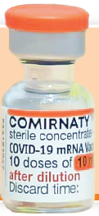
COVID-19 Vaccine Pfizer BioNTech Comirnaty
10 micrograms/dose vaccine presentation
the vaccine packs contain 10 vials of vaccine
the vaccine is contained in a multidose clear glass vial. The vial has a rubber (bromobutyl) stopper, aluminium seal and an orange flip-off plastic cap. The stopper does not contain latex
each vial contains 1.3 ml of vaccine and should be diluted with 1.3 ml of Sodium Chloride 0.9% Solution for Injection (normal saline)
if the dose-sparing needles and syringes being supplied with the vaccine are used, it should be possible to obtain 10 full 0.2ml doses from the vial. If standard syringes and needles are used, there may not be sufficient volume to extract a tenth dose from a single vial
care should be taken to ensure a full 0.2 ml dose will be administered to the patient from the same vial. If the amount of vaccine remaining in the vial cannot provide a full dose of 0.2 ml, discard the vial and any excess volume. Do not pool excess vaccine from multiple vials

Slide 194
Diluent for COVID-19 Pfizer BioNTech Comirnaty
10 micrograms/dose vaccine
only Sodium Chloride 0.9% Solution for Injection (normal saline) should be used as a diluent for this vaccine
a separate ampoule containing a minimum of 2 ml of normal saline is required for vaccine reconstitution
each ampoule of diluent is single use and any remaining diluent must be discarded after 1.3 ml has been withdrawn, regardless of the ampoule volume
there are no special storage requirements for the diluent and this can be stored with other ambient products (needles and syringes) in a dry environment away from direct sunlight

Slide 195
Ordering COVID-19 Pfizer BioNTech vaccine
pre-authorised NHS Trusts should order the Pfizer BioNTech COVID-19 vaccine via the ImmForm platform. PCN designated sites need to use the Foundry system to order vaccines. Ordering is only available for pre-authorised sites
each pack of vaccine ordered should automatically generate an order for the required number of the following for that vaccine pack:
      diluent
      combined needles and syringes for dilution
      syringes and needles for vaccine administration
      patient information leaflets
      Patient vaccination record cards should be ordered directly from the Health Publications website

Slide 196
COVID-19 Pfizer BioNTech Comirnaty 10 micrograms/dose vaccine dose and schedule
a single dose is 0.2 ml
2 doses of vaccine are required with a minimum 21-day interval between doses
currently, JCVI is recommending an interval of 8 weeks between primary doses of the Pfizer BioNTech Comirnaty 10 micrograms/dose COVID-19 vaccine for high risk 5 to 11 year olds
the main exception to the 8 week lower interval would be those about to commence immunosuppressive treatment. In these children, the minimal interval between doses (21 days for Pfizer) may be followed to ensure vaccine is given whilst their immune system is better able to respond

Slide 197
Storage and transportation of Pfizer BioNTech Comirnaty 10 micrograms/dose vaccine
For information only as those handling vaccines at ultra low temperatures should have received specific additional training for this and should be working to detailed standard operating procedures:
the vaccine will be delivered frozen to healthcare facilities with ultra low temperature (ULT) freezers
vaccine packs will be shipped inside isothermic boxes (validated boxes which will maintain a constant temperature for a specified period of time) inside a cardboard box
the isothermic box will also contain dry ice which should be disposed of carefully following local protocols
upon delivery, the vaccine packs should be removed from the isothermic box and transferred to a suitable ULT freezer to ensure ongoing storage between -90ºC to -60ºC
the vaccine should be kept upright, in its original packaging and away from prolonged light exposure
shelf-life is 6 months at -90ºC to -60ºC

Slide 198
Thawing
when required, frozen vials should be transferred to 2ºC to 8ºC to thaw; a 10 vial pack may take 4 hours to thaw at this temperature range
Individual frozen vials may be thawed at room temperature (up to 30ºC) for 30 minutes
upon moving the vaccine to +2°C to +8°C storage, the updated expiry date must be written on the outer carton and the vaccine should be used or discarded by the updated expiry date. The original expiry date should be crossed out
once thawed, the vaccine should not be re-frozen
thawed vials can be handled in room light conditions

Slide 199
Storage of COVID-19 Pfizer BioNTech Comirnaty 10 micrograms/dose vaccine in a thawed state
the vaccine may be delivered to where it is going to be administered thawed but refrigerated at +2°C to +8°C
refrigerated vaccine must be transferred immediately to a vaccine fridge on arrival and stored in a carefully monitored temperature range of +2 and +8ºC
when removed from the freezer, the undiluted vaccine has a maximum shelf life of up to 10 weeks at +2°C and +8°C within the 6 month shelf life
the expiry date on the outer carton should have been updated to reflect the refrigerated expiry date and the original expiry date should have been crossed out
prior to use, the unopened vials can be stored for up to 12 hours at temperatures between +8°C and +30°C

Slide 200
Storage and use of COVID-19 Pfizer BioNTech Comirnaty 10 micrograms/dose vaccine
the Pfizer BioNTech Comirnaty 10 micrograms/dose vaccine has very specific storage, reconstitution and 'use within' requirements
all those involved in the delivery of the COVID-19 vaccination programme must be aware of the recommended storage requirements
The vaccine must not be given if you are not confident that it has been stored or reconstituted as recommended by the manufacturer or as advised by a vaccine expert
If the vaccine is stored incorrectly:
label and isolate affected vaccines in the fridge and do not use until further notice
seek advice from the manufacturer or a source of expert advice

Slide 201
COVID-19 Pfizer BioNTech Comirnaty 10 micrograms/dose vaccine reconstitution
The following equipment is required for reconstitution:
one Pfizer BioNTech Comirnaty 10 micrograms/dose COVID-19 vaccine multidose vial
one plastic ampoule of Sodium Chloride 0.9% Solution for Injection - this will be supplied in multiple presentations (different manufacturers and different sized ampoules)
an alcohol swab and 1 of the combined needle and syringes supplied for dilution of the Pfizer BioNTech vaccine
After dilution the vaccine should be used as soon as is practically possible.
Reconstituted vaccine can be stored between +2°C and +30°C but must be used within 12 hours following dilution

Slide 202
Reconstituting COVID-19 Pfizer BioNTech Comirnaty 10 micrograms/dose vaccine (1)
clean hands with alcohol-based gel or soap and water
assemble 1 ampoule of Sodium Chloride 0.9% Solution for Injection, a single use alcohol swab and one of the combined 2ml needle and syringes provided
remove one vial of vaccine from the vaccine fridge. Ensure it is the orange-capped 10 micrograms/dose formulation
gently invert the vial 10 times prior to dilution. One inversion means turning the vial upside down and back again. Do not shake
check the expiry date and the appearance of the vaccine. Prior to dilution, the thawed vaccine may contain white to off-white opaque amorphous particulates. Return the vial to the manufacturer if the appearance of the solution does not match this description
clean the vial stopper with the single use alcohol swab and allow to air dry fully

Slide 203
Reconstituting COVID-19 Pfizer BioNTech Comirnaty 10 micrograms/dose vaccine (2)
invert the ampoule containing the Sodium Chloride 0.9% Solution for Injection diluent and withdraw 1.3ml slowly to avoid formation of bubbles
discard the diluent ampoule and any remaining diluent in it. Do not use any other type of diluent
add diluent to the vaccine vial. You may feel some pressure in the vial as you add the diluent. Equalise the vial pressure by withdrawing 1.3 ml of air into the empty diluent syringe before removing the needle from the vial
remove the needle from the vial and dispose into yellow sharps bin
gently invert the diluted solution 10 times. Do not shake - this could affect the potency of the vaccine
the diluted vaccine should be an off-white solution with no particulates visible
the diluted vial should be clearly labelled with the date and time of discard which should be 12 hours from the time of dilution

Slide 204
Dose preparation of COVID-19 Pfizer BioNTech Comirnaty 10 micrograms/dose vaccine
if the vaccine has previously been reconstituted, check the discard time on the label to ensure that it is still within the 12 hour allowed time period from when it was reconstituted
using aseptic technique, clean top of vial with a single use alcohol swab and allow to air dry fully
unwrap 1 of the 1ml combined 23g/25mm needle and syringes provided (recommended needle length depends on body mass of patient. Longer length (38mm) needles are recommended for morbidly obese children to ensure the vaccine is injected into muscle)
withdraw a dose of 0.2 ml of diluted product for each vaccination. Ensure correct dose is drawn up
any air bubbles should be removed before removing the needle from the vial in order to avoid losing any of the vaccine dose
the same needle and syringe should be used to draw up and administer the dose of vaccine to prevent under dosing of the vaccine to the person
the needle should only be changed between the vial and the patient if it is contaminated or damaged

