Slide 1
The national childhood flu immunisation programme
2020 to 2021
Training for healthcare practitioners
Notes:
Rationale of resource
This training resource is designed to educate health care practitioners involved in delivering the childhood flu immunisation programme for the 2020/21 flu season. It focuses solely on the childhood flu programme and the live attenuated intranasal vaccine being offered to children. For those healthcare practitioners who will deliver the national programme to all age groups (e.g. Practice Nurses), please also use the slide set that covers the entire national flu immunisation programme (available at https://www.gov.uk/government/collections/annual-flu-programme )
Not all slides in this resource may be required for training – trainers should select slides depending on audience background, role in the programme and previous experience.
As it only details the administration of the live intranasal vaccine and does not cover the administration techniques involved in vaccinating with injected inactivated flu vaccines, staff who are required to deliver these vaccinations should refer to their line manager for alternative training.
Note: For the purposes of this resource the term ‘influenza’ will be replaced by the term ‘flu’ unless it relates to a specific virus / strain.

Slide 2
Flu vaccination programme and COVID-19
    The flu vaccination programme for the 2020/21 flu season has been extended, with more groups eligible to receive flu vaccine than in previous years. As COVID-19 is likely to be co-circulating with flu, protecting those at high risk of flu, who are also those most vulnerable to hospitalisation as a result of COVID-19, is vitally important.
    Control measures to prevent the spread of the SARs-CoV-2 virus such as shielding and social distancing will mean that delivering the flu vaccine this year will be more challenging as flu vaccines are likely to be delivered in a very different way than in previous years and a range of different ways of delivering the programme this year should be considered. Flu immunisers are also likely to need to wear personal protective equipment (PPE) in keeping with the advice that is current at the time of delivering the flu vaccine.
    This slideset will focus on the childhood flu programme recommendations for 2020/21. Those involved in delivering this year’s flu vaccine programme should ensure that they are aware of the specific guidance that they should follow in order to safely and effectively deliver flu vaccines during the ongoing COVID-19 pandemic. This includes, but is not limited to, guidance on PPE and infection control measures.

Slide 3
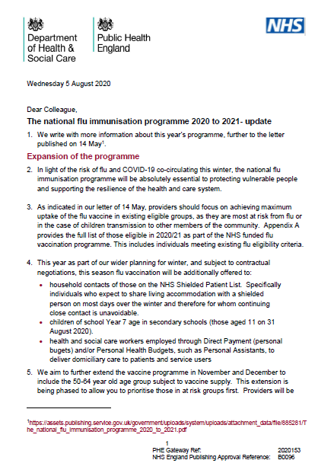
Essential further reading
Please ensure that you read the national flu immunisation programme 2020/21 letters available on the PHE Annual flu programme webpage (www.gov.uk/government/collections/annual-flu-programme)
In addition to providing key information about this year’s flu programme, these letters also contain links to the relevant coronavirus-related guidance. It is recommended that you regularly check this webpage during the flu vaccination period as any further information that becomes available about the flu vaccine programme will be published there.

Slide 4

Key messages
higher demand for flu vaccine is expected this autumn because of concerns about COVID-19. Patients will need reassurance that appropriate measures are in place to keep them safe from COVID-19, as it is likely to be co-circulating with flu
the childhood seasonal influenza (flu) programme is being rolled out in a phased approach over a number of years. School year 7 is being included for 2020/21 in order to try to reduce transmission of flu in the community given the concerns about co-circulation of the SARs-CoV-2 virus during the 2020/21 flu season
the childhood flu programme should reduce the impact of seasonal flu on children and reduce transmission of flu within the community
by reducing transmission of flu, it should also avert many cases of severe flu and flu-related deaths in older adults and people in clinical risk groups
Notes:
Following a recommendation in 2012 by the Joint Committee on Vaccination and Immunisation (JCVI) ¹ that the routine annual flu vaccination programme should be extended to include children, the phased introduction of this extension began in 2013. In 2013, flu vaccine was offered to all two and three year old children, and to four to ten year olds (up to and including pupils in school year 6) in seven different geographical pilot areas.
For the 2014/15 flu season, flu vaccine was offered to all four year old children as well as to all two and three year old children. The geographical pilots of primary school aged children started in 2013/14 continued and there were also several different geographical pilots in secondary school aged children in Years 7 and 8.
In 2015/16, flu vaccine was offered to all two-, three- and four-year-olds, to children of school year 1 and 2 age and to all primary school-aged children in areas that participated in previous primary school pilots.
In 2016/17. flu vaccine was offered to all two-, three- and four-year-olds, to children of school year 1, 2 and 3 age and to all primary school-aged children in areas that participated in previous primary school pilots.
In 2017/18, flu vaccine was offered to all two-, three- and four-year-olds, to children of school year 1, 2 , 3 and 4 age and to all primary school-aged children in areas that participated in previous primary school pilots. This was the first flu season that Reception Year children (aged 4-5 years) were offered flu vaccination in their reception class, rather than through general practice
In the 2018/19 flu season, flu vaccine was offered to all children aged two to nine years old (but not ten years or older) on 31 August 2018 and to all primary school-aged children in former primary school pilot areas.
In the 2019/20 flu season, flu vaccine was offered to all children aged two to ten years (but not eleven years or older) on 31 August 2019. It should also be offered to children from six months of age in clinical risk groups.
The key change to the childhood flu programme in the 2020/21 flu season is that:
Children in School Year 7 (children aged 11 but not 12 by 31 August 2020) will be included in the programme which means all children from Reception through to and including Year 7 are eligible for vaccination.

Slide 5
Aims of resource
The purpose of this training resource is to:
develop the knowledge base of healthcare practitioners regarding the 2020/21 flu vaccination programme for children
support healthcare practitioners involved in discussing flu vaccination for children with parents and carers by providing evidence based information
promote high uptake of flu vaccination in children through increasing the knowledge of those involved in delivering the vaccination programme
provide information on the administration of the live attenuated intranasal influenza vaccine

Slide 6
Learning outcomes
Following training, healthcare practitioners will be able to:
understand the evidence base for the administration of flu vaccination to children
describe the aetiology of flu
understand how flu is transmitted and the possible effects of flu on children
explain which vaccine should be used and the contraindications and the precautions to this vaccine
explain the possible side effects from the live attenuated flu vaccine
explain the sequence of steps in administration of the intranasal flu vaccine
identify sources of additional information
understand the importance of their role in raising the issue of vaccination with parents and carers of children and providing evidence based information about flu vaccination

Slide 7
Key roles of healthcare practitioners
Key roles of healthcare practitioners in relation to the childhood flu programme are:
to be able to describe the evidence base for the administration of the childhood flu vaccination
to advise parents/carers of children who are eligible to receive the flu vaccination that it is strongly recommended that children are vaccinated against flu
to safely administer live intranasal flu vaccine (or other flu vaccine as appropriate) in accordance with the vaccine schedule
to ensure any adverse effects are managed and reported appropriately
The national childhood flu immunisation programme 2020/21

Slide 8
Flu overview
flu is an acute viral infection of the respiratory tract (nose, mouth, throat, bronchial tubes and lungs)
it is a highly infectious illness which spreads rapidly in communities
even people with mild or no symptoms can infect others
most cases in the UK occur during an 8 to 10 week period during the winter
The national childhood flu immunisation programme 2020/21

Slide 9
Influenza viruses
A viruses
  cause outbreaks most years and are the usual cause of epidemics and pandemics
  live and multiply in many different animals and may spread between them
  birds, particularly wildfowl, are the main animal reservoir
  B viruses
  tend to cause less severe disease and smaller outbreaks
  predominantly found in humans
  burden of disease mostly in children

Slide 10

Flu A virus
Genetic material (RNA) in the centre
Two surface antigens:
Haemagglutinin (H) (blue)
Neuraminidase (N) (red)
There are 18 different types of H and 11 different types of N
The role of haemagglutinin is to bind to the cells of the infected person
The role of neuraminidase is to release the virus from the cell surface
Notes:
Schematic model of a flu A virus.
There are two antigens on the surface, as illustrated.
The role of the H antigen is to bind to the cells of the host. There are 18 different types of H.
The role of the N antigen is to release the virus from the cell surface. There are 11 different types of N.
The different types of H and N are identified by numbers, hence H1N1 or H3N2 for example.

Slide 11
Genetic changes in the flu virus – what this means
Changes in the surface antigens (H and N) result in the flu virus constantly changing
Antigenic drift: minor changes (natural mutations) in the genes of flu viruses that occur gradually over time
Antigenic shift: when two or more different strains combine. This abrupt major change results in a new subtype. Immunity from previous flu infections/vaccinations may not protect against the new subtype, potentially leading to a widespread epidemic or pandemic
Because of the changing nature of flu viruses, the WHO monitors their epidemiology throughout the world. Each year WHO makes recommendations about the strains of influenza A and B that are predicted to be circulating in the forthcoming winter. These strains are then included in the flu vaccine developed each year
Notes:
The World Health Organization (WHO) convenes a group that reviews the global influenza situation (once each year for the northern hemisphere and once for the southern hemisphere) and recommends which flu strains should go in the seasonal vaccine to be produced by manufacturers for the following season six to eight months later. This recommendation is based on information about the circulating viruses and epidemiological data from around the world at that time.
Most influenza vaccines are now quadrivalent - containing two subtypes of influenza A and two B viruses. The use of quadrivalent flu vaccines containing a B strain from each of the two B strain lineages should improve the matching of the vaccine to the circulating B strain(s).

Slide 12
Features of flu
  easily transmitted by large droplets, small-particle aerosols and by hand to mouth/eye contamination from a contaminated surface or respiratory secretions of infected person
  people with mild or no symptoms can still infect others
  incubation period 1-5 days (average 2-3 days) though may be longer especially in people with immune deficiency
  Common symptoms include:
  sudden onset of fever, chills, headache, muscle and joint pain and extreme fatigue
  dry cough, sore throat and stuffy nose
  in young children gastrointestinal symptoms such as vomiting and diarrhoea may be seen
Notes:
Serological studies in healthcare professionals have shown that approximately 30 to 50% of flu infections can be asymptomatic² but the proportion of flu infections that are asymptomatic may vary depending on the characteristics of the influenza strain.
In healthy individuals, flu is usually unpleasant but self-limiting with recovery within 5-7 days³.

Slide 13
Possible complications of flu
Common:
  bronchitis
  otitis media (children), sinusitis
  secondary bacterial pneumonia
Less common:
  meningitis, encephalitis, meningoencephalitis
  primary influenza pneumonia
Risk of most serious illness is higher in
      children under six months
      older people
      those with underlying health conditions such as respiratory disease, cardiac disease, long-term neurological conditions or immunosuppression
      pregnant women (flu during pregnancy may be associated with perinatal mortality, prematurity, smaller neonatal size and lower birth weight)
Notes:
The risk of serious illness from flu is higher among children under six months of age, older people and those with underlying health conditions such as respiratory disease, cardiac disease or immunosuppression, as well as pregnant women. These groups are at greater risk of complications from flu such as bronchitis or pneumonia.

Slide 14
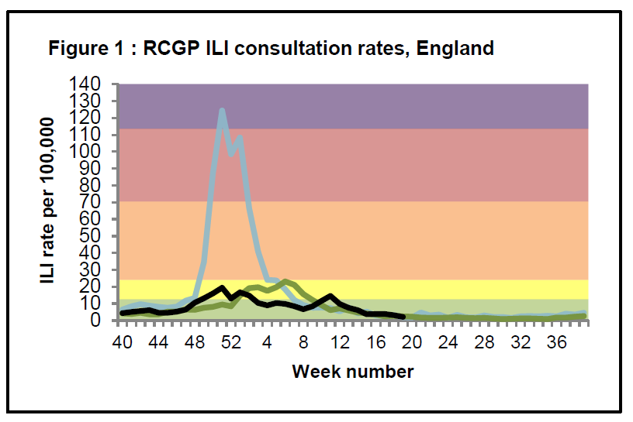
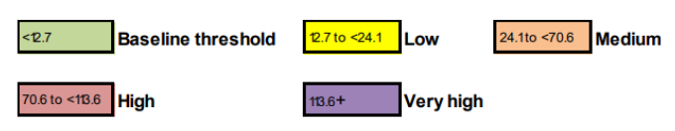
Flu epidemiology
Flu activity usually between September to March (weeks 37 and 15)
impact of flu varies each year: low levels of flu seen in the community in 2019/20 season
Influenza A(H3N2) dominated the season
peak admission rates to hospital and ICU/HDU with flu were similar or lower than seen in the 2018/19 and 2017/18 seasons but higher than all other seasons since 2010/11
- 2010-11
- 2018-19
- 2019-20
Weekly all age GP influenza-like illness rates for 2019/20 and past seasons, England (RCGP)
The national childhood flu immunisation programme 2020/21
Notes:
The impact of flu on the population varies from year to year and is influenced by changes in the virus that, in turn, influence the proportion of the population that may be susceptible to infection and the severity of the illness.
The graph shows the rate of influenza/influenza-like illness episodes in England and Wales per 100,000 consultations in primary care for 2010/11 flu season, 2018/19 season and 2019/20 season. The data show that flu viruses circulate each winter season, but the degree of activity varies substantially.
In the 2018 to 2019 season, low levels of influenza activity in the community were observed in the UK with A(H1N1)pdm09 being the dominant influenza A sub-type, later followed by A(H3N2). Peak hospitalisation rates were slightly lower than seen in the 2017/18 season, though they still reached high impact. The burden of hospitalisation for flu was mainly in middle-age and older adults. Peak ICU rates were similar to last flu season – reaching high impact with the burden mainly in young and middle-age adults.
In the 2019 to 2020 season, activity started to increase from week 47, low levels of activity were seen in England, and medium levels in Scotland, Northern Ireland and Wales.
Influenza transmission resulted in medium impact through secondary care indicators (hospitalisations and ICU/HDU admissions). Peak admission rates of influenza to hospital and ICU/HDU were similar or lower than seen in the 2018 to 2019 and 2017 to 2018 seasons but higher than all other seasons since 2010 to 2011.

Slide 15
UK flu vaccination programme
Late 1960s: annual flu immunisation recommended to directly protect those in clinical risk groups who are at a higher risk of influenza associated morbidity and mortality
2000: flu vaccine policy extended to include all people aged 65 years or over
2010: pregnancy added as a clinical risk category for routine flu immunisation
2013: phased introduction of an annual childhood flu vaccination programme for all children aged 2-16y began with vaccine offered to all children aged 2 and 3 years and seven geographical pilots in primary school aged children
2014: phased introduction of childhood flu vaccination programme continued with vaccine offered to all children aged 2, 3 and 4 years and geographical pilots in primary and secondary school aged children
2015: in addition to vaccinating 2,3,4y olds in primary care, the programme began nationally in primary schools in a phased roll-out starting with the youngest school-aged children first.
Between 2016 and 2019: phased introduction of childhood flu vaccination programme continued with a year on year addition of the next school year
2020: offer to all children aged 2 to 11 years old (but not 12 years or older) on 31 August 2020). This now includes school year 7
Notes:
In the 2020/21 flu season, flu vaccine should be offered to all children including those in school year 7 so includes children who are aged two to eleven years old (but not twelve years or older) on 31 August 2020. It should also be offered to children from six months of age in clinical risk groups

Slide 16
Rollout of the childhood flu vaccination programme in England
    extending flu programme to include children involves considerable planning and work in order to obtain a high level of uptake
    for this reason, the programme has been rolled out over a number of flu seasons and has included geographical piloting in different age groups
    the pilots have tested a number of delivery models – mostly in schools but some through GP and community pharmacies which have allowed PHE and NHS England the opportunity to ascertain the most effective way of implementing it
the phased introduction of this programme began in 2013 when flu vaccine was offered to all 2 and 3 year old children and to those aged 4 to 10 years (up to and including pupils in school year 6) in seven different geographical pilot areas
each year, more age groups have been added to the national programme and in the 2019/20 flu season, all children of primary school age were eligible for vaccination (Reception to year 6) in addition to all 2 and 3 year olds
with concerns about co-circulation of the SARs-CoV-2 virus during the 2020/21 flu season, it is particularly important to reduce transmission of flu in the community. For this reason, the schools programme has been extended to include all children in Year 7 in secondary school in addition to all children of primary school age and 2&3yr olds
Notes:
During the 2020/21 flu programme, the vaccine will also be offered to children in school year 7.
In 2013/14, flu vaccinations were offered to primary school-aged children in a cross-section of urban, rural and inner city settings. These pilots continued in 2014/15 and there were also further pilots for children in years 7 and 8 (aged around 11 to 13 years) in selected secondary schools around the country.
In 2015/16 , 2016/17, 2017/18 and 2018/19, flu vaccine was offered to all primary school aged children (school years 1 to 6) in the areas that participated in the former primary school pilots.
The pilots tested a variety of delivery methods and have mostly been in primary schools, with some working through general practice and community pharmacies.
The function of partial implementation and pilots is to test the delivery mechanisms to ensure successful implementation of the programme and not the vaccine itself - which was extensively tested prior to it’s launch in the United States market and subsequently used in the US for over ten years.

Slide 17
Extending the seasonal flu vaccination programme to include children

Slide 18
Rationale for vaccinating children against flu
Extension of the seasonal flu vaccination programme to children aims to appreciably lower the public health impact of flu by:
providing direct protection thus preventing a large number of cases of flu in children
providing indirect protection by lowering flu transmission from children:
      to other children
      to adults
      to those in the clinical risk groups of any age
Reducing flu transmission in the community should avert many cases of severe flu and flu-related deaths in older adults and people with clinical risk factors
Annual administration of flu vaccine to children is expected to substantially reduce flu-related illness, GP consultations, hospital admissions and deaths
Notes:
In July 2012, the JCVI recommended extending the annual flu programme to include healthy children aged 2 to their 17th birthday in order both to lower the potentially serious impact of flu in vaccinated children and also to have a more profound effect on flu transmission¹. Children are the main source of transmission in the population, and extending the flu programme to include healthy children should therefore reduce the spread of infection from children to other children, to adults and to those in clinical risk groups of any age.

Slide 19
Review of burden of flu in children
average flu season: estimated 0.3% to 9.8% of 0-14 year old children present to a GP with flu
incidence rates can be markedly higher in the younger age groups
influenza-associated hospitalisation rates:
- 83-1,038/ 100,000 children 0-59 months old (highest in <6m)
- 16-210/100,000 children 5-17 years
children under 5 years of age have the highest hospital admission rate for flu of any age group
children more vulnerable to infection than adults when exposed
children with flu contribute to the burden of flu in all age groups because they are more likely to pass on the infection than adults
Notes:
Average influenza season: estimated 0.3% to 9.8% of 0-14 year old children present to a GP with flu⁵
Incidence rates can be markedly higher in the younger age groups
Flu associated hospitalisation rates⁶⁻¹⁰:
- 83-1,038/ 100,000 children 0-59 months old (highest in <6 months)
- 16-210/100,000 children 5-17 years
Children more vulnerable to infection than adults when exposed
Children with flu contribute to the burden of flu in all age groups because they are more likely to pass on the infection than adults

Slide 20
Cost effectiveness of extending seasonal flu vaccination programme to children
Studies commissioned by the JCVI suggest that despite the high cost, extending the flu vaccination programme to children is:
highly likely to be cost-effective
well below the established cost-effectiveness threshold when indirect protection to the whole population is taken into account, particularly over the longer-term
Notes:
Studies commissioned by the JCVI ¹¹ suggest that despite the high cost, extending the flu vaccination programme to low risk children is:
Highly likely to be cost-effective
Well below the established cost-effectiveness threshold when indirect protection to the whole population is taken into account, particularly over the longer-term

Slide 21
2019/20 childhood flu uptake
All 2 and 3 year olds were offered vaccination through GP surgeries (combined uptake 43.8%). National uptake slightly decreased in both ages from the 2018/19 season:
        uptake in two year olds 43.4% (43.8% in 2018/19)
        uptake in three year olds 44.2% (45.9% in 2018/19)
Overall uptake of 60.4% for children in Reception and school years 1, 2, 3, 4, 5 and 6. This increased in most school years from the 2018/19 season
        reception - 64.3% (64.3% in 2018/19)
        school year 1 - 63.6% (63/6% in 2018/19)
        school year 2 - 62.6% (61.5% in 2018/19)
        school year 3 - 60.6% (60.4% in 2018/19)
        school year 4 - 59.6% (58.3% in 2018/19)
        school year 5 - 57.2% (56.5% in 2018/19)
        school year 6 - 55% in school year 6
Uptake levels reached the highest levels to date in England in 2018/19 flu season but dropped in the 2019/20 season
The national childhood flu immunisation programme 2020/21

Slide 22
Flu vaccine uptake for children in a clinical risk group 2019/20 (% )
Risk group: | 6 months to under 2 years | 2 years to under 5 years | 5 years to under 16 years
Patients with Diabetes | 17.4 | 57.7 | 51.9
Patients with Chronic Kidney Disease | 15.1 | 43.9 | 36.7
Patients with immunosuppression | 13.4 | 44.9 | 37.0
Patients with Chronic Neurological Disease (including Stroke/TIA, Cerebral Palsy or MS) | 12.4 | 43.8 | 39.6
Patients with Chronic Respiratory Disease | 23.5 | 54.9 | 45.5
Patients with Chronic Heart Disease | 17.0 | 46.2 | 36.9
Patients with Chronic Liver Disease | 21.3 | 50.5 | 35.8
Patients with Asplenia or dysfunction of the spleen | 21.0 | 47.6 | 32.1
vaccine uptake is particularly low in the younger age groups with clinical conditions that put them at most risk of complications from flu
immunisers should make sure that all at-risk children have the opportunity to receive flu vaccine
parents of at-risk children eligible to receive vaccine at school can choose to receive vaccine in general practice, especially if school session is later in the year and parent does not want their child to wait
The national childhood flu immunisation programme 2020/21
Notes:
Uptake was 44.9% for all those at risk aged 6 months to 64 years. This compares to 48.9% in 2018/19 48.6% in 2016/17, 45.1% in 2015/2016 and 50.3% in 2014/2015

Slide 23
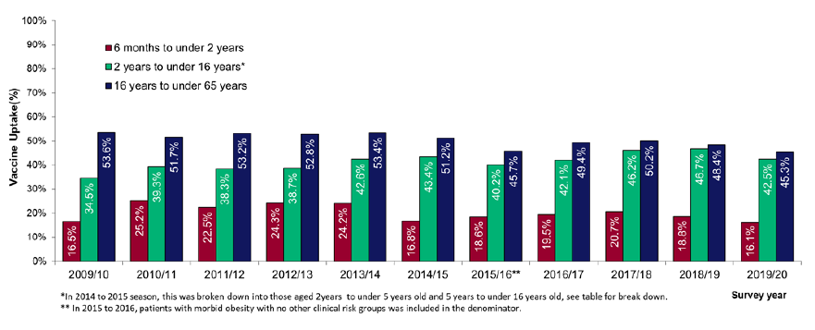
Vaccine uptake for children in a clinical risk group (2019/20)
Target groups for vaccination | % vaccine uptake
Six months to under two years in a clinical risk group | 16.1
Two years to under 5 years in a clinical risk group | 49.0
5 years to under 16 years in a clinical risk group | 41.7
Vaccine uptake figures show that uptake in children in clinical risk groups is higher in the age group where all children (healthy and clinical risk group) have been offered flu vaccination
Vaccine uptake in those aged 6 months to under 2 years remains the lowest in uptake by age band
Vaccine uptake in the under 65 at-risk by age group
The national childhood flu immunisation programme 2020/21
Notes:
This season saw a vaccine uptake of 43.4% for all GP-registered 2 year olds (compared to 43.8% in 2018 to 2019) and was 44.2% in 3 year olds (compared to 45.9% in 2018 to 2019) in England. The combined uptake for 2 and 3 year olds was 43.8% compared to 44.9% in 2018 to 2019
Vaccine uptake in patients aged 6 months to under 65 years in 1 or more clinical risk group(s) was 44.9% compared to 48.0% in 2018 to 2019 and 49.7% in 2017 to 2018 .
Uptake was highest in those aged 2 to under 5 years at-risk at 49% (52.7% in 2018/19). Uptake remained lowest in children aged 6 months to under 2 years at 16.1% (18.8% in 2018/19).
Vaccine uptake in the individual risk groups has decreased for all clinical risk groups compared to the 2019/20 flu season for all patients under 65 years old. Vaccine uptake in those aged 6 months to under 2 years (down from 18.8% in 2018/19) remains the lowest in uptake by age band and those aged 2 years to under 5 years (49.0% down from 52.7% 2018/19) remains the highest

Slide 24
Types of flu vaccine

Slide 25
Types of flu vaccines
Two main types of vaccine available:
  inactivated – by injection
  live attenuated – by nasal application
none of the flu vaccines can cause clinical influenza in those that can be vaccinated
both the live and inactivated flu vaccines supplied by PHE for children are quadrivalent vaccines – they contain two subtypes of Influenza A and both B virus types
the inactivated vaccine is recommended for children who cannot receive live attenuated vaccine
Notes:
Inactivated flu vaccines given by intramuscular injection have been used in the UK for many years. The live intranasal influenza vaccine (LAIV) was introduced into the UK schedule in 2013. However, a live intranasal flu vaccine called FluMist (same vaccine as Fluenz, different trade name) was introduced in the US schedule in 2003 so although the live vaccine is newer, there is well over a decade’s experience of widespread use of the vaccine in the US. We now have 6 years experience using Fluenz LAIV vaccine in the UK.
Inactivated flu vaccines used to be trivalent only, containing two subtypes of influenza A and one B virus. However, quadrivalent vaccines, containing two subtypes of influenza A and both B virus types are now used more widely in the UK. The live intranasal vaccine is a quadrivalent vaccine (hence the ‘Tetra’ part of the name Fluenz Tetra). An inactivated quadrivalent vaccine is available to order from ImmForm for children aged 6 months and over who are contraindicated to receive the LAIV.
NB The Fluenz vaccine used in the 2013/14 flu season was a trivalent live vaccine. The quadrivalent Fluenz Tetra vaccine was first used in the 2014/15 flu season and has been used in all flu seasons subsequently.

Slide 26
Live attenuated influenza vaccine (LAIV)
a live attenuated intranasal spray is the recommended vaccine for the childhood flu programme
LAIV has been shown to be more effective in children compared with inactivated flu vaccines
it may offer some protection against strains not contained in the vaccine as well as to those that are and has the potential to offer better protection against virus strains that have undergone antigenic drift
since this vaccine is comprised of weakened whole live virus, it replicates natural infection which induces better immune memory (thereby offering better long-term protection to children than from the inactivated vaccines)
in addition to being attenuated (weakened), the live viruses in LAIV have been adapted to cold so that they cannot replicate efficiently at body temperature
LAIV has a good safety profile in children aged two years and older
The national childhood flu immunisation programme 2020/21
Notes:
[Fluenz Tetra is a quadrivalent live attenuated intranasal flu vaccine. The majority of published literature is about Fluenz (a trivalent vaccine used prior to the addition of the other B strain) but most of this will apply to Fluenz Tetra]
LAIV has been shown to be more effective in children compared with inactivated flu vaccines¹²⁻¹⁴ and it may offer some protection against strains not contained in the vaccine as well as to those that are and has potential to offer better protection against strains that have undergone antigenic drift compared to the original virus strains in the vaccine.
Since this vaccine is comprised of weakened whole live virus, it replicates natural infection which induces better immune memory. This should mean it also offers better long-term protection to children than they may get from the inactivated vaccines.
LAIV contains live viruses that have been attenuated (weakened) and adapted to cold so that they cannot replicate efficiently at body temperature. The vaccine viruses replicate in the cooler nasal mucosa but not at body temperature in the lungs. This means they cannot cause clinical flu in immunocompetent children.
The live intranasal vaccine has a good safety profile in children aged two years and older. It has been used for over a decade in the United States. The vaccine was extensively tested prior to it’s launch in the Unites States market. Since then there has been extensive post launch surveillance in the USA , involving millions of doses in children with no evidence found of any safety concerns. It has also been used for the past six flu seasons in the UK where hundreds of thousands of children have been safely and successfully vaccinated. As with all vaccines and medicines, MHRA closely and continuously monitors the safety of the LAIV. LAIV is also being used in other countries such as Finland and Canada.

Slide 27
LAIV effectiveness
research into the first 3 years of the childhood flu programme compared pilot areas, where the entire primary school age cohort was offered vaccination, to non-pilot areas
the results have shown a positive impact on flu transmission from vaccinating children of primary school age
these include reductions in: GP consultations for influenza-like illness, swab positivity in primary care, laboratory confirmed hospitalisations and percentage of respiratory emergency department attendances
overall adjusted vaccine effectiveness (VE) for 2019/20 for 2 to 17 year olds receiving LAIV was 45.4%
        effectiveness against influenza A(H3N2) was 31.2%
        effectiveness against influenza A(H1N1)pmd09 was 53.5%
      the interim evaluation of influenza vaccine effectiveness against influenza B for 2019/20 was > 60% among all ages in primary care, with a lower VE among those aged 18 to 64 years in the European Union primary care setting*.
      (*Eurosurveillance, Vol 25, issue 10,25 March 2020)
Notes:
Research into the first three years of the programme compared the differences between pilot areas, where the entire primary school age cohort was offered vaccination, to non-pilot areas. The results have shown a positive impact on flu transmission across a range of surveillance indicators from vaccinating children of primary school age. These include reductions in: GP consultations for influenza-like illness, swab positivity in primary care, laboratory confirmed hospitalisations and percentage of respiratory emergency department attendances.
Since the introduction of the LAIV programme for children in the UK the vaccine effectiveness for laboratory confirmed infection has been good. In 2015/16 it was 57.6% and in 2016/17 it was 65.8%, both within the normal range for this vaccine. Although the overall vaccine effectiveness was lower in 2017/18 at 26.9%, protection varied considerably by strain with vaccine effectiveness against the H1N1pdm09 strain at 90.3% and 60.8% against influenza B, both of which can have an important impact on children.

Slide 28
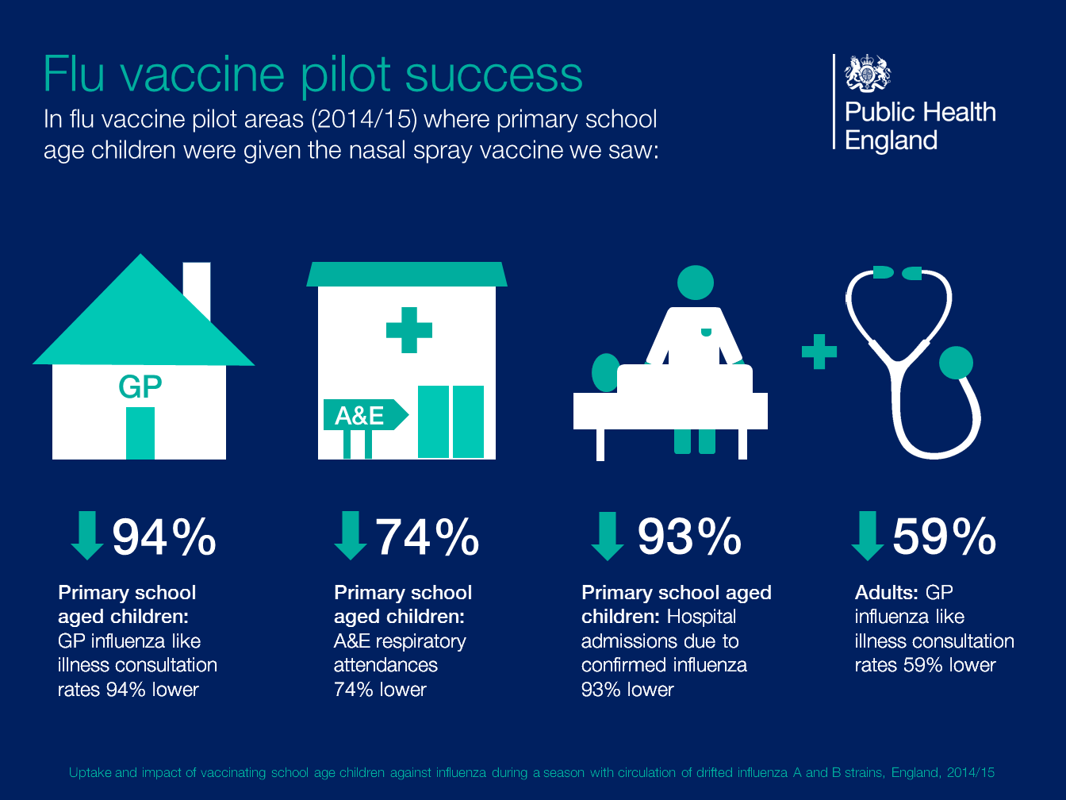

Slide 29
How many doses?
two doses of the inactivated flu vaccines are required to achieve adequate antibody levels in younger children
however, a single dose of LAIV should provide protection to previously unvaccinated healthy children
only modest additional protection provided by a second dose of LAIV
only children who are in clinical risk groups aged two to less than nine years who have not received flu vaccine previously should be offered a second dose of LAIV, given at least four weeks apart (if no contraindications – otherwise offer inactivated vaccine)
The national childhood flu immunisation programme 2020/21
Notes:
Two doses of the inactivated flu vaccines are required to achieve adequate antibody levels in younger children^{15,16}.
A single dose of LAIV should provide protection to previously unvaccinated healthy children however^{17,18}.
Only modest additional protection provided by a second dose of LAIV.
JCVI advise greater population health impact can be achieved if the limited quantity of LAIV available is given as one dose schedule to larger number of children.
Only children less than nine years who are in clinical risk groups and have not received flu vaccine previously should be offered a second dose of LAIV

Slide 30
Child eligibility for flu vaccine
Eligible group | Type of flu vaccine
At risk children aged from 6 months to less than 2 years | Offer QIVe. LAIV and QIVc are not licenced for children under 2 years of age.
At risk children aged 2 to under 18 years | Offer LAIV If LAIV is contraindicated or otherwise unsuitable offer: QIVe to children less than 9 years of age. QIVc should ideally be offered to children aged 9 years and over who access the vaccine through general practice. Where QIVc vaccine is unavailable, GPs should offer QIVe. It is acceptable to offer only QIVe to the small number of children contraindicated to receive LAIV aged 9 years and over who are vaccinated in a school setting.
Aged 2 and 3 years on 31 August 2020 All primary school aged children and those in Year 7 (aged 4 to 11 on 31 August 2020) | Offer LAIV If child is in a clinical risk group and is contraindicated to LAIV (or it is otherwise unsuitable) offer inactivated influenza vaccine (see above). For children not in at risk groups, this year if a parent refuses LAIV in some areas an alternative QIVe or QIVc vaccine may be offered to them where possible.
The national childhood flu immunisation programme 2020/21

Slide 31
The LAIV used in the UK is Fluenz Tetra
  generic name: influenza vaccine (live attenuated, nasal)
  brand name: Fluenz Tetra
  marketed by AstraZeneca
  Licensed from 24 months to less than 18 years of age
  nasal spray (suspension) in a prefilled nasal applicator
  supplied as pack containing 10 doses
Image courtesy of AstraZeneca
Notes:
Fluenz Tetra is a live attenuated vaccine (a weakened form of flu virus which cannot cause disease but which protects against flu). It is a cold adapted virus which means it cannot replicate at body temperature.
This is a nasal vaccine and must not be injected.
It is supplied in a box containing 10 prefilled nasal applicators.
Live attenuated influenza vaccine (Fluenz Tetra) has been shown to provide greater protection for children than inactivated influenza vaccine¹²⁻¹⁴. This vaccine is the preferred vaccine for children aged two to less than 18 years.
It became available in the UK for the 2012/13 flu season. It has been used in USA (same vaccine but under the name FluMist) for many years and millions of doses have been given.

Slide 32
Fluenz Tetra composition 2020/21
Active ingredients:
A/Guangdong-Maonan/SWL1536/2019 (H1N1)pdm09 - like strain
A/Hong Kong/2671/2019 (H3N2) - like strain
B/Washington/02/2019 - like strain
B/Phuket/3073/2013 - like strain
Excipients:
Sucrose
Dipotassium phosphate
Potassium dihydrogen phosphate
Gelatin (porcine, Type A)
Arginine hydrochloride
Monosodium glutamate monohydrate
Water for injections
The vaccine may contain residues of the following substances: egg proteins (e.g. ovalbumin) and gentamicin. The maximum amount of ovalbumin is less than 0.024 micrograms per 0.2 ml dose (0.12 micrograms per ml)
Image courtesy of AstraZeneca
Notes:
The vaccine complies with the WHO recommendation (Northern Hemisphere) and EU decision for the 2020/21 season as to which strains of influenza they should contain. Fluenz Tetra protects against the same strains of influenza in the quadrivalent inactivated flu vaccines.
The virus strains were produced in VERO cells by reverse genetic technology and grown in fertilised hens’ eggs from healthy chicken flocks.
Fluenz Tetra does not contain any preservatives such as thiomersal.
Fluenz Tetra is supplied as a 0.2 ml suspension in a single-use nasal applicator (Type 1 glass), with nozzle (polypropylene with polyethylene transfer valve), nozzle tip-protector cap (synthetic rubber), plunger rod, plunger-stopper (butyl rubber) and a dose-divider clip which should not affect latex sensitive individuals .
Fluenz pack size of 1 or 10.
.

Slide 33

Fluenz Tetra presentation
  single use prefilled nasal applicator
  ready to use (no reconstitution or dilution required)
  nasal spray (suspension)
  the suspension is colourless to pale yellow, clear to opalescent. Small white particles may be present
  each applicator contains 0.2ml (administered as 0.1ml per nostril)
Notes:
Fluenz Tetra is supplied as a single use prefilled nasal applicator.
The nasal applicator is ready to use. No reconstitution or dilution is required.
The nasal suspension is colourless to pale yellow, clear to opalescent. Small white particles may be present¹⁹.

Slide 34
Storage of Fluenz Tetra
Fluenz Tetra must be stored in accordance with manufacturer’s instructions:
  store between +2⁰C and +8⁰C
  do not freeze
  store in original packaging
  protect from light
Check expiry dates regularly:
  Fluenz Tetra has an expiry date 18 weeks after manufacture – this is much shorter than inactivated flu vaccines
  it is important that the expiry date on the nasal spray applicator is checked before use
Notes:
Fluenz Tetra must be stored in accordance with the manufacturers instructions¹⁹. As with most vaccines, Fluenz Tetra should be stored between +2°C and +8°C.
The vaccine should be stored in the original packaging. This makes it easy to identify in the vaccine fridge and to check batch numbers and expiry dates. The original packaging also provides some protection against fluctuation of temperature and protection from light.
Vaccines are expensive and it is important to minimise wastage through inappropriate storage.
Fluenz Tetra has a shelf life of 18 weeks that starts at the point of release from the manufacturer. This is a shorter shelf life than other flu vaccines and some of this time will have passed when the vaccine reaches the place where it is to be administered. It is important that the expiry date on the nasal spray applicator is checked before use. If the expiry date has passed, arrangements should be made to have the vaccine disposed of safely.

Slide 35
LAIV dosage and schedule reminder
  a single dose is 0.2ml (administered as 0.1ml per nostril)
  a single dose for all children not in clinical at risk group
  children aged two years to less than nine years who are in clinical at risk groups and who have not received flu vaccine before should receive two doses of LAIV (if not medically contraindicated) with the second dose at least four weeks after the first
NB: This advice differs from that given in the Fluenz Tetra SPC
Where Green Book advice differs from SPC, Green Book should be followed.
Notes:
The dose of Fluenz Tetra is 0.2ml, administered as a divided dose (0.1ml) into each nostril. After administering half of the dose in one nostril, administer the other half in the other nostril immediately or shortly thereafter.
Children who are not in a clinical at risk group require a single dose (0.2ml).
The marketing authorisation holder’s Summary of Product Characteristics (SPC)¹⁹ states that children who have not previously been vaccinated against seasonal influenza should be given a second dose after an interval of at least 4 weeks. The JCVI have considered this issue and have recommended that for children who are not in a clinical at risk group, a single dose of Fluenz Tetra should be given³.
Healthcare practitioners are reminded that in some circumstances the recommendations regarding vaccines given in the Green Book chapters may differ from those in the SPC for a particular vaccine. When this occurs, the recommendations in the Green Book are based on current expert advice received from the JCVI and this advice should be followed²⁰. The Green Book recommendations and/or further advice from the Department of Health and Social Care should be reflected in PGDs.
However children aged under nine years of age in clinical at risk groups and who are receiving flu vaccine for the first time will require the two dose schedule.

Slide 36
Administration of LAIV
  LAIV is different from other flu vaccines – it is for nasal use only and must not be injected
  do not attempt to attach a needle
  LAIV can be administered at the same time as, or at any interval from other vaccines including live vaccines
  child should breathe normally – no need to actively inhale or sniff
  the vaccine is rapidly absorbed so no need to repeat either half of dose if patient sneezes, blows their nose or their nose drips following administration
Notes:
LAIV can be given at the same time as other vaccines, including live vaccines³.
Although it was previously recommended that, where vaccines cannot be administered simultaneously; a four-week interval should be observed between live viral vaccines, JCVI have advised that no specific intervals need to be observed between the live attenuated intranasal flu vaccine and other live vaccines²²

Slide 37
Supply and administration of flu vaccines
A range of mechanisms can be used for the supply and administration of vaccines including:
  Patient Specific Prescription written manually or electronically by a registered medical practitioner or other authorised prescriber
  Patient Specific Direction (PSD)
  Patient Group Direction (PGD)
PGD templates for the supply and administration of the live attenuated and inactivated flu vaccines are available on the PHE website:
https://www.gov.uk/government/collections/immunisation-patient-group-direction-pgd
Please see notes on the PHE Immunisation PGD webpage about requirement for further authorisation before PHE PGDs can be used

Slide 38
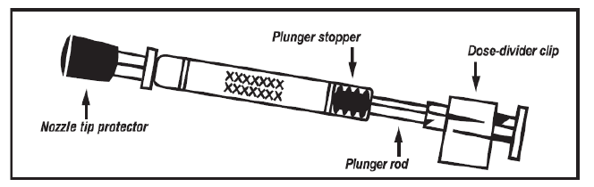
LAIV applicator
Image taken from Fluenz Tetra® SPC

Slide 39
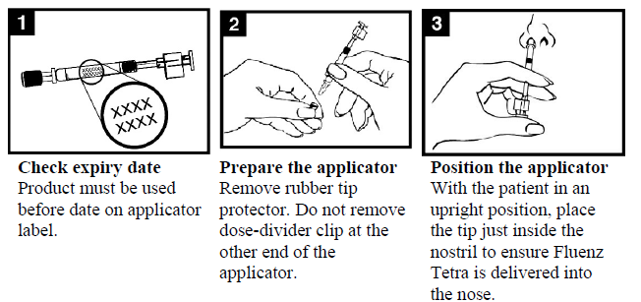
Administration of LAIV
Images taken from Fluenz Tetra® SPC
Notes:
Check the expiry date - the vaccine must be used before the date on the applicator label.
Prepare the applicator - remove the rubber tip protector. Do not remove the dose divider clip at the other end of the applicator.
Position the applicator – with the patient in an upright position, place the tip just inside the nostril to ensure LAIV is delivered into the nose.

Slide 40
Administration of LAIV
Images taken from Fluenz Tetra® SPC
Notes:
Depress the plunger – with a single motion, depress the plunger as rapidly as possible until the dose-divider clip prevents you from going further.
5. Remove the dose-divider clip – for administration in the other nostril, pinch and remove the dose-divider clip from the plunger.
6. Spray in other nostril – place the tip just inside the other nostril and with a single motion, depress the plunger as rapidly as possible to deliver remaining vaccine.

Slide 41
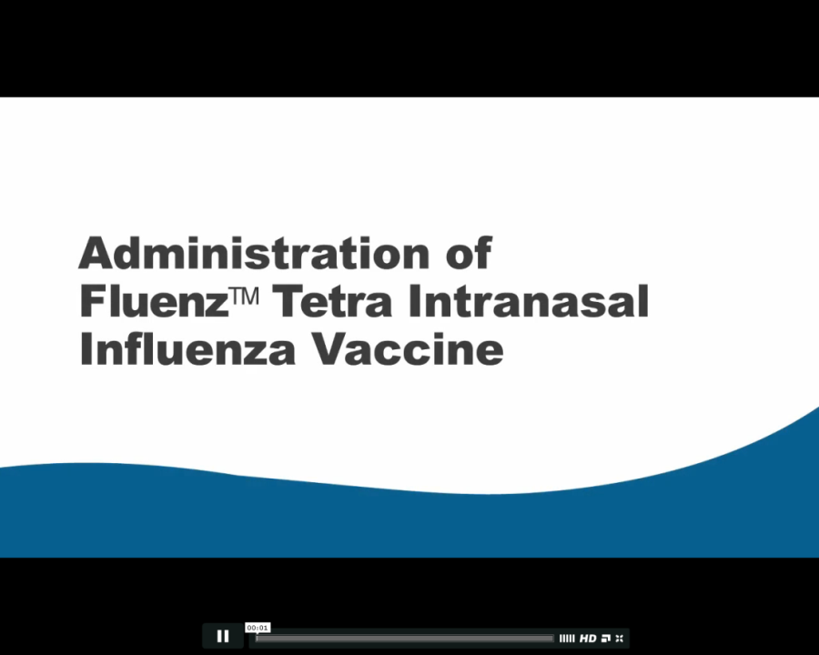
Administration video
A video for health professionals on how to administer the LAIV vaccine has been produced by NHS Education for Scotland (NES).
It is available to view on the NES website at:
http://www.nes.scot.nhs.uk/education-and-training/by-theme-initiative/public-health/health-protection/seasonal-flu/childhood-seasonal-flu-vaccination-programme-resources-for-registered-practitioners.aspx
The national childhood flu immunisation programme 2020/21

Slide 42
Contraindications to LAIV
There are very few children who cannot receive any flu vaccine
Where live attenuated flu vaccine cannot be given, it is likely that inactivated vaccine could be given instead
Where there is doubt, expert advice should be sought promptly so that the period the child is left unvaccinated is minimised
Notes:
There are very few children who cannot receive any flu vaccine. When there is doubt, appropriate advice should be sought promptly from the screening and immunisation or health protection team or the child’s consultant, so that the period the individual is left unvaccinated is minimised.

Slide 43
Contraindications to LAIV
confirmed anaphylactic reaction to a previous dose of flu vaccine
confirmed anaphylactic reaction to a component in LAIV (eg gelatine) or residue from the manufacturing process (eg gentamicin), except egg proteins (see subsequent slide on egg allergy)
clinically severely immunocompromised due to a condition or immunosuppressive therapy such as:
        acute and chronic leukaemias
        lymphoma
        HIV infection not on highly active antiretroviral therapy (HAART)
        cellular immune deficiencies
        high dose corticosteroids
receiving salicylate therapy
known to be pregnant
Also contraindications for children with acute and severe asthma - see next slide
The national childhood flu immunisation programme 2020/21
Notes:
Confirmed anaphylaxis is rare. Other allergic conditions such as rashes may occur more commonly and are not contraindications to further immunisation. A careful history of the event will often distinguish between true anaphylaxis and other events that are either not due to the vaccine or are not life threatening. In the latter circumstance, it may be possible to continue the immunisation course. Specialist advice must be sought on the vaccines and the circumstances in which they could be given. The risk to the individual of not being immunised must be taken into account.
The live attenuated influenza vaccine (Fluenz Tetra) should not be given to children or adolescents who are clinically severely immunodeficient due to conditions or immunosuppressive therapy such as: acute and chronic leukaemias; lymphoma; HIV infection not on highly active antiretroviral therapy (HAART); cellular immune deficiencies; and high dose corticosteroids. It is not contraindicated for use in children or adolescents with stable HIV infection receiving antiretroviral therapy; or who are receiving topical/inhaled corticosteroids or low-dose systemic corticosteroids or those receiving corticosteroids as replacement therapy, e.g. for adrenal insufficiency.
Chapter 6 of the Green Book on contraindications and special precautions gives further advice on the use of live vaccines in individuals who are severely immunosuppressed²². It states that the definition of “systemic high doses steroids” (and until at least three months after treatment has stopped) would include children who receive prednisolone, orally or rectally, at a daily dose (or its equivalent) of 2mg/ kg/day for at least one week, or 1mg/kg/day for one month. Occasionally, individuals on lower doses of steroids may be immunosuppressed and at increased risk from infections. In those cases, live vaccines should be considered with caution, in discussion with a relevant specialist physician”.
The live attenuated vaccine is contraindicated in children and adolescents receiving salicylate therapy (other than for topical treatment of localised conditions) because of the association of Reye's syndrome with salicylates and wild-type flu infection as described in the SPC for Fluenz Tetra.
Safety data for the live attenuated flu vaccine when given in pregnancy is limited . Whilst there is no evidence of risk with live attenuated flu vaccine, inactivated flu vaccines are preferred for those who are pregnant. There is no need, however, to specifically test eligible girls for pregnancy or to advise avoidance of pregnancy in those who have been recently vaccinated.

Slide 44
Acute and severe asthma
children with asthma on inhaled corticosteroids may safely be given LAIV irrespective of the dose prescribed
LAIV is not recommended for children and adolescents currently experiencing an acute exacerbation of symptoms including - those who have had increased wheezing and/or - needed additional bronchodilator treatment in the previous 72 hours
Such children should be offered a suitable inactivated influenza vaccine to avoid a delay in protection
children who require regular oral steroids for maintenance of asthma control, or have previously required intensive care for asthma exacerbation should only be given LAIV on the advice of their specialist
As these children may be at higher risk from influenza infection, those who cannot receive LAIV should receive a suitable inactivated influenza vaccine
Children with significant asthma and aged under nine years who have not been previously vaccinated against influenza will require a second dose (of either LAIV or inactivated vaccine as appropriate).
The national childhood flu immunisation programme 2020/21
Notes:
In 2019, JCVI advised that children with asthma on inhaled corticosteroids may safely be given LAIV, irrespective of the dose prescribed. LAIV is not recommended for children and adolescents currently experiencing an acute exacerbation of symptoms including those who have had increased wheezing and/or needed additional bronchodilator treatment in the previous 72 hours. Such children should be offered a suitable inactivated influenza vaccine to avoid a delay in protection.
There are limited safety data in children who require regular oral steroids for maintenance of asthma control, or have previously required intensive care for asthma exacerbation – such children should only be given LAIV on the advice of their specialist. As these children may be at higher risk from influenza infection, those who cannot receive LAIV should receive a suitable inactivated influenza vaccine. Children with significant asthma and aged under nine years who have not been previously vaccinated against influenza will require a second dose (of either LAIV or inactivated vaccine as appropriate).

Slide 45
Egg allergy
children with an egg allergy (including those with previous anaphylaxis to egg) can be safely vaccinated with LAIV in any setting (including primary care and schools)
children who have required admission to intensive care for a previous severe anaphylaxis to egg should be given LAIV in the hospital setting
children with both egg allergy and a clinical risk factor that contraindicate LAIV (eg immunosuppression) should be offered an* inactivated flu vaccine with a very low ovalbumin content (less than 0.12μg/ml)
children over age nine years with egg allergy can also be given the quadrivalent inactivated egg-free vaccine, Flucelvax Tetra (QIVc)
egg-allergic children with asthma can receive LAIV if their asthma is well-controlled (see previous slide on severe asthma)
*Children in a clinical risk group and aged under nine years who have not been previously vaccinated against influenza will require a second dose whether given LAIV or inactivated vaccine
The national childhood flu immunisation programme 2020/21
Notes:
JCVI has advised (JCVI, 2015) that children with an egg allergy – including those with previous anaphylaxis to egg – can be safely vaccinated with LAIV in any setting (including primary care and schools). The only exception is for children who have required admission to intensive care for a previous severe anaphylaxis to egg, for whom no data are available; such children are best given LAIV in the hospital setting. LAIV remains the preferred vaccine for this group and the intranasal route is less likely to cause systemic reactions.
Children with egg allergy but who also have another condition which contraindicates LAIV should be offered an inactivated influenza vaccine with a very low ovalbumin content (less than 0.12 micrograms/ml). Children in a clinical risk group and aged under nine years who have not been previously vaccinated against influenza will require a second dose (of either LAIV or inactivated vaccine as appropriate).

Slide 46
Precautions to LAIV
Acute severe febrile illness:
  defer until recovered
Heavy nasal congestion:
  defer until resolved or, if the child is in an at-risk group, consider inactivated flu vaccine to avoid delaying protection
Use with antiviral agents against flu:
LAIV should not be administered at the same time or within 48 hours of cessation of treatment with flu antiviral agents
administration of flu antiviral agents within two weeks of administration of LAIV may adversely affect the effectiveness of the vaccine
Notes:
Minor illnesses without fever of systemic upset are not valid reasons to postpone vaccination. If the individual is acutely unwell the vaccination may be deferred until they have recovered. This is to avoid confusing the differential diagnosis of any acute illness by wrongly attributing any signs or symptoms to the adverse effects of the vaccine.
There are no data on the effectiveness of LAIV when given to children with a heavily blocked or runny nose (rhinitis) attributable to infection or allergy. As heavy nasal congestion might impede delivery of the vaccine to the nasopharyngeal mucosa, deferral of administration until resolution of the nasal congestion or an appropriate alternative intramuscularly administered flu vaccine should be considered.

Slide 47
Inadvertent administration of LAIV
if an immunocompromised individual receives LAIV, the degree of immunosuppression should be assessed
if patient is severely immunocompromised, antiviral prophylaxis should be considered
otherwise they should be advised to seek medical advice if they develop flu-like symptoms in the 4 days following administration of the vaccine
if antivirals are used for prophylaxis or treatment, patient should also be offered inactivated flu vaccine in order to maximise their protection in the forthcoming flu season (this can be given straight away)
The national childhood flu immunisation programme 2020/21
Notes:
If an immunocompromised individual receives LAIV then the degree of immunosuppression should be assessed. If the patient is severely immunocompromised, antiviral prophylaxis should be considered, otherwise they should be advised to seek medical advice if they develop flu-like symptoms in the four days (the usual incubation period) following administration of the vaccine. If antivirals are used for prophylaxis or treatment, then in order to maximise their protection in the forthcoming flu season, the patient should also be offered inactivated flu vaccine. This can be given straight away.

Slide 48
Risk of transmission of vaccine virus
theoretical potential for transmission of live attenuated vaccine virus to immunocompromised contacts
risk is for one to two weeks following vaccination
extensive use of the live attenuated flu vaccine in US – no reported instances of illness or infections from the vaccine virus among immunocompromised patients inadvertently exposed to vaccinated children
however, where close contact with very severely immunocompromised patients (eg bone marrow transplant patients requiring isolation) is likely or unavoidable (eg household members) consider an appropriate inactivated flu vaccine instead
Notes:
There is a theoretical potential for transmission of live attenuated flu virus in LAIV to immunocompromised contacts for one to two weeks following vaccination. In the US, where there has been extensive use of the live attenuated flu vaccine, there have been no reported instances of illness or infections from the vaccine virus among immunocompromised patients inadvertently exposed. Where close contact with very severely immunocompromised patients (e.g. bone marrow transplant patients requiring isolation) is likely or unavoidable (for example, household members), however, appropriate alternative inactivated flu vaccines should be considered.

Slide 49
Exposure of healthcare professionals to live attenuated influenza vaccine viruses
theoretically there may be some low level exposure to the vaccine viruses for those administering LAIV and/or from recently vaccinated patients
in the US, where there has been extensive use of LAIV, there have not been any reported instances of illness or infections from the vaccine virus among healthcare professionals inadvertently exposed
risk of acquiring vaccine viruses from the environment is unknown but probably low
the vaccine viruses are cold-adapted and attenuated and therefore unlikely to cause symptomatic flu
as a precaution, very severely immunosuppressed individuals should not administer LAIV
other healthcare workers who have less severe immunosuppression or are pregnant, should follow normal clinical practice to avoid inhaling the vaccine and ensure that they themselves are appropriately vaccinated
The national childhood flu immunisation programme 2020/21
Notes:
In theory, healthcare workers may have low level exposure to live attenuated influenza vaccine viruses during administration of the vaccine and/or from recently vaccinated patients. The vaccine viruses are cold-adapted and attenuated, and are unlikely to cause symptomatic flu. In the US, where there has been extensive use of the live attenuated flu vaccine, no transmission of vaccine virus in healthcare settings ever has been reported and there have been no reported instances of illness or infections from the vaccine virus among healthcare professionals inadvertently exposed. Thus, the Centers for Disease Control and Prevention has considered that the risk of acquiring vaccine viruses from the environment is unknown but is probably low²³. As a precaution, however, very severely immunosuppressed individuals should not administer live attenuated influenza vaccine. Other healthcare workers who have less severe immunosuppression or are pregnant, should follow normal clinical practice to avoid inhaling the vaccine and ensure that they themselves are appropriately vaccinated.

Slide 50
LAIV and ‘viral shedding’
    LAIV does not create an external mist of vaccine virus in the air when children are being vaccinated and others in the room should not be at risk of ‘catching’ the vaccine virus
    administration of the intranasal vaccine delivers just 0.1ml of fluid straight into each nostril and almost all the fluid is immediately absorbed into the child’s nose
    although vaccinated children are known to shed virus a few days after vaccination, the vaccine virus that is shed is less able to spread from person to person than natural flu infection
    the amount of virus shed is normally below the levels needed to pass on infection to others and the virus does not survive for long outside of the body. This is in contrast to natural flu infection, which spreads easily during the flu season

Slide 51
Infection control issues
although there are no required infection control precautions specific to the administration of LAIV, providers are expected to deliver the programme according to guidelines on social distancing that are current at the time and will need to wear the recommended personal protective equipment that is in line with the current advice from the government
routine hand hygiene procedures should be performed before and after each child contact
Disposal of clinical waste:
Used, part-used or out of date/wasted LAIV applicators should be disposed of in a rigid yellow sharps container with yellow lid

Slide 52
Delivering the flu vaccine programme during the COVID-19 pandemic
patients will need reassurance that appropriate measures are in place to keep them safe from COVID-19, as it is likely to be co-circulating with flu. This reassurance will be especially important for those on the NHS Shielded Patient List.
providers will be expected to deliver the programme according to guidelines on social distancing that are current at the time. Standard operating procedures in the context of COVID-19 have been issued for General Practice, community pharmacy, and community health services
providers need to be prepared to make adjustments to the programme in the face of any local restrictions to ensure those at highest risk can continue to be vaccinated
Notes:
www.england.nhs.uk/coronavirus/publication/managing-coronavirus-covid-19-in-general-practice-sop/
www.england.nhs.uk/coronavirus/publication/standard-operating-procedure-community-pharmacy/
www.england.nhs.uk/coronavirus/publication/covid-19-prioritisation-within-community-health-services-with-annex_19-march-2020/
www.england.nhs.uk/coronavirus/publication/novel-coronavirus-covid-19-standard-operating-procedure-community-health-services/
For guidance on immunisation during COVID-19, including personal protective equipment, see: ‘Clinical Guidance for Healthcare professionals on maintaining immunisation programmes during COVID-19’ at: www.england.nhs.uk/coronavirus/wp-content/uploads/sites/52/2020/06/clinical-guidance-for-hcps-on-imms-for-covid-19.pdf

Slide 53
Considerations when delivering the flu vaccine programme during the COVID-19 pandemic
careful appointment planning to minimise waiting times and maintain social distancing when attending
provide patients with information in advance of their appointment to explain what to expect
recall at risk patients if they do not attend
consider social distancing innovations such as drive in vaccinations and ‘car as waiting room’ models, if possible
for those on the Shielded Patient List who are high risk for COVID-19, consider the use of domiciliary visits
for the schools vaccination programme, any social distancing measures will create additional challenges. The expectation is that school estate will still be used in the event of any local school closures where possible

Slide 54
Infection prevention and control when administering vaccines
individuals should attend for vaccination at premises that are following the recommended infection prevention and control (IPC) guidance. www.england.nhs.uk/coronavirus/primary-care/infection-control/
those displaying symptoms of COVID-19, or who are self-isolating because they are confirmed COVID-19 cases or are contacts of suspected or confirmed COVID-19 cases, should not attend until they have recovered and completed the required isolation period.
healthcare professionals administering the vaccine may need to wear personal protective equipment (PPE) in keeping with current advice at the time. See: www.gov.uk/government/publications/wuhan-novel-coronavirus-infection-prevention-and-control/covid-19-personal-protective-equipment-ppe

Slide 55
Adverse reactions to LAIV
Commonly reported adverse reactions (affects more than 1 in 10 Fluenz Tetra recipients):
blocked or runny nose
headache
fever
malaise
myalgia
decreased appetite
Hypersensitivity reactions (including facial oedema, urticaria and anaphylaxis) can occur but are very rare
The national childhood flu immunisation programme 2020/21

Slide 56

Reporting suspected adverse reactions
All serious suspected reactions following influenza vaccines should be reported to the Medicines and Healthcare products Regulatory Agency using the Yellow Card scheme
Yellow card scheme: http://mhra.gov.uk/yellowcard:
voluntary reporting system for suspected adverse reaction to medicine/vaccines
success of scheme depends on early, complete and accurate reporting
report even if uncertain about whether vaccine caused condition
see chapter 8 of Green Book for details
Notes:
All serious suspected reactions following flu vaccines should be reported to the Medicines and Healthcare products Regulatory Agency using the Yellow Card scheme at http://yellowcard.mhra.gov.uk/.

Slide 57
Inactivated influenza vaccine for children contraindicated to receive LAIV
children for whom LAIV is medically contraindicated should be offered a suitable alternative inactivated flu vaccine
for children in clinical risk groups under 18 years of age where LAIV is contraindicated or otherwise unsuitable:
      QIVe should be offered to children less than 9 years of age
      QIVc (locally procured) should ideally be offered to children aged 9 years and over who access the vaccine through general practice. Where QIVc vaccine is unavailable, GPs should offer QIVe (supplied free of charge by PHE)
      it is acceptable to offer QIVe to the small number of children contraindicated to receive LAIV aged 9 years and over who are vaccinated in a school setting
if the inactivated vaccine supplied by PHE is not used, please be aware that not all inactivated flu vaccines are licensed for children and some contain too much ovalbumin for egg allergic children
always check SPC for vaccine suitability before administration
The national childhood flu immunisation programme 2020/21
Notes:
The inactivated flu vaccines are interchangeable; the second dose, if required, should be given at least four weeks after the first dose in accordance with the manufacturer’s SmPC for that vaccine.

Slide 58
Vaccine ordering
all flu vaccines for children (both live and inactivated) are purchased centrally by PHE. In 2020/21, this will be for:
        all children aged 2 to 3yrs, and children in reception class and school years 1 to 7
        all children in clinical risk groups aged 6 months to less than 18 years
PHE will supply LAIV for those children who can receive it and a quadrivalent inactivated flu vaccine for those children for whom LAIV is contraindicated
flu vaccines for children can be ordered through the ImmForm website as for other centrally purchased vaccines (www.immform.dh.gov.uk)
it is important not to order or hold more than two weeks’ worth of LAIV – stockpiling increases the risk of significant loss if there are cold chain failures. It also increases the risk of out of date vaccine being used as Fluenz Tetra has a short shelf life
The national childhood flu immunisation programme 2020/21
Notes:
For children in risk groups under 18 years of age where LAIV is contraindicated, a suitable quadrivalent inactivated flu vaccine will be provided centrally by PHE and should be offered. LAIV and inactivated injectable vaccines can be ordered through the ImmForm website: www.immform.dh.gov.uk.

Slide 59
Porcine gelatine
the LAIV contains a highly purified form of gelatine derived from pigs
gelatine is used in LAIV as a stabiliser - it protects the live viruses from the effects of temperature
gelatine is commonly used in a range of pharmaceutical products, including many capsules and some vaccines
there is no other live attenuated flu vaccine available that does not contain porcine gelatine. The manufacturer of LAIV (Fluenz Tetra) tested 40 potential stabilisers – gelatine was chosen because without it, stability was significantly reduced
in order to prevent localised outbreaks in the 2020/21 flu season, an inactivated flu vaccine may be offered to those children whose parents refuse the live attenuated influenza vaccine (LAIV) due to the porcine gelatine content
The national childhood flu immunisation programme 2020/21
Notes:
See PHE’s website (www.gov.uk/government/news/vaccines-and-gelatine-phe-response) for Q&As and more information on vaccines and gelatine

Slide 60
Recording of flu vaccine given to children
The following information should be recorded:
vaccine name, product name, batch number and expiry date
dose administered
date immunisation given
route/site used
name and signature of vaccinator
This information should be recorded in:
Personal Child Health Record (the ‘Red Book’)
child’s GP record (or other patient record, depending on location)
practice computer system
Child Health Information System

Slide 61
Data collection
flu vaccine uptake data is collected via the web-based ImmForm system (www.immform.phe.gov.uk) where it is managed and published by PHE
over 95% GP practices are able to make automated data returns where the number of their patients vaccinated is directly extracted from their IT system and put into ImmForm
for data to be accurate and complete, it is critical that any vaccines given outside the surgery, such as those given in pharmacies, are reported to the patient’s GP
data is collected and published monthly on all the groups for whom flu vaccine is indicated at national level and local NHS England team level to enable performance to be reviewed and time to take action if needed
flu vaccine uptake data is published at: www.gov.uk/government/collections/vaccine-uptake
The national childhood flu immunisation programme 2020/21
Notes:
As in previous years, flu vaccine uptake data collections will be managed using the ImmForm website (www.immform.dh.gov.uk). PHE coordinates the data collection and will issue further details of the collection and guidance on the data collection process for the 2020/21 programme. This guidance will be available at: www.gov.uk/government/collections/vaccine-uptake which is where flu vaccine uptake data is also published. Queries concerning data collection content or process should be emailed to influenza@phe.gov.uk. Queries concerning ImmForm login details and passwords should be emailed to helpdesk@immform.org.uk.
More detail about data collection in 2020/21 is available in Appendix G The national flu immunisation programme 2020/21 second letter (dated 5 August 2020) available at https://www.gov.uk/government/publications/national-flu-immunisation-programme-plan
Vaccine uptake figures are published at: https://www.gov.uk/government/collections/vaccine-uptake

Slide 62
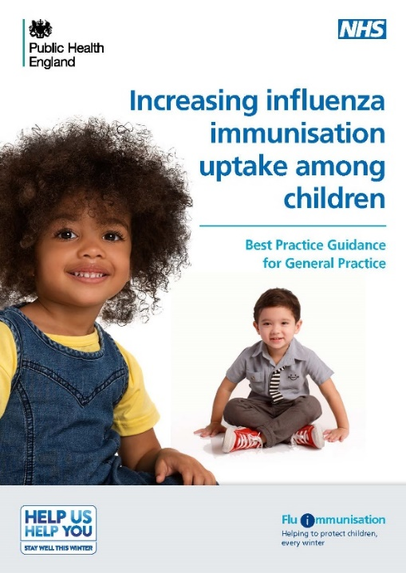
Increasing flu immunisation uptake among children
Best practice guidance for general practice
PHE have produced a summary of key strategies to help to increase flu vaccine uptake in pre-school children (from 2yrs) which consider the following areas:
staff responsibilities
practice goals
identifying eligible children
inviting/contacting parents
ordering vaccines and clinics and appointments
promoting the vaccine offer to parents
ideas to sustain and promote uptake during flu season
recommendations for end of flu season review
Staff involved in delivering flu vaccine to children in any setting are encouraged to consider what strategies they can implement to maximise vaccine uptake whilst taking into account the social distancing and PPE requirements implemented to keep patients safe from COVID-19
Notes:
Note to trainers:
The content of the Best Practice Guidance for Increasing flu immunisation uptake among children is set out on the next seven slides for those trainers who wish/are able to spend time discussing strategies for maximising uptake. These should be considered along with the constraints placed upon services who also need to keep patients safe from COVID-19. Trainers and all those involved in the delivery of the flu programme should regularly check the annual flu programme pages on GOV.UK for updated information on infection prevention and control measures that should be implemented in the delivery of immunisation services.
Flu vaccine: best practice guidance for general practice is available on the PHE website at https://assets.publishing.service.gov.uk/government/uploads/system/uploads/attachment_data/file/635595/Flu_gp_best_practice_guidance.pdf

Slide 63

Increasing flu immunisation uptake among children
Best practice guidance for general practice
Staff responsibilities
• every practice should have a lead member of staff with responsibility for running the flu immunisation campaign and all staff should know who the lead person is
• all staff should understand the reason for the programme and have access to PHE resources
• every member of the practice should know their role and responsibilities
• get all staff involved in promoting the vaccine message to parents
• hold regular meetings so that all staff know the practice plan and progress
• include health visitors, midwives, pharmacists and other healthcare professionals linked to your practice in your planning

Slide 64
Increasing flu immunisation uptake among children
Best practice guidance for general practice
Practice goals
• set a higher goal than the previous season
• create computer searches to measure uptake and assess progress towards the goal
• calculate practice income depending on uptake
• advertise the practice goal and have a ‘Blue Peter’ style ‘Totaliser’
Identifying eligible children
• the lead member of staff to identify eligible children
• check accuracy of searches and coding to ensure all eligible children are identified
• make sure the correct flu vaccination codes are in your system and that staff are aware –don’t let hard work go unmeasured
• create IT system reminders so that opportunistic immunisation happens
• create a system for opportunistic identification of eligible children attending the practice for other clinics or with parents and siblings – use flags or sticky notes to alert staff. Don’t send a child away unimmunised

Slide 65
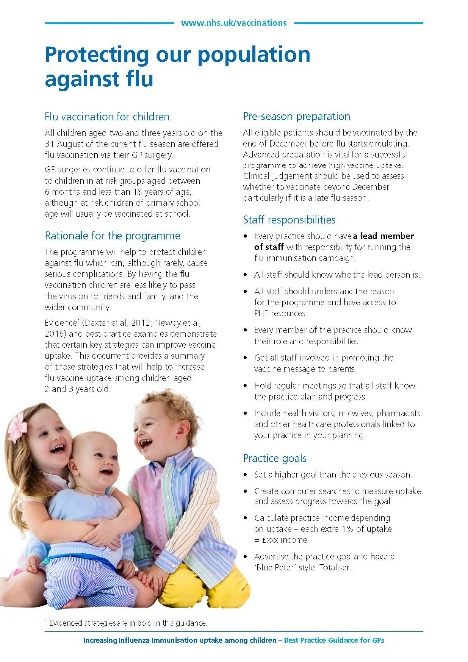
Increasing flu immunisation uptake among children
Best practice guidance for general practice
Invitation/contacting parents
• send a personalised invitation to eligible children – use the parent’s and child’s names, sign your name at the bottom
• phone calls can be more effective than letters; and try text messages for reminders
• ensure that staff phoning patients have a script but can also answer questions and address concerns
• plan phone calls after 4pm when more working parents might be available
• send letters if telephone contact is not possible
• set a date – invite every eligible child before the end of October
• be tenacious – make multiple contacts until child is immunised

Slide 66
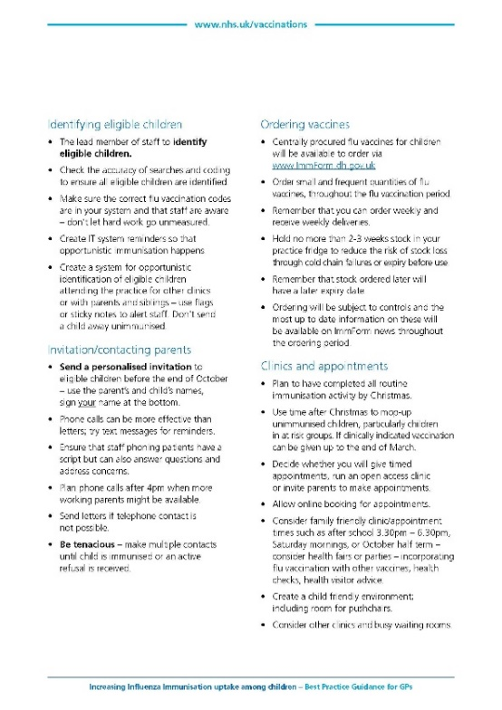
Increasing flu immunisation uptake among children
Best practice guidance for general practice
Ordering vaccines
Centrally procured flu vaccines for children will be available to order via www.ImmForm.dh.gov.uk
Order small and frequent quantities of flu vaccines, spread throughout the flu vaccination period
Remember that you can order weekly and receive weekly deliveries
Hold no more than 2-3 weeks stock in your practice fridge to reduce the risk of stock loss through cold chain failures or expiry before use
Remember that stock ordered later will have a later expiry date
Ordering will be subject to controls and the most up to date information on these will be available on ImmForm news throughout the ordering period

Slide 67
Increasing flu immunisation uptake among children
Best practice guidance for general practice
Clinics and appointments
Plan to have completed all routine immunisation activity by Christmas.
Use time after Christmas to mop-up unimmunised children, particularly children in at risk groups. If clinically indicated vaccination can be given up to the end of March.
Decide whether you will give timed appointments, run an open access clinic or invite parents to make appointments.
Allow online booking for appointments.
Consider family friendly clinic/appointment times such as after school 3.30pm – 6.30pm, Saturday mornings, or October half term – consider health fairs or parties – incorporating flu vaccination with other vaccines, health checks, health visitor advice.
Create a child friendly environment; including room for pushchairs.
Consider other clinics and busy waiting rooms
Staff involved in delivering flu vaccine to children in any setting are encouraged to consider what strategies they can implement to maximise vaccine uptake whilst taking into account the social distancing and PPE requirements implemented to keep patients safe from COVID-19

Slide 68

Increasing flu immunisation uptake among children
Best practice guidance for general practice
Promote the vaccination offer to parents
• ensure every parent has a personalised invitation for their child
• display PHE child flu immunisation posters and leaflets in the reception and waiting rooms
• create attractive displays in waiting rooms. Consider posters or banners outside the practice – on a notice board, walls or even on the roof
• place prominent information about the child flu immunisation programme on the practice website
• engage with the local primary school – ask if they can give leaflets to parents with preschool age children and/or display posters on school/parent notice boards
• engage with local pre-school nurseries, children’s centres, libraries, toddler groups in your area. Ask staff to put up posters and issue leaflets to parents of children who are 2 years old and older. Highlight the benefits of their children being immunised to these preschool groups and nurseries

Slide 69
Increasing flu immunisation uptake among children
Best practice guidance for general practice
During the season
Increasing resources in-season is difficult so comprehensive preparation and planning is critical. There are things you can do to help sustain efforts and uptake:
• review your uptake against your goals and financial plan; celebrate/promote success as the programme progresses
• remain tenacious – re-run searches for eligible children
• continue to offer vaccination, even once you have achieved your practice and campaign goals
• keep staff engaged and enthused – consider incentives, promoting staff competition
• ensure all practice staff have their flu jab – it is powerful to be able to say to patients “I’ve had mine”
Post season
• review your campaign, measure and celebrate success – thank everyone involved
• share the review of your campaign with your stakeholders, patient focus group and partners who helped you achieve your goals
• capture lessons learnt and adapt next year’s plan – aim for higher uptake next year

Slide 70
Key messages
higher demand for flu vaccine is expected this autumn because of concerns about COVID-19. Patients will need reassurance that appropriate measures are in place to keep them safe from COVID-19, as it is likely to be co-circulating with flu
the childhood seasonal influenza (flu) programme is being rolled out in a phased approach over a number of years. School year 7 is being included for 2020/21 in order to try to reduce transmission of flu in the community given the concerns about co-circulation of the SARs-CoV-2 virus during the 2020/21 flu season
the childhood flu programme should reduce the impact of seasonal flu on children and reduce transmission of flu within the community
by reducing transmission of flu, it should also avert many cases of severe flu and flu-related deaths in older adults and people in clinical risk groups
Notes:
Following a recommendation in 2012 by the Joint Committee on Vaccination and Immunisation (JCVI) ¹ that the routine annual flu vaccination programme should be extended to include children, the phased introduction of this extension began in 2013. In 2013, flu vaccine was offered to all two and three year old children, and to four to ten year olds (up to and including pupils in school year 6) in seven different geographical pilot areas.
For the 2014/15 flu season, flu vaccine was offered to all four year old children as well as to all two and three year old children. The geographical pilots of primary school aged children started in 2013/14 continued and there were also several different geographical pilots in secondary school aged children in Years 7 and 8.
In 2015/16, flu vaccine was offered to all two-, three- and four-year-olds, to children of school year 1 and 2 age and to all primary school-aged children in areas that participated in previous primary school pilots.
In 2016/17. flu vaccine was offered to all two-, three- and four-year-olds, to children of school year 1, 2 and 3 age and to all primary school-aged children in areas that participated in previous primary school pilots.
In 2017/18, flu vaccine was offered to all two-, three- and four-year-olds, to children of school year 1, 2 , 3 and 4 age and to all primary school-aged children in areas that participated in previous primary school pilots. This was the first flu season that Reception Year children (aged 4-5 years) were offered flu vaccination in their reception class, rather than through general practice
In the 2018/19 flu season, flu vaccine was offered to all children aged two to nine years old (but not ten years or older) on 31 August 2018 and to all primary school-aged children in former primary school pilot areas.
In the 2019/20 flu season, flu vaccine was offered to all children aged two to ten years (but not eleven years or older) on 31 August 2019. It should also be offered to children from six months of age in clinical risk groups.
The key change to the childhood flu programme in the 2020/21 flu season is that:
Children in School Year 7 (children aged 11 but not 12 by 31 August 2020) will be included in the programme which means all children from Reception through to and including Year 7 are eligible for vaccination.

Slide 71
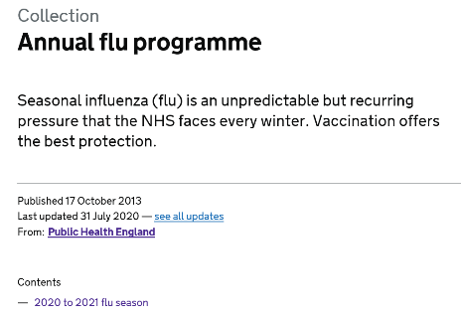
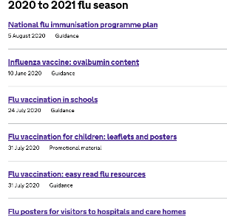
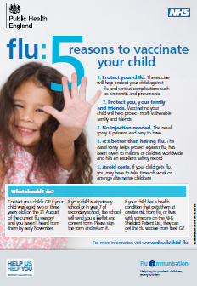


Resources
Letter detailing 2020/21 flu programme
Available at: www.gov.uk/government/publications/national-flu-immunisation-programme-plan
Green Book Influenza chapter. Available at: www.gov.uk/government/organisations/public-health-england/series/immunisation-against-infectious-disease-the-green-book
PGD templates for flu vaccines. Available at: www.gov.uk/government/collections/immunisation-patient-group-direction-pgd
Flu immunisation: toolkit for programme extension to children. Available at: www.gov.uk/government/publications/flu-immunisation-toolkit-for-programme-extension-to-children
Increasing influenza immunisation uptake among children. Best Practice Guidance for General Practice. Available at www.gov.uk/government/organisations/public-health-england/series/annual-flu-programme
Leaflets and posters prepared specifically for the childhood flu programme. Available at: www.gov.uk/government/organisations/public-health-england/series/annual-flu-programme
A video for health professionals on how to administer the live vaccine produced by NHS Education for Scotland. Available at www.nes.scot.nhs.uk/education-and-training/by-theme-initiative/public-health/health-protection/seasonal-flu/childhood-seasonal-flu-vaccination-programme-resources-for-registered-practitioners.aspx
Notes:
References
Joint Committee on Vaccination and Immunisation. JCVI statement on the annual influenza vaccination programme – extension of the programme to children. 25 July 2012. Available at: https://www.gov.uk/government/publications/jcvi-statement-on-the-routine-annual-influenza-vaccination-programme
Wilde J.A, McMillan J.A, Serwint J. et al. (1999) Effectiveness of influenza vaccine in healthcare professionals: a randomised trial. JAMA 281: 908–13
Immunisation against infectious disease (‘the Green Book’) Chapter 19 ‘Influenza’. Updated 21 May 2015. Available at: https://www.gov.uk/government/organisations/public-health-england/series/immunisation-against-infectious-disease-the-green-book
Public Health England. Flu annual report: winter 2016 to 2017. Available at: https://www.gov.uk/government/uploads/system/uploads/attachment_data/file/613493/Surveillance_of_influenza_and_other_respiratory_viruses_in_the_UK_2016_to_2017.pdf
Ruf B.R., Knuf M. (2013) The burden of seasonal and pandemic influenza in infants and children. European Journal of Pediatrics. 2014 Mar;173(3):265-76. doi: 10.1007/s00431-013-2023-6. Epub 2013 May 10
Izurieta H.S., Thompson W.W., Kramarz P., Shay D.K.., Davis R.L., DeStefano F., Black S., Shinefield H., Fukuda K. (2000) Influenza and the rates of hospitalisation for respiratory disease among infants and young children. New England Journal of Medicine 342(4):232-239
Mullooly J.P., Barker W.H. (1982) Impact of type A influenza on children: a retrospective study. American Journal of Public Health 72(9): 1008-1016
Neuzil K.M., Mellen B.G., Wright P.F., Mitchel E.F. Jr, Griffin M.R. (2000) The effect of influenza on hospitalisations, outpatient visits and courses of antibiotics in children. New England Journal of Medicine 342(4):225-231
Poehling K.A., Edwards K.M., Weinberg G.A., Szilagyi P., Staat M.A., Iwane M.K., Bridges C.B., Grijalva C.G., Zhu Y., Bernstein D.I., Herrera G., Erdman D., Hall C.B., Seither R., Griffin M.R., Network NVS (2006) The under recognised burden of influenza in young children. New England Journal of Medicine 31-40 355(1):
Weigl J.A., Puppe W., Schmitt H.J. (2002) The incidence of influenza-associated hospitalisations in children in Germany. Epidemiology and Infection 129(3):525-533
Pitman R.J., Nagy L.D. and Sculpher M.J. (2013) Cost-effectiveness of childhood influenza vaccination in England and Wales: Results from a dynamic transmission model. Vaccine 31(6):927-42
Belshe RB, Edwards KM, Vesikari T et al. (2007) Live attenuated versus inactivated influenza vaccine in infants and young children. New England Journal of Medicine 356(7): 685-96. http://www.ncbi.nlm.nih.gov/sites/entrez/17301299
Ashkenazi S, Vertruyen A, Aristegui J et al. (2006) Superior relative efficacy of live attenuated influenza vaccine compared with inactivated influenza vaccine in young children with recurrent respiratory tract infections. The Pediatric Infectious Disease Journal 25(10): 870-9. http://www.ncbi.nlm.nih.gov/sites/entrez/17006279
Fleming DM, Crovari P, Wahn U et al. (2006) Comparison of the efficacy and safety of live attenuated cold-adapted influenza vaccine, trivalent, with trivalent inactivated influenza virus vaccine in children and adolescents with asthma. The Pediatric Infectious Disease Journal 25(10): 860-9. http://www.ncbi.nlm.nih.gov/sites/entrez/17006278
Allison MA Daley MF, Crane LA et al. (2006) Influenza vaccine effectiveness in healthy 6 to 21 month-old children during the 2003--2004 season. The Journal of Pediatrics 149: 755-62.
Neuzil KM, Jackson LA, Nelson J et al. (2006) Immunogenicity and reactogenicity of 1 versus 2 doses of trivalent inactivated influenza vaccine in vaccine-naive 5-8-year-old children. Journal of Infectious diseases 194(8): 1032-9. http://www.ncbi.nlm.nih.gov/sites/entrez/16991077
Bracco Neto H, Farhat CK, Tregnaghi MW, et al. (2009) Efficacy and safety of 1 and 2 doses of live attenuated influenza vaccine in vaccine-naive children. Pediatr Infect Dis J. 28: 365-71
Block S L, Toback SL, Yi T et al. (2009) Efficacy of a single dose of live attenuated influenza vaccine in previously unvaccinated children: a post hoc analysis of three studies of children aged 2 to 6 years. Clin Ther. 31: 2140-7.
Fluenz Tetra Summary of Product Characteristics. Last text revision: 30 March 2017 . Available at: https://www.medicines.org.uk/emc/medicine/29112
Immunisation against infectious disease (‘the Green Book’) Chapter 5 ‘Immunisation by nurses and other healthcare professionals”. Updated 20 March 2013. Available at: https://www.gov.uk/government/organisations/public-health-england/series/immunisation-against-infectious-disease-the-green-book
Immunisation against infectious disease (‘the Green Book’) ’. Revised recommendations for administering more than 1 live vaccine 24 April 2015. Available at: https://www.gov.uk/government/publications/revised-recommendations-for-administering-more-than-1-live-vaccine
Immunisation against infectious disease (‘the Green Book’) ’. Chapter 6 Contraindications and special considerations. Updated 4 April 2013. Available at: https://www.gov.uk/government/publications/contraindications-and-special-considerations-the-green-book-chapter-6
Centers for Disease Control and Prevention (2013) Prevention and Control of Seasonal Influenza with Vaccines: Recommendations of the Advisory Committee on Immunization Practices — United States, 2013–2014. MMWR September 20, 62(RR07);1-43 http://www.cdc.gov/mmwr/pdf/rr/rr6207.pdf

Slide 72

About Public Health England
Public Health England exists to protect and improve the nation's health and wellbeing, and reduce health inequalities. It does this through world-class science, knowledge and intelligence, advocacy, partnerships and the delivery of specialist public health services. PHE is an operationally autonomous executive agency of the Department of Health.
Public Health England
Wellington House
133-155 Waterloo Road
London SE1 8UG
Tel: 020 7654 8000
www.gov.uk/phe
Twitter: @PHE_uk
Facebook: www.facebook.com/PublicHealthEngland
For enquiries relating to this document, please contact: immunisation.lead@phe.gov.uk
© Crown copyright 2020
You may re-use this information (excluding logos) free of charge in any format or medium, under the terms of the Open Government Licence v3.0. To view this licence, visit OGL or email psi@nationalarchives.gsi.gov.uk. Where we have identified any third party copyright information you will need to obtain permission from the copyright holders concerned.
Published August 2020
PHE publications gateway number: 2020202

