Slide 1
The national flu immunisation programme 2022 to 2023
Training for healthcare practitioners
Notes:
This resource is designed to update health care practitioners involved in delivering the national flu immunisation programme for the 2022 to 2023 flu season and includes information about both the inactivated vaccines and the live attenuated influenza vaccine used for the childhood flu programme.
This resource is designed to be used by anyone involved in the flu programme. Not all slides will be required for training – trainers should select slides depending on audience background, role in the programme and length of training session.
This resource does not cover vaccine administration technique. If staff are required to deliver flu vaccinations they should refer to their line manager for additional training.
Note: For the purposes of this resource, the term ‘influenza’ will be replaced by the term ‘flu’ unless it relates to a specific virus/strain.

Slide 2
Flu vaccine programme 2022 to 2023
as a result of non-pharmaceutical interventions in place for COVID-19 (such as mask-wearing, reduced social interactions and international travel) influenza activity levels were extremely low globally in the past 2 flu seasons
as social contact returns to pre-pandemic norms, likely to be a resurgence in influenza activity in winter 2022 to 2023 to levels similar to, or higher than before the pandemic
potential for co-circulation of influenza, COVID-19 and other respiratory viruses
therefore vital that everyone who is eligible for flu vaccine is offered the opportunity to receive it
the expanded flu programme (50 to 65y and some secondary school Year groups) run in last 2 flu vaccination seasons will continue this year so it is important to know who is eligible

Slide 3
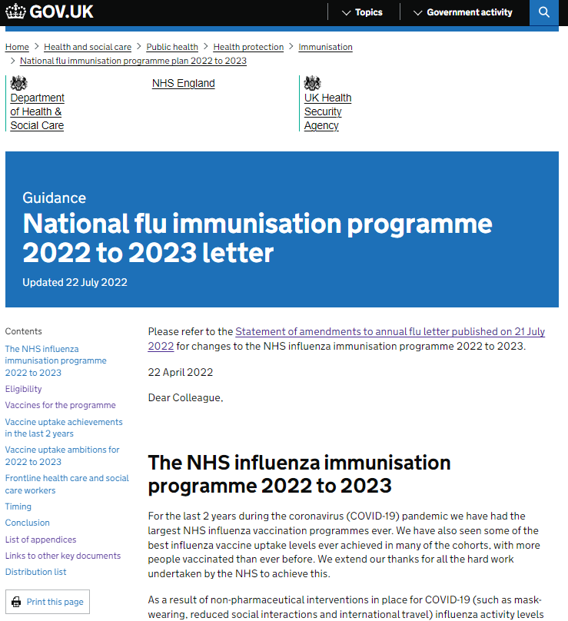
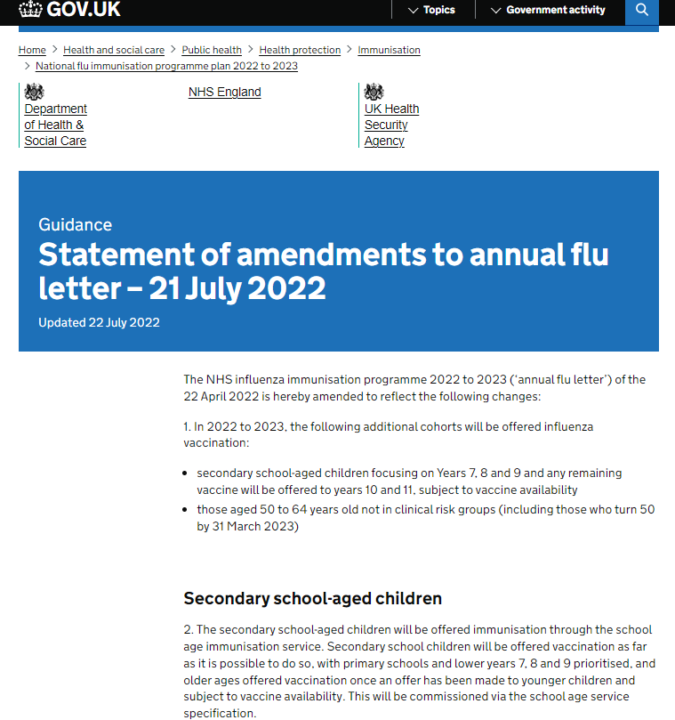
Essential further reading
Please ensure that you read the national flu immunisation programme 2022 to 2023 letter and the amendment statement (published 21 July)
These provide key information about this year’s flu programme
It is recommended that you regularly check the UKHSA ‘Annual flu programme’ webpage during the flu vaccination period as any further information that becomes available about the programme will be published here
www.gov.uk/government/collections/annual-flu-programme#2022-to-2023-flu-season
Also read the Green Book Influenza chapter

Slide 4
Key messages
flu immunisation is one of the most effective interventions we can provide to reduce harm from flu and pressures on health and social care services during the winter
it is important to increase flu vaccine uptake in clinical risk groups because of increased risk of death and serious illness if people in these groups catch flu
flu during pregnancy may be associated with perinatal mortality, prematurity, smaller neonatal size, lower birth weight and increased risk of complications for mother
vaccination of health and social care workers protects them and reduces risk of spreading flu to their patients, service users, colleagues and family members
by preventing flu infection through vaccination, secondary bacterial infections such as pneumonia are prevented. This reduces the need for antibiotics and helps prevent antibiotic resistance
for a number of years, only around half of patients aged 6 months to under 65 years in clinical risk groups have been vaccinated
the childhood flu programme should reduce the impact of seasonal flu on children and reduce transmission of flu within the community
by reducing transmission of flu, it should also avert many cases of severe flu and flu-related deaths in older adults and people in clinical risk groups
Notes:
Morbidity and mortality attributed to flu is a key factor in NHS winter pressures and a major cause of harm to individuals especially vulnerable people. The annual flu immunisation programme helps to reduce GP consultations, unplanned hospital admissions and pressure on A&E and is therefore a critical element of the system-wide approach for delivering robust and resilient health and care services during the winter.

Slide 5
Aims of resource
The purpose of this training resource is to:
develop the knowledge base of healthcare practitioners regarding the 2022 to 2023 seasonal flu vaccination programme
support healthcare practitioners involved in discussing flu vaccination with those eligible by providing evidence based information
promote high uptake of flu vaccination in all eligible groups by increasing the knowledge of those involved in delivering the vaccination programme
provide information on the administration of flu vaccines

Slide 6
Learning outcomes
On completion of this resource, healthcare practitioners will be able to:
describe the cause of flu
understand how flu is transmitted and the possible effects of flu
understand the evidence base for the administration of flu vaccination those in clinical risk groups, to children and to those aged 50 years and over
explain which vaccines should be used and the precautions and contraindications to the administration of these
explain the sequence of steps in flu vaccine administration
explain the possible side effects from flu vaccines
understand the importance of their role in promoting and providing evidence based information about flu vaccination to patients
identify sources of additional information

Slide 7
Key roles of healthcare practitioners
Key roles of healthcare practitioners in relation to the flu programme are to:
be able to describe the evidence base for the administration of the flu vaccination to all eligible groups
advise individuals (or their parents or carers) who are eligible to receive the flu vaccination why it is strongly recommended that they are vaccinated against flu
safely administer flu vaccines in accordance with the vaccine schedule
ensure any adverse effects are managed and reported appropriately

Slide 8
Evolution of UK flu vaccination programme
Late 1960s: annual flu immunisation recommended to directly protect those in clinical risk groups who are at a higher risk of influenza associated morbidity and mortality
2000: flu vaccine policy extended to include all people aged 65 years or over
2010: pregnancy added as a clinical risk category for routine flu immunisation
2013: phased introduction of an annual childhood flu vaccination programme for all children aged 2 to 16y began with vaccine offered to all children aged 2 and 3 years and 7 geographical pilots in primary school aged children
2014: phased introduction of childhood flu vaccination programme continued with vaccine offered to all children aged 2, 3 and 4 years and geographical pilots in primary and secondary school aged children
2015: in addition to vaccinating 2, 3, and 4 year olds in primary care, the programme began nationally in primary schools in a phased roll-out starting with the youngest school-aged children first.
Between 2016 and 2019: phased introduction of childhood flu vaccination programme continued with a year on year addition of the next school year
2020: offer to all children aged 2 to 11 years old (but not 12 years or older) on 31 August 2020 and extended to those aged 50 to 64 years
  2021: offer to all children aged 2 to 15 years old (but not 16 years or older on 31 August 2021 and extended to those aged 50 to 64 years
  2022 offer to all children aged 2 to 3 on 31 Aug 2022, to primary school aged children (Reception to Year 6), and extended to secondary school age (Years 7 to 9, then 10 & 11 if vaccine supply allows) and to all those aged 50 years and over (starting with risk groups and over 65 years first)
Notes:
Following a recommendation in 2012 by the Joint Committee on Vaccination and Immunisation (JCVI) that the routine annual flu vaccination programme should be extended to include children, a phased introduction of this extension began in 2013. In 2013, flu vaccine was offered to all 2 and 3 year old children, and to 4 to 10 year olds (up to and including pupils in school year 6) in 7 different geographical pilot areas.
For the 2014 to 2015 flu season, flu vaccine was offered to all 4 year old children as well as to all 2 and 3 year old children. The geographical pilots of primary school aged children started in 2013 to 2014 continued and there were also several different geographical pilots in secondary school aged children in Years 7 and 8.
In 2015 to 2016, flu vaccine was offered to all 2, 3 and 4-year-olds, to children of school year 1 and 2 age and to all primary school-aged children in areas that participated in previous primary school pilots.
In 2016 to 2017, flu vaccine was offered to all 2, 3 and 4-year-olds, to children of school year 1, 2 and 3 age and to all primary school-aged children in areas that participated in previous primary school pilots.
In 2017 to 2018, flu vaccine was offered to all 2, 3 and 4-year-olds, to children of school year 1, 2 , 3 and 4 age and to all primary school-aged children in areas that participated in previous primary school pilots. This was the first flu season that Reception Year children (aged 4 to 5 years) were offered flu vaccination in their reception class, rather than through general practice
In the 2018 to 2019 flu season, flu vaccine was offered to all children aged 2 to 9 years old (but not 10 years or older) on 31 August 2018 and to all primary school-aged children in former primary school pilot areas.
In the 2019 2020 flu season, flu vaccine was offered to all children aged 2 to 10 years (but not 11 years or older) on 31 August 2019. It should also be offered to children from 6 months of age in clinical risk groups.
During the 2020 to 2021 season, the national programme was extended to include children of Year 7 (aged 11 rising to 12 years old)
In the 2021 to 2022 flu season, in addition to 2 and 3 year olds and primary school aged children, children in School Year 7 to 11 in secondary school were also offered the vaccine.
For the 2022 to 2023 flu season, flu vaccine will be offered to all children aged 2 or 3 years on 31 August 2022, to all primary school aged children (from Reception to Year 6) then to secondary school-aged children (focusing on Years 7, 8 and 9 following the primary school vaccination visits with any remaining vaccine being offered to Years 10 and 11, subject to vaccine availability later still in the season). Vaccine will also be offered to those aged 50 to 64 years old not in clinical risk groups (including those who turn 50 by 31 March 2023). Providers are asked not to start vaccinating this age group until mid-October 2022 to enable prioritisation of those with clinical risks and in the older age groups.

Slide 9
Influenza overview
flu is an acute viral infection of the respiratory tract (nose, mouth, throat, bronchial tubes and lungs)
it is a highly infectious illness which spreads rapidly in communities
even people with mild or no symptoms can infect others
most cases in the UK occur during an 8 to 10 week period during the winter

Slide 10
Influenza viruses
A viruses
cause outbreaks most years and are the usual cause of epidemics and pandemics
live and multiply in many different animals and may spread between them
birds, particularly wildfowl, are the main animal reservoir
B viruses
tend to cause less severe disease and smaller outbreaks
predominantly found in humans
burden of disease mostly in children

Slide 11

Flu A virus
Genetic material (RNA) in the centre
Two surface antigens:
Haemagglutinin (H) (blue)
Neuraminidase (N) (red)
There are 18 different types of H and 11 different types of N
The role of haemagglutinin is to bind to the cells of the infected person
The role of neuraminidase is to release the virus from the cell surface
The different types of H and N are identified by numbers, hence H1N1 or H3N2 for example
The national flu immunisation programme 2021 to 2022
Notes:
Schematic model of a flu A virus.
There are 2 antigens on the surface, as illustrated.
The role of the H antigen is to bind to the cells of the host. There are 18 different types of H.
The role of the N antigen is to release the virus from the cell surface. There are 11 different types of N.
The different types of H and N are identified by numbers, hence H1N1 or H3N2 for example.

Slide 12
Genetic changes in the flu virus – what this means
Changes in the surface antigens (H and N) result in the flu virus constantly changing
antigenic drift: minor changes (natural mutations) in the genes of flu viruses that occur gradually over time
antigenic shift: when 2 or more different strains combine. This abrupt major change results in a new subtype. Immunity from previous flu infections/vaccinations may not protect against the new subtype, potentially leading to a widespread epidemic or pandemic
Because of the changing nature of flu viruses, WHO monitors their epidemiology throughout the world. Each year WHO makes recommendations about the strains of influenza A and B which are predicted to be circulating in the forthcoming winter.
These strains are then included in the flu vaccine developed each year
The national flu immunisation programme 2021 to 2022
Notes:
The World Health Organization (WHO) convenes a group that reviews the global influenza situation (once each year for the northern hemisphere and once for the southern hemisphere) and recommends which flu strains should go in the seasonal vaccine to be produced by manufacturers for the following season 6 to 8 months later. This recommendation is based on information about the circulating viruses and epidemiological data from around the world at that time.
In previous years, most influenza vaccines were trivalent, containing 2 subtypes of influenza A and one B virus but quadrivalent vaccines with an additional B virus have been developed in recent years. The first authorised quadrivalent flu vaccine was made available for use in the UK in 2013. The use of quadrivalent flu vaccines containing a B strain from each of the 2 B strain lineages should improve the matching of the vaccine to the circulating B strain(s).

Slide 13
Features of flu
  easily transmitted by large droplets, small-particle aerosols and by hand to mouth/eye contamination from a contaminated surface or respiratory secretions of infected person
  people with mild or no symptoms can still infect others
  incubation period 1 to 5 days (average 2 to 3 days) though may be longer especially in people with immune deficiency
  Common symptoms include:
  sudden onset of fever, chills, headache, muscle and joint pain and extreme fatigue
  dry cough, sore throat and stuffy nose
  in young children gastrointestinal symptoms such as vomiting and diarrhoea may be seen
Notes:
Serological studies in healthcare professionals have shown that approximately 30 to 50% of flu infections can be asymptomatic but the proportion of flu infections that are asymptomatic may vary depending on the characteristics of the influenza strain.
In healthy individuals, flu is usually unpleasant but self-limiting with recovery within 5-7 days.

Slide 14
Possible complications of flu
Common:
  bronchitis
  otitis media (children), sinusitis
  secondary bacterial pneumonia
Less common:
  meningitis, encephalitis, meningoencephalitis
  primary influenza pneumonia
Risk of most serious illness is higher in:
      children under 6 months
      older people
      those with underlying health conditions such as respiratory disease, cardiac disease, long-term neurological conditions or immunosuppression
      pregnant women (flu during pregnancy may be associated with perinatal mortality, prematurity, smaller neonatal size and lower birth weight)
Notes:
The risk of serious illness from flu is higher among children under 6 months of age, older people and those with underlying health conditions such as respiratory disease, cardiac disease or immunosuppression, as well as pregnant women. These groups are at greater risk of complications from flu such as bronchitis or pneumonia.

Slide 15
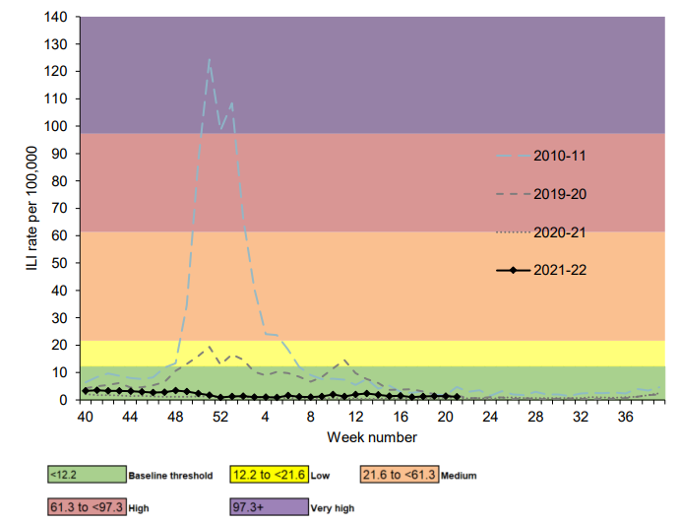
Flu epidemiology
flu activity usually occurs between September to March (weeks 37 and 15)
impact of flu varies each year: the number of flu cases in the 2021 to 2022 flu season was higher than levels observed during the 2020 to 2021 season but remained much lower than those in previous seasons
hospital and ICU/HDU admissions remained below the baseline threshold levels for the majority of the season but rose slightly above baseline in late March 2022. While rates were higher than those observed in 2020 to 2021, admissions were lower than those seen in previous seasons
Weekly all age GP influenza-like illness rates for 2021 to 2022 and past seasons, England (RCGP)
Notes:
The impact of flu on the population varies from year to year and is influenced by changes in the virus that, in turn, influence the proportion of the population that may be susceptible to infection and the severity of the illness.
The graph shows the rate of influenza/influenza-like illness episodes in England and Wales per 100,000 consultations in primary care for the 2010/11, 2019/20, 2020/21 and 2021/22 seasons. The data show that flu viruses circulate each winter season, but the degree of activity varies substantially.
In the 2020 to 2021 and 2021 to 2022 flu seasons, low levels of flu activity were seen across the UK but during these seasons, public health messaging, social and physical distancing measures, national lockdowns, local and international travel restrictions and the wearing of face coverings were in place due to COVID-19. Hospital and ICU/HDU admissions were much lower than seen in previous years.

Slide 16
When to vaccinate
those eligible should be given flu vaccination as soon as vaccine is available so that people are protected when flu begins to circulate in the community
ideally most vaccination should be completed before the end of December before flu circulation usually peaks
flu can circulate considerably later than this however so clinical judgement should be applied to assess needs of individual patients and whether it is appropriate to continue to offer vaccination from January to March
this decision should take into account level of flu-like illness in community and fact that the immune response following flu vaccination takes about 2 weeks to develop fully
as antibody levels likely to reduce in subsequent seasons and there may be changes to circulating strains from one season to next, annual revaccination is important
Notes:
Although influenza activity is not usually significant in the UK before the middle of November, the influenza season can start early and therefore the ideal time for immunisation is between September and early November. After immunisation, protective immune responses may be achieved within 14 days. Protection afforded by the vaccine is thought to last for at least one influenza season. However, as the level of protection provided in subsequent seasons is likely to reduce and there may be changes to the circulating strains from one season to the next, annual revaccination is important.

Slide 17
Rollout of the childhood flu vaccination programme in England
Extension of the seasonal flu vaccination programme to children aims to lower the public health impact of flu by:
providing direct protection by preventing cases of flu infection in children
providing indirect protection by lowering flu transmission from children to other children, adults and to those in the clinical risk groups of any age
Reducing flu transmission in the community averts many cases of severe flu and flu-related deaths in older adults and people with clinical risk factors
Annual administration of flu vaccine to children is expected to substantially reduce flu-related illness, GP consultations, hospital admissions and deaths
    the programme has been rolled out over a number of flu seasons and has included geographical piloting in different age groups. Each year, more age groups have been added to the national programme
    in the 2022 to 2023 flu season, all children aged 2 to 3 years on 31 August 2022, Reception to Year 6 and then Years 7 to 9 are eligible for vaccination. Any remaining vaccine will be offered to Years 10 and 11, subject to vaccine availability later in the season
    children aged 6 months to 2 years in a clinical risk group are eligible due to their underlying medical condition or treatment
with concerns about co-circulation of the SARs-CoV-2 virus during the 2022 to 2023 flu season, it is particularly important to reduce transmission of flu in the community
Notes:
In July 2012, the JCVI recommended extending the annual flu programme to include healthy children aged 2 to their seventeenth birthday in order both to lower the potentially serious impact of flu in vaccinated children and also to have a more profound effect on flu transmission. Children are the main source of transmission in the population, and extending the flu programme to include healthy children should therefore reduce the spread of infection from children to other children, to adults and to those in clinical risk groups of any age. JCVI recognised that implementation of this programme would be challenging and due to the scale of the programme it is being phased in.
The children’s programme began in 2013/14 with all 2 and 3-year-olds being offered vaccination through general practice and geographic pilots in primary school-aged children. In 2014/15 this offer was extended to 4-year-olds through general practice, with pilots in primary and secondary school-aged children (in years 7 and 8). In 2015/16 the programme was extended to include children of appropriate age in school years 1 and 2 and in 2016/17, the offer of flu vaccine to extended to children in school year 3. In 2017/18, children in reception class and school years 1 to 4 were offered flu vaccine in school and pre-school age children (2y and 3y) were offered flu vaccine in primary care. In 2018/19, children in reception class and school years 1 to 5 were offered flu vaccine in school and pre-school age children (2y and 3y) continued to be offered the vaccine in primary care. Children of school age that are in an at risk group can also access the vaccine in primary care. In 2019/20, children in school year 6 were offered the vaccine and for 2020/21, school year 7 has been included so all children aged 2 to 11 (but not 12 years or older) on 31 August 2020 were be offered the vaccine.
During 2021/22, all those aged 2 and 3 years, primary school aged children and those in secondary school year 7 to 11 (aged 4 to 15 years on 31 August 2021) were offered flu vaccine.
An analysis of data comparing the level of flu-related demand on NHS services in 2014/15 primary school pilot areas with non-pilot areas indicates that immunisation of children does have a significant impact. Results were obtained from a range of surveillance indicators including GP consultations for influenza-like illness, swab positivity in primary care, laboratory confirmed hospitalisations and percentage of respiratory emergency department attendances. The key findings were:
• the GP consultation rate for ‘influenza-like illness’ among primary school aged children was 94% lower compared to non-pilot areas
• A&E respiratory attendances by primary school aged children were 74% lower
• hospital admissions of primary school aged children caused by confirmed influenza were 93% lower
• a positive impact could also be measured among the adult population. The GP consultation rate for ‘influenza-like illness’ among adults was 59% lower compared to non-pilot areas

Slide 18
Flu vaccine eligibility: 2022 to 2023 flu season
all children aged 2 or 3 years on 31 August 2022
all primary school aged children (from Reception to Year 6)
secondary school-aged children (focusing on Years 7, 8 and 9 following the primary school vaccination visits with any remaining vaccine being offered to Years 10 and 11, subject to vaccine availability later in the season)
those aged 6 months to under 65 years in clinical risk groups
all pregnant women (including those women who become pregnant during the influenza season)
those aged 65 years and over
those aged 50 to 64 years old not in clinical risk groups (including those who turn 50 by 31 March 2023). (Providers are asked not to start vaccinating this age group until mid-October 2022 to enable prioritisation of those with clinical risks and in the older age groups)
those living in long-stay residential care homes or other long-stay care facilities
carers
close contacts of immunocompromised individuals
frontline staff employed by social care providers without employer led occupational health schemes (see flu letter for details)
Notes:
Organisations should vaccinate all frontline health care workers and social care workers, in order to meet their responsibility to protect their staff and patients and ensure the overall safe running of services. There are limited circumstances where social care workers without access to an employer led occupational health scheme can access the vaccine on the NHS.
“Long stay care facilities” does not include prisons, young offender institutions, university halls of residence or boarding schools (except if children in boarding school are of primary school age)
“Carers” are those who are in receipt of a carer’s allowance, or those who are the main carer of an older or disabled person whose welfare may be at risk if the carer falls ill
Vaccination should also be offered to close contacts immunocompromised individuals, specifically individuals who expect to share living accommodation on most days over the winter and, therefore, for whom continuing close contact is unavoidable. Child contacts of very severely immunocompromised individuals should be given inactivated vaccine rather than the live vaccine that would normally be recommended for children under 18 years.
This list is not exhaustive, and the healthcare practitioner should ensure they are aware of all eligible groups listed in the flu programme letter and apply clinical judgement to take into account the risk of flu exacerbating any underlying disease that a patient may have, as well as the risk of serious illness from flu itself. Flu vaccine should be offered in such cases even if the individual is not in the clinical risk groups specified above

Slide 19
Clinical risk groups
increasing flu vaccine uptake in clinical risk groups is important because of increased risk of death and serious illness if people in these groups catch flu
for a number of years only around half of patients aged 6 months to under 65 in clinical risk groups have been vaccinated
vaccine uptake for all clinical risk groups needs to improve
aim of the flu programme for 2022 to 2023 is to demonstrate a 100% offer to all eligible patients and to achieve at least the uptake levels of 2021 to 2022 for each cohort
strategies to improve vaccine uptake should be tailored to each risk group to ensure optimum uptake of vaccine in each of them.
further information on flu vaccination for those with learning disabilities can be found on the GOV.UK website
  www.gov.uk/government/publications/flu-vaccinations-for-people-with-learning-disabilities/flu-vaccinations-supporting-people-with-learning-disabilities

Slide 20
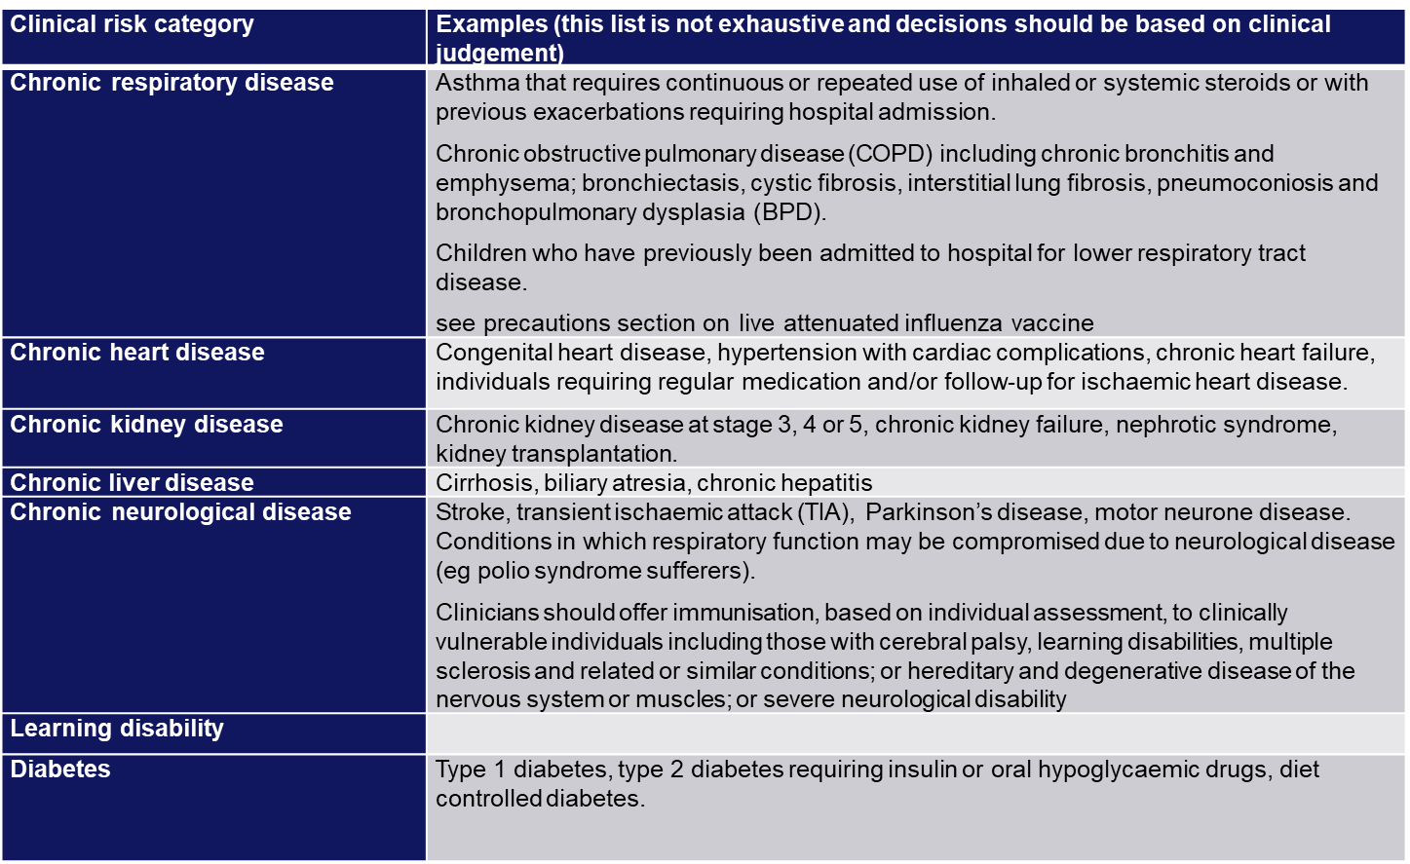
Clinical risk groups who should receive flu vaccine (1)
Notes:
Flu vaccine should be offered to the eligible groups set out in the table.
[Note to trainers: Although difficult to read the detail on this slide in a lecture theatre/classroom situation, this table is presented here in order to show immunisers that under each risk group category, individual conditions are listed and detailed. Healthcare practitioners should refer to the latest Green Book influenza chapter for further detail about clinical risk groups included in the national flu immunisation programme. This chapter is regularly updated, sometimes during the flu season, and can be found at: www.gov.uk/government/collections/immunisation-against-infectious-disease-the-green-book]

Slide 21
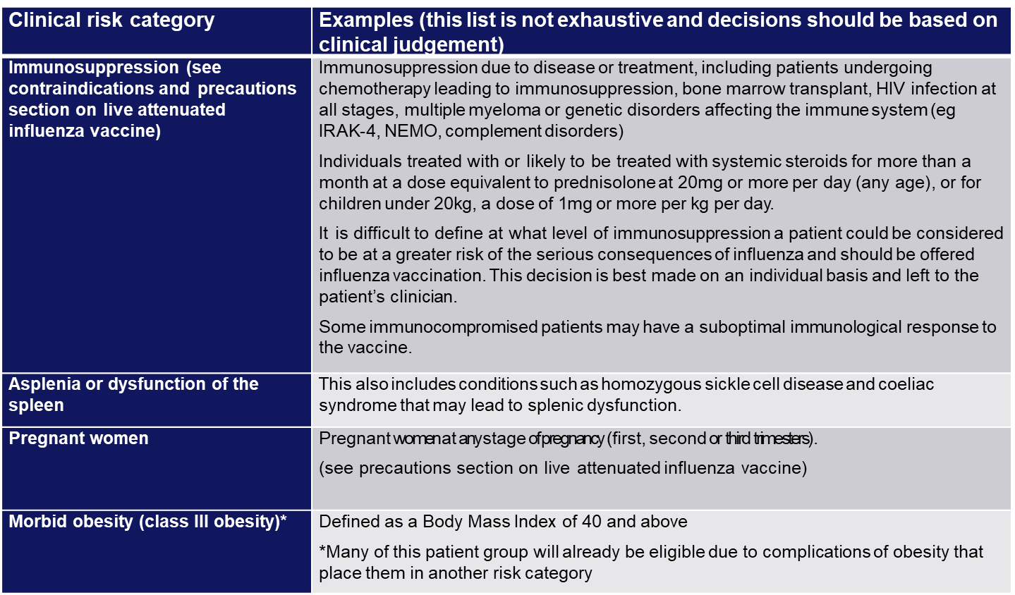
Clinical risk groups who should receive flu vaccine (2)
Notes:
Increasing flu vaccine uptake in clinical risk groups is important because of the increased risk of serious illness should people in these groups catch flu. The table above shows flu mortality by clinical risk group and the increased risk of death for those in these groups.

Slide 22
Why vaccinate these risk groups?
Influenza-related population mortality rates and relative risk of death among those aged 6 months to under 65 years by clinical risk group in England, September 2010 to May 2011
 | Number of fatal flu cases (%) | Mortality rate per 100,000 population | Age-adjusted relative risk
In a risk group | 213 (59.8) | 4.0 | 11.3 (9.1-14.0)
Not in any risk group | 143 (40.2) | 0.4 | Baseline
Chronic renal disease | 19 (5.3) | 4.8 | 18.5
Chronic heart disease | 32 (9.0) | 3.7 | 10.7 (7.3-15.7)
Chronic respiratory disease | 59 (16.6) | 2.4 | 7.4 (5.5-10.0)
Chronic liver disease | 32 (9.0) | 15.8 | 48.2 (32.8-70.6)
Diabetes | 26 (7.3) | 2.2 | 5.8 (3.8-8.9)
Immunosuppression | 71 (19.9) | 20.0 | 47.3 (35.5-63.1)
Chronic neurological disease (excluding stroke/transient ischaemic attack) | 42 (11.8) | 14.7 | 40.4 (28.7-56.8)
Total | 378 | 0.8

Slide 23
Pregnant women
All pregnant women are recommended to receive the inactivated flu vaccine irrespective of their stage of pregnancy
pregnant women are at increased risk from complications if they contract flu
having flu during pregnancy may be associated with premature birth and smaller birth size and weight
flu vaccination during pregnancy provides passive immunity against flu to infants in the first few months of life
studies on safety of flu vaccine in pregnancy show that inactivated flu vaccine can be safely and effectively administered during any trimester of pregnancy
no study to date has demonstrated an increased risk of either maternal complications or adverse fetal outcomes associated with inactivated flu vaccine
women should be offered flu vaccine every time they are pregnant
Notes:
All pregnant women are recommended to receive the inactivated flu vaccine irrespective of their stage of pregnancy.
There is good evidence that pregnant women are at increased risk from complications if they contract flu .In addition, there is evidence that having flu during pregnancy may be associated with premature birth and smaller birth size and weight and that flu vaccination may reduce the likelihood of prematurity and smaller infant size at birth associated with an influenza infection during pregnancy. Furthermore, a number of studies show that flu vaccination during pregnancy provides passive immunity against flu to infants in the first few months of life. A review of studies on the safety of flu vaccine in pregnancy concluded that inactivated flu vaccine can be safely and effectively administered during any trimester of pregnancy and that no study to date has demonstrated an increased risk of either maternal complications or adverse fetal outcomes associated with inactivated influenza vaccine.
The ideal time for flu vaccination is before flu starts circulating. However, even after flu is in circulation, vaccine should continue to be offered to those at risk and newly pregnant women. If a woman becomes pregnant after the usual vaccinating period of October to January, it is still worth considering offering the vaccine if flu is still circulating in the community. Women should be offered the vaccine every time they are pregnant as the flu virus constantly mutates and therefore the strains included in the vaccine are reviewed annually.

Slide 24
Residential care/nursing home residents and staff
flu vaccine should be offered to those living in long-stay residential care homes or other long-stay care facilities where rapid spread is likely to follow introduction of infection and cause high morbidity and mortality
this does not include prisons, young offender institutions, university halls of residence, or boarding schools unless of primary school age
where employee-led occupational health services are not in place, flu vaccination for social care and hospice workers employed by registered residential or domiciliary care providers as well as those employed through Direct Payment or Personal Health Budgets to deliver domiciliary care to patients and service users will be available through community pharmacy and general practice
where a social care employer is not able to provide an occupational health scheme, the Community Pharmacy Seasonal Influenza Vaccination Advanced Service and Seasonal Influenza Vaccination Programme Enhanced Service will enable community pharmacies and general practices to vaccinate both residential care or nursing home residents and staff in the home setting in a single visit
where these flu vaccinations are delivered by general practice, vaccination of eligible residents and staff should be undertaken regardless of whether they are registered with the practice (subject to negotiation)

Slide 25
Health and social care workers
vaccination of health and social care workers protects them and reduces risk of spreading flu to their patients, service users, colleagues and family members
evidence that vaccination significantly lowers rates of flu-like illness, hospitalisation and mortality in the elderly in long-term healthcare settings
reduces transmission of flu to vulnerable patients, some of whom may have impaired immunity and may not respond well to immunisation
frontline health and social care workers have a duty of care to protect their patients and service users from infection
vaccination of frontline workers also helps reduce sickness absences and contributes to keeping the NHS and care services running through winter pressures
NHS and social care bodies have a responsibility to ensure, as far as is reasonably practicable, that health and social care workers are free of, and are protected from exposure to infections that can be caught at work (Health and Social Care Act 2008, Code of Practice on the prevention and control of infections)
Notes:
Frontline health and social care workers have a duty of care to protect their patients and service users from infection. This includes getting vaccinated against flu.
Flu outbreaks can occur in health and social care settings with both staff and their patients/service users being affected when flu is circulating in the community. It is important that health and social care workers protect themselves by having the flu vaccine, and, in doing so, they reduce the risk of spreading flu to their patients, service users, colleagues and family members.
Vaccination of healthcare workers against flu has been shown to significantly lower rates of flu-like illness, hospitalisation and mortality in the elderly in long-term healthcare settings. Vaccination of staff in acute care settings may provide similar benefits. Flu immunisation of frontline health and social staff care staff may reduce the transmission of infection to vulnerable patients, some of whom may have impaired immunity, increasing their risks of flu and who may not respond well to immunisation.
Vaccination of health and social care workers also helps reduce the level of sickness absenteeism that can jeopardise the NHS and care services. This is essential in the winter when pressures on these services increase. and will contribute to keeping the NHS and care services running. This is particularly important when responding to winter pressures.
Immunisation should be provided to healthcare and social care workers in direct contact with patients/clients to protect them and to reduce the transmission of flu within health and social care premises, to contribute to the protection of individuals who may have a suboptimal response to their own immunisations, and to avoid disruption to services that provide their care. This includes:
health and social care staff directly involved in the care of their patients or clients
those living in long-stay residential care homes or other long-stay care facilities where rapid spread is likely to follow introduction of infection and cause high morbidity and mortality (this does not include prisons, young offender institutions, university halls of residence etc.)
those who are in receipt of a carer’s allowance, or those who are the main carer of an elderly or disabled person whose welfare may be at risk if the carer falls ill.
others involved directly in delivering health and social care such that they and vulnerable patients/clients are at increased risk of exposure to influenza (further information is provided in guidance from UK health departments)
All frontline health and social care workers with direct patient/service user contact should be provided with flu vaccination by their employer.
This includes staff in all NHS trusts, general practices, care homes, and domiciliary care
Employers are encouraged to commission a service which makes access to the vaccine easy for all staff, encourage staff to get vaccinated and to monitor the delivery of their programme.
The definition of healthcare workers from the Green Book chapter 12 should be used to identify those eligible as part of the frontline and social care workers programme.
NHS Trusts are asked to complete a self assessment against best practice checklist
NHS England and Improvement (NHSE/I) will continue to support vaccination of social care and hospice workers, with vaccination available through their employer, community pharmacy or their registered GP practice

Slide 26
Vaccination of those not in a clinical risk group
the list of clinical risk groups is not exhaustive, healthcare practitioners should apply clinical judgement to take into account the risk of flu exacerbating any underlying disease as well as the risk of serious illness from flu itself
flu vaccine should be offered to such cases and will be reimbursed, even if the individual is not in the clinical risk groups specified
Notes:
The list of clinical risk groups is not exhaustive, and the healthcare practitioner should apply clinical judgement to take into account the risk of influenza exacerbating any underlying disease that a patient may have, as well as the risk of serious illness from flu itself. Flu vaccine should be offered in such cases even if the individual is not in one of the specified clinical risk groups.

Slide 27
Flu vaccine uptake in England (%)
Target group | 2021/22 | 2020/21 | 2019/20 | 2018/19
Patients aged 65 years and over | 82.3 | 80.9 | 72.4 | 72.0
Patients aged 6 months to under 65 years in risk groups | 52.9 | 53.0 | 44.9 | 48.0
Pregnant women in risk groups* | 51.8 | 57.7 | 65.9 | 60.2
Pregnant women not in risk groups | 36.0 | 41.5 | 42.1 | 43.7
All pregnant women | 37.9 | 43.6 | 43.7 | 45.2
Frontline health and social care workers | 60.5** | 76.8 | 74.3 | 70.3
*The pregnant women and healthcare workers who are also in one or more clinical risk groups may also be included in the <65 years at risk category
** Excludes social care workers

Slide 28
Flu vaccine uptake by individual clinical risk group in 2021 to 2022 (%) GP registered patients aged 6 months to under 65 years
Risk group | 6 months to under 2 years | 2 years to under 5 years | 5 years to under 16 years | 16 years to under 65 | Total under 65 years
Patients with Diabetes | 17.3 | 53.3 | 53.2 | 64.2 | 64.1
Patients with Chronic Kidney Disease | 11.4 | 48.3 | 44.4 | 62.4 | 62.0
Patients with immunosuppression | 20.3 | 49.6 | 49.0 | 60.3 | 59.9
Patients with Chronic Neurological Disease (including Stroke/TIA, Cerebral Palsy or MS) | 14.9 | 48.1 | 47.9 | 54.9 | 54.1
Patients with Chronic Respiratory Disease | 18.2 | 55.6 | 53.1 | 56.4 | 56.1
Patients with Chronic Heart Disease | 14.5 | 50.4 | 49.3 | 53.3 | 53.0
Patients with Chronic Liver Disease | 16.9 | 49.9 | 42.0 | 48.3 | 48.2
Patients with Asplenia or dysfunction of the spleen | 21.9 | 56.6 | 53.6 | 55.6 | 55.3
Patients with morbid obesity (BMI>=40) (no other risk factor) | - | 47.0 | 42.4 | 47.4 | 47.4
vaccine uptake for those with an underlying clinical risk factor varies widely between the individual risk groups and by age category
uptake for all those in clinical risk groups needs to improve since, despite continued efforts to improve uptake, only around half of those in most of the clinical risk groups are being immunised
uptake in the youngest risk groups (6 months to 2 years) is below 20%

Slide 29
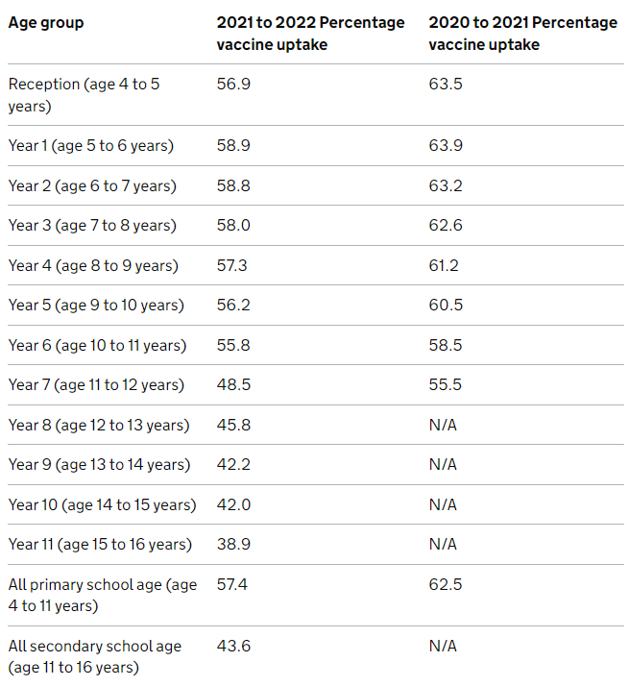
2021 to 2022 childhood flu uptake
In the 2021 to 2022 season:
all 2 and 3 year olds were offered vaccination through GP surgeries
  uptake for all GP-registered 2 year olds was 48.7% (55.3% in 2020 to 2021)
  uptake for all GP-registered 3 year olds was 51.4% (58% in 2020 to 2021)
  combined uptake for 2 and 3y olds was 50.1% (56.7% in 2020 to 2021)
flu vaccine programme was extended to include all children in secondary school (all children from Reception to Year 11, aged 4 to 16 years old)
  primary school age (age 4 to 11 years old) uptake was 57.4% (61.9% in 2020 to 2021)
  secondary school age children (age 11 to 16 years old) uptake was 43.6%
  overall uptake in school age children was 51.7%
  vaccine uptake in children of school age decreases with increasing age

Slide 30
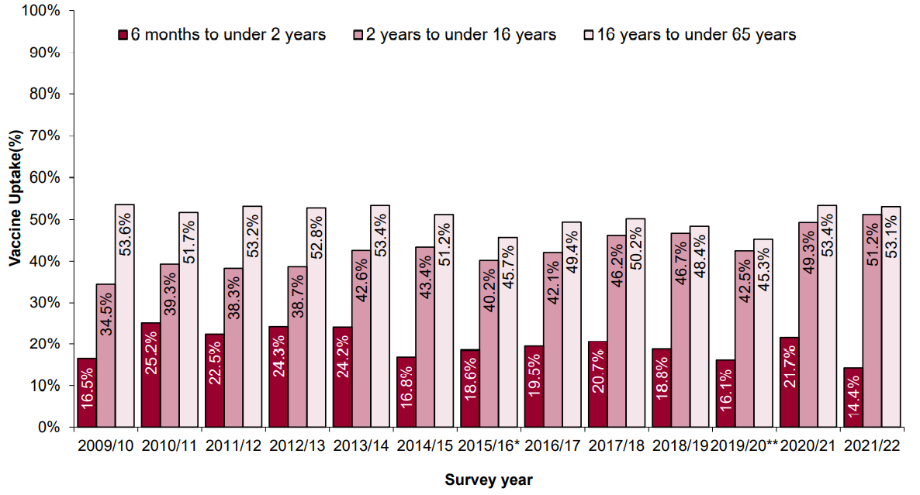
Vaccine uptake for children in a clinical risk group 2021 to 2022
Target groups for vaccination | % vaccine uptake
6 months to under 2 years in a clinical risk group | 14.4
2 years to under 5 years in a clinical risk group | 51.8
5 years to under 16 years in a clinical risk group | 51.2
Vaccine uptake in the under 65 at-risk by age group
figures show that vaccine uptake in children in clinical risk groups is higher in the age group where all children (healthy and clinical risk group) have been offered flu vaccination
uptake in those aged 6 months to under 2 years remains the lowest in uptake by age band
Notes:
Only one age band decreased in uptake from the previous season, which was patients with diabetes aged 6 months to 2 years which declined by 0.1%.All other groups increased.
vaccine uptake is particularly low in the younger age groups with clinical conditions that put them at most risk of complications from flu
immunisers should make sure that all at-risk children have the opportunity to receive flu vaccine
parents of at-risk children eligible to receive vaccine at school can choose to receive vaccine in general practice, especially if school session is later in the year and parent does not want their child to wait

Slide 31
Vaccine uptake for health and social care workers
During 2021 to 2022, 60.5% of frontline HCWs were vaccinated (813,435 doses given)
  all doctors 63.5%
  qualified nurses (including GP Practice Nurses) 61.5%
all frontline health care and social care workers should be offered vaccination by their employer
employer’s have a responsibility to help protect their staff and patients or clients and ensure the overall safe running of services
employers should commission or implement a service which makes access to the vaccine easy for all frontline staff, encourages staff to get vaccinated, and monitors the delivery of their programme
in 2022 to 2023, NHSE will continue to support vaccination of social care and hospice workers. Eligible groups will remain the same as in 2021 to 2022 and vaccination will be available through community pharmacy and general practice. This scheme is intended to complement, not replace, any established occupational health schemes that employers have in place to offer flu vaccination to their workforce
Good practice guidance material can be found at Increasing Health Care Worker and Social Care Worker Flu Vaccinations: Five components and marketing resources will be available to download and order from the Campaign Resource Centre
A healthcare worker influenza vaccination best practice management checklist for Trusts can be found in Appendix H of the NHS influenza immunisation programme 2022 to 2023 letter
Notes:
It is the responsibility of the NHS and social care bodies to ensure, as far as is reasonably practicable, that health and social care workers are free of, and are protected from exposure to infections that can be caught at work. Trusts/ employers should ensure that health and social care staff directly involved in delivering care are encouraged to be immunised and that processes are in place to facilitate this.

Slide 32
Influenza vaccines and their components
Two main types of flu vaccine available:
  inactivated – given by injection
  live attenuated – given by nasal application
None of the flu vaccines can cause clinical influenza in those that can be vaccinated
both the live and inactivated flu vaccines are quadrivalent vaccines – they contain 2 subtypes of Influenza A and both B lineages
the live attenuated vaccine is licensed for children aged 2 up to 18 years -
the inactivated vaccines are recommended for people aged 18+, children in clinical risk groups aged 6m to 2 years and for children aged 2 to 18 years who cannot receive live attenuated vaccine
Notes:
Inactivated flu vaccines given by intramuscular injection have been used in the UK for many years. The live intranasal influenza vaccine (LAIV) was introduced into the UK schedule in 2013. However, a live intranasal flu vaccine called FluMist (same vaccine as Fluenz, different trade name) was introduced in the US schedule in 2003 so although the live vaccine is newer, there is nearly 20 years experience of widespread use of the vaccine in the US.
In previous years, most inactivated flu vaccines were trivalent, containing 2 subtypes of influenza A and one B virus. However, quadrivalent vaccines, containing 2 subtypes of influenza A and both B virus types have been developed and are now recommended for all eligible groups including pregnant women and those in an at risk group under 50 years of age. The live intranasal vaccine is a quadrivalent vaccine (hence the ‘Tetra’ part of the name Fluenz Tetra). An inactivated quadrivalent vaccine was made available for the first time in 2013 and is the preferred vaccine for children who are contraindicated to receive the LAIV .
NB The Fluenz vaccine used in the 2013/14 flu season was a trivalent live vaccine. Fluenz Tetra was first used in the 2014/15 flu season and has been used since.
We now have 9 years experience using Fluenz LAIV vaccine in the UK.

Slide 33
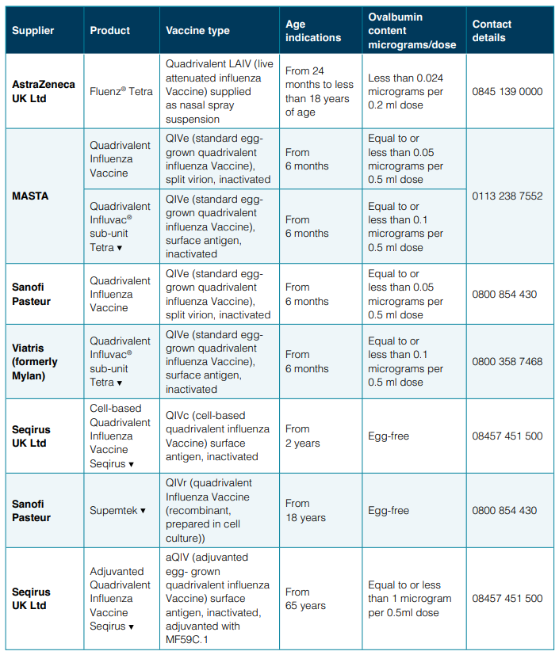
Influenza vaccines available for 2022 to 2023
Several different flu vaccines are available for the 2022 to 2023 flu season
Poster detailing these available from GOV.UK website:
www.gov.uk/government/publications/influenza-vaccines-marketed-in-the-uk
Notes:
There are a number of different flu vaccines available each year and it is important to be aware of the age indications and the ovalbumin content of each of them.

Slide 34
Flu vaccine presentation and dosage
inactivated influenza vaccines are for intramuscular (IM) administration and are supplied as suspensions in pre-filled syringes containing a 0.5ml dose
the live intranasal flu vaccine is supplied as a nasal spray suspension in a single use, pre-filled, nasal applicator with a divider clip. No reconstitution or dilution is required. Each vaccine contains 0.2ml (administered as 0.1 ml per nostril)
some flu vaccines are restricted for use in particular age groups
the SmPC for individual products should always be referred to when ordering vaccines for particular patients
Notes:
Inactivated flu vaccine for intramuscular (IM) administration is supplied as a suspension in a pre-filled syringe. They should be shaken well before they are administered
The LAIV is supplied as a single use prefilled nasal applicator that is ready to use. No reconstitution or dilution is required.
All but one of the flu vaccines available in the UK are inactivated, do not contain live viruses and cannot cause clinical influenza in those that can be vaccinated. In previous years, most of the available flu vaccines were prepared from viruses grown in embryonated hens eggs. For 2022/23, flu vaccines are available that are cell based, egg based or recombinant. The flu vaccines available in the UK for the 2022/23 flu season are listed in the “The national flu immunisation programme 2022/23” letter and also at Influenza vaccines marketed in the UK - GOV.UK (www.gov.uk)

Slide 35
Inactivated influenza vaccine
For the 2022 to 2023 flu season (northern hemisphere winter), the WHO have recommended that quadrivalent vaccines contain the following:
Egg-based vaccines
an A/Victoria/2570/2019 (H1N1)pdm09-like virus
an A/Darwin/9/2021 (H3N2)-like virus
a B/Austria/1359417/2021 (B/Victoria lineage)-like virus
a B/Phuket/3073/2013 (B/Yamagata lineage)-like virus
Cell or recombinant-based vaccines
an A/Wisconsin/588/2019 (H1N1)pdm09-like virus
an A/Darwin/9/2021 (H3N2)-like virus
a B/Austria/1359417/2021 (B/Victoria lineage)-like virus
a B/Phuket/3073/2013 (B/Yamagata lineage)-like virus
This vaccine composition differs from the 2021 to 2022 vaccine composition as one of the influenza A virus strains and one of the influenza B virus strains have been replaced

Slide 36
Adjuvanted influenza vaccine (aQIV)
adjuvanted trivalent influenza vaccine (aTIV) was used in the UK in the 2018 to 2019 and 2019 to 2020 flu seasons in the 65y and over age group and has been given in other countries for a number of years with an excellent safety record
an adjuvanted quadrivalent vaccine (aQIV) replaced aTIV for the 2021 to 2022 flu season onwards
aQIV contains 2 subtypes of Influenza A (H3N2 and H1N1pdm09) and both B virus lineages
adjuvanted vaccines have higher immunogenicity and effectiveness than non-adjuvanted, standard dose vaccines in older people
the adjuvant known as MF59 has been added to the vaccine to enhance the immune response to counter the effect of immunosenescence (age related reduction in immune response)
MF59 adjuvant is an oil-in-water emulsion of squalene oil which is a naturally occurring substance found in humans, animals and plants. In humans, it is made in the liver and circulates in the bloodstream
aQIV is made using an egg-based manufacturing process

Slide 37
Quadrivalent influenza cell culture vaccine (QIVc)
QIVc was licenced in the US in 2016 and in the UK in December 2018
QIVc is a quadrivalent vaccine containing 2 subtypes of Influenza A (H3N2 and H1N1pdm00) and both B virus lineages
QIVc has a similar safety profile to other flu vaccines (similar rate and type of adverse reactions reported). Hundreds of millions of doses of cell-based vaccine have been administered worldwide with no serious safety concerns
the cell-based vaccine manufacturing process uses an animal cell line (Madin-Darby Canine Kidney, or MDCK) to grow the influenza virus rather than the traditional egg based manufacturing methods
this manufacturing process eliminates the risk of egg-adaptation and may result in the vaccine containing virus that is a closer match to wild-type circulating flu viruses
QIVc is licenced for use in those aged 2 years and over and is egg free

Slide 38
Quadrivalent recombinant influenza vaccine (QIVr)
QIVr is a quadrivalent flu vaccine made using recombinant DNA technology
it does not require the use of, or growth of flu virus during the manufacturing process which means that the antigen in the vaccine cannot adapt or mutate and should therefore be an exact match to the flu A and B strains contained in the vaccine
it also contains 3 times the amount of flu virus haemagglutinin antigen contained in standard inactivated flu vaccines in order to enhance the immune response made to it
the type and rates of local and systemic reactions following vaccination with QIVr are similar to those seen following vaccination with other flu vaccines (injection site tenderness, headache, fatigue, muscle ache and joint pain)
since eggs are not required to grow the flu virus, cell-based flu vaccines (QIVc and QIVr) contain no egg and they also do not contain any live virus, antibiotics or gelatine
first used in the UK 2021 to 2022 flu season, QIVr is licensed from 18 years of age

Slide 39
Recombinant vaccine technology
to make recombinant vaccine, the manufacturers take the DNA (genetic instructions) for making the surface protein, haemagglutinin, found on flu viruses
the haemagglutinin DNA is then combined with a baculovirus (a virus that infects invertebrates); this results in a “recombinant” baculovirus
the role of the baculovirus is to help transport the DNA instructions for making the haemagglutinin antigen into a host cell
once the recombinant virus enters the host cell line (an insect cell line in which the baculovirus grows well), it instructs the cells to rapidly produce the haemagglutinin antigen
this antigen is grown in bulk, collected, purified, and then packaged as recombinant flu vaccine
when the vaccine is injected, the haemagglutinin antigen in it triggers the immune system to create antibodies that specifically target the flu virus

Slide 40
Egg grown quadrivalent influenza vaccine (QIVe)
the most common way to make flu vaccines is the egg-based manufacturing process
flu viruses are injected into fertilised hen’s eggs and incubated for several days to allow the viruses to replicate.
the fluid containing virus is harvested from the eggs and then, for inactivated flu vaccines, the vaccine viruses are inactivated (killed) and the virus antigen is purified
the egg-grown quadrivalent influenza vaccines (QIVe) protect against 4 strains of flu: 2 A types and both B lineages
this vaccine can be considered for use in at risk adults and pregnant women aged less than 65 years if the JCVI preferred vaccines for these groups (QIVc and QIVr) are not available

Slide 41
High dose quadrivalent influenza vaccine (QIV-HD)
quadrivalent influenza vaccine high dose (QIV-HD) was first licenced in the US in 2009 and was licensed in the UK in January 2019
QIV-HD is a quadrivalent inactivated flu vaccine containing 2 subtypes of Influenza A and both B lineages
QIV-HD contains 4 times the amount of antigen contained in standard-dose inactivated influenza vaccines. The additional antigen content is intended to enhance the immune response to counter the effect of immunosenescence in those aged 65 and over
QIV-HD has been proven to be safe and effective
QIV-HD is made using an egg-based manufacturing process
High dose trivalent influenza vaccine is not available in the UK market for the 2022 to 2023 flu season

Slide 42
Inactivated influenza vaccine for children who cannot receive LAIV
children in at-risk groups for whom LAIV is unsuitable, and healthy children whose parents object to LAIV on the grounds of its porcine gelatine content, should be offered QIVc if aged 2 years to less than 18 years
where QIVc vaccine is unavailable, QIVe could be offered (unless contraindicated) but QIVe has not been procured by UKHSA for this age group
if the inactivated vaccine (QIVc) supplied by UKHSA is not used, please be aware that not all inactivated flu vaccines are licensed for children and some contain too much ovalbumin for egg allergic children
always check SmPC for vaccine suitability before administration
Notes:
The inactivated flu vaccines are interchangeable; the second dose, if required, should be given at least 4 weeks after the first dose in accordance with the manufacturer’s SmPC for that vaccine.

Slide 43
Live attenuated influenza vaccine (LAIV)
a live attenuated (weakened) influenza vaccine (LAIV) given intranasally is the recommended vaccine for the childhood flu programme
LAIV has been shown to be more effective in children compared with inactivated influenza vaccines
it may offer some protection against strains not contained in the vaccine as well as to those that are and has the potential to offer better protection against virus strains that have undergone antigenic drift
since this vaccine is comprised of weakened whole live virus, it replicates natural infection which induces better immune memory (thereby offering better long-term protection to children than from the inactivated vaccines)
in addition to being attenuated, the live viruses in LAIV have been adapted to cold so that they cannot replicate efficiently at body temperature
LAIV has a good safety profile in children aged 2 years and older
Notes:
Fluenz Tetra is a live attenuated vaccine (a weakened form of flu virus which cannot cause disease but which protects against flu). It is a cold adapted virus which means it cannot replicate at body temperature.
This is a nasal vaccine and must not be injected.
It is supplied in a box containing 10 prefilled nasal applicators.
Live attenuated influenza vaccine (Fluenz Tetra) has been shown to provide greater protection for children than inactivated influenza vaccine. This vaccine is the preferred vaccine for children aged 2 to less than 18 years.
It became available in the UK for the 2012/13 flu season. It has been used in USA (same vaccine but under the name FluMist) for many years and millions of doses have been given.

Slide 44
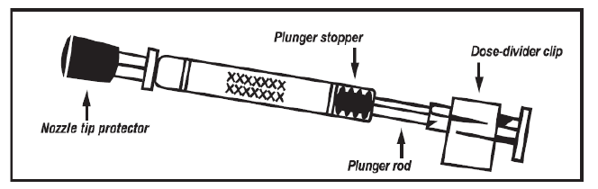

The LAIV used in the UK is Fluenz Tetra
  licensed from 24 months to less than 18 years of age
  nasal spray (suspension) in a prefilled nasal applicator
  the suspension is colourless to pale yellow, clear to opalescent. Small white particles may be present
  supplied in a pack containing 10 doses (single use prefilled nasal applicators)
  ready to use (no reconstitution or dilution required)
  each applicator contains 0.2ml (administered as 0.1ml per nostril)

Slide 45
Porcine gelatine
the LAIV contains a highly purified form of gelatine derived from pigs
gelatine is used in LAIV as a stabiliser - it protects the live viruses from the effects of temperature
gelatine is commonly used in a range of pharmaceutical products, including many capsules and some vaccines
there is no other live attenuated flu vaccine available that does not contain porcine gelatine. The manufacturer of LAIV (Fluenz Tetra) tested 40 potential stabilisers – gelatine was chosen because without it, stability was significantly reduced
for eligible children whose parents refuse LAIV due to the porcine gelatine content, the injectable cell-based Quadrivalent Influenza Vaccine (QIVc) will be centrally supplied for these children and should be ordered from ImmForm

Slide 46
2022 to 2023 flu vaccine recommendations for those aged 65 years and over
For those aged 65 years and over in the 2022 to 2023 flu season, and those aged 64 years who will become 65 before 31 March 2023, JCVI advises the use of the following inactivated vaccines:
  adjuvanted quadrivalent influenza vaccine (aQIV)*
  quadrivalent recombinant influenza vaccine (QIVr)
  or, if aQIV and QIVr are not available, cell-based quadrivalent influenza vaccine (QIVc)
*aQIV may be offered ‘off-label’ to those who become 65 years of age before 31 March 2023
the JCVI have advised that aQIV and QIVr are considered equally suitable for use in 2022 to 2023 and that they should be considered as equivalent
if aQIV and QIVr are not available, QIVc is considered to be an acceptable alternative for use in this age group and preferable to standard egg culture influenza vaccines (QIVe)

Slide 47
At-risk adults aged under 65 years and pregnant women
at-risk adults, including pregnant women, aged 18 to less than 65 years old should be offered:
  cell-based quadrivalent influenza vaccine (QIVc) or recombinant quadrivalent influenza vaccine (QIVr)
  if QIVc or QIVr are not available, egg-grown quadrivalent influenza vaccine (QIVe) can be considered for use
limited evidence shows there is a potential advantage to using cell-cultured flu vaccines compared with egg-cultured flu vaccines, due to the possible impact of ‘egg-adaption’ on vaccine effectiveness, particularly against A(H3N2) strains.
JCVI consider there is good evidence that QIVr is more effective than QIVe in adults under 65 years of age and it is also not affected by egg adaption
however, QIVe can also be given to this age group if QIVc or QIVr are not available

Slide 48
2022 to 2023 flu vaccine recommendations for those aged 50 to 64 years NOT in a risk group
For those aged 50 to 64 years not in a risk group and over in the 2022 to 2023 flu season (and those who turn 50 by 31 March 2023), the following inactivated vaccines are recommended:
  QIVe
  QIVc or QIVr
QIVc or QIVr should only be offered where it does not divert stock from clinical at-risk groups and those age 65 years and over
Vaccine providers are asked not to start vaccinating this age group until mid-October 2022 to enable prioritisation of those with clinical risks and in the older age groups

Slide 49
Flu vaccine for children
children in risk groups aged 6 months to 2 years: offer QIVe
for egg-allergic children under 2 years it is advised that QIVc is offered off-label
at risk children aged 2 years up to 18th birthday, offer live attenuated influenza vaccine (LAIV) unless contraindicated or otherwise unsuitable*
children aged 2 and 3 years on 31 August 2022, all primary school aged children (from Reception to Year 6) and eligible secondary school aged children should be offered LAIV unless contraindicated or otherwise unsuitable*
* if LAIV is contraindicated or otherwise unsuitable, offer QIVc

Slide 50
Number of doses
2 doses of the inactivated flu vaccines are required to achieve adequate antibody levels in younger children
however, a single dose of LAIV should provide protection to previously unvaccinated healthy children
only modest additional protection provided by a second dose of LAIV
only children aged 6 months to less than 9 years who are in clinical risk groups or who are a household contact of an immunosuppressed individual who have not received flu vaccine previously should be offered a second dose of LAIV, given at least 4 weeks apart (if no contraindications – otherwise offer inactivated vaccine)
healthy children under 9 years who cannot receive LAIV due to contraindications and those whose parents request they receive IIV instead of LAIV should be offered a single dose, even if they have not previously received influenza vaccine

Slide 51
Influenza vaccine effectiveness
vaccine effectiveness (VE) varies from one season to the next. Overall effectiveness has been estimated at between 30% to 60% (adults aged 18 to 65 years) for flu infection in primary care
there is lower effectiveness in older people although immunisation can provide important protection against flu GP consultation and severe disease/flu confirmed hospital admission
in the last decade, there has generally been a good match between the strains of flu in the vaccine and those circulating but there has often been poorer effectiveness against influenza A (H3N2), particularly in the elderly, where burden of infection from that strain is highest
potential explanations for the low effectiveness against influenza A(H3N2) include
        immunosenescence (age related reduction in immune response)
        genetic drift of the circulating viral strain (compared to the vaccine strain, as happened in 2014 to 2015 flu season)
        egg adaptation (in recent seasons, changes to the virus during the manufacturing process have arisen with A(H3N2) strain when flu vaccine strains are propagated in eggs which means that the vaccines do not work as well)
for the 2021 to 2022 flu season, provisional end-of-season vaccine effectiveness was 26% against all laboratory-confirmed influenza illness in adults aged 50 years and over and 73% for children aged 1 to 17 years

Slide 52
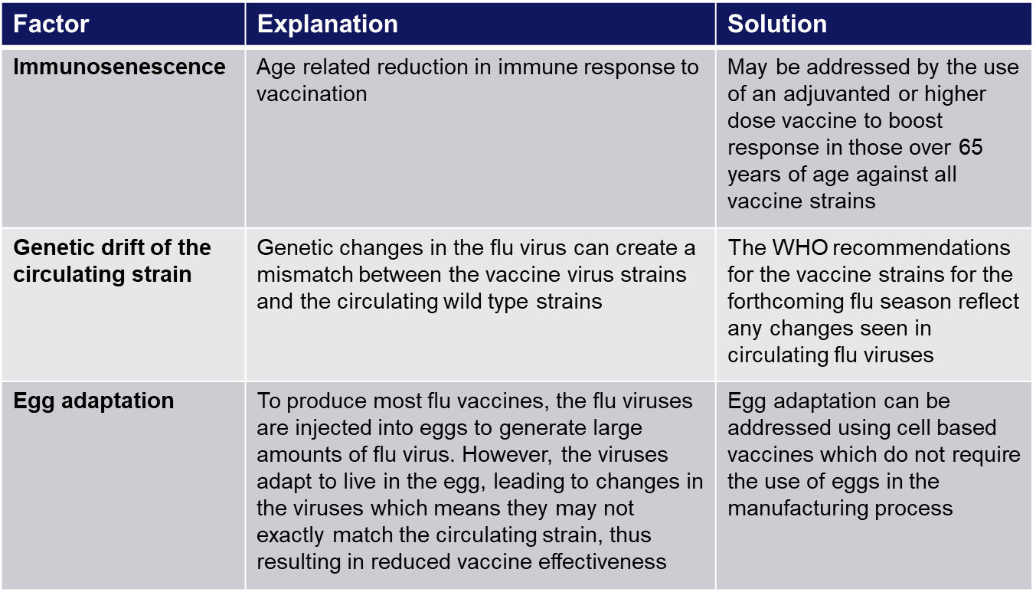
Improving vaccine effectiveness
There are a number of potential factors leading to reduced vaccine effectiveness

Slide 53
LAIV effectiveness
overall adjusted vaccine effectiveness (VE) for 2021 to 2022 for 1 to 17 year olds receiving flu vaccine was 73%
overall adjusted vaccine effectiveness (VE) for 2021 to 2022 for 2 to 17 year olds receiving LAIV specifically was 72%
the results from research into the first 3 years of the children’s flu programme showed a positive impact on flu transmission from vaccinating children of primary school age
these include reductions in: GP consultations for influenza-like illness, swab positivity in primary care, laboratory confirmed hospitalisations and percentage of respiratory emergency department attendances

Slide 54
Contraindications to flu vaccination
there are very few individuals who cannot receive any flu vaccine
where LAIV cannot be given to a child, it is likely that inactivated vaccine could be given instead
where there is doubt, expert advice should be sought promptly so that the period the individual is left unvaccinated is minimised
Contraindications for all flu vaccines:
confirmed anaphylactic reaction to a previous dose of flu vaccine
confirmed anaphylactic reaction to a component of flu vaccine (for example to gelatine in LAIV) or residue from the manufacturing process (gentamicin), except egg proteins (see slide on egg allergy)
Additional contraindications for LAIV :
        clinically severely immunocompromised due to a condition or immunosuppressive therapy such as:
        acute and chronic leukaemias
        lymphoma
        HIV infection not suppressed by highly active antiretroviral therapy (HAART)
        cellular immune deficiencies
        high dose corticosteroids
        receiving salicylate therapy e.g. aspirin
        known to be pregnant
Also contraindications for children with acute and severe asthma - see specific slide
Notes:
Confirmed anaphylaxis is rare. Other allergic conditions such as rashes may occur more commonly and are not contraindications to further immunisation. A careful history of the event will often distinguish between true anaphylaxis and other events that are either not due to the vaccine or are not life threatening. In the latter circumstance, it may be possible to continue the immunisation course. Specialist advice must be sought on the vaccines and the circumstances in which they could be given. The risk to the individual of not being immunised must be taken into account.
The live attenuated influenza vaccine (Fluenz Tetra) should not be given to children or adolescents who are clinically severely immunodeficient due to conditions or immunosuppressive therapy such as: acute and chronic leukaemias; lymphoma; HIV infection not suppressed by antiretroviral therapy (HAART); cellular immune deficiencies; and high dose corticosteroids. It is not contraindicated for use in children or adolescents living with HIV infection who are receiving antiretroviral therapy and attaining viral suppression; or who are receiving topical/inhaled corticosteroids or low-dose systemic corticosteroids or those receiving corticosteroids as replacement therapy, e.g. for adrenal insufficiency.
Chapter 6 of the Green Book on contraindications and special precautions gives further advice on the use of live vaccines in individuals who are severely immunosuppressed. It states that the definition of “systemic high doses steroids” (and until at least 3 months after treatment has stopped) would include children who receive prednisolone, orally or rectally, at a daily dose (or its equivalent) of 2mg/ kg/day for at least one week, or 1mg/kg/day for one month. Occasionally, individuals on lower doses of steroids may be immunosuppressed and at increased risk from infections. In those cases, live vaccines should be considered with caution, in discussion with a relevant specialist physician”.
The live attenuated vaccine is contraindicated in children and adolescents receiving salicylate therapy (other than for topical treatment of localised conditions) because of the association of Reye's syndrome with salicylates and wild-type flu infection as described in the SPC for Fluenz Tetra. Reye's syndrome has been reported following the use of salicylates during wild-type influenza infection.
Because of the theoretical risk of Reye’s syndrome following administration of the LAIV to children on aspirin therapy or other salicylate-containing medicine, they should not be given LAIV and should instead be offered an inactivated flu vaccine.
Safety data for the live attenuated flu vaccine when given in pregnancy is limited. Whilst there is no evidence of risk with live attenuated flu vaccine, inactivated flu vaccines are preferred for those who are pregnant. There is no need, however, to specifically test eligible girls for pregnancy or to advise avoidance of pregnancy in those who have been recently vaccinated.
Confirmed anaphylaxis is rare. Other allergic conditions such as rashes may occur more commonly and are not contraindications to further immunisation. A careful history of the event will often distinguish between true anaphylaxis and other events that are either not due to the vaccine or are not life threatening. In the latter circumstance, it may be possible to continue the immunisation course. Specialist advice must be sought on the vaccines and the circumstances in which they could be given. The risk to the individual of not being immunised must be taken into account.
The SmPCs for individual products should always be referred to when deciding which vaccine to give. There are very few individuals who cannot receive any flu vaccine. When there is doubt, appropriate advice should be sought promptly from the local screening and immunisation or health protection team or the patient’s consultant so that the period the individual is left unvaccinated is minimised.

Slide 55
Precautions to flu vaccination
Acutely unwell/severe febrile illness:
  defer until recovered
Heavy nasal congestion:
  defer live intranasal vaccine until resolved or, if the child is in a risk group, consider inactivated flu vaccine to provide protection without delay
Use with antiviral agents against flu:
  LAIV should not be administered at the same time or within 48 hours of cessation of treatment with flu antiviral agents
  administration of flu antiviral agents within 2 weeks of administration of LAIV may adversely affect the effectiveness of the vaccine
Notes:
Minor illnesses without fever or systemic upset are not valid reasons to postpone vaccination. If the individual is acutely unwell, immunisation may be postponed until they have recovered. This is to avoid confusing the differential diagnosis of acute illness by wrongly attributing any signs or symptoms to the adverse effects of the vaccine.
There are no data on the effectiveness of LAIV when given to children with heavily blocked or runny nose (rhinitis) attributable to infection or allergy. As heavy nasal congestion might impede delivery of the vaccine to the nasopharyngeal mucosa, deferral of administration until resolution of the nasal congestion should be considered or an appropriate alternative intramuscularly administered influenza vaccine should be considered.
There is a potential for influenza antiviral agents to lower the effectiveness of the live attenuated influenza vaccine. Therefore, influenza antiviral agents and LAIV should not be administered concomitantly. LAIV should be delayed until 48 hours following the cessation of treatment with influenza antiviral agents. Administration of influenza antiviral agents within 2 weeks of administration of LAIV may adversely affect the effectiveness of the vaccine.
Minor illnesses without fever of systemic upset are not valid reasons to postpone vaccination. If the individual is acutely unwell the vaccination may be deferred until they have recovered. This is to avoid confusing the differential diagnosis of any acute illness by wrongly attributing any signs or symptoms to the adverse effects of the vaccine.

Slide 56
Acute and severe asthma
children with asthma on inhaled corticosteroids may safely be given LAIV irrespective of the dose prescribed
however, LAIV is not recommended for children and adolescents currently experiencing an acute exacerbation of symptoms including
  - those who have had increased wheezing and/or
  - needed additional bronchodilator treatment in the previous 72 hours
Such children should be offered a suitable inactivated influenza vaccine to avoid a delay in protection
children who require regular oral steroids for maintenance of asthma control, or have previously required intensive care for asthma exacerbation should only be given LAIV on the advice of their specialist
as these children may be at higher risk from influenza infection, those who cannot receive LAIV should receive a suitable inactivated influenza vaccine
children with significant asthma and aged under 9 years who have not been previously vaccinated against influenza will require a second dose (of either LAIV or inactivated vaccine as appropriate)
Notes:
In 2019, JCVI advised that, on the basis of recent data, children with asthma on inhaled corticosteroids may safely be given LAIV, irrespective of the dose prescribed. LAIV is not recommended for children and adolescents currently experiencing an acute exacerbation of symptoms including those who have had increased wheezing and/or needed additional bronchodilator treatment in the previous 72 hours. Such children should be offered a suitable inactivated influenza vaccine to avoid a delay in protection.
There are limited safety data in children who require regular oral steroids for maintenance of asthma control, or have previously required intensive care for asthma exacerbation – such children should only be given LAIV on the advice of their specialist. As these children may be at higher risk from influenza infection, those who cannot receive LAIV should receive a suitable inactivated influenza vaccine. Children with significant asthma and aged under 9 years who have not been previously vaccinated against influenza will require a second dose (of either LAIV or inactivated vaccine as appropriate).

Slide 57
Egg allergy in adults
for many years, most flu vaccines have been prepared from flu viruses grown in embryonated hens’ eggs and the final vaccine product contains varying amounts of egg protein as ovalbumin
the ovalbumin content for the 2022 to 2023 flu vaccines is published on the GOV.UK Annual flu programme webpage
for the 2022 to 2023 season, those aged 18 years and over are recommended to receive either QIVc or QIVr, both of which are egg free
adults with egg allergy can be immunised in any setting using:
  the cell-based quadrivalent inactivated egg-free vaccines QIVc or QIVr
  QIVe should only be offered if it is not possible to give QIVc or QIVr. If QIVe is given, it must have an ovalbumin content less than 0.12 micrograms/ml (equivalent to <0.06 micrograms for 0.5ml dose)
adults with severe anaphylaxis to egg which has previously required intensive care should be offered an egg-free vaccine or referred to a specialist for assessment with regard to receiving immunisation in hospital if this is not possible

Slide 58
Egg allergy in children
children with an egg allergy (including those with previous anaphylaxis to egg) can be safely vaccinated with LAIV in any setting (including primary care and schools)
children who have required admission to intensive care for a previous severe anaphylaxis to egg should be given LAIV in the hospital setting
children with both egg allergy and a clinical risk factor that contraindicate LAIV (for example immunosuppression) should be offered an* inactivated flu vaccine with a very low ovalbumin content (less than 0.12micrograms/ml)
children over age 2 years with egg allergy can also be given the quadrivalent cell-based inactivated egg-free vaccine QIVc
egg-allergic children with asthma can receive LAIV if their asthma is well-controlled (see previous slide on severe asthma)
*Children aged 6 months to under 9 years in a clinical risk group who have not been previously vaccinated against influenza will require a second dose (of either LAIV (over 2 years) or inactivated vaccine as appropriate)

Slide 59
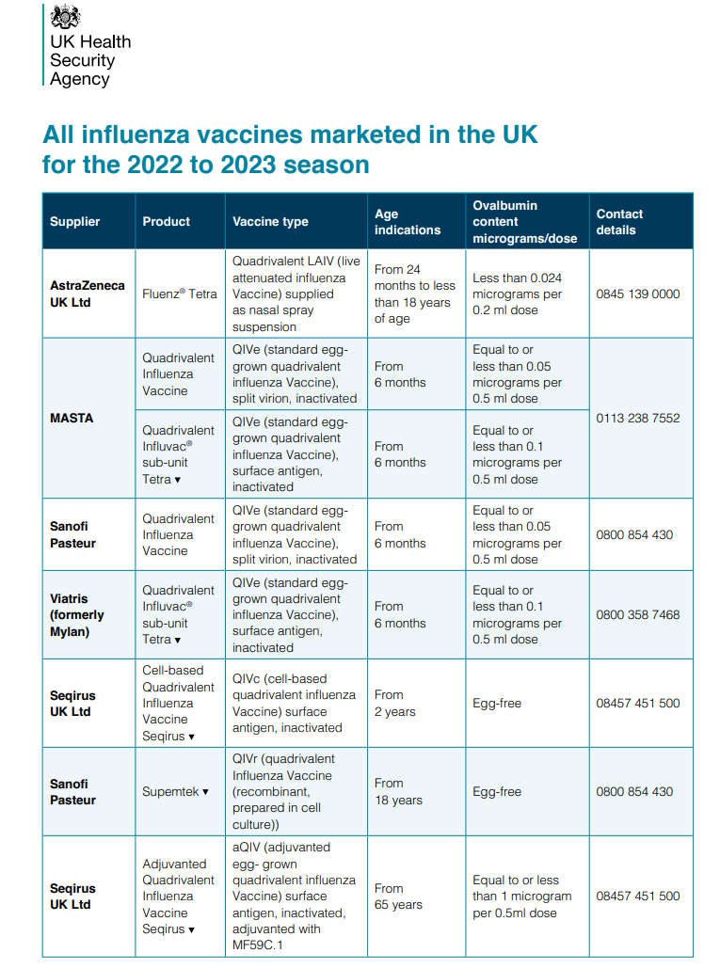
Ovalbumin content
The ovalbumin content of the flu vaccines available for 2022 to 2023 is given on the table available on the GOV.UK website

Slide 60
Salicylate therapy and LAIV
children and adolescents who are receiving salicylate therapy (e.g. aspirin) (other than for topical treatment of localised conditions such as in skin creams for verrucae) should not be given LAIV
this is because of the association of Reye’s syndrome with salicylates and wild-type influenza infection
Reye's syndrome has been reported following the use of salicylates during wild-type influenza infection
because of the theoretical risk of Reye’s syndrome following administration of the LAIV to children on aspirin therapy or other salicylate-containing medicine, they should not be given LAIV and should instead be offered an inactivated flu vaccine
Reye's syndrome is a very rare disorder that can cause serious liver and brain damage. If not treated promptly, it may lead to permanent brain injury or death
Notes:
Reye’s syndrome

Slide 61
Inadvertent administration of LAIV
if an immunocompromised individual receives LAIV, the degree of immunosuppression should be assessed
if the individual is severely immunocompromised, antiviral prophylaxis should be considered
otherwise they should be advised to seek medical advice if they develop flu-like symptoms in the 4 days following administration of the vaccine
if antivirals are used for prophylaxis or treatment, the individual should also be offered inactivated flu vaccine in order to maximise their protection (this can be given straight away)

Slide 62
LAIV and ‘viral shedding’
    LAIV does not create an external mist of vaccine virus in the air when children are being vaccinated and others in the room should not be at risk of ‘catching’ the vaccine virus
    administration of the intranasal vaccine delivers just 0.1ml of fluid straight into each nostril and almost all the fluid is immediately absorbed into the child’s nose
    although vaccinated children are known to shed virus a few days after vaccination, the vaccine virus that is shed is less able to spread from person to person than natural flu infection
    the amount of virus shed is normally below the levels needed to pass on infection to others and the virus does not survive for long outside of the body. This is in contrast to natural flu infection, which spreads easily during the flu season

Slide 63
Risk of transmission of live vaccine virus
there is a theoretical potential for transmission of live attenuated flu virus to very severely immunocompromised contacts for 1 to 2 weeks following vaccination
following extensive use of LAIV in the US, there have been no reported instances of illness or infections from the vaccine virus among immunocompromised patients inadvertently exposed to vaccinated children
however, if close contact with very severely immunocompromised patients (such as bone marrow transplant patients requiring isolation) is likely or unavoidable (for example other household members) consider an appropriate inactivated flu vaccine instead
Notes:
There is a theoretical potential for transmission of live attenuated influenza virus in the LAIV to immunocompromised contacts for 1 to 2 weeks following vaccination. In the US, where there has been extensive use of the live attenuated influenza vaccine, there have been no reported instances of illness or infections from the vaccine virus among immunocompromised patients inadvertently exposed. Where close contact with very severely immunocompromised patients (such as bone marrow transplant patients requiring isolation) is likely or unavoidable (for example, household members), however, appropriate alternative inactivated influenza vaccines should be considered.

Slide 64
Exposure of healthcare professionals to live attenuated influenza vaccine viruses
theoretically there may be some low level exposure to the vaccine viruses for those administering LAIV and/or from recently vaccinated patients
in the US, where there has been extensive use of LAIV, there have not been any reported instances of illness or infections from the vaccine virus among healthcare professionals inadvertently exposed
risk of acquiring vaccine viruses from the environment is unknown but probably low
the vaccine viruses are cold-adapted and attenuated and therefore unlikely to cause symptomatic flu
as a precaution, very severely immunosuppressed individuals should not administer LAIV
other healthcare workers who have less severe immunosuppression or are pregnant, should follow normal clinical practice to avoid inhaling the vaccine and ensure that they themselves are appropriately vaccinated

Slide 65
Vaccine ordering
UKHSA procures and supplies the flu vaccines (live and inactivated) for the children’s flu programme including:
        LAIV for eligible children aged 2 to 18 years
        QIVc for children aged 2 years to less than 18 years in at-risk groups for whom LAIV is unsuitable, and healthy children whose parents object to LAIV on the grounds of its porcine gelatine content
        QIVe for children in clinical risk groups aged 6 months to less than 2 years
flu vaccines for children can be ordered through the ImmForm website as for other centrally purchased vaccines
providers are responsible for ordering sufficient flu vaccine for all other eligible patients aged 18 years and older directly from manufacturers
providers should ensure they are able to offer the most effective vaccine for each eligible group consistent with national guidance
provided a patient is offered a recommended vaccine for their age, providers are not expected to have to offer a choice between vaccines
initial batches of vaccine may be subject to delay, or fewer doses than planned may be available initially. Providers should remain flexible when scheduling vaccination sessions and be prepared to reschedule if necessary
it is important not to order or hold more than 2 weeks’ worth of LAIV – stockpiling increases the risk of significant loss if there are cold chain failures. It also increases the risk of out of date vaccine being used as Fluenz Tetra has a short shelf life

Slide 66
Storage of flu vaccine
  Efficacy, safety and quality may be adversely affected if vaccines are not stored at the temperatures specified in the licence
All flu vaccines, inactivated and LAIV, must be stored in accordance with manufacturer’s instructions:
  store between +2⁰C and +8⁰C
  do not freeze
  store in original packaging
  protect from light
Check expiry dates regularly:
  the LAIV has an expiry date 18 weeks after manufacture – this is much shorter than inactivated flu vaccines
  it is important that the expiry date on the nasal spray applicator is checked before use
Notes:
Vaccines should be stored in the original packaging at +2°C to +8°C and protected from light. All vaccines are sensitive to some extent to heat and cold. Heat speeds up the decline in potency of most vaccines, thus reducing their shelf life. Efficacy, safety and quality may be adversely affected if vaccines are not stored at the temperatures specified in the licence. Freezing may cause increased reactogenicity and loss of potency for some vaccines and can also cause hairline cracks in the container, leading to contamination of the contents.
LAIV has a shelf life of 18 weeks that starts at the point of release from the manufacturer. This is a shorter shelf life than other influenza vaccines and some of this time will have passed when the vaccine reaches the place where it is to be administered. It is important that the expiry date on the nasal spray applicator is checked before use. If the expiry date has passed, arrangements should be made to have the vaccine disposed safely.
The vaccine should be stored in the original packaging. This makes it easy to identify in the vaccine fridge and to check batch numbers and expiry dates. The original packaging also provides some protection against fluctuation of temperature and protection from light.
Vaccines are expensive and it is important to minimise wastage through inappropriate storage.

Slide 67
Legal framework for vaccination
A range of mechanisms can be used for the supply and administration of vaccines, including:
Patient prescription written manually or electronically by a registered medical practitioner or other authorised prescriber
  Patient Specific Direction (PSD)
  Patient Group Direction (PGD)
  Written instruction (WI)
PGD templates for the administration of the live and inactivated flu vaccines are available on the GOV.UK website:
www.gov.uk/government/collections/immunisation-patient-group-direction-pgd
    Those using national immunisation PGDs developed by UKHSA must ensure that each PGD is organisationally authorised and signed in section 2 by an appropriate authorising person, in accordance with Human Medicines Regulations 2012 (HMR2012).
    Without such authorisation, the PGD is not legal or valid.

Slide 68
Vaccine administration (inactivated vaccines)
inactivated flu vaccines should be given intramuscularly into the upper arm (deltoid muscle) of those aged 12 months or older and into the anterolateral aspect of the thigh in infants aged 6 months to one year of age
due to the presence of adjuvant and therefore increased potential for more local reactions if administered by subcutaneous injection, aQIV should only be administered intramuscularly using a 25mm length needle
the cell-based quadrivalent vaccines (QIVc and QIVr) are also not licensed for subcutaneous administration so should only be administered intramuscularly
inactivated and live flu vaccines can currently be given at the same time as, or at any interval before or after, other currently used live and inactivated vaccines except Shingrix
Shingrix and the aQIV should ideally be separated by an interval of at least 7 days to avoid incorrect attribution of potential adverse events
if any new vaccines are introduced during the flu vaccination season, please ensure any specific guidance given about concomitant administration for these is followed
if given at the same time, different vaccines should be given at separate sites, preferably in a different limb. If given in the same limb, they should be given at least 2.5cm apart
Notes:
The Shingrix special edition of Vaccine Update published in May 2022 stated that Shingrix can be given concomitantly with inactivated influenza vaccine. This is correct for all inactivated flu vaccines other than the adjuvanted quadrivalent influenza vaccine (aQIV). The aQIV is offered to people aged from 65 years (or becoming 65 by end of March each flu season) as part of the annual flu vaccination programme. Because of the absence of data on co-administration of Shingrix vaccine with adjuvanted influenza vaccine, it should not be routine to offer appointments to give this vaccine at the same time as the adjuvanted influenza vaccine. Based on current information, scheduling should ideally be separated by an interval of at least 7 days to avoid incorrect attribution of potential adverse events. Where individuals attend requiring both vaccines however, and require rapid protection or are considered likely to be lost to follow up, co-administration may still be considered. This does not apply to the Zostavax vaccine which can be given at the same time as any of the inactivated flu vaccines.

Slide 69
Patients taking anticoagulants or with a bleeding disorder
Individuals on stable anticoagulation therapy (including individuals on warfarin who are up-to-date with their scheduled INR testing and whose latest INR was below the upper threshold of their therapeutic range) can receive intramuscular vaccination
if in any doubt, consult with the clinician responsible for prescribing or monitoring the individual’s anticoagulant therapy
Individuals with bleeding disorders may be vaccinated intramuscularly if, in the opinion of a doctor familiar with the individual's bleeding risk, vaccines or similar small volume intramuscular injections can be administered with reasonable safety by this route
if the individual receives medication/treatment to reduce bleeding, for example treatment for haemophilia, intramuscular vaccination can be scheduled shortly after such medication/treatment is administered
a fine needle (equal to 23 gauge or finer calibre) should be used for the vaccination, followed by firm pressure applied to the site (without rubbing) for at least 2 minutes
influenza vaccines licensed for intramuscular or subcutaneous administration may alternatively be administered by the subcutaneous route
QIVc, QIVr and aQIV are not licensed for subcutaneous administration so should only be administered intramuscularly

Slide 70
Consequences of incorrect injection technique
it is essential that the correct site and injection technique are used to administer vaccines
injecting too high into the upper arm might result in the vaccine being deposited in the shoulder capsule rather than the deltoid muscle
if this happens, inflammation can occur, leading to a shoulder injury or a frozen shoulder
  this leads to pain, weakness and a limited range of motion that can last for months
injecting too far to the side of the arm or too low on the arm risks injecting into the axillary nerve or the radial nerve
  this can cause a burning or shooting pain during the procedure and can lead to nerve damage (neuropathy/paralysis)
to avoid shoulder injury, always assess the limb before administering the vaccine to identify the correct site for injection

Slide 71
Administration of Live Attenuated Influenza vaccine (LAIV)
  LAIV is different from other flu vaccines – it is a live attenuated nasal vaccine and must not be injected
  do not attempt to attach a needle
  LAIV can be administered at the same time as, or at any interval from other currently used vaccines including live vaccines
  the applicator has a divider clip to enable one application in each nostril
  the vaccinee should breathe normally - they do not need to actively inhale or sniff
  the vaccine is rapidly absorbed so there is no need to repeat either half of dose if patient sneezes, blows their nose or their nose drips following administration

Slide 72
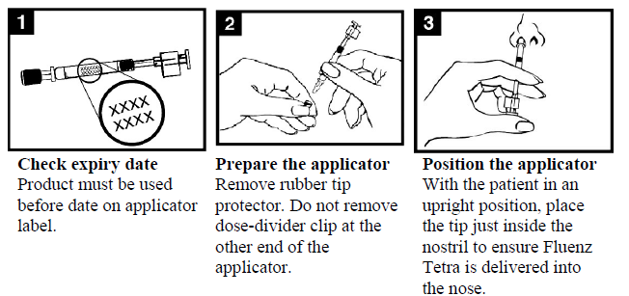
Administration of LAIV (1)

Slide 73
Administration of LAIV (2)

Slide 74
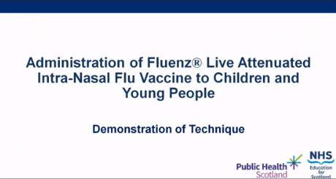
LAIV administration video
A video for healthcare practitioners on how to administer LAIV has been produced by NHS Education for Scotland and Public Health Scotland
It is available to view on the NES website at: https://learn.nes.nhs.scot/63183/immunisation/seasonal-flu/administration-of-fluenz-tetra-video (recommended watching from 2 minutes to 4m 30s for vaccinators in England)

Slide 75
Commonly reported adverse reactions
Following inactivated flu vaccine:
pain, swelling or redness at the injection site, low grade fever, malaise, shivering, sweating, fatigue, headache, myalgia and arthralgia
a small painless nodule may also form at the injection site
these symptoms usually disappear within 1 to 2 days without treatment
due to the MF59 adjuvant, a higher incidence of mild post-immunisation reactions has been reported with aTIV, compared to non-adjuvanted influenza vaccines
Following live attenuated flu vaccine:
nasal congestion/rhinorrhoea, reduced appetite, weakness, fever and headache
Rarely, after live or inactivated vaccine, immediate reactions such as urticaria, angio-oedema, bronchospasm and anaphylaxis can occur

Slide 76
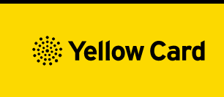
Reporting adverse events
All serious suspected reactions following flu vaccination should be reported to the Medicines and Healthcare products Regulatory Agency (MHRA) using the Yellow Card scheme
five of the flu vaccines recommended for use during the 2022 to 2023 flu season carry a black triangle symbol (▼) to encourage reporting of all serious suspected adverse reactions
anyone (patients and HCWs) can make a Yellow Card report, even if they are uncertain as to whether a vaccine caused the condition/side effect
vaccinees should be advised that they can report any adverse reactions using the MHRA’s online Yellow Card scheme (www.mhra.gov.uk/yellowcard), by downloading the Yellow Card app or by calling the Yellow Card scheme on 0800 731 6789 9am to 5pm Monday to Friday

Slide 77
Recording flu vaccine given
As a wide variety of influenza vaccines are on the UK market each year, it is especially important that the following information be recorded:
vaccine name, product name, batch number and expiry date
dose administered
date immunisation given
route/site used
name and signature of vaccinator
This information should be recorded in:
patient's GP record (or other patient record, depending on location)
personal Child Health Record (the ‘Red Book’) if a child
practice computer system
Child Health Information System if a child
Information on flu vaccines administered outside general practice (for example maternity providers, pharmacies, schools) must be passed back to the patient’s GP practice in a timely manner so patient records can be updated
Notes:
As a wide variety of influenza vaccines are on the UK market each year, it is especially important that the exact brand of vaccine, batch number and site at which each vaccine is given is accurately recorded in the patient records. Where the vaccine is given for occupational reasons, it is recommended that the employer keep a vaccination record. It is important that vaccinations given either at a general practice or elsewhere (for example, at community pharmacies, or antenatal clinics) are recorded on appropriate health records for the individual (using the appropriate clinical code) in a timely manner, including the relevant Child Health Information System. If given elsewhere, a record of vaccination should be returned to the patient’s general practice to allow clinical follow up and to avoid duplicate vaccination.

Slide 78
Data collection
flu vaccine uptake data is collected via the web-based ImmForm system (www.immform.phe.gov.uk) where it is managed and published by UKHSA
over 95% GP practices are able to make automated data returns where the number of their patients vaccinated is directly extracted from their IT system and put into ImmForm
for data to be accurate and complete, it is critical that any vaccines given outside the surgery, such as those given in pharmacies, are reported to the patient’s GP
data is collected and published monthly on all the groups for whom flu vaccine is indicated at national level and local NHS England team level to enable performance to be reviewed and time to take action if needed
uptake data for HCWs and school-aged children is manually submitted by trusts and area teams via ImmForm
flu vaccine uptake data is published at: www.gov.uk/government/collections/vaccine-uptake
Notes:
As in previous years, flu vaccine uptake data collections will be managed using the ImmForm website (https://portal.immform.phe.gov.uk/). UKHSA coordinates the data collection and will issue further details of the collection and guidance on the data collection process for the 2022/23 programme. This guidance will be available at: www.gov.uk/government/collections/vaccine-uptake which is where flu vaccine uptake data is also published. Queries concerning data collection content or process should be emailed to influenza@phe.gov.uk. Queries concerning ImmForm login details and passwords should be emailed to helpdesk@immform.org.uk.
More detail about data collection in 2022/23 is available in Appendix I of The national flu immunisation programme 2022/23 available at https://www.gov.uk/government/publications/national-flu-immunisation-programme-plan

Slide 79
Vaccine uptake ambitions for 2022 to 2023
the last 2 seasons have had the most successful flu vaccination programme ever,
WHO target of 75% was exceeded for those aged 65 years and over for 2 years in a row and higher uptake in most other cohorts compared to previous years was achieved
higher uptake likely partly driven by:
  concerns about the COVID-19 pandemic
  a greater understanding about the role of vaccines in preventing illness
  flu vaccination being offered to some eligible patients when they presented for their COVID-19 vaccination or booster
aim of the 2022 to 2023 flu programme is to:
  demonstrate a 100% offer to all those eligible
  achieve at least the uptake levels of 2021 to 2022 for each cohort and ideally exceed them

Slide 80
Achieving high flu vaccine uptake
many of the groups who are vulnerable to flu are also more vulnerable to COVID-19. Not only is it important to help protect those most at risk of flu, it is also important to protect the health of those who are vulnerable to hospitalisation and death from COVID-19 by ensuring they do not get flu
it is essential to increase flu vaccination levels for those living in the most deprived areas, from ethnic minorities and other underserved communities to have as high uptake as the population as a whole
high quality, dedicated and interculturally competent engagement with local communities, employers, faith and advocacy groups will be required
providers should ensure they have robust plans in place for tackling health inequalities for all underserved groups to ensure equality of access to the flu vaccine
efforts should be made to show improvement in coverage in those groups who were more than 5% lower than the national average

Slide 81
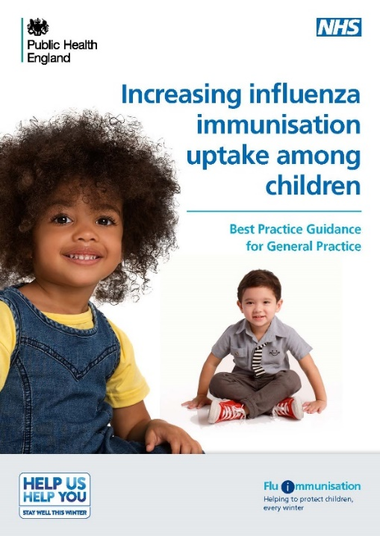
Increasing flu immunisation uptake among children
Best practice guidance for general practice
UKHSA (formerly PHE) have previously produced a summary of key strategies to help to increase flu vaccine uptake in pre-school children (from 2 years) which consider the following areas:
staff responsibilities
practice goals
identifying eligible children
inviting/contacting parents
ordering vaccines and clinics and appointments
promoting the vaccine offer to parents
ideas to sustain and promote uptake during flu season
recommendations for end of flu season review
Notes:
Note to trainers:
The content of the Best Practice Guidance for Increasing flu immunisation uptake among children is set out on the next 7 slides for those trainers who wish/are able to spend time discussing strategies for maximising uptake. These should be considered along with the constraints placed upon services who also need to keep patients safe from COVID-19. Trainers and all those involved in the delivery of the flu programme should regularly check the annual flu programme pages on GOV.UK for updated information on infection prevention and control measures that should be implemented in the delivery of immunisation services.
Flu vaccine: best practice guidance for general practice is available at https://assets.publishing.service.gov.uk/government/uploads/system/uploads/attachment_data/file/635595/Flu_gp_best_practice_guidance.pdf

Slide 82
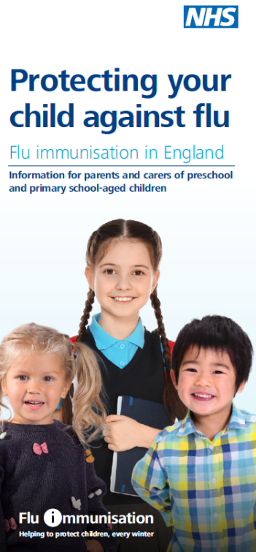
Increasing flu immunisation uptake among children
Best practice guidance for general practice
Staff responsibilities
every practice should have a lead member of staff with responsibility for running the flu immunisation campaign and all staff should know who the lead person is
all staff should understand the reason for the programme and have access to UKHSA flu resources
every member of the practice should know their role and responsibilities
get all staff involved in promoting the vaccine message to parents
hold regular meetings so that all staff know the practice plan and progress
include health visitors, midwives, pharmacists and other healthcare professionals linked to your practice in your planning

Slide 83
Increasing flu immunisation uptake among children
Best practice guidance for general practice
Practice goals
set a higher goal than the previous season
create computer searches to measure uptake and assess progress towards the goal
calculate practice income depending on uptake
advertise the practice goal and have a ‘Blue Peter’ style ‘Totaliser’
Identifying eligible children
the lead member of staff to identify eligible children
check accuracy of searches and coding to ensure all eligible children are identified
make sure the correct flu vaccination codes are in your system and that staff are aware –don’t let hard work go unmeasured
create IT system reminders so that opportunistic immunisation happens
create a system for opportunistic identification of eligible children attending the practice for other clinics or with parents and siblings – use flags or sticky notes to alert staff. Don’t send a child away unimmunised

Slide 84
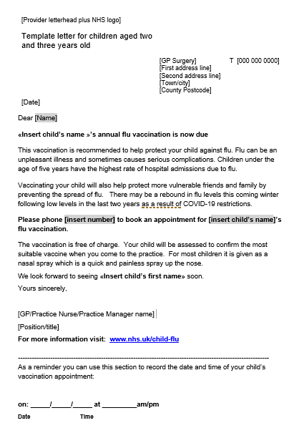
Increasing flu immunisation uptake among children
Best practice guidance for general practice
Invitation/contacting parents
send a personalised invitation to eligible children – use the parent’s and child’s names, sign your name at the bottom
phone calls can be more effective than letters; and try text messages for reminders
ensure that staff phoning patients have a script but can also answer questions and address concerns
plan phone calls after 4pm when more working parents might be available
send letters if telephone contact is not possible
set a date – invite every eligible child before the end of October
be tenacious – make multiple contacts until child is immunised

Slide 85
Increasing flu immunisation uptake among children
Best practice guidance for general practice
Ordering vaccines
Centrally procured flu vaccines for children will be available to order via www.ImmForm.phe.gov.uk
Order small and frequent quantities of flu vaccines, spread throughout the flu vaccination period
Remember that you can order weekly and receive weekly deliveries
Hold no more than 2 to 3 weeks stock in your practice fridge to reduce the risk of stock loss through cold chain failures or expiry before use
Remember that stock ordered later will have a later expiry date
Ordering will be subject to controls and the most up to date information on these will be available on ImmForm news throughout the ordering period

Slide 86
Increasing flu immunisation uptake among children
Best practice guidance for general practice
Clinics and appointments
plan to have completed all routine immunisation activity by Christmas
use time after Christmas to mop-up unimmunised children, particularly children in at risk groups. If clinically indicated vaccination can be given up to the end of March
decide whether you will give timed appointments, run an open access clinic or invite parents to make appointments
allow online booking for appointments
consider family friendly clinic/appointment times such as after school 3.30pm – 6.30pm, Saturday mornings, or October half term – consider health fairs or parties – incorporating flu vaccination with other vaccines, health checks, health visitor advice
create a child friendly environment; including room for pushchairs
consider other clinics and busy waiting rooms

Slide 87
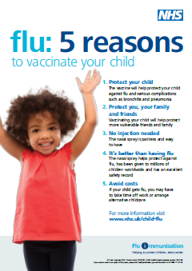
Increasing flu immunisation uptake among children
Best practice guidance for general practice
Promote the vaccination offer to parents
ensure every parent has a personalised invitation for their child
display UKHSA child flu immunisation posters and leaflets in the reception and waiting rooms
create attractive displays in waiting rooms. Consider posters or banners outside the practice – on a notice board, walls or even on the roof
place prominent information about the child flu immunisation programme on the practice website
engage with the local primary school – ask if they can give leaflets to parents with preschool age children and/or display posters on school/parent notice boards
engage with local pre-school nurseries, children’s centres, libraries, toddler groups in your area. Ask staff to put up posters and issue leaflets to parents of children who are 2 years old and older. Highlight the benefits of their children being immunised to these preschool groups and nurseries

Slide 88
Increasing flu immunisation uptake among children
Best practice guidance for general practice
During the season
Increasing resources in-season is difficult so comprehensive preparation and planning is critical. There are things you can do to help sustain efforts and uptake:
review your uptake against your goals and financial plan; celebrate/promote success as the programme progresses
remain tenacious – re-run searches for eligible children
continue to offer vaccination, even once you have achieved your practice and campaign goals
keep staff engaged and enthused – consider incentives, promoting staff competition
ensure all practice staff have their flu jab – it is powerful to be able to say to patients “I’ve had mine”
Post season
review your campaign, measure and celebrate success – thank everyone involved
share the review of your campaign with your stakeholders, patient focus group and partners who helped you achieve your goals
capture lessons learnt and adapt next year’s plan – aim for higher uptake next year

Slide 89
Delivering the programme if COVID-19 is circulating
patients will need reassurance that appropriate measures are in place to keep them safe from COVID-19 as it is likely to be co-circulating with flu
providers will be expected to deliver the programme according to any guidelines on social distancing and PPE that are current at the time
providers need to be prepared to make any necessary adjustments to the programme to ensure those at highest risk can continue to be vaccinated
careful appointment planning to minimise waiting times when attending
provide patients with information in advance of their appointment to explain what to expect
recall at risk patients if they do not attend
consider other innovative methods to deliver flu vaccinations when appropriate to do so

Slide 90
Key messages to health and social care workers
    getting vaccinated against flu can help protect you, your patients and family
    everyone is susceptible to flu, even if you are in good health and eat well
    you can be infected with the virus and have no symptoms but can still pass flu virus to others including patients or residents
    good infection control measures reduce spread of flu and other acute respiratory infections in healthcare settings but are not sufficient alone to prevent them
    throughout the last 10 years there has generally been a good to moderate match between the strains of flu virus in the vaccine and those that subsequently circulated
    impact of flu on frail and vulnerable patients can be fatal and outbreaks can cause severe disruption in communities, care homes and hospitals
    flu vaccine has a good safety record and will help protect you. It cannot give you flu. Having the vaccination can encourage your colleagues to do likewise
    staff act as positive role models for patients aged 50 and over, those with long-term health conditions and pregnant women to take up the offer too
    duty of care as professionals to patients or residents to do everything in your power to protect them against infection, including being immunised against flu

Slide 91
Key messages
flu immunisation is one of the most effective interventions we can provide to reduce harm from flu and pressures on health and social care services during the winter
it is important to increase flu vaccine uptake in clinical risk groups because of increased risk of death and serious illness if people in these groups catch flu
influenza during pregnancy may be associated with perinatal mortality, prematurity, smaller neonatal size, lower birth weight and increased risk of complications for mother
vaccination of health and social care workers protects them and reduces risk of spreading flu to their patients, service users, colleagues and family members
by preventing flu infection through vaccination, secondary bacterial infections such as pneumonia are prevented. This reduces the need for antibiotics and helps prevent antibiotic resistance
for a number of years, only around half of patients aged 6 months to under 65 years in clinical risk groups have been vaccinated
the childhood flu programme should reduce the impact of seasonal flu on children and reduce transmission of flu within the community
by reducing transmission of flu, it should also avert many cases of severe flu and flu-related deaths in older adults and people in clinical risk groups

Slide 92
Resources
Letters detailing 2022/23 flu programme
Available at: www.gov.uk/government/publications/national-flu-immunisation-programme-plan
Green Book Influenza chapter Available at: www.gov.uk/government/collections/immunisation-against-infectious-disease-the-green-book
Leaflets, posters, information materials and other resources to support the annual flu programme Available at: www.gov.uk/government/collections/annual-flu-programme
A Flu elearning programme is freely available to access https://www.e-lfh.org.uk/programmes/flu-immunisation/
PGD templates for flu vaccines www.gov.uk/government/collections/immunisation-patient-group-direction-pgd
A video for health professionals on how to administer the LAIV vaccine produced by NHS Education for Scotland is available at https://learn.nes.nhs.scot/63183/immunisation/seasonal-flu/administration-of-fluenz-tetra-video
Summaries of Product Characteristics (SmPC) for flu vaccines are available at www.medicines.org.uk/emc/
Leaflets and posters prepared specifically for the flu programme. Available at: www.gov.uk/government/collections/annual-flu-programme#2022-to-2023-flu-season
Healthcare Workers Flu Immunisation resources (leaflets, posters, guides and resource packs) available at https://campaignresources.phe.gov.uk/resources/campaigns/92-healthcare-workers-flu-immunisation-/resources

Slide 93
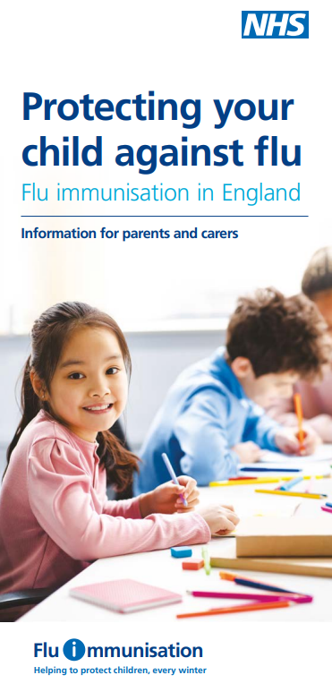

Resources (continued)
Flu vaccination guidance and resources for schools www.gov.uk/government/publications/flu-vaccination-in-schools
Flu immunisation: toolkit for programme extension to children www.gov.uk/government/publications/flu-immunisation-toolkit-for-programme-extension-to-children
Increasing flu immunisation uptake among children: Best Practice Guidance for General Practice
  www.gov.uk/government/organisations/public-health-england/series/annual-flu-programme
The national flu immunisation programme 2022 to 2023

