Slide 1
Chapter 2 – Antimicrobial Resistance
ESPAUR report 2020 – Chapter 2 Figure Annex

Slide 2
Overview
Data presented in this annex complement the data presented in the ESPAUR Report 2020 in Chapter 2 (Antimicrobial Resistance)
The graphs use data taken from the PHE Second Generation Surveillance System Antimicrobial Resistance module for England, unless otherwise noted.
For interpretation of the data please refer to the ESPAUR report 2020.

Slide 3
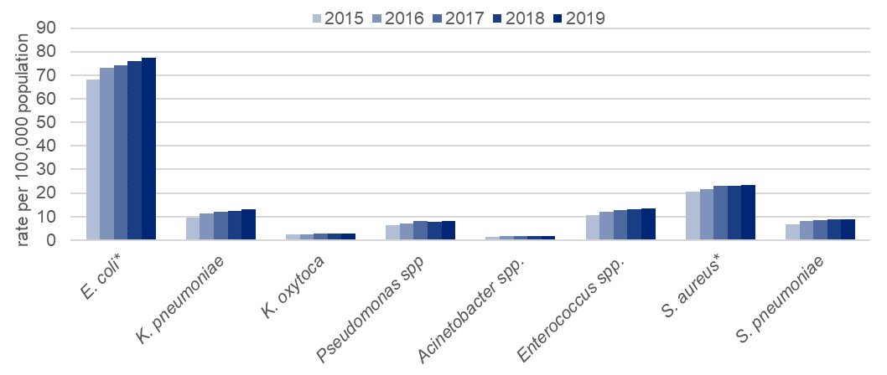
Incidence of bloodstream infection caused by key pathogens, per 100,000 population; England 2015 to 2019
Notes:
Accessibility text
Title: Graph showing the trend in the rate of bloodstream infection per 100,000 population for key pathogens, England 2015 to 2019
Description: Graph showing the rate per 100,000 population number of Escherichia coli (E. coli), Klebsiella pneumoniae (K. pneumoniae), Klebsiella oxytoca (K. oxytoca), Pseudomonas species, Acinetobacter species, Enterococcus species, Staphylococcus aureus (S. aureus) and Streptococcus pneumoniae (S. pneumoniae) from bloodstream infection reported by year in England between 2015 and 2019.
There has been a year on year increase in infection rate in the majority of these pathogens. The highest rates are for E. coli bacteraemia, which rose from 68 per 100,000 population to 78 per 100,000 between 2015 and 2019.
The incidence increased from 9.5 to 13.2 per 100,000 for K. pneumoniae, 2.4 to 3.0 per 100,000 for K. oxytoca, 6.4 to 8.1 per 100,000 for Pseudomonas species, 1.5 to 1.8 per 100,000 for Acinetobacter species, 10.5 to 13.5 per 100,000 for Enterococcus species, 20.5 to 23.5 per 100,000 for S. aureus, and 6.7 to 8.7 per 100,000 for S. pneumoniae.
The only pathogen to not show the highest rate in 2019 was S. pneumoniae where the peak occurred in 2018 with 9.0 per 100,000 population. For Pseudomonas species the highest rate of 8.1 per 100,000 population was observed in 2017 and 2019.

Slide 4
Annual estimated burden of antibiotic-resistant BSI; England 2015 to 2019
Notes:
Accessibility text
Title: Estimated trends in burden of bloodstream infections due to antibiotic-resistant pathogens in England, 2015 to 2019
Description: The estimated total numbers of bloodstream infections caused by pathogens resistant to 1 or more key antibiotics increased year on year from 13,671 in 2015 to 18,110 in 2019, a rise of 32%.
For infections that occurred in 2019, the burden of antibiotic-resistant bloodstream infections caused by Enterobacterales is 85%, of which 86% are E. coli; (73% of the total resistant bloodstream infections). The burden of resistant infections caused by the Gram-positive organisms, Staphylococcus aureus, Streptococcus pneumoniae and Enterococcus species represent 12% of the total of antimicrobial resistant bloodstream infections in 2019.

Slide 5
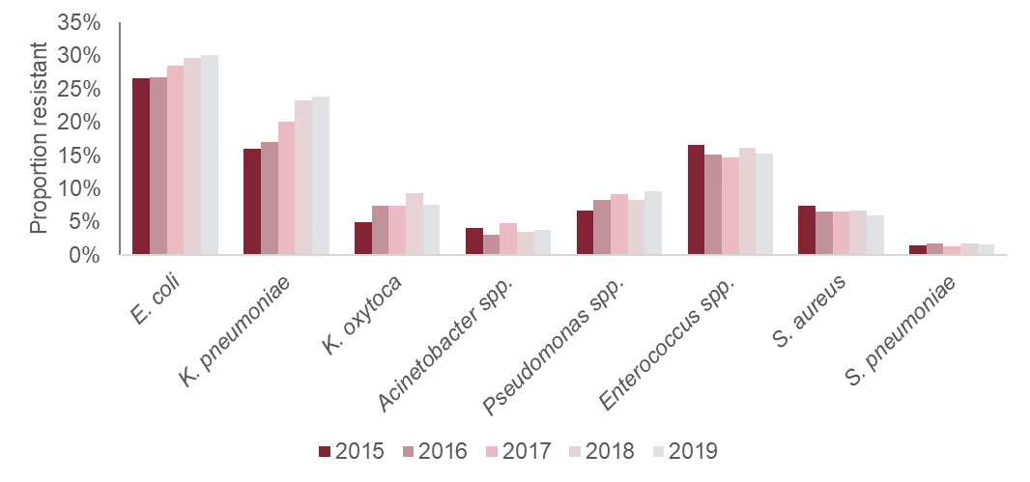
Proportion of bloodstream infections, by causative species*, resistant to 1 or more key antibiotic combination; England 2015 to 2019
* as used in the AMR burden analyses presented in Annex Table Accessory 1
Notes:
Accessibility text
Title: Estimated trends in proportion of bloodstream infections resistant to one or more key antibiotic combinations in England by causative species, 2015 to 2019
Description: The estimated proportion of bloodstream infections caused by pathogens resistant to 1 or more key antibiotics generally increased year on year for E. coli (from 27% in 2015 to 30% in 2019), K. pneumoniae (from 16% in 2015 to 24% in 2019), K. oxytoca (from 5% in 2015 to 8% in 2019, with a peak of 9% in 2018), and Pseudomonas species (from 7% in 2015 to 10% in 2019).
The proportion caused by species resistant to one or more key antibiotic combinations remained similar for Acinetobacter species with 4% in both 2015 and 2019, and a peak of 5% in 2017, and for S. pneumoniae (from 1% in 2015 to 2% in 2019). The proportion decreased slightly for Enterococcus species (from 17% in 2015 to 15% in 2019) and S. aureus (from 7% in 2015 to 6% in 2019).

Slide 6
Proportion of E. coli BSI resistant to third-generation cephalosporins; a) England and b) by region, 2015 to 2019
Notes:
Accessibility text
(a)
Title: Graph showing resistance to third-generation cephalosporins in E. coli from bloodstream infection specimens in England, 2015 to 2019
Description: Graph showing the proportion of E. coli bloodstream infections resistant to third-generation cephalosporins by year and the number of reports with a resistant, intermediate and susceptible test result to third-generation cephalosporins and the number without a susceptibility test to third-generation cephalosporins.
The proportion of E. coli resistant to third generation cephalosporins and the number of reports of resistant specimens increased year on year, from 11.6% resistant in 2015 (3,192 resistant specimens reported) to 14.6% resistant in 2019 (5,310 resistant specimens reported). The total number of E. coli bloodstream specimens tested for resistance to third-generation cephalosporins increased year on year from 27,552 in 2015 to 36,375 in 2019.
(b)
Title: Graph showing proportion of E. coli bloodstream infections resistant to third-generation cephalosporins by region, 2015 to 2019
Description: Proportion of E. coli bloodstream infections resistant to third-generation cephalosporins increased in all regions between 2015 and 2019. The level of resistance and increase was greatest in London, increasing from 15.6% in 2015 to 22.0% in 2019. Proportion resistant in the North of England increased from 11.1% in 2015 to 13.6% in 2019; in the Eastern and Midlands from 11.1% in 2015 to 14.3% in 2019; and in the South of England from 13.3% in 2015 to 15.5% in 2019.

Slide 7
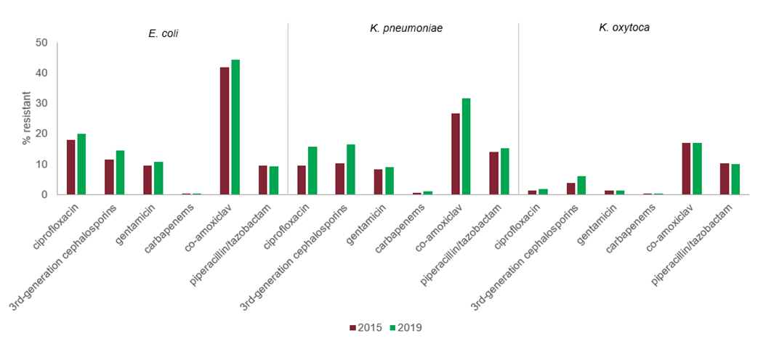
Antibiotic resistance in Enterobacterales species BSI to key antibiotics; England 2015 and 2019
Notes:
Accessibility text
Title: Graph showing the percentage resistance to key antibiotics in 2015 and 2019 for E. coli, K. pneumoniae and K. oxytoca bloodstream infections; England data
Description: Graph showing the percentage resistant to key antibiotics in Escherichia coli (E. coli), K. pneumoniae and K. oxytoca bloodstream infections in England in 2015 and 2019.
There has been an increase in the proportion resistant to the majority of the monitored antibiotics in E. coli bacteraemia reports between 2014 and 2018, including ciprofloxacin, third-generation cephalosporins, gentamicin, and co-amoxiclav; the proportion resistant to carbapenems or piperacillin/tazobactam has remained stable.
In 2019 the percentage of E. coli bacteraemia that were resistant to ciprofloxacin was 20%, third-generation cephalosporins (including cefotaxime, ceftazidime, cefpodoxime and ceftriaxone) was 15%, gentamicin was 11%, carbapenems (including meropenem and imipenem, or ertapenem when neither were tested) was 0.1%, piperacillin/tazobactam was 9% and co-amoxiclav was 44%.
There has been an increase in the proportion resistant to the majority of the monitored antibiotics in Klebsiella pneumoniae bacteraemia reports between 2015 and 2019, including ciprofloxacin, third-generation cephalosporins, gentamicin, carbapenems, co-amoxiclav and piperacillin/tazobactam.
In 2019 the percentage of K. pneumoniae bacteraemia that were resistant to ciprofloxacin was 16%, third-generation cephalosporins (including cefotaxime, ceftazidime, cefpodoxime and ceftriaxone) was 16%, gentamicin was 9%, carbapenems (including meropenem and imipenem, or ertapenem when neither were tested) was 1%, co-amoxiclav was 32% and piperacillin/tazobactam was 15%.
There has been an increase in the proportion resistant to ciprofloxacin and third-generation cephalosporins in Klebsiella oxytoca bacteraemia reports between 2015 and 2019; the proportion resistant to carbapenems, co-amoxiclav and piperacillin\tazobactam decreased slightly; the proportion resistant to gentamicin has remained stable.
In 2019 the percentage of K. oxytoca bacteraemia that were resistant to ciprofloxacin was 2%, third-generation cephalosporins (including cefotaxime, ceftazidime, cefpodoxime and ceftriaxone) was 6%, gentamicin was 1%, carbapenems (including meropenem and imipenem, or ertapenem when neither were tested) was 0.1%, co-amoxiclav was 17% and piperacillin/tazobactam was 10%.

Slide 8
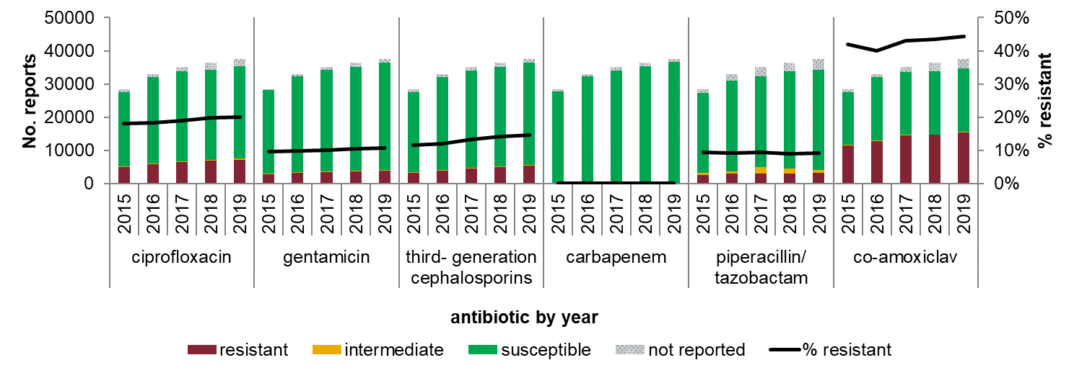
E. coli bacteraemia resistance to key antimicrobials; England 2015 to 2019
Notes:
Accessibility text
Title: Antibiotic Susceptibility Test results for E. coli against key antibiotic agents by laboratories in England between 2015 and 2019
Description: Graph showing the number of Escherichia coli (E. coli) bacteraemia reported by year in England between 2015 and 2019 and the number of reports with susceptibility testing and results to key antibiotics. The chart also shows the proportion resistant to the agents over the time period.
There has been a year on year increase in E. coli bacteraemia reports. The proportion resistant to the key antibiotics, gentamicin, carbapenems and piperacillin/tazobactam, has remained stable. An increase in the percentage resistant for ciprofloxacin, third-generation cephalosporins and co-amoxiclav is noted between 2015 and 2019.
In 2019 the percentage of E. coli bacteraemia that were resistant to ciprofloxacin was 20%, gentamicin was 11%, third-generation cephalosporins (including cefotaxime, ceftazidime, cefpodoxime and ceftriaxone) was 15%, carbapenems (including meropenem and imipenem, or ertapenem when neither were tested) was 0.1%, piperacillin/tazobactam was 9% and co-amoxiclav was 44%.

Slide 9
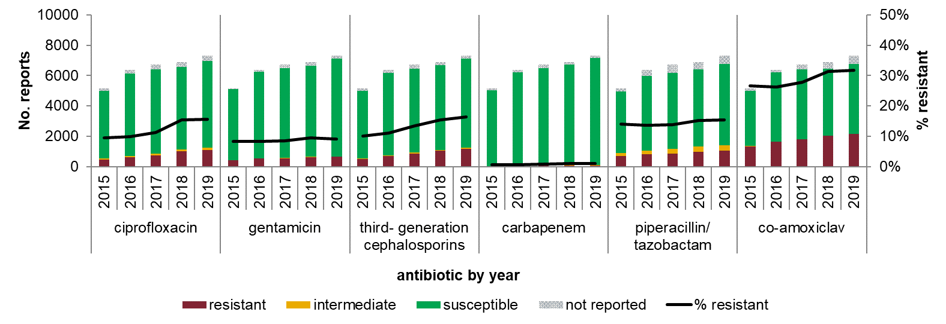
K. pneumoniae bacteraemia resistance to key antimicrobials; England 2015 to 2019
Notes:
Accessibility text
Title: Antibiotic Susceptibility Test results for Klebsiella pneumoniae against key antibiotic agents by laboratories in England between 2015 and 2019
Description: Graph showing the number of Klebsiella pneumoniae (K. pneumoniae) bacteraemia reported by year in England between 2015 and 2019 and the number of reports with susceptibility testing and results to key antibiotics. The chart also shows the proportion resistant to the agents over the time period.
There has been a year on year increase in K. pneumoniae bacteraemia reports. The proportion resistant to gentamicin and carbapenems, has remained stable. An increase in the percentage resistant for ciprofloxacin, third-generation cephalosporins, and co-amoxiclav is noted between 2015 and 2019. A small increase in the percentage resistant for piperacillin/tazobactam was also observed between 2015 and 2019.
In 2019 the percentage of K. pneumoniae bacteraemia that were resistant to ciprofloxacin was 16%, gentamicin was 9%, third-generation cephalosporins (including cefotaxime, ceftazidime, cefpodoxime and ceftriaxone) was 16%, carbapenems (including meropenem and imipenem, or ertapenem when neither were tested) was 1.1%, piperacillin/tazobactam was 15% and co-amoxiclav was 32%.

Slide 10
K. oxytoca bacteraemia resistance to key antimicrobials; England 2015 to 2019
Notes:
Accessibility text
Title: Antibiotic Susceptibility Test results for Klebsiella oxytoca against key antibiotic agents by laboratories in England between 2015 and 2019
Description: Graph showing the number of Klebsiella oxytoca (K. oxytoca) bacteraemia reported by year in England between 2015 and 2019 and the number of reports with susceptibility testing and results to key antibiotics. The chart also shows the proportion resistant to the agents over the time period.
There has been a year on year increase in K. oxytoca bacteraemia reports. The proportion resistant to key antibiotics, including ciprofloxacin, gentamicin, carbapenems, piperacillin/tazobactam, and co-amoxiclav has remained stable between 2015 and 2019. An increase in the percentage resistant for third-generation cephalosporins is noted between 2015 and 2019.
In 2019 the percentage of K. oxytoca bacteraemia that were resistant to ciprofloxacin was 2%, gentamicin was 1%, third-generation cephalosporins (including cefotaxime, ceftazidime, cefpodoxime and ceftriaxone) was 6%, carbapenems (including meropenem and imipenem, or ertapenem when neither were tested) was 0.1%, piperacillin/tazobactam was 10% and co-amoxiclav was 17%.

Slide 11
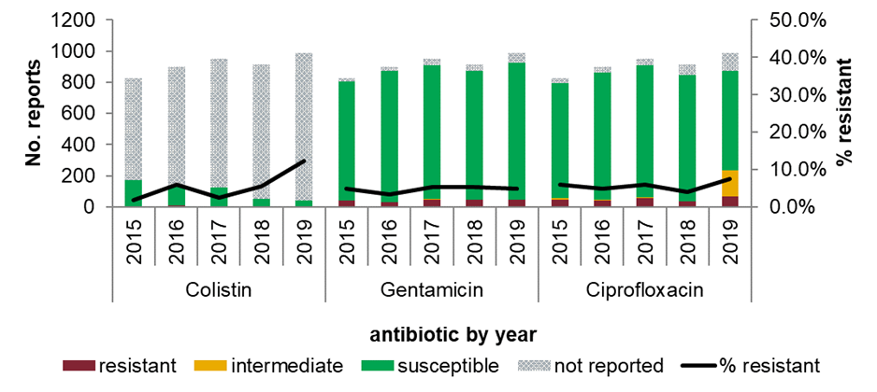
Acinetobacter spp. bacteraemia resistance to key antibiotics; England 2015 to 2019
Notes:
Accessibility text
Title: Graph showing Antibiotic Susceptibility Test results for Acinetobacter spp. bacteraemia against key antibiotic agents by laboratories in England between 2015 and 2019
Description: Graph showing the number of Acinetobacter spp. bacteraemia reported by year in England between 2015 and 2019 and the number of reports with susceptibility testing and results to colistin, gentamicin and ciprofloxacin. The chart also shows the proportion resistant to the agents over the time period.
There has been a year on year increase in Acinetobacter spp. bacteraemia reports between 2015 and 2017, there was levelling in numbers between 2017 and 2018 and an increase in 2019 to the peak number of reports.
The graph demonstrates that the vast majority of Acinetobacter spp. bacteraemia are not tested for colistin resistance. Of those that are tested the percentage resistant for colistin in 2019 was 12%.
The proportion resistant for gentamicin has remained stable with minor fluctuations between 2015 and 2019. In 2019, the percentage of Acinetobacter species bacteraemia that were resistant to gentamicin was 5%.
The proportion resistant for ciprofloxacin remained stable with minor fluctuations between 2015 and 2018 and increased slightly in 2019 to 8%.

Slide 12
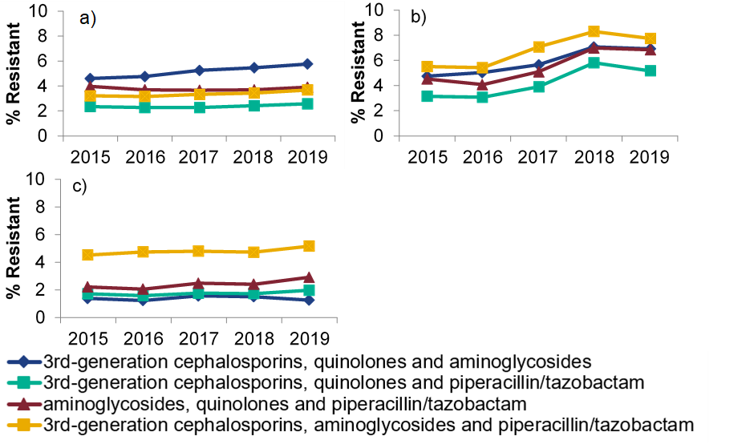
Proportion of a) E. coli BSI, b) K. pneumoniae BSI and c) Pseudomonas spp. BSI resistant to multiple antibiotic combinations, England 2015 to 2019
Notes:
Accessibility text
(a)
Title: Graph showing the proportion of E. coli bloodstream infections resistant to multiple antibiotic combinations in England between 2015 and 2019
Description: Graph shows that over the five year period the percentage of E. coli bacteraemia resistant to three of more key antibiotic groups (three of third-generation cephalosporin, quinolones, aminoglycosides and piperacillin/tazobactam in combinations) remained relatively stable.
In 2019, the percentage of E. coli bloodstream infections that were resistant to third-generation cephalosporins, quinolones and aminoglycosides was 6%; the proportion resistant to third-generation cephalosporins, quinolones and piperacillin/tazobactam was 3%; resistant to aminoglycosides, quinolones and piperacillin/tazobactam was 4% and; resistant to third-generation cephalosporins, aminoglycosides and piperacillin/tazobactam was 4%.
(b)
Title: Graph showing the proportion of K. pneumoniae bloodstream infections resistant to multiple antibiotic combinations in England between 2015 and 2019
Description: Graph shows an overall increase in the percentage of K. pneumoniae bacteraemia resistant to three of more key antibiotic groups (three of third-generation cephalosporin, quinolones, aminoglycosides and piperacillin/tazobactam in combinations), with a slight reduction between 2018 and 2019.
In 2019, the percentage of K. pneumoniae bloodstream infections that were resistant to third-generation cephalosporins, quinolones and aminoglycosides was 7%; the proportion resistant to third-generation cephalosporins, quinolones and piperacillin/tazobactam was 5%; resistant to aminoglycosides, quinolones and piperacillin/tazobactam was 7% and; resistant to third-generation cephalosporins, aminoglycosides and piperacillin/tazobactam was 8%.
(c)
Title: Graph showing the proportion of Pseudomonas species bloodstream infections resistant to multiple antibiotic combinations in England between 2015 and 2019
Description: Graph shows that over the five year period the percentage of Pseudomonas species bacteraemia resistant to three of more key antibiotic groups (three of third-generation cephalosporin, quinolones, aminoglycosides and piperacillin/tazobactam in combinations) remained relatively stable.
In 2019, the percentage of Pseudomonas species bloodstream infections that were resistant to third-generation cephalosporins, quinolones and aminoglycosides was 1%; the proportion resistant to third-generation cephalosporins, quinolones and piperacillin/tazobactam was 2%; resistant to aminoglycosides, quinolones and piperacillin/tazobactam was 3% and; resistant to third-generation cephalosporins, aminoglycosides and piperacillin/tazobactam was 5%.

Slide 13
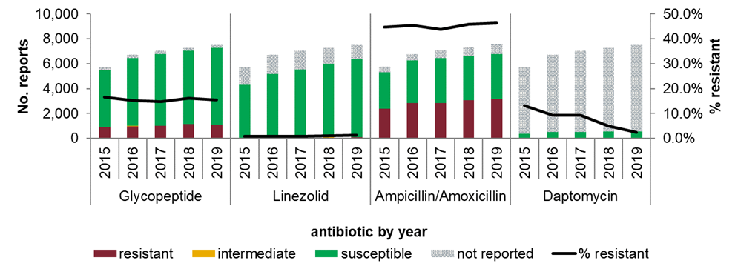
Enterococcus spp. bacteraemia resistance to key antibiotics; England 2015 to 2019
Notes:
Accessibility text
Title: Graph showing Antibiotic Susceptibility Test results for Enterococcus spp. bacteraemia against key antibiotic agents by laboratories in England between 2015 and 2019
Description: Graph showing the number of Enterococcus spp. bacteraemia reported by year in England between 2015 and 2019 and the number of reports with susceptibility testing and results to glycopeptide, linezolid, ampicillin/amoxicillin and daptomycin. The chart also shows the proportion resistant to the agents over the time period.
There has been a year on year increase in Enterococcus spp. bacteraemia reports between 2015 and 2019. The proportion resistant for glycopeptide has decreased slightly between 2015 and 2019. In 2015 the percentage that were resistant to glycopeptide was 17%, and in 2019 was 15%. The proportion resistant for daptomycin has decreased year on year. In 2015 the percentage of Enterococcus spp. bacteraemia that were resistant to daptomycin was 13%, and in 2019 was 2%.
The proportion resistant for linezolid and ampicillin/amoxicillin has remained stable with minor fluctuations between 2015 and 2019. In 2019 the percentage of Enterococcus spp. bacteraemia that were resistant to linezolid was 1%, ampicillin/amoxicillin was 46%.

Slide 14
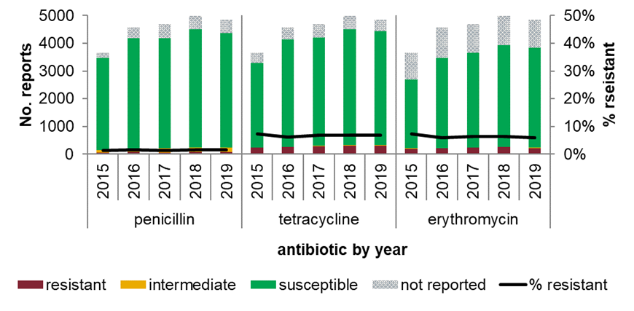
S. pneumoniae bacteraemia resistance to key antimicrobials; England 2015 to 2019
Notes:
Accessibility text
Title: Graph showing Antibiotic Susceptibility Test results for Streptococcus pneumoniae bacteraemia against key antibiotic agents by laboratories in England between 2015 and 2019
Description: Graph showing the number of S. pneumoniae bacteraemia reported by year in England between 2015 and 2019 and the number of reports with susceptibility testing and results to key antibiotics. The chart also shows the proportion resistant to the agents over the time period.
There has been an increase in S. pneumoniae bacteraemia reports between 2015 and 2018, and a slight decrease in 2019. The proportion resistant to key antibiotics, including penicillin, tetracycline and erythromycin, has remained stable with minor fluctuations between 2015 and 2019.
In 2019 the percentage of S. pneumoniae bacteraemia that were resistant to penicillin was 2%, tetracycline was 7% and erythromycin was 6%.

Slide 15
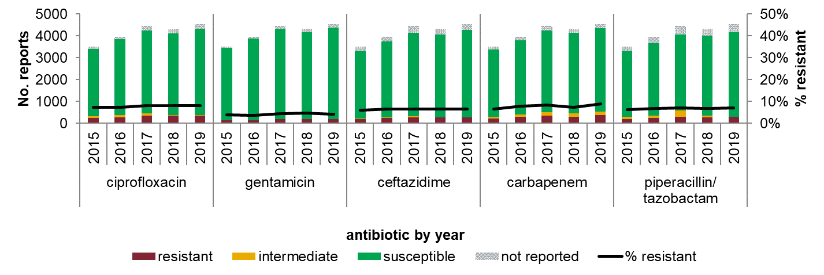
Pseudomonas spp. bacteraemia resistance to key antimicrobials; England 2015 to 2019
Notes:
Accessibility text
Title: Antibiotic Susceptibility Test results for Pseudomonas spp. bacteraemia against key antibiotic agents by laboratories in England between 2015 and 2019
Description: Graph showing the number of Pseudomonas spp. bacteraemia reported by year in England between 2015 and 2019 and the number of reports with susceptibility testing and results to key antibiotics. The chart also shows the proportion resistant to the agents over the time period.
There has been a year on year increase in Pseudomonas spp. bacteraemia reports, with a decrease in number of reports in 2018, followed by an increase again in 2019. The proportion resistant to key antibiotics, including ciprofloxacin, gentamicin, ceftazidime, piperacillin/tazobactam and carbapenems, has remained stable with minor fluctuations between 2015 and 2019.
In 2019 the percentage of Pseudomonas spp. bacteraemia that were resistant to ciprofloxacin was 8%, gentamicin was 4%, ceftazidime was 7%, carbapenems (including meropenem and imipenem) was 9% and piperacillin/tazobactam was 7%.

