Slide 1
Antibiotic consumption
ESPAUR Report 2019-20 – Chapter 4 Figure Annex

Slide 2
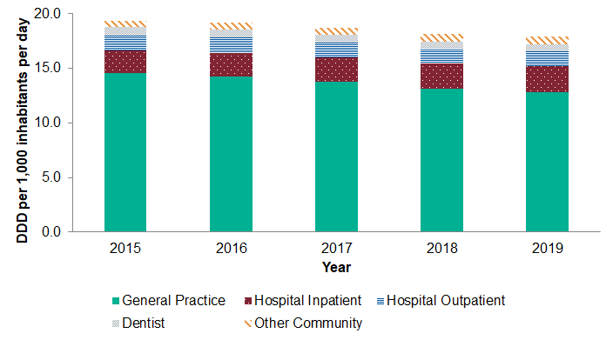
Total antibiotic consumption by prescriber setting, expressed as DDDs per 1,000 inhabitants per day, England, 2015-2019
Notes:
Antibiotic consumption by settings
Antibiotic consumption by settings: general practice, hospital inpatient, hospital outpatient, dentist and other community, from 2015 to 2019.
In 2019, the majority of antibiotics were prescribed in the GP setting (71.4%; 12.8 DID), followed by hospital inpatients (13.3%; 2.4 DID), hospital outpatients (7.7%; 1.4 DID) other community settings (4.1%; 0.737 DID) and dental practice (3.4%; 0.611 DID).
In the last five years, the overall antibiotic consumption has decreased by 7.5 %. Decreasing trends were observed for the GP setting ( from 14.7 to12.8 DID) and dentist (0.759 to 0.611 ). An 8.8% increase was observed for combined hospital settings both hospital inpatients and hospital outpatients.

Slide 3
Total antibiotic consumption by antibiotic groups, expressed as DDDs per 1,000 inhabitants per day, England, 2015-2019
Note: p-value for trend from 2015 to 2019; ⁺ where trend is statistically significant trend (p<0.05)
.
Notes:
Total antibiotic consumption by antibiotic groups from 2015 to 2019, with trend and p-values for trend.
1. Penicillins (excluding inhibitors), decreasing trend from 6.161 to 5.653, p-value is statistically significant at 0.018
2. Penicillins (inhibitor combinations only), decreasing trend from 1.208 to 1.106, p-value is statistically significant at 0.078
3. First and second-generation cephalosporins, decreasing trend from 0.301 to 0.238, p-value is statistically significant at 0.012
4. Third, fourth and fifth-generation cephalosporins, increasing trend from 0.057 to 0.078, p-value is statistically significant at 0.015
5. Carbapenems, decreasing trend from 0.058 to 0.052, p-value is not statistically significant at 0.012
6. Tetracyclines, decreasing trend from 4.828 to 4.730, p-value is not statistically significant at 0.260
7. Macrolides, lincosamides and streptogramins, decreasing trend from 3.230 to 2.730, p-value is statistically significant at 0.006
8. Sulfonamides and trimethoprim, decreasing trend from 1.357 to 0.777, p-value is statistically significant at 0.002
9. Quinolone antibacterials, increased from 0.515 in 2016 to 0.548 in 2018, then decreased to 0.499 in 2019, p-value is not statistically significant at 0.914
10. Anti-Clostridioides difficile agents (includes oral vancomycin and fidaxomicin), remained stabled at 0.004, p-value is not statistically significant at 0.310
11. Oral metronidazole, decreasing trend from 0.359 to 0.298, p-value is statistically significant at 0.002
12. Other antibacterials (ATC 3rd level pharmacological subgroup ‘J01X’) include: glycopeptide antibacterials, polymyxin, steroid antibacterials, imidazole derivatives, nitrofuran derivatives, other antibacterials (full list in chapter annex), increasing trend from 1.156 to 1.603, p-value is statistically significant at 0.002

Slide 4
Total antibiotic consumption by antibiotic groups and prescriber settings, expressed as DDDs per 1,000 inhabitants per day, England, 2019
Antibiotic Group | General Practice | Hospital Inpatient | Hospital Outpatient | Dentist | Other Community | Total
Penicillins (excluding inhibitors) | 3.939 | 0.620 | 0.276 | 0.461 | 0.357 | 5.653
Penicillins (inhibitor combinations only) | 0.392 | 0.472 | 0.199 | 0.002 | 0.042 | 1.106
First and second-generations cephalosporins | 0.153 | 0.055 | 0.021 | 0.001 | 0.008 | 0.238
Third, fourth and fifth-generations cephalosporins | 0.001 | 0.064 | 0.013 | 0.000 | 0.000 | 0.078
Carbapenems | 0.000 | 0.045 | 0.007 | 0.000 | 0.000 | 0.052
Tetracyclines | 4.062 | 0.286 | 0.283 | 0.003 | 0.097 | 4.730
Macrolides, lincosamides and streptogramins | 2.111 | 0.272 | 0.192 | 0.038 | 0.117 | 2.730
Sulfonamides and trimethoprim | 0.558 | 0.086 | 0.110 | 0.000 | 0.024 | 0.777
Quinolone antibacterials | 0.257 | 0.115 | 0.114 | 0.000 | 0.014 | 0.499
Anti-Clostridioides difficile agents | 0.001 | 0.002 | 0.001 | 0.000 | 0.000 | 0.004
Oral metronidazole | 0.095 | 0.054 | 0.038 | 0.106 | 0.005 | 0.298
Other antibacterials | 1.216 | 0.225 | 0.088 | 0.000 | 0.075 | 1.603
Aminoglycosides | 0.005 | 0.091 | 0.031 | 0.000 | 0.000 | 0.127
Amphenicols | 0.000 | 0.001 | 0.000 | 0.000 | 0.000 | 0.001
Total | 12.789 | 2.386 | 1.374 | 0.611 | 0.737 | 17.896
Notes:
1. Penicillins (excluding inhibitors) was prescribed the most in the GP setting (3.939 DID)
2. Penicillins (inhibitor combinations only) was prescribed the most in hospital inpatients (0.472 DID)
3. First and second-generation cephalosporins was prescribed the most in the GP setting (0.153 DID)
4. Third, fourth and fifth-generation cephalosporins was prescribed the most in hospital inpatients (0.064 DID)
5. Carbapenems was prescribed the most in hospital inpatients (0.045 DID)
6. Tetracyclines was prescribed the most in the GP setting (4.062 DID)
7. Macrolides, lincosamides and streptogramins was prescribed the most in the GP setting (2.111 DID)
8. Sulfonamides and trimethoprim was prescribed the most in the GP setting (0.558 DID)
9. Quinolone antibacterials was prescribed the most in GP setting (0.257 DID)
10. Anti-Clostridioides difficile agents (includes oral vancomycin and fidaxomicin), was prescribed the most in hospital inpatients (0.002 DID)
11. Oral metronidazole was prescribed the most in dental practices (0.106 DID)
12. Other antibacterials (ATC 3rd level pharmacological subgroup ‘J01X’) include: glycopeptide antibacterials, polymyxin, steroid antibacterials, imidazole derivatives, nitrofuran derivatives, other antibacterials (full list in chapter annex), was prescribed the most in the GP settings (1.216 DID)

Slide 5
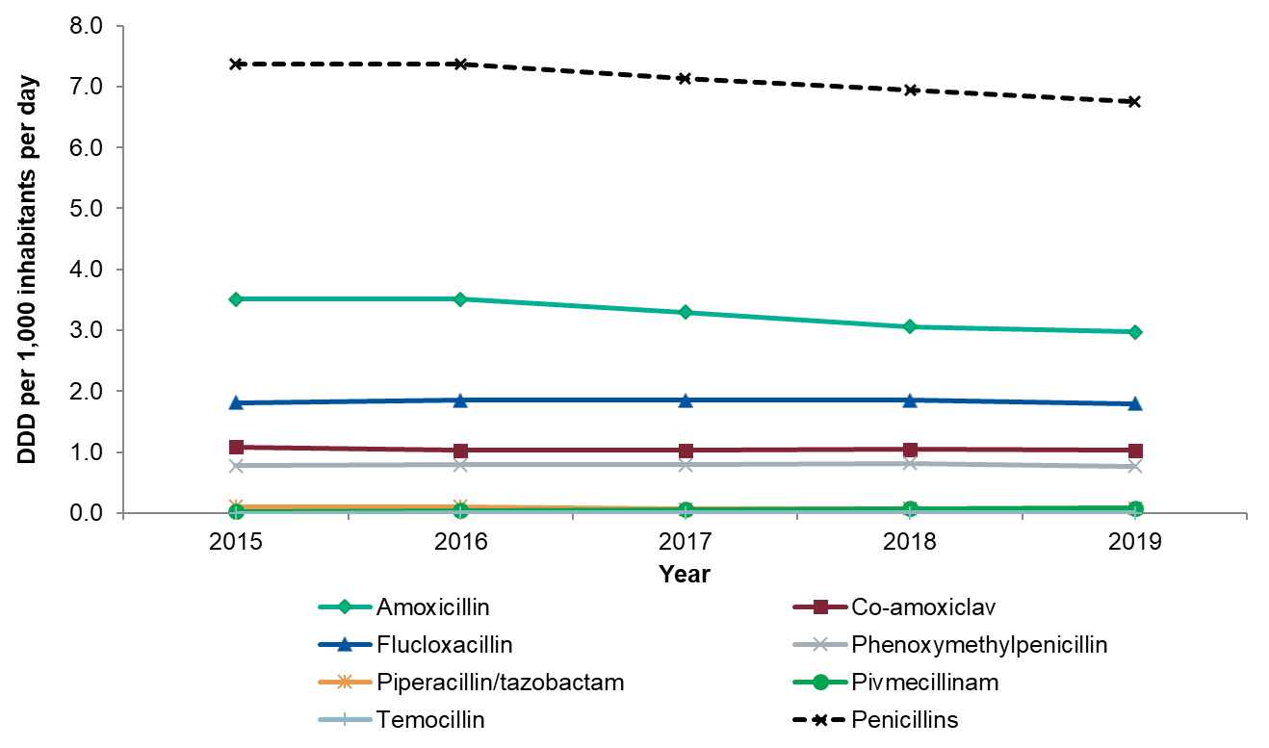
Consumption of the most commonly utilised penicillins, expressed as DDDs per 1,000 inhabitants per day, England, 2015-2019
Notes:
Penicillins consumption have decreased from 7.369 to 6.759 DID during the last 5 years. Amoxicillin was the most commonly used penicillin and has decreased from 3.507 to 2.976 DID. This was followed by flucloxacillin, which have also decreased (1.814 to 1.795 DID).

Slide 6
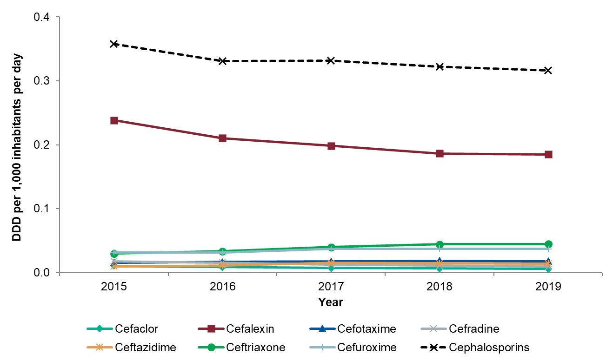
Consumption of the most commonly utilised cephalosporins expressed as DDDs per 1,000 inhabitants per day, England, 2015-2019
Notes:
Cephalosporins consumption have decreased from 0.358 to 0.316 DID during the last 5 years. The most commonly used cephalosporin was cefalexin and has decreased from 0.239 to 0.185 DID. The second most commonly prescribed cephalosporin was ceftriaxone, which has increased from 0.030 to 0.045 DID.

Slide 7
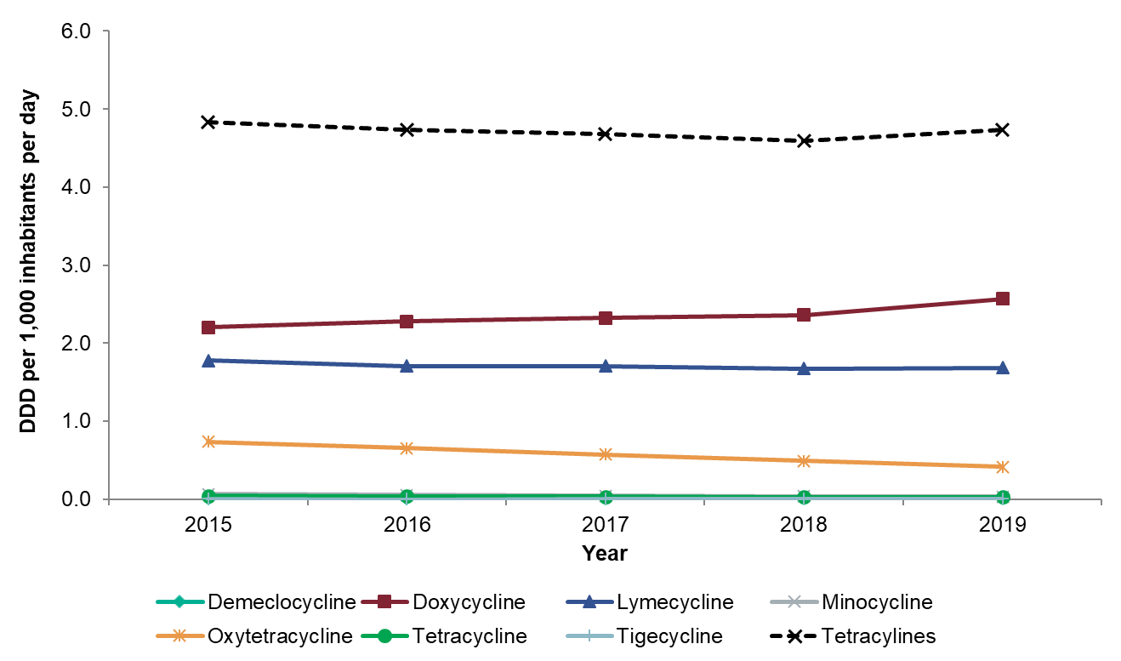
Consumption of tetracyclines, expressed as DDDs per 1,000 inhabitants per day, England, 2015-2019
Notes:
Tetracyclines consumption have decreased from 4.828 to 4.730 DID during the last 5 years. The most commonly used tetracycline was doxycycline, which has increased from 2.202 to 2.568 DID. The second most commonly prescribed tetracycline was lymecycline, which slightly increased from 1.673 in 2018 to 1.682 in 2019.

Slide 8
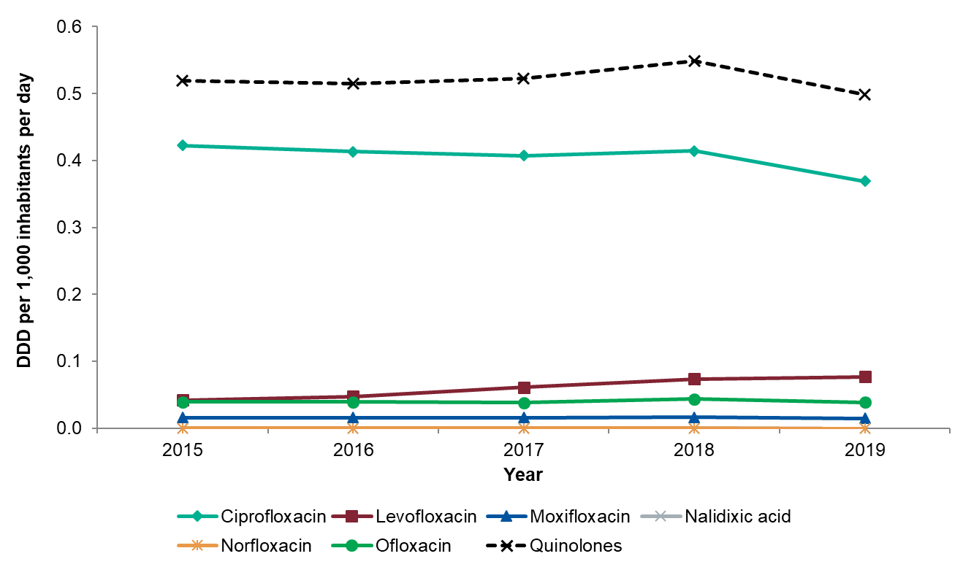
Consumption of quinolones, expressed as DDDs per 1,000 inhabitants per day, England 2015-2019
Notes:
Quinolones consumption have decreased from 0.519 to 0.499 DID during the last 5 years. The most commonly used quinolone was ciprofloxacin, which has decreased from 0.422 to 0.369 DID. The second most commonly prescribed quinolone was levofloxacin, which has increased from 0.042 to 0.077.

Slide 9
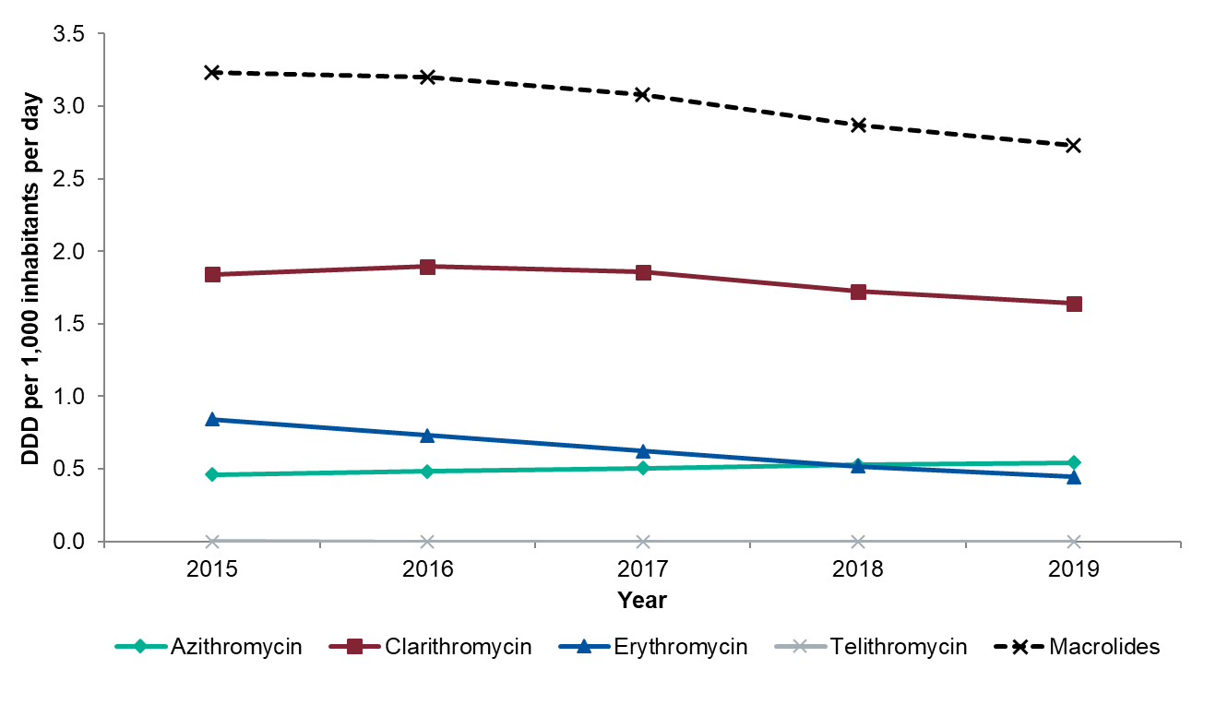
Consumption of macrolides, expressed as DDDs per 1,000 inhabitants per day, England, 2015-2019
Notes:
Marcolides consumption have decreased from 3.230 to 2.730 DID during the last 5 years. The most commonly used marcolide was clarithromycin, which has decreased from 1.841 to 1.642 DID. The second most commonly prescribed marcolide was erythromycin, which has decreased from 0.842 to 0.444.

Slide 10
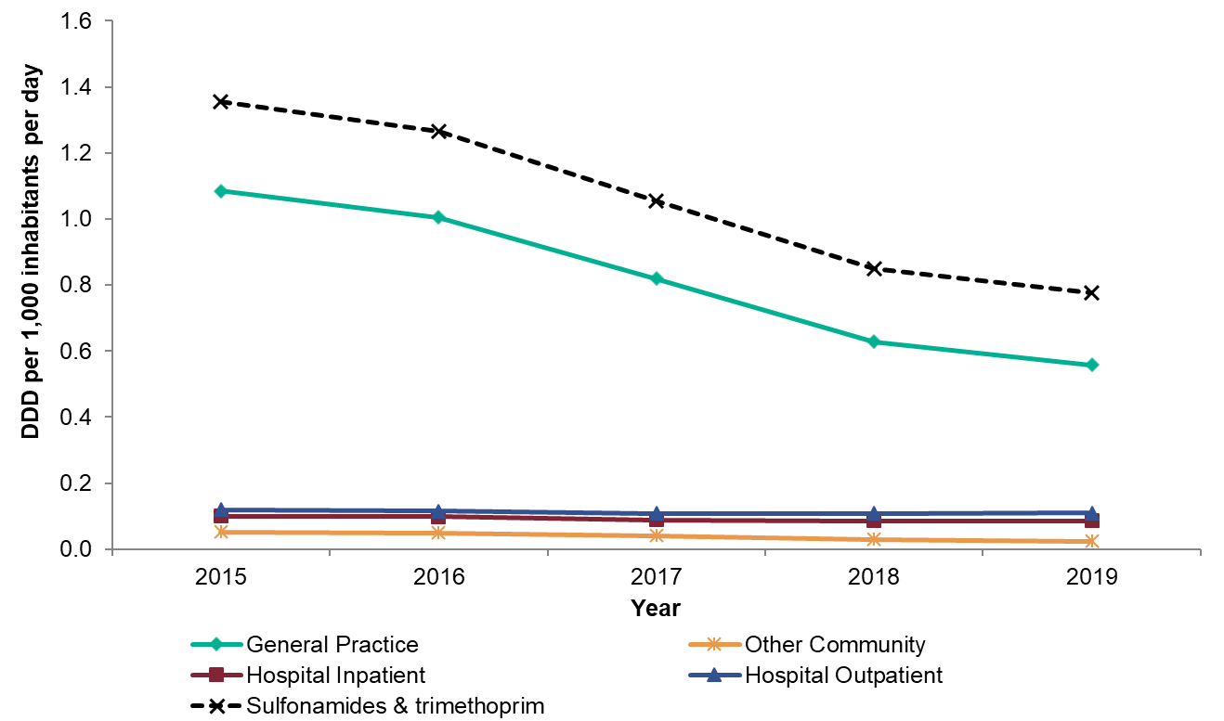
Consumption of sulfonamides and trimethoprim by prescriber setting, expressed as DDDs per 1,000 inhabitants per day, England, 2015-2019
Notes:
Overall sulfonamides and trimethoprim consumption has decreased from 1.357 to 0.777 DID. The GP setting prescribed the most sulphonamides and trimethoprim, and is the main driver (1.085 to 0.558 DID) of the overall observed reduction.

Slide 11
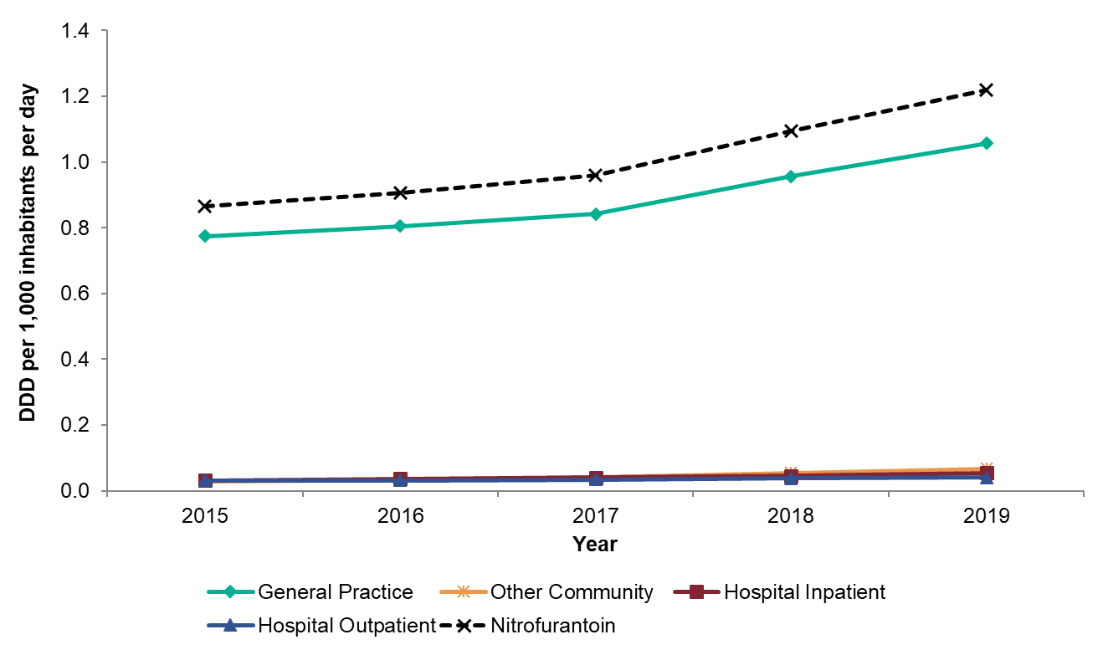
Consumption of nitrofurantoin by prescriber location expressed as DDDs per 1,000 inhabitants per day, England, 2015-2019
Notes:
Nitrofurantoin consumption has increased from 0.866 to 1.219 DID. Nitrofurantoin was prescribed the most in the GP settings, and is the main driver (0.774 to 1.057 DID) of the overall observed increase.

Slide 12
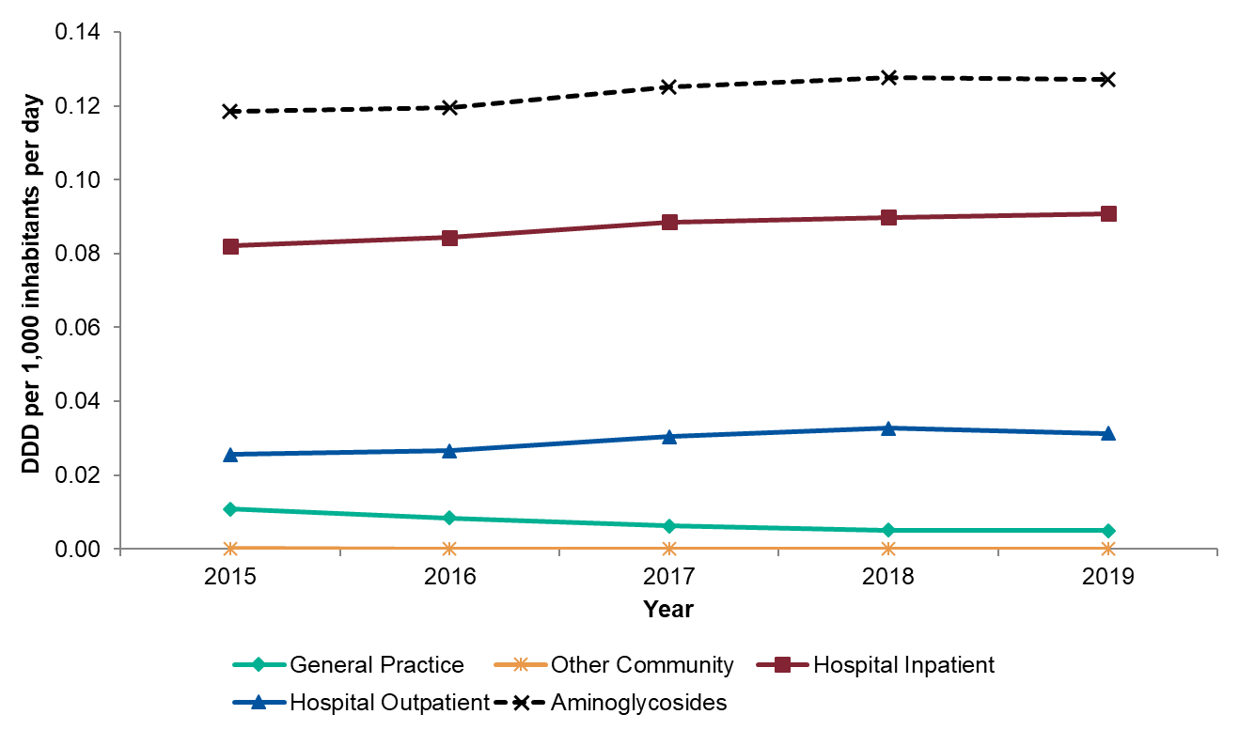
Consumption of aminoglycosides by prescriber location expressed as DDDs per 1,000 inhabitants per day, England, 2015-2019
Notes:
Aminoglycosides consumption has increased from 0.119 to 0.127 DID. Aminoglycosides are mainly prescribed in hospital inpatients, which has increased from 0.082 to 0.091 DID. The second most prescribed setting was in hospital outpatients, which has also increased (0.026 to 0.031 DID). Consumption of aminoglycosides has decreased in the GP setting (0.011 to 0.005) and is consumed on low levels in the other community setting (<0.001).

Slide 13
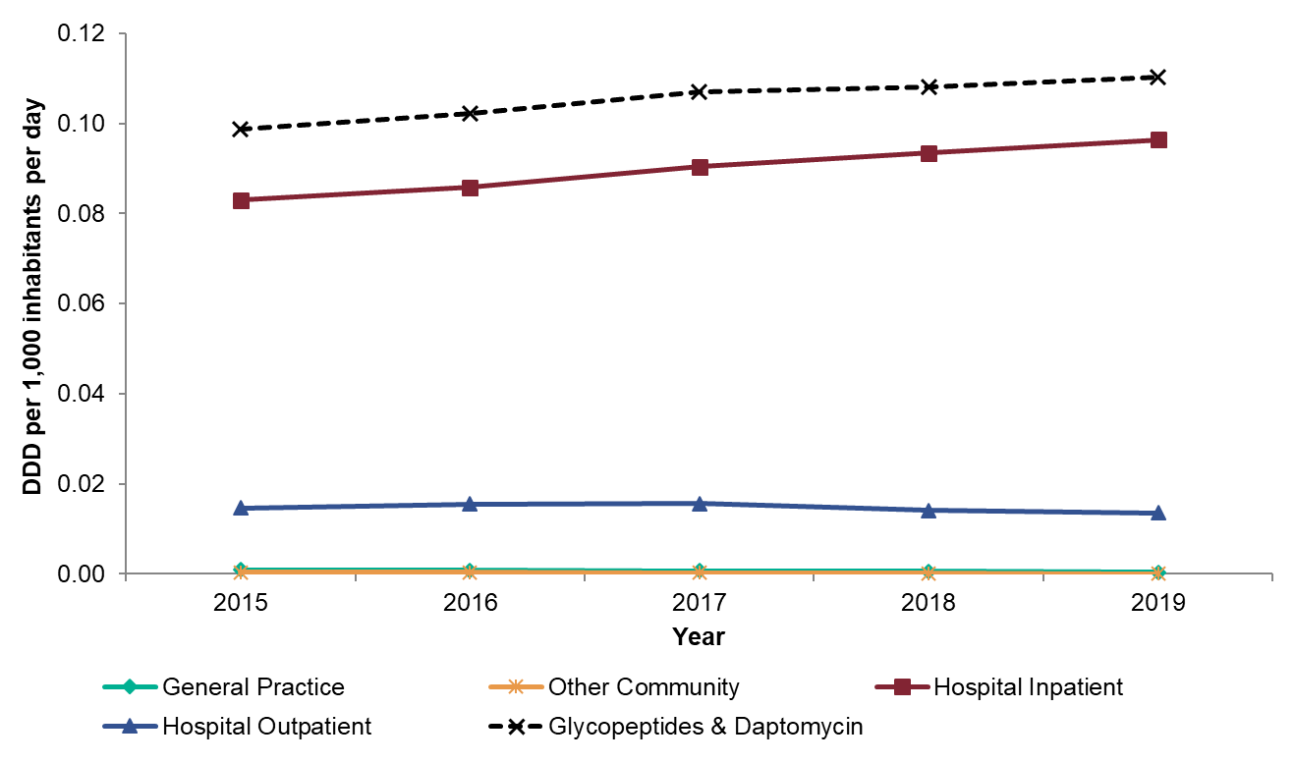
Consumption of parenteral glycopeptides and daptomycin by prescriber location, expressed as DDDs per 1,000 inhabitants per day, England, 2015-2019
Notes:
Consumption of parenteral glycopeptides and daptomycin has increased from 0.099 to 0.110 DID. This increase was mainly driven by the increase observed in hospital inpatients, which has increased from 0.083 to 0.096 DID. Hospital outpatients has remained largely stable (0.013 DID in 2019).

Slide 14
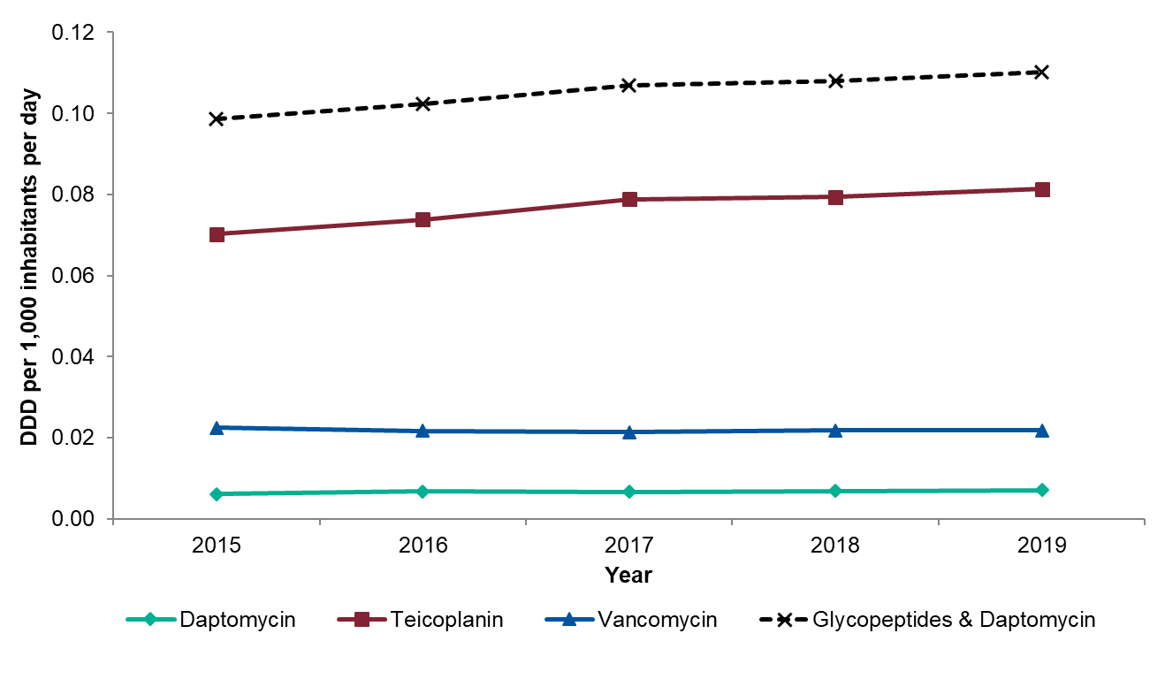
Consumption of parenteral glycopeptides and daptomycin, expressed as DDDs per 1,000 inhabitants per day, England, 2015-2019
Notes:
Consumption of parenteral glycopeptides and daptomycin has increased from 0.099 to 0.110 DID. Teicoplanin (0.070 to 0.081 DID) was the main driver of the overall increase. Consumption of parenteral vancomycin (0.022 DID in 2019) and daptomycin (0.007 DID in 2019) remained stable.

Slide 15
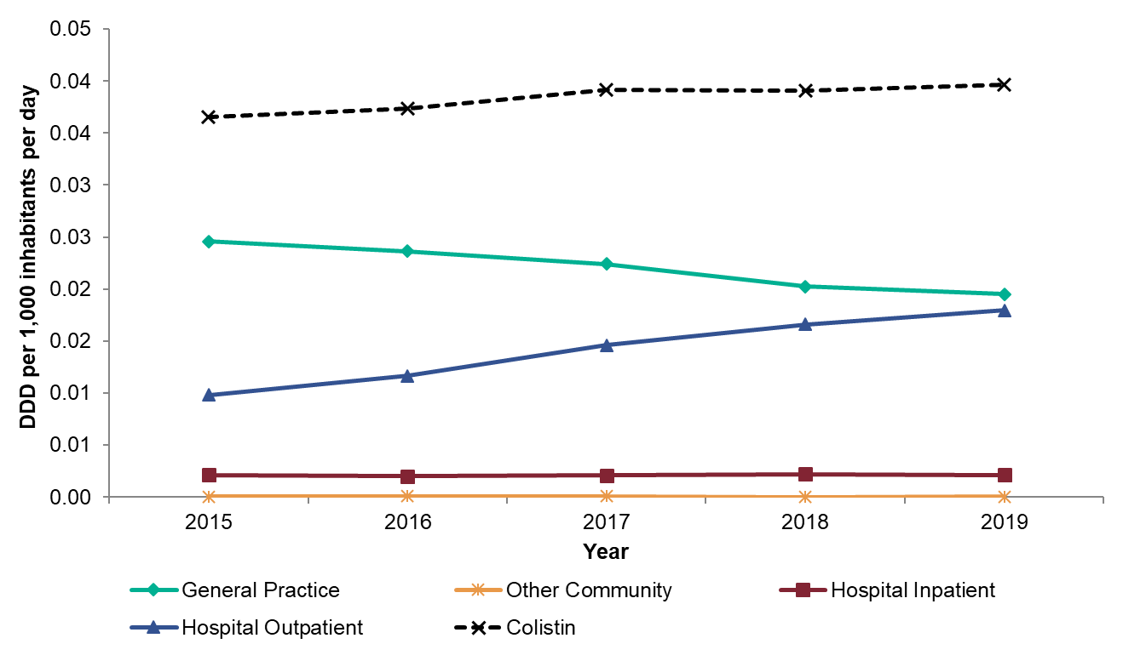
Consumption of colistin in by prescriber location, expressed as DDDs per 1,000 inhabitants per day, England, 2015-2019
Notes:
Consumption of colistin has increased from 0.037 to 0.040 DID. Colistin was prescribed the most in the GP setting, which has been decreasing (0.025 to 0.020 DID). The second most prescribed location for colistin was in hospital outpatients and it has been increasing since 2015 (0.010 to 0.018). Low levels were prescribed in hospital inpatients (0.002 DID in 2019) and the other community (<0.001).

Slide 16
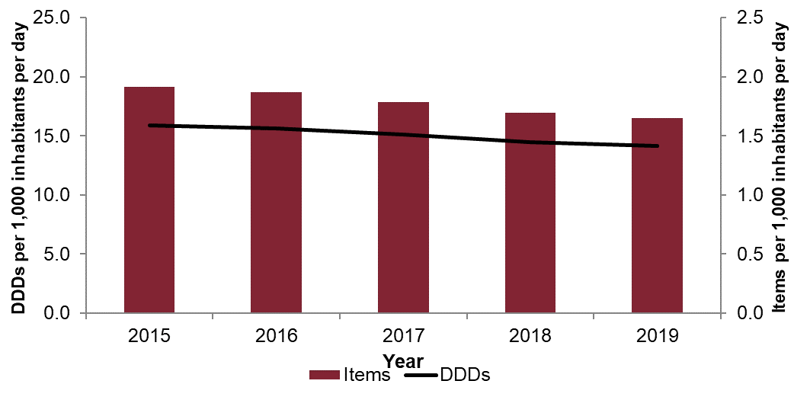
Total antibiotic consumption in primary care, expressed as items and DDDs per 1000 inhabitants per day, England, 2015-2019
Notes:
Total antibiotic consumption (per 1,000 inhabitants per day) in primary care with items in columns, overlay with DDDs as the line. Consumption measured in both DDDs have decreased over the five-year period; DDD have decreased from 15.903 to 14.137 and whilst items have decreased from 1.912 to 1.650.

Slide 17
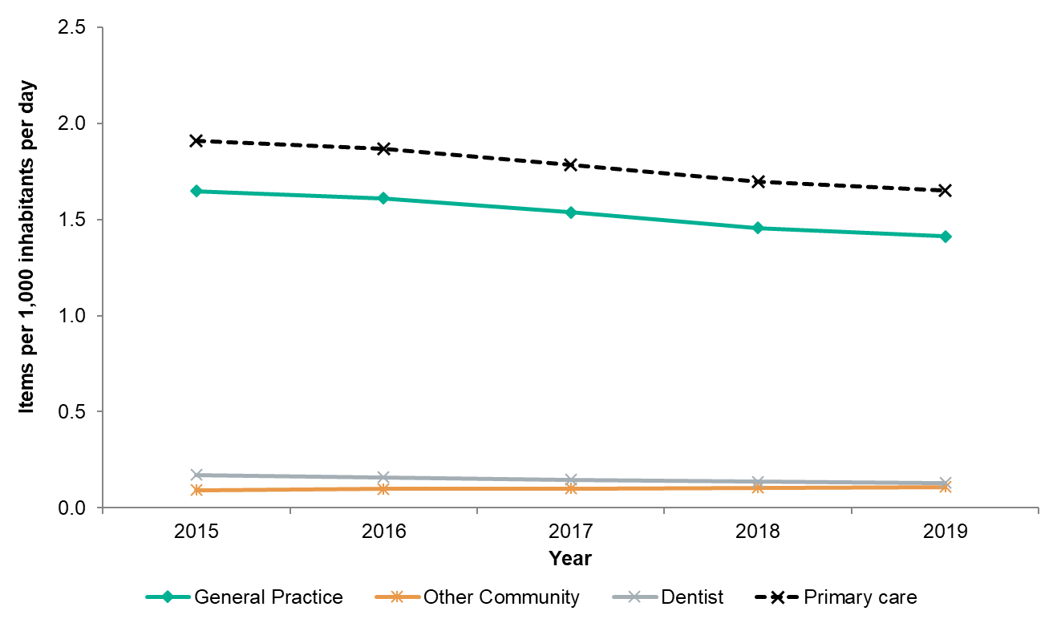
Antibiotic items in primary care by prescriber group, expressed as items per 1,000 inhabitants per day, England, 2015-2019
Notes:
There has been an overall decrease of antibiotic items prescribed in primary care over the last five-years (from 1.912 to 1.650 DID). This is mainly driven by the items prescribed in the GP settings, which has been decreasing (from 1.649 to 1.413 DID). Antibiotic items are prescribed at low levels in dental practices (0.129 DID in 2019) and other community (0.109 DID in 2019).

Slide 18
Antibiotic items prescribed by GP, expressed as items per 1,000 inhabitants per day, England, 2015-2019
Notes:
Total antibiotic items prescribed by GP by antibiotic groups from 2015 to 2019, with trend and p-values for trend.
1. Penicillins (excluding inhibitors), decreasing trend from 0.731 to 0.613, p-value is statistically significant at 0.002
2. Penicillins (inhibitor combinations only), decreasing trend from 0.086 to 0.056, p-value is statistically significant at 0.009
3. First and second-generation cephalosporins, decreasing trend from 0.049 to 0.035, p-value is statistically significant at 0.005
4. Third, fourth and fifth-generation cephalosporins, remained stable at <0.001, p-value is not statistically significant at <0.001
5. Carbapenems, remained stable at <0.001, p-value is not statistically significant at <0.001
6. Tetracyclines, decreasing trend from 0.210 in 2015 to 0.212 in 2019, p-value is not statistically significant at 0.788
7. Macrolides, lincosamides and streptogramins, decreasing trend from 0.209 to 0.165, p-value is statistically significant at <0.001
8. Sulfonamides and trimethoprim, decreasing trend from 0.181 to 0.084 p-value is statistically significant at 0.002
9. Quinolone antibacterials, decreased from 0.036 in 2014 to 0.030 in 2018, p-value is statistically significant at 0.022
10. Anti-Clostridioides difficile agents, remained stable at <0.001, p-value is not statistically significant at 0.037
11. Oral metronidazole, decreasing trend from 0.034 to 0.026, but p-value is not statistically significant at <0.001
12. Other antibacterials (full list in chapter annex), increasing trend from 0.116 to 0.195, p-value is statistically significant at 0.003

Slide 19
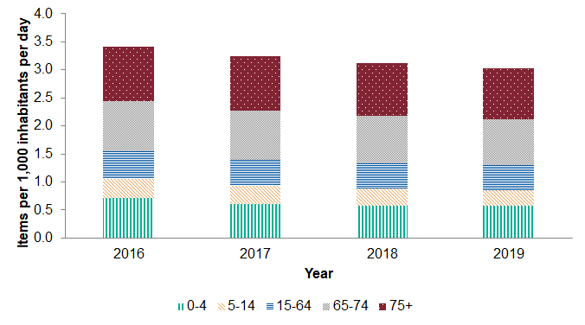
Total consumption in items in general practices by age group, expressed as items per 1,000 inhabitants per day, England, 2016-2019
Notes:
Total antibiotic consumption in items in general practices by age group (0 to 4, 5 to 14, 15 to 64, 65 to 74 and over 75) from 2016 to 2019.
Reduction in consumption was observed in all age group (in stacked columns)
1. Zero to four; 0.709 to 0.570
2. Five to 14; 0.343 to 0.284
3. 15 to 64; 0.489 to 0.440
4. 65 to 74; 0.903 to 0.827
5. Over 75 0.971 to 0.908

Slide 20
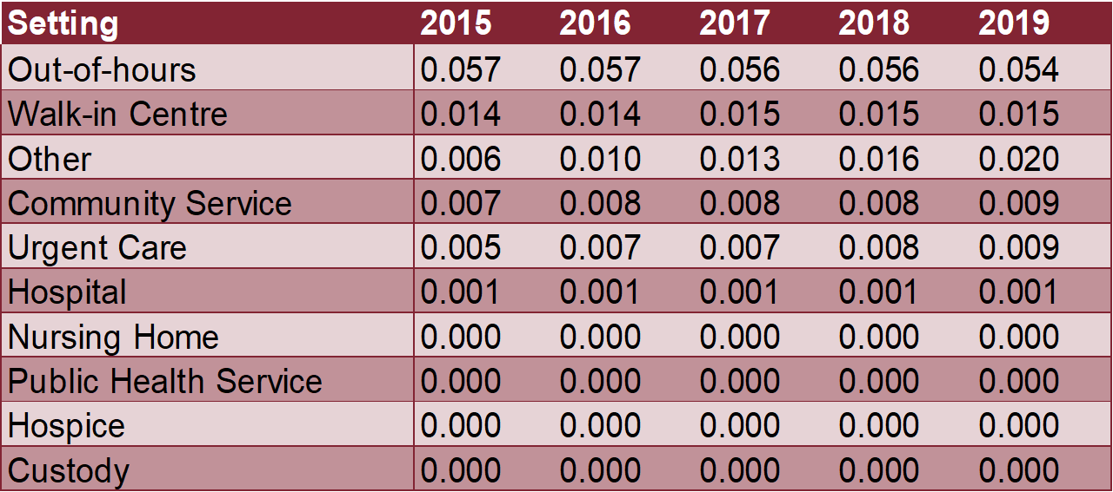
Other community antimicrobial consumption, expressed as items per 1,000 inhabitants per day, England, 2015-2019
Notes:
The out-of-hours setting prescribed the most antimicrobial items in the other community at 0.054 items per 1,000 inhabitants per day in 2019. This is followed by walk-in centres (0.015 items per 1,000 inhabitants per day) and the other settings (0.020 items per 1,000 inhabitants per day) in 2019. Low levels (<0.001 items per 1,000 inhabitants per day) of antimicrobial items were prescribed in nursing homes, public health service, hospice and custody settings.

Slide 21
Dental antibiotic consumption for the most commonly used antibiotic, expressed as DDDs and items per 1,000 inhabitants per day, 2015-2019
Notes:
Dental antibiotic consumption, measured in DDDs and items (per 1,000 inhabitants per day) from 2015 to 2019:
1. Amoxicillin has decreased in both items and DDDs; 0.112 to 0.085 in items and 0.567 to 0.460 in DDDs
2. Co-amoxiclav remained broadly stable; 0.001 in items and decrease slightly in DDDs from 0.003 to 0.002
3. Clarithromycin in items remained stable at <0.001 and increased slightly in DDDs from 0.003 to 0.004
4. Clindamycin in items remained stable at 0.001 and broadly stable at 0.002 DDDs in 2019
5. Erythromycin in items and DDDs have both reduced; items: 0.007 to 0.004 and DDDs: 0.048 to 0.031
6. Metronidazole in items and DDDs have both reduced; items: 0.049 to 0.037 and DDDs: 0.124 to 0.106

Slide 22
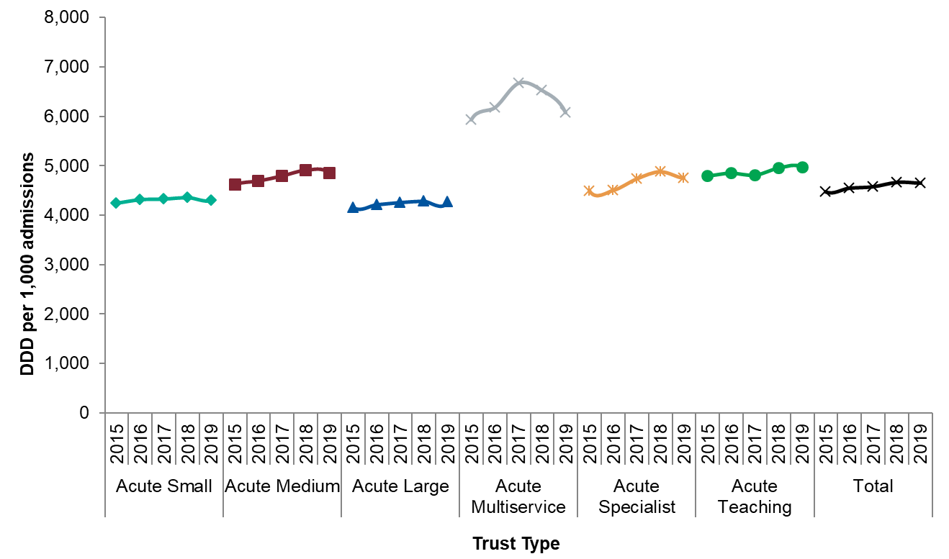
Antibiotic prescribing in acute Trusts, by Trust type, expressed as DDDs per 1,000 admissions, England, 2015-2019
Notes:
Acute small Trusts consumption decreased slightly with 4543 DDDs per 1,000 admissions.
Acute medium Trusts consumption increased slightly from 4640 in 2015 to 4902 in 2019 DDDs per 1,000 admissions.
Acute large Trusts consumption increased slightly from 4281 to 4387 DDDs per 1,000 admissions.
Consumption in acute multiservice Trusts has an increasing trend from 5928 to 6183 DDDs per 1,000 admissions.
Acute specialist Trusts consumption has increased from 4954 to 5195 DDDs per 1,000 admissions.
Acute teaching Trusts consumption has increased from 4672 to 4851 DDDs per 1,000 admissions.

Slide 23
Antibiotic consumption in Trusts, by antibiotic group, expressed as DDDs per 1,000 admissions, England, 2015-2019
Notes:
Antibiotic consumption in Trusts by antibiotic groups from 2015 to 2019, with trend and p-values for trend.
1. Penicillins (excluding inhibitors), decreasing trend from 1144.7 to 1125.5, p-value is not statistically significant at 0.333
2. Penicillins (inhibitor combinations only), increasing trend from 802.5 to 842.4, p-value is not statistically significant at 0.140
3. First and second-generation cephalosporins, decreasing trend from 97.5 to 95.0, p-value is not statistically significant at 0.923
4. Third, fourth and fifth-generation cephalosporins, decreasing trend in 2018 from 100.3 to 97.3 in 2019 , p-value is statistically significant at 0.030
5. Carbapenems, decreasing trend from 76.3 to 64.6, p-value is statistically significant at 0.007
6. Tetracyclines, increasing trend from 528.1 to 714.1, p-value is statistically significant at 0.009
7. Macrolides, lincosamides and streptogramins, decreasing trend from 681.4 to 583.0, p-value is statistically significant at 0.035
8. Sulfonamides and trimethoprim, decreasing trend from 290.0 to 245.5, p-value is statistically significant at 0.009
9. Quinolone antibacterials, increasing trend from 259.9 to 304.5, p-value is statistically significant at 0.011
10. Anti-Clostridioides difficile agents (includes oral vancomycin and fidaxomicin), increasing trend from 4.3 to 4.4, p-value is not statistically significant at 0.422
11. Oral metronidazole, decreasing trend from 131.5 to 113.8, p-value is statistically significant at 0.003
12. Other antibacterials (ATC 3rd level pharmacological subgroup ‘J01X’) include: glycopeptide antibacterials, polymyxin, steroid antibacterials, imidazole derivatives, nitrofuran derivatives, other antibacterials (full list in chapter annex), increasing trend from 323.4 to 392.4, p-value is statistically significant at 0.004

Slide 24
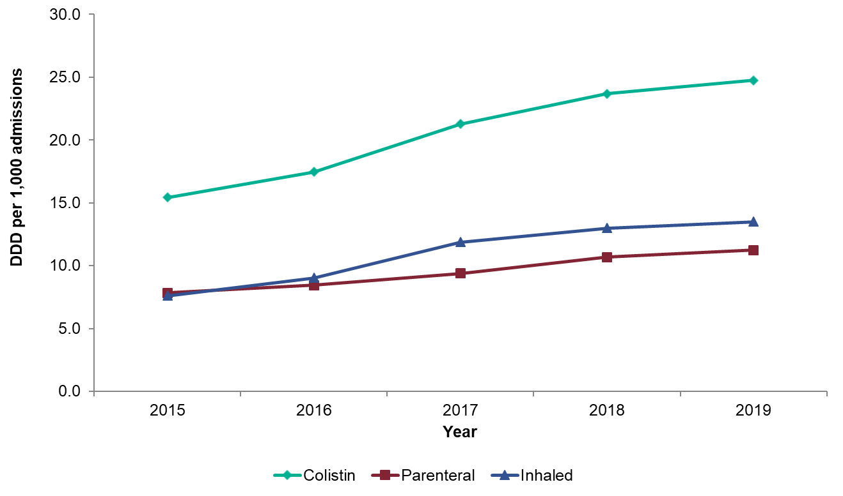
Consumption of colistin in secondary care by administration route, expressed as DDDs per 1,000 admissions, England, 2015-2019
Notes:
Colistin consumption has increased from 15.8 to 25.2 DDDs per 1,000 admissions. The inhaled route (13.7 DDDs per 1,000 admissions) was used more than the parenteral route (11.5 DDDs per 1,000 admissions) in 2019.

Slide 25
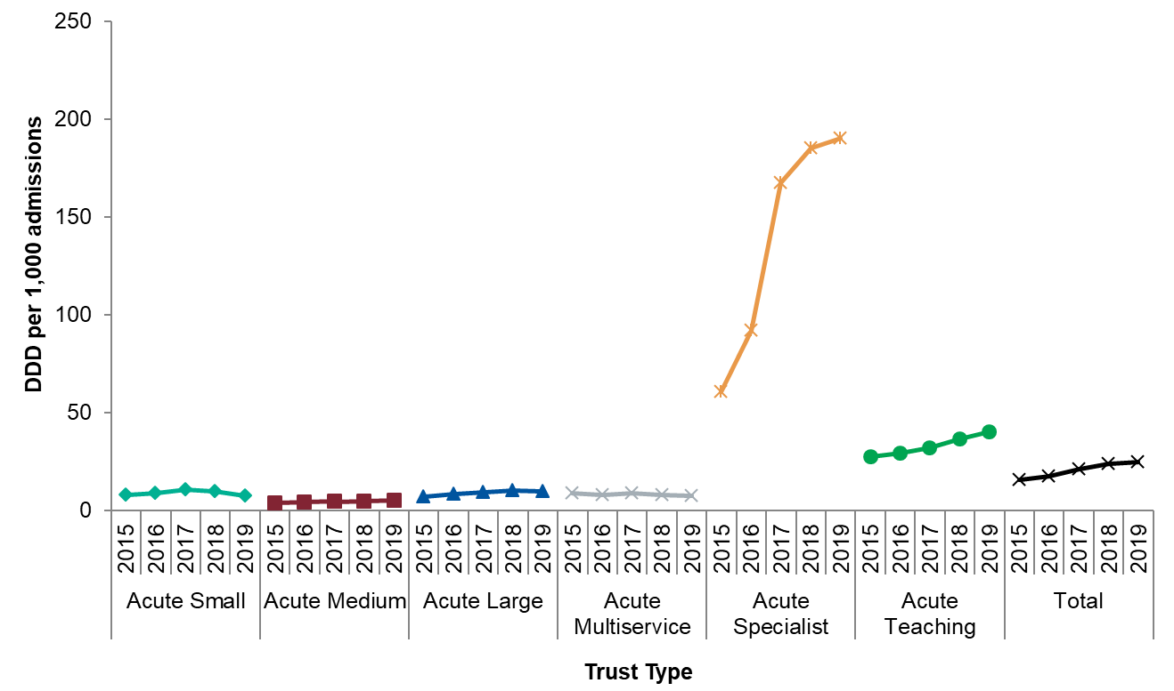
Consumption of colistin in secondary care by Trust type, expressed as DDDs per 1,000 admissions, England, 2015-2019
Notes:
Colistin was consumed the most in specialist Trusts, which has increased from 66.8 to 208.4 DDDs per 1,000 admissions. The consumption of colistin has increased in teaching and medium Trusts, whereas decreases in usage was observed in multiservice, large and small acute trusts types.

Slide 26
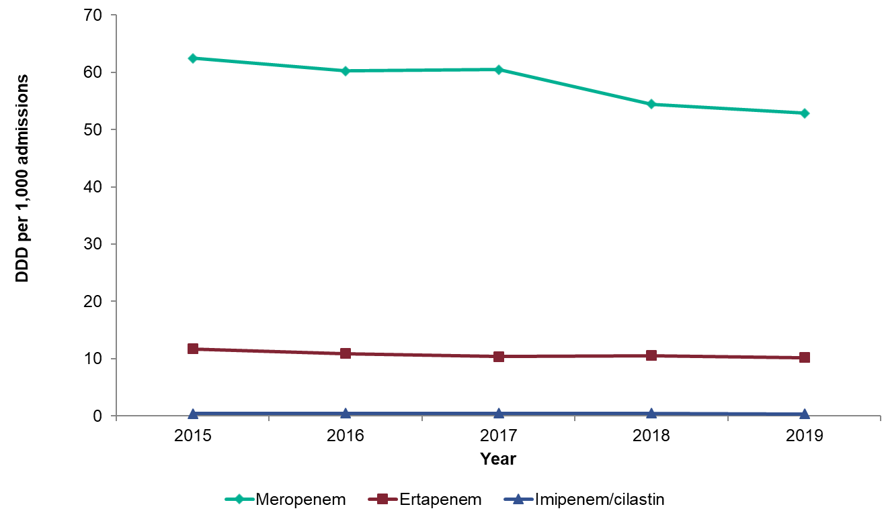
Consumption of carbapenems in secondary care, expressed as DDDs per 1,000 admissions, England, 2015-2019
Notes:
Meropenem was the highest consumed carbapenem, although a small decrease in usage was observed (from 63.9 to 53.9 DDDs per 1,000 admissions). Ertapenem usage has also decreased (from 12.0 to 10.4 DDDs per 1,000 admissions). Imipenem/cilastin is used in low levels (0.4 DDDs per 1,000 admissions in 2019).

Slide 27
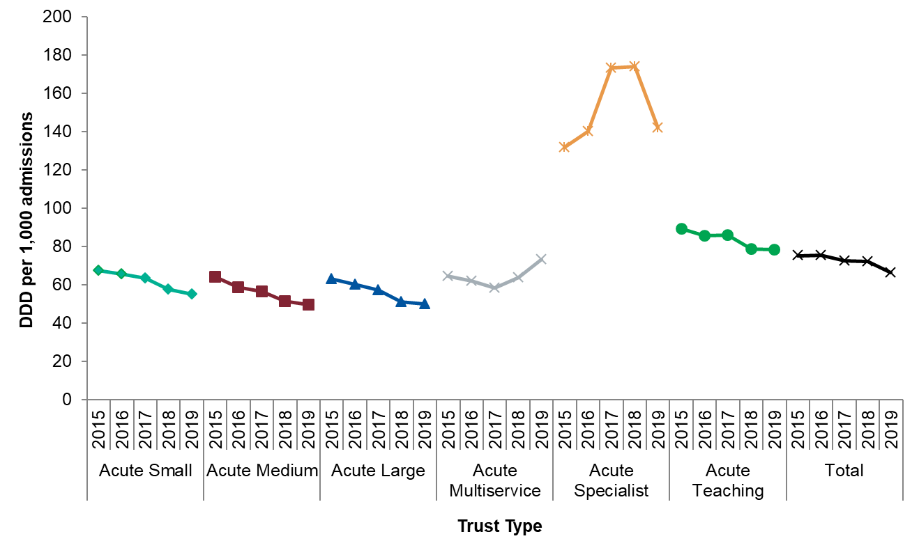
Consumption of carbapenems in secondary care by Trust type, expressed as DDDs per 1,000 admissions, England, 2015-2019
Notes:
Total carbapenem consumption has decreased from 76.3 to 64.6 DDDs per 1,000 admissions. By Trust type, carbapenems were used the most in specialist Trusts and it has decreased from 145.1 to 155.5 DDDs per 1,000 admissions. Consumption in other Trust types have all decreased, with the exception of multiservice Trusts.

Slide 28
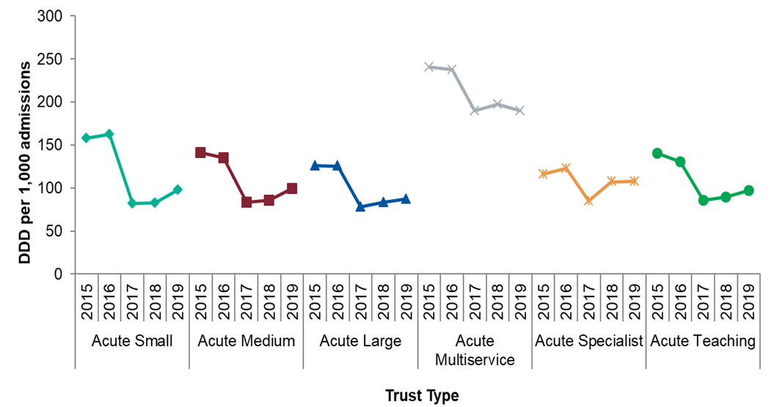
Consumption of piperacillin/tazobactam in secondary care by trust type, expressed as DDDs per 1,000 admissions, England, 2015-2019
Notes:
Piperacillin/tazobactam usage by acute trust type: small, medium, large, multiservice, specialist and teaching.
Usage has increased slightly in acute large, medium, small and acute teaching in 2019. The highest consumption was in acute multiservice in 2019, with 193.0 DDDs per 1,000 admissions.

Slide 29
Quinolone antibacterials and cephalosporins consumption in Trusts, expressed as DDDs per 1,000 admissions, England, 2015-2019
Notes:
Consumption of quinolone antibacterials and cephalosporins including levofloxacin, ceftazidime/avibactam and ceftolozane/tazobactam have all increased from 2018 to 2019. However ciprofloxacin, cefuroxime, cefotaxime, ceftazidime and ceftriaxone have all decreased in 2019.
Ciprofloxacin was consumed the most in 2019 (184.7 DDDs per 1,000 admissions), followed by levofloxacin (75.6 DDDs per 1,000 admissions). Ceftazidime/avibactam (0.5 DDDs per 1,000 admissions) and ceftolozane/tazobactam (0.5 DDDs per 1,000 admissions) were used in low volumes.

Slide 30
Prescribing in secondary care by speciality, expressed as DDDs per admissions, England, 2015-2019
Notes:
The highest consumption by specialist group was Intensive Care Unit (55.8 DDDs per admission in 2019), followed by AE/Non-specific out-patient department (14.5 DDDs per admission in 2019). The lowest consumptions were observed in specialist surgery and paediatrics (2.2 DDDs per admission in 2019).

Slide 31
Proportion of all prescribing attributed to piperacillin/tazobactam, carbapenems and colistin in secondary care by speciality, expressed as DDDs per admissions, England, 2019
Notes:
For piperacillin/tazobactam, the highest prescribing occurred in ICU (6.0%). The highest carbapenems prescribing also occurred in ICU (5.0%), whereas the highest colistin prescribing was in paediatrics (2.8%).

