Slide 1
Administering BCG Vaccination

Slide 2
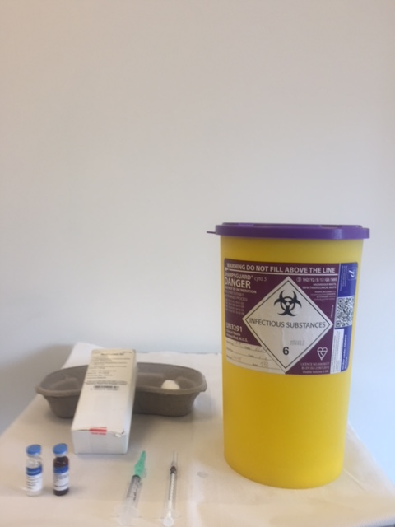
BCG Vaccine AJ V
2 Administering BCG Vaccination
Notes:
BCG vaccine AJV contains a live attenuated Danish strain 1331 derived from M. bovis is the only licensed BCG vaccine in the UK
the vaccine does not contain thiomersal or any other preservatives and is presented as a powder for reconstitution in a glass vial with synthetic stopper
each pack contains 10 vials of Diluted Sauton AJV Solvent and BCG vaccine AJV powder for suspension for (intradermal) injection
the powder must be reconstituted with 1ml of the Diluted Sauton AJV Solvent which is supplied separately
one vial of reconstituted vaccine contains 1 ml of 10 doses (of 0.1 ml) for adults and children aged 12 months and over or 20 doses (of 0.05 ml) for infants under 12 months of age
The extractable number of doses that can be removed from the vial of reconstituted BCG Vaccine AJV depends on the specific type of syringe and needle used as well as on the surplus of vaccine, removed by the individual vaccine administrator during vaccination.

Slide 3
Storage of BCG Vaccine AJV
the unreconstituted vaccine and its diluent should be stored in the original packaging at +2 ͦ C to 8 ͦ C and protected from light
the vaccine should be reconstituted with the diluent supplied by the manufacturer and used immediately
unused reconstituted vaccine should be discarded after 4 hours
the vaccine can be used for up to 4 hours at room temperature after reconstitution
Presentation:
the vaccine is a freeze dried powder for suspension for injection
BCG Vaccine AJV is supplied in a glass vial containing 10 adult doses, fitted with a rubber stopper which is latex free
the powder must be reconstituted with 1ml of the AJV diluent supplied separately
3 Administering BCG Vaccination

Slide 4
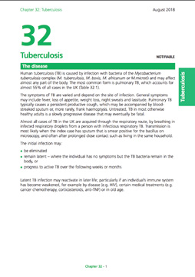
Individuals eligible for BCG (1)
from September 2021, all infants (aged 28 days to 12 months) living in areas of the UK where the annual incidence of TB is 40/100,000 or greater
from September 2021, all infants (aged 28 days to 12 months) with a parent or grandparent who was born in a country where the annual incidence of TB is 40/100,000 or greater
previously unvaccinated children aged 1 to 5 years with a parent or grandparent who was born in a country where the annual incidence of TB is 40/100,000 or greater
previously unvaccinated, tuberculin-negative children aged from 6 to under 16 years of age with a parent or grandparent who was born in a country where the annual incidence of TB is 40/100,000 or greater
For country information on prevalence visit GOV.UK
4 Administering BCG Vaccination
Notes:
JCVI responsible for UK immunisation policy and criteria for BCG is risk based since 2005 following review of TB epidemiology.
However as from Sept 2021 timing of BCG vaccination moved from at birth to at 28 days for eligible babies to support introduction of SCID evaluation and to address mix model of BCG provision in England
Important to note that BCG can be given earlier than 28 days if the SCID outcome result is available

Slide 5
Individuals eligible for BCG (2)
previously unvaccinated tuberculin-negative individuals under 16 years of age who are household (or equivalent) contacts of cases of pulmonary and/or laryngeal TB
previously unvaccinated, tuberculin-negative individuals under 16 years of age who were born in or who have lived for a prolonged period (at least 3 months) in a country with an annual TB incidence of 40/100,000 or greater
individuals at occupational risk, for example, individuals providing care or have direct contact patients with TB or contact with infectious clinical materials or derived isolates
5 Administering BCG Vaccination

Slide 6
Individual requests for BCG vaccination
people seeking vaccination for themselves or their children should be assessed for specific risk factors for TB. Those without risk factors should not be offered BCG vaccination but should be advised of the current policy and given written information. Further information is available at GOV.UK
people with risk factors should be tuberculin tested and offered BCG vaccination according to local service arrangements
6 Administering BCG Vaccination
Notes:
Usually are referred to private travel clinics

Slide 7
BCG vaccine should NOT be given to those:
who have already had a BCG Vaccination
with a past history of TB, latent or active
with an induration of 5mm or more following Mantoux tuberculin skin testing
who have had a confirmed anaphylactic reaction to a component of the vaccine
Infants born to a mother who received immunosuppressive biological therapy during pregnancy
infants less than 2 years old in a household where an active infectious TB is suspected or confirmed
Infants with suspected SCID Screen or unknown SCID Screen outcome
who are pregnant
have a generalised septic skin condition
Notes:
Important to take accurate reliable BCG history and if any contraindications to avoid adverse reactions
Immunisation with live vaccines, including BCG, should be delayed for 6 months in children born of mothers who were on immunosuppressive biological therapy during pregnancy.
If there is any doubt as to whether an infant due to receive a live attenuated vaccine may be immunosuppressed due to the mother’s therapy, including exposure through breast-feeding, specialist advice should be sought
If the mother was only taking them during pregnancy, then a baby could have BCG from 6 months onwards.

Slide 8
BCG vaccine should NOT be given to those:
who are receiving or have received in past 6 months immunosuppressive chemotherapy or radiotherapy or immunosuppressive therapy for a solid organ transplant
who are receiving or have received in the past 12 months: Immunosuppressive biological therapy (e.g. anti –TNF therapy such as alemtuzumab, ofatumumab and
who are receiving or have received in the past 3 months immunosuppressive therapy including:
adults and children on high dose corticosteroids (> 40mg prednisolone per day or >2mg/kg in children under 20kg) for more than 7 days
adults and children on lower dose corticosteroids (> 20mg prednisolone per day or >1mg/kg in children under 20kg for more than 14 days
on-biological oral immune modulating drugs e.g. methotrexate >25mg per week, azathioprine>3.0mg/kg/day or 6-mercaptopurine>1.5/kg/day.
known or suspected to be HIV positive

Slide 9
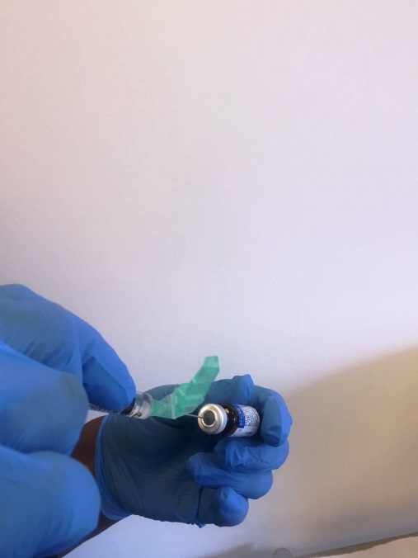
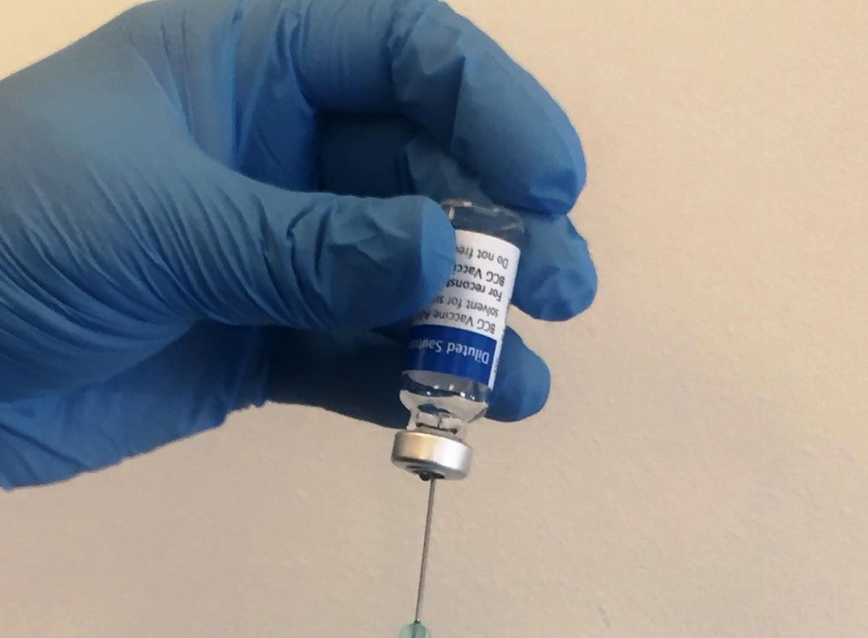
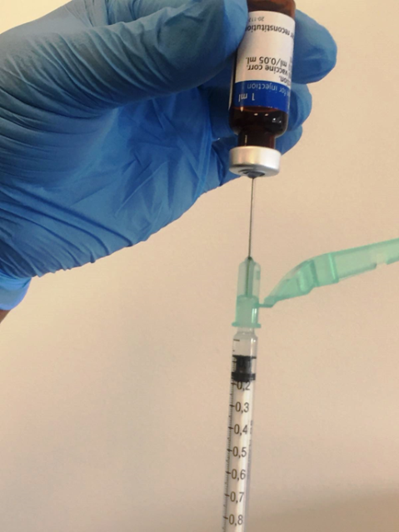
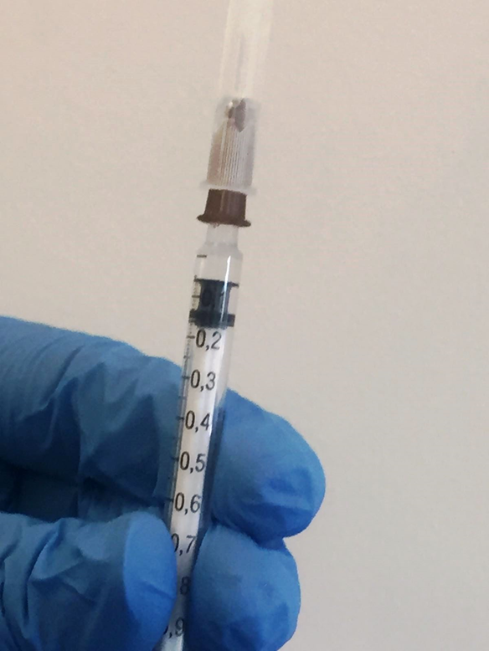
Preparation
1. With a long bevelled needle constitute the BCG diluent and the freeze-dried powder.
2. Remove needle and syringe and gently invert or swirl the vial to mix vaccine – do not shake vigorously.
3. Using a long bevelled needle fitted to a 1ml graduated syringe, draw just above the required dose with needle (no air bubbles) to be left in the syringe.
4. Remove and attach firmly the short-bevelled needle and prime to remove any excess vaccine/air.
Constituted vaccine should be used within 4 hours.
5. Primed needle to the require dose now ready to administer the vaccine through the intradermal technique.
1b
1a
2a
3
4 & 5
9 Administering BCG Vaccination
Notes:
0.05ml for infants under 12 months
0.1ml for children aged 12 months or older
In all cases, BCG vaccine must be administered strictly intradermally, normally into the lateral aspect of the left upper arm at the level of the insertion of the deltoid muscle (just above the middle of the left upper arm – as recommended by WHO).
Sites higher on the arm, and particularly the tip of the shoulder, are more likely to lead to keloid formation and should be avoided

Slide 10
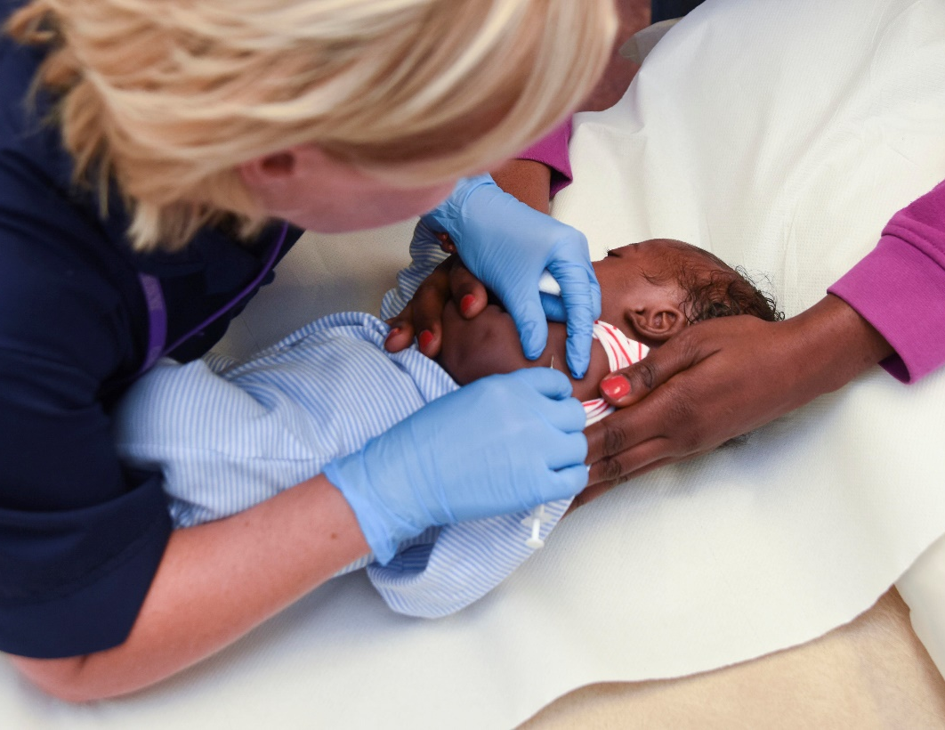
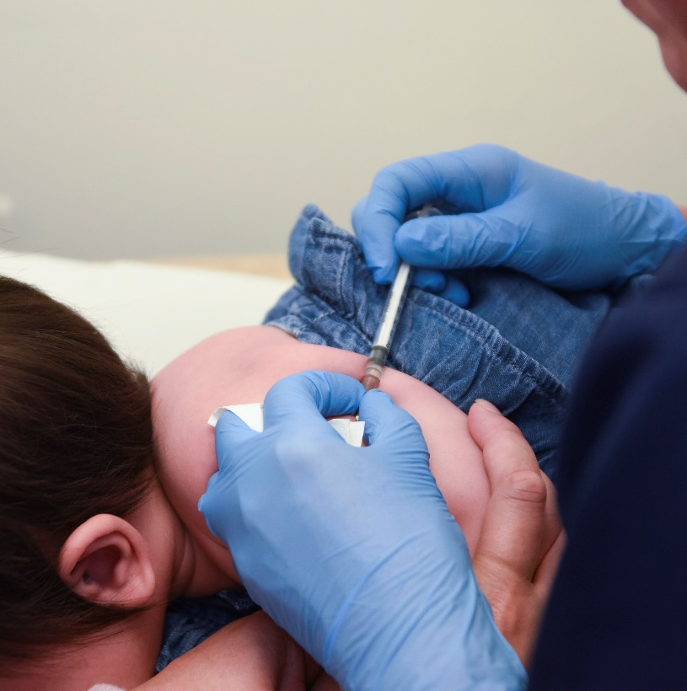
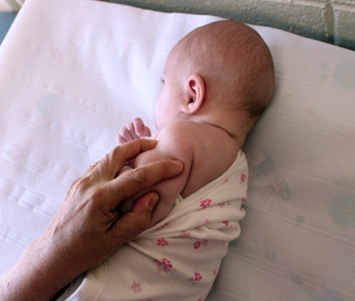
Positioning infants and younger children for intradermal administration of BCG vaccine
Photographs courtesy of Emma Gluba and Della Milne
10 Administering BCG Vaccination

Slide 11
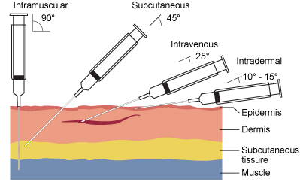
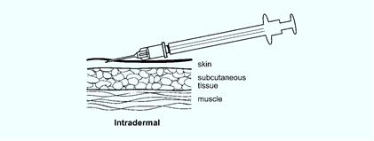
BCG vaccine must be administered strictly intradermally
The type of syringe and needle size is important to ensure correct administration of the intradermal injection (jet injectors and multiple puncture devices should not be used)
1ml graduated syringe or tuberculin syringe
26G 10mm (0.45mm x 10mm) short bevelled needle

Slide 12
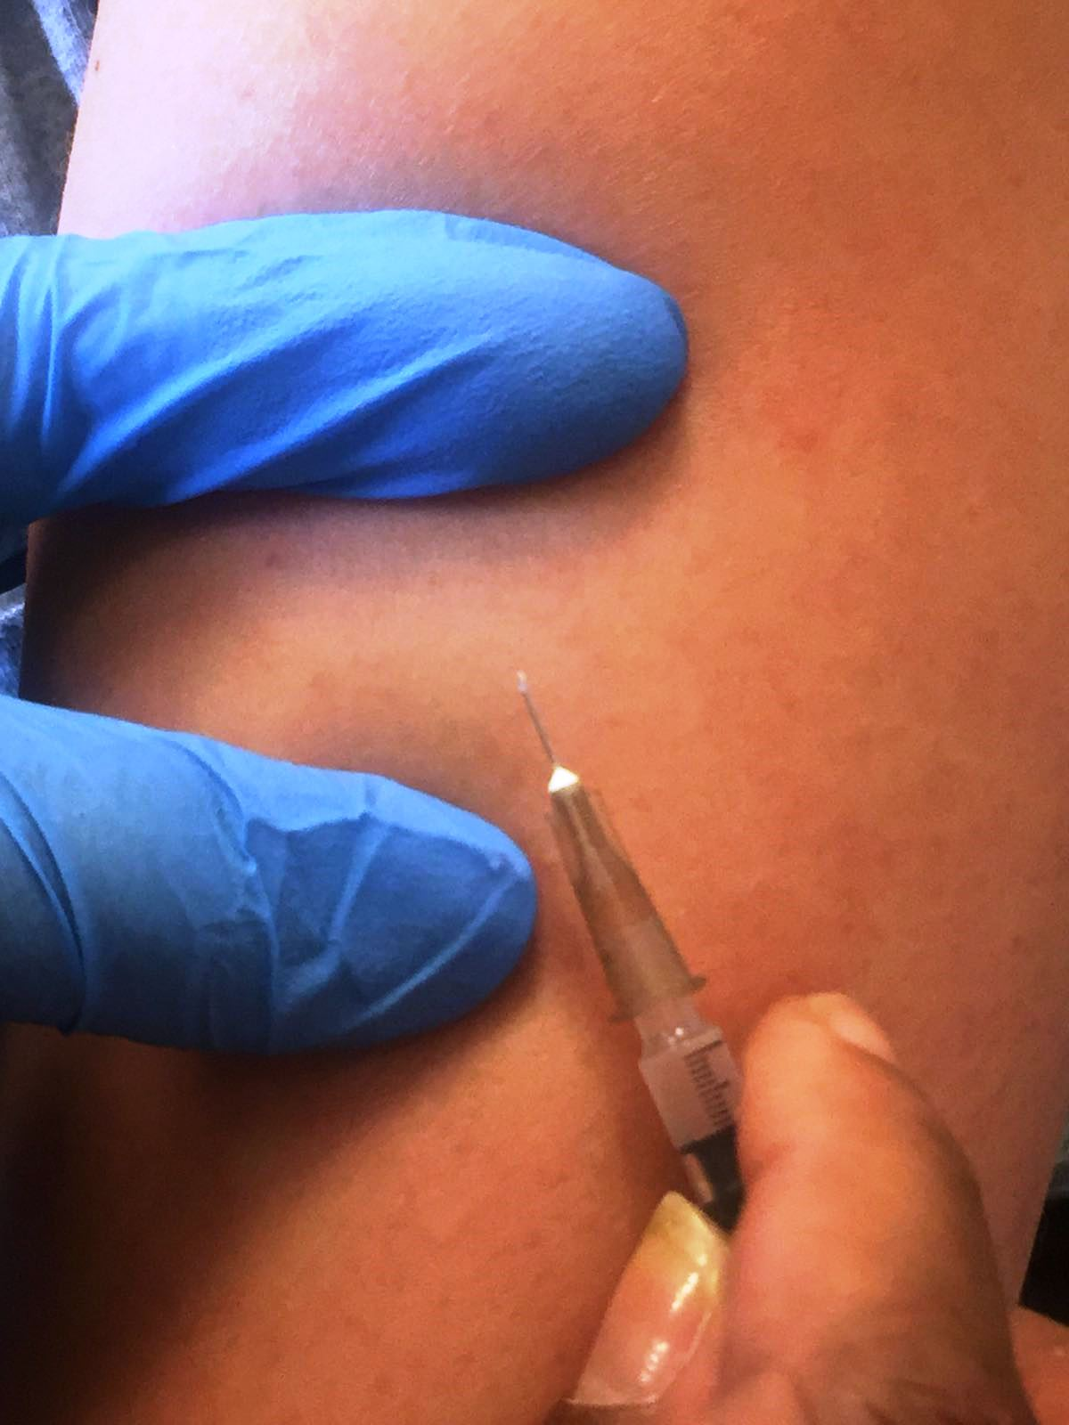
Intradermal technique of administering BCG vaccine
It is not necessary to disinfect the skin. If the skin is visibly dirty it should be washed with soap and water.
the intradermal injection is administered
with the bevel facing up
12 Administering BCG Vaccination

Slide 13
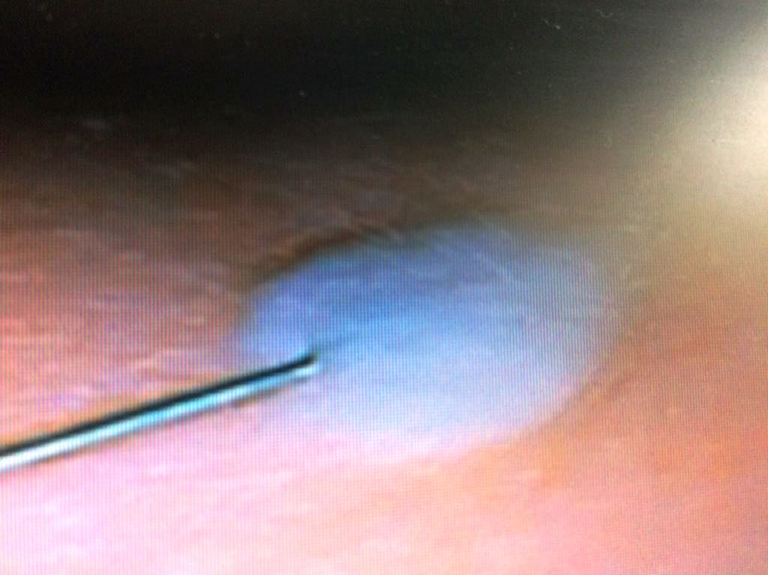
Intradermal technique of administering BCG vaccine
a correctly given intradermal injection results in a tense, blanched, raised bleb, and considerable resistance is felt when the fluid is being injected
A bleb is typically of 7mm diameter following
a 0.1ml intradermal injection, and 3mm
following a 0.05ml intradermal injection
If little resistance is felt when injecting and
a diffuse swelling occurs as opposed to a tense
blanched bleb, the needle is too deep the needle
should be withdrawn and reinserted intradermally
before more vaccine is given
A bleb should appear during administration and be
visible after vaccination
You can download and watch this video which shows the intradermal technique here:
https://bit.ly/2opWyBv
13 Administering BCG Vaccination
Notes:
The intradermal technique video can be found here: https://bit.ly/2opWyBv.
You can download and watch this video on your computer.
Please use slideshow mode From current slide to hover over URL (address for video).

Slide 14
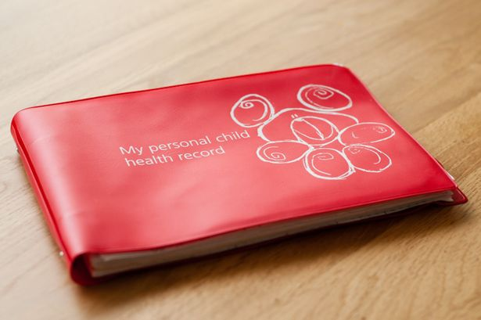
Documentation
Local BCG recording mechanism
Child Health Information System
Red book
14 Administering BCG Vaccination
Notes:
SCID SCREEN OUTCOME
Vaccine & Solvent batch numbers
Expiry dates
Dosage (0.05ml for under 1 year old and 0.1ml for 1 year and above)
Date and time vaccine was administered
Injection site lateral aspect of left upper arm at the level of the insertion of the deltoid muscle
Clinic area/site
Immunisers name, signature & designation
Any relevant changes e.g. name/address/DOB

Slide 15
BCG immunisation: expected reaction and after care
the expected reaction to successful BCG vaccination, seen in 90 to 95% of recipients, is induration at the injection site followed by a local lesion which starts as a papule 2 or more weeks after vaccination
the local lesion may ulcerate and then slowly subside over several weeks or months to heal, leaving a small, flat scar
the reaction to BCG may also include enlargement of a regional lymph node to less than 1cm
15 Administering BCG Vaccination
Notes:
Explain to parent nature of the BCG vaccination – majority of recipients will have a local reaction, around 5-10% do not.

Slide 16
Care of the immunisation site
it is not necessary to protect the site from becoming wet during washing and bathing
the injection site is best left uncovered to facilitate healing
the ulcer should be encouraged to dry, and abrasion (by tight clothes, for example) should be avoided
should any oozing occur, a temporary dry dressing may be used until a scab forms. It is essential that air is not excluded
if absolutely essential (for example, to permit swimming), an impervious dressing may be used but it should be applied only for a short period as it may delay healing and cause a larger scar
the possibility of bacterial superinfection in a discharging lesion should be considered
16 Administering BCG Vaccination
Notes:
Topical application of creams to be avoided if BCG site is hot and red or discharging, refer to GP or TB specialist team for further assessment

Slide 17
Post BCG immunisation
further observation after routine vaccination with BCG is not necessary, other than as part of monitoring of the quality of the programme, nor is further tuberculin testing recommended
no further immunisation should be given in the arm used for BCG immunisation for at least 3 months because of the risk of regional lymphadenitis
17 Administering BCG Vaccination
Notes:
Mantoux testing after BCG to check for immunity does not correlate with immunity

Slide 18
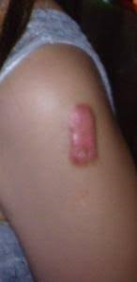
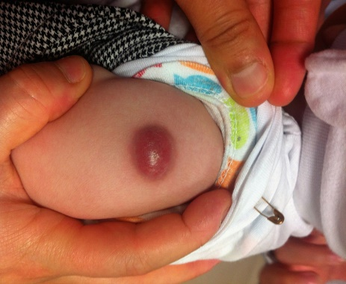
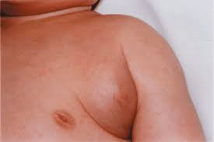
Where should I report adverse incidents?
As with any vaccine, suspected adverse reactions to BCG Vaccine AJV should be reported to the MHRA using the Yellow Card scheme and refer to TB specialist team.
Photographs courtesy of Della Milne, Essex Milne Partnership University Foundation Trust
https://yellowcard.mhra.gov.uk/
18 Administering BCG Vaccination
Notes:
Can be caused by poor technique-
sites higher than the recommended site (insertion of deltiod muscle) particularly the tip of the shoulder are more likely to lead to keloid formation and should be avoided

Slide 19
Suggestions for running a smooth BCG clinic
have a dedicated infant BCG clinic only – more efficient
organised pre-BCG clinic list
SCID result available (from day 17) ideally or, if possible, before appointment for BCG is posted out
send out to parents or guardian consent form and checklist prior to appointment to pre-complete prior to clinic appointment
useful to send out Commonly Asked Questions/BCG information with the above
ensure clinic flow is in line with COVID-19 IPC measures, for example, limit to 1 parent or guardian per baby, limit numbers of people in waiting room
letters to include information if interpreter is required, so interpreter can be booked beforehand
or those who do not attend, contact by phone if possible, letters to GP, contact Health Visitor – please refer to schedule 2, 4 and 6
BCG letter template for GPs (sent within 5 days of BCG vaccination) – please refer to schedule 2 , 4 and 6)
Child Health to be informed within 5 days of BCG vaccination (or outcome) – please refer to schedule 2,4 and 6
19 Administering BCG Vaccination

Slide 20
Further reading and references
Chapter 32 in the Green Book for further details regarding BCG vaccination
Updated UKHSA PGD template
WHO
NICE TB Guidance
Tuberculosis management
20 Administering BCG Vaccination

