Slide 1

Introduction to Tuberculosis

Slide 2

Aims of this session
By the end of this session, you should have a basic understanding of:
  history of TB & Epidemiology
  what is TB?
  transmission, diagnosis & treatment
  prevention and control
2 Introduction to Tuberculosis
Notes:
By the end of the session you will have gained some background into the history of TB, current Worldwide and UK epidemiology, what is TB, how its transmitted, diagnosed and treated and will end on some programmes and actions taken to prevent the spread of TB and identify TB before it becomes active.

Slide 3
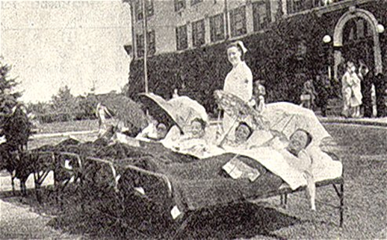
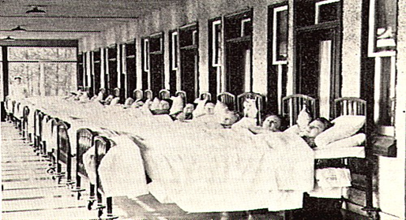
History
2400bc
  Egyptian mummies
19th Century
  Bacilli discovered
20th Century
  120000 cases
  ‘White Plague’
  traumatic interventions
1944
  antibiotic – Streptomycin
  first successfully treated case
3 Introduction to Tuberculosis
Notes:
TB is one of the oldest human diseases, it has been hypothesized that it originated more than 150 million years ago. One of the first documented evidence of TB were TB lesions identified on the spines of Egyptian mummies. In the middle ages it was known as Scrofula, a disease affecting lymph nodes and known in England and France as the ‘King’s Evil’ as it was believed to be healed after a royal touch. Despite awareness of it infectious nature it took until 1882 for the bacilli to be discovered by Dr Robert Koch.
At the start of the 20th Century there was 120000 notifications in England & Wales and it was known as the “White Plague” due to the paleness of the skin of those affected by the disease, with New York & London being the 2 worst effected cities in the world. Despite the bacilli being discovered in 1882 it took until 1944 when the first antibiotic was used. Until then people sick with TB were sent to TB sanatoriums and faced traumatic thoracic surgery or unpleasant interventions in an attempt to treat the disease.
In 1944 we saw the first successfully treated case with Streptomycin – however drug resistance was soon discovered with the use of just 1 antibiotic leading to multi-drug regimes still used today.

Slide 4
TB incidence and mortality rates in England and Wales, 1913 to 2018
WWI
Improvement in living standards
WWII
Chemotherapy
BCG
Pasteurisation
Short course therapy
Source: Enhanced Tuberculosis Surveillance System (ETS), Office for National Statistics (ONS)
4 Introduction to Tuberculosis
Notes:
England and Wales has collected surveillance data on TB since 1913 which allows us to see how incidence and mortality has changed over time
As you can see from this diagram we saw a major decline from the beginning of the 20th century with a couple of peaks linked to world war I and II. This decline was due to improved public health measures – before BCG or curative drugs became available.
This decline continued in the 1950s with the advent of TB drugs, BCG vaccination and pasteurisation of milk. This continued into the 1980’s when it was thought that we were close to eradicating TB and funding for TB services were drastically reduced. Unfortunately we then saw a gradual rise in cases linked to the rise of drug resistance and the emergence of HIV. In response to the resurgence of TB, the World Health Organization issued a declaration of a global health emergency in 1993.

Slide 5
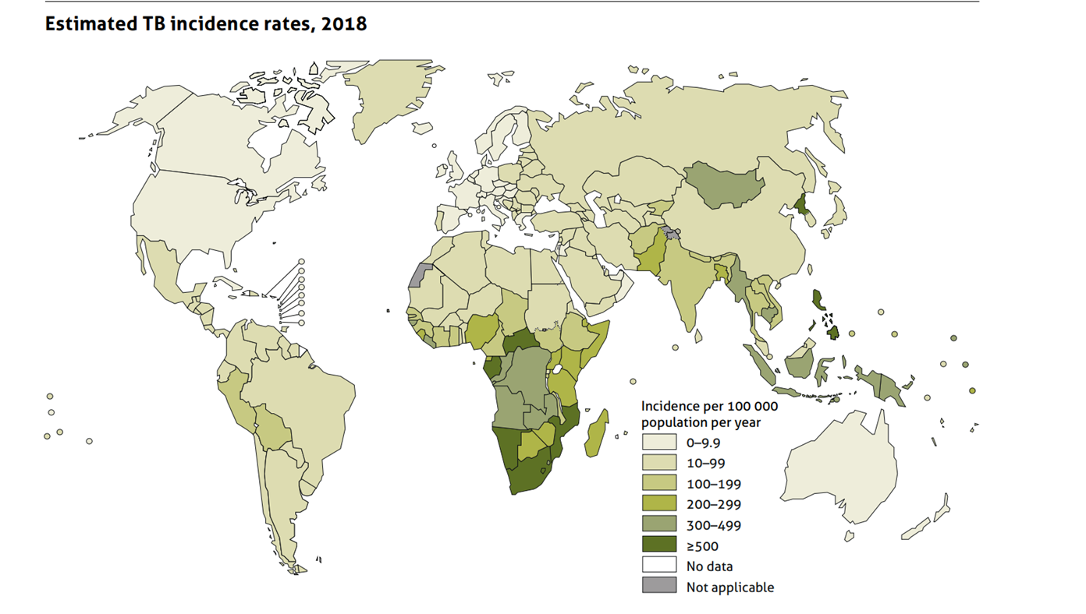
Worldwide picture
TB is curable and preventable but:
in 2019, an estimated 10 million people fell ill with tuberculosis (TB) worldwide – 5.6 million men, 3.2 million women and 1.2 million children
a total of 1.4 million people died from TB in 2019 (including 208 000 people with HIV – worldwide, TB is one of the top 10 causes of death and the leading cause from a single infectious agent (above HIV/AIDS)
30 high TB burden countries accounted for 87% of new TB cases; 8 countries account for two thirds of the total, with India leading the count
multidrug-resistant TB (MDR-TB) remains a public health crisis and a health security threat. In 2018, there were estimated half a million new cases with resistance to rifampicin of which 78% had MDR-TB
TB treatment saved about 58 million lives globally between 2000 and 2018 with a treatment success rate of 85% in 2017
global commitment to end the TB epidemic by 2035, with targets of reducing TB deaths by 90% and TB incidence by 80%
5 Introduction to Tuberculosis
Notes:
Today 28 years later. TB remains present in all countries and all age groups, it remains a curable and preventable disease but…………………
In 2019 whilst TB deaths have reduce from 3 million in 1993 to 1.4 million, 10 million people were still diagnosed with TB, of those 5.6 million were men, 3.2 million women and 1.2 million children. TB continues to be the leading killer in those diagnosed with HIV.
There are 30 high TB burden countries which accounted for 87% of new TB cases and 8 countries account for two thirds of the total, with India leading the count, followed by Indonesia, China, the Philippines, Pakistan, Nigeria, Bangladesh and South Africa.
Multi-drug resistant TB continues to be an emerging concern with an estimated half a million new cases resistant to one of the most effective first line agents and of these 78% were resistant to more than 1 drug. Unfortunately we are now seeing cases of Extensively drug-resistant TB (XDR-TB) which is a form of TB that responds to even fewer available medicines.
However on a more positive note between 2000 to 2018 TB treatment did save 58 million lives.
End the TB epidemic by 2035 is among the health targets of the United Nations Sustainable Development Goals working closely with the WHO with some of the main targets to reduce TB deaths by 90% and incidence of TB by 80%

Slide 6
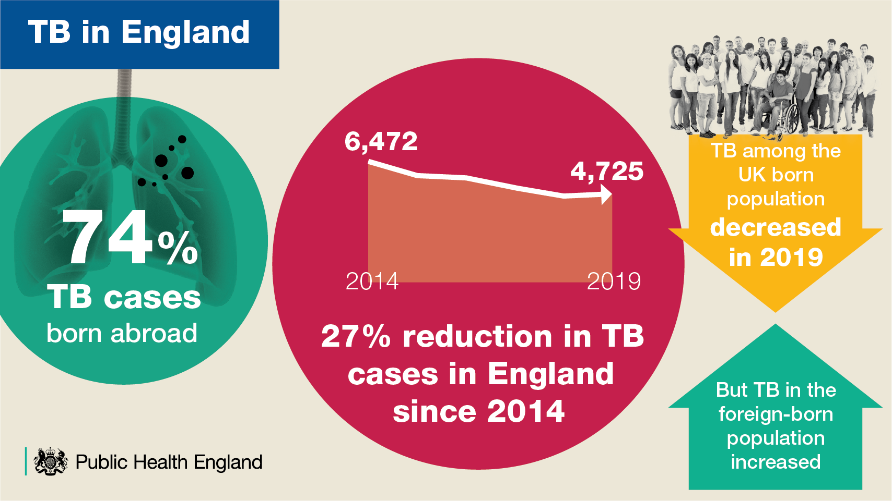
Notes:
Closer to home, England saw a 27% reduction in TB cases between 2014 and 2019. Rates of TB continue to be higher amongst those born abroad accounting for 74% of all notifications with London being the worst affected city notifying 1,665 cases in 2019. One of our emerging concerns in England are those with social risk factors where we have seen an increase from 9.8% in 2014 to 13.8% in 2019. Those with SRF’s often delay accessing healthcare and present late. They are therefore one and a half times more likely to present with infectious TB and one and a half times more likely to die. The TB Action Plan for 2021 to 2026 was recently published in England and is focusing on 5 priority areas to support a year on year reduction in TB incidence enabling the UK to meet its commitment to the WHO elimination targets.

Slide 7
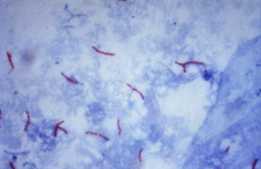
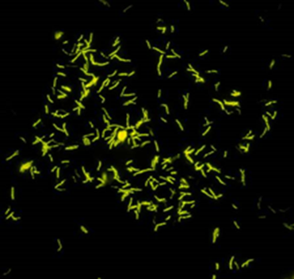


What is tuberculosis (TB)?
TB is a bacillus, meaning rod shaped bacteria: it is from the genus mycobacteria
it usually affects the lungs but can present in any part of the body
only TB of the lungs or throat are infectious
TB is spread through the air from one person to another by inhalation of droplets
it usually requires prolonged close contact but people with weakened immune systems are at more at risk of catching TB
not everyone infected with TB bacteria becomes sick
7 Introduction to Tuberculosis
Notes:
what is TB?
TB is a bacillus which means a rod shaped bacteria and from the genus mycobacteria, it commonly affects the lungs but can appear anywhere in the body such as kidneys, spine, or brain. Only TB of the lungs and throat are infectious and is spreads from person to person when someone with infectious TB coughs, talks, sings, laughs or sneezes and those in close proximity inhale droplets. It usually requires close prolonged contact but increasing evidence is showing that those with weakened immune systems due to certain health conditions or medication may catch TB after much shorter exposure.

Slide 8
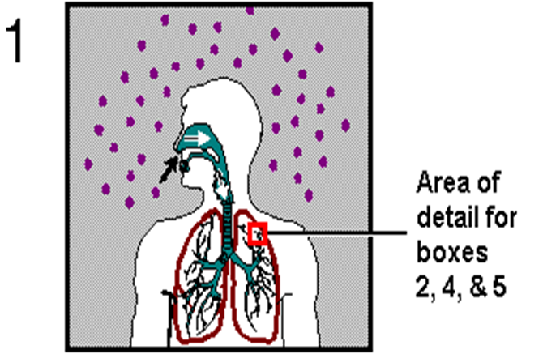
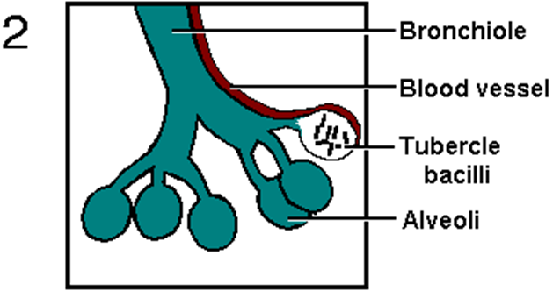
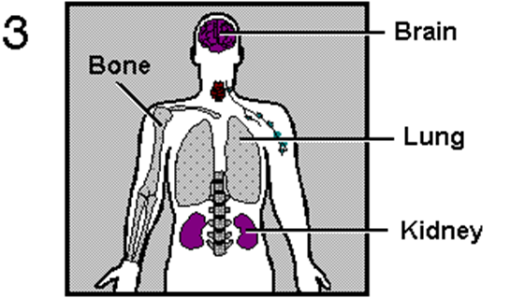
Aetiology, pathogenesis & transmission of TB
TB bacilli are inhaled, enter the lungs and travel to the alveoli
TB bacilli multiply in the alveoli
a small number of TB bacilli enter the bloodstream and spread throughout the body
the bacilli may reach any part of the body
8 Introduction to Tuberculosis
Notes:
what happens next!
When TB bacilli are inhaled, it enters the lungs and travels to the alveoli where it multiples. A small number of TB bacilli enter the bloodstream and spread throughout the body. The bacilli may reach any part of the body. NEXT SLIDE please

Slide 9
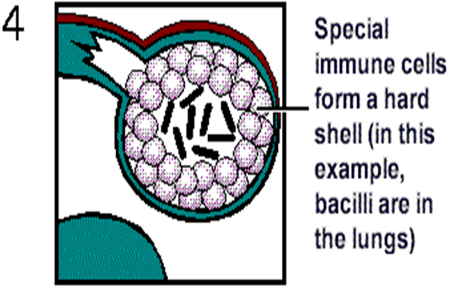
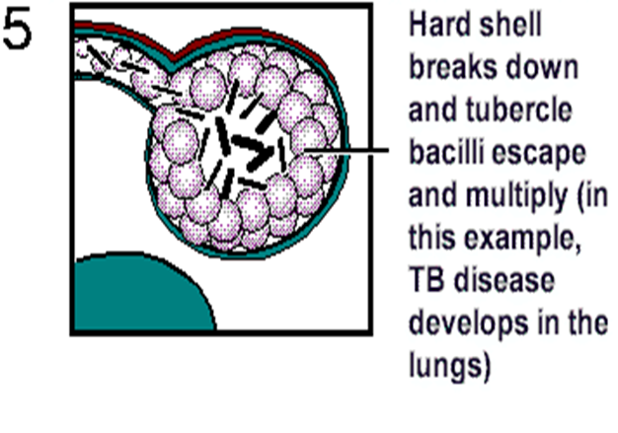
Aetiology, pathogenesis & transmission of TB
Within 2 to 10 weeks, the immune system produces immune cells called macrophages that surround the TB bacilli.
Then 1 of 3 things happens:
  immune system destroys the infection
  immune system ‘walls off; infection – Latent TB (LTBI)
  immune system fails to control the bacilli and it begins to multiply – Active TB
  Of those infected:
  5% will progress to disease <2 years
  5% will progress to disease sometime in their lifetime
9 Introduction to Tuberculosis
Notes:
Within 2 to 10 weeks, the immune system produces immune cells called macrophages that surround the TB bacilli.
Then 1 of 3 things can happen:
The immune system may destroy the infection OR
Special immune cells form a hard shell called a granuloma walling off the infection and keeping the bacilli contained and under control called latent or dormant TB infection OR
The immune system fails to keep the bacilli under control and the bacilli begin to multiply rapidly causing TB disease
Of those infected
5% will progress to disease within the first 2 years from exposure
5% will progress to disease some time in their lifetime

Slide 10
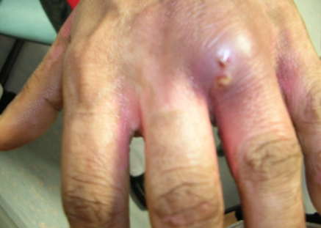
Sites of Disease
Pulmonary 57%
Lymph Nodes 33%
Gastrointestinal 6%
Bone (inc spine) 5%
CNS (inc meningitis) 4%
Miliary 3%
Genitourinary 2%
Cryptic <1%
10 Introduction to Tuberculosis
Notes:
TB can affect any part of the body with the most common site being pulmonary accounting for 57% of all notifications followed by lymph node TB at 33%. But as you can see from this list TB can affect almost any part of the body from affecting multiple sites to just one site as we can see in the picture of the hand showing a small wound affecting the knuckle.

Slide 11


Risk factors for TB
Consider:
country of birth or travel history
previous TB contact
immunosuppression – due to disease or medication
living condition – homelessness, poor housing or overcrowding
social risk factors
11 Introduction to Tuberculosis
Notes:
The key to diagnosing TB is to ‘Think TB’ in the first place and so it is really important to first understand those that are at risk. We need to consider where people have lived or travelled, whether they have had previous exposure to TB and could have had LTBI which has now reactivated, those with health conditions that weaken their immune system, the living conditions of individuals and those with low incomes and therefore likely poor nutrition. But we also need to be aware that despite how long TB has been around, also to important to note that stigma associated with TB prevents people seeking help or accepting a the diagnosis.
Remember that although certain risk factors increase your chances of getting TB, TB can affect any age group, ethnic group or social class’

Slide 12
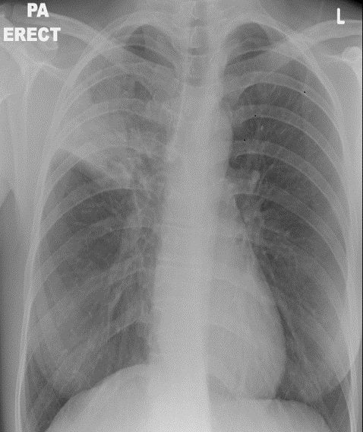
Typical presentation of pulmonary TB
Symptoms:
cough, sputum, sometimes haemoptysis, night sweats, fevers, weight loss, fatigue
Examination may show:
clubbing fingers or toes (advanced disease)
enlarged LN in neck or other areas
unusual breath sounds (crackles)
Diagnosis:
CXR
sputum microscopy, culture (x3 AFB) or bronchial washings
12 Introduction to Tuberculosis
Notes:
A typical presentation of pulmonary TB.
Patients with symptoms of pulmonary TB commonly report a history of a prolonged cough of at least 3 weeks or longer which is usually productive, with drenching night sweats and unexplianed weight loss. They may also report coughing up blood in more advance stages of disease. Diagnosis of pulmonary TB requires a CXR and collection of sputum or bronchial samples which are sent to microbiology for TB culture. It is vital that samples are collected as this not only helps identify the TB bacteria but also provides drug sensitivities to ensure that patients are treated with the correct drug regimens.

Slide 13
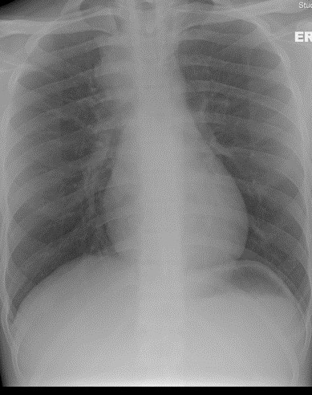
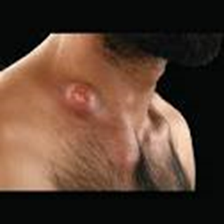
Typical presentation of lymph node TB
Symptoms:
systemic symptoms absent or less severe than pulmonary
Examination:
lack of erythema and warmth
start off discrete, later mat together, and, as necrosis develops, may discharge
Diagnosis:
histology
culture
CXR (in case also has Pulmonary TB /Pulmonary should always be excluded)
13 Introduction to Tuberculosis
Notes:
Typical presentation of lymph node TB.
Nearly half of non-respiratory TB in UK occurs in peripheral LN, mainly cervical
Other than swellings or localised pain, a patient may not have any other systemic symptoms that are often associated with TB. There is often a delay in diagnosing extra-pulmonary TB as it can mimic other disease and conditions. So once again important to think TB, considering risk factors alongside ensuring samples are obtained for TB culture. Even if a patient reports no lung symptoms a CXR should always be done this may give you the opportunity to obtain spontaneous samples easily if there is also evidence of pulmonary TB but also provides information on possible risks to others for contact tracing following a diagnosis.

Slide 14
Treatment for active TB
Standard treatment for TB is a minimum of 6 months:
2 months (initial phase) of Isoniazid, Rifampicin, Pyrazinamide and Ethambutol. Known as standard quadruple therapy
Followed by:
4 months (continuation phase) of Isoniazid and Rifampicin. Known as standard dual therapy
N.B. If there is central nervous system involvement the continuation phase of treatment is extended to 10 months making a 12 month full treatment plan
TB treatment is taken all together on an empty stomach 1 hour before breakfast; compliance is essential for cure
14 Introduction to Tuberculosis
Notes:
Standard treatment for tuberculosis consists of 4 antibiotics for the initial phase of 2 months followed by 2 antibiotics for the 4 months continuation phase. Some regimes are longer as in TB meningitis when 12 months of treatment is required to cure the disease and even longer treatment regimen when there is drug resistance detected hence why the collection of samples for TB culture is important so that patients receive the correct care and treatment.
Compliance is especially important for good treatment outcomes and patients are allocated TB nurse case managers to help support them through treatment which can be difficult due to side-effects to the medication, can be difficult due to the length of treatment or can be challenging for those where other social risk factors such as homelessness, alcohol & drug misuse have an impact on individuals managing their treatment. In some cases the TB team will Directly observe treatment known as DOT to give additional support to patients.

Slide 15
Control and prevention of TB
The TB Action Plan for England 2021 to 2026
the aim of the TB Action Plan is to improve the prevention, detection and control of TB in England. It will focus on the needs of those affected by TB and TB services whilst recognising the impact and learning of the coronavirus (COVID-19) pandemic
the TB Action Plan will support a year-on-year reduction in TB incidence and in-UK TB transmission and enable the UK to meet its commitment to the World Health Organization (WHO) elimination targets by 2035.
the 5 key priorities of the TB Action Plan are:
  Priority 1 – Recovery from COVID-19
  Priority 2 – Prevent TB
  Priority 3 – Detect TB
  Priority 4 – Control TB disease
  Priority 5 – Workforce
15 Introduction to Tuberculosis
Notes:
Control & Prevention
The TB Action Plan for England for 2021 to 2026 was published with the aim to improve the prevention, detection and control of TB in England aiming for a year on year reduction of TB rates in the UK whilst contributing to the global picture and the aims of the World Health Organisations targets set for 2035. The action plan sets out 5 key priorities of focus for the next 5 years as listed. Each priority has a set of actions, outcomes and indicators with the aim that working groups supported by a National TB Action Plan implementation Group will focus on individual priorities and actions. The key to its success will be collaborative multi-stakeholder engagement for its delivery. It also highlights actions for specific population groups where there may have been key challenges in TB control identified in the previous TB Strategy.

Slide 16

Early Diagnosis
If you see a person who is unwell, tired, maybe with unexplained weight loss, maybe feverish, perhaps with swollen lymph glands or a cough for 3 weeks or longer…..
….. if they come from a high risk group/previous contact with TB
…. could it be TB?
16 Introduction to Tuberculosis
Notes:
Early diagnosis is a key element of stopping the spread of TB. We need to remember to THINK TB in patients who present with the above symptoms and come from a high risk group. BUT we also need to remember that TB can present in many different ways and a persistent back pain with no known cause or injury in someone from a high risk group could be a missed diagnosis of spinal TB.

Slide 17
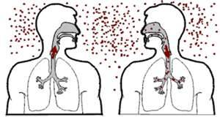
Contact tracing
Contact tracing is important because:
1% of contacts screened have active TB
10% of contacts screened have latent TB infection
if infected, 10 to 20% of child contacts under 1 year are at risk of developing meningeal or disseminated TB
if infected, 30 to 40% of child contacts under 1 year are at risk of pulmonary or mediastinal lymphatic disease
17 Introduction to Tuberculosis

Slide 18
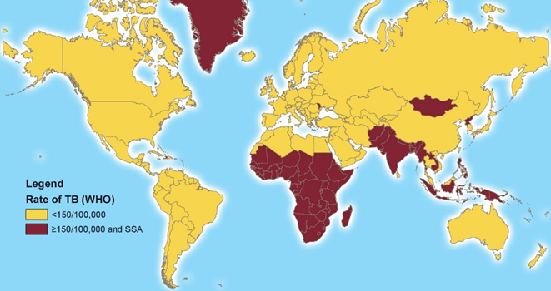
NE LTBI Screening Programme
The latent TB Infection (LTBI) programme tests new entrants to the UK based on eligibility criteria.
These are:
born or spent more than 6 months in a high TB incidence country (≥150/100,000 or Sub Saharan Africa)
entered the UK within the last 5 years (including entry via other countries)
aged between 16 to 35 years
no previous history of TB or LTBI
not previously screened for LTBI in the UK
18 Introduction to Tuberculosis
Notes:
The national latent TB infection (LTBI) testing and treatment programme has been in place since 2015 and was one of the key actions of the previous TB strategy 2015-2020. It is funded by NHS England and implemented locally by CCG’s in either primary or secondary care
The LTBI programme tests new entrants to the UK on the above criteria. Since its launch in 2015 until March 2019 just over 45,000 LTBI tests have been performed. Of those 17% were positive for latent TB. 64% of people with a positive test commenced preventative TB treatment and of those 69% completed the course.

Slide 19
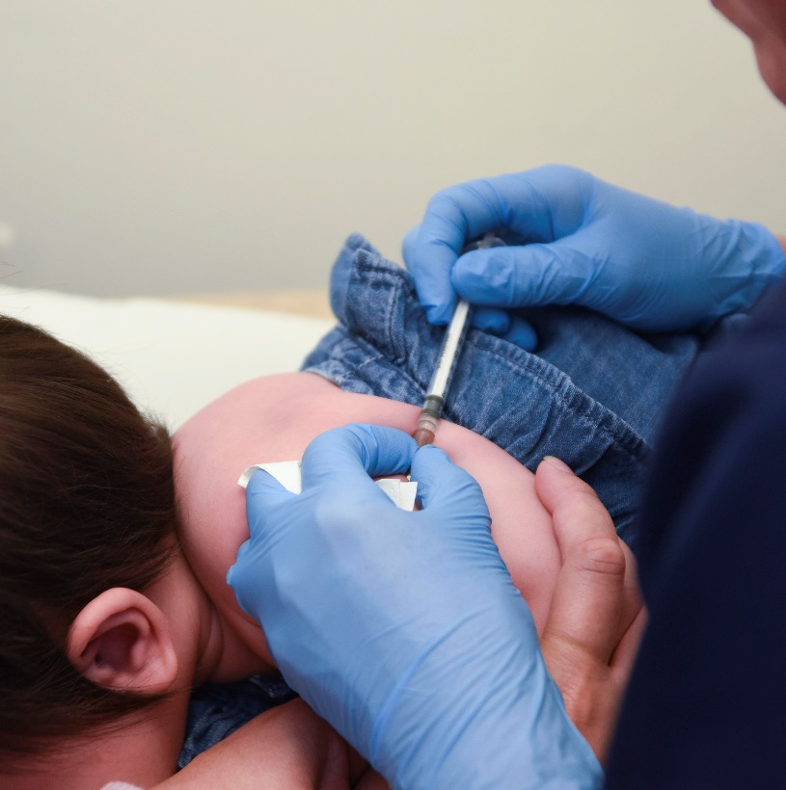
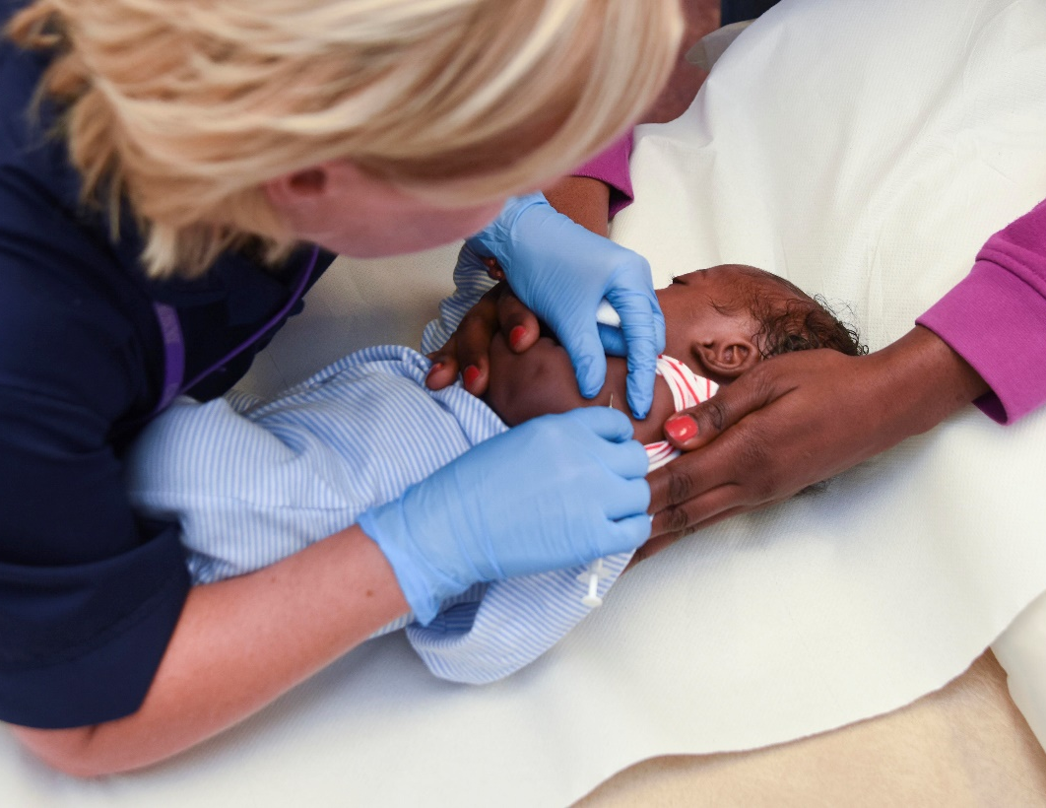
BCG Vaccination
The aim of the BCG Immunisation Programme is to protect those who are at an increased risk from exposure to TB and developing disease.
19 Introduction to Tuberculosis
Notes:
the BCG vaccination programme is aimed at those most at risk of developing TB. Whilst BCG does not necessarily stop people from getting TB there is good evidence that it can protect babies and young children from developing severe forms of disease.
Further information can obtained from chapter 32 in the Green Book
Also refer to introduction of SCID evaluation and moving timing from at birth to at 28-days slide set and BCG vaccination administration slide set

Slide 20
References and further reading
Tuberculosis: NICE, January 2016
The Truth About TB
UKHSA website (Tuberculosis) – for TB annual report
The Green Book
The TB Action Plan 2021 to 2026
National latent TB infection testing and screening programme
Collaborative TB Strategy for England 2015 to 2020
Tuberculosis contact investigation in low prevalence countries: a European consensus
20 Introduction to Tuberculosis

