Slide 1
Hepatitis C in England 2022 report Working to eliminate hepatitis C as a public health problem Data to end of December 2020

Slide 2
Prevalence of HCV infection in England
The estimated prevalence of chronic HCV infection in England has continued to decline to around 81,000 (95% credible interval: 66,000 to 94,000) in 2020.
Of the 81,000 people living with chronic HCV, modelling suggests 27% of these infections are in people with current or recent drug injecting risk, 62% are in those with a past drug injecting history but who are no longer injecting, and 11% are in those with no history of injecting.
Note: For the full context of this slidedeck, please refer to the Hepatitis C in England 2022 report.

Slide 4
Estimates of chronic prevalence of HCV in England, 2010 to 2020 (bars represent 95% credible intervals)(25)
Data source: Modelled estimates of chronic HCV prevalence (see Appendix 3, section 1 of the full report), based on HCV prevalence data from the Unlinked Anonymous Monitoring Survey of People Who Inject Drugs (4); estimates of the number of people who inject drugs (26); Hospital Episode Statistics (HES), NHS Digital for England. Produced by UKHSA (data on severe HCV-related liver disease); Trent cohort data (estimates of disease progression probabilities) and data on HCV treatment (IMS sales data, Sentinel Surveillance of Bloodborne Virus Testing and the NHS England Hepatitis C Patient Registry and Treatment Outcome System).
Notes:
The estimated prevalence of chronic HCV infection in England has continued to decline to around 81,000 (95% credible interval: 66,000 to 94,000) in 2020.
Of the 81,000 people with chronic HCV, modelling suggests 27% of these infections are in people with current or recent drug injecting risk, 62% are in those with a past drug injecting history but who are no longer injecting, and 11% are in those with no history of injecting.

Slide 5
Prevalence of HCV infection in people who inject drugs (PWID)
Data from the UAM Survey suggests the prevalence of chronic HCV infection in PWID to be 17.3% in 2020 (23.8% in 2019; 28.7% in 2015), although 2020 data is provisional given the difference in geographical distribution of samples collected in 2020 during the COVID-19 pandemic, the change in risk profile of participants, and the smaller sample size (4).
Increases in those ever infected with HCV, combined with recent decreases in chronic HCV infection, among PWID between 2015 and 2020 suggest that increased access to treatment, rather than improved harm reduction, is the main driver of the reduction in prevalence of chronic HCV infection among PWID.

Slide 6
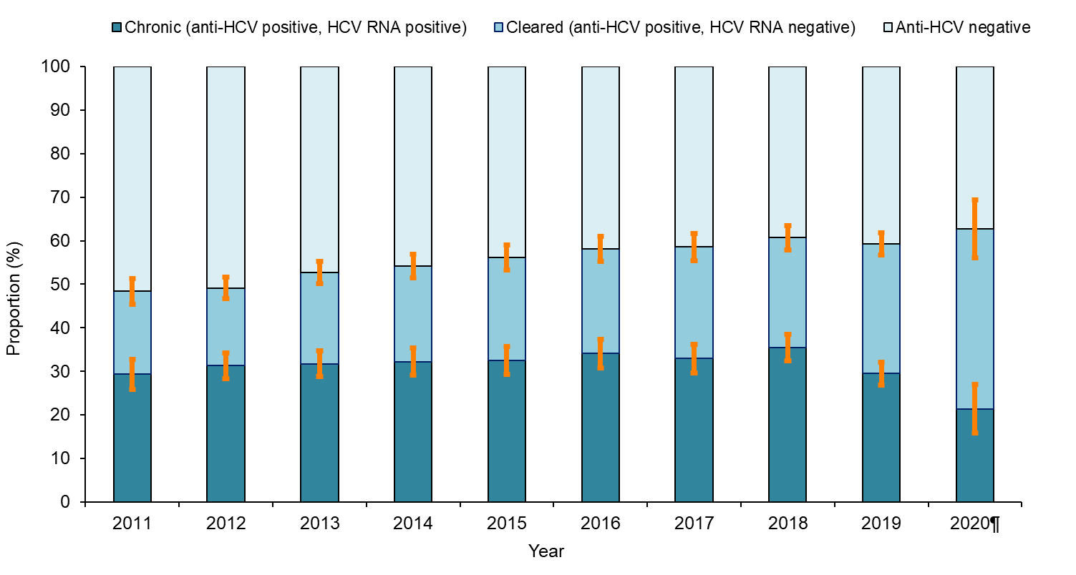
Trend in HCV prevalence* among people injecting psychoactive drugs in England: 2011 to 2020
Data source: Unlinked Anonymous Monitoring Survey of people who inject drugs in contact with specialist services (4)
Notes:
* Estimates for chronic and cleared HCV infection have been adjusted to take into account anti-HCV positive samples with missing RNA status. The ratio of chronic or cleared infection was applied to the anti-HCV positive samples with missing RNA status by year and region. Note: chronic prevalence in 2019 and 2020 without adjustment for insufficients was near identical at 23.8% and 18.7% respectively.
¶ Due to limitations in recruitment as a result of the COVID-19 pandemic, 2020 data is provisional.
Data suggests the prevalence of chronic HCV infection in PWID to be 17.3% in 2020 (23.8% in 2019, 28.7% in 2015) although 2020 data is provisional given the difference in geographical distribution of samples collected in 2020 during the COVID-19 pandemic, the change in risk profile of participants, and the smaller sample size (4).
Increases in those ever infected with HCV, combined with recent decreases in chronic HCV infection among PWID, between 2015 and 2020 suggest that increased access to treatment, rather than improved harm reduction, is the main driver of the reduction in prevalence of chronic HCV infection among PWID.

Slide 7
Incidence of HCV infection
Whilst alternative ways of monitoring HCV incidence need to be considered, proxy measures based on HCV prevalence suggest some progress has been made, with modelled estimates showing a decrease in HCV prevalence of 37% among the general population, and provisional UAM data showing a relative percentage decrease of 40% among PWID, between 2015 and 2020.
Preliminary estimates of reinfection following treatment using surveillance data suggest conservative reinfection rates of 8%, which are higher among those with a known history of injecting drug use (11%). Therefore, current evidence suggests more needs to be done to prevent new and reinfections.

Slide 8
Reducing the incidence of HCV infection (WHO impact target)
Impact target area | WHO GHSS 2020 target relative to 2015 baseline(3) | WHO GHSS 2030 target relative to 2015 baseline(3) | WHO interim guidance elimination validation target: annual absolute HCV incidence rates(2)
Incidence: New cases of chronic viral hepatitis C infection | 30% reduction | 80% reduction | ≤ 5/100,000 persons (≤2/100 for PWID)
Proxy measure: alternative WHO approach, but not adequate for validation of elimination |  |  | Reduction in HCV viraemia prevalence by 80% from 2015 baseline (in general population and PWID)
Progress in England
Proxy measure: reduction in HCV viraemia prevalence from 2015 baseline (in general population) |  |  | 37.2% by 2020* (31.0% by 2019)
Proxy measure: reduction in HCV viraemia prevalence from 2015 baseline (in PWID) |  |  | 39.7% by 2020** (17.1% by 2019)
* 2020 figures include provisional data from the UAM study, that may have been affected by COVID-19
** 2020 figures are provisional due to the impact of COVID-19 on national bio-behavioural surveys of BBV in PWID in 2020 (UAM Survey)
Notes:
Whilst alternative ways of monitoring HCV incidence need to be considered, proxy measures based on HCV prevalence suggest some progress has been made, with modelled estimates showing a decrease in HCV prevalence of 37% among the general population, and provisional UAM data showing a relative percentage decrease of 40% among PWID, between 2015 and 2020

Slide 9
HCV-related morbidity and mortality
Since 2015, HCV-related mortality fell by 35% by 2020.
This 35% fall has surpassed (more than 3-fold) the World Health Organization (WHO) 2020 elimination target of a 10% reduction by 2020 from the 2015 baseline.
The WHO interim target to reduce HCV-related mortality to less than or equal to 2 per 100,000 persons has already been hit in England (0.56 per 100,000 population in 2020).
By 2020, first hospitalisations for serious HCV-related liver disease were down 17% on levels in 2015.
By 2020, registrations for a first liver transplant in patients with HCV-related disease were down 40% on levels in 2015.

Slide 10
Reducing HCV-related mortality (WHO impact target)
Impact target area | WHO GHSS 2020 target relative to 2015 baseline(3) | WHO GHSS 2030 targets relative to 2015 baseline(3) | WHO interim guidance elimination validation target: annual absolute HCV-related mortality rate(2)
Mortality: Viral hepatitis C deaths | 10% reduction | 65% reduction | ≤ 2/100,000 persons
Progress in England
Mortality: Viral hepatitis C deaths | 34.9% reduction |  | 0.56 per 100,000 population (2020)*
Even if reporting of HCV on death certification has not improved beyond levels historically reported (51, 52) these preliminary figures suggest the 2030 WHO interim elimination metric has already been met.
Notes:
Since 2015, HCV-related mortality fell by 35% by 2020
This 35% fall has surpassed (more than 3-fold) the World Health Organization (WHO) 2020 elimination target of a 10% reduction by 2020 from the 2015 baseline
The WHO interim target to reduce HCV-related mortality to ≤2/100,000 persons has already been hit in England (0.56 per 100,000 population in 2020).

Slide 12
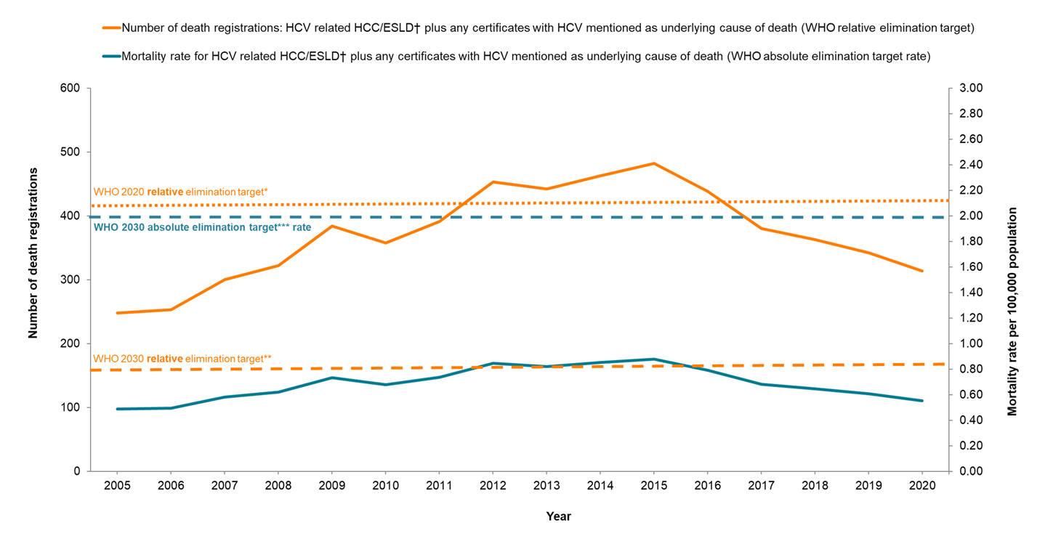
Death registrations and annual HCV-related mortality rates in England,¶ 2005 to 2020
Data source: Office for National Statistics (53)
Notes:
† Defined by codes or text entries for ascites, bleeding oesophageal varices, hepato-renal syndrome, hepatic encephalopathy or hepatic failure
¶ Excluding deaths registered in England when the deceased’s usual residence is outside England.
*10% reduction on 2015 level; **65% reduction on 2015 level; ***≤ 2/100,000 persons
Since 2015, HCV-related mortality fell by 35% by 2020
This 35% fall has surpassed (more than 3-fold) the World Health Organization (WHO) 2020 elimination target of a 10% reduction by 2020 from the 2015 baseline
The WHO interim target to reduce HCV-related mortality to ≤2/100,000 persons has already been hit in England (0.56 per 100,000 population in 2020).

Slide 13
Proportion of people with chronic HCV diagnosed (WHO programme target) and aware of their infection
National data and surveys suggest that more than half of people who inject drugs may be unaware of their chronic HCV infection
More needs to be done to improve diagnosis overall, including among people with past risk factors for infection.
In partnership with stakeholders, a variety of initiatives and resources have, or are being developed to help raise awareness of HCV and increase the numbers diagnosed, including through improved case finding and testing in both the general population and among risk groups. These are summarised, with live links, in the HCV in England 2022 report.
Notes:
In 2020, 40.4% of PWID sampled in the UAM Survey were aware of their current chronic infection (33.9% in 2019), a reduction from that seen in 2017 when this data was first available (58.2%).
The lower levels of awareness in 2019 and 2020 may be a result of increased UAM Survey recruitment through outreach services, compared to traditional recruitment through services offered at the drug service building. Participants recruited through outreach may have been less likely to be engaged with drug services, and thus less likely to be aware of their current HCV infection. Furthermore, as the majority were recruited through outreach BBV testing, they may have been tested for HCV alongside the UAM but not received their test results at the time of questionnaire completion, leading to underestimation of levels of awareness. This is supported by National Drug Treatment Monitoring System (NDTMS) data which suggest higher levels of awareness among people who have ever injected drugs newly presenting to drug or alcohol treatment in England in tax year 2019 to 2020 who had received an HCV test; 47% reported knowing their HCV ribonucleic acid (RNA) status, of whom 24% reported they were chronically infected with HCV.

Slide 14
Proportion of people with chronic HCV diagnosed (WHO programme target) and aware of their infection
Service coverage/programme target area | WHO EURO 2020 target(6) | WHO GHSS 2030 target (3) | WHO interim guidance elimination validation target (2)
Proportion of people with chronic HCV diagnosed | 50% [75% of estimated number of patients at late stage of viral hepatitis-related liver disease (cirrhosis or HCC) diagnosed] | ≥90% | ≥90%
Progress in England
Proxy measure: Proportion of PWID testing positive for HCV RNA in the UAM Survey who are aware of their chronic HCV infection |  |  | 40.4% in 2020 (33.9% in 2019)
Notes:
In 2020, 40.4% of PWID sampled in the UAM Survey were aware of their current chronic infection (33.9% in 2019), a reduction from that seen in 2017 when thei data was first available (58.2%).
The lower levels of awareness in 2019 and 2020 may be a result of increased UAM Survey recruitment through outreach services, compared to traditional recruitment through services offered at the drug service building. Participants recruited through outreach may have been less likely to be engaged with drug services, and thus less likely to be aware of their current HCV infection. Furthermore, as the majority were recruited through outreach BBV testing, they may have been tested for HCV alongside the UAM but not received their test results at the time of questionnaire completion, leading to underestimation of levels of awareness. This is supported by National Drug Treatment Monitoring System (NDTMS) data which suggests higher levels of awareness among people who have ever injected drugs newly presenting to drug or alcohol treatment in England in tax year 2019 to 2020 who had received an HCV test; 47% reported knowing their HCV ribonucleic acid (RNA) status, of whom 24% reported they were chronically infected with HCV.

Slide 16
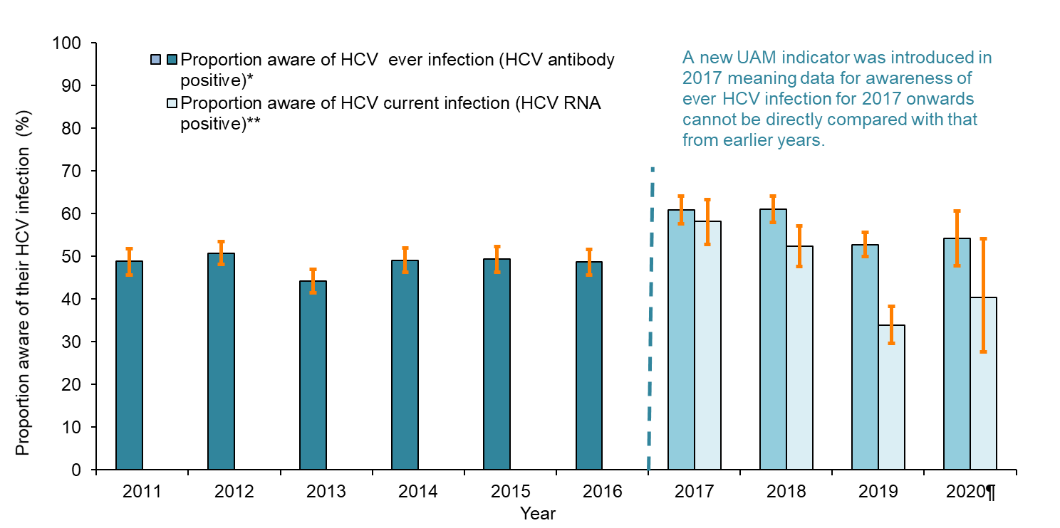
Estimated proportion of people injecting psychoactive drugs testing positive for HCV who are aware of their infection, England, 2010 to 2020 (bars are 95% CI)
Data source: Unlinked Anonymous Monitoring Survey of people who inject drugs: people injecting psychoactive drugs (4)
Notes:
¶Due to limitations in recruitment as a result of the COVID-19 pandemic, 2020 data are provisional.
* Due to a change in the questionnaire for 2017, completion of the self-reported status question was lower, resulting in a higher proportion of missing data than seen in previous years for 2017 and 2018.
** Data regarding awareness of HCV RNA result, and therefore chronic infection status, are available for 2017 onwards due to changes in the UAM Survey questionnaire.
In 2020, 40.4% of PWID sampled in the UAM Survey were aware of their current chronic infection (33.9% in 2019), a reduction from that seen in 2017 when these data were first available (58.2%).
The lower levels of awareness in 2019 and 2020 may be a result of increased UAM Survey recruitment through outreach services, compared to traditional recruitment through services offered at the drug service building. Participants recruited through outreach may have been less likely to be engaged with drug services, and thus less likely to be aware of their current HCV infection. Furthermore, as the majority were recruited through outreach BBV testing, they may have been tested for HCV alongside the UAM but not received their test results at the time of questionnaire completion, leading to underestimation of levels of awareness. This is supported by National Drug Treatment Monitoring System (NDTMS) data which suggest higher levels of awareness among people who have ever injected drugs newly presenting to drug or alcohol treatment in England in tax year 2019 to 2020 who had received an HCV test; 47% reported knowing their HCV ribonucleic acid (RNA) status, of whom 24% reported they were chronically infected with HCV.

Slide 17
Prevention of infection
Harm reduction among people who inject drugs remains sub-optimal, with reductions in the prevalence of chronic HCV infection primarily the result of increased HCV treatment.
Harm reduction among people who inject drugs needs to be scaled up to prevent both primary infection and reinfection following HCV treatment if elimination is to be achieved and sustained.

Slide 18
Prevention of infection by ensuring adequate harm reduction in PWID (WHO programme targets)
Service coverage/ programme target area | WHO EURO 2020 targets (6) | WHO GHSS 2030 target(3) | WHO interim guidance elimination validation target (2)
Harm reduction: A comprehensive package of harm reduction services to all PWID(72) including: | • At least 200 sterile needles and syringes provided per person who injects drugs per year • At least 40% of opioid dependent PWID receive OST • 90% of PWID receiving targeted HCV information, education and communication | At least 300 sterile needles and syringes provided per person who injects drugs per year | At least 300 sterile needles and syringes provided per person who injects drugs per year
Progress in England
Harm reduction: A comprehensive package of harm reduction services to all PWID(72) including: | • Among people injecting psychoactive drugs participating in the UAM Survey during 2020, 62.7%† reported adequate NSP for their needs (66.1% in 2019) • 55.5% of opioid dependent PWID receive OST (tax year 2011 to 2012*) • 75.8%† of UAM Survey participants in 2020 (79.9% in 2019), who had injected drugs in the last year, reported receiving some form of information that explained what HCV is, how they could avoid catching it, or how it is treated, in the last year.
Notes:
* Analysis of injecting drug use prevalence is under development to provide updated, robust estimates of the number of PWID and the proportion on OST.
† 2020 figures are provisional due to the impact of COVID-19 on national bio-behavioural surveys of BBV in PWID in 2020 (UAM Survey).

Slide 20
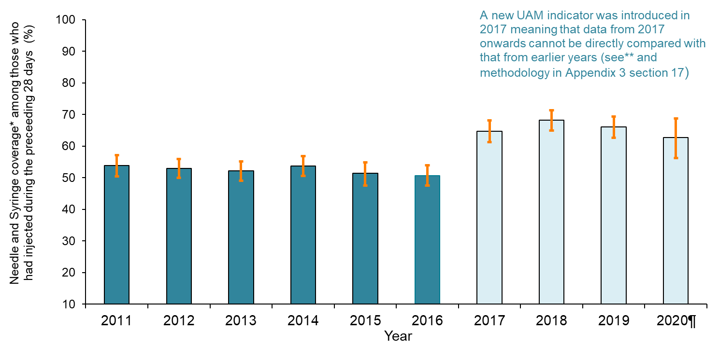
Estimated proportion of people injecting psychoactive drugs reporting adequate* needle and syringe provision in England, 2011 to 2020 (bars are 95% CI)
Data source: Unlinked Anonymous Monitoring Survey of people who inject drugs: people injecting psychoactive drugs (4)
Notes:
¶Due to limitations in recruitment as a result of the COVID-19 pandemic, 2020 data are provisional.
* Needle and syringe provision is considered ‘adequate’ when the reported number of needles received, met or exceeded the number of times the individual reported injecting.
**Questions around NSP access were updated to reflect changes in NSP provision that have been observed nationally and to incorporate information on secondary distribution of injecting equipment occurring among this population. Prior to 2017, participants in the UAM Survey were asked how many needles they collected per month, and from 2017 onwards they were asked to report the frequency of NSP visits per month and the number of needles collected per visit for themselves and for others. As a result, the indicator from 2017 onwards is not directly comparable to previous years
Among people injecting psychoactive drugs participating in the UAM Survey during 2020, 62.7% reported adequate NSP for their needs (66.1% in 2019)

Slide 21
Uptake of HCV testing
Whilst much progress has been made to increase the numbers accessing HCV testing, particularly through NHS England funded elimination initiatives, testing has been impacted by the COVID-19 pandemic and has only partially recovered. If elimination targets are to be met, a redoubling of effort is required to ensure that everyone at risk of HCV infection can access testing.
It will be critical to expand our reach to underserved groups, particularly as numbers with HCV infection fall, and to implement and evaluate approaches that facilitate testing (and treatment) of those groups who are at greatest risk of falling out of the care pathway.

Slide 22
Information on HCV testing in various settings is available in the HCV in England 2022 report
Data on HCV testing is available for:
primary care and the wider population
people who inject drugs and/or attend drug and alcohol services
people in secure and detained settings
those who have experienced homelessness
South Asian and other minority ethnic populations
people attending sexual health and HIV services
the blood donor (lower risk) population
Some examples of these follow:

Slide 23
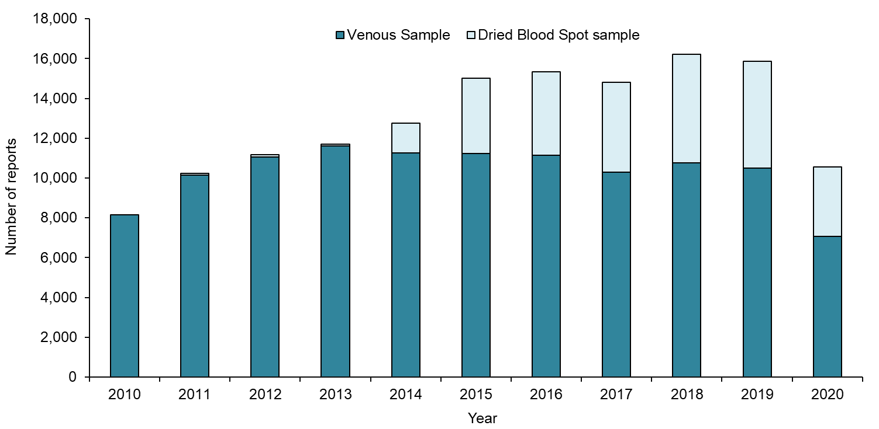
Number of laboratory reports* of HCV from England: 2010 to 2020**
Data source: SGSS (36)
Notes:
*Laboratory reports include positive test results for HCV antibody and/or HCV RNA. 2020 data is provisional and figures for previous years are subject to change as a result of late reporting and the associated de-duplication procedure. The nature of laboratory reporting and the associated de-duplication procedure is such that reinfections are not captured. In addition, patient identifiable data submitted by NHS laboratories is variable, particularly from sexual health and drug and alcohol services, which limits the ability to deduplicate. Results for children under one year of age are excluded to rule out the likelihood of simply detecting maternal antibody.
** HCV DBS testing data from 2011 onwards has now been obtained and included from additional laboratories, resulting in an increase in the overall number of HCV reports.
Between 2010 and 2019, there has been a more than 90% increase in the number of individuals with new laboratory confirmed diagnoses of HCV infection in England to 15,848 reports in 2019. A decrease of 33.3% was observed to 10,563 reports in 2020, likely due to COVID-19 pandemic restrictions. Of all laboratory reports between 2010 to 2020, 69.8% were in men and just under half (46.2%) were in individuals aged between 30 and 44 years.
Since 2017, more than 30% of laboratory reports are from testing dried blood spot (DBS) samples.

Slide 24
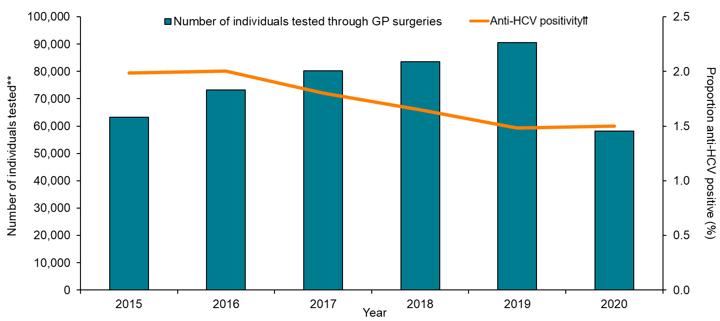
Number of individuals tested for anti-HCV by year, and proportion positive, through GP surgeries in 19 sentinel laboratories: 2015 to 2020* †
Data source: Sentinel Surveillance of Bloodborne Virus Testing (32)
Notes:
* Excludes samples collected outside routine testing such as look back studies, reference testing and children aged under one year. Patient identifiable data submitted by NHS laboratories is variable, particularly from sexual health and drug and alcohol services, which limits the ability to deduplicate. Data are de-duplicated subject to availability of date of birth, Soundex, NHS number and first initial. The proportion positive is calculated using number of individuals tested. Numbers include venous and DBS testing, with retrospective DBS data added from 2014.
** Includes all tests until a person is diagnosed positive, no tests are counted after a positive test, a person can be counted more than once.
† Trend data does not reflect cumulative data as only locations that have consistently reported during the 5 years presented are included in trend data to remove any artificial changes in testing.
†† The positive result is the first reported by participating laboratories and may not reflect an individual’s first diagnosis.
Testing in GP services is important if we are to find those with undiagnosed infection who are not in contact with other services, like drug services, that routinely offer HCV testing. In sentinel laboratories (32) the number of individuals tested via GP surgeries increased by 43.3% between 2015 and 2019, a proportion of which will be driven by requests from other services via shared care. However, a 35.8% decrease was observed between 2019 and 2020, likely due to COVID-19 pandemic restrictions(1, 24). The proportion of tests conducted via GP surgeries identified as anti-HCV positive declined from 2.0% in 2015 to 1.5% in 2019 and 2020. This is consistent with expanding testing programmes, which often result in larger numbers of individuals at relatively lower risk of infection being tested.

Slide 25
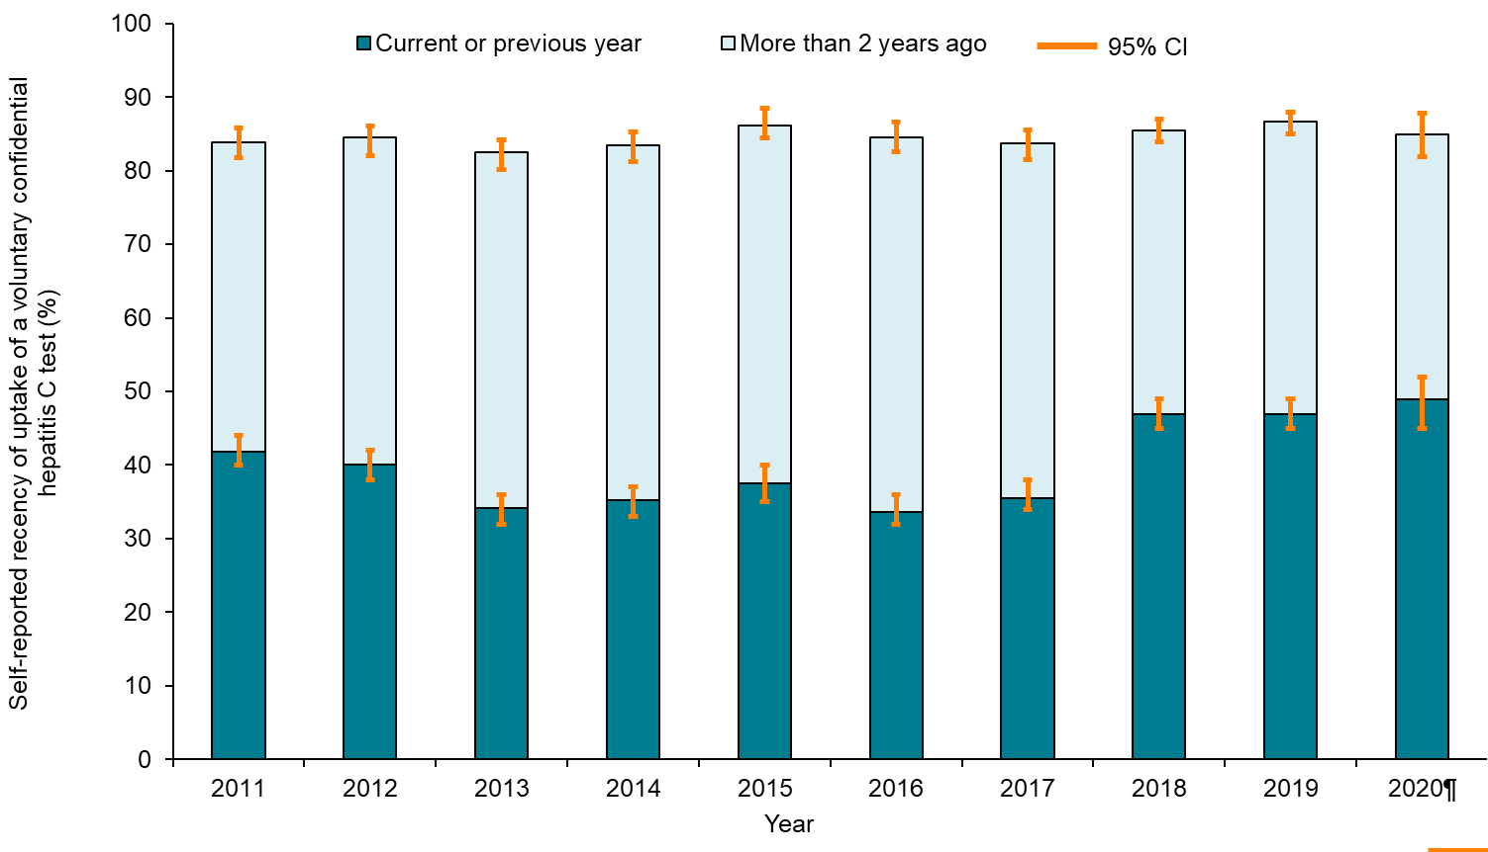
Trends in self-reported uptake of testing for HCV infection among PWID in England: 2009 to 2020
Data source: Unlinked Anonymous Monitoring Survey of People Who Inject Drugs: people injecting psychoactive drugs (4)
Notes:
¶Due to limitations in recruitment as a result of the COVID-19 pandemic, 2020 data are provisional.
In the UAM Survey, an increase in the proportion reporting an HCV test in the current or previous year from 41.8% in 2011 to 48.9% in 2020, suggests that people are testing more frequently than in earlier years. It is notable that UAM data for 2020 suggest that around 31.4% of people reported having their most recent HCV test outside drug services (18.6% via prison healthcare and 7.5% via their general practitioner).

Slide 26
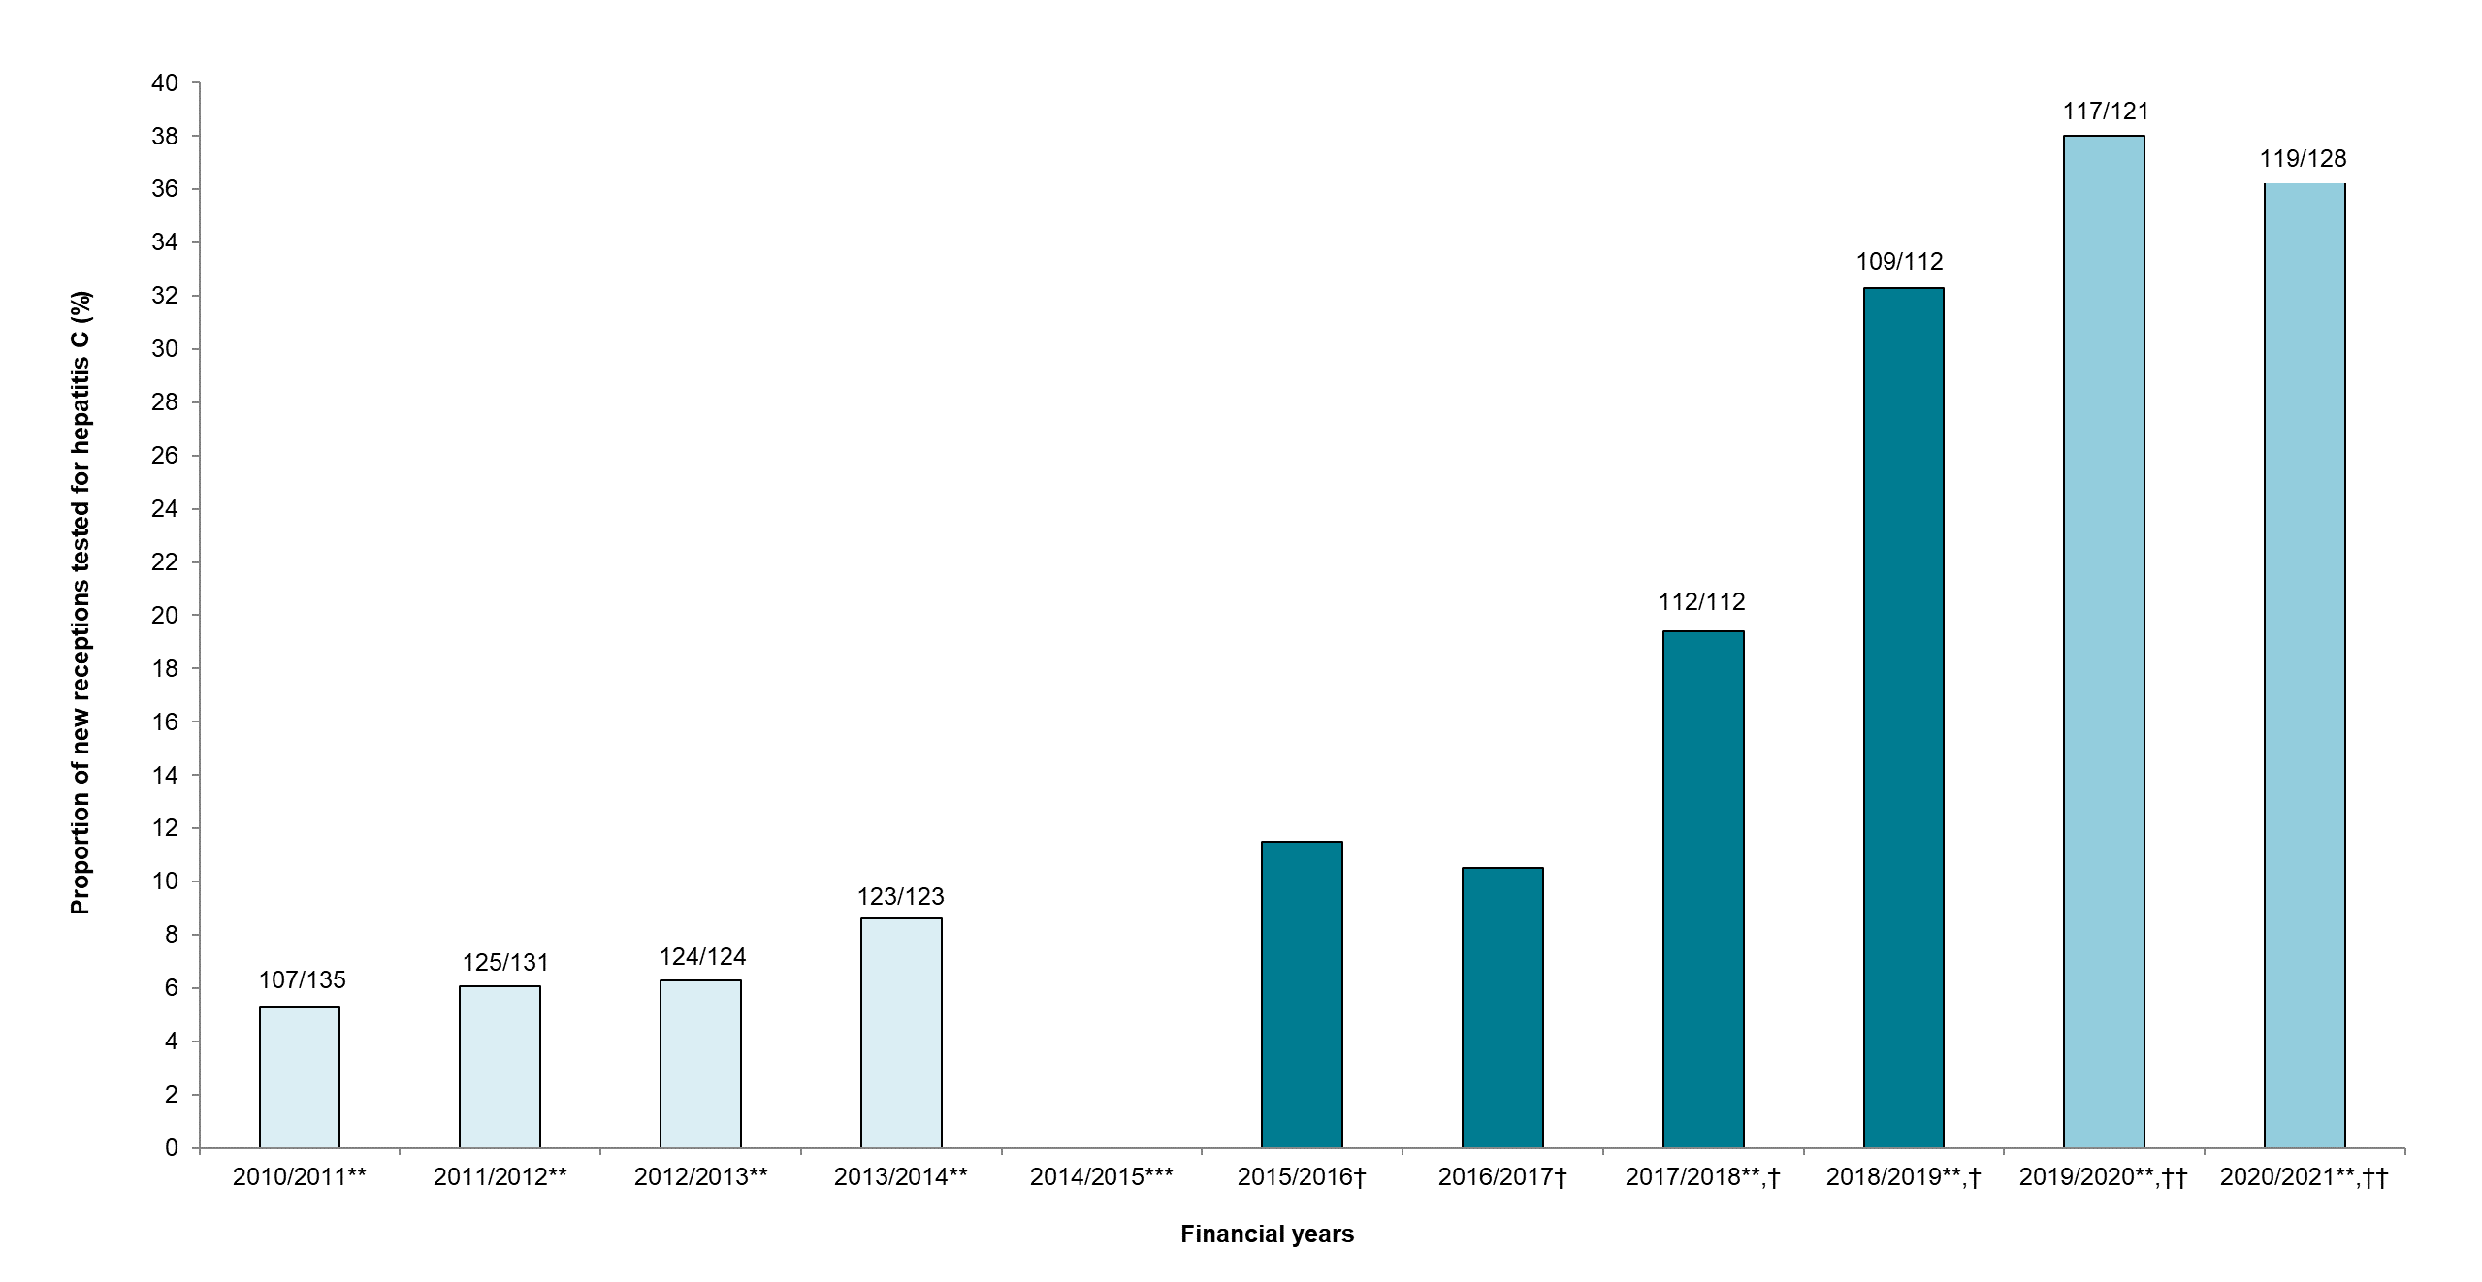
Proportion of new receptions to secure and detained settings tested for HCV: from tax year 2010 to 2011 up to tax year 2020 to 2021*
Data source: Prison Health Performance Quality Indicators (PHPQIs, NHS Trust Development Agency: palest blue Bars), Health and Justice Indicators of performance (HJIPs, dark teal bars), and the Health and Justice Strategic Reporting Unit’s Health and Justice Information System data (H&J SRU, light teal bars).
Notes:
* People previously identified as HCV positive at the reception screen and those with codes indicating resolved HCV infection, are excluded.
** Figures above bars are the number of secure and detained settings providing data / total number of secure and detained settings (numbers change due to closures and are not available for tax years 2015 to 2016
and 2016 to 2017).
*** Robust data not available for the first year following introduction of HJIPs.
†HJIPs provide data for prisons only.
†† Anti-HCV tests undertaken within 14 days of reception (includes new receptions and transfers).
Prison Health Performance and Quality Indicators (PHPQIs), Health and Justice Indicators of Performance (HJIPs) and recent data from the H&J SRU have shown a rise in HCV tests performed among new receptions to secure and detained settings from 5.3% in tax year 2010 to 2011 to 38.0% in tax year 2019 to 2020; this fell to 36.6% in tax year 2020 to 2021, likely due to COVID-19 pandemic restrictions. It is likely that increases in testing are due to the introduction of BBV opt-out reception testing which was agreed in October 2013 by PHE, NHS England and HMPPS,(77) and high intensity test and treat (HITT) initiatives that have taken place in tax years 2019 to 2020 (n=11) and tax year 2020 to 2021 (n=9). While this increase in testing is welcomed, current levels are still below the minimum BBV testing threshold proposed by NHS England (50% to 74%), and well below the target threshold of at least 75% uptake, which may be partly because of high prisoner turnover across the estate.

Slide 27
Trend in HCV prevalence* among PWID reporting homelessness in the last year in England: 2011 to 2020
Data source: Unlinked Anonymous Monitoring Survey of people who inject drugs in contact with specialist services (4)
Notes:
* Estimates for chronic and cleared HCV infection have been adjusted to take into account anti-HCV positive samples with missing RNA status. The ratio of chronic/cleared infection was applied to the anti-HCV positive samples with missing RNA status by year and region.
¶Due to limitations in recruitment as a result of the COVID-19 pandemic, 2020 data are provisional.
Data from the UAM Survey suggest that levels of chronic HCV infection fell to around 21.4% among PWID who report currently experiencing homelessness in 2020 from at least 30% in 2015-2019; this level was not significantly higher than in those who had been previously homeless (13.4%; p=0.113 ) or those who had never experienced homelessness (13.7%; p=0.156), although 2020 UAM data are provisional and should be treated cautiously(1). Prior to 2020, chronic prevalence among PWID reporting current homelessness remained relatively stable at around 32% (range: 29.3 to 35.5; p=0.597). This might suggest that recent initiatives to find and treat HCV in those experiencing homelessness during the COVID-19 pandemic(59) are having an effect. However, given the difference in geographical distribution of the samples collected in 2020 during the COVID-19 pandemic, the change in risk profile of participants and the smaller sample size, the extent of changes to chronic HCV prevalence should be interpreted with caution; 2020 data are provisional (4).

Slide 28
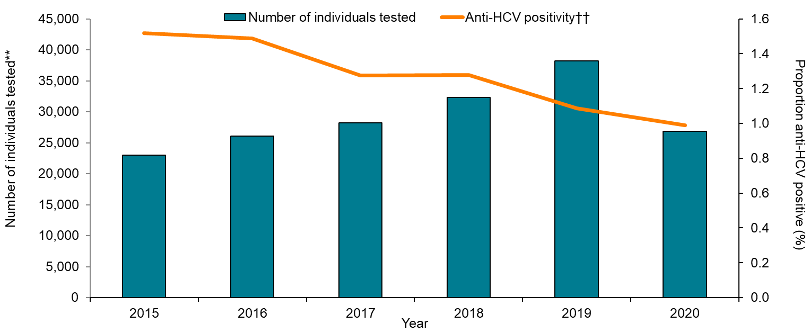
Number of individuals tested for anti-HCV by year, and proportion positive, in people of South Asian^ origin in 19 sentinel laboratories: 2015 to 2020* †
Data source: Sentinel Surveillance of Bloodborne Virus Testing (32)
Notes:
^ Ethnicity is assigned using information from laboratory reports, and supplemented using name analysis software (Nam Pehcham (80) and ONOMAP (81)) when ethnicity is not reported.
* Excludes samples collected outside routine testing such as look back studies, reference testing, renal patients and children aged under one year. Patient identifiable data submitted by NHS laboratories is variable, particularly from sexual health and drug and alcohol services, which limits the ability to deduplicate. Data are de-duplicated subject to availability of date of birth, Soundex, NHS number and first initial. The proportion positive is calculated using number of individuals tested. Numbers include venous and DBS testing, with retrospective DBS data added from 2014.
** Includes all tests until a person is diagnosed positive, no tests are counted after a positive test, a person can be counted more than once.
† Trend data does not reflect cumulative data as only locations that have consistently reported during the 5 years presented are included in trend data to remove any artificial changes in testing.
†† The positive result is the first reported by participating laboratories and may not reflect an individual’s first diagnosis
Data shows that HCV testing increased between 2015 and 2019 by 66.0% in South Asian populations, with fall in 2020 of 29.6%, likely due to COVID-19 pandemic .
The proportion testing positive fell from 1.5% to 1.0% in the South Asian population between 2015 and 2020. The fall in percentage testing positive is consistent with expanding HCV testing in the South Asian population as increasing numbers of individuals at relatively lower risk of infection are tested.

Slide 29
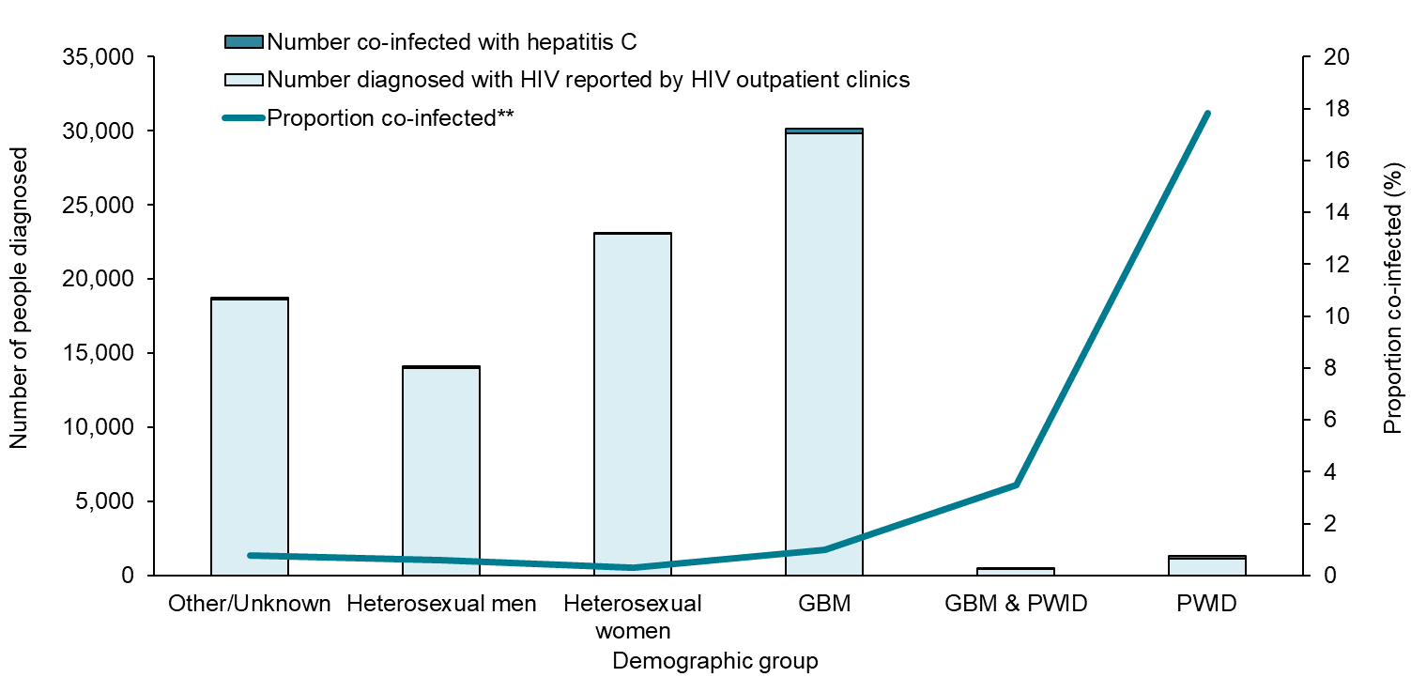
Proportion of people accessing HIV care who have HCV by demographic group,* England, 2020†,††
Data Source: HARS (90)
Notes:
* Demographic group refers to probable route of HIV acquisition which may not reflect how a person identifies sexually. The total number includes people with unknown or other routes of exposure.
** Proportion co-infected is calculated of all individuals attending for HIV care, including those not tested or where their testing status is unknown.
†A follow-up exercise was conducted in 2020 and 2021 to confirm the HIV and HCV coinfection status; 104 out of 158 centres responded and this resulted in approximately 1,000 patients being reassigned to not being HCV coinfected in 2020.
††The data reported in 2020 are impacted by the reconfiguration of sexual health services during the national response to COVID-19.
Note: Gay, bisexual or other men who have sex with men (GBM)
In 2020, of the people living with diagnosed HIV and accessing care in England, 0.9% (804/87,006) tested positive for either an acute or chronic HCV infection (1.0% (823/86,067) in 2019), and HCV co-infection varied by exposure group. In 2020, the proportion co-infected was highest in people living with HIV who reported exposure through injecting drug use alone (17.8% in 2020) and in combination with acquiring HIV through sex between men (3.5%). HCV co-infection was least common among people with diagnosed HIV who were heterosexual men (0.6%) or women (0.3%).

Slide 30
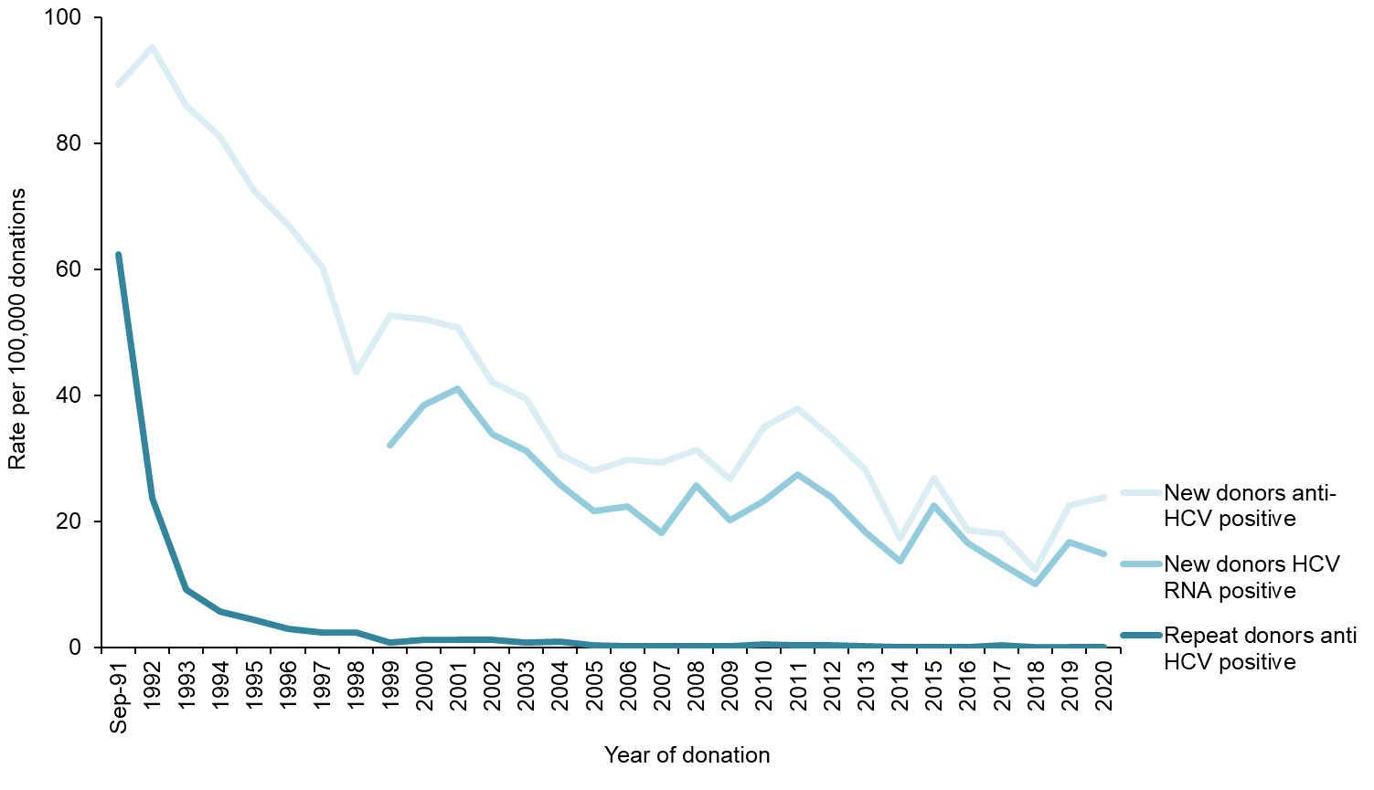
Rate of HCV among donations from new and repeat blood donors in England: September 1991 to 2020*
Data source: NHSBT UKHSA Epidemiology Unit
Notes:
*1991 to1995 includes Wales,1996 to 2016 includes North Wales
Overall, in England, rates of HCV infection in blood donors remain low at around 23.8 per 100,000 donations in 2020, with 25 confirmed cases positive that year. Risk factors for infection included non-disclosed injecting drug use, donors also reported possible blood contact via a range of not necessarily causal exposures e.g. tattoos and piercings. Higher rates of HCV were also seen in donors from countries where HCV is endemic.

Slide 31
Monitoring access to HCV treatment (WHO programme target)
Substantial progress has been made to increase the numbers accessing HCV treatment, with around 58,850 treatment initiations between tax years 2015 to 2016 and 2020 to 2021.
Further work is required to reach the 2030 WHO target of at least 80% of people with chronic HCV diagnosed, accessing treatment (65% in 2015 to 2020).
Among those who started treatment and were not lost to follow-up, rates of viral clearance are high at 95%.

Slide 32
Monitoring access to HCV treatment (WHO programme target)
Service coverage/programme target area | WHO EURO 2020 targets (6) | WHO GHSS 2030 target(3) | WHO interim guidance elimination validation target (2)
Treatment coverage of people diagnosed with chronic HCV | [90% of diagnosed patients with chronic HCV are linked to care and adequately monitored] 75% (>90% cured) | ≥80% | ≥80%
Progress in England
Treatment coverage of people diagnosed with chronic HCV (2015-2020) | [73.5%* of diagnosed patients with chronic HCV are linked to specialist HCV treatment services] 65.3%** of those with diagnosed chronic HCV initiating treatment (78.6% SVR of those with treatment outcome reported)*** |  | 65.3%**
Notes:
*55.2% of individuals who tested positive for HCV RNA in sentinel surveillance were successfully linked to the national treatment registry database, a figure that rose to 73.5% when those with no NHS number or name and date of birth in SSBBV for linkage were excluded.
** Numerator: Number starting treatment; Denominator: Number of individuals who tested positive for HCV RNA in sentinel surveillance with NHS number or name and date of birth in SSBBV for linkage.
*** Numerator: Number achieving SVR; Denominator: Number with a treatment outcome reported.

Slide 34
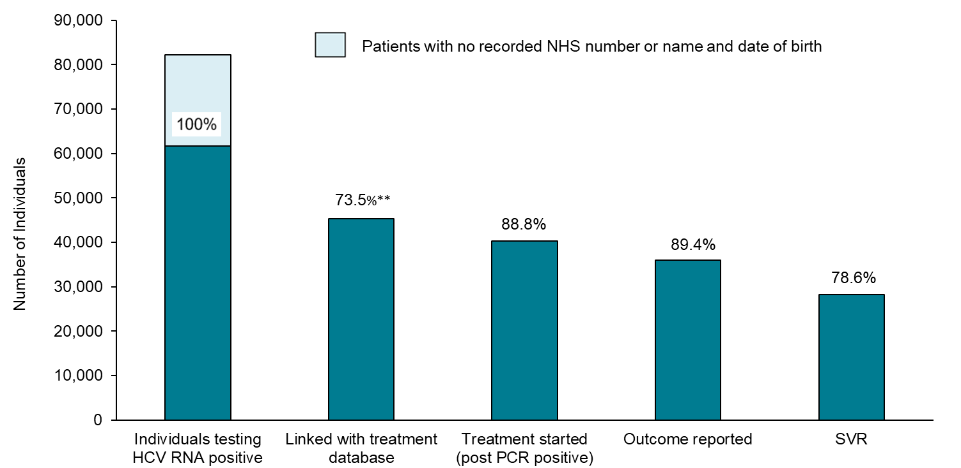
Treatment pathway for individuals with a positive RNA or antigen test in SSBBV between 2015 and 2020*
Data source: Sentinel Surveillance of Bloodborne Virus Testing (32) and NHS England data from the Hepatitis C Patient Registry and Treatment Outcome System as of 19 October 2021.
Notes:
* RNA and antigen tests were linked to the NHS England’s Hepatitis C Patient Registry and Treatment Outcome System using NHS Number, Name, DOB, hospital number and excludes children aged <1 year. Patient identifiable data submitted by sentinel laboratories is variable, particularly from sexual health and drug and alcohol services, which limits the ability to link datasets or de-duplicate. Data are de-duplicated subject to availability of date of birth, Soundex, NHS number and first initial. All data are provisional.
** 55.2% of individuals who tested positive for HCV RNA in sentinel surveillance were successfully linked to the national treatment registry database, a figure that rose to 73.5% when those with no NHS number or name and date of birth in SSBBV testing for linkage were excluded.
While work is ongoing to quantify the national treated proportion, data from sentinel laboratories has been linked to NHS England’s Hepatitis C Patient Registry and Treatment Outcome System to follow individuals through the care pathway, from testing to treatment initiation and outcome. For the period 2015 to 2020, 82,173 individuals tested positive for HCV RNA in sentinel surveillance, of these 55.2% were successfully linked to the national treatment registry database, a figure that rose to 73.5% when those with no NHS number or name and date of birth in SSBBV were excluded. Of those linked to the registry, 88.8% commenced treatment for their HCV infection. A treatment outcome was available for 89.4% of those who commenced treatment, of whom 78.6% were reported to have achieved SVR-12.
Although the majority of those who started treatment were known to have successfully cleared the virus, 16.3% of patients were lost to follow up, 4.0% were reported as either having breakthrough (HCV RNA negative during treatment but became HCV RNA positive again during treatment), relapse, non-response to treatment or other outcomes, and 1.1% had died after initiation of treatment, before SVR could be established.
When those who were lost to follow-up or who had died were excluded, 95.1% achieved a SVR.

Slide 35
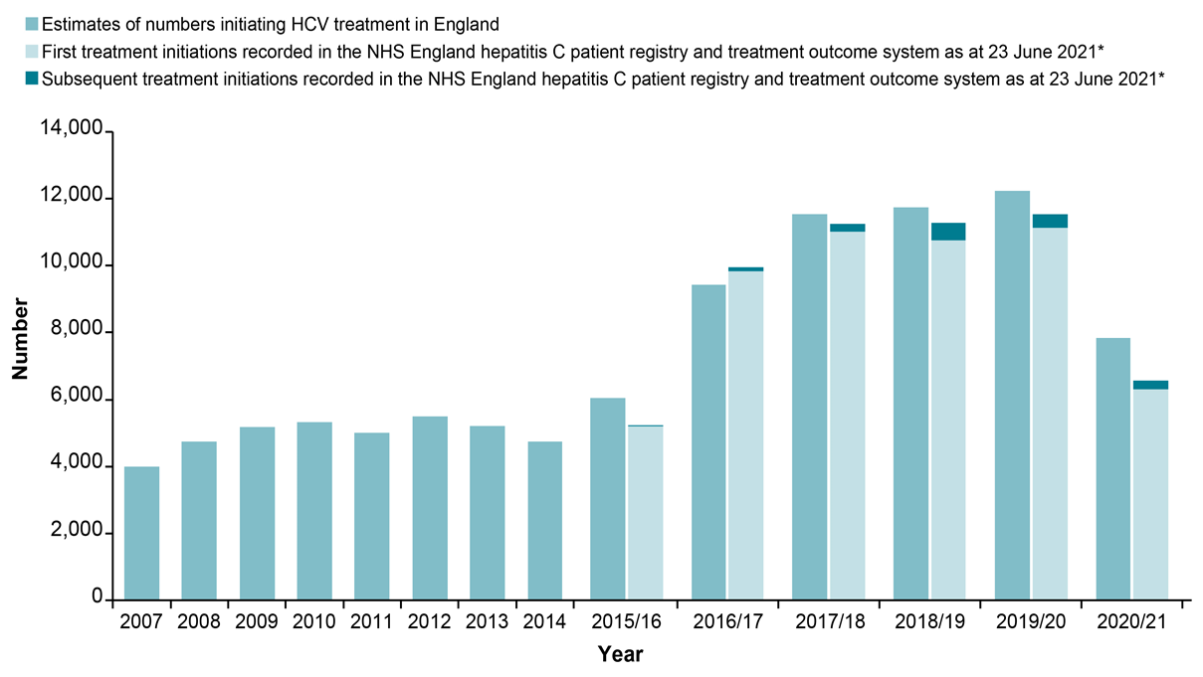
Provisional estimates of numbers initiating HCV treatment in England, 2007 to tax year 2020 to 2021
Data Source: (i) NHS England for data from the hepatitis C patient registry and treatment outcome system as of 23 June 2021 and for DAA drug commissioning data for tax years 2015 to 2016 and 2020 to 2021 (commissioning data is based on clinician intention to treat and invoicing and is subject to data quality issues and contract adjustments); (ii) Sentinel surveillance of hepatitis bloodborne virus testing for scaled estimates for the period 2012 to 2014; (iii) Estimates from Roche sales, IMS supply chain manager, and Pharmex data for 2007 to 2011 (28).
Notes:
*Treatment initiations include first treatments episodes (n=54,350) and subsequent treatment episodes (n=1,495). For treatment episodes with missing start dates (n=818), their distribution across the years was assumed to mirror that of those patients with treatment start dates and they were allocated to treatment years accordingly. Within the register there were 334 records where individuals with a first treatment recorded restarted this treatment (10 in tax year 2015 to 2016; 41 in 2016 to 2017; 60 in 2017 to 2018; 72 in 2018 to 2019; 89 in 2019/2020 and 62 in 2020/2021) and there were 308 records where it was not possible to determine whether the record was a treatment restart, the same or a subsequent treatment (1 in tax year 2015 to 2016; 6 in tax year 2016 to 2017; 8 in tax year 2017 to 2018; 24 in tax year 2018 to 2019; 49 in tax year 2019 to 2020 and 220 in tax year 2020 to 2021).
*Treatment initiations include first treatments episodes (n=54,350) and subsequent treatment episodes (n=1,495). For treatment episodes with missing start dates (n=818), their distribution across the years was assumed to mirror that of those patients with treatment start dates and they were allocated to treatment years accordingly. Within the register there were 334 records where individuals with a first treatment recorded restarted this treatment (10 in tax year 2015 to 2016; 41 in 2016 to 2017; 60 in 2017 to 2018; 72 in 2018 to 2019; 89 in 2019/2020 and 62 in 2020/2021) and there were 308 records where it was not possible to determine whether the record was a treatment restart, the same or a subsequent treatment (1 in tax year 2015 to 2016; 6 in tax year 2016 to 2017; 8 in tax year 2017 to 2018; 24 in tax year 2018 to 2019; 49 in tax year 2019 to 2020 and 220 in tax year 2020 to 2021).
NHS England commissioning data suggest significant increases in the number of people accessing HCV treatment since 2014 as access to new DAA drugs increased in England (44-52). By tax year 2019 to 2020, the annual number treated (n=12,229) was up 140.0% on the mean level reported in earlier years (5,096, 2008 to 2014), and up 4.0% on the previous year. In tax year 2020 to 2021, treatment initiations fell by 35.9% to 7,835, likely due to COVID-19 pandemic restrictions (24). Overall, between tax years 2015 to 2016 and 2020 to 2021, NHS England commissioning data suggest that 58,848 treatment initiations took place.
Data are also available from the HCV patient registry and treatment outcome system that was commissioned by NHS England in 2017 from the Arden and Greater East Midlands Commissioning Support Unit to capture more detailed information for patients(98). These registry data (palest blue and dark teal bars), suggest that around 56,000 treatment initiations (n= 55,845) took place between tax years 2015 to 2016 and 2020 to 2021, approximately 3,000 less than estimated via commissioning data (n=3,003) and around 4,500 less (n=4,498) when subsequent treatments for the same patient are excluded. When compared to the commissioning data, overall numbers may be lower in the patient registry and treatment outcome system, if data entry is incomplete.
Amongst those in whom it was possible to determine the outcome of their first treatment (n= 39,333), 95.0% achieved a SVR 12 weeks after completion of treatment (0.4% breakthrough, 3.4% relapse and 1.2% non-response). A variety of DAA drugs were used, with 32.9% receiving them in combination with ribavirin.

Slide 36
Addressing inequalities
There is an urgent need, particularly following the COVID-19 pandemic, to redouble efforts to improve harm reduction, testing and access to treatment for the most vulnerable populations or inequalities will widen.
As we approach elimination it will be increasingly important to take a person-centred approach.

Slide 38
WHO GHSS targets (3) for viral hepatitis, relevant to HCV in the UK context, with 2020 targets updated to reflect the action plan for the health sector response to viral hepatitis in the WHO European Region (6) and proposed interim targets from the WHO interim guidance for country validation of hepatitis elimination (2)
Impact target area | WHO GHSS 2020 target relative to 2015 baseline (3) | WHO GHSS 2030 target relative to 2015 baseline (3) | WHO interim guidance elimination validation target: annual absolute HCV incidence rates (2)
Incidence: New cases of chronic viral hepatitis C infection | 30% reduction | 80% reduction | Equal to or less than 5 per 100,000 persons (equal to or less than 2 per 100 for PWID)
[Proxy incidence measure: alternative WHO approach, but not adequate for validation of elimination] |  |  | [Reduction in HCV viraemia prevalence by 80% from 2015 baseline (in general population and PWID)]
Mortality: Viral hepatitis C deaths | 10% reduction | 65% reduction | Equal to or less than 2 per 100,000 persons
Service coverage or programme target area | WHO EURO 2020 target (6) | WHO GHSS 2030 target (3) | WHO interim guidance elimination validation target (2)
Blood safety:* Proportion of donations screened in a quality-assured manner | 100% | 100% | 100%
Percentage of injections administered with safety engineered devices in and out of health facilities** Unsafe injections:** | 50% | 90% | 0%
* In England, 2020 and 2030 targets are already met (104)
** In England, 2020 and 2030 targets are already met in the health care setting as the UK follows the EU Directive for the prevention of sharps injuries in the health care setting (105) by using safety engineered devices

Slide 39
WHO GHSS targets(3) for viral hepatitis, relevant to HCV in the UK context, with 2020 targets updated to reflect the action plan for the health sector response to viral hepatitis in the WHO European Region (6) and proposed interim targets from the WHO interim guidance for country validation of hepatitis elimination (2)
Service coverage or programme target area | WHO EURO 2020 target (6) | WHO GHSS 2030 target (3) | WHO interim guidance elimination validation target (2)
Proportion of people with chronic HCV diagnosed | 50% [75% of estimated number of patients at late stage of viral hepatitis-related liver disease (cirrhosis or HCC) diagnosed] | Greater than or equal to 90% | Greater than or equal to 90%
Harm reduction: A comprehensive package of harm reduction services to all PWID (72) including: | • At least 200 sterile needles and syringes provided per person who injects drugs per year • At least 40% of opioid dependent PWID receive OST • 90% of PWID receiving targeted HCV information, education and communication | At least 300 sterile needles and syringes provided per person who injects drugs per year | At least 300 sterile needles and syringes provided per person who injects drugs per year
Treatment coverage of people diagnosed with chronic HCV | [90% of diagnosed patients with chronic HCV are linked to care and adequately monitored] 75% (more than 90% cured) | Greater than or equal to 80% | Greater than or equal to 80%

Slide 40
References
1. UK Health Security Agency (UKHSA). 'HCV in England report 2022 Headline Data Table' 2022 (viewed on 7 February 2022)
2. World Health Organization (WHO). 'Interim guidance for country validation of viral hepatitis elimination' 2021 (viewed on 7 February 2022)
3. WHO. 'Global health sector strategy on viral hepatitis, 2016 to 2021: towards ending viral hepatitis' 2016 (viewed on 7 February 2022)
4. Public Health England (PHE). ‘Unlinked Anonymous Monitoring Survey of PWID in contact with Specialist Drug Services' 2020 (viewed on 7 February 2022)
6. WHO. 'Action plan for the health sector response to viral hepatitis in the WHO European Region (2017)' (viewed on 7 February 2022)
23. Harris RJ and others. 'New treatments for hepatitis C virus (HCV): scope for preventing liver disease and HCV transmission in England' Journal of Viral Hepatitis 2016: volumen 23, issue 8, pages 631-643
24. PHE. 'Impact of COVID-19 on STIs, HIV and viral hepatitis in England: 2020 report (provisional data)' (viewed on 7 February 2022)
25. PHE. 'HCV in the UK 2020' (viewed on 7 February 2022)
26. Hay G, and others. 'Estimates of the prevalence of opiate use and/or crack cocaine use 2011 to 2012: Sweep 8 report' 2014 (viewed on 7 February 2022)
28. Harris RJ and others. 'Increased uptake and new therapies are needed to advert rising hepatitis C- related end stage liver disease in England: modelling the predicated impact of treatment under different scenarios' Journal of Hepatology 2014: volume 61, issue 3, pages 530-537
32. PHE. 'Sentinel surveillance of blood borne virus testing in England: 2020' (viewed on 7 February 2022)
34. Hay G and others. 'National and regional estimates of the prevalence of opiate use and/or crack cocaine use 2005/06: a summary of key findings’ Research Development and Statistics Directorate, Home Office Home Office 2007 (viewed on 7 February 2022)
36. PHE. 'Laboratory reports of hepatitis C in England and Wales, April to June 2020. Health Protection Report' 2021 (viewed on 7 February 2022)
44. National Institute for Health and Care Excellence (NICE). 'Ombitasvir–paritaprevir–ritonavir with or without dasabuvir for treating chronic hepatitis C. NICE technology appraisal guidance [TA365]' 2015 (viewed on 7 February 2022)
45. NICE. 'Daclatasvir for treating chronic hepatitis C' 2015 (viewed on 7 February 2022)
46. NNICE. 'Ledipasvir–sofosbuvir for treating chronic hepatitis C' 2015 (viewed on 7 February 2022)
47. NICE. 'Sofosbuvir–velpatasvir for treating chronic hepatitis C' 2017 (viewed on 7 February 2022)

Slide 41
References
48. NICE. 'Elbasvir–grazoprevir for treating chronic hepatitis C' 2016 (viewed on 7 February 2022)
49. NICE. 'Glecaprevir–pibrentasvir for treating chronic hepatitis C. Technology appraisal guidance [TA499]' 2018 (viewed on 7 February 2022)
50. NICE. 'Sofosbuvir–velpatasvir–voxilaprevir for treating chronic hepatitis C. Technology appraisal guidance [TA507]' 2018 (viewed on 7 February 2022)
51. PHE. 'Hepatitis C in the UK 2017 report' (viewed on 7 February 2022)
52. Mann AG and others. 'Diagnoses of, and deaths from, severe liver disease due to hepatitis C in England between 2000 and 2005 estimated using multiple data sources' Epidemiology and Infection 2013: volume 137, issue 4, pages 513-518
53. Office for National Statistics. 'Deaths broken down by age, sex, area and cause of death' 2020 (viewed on 7 February 2022)
59. PHE. 'Evaluation of hepatitis C test and treat interventions targeted at homeless populations (outside London) in England during the COVID-19 pandemic 2020 report' 2021 (viewed on 7 February 2022)
72. WHO. 'WHO, UNODC, UNAIDS technical guide for countries to set targets for universal access to HIV prevention, treatment and care for injecting drug users – 2012 revision' 2013 (viewed on 7 February 2022)
77. NHS England. 'National Partnership Agreement between: The National Offender Management Service, NHS England and Public Health England for the Co-Commissioning and Delivery of Healthcare Services in Prisons in England 2015-2016' 2014 (viewed on 7 February 2022)
80. Cummins C and others. 'An assessment of the Nam Pehchan computer program for the identification of names of south Asian ethnic origin' Journal of Public Health Medicine 1999: volume 21, issue 4, pages 401-406
81. ONOMAP. ONOMAP 2012 (viewed on 7 February 2022)
90. PHE. 'HIV surveillance systems' 2008 ( viewed on 7 February 2022)
98. PHE. 'Hepatitis C treatment monitoring in England (data to end April 2018)' 2018 (viewed on 7 February 2022)
104. Joint United Kingdom (UK) Blood Transfusion and Tissue Transplantation Services Professional Advisory Committee 'Guidelines for the Blood Transfusion Services in the UK' 2022 (viewed on 7 February 2022)
105. European Agency for Safety and Health at Work. 'Directive 2010/32/EU - prevention from sharp injuries in the hospital and healthcare sector' 2010 (viewed on 7 February 2022)

