Slide 1
UKHSA Advisory Board People Delivery Plan Jac Gardner, Chief People Officer 24 January 2023

Slide 2
Purpose and Ask
This is an opportunity for us to share with the Advisory Board our progress in developing our People Priorities for UKHSA, and to use the experience of the board in further shaping task, timeline and efforts.
Share
Discuss
Action
How the UKHSA Strategy and outcomes framework deploys into people priorities
The key outputs as part of our overall delivery plan
How we are tracking and managing the delivery of these
Is the Plan focused on delivering the right strategic outcomes and business imperatives?
Does the Board have any concerns or suggestions around delivery?
What further opportunities could be explored to maximise the value People Group can bring to our UKHSA strategy deployment?
Notes:
How to deliver priorities in the people space – Adam leading on slides.......
Order of Content
People Delivery Plan is here to deliver as part of UKHSA Overall direction
There are key elements of strategic priorities where we recognize that People has a specific role to play beyond that of general support to organization
We are aware of how we link into the outcomes framework to make sure that we have golden thread from what we are doing locally back through to the strategic priorities
The people strategy is the fulcrum between the overarching strategy and the activity/focus of the people group
Last time we shared with you the draft list of activities – these have now been developed further and fleshed out
We have good management of this through our delivery tracker, owned by Pillar 4 – include stats on them – and see spreadsheet for full extract of deliverables (not distributed to all?)
Key upcoming milestones are as follows – plan on a page stuff…

Slide 3
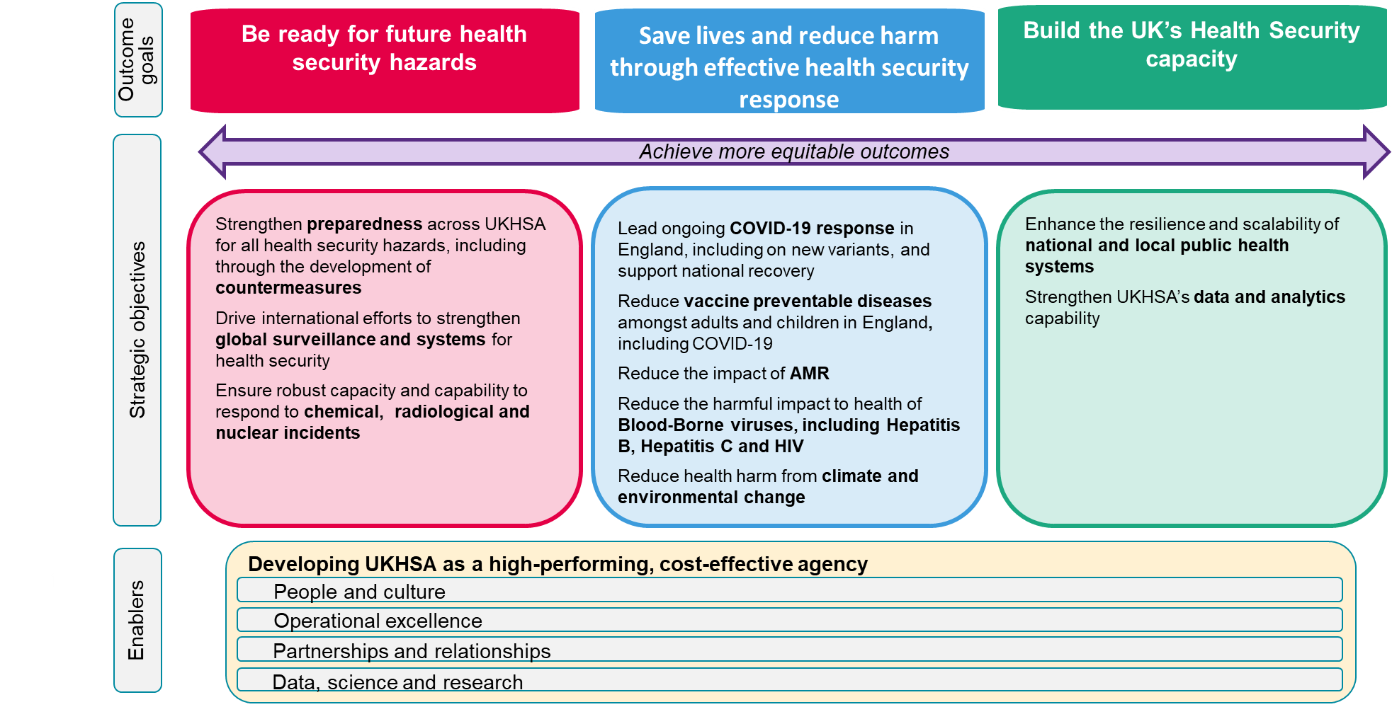
UKHSA Strategic Priorities – People Impact
We have a role in people group of supporting all strategic priorities through the provision of core enabling services to the organisation – however there are some specific strategic priorities that required targeted people interventions
As the surge models are completed – there is a need here for the people elements of surge to be coordinated and aligned across the agency
An element of strengthening the capability will be to attract and retain the workforce – we will work with the organisation to deliver this through Strategic workforce planning and pay frameworks
Need for People Group to support the building of capability/capacity in this area via Strategic Workforce Planning, OD, Ways of Working etc.
Operational Excellence is as much about the right leadership, strategic direction, and employee involvement as it is about process and technology – People Group therefore have a key role to play in this enabling objective
As the owners of this enabler we are measured on this in the outcomes framework based on the following items;
Rightsizing the agency
Embedding our culture
Develop and implement employee offer

Slide 4
Our People Strategy
The people strategy provides the fulcrum between UKHSA Strategy and People Activity – ensuring that activity is aligned to key strategic blocks which support the overall organisational direction
A resilient organisation
Attract and retain our talent
Leaders who excel
We have a right-sized organisation that is designed to deliver our core services, with the flexibility to respond to health security incidents. We have clear accountabilities and we collaborate purposefully with our key stakeholders and partners
Talented people are excited to join us and contribute to our mission. We have the right reward structures, policies and development opportunities in place to ensure a great employee experience.
Our leaders are informed and engaged in our business priorities and feel confident to empower their teams to deliver. They collaborate across the organisation to ensure the best outcomes and hold themselves and eachother accountable for sucess
A values-led organisation
Growing our expertise
Enhancing HR value
Our core HR processes and services are efficient, technology enabled and customer focused. We add value through our leadership and advice on key people priorities and support the organisation through effective change
We create a diverse environment where we encourage and support everyone to be at their best. We are performance focused and values led – impactful, insightful and inclusive
The knowledge and skills of our people are critical to UKHSA; they help us to be world-leading in what we do. We provide professional development and career paths across all disciplines and have active engagement with our external partners to build health science capabilities for the future

Slide 5
UKHSA Strategy Alignment – Deployment to People Delivery Plan
Build the UK’s Health Security Capacity
Enhance the resilience and scalability of national and local health protection systems
Strengthen UKHSA’s data and analytics capability
Be ready for future health security hazards
Ensure robust capacity and capability to respond to chemical, radiological and nuclear incidents
ExCo Outcome Goals
Strategic Objectives
Operational excellence and developing our infrastructure and technology
People and Culture
Enablers
Delivering the Harlow programme
Agency Right-sizing
Embedding our culture
Developing our employee offer
Outcome Framework
A resilient Organisation
Attract and retain talent
Leaders who excel
A values led organisation
Growing our expertise
Enhancing HR Value
People Strategy Objectives
R4: Achieve ramp down of covid funded workforce
A5: Address Reward Priorities (DDAT/Science)
L5: Leadership Development Strategy Completed
V3: Employee engagement action plan and listening strategy
G4: Develop Career Path Framework
E5: People Strategy & Plan
Key Priorities
R2: Recruit to core roles
A3: EVP Phase 1 (Attraction)
E7: Strategic Workforce Planning Implemented
L6: UKHSA Vision Development
A4: Develop Reward Strategy and Business Case
E1: Restructure People Group (Complete)
L7: Leadership Development Programme Cascaded
A7: EVP Phase 2 (Whole Employee Journey)

Slide 6
Our capacity to deliver
People Group Restructure
We have finished the restructure of the people group – forming 4 key pillars of activity, rationalising leadership positions, removing layers of management, re-evaluating grades (removing inflation) and creating clearer boundaries and accountabilities. This has all been done with a customer centric focus and to build capability.
Chief People Officer
HR Business Partnering Division
HR Operations Division
Culture, Learning & Development Division
People Strategy Division
Working across the UKHSA with a strong insight and partnership on the people aspects of our strategy, ensuring we can plan and allocate our experts to
support and enable business
delivery.
Delivering our core business facing People services; a
digitally enabled entry point and front door into HR for our employees and line managers.
Creating a skilled and high
performing workforce through accessible and visible learning and upskilling across a range of expertise, with a focus on attractive career paths, development and retention.
Ensuring that we continue to
evolve our organisation and
that we support our people
through positive change. Creating people insights to inform decision making. Ensuring rewards are
competitive and reflect the
contributions of our people.
MaPs Dependency
The success of several people group priorities are linked to the success of the MAPS programme – owned by DG-Finance, Commercial and Corporate. Key ones are noted below
E4 Payroll transition
E8 Move to ESS/MSS model
E3 Develop data & insight to inform workforce planning
A5 Design and implement a streamlined HR process
A6 Design and implement a streamlined resourcing process

Slide 7
Strategic Priority Activity
Milestone
Lead
Project
Jan | Feb | Mar | Apr | May | Jun | Jul | Aug | Sep | Oct | Nov | Dec
Vaccine Task Force integrated into UKHSA - Completed
R1 Core/flex model defined
Rightsizing - Completed
R4 Achieve ramp-down of Covid funded workforce
A resilient organisation
R5 Operating model to enable functional efficiency plans
Organisation Design incl. accountability - Completed
R2 Recruit to core roles
R3 Organised and flexible to deliver our remit in 2023+
A2 Address reward priorities
A4 Develop total reward strategy and business case
A7 EVP Phase 2 (Whole Employee Journey)
A3 EVP Phase 1 (Attraction)
A5 Design and implement a streamlined HR process
Attract & retain our talent
In-year awards re-launch - Completed
A1 Delivery of recruitment improvement project
A6 Design and implement a streamlined resourcing process
Notes:
Dates to be defined:
Casework service
Define Strategic HRBP Model
Reboot Pulse as channel for services
Re-set MaPS Programme (data, functionality & Op Model)

Slide 8
Strategic Priority Activity
Milestone
Lead
Project
Jan | Feb | Mar | Apr | May | Jun | Jul | Aug | Sep | Oct | Nov | Dec
SCS Leadership Away Day - Completed
L5 Leadership development strategy completed
L6 UKHSA Vision Development
L7 Leadership development programme cascaded
Leaders who excel
L3 Finalisation of SCS Structure
L4 Quarterly Line Manager Engagement Event
V1 Organisation Action Plan (CSPS)
V6 People Awards
V2 Group level action plans (CSPS)
V3 Employee engagement action plan and listening strategy
V7 Ways of working & location plan implemented
People Survey completed and shared - Completed
A values led organisation
V4 D&I Strategy deployed & targets met
Embedding of values - Completed
Continued development of staff networks - Completed
V5 Wellbeing Strategy Refresh
Notes:
Dates to be defined
L1 Revised Performance Management Launch – TBC

Slide 9
Strategic Priority Activity
Milestone
Lead
Project
Jan | Feb | Mar | Apr | May | Jun | Jul | Aug | Sep | Oct | Nov | Dec
G2 Establish talent networks and targeted development
G5 Partnership Strategy
- March 2024
Job evaluations and grading support - Completed
G3 Re-establish professional network forum
Growing our expertise
G1 Develop a framework for critical skills development
G4 Develop framework for career paths
E9 Transformation
roadmap delivery
E1 Resource People Group
Line Manager hub implemented – Completed
Restructure People Group – Completed
MaPS (continued improvement) - Completed
E5 People Strategy
E8 Move to ESS/MSS model
Enhancing HR value
E6 Internal OD consultancy set-up
E4 Payroll transition
E3 Develop data & insight to inform workforce planning
E7 Strategic Workforce Planning implemented

